Slide 1


Financial Accounting
Prepared by Dr. Emad Zaher
Assistant Professor of Accounting
MGM611
Lecture (6)
Merchandising operations & Inventory systems

Slide 2

  Learning Objectives
LO 1 Describe merchandising operations and inventory systems.
LO 2 Prepare a multiple-step income statement versus single - step income statement.
LO 3 Record purchases under a perpetual inventory system.
LO 4 Record sales under a perpetual inventory system.
Prepared by Dr. Emad Zaher

Slide 3
Merchandising Companies
Manufacturer
Wholesaler
Retailer
Consumers
Merchandising Companies
Buy and Sell Goods
The primary source of revenues
is referred to as sales revenue or sales.
Prepared by Dr. Emad Zaher

Slide 4
Merchandising Operations
Income Measurement
Sales
Revenue
Not used in a service business
Less
Cost of
Goods Sold
Equals
Gross
Profit
Less
Cost of goods sold is the total cost of merchandise sold during the period.
Operating
Expenses
Net
Income
(Loss)
Equals
Prepared by Dr. Emad Zaher

Slide 5
Companies types
service companies | merchandising companies
provide service | Sale goods
Short
Operating Cycle
Long
Operating Cycle
Multiple step - Income statement
Single step income statement
Net sales
100000
revenues
- Cost of goods sold
(60000)
100000
Gross profit
40000
- expenses
(60000)
Net income
40000
- Operating expenses:
(10000)
Income from operations
30000
Other revenues and gains:
5000
- Other expenses and losses:
(1000)
Net income
34000
Prepared by Dr. Emad Zaher

Slide 6
Companies types
Merchandising companies
Sales returns and allowance
-
Sale goods
-
sales discount
1- Net sales =
Sales
2- gross profit =
Net sales -
cost of good sold
Operating Cycle
Multiple step income statement
3- operation income =
gross profit -
operation expense
Net sales
100000
- Cost of goods sold
(60000)
+
Gross profit
40000
4- Net income
= operation income
interest revenue and gains
- Operating expenses:
(10000)
Income from operations
30000
–
interest expenses and loss
Other revenues and gains:
5000
- Other expenses and losses:
(1000)
Net income
34000
Prepared by Dr. Emad Zaher

Slide 7
Nonoperating Activities
    Various revenues and expenses and gains and losses that are unrelated to company’s main line of operations.
Other Revenues and Gains
Interest revenue from notes receivable and marketable securities.
Dividend revenue from investments in common stock.
Rent revenue from subleasing a portion of the store.
Gain from the sale of property, plant, and equipment.
Other Expenses and Losses
Interest expense on notes and loans payable.
Casualty losses from recurring causes, such as vandalism and accidents.
Loss from the sale or abandonment of property, plant, and equipment.
Loss from strikes by employees and suppliers.

Slide 8
Prepared by Dr. Emad Zaher

Slide 9
Do IT
  The multiple-step income statement for a merchandiser shows each of the following features except:
  gross profit.
  cost of goods sold.
  a sales revenue section.
  investing activities section.
Prepared by Dr. Emad Zaher

Slide 10
Do IT
Indicate whether the following statements are true or false.
The primary source of revenue for a merchandising company results from performing services for customers.
The operating cycle of a service company is usually shorter than that of a merchandising company.
Sales revenue less cost of goods sold equals gross profit.
Ending inventory plus the cost of goods purchased equals cost of goods available for sale.
Solution: 1. False 2. True 3. True 4. False
Prepared by Dr. Emad Zaher

Slide 11
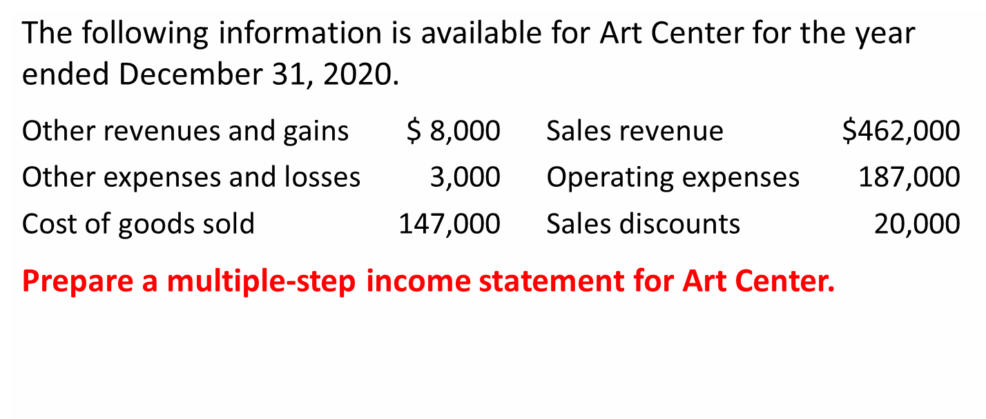
Do IT
Prepared by Dr. Emad Zaher

Slide 12
DO IT Multiple-Step Statement
Art Center Income Statement For the Year Ended December 31, 2020
Sales
Sales revenue |  |  | $462,000
Sales discounts |  |  | 20,000
Net sales |  |  | 442,000
Cost of goods sold |  |  | 147,000
Gross profit |  |  | 295,000
Operating expenses |  |  | 187,000
Income from operations |  |  | 108,000
Other revenues and gains | $8,000
Other expenses and losses | 3,000 |  | 5,000
Net income |  |  | $113,000
Prepared by Dr. Emad Zaher

Slide 13
Multiple step income statement
EX(1)
Sales returns and allowance
-
Sales revenue $480.000 , sales returns and allowances $ 12.000 , Sales discounts 8.000 , Salaries and wages expense 64.000 , Utilities expense 17.000 , Advertising expense 16.000 , Depreciation expense 8.000 , Freight – out 7.000 , Insurance expense 2.000 , Interest revenue 3.000 , Gain on disposal of plant assets 600 , Interest expenses 1800 , loss from vandalism 200 , Cost of goods sold 316.000
-
sales discount
1- Net sales =
Sales
= 480000 - 12000 - 8000 = 460000
2- gross profit =
Net sales -
cost of good sold
    = 460000 - 316000 = 144000 LE
3- operation income =
gross profit -
operation expense
    = 144000 - 114000 = 30000 LE
+
interest revenue and gains
4- Net income
= operation income
Salaries and wages expense 64.000
Utilities expense 17.000
Advertising expense 16.000
Depreciation expense 8.000
Freight – out 7.000
Insurance expense 2.000
3000 + 600
31600
300000 +
–
interest expenses and loss
1800 + 200
Total operating expenses | 114000
Prepared by Dr. Emad Zaher

Slide 14
DO IT
Prepared by Dr. Emad Zaher

Slide 15
Single - step income statement
Multiple step income statement
Prepared by Dr. Emad Zaher

Slide 16
DO IT
Prepared by Dr. Emad Zaher

Slide 17
Prepared by Dr. Emad Zaher

Slide 18
Inventory Systems
Perpetual systems
  Continually update accounting records for merchandising transactions
  companies keep detailed records of the cost of each inventory purchase and sale and determines the cost of goods sold each time a sale occurs.
  Applied in the Companies that sell merchandise with high unit values
Periodic systems
  Accounting records relating to merchandise transactions are updated only at the end of the accounting period.
  Applied in the Companies that sell merchandise with low unit values
Prepared by Dr. Emad Zaher

Slide 19
Do IT
  The cost of goods sold is determined and recorded each time a sale occurs in:
  periodic inventory system only.
  a perpetual inventory system only.
  both a periodic and perpetual inventory system.
  neither a periodic nor perpetual inventory system.
Prepared by Dr. Emad Zaher

Slide 20
Prepared by Dr. Emad Zaher

Slide 21
Prepared by Dr. Emad Zaher

Slide 22
Prepared by Dr. Emad Zaher

Slide 23
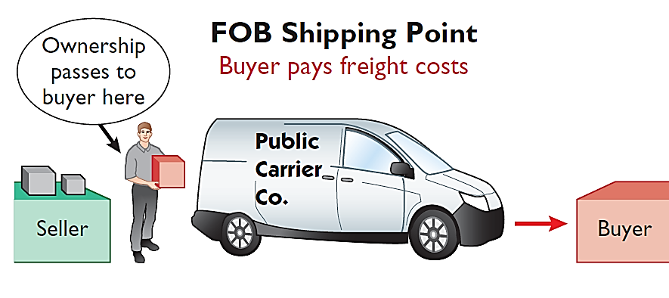
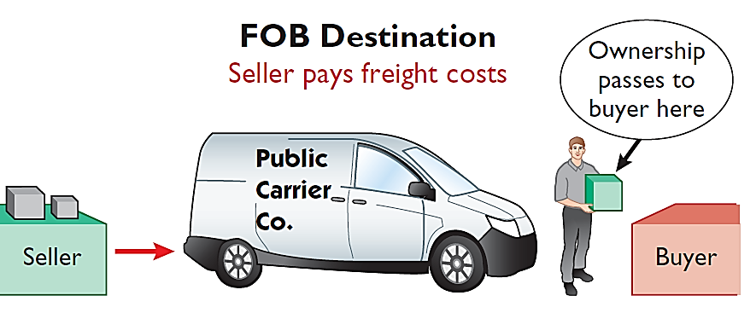
Freight Costs
Ownership of goods passes to buyer when public carrier accepts goods from seller.
Ownership of goods remains with seller until the goods reach buyer.
Freight costs incurred by the seller are an operating expense.

Slide 24
Prepared by Dr. Emad Zaher

Slide 25
Prepared by Dr. Emad Zaher

Slide 26
Prepared by Dr. Emad Zaher

Slide 27
Purchase Discounts
2/10, n/30 |  | 1/10 EOM |  | n/10 EOM
2% discount if paid within 10 days, otherwise net amount due within 30 days. |  | 1% discount if paid within first 10 days of next month |  | Net amount due within the first 10 days of the next month
Prepared by Dr. Emad Zaher

Slide 28
Prepared by Dr. Emad Zaher

Slide 29
Prepared by Dr. Emad Zaher

Slide 30
Prepared by Dr. Emad Zaher

Slide 31
Prepared by Dr. Emad Zaher

Slide 32
Prepared by Dr. Emad Zaher

Slide 33
Information related to Almond Co. is presented below.
On April 5, purchased merchandise from Morris Company for $23,000, terms 2/10, net/30, FOB shipping point.
Inventory
23000
Acc . Payable
23000
2- On April 6, paid freight costs of $900 on merchandise purchased from Morris.
Inventory
900
cash
900
3- On April 7, purchased equipment on account for $26,000.
Equipment
26000
Acc . Payable
26000
Prepared by Dr. Emad Zaher

Slide 34
Information related to Almond Co. is presented below.
On April 5, purchased merchandise from Morris Company for $23,000, terms 2/10, net/30, FOB shipping point.
Inventory
23000
Acc . Payable
23000
2- On April 6, paid freight costs of $900 on merchandise purchased from Morris.
Inventory
900
cash
900
4- On April 8, returned damaged merchandise to Morris Company and was granted a $3,000 credit for returned merchandise.
Acc . Payable
3000
Inventory
3000

Slide 35
Information related to Almond Co. is presented below.
On April 5, purchased merchandise from Morris Company for $23,000, terms 2/10, net/30, FOB shipping point.
Inventory
23000
Acc . Payable
23000
4- On April 8, returned damaged merchandise to Morris Company and was granted a $3,000 credit for returned merchandise..
Acc . Payable
3000
Inventory
3000
6- On April 15, paid the amount due to Morris Company in full.
20000
Acc . Payable
1- الصافي = 23000 - 3000 = 20000
2- المدة = 15 - 5 = 10
Inventory
400
Cash
19600
3- الخصم = 20000 x 2% = 400
Prepared by Dr. Emad Zaher

Slide 36
Information related to Almond Co. is presented below.
On April 5, purchased merchandise from Morris Company for $23,000, terms 2/10, net/30, FOB shipping point.
Inventory
23000
Acc . Payable
23000
4- On April 8, returned damaged merchandise to Morris Company and was granted a $3,000 credit for returned merchandise..
Acc . Payable
3000
Inventory
3000
7- Assume that Almond Co. paid the balance due to Morris Company on May 4 instead of April 15. Prepare the journal entry to record this payment
Acc . Payable
20000
1- الصافي = 23000 - 3000 20000 =
2- المدة = تجاوزت 10 أيام
Cash
20000
3- الخصم = Zero

Slide 37
Sales transactions under perpetual inventory system
Prepared by Dr. Emad Zaher

Slide 38
On December 3, Sayed Company sold $570,000 of merchandise to Shephard Co., terms 2/10, n/30, FOB shipping point. The cost of the merchandise sold was $350,000.
sale of merchandise
Acc. receivable
570000
Sales revenue
570000
Cost of good sold
350000
inventory
350000
Prepared by Dr. Emad Zaher

Slide 39
2. On December 8, Shephard Co. was granted an allowance of $20,000 for merchandise purchased on December 3.
sale of merchandise
sales returns and allowances
Acc. receivable
sales returns
20000
570000
Sales revenue
570000
Acc. receivable
20000
Cost of good sold
350000
inventory
20000
inventory
350000
Cost of good sold
20000
Prepared by Dr. Emad Zaher

Slide 40
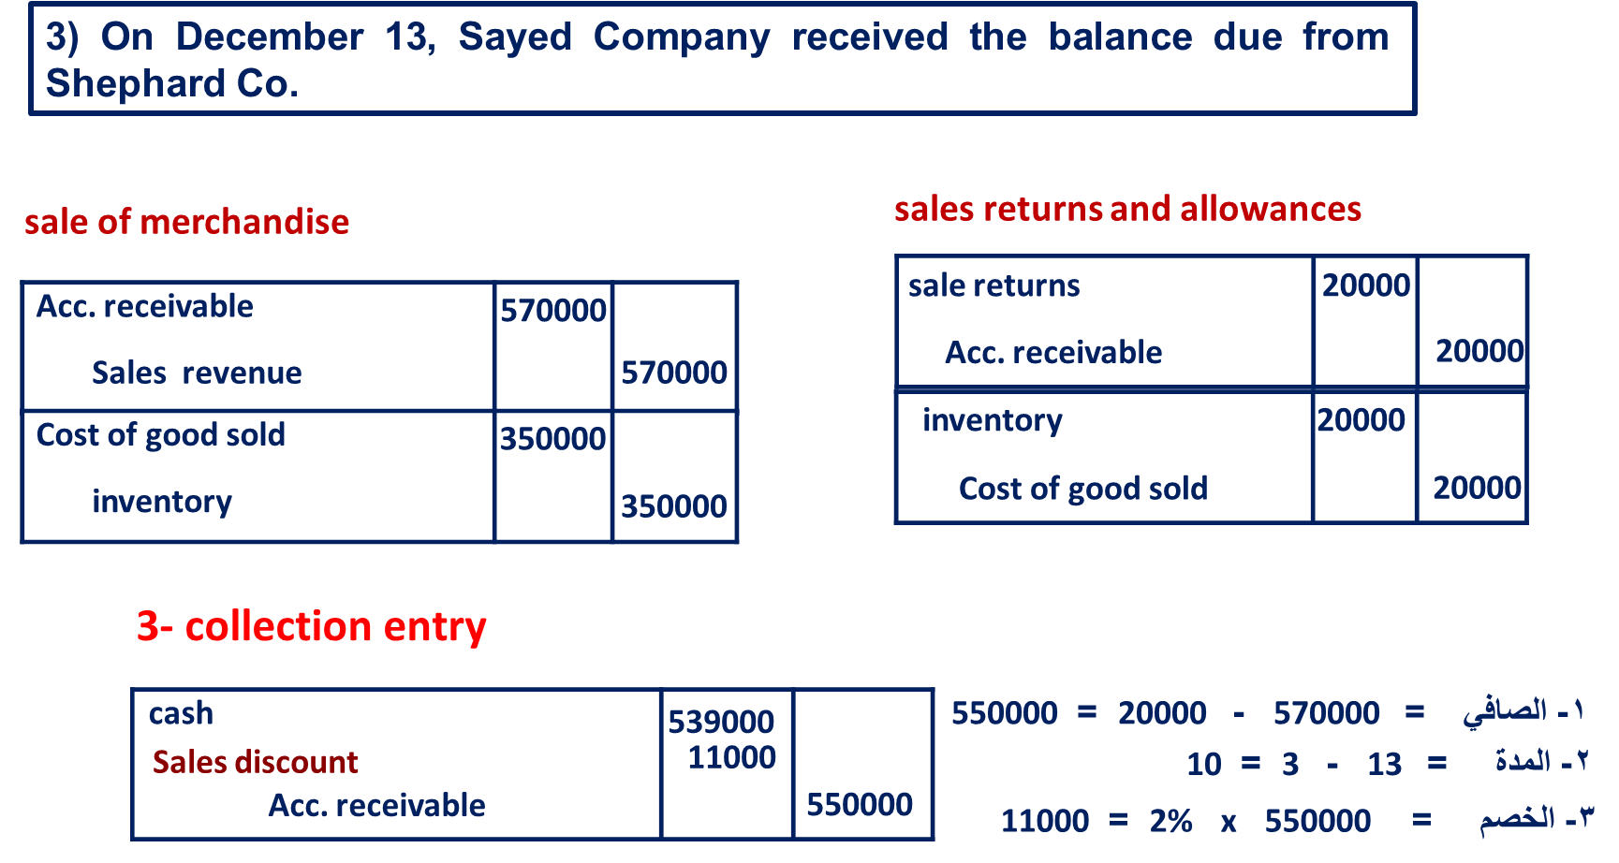
Prepared by Dr. Emad Zaher

Slide 41



Thank You

