Slide 1



Social Media and Crises
DGM 730
Final Revision
Prepared by
Dr. Doaa Rady
https://midocean.ae/

Slide 2

Final Exam: Social Media and Crises (DGM 730)
About Exam Design
  20 Questions
  60 mins
  Each question 3 mins
5 Audio Questions
True or False
MCQ
Exam date: الإثنين 29/04/2024
من 07:30 إلى 08:30 مساءً
https://midocean.ae/

Slide 3

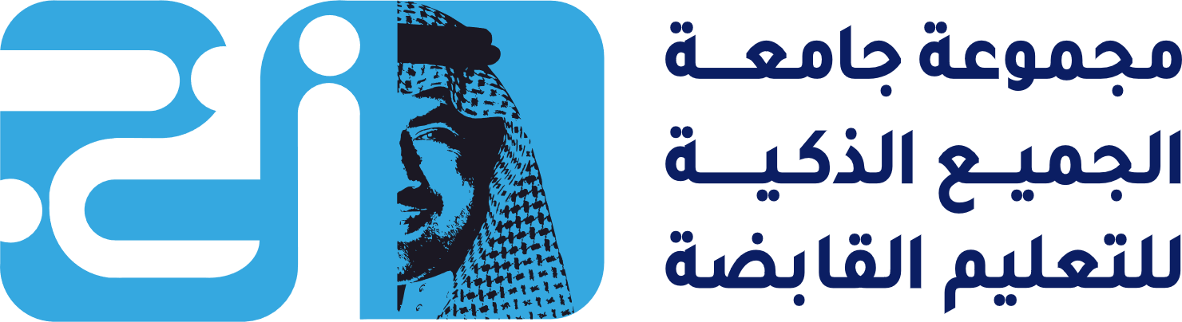
Lecture 1

Slide 4

Lecture
01
What is a company social media policy?
Social media has become a large part of our everyday lives. Consumers expect brands to have an active online presence and the ability to answer any questions they have fast.
But a poorly timed or worded social post could harm your brand reputation.
Although people may forgive your brand, the internet never forgets, so it’s better to be safe than sorry! Implementing a social media policy will help protect your company and give employees the space to advocate for themselves while staying true to the brand and its values.

Slide 5
Lecture
01
Why do you need a social media policy for employees
Promote DEI (Diversity, Equity, & Inclusion) التنوع والإنصاف والشمول
Brand diversity in social media is more important than ever. Company alignment with التوافق معpersonal values is 74% more important to consumers than it was in 2021, so brands need to show and tell audiences what the company values.
Amplifying diverse voices via social media is an actionable step brands can take to prioritize representation and attract top talent from marginalized communities. An inclusive social media policy will empower and encourage voices from all backgrounds to advocate for the brand.

Slide 6
Lecture
01
Why do you need a social media policy for employees
Minimize legal action against your brand تقليل الإجراءات القانونية ضد علامتك التجارية
Social media presents complicated considerations such as privacy law and copyright law. A well made social media policy will protect the company from potential lawsuits.
Consult with your legal counsel and outline a list of dos and don’ts for the company to follow. These rules of thumb القواعد الأساسية will help ensure the organization and contractors are compliant with laws, reducing the risk of legal action against the company.

Slide 7
Lecture
01
Why do you need a social media policy for employees
Protect your brand from privacy and security risks
حماية علامتك التجارية من مخاطر الخصوصية والأمان
There are many privacy and security risks involved with using social media.
The larger your team is, the larger those risks become. A good social media policy combined with security protocols will protect your accounts against hacking, phishing and fraud accounts.
And since social media is a common resource for scammers and criminals, it’s imperative your social media policy includes guidelines that protect both your employees and company. Whether it’s defending against phishing scams or ransomware attacks هجمات الفدية, make sure that everyone in your organization is vigilant يقظ about online protection.

Slide 8


Lecture
01
Understanding copyright and creative commons
Copyright law gives creators certain kinds of control over their creative work. If people want to use copyrighted work, they often have to ask for permission from the creator.
Creative Commons المشاع الإبداعيworks within copyright law. It allows creators to grant permission to everyone in the world to use their work in certain ways.
Copyright Symbol
Creative Commons Symbol

Slide 9
Lecture
01
Understanding copyright and creative commons
What is Copyright?
Copyright grants authors the exclusive rights regarding the use and reproduction of their original work. With the Licensing of the Press Act 1662, the English Parliament addressed the unauthorized printing الطباعة غير المصرح بها of books and pamphlets. This legal concept was then adapted by various countries.
Copyright is one of the group of laws under intellectual property which immediately applies to any novel work which facilitates authors’ selling activities. However, when an employee gets paid for creating a certain material, the employer often gets the copyright. An infringement التعدي of copyright occurs when an owner’s product is reproduced without permission. Copyright registration is not needed in most countries; however, many authors still opt to register for marketing purposes.

Slide 10
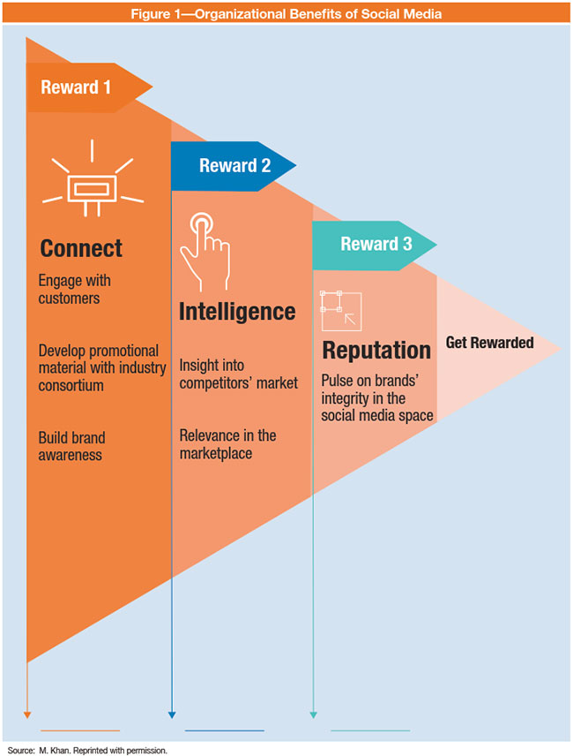
Lecture
01
Social Media risks and rewards
Some of the most advanced social media topics and benefits include:
Connecting with customers—The ability to engage with customers is the most critical aspect of social media. Developing a brand and promoting it through various channels of social media can create further brand value and awareness.
Marketing intelligence ذكاء/استخبارات —Social media marketing gives the organization the ability to monitor the brand and listen to what the public is saying in the social media space.

Slide 11
Lecture 2

Slide 12
Lecture
02
What is a Crisis?
Crisis management is literally managing the ongoing situation. Crisis situations can be divided into three stages which are pre-crisis stage, crisis and the post-crisis stage. For any crisis management the first and most important step is to save lives.
One of the challenges faces leaders is time—time to assess the situation, time to react, and time to repair.
Now, the age of the instant crisis has arrived. Companies, nonprofit organizations (NGOs), governments, and high-profile individuals often seem unable to cope. The ingredients include speed, pervasiveness, and huge numbers.
Example: Verizon adds a $2 charge, and one-hour later 100,000 signatures appear on a Twitter petition.

Slide 13
Lecture
02
Conventional crises which now play-out differently
Whenever an organization is faced with a crisis, it is facing a major threat towards its operations. During a crisis an organization needs to find out the best way to communicate with the public to manage the situation. Nowadays this includes operating in social media platforms.
Today’s social media tools are bringing rapid change to organizational communication and public relations. These technologies have shifted the emphasis of internet services from being consumption-based towards becoming interactive and collaborative, creating new opportunities for interaction between organizations and publics.

Slide 14
Lecture
02
Crisis created by use of social media
The power of online media means that today’s crises emerge at lightning speed, and spread further and faster than ever before. Social media also imposes higher standards of transparency. Incidents which could previously be kept under wraps are now much more likely to become public knowledge (sometimes even before the organization itself is fully aware of them).
To put it simply, a crisis fueled by social media is not something you want to face unprepared. Social media poses internal and external risks, both of which could have a potentially devastating effect on your organization's reputation and bottom line.

Slide 15
Lecture
02
Types of crisis
1) Natural Crisis:
Disturbances in the environment and nature lead to natural crisis.
Such events are generally beyond the control of human beings.
Tornadoes, Earthquakes, Hurricanes, Landslides, Tsunamis, Flood, Drought all result in natural disaster.
2) Technological crisis:
Technological crisis arises as a result of failure in technology. Problems in the overall systems lead to technological crisis.
Breakdown of machine, corrupted software and so on give rise to technological crisis.

Slide 16
Lecture
02
Types of crisis
9) Sudden Crisis:
As the name suggests, such situations arise all of a sudden and on an extremely short notice.
Managers do not get warning signals and such a situation is in most cases beyond anyone’s control.
10) Smoldering Crisis الأزمة المشتعلة :
Neglecting minor issues in the beginning lead to smoldering crisis later.
Managers often can foresee crisis توقع الأزمة, but they should not ignore the same and wait for someone else to take action.
Warn the employees immediately to avoid such a situation.

Slide 17
Lecture
02
Misuse of social media
Social Media Misuse means social media use that is unauthorized, that threatens, humiliates, harasses, or intimidates غير مصرح به، والذي يهدد أو يهين أو يضايق أو يخيف school-related individuals, disrupts the educational process, and/or violates local, state, or federal law.
Some misuses that are associated with the social media are:
    Defamation التشهير
    False and unreliable informationمعلومات خاطئة وغير موثوقة
    Cyberbullyingالتنمر الإلكتروني
    Loss of Privacyفقدان الخصوصية
    Fraudاحتيال

Slide 18
Lecture 3

Slide 19
Lecture
03
How does social media affect a crisis?
Social media is a double-edged sword when it comes to handling a crisis, capable of resolving the situation or making things much, much worse, depending on how you use it. The vast number of people on social media means that a single wrong move can harm your brand's reputation in front of literally millions of vocal users.

Slide 20
Lecture
03
The levels of Social Media Crisis
The three phases of a crisis
Pre-crisis phase: entails prevention and preparation for a potential crisis and the reduction of the risk of one occurring. This includes creating a crisis management plan, training and preparing a crisis response team and performing tests and drills.
Research showed that organizations generally handle crises better when they have a crisis management plan that is updated at least once a year, and a specific crisis management team that exercises it annually.

Slide 21
Lecture
03
The levels of Social Media Crisis
The three phases of a crisis
Crisis response phase: looks at the initial crisis response and then reputation repair. After encountering a crisis, it is important to be rapid and accurate.
Researchers suggest that a response should be in place within the first hour after it occurs. The reason is that they have a chance to articulate their side of the story and to stay on top of where the conversation is going.
When addressing the media regarding a crisis, an organization should very carefully select their spokesperson. Ideally, the spokesperson should present information clearly and avoid using technical terms. Further, the spokesperson should appear pleasant, maintain strong eye contact, and no exhibit no visual nervous habits.

Slide 22
Lecture
03
The life cycle of
Social Media Crisis
The Preparedness and Prevention Stage
The organizations must at this stage create an emergency plan to confront the crisis, and form a crisis management team, who has previous experience in crisis management as possible.
This stage also includes discovering the weak points in the organization and developing a plan to confront them, and identifying the necessary methods and tools necessary to help confronting the crisis, training employees on how to face crises, benefit from the lessons of others, develop information about crises and expected problems, and evaluate their degree of severity.
مرحلة الاستعداد والوقاية

Slide 23
Lecture
03
How to analyze a crisis?
Identify the root cause
The first step is to find out what triggered the crisis, how it spread, and who was affected. You can use tools like social listening, sentiment analysis, and web analytics to monitor the online conversations, feedback, and traffic related to the crisis. You can also interview your team members, customers, and stakeholders to get their perspectives and insights. By identifying the root cause, you can understand what went wrong and how to prevent it from happening again.

Slide 24
Lecture
03
The categories of Social Media Crisis
Types of social media crises
Social media crises can even be classified into types:
Multi-channel crisis – extremely dangerous because it has the potential to go viral and generate a great deal of negative publicity very quickly.
Emerging crisis – If you don’t anticipate and deal with it as soon as possible, it can quickly escalate into a bigger scandal.
Industry crisis – occurs when a vendor or competitor is experiencing a social media crisis. For example, when many fashion brands are suddenly all attacked for non-transparent actions.
Fake news – in the age of social media, a post can go viral in just one click. The ability to detect rumors about your brand quickly is essential.

Slide 25
Lecture 4

Slide 26
Lecture
04
Crisis Communication
Definition of Crisis Communication
Crisis communication research mainly deals with the interrelationships between crisis situations, communication strategies and crisis perceptions.
Crisis communication, when done successfully, can help mitigate negative media coverage and manage perceptions both during and after the crisis.
Crisis communication has been broadly defined as “the collection, processing, and dissemination of information required to address a crisis situation”.
Also, crisis communication defined as “the ongoing process of creating shared meaning among and between groups, communities, individuals and agencies, within the ecological context of a crisis, for the purpose of preparing for and reducing, limiting and responding to threats and harm”

Slide 27
Lecture
04
How influencers can help you manage a social media PR crisis
2. Improve the search results for your brand
A timely and well-executed influencer marketing strategy can improve positive mentions and remarks about your brand. This increases social momentum as the influencer’s audience engages with the positive content.

Slide 28
Lecture
04
PR Models
Models developed to explain the behavior of PR practitioners in 1970s. Asymmetrical communication التواصل غير المتماثل is unbalanced in that the organization tries to change the public and symmetrical communication is balanced in that there are adjustments by the organization and its stakeholders.
There are four models of public relations which includes press agentry/publicity, public information, two-way asymmetrical, and two-way symmetrical.
1) The press agentry/publicity model وكالة الصحف/ الدعاية is characterized as a one-way asymmetrical model of communication, traveling from the organization to the public primarily through the mass media, used as a way of persuading and manipulating a desired audience to act as the organization wishes. (Pure Propaganda)

Slide 29
Lecture
04
Social-mediated crisis management (SMCM)
Social media has the potential to one day contribute to agenda building for public relations practitioners so they must learn to adopt it into their practices.
ﻧﻣوذج إدارة اﺗﺻﺎﻻت اﻷزﻣﺔ ﻋﺑر وﺳﺎﺋل اﻟﺗواﺻل اﻻﺟﺗﻣﺎﻋﻲ

Slide 30
Lecture
04
Social-mediated crisis management (SMCM)
ﻧﻣوذج إدارة اﺗﺻﺎﻻت اﻷزﻣﺔ ﻋﺑر وﺳﺎﺋل اﻟﺗواﺻل اﻻﺟﺗﻣﺎﻋﻲ
The Social-Mediated Crisis Communication (SMCC) model is also known as the “social-mediated dialogue” between organizations and publics during crises.
This model is considered to be the first theoretical model to focus on relationships between online and offline audiences, organizations, social media platforms, and traditional media, before, during and after the crises.
In Social-Mediated Crisis Communication model, both the direct and indirect exchange of information on social media, as well as between traditional media and social media are significant .

Slide 31
Lecture
SCCT: Situational Crisis Communication Theory النظرية الموقفية لاتصال الأزمة
04
Coombs (2014) summarized 10 SCCT communication strategies under four crisis response strategy clusters as shown in the Table.
Organizations usually adopt different types of SCCT communication strategies, depending on their belongingness to the victim, accidental, or preventable clusters.
For example, organizations may choose the strategies in the 1) denial posture وضعية الإنكار to avoid any connections with a crisis. They may also use the strategies in the 2) diminishment cluster ضعف الموقف to lower a crisis’s negative effects. 3) Rebuilding posture إعادة بناء الموقف allows organizations to re-establish relationships with the stakeholder through apologies or compensations. Strategies in the 4) bolstering posture تعزيز الموقف enable organizations to build a positive relationship with the stakeholders.

Slide 32
Lecture
04
Image Restoration Theory
William Benoit (1995; 1997) developed a theory of image restoration نظرية استعادة الصورة to understand how corporations recover from crises. The process of image repair is most often framed as apologia اعتذار , or a genre of public apologetic discourse.
Image restoration theory is based on the assumption that image and reputation have both symbolic and economic value, that threats to an organization’s image can occur (sometimes frequently), and that communication can help repair the damage.
An attack on one’s image has two components: 1) an offensive act فعل مسئ and 2) an accusationالاتهام of responsibility for the act. If there is no offensive act or no accusations of responsibility for the act, there is no reputational threat.

Slide 33
Lecture 5

Slide 34
Lecture
05
Crisis Communications Plan
Develop an Integrated Crisis Communications Plan
Create a crisis communications team
Crisis communications team leader (CCTL): Responsible for coordinating the team’s response, overseeing message development, scheduling crisis communications team meetings and facilitating approvals with senior leadership. This may be a senior communications leader within your organization.
Crisis communications coordinator (CCC): In the event of a larger crisis, this person will assist the CCTL with prioritizing the team’s responsibilities and project managing a response. They will liaise with all of the communications team leaders: social, PR, internal communication, investor relations, customer marketing, etc. This may be a communications manager from any discipline or your social team lead.

Slide 35
Lecture
05
Crisis Communications Plan
Develop an Integrated Crisis Communications Plan
2. Be prepared for different crisis scenarios
It’s impossible to know exactly what crises may come up. The way every company had to handle communications over the last few years differed between industries, locations, products and more.
That’s why it’s beneficial to you and your company to prepare for different potential crisis scenarios.
Identify what types of scenarios might emerge that could adversely impact your business. List the types of events that could cause each type of crisis, as well as the right member of your executive team to help your crisis communications team leader run point.

Slide 36
Lecture
05
Acceptable use policies (AUPs)
Acceptable use policies (AUPs) to manage social media use
Developing an AUP to cover social media
Start by expanding your company's existing acceptable use policies governing email and web communications
Clearly specify what is acceptable and what is inappropriate to post to social media sites
State what can be posted during business hours and outside of business hours (if indeed there is any difference). Where there is no differentiation, clearly state this in the policy
Let staff know that messages posted to social media sites will be monitored. This is vital
سياسات الاستخدام المقبول

Slide 37
Lecture
05
Factors to Consider Before Posting
Factors to consider before posting
  1. Identify the message goal
It is counterproductive to create social media messages that do not have a specific goal. Furthermore, social media message goals should reflect the organization’s overall mission. Message goals can include increasing brand awareness, creating a favorable perception of an organization, and convincing the audience to buy a product. The goal should be clearly articulated in the content. Also, select the social media platform that would be the most effective in accomplishing the message goal. Each social media tool has specific characteristics and audiences, which will affect whether the message goals are achieved.

Slide 38
Lecture 6

Slide 39
Lecture
06
Managing accessibility
What is social media accessibility?
Social media accessibility is the practice of designing and developing social media content and posts that provide a smooth, inclusive experience for everyone—including for you, the marketer.
Non-accessible content can cause all sorts of annoying, disruptive experiences—like videos with a lot of background noise that don’t use captions. Creating more accessible social content is truly a win-win for everyone involved—from you, to your audience.

Slide 40
Lecture
06
Assessing and Managing Social Media Issues and Risks
What is social media risk management?
Social media risk management is the process of identifying, assessing, and mitigating risks that stem from social media.
Your brand, customers, and employees are all active on social media.
This means your social channels are a common ground where conversations — both good and bad — and crises can start.

Slide 41
Lecture
06
Managing a 24/7
information stream
What is social media monitoring (and analytics)?
Social media monitoring is keyword monitoring on social media platforms to search for mentions of predefined keywords. What keywords are worth tracking? In business, they could be connected to:
  Brand
  Product
  Service
  Industry
  CEO
  Competitors
  Marketing campaigns
  Hashtags
  Anything business-related

Slide 42
Lecture
06
The Seven Functional Blocks of Social Media
There are seven functional blocks of social media that apply to all users across any given platform:
1) Identity, (Identity deals with how users reveal themselves in a social media setting. Most of the information disclosed in this block is personal characteristics of the users such as age, name, gender, profession, and other information that represents them. This identity that is formed, generally happens through expression of what a person likes, dislikes, feels and thinks whether it is done consciously or unconsciously.)
2) Conversations, (This refers to the way in which users' communication in a social media setting, either as a group user or an individual. People communicate daily, using social media for a variety of purposes, often to, obtain information on important topics or to stay in touch with friends and family.)

Slide 43
Lecture
06
The Seven Functional Blocks of Social Media
6) reputation, (Organizations need to always keep the public aware of what channels are official, so that information is not misconstrued. If an unofficial page is perceived to be official by the public and disseminates false or skewed information, this could aid in the damage of an organization’s image.)
7) groups, (This function allows for users to come together as a community for a common goal or purpose. Facebook and Flickr for example have the ability to create two different kinds of groups that people can be a part of.)
The following figure shows the functions of social media along with the implication of each function. With the growth and expansion of social media in society in particular fields such as public relations, it is necessary for the academic community to analyze them for patterns that could emerge to help predict future of certain channels of social media in the professional world.

Slide 44
Lecture
06
The Seven Functional Blocks of Social Media

Slide 45
Lecture
06
The Seven Functional Blocks of Social Media
Social media creates a media of the masses.
Social media have been classified into these categories: Internet forums, weblogs, social blogs, wikis, podcasts, pictures and video.
From a public relations perspective, blogs and other forms of social networking are excellent ways to segment the public as groups of individuals who read the same blog or visit the same social networking site as those who share common interests.
This interaction has resulted in a participatory culture where ordinary citizens can have their voices be heard by the general public and large organizations, if they are listening.
Because of these reasons it is time organizations and public relations practitioners to pay attention to the online conversations taking part without them and learn ways to get involved with their online publics.

Slide 46
Lecture
06
Preventing Social Media Risk
1) Guidelines
As general best practice, a high-level overall policy should be rolled out to guide the use of social media by all employees of the organization and any third party acting on behalf of the organization. The guidelines should highlight key components including:
Scope—Defining the overall scope of the policy guidelines that is set forth by the enterprise for its employees
Purpose—Definition of the purpose of the guidelines for the organization, specifically, how social media activity on behalf of the organization will take place and what sort of information is relevant to share via that activity.

Slide 47
Lecture 7

Slide 48
Lecture
07
Monitoring Tools
The importance of monitoring
1. Build a strong brand
  Media monitoring helps you to see what people think about your brand. Media monitoring enables you to spot any misconceptions so you can take action to correct them.
2. Manage your reputation and respond to crisis situations
  The monitoring tool will notify you as soon as your brand is mentioned in journalistic or social media. You can even set up app notifications for certain words that would indicate a crisis.
3. Elevate your brand with key opinion leaders
  Key Opinion Leaders (KOLs) are thought leaders whose opinions are valued in a specific industry. Cooperation with the right influencer can skyrocket your brand awareness and boost your sales.
  Media monitoring helps you to follow the experts, bloggers, “gurus” and advocacies in your business and find the best fit for your brand.
Guru is a person that is generally recognized as a leader or teacher. from gurū, a word in Hindi

Slide 49
Lecture
07
How to respond to ‘radicalised’ customers or stakeholders?
Radicalisation as a four-stage process
1) Pre-radicalما قبل التطرف: The person joins or identifies with a group or organisation
2) Self-identifyتحديد الذات: The person believes and accepts the beliefs and views held by the group or organization
3) Indoctrinationالتلقين: The person is groomed by the group or organisation pulling them further down the pathway
4) Terrorismالإرهاب: The person becomes involved in committing terrorist acts

Slide 50
Lecture
07
What is digital activism? and
who are digital activists?
Grassroots
القاعدة الشعبية
is a type of movement or campaign that attempts to mobilize individuals to take some action to influence an outcome, often of a political nature.
Digital activism, also known as cyberactivism, form of activism that uses the Internet and digital media as key platforms for mass mobilization and political action.
Digital activism (D.A.) refers to political activism on the internet or political movements relying on it.
Digital activism has proved to be a powerful means of grassroots political mobilization and provides new ways to engage protesters. Additionally, online actions can be important in countries where public spaces are highly regulated or are under military control. In such cases, online actions are a better option than possibly physically dangerous “live” actions. E.G. The Arab Spring
Cyberactivism is the process of using Internet-based socializing and communication techniques to create, operate and manage activism of any type.;
social media for social change refers to social software applications

Slide 51
Lecture
07
What is digital activism? and
who are digital activists?
Smart mobs
الغوغاء الذكية
is a large group of people mobilized by social media to meet in a public place typically for the purpose of social or political protest.
From the early experiments of the 1980s to the modern “smart mobs” and blogs, activists and computer specialists have approached digital networks as a channel for action.
Initially, online activists used the Internet as a medium for information distribution, given its capacity to reach massive audiences across borders instantaneously.
A more-developed undertaking of digital activism used the World Wide Web as a site of protest that mirrors and amplifies off-line demonstrations. Some forms of digital activism are e-mail and social-media campaigning, virtual sit-ins, and “hacktivism” (disrupting Web sites).

Slide 52
Lecture 8

Slide 53
Lecture
08
A Real-time Monitoring Dashboard
What is a social media monitoring dashboard?
Social media monitoring dashboards visualize important performance metrics for a brand’s marketing efforts on social media. This includes followership, organic performance, the performance of paid advertising, and the visibility of their brand through 3rd party content and discussions (otherwise known as social listening).
A social media management dashboard is a tool used to track, measure, and analyze the performance of your social media channels, all in one place. It can help you understand everything from follower growth to competitor intelligence to social sentiment.
Why So Popular?
Authentic viewpoints, Grassroots opinion, Unprompted views, Can be cheaper than surveys, focus groups, Consumers not “expecting” marketers and researchers to be listening.

Slide 54
Lecture
08
A Real-time Monitoring Dashboard
Real-time dashboards are a form of visualization that automatically updates the user's screen with relevant information based on the latest available data. In other words, a real-time dashboard is a graphical user interface with a simple display that visualizes performance indicators and essential metrics crucial to specific business processes, functions, and objectives.
A live dashboard is a performance tool used to analyze, track, and report on the company’s data in real time with the help of interactive data visualizations.
These real time dashboards are automatically updated and provide the user with instant access to critical data.

Slide 55
Lecture
08
Managing Real-time Publication
3 key advantages to having good social media management
1: Effective platform management saves time
You will probably have one or two key platforms you primarily focus on (let’s say, Facebook for advertising and support and Twitter for building brand awareness). Still, you can’t afford to skip the basic hygiene factors on some others (for example, your LinkedIn company page), which means switching costs.
When you publish or respond in multiple channels without a cohesive plan, this will create unnecessary costs, loss of focus, and poor follow-through. You can invest in a tool to manage all platforms in one place. This keeps you focused on an actual strategy and reduces switching costs to help you act faster.

Slide 56
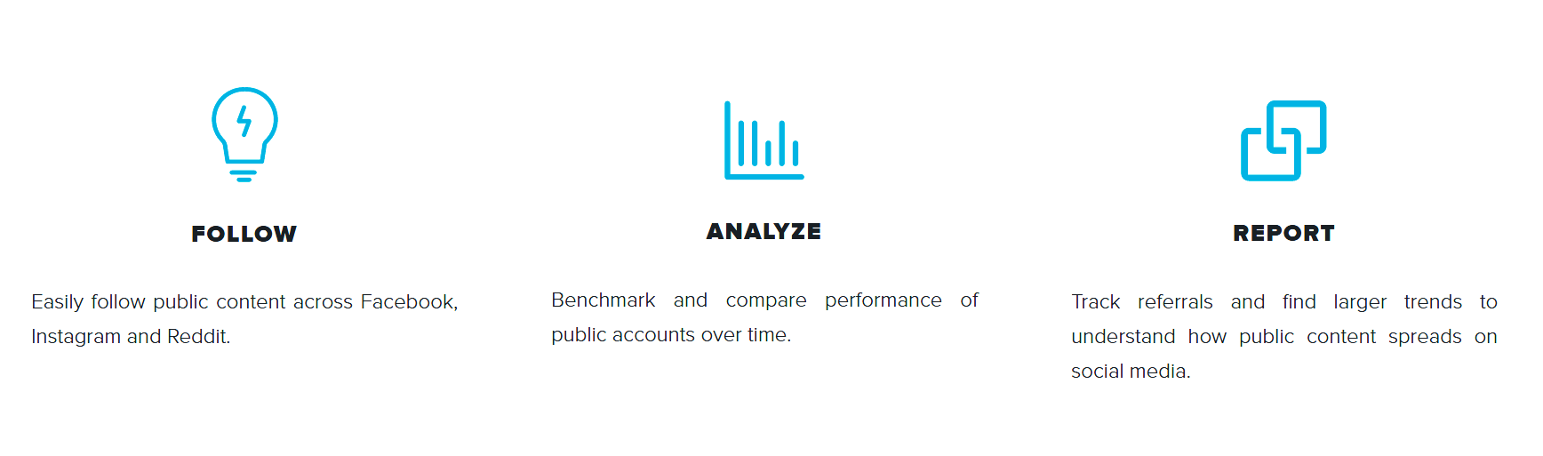
Lecture
08
Social Media Monitoring Tool
An Example: Crowd Tangle

Slide 57
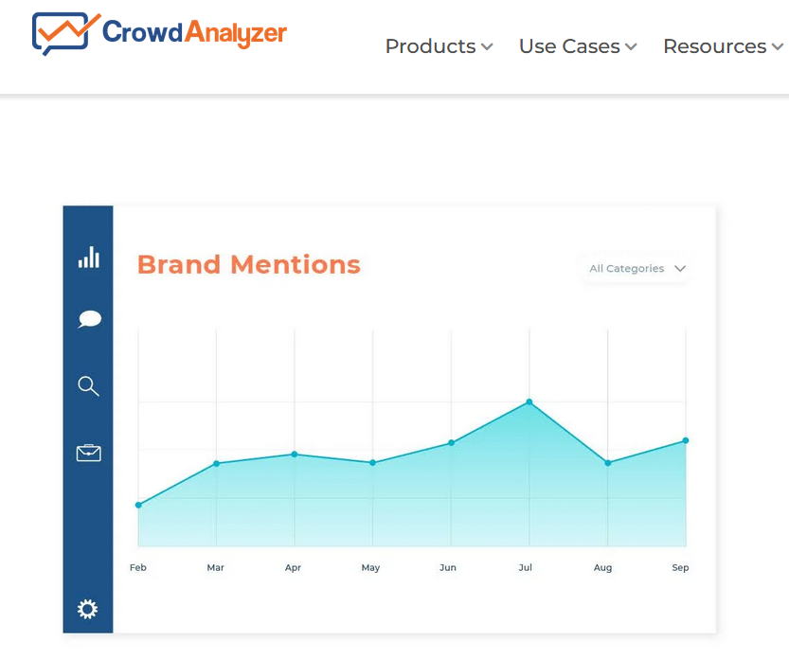
Lecture
08
A Real-time Monitoring Dashboard
Examples of tools
  10 brand social media monitoring tools (Free & Paid)
    1. Hootsuite
    2. Nexalogy
    3. Mentionlytics
    4. Reputology
    5. Tweepsmap
    6. Reddit Keyword Monitor Pro
    7. Talkwalker
    8. Sprout Social
    9. Agora Pulse
    10. Crowd Analyzer (Arabic Media Monitoring Platform)

Slide 58
Lecture 9

Slide 59
Lecture
09
How to Build Social Media Strategy?
1. Select Relevant and Realistic Social Media Marketing Goals
One of the most significant problems faced by many businesses engaged in social media is that they have never spent the time to set relevant and realistic social media marketing goals. They know they need to be on social media, but have no idea why they are there.
Of course, your social media marketing plan needs to fit into your business planning as a whole. Ideally, you will have set strategic goals for how you want your business to progress. Your social media marketing goals should complement your overarching business goals.

Slide 60
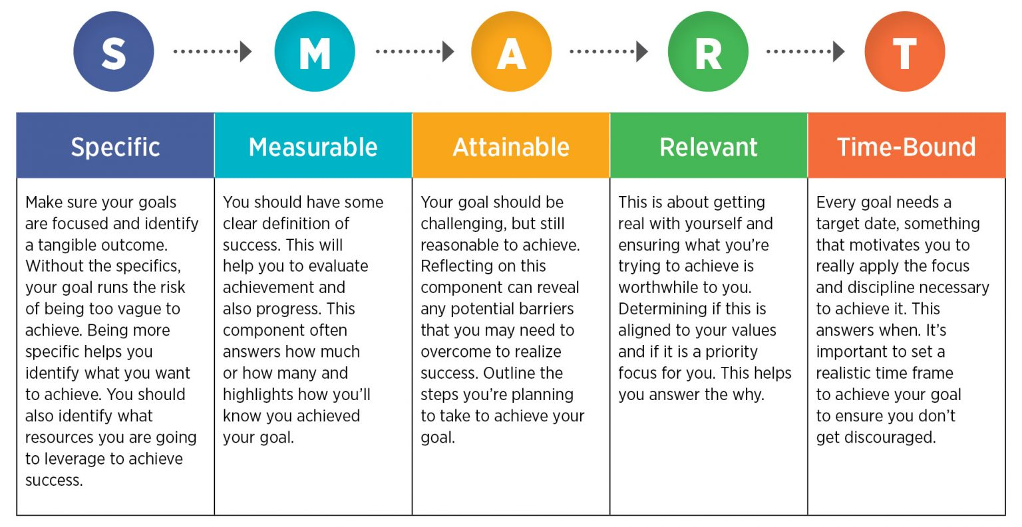
Lecture
09
How to Build Social Media Strategy?
1. Select Relevant and Realistic Social Media Marketing Goals
Suitable Social Media Goals Could include:
Increasing brand awareness
Achieving a set higher quantity of sales
Improving your ROI
Driving people to increase in-store sales
Grow your fan base
Goals have 5 elements SMART

Slide 61
Lecture
09
How to Build Social Media Strategy?
4. Understand Your Social Media Audience
Not all social media audiences are alike. Different types of people use social media in varying ways. If you’re going to meet your goals, you need to be using the same social media networks as your target audience. Similarly, if you intend to engage in influencer marketing, you need to ensure that you engage influencers whose audience matches your target market.

Slide 62
Lecture
09
How to Build Social Media Strategy?
8. Plan the Types of Content You Intend to Share
Of course, to be successful on social media, you will need high-quality content to share. One of the biggest mistakes that businesses do is to share excessive promotional material. Remember, social networks are designed to be social – they were never intended to be a marketplace for you to sell your products.
Therefore, you need to balance the content you share socially, to be a mixture of informative and entertaining items, with a small percentage of promotional material added in. You will also need to like and share other people’s content.
This is probably the most significant reason that most influencers gain that status. They know their audience well and create the perfect content to interest their followers. As a brand, you need to do the same.

Slide 63
Lecture
09
How to Build Social Media Strategy?
17. Consider Working with Brand Advocates
You might already have access to keen and eager people who are happy to promote your brand on social media. You can include these brand advocates in your social media marketing strategy. They may not have the same reach as the top influencers in your niche, but some will already have sizeable audiences and solid reputations, and you have the added advantage that they already know and like your product.
Brand advocacy simply means that the people who love your product or services continue to show support for your brand by promoting your organization organically to new audiences. Your brand advocates can play a significant role in word-of-mouth marketing and drive new business by being enthusiastic fans of what your company does.
Brand advocates can include your executive leadership, company partners, employees, and existing customers.

Slide 64
Lecture 10

Slide 65
Lecture
10
Introduction
The use of social media has increased in the world of communication, with Twitter and Facebook as the most used platforms, and organizations have gained mileage by using it to communicate in a much more effective and fast way with their customers about their businesses as well as responding to queries and questions.
However, in as much as the emergence of social media has brought in the advantage of fast, effective communication, it has also given room for the fast spread of negative. An organization depends on its reputation, it is a pertinent aspect that directly translates to its financial achievement, and with the emergence of social media, crisis might arise and spread faster than it can ever do on any other traditional forms of communication.

Slide 66
Lecture
10
Introduction
Therefore, the success of any organization is highly dependent on what it says or the effort it makes after a crisis strike.
For this reason, crisis management helps the companies in being able to address issues that threaten its reputation.
It has been suggested that it is paramountأساسي for organizations to understand fully how to manage different kinds of crisis via social media.
Wang (2015) observes that social media has been utilized for public relations since its advent in 2004, and this has had an influence on both individuals and the society.

Slide 67
Lecture
10
Internal Communication
Organizations communicate in two directions: internally to staff and externally to clients, customers, shareholders, stakeholders, the media.
Faulty internal communications can lead to mistakes, discouraged and unhappy staff, employees leaving the company.
Poor external communications can damage image and sales. It really is that simple. Any overall management strategy needs a communications plan or the whole operation might fail.
A communications audit analyzes an organization’s practices to reveal how effective they are—throughout a whole company or in specified parts of the organization. It can pinpoint problem areas such as frequent misunderstandings, information blocks, information lacks, information duplication, misrepresentation. An audit could be part of a periodic health check, but it is especially helpful at a time of change: a merger or acquisition, launch of a new product or service, entry into new markets, for example.

Slide 68
Lecture
10
Influencer Communication
This is due to at least two characteristics of influencer communication:
First, many influencers strive to monetize their status as micro-celebrities.
Second, influencers combine functions that different actors have fulfilled previously, e.g. creative agencies, advertising media, journalistic media, testimonial givers, and opinion leaders. This intermingling of functions in just one actor implies that routine procedures that are tailored to mono-functional actors may fall short.
For example, organizations have to approach travel influencers differently than travel journalists.
Due to these two characteristics, organizations’ communication departments and their agencies are confronted with the task of adapting their routines to influencer communication or even developing new routines.

Slide 69
Lecture
10
Media Communication
Relationships & Preparation
Good media relations begin
long before you are contacted.
Draft and implement a media policy.
Educate employees on the policy.
Identify and train a lead spokesperson.
Establish relationships with reporters.
Know your Target Audiences.
Develop and know your Key and Secondary Messages.
Anticipate and prepare for questions.
Answer questions with your messages.
No comment is usually no good.
If you hide from the media, most people
will suspect that you have something to hide.

Slide 70
Lecture
10
Media Communication
Develop Your Messages :
What you say will have an effect on each target audience.
So, what do you say?
  Key Messages
  The Key Message is applicable to any audience.
  The Key Message should register an immediate impression.
  Secondary Messages
  Secondary Messages are customized for specific audiences.
  Develop your messages before you talk with a reporter.
  Rehearse and repeat them during the interview, no matter the question.

Slide 71
Lecture
10
Ten rules for crisis management
2. Communicate, communicate, communicate.
The first rule of crisis management is to communicate. Early hours are critical and they set the tone for the duration of the crisis. The media’s first questions are likely to be simple and predictable:
              What happened? What are you doing about it?
              Why happened? Were there warning signs?
              Where?
              When did you know of the problem?
              Who’s to blame?
              How will life or property be protected or compensated?
5 Ws & H?

Slide 72



Thank You

