Slide 1
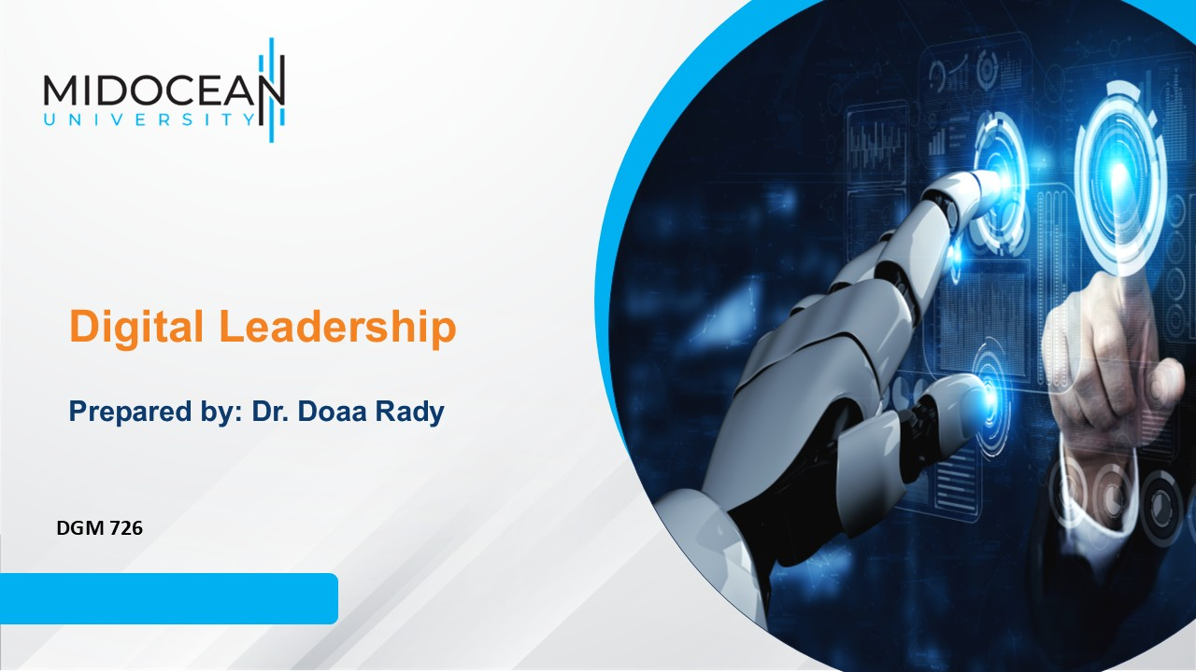
Lecture 8
Leading Digital Organizations

Slide 2

Lec.8
Last Lecture, we leaned about
  Action-Centered Leadership
    The Task
    Individuals
    Team
    The Task Oriented Profile
    The Individual Oriented Profile
    The Team Oriented Profile
  Team Building
    What is a team?
    The advantages of teams
    The disadvantages of teams
    When should you build teams?
    What makes a good team?
    How do you build a team?
  Virtual Teams
    What is a virtual team?
    Factors impact virtual
    teams’ performance
    Challenges of virtual teams
    Adaptability of virtual teams
    Trust in virtual teams

Slide 3
Lecture outline
Lec.8
Today’s Lecture we will Know about
  Leading Digital Organizations in a VUCA World
  Digital Leadership Model
  Effective Communication in virtual organizations
    Aspects of successful communication
    Employee engagement as internal communication strategy
  Digital Skills for Improving Organizational Performance
  Digital Literacy Skills

Slide 4
Lec.8
Learning Outcomes
Understand Leading Digital Organizations in a VUCA World
Analyze and apply Digital Leadership Model
Know the Digital Skills for Improving Organizational Performance
Understand Digital Literacy Skills
Know how to use Effective Communication in virtual organizations

Slide 5
Introduction
Looking at the industrial era 4.0, humans are faced with the situation of being able to compete with others to survive in the world of competition.
One of the efforts made is through increasing the qualifications and abilities possessed in order to be able to adapt to developments.
In competition in the era of the industrial revolution 4.0, humans are faced with conditions to compete with the existence of technology that is developing faster.
Therefore, there is concern about the role of humans which can later be replaced by the role of robots. The automation offered through technology will have an impact on human existence.
Lec.8

Slide 6

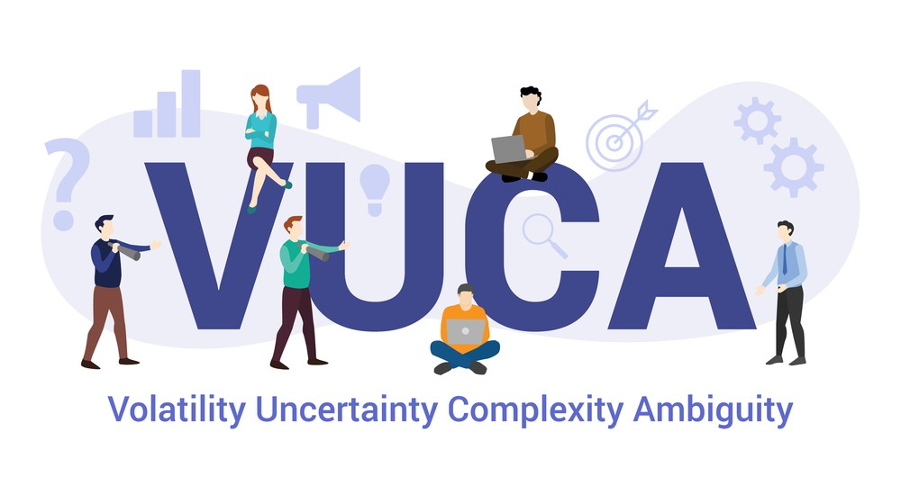
Lec.8
Leading Digital Organizations
in a VUCA World

Slide 7
VUCA
Lec.8
There have been many changes in Information and Communication Technology, and one thing that can be noticed was it is very agile and dynamic. The U.S. military coined the acronym VUCA (volatility, uncertainty, complexity, and ambiguity) in the late 1990s, and it has become general shorthand for conditions leaders may encounter especially in digital transformation context and leaders need to be prepared for many types of turbulence or upheaval.

Slide 8
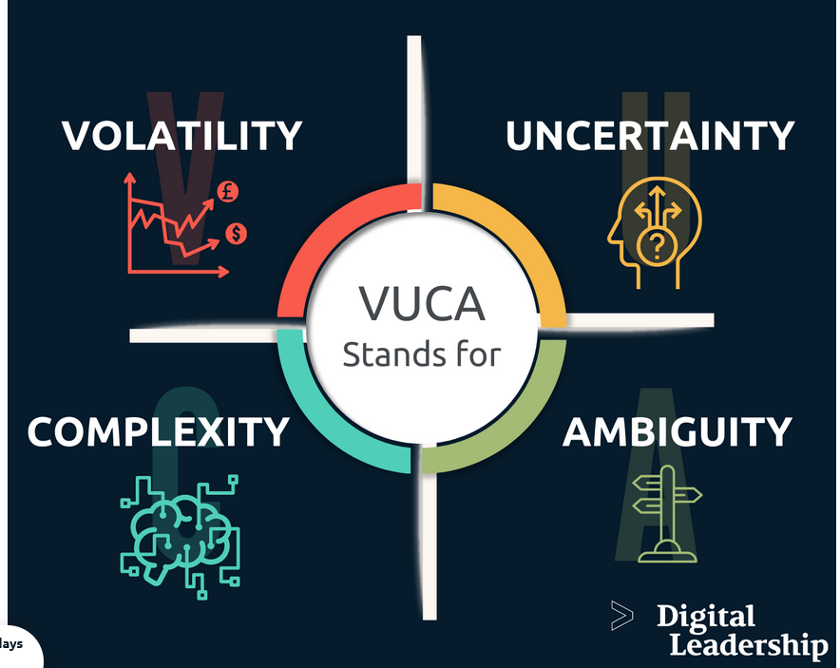
VUCA
Lec.8
Volatility in VUCA stands for the fact that we live in a world that is constantly changing, becoming more unstable, more unpredictable and more rapid. Volatility refers to frequent and strong changes in the market environment.
Uncertainty in VUCA stands for the rapidly decreasing predictability of events, forecasts, and experiences from the past as a basis for shaping the future losing their validity and relevance.

Slide 9
VUCA
Lec.8
Complexity in VUCA stands for the fact that our world is more complex than ever. What is the cause? What is the effect? – Problems and their effects are becoming more complex and harder to understand. Decisions become an uncontrollable web of reaction and counter-reaction.
Ambiguity refers to the ambiguity of the information situation. Information that can be interpreted in different ways carries a high risk and often leads to wrong decisions.

Slide 10
VUCA
Lec.8
The VUCA world is synonymous with the increasing dynamics in digital markets. In contrast, the VUCA model offers a framework for action and orientation for corporate management under these conditions.
The current market resembles a VUCA world, which means companies need digital leaders to face these elements to sustain in the market.
Digital Leadership played a very important role during the COVID-19 crisis. It was a shock for the entire system. It was a display of a volatile, uncertain, complex, and ambiguous environment.

Slide 11
VUCA
Lec.8
The companies that could sustain during that time were the ones with strong digital leaders working at their organizations.
The pandemic drove the rapid adoption of digital technologies and ways of working needed for companies just to stay relevant and continue to operate. Not only did the stock market experience a historic drop in value, but companies have had to dramatically change the way they operate amidst a social lock-down.
Every industry had to go through some level of digitalization to sustain.

Slide 12
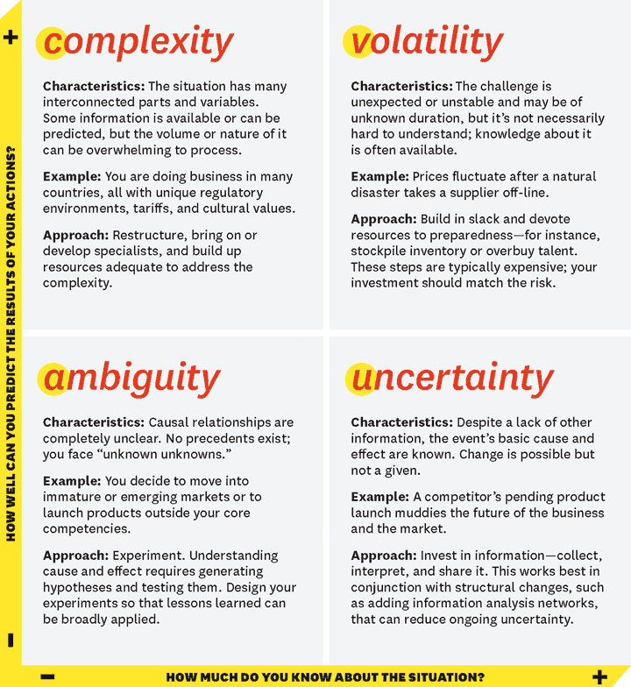
VUCA
Lec.8
The VUCA elements, organized by how much we know about the situation (along the x-axis) and how well we can predict the results of our actions (along the y-axis). It shows very the difference between each of the elements, explaining the characteristics, providing a straightforward example, and giving a couple of potential approaches.

Slide 13

Lec.8
Digital Leadership Model

Slide 14
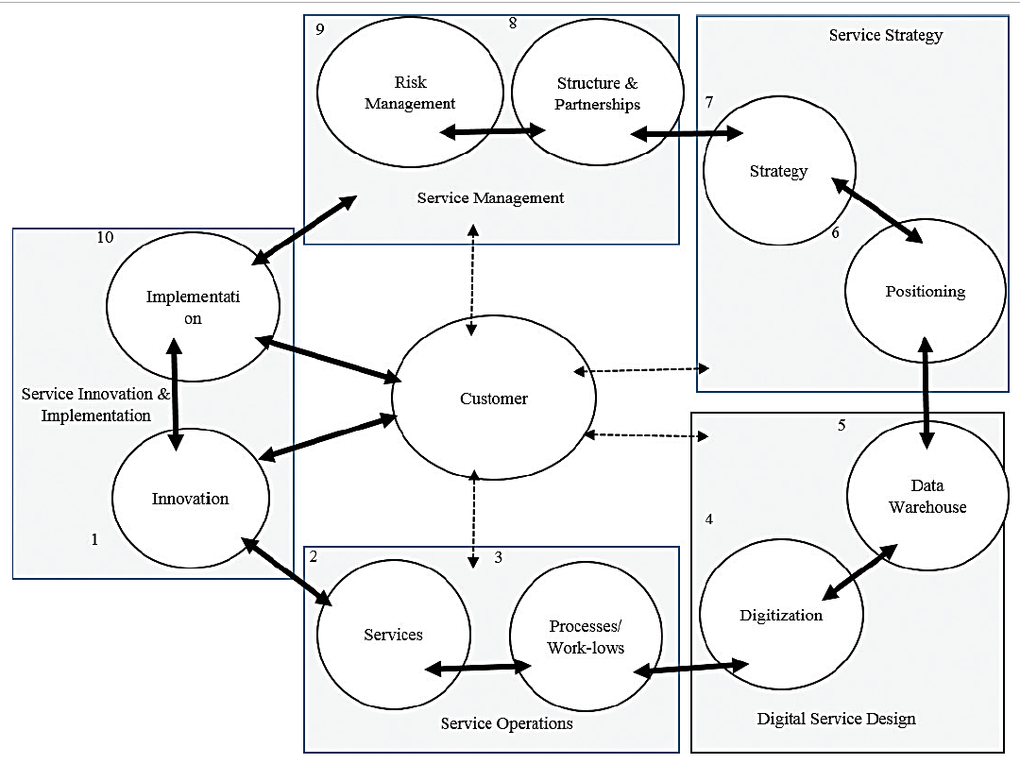
Digital Leadership Model
Lec.8
Figure: Digital leadership: customer centric, service driven and agility focused

Slide 15
Lec.8
Digital Leadership Model
A structured approach to build agility in the design and delivery of digital services. The 10-step Model, shown in the previous figure, uses five distinct “service-level” components that create and sustain value throughout the design and delivery process.
  1. Service innovation and delivery (steps 1 and 10): Develop innovative customer value propositions, often co-created with customer engagement, which are reviewed/refined after implementation to sustain innovation.

Slide 16
Lec.8
Digital Leadership Model
  2. Service operations (steps 2 and 3): Identify customer service encounters that incrementally and collectively influence customer engagement in value creation, and map these encounters to specific processes/work-flows that will operationalize these service encounters.
  3. Digital service design (steps 4 and 5): Leverage advanced technology to automate select processes/work-flows to develop digital services, and build a data warehouse to analyze value created and delivered and gain keen insight into customer decision processes.

Slide 17
Lec.8
Digital Leadership Model
  4. Service strategy (steps 6 and 7): Strategically position digital services to address a customer’s competitive strategy.
  5. Service management (steps 8 and 9): Structure the management team that includes both internal employees and external suppliers/partners to deliver digital services for customer use while mitigating customer risks.

Slide 18
Lec.8
Digital Leadership Model
The customer focus is at the center of each of these service components. The service operations will meet evolving customer value propositions, and digital services designed will support customer engagement. The service strategy positions digital services to meet customer strategy, and service management ensures that a team of internal and external partners will deliver digital services to mitigate customer risk.
In addition, service level agility is supported at each service encounter with modular system (service operations and digital service design) and business architecture (service strategy and management) to address changes in customer expectations or technologies all through the customer engagement in the purchase, design, and delivery process.

Slide 19
Lec.8
Digital Leadership Model
This model is customer-centric in value creation, service-driven and evolving as customer expectations and technologies change and agility-focused to support configurability in both the design and delivery of the services.

Slide 20

Lec.8
Effective Communication
in virtual organizations

Slide 21
Lec.8
Effective Communication in virtual organizations
Virtual teams communicate via ICT (e.g., email, web conferencing, instant messaging and telephone)
Communication in virtual teams separate from communication in traditional teams, as a result of lack of in-person interaction.
Poor communication quality is the main problem in virtual teams and that most effort was put in improving communication.
A study showed that communication quality – in means of poor communication quality - is a primary reason for failure in virtual teams. All in all, the study showed that communication is the primary factor affecting team effectiveness.

Slide 22
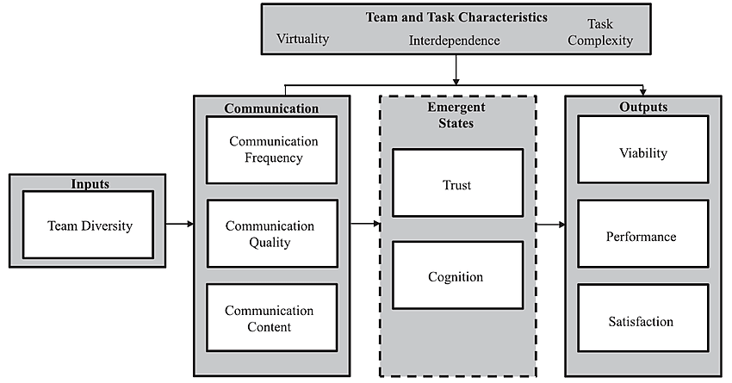
Lec.8
Effective Communication in virtual organizations
The process of communication in virtual teams include various factors, however, communication is highlighted as the leading aspect, as shown in the figure.

Slide 23
Lec.8
Effective Communication in virtual organizations
The initial factor is team diversity, which further elaborates to communication. Communication is not only one independent factor, but a combination of equally weighing factors: frequency, quality and content.
Communication affects trust and cognition, which in its own turn influences outcomes - viability, performance, and satisfaction.
Virtual teams, who perform poorly in the first sector – communication – will eventually impair their outcomes, as levels of performance decreases in correlation with levels of communication.

Slide 24
Lec.8
Effective Communication in virtual organizations
Aspects of successful communication in virtual teams
Successful communication is inevitable for a virtual team to be flexible and responsive, and it additionally allows teams and organizations to collaborate beyond space and time.
Technology, as a core element of virtual teams, influences quality of communication. The issue lies in the way members use the technology.
To achieve success in communication and in team outcomes, members must choose the right type of technology separately for each task.
Different tasks require different types of technology (telephone, email, videoconference) and the key factor is how they are used.

Slide 25
Lec.8
Effective Communication in virtual organizations
Key questions to ask when strategizing communication:
    “Is the time and frequency of meetings satisfactory?”,
    “Is technological support for meetings adequate?”,
    “Is the team using e-mail, instant messaging, message boards, or other channels effectively?”, and
    “Is every member’s voice being heard?”
Communication competence includes “affective, cognitive, and behavioral elements” and is shown in individuals as an ability to understand the different levels of communication.
Communication competence includes “knowledge of communication and context, and ability to obtain goals (skill)”.
Members must see the team’s and organization’s goals as their own, in order to be an efficient and effective team member.

Slide 26
Lec.8
Effective Communication in virtual organizations
Communication skills and key functions needed in an organization
Communication skills includes “The ability to convey information effectively and efficiently through verbal and non-verbal communication”.
Companies today are interested in employing people with skills in communication, teamwork, problem-solving, initiative, planning, organizing, self management, learning and technology. The growing interest in these skills are correlating with the development and increase of virtual teams.

Slide 27
Lec.8
Effective Communication in virtual organizations
Communication skills and key functions needed in an organization
The ability to transmit information effectively and efficiently can be examined with the Shannon-Weaver model. The model consists of components, such as information source, transmitter, signal, receiver, and message. Communication binds the several levels of an organization together and it acts as a tool for distributing information.

Slide 28
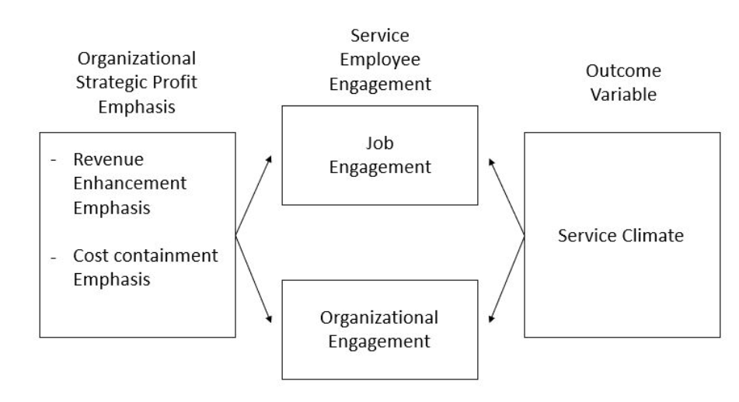
Lec.8
Effective Communication in virtual organizations
Employee engagement as internal communication strategy
The development of the knowledge era has lifted human resources as an important aspect in organizations and in communication. One of many aspects of human resources is employee engagement that influence “both individual employee outcomes and organizational level success and financial performance”.

Slide 29
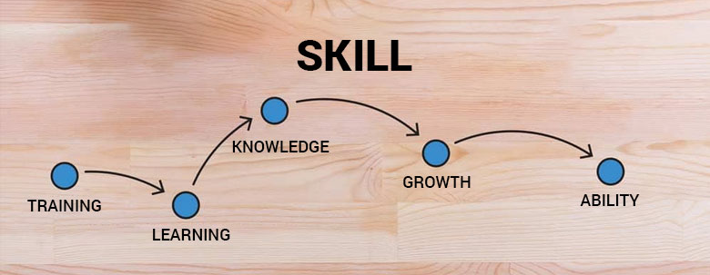
Lec.8
Digital Skills for Improving
Organizational Performance

Slide 30
Lec.8
Digital Skills for Improving Organizational Performance
Digital skills include all technology-related skills ranging from basic skills or literacy, general skills for all workers, and specific skills for information technology professionals.
There are 4 dimensions in measuring digital skills including digital technical skills, digital communication, digital analysis, and digital thinking.

Slide 31
Lec.8
Digital Skills for Improving Organizational Performance
Digital Skills
Empirical studies showed that leadership has a role in the development of abilities, competencies and skills.
Digital Leadership
Organization Performance

Slide 32
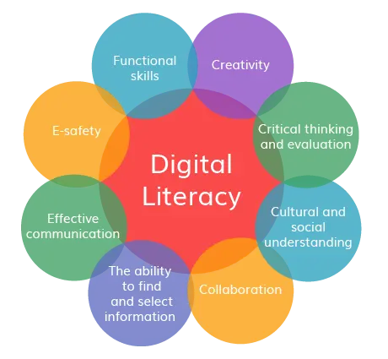
Lec.8
Digital Literacy Skills
Lifelong learning skills

Slide 33
Lec.8
Digital Literacy Skills
Digital literacy is the knowledge of, and the ability to use digital technologies to locate information; evaluate information; synthesize, create, and communicate information; and understand the human and technological complexities of a digital media landscape.
Being digitally literate means having the skills to be an informed consumer, critical thinker, and creator in the digital world, and requires an ability to continuously learn and grow alongside technological developments.

Slide 34
Lec.8
Digital Literacy Skills
1. Information and data literacy | 1.1 Browsing, searching and filtering data, information and digital content 1.2 Evaluating data, information and digital content 1.3 Managing data, information and digital content
2. Communication and collaboration | 2.1 Interacting through digital technologies 2.2 Sharing through digital technologies 2.3 Engaging in citizenship through digital technologies 2.4 Collaborating through digital technologies 2.5 Netiquette 2.6 Managing digital identity

Slide 35
Lec.8
Digital Literacy Skills
3. Digital content creation | 3.1 Developing digital content 3.2 Integrating and re-elaborating digital content 3.3 Copyright and licenses 3.4 Programming
4. Safety | 4.1 Protecting devices 4.2 Protecting personal data and privacy 4.3 Protecting health and well-being 4.4 Protecting the environment
5. Problem solving | 5.1 Solving technical problems 5.2 Identifying needs and technological responses 5.3 Creatively using digital technologies 5.4 Identifying digital competence gaps

Slide 36
Lec.8
Digital Literacy Skills
Digital skills exist along a continuum ranging from basic to intermediate to advanced.
1) Basic digital skills comprise the effective use of hardware (e.g., typing or operating touch-screen technology), software (e.g., word processing, organizing files on laptops, and managing privacy settings on mobile phones), and internet/ICT tasks (e.g., emailing, browsing the internet, or completing an online form).

Slide 37
Lec.8
Digital Literacy Skills
2) Intermediate digital skills comprise the ability to critically evaluate technology or create content; they are characterized as “job-ready skills” and include desktop publishing, digital graphic design, and digital marketing.
3) Finally, specialists use advanced digital skills in ICT professions such as computer programming and network management.

Slide 38
Conclusion
Lec.8
We learned about
  Leading Digital Organizations in a VUCA World
  Digital Leadership Model
  Digital Skills for Improving Organizational Performance
  Digital Literacy Skills
  Effective Communication in virtual organizations
    Aspects of successful communication
    Employee engagement as internal communication strategy

Slide 39


References
Lec.8
Rabinowitz, P. (n.d.). Leadership and Management chapter 13:16. Community Tool Box. Retrieved January 4, 2023, from https://ctb.ku.edu/en/table-of-contents
Bli-Group-Wp. (2011). Leadership Course material. Amideast Egypt. Business Intelligence, Training & Consulting, http://bli-group.com/
Hyvönen, M., & Utoslahti, E. (2021, May 25). Leadership and communication in virtual teams. theseus.fi. Retrieved March 12, 2023, from https://www.theseus.fi/bitstream/handle/10024/500605/Leadership_and_Communication_in_Virtual_Teams.pdf?sequence=2
Pandowo, M., Tewal, B., & E.W. Tulungen, E. (2022). The Role of Digital Leadership Mediated by Digital Skill in Improving Organizational Performance. Vol. 5 (2), 2022: 156-171, Journal of Accounting Research, Organization, and Economics. Retrieved March 22, 2023, from https://www.researchgate.net/publication/363663523_The_Role_of_Digital_Leadership_Mediated_by_Digital_Skill_in_Improving_Organizational_Performance
Flora, E. (2023, February 24). Leading digital organizations in a VUCA World. Beyond20. Retrieved March 22, 2023, from https://www.beyond20.com/blog/leading-in-a-vuca-world/
UNESCO Institute for Statistics. (2018). UNESCO UIS. Retrieved March 22, 2023, from http://uis.unesco.org/sites/default/files/documents/ip51-global-framework-reference-digital-literacy-skills-2018-en.pdf

Slide 40



Thank You

