Slide 1

PMG 622
Agile Project Management
ZOOM MEETING: 05 (28-02-22)
Everyone’s Smart
University
دكتور مهندس استشاري ادارة المشروعات
Eng. Dr. Akram Mustafa Suliman Ali,
PhD. AU, BEng. & MSc. AAST, CEng CMarEng MIMarEST, PE, PMP®,
ASQ CSSBB, ISO Lead Auditor, NDT Level II,

Slide 2
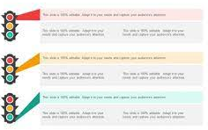
watermelon project
(green on the outside, red on the inside)- a project status light is green up until 1 month before the release date

Slide 3
The Underlying Philosophies of Agile
Saturation of Information
Time Boxing
Delivering Through Teams

Slide 4
Scrum roles, artifacts & ceremonies
Plan
Brief
Execute
Debrief
SCRUM ARTIFICATS
  Product Backlog
  Sprint Backlog
  Increment
SCRUM CERMONIES
  Sprint Planning.
  Daily Scrum.
  Sprint Review.
  Sprint Retrospective.
SCRUM ROLES
  Product Owner
  Development Team Members
  Scrum Master
Sprint Backlog
Notes:
OODA
Refrain and Reframe
Interrupt meeting by dropping something or making some distraction to gather attention to you.

Slide 5


Slide 6
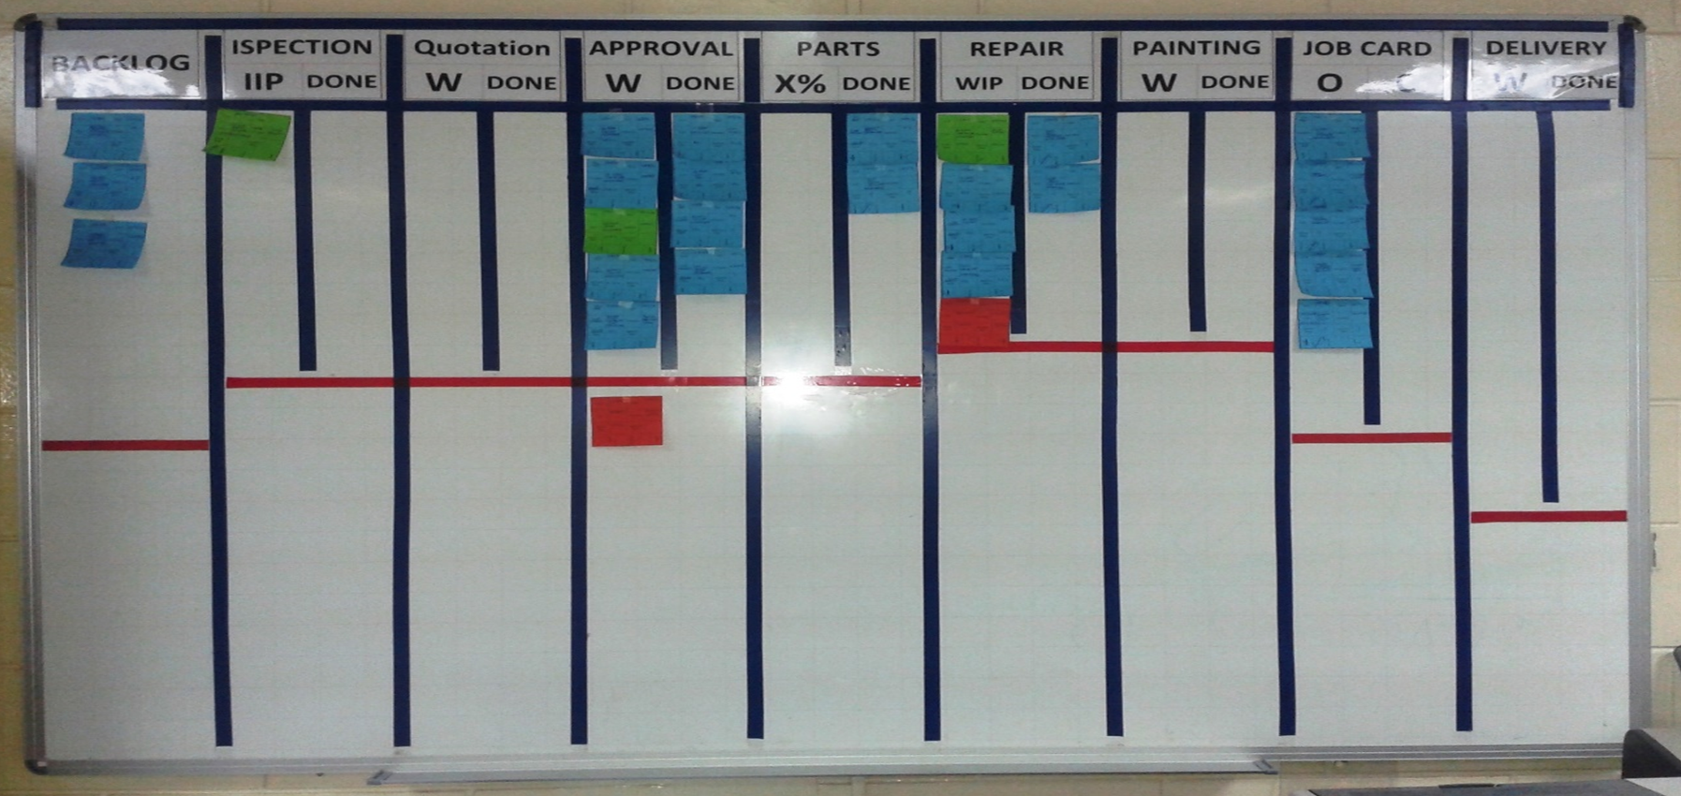
Sample Use of the Scrum Board
Notes:
There is no detailed reporting to management. Anyone in management or on another team can walk by and look at the scrum board and know where everything stands.

Slide 7
Quick Review and Introduction

Slide 8
Lecture 1 : An introduction to agile
Lecture 2: Life Cycle Selection
Lecture 3: Implementing Agile: Creating an Agile Environment
Lecture 4: Implementing Agile: Delivering in an Agile Environment [1/2]
Lecture 5: Implementing Agile: Delivering in an Agile Environment [2/2]
Lecture 6: Organizational Considerations for Project Agility

Slide 9
Lecture 07: Annex A3 Overview of Agile and Lean Frameworks [1/2]
Lecture 08: Annex A3 Overview of Agile and Lean Frameworks [2/2]
Lecture 09: Agile Planning
Lecture 10: ACP
Lecture 11: Teams / Professional Ethics / ACP Q&A [1/2]
Lecture 12: ACP Q&A [2/2]

