Slide 1
Project Activity Planning
-The more time you spend planning, the less time you’ll need to spend on implementation.
-Careful planning is solidly associated with project success.
-The primary purpose of planning
-what must be done
-when it must be done, what resources will be required
-and when each resource will be needed.
-Plan is an estimate and it is always carried out in an environment of uncertainty.

Slide 2
INITIAL PROJECT COORDINATION AND THE PROJECT PLAN
-It is crucial that the project’s objectives be clearly tied to the overall mission, goals, and strategy of the organization.
-Unless all parties to the planning process have a clear understanding of precisely what it is the project is expected to deliver, planning is sure to be inadequate or misguided.
-Each individual/unit accepting responsibility for a portion of the project should agree to deliver, by the next project meeting, a preliminary but detailed plan about how that responsibility will be accomplished
-The risk management group develops a risk management plan that includes proposed methodologies for managing risk

Slide 3
INITIAL PROJECT COORDINATION AND THE PROJECT PLAN
Each subsequent approval hardens the plan somewhat, and when senior management has endorsed it, any further changes in the project’s scope must be made by processing a formal change order.
Outside Clients
The fundamental planning process is unchanged except for the fact that the project’s scope cannot be altered without the client’s permission. A common “planning” problem in these cases is that marketing has promised deliverables that engineering may not know how to produce.

Slide 4
Project Plan Elements
Overview | Objectives or Scope | General Approach | Contractual Aspects | Schedules | Resources | • Personnel | Risk Management Plans | Evaluation Methods
This is a short summary of the objectives and scope of the project. It is directed to top management | This contains a more detailed statement of the general goals noted in the overview section | This section describes both the managerial and the technical approaches to the work | This critical section of the plan includes a complete list and description of all reporting requirements, customer-supplied resources, advisory committees, project review and cancellation procedures, etc | the various schedules and lists all milestone events | There are two primary aspects to this section. The first is the budget Second, cost monitoring and control procedures should be described | the expected personnel requirements of the project. Special skills, types of training needed, possible recruiting problems | This covers potential problems as well as potential lucky breaks that could affect the project. Sometimes it is difficult to convince planners to make a serious attempt to anticipate potential difficulties or benefits | Every project should be evaluated against standards and by methods established at the project’s inception, allowing for both the direct and ancillary goals of the project.

Slide 5
SYSTEMS INTEGRATION
Sometimes called (systems engineering or concurrent engineering) is one part of integration management.
1-Performance
3. Cost
2. Effectiveness

Slide 6
SYSTEMS INTEGRATION
1. Performance
Performance is what a system does. It includes system design, reliability, quality, maintainability, and repairability.
. Any of these system performance characteristics are subject to overdesign as well as underdesign but must fall within the design parameters established by the client. If the client approves, we may give the client more than the specifications require
2. Effectiveness
The objective is to design the individual components of a system to achieve the desired performance.
3. Cost
Considered to be a design parameter and can be accumulated in several areas. Added design cost may lead to decreased component cost, leaving performance and effectiveness otherwise unchanged

Slide 7
THE ACTION PLAN
Action Plan Is The set of activities, their schedules, and the resources needed to complete the project.
A simple method to assist in sorting out and planning all this detail is a hierarchical planning system—a method of constructing an action plan and a WBS. We have also named it the “level planning process.”
Factors that should be associated with success in implementation projects:
Project mission. It is important to spell out clearly defined and agreed-upon objectives in the project plan.
Top management support. It is necessary for top managers to get behind the project at the outset and make clear to all personnel involved that they support successful completion.
Project’s action plan. A detailed, scheduled plan of the required steps in the implementation process needs to be developed, including all resource requirements (money, raw materials, staff, etc.).

Slide 8
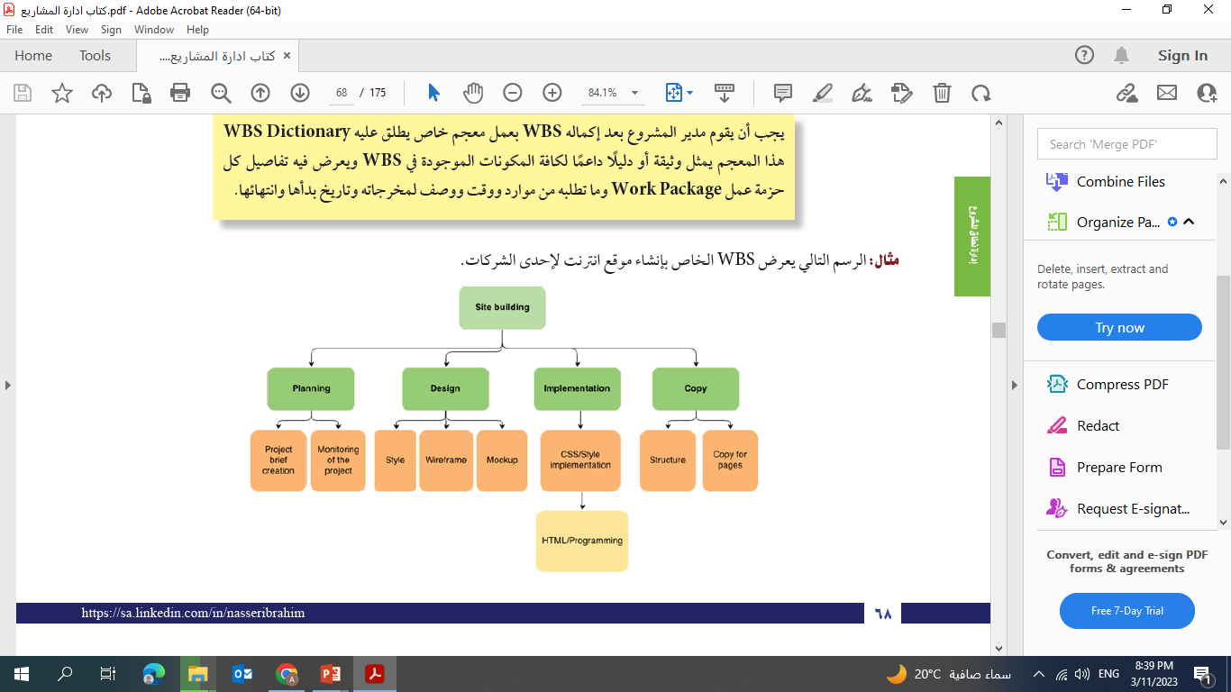
The Work Breakdown Structure (WBS) is not one thing. It can take a wide variety of forms that, in turn, serve a wide variety of purposes
The WBS is an important document and can be tailored for use in a number of different ways. It may illustrate how each piece of the project contributes to the whole in terms of performance, responsibility, budget, and schedule.

