Slide 1


Attitudes and Job Satisfaction
Organizational Behavior
and Projects
Lecture 6
PMG421
Understanding Working
Teams
Prepared by
Dr. Mohammed Mustafa
www.midocean.ae

Slide 2




Teamwork in the Workplace
Team Development Over Time
Things to Consider When Managing Teams
Opportunities and Challenges to Team Building
Team Diversity
Multicultural Team
www.midocean.ae

Slide 3
Learning Objectives
Contrast groups and teams.
Contrast the five types of team arrangements.
Identify the characteristics of effective teams.
Explain how organizations can create effective teams.
Decide when to use individuals instead of teams.
www.midocean.ae

Slide 4

Teamwork in the Workplace
t's the ability to work with others and to help others attain their full potential and achieve the shared goals.
As well, teamwork is one of the most desirable skills an employer can seek in its employees.
www.midocean.ae

Slide 5
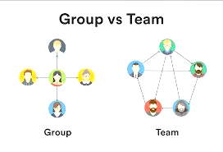
Differences Between Groups and Teams
Work group; A group that interacts primarily to share information and make decisions to help each group member perform within their respective area of responsibility.
www.midocean.ae

Slide 6
Differences Between Groups and Teams – Cont.
Work team; A group whose individual efforts result in performance that is greater than the sum of the individual inputs.
www.midocean.ae

Slide 7
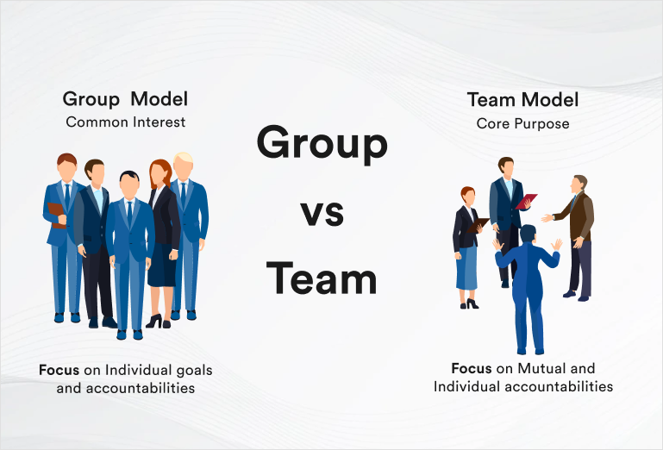
Differences Between Groups and Teams – Cont.
www.midocean.ae

Slide 8
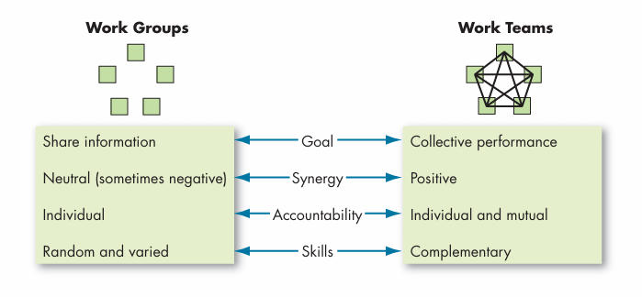
Comparing Between Groups and Teams
www.midocean.ae

Slide 9
Types of Teams
Teams can do a number of things, such as make products, provide services, negotiate deals, coordinate projects, offer advice, and make decisions. In this section, we first describe four common types of teams in organizations: problem-solving teams, self-managed work teams, cross-functional teams, and virtual teams.
www.midocean.ae

Slide 10
(1) Problem-solving team
A team of employees from the same department who meet for a few hours each week to discuss ways of improving quality, efficiency, and the work environment
www.midocean.ae

Slide 11
(2) Self-managed work team
A team of employees who autonomously implement solutions and take responsibility for the outcomes of the solutions (responsibilities normally adopted by supervisors).
www.midocean.ae

Slide 12
(3) Cross-functional team
A team of employees from about the same hierarchical level but from different work areas who come together to accomplish a task
www.midocean.ae

Slide 13
There are some points for making a
cross-functional team to be more successful
Establishing an accountable leader who is responsible from the team’s formation to its dissolution.
Ensuring that each team has established goals, resources, and deadlines.
Establishing a clear mission for the team that acts as their main objective.
Continuously reevaluating the team and its progress toward success.
Reconsidering the usefulness of the team if it is unsuccessful
www.midocean.ae

Slide 14
(4) Virtual team
A team of employees that uses technology to tie together physically dispersed members in order to achieve a common goal.
www.midocean.ae

Slide 15
(5) Multiteam system
A collection of two or more interdependent teams that share a superordinate goal; a team of teams.
www.midocean.ae

Slide 16
Creating or Developing Effective Team
Teams are often created deliberately but sometimes evolve organically. For example, tech startup teams are often started naturally by friends; in Noam Wasserman’s research of over ten thousand tech startups, nearly 40 percent of founders were friends before going into business
www.midocean.ae

Slide 17
Developing or Creating Effective Team
Teams are often created deliberately but sometimes evolve organically. For example, tech startup teams are often started naturally by friends; in Noam Wasserman’s research of over ten thousand tech startups, nearly 40 percent of founders were friends before going into business
www.midocean.ae

Slide 18
Creating or Developing Effective Team – Cont.
Many people have tried to identify factors related to team effectiveness.
To help, some studies have organized what was once a large list of characteristics into a relatively focused model.
www.midocean.ae

Slide 19
Key components of effective team
Exhibit below summarizes what we currently know about what makes teams effective.
We can organize the key components of effective teams into three general categories.
First are the resources and other contextual influences that make teams effective.
The second relates to the team’s composition.
Finally, process and state variables are events within the team that influence effectiveness.
www.midocean.ae

Slide 20
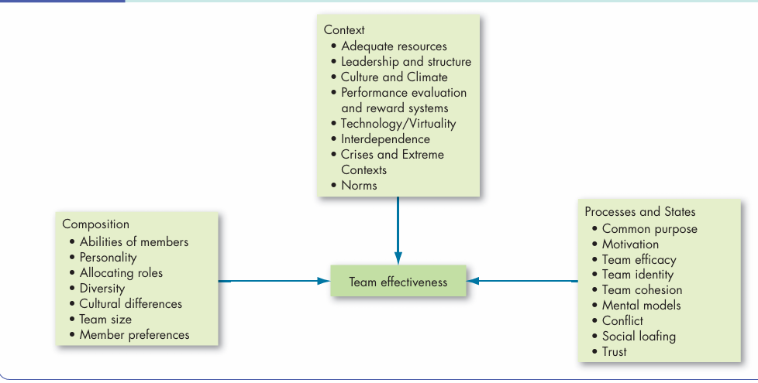
Team Effectiveness Model
www.midocean.ae

Slide 21
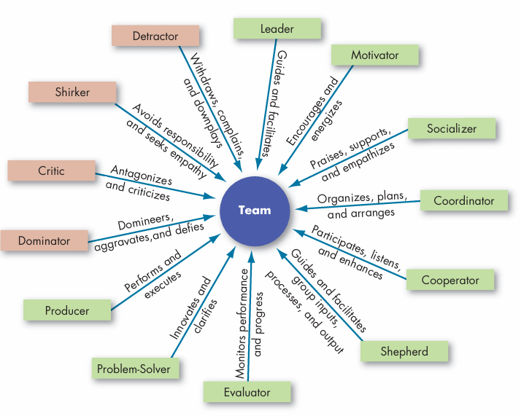
Key Roles of Teams
www.midocean.ae

Slide 22
Team Processes and states
Team Processes Why are processes important to team effectiveness? Teams should create outputs greater than the sum of their inputs.
Common Plan and Purpose Effective teams begin by analyzing the team’s mission, developing goals to achieve that mission, and creating strategies for achieving the goals.
www.midocean.ae

Slide 23

Team Processes and states
Reflexivity A team characteristic of reflecting on and adjusting the master plan when necessary.
Mental model Team members’ shared knowledge about the key elements within their task environment.
www.midocean.ae

Slide 24

Team Conflict
Conflict has a complex relationship with team performance, and it is not necessarily bad (see the chapter on conflict and negotiation).
Although we have previously described role conflict in the prior chapter on group behavior, we discuss three additional types of conflict in teams in this section
www.midocean.ae

Slide 25
Turning Groups of Employees into Teams
Many organizations have historically gone to great lengths to hire, train, and reward team members given how important teams are to the success of organizations.
For example, Don Yaeger (author and associate editor at Sports Illustrated) notes that organizations wish to hire people “who think team first”— instead of those who engage in self-centered behavior.
www.midocean.ae

Slide 26
Turning Groups of Employees into Teams – Cont.
Search and rescue teams have also engaged in team training in order to hone team processes that lead to successful search and rescue missions.
Dental teams have also implemented team bonus plans in order to reward team performance
www.midocean.ae

Slide 27
Selection: Hiring for Team Effectiveness
Some people already possess the interpersonal skills to be effective in teams.
Therefore, managers, when hiring team members, try to be certain that candidates can fulfill their team roles as well as technical requirements.
www.midocean.ae

Slide 28
Selection: Hiring for Team Effectiveness – Cont.
A number of personality traits, abilities, and other characteristics lead to effective team performance.
Managers should be sure to hire applicants who have the highest potential to perform well in a team and strategically place them in teams where they are most likely to work well with the other team members.
www.midocean.ae

Slide 29

Training: Creating Effective Teams
Training specialists conduct exercises that enable teams to perform more effectively by learning relevant team skills and practices.
www.midocean.ae

Slide 30
Training: Creating Effective Teams – Cont.
A large body of research suggests that team training is effective at improving team member attitudes, team processes, and cognitive aspects like developing shared mental models and that these findings generalize to particularly important industries (e.g., medical services).
Especially important to team functioning, teams should be trained to develop shared mental models and transactive memory systems.
www.midocean.ae

Slide 31

Rewarding: Providing Incentives for Exceptional Teams
A traditional organization’s reward system must be reworked to encourage cooperative efforts rather than competitive ones.
As Ashira Prossack, an internationally renowned business coach, notes, rewarding teams has the benefit of providing a common goal that every team member can work to achieve and gives each member an opportunity to be recognized.
Overall, rewarding teams builds a more united bond and encourages the team to work together.
www.midocean.ae

Slide 32

Rewarding: Providing Incentives for
Exceptional Teams – Cont.
A number of companies offer team rewards, and not all of them are financial.
For instance, Nick Vukmaravich, director of Sales of Pingboard, headquartered in Austin, uses experiences as team rewards.
If the sales team meets the sales goals, they have been rewarded in the past with prizes like a full day touring the Texas wine country.
www.midocean.ae

Slide 33
Beware! Teams Aren’t Always the Answer?
Teamwork takes more time and often more resources than individual work.
Teams have increased communication demands, conflicts to manage, and meetings to run. So the benefits of using teams must exceed the costs, and that is not always possible.
Because of this, many otherwise effective employees may find them selves overwhelmed when there is too much of a focus on teams and teamwork or when team demands become excessive.
www.midocean.ae

Slide 34
Beware! Teams Aren’t Always the Answer? – Cont.
How do you know whether the work of your group would be better done in teams? You can apply three tests.
First, can the work be done better by more than one person? Good indicators are the complexity of the work and the need for different perspectives.
Simple tasks that do not require diverse input are probably better left to individuals.
www.midocean.ae

Slide 35
Beware! Teams Aren’t Always the Answer? – Cont.
Second, does the work create a common purpose or set of goals for the people in the group that is more than the aggregate of individual goals?
Many service departments of new-vehicle dealers have introduced teams that link customer service people, mechanics, parts specialists, and sales representatives.
Such teams can better manage collective responsibility for ensuring that customer needs are properly met.
www.midocean.ae

Slide 36
Beware! Teams Aren’t Always the Answer? – Cont.
The final test is to determine whether the members of the group are interdependent.
Using teams makes sense when there is interdependence among tasks—the success of the whole depends on the success of each one, and the success of each one depends on the success of the others.
www.midocean.ae

Slide 37
Beware! Teams Aren’t Always the Answer? – Cont.
For example, Soccer, for instance, is an obvious team sport. Success requires a great deal of coordination among interdependent players. Conversely, bowling teams are not really teams.
They are groups of individuals performing individually and whose total performance is merely the aggregate summation of their individual performances
www.midocean.ae

Slide 38

www.midocean.ae

Slide 39



Thank You

