Slide 1


Competitiveness
Strategy
Productivity
Prepared by Dr. Injy Nashaat
Lecture 2

Slide 2

Better quality, higher productivity, lower costs, and the ability to respond quickly to customer needs are more important than ever, and…
  the bar is getting higher
2-2

Slide 3
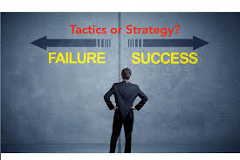
Chapter Focus
This chapter focuses on three separate but related ideas that are vitally important to business organizations
  Competitiveness
  Strategy
  Productivity
2-3

Slide 4

Competitiveness
Competitiveness:
  How effectively an organization meets the wants and needs of customers relative to others that offer similar goods or services
  Organizations compete through some combination of their marketing and operations functions
    What do customers want?
    How can these customer needs best be satisfied?
2-4

Slide 5
Marketing’s Influence
Identifying consumer wants and/or needs
Pricing and quality
Advertising and promotion
2-5

Slide 6

Businesses Compete Using Operations
Product and service design
Cost
Location
Quality
Quick response
Flexibility
Inventory management
Supply chain management
Service
Managers and workers
Government statistics are a good source of data about productivity trends in the service & goods sectors.
2-6

Slide 7
Why Some Organizations Fail
Neglecting operations strategy
Failing to take advantage of strengths and opportunities and/or failing to recognize competitive threats
Too much emphasis on short-term financial performance at the expense of R&D
Too much emphasis on product and service design and not enough on process design and improvement
Neglecting investments in capital and human resources
Failing to establish good internal communications and cooperation
Failing to consider customer wants and needs
2-7

Slide 8
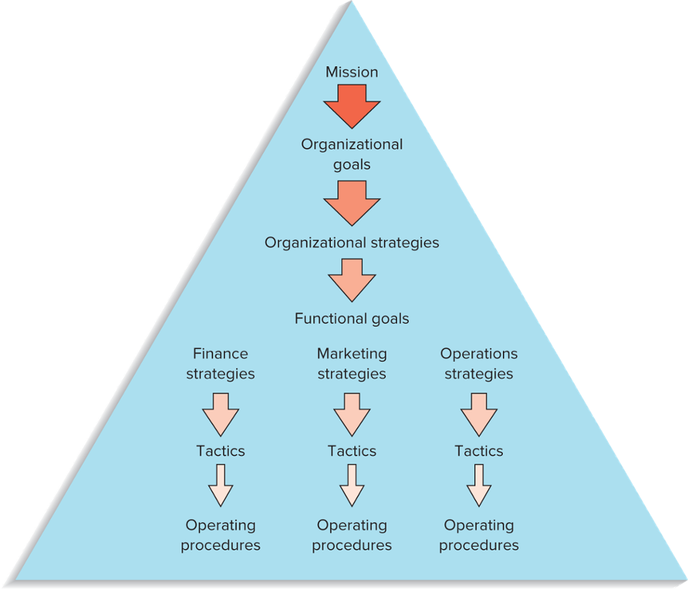
Hierarchical Planning
Mission
Goals
Organizational strategies
Functional strategies
Tactics
FIGURE 2.1
Planning and decision making are hierarchical in organizations
2-8

Slide 9

Mission
Mission
  The reason for an organization’s existence
Mission statement
  States the purpose of the organization
  The mission statement should answer the question of “What business are we in?”
2-9

Slide 10
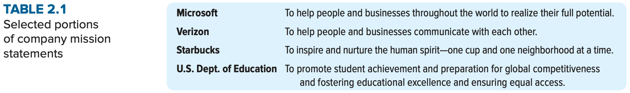
Mission Statement
2-10

Slide 11

Goals
The mission statement serves as the basis for organizational goals
Goals
  Provide detail and the scope of the mission
  Goals can be viewed as organizational destinations
  Goals serve as the basis for organizational strategies
2-11

Slide 12
Strategies
Strategy
  A plan for achieving organizational goals
    Serves as a roadmap for reaching the organizational destinations
  Organizations have
    Organizational strategies
      Overall strategies that relate to the entire organization
      Support the achievement of organizational goals and mission
    Functional level strategies
      Strategies that relate to each of the functional areas and that support achievement of the organizational strategy
  Traditional strategies of business organizations have tended to emphasize cost minimization or product differentiation
2-12

Slide 13
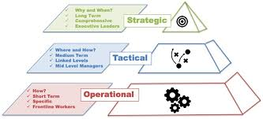
Tactics and Operations
Tactics
  The methods and actions taken to accomplish strategies
  The “how to” & “ Who” parts of the process
Operations
  The actual “doing” part of the process
2-13

Slide 14
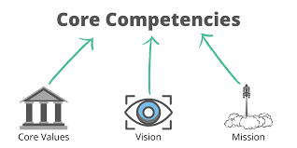
Core Competencies
Core competencies
  The special attributes or abilities that give an organization a competitive edge
    To be effective, core competencies and strategies need to be aligned
2-14

Slide 15
Sample Operations Strategies
Organizational Strategy | Operations Strategy | Examples of Companies or Services
Low Price | Low cost | U.S. first-class postage Wal-Mart
Responsiveness | Short processing times On-time delivery | McDonald’s restaurants FedEx
Differentiation: High Quality | High performance design and/or high-quality processing Consistent quality | Sony TV Coca-Cola
Differentiation: Newness | Innovation | 3M, Apple
Differentiation: Variety | Flexibility Volume | Burger King (Have it your way”) McDonald’s (“Buses Welcome”)
Differentiation: Service | Superior customer service | Disneyland IBM
Differentiation: Location | Convenience | Supermarkets; mall stores
2-15

Slide 16
Strategy Formulation
Effective strategy formulation requires considering:
  Core competencies
  Environmental scanning
    SWOT: Strengths, Weaknesses, Opportunities, and Threats
Successful strategy formulation also requires considering:
  Order qualifiers
  Order winners
2-16

Slide 17
Strategy Formulation (cont.)
Order qualifiers
  Characteristics that customers perceive as minimum standards of acceptability for a product or service to be considered as a potential for purchase.
Order winners
  Characteristics of an organization’s goods or services that cause it to be perceived as better than the competition
Standardization has the advantage of reducing variability
2-17

Slide 18
Environmental Scanning
Environmental scanning is necessary to identify
  Internal factors
    Strengths and weaknesses
  External factors
    Opportunities and threats
2-18

Slide 19
Key External Factors
Economic conditions
Political conditions
Legal environment
Technology
Competition
Customers
Suppliers
Markets
2-19

Slide 20
Key Internal Factors
Human resources
Facilities and equipment
Financial resources
Customers
Products and services
Technology
Other
2-20

Slide 21
Mission and Strategies
Supply Chain Strategy
  How the organization should work with suppliers and policies relating to customer relationships and sustainability
Sustainability Strategy
  Work with governmental regulations and interest groups to achieve sustainability goals
Global Strategy
  Work with international suppliers/producers and also with countries where the products and services are sold
2-21

Slide 22
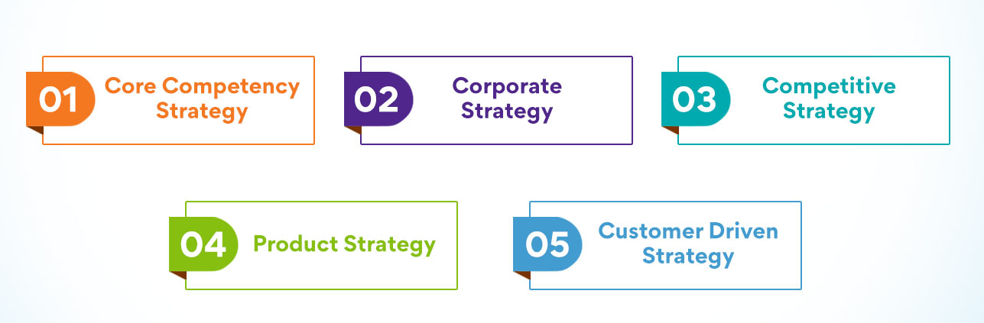
Operations Strategy
Operations strategy
  The approach, consistent with organization strategy, that is used to guide the operations function
2-22

Slide 23
Strategic OM Decision Areas
Decision Area | What the Decisions Affect
Product and service design | Costs, quality, liability, and environmental issues
Capacity | Cost, structure, flexibility
Process selection and layout | Costs, flexibility, skill level needed, capacity
Work design | Quality of work life, employee safety, productivity
Location | Costs, visibility
Quality | Ability to meet or exceed customer expectations
Inventory | Costs, shortages
Maintenance | Costs, equipment reliability, productivity
Scheduling | Flexibility, efficiency
Supply chains | Costs, quality, agility, shortages, vendor relations
Projects | Costs, new products, services, or operating systems
2-23

Slide 24
Quality-Based Strategies
Quality-based strategy
  Strategy that focuses on quality in all phases of an organization
    Pursuit of such a strategy is rooted in poor-quality factors:
      Trying to overcome a poor-quality reputation
      Desire to maintain a quality image
      A desire to catch up with the competition
      A part of a cost reduction strategy
2-24

Slide 25
Time-Based Strategies
Time-based strategies
  Strategies that focus on the reduction of time needed to accomplish tasks.
    It is believed that by reducing time, costs are lower, quality is higher, productivity is higher, time-to-market is faster, and customer service is improved
2-25

Slide 26

Time-Based Strategies (cont.)
Areas where organizations have achieved time reductions:
  Planning time
  Product/service design time
  Processing time
  Changeover time
  Delivery time
  Response time for complaints
2-26

Slide 27

Agile Operations
Agile operations
  A strategic approach for competitive advantage that emphasizes the use of flexibility to adapt and prosper in an environment of change
  Involves the blending of several core competencies:
      Cost
      Quality
      Reliability
      Flexibility
2-27

Slide 28
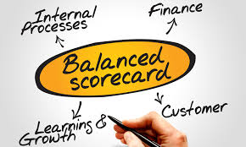
The Balanced Scorecard Approach
A top-down management system that organizations can use to clarify their vision and strategy and transform them into action
  Develop objectives
  Develop metrics and targets for each objective
  Develop initiatives to achieve objectives
  Identify links among the various perspectives
    Finance
    Customer
    Internal business processes
    Learning and growth
  Monitor results
2-28

Slide 29
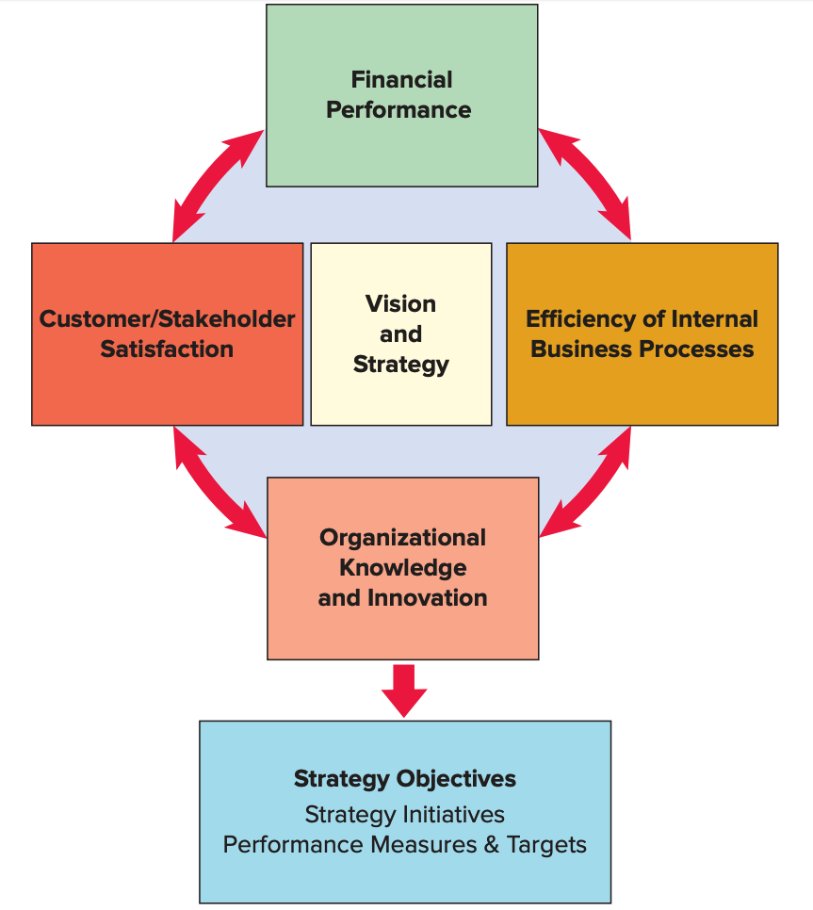
The Balanced Scorecard
The balanced scorecard involves measuring four main aspects of a business: Learning and growth, business processes, customers, and finance
2-29

Slide 30
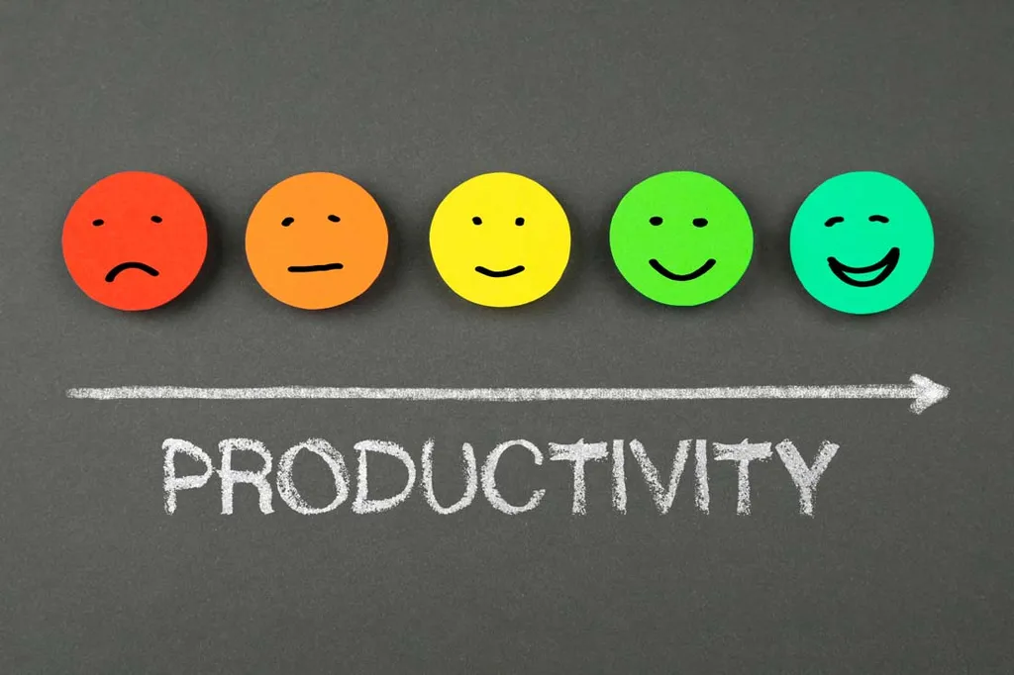
Productivity
Productivity
  A measure of the effective use of resources, usually expressed as the ratio of output to input
Productivity measures are useful for
  Tracking an operating unit’s performance over time
  Judging the performance of an entire industry or country
2-30

Slide 31
Why Productivity Matters
High productivity is linked to higher standards of living
  As an economy replaces manufacturing jobs with lower productivity service jobs, it is more difficult to maintain high standards of living
Higher productivity relative to the competition leads to competitive advantage in the marketplace
  Pricing and profit effects
For an industry, high relative productivity makes it less likely it will be supplanted by foreign industry
2-31

Slide 32
Productivity Measures
2-32

Slide 33
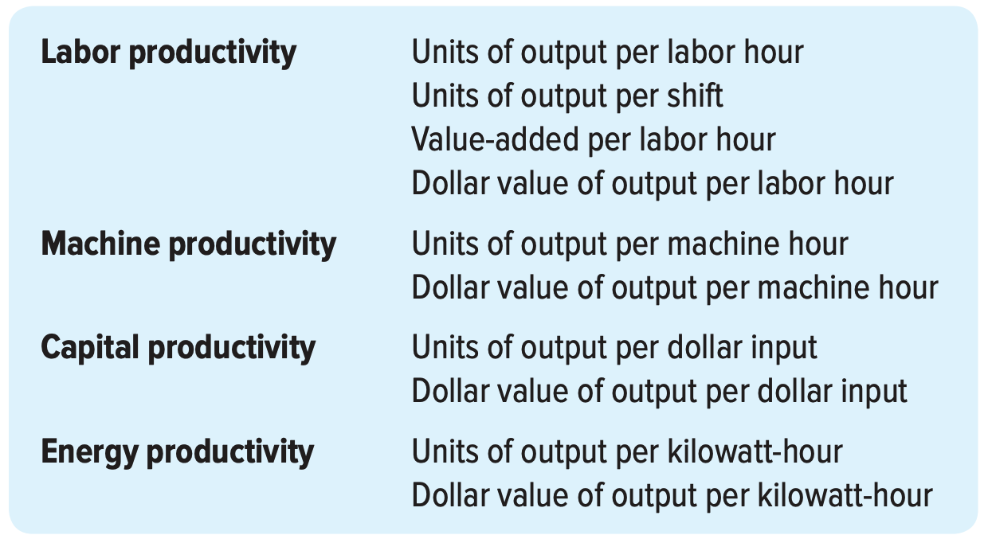
Some examples of partial productivity measures
2-33

Slide 34
Productivity Calculation Example
Units produced: 5,000
Standard price: $30/unit
Labor input: 500 hours
Cost of labor: $25/hour
Cost of materials: $5,000
Cost of overhead: 2× labor cost
What is the
multifactor
productivity?
2-34

Slide 35
Solution
What is the implication of an unitless measure of productivity?

Slide 36
Productivity Growth
Example: Labor productivity on the ABC assembly line was 25 units per hour in 2014. In 2015, labor productivity was 23 units per hour. What was the productivity growth from 2014 to 2015?
2-36

Slide 37
Service Sector Productivity
Service sector productivity is difficult to measure and manage because
  It involves intellectual activities
  It has a high degree of variability
A useful measure related to productivity is process yield
  Where products are involved
    Ratio of output of good product to the quantity of raw material input
  Where services are involved, process yield measurement is often dependent on the process:
    Ratio of cars rented to cars available for a given day
    Ratio of student acceptances to the total number of students approved for admission
2-37

Slide 38
Factors Affecting Productivity
Capital
Quality
Methods
Management
Technology
2-38

Slide 39
Improving Productivity
Develop productivity measures for all operations
Determine critical (bottleneck) operations
Develop methods for productivity improvements
Establish reasonable goals
Make it clear that management supports and encourages productivity improvement
Measure and publicize improvements
Don’t confuse productivity with efficiency
Outsourcing tends to improve quality to increase the productivity
2-39

Slide 40



Thank You

