Slide 1





Bonds & Stocks: characteristics
Lecture 3
Prepared by Dr. Walaa Mohamed
MGM 237
Introduction to Finance

Slide 2
LEARNING OBJECTIVES
After studying this lecture, you should be able to do the following:
LO 3.1 Identify the major sources of external long-term ﬁnancing for corporations.
LO 3.2 Describe the global market for bonds, the role of bond covenants, and bond ratings.
LO 3.3 Compare characteristics of corporate bonds with respect to bondholder security, time to maturity, and income return.
LO 3.4 Describe major characteristics of preferred stock and common stock.
LO 3.5 Describe the process for issuing dividends by a ﬁrm and diﬀerences between cash dividends, stock dividends, and share repurchases.

Slide 3
Long-Term External Financing Sources for Businesses
Businesses obtain long-term ﬁnancing from internal funds, which are generated from proﬁts, and from external funds, which are obtained from capital markets.
The proportion of internal to external ﬁnancing varies over the business cycle. During periods of economic expansion, ﬁrms usually rely more on external funds because the funds needed for investment opportunities outstrip the ﬁrms’ ability to ﬁnance them internally. During periods of economic contraction, the reverse is true. As proﬁtable investment opportunities become fewer, the rate of investment is reduced and reliance on external capital markets decreases.
Long-term funds are obtained by issuing corporate bonds and stocks.

Slide 4
1. Bonds
A bond is an agreement or contract between lenders and the borrowing organization; typically, a ﬁrm or government body. As such, the lenders or bondholders of a corporation have certain rights and privileges not enjoyed by the ﬁrm’s owners (those holding shares of common stock). A debt holder may force the ﬁrm to abide by the terms of the debt contract even if the result is reorganization or bankruptcy of the ﬁrm. The periodic interest payments due to the holders of debt securities must be paid or else the creditors can force the ﬁrm into bankruptcy. Table 10.1 summarizes important characteristics of bonds, which we’ll be reviewing in this section.

Slide 5
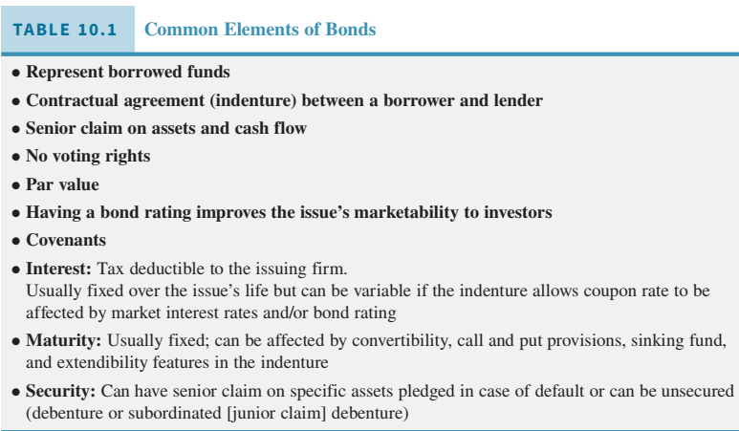

Slide 6
Except for rarely issued perpetuities, all debt issues have maturity dates, the point when issuers are obligated to pay the bond’s principal (par value (debt); face value) to bondholders. In the United States, par value is usually $1,000 for corporate bonds. All but zero- coupon issues pay interest, called coupon payments. If a bond has an 8 percent coupon and a par value of $1,000, it pays annual interest of 8 percent of $1,000, or 0.08 × $1,000 = $80. A bond with a 10 percent coupon would pay interest of $100 per year. Eurobonds pay a single annual coupon interest payment. In the United States, bonds pay interest semi-annually; an 8 percent coupon will pay interest of $40 every six months during the life of the bond.
Note please:
- par value (debt); face value principal amount that the issuer is obligated to repay at maturity.
- coupon payments interest payments on a bond.
- a perpetuity is a bond without a maturity date. Its owners and heirs receive interest payments on a regular basis as long as the ﬁrm exists. In general, a security that is a perpetuity pays a constant periodic cash ﬂow as long as the issuer exists.

Slide 7
Bondholders have legal status as creditors, not owners, of the ﬁrm. As such, they have priority claims on the ﬁrm’s cash ﬂows and assets. This means that bondholders must receive their interest payments before the ﬁrm’s owners receive their dividends. In the case of bankruptcy, the debt holders must receive the funds owed to them before funds are distributed to the ﬁrm’s owners. Because of this ﬁrst claim on a ﬁrm’s cash ﬂow and assets, debt is a less risky investment than equity.
Oﬀsetting the advantages of owning debt is its lower return. The interest payments creditors receive usually are considerably less over a period of years than the returns received by equity holders. Also, as long as the corporation meets its contractual obligations, the creditors have little choice in its management and control except for those formal agreements and restrictions that are stated in the loan contract.

Slide 8

Long-term corporate debt securities fall into two categories: secured obligations and unsecured obligations. A single ﬁrm can have many types of debt contracts outstanding. Although ownership of many shares of stock may be evidenced by a single stock certiﬁcate, the bondholder has a separate security for each bond owned. Bonds can be registered bonds or bearer bonds. Bonds currently issued in the United States are registered bonds in that the issuer knows the bondholders’ names and interest payments are sent directly to the bond- holder. Bearer bonds have coupons that are “clipped” from the side of the bond certiﬁcate and presented, like a check, to a bank for payment. Thus, the bond issuer does not know who is receiving the interest payments. Bearer bonds are more prevalent outside of the United States. Regulations prevent their issuance in the United States, primarily because unscrupulous investors may evade income taxes on the clipped coupons

Slide 9
Bonds can be sold in the public market, following registration with the U.S. Securities and Exchange Commission (SEC), and traded by investors. There is a “private” market, too; bonds can be sold in a private placement to qualiﬁed investors, typically institutional investors such as insurance companies and wealthy individuals. Other forms of debt capital exist in addition to bonds. Businesses can borrow from banks.

Slide 10
Who Buys Bonds?
The U.S. Treasury has a Treasury Direct program to sell Treasury securities directly to individual investors, but the main buyers of Treasury bonds are large institutions, such as pension funds or insurance companies, which hold them for investment purposes. Others, such as investment banks, may purchase them and then resell them to smaller investors.
Similarly, corporate debt markets are oriented toward the large institutional investor who can purchase millions of dollars of bonds at a time. But several innovative ﬁrms, such as Ally Financial (formerly GMAC), IBM, United Parcel Service (UPS), Caterpillar, and GE Capital, initiated programs in recent years to sell $1,000 par value bonds directly to the retail, or individual, investor. Called InterNotes, medium-term notes, or direct access notes (depending on the issuer and the investment banker selling them), the programs target small investors who have only a few thousand dollars rather than millions to invest in bonds.

Slide 11
Bond Covenants
The trust indenture is an extensive document that details the various provisions and coven- ants of the loan arrangement. A trustee represents the bondholders to ensure the bond issuer respects the indenture’s provisions. In essence, the indenture is a contract between the bond- holders and the issuing ﬁrm. The indenture details the par value, maturity date, and coupon rate of the issue. A bond indenture may include covenants, which can impose restrictions or extra duties on the ﬁrm.
Examples of covenants include keep pledged assets in good working order, and send audited ﬁnancial statements to bondholders. Others include restrictions on the amount of the ﬁrm’s debt, total annual dividend payments, the amount and type of additional covenants it may undertake, and asset sales.

Slide 12
These examples illustrate the purpose of covenants, which is to protect the bond-holders’ stake in the ﬁrm. Bonds have value, ﬁrst, because of the ﬁrm’s ability to pay coupon interest and, second, because of the value of the assets or collateral backing the bonds in case of default. Without proper covenant protection, the value of a bond can decline sharply if a ﬁrm’s liquidity and assets depreciate or if its debt grows disproportionately to its equity. These provisions aﬀect the issue’s bond rating (discussed below) and the ﬁrm’s ﬁnancing costs, since bonds giving greater protection to the investor can be sold with lower coupon rates. The ﬁrm must decide if the restrictions and duties in the covenants are worth the access to lower-cost funds.

Slide 13
Bond Ratings
Most bond issuers purchase bond ratings from one or more agencies, such as Standard & Poor’s (S&P), Moody’s, or Fitch. For a one-time fee, the rater examines the credit quality of the ﬁrm (e.g., its ability to pay the promised coupon interest), the indenture provisions, covenants, and the expected trends of ﬁrm and industry operations. From its analysis and discussions with management, the agency assigns a bond rating (as shown in Table 10.2) that indicates the likelihood of default (nonpayment of coupon or par value, or violation of the bond indenture) on the bond issue.4 In addition, the rating agency commits to continually reexamine the issue’s risk. For example, should the ﬁnancial position of the ﬁrm weaken or improve, S&P may place the issue on its Credit Watch list, with negative or positive implications. After that, S&P will downgrade, upgrade, or reaﬃrm the original rating.

Slide 14
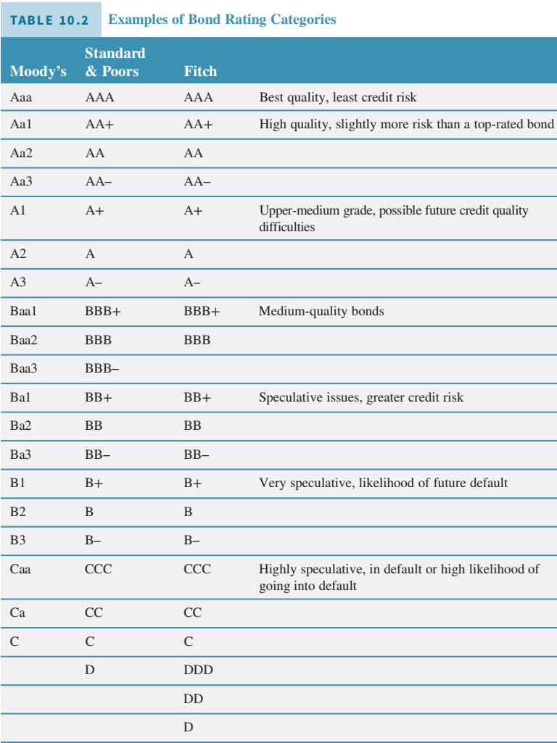

Slide 15
Despite the initial cost and the issuer’s concern of receiving a lower-than-expected rating, a bond rating makes it much easier to sell the bonds to the public. The rating acts as a signal to the market that an independent agency has examined the qualities of the issuer and the bond issue, and has determined that the credit risk of the bond issue justiﬁes the published rating.
An unrated bond issue will likely obtain a cool reception from investors. Investors may have good reason to wonder, “What is the ﬁrm trying to hide? If this was an attractive bond issue, the ﬁrm would have rated it.” In addition, certain types of investors, such as pension funds and insurance companies, may face restrictions against purchasing unrated public debt. Collateral provisions aﬀect its credit rating.
Bonds with junior or unsecured claims receive lower bond ratings, leading investors to demand higher yields to compensate for the higher risk. Thus, bond issues of a single ﬁrm can have diﬀerent bond ratings if their security provisions diﬀer.

Slide 16
Viewing Table 10.2, investment-grade bonds are those with ratings of Baa3, BBB–, or better. They are called “investment grade” as, historically, investors (individuals and managed funds, such as bank trust department portfolios and pension funds) were allowed to invest in such bonds. Bonds below an investment-grade rating were deemed too risky for such conservative portfolios and were not allowed to be held.
Times and regulations change, however, and bonds that are below investment grade, meaning they have ratings of Ba1, BB+, or lower, have gained a spot in many investment portfolios. Known as junk bonds or (euphemistically) high-yield bonds, they have more risk but oﬀer higher expected returns and have beneﬁts in lowering unsystematic risk in diversiﬁed portfolios.

Slide 17
Formerly, issuing companies would seek the highest bond rating possible for new issues for two reasons. First, having high-rated debt added prestige to the company; an AAA- rated ﬁrm was viewed as being managed well, ﬁnancially stable, and strong. In addition, such bonds gave the appearance of being a safe investment and, as they had an investment-grade rating, they would ﬁnd demand among investors such as trust departments and pension funds.
The second main reason for seeking a high bond rating is that the higher rating saves the ﬁrm interest expense, as coupon rates on highly rated bonds are lower than those on lower-rated bonds because of the risk–expected return trade-oﬀ.

Slide 18
Global Bond Market
Many U.S. corporations have issued Eurodollar bonds. Eurodollar bonds are dollar- denominated bonds that are sold outside the United States. Because of this, they escape review by the SEC, somewhat reducing the expense of issuing the bonds. Eurodollar bonds usually have ﬁxed coupons with annual coupon payments. Most mature in ﬁve to ten years, so they are not attractive for ﬁrms that want to issue long-term debt. Most Eurodollar bonds are debentures. This is not a major concern to investors, as only the largest, ﬁnancially strongest ﬁrms have access to the Eurobond market. Investors do care that the bonds are sold in bearer form because investors can remain anonymous and evade taxes on couponincome. Some researchers believe this is the main reason Eurodollar bond interest rates are low relative to U.S. rates.

Slide 19
U.S. ﬁrms aren’t the only issuers of securities outside their national borders. For example, foreign ﬁrms can issue securities in the United States if they follow U.S. security registration procedures. Yankee bonds are U.S. dollar denominated bonds that are issued in the United States by a foreign issuer. Some issuers ﬁnd the longer maturities of Yankees attractive to meet long-term ﬁnancing needs. While Eurodollar bonds typically mature in ﬁve to ten years, Yankees may have maturities as long as 30 years. Nonetheless, the euro is becoming a strong competitor to the U.S. dollar for ﬁrms that want to raise funds in a currency that has broad appeal to many investors.
For instance, Company ABC is headquartered in France. If Company ABC issues bonds in the United States that are denominated in U.S. dollars, the bonds are Yankee bonds.
Global bonds: Increasingly, the international bond market is ignoring national boundaries. A growing number of debt issues are being sold globally.

Slide 20
Different Types of Bonds
There are a number of diﬀerent types of bonds, each oﬀering diﬀerent levels of security to their investors:
Mortgage bonds, despite their name, are not secured by home mortgages. Rather, they are backed, or secured, by speciﬁcally pledged property of a ﬁrm. As a rule, the mortgage applies only to real estate, buildings, and other assets classiﬁed as real property. For a corporation that issues bonds to expand its plant facilities, the mortgage usually includes a lien, or legal claim, on the facilities to be constructed.
When a parcel of real estate has more than one mortgage lien against it, the ﬁrst mortgage ﬁled for recording at the appropriate government oﬃce—generally, the county recorder’s oﬃce—has priority. Because ﬁrst mortgage bonds have priority with respect to asset distribution if the business fails, they generally provide a lower yield to investors than the later liens.

Slide 21
An equipment trust certiﬁcate is a type of mortgage bond that gives the bondholder a claim to speciﬁc “rolling stock” (movable assets), such as railroad cars or airplanes. The serial numbers of the speciﬁc items of rolling stock are listed in the bond indenture and the collateral is periodically examined by the trustee to ensure its proper maintenance and repair.
There are two basic types of mortgage bonds. A closed-end mortgage bond does not permit future bond issues to be secured by any of the assets pledged as security under the closed-end issue. Alternatively, an open-end mortgage bond is one that allows the same assets to be used as security in future issues. As a rule, open-end mortgages usually stipulate that any additional real property acquired by the company automatically becomes a part of the property secured under the mortgage. This provides added protection to the lender.

Slide 22
Debenture bonds are unsecured obligations and depend on the general credit strength of the corporation for their security. They represent no speciﬁc pledge of property. Debenture bonds are used by governmental bodies and by many industrial and utility corporations.
The riskiest type of bond is a subordinated debenture. As the name implies, the claims of these bondholders are subordinate, or junior, to the claims of debenture holders. Most junk bonds or high-yield bonds, which we discussed earlier, are subordinated debentures.
Another bond market innovation is “asset securitization.” Securitization involves issuing bonds whose coupon and principal payments arise from another existing cash ﬂow stream. Sup- pose a mortgage lender, by virtue of previously issued mortgages, has a steady cash ﬂow stream coming into the ﬁrm. By selling bonds which use that cash ﬂow stream as collateral, the mortgage banker can receive funds today rather than waiting for the mortgages to be paid oﬀ over time.

Slide 23
Principal and interest on the newly issued bonds will be paid by homeowners’ mortgage payments. In essence, the mortgage payments will “pass through” the original mortgage lender to the investor who purchased the mortgage-backed securities. However, not all the interest payments are passed on; the mortgage lender will be paid a servicing fee from these cash ﬂows to compensate them for collecting the mortgage payments and distributing them to the bondholders.
Securitization allows the original lender to reduce the risk exposure, as any homeowner defaults are a risk borne by the investor. In addition, the lender receives new funds, which can, in turn, form the basis for new loans and new issues of mortgage-backed securities. In 2007–2008, the agency issues of this arrangement became clearly known. It led to eﬀorts to encourage loans of questionable quality (“subprime” mortgage loans), as the loans would be packaged and sold to others.

Slide 24
A straight bond will have a set time to maturity. That is, it will pay coupon interest every six months until the bond matures, at which time the ﬁnal interest payment is made and the bond’s par value is paid to investors. But a variety of features can aﬀect the bond’s ﬁnal maturity.
Geography can play a role. U.S. ﬁrms routinely issue bonds with ten to 30-year maturities (and even longer in some instances). Bonds in the European market rarely extend their maturity past the seven to ten-year range. Indeed, as interest rates have been quite low, some ﬁrms and governments are issuing very long-term bonds to “lock in” low interest rates.

Slide 25
A convertible bond can be changed or converted, at the investor’s option, into a speciﬁed number of shares of the issuer’s common stock (deﬁned as the bond’s conversion ratio). The conversion ratio is set initially to make conversion unattractive. If the ﬁrm meets with success, however, its stock price will rise and the bond’s price will be aﬀected by its conversion value (the stock price times the conversion ratio) rather than its value as a straight bond.
For example, suppose a ﬁrm has issued a $1,000 par value convertible bond. Its conversion ratio is 30 and the stock currently sells for $25 a share. The conversion value of the bond is 30 × $25/ share or $750. It makes sense to hold onto the bond rather than convert a bond with a purchase price of about $1,000 into stock that is worth only $750. Should the stock’s price rise to $40, the bond’s conversion value will be 30 × $40/share or $1,200. Now it may be appropriate for investors to convert their bond into the more valuable shares. Why would a ﬁrm issue convertible bonds? Some may do so as way to raise equity at a time when the ﬁrm’s stock or the overall stock market is out of favor. By selling convertible bonds, they can raise capital and erase the debt from their books when the bonds are converted after the stock price rises.

Slide 26
Callable bonds can be redeemed prior to maturity by the ﬁrm. Such bonds will be called and redeemed if, for example, a decline in interest rates makes it attractive for the ﬁrm to issue lower coupon debt to replace high coupon debt. A ﬁrm with cash from successful marketing eﬀorts or a recent stock issue also may decide to retire its callable debt.
Most indentures state that, if called, a callable bond must be redeemed at its call price; typically, par value plus a call premium of one year’s interest. Thus, to call a 12 percent coupon, $1,000 par value bond, an issuer must pay the bondholder $1,120.
Investors in callable bonds are said to be subject to call risk. Despite receiving the call price, investors are usually displeased when their bonds are called away. As bonds are typically called after a substantial decline in interest rates, the call eliminates their high coupon payments; investors will have to reinvest the proceeds in bonds that oﬀer lower yields.
To attract investors, callable bonds must oﬀer higher coupons or yields than noncallable bonds of similar
credit quality and maturity.

Slide 27
Putable bonds (sometimes called retractable bonds) allow investors to force the issuer to redeem them prior to maturity. Indenture terms diﬀer as to the circumstances when an investor can “put” the bond to the issuer prior to the maturity date and receive its par value. Some bond issues can be put only on certain dates. Others can be put to the issuer in case of a bond rating downgrade. The put option allows the investor to receive the full face value of the bond, plus accrued interest. Since this protection is valuable, investors “pay” for it in the form of a lower coupon rate.
Extendable notes have their coupons reset every two or three years to reﬂect the cur- rent interest rate environment and any changes in the ﬁrm’s credit quality. At each reset, the investor may accept the new coupon rate (and eﬀectively extend the maturity of the investment) or put the bonds back to the ﬁrm.

Slide 28
Income From Bonds
A typical bond will pay a ﬁxed amount of interest each year over the bond’s life. U.S. bonds pay interest semi-annually while Eurobonds pay interest annually.
Zero-coupon bonds pay no interest over the life of the bond. The investor buys the bond at a steep discount from its par value; the return to the investor over time is the diﬀerence between the purchase price and the bond’s par value when it matures. A drawback to taxable investors is that the Internal Revenue Service (IRS) assumes interest is paid over the life of the bond so investors must pay tax on interest they don’t receive. Because of these tax implications, zero-coupon bonds are best suited for tax-deferred investment accounts, such as individual retirement accounts (IRAs) or tax-exempt investment organizations, such as pension funds.

Slide 29
Why would an investor purchase a zero-coupon bond? Many bond investors have long-term time horizons before the invested funds are needed (to pay for a child’s college education, personal retirement, or other ﬁnancial goals). Such investors will not spend the bond’s coupon interest when it is received; they will reinvest it in other securities. When these investors purchase regular bonds, they face the risk of not knowing what the return will be on the reinvested coupons over the life of the bond. Interest rates may rise, fall, or cycle up and down over the life of the investment. Zero-coupon bonds eliminate this uncertainty by, in essence, locking in the return (the diﬀerence between the price paid and the par value) when the bond is purchased.

Slide 30
A large risk faced by bond investors is an unexpected change in inﬂation. An unexpected increase in inﬂation can cause lower real returns to an investor as the bond’s ﬁxed interest rate does not adjust to varying inﬂation. In 1997, the U.S. Treasury oﬀered an innovation to investors in U.S. debt: Treasury Inﬂation Protected Securities. They are issued in $1,000 minimum denominations and the principal value of the notes changes in accordance with changes in the consumer price index (CPI).
Here’s how Treasury Inﬂation Protected Securities (TIPS) work. Interest payments are computed based upon the inﬂation-adjusted principal value. In times of rising consumer prices, the principal value and interest payments rise in line with inﬂation. Should the CPI fall, the principal amount is reduced accordingly. As an example, suppose an inﬂation-indexed note with a $1,000 par value is sold at a 3 percent interest rate. If inﬂation over the next year is 4 per- cent, the principal value rises to $1,000 plus 4 percent, or $1,040. The annual interest payment will be 3 percent of $1,040; that is, 0.03 × $1,040, or $31.20. With 4 percent inﬂation, the principal rises by 4 percent (from $1,000 to $1,040) as does the interest (from $30 to $31.20).

Slide 31
2. Corporate Equity Capital
Corporate equity capital is the ﬁnancial capital supplied by the owners of a corporation.
Common stock (see Table 10.3) represents ownership shares in a corporation. Ownership gives common stockholders certain rights and privileges that bondholders do not have. Common shareholders can vote to select the corporation’s board of directors. The board of directors, in turn, exercises general control over the ﬁrm. In addition to voting for the board, common shareholders may vote on major issues facing the ﬁrm, such as mergers.

Slide 32
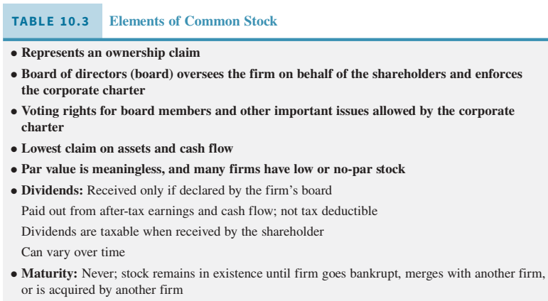

Slide 33
The common shareholders have a claim on all business proﬁts that remain after the holders of all other classes of debt and equity securities have received their coupon payments or returns. But the ﬁrm may wish to retain some of those proﬁts to reinvest in the ﬁrm to ﬁnance modernization, expansion, and growth. When so declared by the board of directors, owners of a ﬁrm’s common stock receive dividend payments. The dividend is typically a cash payment that allows shareholders to receive some income from their investment. To many investors, an attractive characteristic of common stock dividends is their potential to increase over time. As a ﬁrm achieves success, its proﬁts should grow and the shareholders can expect to see the dollar amount of their dividends rise. Of course, success and growth are not guaranteed. A ﬁrm may experience poor earnings or losses, in which case shareholders bear the risk of smaller dividends or the elimination of dividend payments until the ﬁrm’s ﬁnancial situation improves.

Slide 34
Preferred stock (see Table 10.4) is an equity security that has a preference, or senior claim, to the ﬁrm’s earnings and assets over common stock. Preferred shareholders must receive their ﬁxed dividend before common shareholders can receive a dividend. In liquidation, the claims of the preferred shareholders are to be satisﬁed before common shareholders receive any proceeds. In contrast with common stock, preferred stock generally carries a stated ﬁxed dividend. The dividend is speciﬁed as a percentage of par value or as a ﬁxed number of dollars per year.
For example, a preferred stock may be a 9 percent preferred, meaning that its annual dividend is 9 percent of its par or stated value. In such cases, unlike common stock, a preferred stock’s par value does have important meaning, much like par value for a bond. The dividend for no-par preferred stock is stated in terms of a dollar amount, for example, preferred as to dividends in the amount of $9 annually. The holder of preferred stock accepts the limitation on the amount of dividends as a fair exchange for the priority held in the earnings and assets of the company. Thus, unlike with common stock, the par value of a preferred stock is important. Dividends often are expressed as a percentage of par, and the par value represents the holder’s claim on corporate assets in case of liquidation.

Slide 35
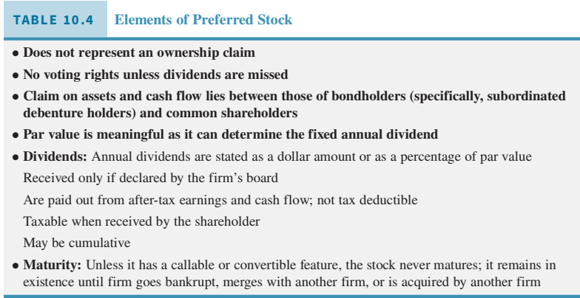

Slide 36
Because preferred stocks are frequently nonvoting, many corporations issue them as a means of obtaining equity capital without diluting the control of the current stockholders. Unlike coupon interest on bonds, the ﬁxed preferred stock dividend is not a tax-deductible expense.
Preferred stock may have special features. For example, it may be cumulative or noncumulative. Cumulative preferred stock requires that before dividends on common stock are paid, preferred dividends must be paid for the current period and for all previous periods in which preferred dividends were missed. Unlike debt holders, the preferred stockholders cannot force the payment of their dividends. They may have to wait until earnings are adequate to pay dividends. Cumulative preferred stock oﬀers some protection for periods during which dividends are not declared.
Callable preferred stock gives the corporation the right to retire the preferred stock at its option.

Slide 37
Convertible preferred stock has a special provision that makes it possible to convert it to common stock of the corporation, generally at the stockholder’s option. This, like many of the special features that preferred stock may have, exists primarily to attract investors to buy securities at times when distribution would otherwise be diﬃcult. Preferred stock that is cumulative and convertible is a popular ﬁnancing choice for investors purchasing shares of stock in small ﬁrms with high growth potential.
Participating preferred stock allows preferred shareholders to participate with common shareholders when larger dividend payouts are available. Holders get a larger dividend, if suﬃcient earnings exist and if common shareholders will be getting a dividend larger than the preferred shareholders. It is a rarely used feature except in some private equity and venture capital investments.

Slide 38
Dividends and Stock Repurchases
Dividends, as we’ve learned, are not a legal obligation of the ﬁrm and may be skipped, decreased, increased, stopped, and started according to the collective wisdom of the corporation’s board of directors. When they are paid, they are typically paid on a quarterly basis, four times over the course of a year.
Many ﬁrms oﬀer shareholders the choice to receive a check for the amount of their dividends or to reinvest the dividends in the ﬁrm’s stock. Dividend reinvestment plans (DRIPs) allow shareholders to purchase additional shares automatically with all or part of the investor’s dividends. Fractional shares can be purchased and DRIP purchases have no or low commissions. Suppose an investor owns suﬃcient shares to receive $10 in dividends on a stock from its quarterly declared dividend. If the stock price is $25, the DRIP program allows the investor to purchase $10/$25, or a 0.40 share of the ﬁrm’s stock. If the stock price is $8, the investor’s reinvested dividends will purchase $10/$8 or 1.25 shares of the stock. Whether the dividends are received as cash or reinvested, the investor must pay taxes on them.

Slide 39
How Do Firms Decide on the Dollar Amount of Dividends?
Most ﬁrms that issue dividends try to maintain a consistent dividend payout ratio, which is dividends per share divided by earnings per share (EPS). The dividend payout ratio for example, Microsoft company’s dividend is $1.44 per share divided by earnings per share, $1.48:
Dividend payout ratio = $1.44/$1.48 = 0.97 or 97 percent
This is quite high. If this were the case, Microsoft likely expects its earnings to rise in the coming year. Rare is the ﬁrm that wants to continually return all of its earnings to shareholders as dividends; typically, funds are retained to ﬁnance growth and expansion.

Slide 40
A key component of the “how much?” decision is what level of dividends is sustainable over time? A ﬁrm does not want to announce it will begin paying dividends and then have to reduce or eliminate the dividend at a later time due to the need to conserve cash. Dividends are thought to send a signal to investors about management’s view of the future cash-generating ability of the ﬁrm. Managers and the board of directors have private information about the strategies, competitive responses, and opportunities facing the ﬁrm that are not known to the investing public. Thus, if the ﬁrm increases dividends, that is a positive signal or indicator to the ﬁnancial markets that management believes the future looks stable, or improving, for the ﬁrm. A reduction in dividends is taken to be a pessimistic indicator of the ﬁrm’s future, so ﬁrms set dividend levels so future reductions are unlikely given their current perspective on the ﬁrm’s future.

Slide 41
As the ﬁrm generates more cash, the ﬁrm will increase its dollar amount of dividends per share as well as its dividend payout ratio. After a while, the ﬁrm will determine a “target” dividend payout ratio that it seeks to maintain over time. However, dividends will not automatically rise along with earnings. If future earnings rise, dividends will not increase until the board feels the higher level of earnings are sustain- able. (Remember, ﬁrms do not want to ever cut the dollar amount of the dividends per share if they can avoid it.) If the higher earnings appear to be sustainable, the ﬁrm will adjust the dividends per share accordingly toward the “target” dividend payout ratio. Some call this the target dividend payout policy.

Slide 42
Some ﬁrms follow a diﬀerent dividend strategy of consistently paying a low regular dividend but declaring a special dividend when times are particularly good. For a ﬁrm in a cyclical industry, with highly variable sales and earnings, this may be a strategy to conserve cash during industry recessions while maintaining the low but stable regular dividend. Shareholders are rewarded when rising earnings allow the company to declare an extra or special dividend. While such a dividend policy may help management control their cash balance, investors, who generally prefer certainty to uncertainty, do not favor such a strategy.
Note please: A cyclical industry is a type of industry that is sensitive to the business cycle, such that revenues generally are higher in periods of economic prosperity and expansion and are lower in periods of economic downturn and contraction.

Slide 43
Other dividend payment strategies suﬀer from the same drawback of creating investor uncertainly due to variable dividend levels. The residual dividend policy states that dividends will vary based upon how much excess funds the ﬁrm has from year to year.
Under a constant payout ratio strategy, the ﬁrm pays a constant percentage of earnings as dividends; as earnings rise and fall, so does the dollar amount of dividends.
Please note that this is not the same as the target payout policy. The ﬁrm adjusts dividends around the target over time, depending on earnings sustainability; during some years, the actual payout ratio will exceed the target, and during others, it will be under it in order to have stable, predictable changes in dividends. The constant payout ratio maintains the payout ratio at the expense of a varying dollar amount of dividends per share.

Slide 44
The board of directors and management will consider several factors as they examine the level of dividend payout. Some of these factors are the following:
Ability of the ﬁrm to generate cash to sustain the level of dividends. Recall that investors react badly to reductions in dividends. If a dividend level is thought to be unsustainable, the ﬁrm’s stock price will fall as investors sell the stock.
Legal and contractual considerations. Dividends, when they are paid, reduce a ﬁrm’s equity. A ﬁrm cannot pay dividends if doing so will reduce the ﬁrm’s equity below the par value of the common stock. In addition, a bond’s indenture (or loan agreement with a bank) may restrict the dollar amount of dividends to ensure adequate cash is available to pay loan interest and principal.
Growth opportunities. Growing ﬁrms require capital, and they will likely want to reinvest all proﬁts into the company to ﬁnance expansion and move into new products or markets. Growing ﬁrms may seek additional funds from loans, bond issues, and new issues of stock. It is unlikely ﬁrms facing growth opportunities will want to initiate or signiﬁcantly increase their dividends.

Slide 45
Cost of other ﬁnancing sources. Dividends are paid, for the most part, from internally generated funds, meaning cash that remains after the ﬁrm’s bills, interest, and taxes are paid. If a ﬁrm has the ability to easily raise low-cost external ﬁnancing sources, it will be better able to maintain a higher level of dividends. Firms that can raise outside ﬁnancing by paying high interest rates or by issuing new shares of stock will likely have lower levels of dividends.
Tax rates.
In addition to giving cash dividends to shareholders, the ﬁrm’s board of directors can announce other decisions, such as a stock dividend or stock split, that, at ﬁrst glance, appear to give extra shares and wealth to shareholders. In reality, as we shall see in the next section, their eﬀect on the value of a ﬁrm’s stock and the wealth of shareholders is zero. But the board can make one other decision with respect to the ﬁrm’s shares that will positively aﬀects share- holders: a stock buyback or share repurchase program. We’ll examine stock dividends, splits, and repurchases next.

Slide 46
Stock Dividends and Stock Splits
A stock dividend is what it sounds like: a dividend paid with shares of stock rather than cash. Rather than mention a dollar ﬁgure, the announcement will state that the ﬁrm is distributing a5 percent (or “X” percent) stock dividend. But a stock dividend has no net eﬀect on the wealth of the shareholders. To see why, consider the following.
Suppose CUL8R Incorporated stock is currently priced at $10 a share, and there are 100,000 shares outstanding; the total market value of the ﬁrm is $10 × 100,000 or $1 million. Suppose you own 1,000 shares, meaning you own 1 percent of the shares outstanding and the value of your holdings is $10 × 1,000 shares or $10,000. CUL8R’s board has declared a 10 percent stock dividend, so now you own 1,100 shares.
Are you any richer? The answer is no; you still own 1 percent of the shares outstanding, and the value of your CUL8R holdings is still $10,000. You own 1,100 shares, but the number of shares outstanding is 10 percent larger, too. There are 110,000 total shares, and you own 1 percent of this total. Nothing has happened to the value or the earnings ability of the ﬁrm with this paper transaction, so the ﬁrm’s stock price will fall and will equal $1 million/110,000 shares, or approximately $9.09. The bottom line is a stock dividend distributes nothing to shareholders and removes nothing from the ﬁrm. No value is transferred.

Slide 47
A stock split has a similar eﬀect. The ﬁrm distributes extra shares for every share owned in a stock split. For example, a ﬁrm may announce a two-for-one stock split; this has the eﬀect of doubling the number of shares outstanding and doubling the holdings of each investor, but as in the case of a stock dividend, the net eﬀect on investor wealth is zero. You may own twice as many shares, but the stock price will be cut in half, leaving your ownership stake (both in terms of value and percentage owned) the same as it was before the stock split. Occasionally, a ﬁrm will announce a “reverse split” in which multiple shares are combined to form one new share. For example, a one-for-four reverse split means four old shares are equal to one new share. When this happens, the stock price will change so again the investor’s wealth remains the same.
You may have noted that there is not much of a diﬀerence between a stock split and a stock dividend. They involve paper transactions in which the number of shares is increased but prices adjust downward to maintain investor wealth at a constant level. In terms of accounting, a distribution of ﬁve shares for four (a 25 percent stock dividend) is considered to be a stock split; a distribution of less than ﬁve for four (less than a 25 percent stock dividend) is considered to be a stock dividend.

Slide 48
Share Repurchases
Rather than distribute funds to shareholders in the form of earnings, a ﬁrm can repurchase its shares. Why would a ﬁrm repurchase its shares of stock? Some ﬁrms purchase shares of their own stock to use in stock-based acquisitions of other ﬁrms. That is, they repurchase shares from current shareholders and then distribute them to owners of a newly acquired ﬁrm.
A major reason for doing this is to reward longer-term shareholders by enhancing the value of the ﬁrm’s shares. Increases in stock prices are not taxed until the shares are sold, and if the shares have been held longer than one year, the maximum tax on the increase in value (called a capital gain) is 15 percent for most investors. This tax savings is thought to be a major reason by some researchers for the increase in stock repurchases in recent years.
Another reason for stock repurchases is that the ﬁrm has the cash and sees its own stock as one of its most attractive investment alternatives. Rather than investing in expanding the business to new markets, the ﬁrm’s board of directors and top managers believe the ﬁrm’s stock is undervalued and oﬀers potential returns. The stock can be purchased at what is perceived to be a low price and re-issued later, after the stock price rises.

