Slide 1


Master Of Real Estate
Management
Prepared by Dr. Ahmad Muhammad
MKT600
Digital Marketing Concepts
Lecture 5

Slide 2



Master Of Real Estate
Management
Lecture 5
MKT600
Digital Marketing Concepts
Prepared by
Dr. Ahmad Muhammad

Slide 3

Chapter
Google Ads and Facebook Ads for Real Estate
05

Slide 4

Chapter
Lecture Objectives
05
To provide a rigorous scientific definition of digital advertising and differentiate it from traditional advertising in terms of communication channels, targeting mechanisms, and the capacities for measurement and optimization. To analyze the core components of digital advertising design (concept, form, copy, image/video, color, motion, and effects) and apply the principles of simplicity and clarity to ensure the effectiveness of the advertising message. To explain the foundational concepts of paid advertising and Search Engine Marketing (SEM) and distinguish SEM from organic Search Engine Optimization (SEO) within an integrated marketing framework. To compute and interpret key performance metrics (Impressions, CPM, CPC, CPA, CTR, and Conversion Rate) and use these indicators to evaluate the efficiency of advertising spend in real estate campaigns. To describe the Pay-Per-Click (PPC) model and the mechanics of search advertising auctions, while clarifying how ad quality and landing-page quality influence ad rank and campaign outcomes. To construct a methodologically sound Google Ads campaign structure (Campaign → Ad Groups → Ads), including keyword selection, match-type strategy, and the use of negative keywords to reduce waste and increase relevance. To design a Facebook/Meta Ads campaign using the three-level structure (Campaign → Ad Set → Ad), including objective selection, audience definition, and the selection of real estate-appropriate ad formats (image, video, carousel), supported by attribute-led, verifiable ad copy. To apply an operational framework for continuous optimization, including measurement and tracking, lead qualification, speed-to-lead follow-up, and budget reallocation based on clear performance indicators, with the aim of improving overall marketing output quality.

Slide 5
Chapter
The Concept of Digital Advertising
05
Advertising constitutes the principal element of the promotional mix. For decades, it was confined to magazines, newspapers, and television channels—then the most effective communication media—until the emergence of the Internet and modern communication technologies. This development ushered in a new paradigm—digital advertising—which has reshaped many advertising concepts and redefined the relationship between the firm and the end user. Through digital advertising, it is possible to reach the targeted customer using innovative, contemporary tools (e.g., search engines, social media platforms, mobile applications, text messages, and digital billboards) at the right time and place—indeed, at the moment most conducive to making a purchase decision.
In this context, digital advertising is defined as a non-personal form of communication—paid or unpaid—undertaken by a given party (individuals or organizations) to promote a product (a good, service, idea, person, place, etc.) by employing modern digital technologies as communication channels between the organization and the target market (e.g., the Internet, social media, independent digital sites, and smartphones).

Slide 6
Chapter
The Concept of Digital Advertising
05
Designing a digital advertisement professionally requires the designer to possess knowledge and expertise in art and design, alongside technical competencies, and to synthesize these in a single integrated whole. Accordingly, digital advertising may be defined, from a technical standpoint, as a hybrid activity whose successful execution depends on an appropriate collaborative space between science, art, and design. Consequently, the design of a digital advertisement proceeds through several important and effective stages that foster its development and ensure the success of all its structural components. These components comprise design elements that bring together written and auditory texts, images, and illustrations, all activated through chromatic, kinetic, and luminous effects. The process entails orchestrating given content (e.g., an item of information or an idea) within a pre-established plan grounded in several pillars and principles derived from the importance of the subject being advertised, leveraging digital technologies (e.g., design software such as Photoshop).
This, in turn, requires the designer to initiate a cognitive and conceptual dialogue that reorganizes the components of the digital advertisement and directs them toward simplicity, in order to achieve clarity in both the form and the content of the design elements and their compositional structures—spaces, shapes, lines, and colors—while incorporating sound effects and animated flash lighting. On this basis, diverse design decisions are made that advance the functional as well as the aesthetic objectives of the design.

Slide 7
Chapter
The Concept of Digital Advertising
05
The digital advertising designer determines the salience of each element within the advertisement, how elements are distributed, and which low-importance components are excluded—thereby shaping audience perception and steering the composition toward simplicity through:
1. Simplicity and Clarity of the Concept in Digital Ad Design:
The advertising concept constitutes the point of departure for the content of a digital advertisement and provides the intellectual foundation for the methodical sequencing of the design process. This process is grounded in digital technologies and information systems to present design elements, structure the sequence of events, and express the objectives of the digital advertisement. Accordingly, the concept must be formulated in a manner that enables clear and simple communication to the audience, using intelligible vocabulary. It should be characterized by a simple compositional structure with high expressive and performative/functional efficacy.
2. Simplicity and Clarity of Forms in Digital Ad Design:
Form is among the most important units of visual language, relying on visual and sensory perception to convey ideas and advertising messages to the audience. Form is typically the first aspect a person perceives or learns, and perception operates primarily at the level of the whole, from which the parts subsequently become clear. In general, the forms used in digital advertisements (e.g., interactive icons, illustrations, symbols, images) carry familiar denotations and connotations. Therefore, designing a digital advertisement requires employing simple, unambiguous forms whose meanings are appropriate to the target segment, in order to produce the intended impact.

Slide 8

Basic Terminology and Calculations:
There are many paid advertising options in digital marketing. However, before we delve into specific techniques and processes, let’s review some basic terminology and calculations:
Search Engine Marketing (SEM):
Often used interchangeably with paid advertising, search engine marketing is actually the practice of maximizing marketing results from search engines. While this does include paid advertising, it also covers organic SEO, as well. So, search engine marketing is the umbrella concept that includes all marketing efforts – paid or unpaid – that maximize an organization’s search engine results.
Impressions:
Impressions represent how many people have been exposed to (“seen”) an ad.
Chapter
05
Paid Advertising and Search Engine Marketing

Slide 9
Chapter
Paid Advertising and Search Engine Marketing
05
CPM:
CPM is the cost to an advertiser for every 1,000 (Latin: “mille”) impressions. In other words, this is the price advertisers pay for every 1,000 views of a specific ad. For example, if your budget was $500 and that delivered 25,000 impressions, your CPM would be $500 ÷ (25,000 / 1,000) = $20. Remember that CPM are measured in 1,000 impressions. Meaning if the total forecasted impressions are 25,000, you’ll need to divide this by 1,000 to calculate your CPM. Because this pricing model charges for every view, regardless of whether the person clicks on it or not, the rates (per 1,000) are often the lowest. The use of CPM campaigns is relatively rare since it is not connected to specific actions or results. However, marketers may still use it for branding or awareness campaigns because they can potentially get their message in front of large audiences at lower rates.

Slide 10
Chapter
Paid Advertising and Search Engine Marketing
05
Average CPM Rates in 2026
Average CPM | Platform
$38.40 | Google Search Ads
$3.12 | Google Display Ads
$8.60 | Facebook Ads
$8.96 | Instagram Ads
$6.46 | Twitter Ads
$6.59 | LinkedIn Ads
$30 | Pinterest Ads
According to TopDraw, the following CPM rates represent averages across a variety of online advertising platforms:
Please note the above amounts are averages. CPM rates will vary significantly depending on the focus of your target audience. So, if you are targeting the world, for example, you will be quoted a much lower CPM rate because the audience is quite general and diverse. However, if you want to target potential customers in a specific country, geographic region, industry, or with specific interests, CPM rates can increase dramatically.

Slide 11
Cost Per Click (CPC)
Cost per Click is the cost to an advertiser for each click on an ad. In other words, an advertiser only gets charged when someone clicks on their ad – not a view like CPM. Since a click indicates initial interest, marketers will generally pay more for these types of ad campaigns. CPC campaigns tend to represent the majority of paid advertising campaigns. For budgeting purposes, let’s assume, once again, you have a $500 budget. And the forecasted CPC rate for your target audience is $2.00. Based on these figures, your budget would cover a maximum of 250 clicks = $500 / $2.00.
Chapter
05
Paid Advertising and Search Engine Marketing

Slide 12
Chapter
Paid Advertising and Search Engine Marketing
05
Average CPC Rates in 2026
Average CPC | Platform
$2.32 | Google Search Ads
$0.67 | Google Display Ads
$1.35 | Facebook Ads
$3.56 | Instagram Ads
$0.38 | Twitter Ads
$5.26 | LinkedIn Ads
$1.50 | Pinterest Ads
Once again, here are some average CPC rates from TopDraw:
Like the above CPM rates, please note the CPC amounts are averages. CPC rates will also vary depending on the focus of your target audience. So, if you are targeting a broad audience, you will be quoted a much lower CPC rate. However, if you plan to target potential customers in a specific country, geographic region, industry, or with specific interests, CPC rates will often be higher.

Slide 13
Chapter
Paid Advertising and Search Engine Marketing
05
Cost per Action / Acquisition (CPA):
Cost per Action (sometimes referred to as Cost per Acquisition) measures how much an advertiser pays to get a “conversion”. Conversions are desired actions that people perform after clicking on an ad, such as making a purchase, downloading some content, booking a demo, etc. Since these CPA activities involve multiple steps, e.g., clicking on the ad, purchasing a product or service, and/or maybe filling out a form, they are the most costly. But, if potential customers do complete all these conversion activities, it is clearly worth more to the advertisers.
Because the scope of these conversions can vary significantly, CPA rates also fluctuate. For example, an automotive dealership, might be willing to spend $250 for someone to sign-up for a test drive. But a marketer offering a downloadable PDF template, where you fill out a form, might only be willing to spend $25 dollars for that contact information. Both examples are valid conversions; but depending on what is being offered and the value it provides to the advertiser, the CPA rate will differ.

Slide 14
Chapter
Paid Advertising and Search Engine Marketing
05
Click-through Rate (CTR) represents the percentage of people who have been exposed to an ad (or link) AND clicked on it, therefore visiting the landing page or destination of the ad / link. It is calculated by dividing the number of clicks by the number of impressions, i.e., clicks ÷ impressions.
If an advertiser’s ad had 15,000 impressions and there were 50 clicks, the click-through rate (CTR) would be 50 / 15,000 = 0.0033 = 0.33%. Now a common question asked is what is a “good” click-through rate? The most appropriate answer to this question is: it depends. Many factors can influence your CTR, such as:
◦ Industry
◦ Type of ad, e.g., search (text), display, video, etc.
◦ Host platform, e.g., Google, Facebook, Bing, LinkedIn, etc.
◦ Your AdRank, which is a metric that determines the position of your ad and how often it gets shown. We’ll dive into this later.
That said, in general, search (text) ads have an average CTR of approximately 2% and display (banner) ads have a CTR of 0.35%. But again, this can vary widely by industry. For example, search ads in the legal industry have an average CTR of approximately 1.4% and dating ads have an average CTR of 3.5%.

Slide 15
Chapter
Paid Advertising and Search Engine Marketing
05
Conversion Rate is calculated by dividing the number of conversions by the number of people who clicked on your ad, i.e., conversions ÷ ad clicks (or visitors).
In our previous example, there were 50 clicks on the ad, which meant that your landing page received 50 visitors. If one of those 50 visitors converted, the conversion rate would be 1 ÷ 50 = 0.02 = 2%. Please note that the conversion rate usually is not based on the number of ad impressions, but rather the number of actual visitors. That said, if you do plan to define your conversion rate differently, be sure to clarify your inputs and make sure everyone in your organization is using the same formula. Once again, industry conversion rates will vary largely because the customer buying decision process and level of commitment differ widely. For example, deciding to purchase a residential apartment (or commit to a long term lease) is very different from simply submitting an online inquiry or booking a property viewing. Therefore, you should try to compare your conversion rates to your specific industry as a baseline. For a variety of benchmarks, you may want to read this Alexa blog post, Average Conversion Rates by Industry, Ad Provider, and More.

Slide 16
What Is PPC?
One of the most common types of paid advertising is the pay-per-click (PPC) model, which can be applied to text ads, video ads, and even display (banner) ads depending on the options offered by the host advertising platform, e.g., Google Ads, Microsoft Ads, Facebook Ads, LinkedIn Ads, etc. PPC marketing is a form of online advertising that allows your organization to appear above organic search results.
Put simply: marketers bid to have their ad appear when people search for specific keywords or key phrases. Whenever the ad appears and someone clicks on it, marketers pay for that click – hence the “pay-per-click” name. Marketers often use pay-per-click as part of a lead generation strategy. In other words, marketers pay to get their messages / ads in front of their target audiences. Sometimes, this approach is referred to as “paying for eyeballs”.
Chapter
05
Paid Advertising and Search Engine Marketing

Slide 17
How Paid Advertising Works?
When a person types a search into an online search engine, there are advertisers interested in showing ads related to that person’s search inquiry. This search triggers an auction, which marketers have previously bid on. The ads that win the auction then appear on the search engine results page. A combination of several variables, including bid amount, the quality of the ad, and quality of the landing page, determine which ad will appear in the top position.
To compete in these public ad auctions, marketers create accounts on these hosted advertising systems like Google Ads to set up their ads and identify where and when they would like for those ads to show up. Since Google Ads is one of the most commonly used Ad networks, let’s take a close look at how marketers set up their advertising campaigns in Google Ads.
Chapter
05
Paid Advertising and Search Engine Marketing

Slide 18
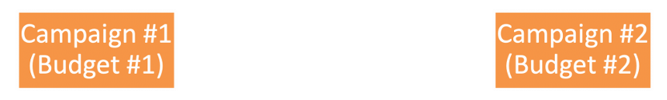
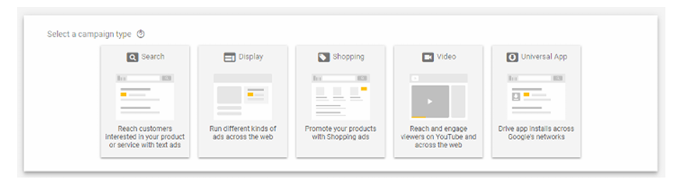
Chapter
Paid Advertising and Search Engine Marketing
05
Campaigns
Accounts are split into campaigns for the convenience of monitoring and reporting on different geographic locations, promotions, types of ads, and/or any other helpful advertising categorization. At the campaign-level, marketers can set their:
budget, language preference(s), target location(s), type of campaign, and more.
The following lists the most common types of campaigns Google offers:

Slide 19
Chapter
05
Paid Advertising and Search Engine Marketing
1) Performance Max campaigns: Access all channels from a single campaign with Google AI optimization
Performance Max is a goal-based campaign type that allows performance advertisers to access all Google Ads inventory from a single campaign. Performance Max helps you drive performance based on your specified conversion goals, delivering more conversions and value by optimizing performance in real-time and across channels using Smart Bidding.
Why choose Performance Max campaigns?
• Simple to set up, with AI optimization: Performance Max campaigns are designed to be easy to launch, and when your campaign is live, it'll be optimized by Google AI to drive the best performance possible. You can steer your results by providing high-quality creative assets and sharing your expertise about which audiences are most likely to convert.
• Increase conversions and value: Google AI optimizes your budget and bids across channels to help capture new conversion opportunities in real time.
• Find new customers: Unlock new audience segments by using real-time understanding of user intent, behavior, and context to show up in the right moments with more relevant ads.
• Gain richer insights: Performance Max campaigns are now part of the “Insights” page to help you understand how AI is currently working and how you can improve your campaign. Using the “Combinations” report, you can learn how your top-performing assets are being combined to build creatives.
Tip: Performance Max will show as a campaign type selection if your advertising objective is “Sales”, “Leads”, or “Local store visits and promotions”.

Slide 20
Chapter
05
Paid Advertising and Search Engine Marketing
2) Search campaigns: Text ads on search results
Search campaigns are text ads on search results that let you reach people while they’re searching on Google for the products and services you offer.
It's great for driving sales, leads, or traffic to your website, as you can show your ads to people actively searching for your products and services.
Why choose Search campaigns?
Sales and leads:
• Boost your online sales and signups.
• Consider using leads if you have a longer sales cycle.
Easy setup:
• Write text ads and pick keywords.
• Skip special files or assets.
• Highly specific targeting: Reach people actively searching for what you offer.

Slide 21
Chapter
05
Paid Advertising and Search Engine Marketing
3) Display campaigns: Image ads on websites
Display campaigns let you reach a relevant audience with visually engaging ads as they browse millions of websites, apps, and Google-owned properties, such as YouTube, to achieve your marketing objectives. Display campaigns are a great way to expand your reach and stay top of mind with an audience beyond just Google Search.
You can also create a Display campaign that uses your data segments to show ads to people who’ve visited your website or have used your app.
Why choose Display campaigns?
• Sales and leads: Use visually engaging call-to-actions to drive sales and signups.
• Awareness and consideration: Create memorable ads to make people aware of your brand or consider your product.
• Reach: Target people beyond search results while they’re browsing websites and apps.
• Your data segments: Follow up with people who’ve already viewed your ads or visited your site.
Type of Display campaigns
• Display: Pick your campaign settings and targeting, and automate some aspects of your Display campaign.
Tip: It's helpful to use an image editing tool to create square and landscape versions of your display ad in the right dimensions and file size.

Slide 22
Chapter
05
Chapter
4) Video campaigns: Video ads on YouTube
Video campaigns let you show video ads on YouTube and other websites.
Some Video campaign types can help you boost general awareness of your brand. Others are designed to drive conversions or get people to shop on your website.
Why choose Video campaigns?
• Awareness and consideration: Use video ads to make people aware of your brand or consider buying your product.
• Sales and leads: Use the “Drive conversions” campaign subtype to set up action-focused video ads.
• Expand your reach: Target people beyond search results while they’re on YouTube.
• Your data segments: Follow up with people who've already viewed your ads or visited your site.
Types of Video campaigns
Choose from 6 types of Video campaigns:
• Drive conversions: Drive sales and leads with action-focused ads and targeting (also known as Video action campaigns).
• Video reach campaigns: Get the most reach for your budget, either by reaching more unique users (through the use of bumper ads, skippable in-stream ads, or an optional mix of the 2 formats) or by reaching users with your entire message (through the use of non-skippable in-stream ads).
• Get views: Get people to consider your product with skippable in-stream or in-feed video ads.
• Ad sequence: Tell a story with a series of video ads in a sequence.
Tip: You'll first need to create your video ad and upload it to YouTube.

Slide 23
Chapter
05
Paid Advertising and Search Engine Marketing
5) App campaigns: Promote your app on many channels
App campaigns help you find new app users and increase sales within your app.
This campaign type uses information from your app to automatically optimize ads across Search, Play, YouTube, Discover, and over 3 million sites and apps.
Why choose App campaigns?
• App promotion: Drive installs, engagements, and signups for your app on mobile devices.
• Multi-channel marketing: Show your app on Search, Display, Play, and YouTube under one campaign.
• Easy setup and management: App campaigns use Google AI-powered targeting, bidding, and ad creation for optimal performance.
Types of App campaigns
If your account is eligible, you may notice 3 App campaign subtypes:
• App installs: Focus your ads on getting people to download your app.
• App engagement: Get existing users to take actions in your app. Use Web to App connect to ensure that your current web campaigns also drive users to your app.
• App pre-registration: Promote pre-registration for apps before they release on Google Play.

Slide 24
Chapter
05
Paid Advertising and Search Engine Marketing
6) Shopping campaigns or Performance Max with Merchant Center feed: Product listings on Google
Shopping campaigns are product listings that are ideal if you’re a retailer looking to sell your product inventory. Shopping ads appear on search results and the Google Shopping tab.
Store owners can also use local inventory ads to promote products available at their physical locations.
Why choose Shopping campaigns?
• Retail marketing: Use visually engaging product listings to promote your retail products.
• Sales and leads: Get people to buy on your online store or sign up for more.
• Boost a nearby storefront: Sell your local store inventory to nearby people.
Tip: To create a Shopping campaign, you'll first need to have a Merchant Center account where you can upload your product inventory.
Note: Consumers use multiple touch points as they explore and decide on products and services (93% use both web and app to research, browse, and purchase), and Google AI makes it easier than ever to connect and enhance your web and app experience so you can drive a 21% increase in your web campaign ROI. The full scope of driving more value from web and app includes using both to better measure, optimize, and grow your campaigns.

Slide 25
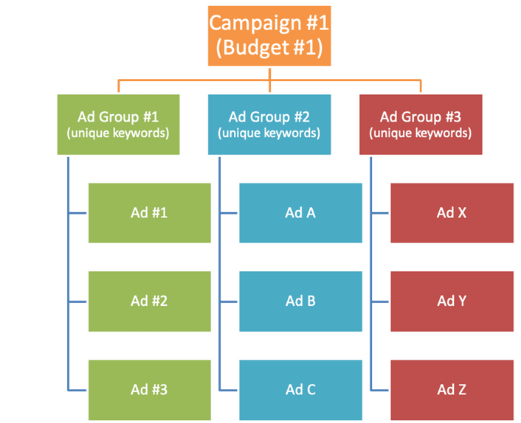
Chapter
05
Paid Advertising and Search Engine Marketing
Ad Groups
As you can see in the image below, each campaign can consist of one or more ad groups. Please note that any setting, e.g., budget, target location, language, etc., set at the campaign-level will be used for all ad groups created for that campaign. Each ad group can contain one or more ads which target a shared set of unique keywords.
Each ad group contains unique key phrases or key words and cannot have the same key phrases or key words as another ad group. Use ad groups to organize your ads by a common theme, such as the types of products or services you want to advertise.

Slide 26
Chapter
05
Paid Advertising and Search Engine Marketing
For example, let’s say you market apartments for sale, villas for rent, and commercial offices on your website. In the lists below, each ad group contains a set of unique keywords focusing on a category you offer. The keyword list in each ad group tells the system to show ads for that category only on searches and websites related to it.
Ad Group 1: Apartments for Sale | Ad Group 2: Villas for Rent | Ad Group 3: Commercial Offices
· 2 bedroom apartment for sale · 3 bedroom apartment for sale · new build apartment for sale · luxury apartment for sale · city center apartment for sale · penthouse for sale | · villa for rent · furnished villa for rent · 4 bedroom villa for rent · beachfront villa for rent · gated community villa rental · private pool villa rental | office space for lease serviced office for rent small office for rent Grade A office for lease coworking space membership business center office rental
Note: Each ad group contains unique keywords and should not overlap with other ad groups.

Slide 27
Queries are the search terms people type into the search box of an online search engine. And as mentioned before, there are three common types of search queries:
• Navigational Queries – With these queries, the user wants to visit a specific site or find a certain vendor / brand.
• Informational Queries – These are queries that cover a broad topic (e.g., digital marketing or PPC) for which there may be thousands of relevant results.
• Transactional Queries – These are queries that indicate an intention to complete a transaction, such as buying something.
Key phrases or words, on the other hand, are what marketers bid on and use to target these individuals by matching their search queries.
Chapter
05
Paid Advertising and Search Engine Marketing

Slide 28
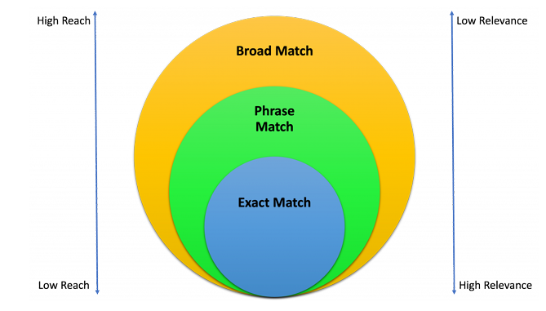
Chapter
05
Paid Advertising and Search Engine Marketing
Marketers have several keyword matching options when matching search queries:
• Exact Match (lowest reach, high relevance, high conversion) will show your ad when the search query has the same meaning as the keywords you bid on.
• Phrase Match (lower reach, medium-high relevance, medium conversion) will show your ad when the search query includes the same meaning as the keywords you bid on.
• Broad Match (highest reach, low relevance, low conversion) will show your ad when the query relates to the keyword.

Slide 29
Chapter
05
Paid Advertising and Search Engine Marketing
Negative Keywords
It is also possible to choose negative keywords, which prevent your ads from being shown when people type in specific search queries and keywords. This prevents unnecessary clicks (costs) and traffic.
Search / Text Ads
As mentioned above, ads represent a subset of Ad Groups and are usually arranged by common themes. Ads are what people will see if the auction is won, so it is vital to get them right. Ideally, you want to test a variety of ads to see which ones perform best. Each text ad can include up to:
• Three (3) Headlines (max. 30 characters each)
• One (1) Display URL (cannot be changed and is based on the account URL),
• Two (2) URL paths (max. 15 characters each),
• Two (2) Descriptions (max. 90 characters each), and
• Several Ad Extensions
Ad extensions boost the look and usefulness of ads. For example, sitelink extensions link directly to different pages within a website, location extensions map to your location, and call extensions include a telephone number that you can click on during business hours. Ad extensions can be more engaging for searchers and can communicate even more specific information.

Slide 30
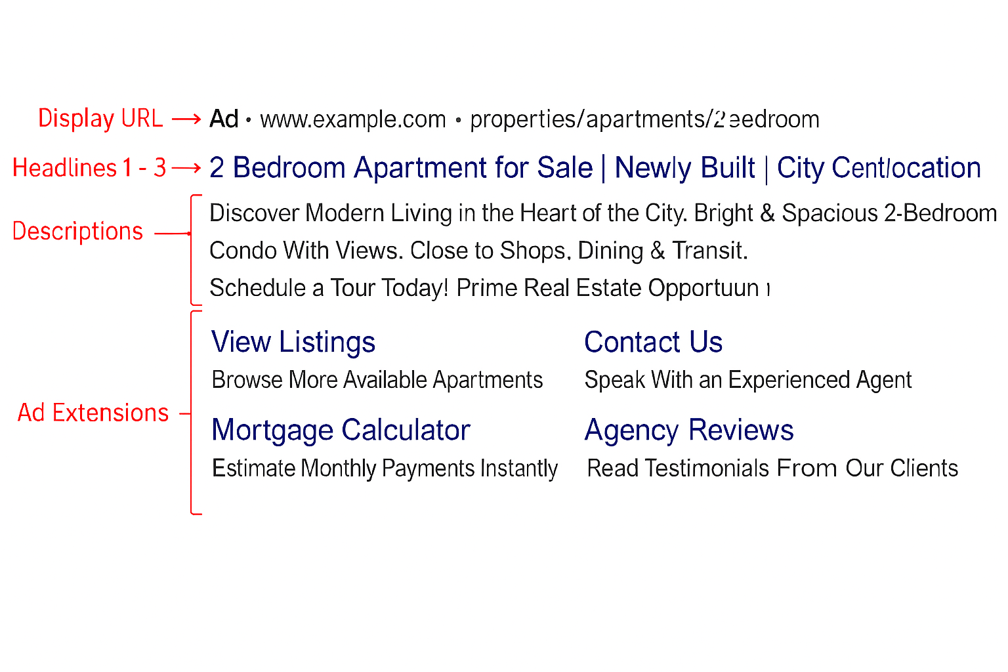
Chapter
05
Paid Advertising and Search Engine Marketing
Negative Keywords
It is also possible to choose negative keywords, which prevent your ads from being shown when people type in specific search queries and keywords. This prevents unnecessary clicks (costs) and traffic.

Slide 31
Chapter
05
Paid Advertising and Search Engine Marketing
• Display URL: Every ad will include one (1) display URL. Please note that the domain name, i.e., www.YourDomain.com, cannot be changed and is based on the domain associated with the Google Ads account.
• Headlines: For each ad, marketers can include up to three (3) Headlines (max. 30 characters each). Often, these headlines are separated by a “vertical bar”, e.g., Headline 1 | Headline 2 | Headline 3. Since this is the main headline, be sure to highlight your key benefits and offers, and use keywords to match potential search queries.
• Descriptions: Every ad allows for two (2) descriptions (max. 90 characters each). Once again, try to capture the interest and attention of your target audience. Use keywords and key phrases. Highlight your compelling offers and benefits. Showcase the reasons why your solution meets the searcher’s immediate needs.
• Ad Extensions: Ad extensions boost the look and usefulness of ads. For example:
◦ Sitelink extensions link directly to different pages within a website
◦ Location extensions map to your location, and
◦ Call extensions include a telephone number that you can click on during business hours.
Ad extensions can be more engaging for searchers and can communicate even more specific information that is easily accessible at the click of a link.

Slide 32
Chapter
05
Paid Advertising and Search Engine Marketing
Campaign Budgets & Bidding
To participate in an auction, marketers need to decide how much they are willing to spend. This is done by setting budgets at the campaign level and bidding at the Ad Group or keyword level. Budgets set at the campaign level can be organized for a specific period of time, e.g., daily, weekly, or monthly budgets. Budgets should be established according to the overall marketing budget. Bids offer a more specific way of controlling your ad spend.
All Ad Groups need to have bids, but keyword-level bids override Ad Group-level bids. Let’s go back to our previous example:
Let’s say you set the maximum bid price for all keyword phrases in Ad Group 1 (Apartments for Sale) at $1. This means that, at most, you would be willing to pay $1 for any search queries that used: 2 bedroom apartment for sale, 3 bedroom apartment for sale, new build apartment for sale, luxury apartment for sale, city center apartment for sale, and penthouse for sale. But, if you were bidding during the peak moving season, “2 bedroom apartment for sale” might be especially popular and there might be a lot more competition for “2 bedroom apartment for sale”. To account for this increase in popularity and competition, you could change the (maximum) bid price for “2 bedroom apartment for sale” to $1.25 and that would override the $1 maximum Ad Group bid. Now, your maximum bid price only for “2 bedroom apartment for sale” would be $1.25. And the maximum bid price for all of the other keywords in Ad Group 1 would remain at $1.

Slide 33
Chapter
05
Paid Advertising and Search Engine Marketing
In terms of bidding, many marketers want to know if they should bid on broad or highly specific keywords. There are trade-offs:
• Broad keywords will bring you more traffic and leads. But bidding on these popular (and competitive) keywords will likely cost more per click and deliver less “qualified” leads. So, these leads will be much more generic and conversion rates will tend to be lower.
• More specific keywords and key phrases will deliver better qualified leads and can cost less, but since they are more specific, there are fewer people who will be searching using these terms. So, they usually produce fewer, but more qualified leads.
Ideally, you want to bid on a combination of both of these because you may be able to convert some of the “generic” leads and you definitely want to convert those leads that most closely match your products and services.
Another common question is: How much should I bid on keywords? Unfortunately, this depends a many different factors:
• When keywords or key phrases are highly competitive, you can end up spending as much as 2-3x the suggested bid price. A safe starting strategy is to bid 10 – 25% higher than the suggested bid price and work your way up based on your resulting ad rank and position.
• For more specific keywords and key phrases, which tend to have less volume and may have lower competition, start with the suggested bid price and slowly increase your bids to improve your ad rank and position.
Lots of marketers use automated bidding methods. These enable advertisers to set a certain goal for their campaigns and after that have the advertising and marketing system establish the most suitable bid for each auction. Since bidding strategies are very important in getting your ads shown, there are many variables to consider.

Slide 34
Due to the complexities of the bidding systems, the actual amount paid by marketers hinges on competitive activity and ad ranking, not simply the highest bid. Your keyword bid represents your maximum bid price. This means you are willing to pay up to this price. However, what you actually pay depends on what others bid.
For example, if you bid $2 for “2 bedroom apartment for sale”, but the next highest bidder had a maximum bid of $1.50, then, to win the auction, you only need to pay $1.51. So, your actual cost per click will be $1.51—even though you were willing to pay up to $2.
Chapter
05
Paid Advertising and Search Engine Marketing

Slide 35
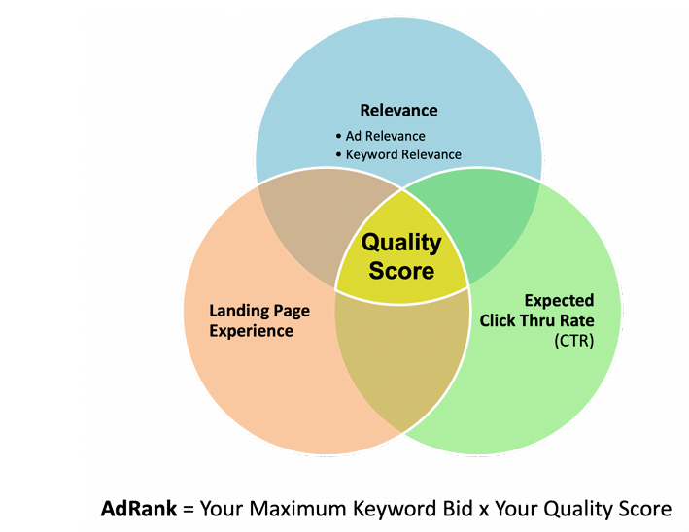
Chapter
05
Paid Advertising and Search Engine Marketing
Ad Rank
There’s even more to winning the auction than having the highest possible bid. Online search engines look at various other elements to establish which ads get shown at the top of the search engine results page, also called “SERP”.
Online search engines have their very own specific means of factoring in other components to identify ad rank. For example, Google takes the following into consideration:
• Bid price
• Ad relevance and quality
• The context of the search (such as the individual’s device and time of day)
• Design effects (e.g., whether it includes extensions that enhance the ad layout)
• Quality Score – a metric that calculates ad significance
The parts of the Quality Score are:
• Expected click-through rate (CTR) based on historical CTR
• The relevance of the keywords to the ad
• The relevance of the search phrase and ad to the search question
• Landing page quality

Slide 36
All of these elements are quite important because the higher the Quality Score, the lower the CPC will be, i.e., the less a marketer needs to pay to have their ad shown. Search engines penalize marketers who bid on keyword phrases with poor Quality Scores by not showing their ads, even if marketers submit high bids.
It is crucial to have engaging as well as relevant ad copy that includes the appropriate keyword phrases. And your landing page quality should not be forgotten either. Ads will be shown less frequently when they point to landing pages that do not deliver on what the ad promises. The landing pages also need to be relevant to the searcher, load rapidly, and provide a good user experience.
Chapter
05
Paid Advertising and Search Engine Marketing

Slide 37
Chapter
05
Paid Advertising and Search Engine Marketing
Targeting
Picking the best keywords is what enables marketers to show ads to the appropriate audiences. But there are other targeting choices offered to maximize campaign results, including targeting by:
• Device
• Location
• Day and time
• Market or industry
By doing this, marketers can target users on mobile devices in the evening, or users under 25 and within a certain distance of a specific location, to enhance their ad’s performance. These are important since variations in ad copy, for instance, might do better for one group of users than for another. Using remarketing tools, marketers can even target or omit previous visitors to a site that do follow-up searches. Bids can also be readjusted for specific keywords based on targeting options, offering marketers much more control over website traffic as well as focusing their bid on those customers, who are more attractive to their organization.

Slide 38
Chapter
05
Paid Advertising and Search Engine Marketing
Conversions
The point of all this hard work is not just to get clicks. The real objective is to get conversions. Conversions are those activities marketers want users to complete after clicking on their ad and actions that support the products or services being advertised.
Common examples of conversions include:
• Purchasing a product or service,
• Signing up for an e-newsletter,
• Booking a demo,
• Downloading content,
• and much more.
It is crucial to track conversions to understand whether a PPC campaign is doing well as well as how many conversions can be credited to paid search as opposed to other advertising and marketing channels. Systems like Google Ads can track conversions utilizing a piece of code placed into the source code of the conversion page (which is reached after conversion, like a “Thank you” page). Conversion monitoring can be difficult since conversion paths also have a tendency to be more complicated than a simple click of an ad and a straight purchase. They typically consist of numerous searches, browsing a variety of related or affiliated websites, or responding to an email, phone call, or in-store promotion. Making use of an analytics solution like Google Analytics can help identify how credit for conversions is attributed to a variety of conversion paths.

Slide 39
Facebook advertising constitutes a qualitative advancement in real estate marketing, integrating extensive reach, high-precision targeting, and a diverse suite of tools within a single platform. Achieving sustained success in this domain requires a rigorous understanding of the platform’s operational mechanics, strategic campaign planning, and creative excellence in content development. Equally critical is the speed and effectiveness of lead follow-up, as timely engagement often determines whether leads progress to qualified prospects and conversions. By applying the theoretical foundations and practical methods presented in this lecture, real estate organizations can design and execute advertising campaigns that efficiently and measurably achieve their marketing objectives.
Chapter
05
Facebook Ads

Slide 40
Chapter
05
Facebook Ads
The strategic importance of employing Facebook advertising in real estate marketing is evident across several key dimensions:
1. Reaching a Wide and Diverse Audience: Facebook’s extensive global user base enables real estate firms to access a broad spectrum of prospective buyers and investors—locally, regionally, and internationally—particularly in the marketing of luxury and investment-oriented properties.
2. Precise and Effective Targeting: Facebook’s advanced targeting capabilities allow marketers to identify and reach highly specific audience segments with substantial precision, using multiple parameters such as geographic location (down to the neighborhood level), demographic characteristics (e.g., age, gender, and education), interests (e.g., investment, interior design, and real estate development), and purchasing behaviors.
3. Cost-Effectiveness: Facebook advertising offers flexible budget management, enabling marketers to initiate campaigns with modest budgets, test performance, and scale expenditures based on empirical results. This makes it a cost-efficient alternative to many forms of traditional advertising.
4. Diversity of Advertising Formats: Facebook supports a wide range of ad formats aligned with real estate marketing needs, including image ads, video ads (e.g., for virtual property tours), and carousel ads to showcase multiple units or features within a single campaign.
5. Performance Measurement and Continuous Optimization: Facebook provides robust analytics dashboards that facilitate systematic tracking of key performance indicators (KPIs) such as reach, engagement, cost per lead (CPL), and conversion rate. These metrics support evidence-based decision-making and continuous campaign optimization.

Slide 41
Chapter
05
Facebook Ads
Essential Features of the Facebook Platform for Real Estate Advertising
1. Campaign Management System (Ads Manager): A centralized, integrated interface that enables the creation, management, and performance monitoring of advertising campaigns in one place. It provides granular control over campaign parameters, including budget allocation, scheduling, placement, and audience targeting.
2. Facebook Pixel: A tracking and measurement tool installed on a real estate company’s website to monitor the behavior of users who arrive via ads, quantify conversions, and support the creation of custom audiences for retargeting and optimization.
3. Custom Audiences and Lookalike Audiences: These features enable targeting of individuals who have previously interacted with real estate assets (e.g., website visitors, leads, or past clients), as well as identifying new audiences with similar characteristics to an existing customer base—thereby enhancing reach while maintaining relevance.
4. Lead Forms (Lead Ads): A native in-app form feature that allows users to submit their contact information without leaving Facebook, reducing friction in the user journey and typically improving completion rates for lead capture.
5. Real Estate Catalog (Property Catalog): An advanced capability for developers and agents managing multiple listings, enabling dynamic and automatically updated property presentation through specialized catalog-based ads—supporting scalable promotion across numerous units or projects.

Slide 42
Chapter
05
Facebook Ads
Components of a Successful Real Estate Advertising Campaign
A successful real estate advertising campaign on Facebook (Meta) is structured around three interconnected hierarchical levels:
1. Campaign Level: This level defines the campaign’s primary objective (e.g., awareness, engagement, lead generation, or conversions), while establishing the overall budget framework and campaign schedule.
2. Ad Set Level: At this level, the target audience is specified with high precision (e.g., geographic location, age range, and relevant interests, where applicable). It also includes setting the budget type (daily or lifetime), scheduling delivery, and selecting placements (i.e., where the ads will appear).
3. Ad Level: This is the user-facing creative unit delivered to the audience. It comprises the creative assets and messaging elements (e.g., images or video, primary text, headline, and a call-to-action button). This level represents the direct point of interaction with prospective clients and strongly influences response behavior.

Slide 43



Thank You

