Slide 1


Intro to Flutter Development
Prepared by Eng. Yousef Salah Kassem
Intro to Flutter Development
Lecture 0

Slide 2

Chapter
Table Of Content
0
Introduction
Mission
Vision
Roadmap
What is Next ?

Slide 3
Introduction

Slide 4
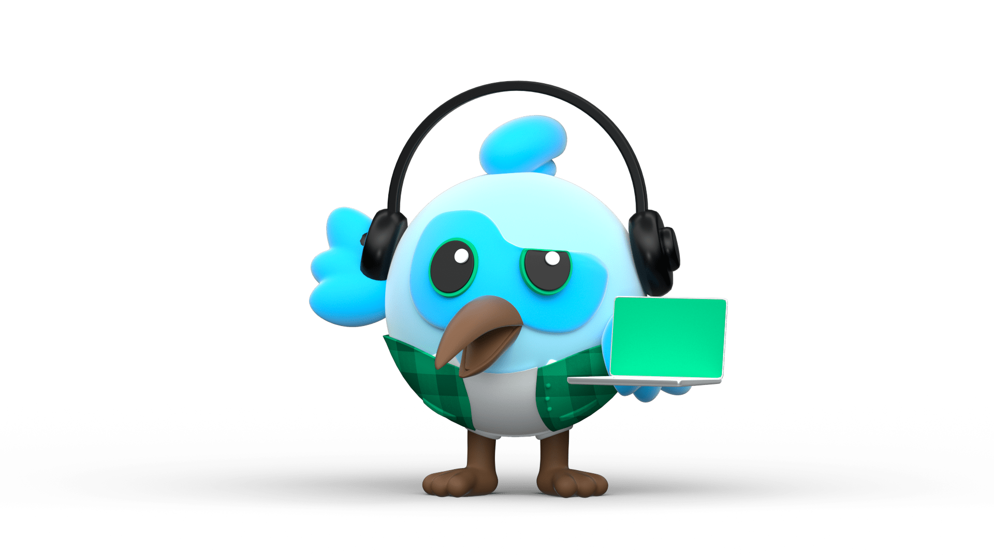

Introduction
Flutter is framework created by google.
A cross-platform framework used to develop application for
Android
iOS
Web
and Desktop
Dart Programming language

Slide 5

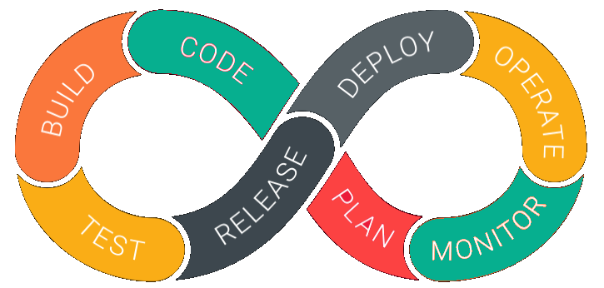

Why Flutter for App Development
1. Open Source | 2. Faster development Cycle | 3. Super Productive
Flutter is Open-Source framework
Therefore, anyone can use it for any given purpose.
Flutter is so fast that it takes less than 30 sec for first full compilation.
Comes with Hot-Reload & Hot-Restart.
Comes with Hot-Reload & Hot-Restart.
Due to Stateful widget hot-reload feature Flutter is very fast iterative coding style.

Slide 6

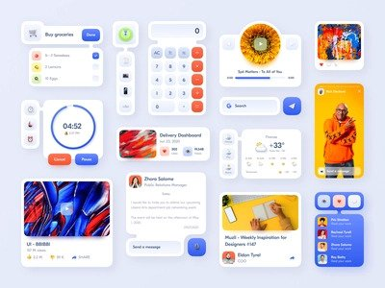

Why Flutter for App Development
4. Ease to learn & code sharing | 5. Widget Libraries | 6. Community Support
Any one who have basic knowledge of OOPS & UI Designing can easily learn Flutter.
Ready to use widget, Flutter have many widget that you can use to build flutter application.
Such as : http, get, share plus, toggle switch etc.
Flutter Community is bit small if we compare with other framework like React.
But Flutter is grow very fast then other framework.

Slide 7
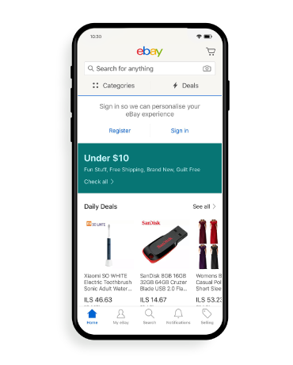
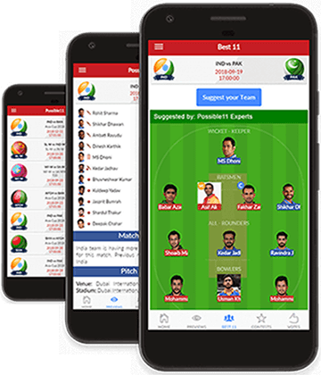
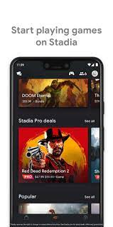
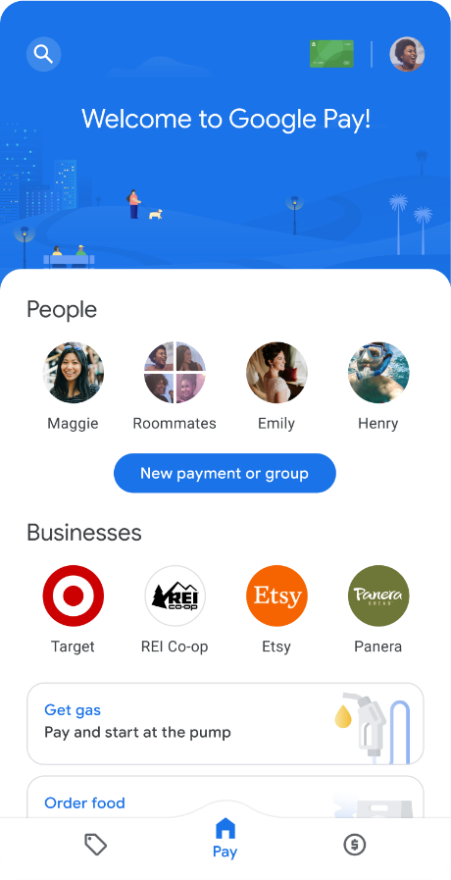
Apps that are build using Flutter
Stadia
gaming platform.
Dream 11
eBay
Google Pay

Slide 8
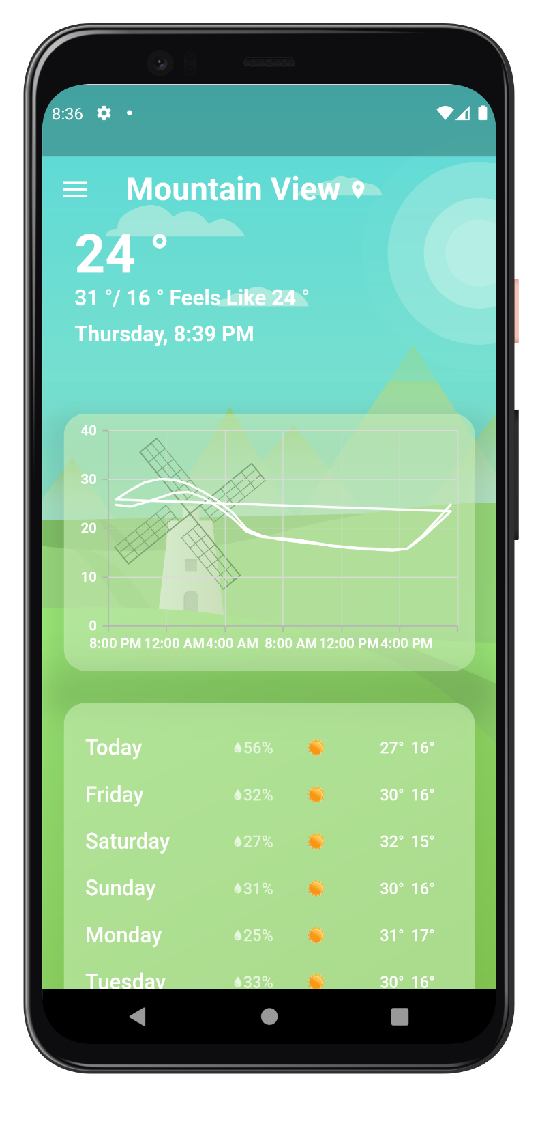
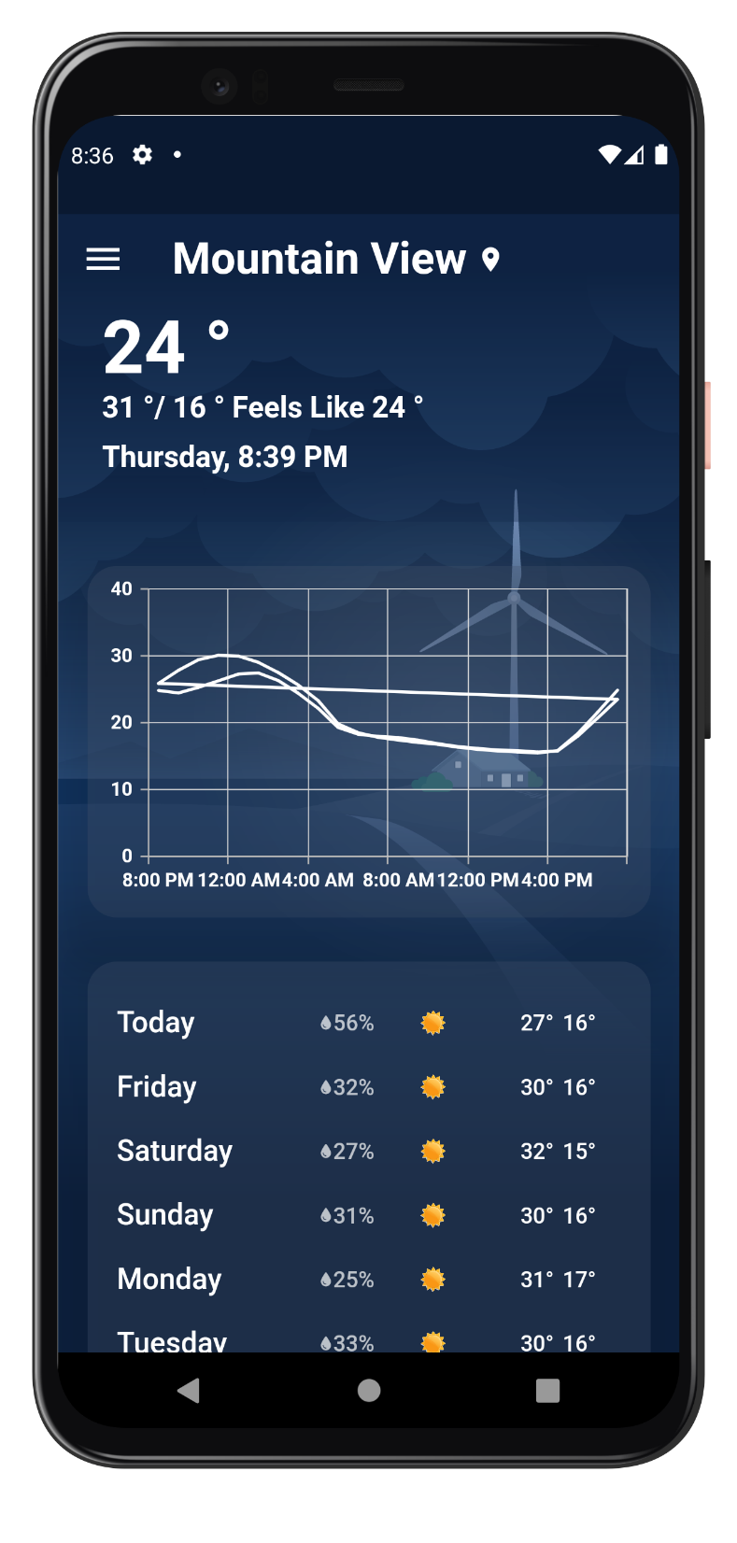
Sample

Slide 9
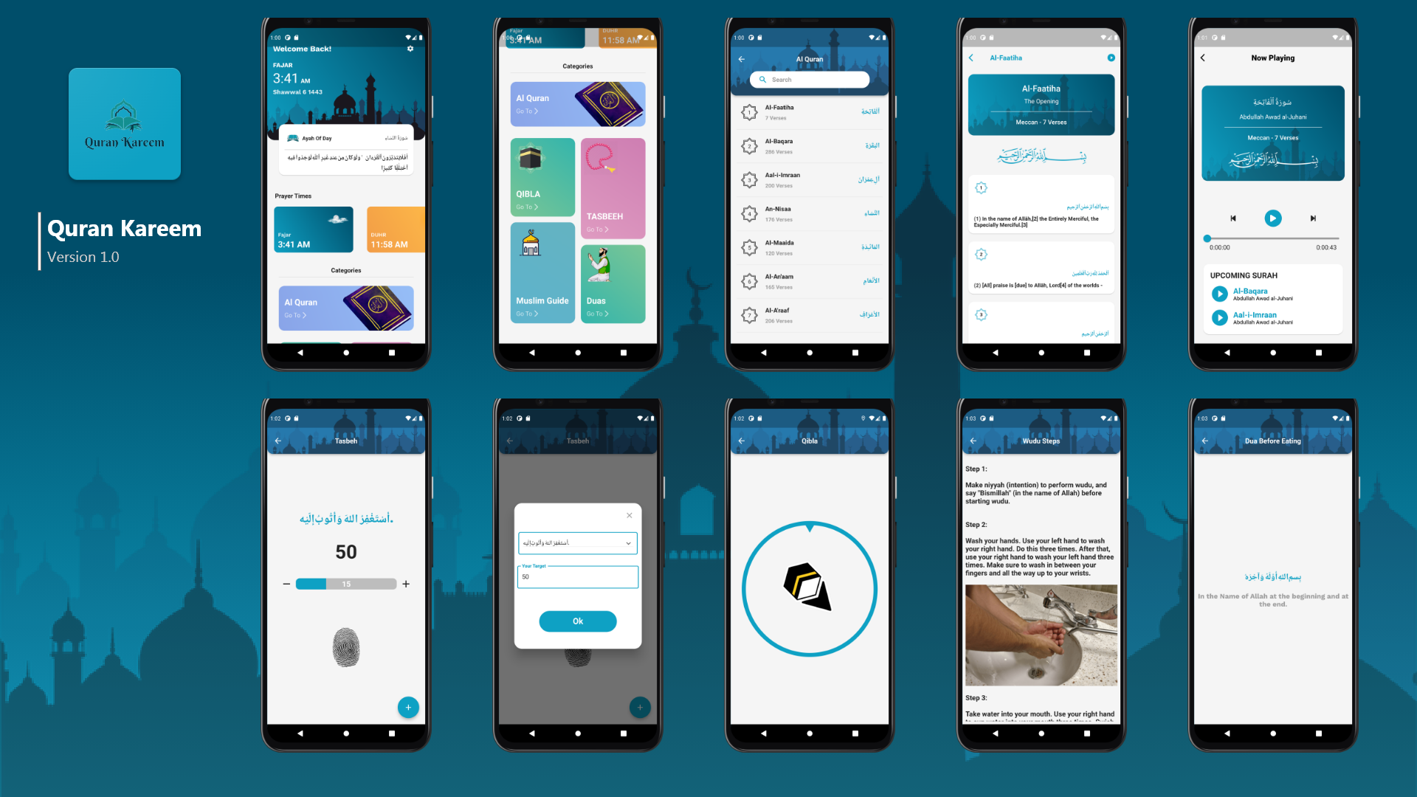

Slide 10
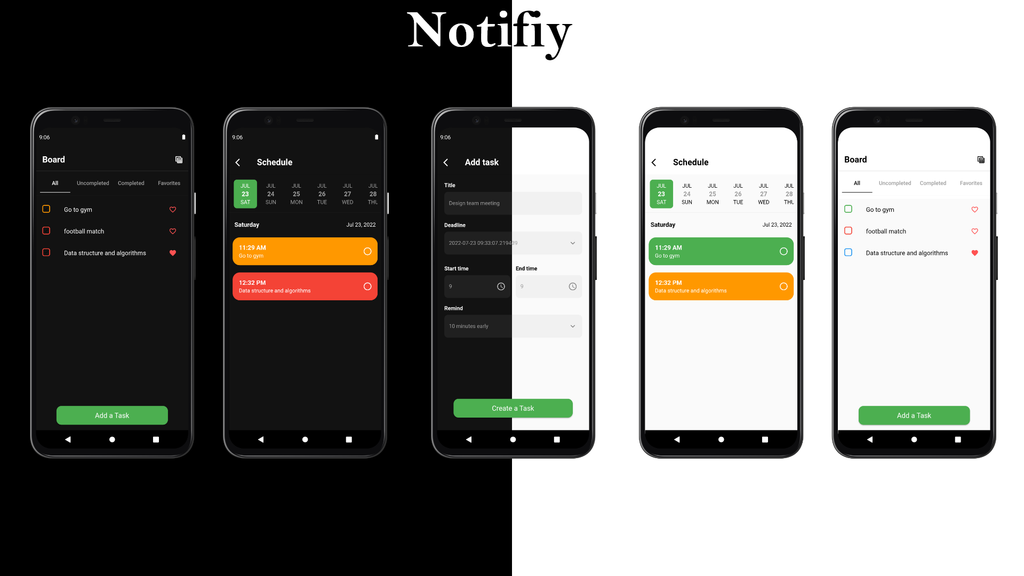

Slide 11
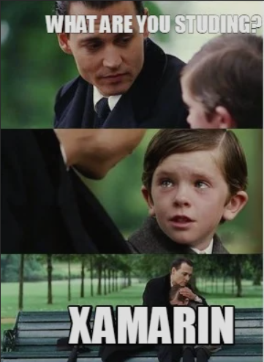
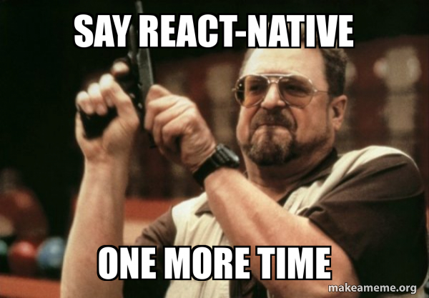
Other Frameworks

Slide 12

Feature of Flutter
Cross Platform App Development.
Easy access to Native Features.
Minimal Coding.
Fast Development
Hot Reload & Hot Restart

Slide 13
Mission
Empower developers to create apps.

Slide 14
Our mission is to empower individuals to embark on a transformative journey from novice to virtuoso in Flutter. We will commence by laying a strong foundation with Dart fundamentals, progressing into a comprehensive exploration of Flutter basics. Our ultimate aim is to enable profound expertise, delving into advanced Flutter topics, software design patterns, and architectural principles. We prioritize cultivating resilient software engineers, transcending the confines of mobile or Flutter development

Slide 15
Vision
Leading cross-platform app innovation.

Slide 16
Our vision is to foster a community of resilient software engineers who excel beyond mobile development. We aspire to equip our learners with the knowledge and skills required to start from scratch and evolve into Flutter experts. By emphasizing clean code and architectural acumen, we aim to create versatile professionals who can tackle any software challenge, transcending the boundaries of a typical mobile or Flutter developer.

Slide 17
Roadmap
Roadmap for Dart Language

Slide 18
Flutter
Weeks | Topics
Week 1 | Introduction to Flutter
Week 2 | Flutter UI Part1
Week 3 | Flutter UI Part2
Week 4 | Flutter UI Part 3
Week 5 | Folder Structure, Custom Widgets, Reusable components, Themes, Animations
Week 6 | Routes

Slide 19
Flutter
Weeks | Topics
Week 7 | Slivers
Week 8 | Responsive ( Flutter Web, desktop, and macos)
Week 9 | Firebase Part 1
Week 10 | Firebase Part 2
Week 11 | Firebase Part 3

Slide 20
What is Next ?

Slide 21



Thank You

