Slide 1


Slide 2


Slide 3


Slide 4
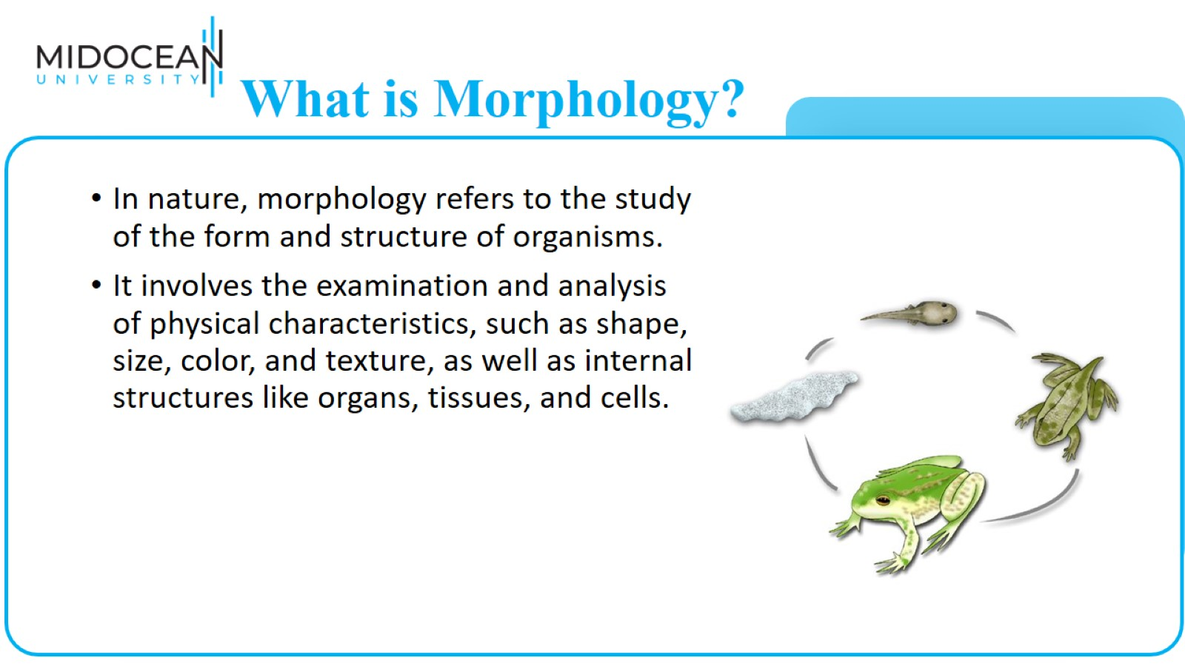
What is Morphology?

Slide 5
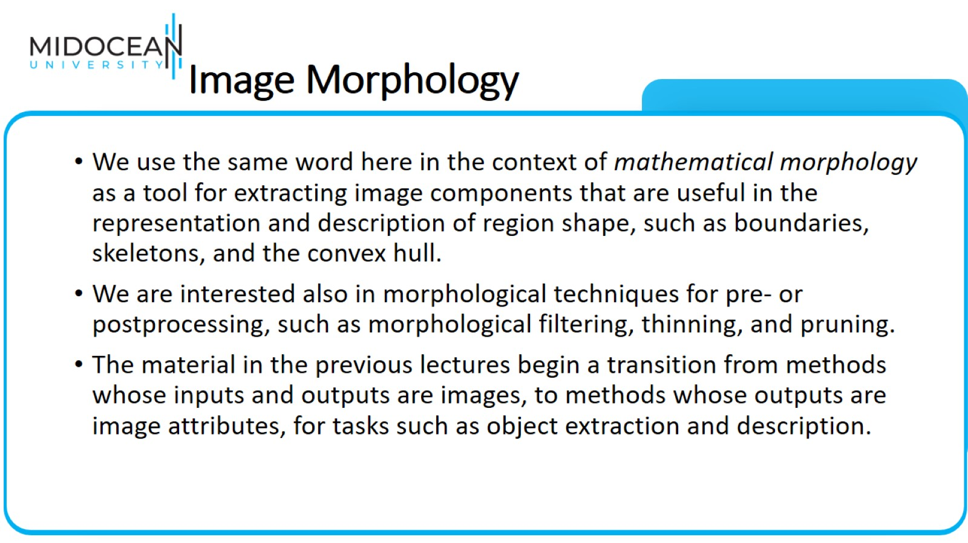
Image Morphology

Slide 6
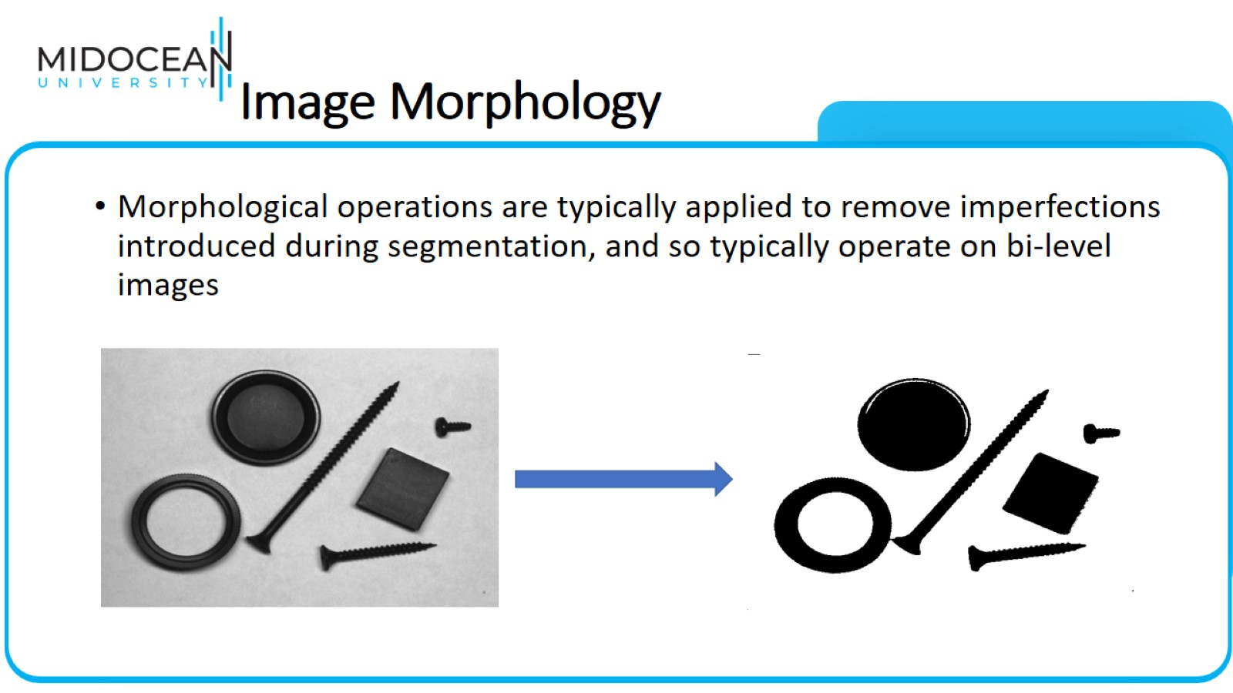
Image Morphology

Slide 7
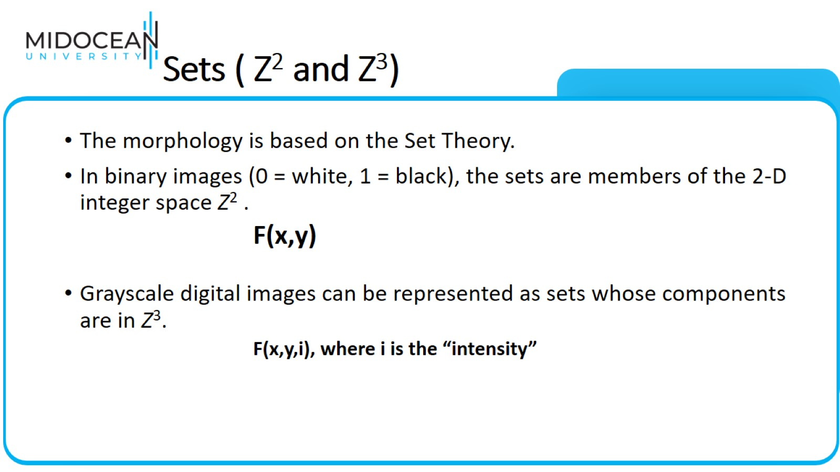
Sets ( Z² and Z³)

Slide 8
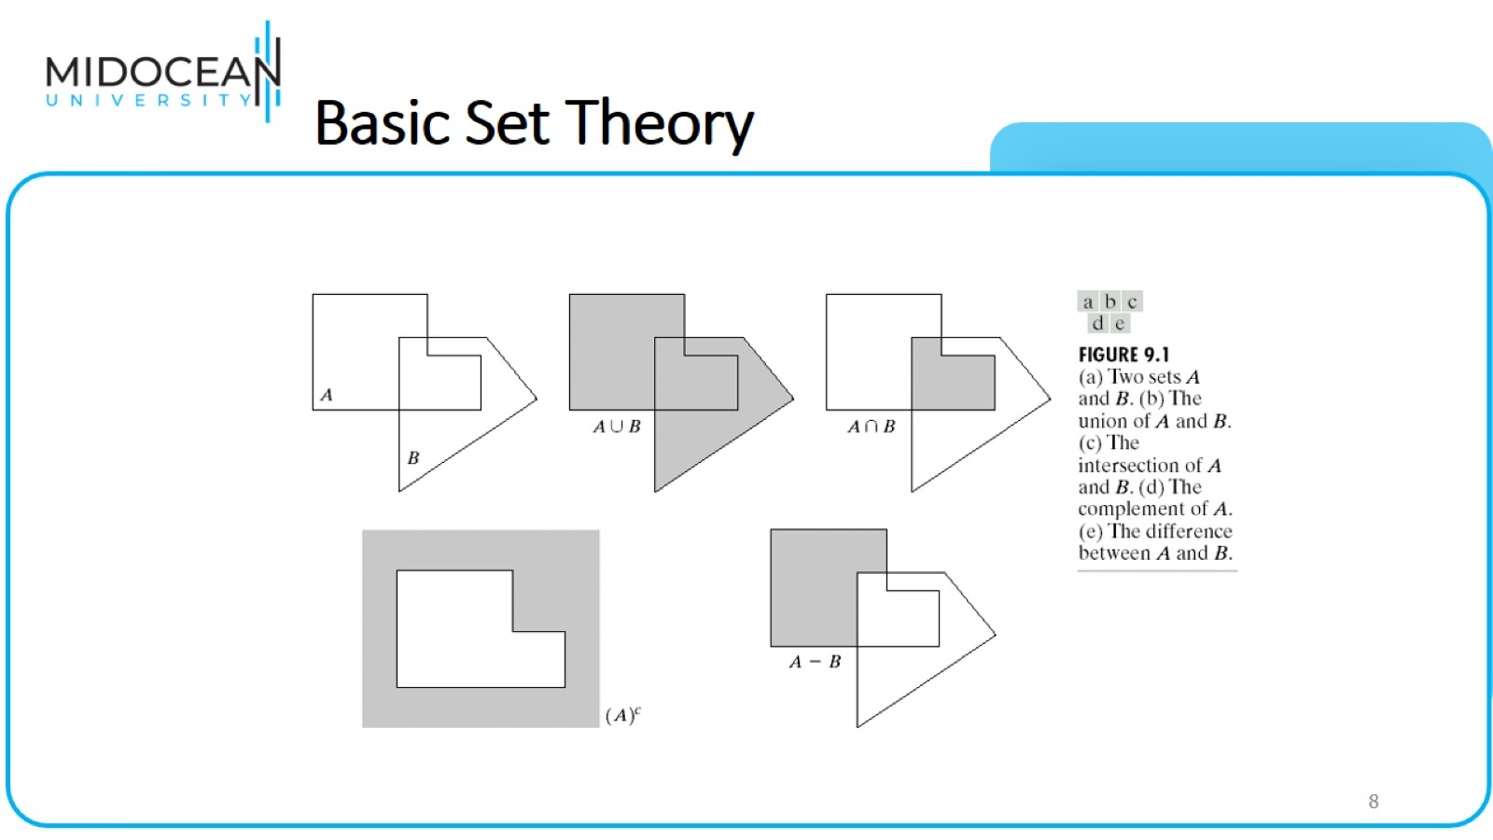
Basic Set Theory

Slide 9
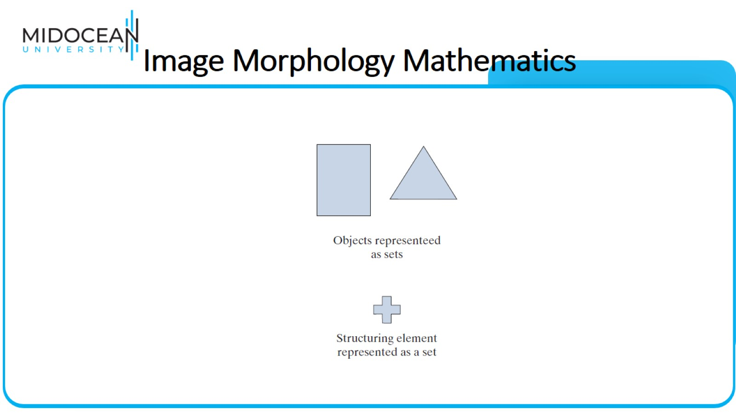
Image Morphology Mathematics

Slide 10
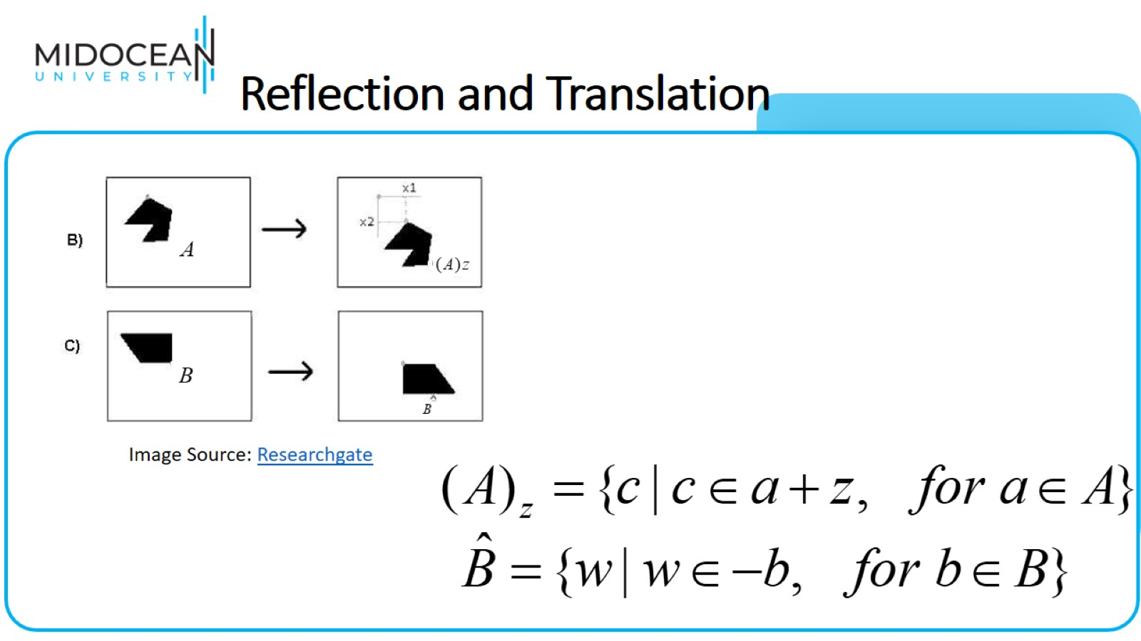
Reflection and Translation

Slide 11
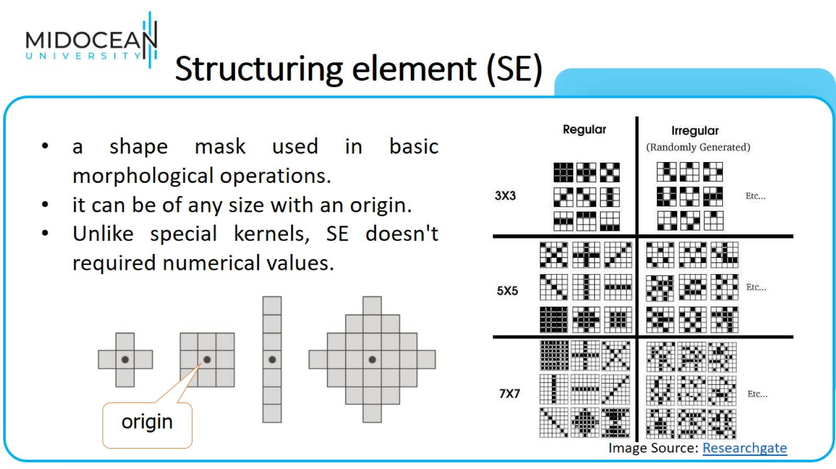
Structuring element (SE)

Slide 12
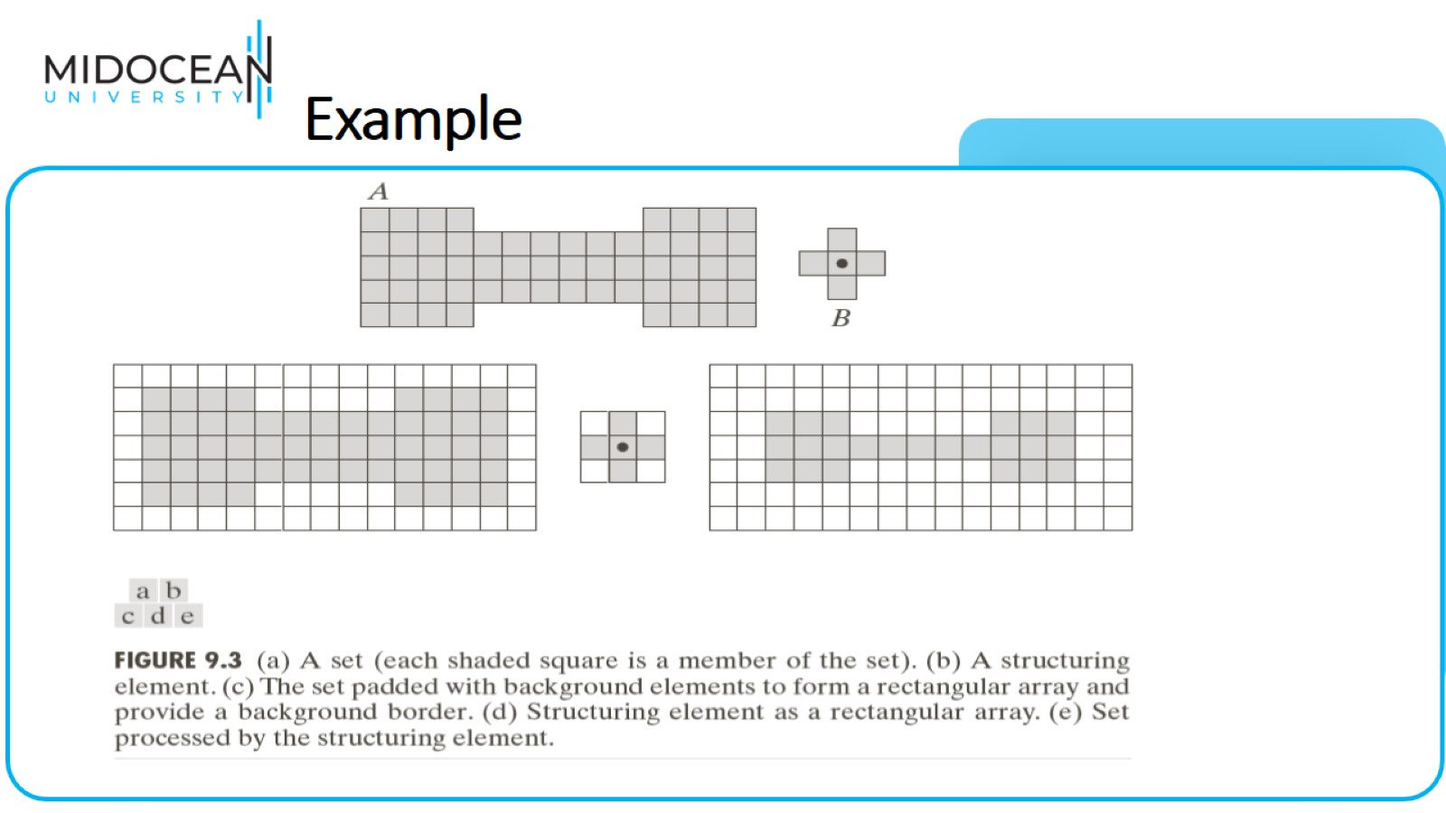
Example

Slide 13
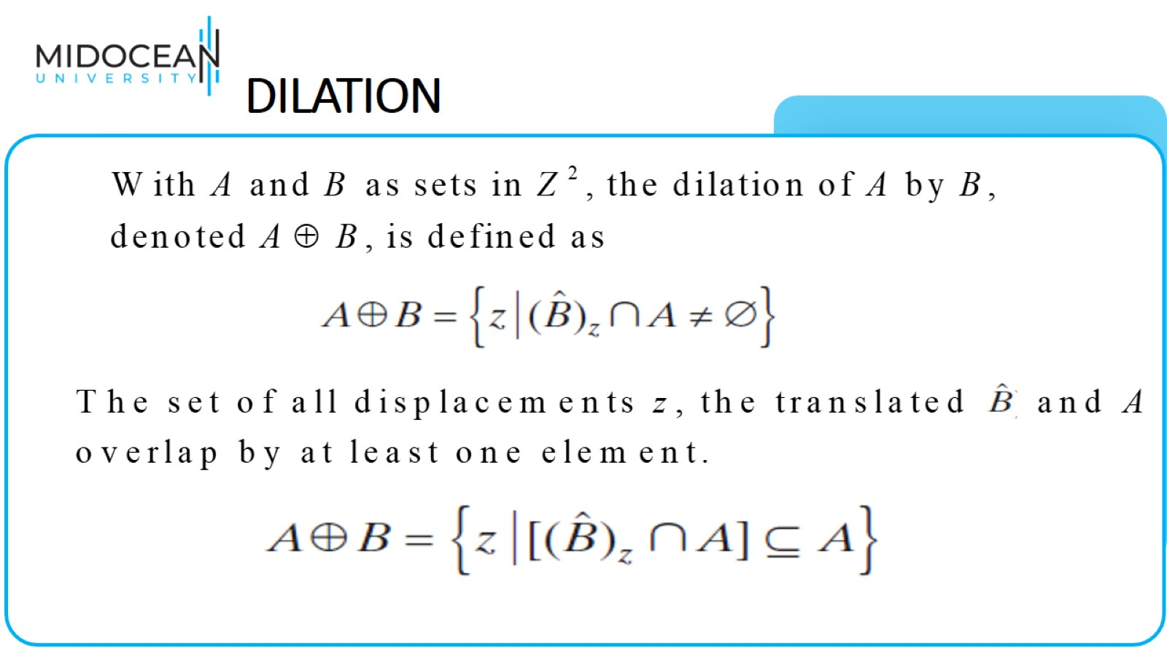
DILATION

Slide 14
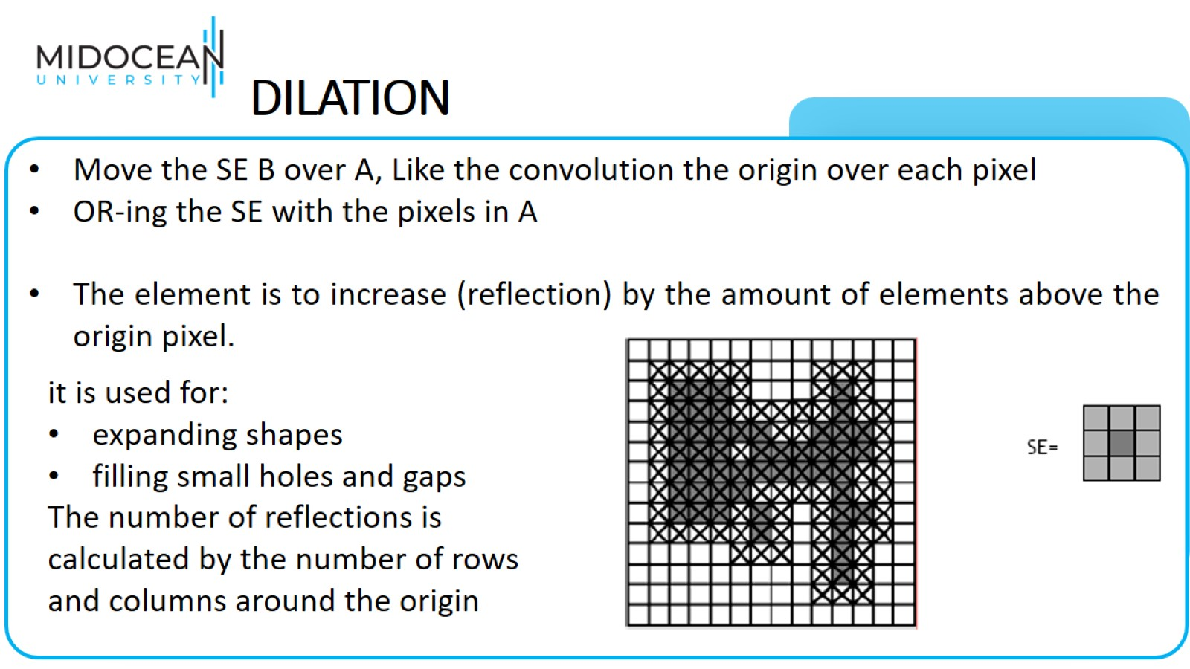
DILATION

Slide 15
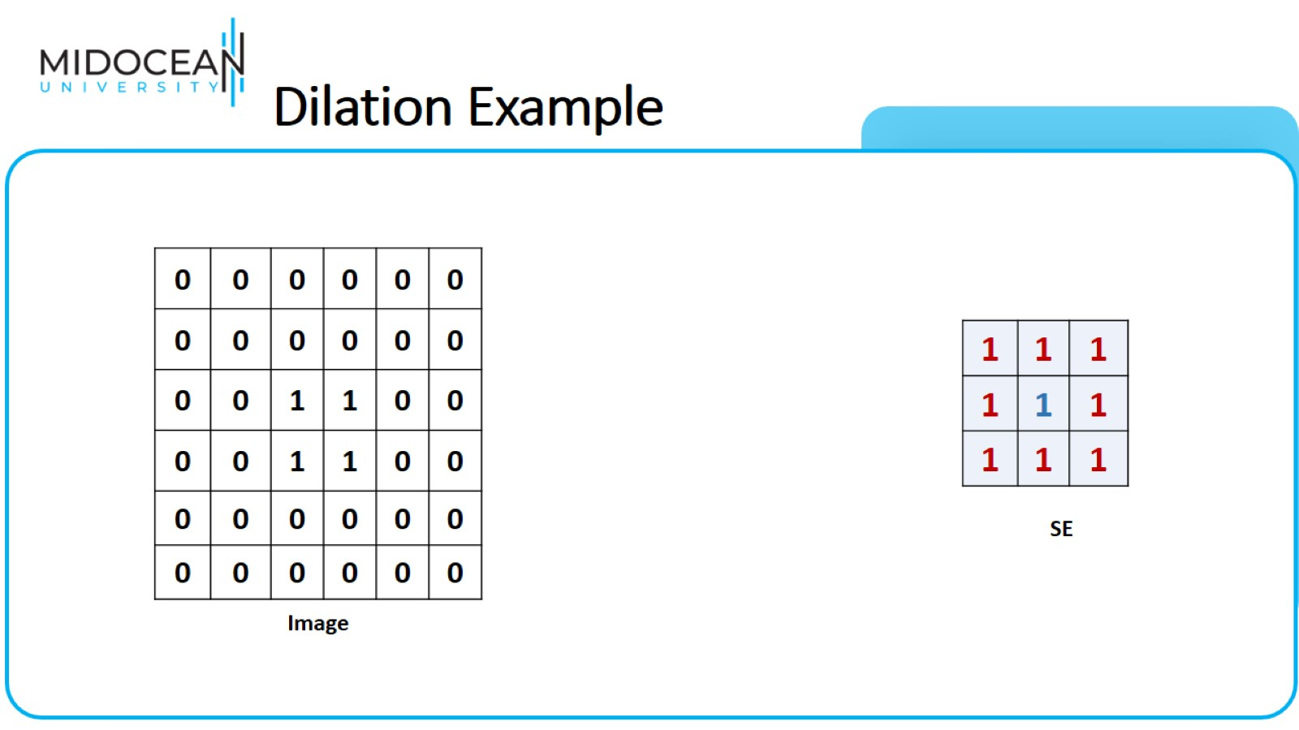
Dilation Example

Slide 16
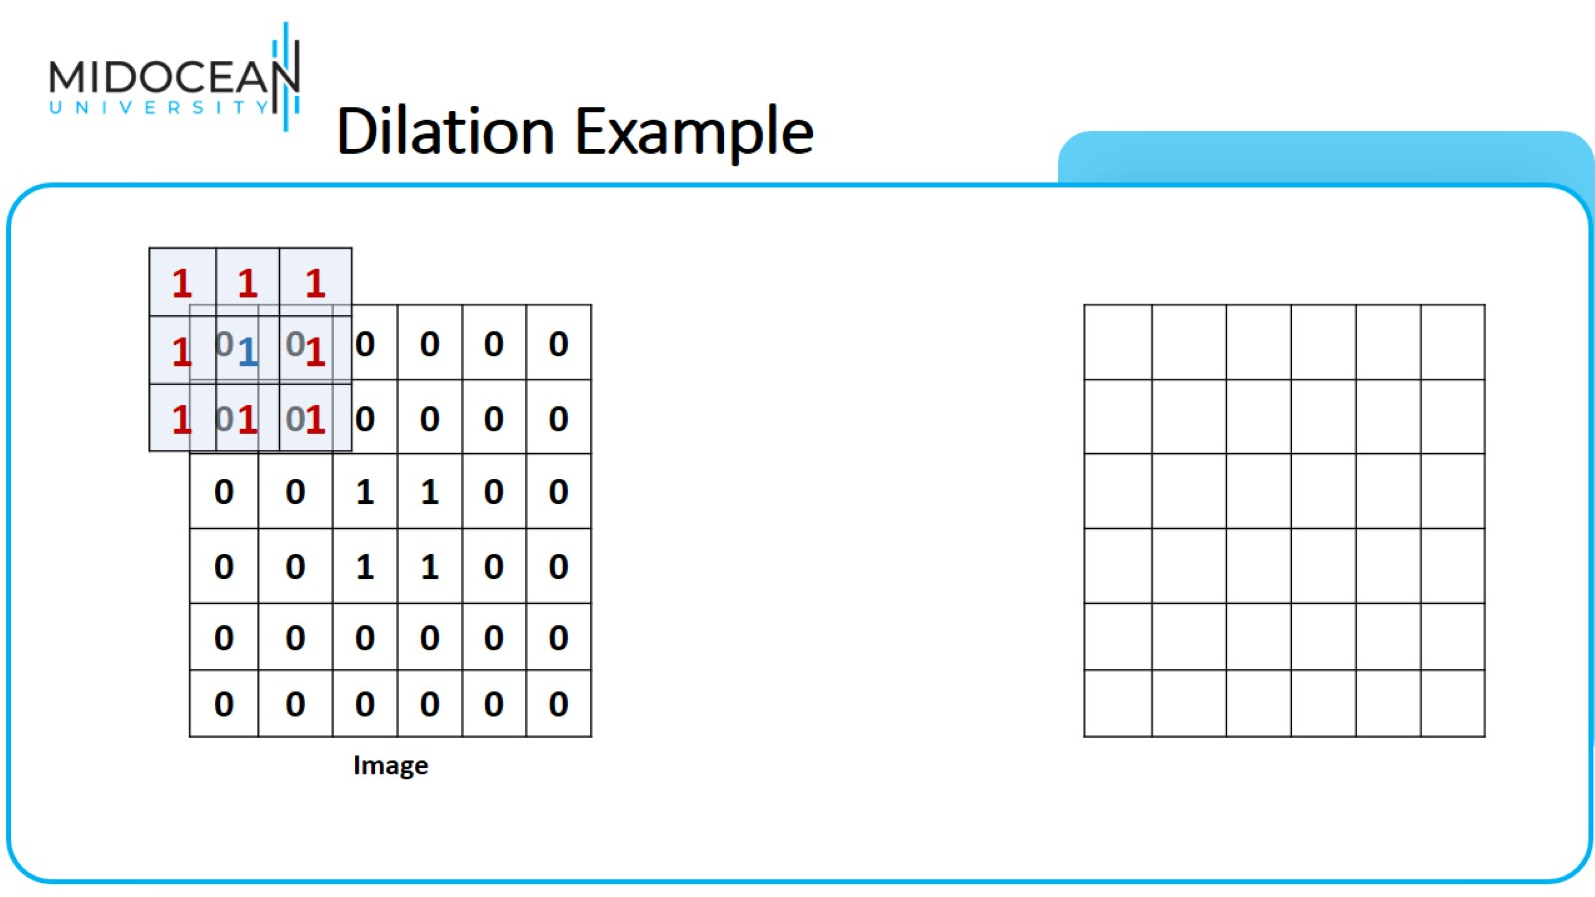
Dilation Example

Slide 17

Dilation Example

Slide 18
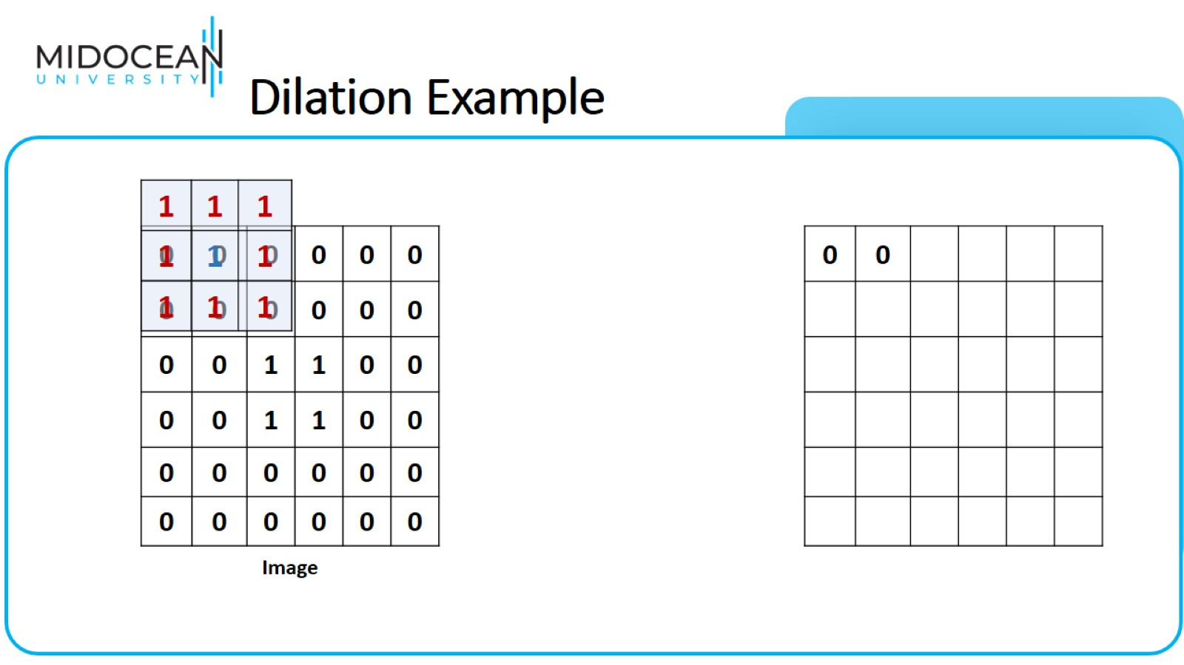
Dilation Example

Slide 19
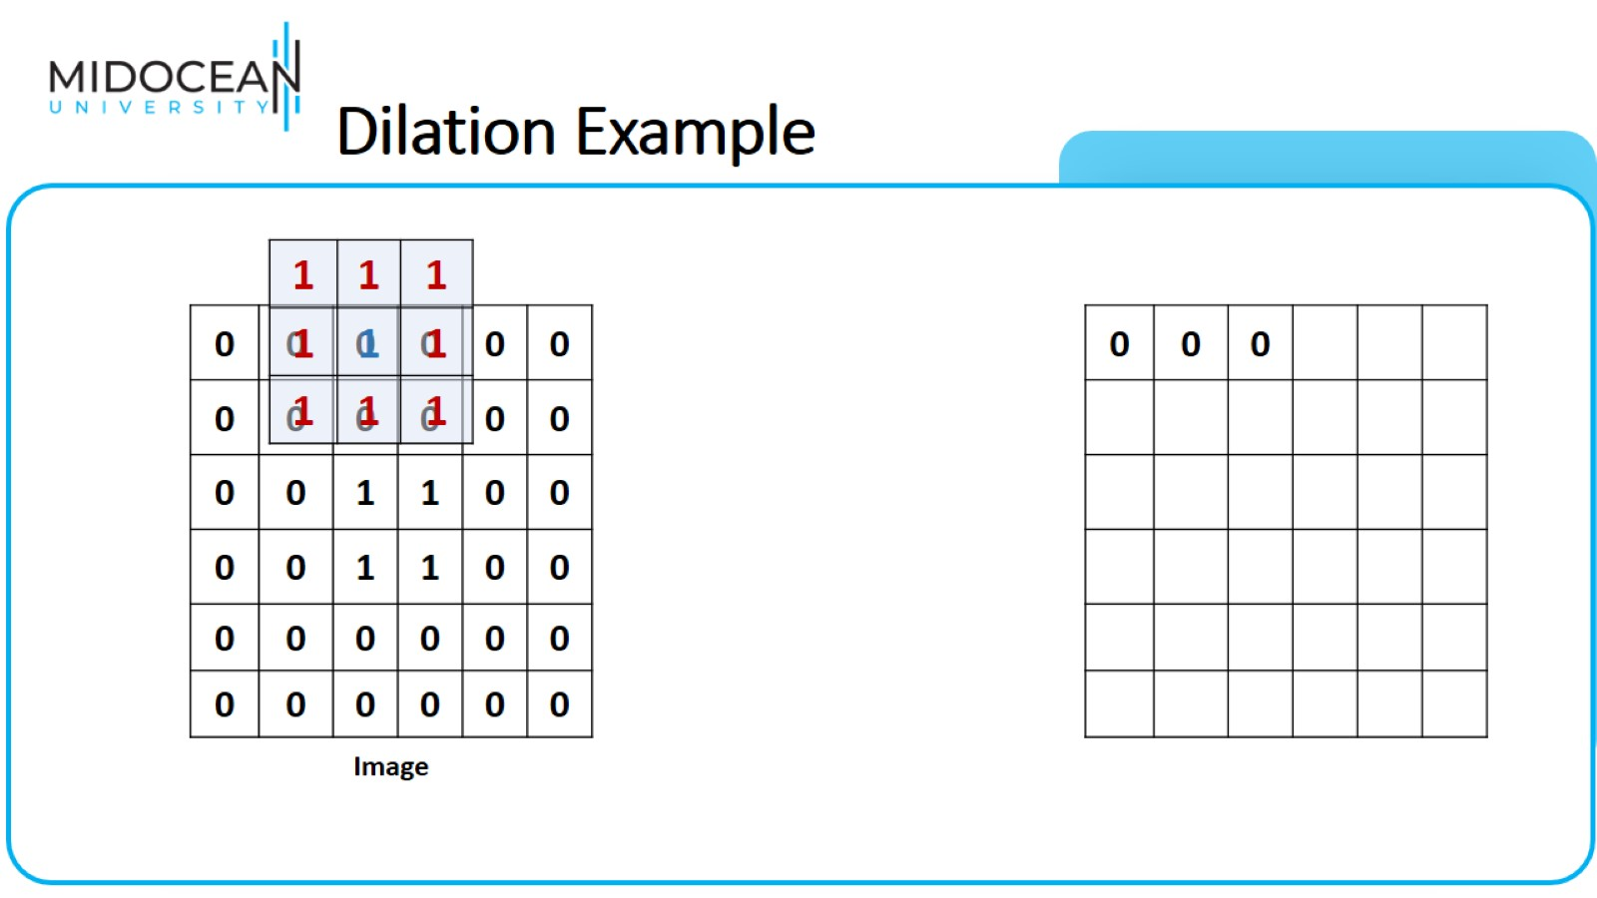
Dilation Example

Slide 20
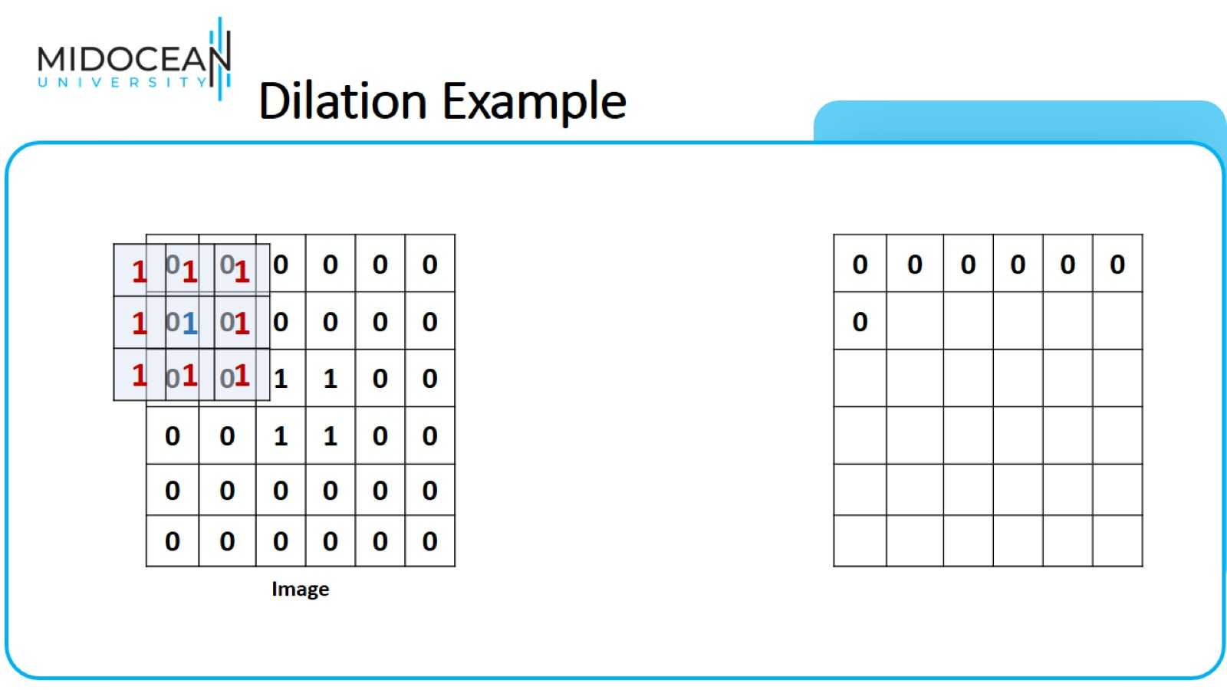
Dilation Example

Slide 21
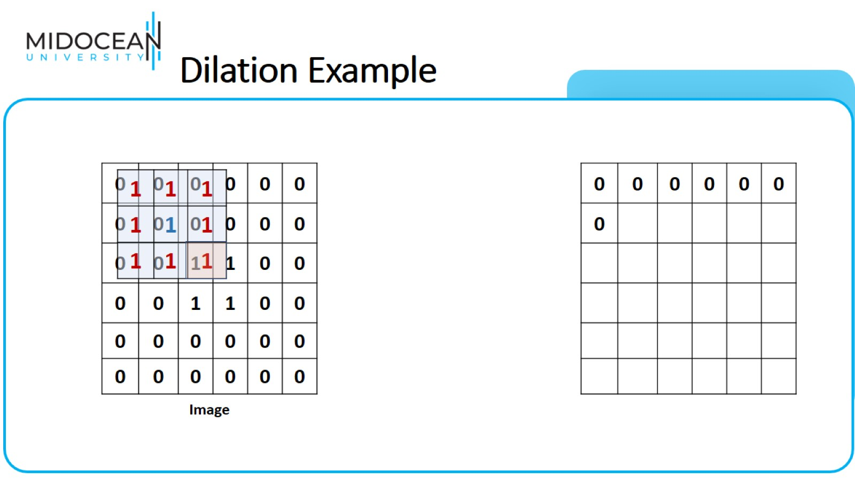
Dilation Example

Slide 22

Dilation Example

Slide 23
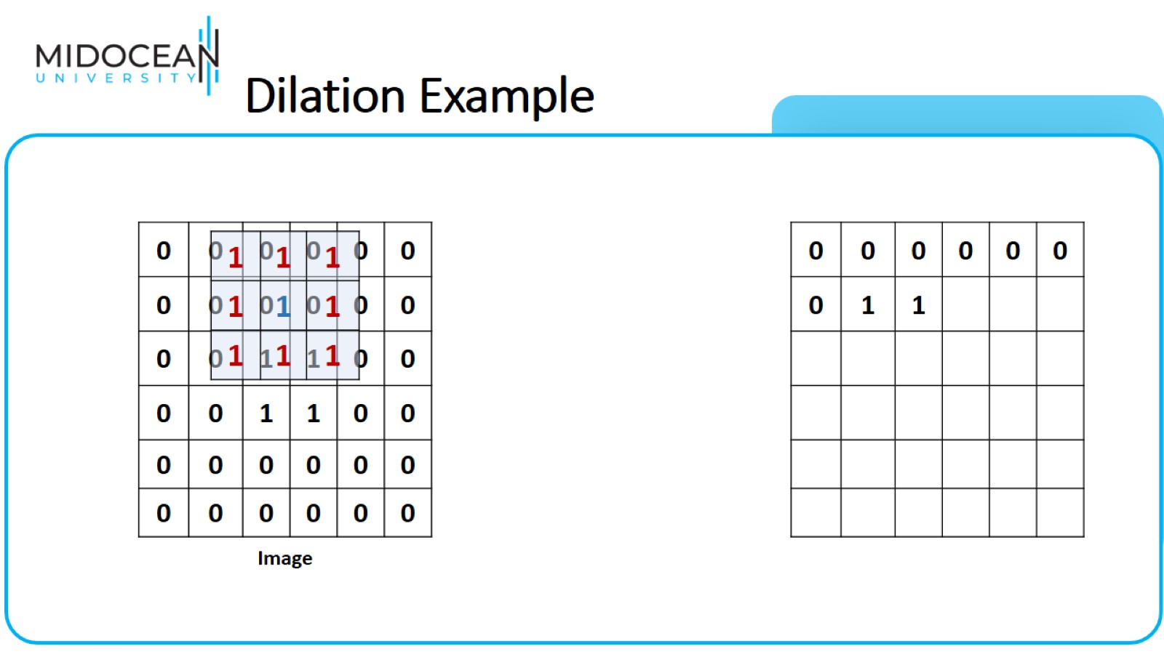
Dilation Example

Slide 24
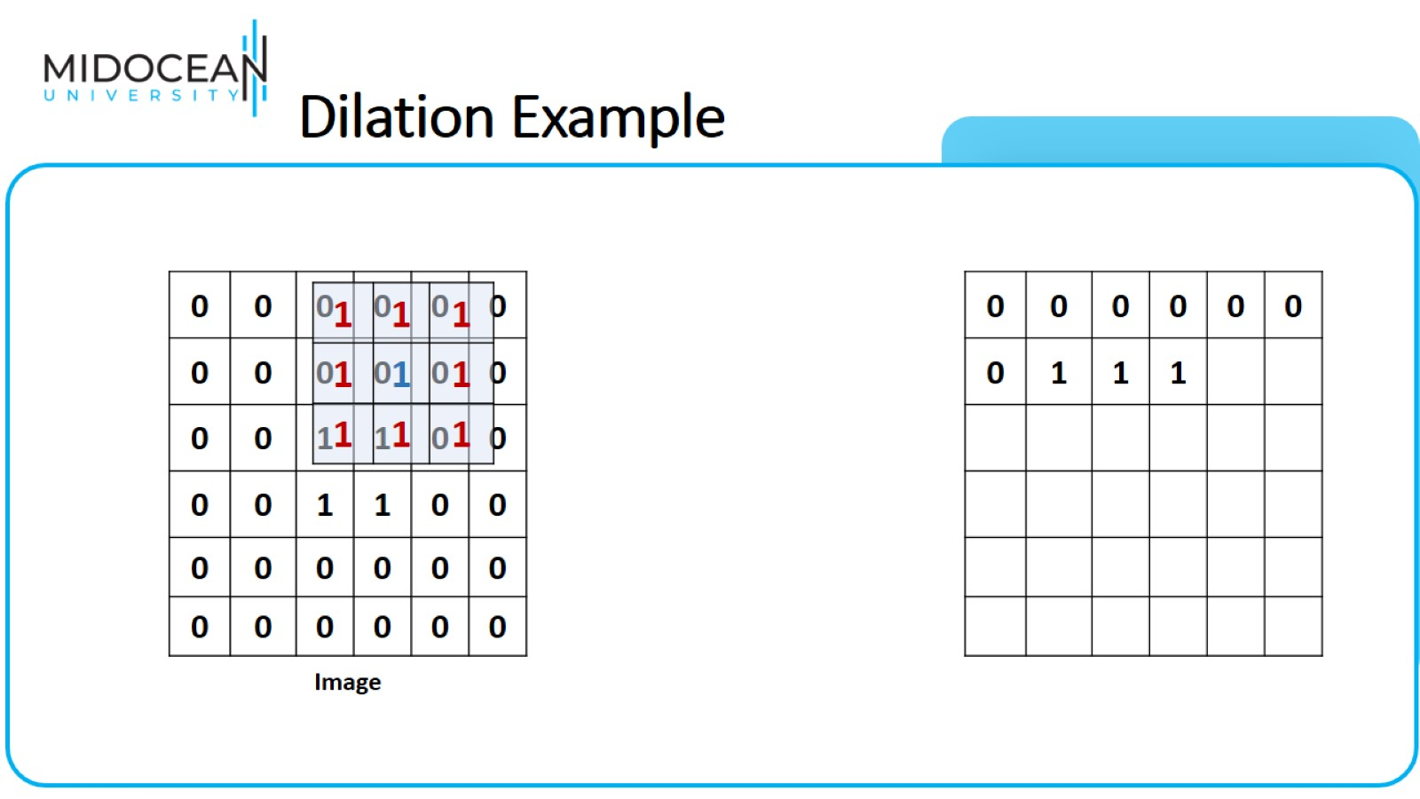
Dilation Example

Slide 25
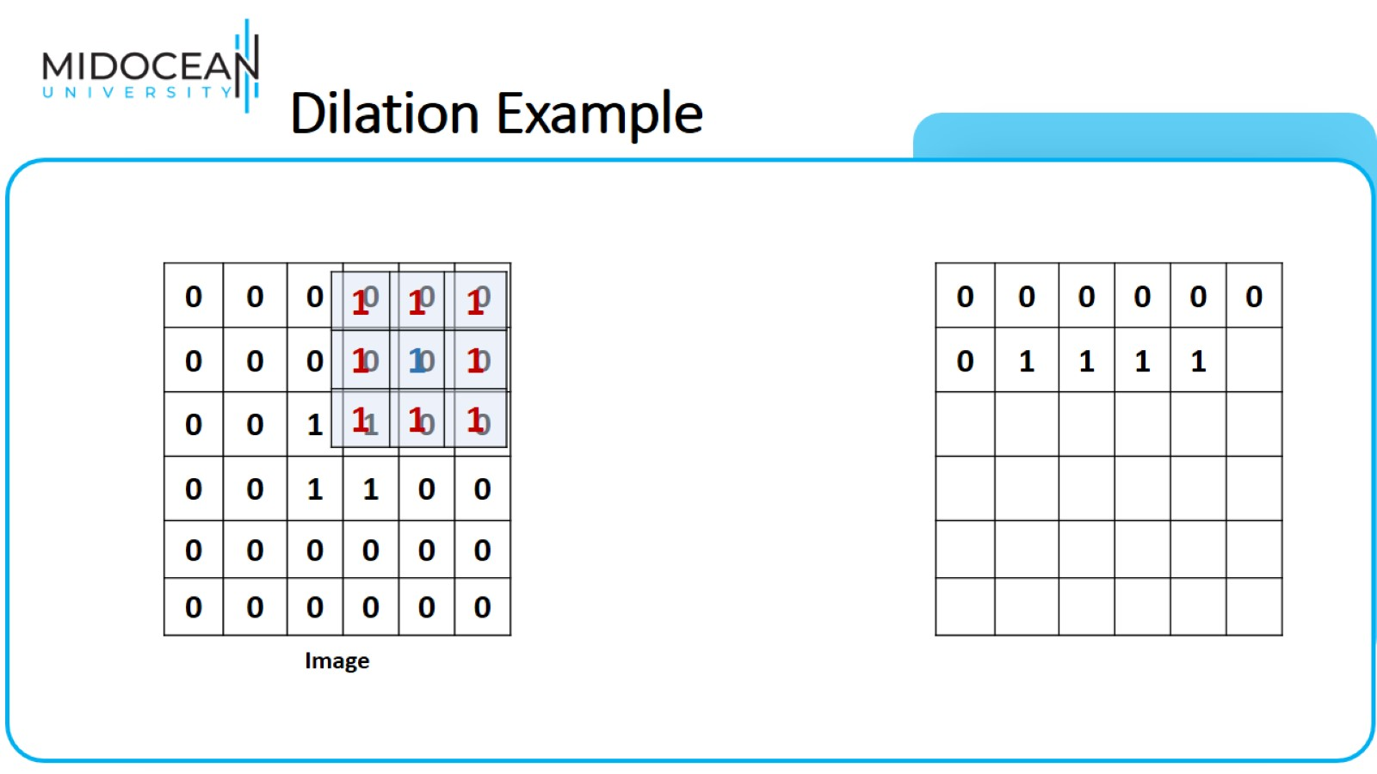
Dilation Example

Slide 26
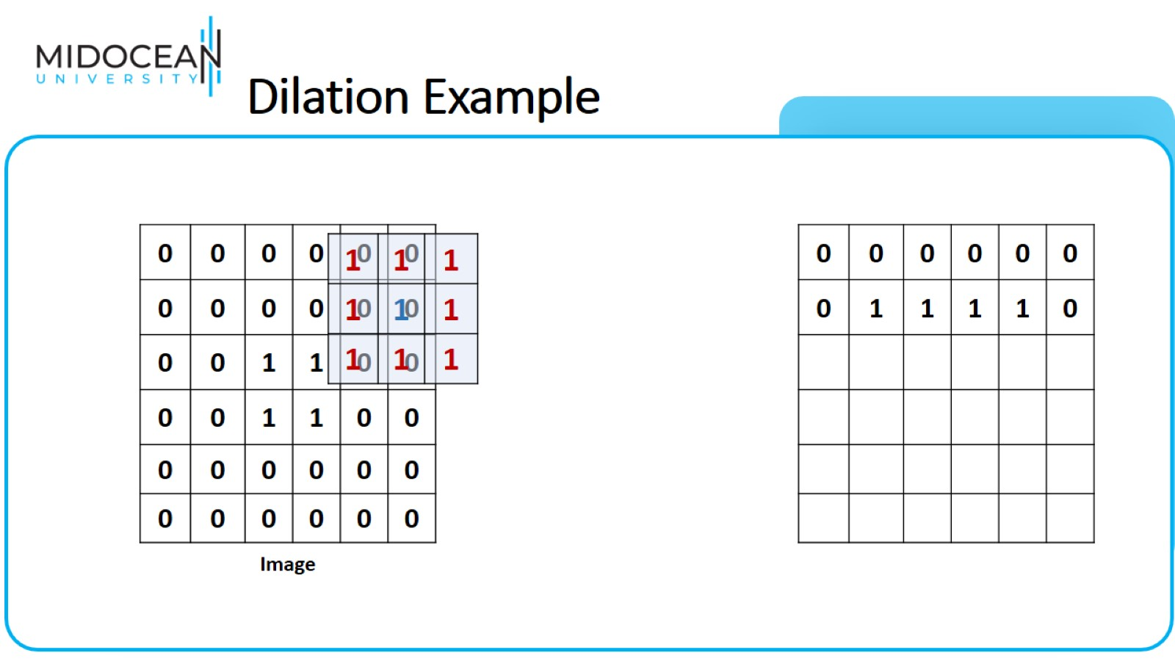
Dilation Example

Slide 27
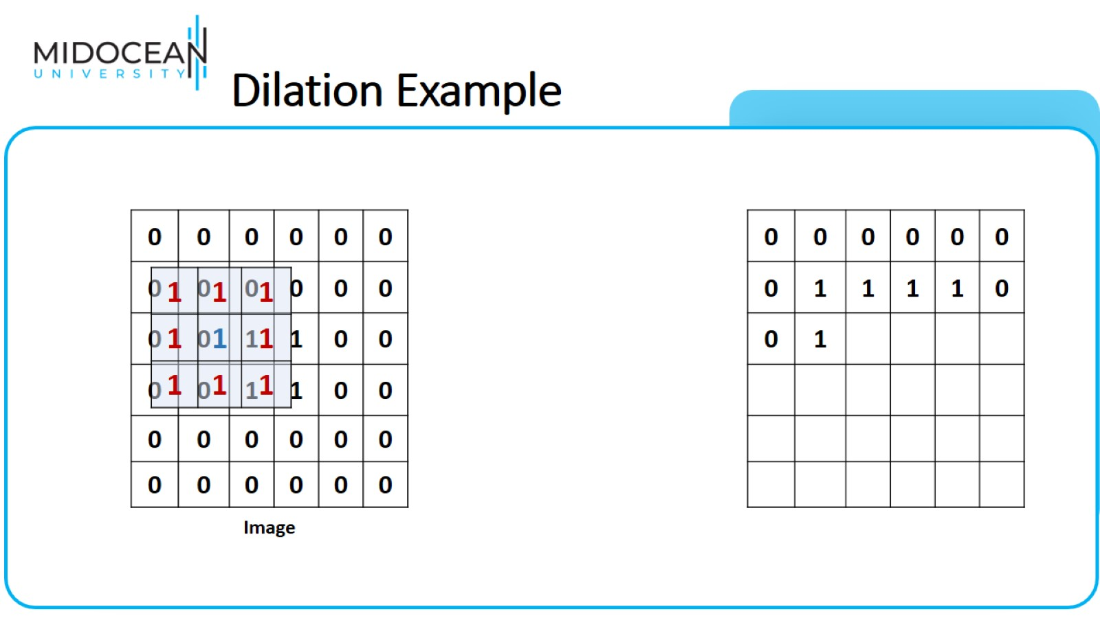
Dilation Example

Slide 28
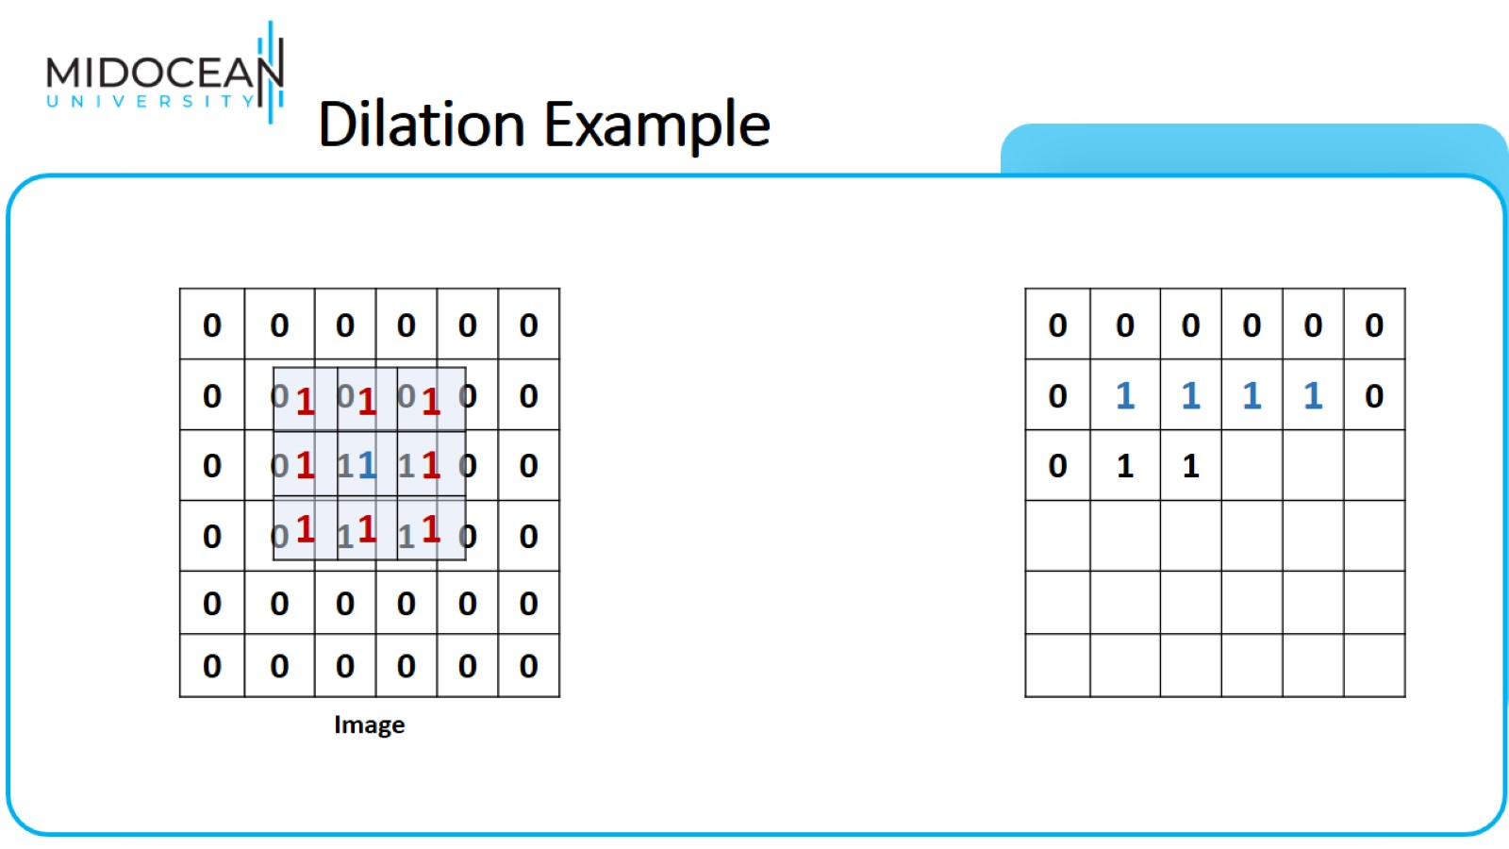
Dilation Example

Slide 29
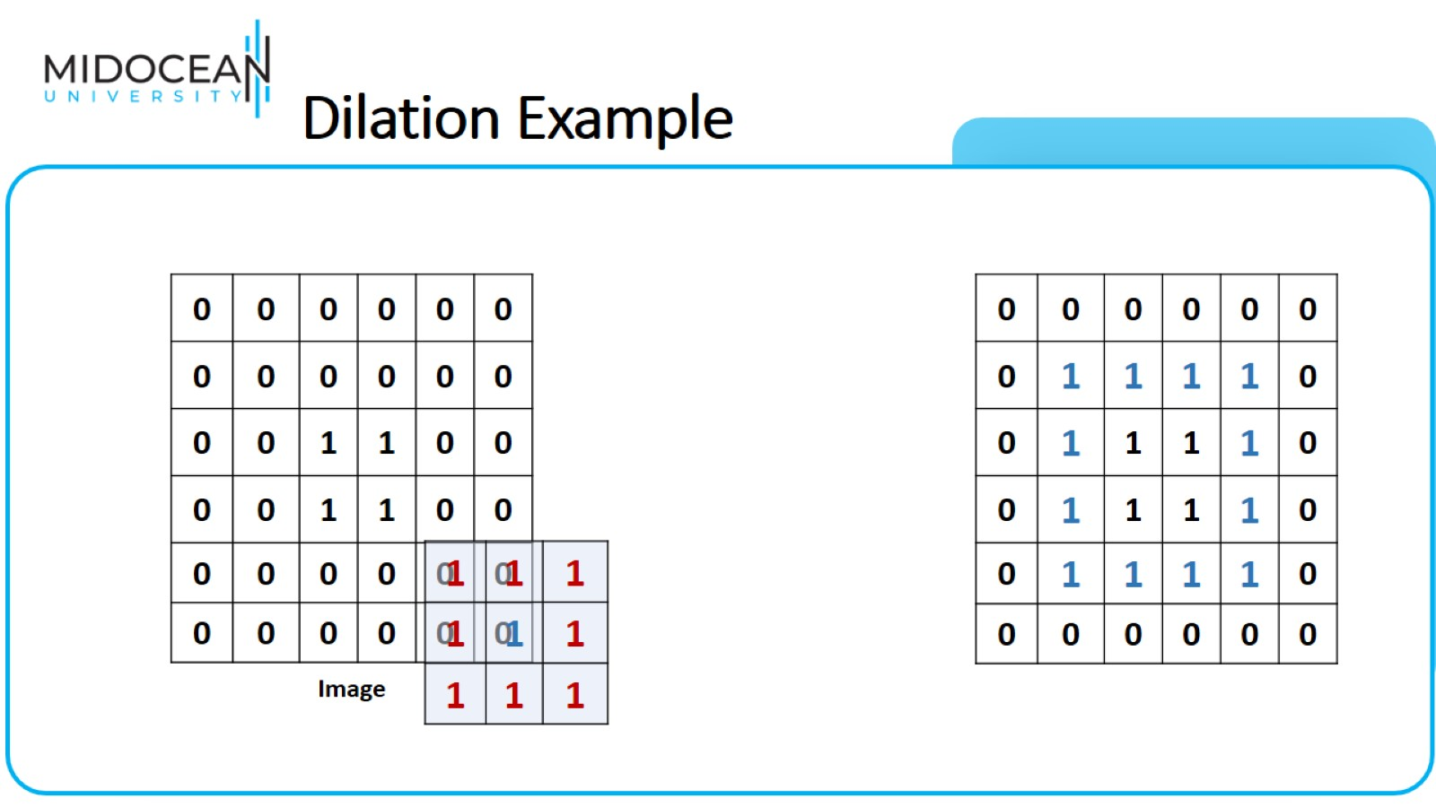
Dilation Example

Slide 30
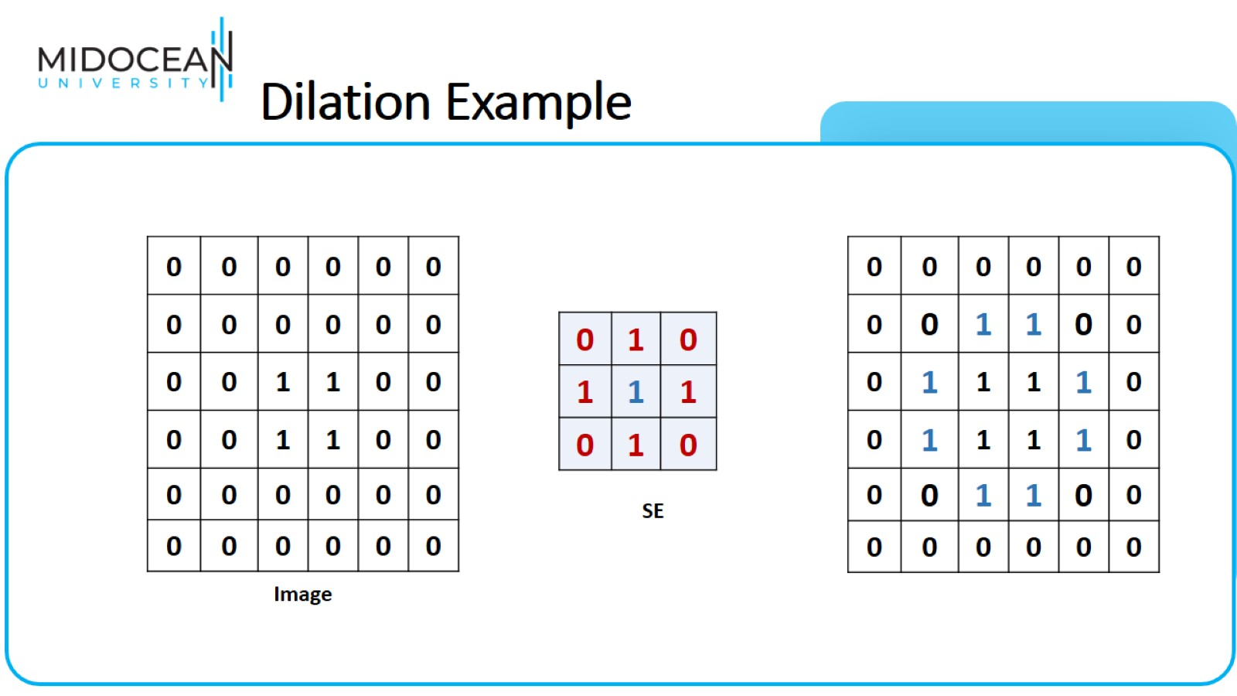
Dilation Example

Slide 31
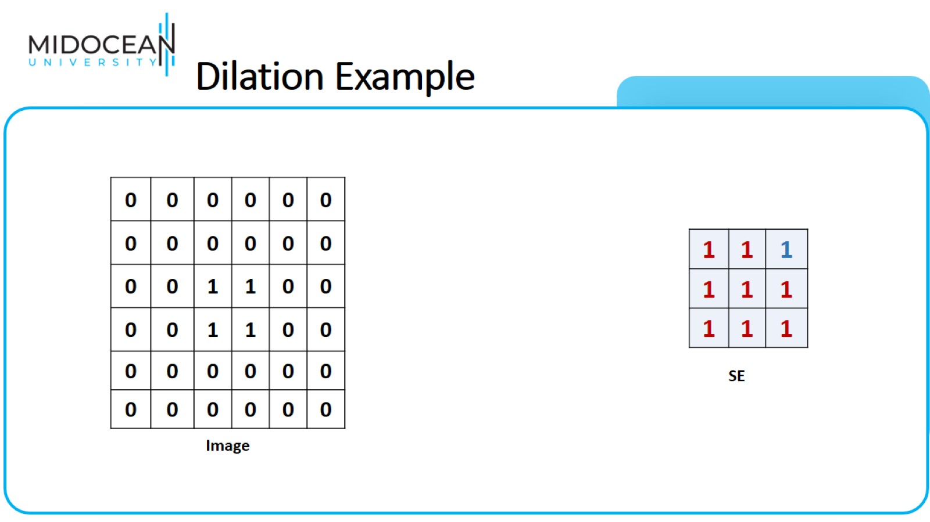
Dilation Example

Slide 32
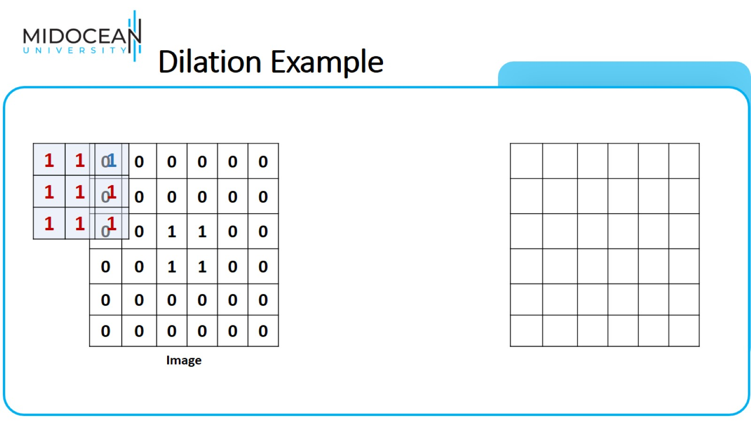
Dilation Example

Slide 33
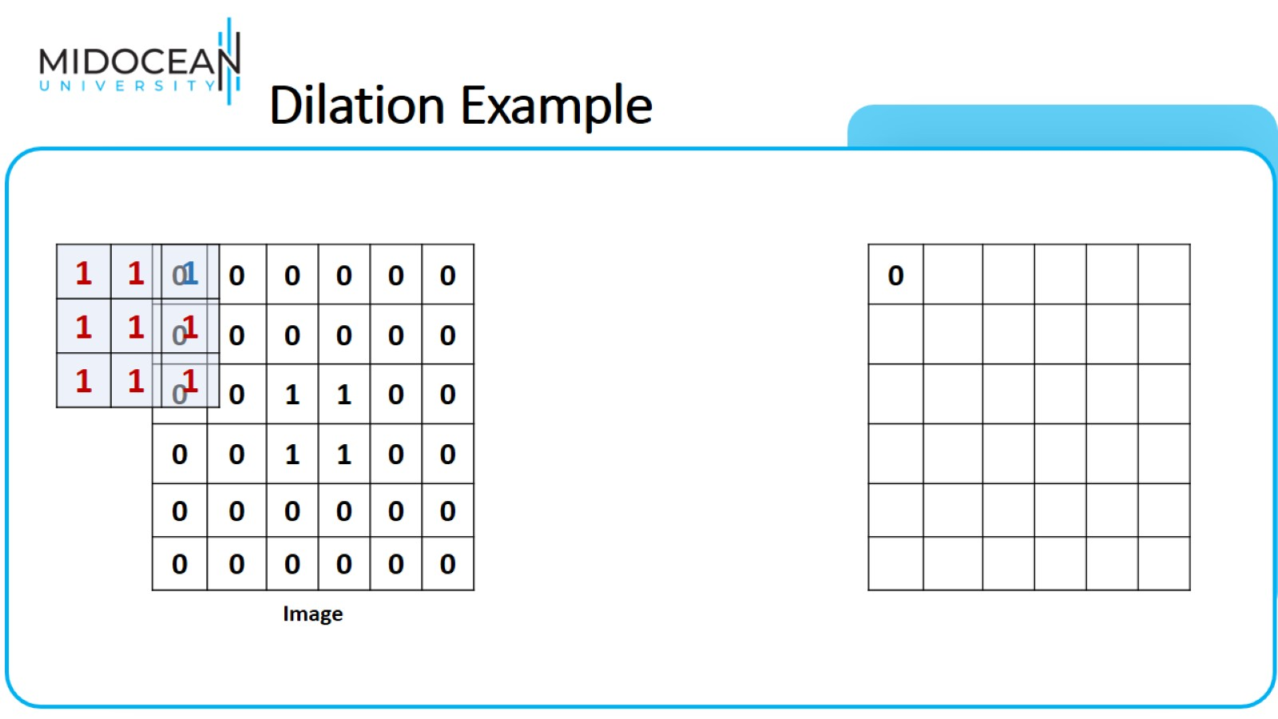
Dilation Example

Slide 34
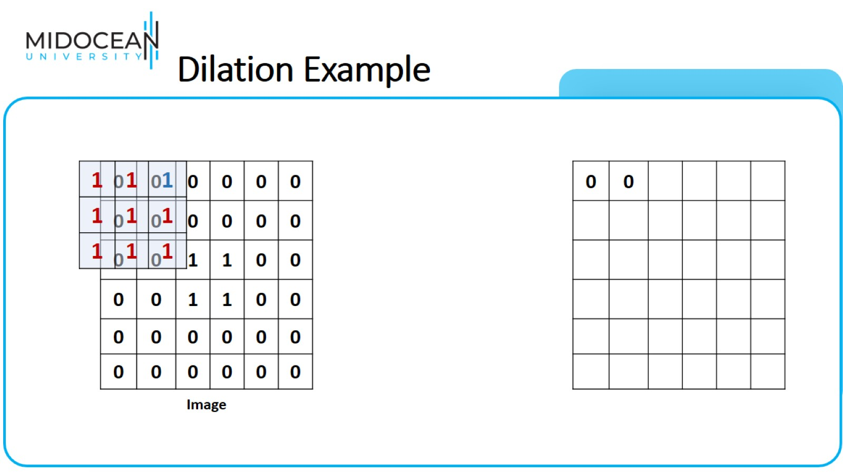
Dilation Example

Slide 35
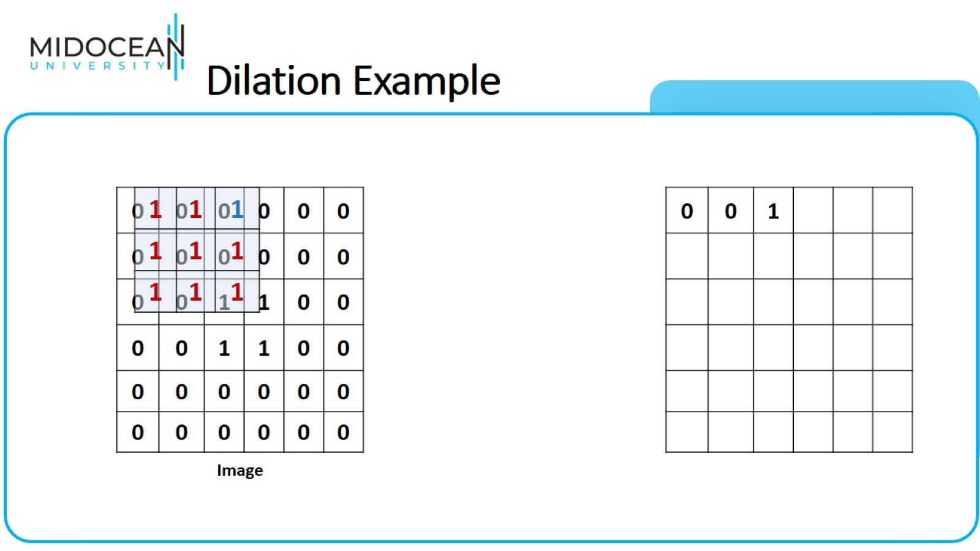
Dilation Example

Slide 36
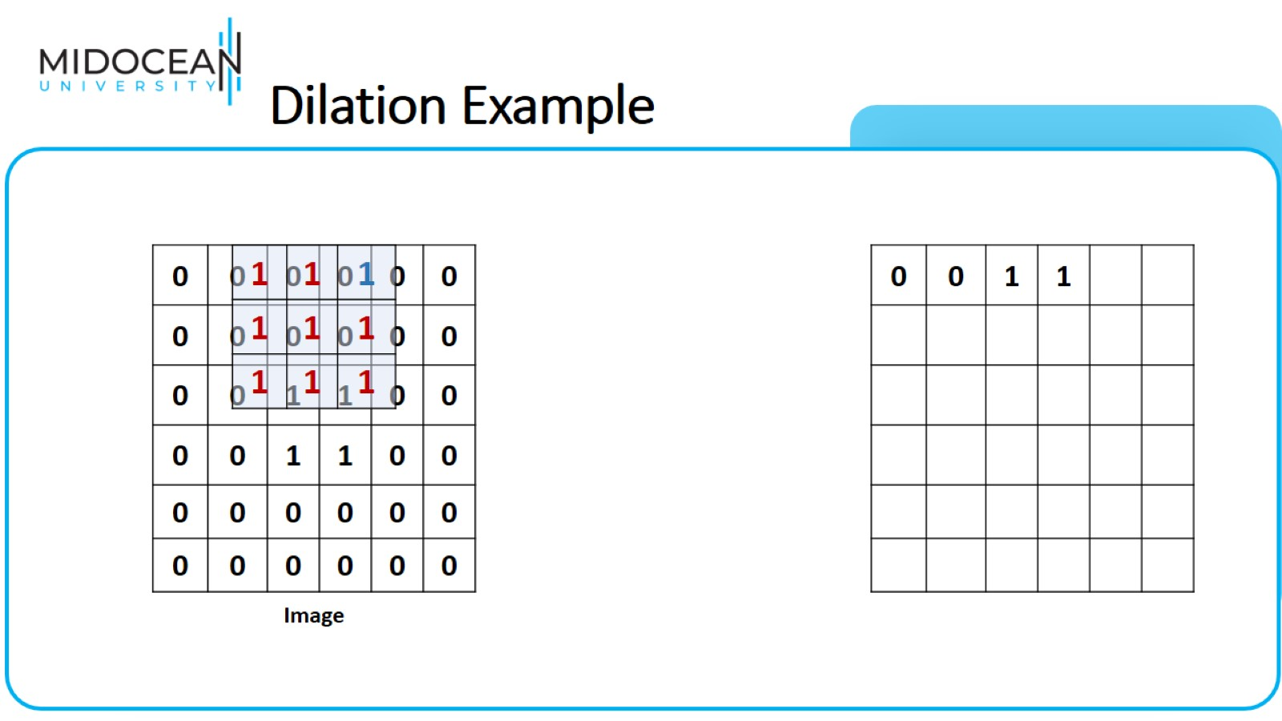
Dilation Example

Slide 37
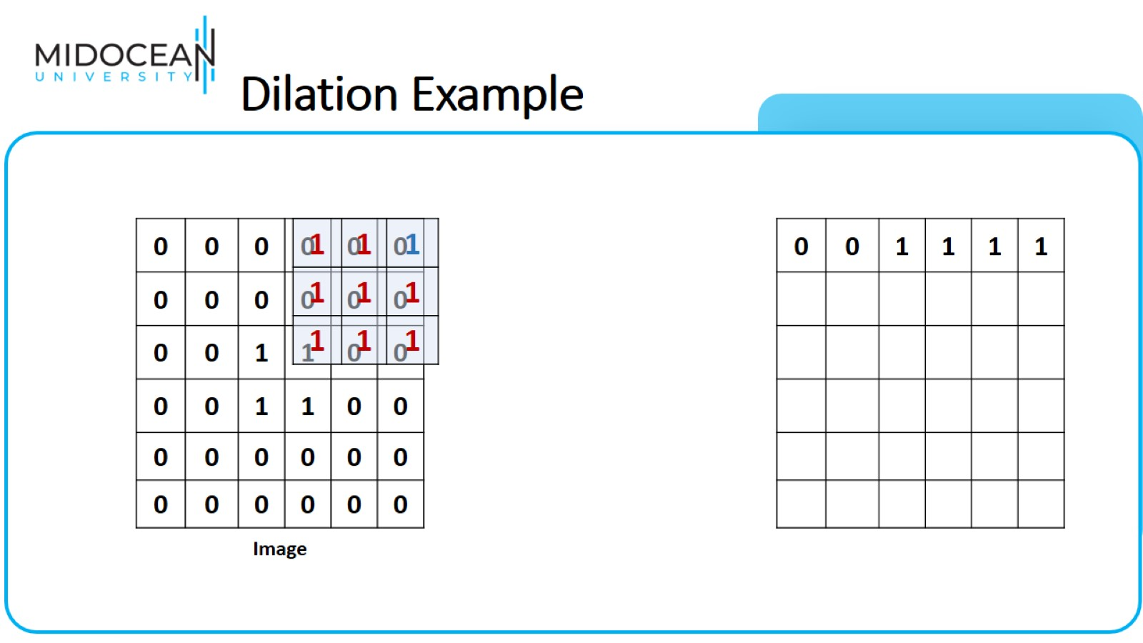
Dilation Example

Slide 38
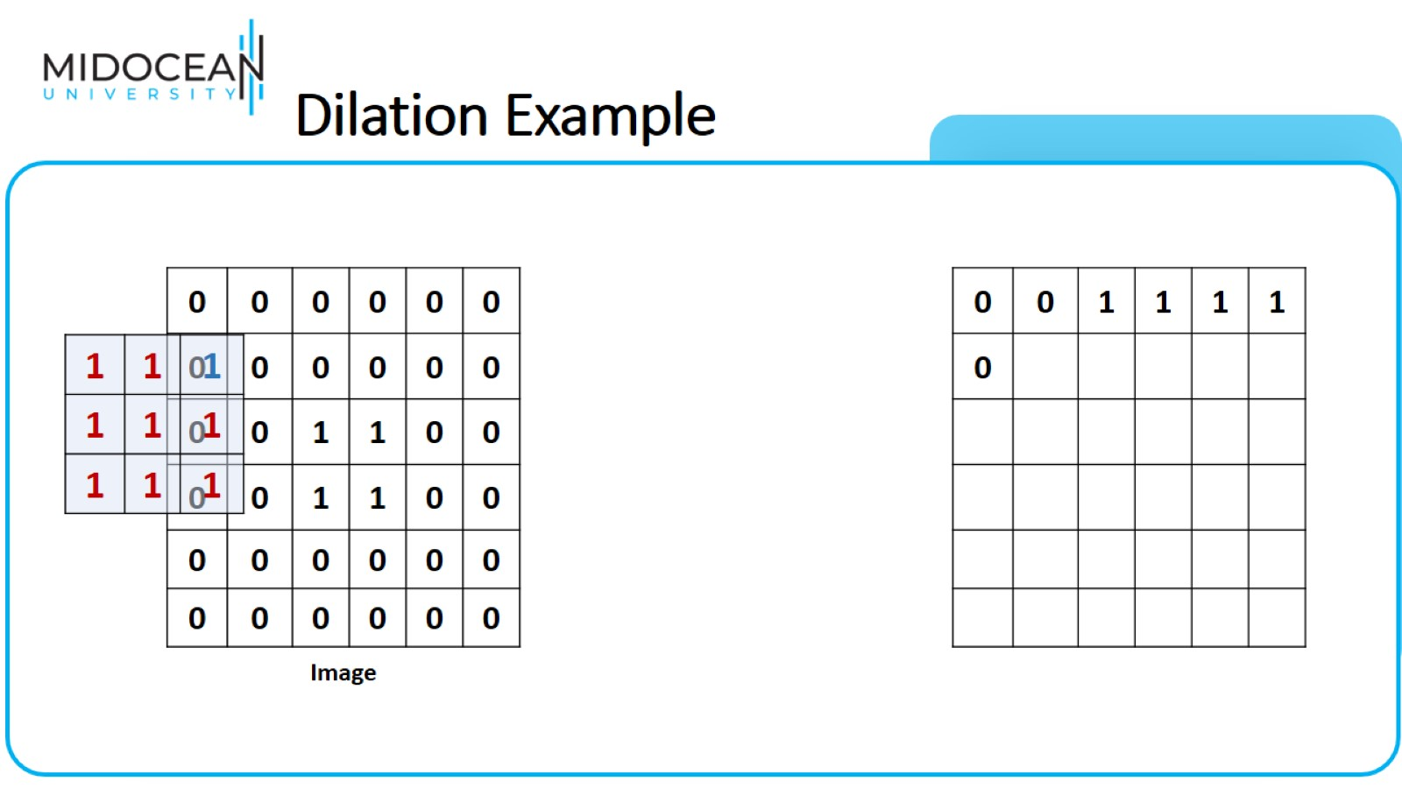
Dilation Example

Slide 39
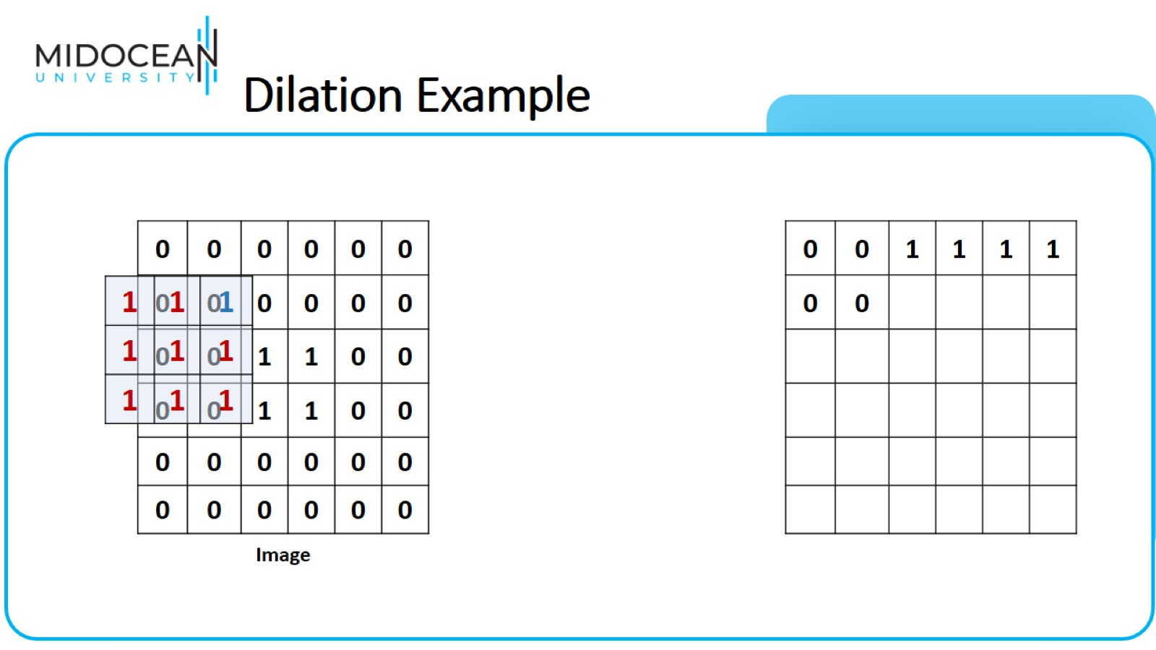
Dilation Example

Slide 40

Dilation Example

Slide 41
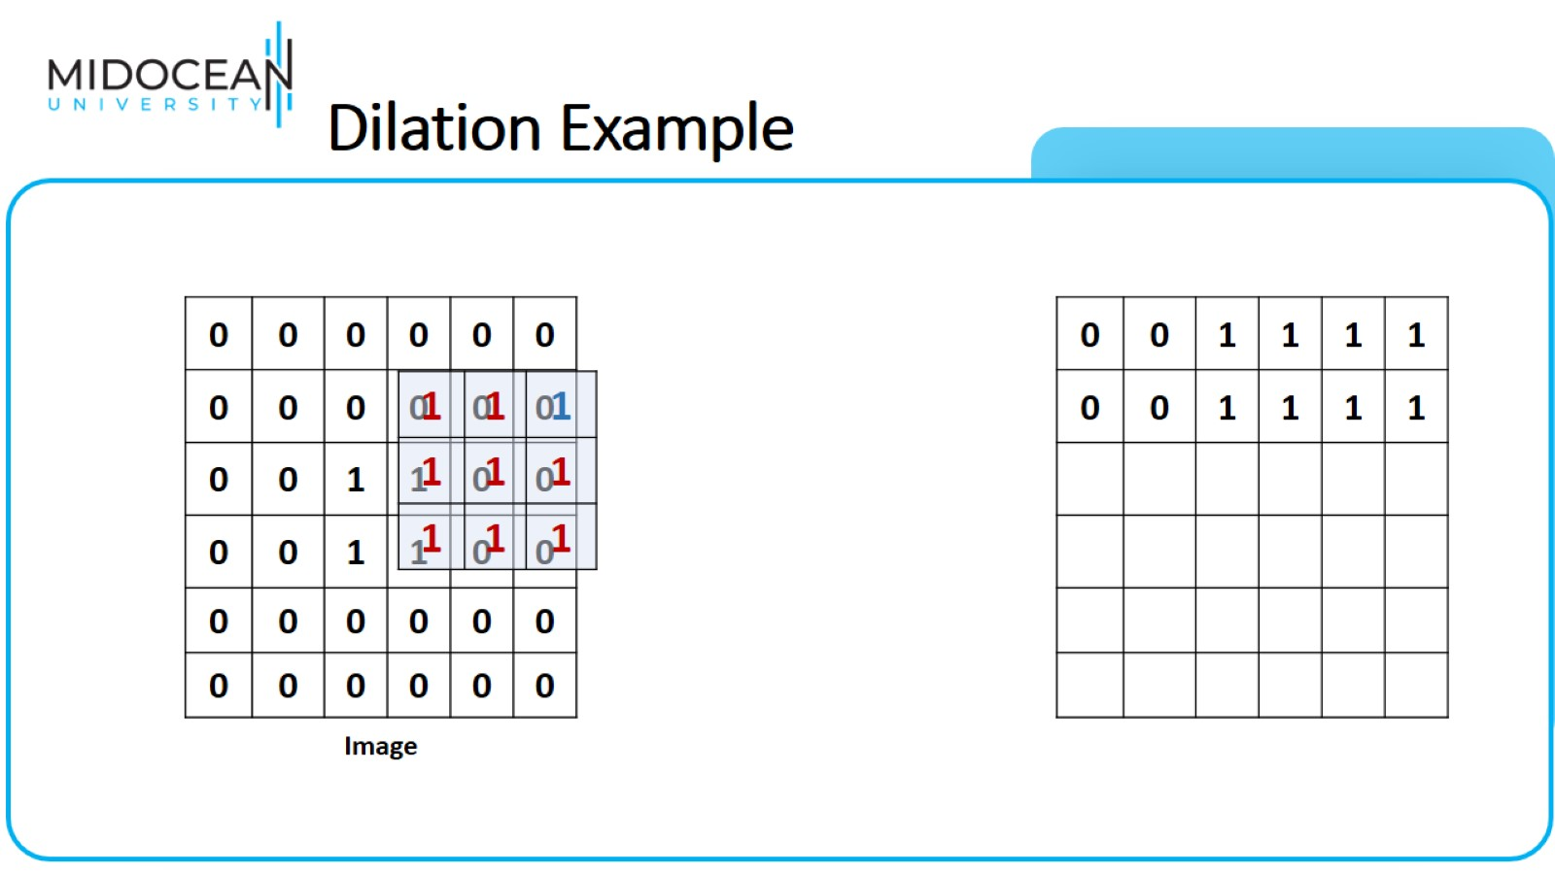
Dilation Example

Slide 42
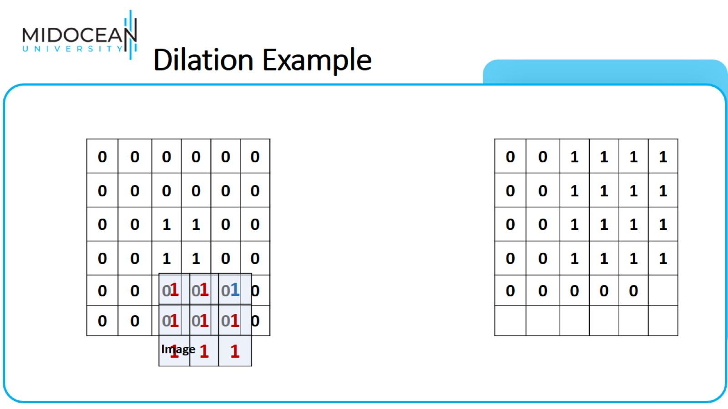
Dilation Example

Slide 43
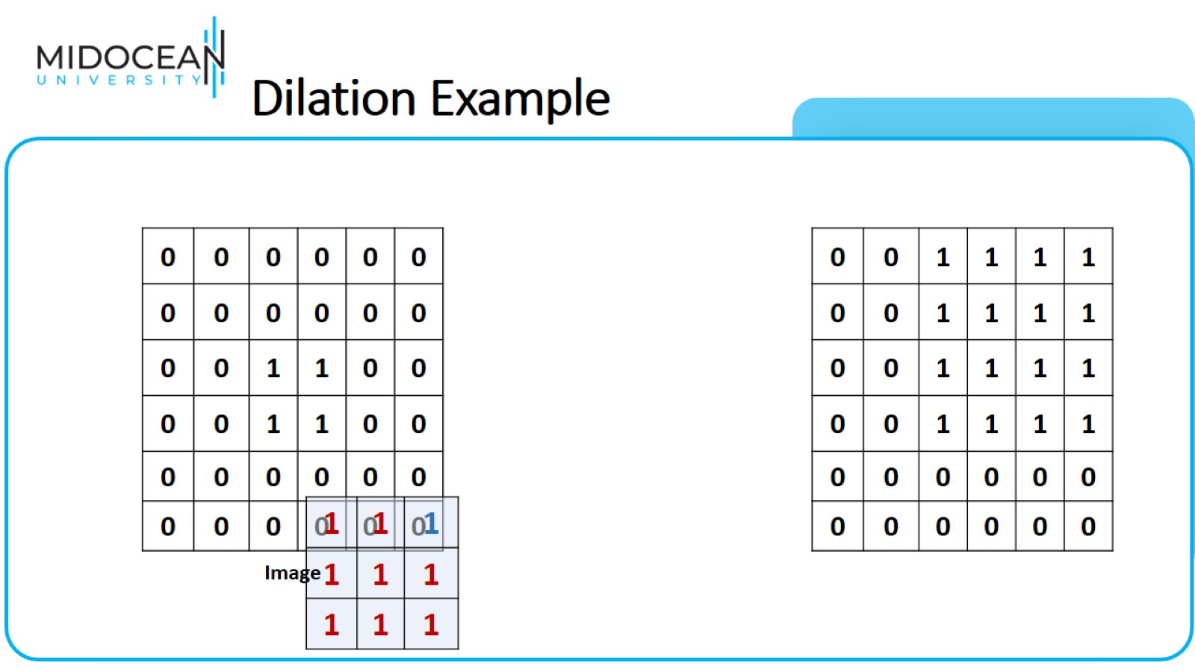
Dilation Example

Slide 44
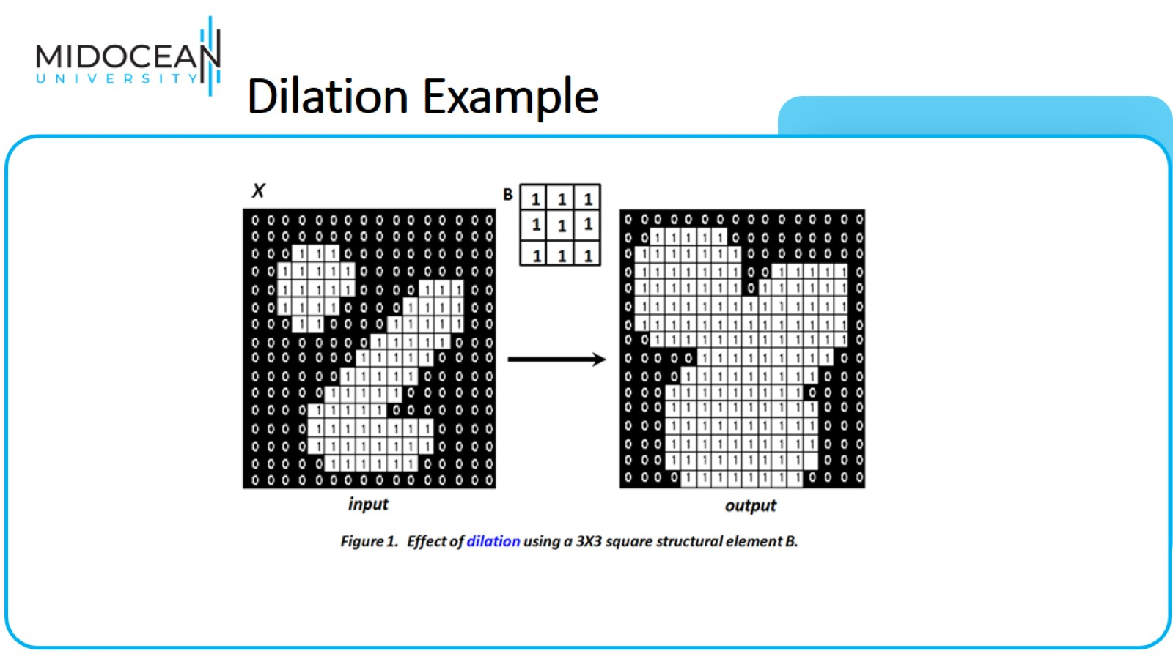
Dilation Example

Slide 45
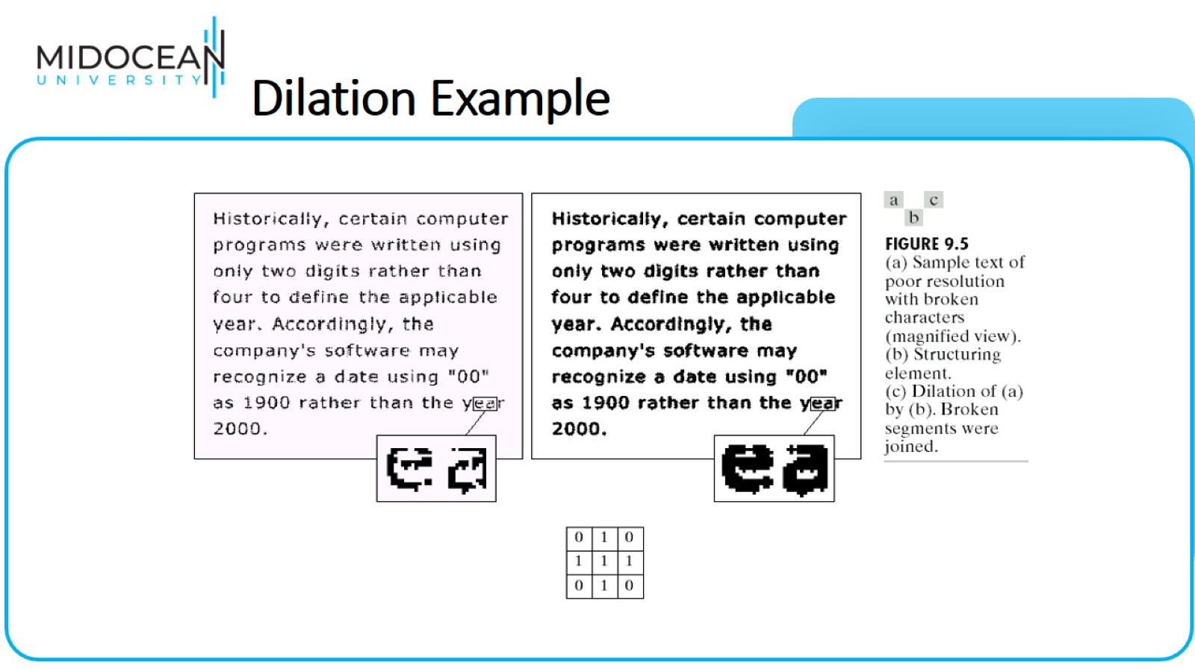
Dilation Example

Slide 46
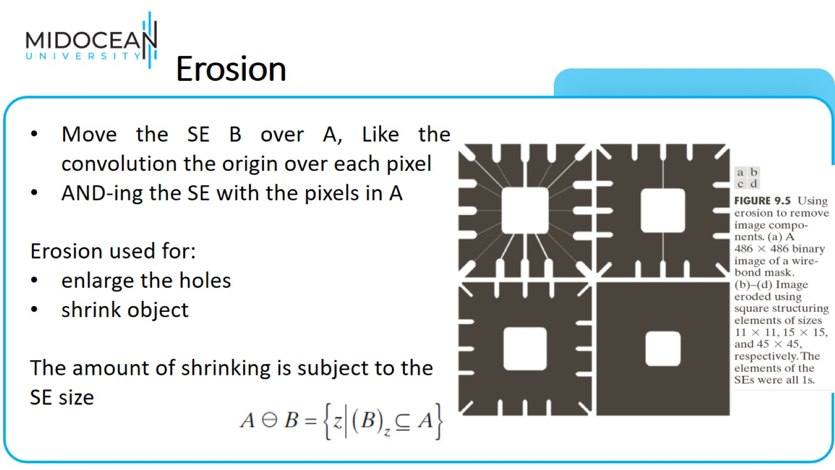
Erosion

Slide 47
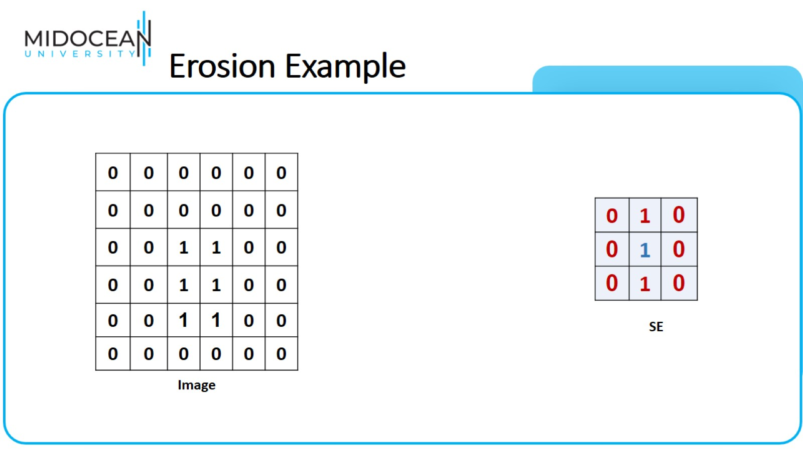
Erosion Example

Slide 48
Erosion Example

Slide 49

Erosion Example

Slide 50

Erosion Example

Slide 51
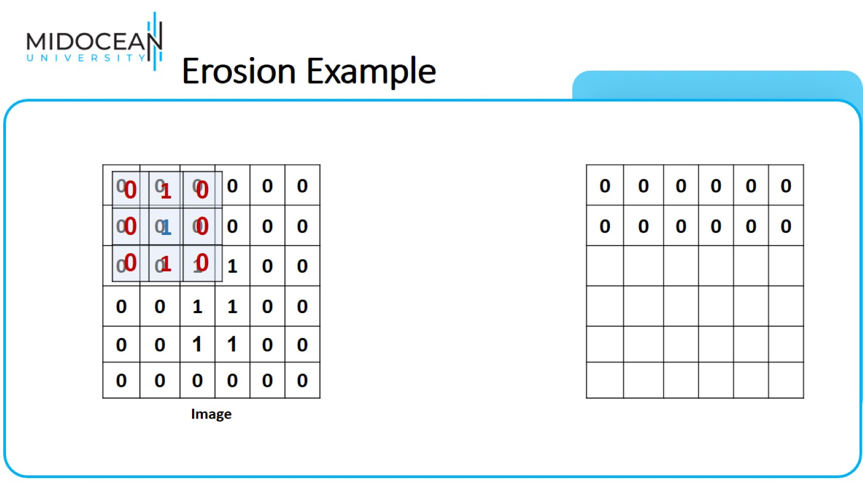
Erosion Example

Slide 52
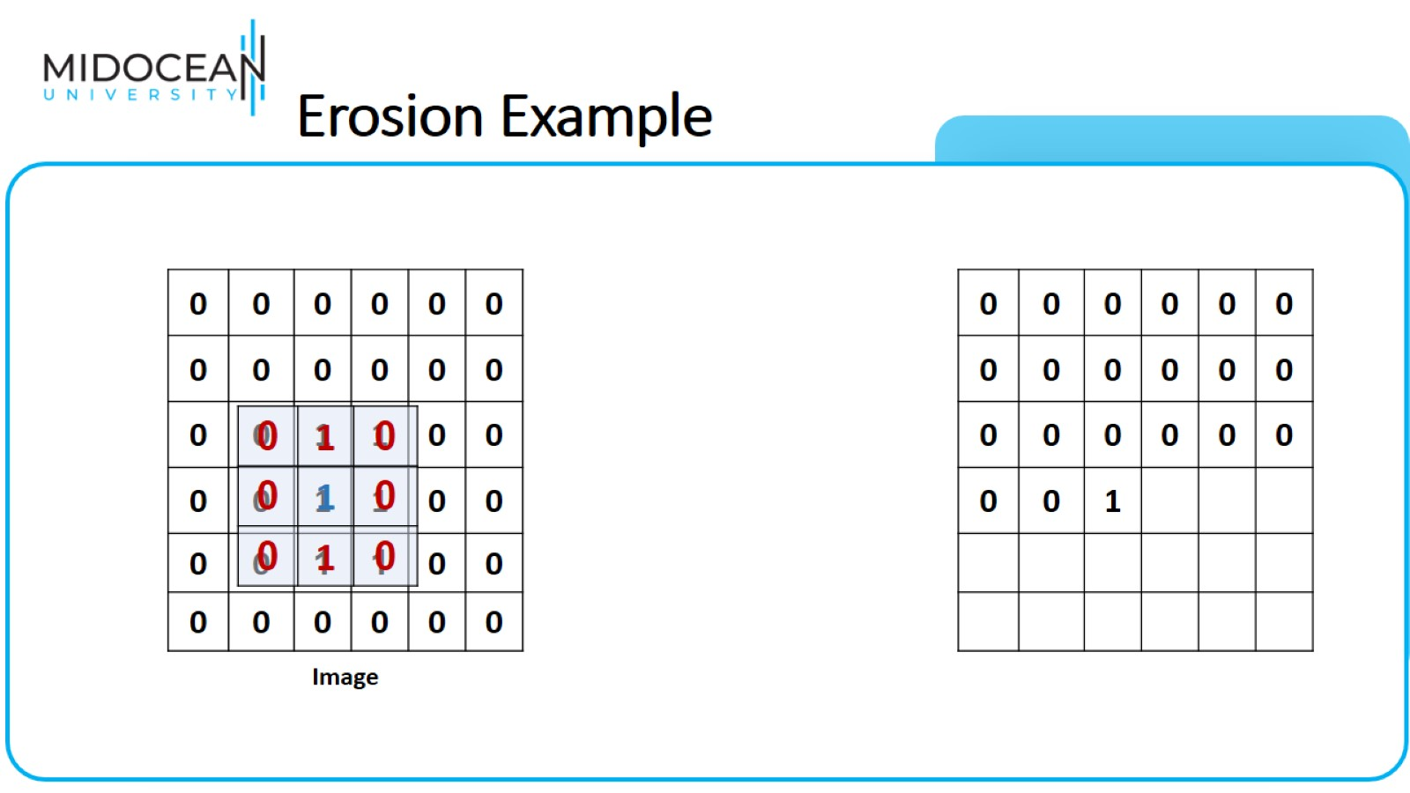
Erosion Example

Slide 53
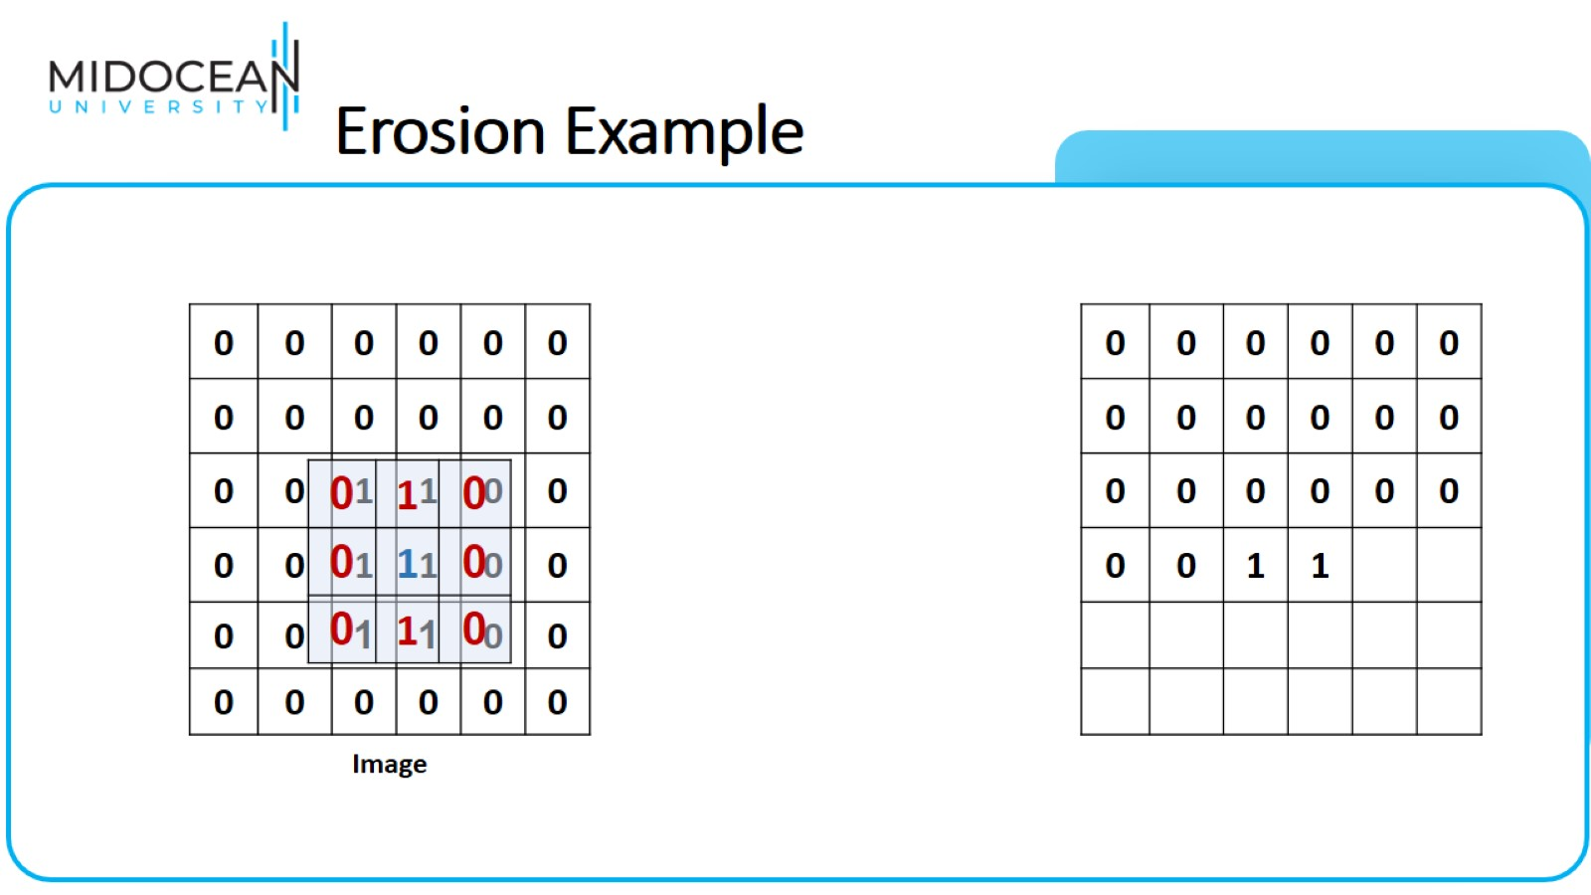
Erosion Example

Slide 54
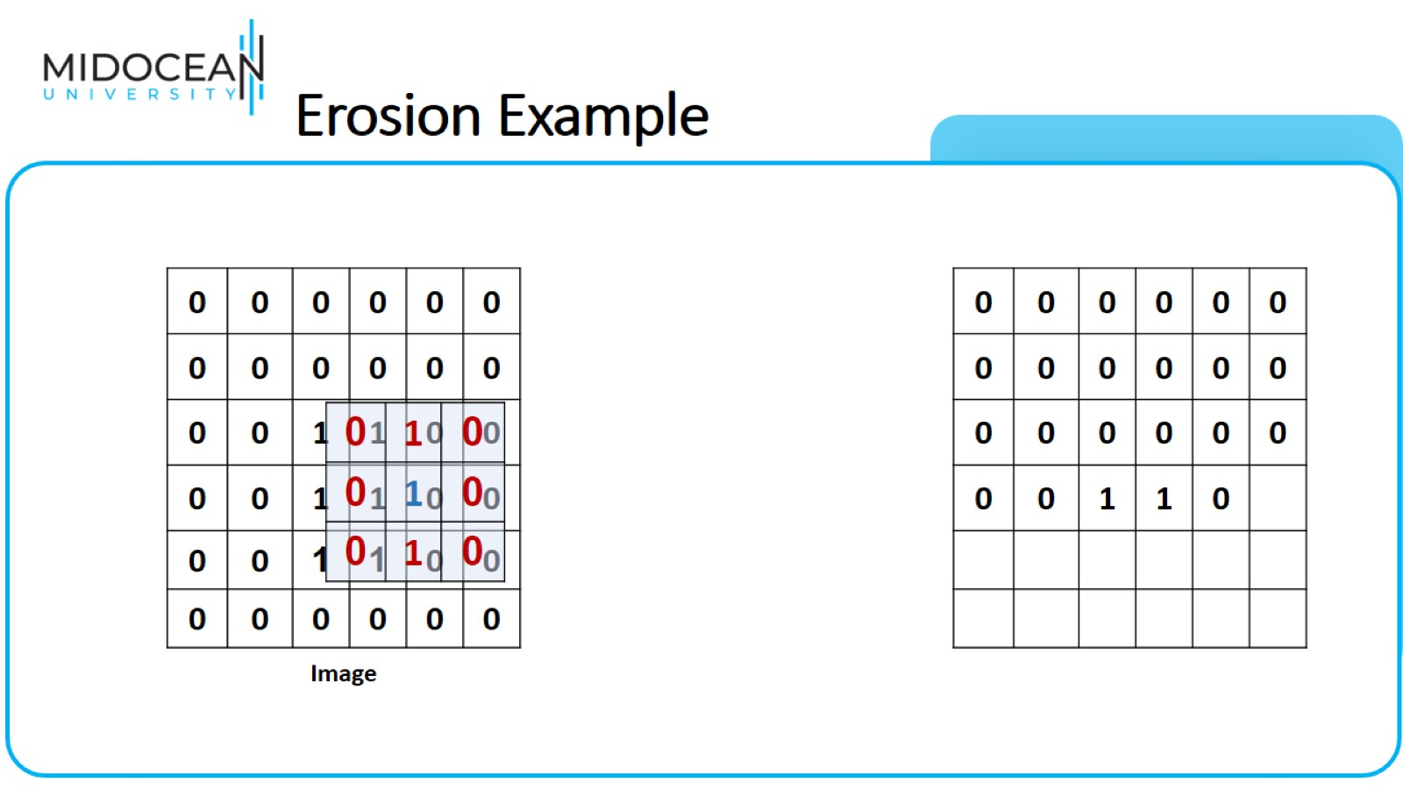
Erosion Example

Slide 55
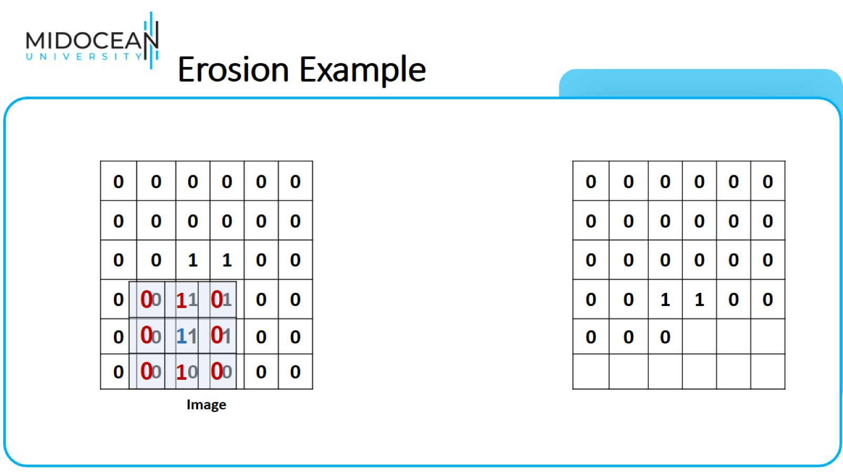
Erosion Example

Slide 56
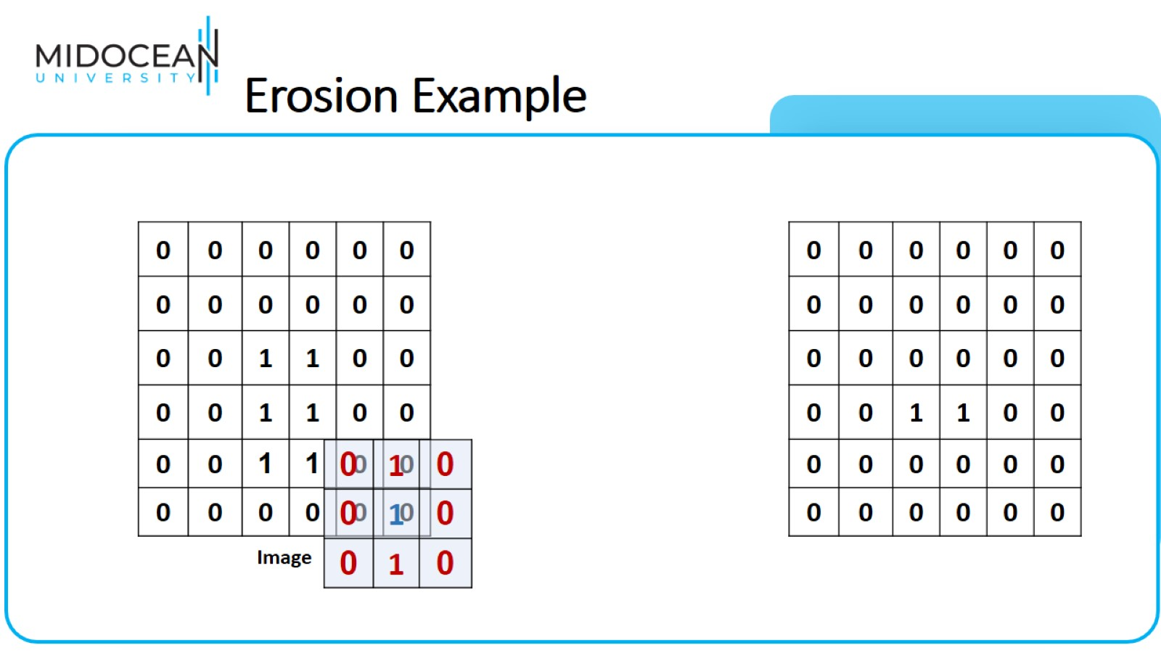
Erosion Example

Slide 57
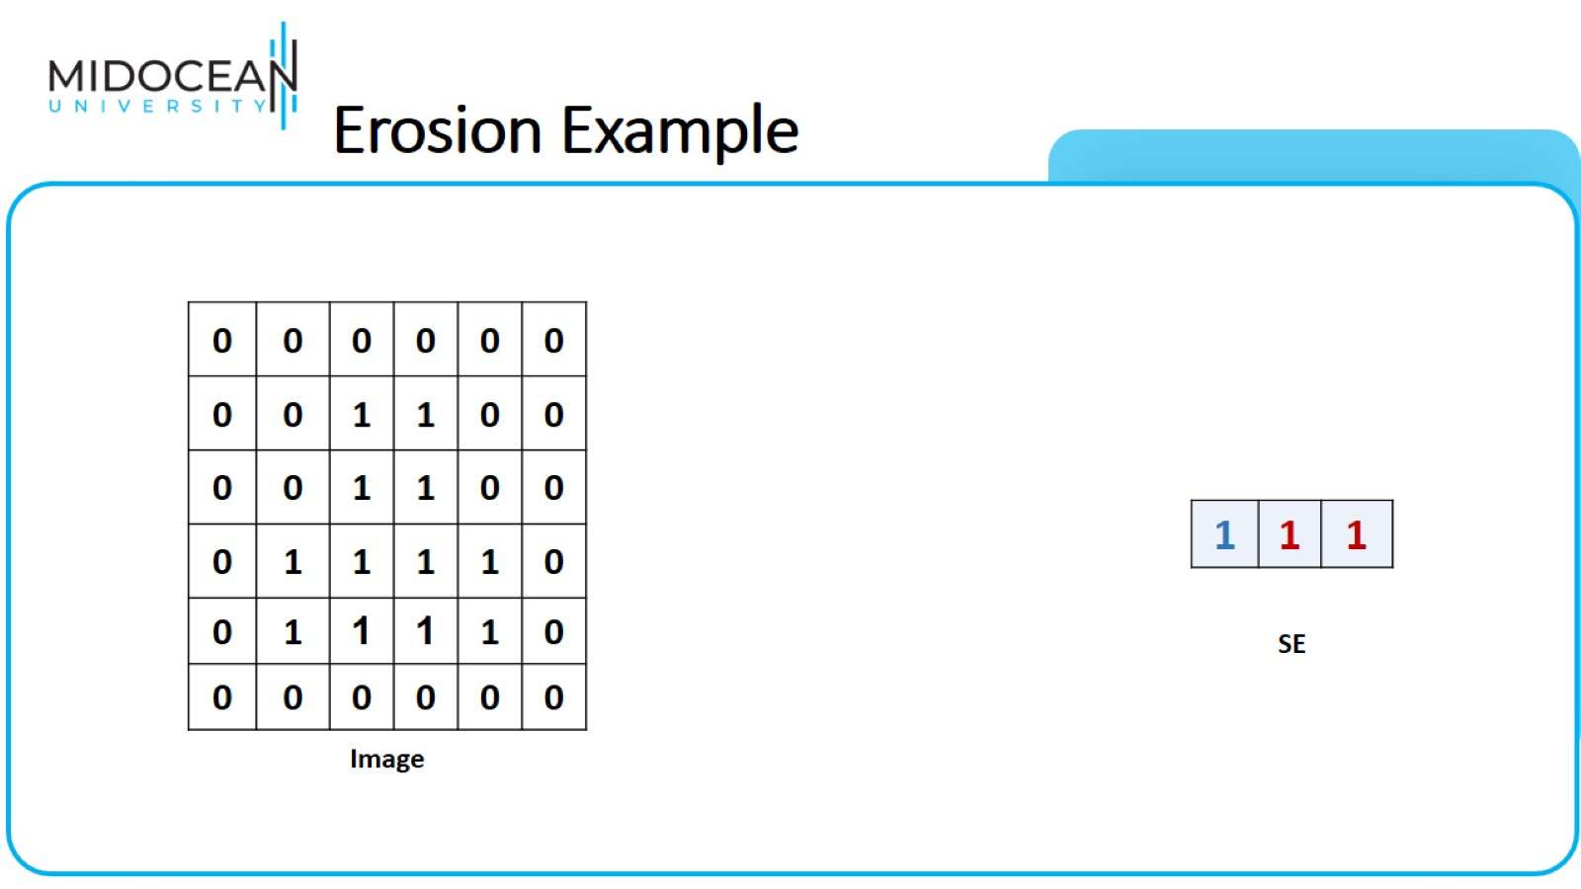
Erosion Example

Slide 58
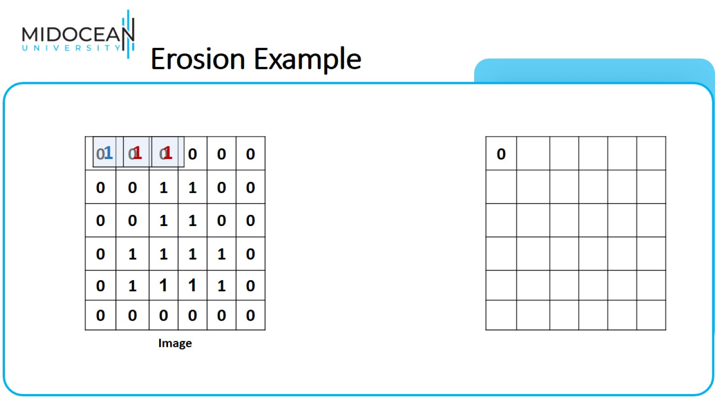
Erosion Example

Slide 59
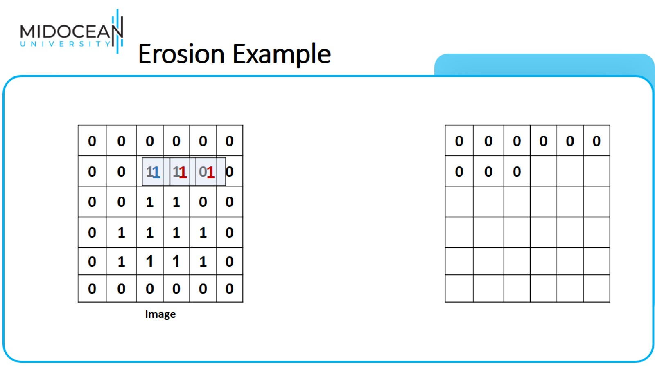
Erosion Example

Slide 60

Erosion Example

Slide 61

Erosion Example

Slide 62

Erosion Example

Slide 63

Erosion Example

Slide 64

Erosion Example

Slide 65

Erosion Example

Slide 66

Erosion Example

Slide 67

Erosion Example

Slide 68

Combining erosion and dilation

Slide 69

Opening

Slide 70

Opening

Slide 71

Closing

Slide 72

Closing

Slide 73

Example: Opening

Slide 74

Example: Closing

Slide 75

Opening and Closing

Slide 76

Removing noise by:
Opening followed by closing

Slide 77

Removing noise by:
Opening followed by closing

Slide 78

Applications of opening

Slide 79

Applications of Closing

Slide 80

Some Basic Image Morphology

Slide 81


Slide 82

Some Basic Image Morphology

Slide 83


Slide 84

Some Basic Image Morphology

Slide 85

Some Basic Morphological Algorithms (4)

Slide 86


Slide 87


Slide 88

Some Basic Image Morphology

Slide 89

Some Basic Image Morphology

Slide 90

Some Basic Image Morphology

Slide 91


Slide 92

Some Basic Some Basic Image Morphology

Slide 93

Some Basic Some Basic Image Morphology

Slide 94

Some Basic Some Basic Image Morphology

Slide 95

Some Basic Some Basic Image Morphology

Slide 96

Boundary Extraction

Slide 97

Boundary Extraction

Slide 98


