Slide 1


Slide 2


Slide 3
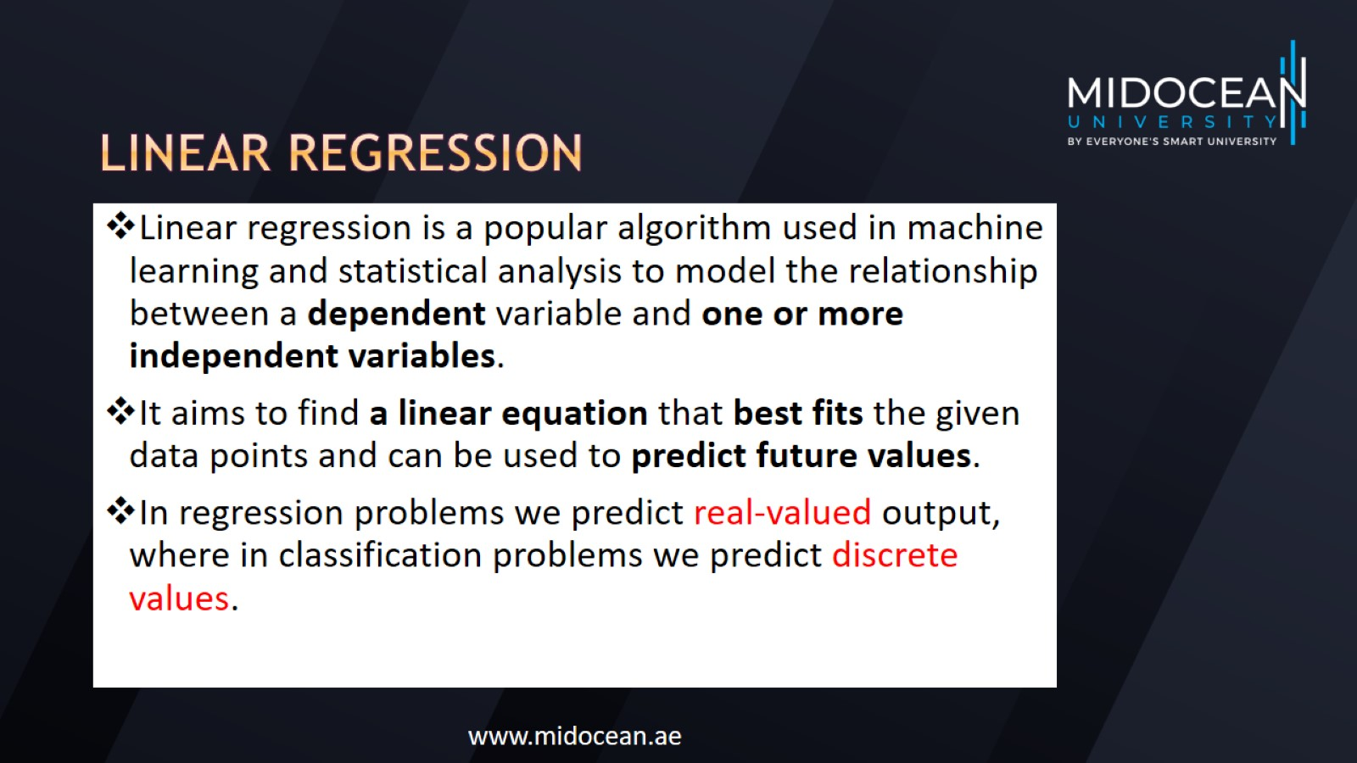
Linear regression

Slide 4
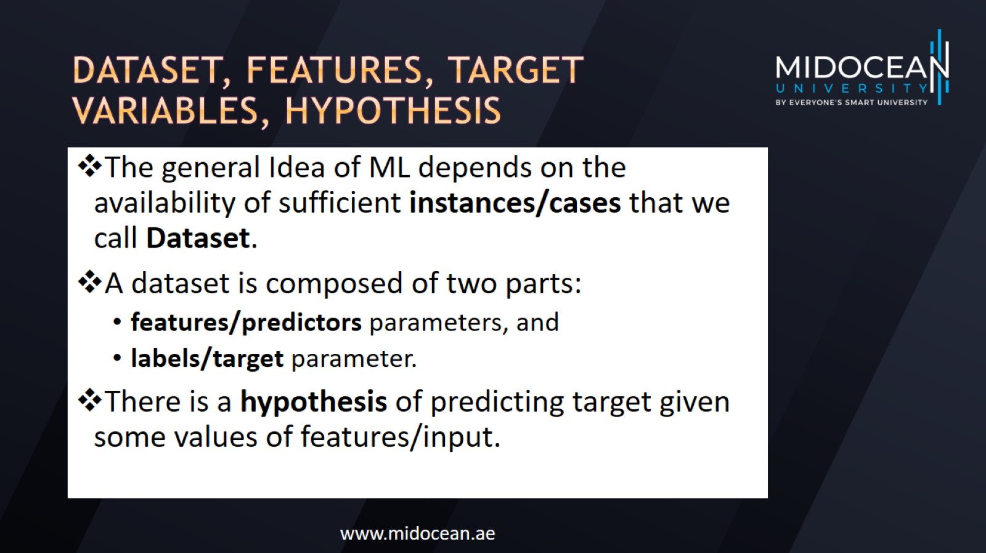
Dataset, Features, target variables, hypothesis

Slide 5
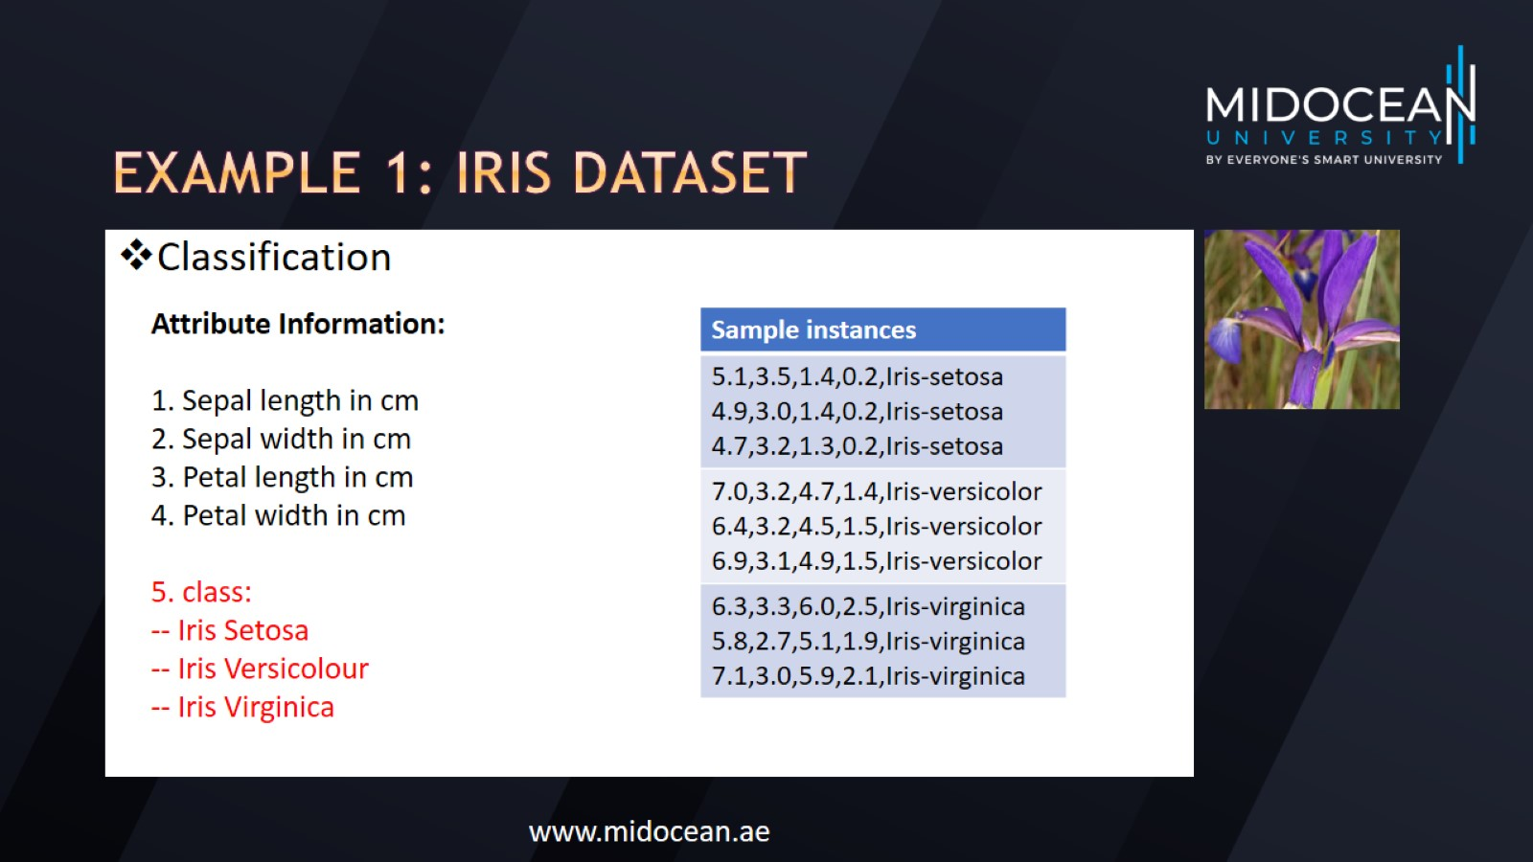
Example 1: IRIS Dataset

Slide 6
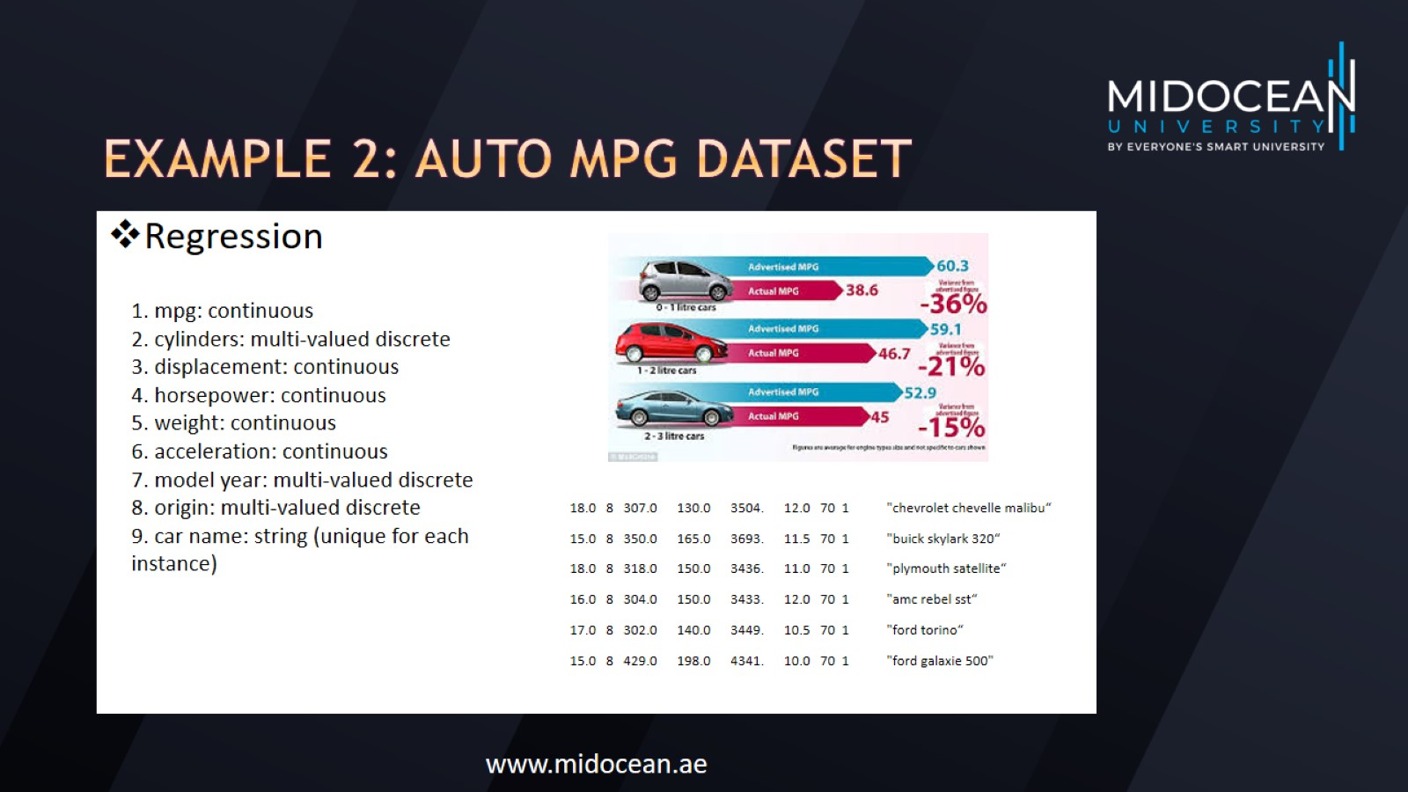
Example 2: Auto MPG DataSet

Slide 7
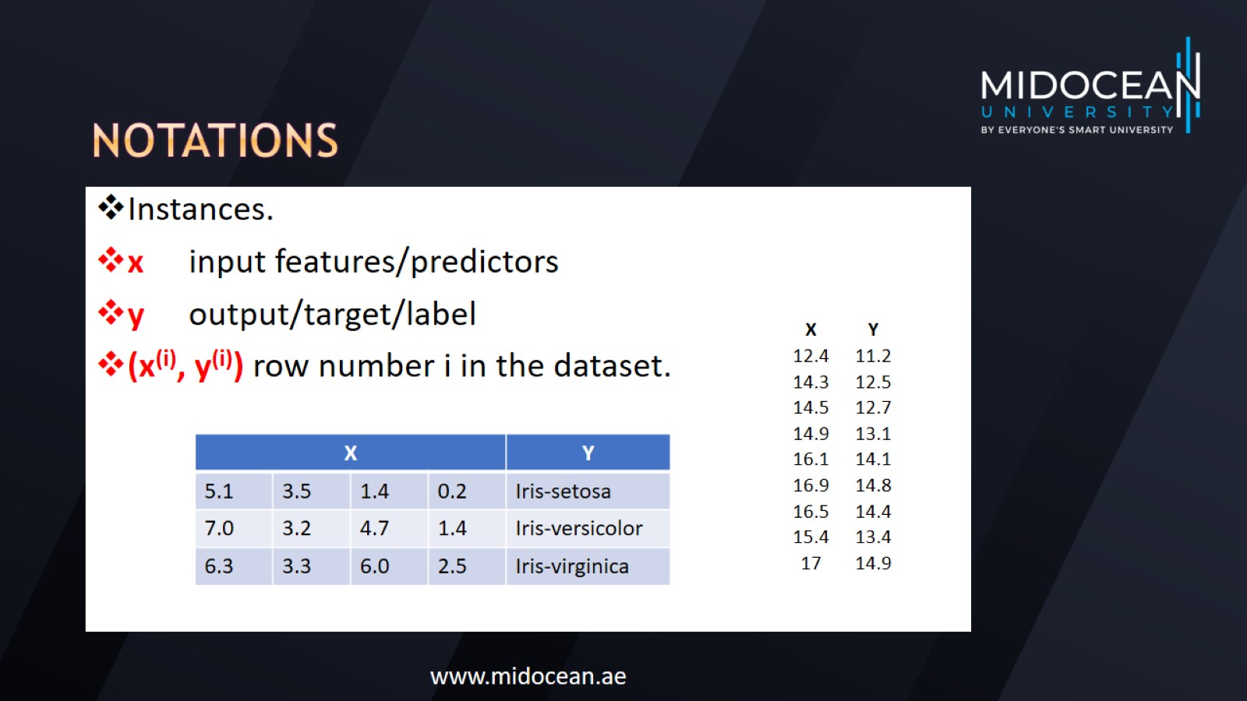
notations

Slide 8
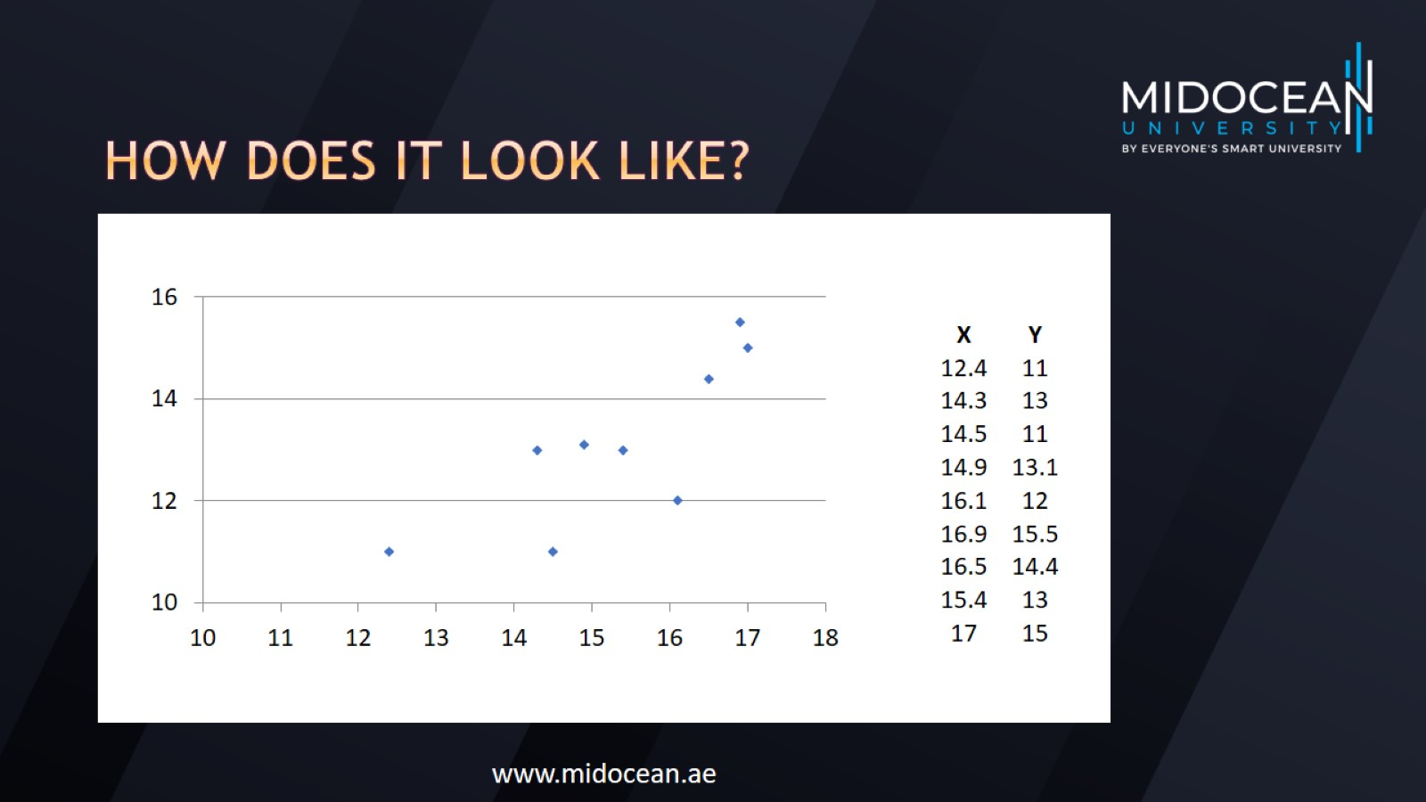
How does it look like?

Slide 9
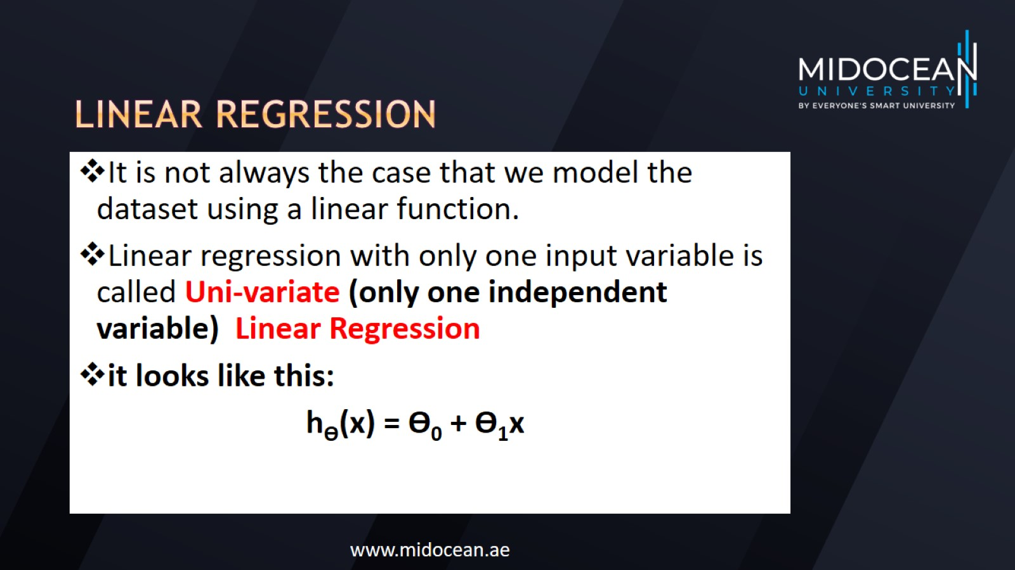
Linear regression

Slide 10
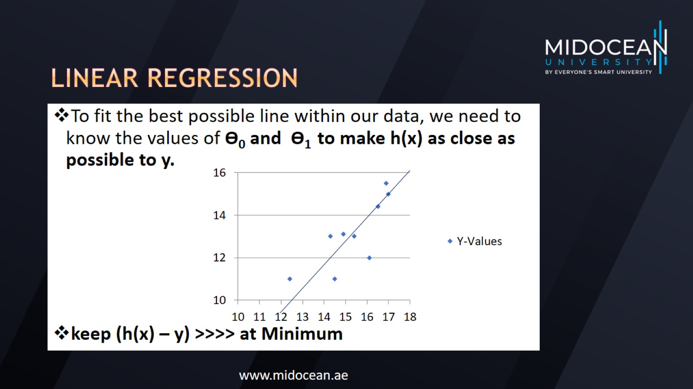
Linear regression

Slide 11
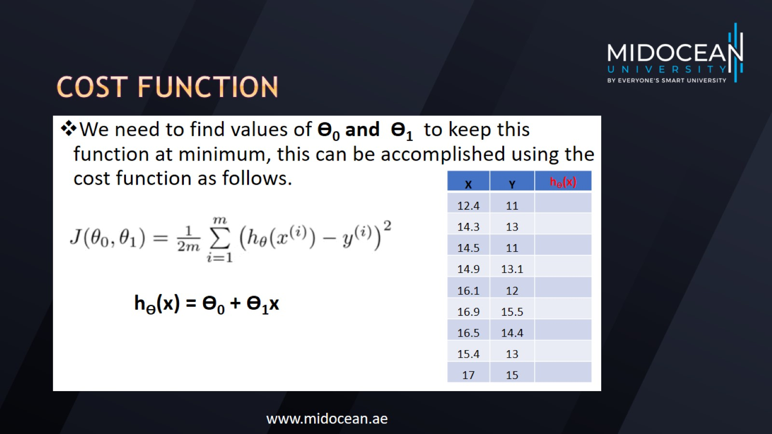
Cost function

Slide 12
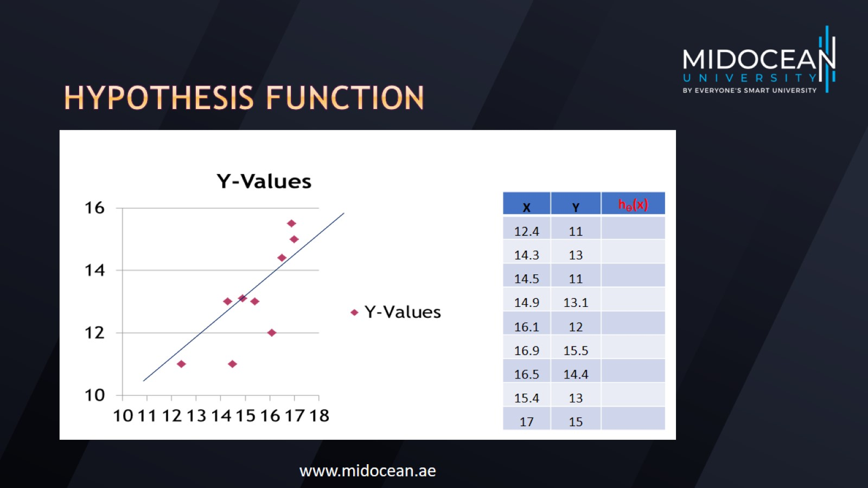
Hypothesis function

Slide 13
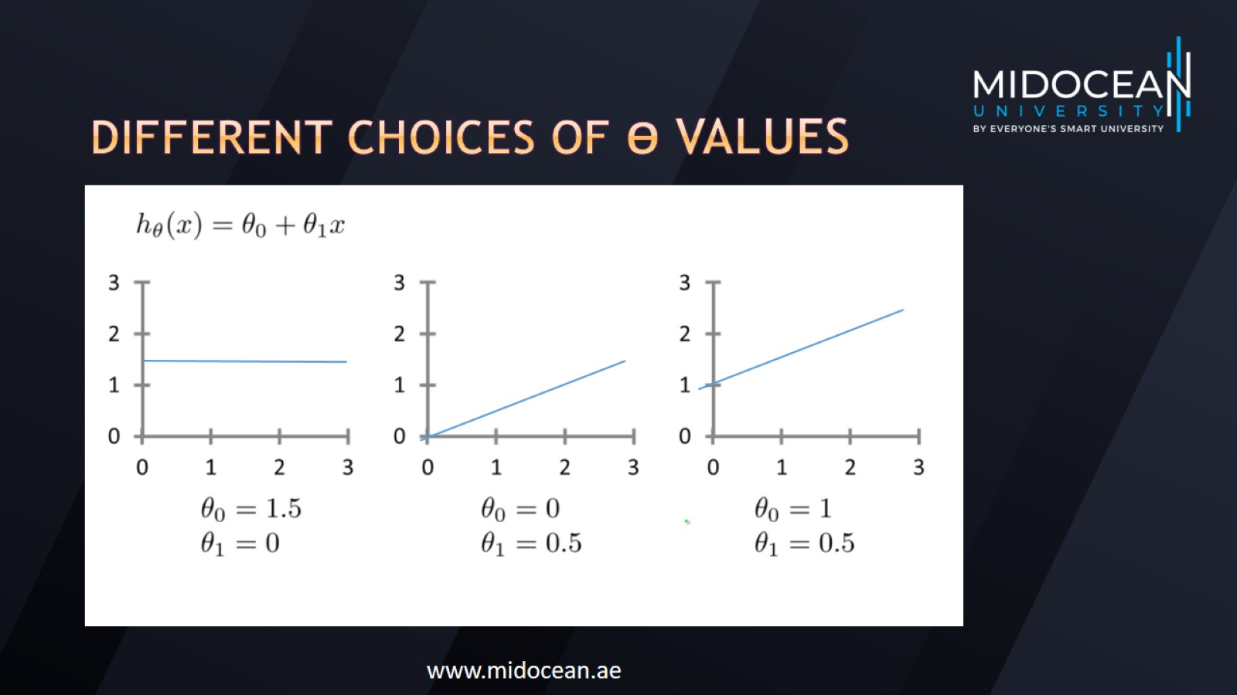
Different choices of Ɵ values

Slide 14
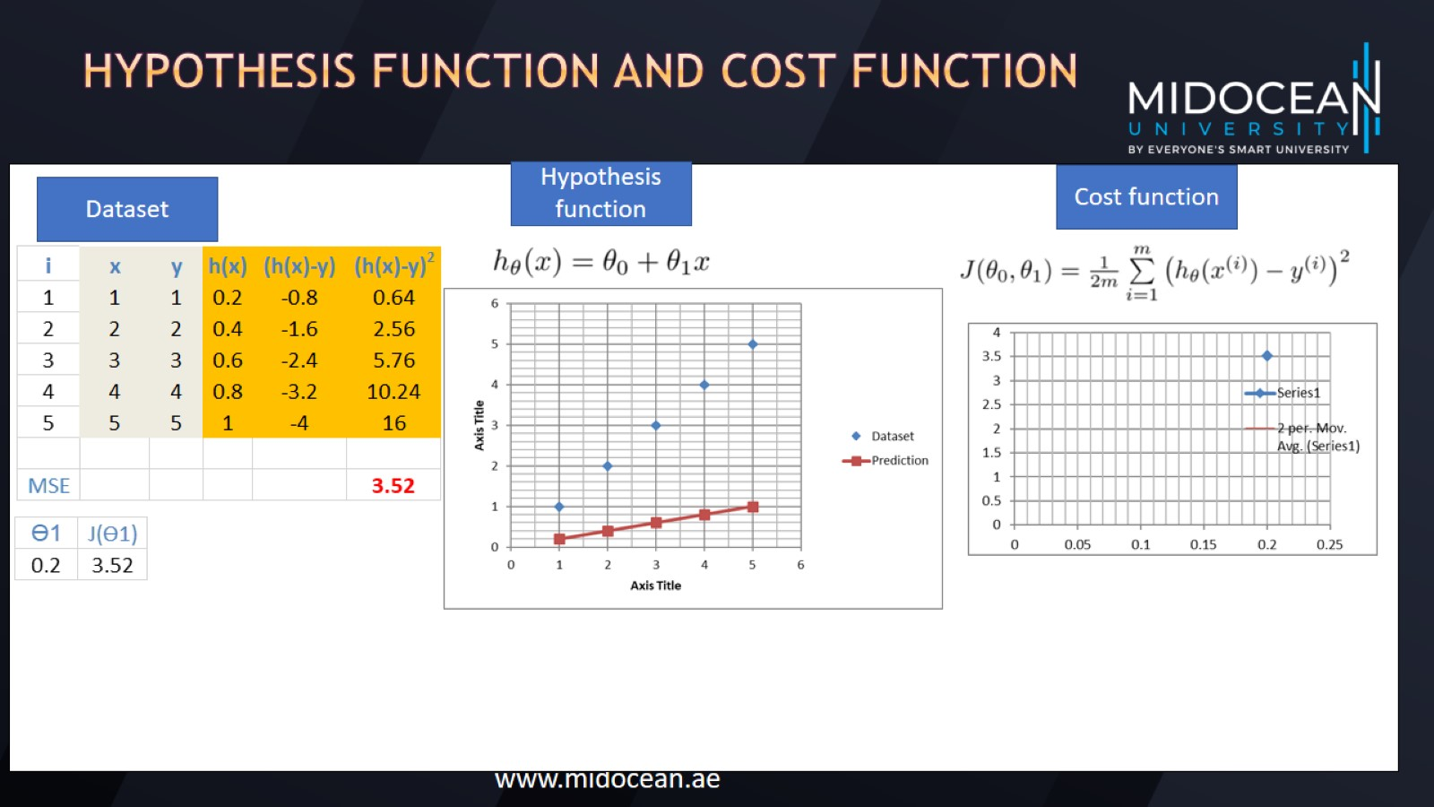
Hypothesis function and Cost function

Slide 15
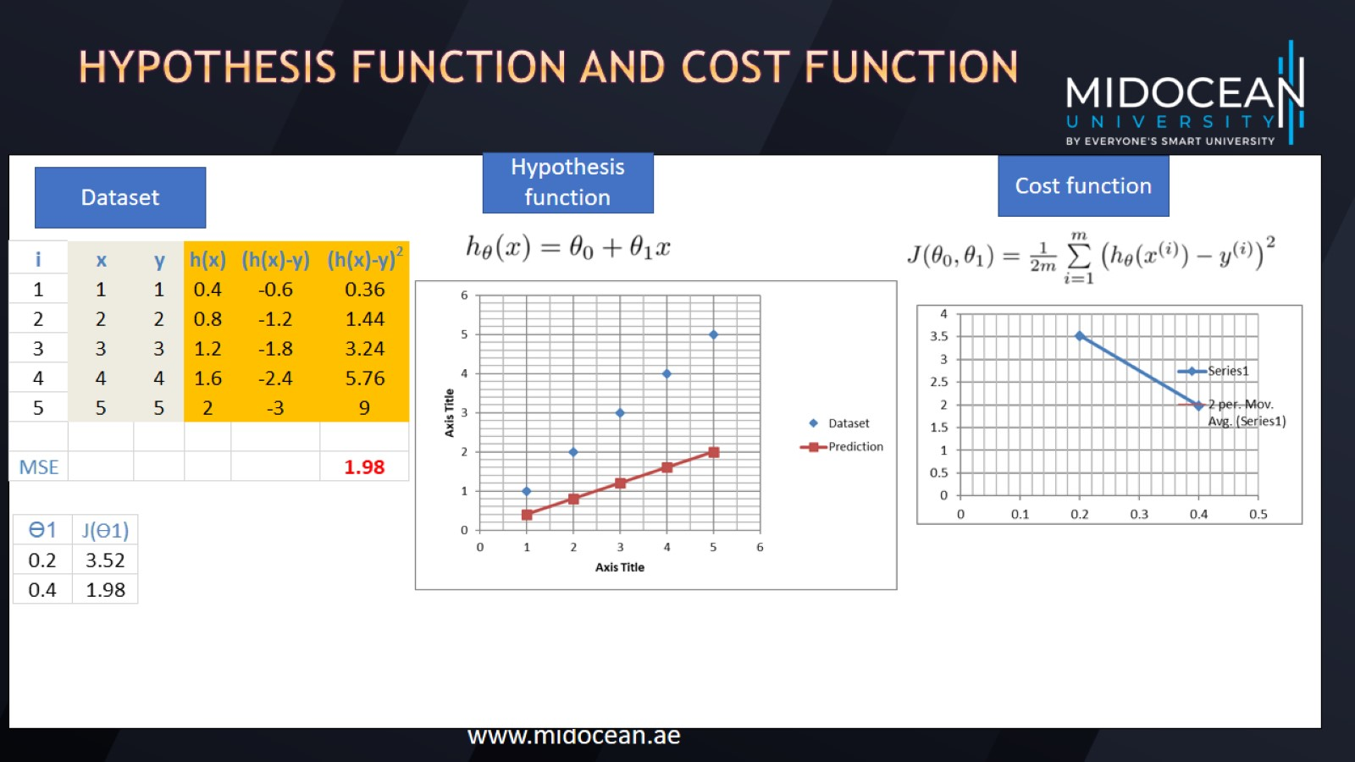
Hypothesis function and Cost function

Slide 16

Hypothesis function and Cost function

Slide 17
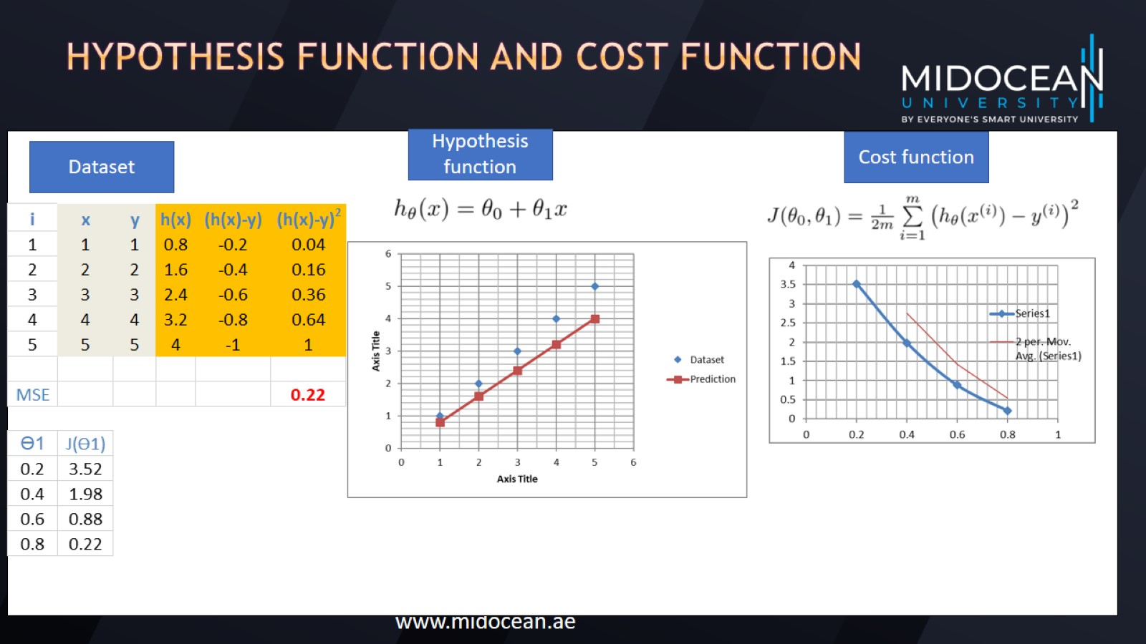
Hypothesis function and Cost function

Slide 18
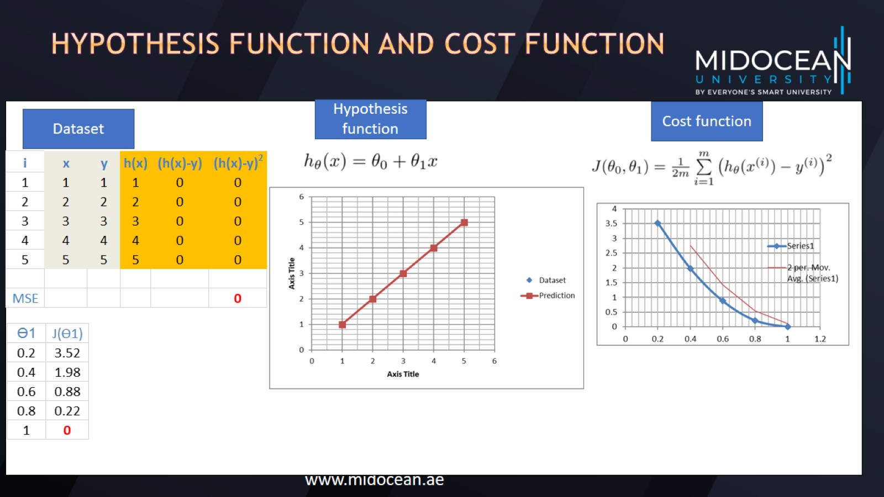
Hypothesis function and Cost function

Slide 19
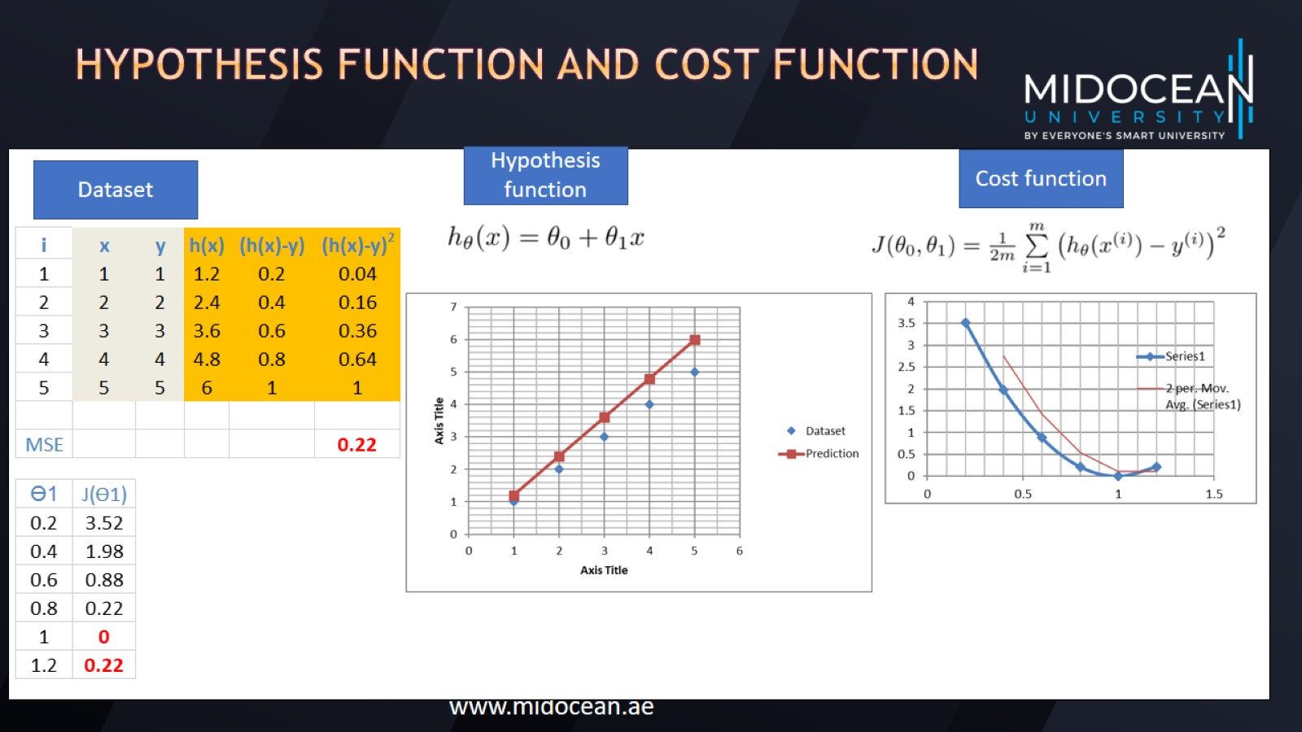
Hypothesis function and Cost function

Slide 20
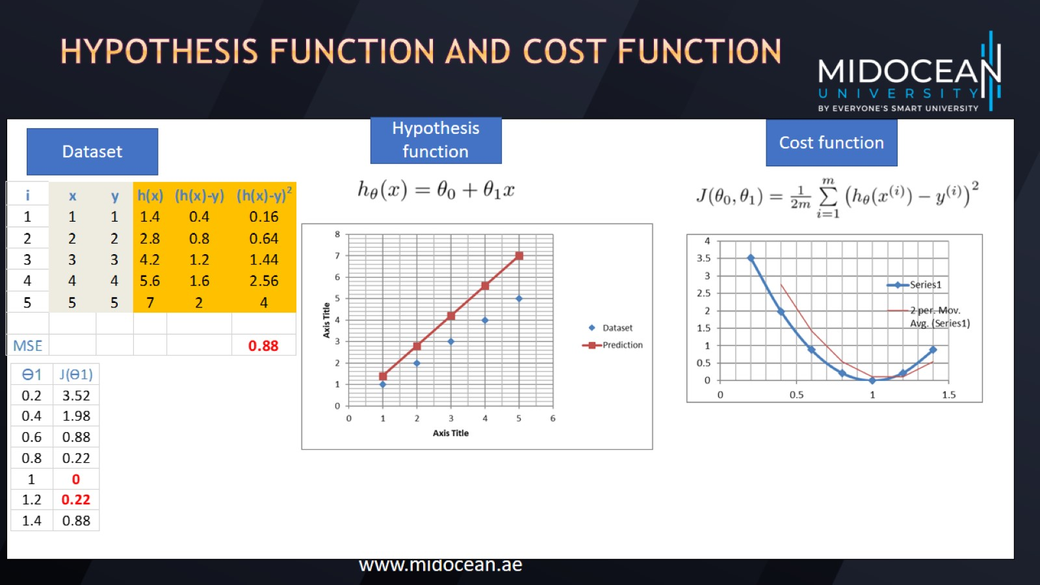
Hypothesis function and Cost function

Slide 21
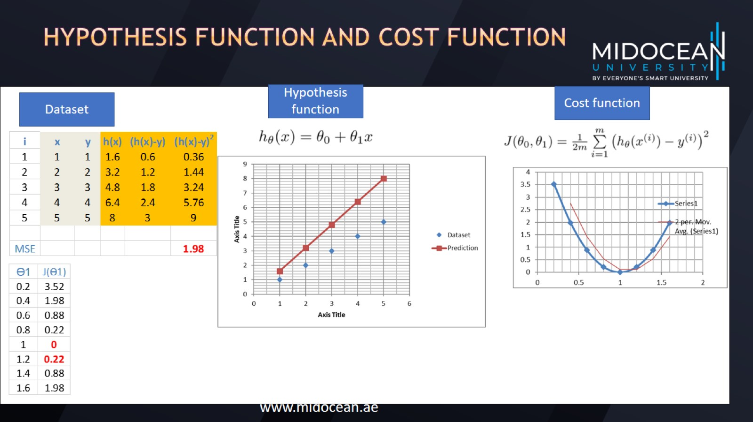
Hypothesis function and Cost function

Slide 22
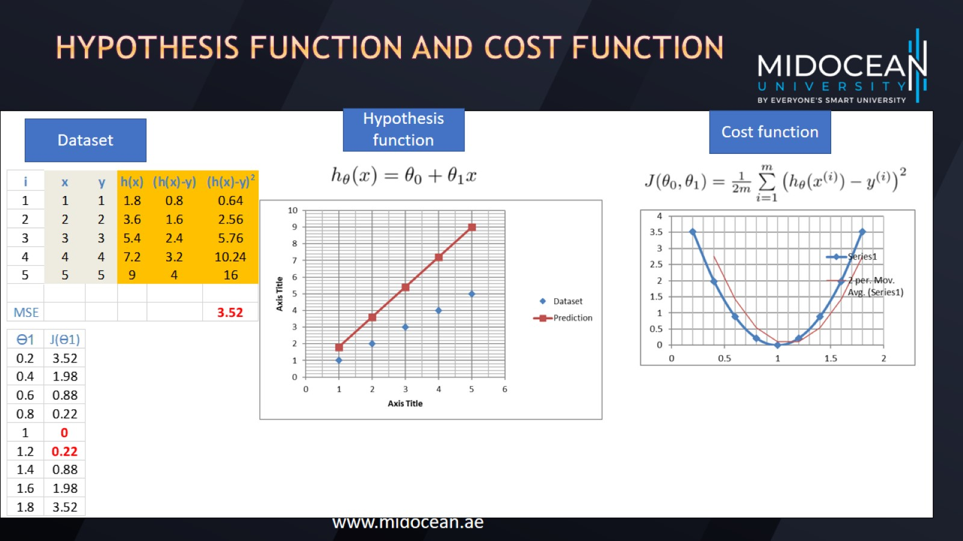
Hypothesis function and Cost function

Slide 23
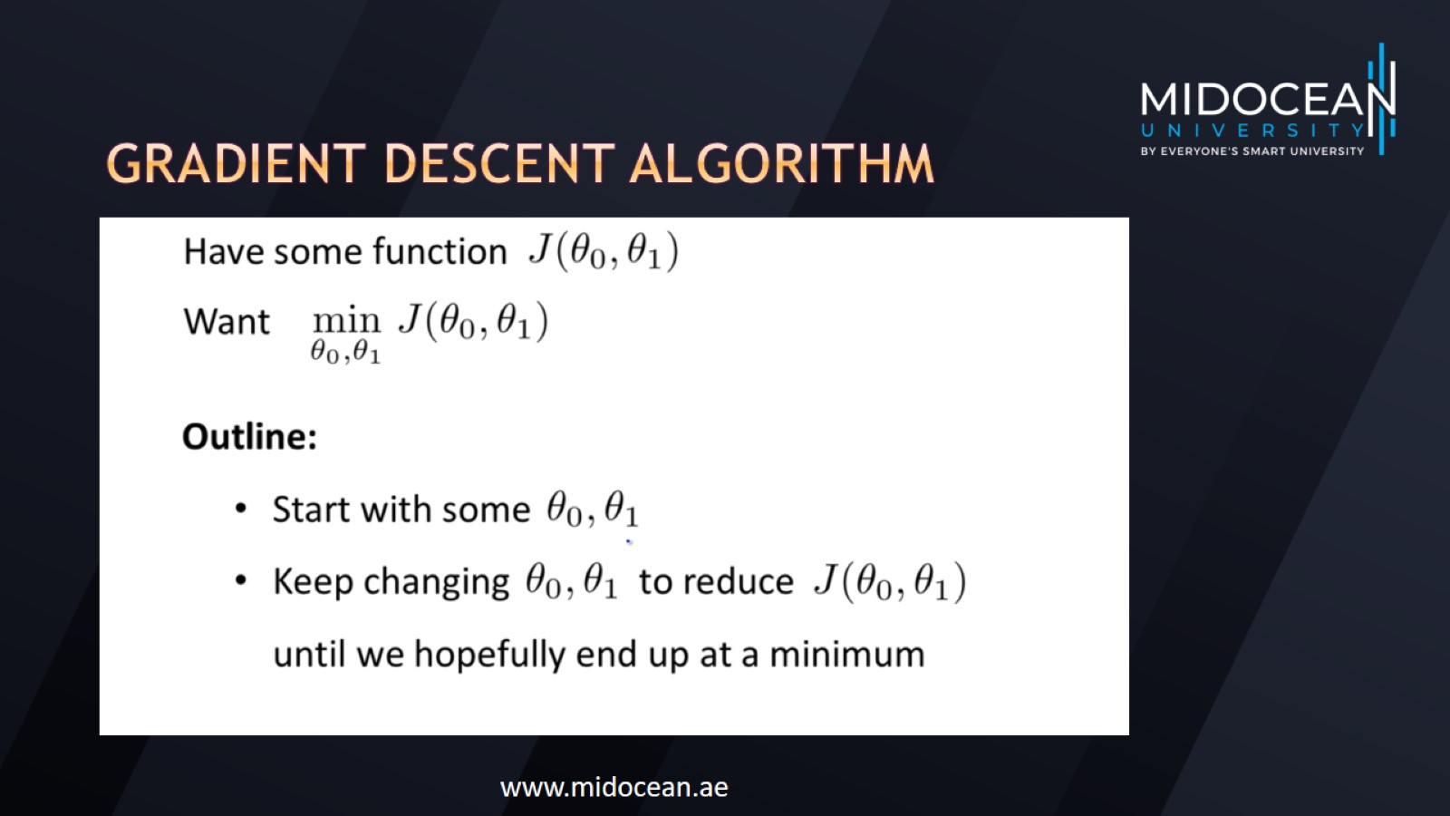
Gradient descent algorithm

Slide 24
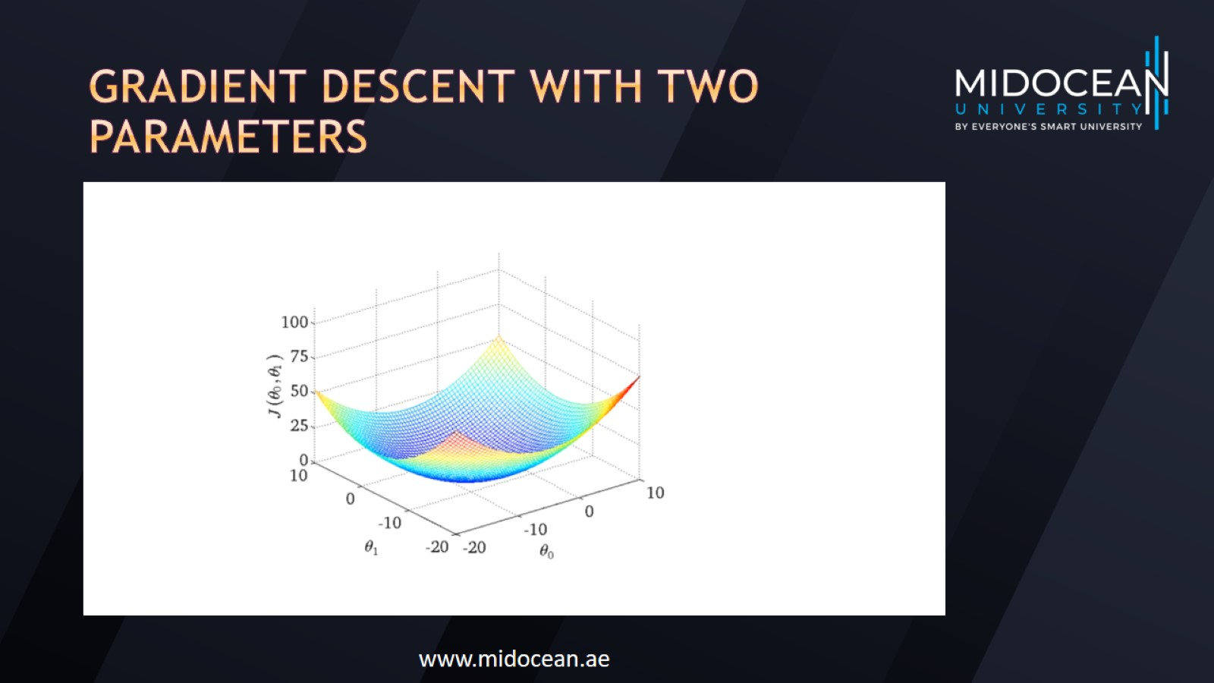
Gradient descent with two parameters

Slide 25
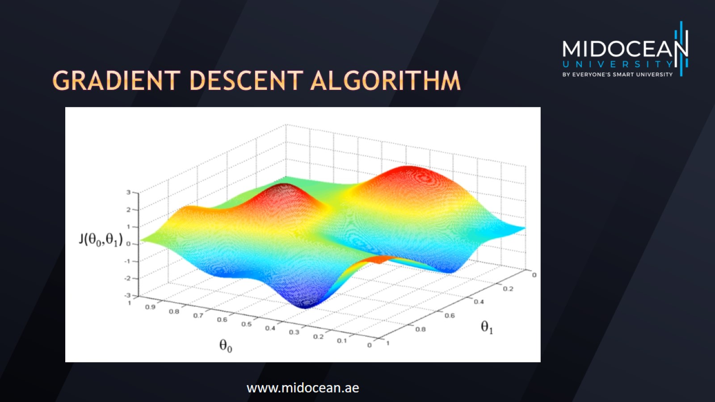
Gradient descent algorithm

Slide 26
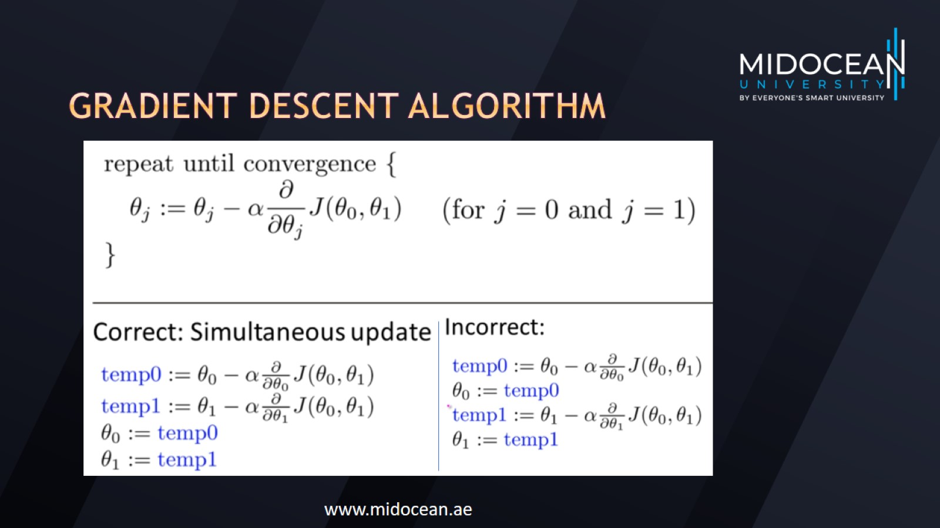
Gradient descent algorithm

Slide 27
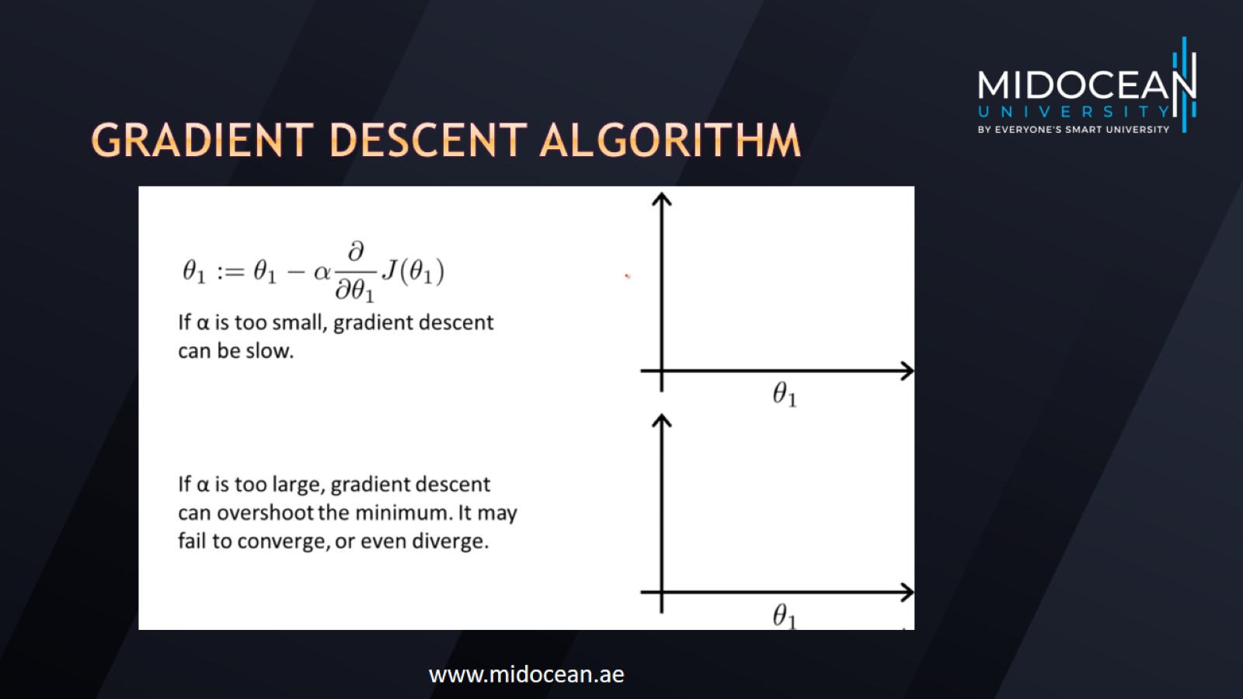
Gradient descent algorithm

Slide 28
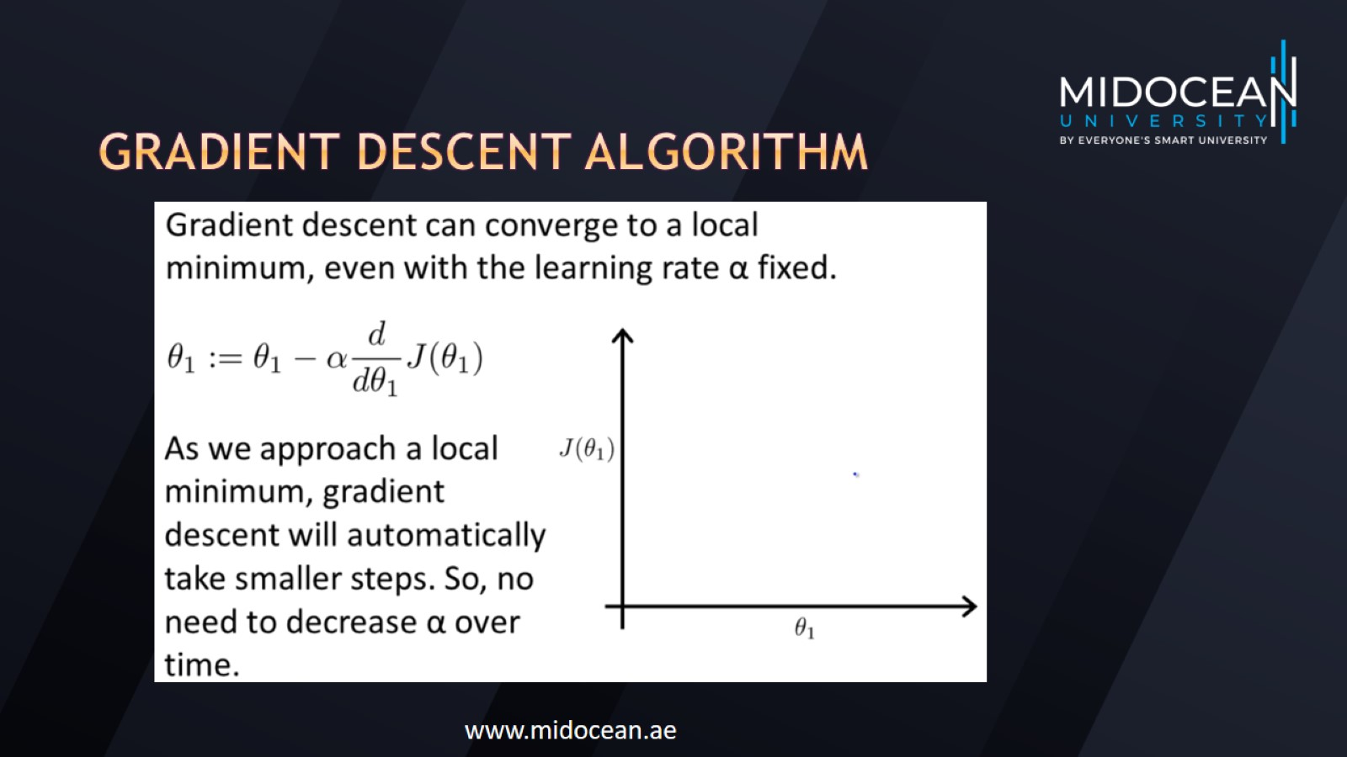
Gradient descent algorithm

Slide 29
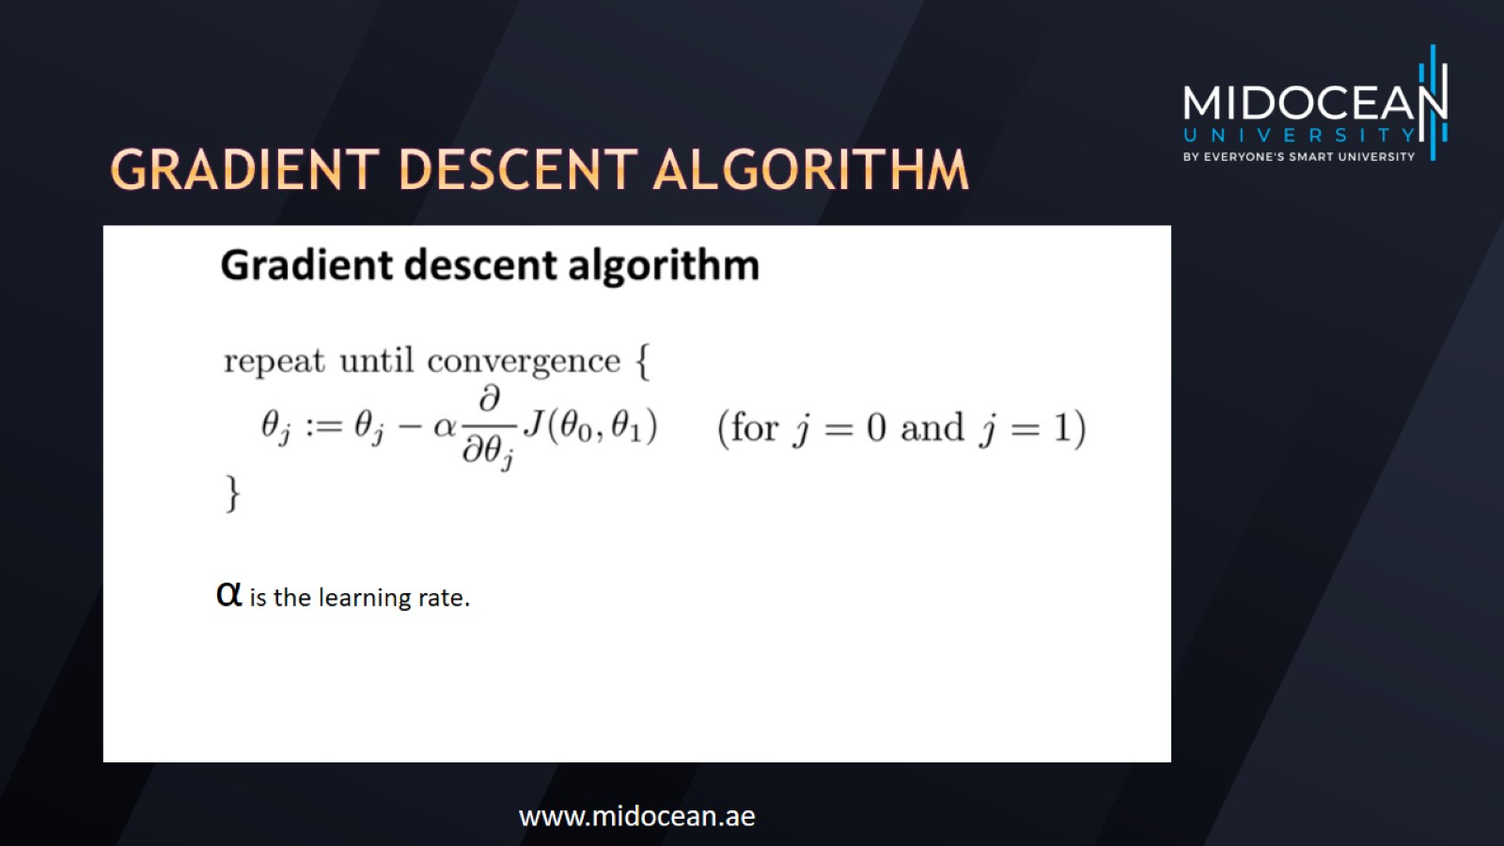
Gradient descent algorithm

Slide 30
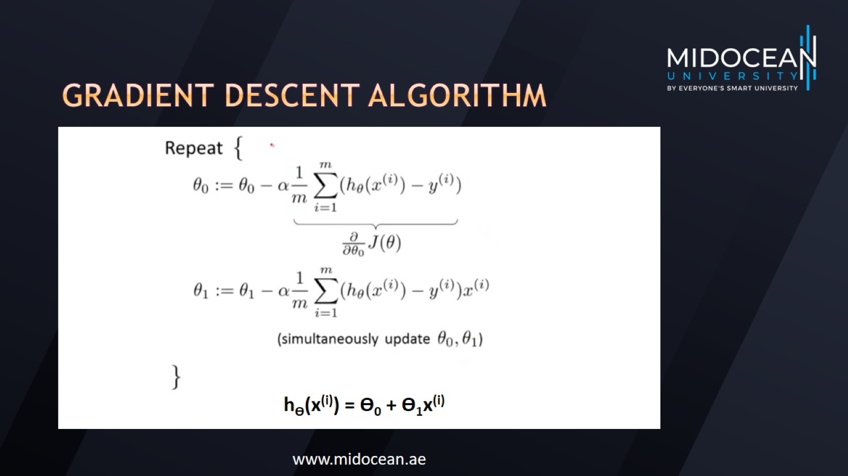
Gradient descent algorithm

Slide 31
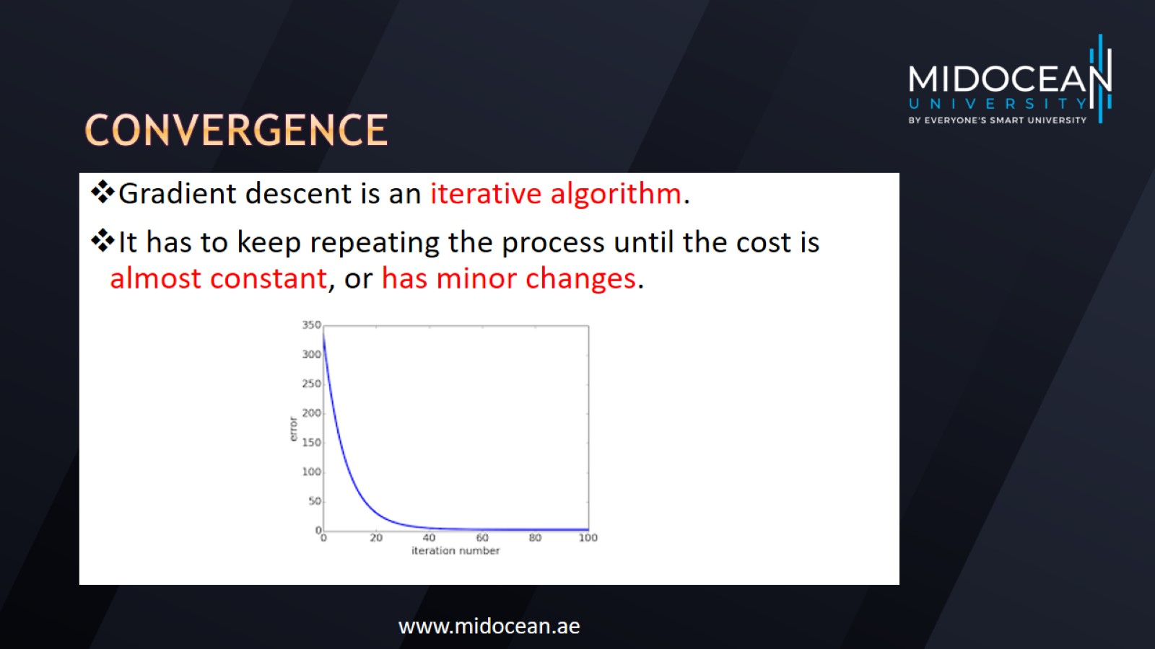
Convergence

Slide 32
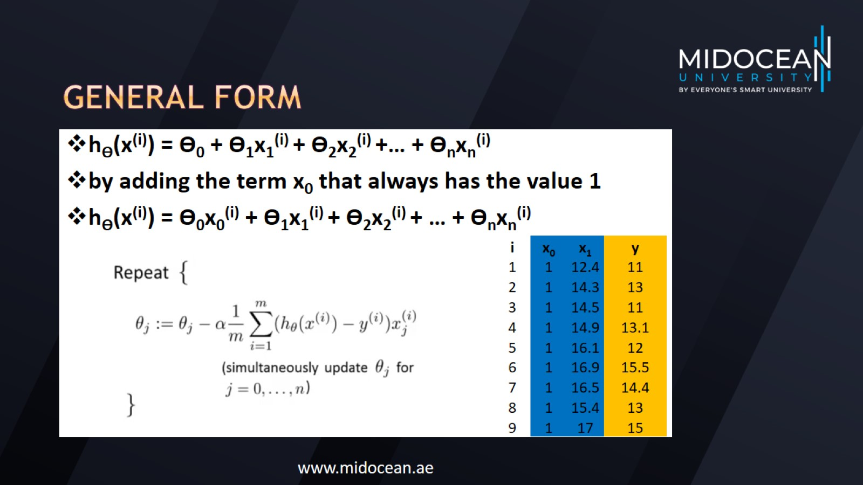
General form

Slide 33
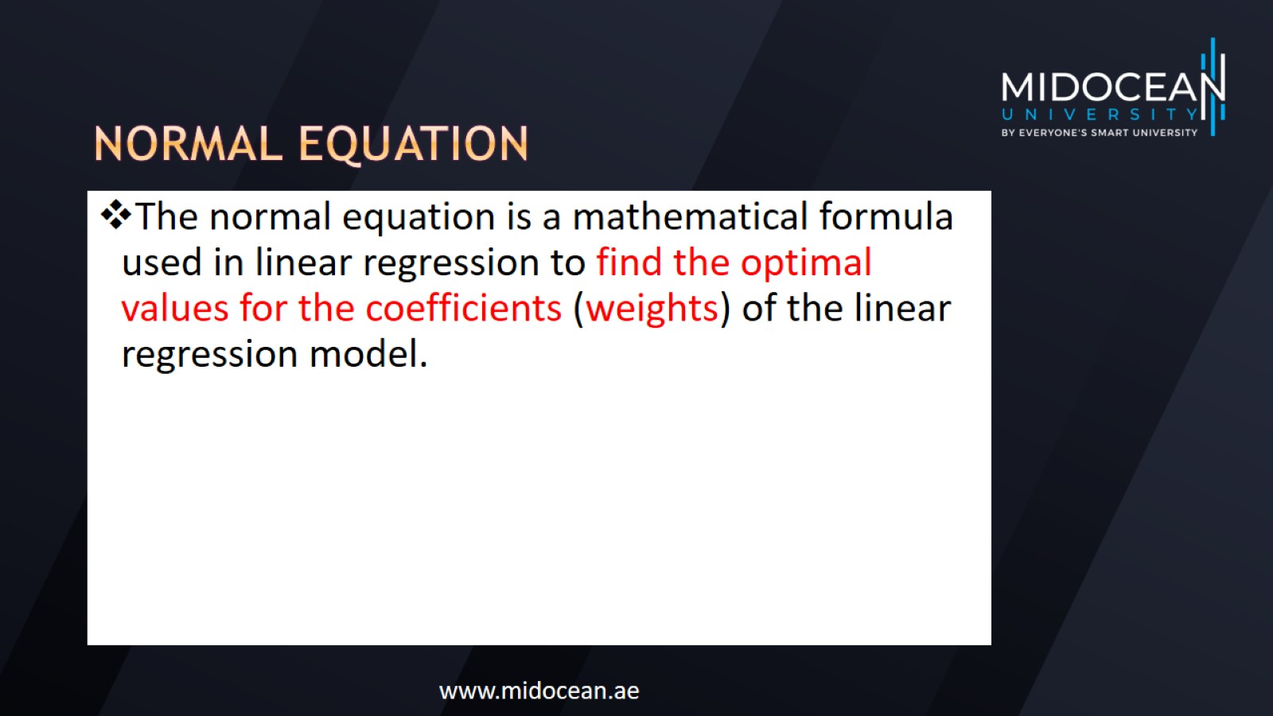
Normal equation

Slide 34
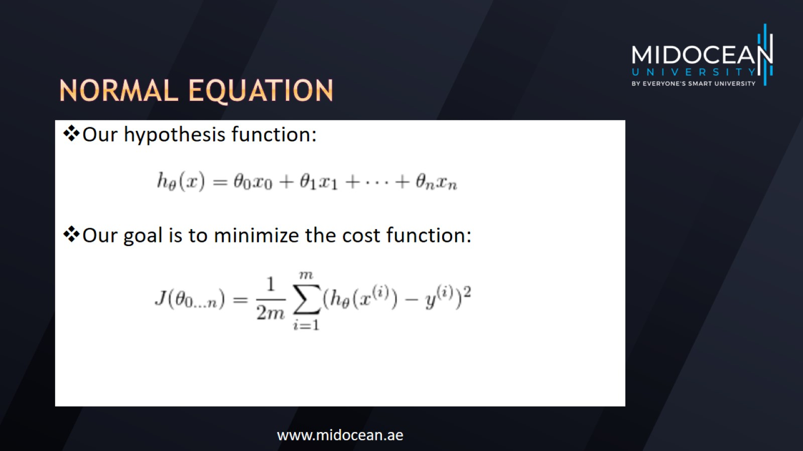
Normal equation

Slide 35
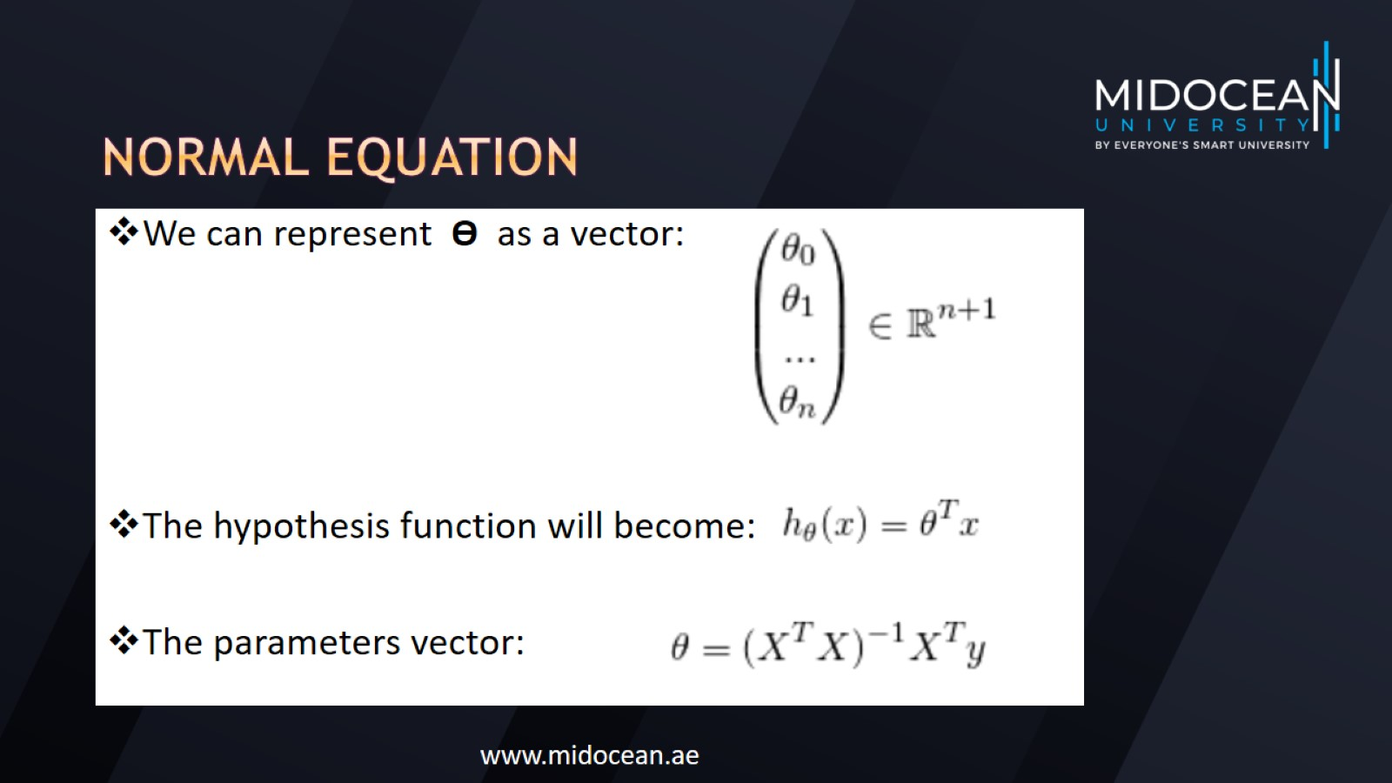
Normal equation

Slide 36

Feature vector

Slide 37

Target vector

Slide 38

Parameters vector

Slide 39
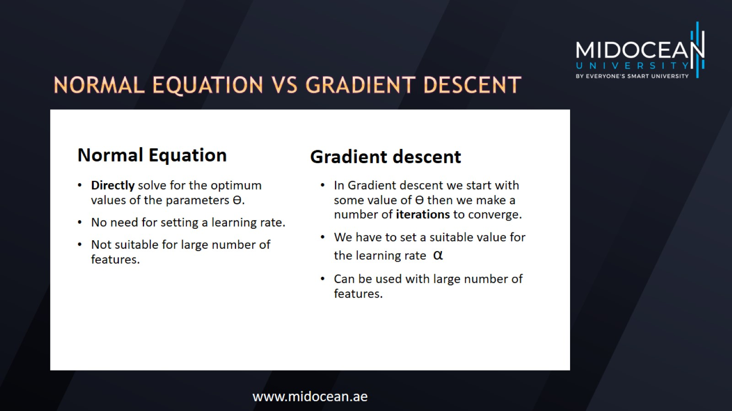
Normal Equation vs gradient descent

Slide 40
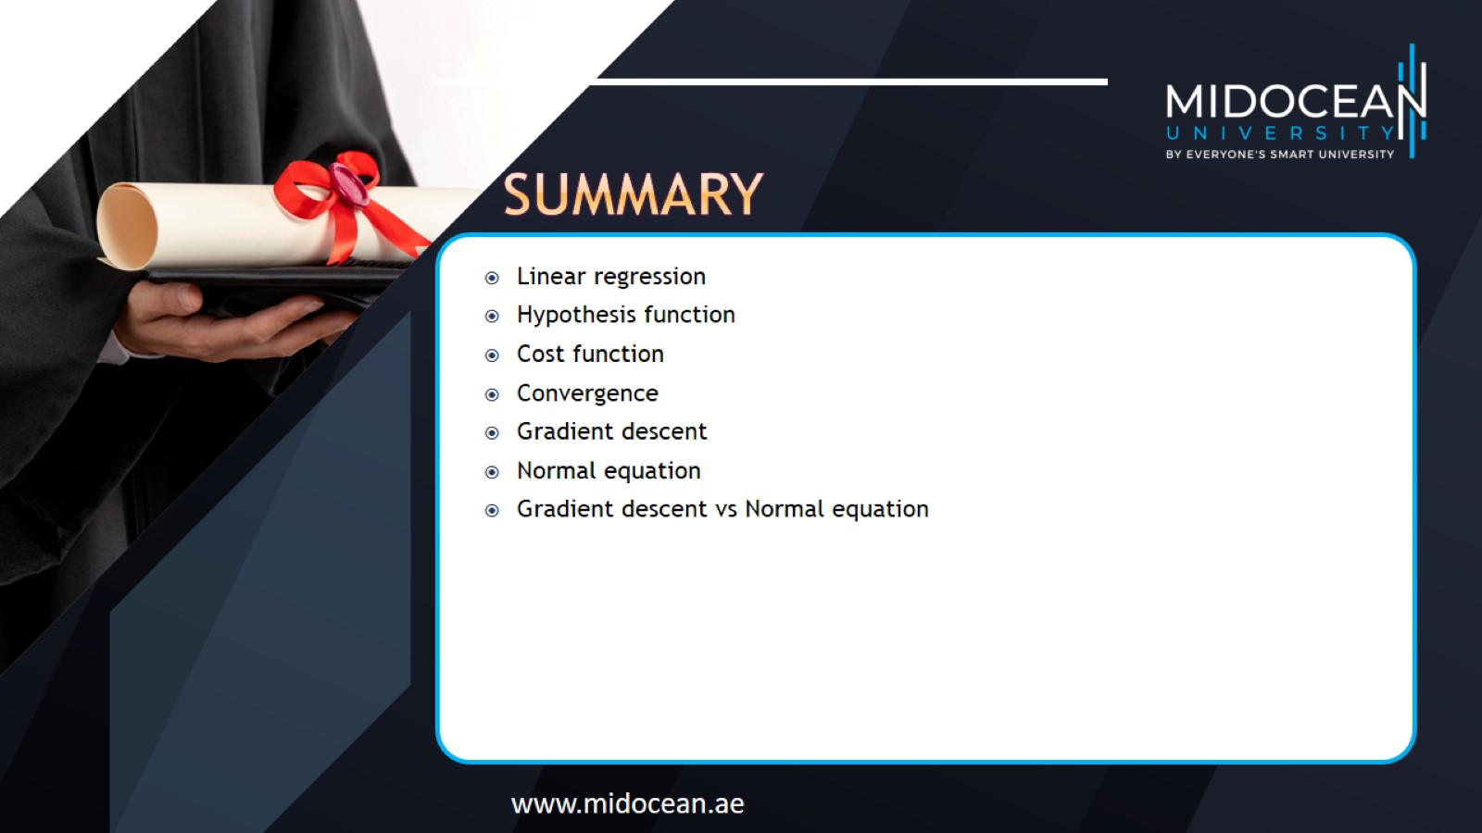

Slide 41


