Slide 1

Prepared by
Dr. Hamada I. AbdulWakel
Lecture 7
CYB615
Network Programming

Slide 2
Module5: Socket Names and Domain
Name System

Slide 3


Lecture 7
Agenda
Domain Name System (DNS).
Client/Server Using Getaddrinfo() method.
DNS module in Python.

Slide 4
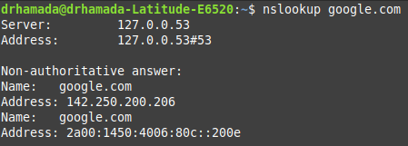
Lecture 7
Domain Name System
The Domain Name System (DNS) is the scheme by which millions of internet hosts cooperate to answer the question of what hostnames resolve to which IP addresses.
  Names are easy to remember.
  On Windows/Linux
nslookup google.com

Slide 5
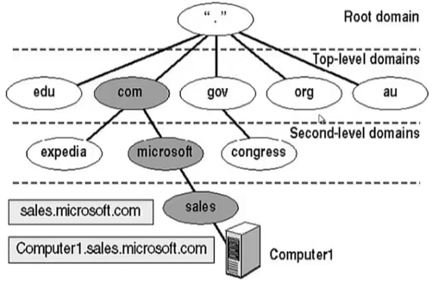
Lecture 7
Internal Work of DNS

Slide 6
Lecture 7
Internal Work of DNS
Domain Names are hierarchical, and each part of a domain name is referred to as either the root, top level, second level or as a sub-domain.
To allow computers to properly recognize a fully qualified domain name:
  Dots are placed between each part of the name.
  All resolvers start their lookups at the root.
  The resolver navigates its way down the tree until it gets to the left-most part of the domain name.

Slide 7
Lecture 7
DNS Servers
Top-level domain (TLD): the few hundred strings like com, edu, net, org, gov that together with country code like eg form the set of possible suffixes for valid domain names.
  Each TLD has its own set of servers and organization that oversees granting ownership to domains.
Domain name: the name that an organization appends as a suffix to its sites and hosts on the internet like python.org or bbc.co.uk.

Slide 8
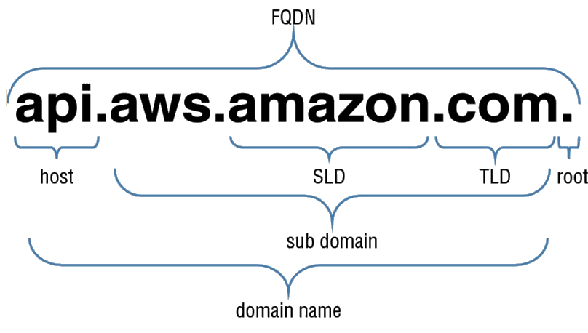
Lecture 7
Fully Qualified Domain Name
Fully qualified domain name (FQDN): names an internet site or host by appending its organization's full domain name to the name of a particular machine in that organization.

Slide 9
Lecture 7
Five Socket Coordinates
The address family: AF_INET, AF_INET6.
Socket type: SOCK_STREAM, SOCK_DGRAM.
The protocol: has the value 0 to force it to be chosen automatically.
The fourth and fifth values: used to make a connection are the IP address and port number.

Slide 10
Lecture 7
IPv6
To able to use AF_INET6 with socket object, you should first test if the python supports IPv6 by checking the has_ipv6.
import socket
print(socket.has_ipv6)

Slide 11
Lecture 7
getaddrinfo() Method
Getaddrinfo() returns a list of tuples for a given network service with which socket objects can be created to connect to that service.
socket.getaddrinfo(host, port, family=0, type=0, proto=0, flags=0)
  Host: IP address or host name.
  Port: could be a number or service name like http and www.
  Family: IP version.
  Type: Stream or Datagram.
  Proto: TCP or UDP.
  Flags: used for filtering the addresses.

Slide 12
Lecture 7
getaddrinfo() Method Example
import socket
from pprint import pprint
infolist = socket.getaddrinfo('google.com', 'www')
pprint(infolist)
info = infolist[0]
print(*info[0:2])
sok = socket.socket(*info[0:2])
print(info[4])
sok.connect(info[4])

Slide 13
Lecture 7
Client/Server Creation Using getaddrinfo()
If you want an address to provide to bind(), then you will call getaddrinfo() with None as the hostname.
Infolist = socket.getaddrinfo(None, 'www', socket.AF_INET)

Slide 14
Lecture 7
Server Creation Using getaddrinfo()
import socket
infolist = socket.getaddrinfo(None, 'www', socket.AF_INET)
info = infolist[0]
s= socket.socket(*info[0:2])
s.bind(info[4]); s.listen();
con, addr = s.accept()
con.send("Server: Hello".encode())
msg = con.recv(1024).decode()
print(msg)

Slide 15
Lecture 7
Client Creation Using getaddrinfo()
import socket
infolist = socket.getaddrinfo(None, 'www', socket.AF_INET)
info = infolist[0]
s= socket.socket(*info[0:2])
s.connect(info[4])
msg = s.rev(1024).decode()
print(msg)
s.send("client: I received your msg".encode())

Slide 16
Lecture 7
getaddrinfo() Flags
Call getaddrinfo() with AI_ADDRCONFIG flag, which filters out any addresses (IPv6 especially) that are impossible for your computer to reach.
If the service that you are connecting supports only IPv4, you will also want to specify AI_V4MAPPED to return the IPv4 addresses

Slide 17
Lecture 7
getaddrinfo() Flags
Cont'd
import socket
print(socket.getaddrinfo('fedoraproject.org', 'ftp')
print(socket.getaddrinfo('fedoraproject.org',
'ftp',
socket.AF_INET,
socket.SOCK_STREAM,
0,
socket.AI_ADDRCONFIG | socket.AI_V4MAPPED))

Slide 18
Lecture 7
Primitive Socket Methods
socket.gethostname(): return local host name
socket.gethostbyname('cern.ch'): return IP
socket.gethostbyaddr('127.0.0.1'): return host name
socket.getprotobyname('UDP'): return a number for this protocol
socket.getservbyname('www'): return port number for this service
socket.getservbyport(80): return service name for this port

Slide 19
Lecture 7
DNS Record Types
Commonly used record types:
  A: host address
  AAAA: IPv6 host address
  CNAME: (Canonical Name for an alias) is a type of record in the DNS used to map a domain name as an alias for another domain. CNAME records always point to another domain name and never directly to an IP address.

Slide 20
Lecture 7
DNS Record Types
Cont'd
Commonly used record types:
  MX: also called mail exchanger record is a resource record in the DNS that specifies a mail server responsible for accepting email messages on behalf of a recipient's domain.
  NS (Name Server): directs to name servers, where to ask if you want know about a subdomain.
  TXT (Descriptive Text): lets the administrator insert into the DNS record.

Slide 21
Lecture 7
DNS Query from Python
Install DNS corresponding module.
pip install dnspython3

Slide 22
Lecture 7
DNS Query from Python
Cont'd
import dns.resolver as dns
def lookup(name):
NSrecord = dns.query(name, 'NS')
For ns in NSrecord:
print(ns)
lookup('google.com')
lookup('matrix219.com')

Slide 23
Lecture 7
DNS Query from Python
Cont'd
import dns.resolver
def lookup(name):
for qtype in 'A', 'AAAA', 'CNAME', 'MX', 'NS':
answer = dns.resolver.query(name, qtype, raise_on_no_answer=False)
for val in answer:
print(val)
lookup('google.com')

Slide 24
THANK YOU

