Slide 1


Slide 2



Slide 3
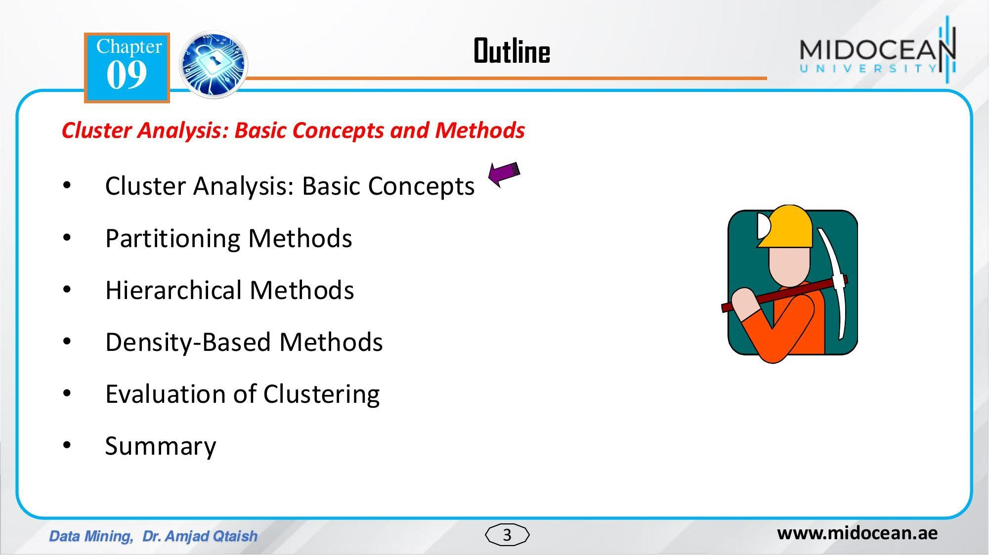


Slide 4
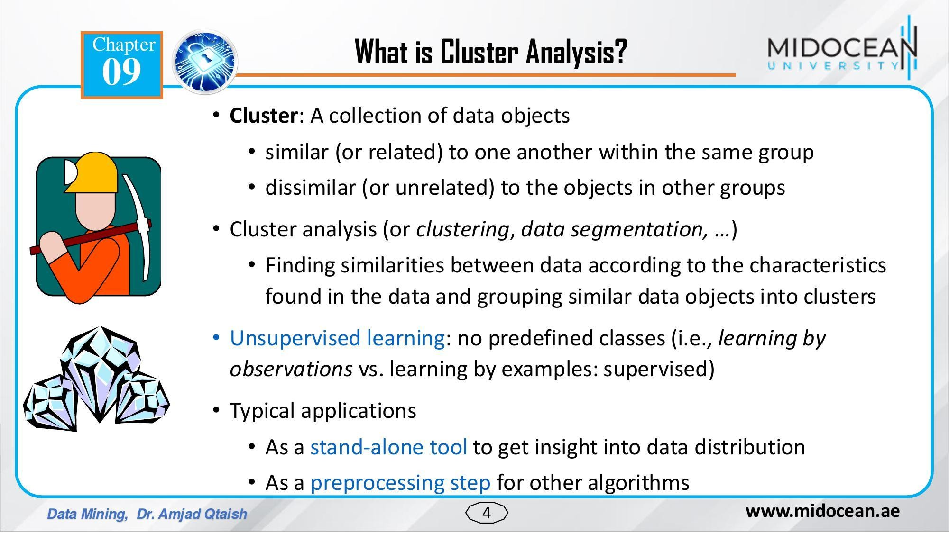

Slide 5
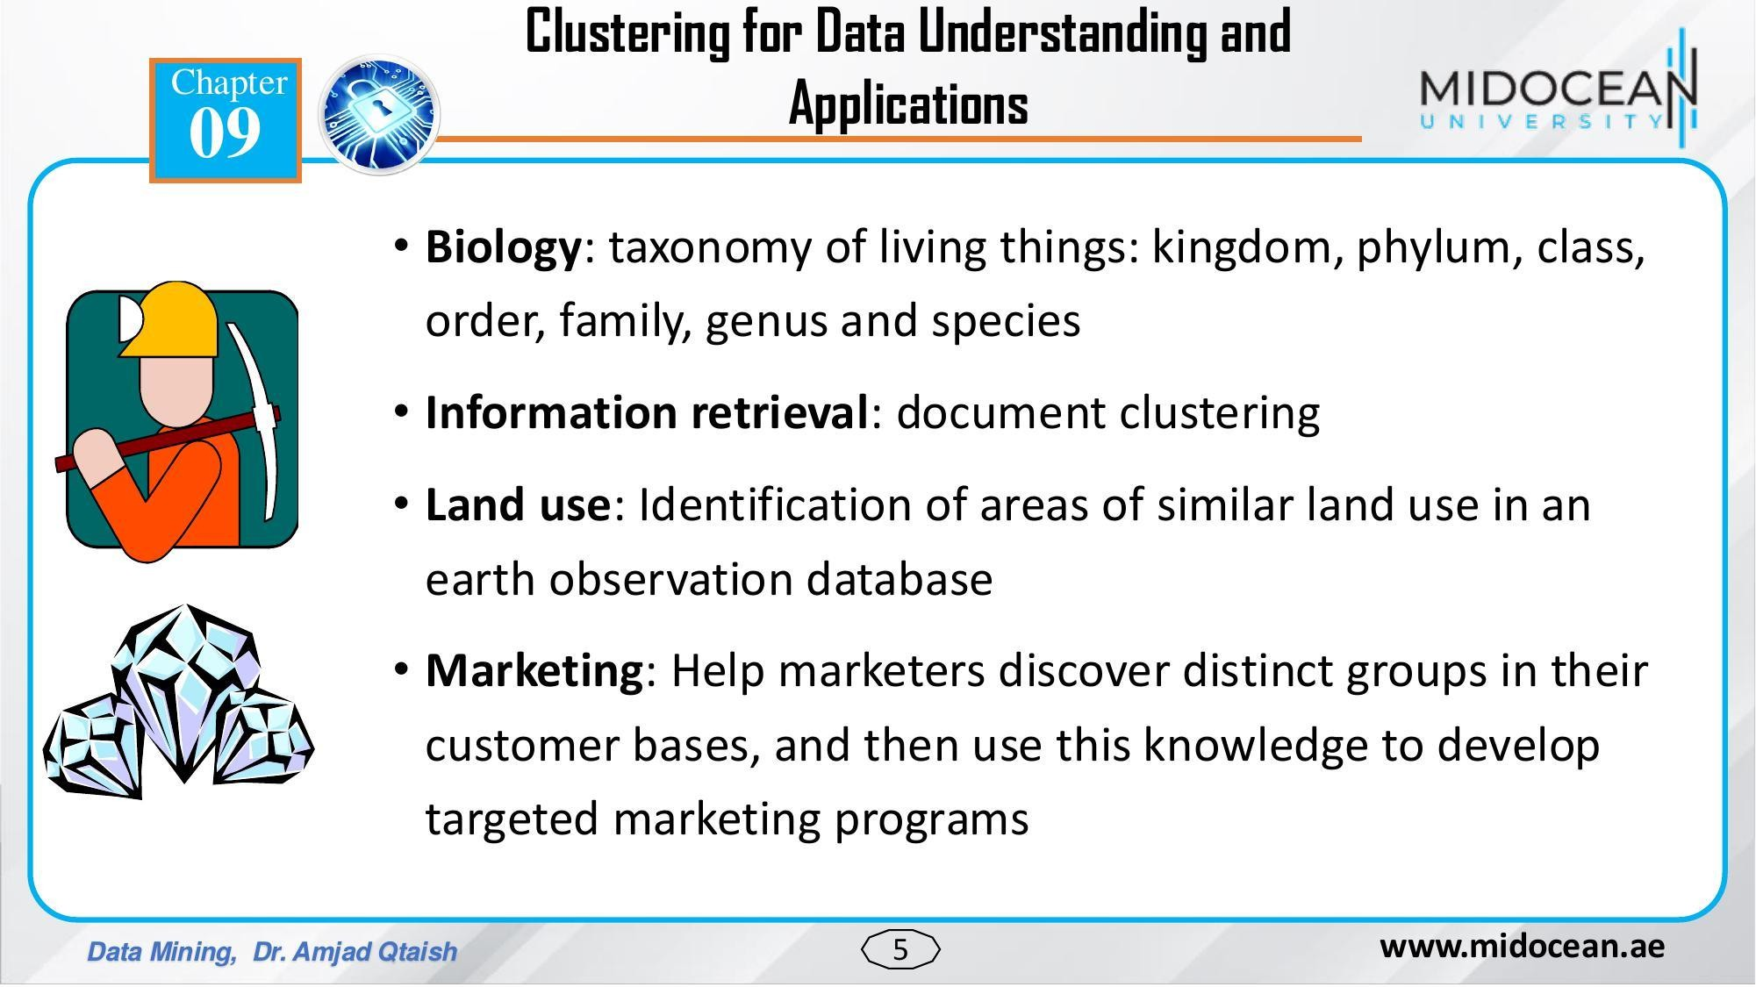

Slide 6
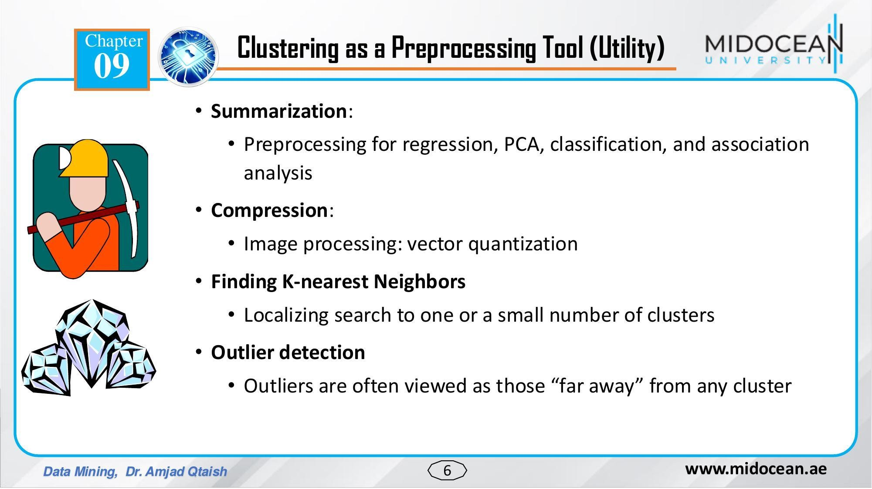

Slide 7
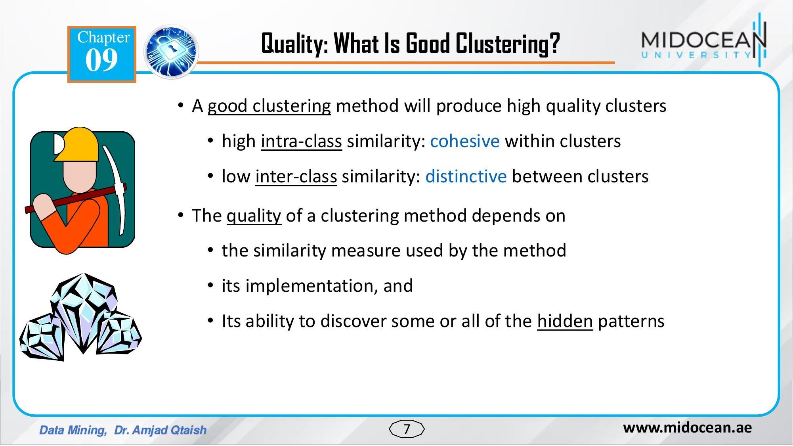

Slide 8
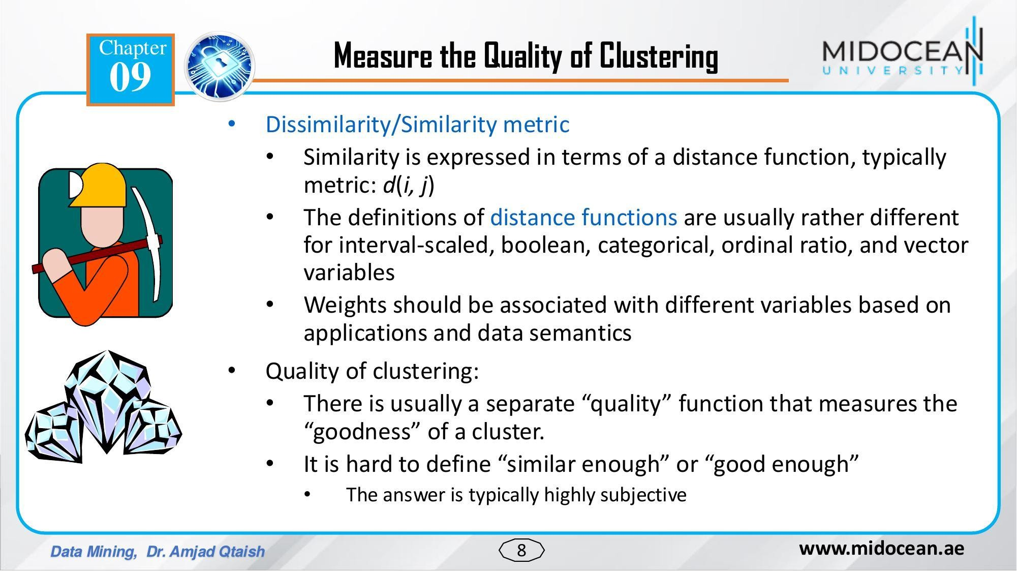

Slide 9
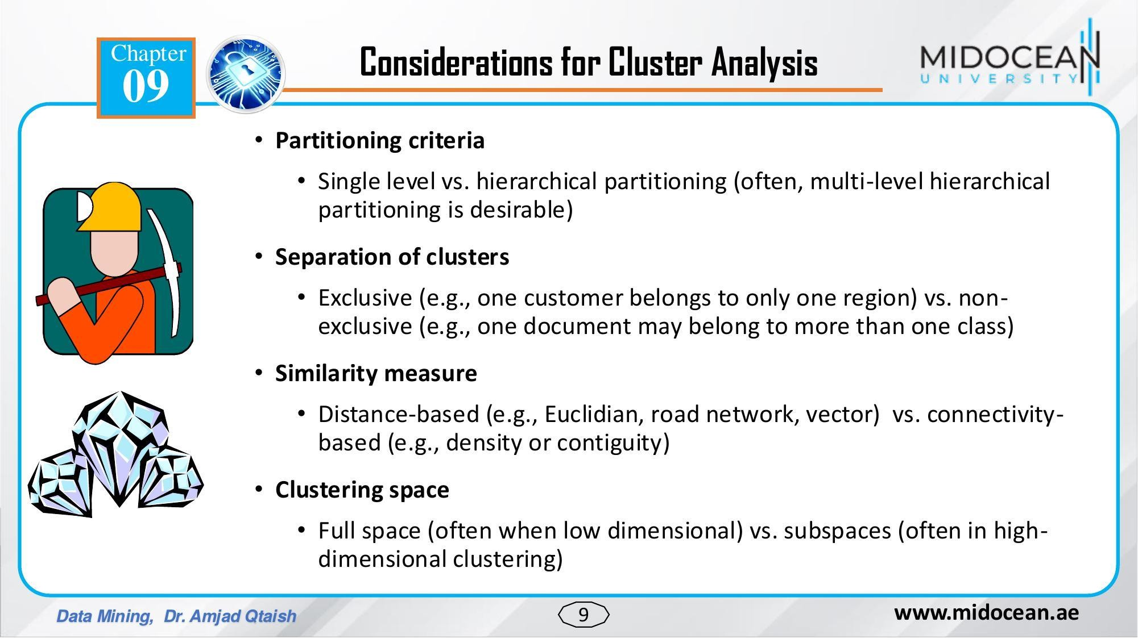

Slide 10
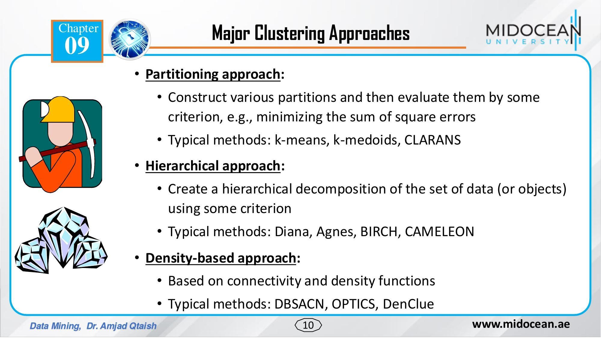

Slide 11
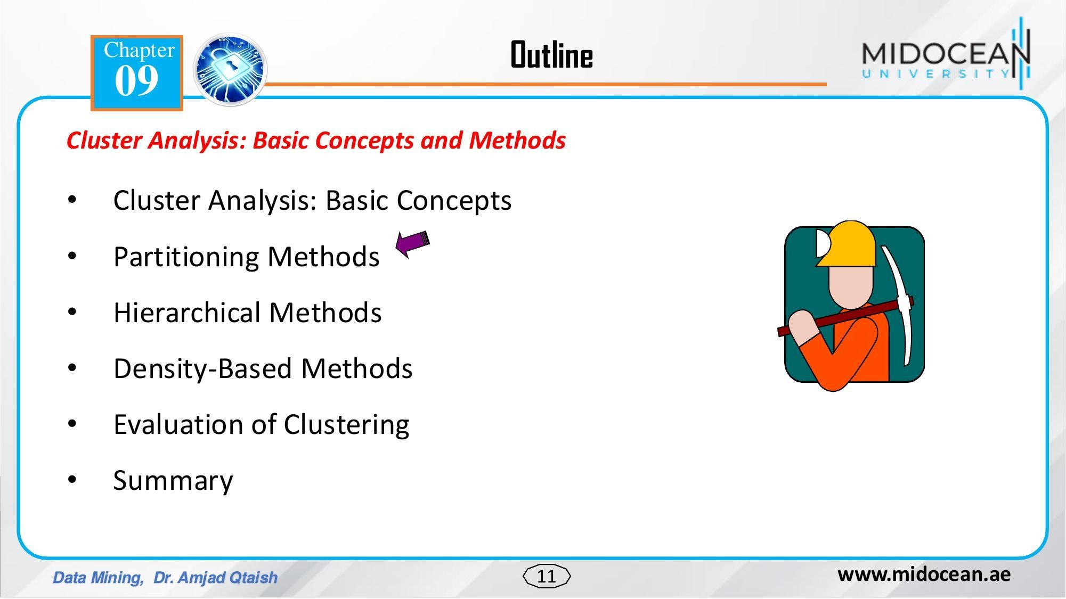

Slide 12
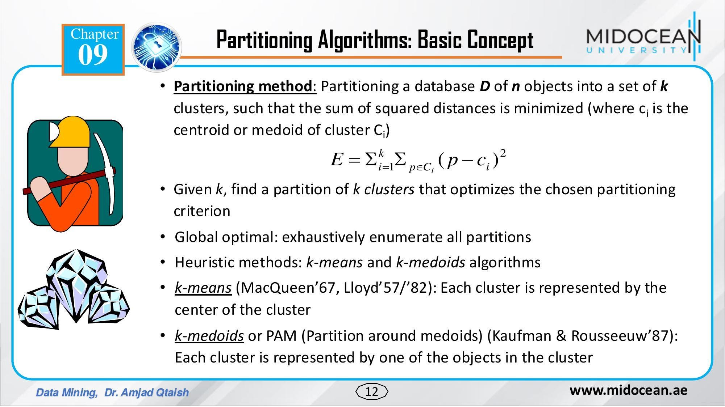

Slide 13
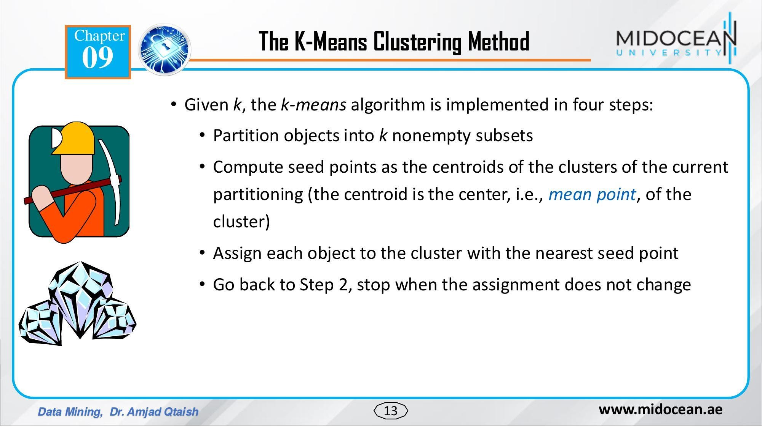

Slide 14
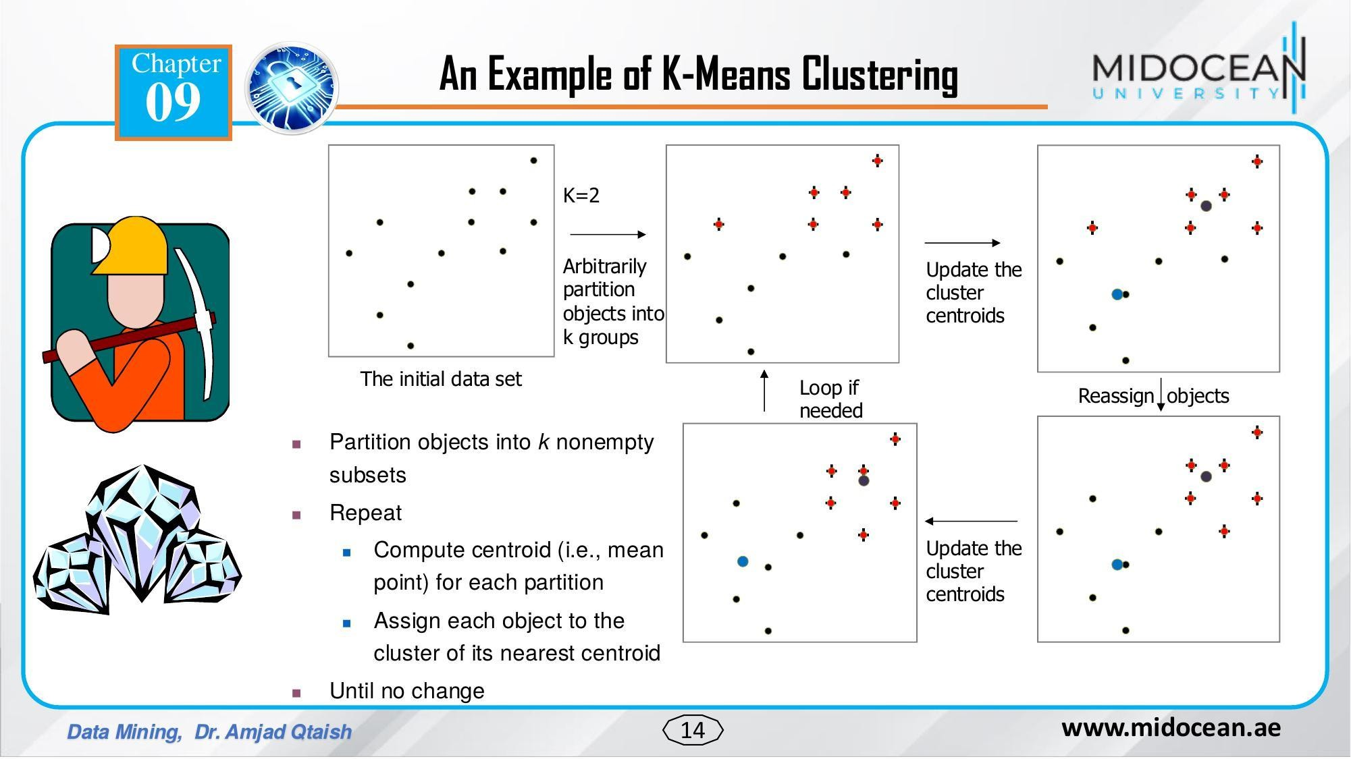

Slide 15
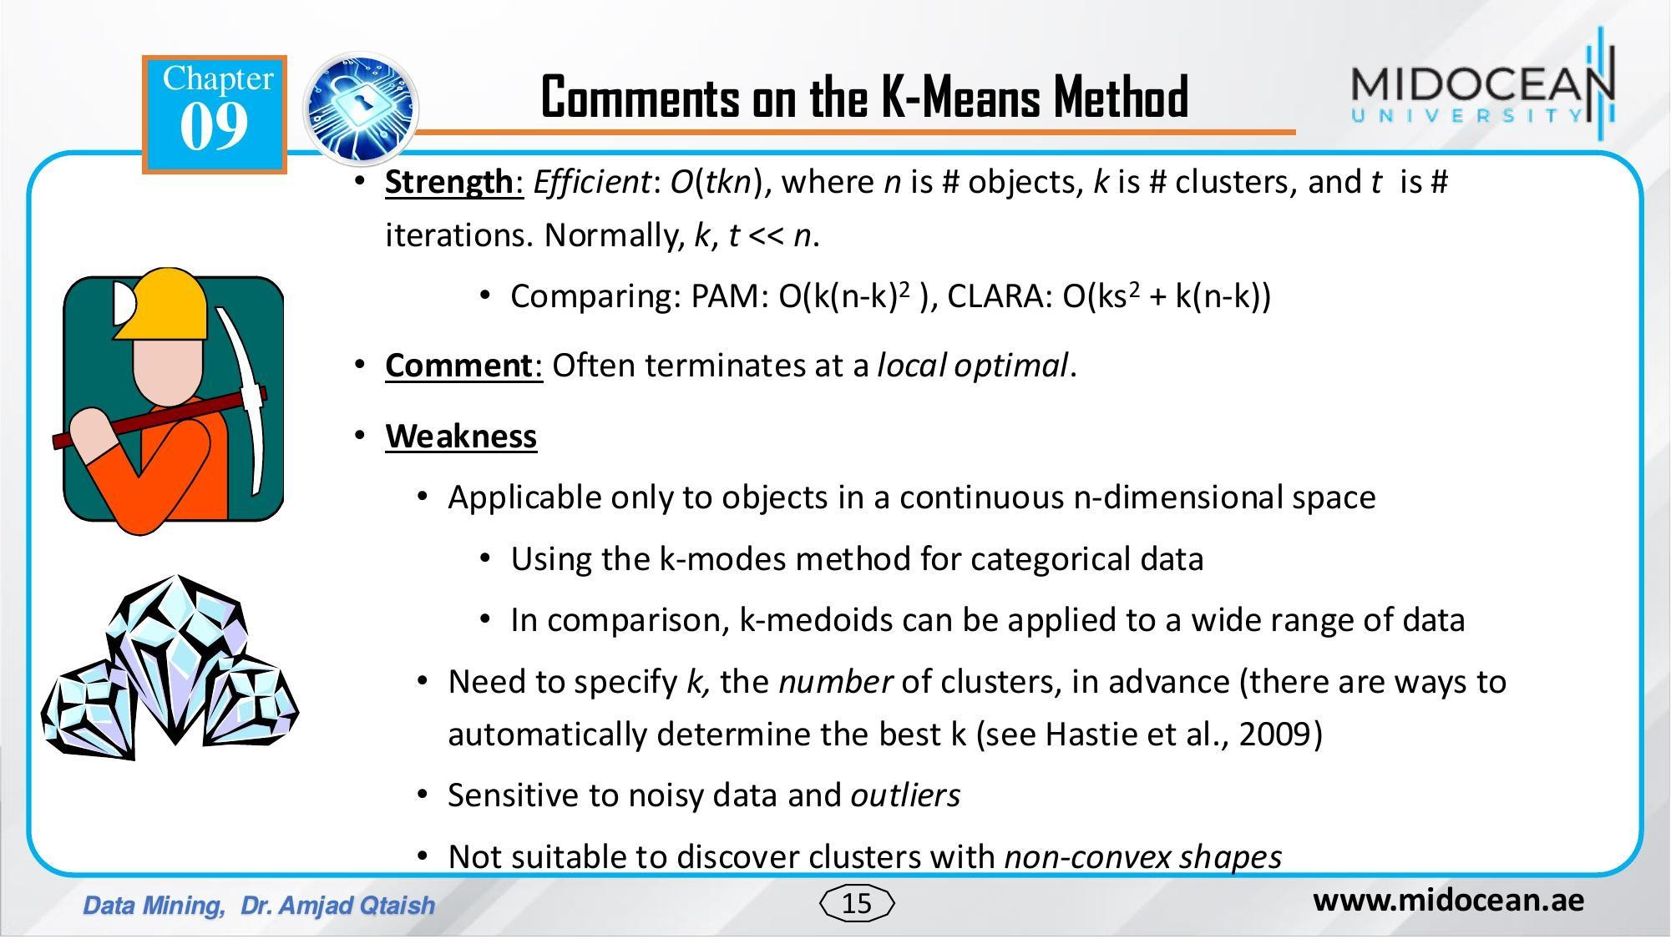

Slide 16
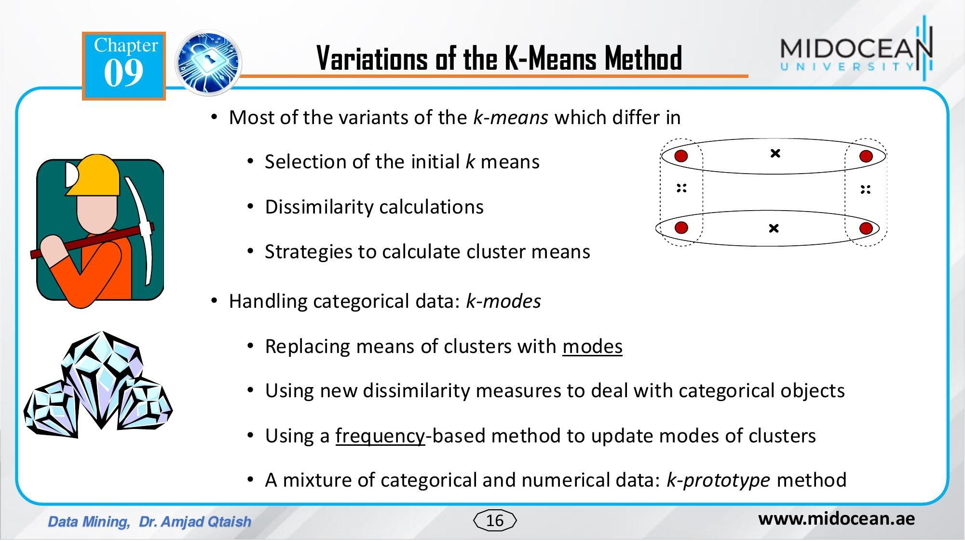

Slide 17
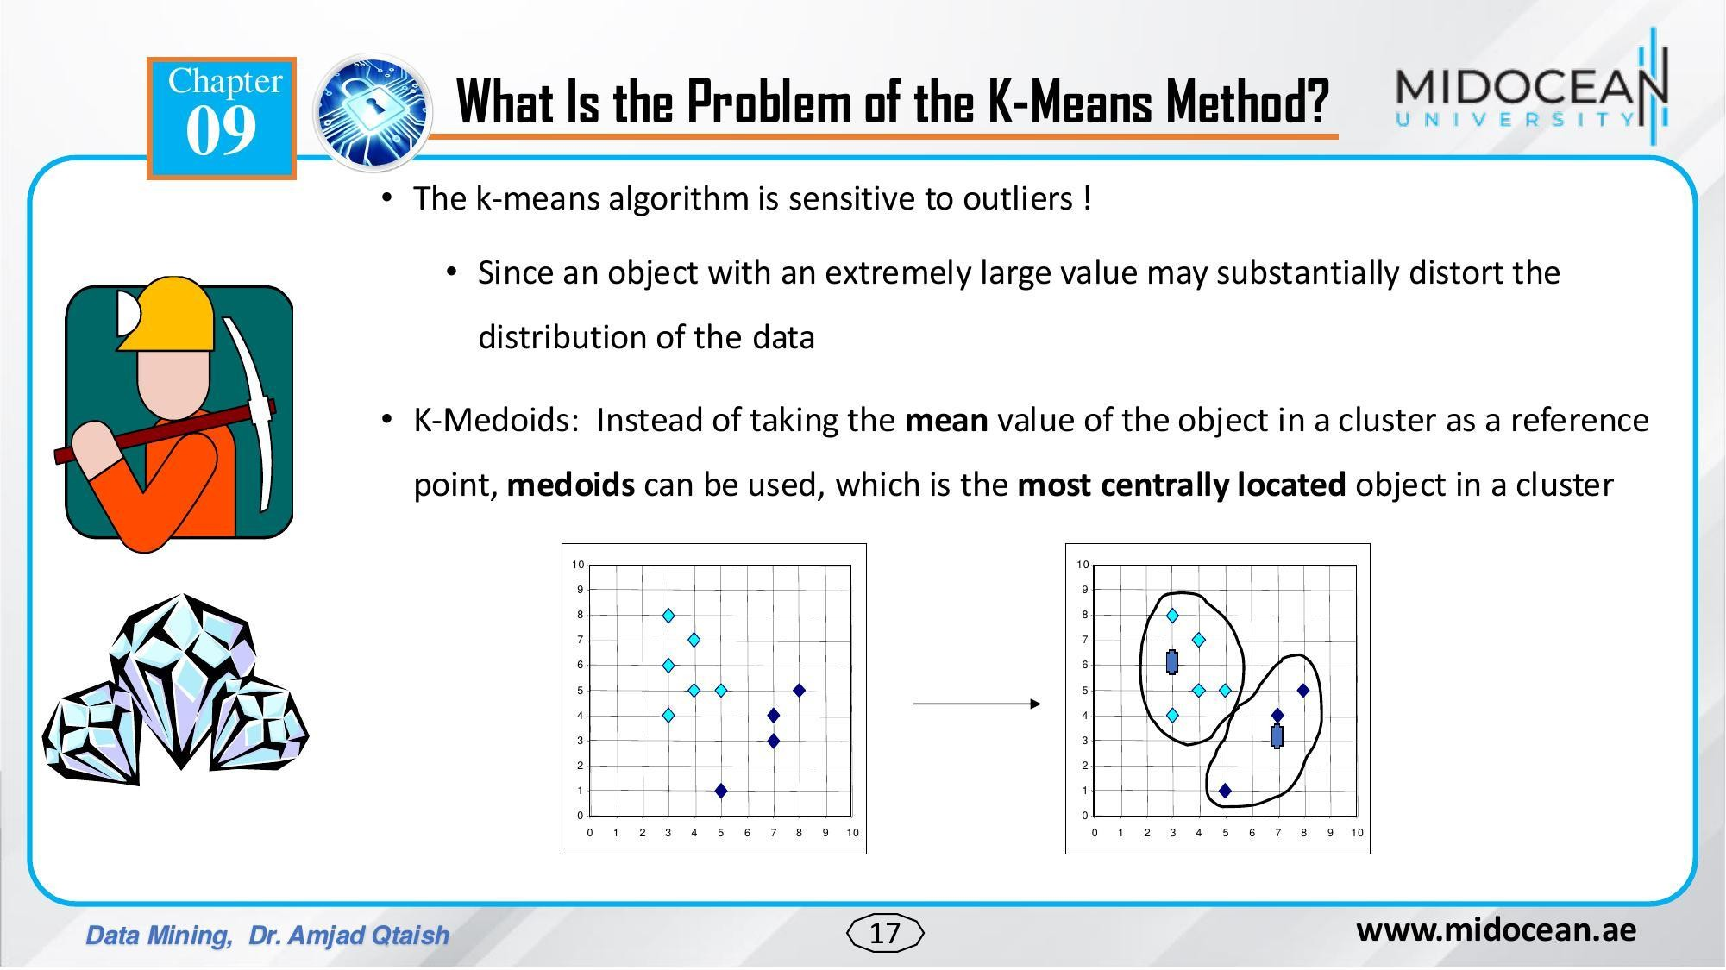

Slide 18
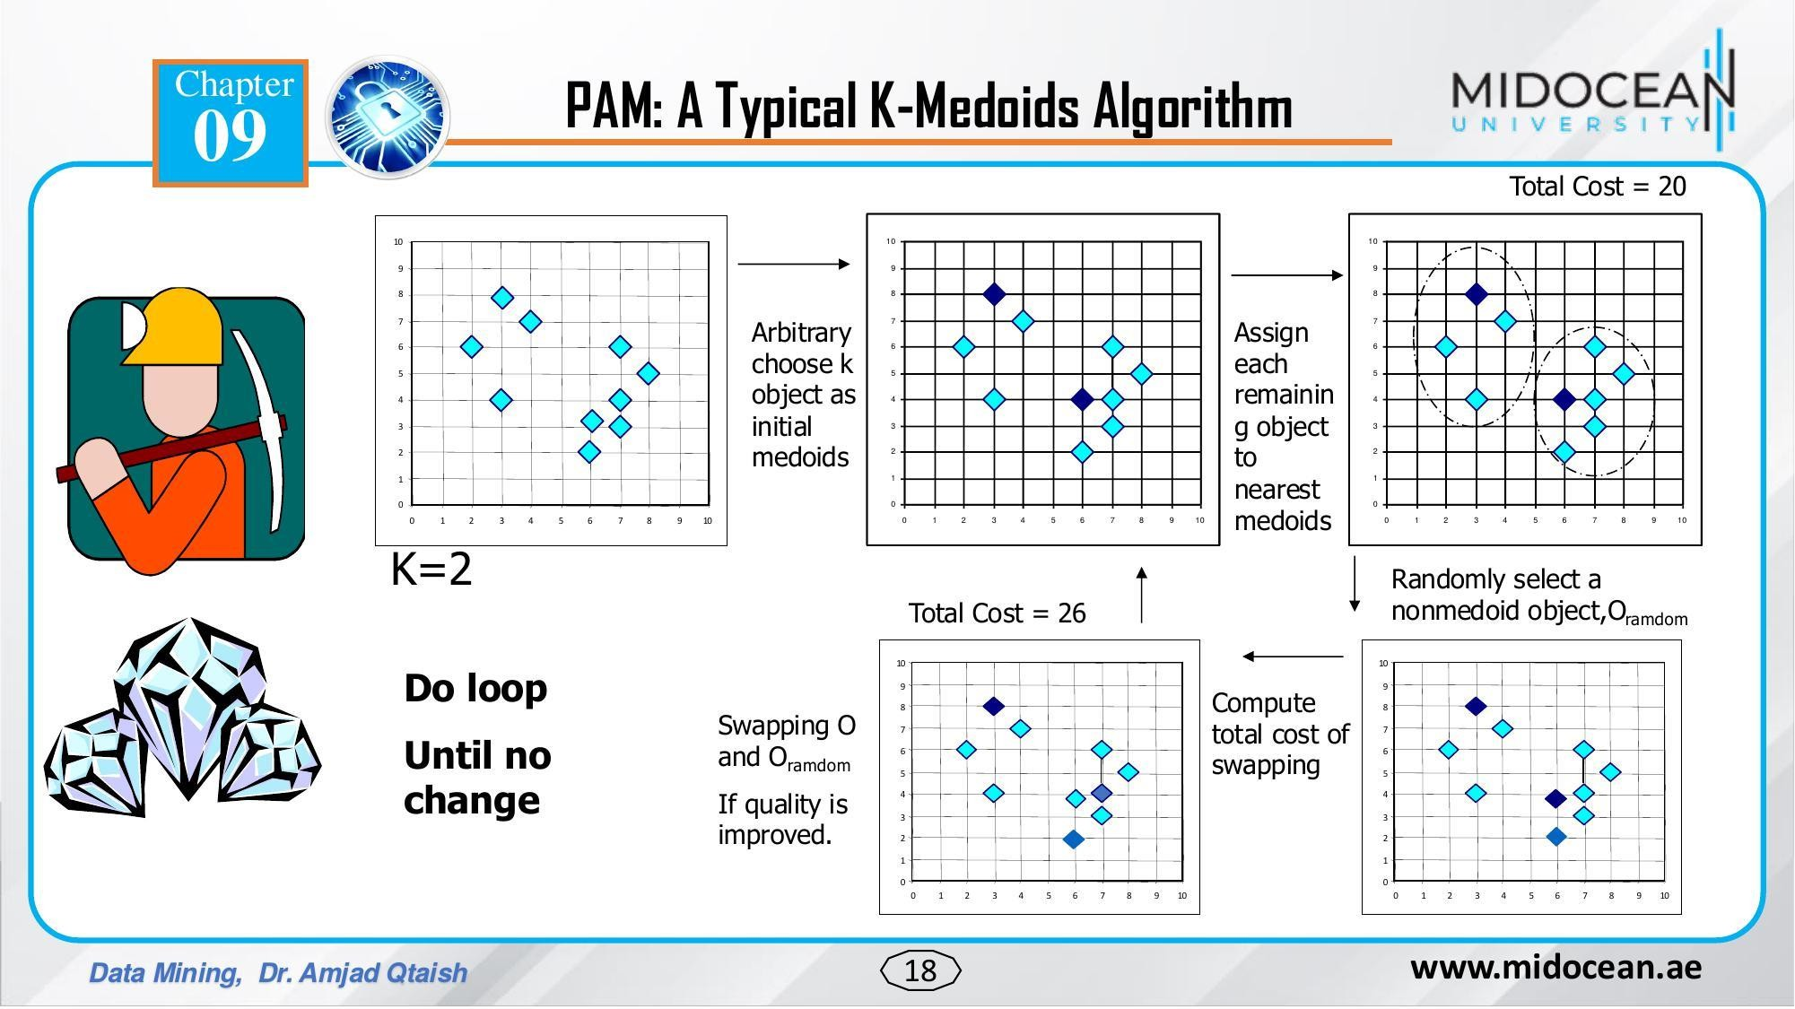

Slide 19


Slide 20
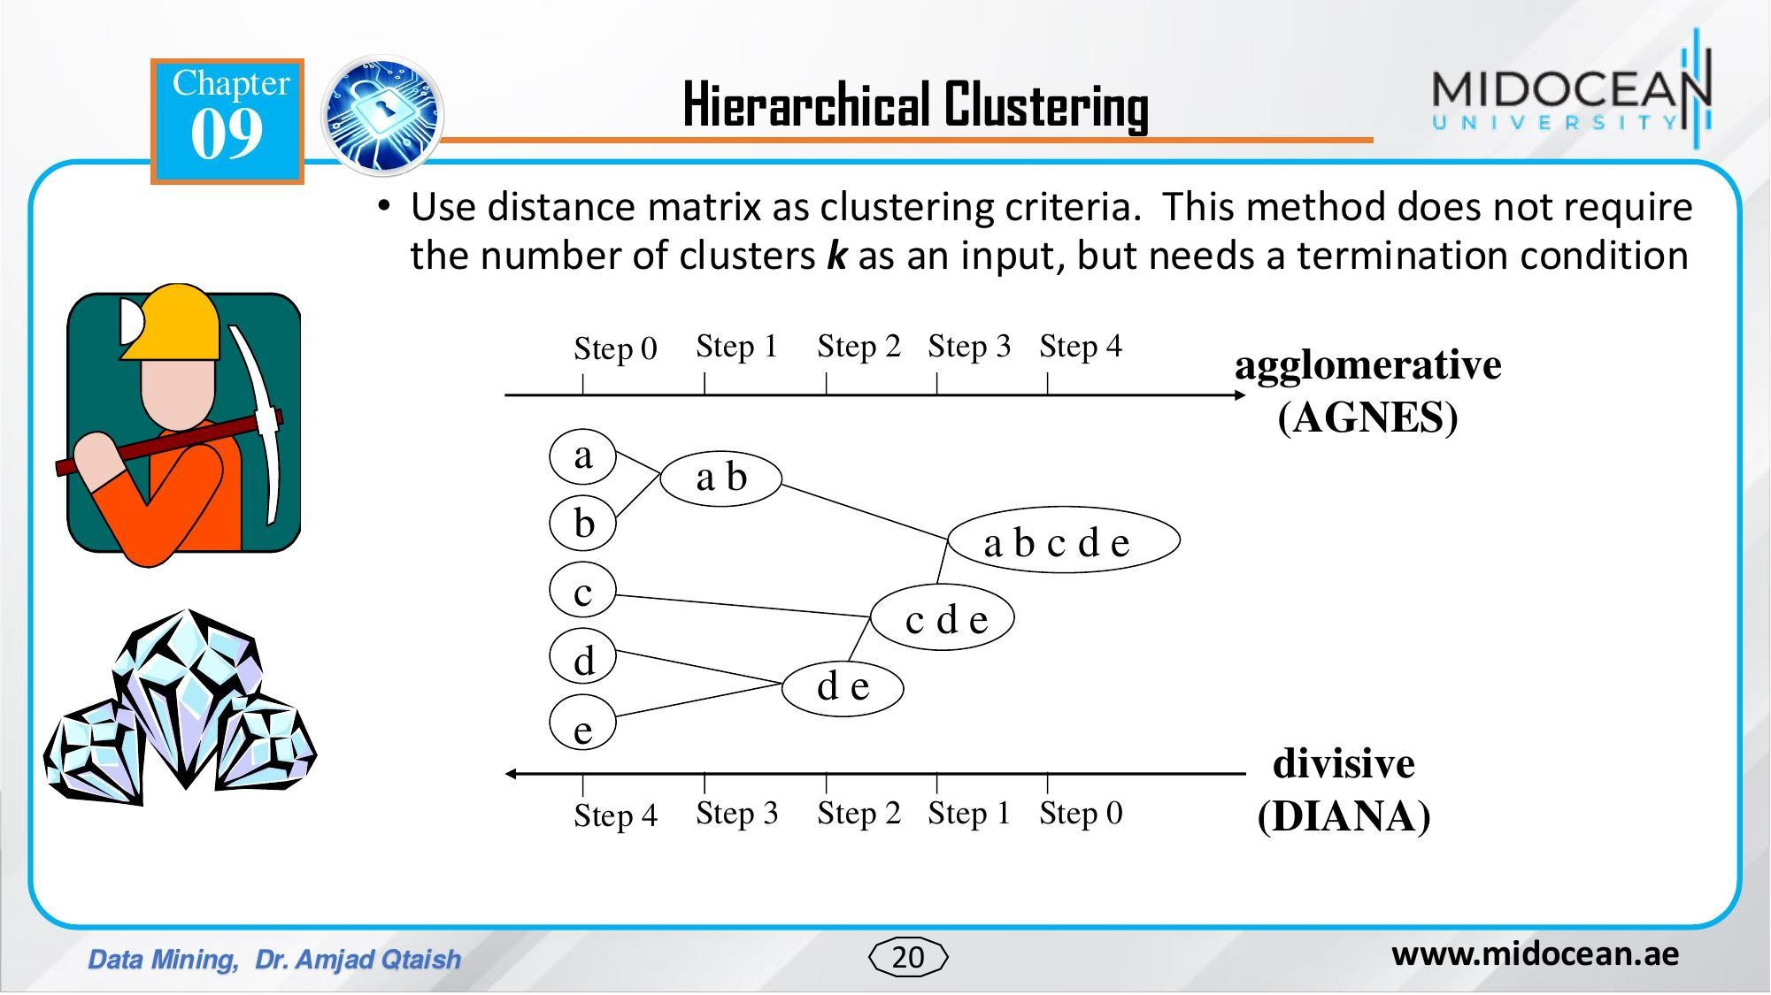

Slide 21
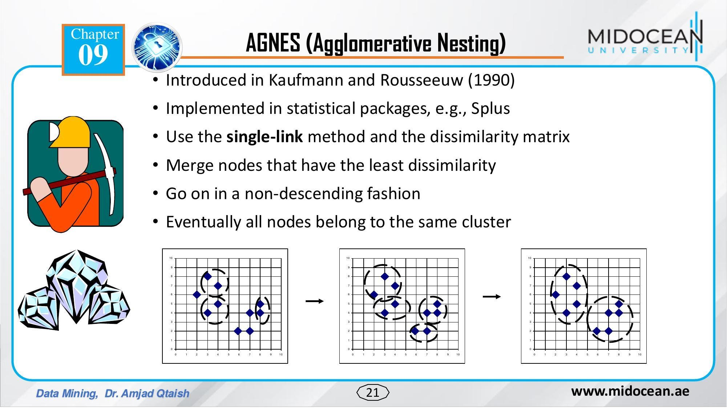

Slide 22
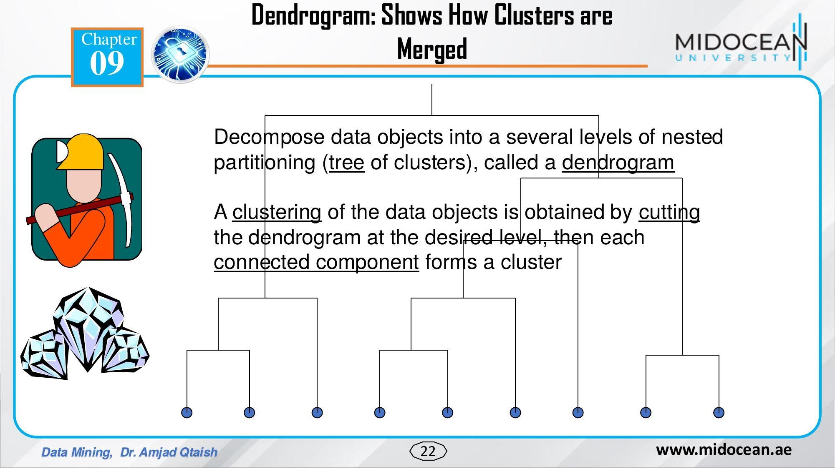

Slide 23
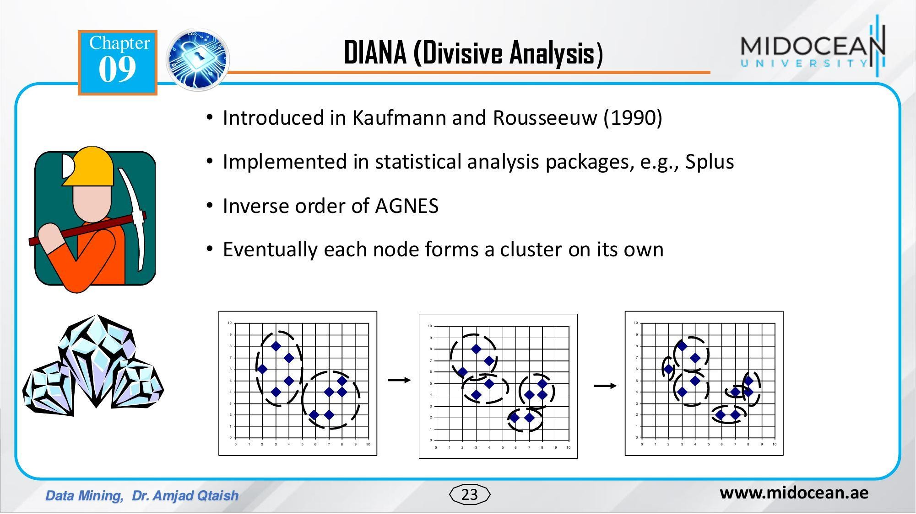

Slide 24
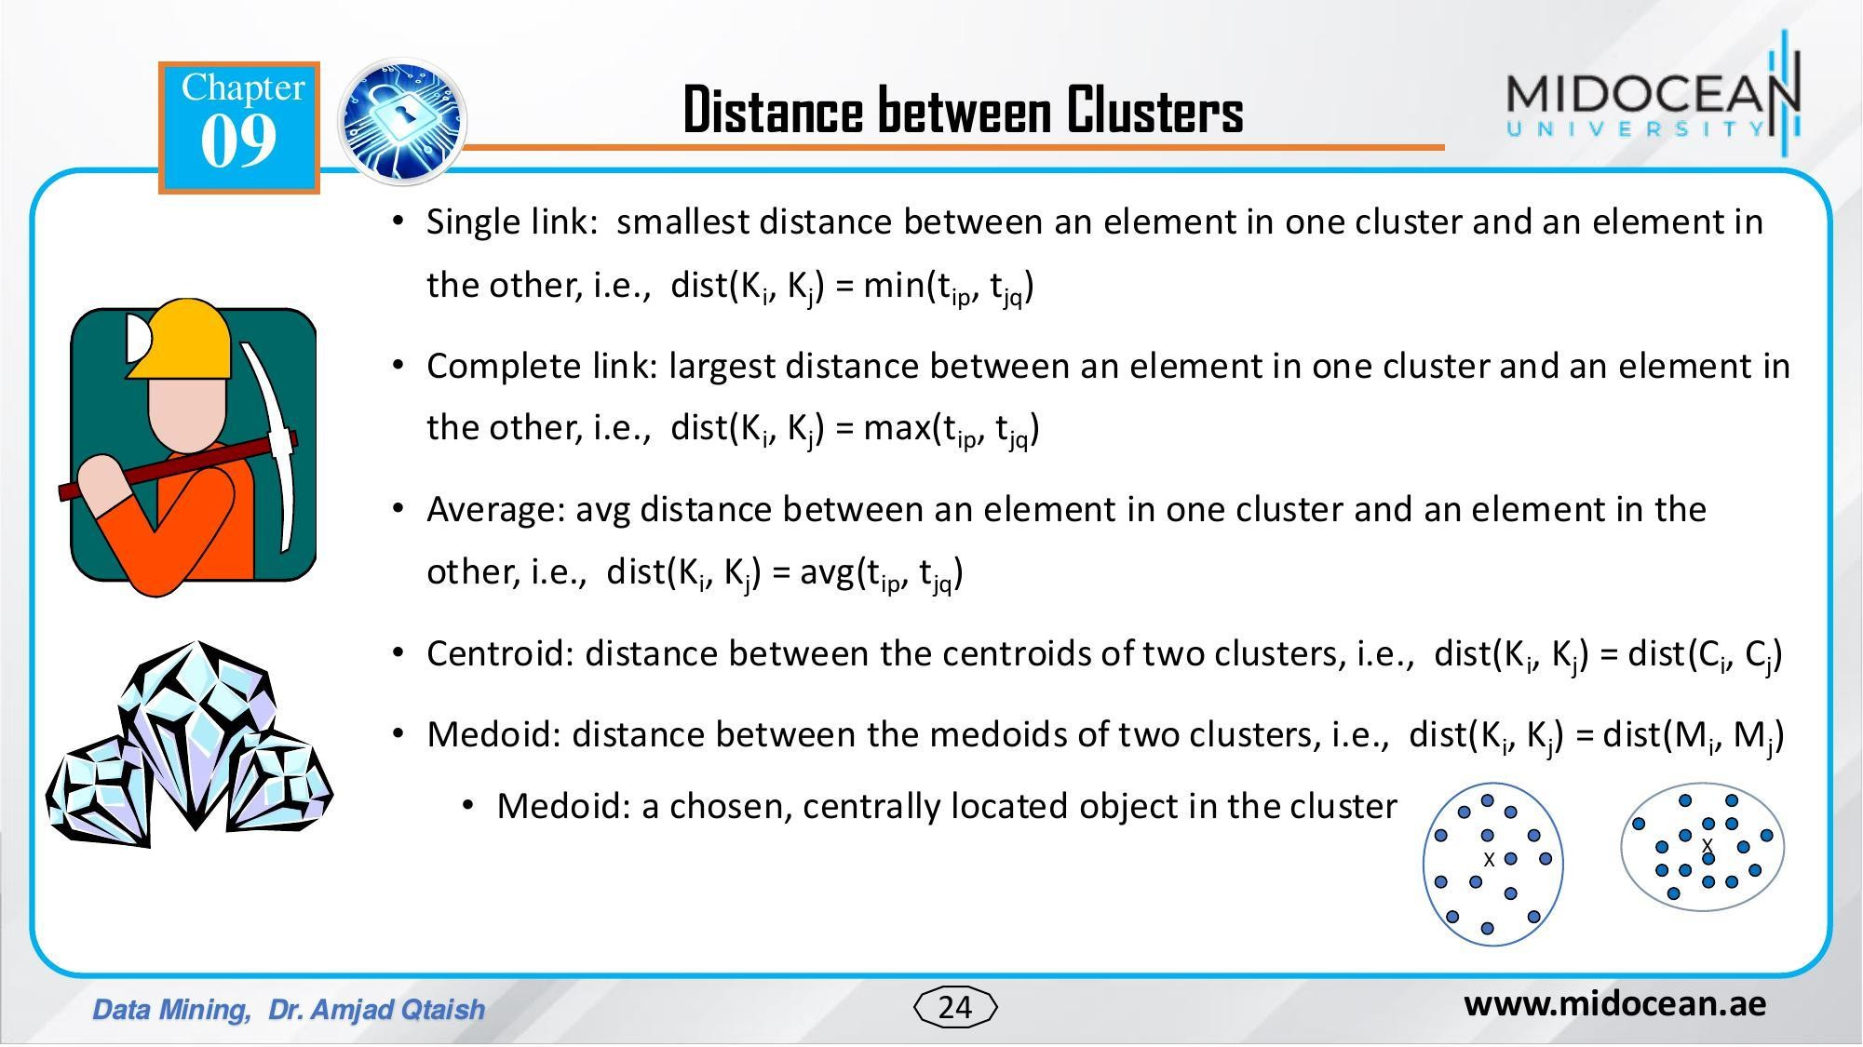

Slide 25
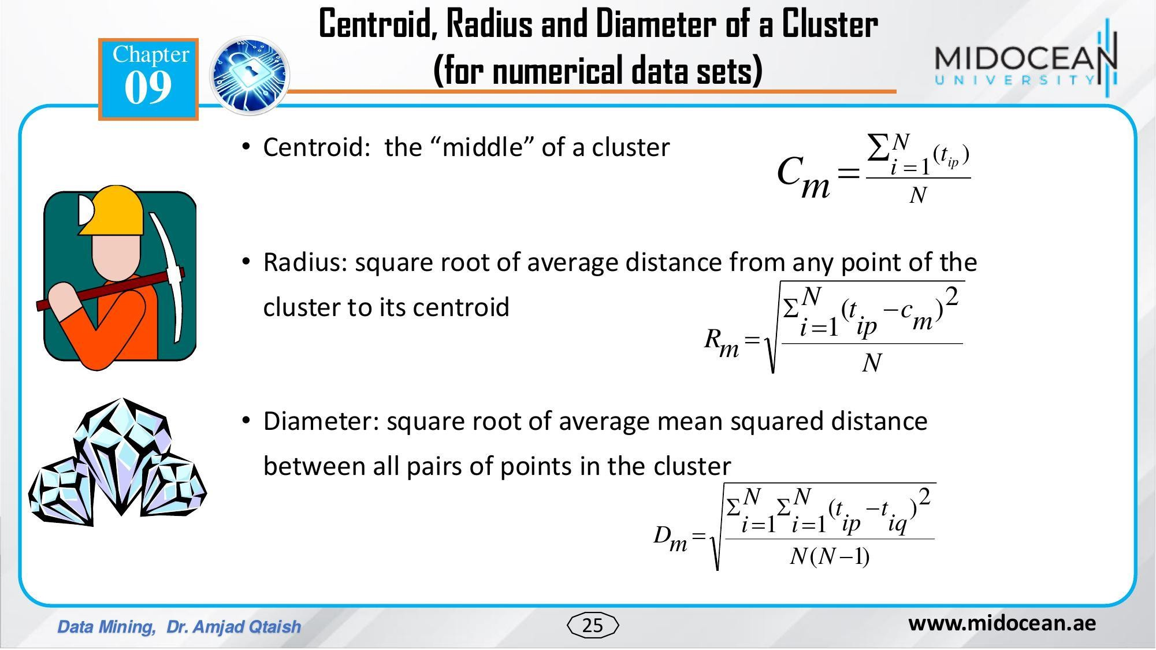

Slide 26
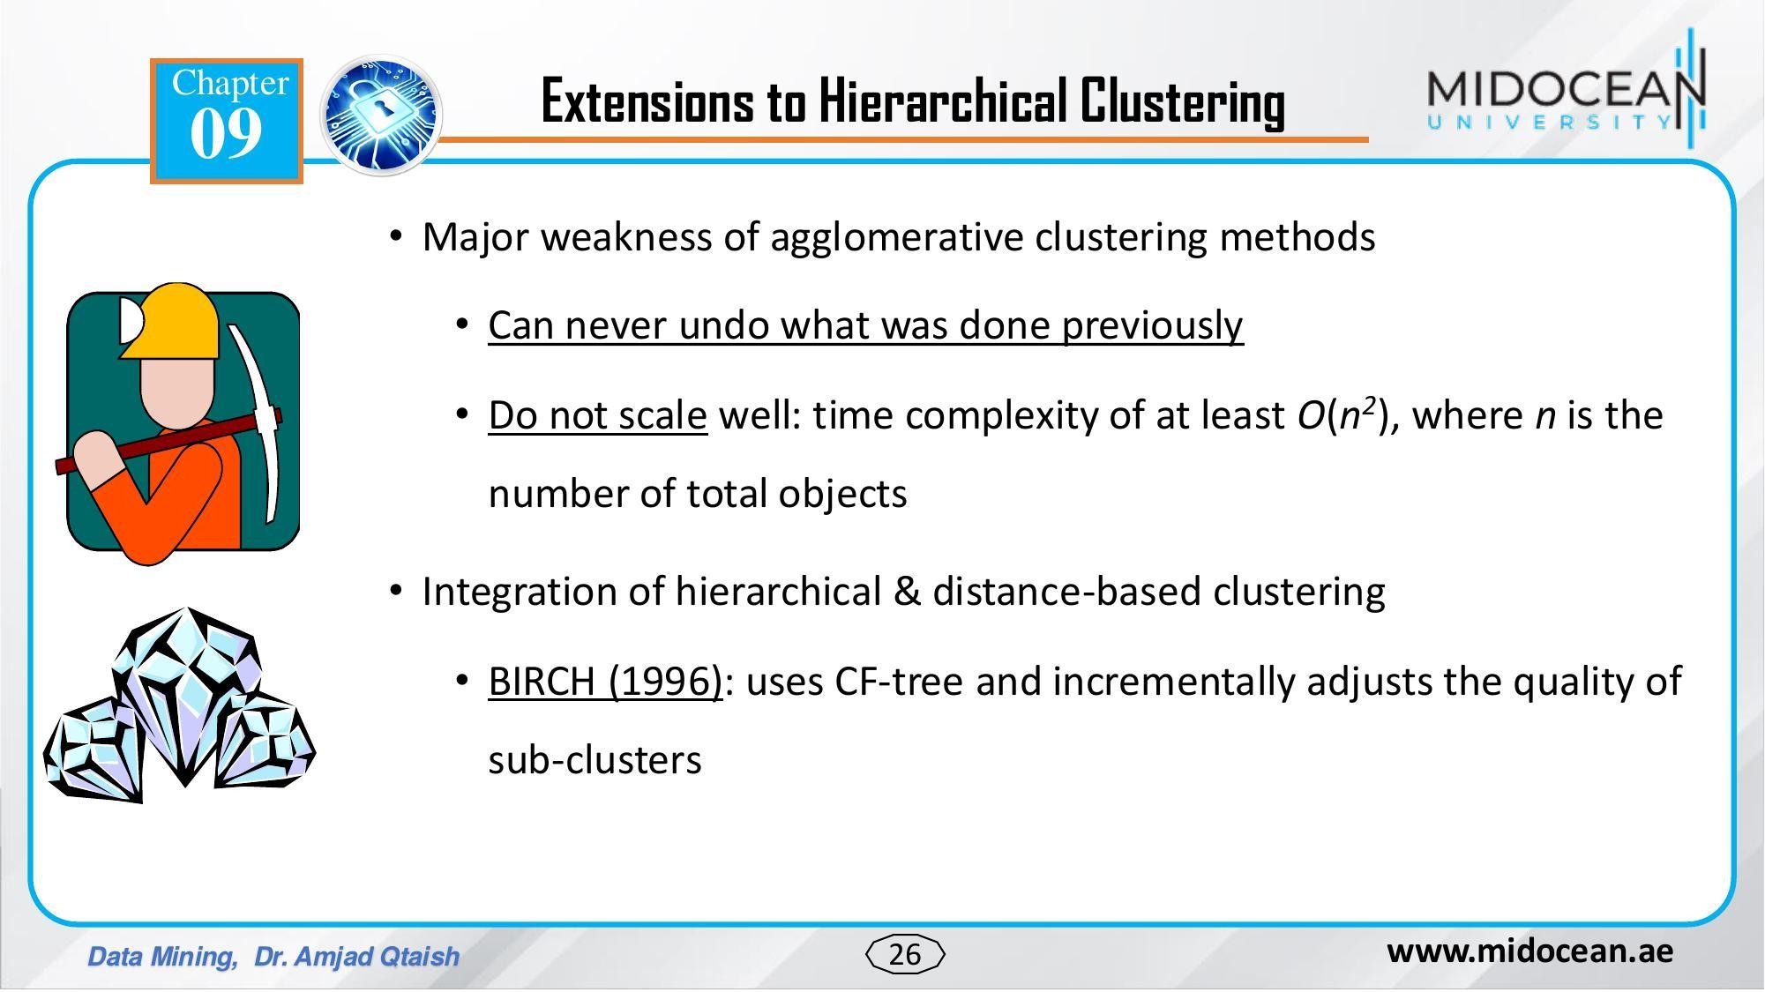

Slide 27
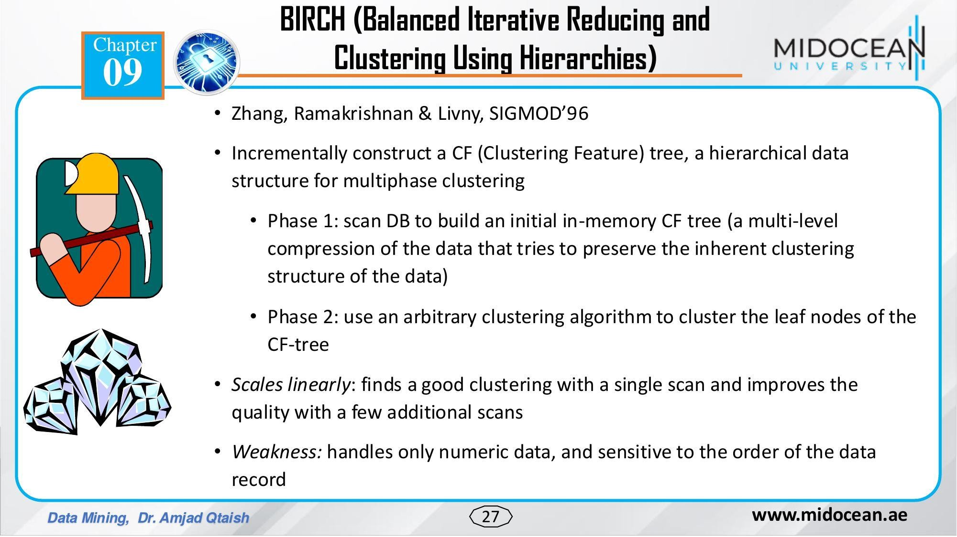

Slide 28
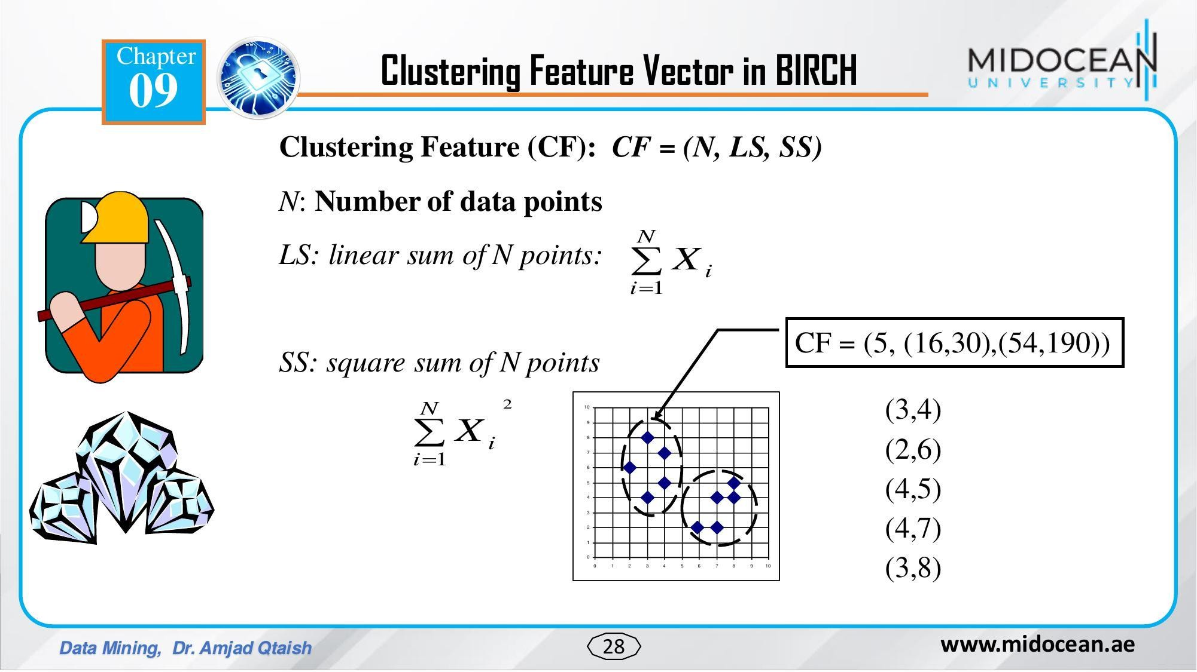

Slide 29
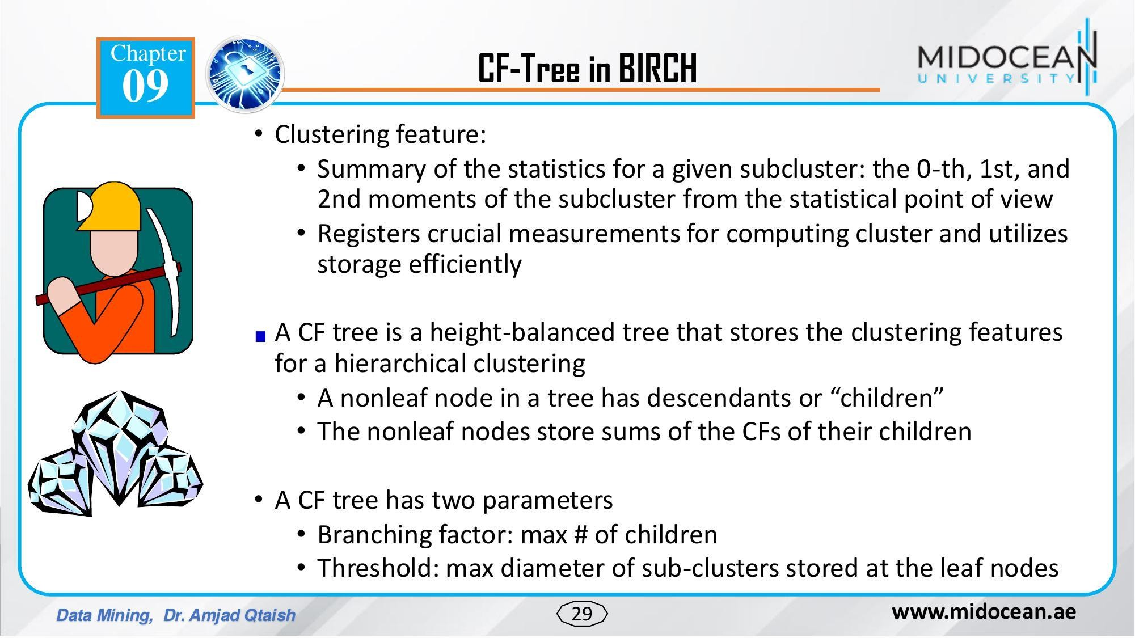

Slide 30
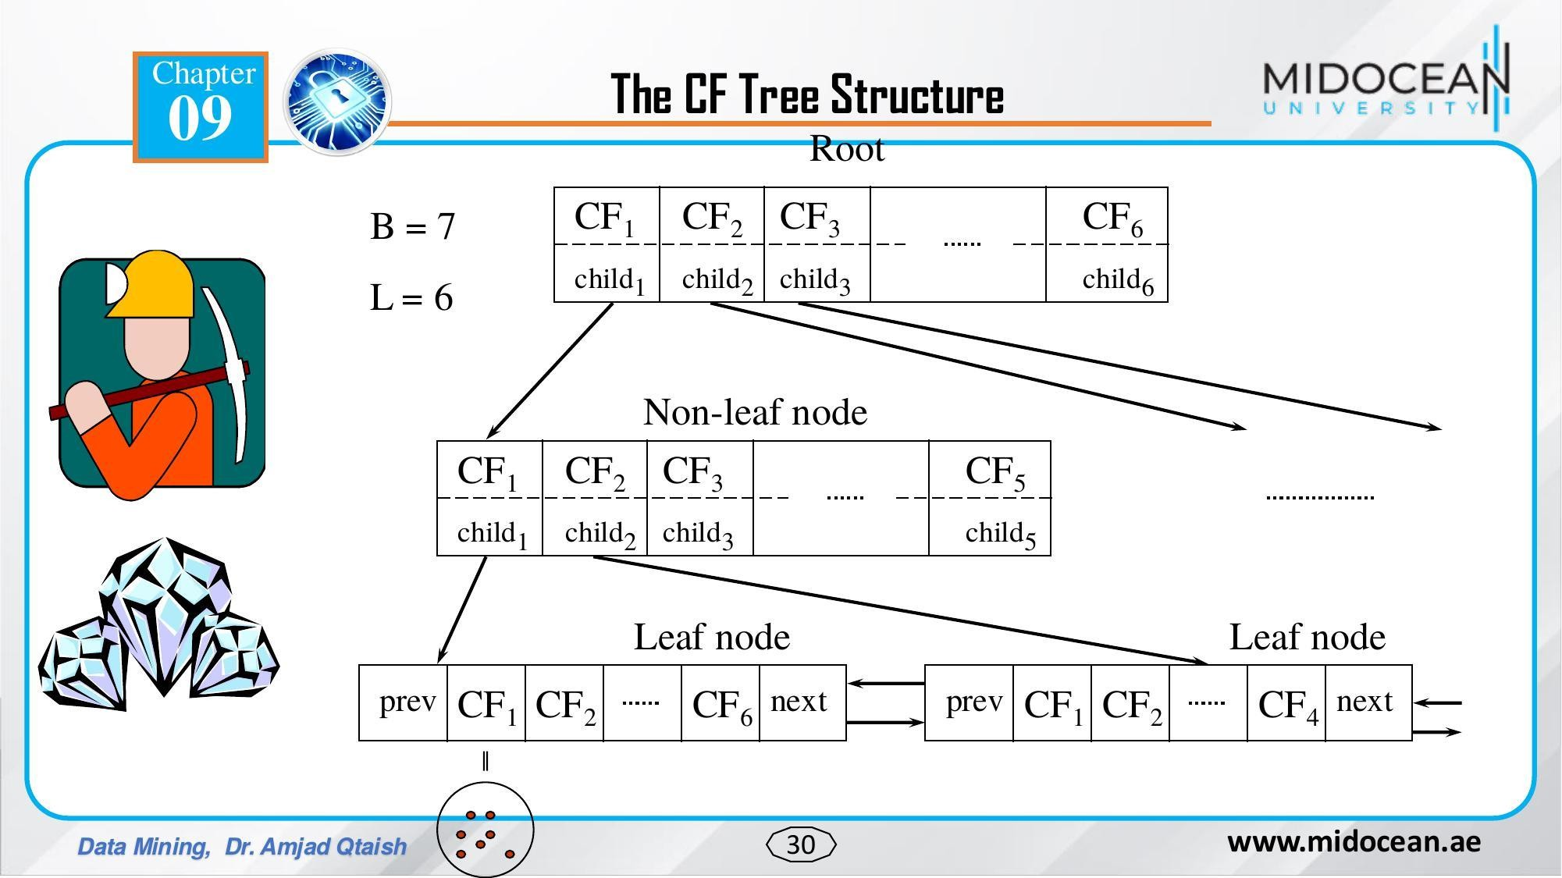

Slide 31
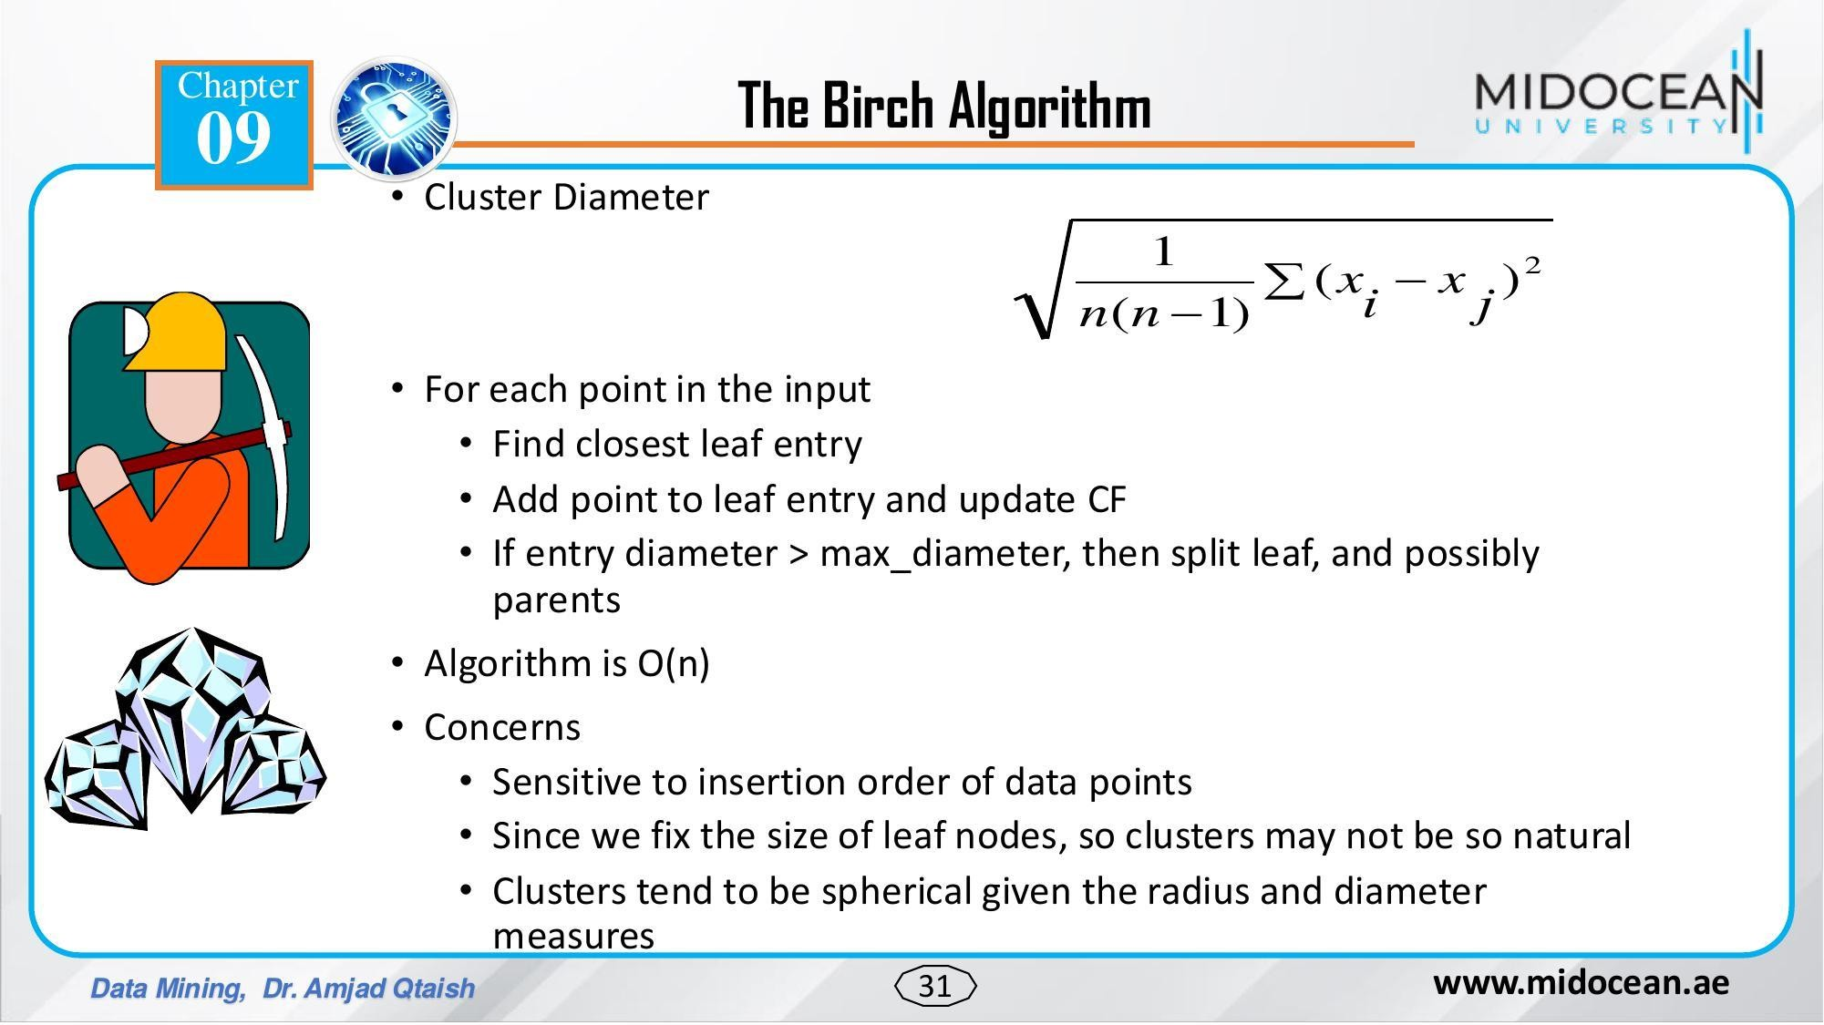

Slide 32
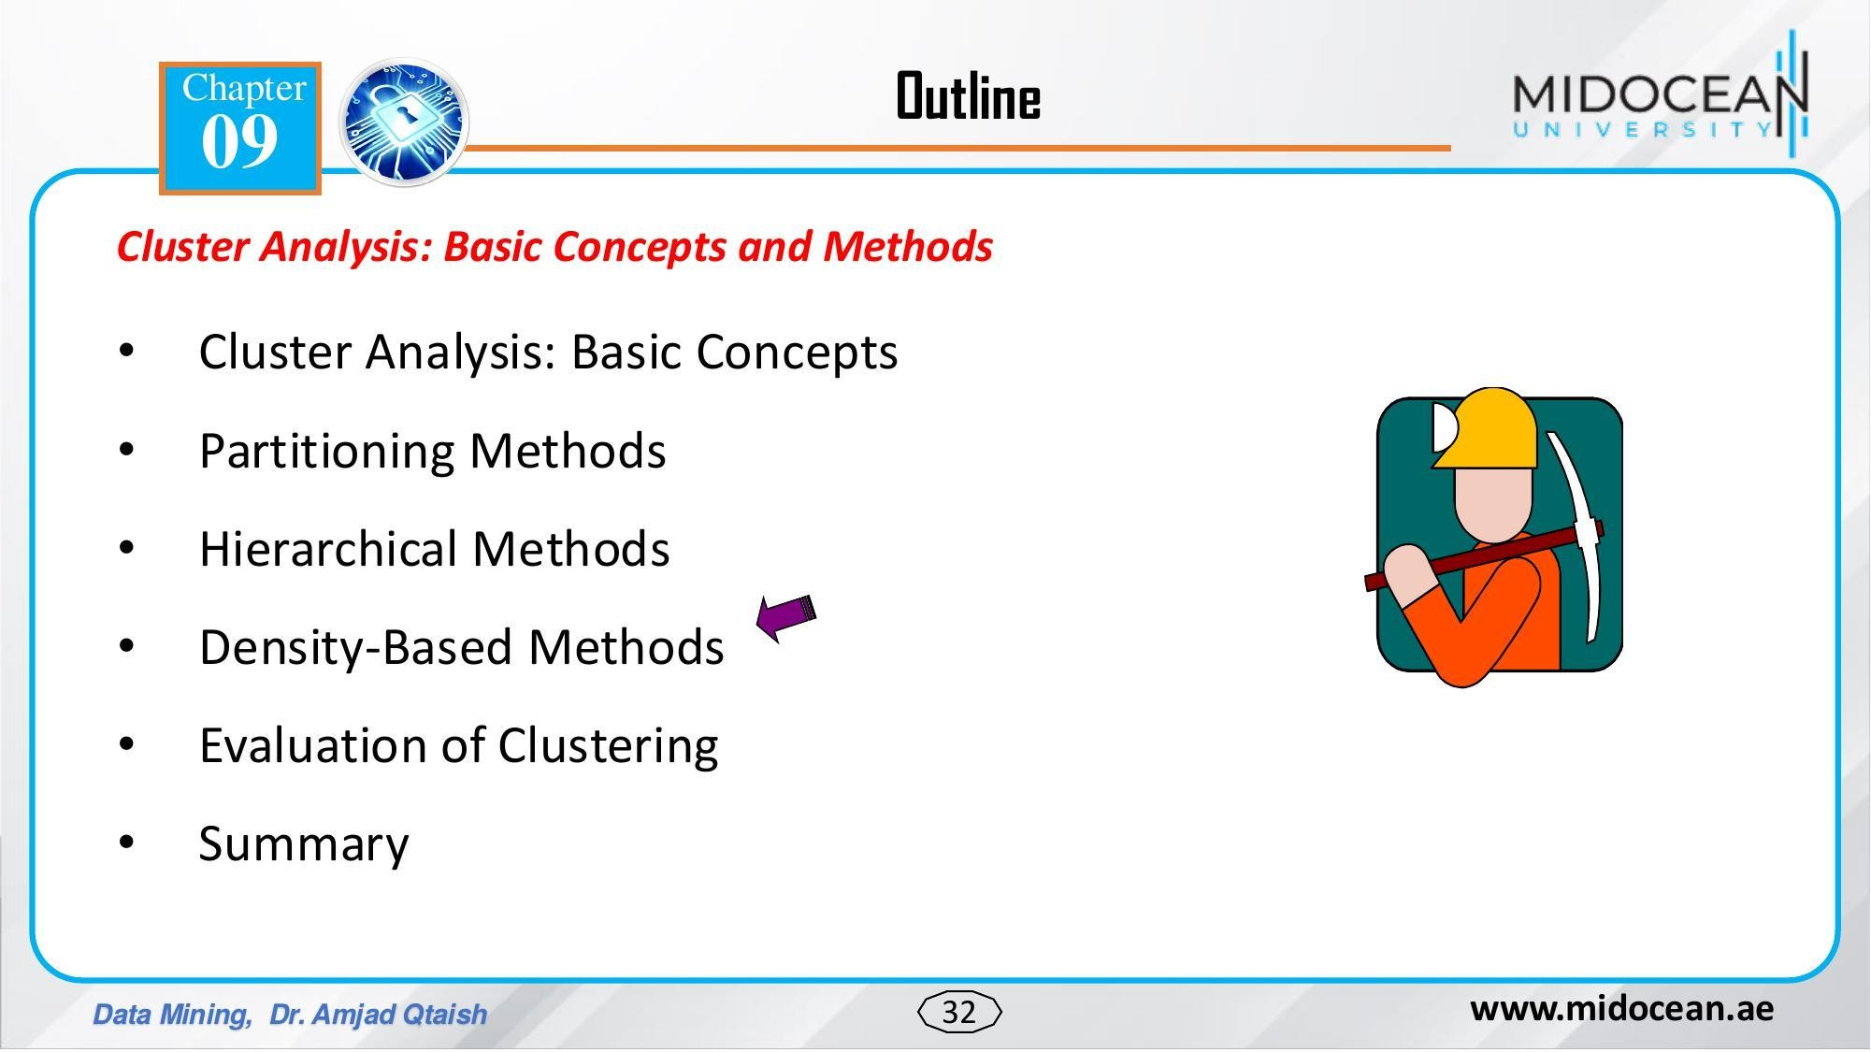

Slide 33
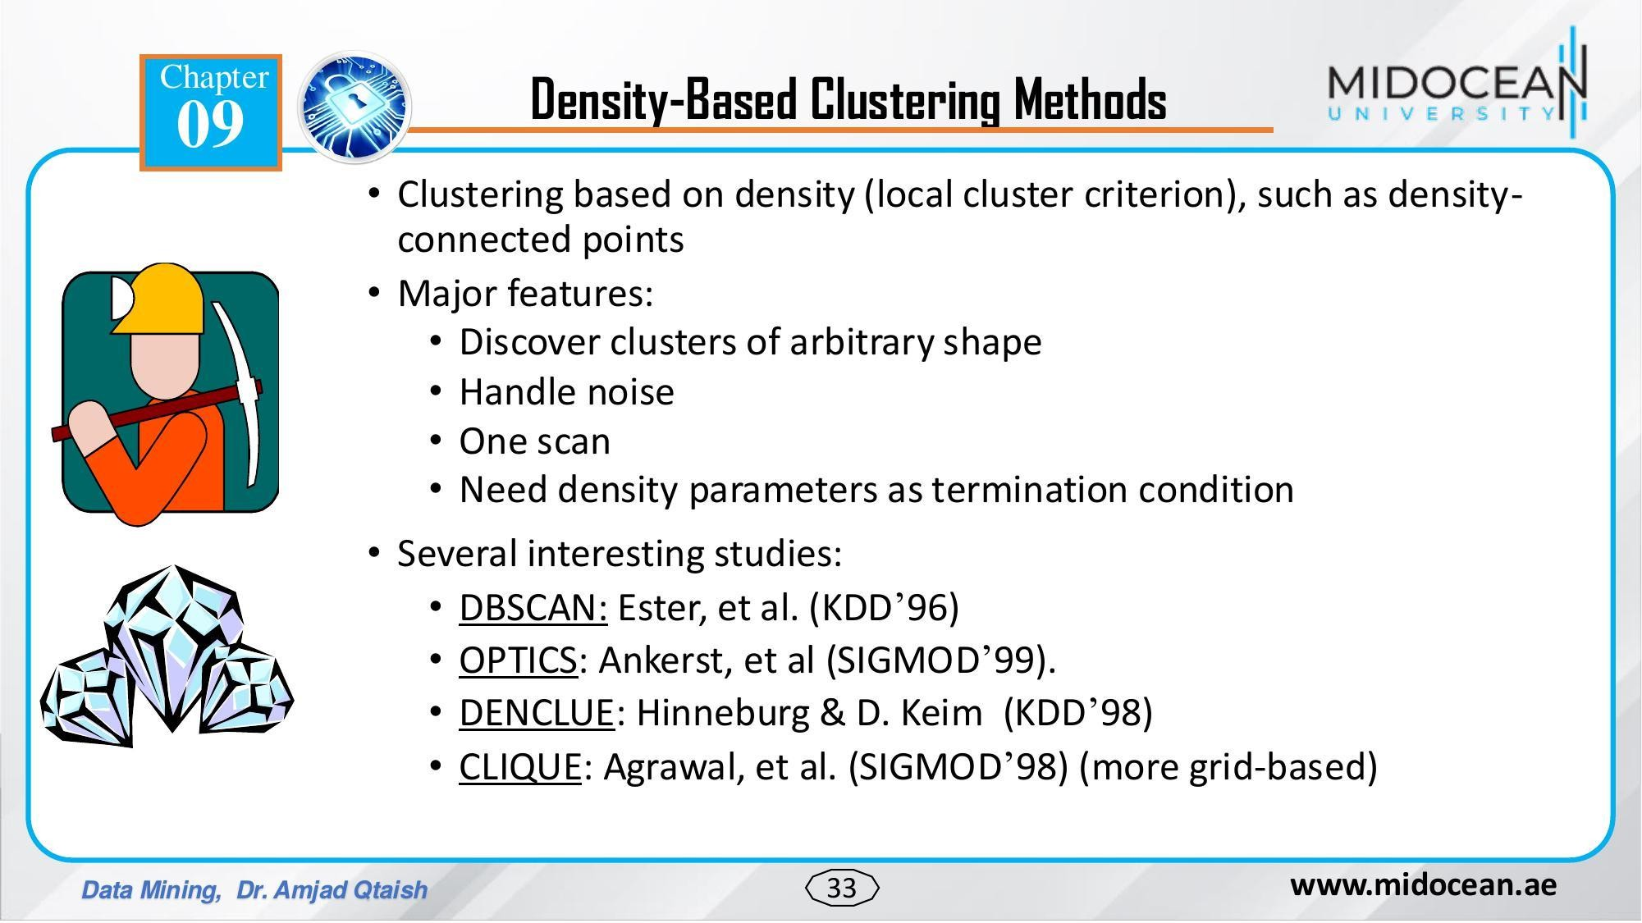

Slide 34
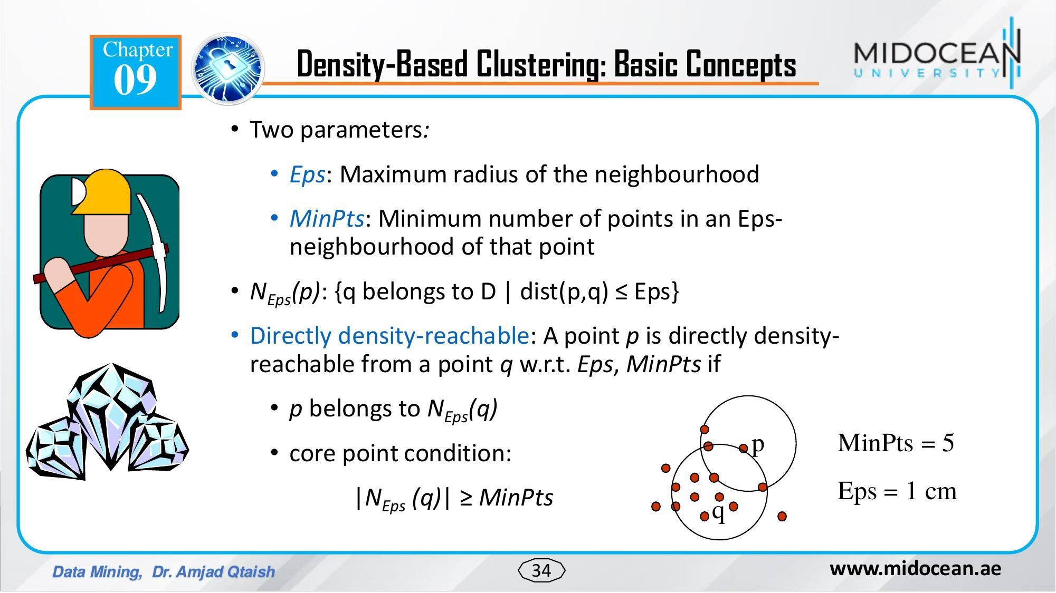

Slide 35
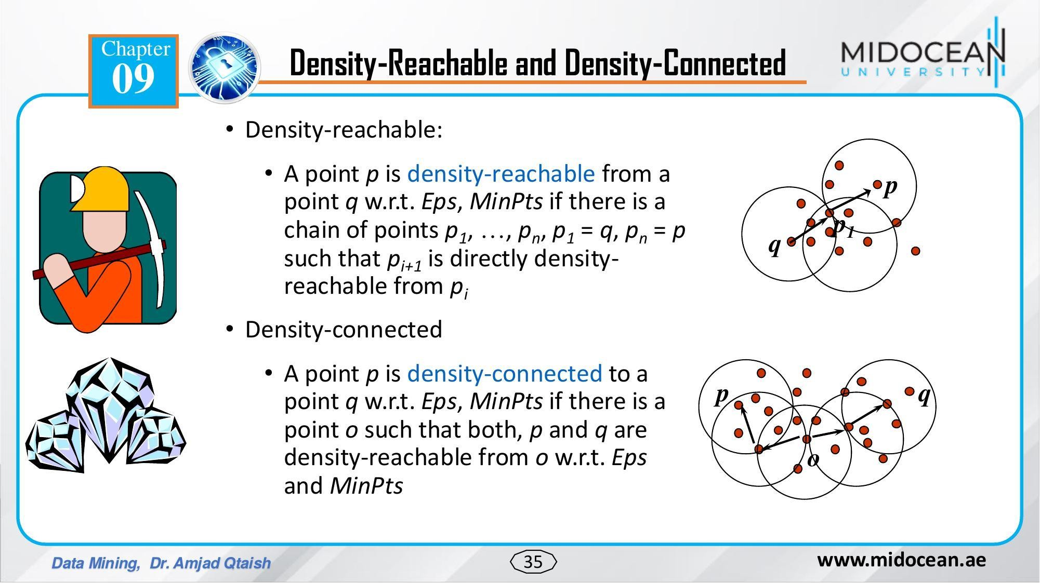

Slide 36
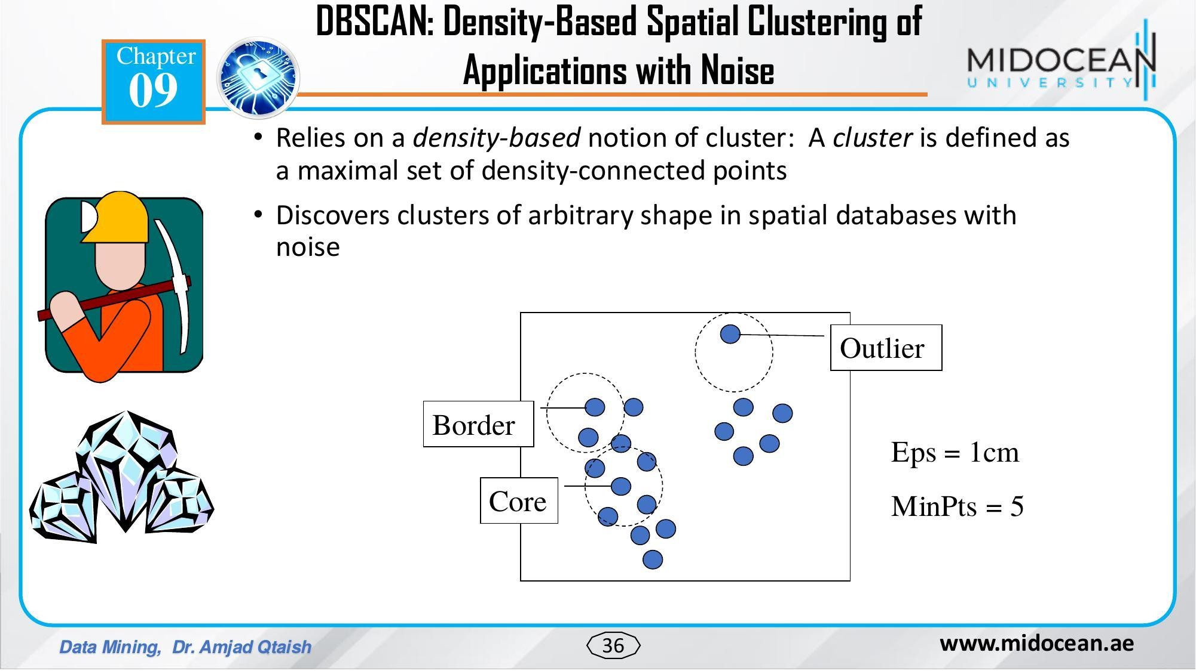

Slide 37
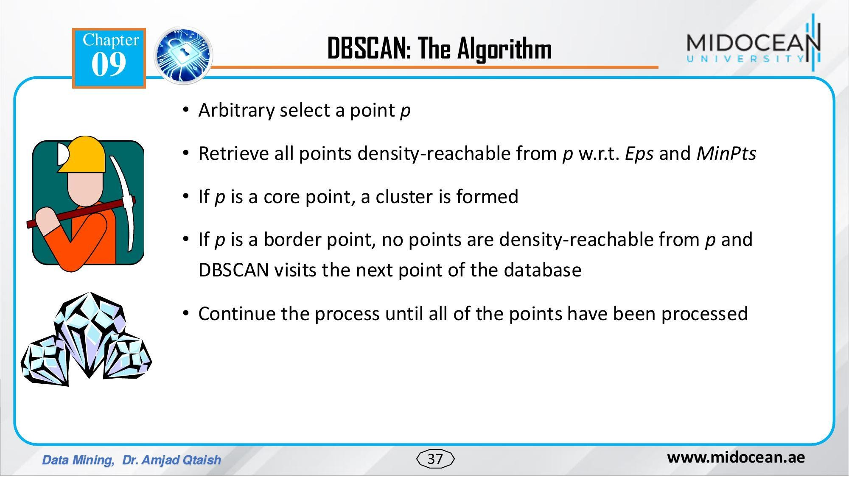

Slide 38
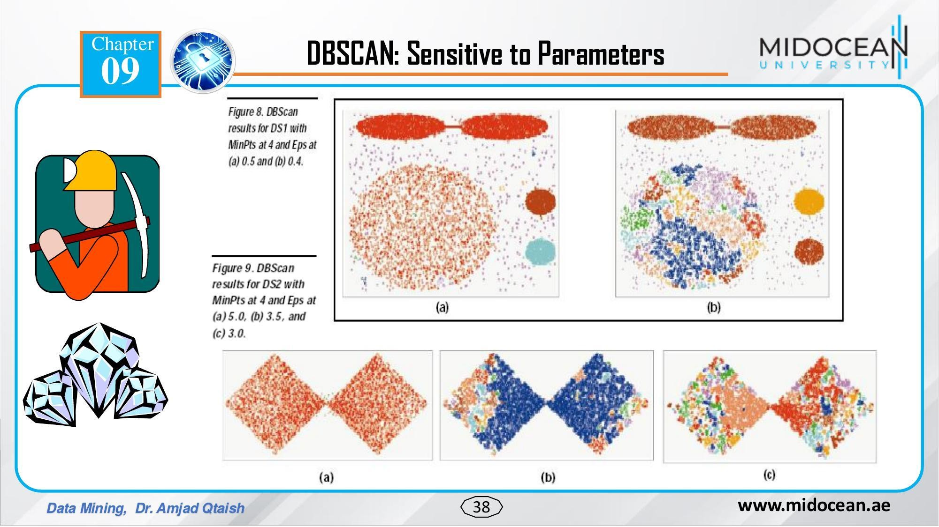

Slide 39
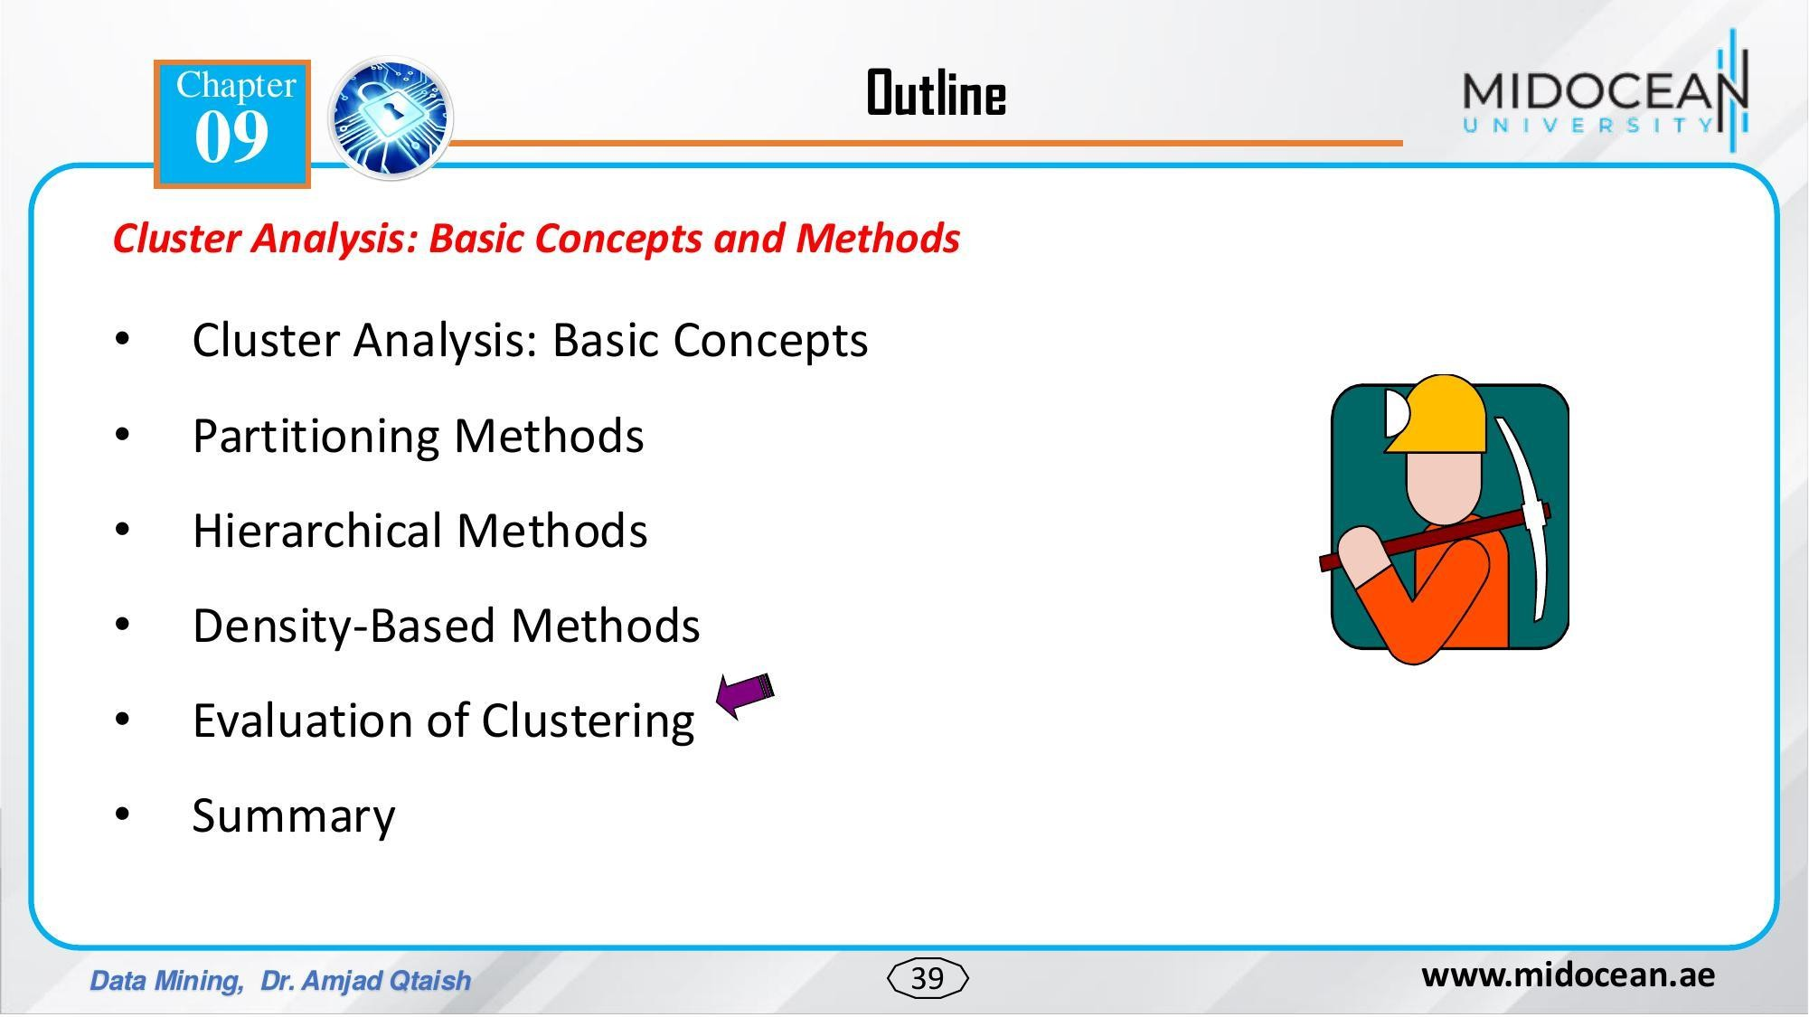

Slide 40
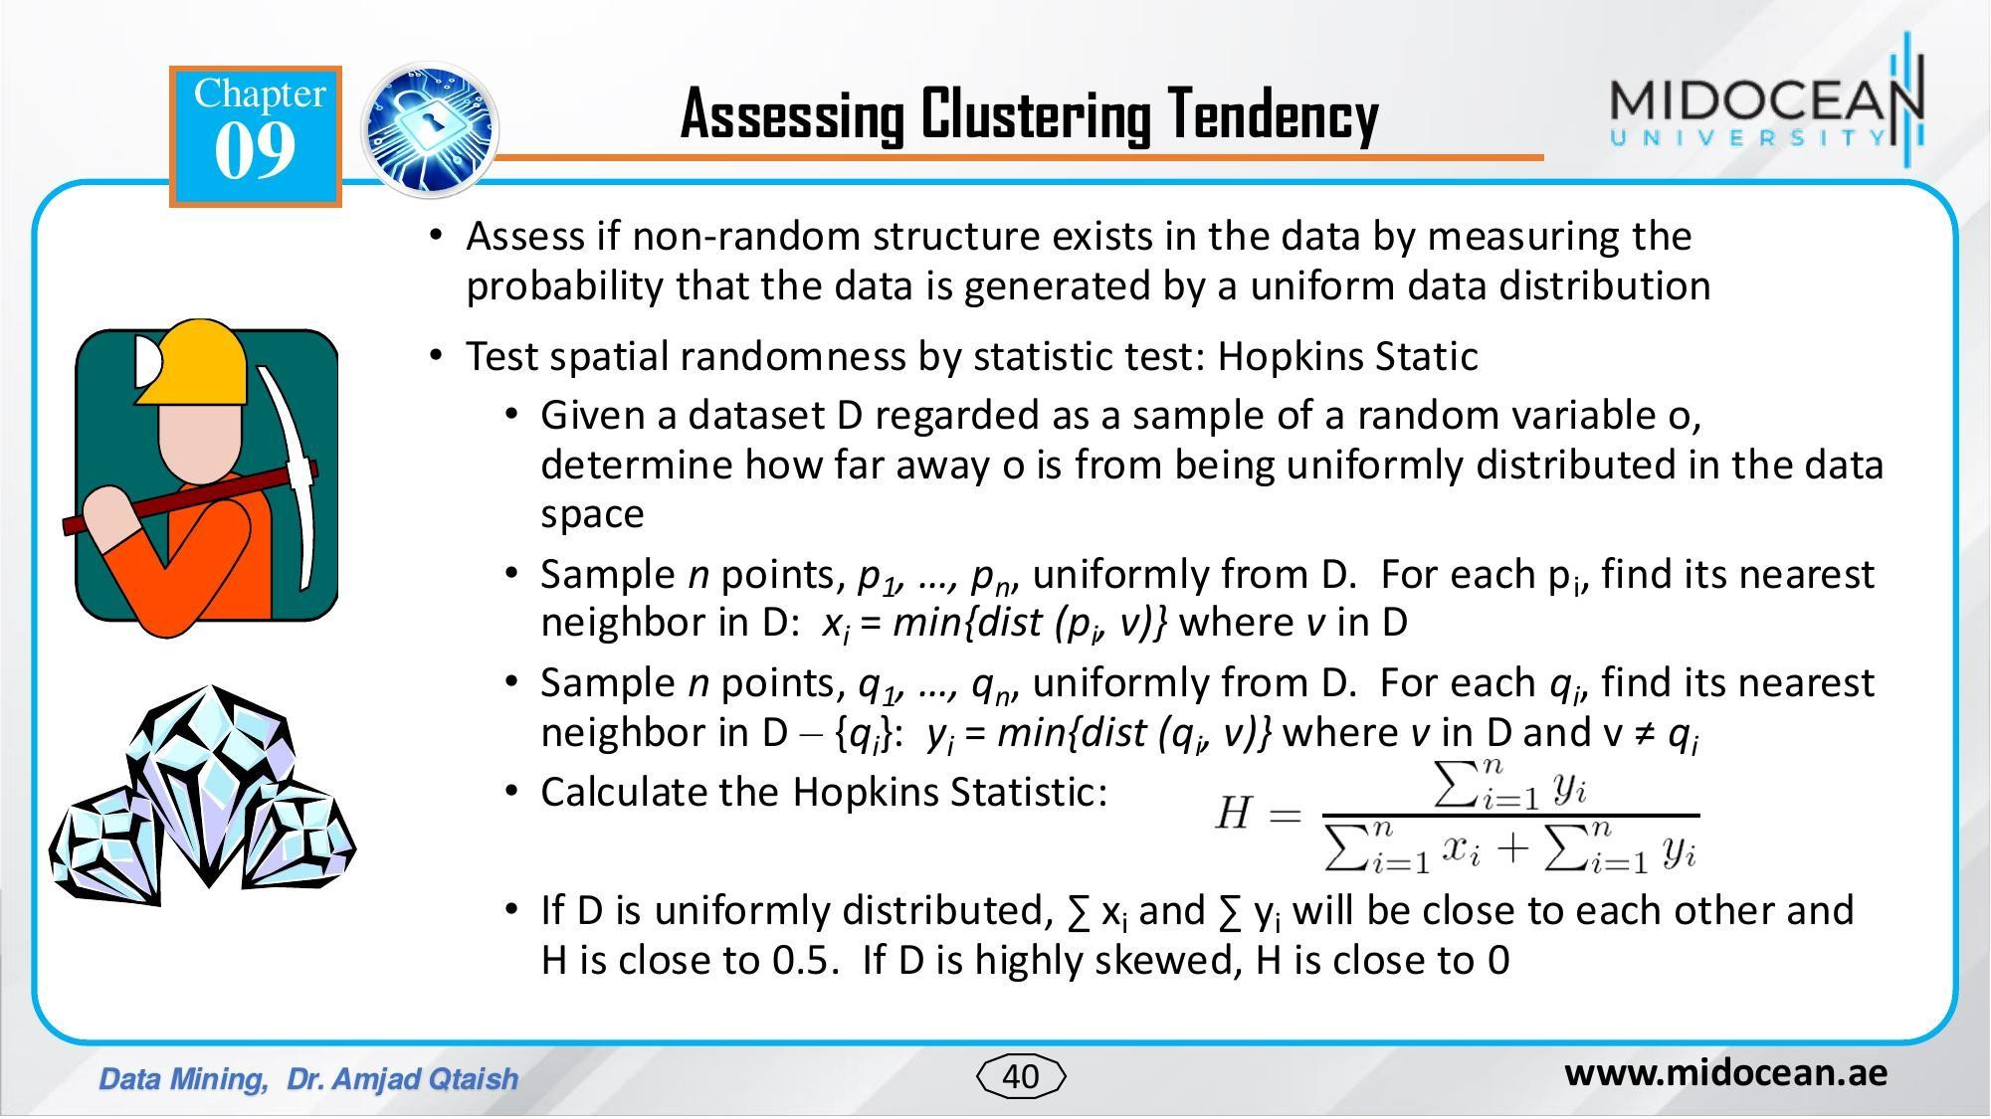

Slide 41
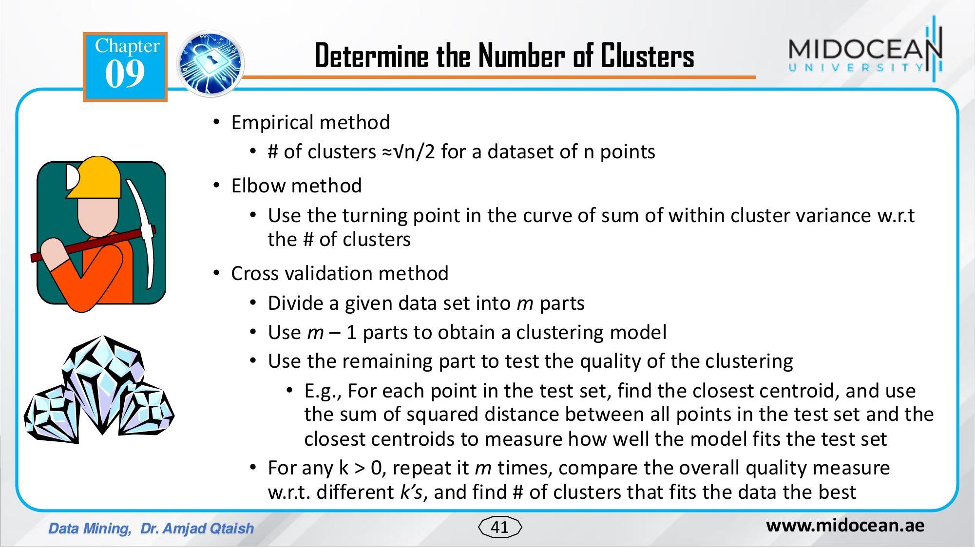

Slide 42
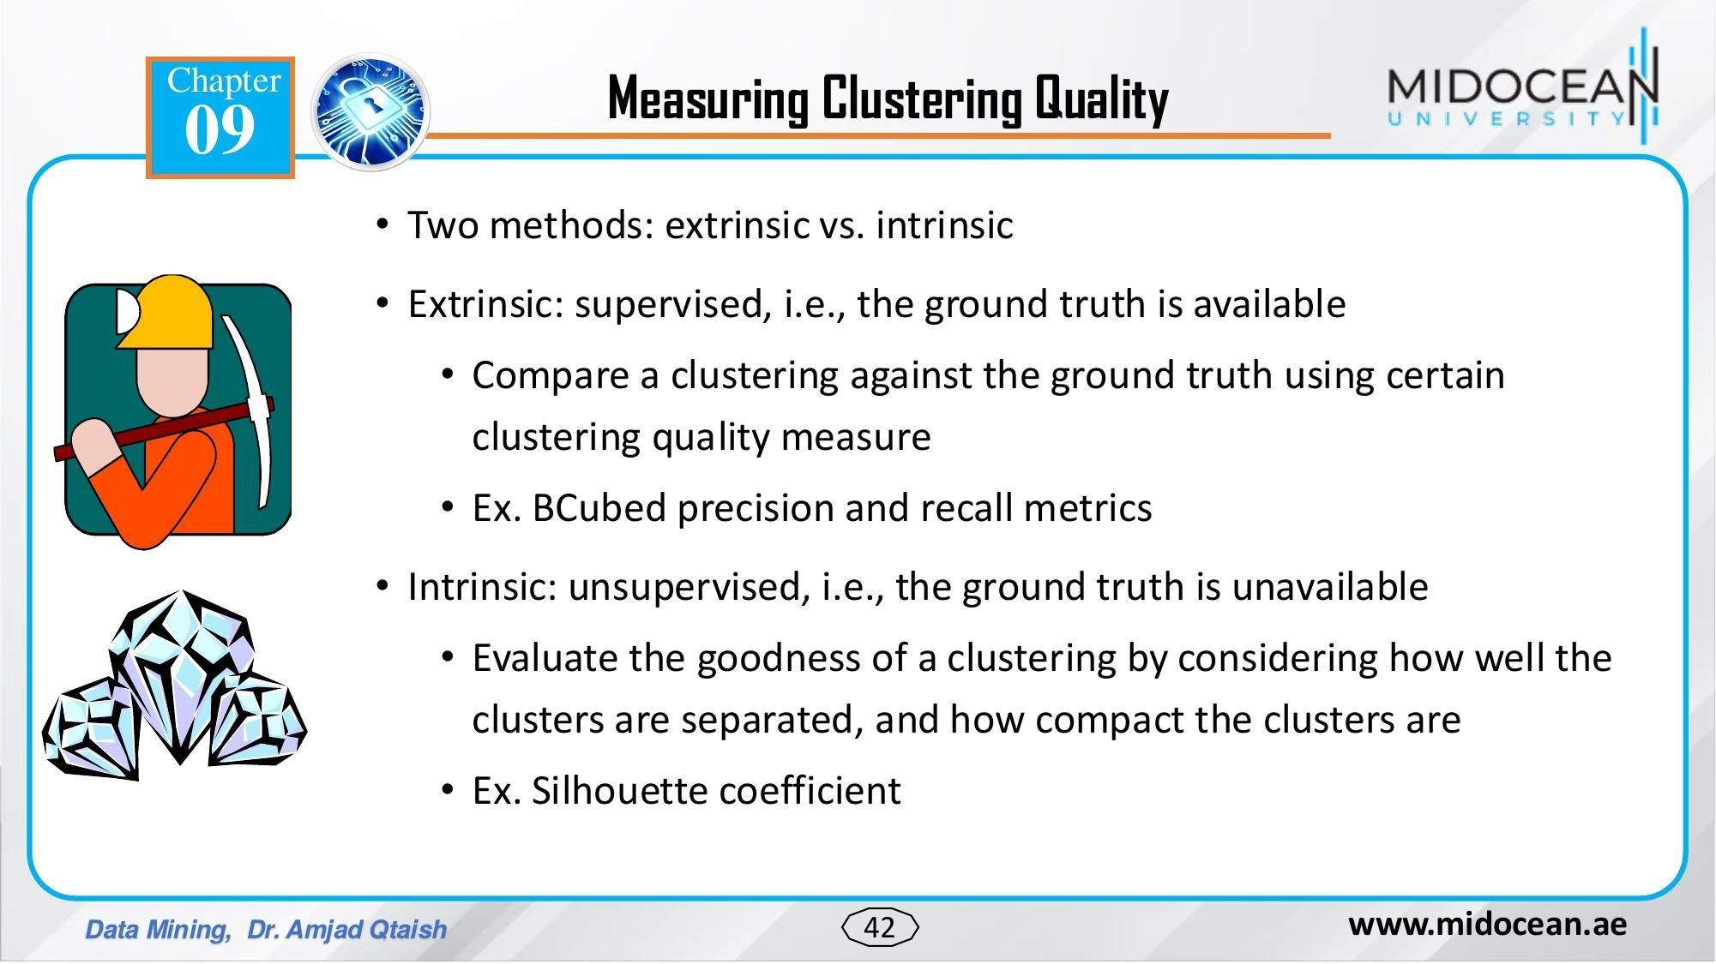

Slide 43
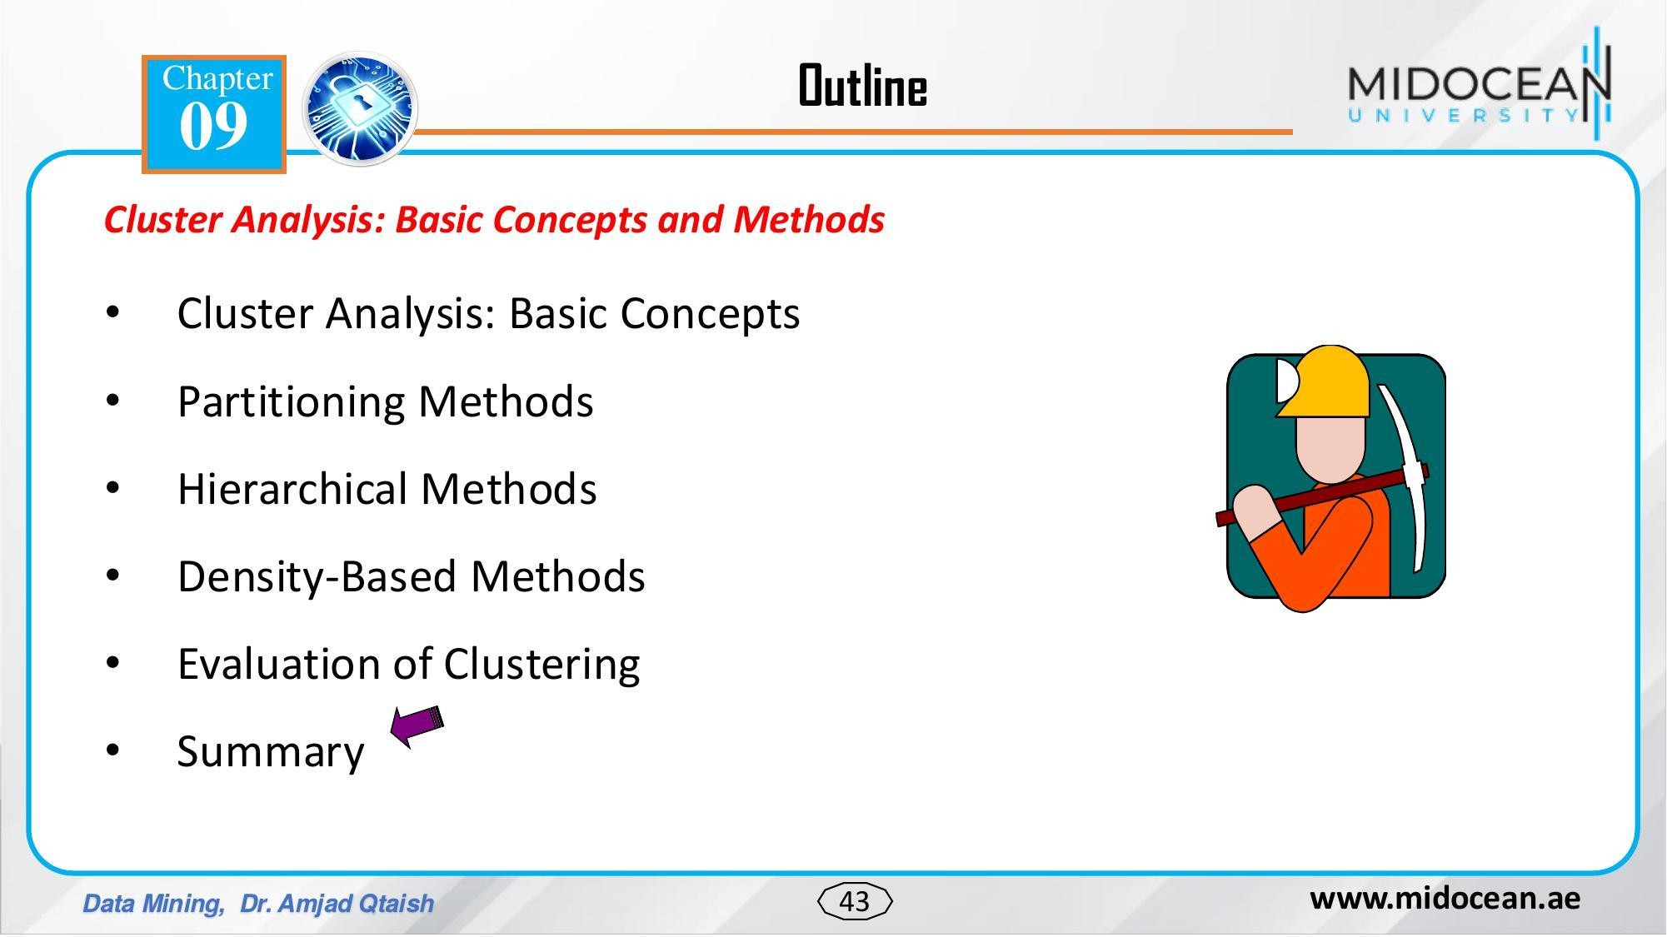

Slide 44
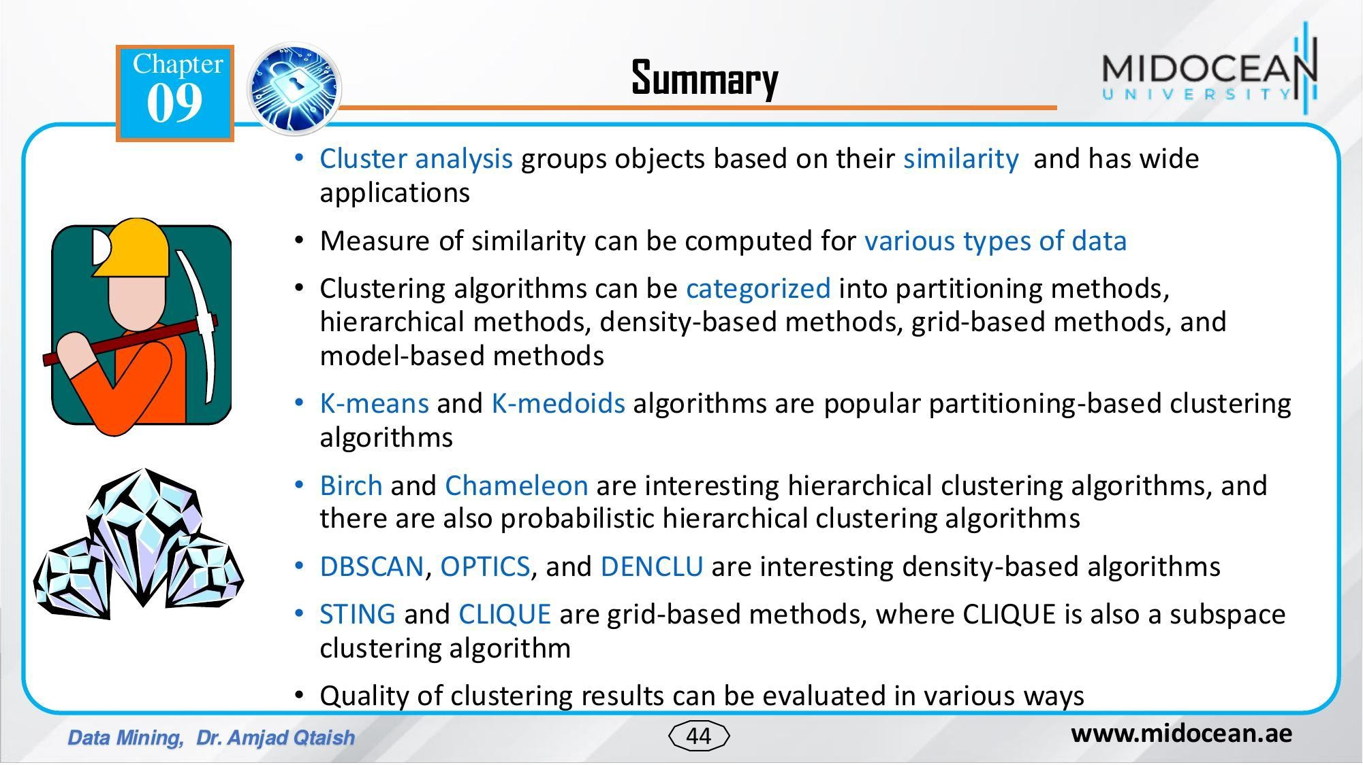

Slide 45


Slide 46


Slide 47






Interactive k-Means (1)
'selected Data
Data
Silhouette Plot
Data Table
Data
y y y
Paint Data
”e
k-Means
Scatter Plot
Save Data

Slide 48








Data Info
s“
Scatter Plot
File
Selected Data
Data
Silhouette Plot
Data Table
Data
Data
Select Columns
k-Means
Scatter Plot (1)
Data Table (1)

Slide 49
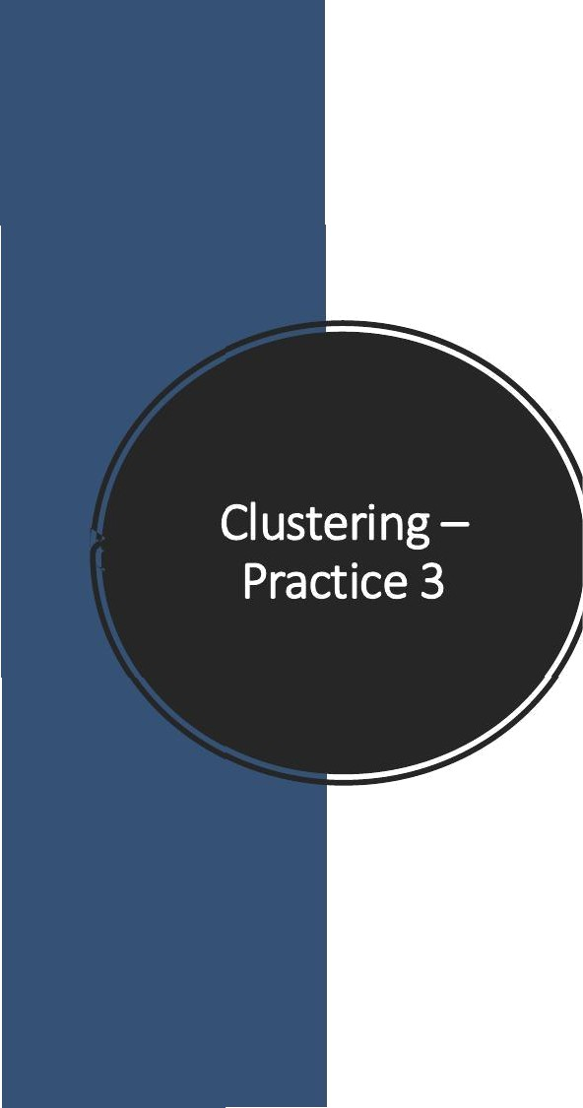




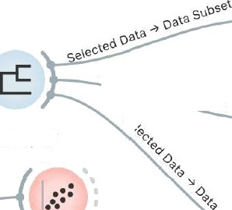

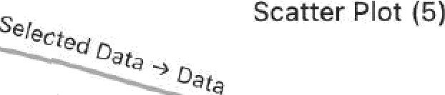






Scatter Plot (1)
Data
k-Means
Scatter Plot (2)
File
Gata
Dis th I1CCS
Distances
Hierarchical Clustering
Oata Table
Scatter Plot
MDS
Louvain Clustering
Data Table (1)
Data
DBSCAN
Scatter Plot (3)

Slide 50
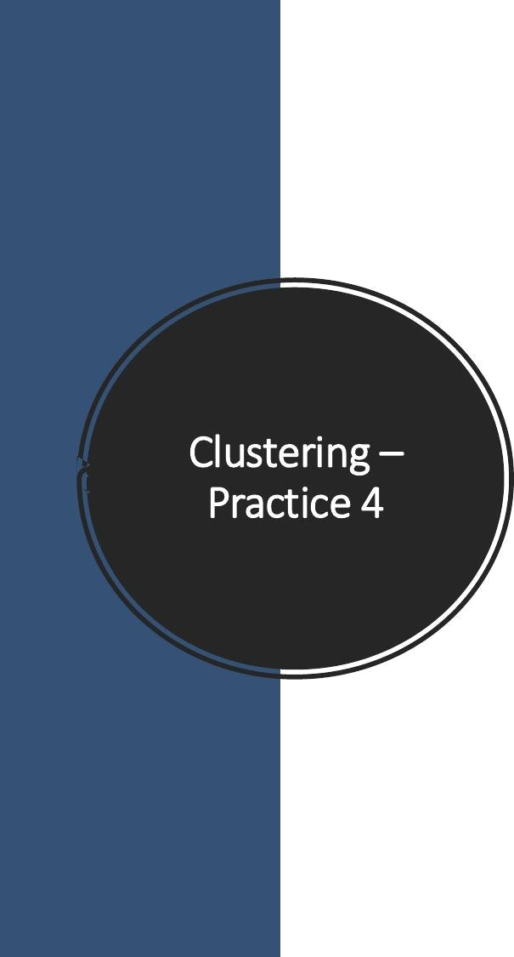















Data Table (1)
Data Table
Uata
Distances
File
Distances
Distance Map
Scatter Plot
Scatter Plot (1)
Distance Matrix
Data Table (2)
Scatter Plot (2)

