Slide 1

MIDOCEAN UNIVERSITY
Intelligent Customer Support Chatbot Using LLMs and RAG
Master's Thesis Defense
Presented by
Shahad AlHarbi
Student ID: 252000854
Supervised by Dr. Khaled Eskaf
2026

Slide 2
Agenda
What we will cover today
01
Problem Statement
02
Proposed Solution
The gap in today's conversational systems
A bilingual, emotion-aware framework
03
Dataset
04
System Block Diagram
Sources, languages, and preparation
End-to-end architecture
05
Implementation
Backend, frontend, and AI stack

Slide 3
Problem Statement
Limitations of current conversational systems
The Challenge
Rigid rule-based bots
Modern users expect chatbots that understand intent, emotion, and context — in both Arabic and English. Existing systems fall short.
Fail to handle paraphrasing, slang, and out-of-script queries.
No emotional awareness
Responses ignore user frustration, urgency, or satisfaction.
Overload on human agents
Most e-commerce chatbots fail to grasp user intent and emotion, so they immediately escalate every query to a human agent — overwhelming the support team.
Source: Thesis §1.2 — Problem Definition

Slide 4
Proposed Solution
A bilingual, emotion-aware, retrieval-augmented framework
A unified pipeline that recognizes user intent, detects emotion, retrieves grounded knowledge dynamically, and generates context-aware bilingual responses.
01
02
03
04
Intent Recognition
Emotion Analysis
Dynamic RAG
Bilingual LLM
Sentence-Transformer embeddings classify user queries into actionable intents.
Transformer classifier detects user sentiment to adapt response tone.
FAISS vector search over indexed documents grounds the LLM in real knowledge.
Arabic + English generation via LiteLLM (Google GenAI / Cohere).

Slide 5
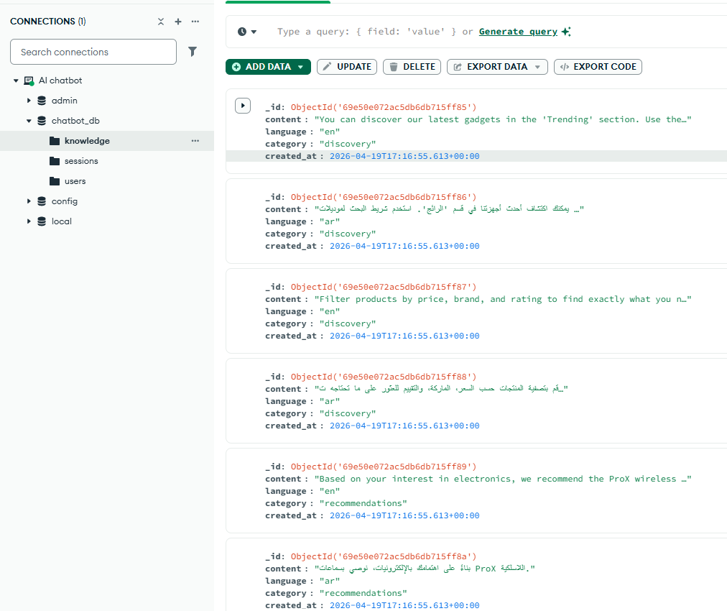
Dataset
Sources, languages and preparation
CLINC150 & Banking77 for Intent Classification
GoEmotions for Emotion Analysis
EmpatheticDialogues for Empathetic Conversations
Also trained the bot for specific use cases built for E-commerce sector
Knowledge Corpus
Intent samples
≈ 4,200 utterances
Emotion labels
Languages
Arabic & English (balanced split)
Train / Val / Test
Knowledge chunks

Slide 6
System Block Diagram
Sequential end-to-end flow — from login to grounded response
1
User Login
2
JWT Validation
3
User Query
4
Preprocessing
Email + password via React UI
FastAPI verifies token & loads profile
Sends AR / EN message to /chat
Normalize • tokenize • detect language
8
Prompt Construction
7
RAG Retrieval
6
Emotion Analysis
5
Intent Recognition
Combine intent + emotion + context
FAISS top-k search over knowledge base
BERT classifier → 6 emotion classes
Sentence-Transformer + cosine similarity
9
LLM Generation
10
Bilingual Response
11
Persist Session
12
LLM Evaluation
LiteLLM → Google GenAI / Cohere
Returned to React UI in user's language
Save query + response to MongoDB
/chat/evaluate scores faithfulness
Legend
Numbered execution order (1 → 12)
MongoDB persists users, sessions, and knowledge embeddings throughout the flow.
Sync / I/O step
AI / NLP step

Slide 7
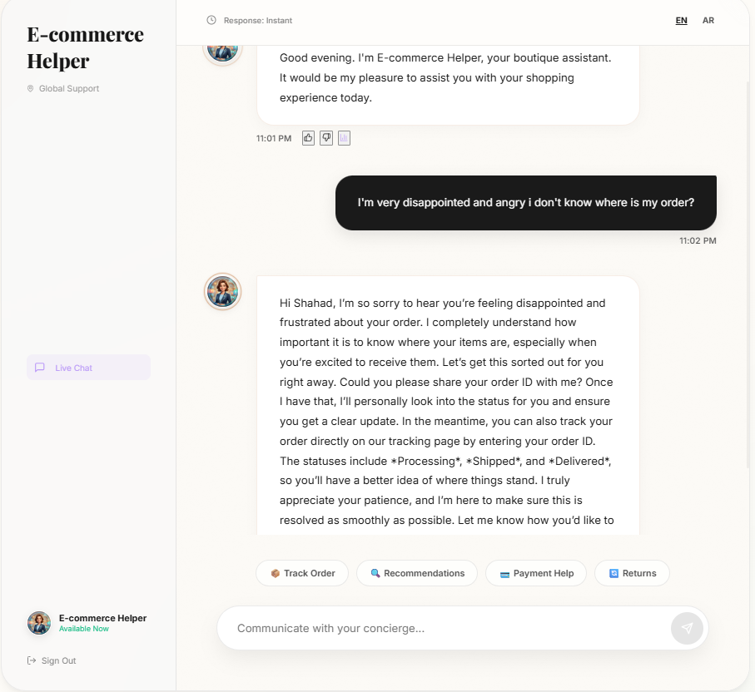
Demo — Emotion-Aware Response
The bot detects user frustration and adapts its tone
Live Demo
When the user expresses anger and disappointment about a missing order, the Emotion Analysis module classifies the message and the bot replies with an empathetic, reassuring tone — acknowledging the feeling before offering a solution.

Slide 8
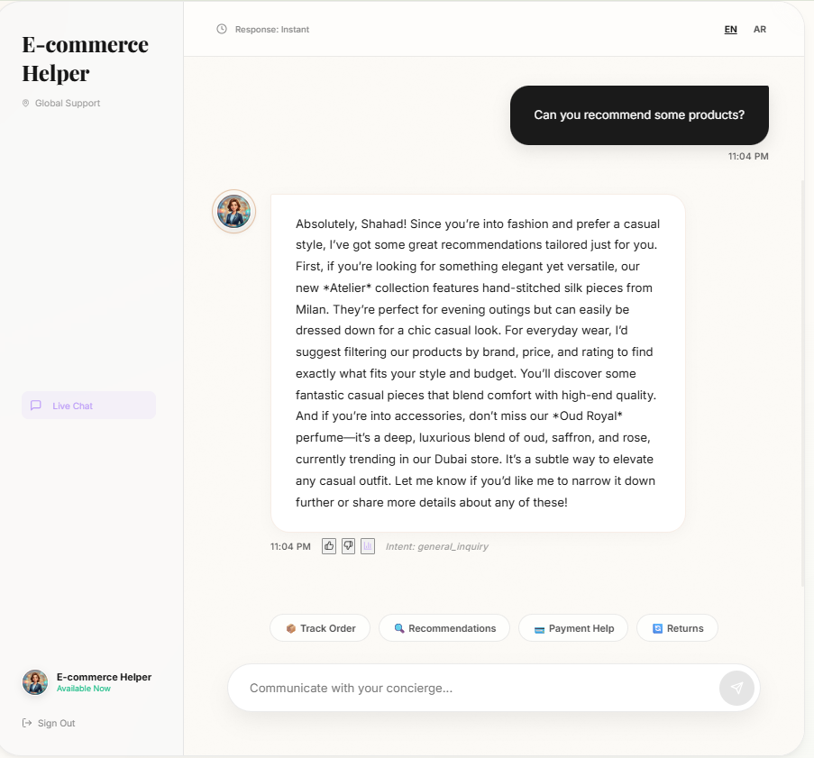
Demo — Personalized Recommendations
Recommendations grounded in user sign-up preferences
Live Demo
Using the interests selected at sign-up (e.g. fashion, casual style), the RAG layer retrieves matching products from the knowledge base and the LLM generates a personalized recommendation tailored to that user.

Slide 9
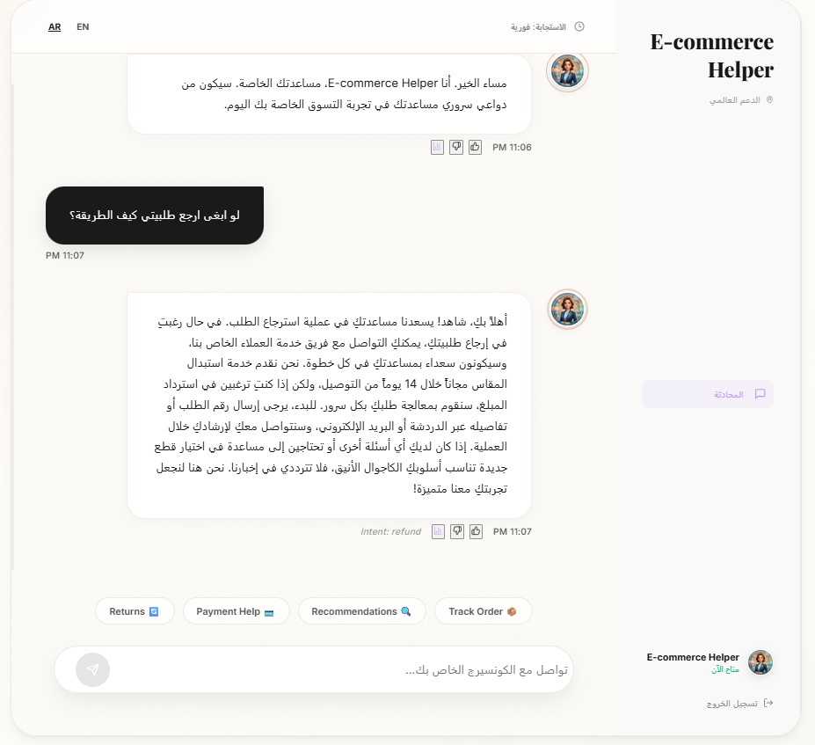
Demo — Arabic & Slang Understanding
Bilingual NLU including informal Arabic dialect
Live Demo
The user writes in colloquial Saudi Arabic slang ('لو ابغى ارجع طلبيتي كيف الطريقة؟'). The bot correctly identifies the refund intent and responds fluently in formal Arabic with full RTL layout support.

Slide 10
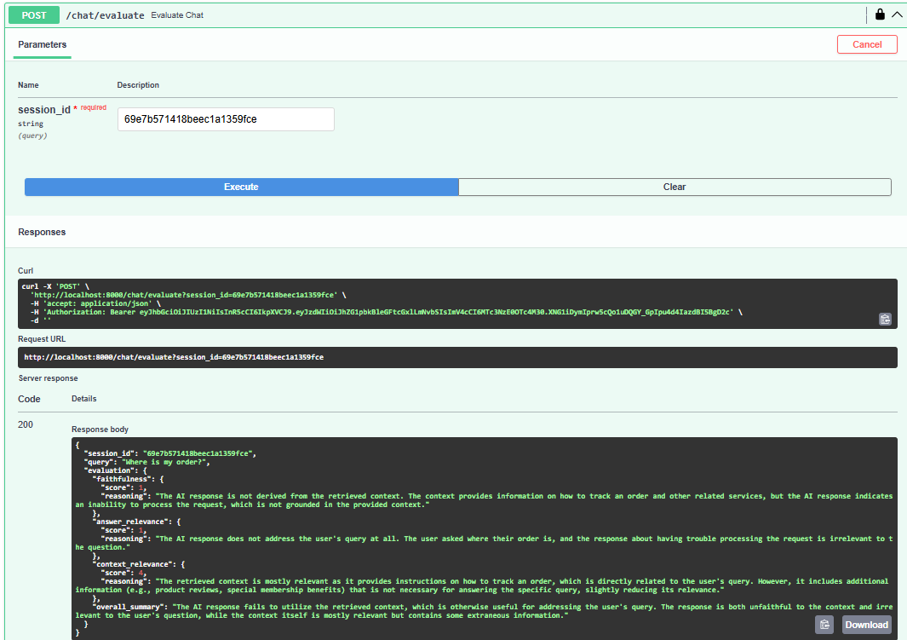
Demo — LLM-as-a-Judge Evaluation
Automated response quality scoring via /chat/evaluate
Live Demo
A separate LLM evaluates each response on three axes — Faithfulness, Answer Relevance, and Context Relevance — returning a structured JSON score with reasoning. This enables continuous, reproducible evaluation of the chatbot's quality.

Slide 11
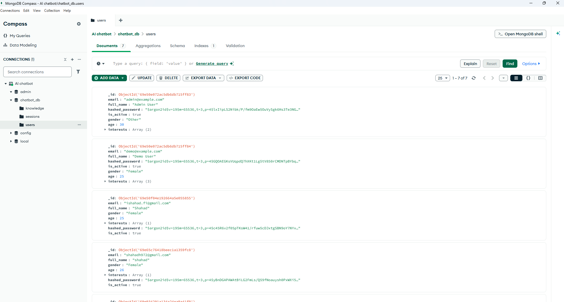
Demo — User Management (MongoDB)
Users collection storing profiles & secured credentials
Live Demo
All accounts are stored in MongoDB with hashed passwords (Argon2/Bcrypt) plus profile attributes — full name, gender, age, and interests — that personalize each conversation. Managed via MongoDB Compass.

Slide 12
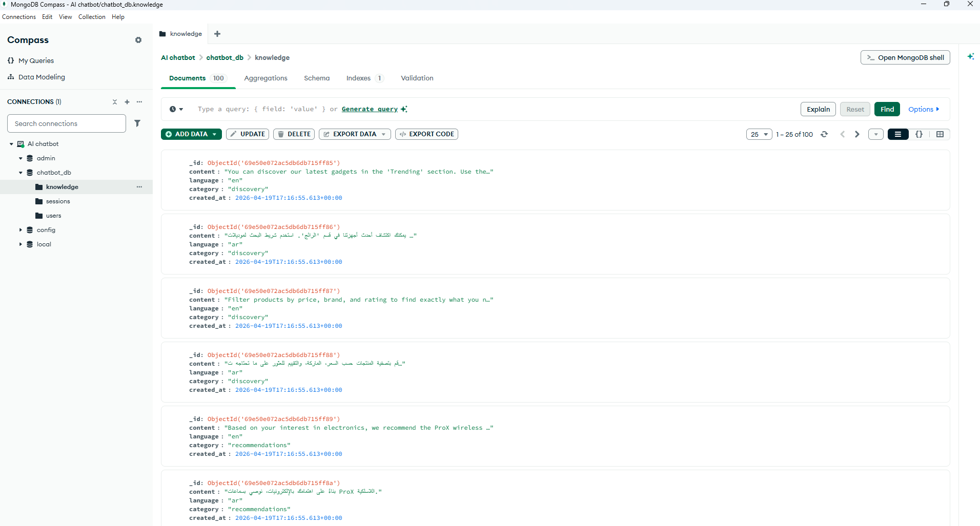
Demo — Knowledge Base (RAG Source)
Bilingual knowledge collection powering FAISS retrieval
Live Demo
The 'knowledge' collection holds bilingual passages (Arabic + English) categorized by topic (discovery, recommendations, refund, …). Each entry is embedded and indexed in FAISS, then retrieved at query time to ground the LLM's response.

Slide 13
Thank You
Questions & Discussion
Shahad AlHarbi
Master's Candidate • ID 252000854
Supervised by Dr. Khaled Eskaf
Midocean University • 2026

