Slide 1




Managing IT and Cyber Risks in Supply Chains
PMG 663
Strategic Sourcing Under Supply Disruption Risk
Lecture 8
Prepared by
Dr. Badur elgasim
www.midocean.ae

Slide 2
Chapter
Learning Objectives
08
Models
The SSOA supplier selection and order quantity allocation
Genetic Algorithm (GA)
Particle Swarm Optimization (PSO)
Sensitivity analysis:
www.midocean.ae

Slide 3
Chapter
08
Introduction
Today’s supply chain being global suffers from more risks which come from sources within and outside of the chain .supply chain risks to be either operational or disruption.
Operational risks are the inherent uncertainties in the system e.g., demand, supply, and cost. Disruption risks are the outcomes of natural or man-made disasters.
The effort to identify and mitigate supply chain risks has traditionally focused on operational risks as disruption risks often had a small likelihood of occurrence
www.midocean.ae

Slide 4
Chapter
08
Recently, disruption risks occur more frequently and as such receive more attention as suppliers tend to be grouped geographically or as clusters for greater economies of scale. disruption risk can affect the productivity, market share, and reputation of the suppliers. For instance, the disasters (Japanese tsunami and Thailand flood) in 2011 have forced many leading automotive and computer manufacturers to reassess their supply network strategies in Asia to effectively mitigate the risks arising from the clustering of suppliers in these two locations, so as to contain disruption cost and maintain service levels
www.midocean.ae

Slide 5
Chapter
08
Planning for disruptions typically requires a proactive process to identify the key locations for catastrophic risks in a supply chain and to estimate the likelihood of its occurrence and the impact. The objective is to minimize the expected total cost comprising supplier management cost, purchasing cost, and an expected loss if a supplier’s reliability to serve is compromised by disruptions.
www.midocean.ae

Slide 6
Chapter
08
Supply disruption can be modeled as either a super, semi-super, or unique event.
A super event: occurs when the suppliers at all locations are disrupted i.e. they all fail at the same time exhibiting a total effect. A semi-super event: is location/region specific and occurs when a set of suppliers at a location are disrupted exhibiting a regional effect.
A unique event: occurs when only one supplier at a location is disrupted exhibiting a local effect
www.midocean.ae

Slide 7
Chapter
The SSOA supplier selection and order quantity allocation
08
Disruption risks can be measured by the expected monetary loss to the supply chain . supplier selection and order quantity allocation The SSOA models under supply disruption risk are classified based on the objective, decision variables, model parameters, and solution methodology. Usually such SSOA models are formulated to minimize the expected total cost considering either all or partial supplier disruptions. Only some studies have simultaneously considered supplier location, selection and order allocation under disruption
www.midocean.ae

Slide 8
Chapter
08
For completeness, presented a good review of the techniques used to select suppliers. While the decision tree technique is most used
to capture the different disruption scenarios an arbitrary allocation of orders is proposed to determine the optimum supply base.
showed that the SSOA problem under supply disruption risk is NP-hard as the computational complexity increases with the number and locations of suppliers, disruption likelihoods, supply capacity, price discounts, and supplier flexibility; hence, they proposed a Genetic Algorithm (GA) approach
www.midocean.ae

Slide 9
Chapter
08
Genetic Algorithm (GA)
GA is a stochastic search technique inspired by a biological system’s improved fitness through evolution. GA starts with a random population of solutions (chromosomes). The chromosomes are evaluated using the given objective function. The best chromosomes exchange information through selection, crossover and mutation to produce offspring chromosomes.
The offspring chromosomes are then evaluated and used to evolve the population if they provide better solutions than a weak population .
www.midocean.ae

Slide 10
Chapter
Particle Swarm Optimization (PSO)
08
Particle Swarm Optimization (PSO), drawn from swarm intelligence, is another technique used by researchers given its simplicity and performance .
However, the work on PSO for SSOA under disruption is scant. applied PSO on multi objective buyer-vendor coordination.
www.midocean.ae

Slide 11
Chapter
08
PSO to solve a multi-echelon unbalanced supply chain planning problem. applied a multi objective binary PSO algorithm on sourcing with price and exchange rate risks. formulate an MILP model for SSOA under disruption risk for super, semi-super, and unique events. minimize the expected total cost (ETC) comprising supplier management cost, raw material purchase cost, and expected supplier loss
www.midocean.ae

Slide 12
Chapter
08
PSO is inspired by the social behavior of a flock of migrating birds trying to reach an unknown destination. In PSO, each solution is a ‘bird’ in the flock and is referred to as a ‘particle’. Each bird looks in a specific direction. When communicating with each other, they identify the bird that is in the best location. Accordingly, each bird speeds towards the best bird with a velocity that depends on its current position.
www.midocean.ae

Slide 13
Chapter
08
Each bird, then, investigates the search space from its new local position, and the process repeats until the flock reaches their desired destination.The search process involves both social interaction and intelligence so that the birds learn from their own experience (local search) an from the experience of the others around them (global search) .The process is continued until the maximum number of generations or the termination criteria is attained.
www.midocean.ae

Slide 14
Chapter
08
Problem Description and Model Formulation
Firms keep a set of preferred suppliers based on cost, quality, and service level.
Such suppliers tend to be clustered geographically, for reasons of pooling of labor and technology sharing (Fig. 11.1).
Siting reliable alternative suppliers and sourcing from both preferred and alternate suppliers is common when minimizing ETC.
www.midocean.ae

Slide 15
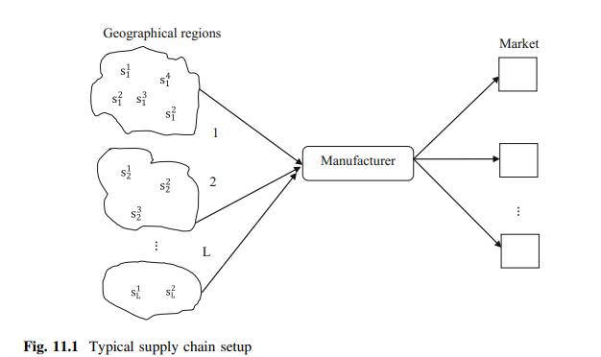
Chapter
08
www.midocean.ae

Slide 16
Chapter
08
Model formulation:
An MILP model: (mixed integer linear programming) is formed to find the choice of suppliers and their order allocations subject to the constraints on capacity and demand. The objective is to minimize the ETC. ETC includes supplier management cost, purchasing cost, and an expected loss cost (ELC) if a supplier is disrupted. While sourcing from multiple suppliers increases the supplier management cost with supply disruption, the expected loss incurred by the manufacturer is less, as the order is now allocated to many suppliers
www.midocean.ae

Slide 17
Chapter
08
We assume the followings in our model:
1. Single product with quantity discounts and a single period planning horizon;
2. Manufacturer produces functional products which have stable demand;
3. We include only Tier-1 suppliers who are independent;
4. Number of suppliers and their geographical regions, capacities are known and fixed;
5. Acquisition and transportation cost of raw materials from suppliers to manufacturer is known and fixed;
www.midocean.ae

Slide 18
Chapter
08
6. A semi-super event is region specific and each region has its disruption likelihood;
7. If some supplier(s) fails to deliver the units ordered due to a disruption, the other un-disrupted suppliers will make up the shortfall at no extra cost ;
8. Each supplier has a different capacity, unique event likelihood, and compensation potential (which is the ability of the supplier to make up for the supply shortfall);
www.midocean.ae

Slide 19
Chapter
08
9. We estimate the disruption likelihood of super, semi-super, and unique events by combining the expert/decision maker’s opinion with historical data
10. Supplier management cost comprising the cost of meetings, negotiation and quality monitoring is a linear function of the number of suppliers
www.midocean.ae

Slide 20
Chapter
08
The steps of the proposed PSO are described below.
The parameters of the proposed algorithms are:
swarm size (N), maximum number of iterations (max_it),
time varying inertia weight (xt), acceleration coefficients (C1t and C2t) and random parameters (r1 and r2)
www.midocean.ae

Slide 21
Chapter
08
Proposed PSO
The steps of the proposed PSO are described below.
Step 1
Particle representation and Swarm initialization:
In the PSO algorithm, each particle is a feasible allocation of demand to the suppliers. The position and velocity of each particle are initialized randomly. The length of a particle depends on the number of suppliers and each bit of a particle represents the fraction of demand assigned to a supplier.
www.midocean.ae

Slide 22
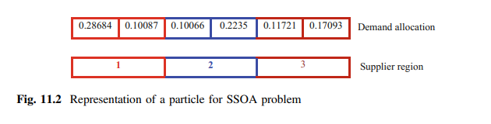
Chapter
08
Figure 11.2 is an example of a particle with 2 suppliers, each sited in three regions. Supplier 1 located in Region 1 receives maximum allocation. A set of feasible particles represents the swarm
www.midocean.ae

Slide 23
Chapter
08
Step 2 Fitness evaluation:
The fitness values of the particles are computed. The individual experience of the particle is captured in the p Best attribute that corresponds to the best performance attained by a particle in its flight. In the first iteration (t), the current position of particle pi[t] is set as the p Best particle p Besti[t]. In subsequent iterations, p Besti[t] is replaced if a better fitness value is found. The best particle in the whole swarm is selected as the global best g Best (gi[t])
www.midocean.ae

Slide 24

Chapter
08
Step 3 Velocity and position update:
The velocity and position update equations are used to update the velocity and position of each particle during the iterations. with r1 and r2 uniformly distributed on (0, 1).
www.midocean.ae

Slide 25
Chapter
08
Illustrative Example
A manufacturer plans to procure materials from a set of suppliers.
To avoid depending on a single supply region, the manufacturer decides to consider alternate suppliers from multiple regions. Scenarios are generated using simulated data as shown in Table 11.2 following the SSOA literature.
www.midocean.ae

Slide 26
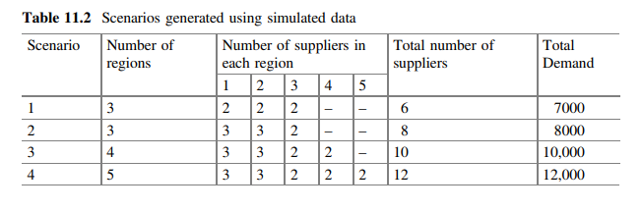
Chapter
08
www.midocean.ae

Slide 27
Chapter
08
The number of suppliers and their regions vary between
(6, 12) and (3, 5) respectively. The total demand varies
from 7000 to 12,000 units. The capacity of the suppliers is generated in the interval (1200, 3500).
Supplier management cost is selected in the interval (1000, 3500)
www.midocean.ae

Slide 28
Chapter
08
The unit purchase cost is drawn in the interval (12, 18). The loss per unit is set to vary between 2 and 4 times of the purchase cost. The minimum order quantity for any supplier is set at 10% of the total demand. All unit quantity discounts with three price breaks are considered following.
The price discount varies from 5 to 25% of the base price and the order quantities for a price break is set to vary between 1.5 and 3 times the minimum order quantity.
www.midocean.ae

Slide 29
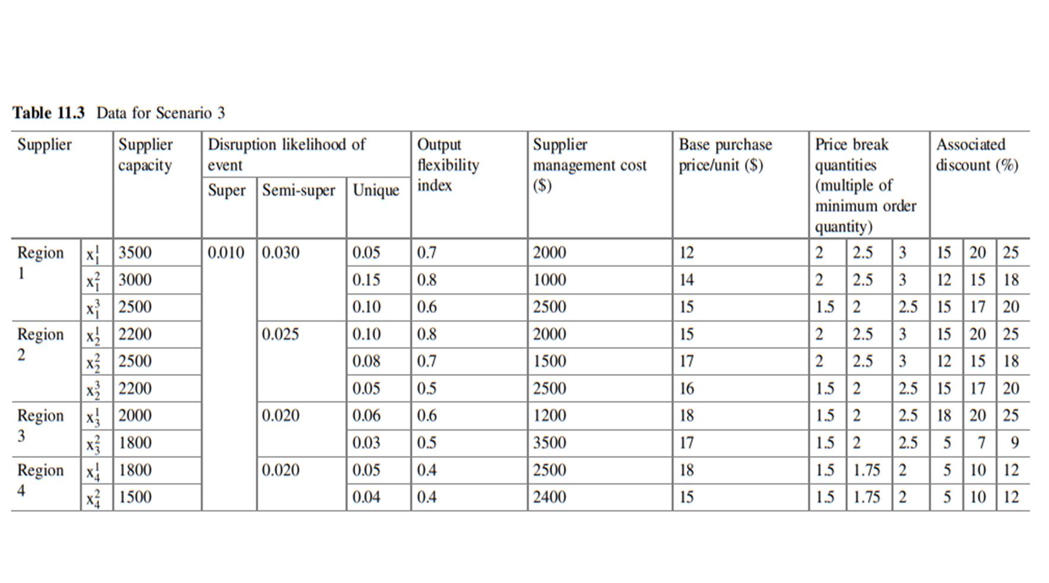
Chapter
08
www.midocean.ae

Slide 30
Chapter
08
Table 11.3 gives the capacity, disruption likelihoods, output flexibility index of the suppliers, supplier management cost and unit purchase cost of the materials for Scenario 3.
It is assumed that Region 1 has established suppliers with good market reputation and is the primary procurement source. The manufacturer intends to locate alternate suppliers from Regions 2, 3 and 4 as Region 1 is prone to disruption risk. It is assumed that the suppliers in Regions 3 and 4 are new and expensive. The suppliers in Regions 1 and 2 are located outside of the manufacturer’s geographical proximity
www.midocean.ae

Slide 31
Chapter
08
Sensitivity analysis:
A sensitivity analysis is performed on Scenarios 3 to study the effect of variations in disruption likelihood, output flexibility and price discount offered by the suppliers on the ETC. Sourcing under supply disruption risk is an important research topic and needs attention
www.midocean.ae

Slide 32
Chapter
08
Sensitivity analysis on ETC shows that the combined effect of mis-estimating the disruption likelihood of super, semi-super, and unique events yields a larger deviation in ETC.
The ETC is found to be less sensitive to the variation in the output flexibility of the suppliers when multiple suppliers are selected.
The ETC is less sensitive to a variation in price discounts when more demand is assigned to a few suppliers.
www.midocean.ae

Slide 33
Chapter
08
. a MILP model is used to select suppliers and allocate order quantity under disruption risk.
Four scenarios were generated using simulated data and PSO was used to minimize the expected total cost. The results were compared against a GA generated set of results. The results suggest that to minimize the ETC, suppliers from different regions who are less prone to disruption and offering minimum purchase cost should be assigned greater demand
www.midocean.ae

Slide 34
Chapter
08
As the SSOA problem under supply disruption risk is NP-hard, particle swarm optimization with time varying inertia weight and acceleration coefficients is applied. Numerical tests are conducted
to illustrate the proposed approach and the results obtained are compared with Genetic Algorithm (GA).
Sensitivity analysis is conducted on the disruption likelihood, supplier upside flexibility, and the price discount regimes
www.midocean.ae

Slide 35
Chapter
08
un-disrupted suppliers have buffer capacity and will compensate the shortfall at no extra cost. In practice, suppliers may charge a premium to supply additional quantities. Several extensions to this work are possible. model could be extended to include stochastic demand with multiple objectives considering service level.
A model for a multi-tier supply network under disruption could be also developed.
www.midocean.ae

Slide 36
Chapter
03
Reference
Supply Chain Risk Management Advanced Tools, Models, and Developments
By: Yacob Khojasteh
-ISBN 978-981-10-4108-8 (eBook)
Chapter 8
www.midocean.ae

Slide 37



Thank You

