Slide 1



Project Feasibility Study
PMG201
Project Overview and Basic Data Analysis
Lecture 1
Prepared by: Mrs. Deena Ibraheem
www.midocean.ae

Slide 2

Project Overview
1. Background and Purpose of a Project.
2. Project Selection Process and Implementation Agency.
3. Contents of a Project.
4. Guidelines for Writing Project Plans for Candidate Projects.
Ⅱ. Basic Data Analysis .
Analysis of the Natural and Living Environments.
Analysis of the Social and Economic Environments.
Project Scope.
www.midocean.ae

Slide 3

Project Overview
A Preliminary Feasibility Study is based on a project plan submitted to the budget authority by the competent authority requesting execution of such study. The level of detail of a project plan depends on its nature. For standardized projects like a national highway network project, only basic information is included like the origin and destination, route length, and number of lanes. For some projects, the competent authority has a completed preliminary project plan as detailed as feasibility study.
www.midocean.ae

Slide 4

1. Background and Purpose of a Project
Projects targeted for preliminary feasibility studies have different backgrounds and purposes. For example, in the case of road or railroad construction projects, the need can be raised in accordance with the Master Plan for Nationwide Transport Network or with the purpose of ensuring balanced regional development.
The need for a project can be raised by a civil petition to improve local.
www.midocean.ae

Slide 5
Background and Purpose of a Project cont..
The purpose of a project is similar to its need in some respects, but it can still be defined as an objective. The purpose of a project should be explicitly defined in its plan.
The study team considers all the information from a project plan submitted by the competent authority, relevant literature, and field visits; identifies the background and purpose of the project; and states them in a report.
www.midocean.ae

Slide 6
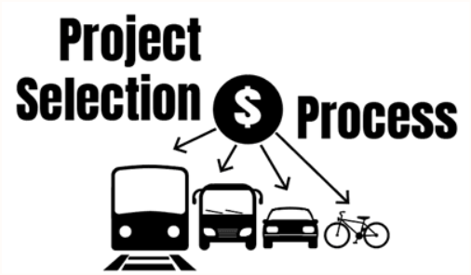
2. Project Selection Process and Implementation Agency
Even when a project subject to a preliminary feasibility study has a background and a purpose, the process by which the project has been chosen as the subject of a study should be clarified. Investigating the process of a project selected as the subject of a preliminary feasibility study and the party or agency that played a leading role in requesting a budget can hint at issues that should be dealt with in the analysis of the project
www.midocean.ae

Slide 7
Project Selection Process and Implementation Agency
Interests can differ between projects led by the central government and those by local government organizations. Though it is not always the case,
1- Projects by the central government often have ripple effects that spread to varying degrees throughout different regions, not only in a specific region.
2- Projects by local government organizations tend to have ripple effects that do not spread much beyond their jurisdictions, if at all.
www.midocean.ae

Slide 8

3. Contents of a Project
Among the details that go into a project plan to be written by the competent authority, the most important is contents of the project other than its background and purpose, selection process, and the implementation agency. Knowing in advance the location of a project, its construction scale, and costs are important clues in roughly determining its economic feasibility.
A project plan needs to state the spatial location, construction details, and total project costs based on data and past experience
www.midocean.ae

Slide 9
Contents of a Project cont.
Although the spatial location of a project is the element first considered when considering whether to pursue it, it requires extensive investigation to determine a specific location and detailed routes. Also, a bit of preliminary investigation is required to estimate construction details and total project costs. Arguably, a preliminary investigation should be conducted to select a specific location and route, and to estimate construction details and total project costs. Nevertheless, there should be no request for a preliminary feasibility study without an estimated spatial location, rough route, or total project costs. To this end, it should be mandatory to include a rough spatial location, construction details, and total project costs in a project plan submitted to the budget authorities.
www.midocean.ae

Slide 10
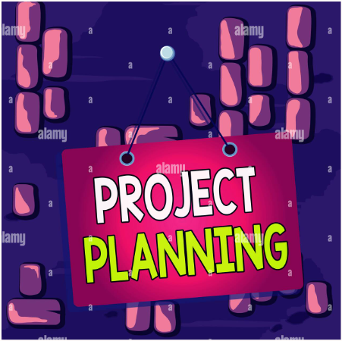
4. Guidelines for Writing Project Plans for Candidate Projects
Based on the above discussion, the competent authorities of projects should write a project plan about candidate projects applying for preliminary feasibility studies as follows and submit it to the budget authorities:
www.midocean.ae
Notes:
Henry Mintzberg is a Canadian academic and author on business and management.

Slide 11



The project plan (draft) of a candidate project should explicitly mention its background and purpose. A vague description of the background or purpose like ‘promotion of regional development’ or ‘resolution of regional transportation problems’ is inadequate and unacceptable.
www.midocean.ae

Slide 12

The project plan (draft) should state the specific location of the project, namely the region where it will be conducted or the route it will cover to the possible maximum extent. Merely mentioning the jurisdiction names of the origin and destination or listing candidate cities is inappropriate.
www.midocean.ae

Slide 13

The implementation agency should be specified. Even for a project where it will likely be determined automatically according to standard procedures, the plan should explicitly state the implementation agency. In this regard, well-defined role sharing between the central government and local government organizations should be clarified as well.
www.midocean.ae

Slide 14

The contents of a project should be rendered explicitly and the total project costs should be estimated and offered. As the project costs depend on the details of a project, only when the project plan can settle which facilities or structures will be included can total project costs be properly estimated. Estimation of total project costs can only be derived at first from the cost data of similar projects, but such estimation is critical to determining the need for investigation into the project.
www.midocean.ae

Slide 15

The plan should also stipulate the expected effects of a project. Such effects as increased production, employment, added value, and the like once it is completed may not be definitely known at this step, but other expected effects need to be roughly presented like, in the case of a transport project, how much travel time can be reduced, how many commuters or travelers can be accommodated, and how much costs can be reduced.
www.midocean.ae

Slide 16

Basic Data Analysis
The first thing to do when pursuing a public investment project or evaluating feasibility is to fully analyze basic data about the region subject to the project. For a preliminary feasibility study, therefore, the study team starts by visiting the target region and gathering basic data about it. The basic data of a region can be largely divided into data on the natural environment and that on the social and economic environment.
www.midocean.ae

Slide 17
Basic Data Analysis cont.
Data on the natural environment refers to that about climate, geological features, altitudes, slopes, etc.
Data on the social and economic environment includes demographics, each industry’s employment structure, gross regional domestic product (GRDP), land use, and so on.
Analysis of the transportation situation should be done to ascertain what the project can do for the transportation system of the target region so that the need for the project can be determined before transportation analysis is conducted in full swing.
www.midocean.ae
Notes:
Fred Luthans is a management professor specializing in organizational behavior.

Slide 18

1. Analysis of the Natural and Living Environments
Depending on their characteristics, some projects are more strongly impacted by the natural environments than others. Projects to build expressways or railroads can be very different in nature and vary greatly in cost depending on topography.
On the other hand, projects to build industrial complexes are influenced more by the social and economic environment than the natural one. Their success or failure depends on the population, industrial structure, regional income level, and such.
www.midocean.ae

Slide 19

Analysis of the Natural and Living Environments cont..
It is also important to look into living environment conditions like water and/or soil pollution, sanitation, and construction noise that have direct impact on daily life. Preliminary feasibility studies should conduct a rough investigation in any form about daily life pollution, etc. that can happen when the concerned project goes ahead.
www.midocean.ae

Slide 20

2. Analysis of the Social and Economic Environments
The most basic data is that on demographics, industrial structure, and GRDP. This is true regardless of the type of project at issue, and these are important determinants of the project’s ripple effects.
Demand is higher in densely populated regions, so the project is likely to be more economically feasible. The industrial structure serves as a definite clue as to whether the project is appropriate for the region.
www.midocean.ae

Slide 21
Analysis of the Social and Economic Environments
GRDP data are important in determining economic feasibility and balanced regional development.
In the case of transport projects like those for roads and railroads, the most important part of basic investigations for preliminary feasibility studies is to know the transportation conditions of the target region.
www.midocean.ae

Slide 22
Analysis of the Social and Economic Environments
It is also important to review upper-level and relevant plans of the concerned project as a sort of socio-economic environment analysis. Review of higher-level plans can indicate whether the concerned project has been well coordinated and check the order of priority for investment determined in higher-level plans.
www.midocean.ae

Slide 23


Project Scope
www.midocean.ae

Slide 24

Scope refers to all the work involved in creating the products of the project and the processes used to create them.
Product scope – the features and functions that characterize a product or service.
Project Scope – the work must be done to deliver a result/product with the specified features and functions.
www.midocean.ae

Slide 25
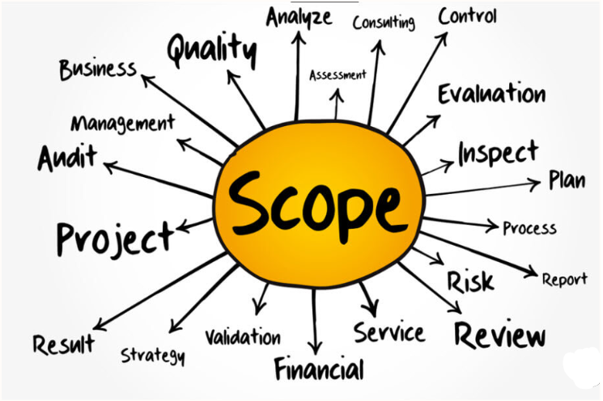
Scope Management
The processes required to ensure that the project includes all the work required, and only the work required, to complete the project successfully.
It is primarily concerned with defining and controlling what is or is not included in the project.
www.midocean.ae

Slide 26

Scope Management
Scope Planning – developing a written scope statement as the basis for future projects.
Scope Definition – subdividing the major project deliverables into smaller, more manageable components.
Create WBS – creating a structure for work division for a project to show elements.
Scope Verification – formalizing acceptance of the project scope.
Scope Change Control – controlling changes to project scope.
www.midocean.ae

Slide 27
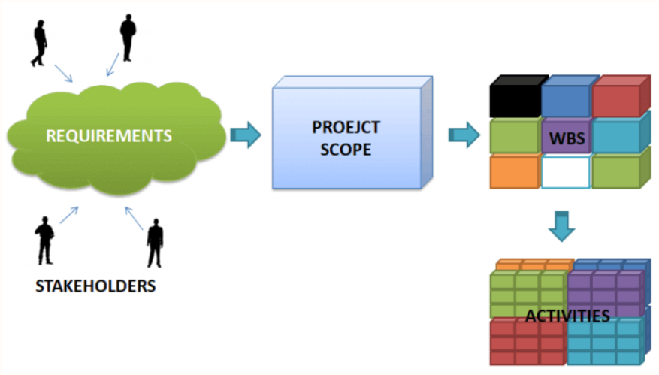
Scope Planning
Scope planning is the process of elaborating
and documenting the project work (scope) that produces
the product.
When there is poor scope definition, final project costs will be higher
www.midocean.ae

Slide 28

Scope Statement
It provides a documented basis for making future project decisions and for confirming or developing common understanding of project scope among the stakeholders.
As the project progresses, the scope statement may need to be revised or refined to reflect approved changes to the scope of the project.
www.midocean.ae

Slide 29
Scope Statement
The scope statement includes, either directly or by reference to other documents :
Project justification (business need)
Project’s product
Requirements or specifications
Project deliverables
Project objectives
Assumptions
Cost and time estimates
Constraints.
www.midocean.ae

Slide 30


Scope Change Control
Scope change control involves controlling changes to the project scope. In order to minimize scope change control, it is crucial to do a good job of verifying project scope.
www.midocean.ae

Slide 31


www.midocean.ae

