Slide 1

Project Quality
Management
Prepared by Dr.Mahmoud Ibrahim
PMG354
Lecture3: Product Fit Solution Quality Plan
(PFS-QP)
2nd HPMQS transformation .
1

Slide 2
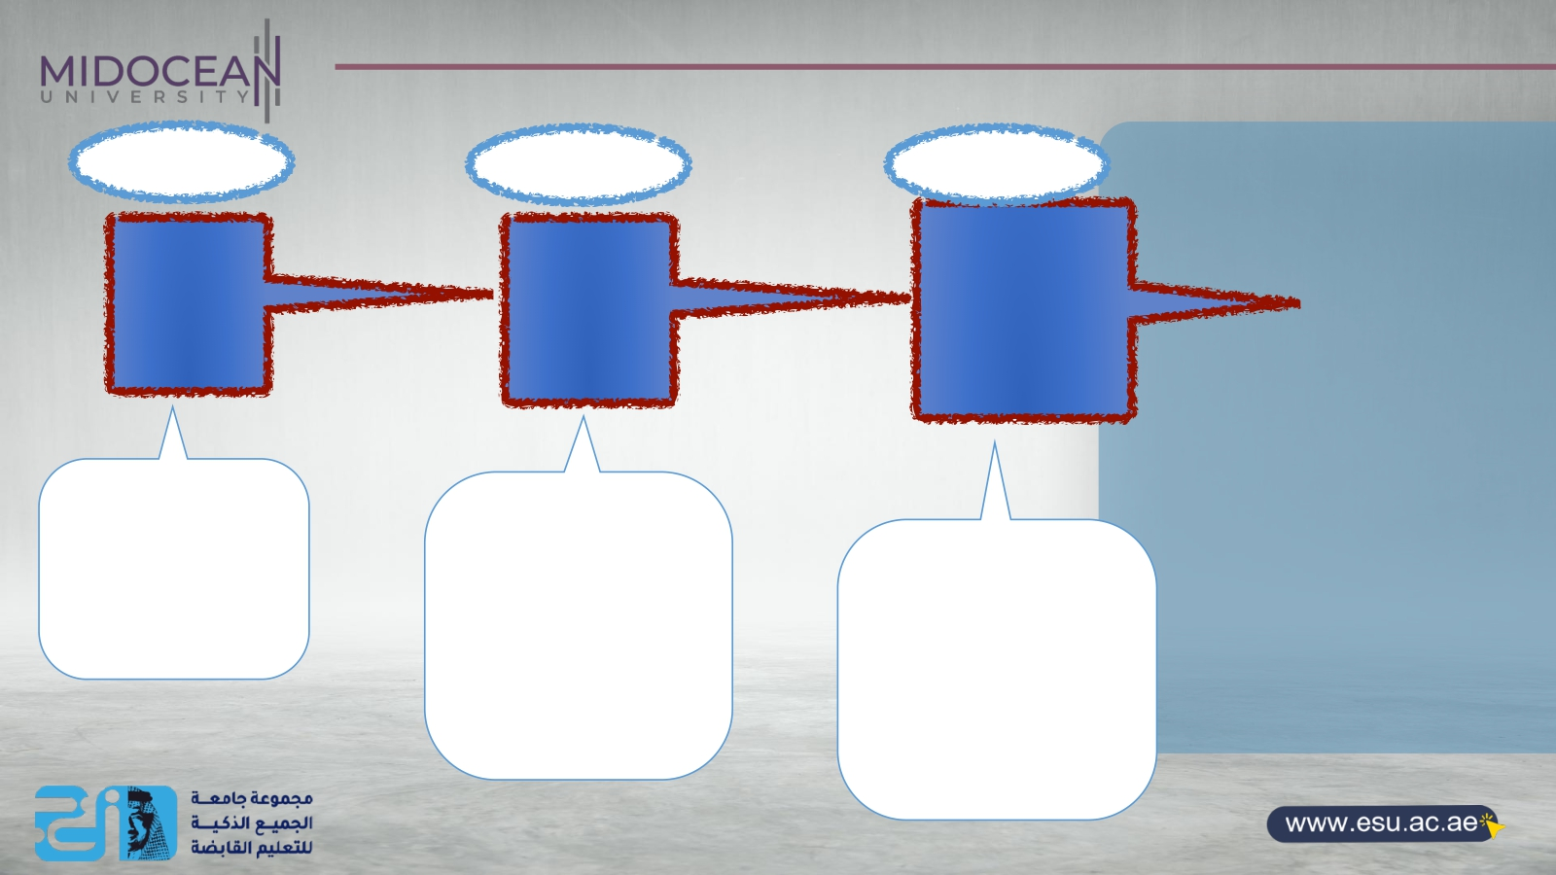
LEC2
HPM -QP
With
outlined
DFT
LEC3
PFT-QP
With DFT
13th SC
+7th SFs
LEC4
Project fit -QP
With DFT
SF
2nd transformation
3rd transformation
4th transformation
It needs to be outlined by the PM
tasks and team
woking environment
to be done
It is setting a
well structured PM
working environment that fit the HPM-QP but it needs a well structure project that fit with this
PM working
environment
Selected the fittest
project governance structure that balance between the PM work task and team and the project work task and
team
2

Slide 3

Welcome on board of the professional quality track
Now we have as an output of the
preparation stage , the full
perspectives HPM original quality
plan as follows:
Hi, in this lecture you
will learn how can
answer
the big question …..
-the holistic deliverable-fit technicality of the PFS
-the PFS success criteria
-the original PMP dependencies Baselines
-the holistic approach for the interdependiesc PLC
3

Slide 4
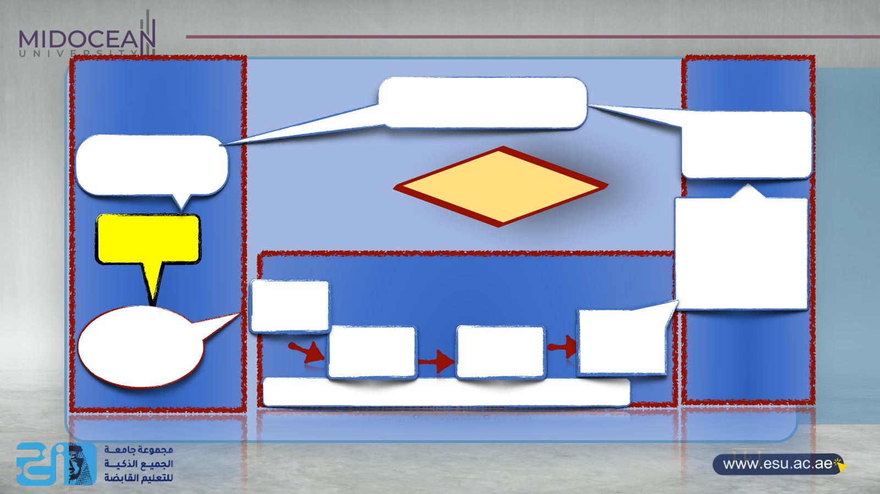
1st sector
Planning DFTs
2—preparationPFS
3—PFSQP
3rd sector
10.Post -implemented Review (PIR) the Business-Fit solution
9. Accepted test and
Hand over the
1-validated Business Pain points
4-HPMQS
life cycle
2 nd sector :Project technicality
Deliverables -Fit producing Processes
Validated Deliverables-
fit
5-Planning
deliverables
6-Executing
deliverables
7.producing
deliverables
8.Resultant
deliverables
4- PFS project fit
PFT
Monitoring&Controlling (IV&V)
source: designed and developed by Dr.Mahmoud Ibrahim @2021
4

Slide 5

The difference between the Project technicality and the DFT
 | Traditional Project technicality | DFT
Definition | it is the governance process and procedures for Project team performance and the project tasks in managing the integration between the PLC stages andPMPs from the project till the official closing of the project. | it is the governance process and procedures for the work team and work tasks that are ensuring the effectiveness of the Fittest deliverable- producing processes to have PFS till having BFS.
Focusing 100% on | On the tasks and activities dependencies for delivering a unique product at the right time with the right budget, according to the PMPs. | On not only the interdependencies of the PLC and the dependencies of the PMPs tasks but also the overlapping with the HPMQS of having the business solutions.
Managed by | Managed by project management structure | Managed by the HPMQS structure
Impact on project success | Minimizing the success rate of the project and confirmed the dissatisfied the clients | Maximizing not only the project success rate but also the effectiveness of the DFT of the business solution.
The relationship between each other | Stand alone (in box ) | Integrated with structured project technically during the PLC and then integrated with the DFT (Outbox )
Its Quality plan | Managed by only the with the compilation criteria which is stated on the Project charter in addition of project quality plan | Integrated among the HPM original quality plan + PFS-QP+project fit success criteria +DF-QP +Integrated validated process for the deliverables.
Its role with Total quality principles | Very limited | Fully integrated with the most updated version of the strategic quality principles
Designed and developed by Dr.Mahmoud Ibrahim @2023 5

Slide 6
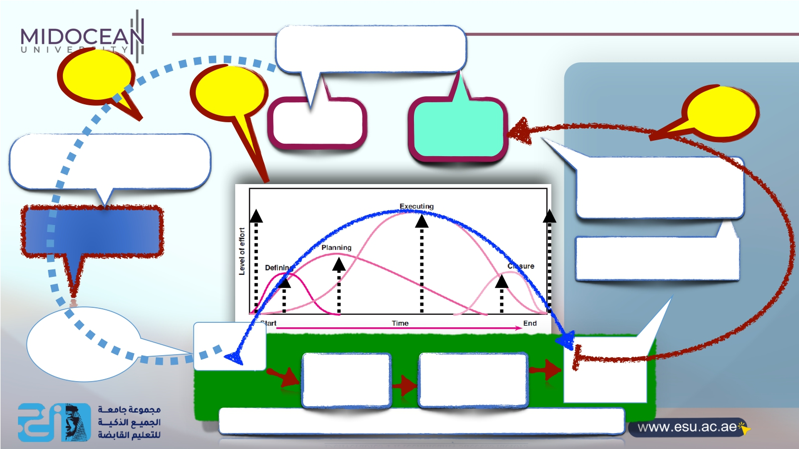
Designed and developed by Dr.Mahmoud Ibrahim @2023
Business operations
Sec.1
New
Sec.2
Sec.3
BPP having
business ?
New
Covered BPP/ BFS
2—preparation PFS
10.HPMQS of validation BFS based on (PIR)
3-developing PFS-QP
9. HPMQS validation3 based on DFAP
4-Initiating
project-fit
HPMQS for
developing DFAP
7.HPMQS validation 1 based on project charter
Deliverables-Fit technicality success factors X 6

Slide 7
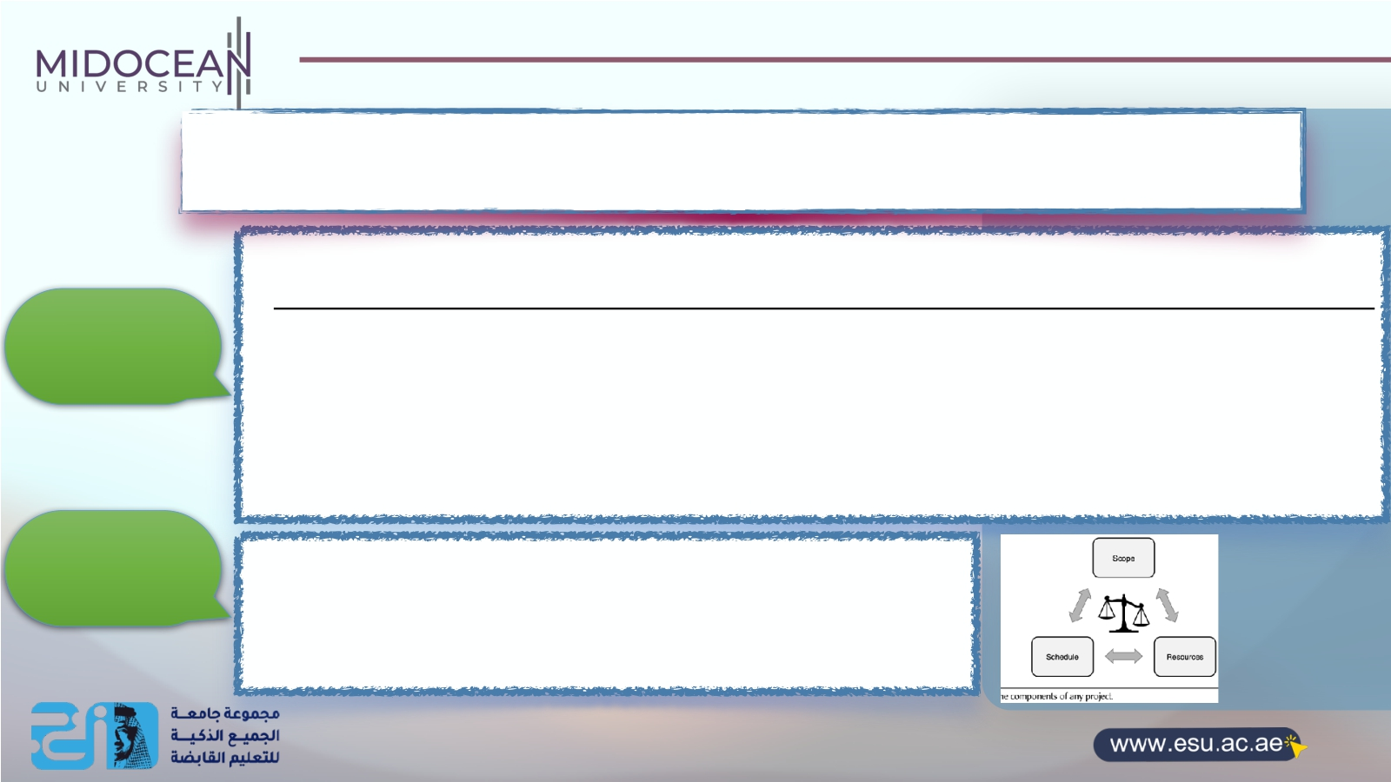
So the outcome of each ……
It lets everyone will understand not only the structure of work tasks and their work team t but also its impact on the business solution that needed to be done on priority with attention to detail:
1-prioritize certain tasks as the project plan is being executed.
2-Activities that must be fulfilled the quality levels and completed to a high-quality standard as a project considered most essential to its success or failure in order to achieve your project's goals.
Deliverables-fit
technicality
Project -technicality
The three success criteria for a project are cost, scope, and time (the triple constraint). While the details might depend on the strategy of the company, therefore the project's success will live or die on these three factors.????!!!!!!
X 7

Slide 8
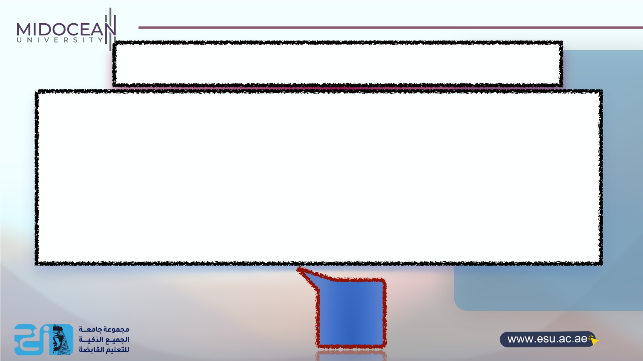
The target questions of the stage
To ensure that the
breaking down :
2nd transformation by having the PFS-QP is effectively
1- hi level description of the HPM original QP into detailed PFS-QP
2-The holistic DFT to detailed DFT with its 13th success criteria with the 7th success factors as (3 success factors regarding the PMP dependencies +4 success factor regarding the Project stages )
Developing
PFS-QP
8

Slide 9

 |  | Lecture outline
1st section content : The PFS-QP baselines
2nd section content : Having the 13th success criteria for the DFT
3rd section content : Having the 7th success factors for PFS-QP
4th section content : The output of this stage
9 9

Slide 10

Section one
The PFS-QP baselines
X

Slide 11

Developing
PFS-QP
What is PFS-QP ?
It is a systematic process of developing DFT success criteria and factors that will confirming the validation of the performance and compliance with the "HPMQS original quality plan” and effectively supporting the project technicality to success the project and satisfied the customers
X 11

Slide 12
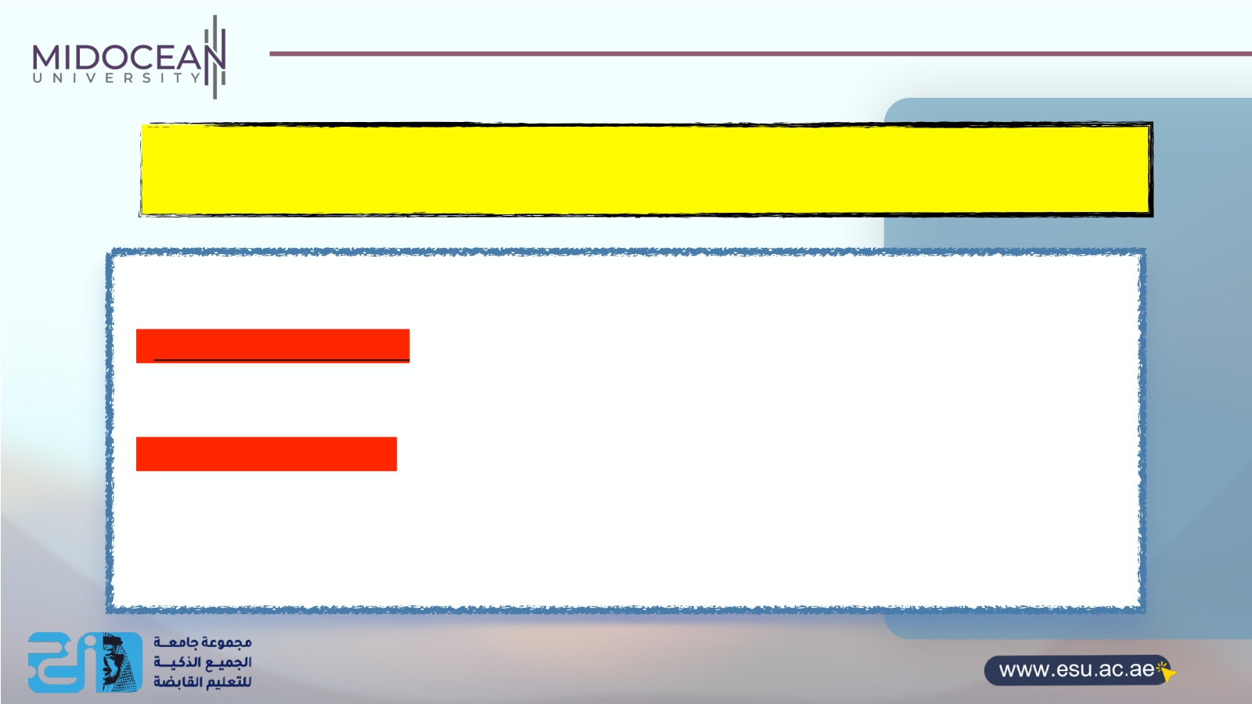
The DFT of the PFS-QP benefits
1-Reduced Action Bias: “Defining clear critical DFT success criteria reduces the risk of action bias — the tendency to favor action over inaction, “let’s go!’ without considering all the causes . Taking time to identify and assess critical success criteria for a more thoughtful approach to any potential project's value.”
2-Greater Competitive Edge: Determining Critical Success criteria of DFT is determining critical will give the organization/company a competitive edge and is the bottom line of success in fulfilling the responsibility of a project management company.
This, in turn, will give rise to satisfied investors and professional bodies and make the project management more effective .”
3-Control and Accountability: Critical success criteria best practices dictate clear reporting of every aspect of a project, full support of agreed-upon criteria by all stakeholders, and a project manager with overall control and ultimate accountability.
Reporting on an ongoing basis and providing transparency in every aspect to those charged with governance and senior
stakeholders is a best practices tenet in advanced project management.
X 12

Slide 13

the real value added of the PFS-QP
Effectively manage the project technicality
(Internal )
1.PFS-QP is ensuring the effectiveness of
the project charter and readiness to be
approved so the actual execution can begin
2.the initiation process does not guarantee that the project will be executed, it needs an approval to the project into the planning process where the work will be defined in
more details
3.it will confirm defining the Project work tasks and resourcing that will add value and/ or reduce risk subject to the constraints of available Project resources and project rules,
4. Managing The PLC dead-points
Effectively manage the DFT
External
1.develop the PFS quality planning for items must be validated to ensure that the program /project is ready to start
2.it will confirm the fittest the Project
management structure .
3.it will confirm the validation of the description the hi level approach regarding standards, tools and processes necessary to achieve “quality delivery”of the right DFS .
4.Confirm the fitting of the working
environment organizational structure
X 13

Slide 14
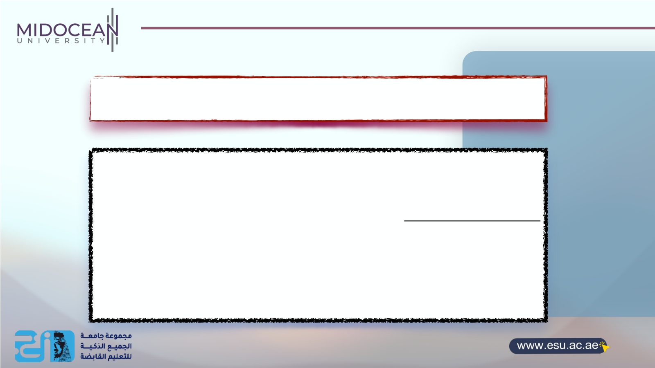
PFS-QP official management approval process official approval
To agree on the validation of the PFS-QP with its DFS success criteria valued and are best aligned by the success factors for the project technicality .
1- the PFS-QP should be documented .
2-Once PFS-QP has been documented, it is presented to a HPMQS committee for approval.
3- they assess the validation of the documented PFS-QP and re-allocates the funding from their budget, and ensures that PFS-QP are considered when sleeting the fit project
3-they authorize the PMQ planning to proceed
4-updating the business case supporting documents
14

Slide 15

Section two
Having the 13th success criteria for the DFT
X

Slide 16

Developing the 13th DFT Success criteria for PFS-QP can include
the following:
1.Discuss whether any broader company initiatives or strategies impact the
structure of this project.
2.Identify any constraints or time-boxes in terms of budget, effort, time or
quality, and the impact to the project.
3.Describe any company standards that will impact how the project is
executed.
4.Note any company or industry best practices that will have an effect on the
project.
5.Describe other options for the overall approach and why you chose the
options you did over the others.( protocols)
6.Talk about how the deliverables will be supported and maintained after the project ends. Also indicate whether the approach was influenced by support and maintenance implications.
7.Discuss any other related projects that are completed, in progress or pending that influenced the approach for this project and why.
8.Discuss, at a high level, how the project will progress from start to end and the interdependencies between the high-level phases and stages.
10.Discuss any techniques that might be of interest to the production .
11.Note whether new technology or new processes are being utilized and why.
12.Identify any unusual staffing requirements, such as consultants or outside specialists, and explain
why you need them.
13.Describe the use of outsourcers, contractors or vendors, especially if they are doing significant
work.
16

Slide 17

Section two
Having the PFS-QP 7th success factors for the project technicality
1-PFS-QP 3rd success factors regarding
PMP dependencies
X

Slide 18

Q. What factors influence project success or failure?
The project technicality critical success factors that influence project success or failure are in-depth project planning, critical milestones, risk management, and project evaluation. If rightly worked upon, these can drive the project successful completion. If not, chances of failure rise.
X 18

Slide 19

1- Regrading the PM progress

Slide 20

I- Well defining the structure key Deliverables types Not just deliverables
1-List external deliverables :All of your final deliverables you are building for the clients should be listed for reviewing and validated
and agreed on with them
2—list internal deliverables:that are client focused to be trusted of the effective work flow of the deliverables such as the Business Requirements Report and Current State Assessment
2- confirming the deeply Understanding that deliverables you are structured and going to produce will impact a long
way of managing the scope of the project management .
3- this approved deliverables structure are well integrated with the stakeholder matrix and the
project communication plan
Deliverable | Components | Description
List each of the key deliverables to be produced by the project. | For each deliverable, itemize the major components to provide a complete view of the deliverable's composition. | Create a detailed description of each deliverable and its components.
PFS value added X 20

Slide 21

2 - well-Defining Critical Milestones
The identification of crucial moments throughout the project is important and is called critical milestones.
-Perform a check or evaluation test at each milestone of the project. From the preparation
part till the very end, to make sure that the PFS is exceeding quality expectations
-This way, you can easily identify and manage the project hidden risks and issues to shift from failure to success.
X 21

Slide 22
2- Regrading the PM plans

Slide 23

1-Project Managers experience Effect on Project Success
You don’t have to be a trained project manager for just managing the project technicality of the project project to be successful but you need to have the necessary skills and knowledge for managing the DFT
1-Make sure you share a PFS-QP its with responsibilities and DFT success criteria before getting to work .
2-educate the deep relationship with the PFS-QP and the project scope and risks early on, and
3-keep him posted with any business solution updating.
X 23

Slide 24

2-Determine the PMP implementing outlines based on the PFD-QP
Project management plans | PFS-QP Reviews
Time Management | how Time Management will be undertaken on this project.
Cost Management | how Cost Management will be undertaken on this project.
Quality Management | how Quality Management will be undertaken on this project.
Change Management | how Change Management will be undertaken on this project.
Risk Management | how Risk Management will be undertaken on this project.
Issue Management | how Issue Management will be undertaken on this project.
Procurement Management | how Procurement Management will be undertaken on this project.
Acceptance Management | how Acceptance Management will be undertaken on this project.
Communications Management | how Communications Management will be undertaken on this project.
X 24

Slide 25
3- Regrading the communication process
for having PFS value added

Slide 26

1-Reporting flow structure
eporting on an ongoing basis and providing transparency in every aspect with QMS governance and senior stakeholders is a best practices in advanced project management.
Therefore ,Critical success criteria best practices ensure:
1- clear reporting of every aspect of a project,
2- full support of agreed-upon criteria by all stakeholders, and
3-a project manager with overall control and ultimate accountability.
PFS value added
X
R
26

Slide 27

2-Trust and communication”
“Trust and communication” is the deliverable technicality key success criteria when everyone is on the same pages .It is the responsibility of the project manager as follows :
1.- well managing teams.,
2.-getting team members to open up to each other
3.-increase productivity.
4.-focus on trust-building and
5.-consistent communication needs to be established between the stakeholders, clients, and team
members.
1-This narrows down the chances of frequent change requests to ZERO.
2-There will be no “surprise attacks” in the middle of the project.
PFS value added
X
27

Slide 28

.
2-PFS-QP 4th success factors
regarding PLC interdependencies
X
28

Slide 29

The dark side of the project technicality
Q.how can the limited project technically lead to project failure?
Major factors that can lead to project failure include
1-Projects can get very busy . There’s a lot to look out of tasks and deliverables. So, losing focus and forgetting about project critical success factors is something that’s common for project managers.
2-After getting stressed by the never-ending deadlines, project managers fail to adequately implement a successful strategy. This results in getting the irrelevant tasks done first and losing focus on the tasks that are the real deal! Well, this initiates the downfall, ultimately leading to project failure.
3-always run out of time and budget if you have poor project management knowledge
and your team losing understanding what exactly they are creating throughout the
project.
X
1- Regrading the project
technicality
29

Slide 30

How can we know that we do have poor project technicality ??
1.lack of scope document,
2.poor planning, lack of communication,
3.unrealistic expectations,
4.inexperienced team,
5.poor project monitoring, and
6.no risk management strategies :Risk management and lack of support also cause problems.
7.Maybe you would have run out of time if you had not top management’s support or if your team
was not well understood what the project was truly meant to create.
8.Keep bottlenecks in stop having knowledge-sharing flows.
In the end, you could end up completing irrelevant tasks first, instead of focusing on tasks that truly drive the project’s progress.All of these factors eventually contribute to missing deadlines and exceeding the budget.
1- Regrading the project
technicality
X 30

Slide 31
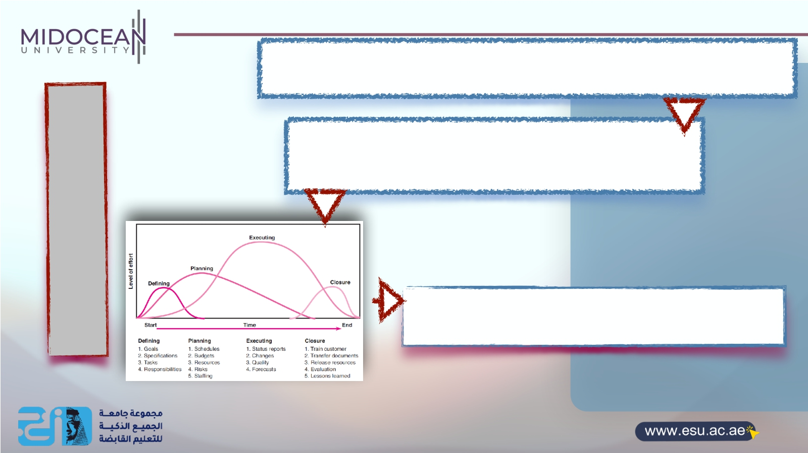
The biggest project technicality problem that damage the relationship and the balance between the (Scope-Time-Cost -Quality )
PLC Dead points
Is losing focus and losing quality performance
PFS-QP is —Internally minimize "the load of managing PLC
dead points" which may lead to damage project even
before completing the deliverables.
2- Regrading the project
dead lines
X 31

Slide 32

The PFS-QP impact on PLC
There are two benefits to creating PFS-QP
First, its information will help the client and stakeholders understand how the project will progress without having to interpret the actual schedule.
Second , it allows the project manager and project team to lay out a high-level vision for project execution and use this vision to help create the lower-level schedule.
#Sometimes the project team finds it hard to build a schedule to complete the work.
3- Regrading the PLC
32

Slide 33

Confirming the alignment with the HPM original
quality plan for the preparation phase and PFS-QP
Phase | Overall Approach
Initiation | Clear steps for initiating A project definition statement (PDS) which is a document that outlines the high-level objectives, deliverables, assumptions, risks, and constraints of a projected approved by the program /project sponsor and client. It is not typically any more created during the initiation phase of a project
Planning | Define the project planning process to ensure that the phases, activities and tasks are undertaken in a coordinated way.
Execution | List the generic activities required to construct and implement each of the project deliverables.
Closure | Identify the steps required to release the deliverables to the business, close the Project Office, reallocate project staff, terminate supplier contracts and perform a Post Implementation Review (PIR).
33

Slide 34
4- Regrading the clients approval

Slide 35

clients approval before producing
1-Both of these deliverables need to be approved by the client, and so they would make sense to list. (Activate the list officially )
2-On the other hand, you would not need to mention internal project documents such as the project schedule, Technical Design Specs or Test Cases.
AS The program sponsor does not understand these deliverables and is not going to see them anyway.(project technicality concerned by the project sponsor )
Note :So the client signed off and approval on this list is the real starting of conducting the acceptance plan
X 35

Slide 36

clients approval after production
(Test deliverables)
A critical success factor that project managers often overlook or ignore is testing deliverables. It is important to test deliverables at every critical milestone to learn what improvements need to be made.
Testing at the very end of a project can often lead to shocking results with not much time or resources at hand to improvise the product.
When testing is done at each stage, corrective measures can be taken immediately to bring back the project on track.
HPMQS try to exceed the expectations while testing deliverables by having PFS-QP
with three validation process based on the success criteria as completion
criteria ,quality targets and acceptance criteria .
X 36

Slide 37

Section three
The output of this stage
37

Slide 38

The real output
the first component is coming from the PFS-QP which Is the transforming of the Business case success criteria to PFS-QP success criteria and factors of the quality criteria ,that will be used as during the second validation process to determine do we have a resultant deliverables or not before closing the project officially
(Presented the DFT)
ote-The second component of the quality criteria is coming from the project quality plan based on the completion criteria at the project charter
(Presented Project technicality (PT)
So the HPM quality criteria =1+2
N
X 38

Slide 39

Thanks for paying attention
Having a success roadmap of planning the governance implementation of the PFS by
developing PFS-QP with its 13th DFT SC +7th
SF
Now let’s recap the
taken topics today
So we will need a very specified project structure
fit to this quality plan for the recommend
business solution
So
We need have the most project fit to PFS-QP
This is will do next lecture
39

Slide 40

Thank You 40

