Slide 1


DIGITAL CONTENT DIRECTION
DGM 733
Prepared by:
Dr. Sherihan Mohamed
Introduction

Slide 2


Intro
OUTLINES:
* Course description
* Learning outcomes
* Topics
* What is digital content?
* Why Media spreads?
* Conclusion

Slide 3

Intro
Digital Content Direction
COURSE DESCRIPTION

Slide 4
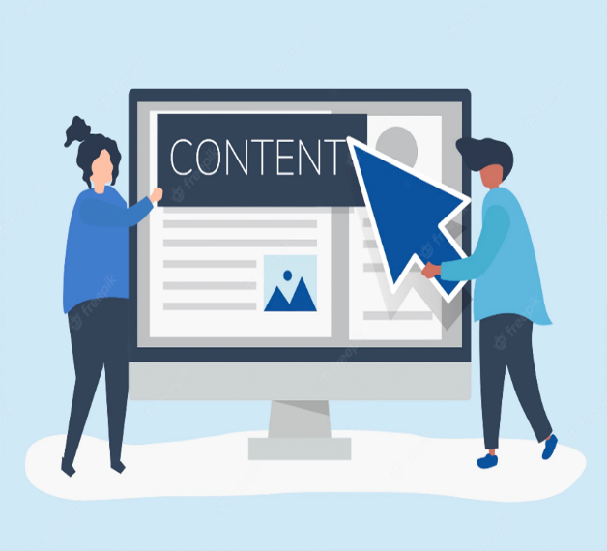
COURSE DESCRIPTION
Intro
This course provides a comprehensive overview of digital content creation and strategy across multiple platforms. It explores not only the production tools and content formats but also the strategic role of content in communication, branding, marketing, and public engagement.

Slide 5
Students will engage with The Main Types Of Digital Content, including digital journalism, public relations content, freelance and entrepreneurial media, video blogging (vlogging), and podcasting. The course also examines the tools used in content creation, from mobile journalism apps to video/audio editing software and content management systems (CMS).

Slide 6
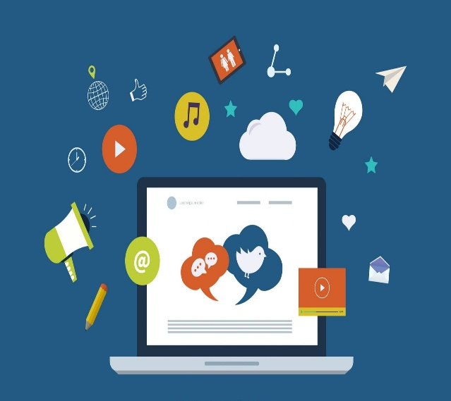
COURSE DESCRIPTION
Intro
A core component of the course is the role of social media platforms in content creation, distribution, and audience engagement. Students will study how virtual communities are built and managed, and explore strategies for moderating and monitoring content to ensure quality, accuracy, and inclusivity.

Slide 7

Furthermore, the course emphasizes creative direction, analytics-driven decision-making, and responsible media practices that prioritize diversity, accessibility, and cultural sensitivity.

Slide 8
Intro
Digital Content Direction
LEARNING OUTCOMES

Slide 9
LEARNING OUTCOMES
Intro
Having successfully completed this course, you should be able to:
Identify and evaluate Major Tools for digital content production.
Distinguish between various types of digital content: journalism, PR, freelance media, vlogging, and podcasting.
Analyze the impact of social media platforms on content creation, distribution, and public discourse.

Slide 10
Understand the dynamics of virtual communities and manage user-generated content within them.
Develop creative and strategic content directions based on platform trends, market insights, and brand goals.
Apply performance analytics to measure campaign effectiveness beyond vanity metrics.

Slide 11
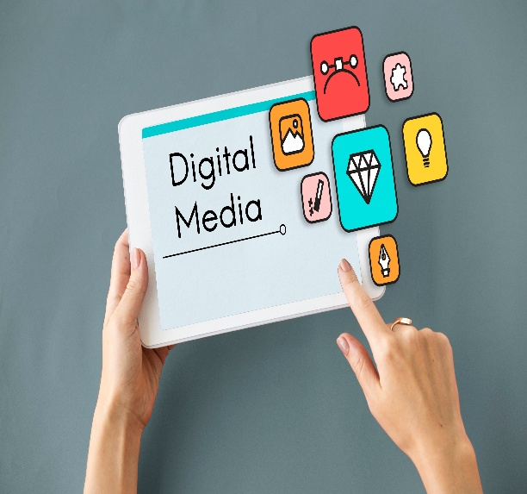
LEARNING OUTCOMES
Intro
Integrate digital content across all stages of the customer journey.
Establish inclusive content practices that address accessibility, representation, and cultural diversity.

Slide 12
Intro
Digital Content Direction
TOPICS

Slide 13
1- Purpose and Strategic Goals of Digital Content
2- Types of Digital Content:
* Digital Journalism * Public Relations Content
* Freelance and Entrepreneurial Media
* Video Blogging (Vlogging) * Podcasting

Slide 14
TOPICS
Intro
3- Digital Content Creators and Industry Roles
4- Essential Tools for Digital Content Creation (e.g., mobile editing apps, CMS, analytics tools)
5- Understanding Audiences and Stakeholders
6- Platform Analysis: Owned vs. Shared Media

Slide 15
7- The Role of Social Media in Content Creation and Distribution
8- Virtual Communities: Building, Managing, and Monitoring Online Spaces
9- Creative Direction and Content Planning
10- SEO and Organic Search Integration
11- Analytics and Performance Indicators
12- Inclusive and Ethical Content Guidelines
13- Managing Content Teams and Editorial Workflows

Slide 16

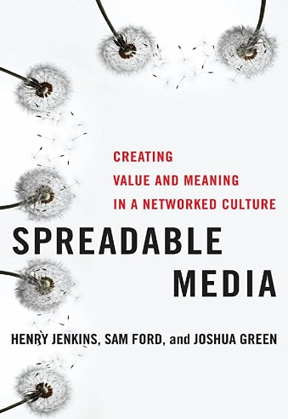

Jay Daniel Thompson & John Weldon (2022), Content Production for Digital Media: An Introduction, Springer Nature Singapore.
Jenkins, H., Ford, S., & Green, J. (2013). Spreadable media: Creating value and meaning in a networked culture. New York University Press.
Intro
Recommended Reference

Slide 17
Intro
Introduction
What is digital content?

Slide 18
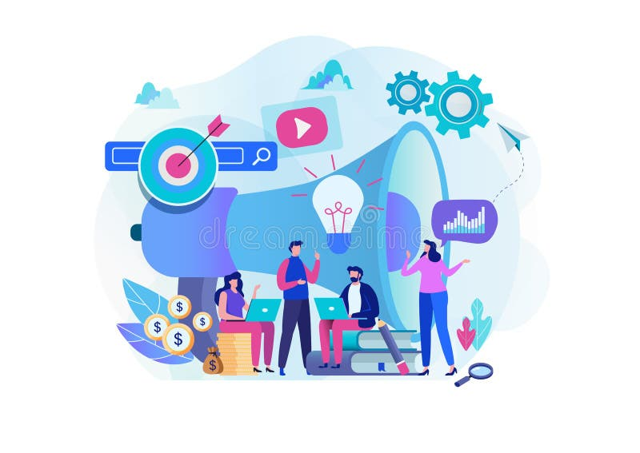
Intro
What is digital content?
Digital content refers to any type of media that an organization uses to engage with visitors, customers, or users of their website or applications, distributed by online delivery systems.

Slide 19
With more organizations now depending on their online presence to attract and retain users, digital content has become a vital resource in digital media producing. The term encompasses every type of publishable media from streaming video, downloadable guides, images, live broadcasts, or a piece of gated information.

Slide 20
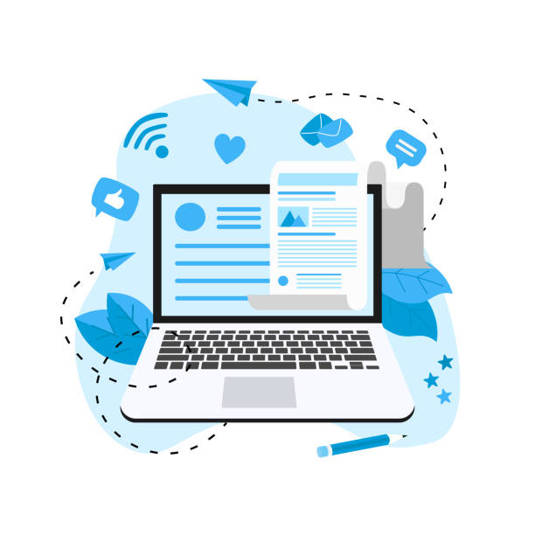
Intro
Viewed narrowly, digital content includes popular media types, while a broader approach considers any type of digital information (e. g. digitally updated weather forecasts, GPS maps, and so on) as digital content.

Slide 21
Types of digital content includes:
* Video: Types of video content include home videos, music videos, TV shows, and movies.
* Audio: Music is the most common form of audio.
* Images: Photo and image sharing is another example of digital content.

Slide 22
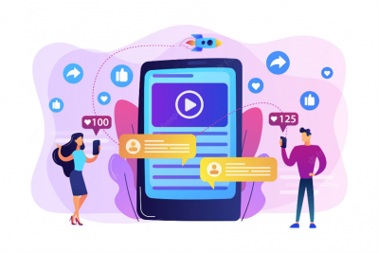
Intro
* Visual Stories: Stories are a new type of digital content.
* Text: Type of digital content which is available in text or written format. Blog websites which store data in form of textual format.

Slide 23
Intro
Introduction
Why Media spreads?

Slide 24
The shift from distribution to circulation signals a movement toward a more participatory model of culture, one which sees the public not as simply consumers of preconstructed messages but as people who are shaping, sharing, reframing, and remixing media content in ways which might not have been previously imagined.

Slide 25

Intro
And they are doing so not as isolated individuals but within larger communities and networks, which allow them to spread content well beyond their immediate geographic proximity.

Slide 26
The term “participatory culture” describe the cultural production and social interactions of fan communities, initially seeking a way to differentiate the activities of fans from other forms of spectatorship. As the concept has evolved, it now refers to a range of different groups deploying media production and distribution to serve their collective interests, as various scholars have linked considerations of fandom into a broader discourse about participation in and through media.

Slide 27
Intro
Previous work on participatory culture stressed acts of reception and production by media audiences,
Audiences are making their presence felt by actively shaping media flows, and producers, brand managers, customer service professionals, and corporate communicators are waking up to the commercial need to actively listen and respond to them.

Slide 28
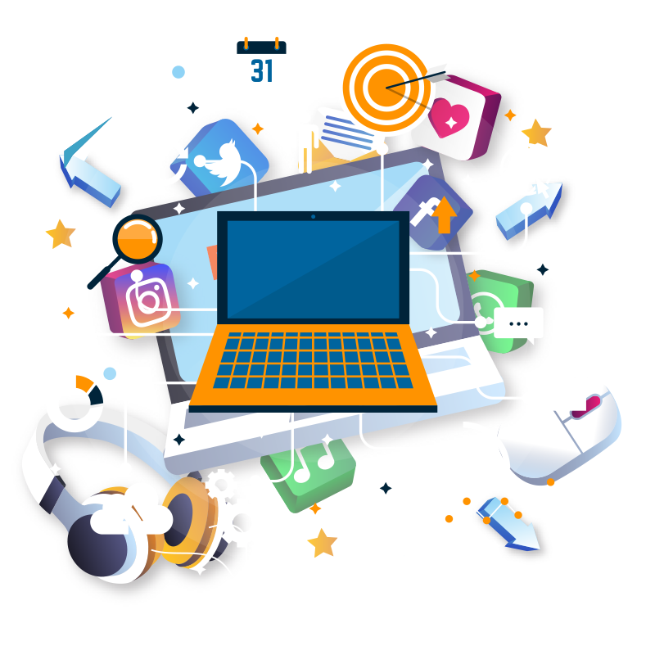
While many content creators are struggling with the growing prominence of such grassroots audience practices, an array of online communication tools have arisen to facilitate informal and instantaneous sharing.

Slide 29
Intro
These platforms offer new capacities for people to pass along media artifacts—and, in the process, to seek models to generate revenue through the activities of their users. However, while new tools have proliferated the means by which people can circulate material, word-of-mouth recommendations and the sharing of media content are impulses that have long driven how people interact with each other.

Slide 30
Spreadable Practices “Spreadability” refers to the technical resources that make it easier to circulate some kinds of content than others, the economic structures that support or restrict circulation, the attributes of a media text that might appeal to a community’s motivation for sharing material, and the social networks that link people through the exchange of meaingful bytes.

Slide 31
Intro
Spreadability assumes a world where mass content is continually repositioned as it enters different niche communities. When material is produced according to a one-size-fits-all model, it imperfectly fits the needs of any given audience. Instead, audience members have to retrofit it to better serve their interests.

Slide 32
As material spreads, it gets remade: either literally, through various forms of sampling and remixing, or figuratively, via its insertion into ongoing conversations and across various platforms. This continuous process of repurposing and recirculating is eroding the perceived divides between production and consumption.

Slide 33

Intro
The circulation of media content within participatory culture can serve a range of interests:
* some cultural (such as promoting a particular genre or performer).
* some personal (such as strengthening social bonds between friends).

Slide 34

* some political (such as critiquing some politics within mass media).
* some economical (such as those which serve the immediate needs of everyday individuals, as well as those which serve the needs of media companies).

Slide 35
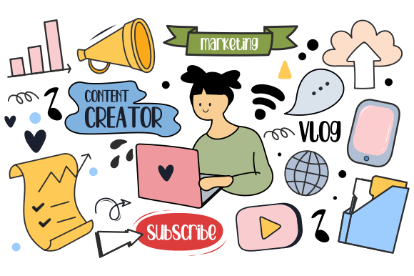
Intro
We are not arguing that fans are somehow resisting consumer capitalism and its intellectual property regimes through these various processes and practices, as many of even these unauthorized activities might indirectly profit media companies and brands.

Slide 36
Whatever audience’s motivations, they may ⁽¹⁾discover new markets, ⁽²⁾generate new meanings, ⁽³⁾ renew once-faded franchises, ⁽⁴⁾support independent producers, ⁽⁵⁾locate global content which was never commercially introduced in a local market, or ⁽⁶⁾disrupt and reshape the operations of contemporary culture in the process.

Slide 37
Intro
OUTLINES:
* Course description
* Learning outcomes
* Topics
* What is digital content?
* Why Media spreads?
* Conclusion

Slide 38



Thank You

Slide 39


DIGITAL CONTENT DIRECTION
Introduction
DMG 733
Prepared by:
Dr. Sherihan Mohamed

