Slide 1


Machine Learning
for Finance
Prepared by Dr. Diaa Salama
FNT633
Naïve Bayes
Lecture 6

Slide 2



Machine Learning
for Finance
Lecture 6
FNT633
Navie Bayes
Prepared by
Dr. Diaa Salama
www.midocean.ae

Slide 3
Week
07
Today
Classification
Naïve Bayes
Classification: Basic Concepts
www.midocean.ae

Slide 4
Week
06
Naïve Bayes Basics
Naïve Bayes Introduction
www.midocean.ae

Slide 5
Week
07
Supervised vs. Unsupervised Learning
Supervised learning (classification)
  Supervision: The training data (observations, measurements, etc.) are accompanied by labels indicating the class of the observations
  New data is classified based on the training set
Unsupervised learning (clustering)
  The class labels of training data is unknown
  Given a set of measurements, observations, etc. with the aim of establishing the existence of classes or clusters in the data
www.midocean.ae

Slide 6
Week
Prediction Problems: Classification vs. Numeric Prediction
07
    Classification
        predicts categorical class labels (discrete or nominal)
        classifies data (constructs a model) based on the training set and the values (class labels) in a classifying attribute and uses it in classifying new data
    Numeric Prediction
        models continuous-valued functions, i.e., predicts unknown or missing values
    Typical applications
        Credit/loan approval:
        Medical diagnosis: if a tumor is cancerous or benign
        Fraud detection: if a transaction is fraudulent
        Web page categorization: which category it is
www.midocean.ae

Slide 7
Week
07
Supervised vs. Unsupervised Learning
Learning
Supervised Learning
Unsupervised Learning
Unsupervised learning (clustering)
The class labels of training data is unknown.
Given a set of measurements,
observations, etc.… with the aim of establishing the existence of
classes or clusters in the data.
Supervised learning (classification)
The class labels and the number of classes of training data is known.
New data is classified based on the training set.
www.midocean.ae

Slide 8
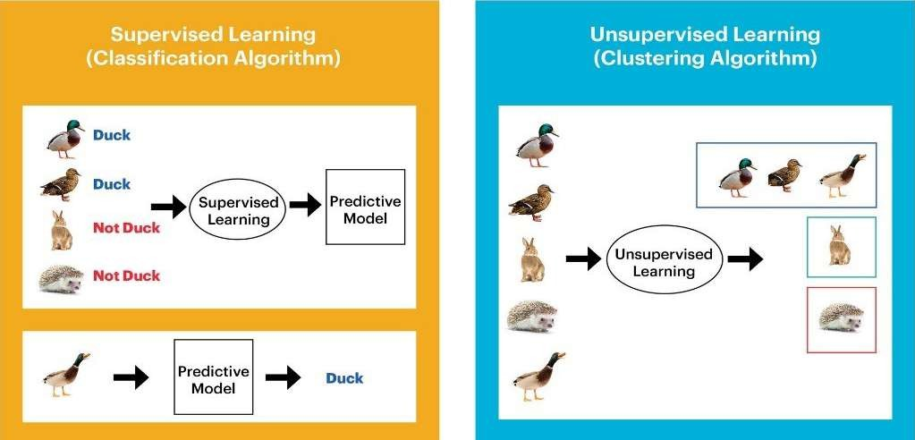
Week
07
Example: Supervised vs. Unsupervised
Class labels √
Class labels x
Number of classes √ or x
Number of classes √
X : Unknown in advance
√ : Known in advance
www.midocean.ae

Slide 9

Week
07
Prediction Problems: Classification vs. Regression
Classification and Regression are two major types of prediction problems.
Classification:
Predicts categorical class labels (discrete or nominal).
Classifies data (constructs a model) based on the training set and the values (class labels) in a classifying attribute and uses it in classifying new data.
Regression:
Models continuous-valued functions, i.e., predicts unknown or missing values.
Activity: (classification or regression?)
For some loan application data → predict “safe” or “risky”.
For a marketing manager → predict how much a given customer will spend during a sale.
www.midocean.ae

Slide 10
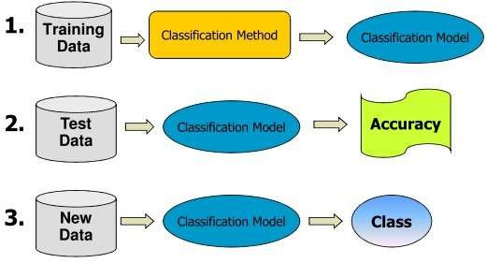
Week
07
Classification Process: the 3 steps
www.midocean.ae

Slide 11
Week
07
Applying the Data Analytics Lifecycle
Discovery
Operationalize
Data Prep
In a typical Data Analytics Problem - you would have gone through:
  Phase 1 – Discovery - have the problem framed
  Phase 2 – Data Preparation - have the data prepared
Now you need to plan the model and determine the method to be used.
Communicate
Results
Model
Planning
Model
Building
www.midocean.ae

Slide 12
Week
07
Phase 3 - Model Planning
Discovery
How do people generally solve this problem with the kind of data and resources I have?
  Does that work well enough? Or do I have to come up with something new?
  What are related or analogous problems? How are they solved? Can I do that?
Operationalize
Data Prep
Communicate
Results
Model
Planning
Model
Building
Do I have a good idea about the type of model to try? Can I refine the analytic plan?
Is the model robust enough? Have we failed for sure?
www.midocean.ae

Slide 13
Week
What Kind of Problem do I Need to Solve?
How do I Solve it?
07
The Problem to Solve | The Category of Techniques | Covered in this Course
I want to group items by similarity. I want to find structure (commonalities) in the data | Clustering | K-means clustering
I want to discover relationships between actions or items | Association Rules | Apriori
I want to determine the relationship between the outcome and the input variables | Regression | Linear Regression Logistic Regression
I want to assign (known) labels to objects | Classification | Naïve Bayes Decision Trees
I want to find the structure in a temporal process I want to forecast the behavior of a temporal process | Time Series Analysis | ACF, PACF, ARIMA
I want to analyze my text data | Text Analysis | Regular expressions, Document representation (Bag of Words).
www.midocean.ae

Slide 14
Week
07
Decision Tree Induction: An Example
Training data set: Buys_computer
The data set follows an example of Quinlan’s ID3 (Playing Tennis)
Resulting tree:
age?
<=30
overcast
>40
31..40
student?
yes
credit rating?
no
yes
excellent
fair
no
yes
no
yes
www.midocean.ae

Slide 15
Week
07
Classification: Basic Concepts
    Classification: Basic Concepts
    Decision Tree Induction
    Bayes Classification Methods
www.midocean.ae

Slide 16
Week
07
Bayesian Classification: Why?
A statistical classifier: performs probabilistic prediction, i.e., predicts class membership probabilities
Foundation: Based on Bayes’ Theorem.
Performance: A simple Bayesian classifier, naïve Bayesian classifier, has comparable performance with decision tree and selected neural network classifiers
Incremental: Each training example can incrementally increase/decrease the probability that a hypothesis is correct — prior knowledge can be combined with observed data
Standard: Even when Bayesian methods are computationally intractable, they can provide a standard of optimal decision making against which other methods can be measured
www.midocean.ae

Slide 17
Week
07
Naïve Bayesian Classifiers
    During this lesson the following topics are covered:
    Naïve Bayesian Classifier
    Theoretical foundations of the classifier
    Use cases
    Evaluating the effectiveness of the classifier
    The Reasons to Choose (+) and Cautions (-) with the use of the classifier
www.midocean.ae

Slide 18
Week
07
Classifiers
Where in the catalog should I place this product listing?
Is this email spam?
Classification: assign labels to objects.
Supervised: training set of pre-classified examples.
Our examples:
  Naïve Bayes,
  Decision Trees
www.midocean.ae

Slide 19
Week
07
Naïve Bayesian Classifier : What is it?
Used for classification
  Actually returns a probability score on class membership:
    In practice, probabilities generally close to either 0 or 1
Input variables are discrete
  Popular for text classification
Output:
  Most implementations: log probability for each class
    You could convert it to a probability, but in practice, we stay in the log space
www.midocean.ae

Slide 20

Week
07
Naïve Bayesian Classifier - Use Cases
Preferred method for many text classification problems.
  Try this first; if it doesn't work, try something more complicated
Use cases
  Spam filtering, other text classification tasks
  Fraud detection
www.midocean.ae

Slide 21
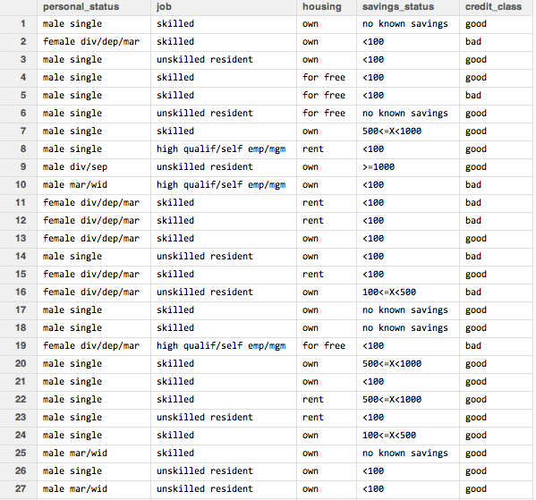
Week
07
Building a Training Dataset
Example : Predicting Good or Bad credit
Predict the credit behavior of a credit card applicant from applicant's attributes:
personal status
job type
housing type
savings account
These are all categorical variables; better suited to Naïve Bayesian classifier than to linear regression.
www.midocean.ae

Slide 22
Week
07
Technical Description - Bayes' Law
B
www.midocean.ae

Slide 23
Week
07
Technical Description - Bayes' Law
B
www.midocean.ae

Slide 24
Week
07
Technical Description - Bayes' Law
B
www.midocean.ae

Slide 25
Week
07
Technical Description - Bayes' Law
B
www.midocean.ae

Slide 26
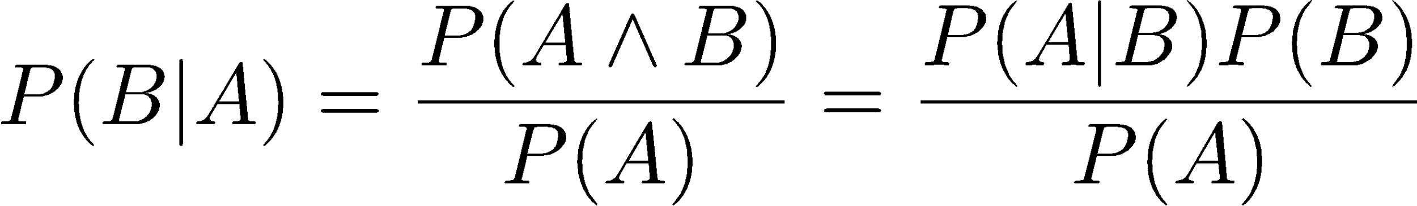
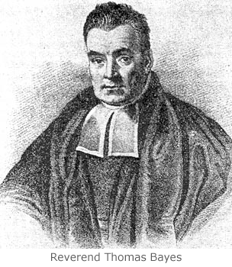
Week
07
Technical Description - Bayes' Law
B is the class label:
  B ε {b₁, b₂, … b_{n}}
A is the specific assignment of input variables
  A = (a₁, a₂, … a_{m})
www.midocean.ae

Slide 27
Week
07
Technical Description - Bayes' Law
B
www.midocean.ae

Slide 28
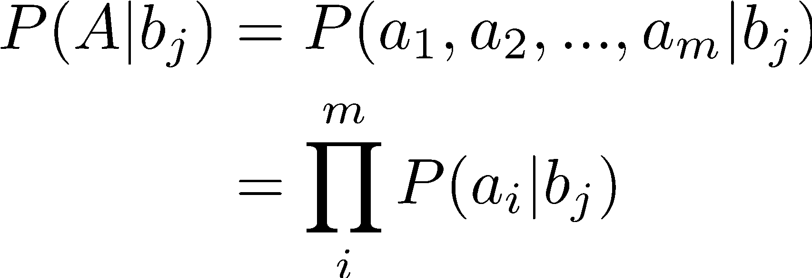
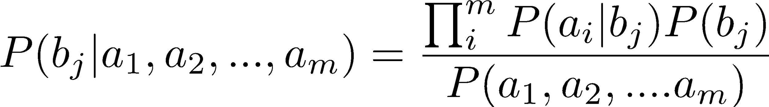
Week
07
The "Naïve" Assumption: Conditional Independence
so:
Independent of class – so it cancels out
www.midocean.ae

Slide 29
Week
07
Building a Naïve Bayesian Classifier
To build a Naïve Bayesian classifier, collect the following statistics from the training data:
  P(b_{j}) for all the class labels.
  P(a_{i}| b_{j}) for all possible assignments of the input variables and class labels.
Credit example:
class labels: {good, bad}
  P(good) = 0.7
  P(bad) = 0.3
aggregates for housing
  P(own|bad) = 0.62
  P(own|good) = 0.75
  P(rent|bad) = 0.23
  P(rent|good) = 0.14
  … and so on
www.midocean.ae

Slide 30
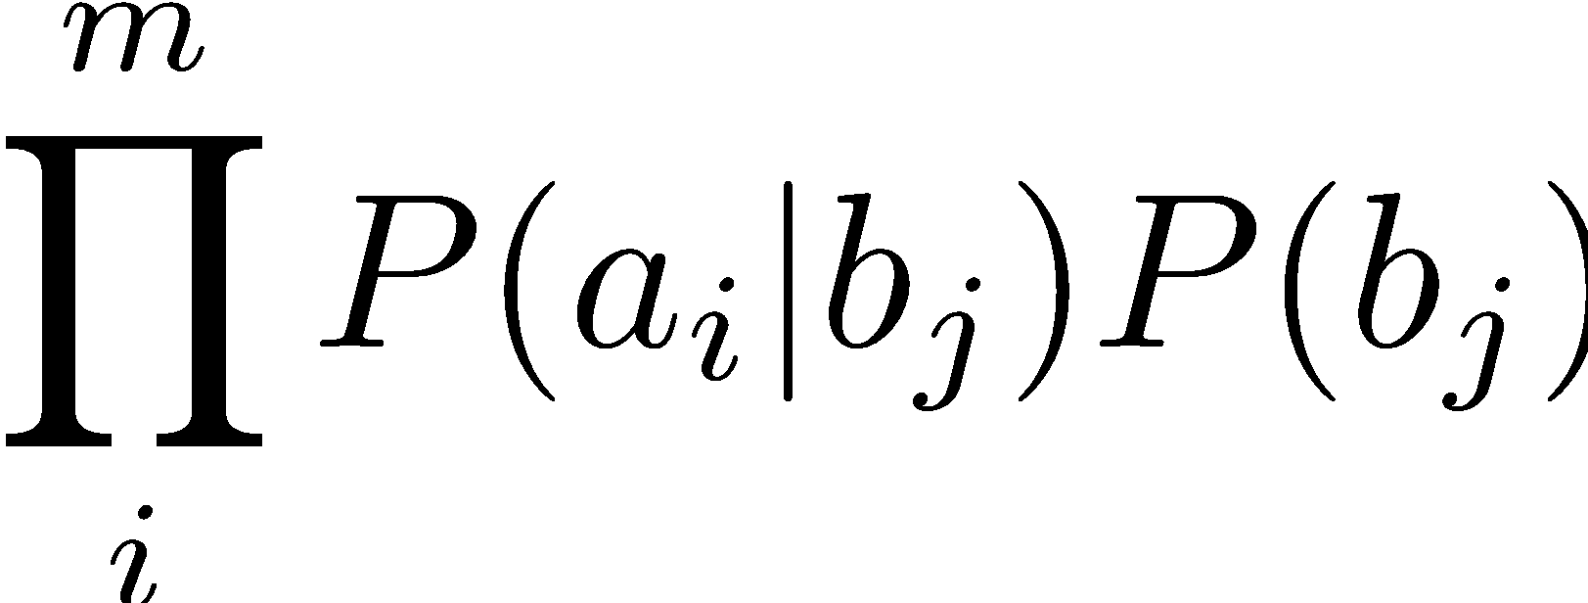
Week
07
Building a Naïve Bayesian Classifier
Assign the label that maximizes the value
www.midocean.ae

Slide 31
Week
07
Back to Credit Example
P(good|X) ~ (0.28*0.75*0.14*0.06)*0.7 = 0.0012
P(bad|X) ~ (0.36*0.62*0.17*0.02)*0.3 = 0.0002
Credit Example: X
female
owns home
Self-employed
savings > $1000
P(good|X) > P(bad|X):
Assign X the label "good"
a_{i} | b_{j} | P(a_{i} | b_{j})
female | good | 0.28
female | bad | 0.36
own | good | 0.75
own | bad | 0.62
self emp | good | 0.14
self emp | bad | 0.17
savings>1K | good | 0.06
savings>1K | bad | 0.02
www.midocean.ae

Slide 32

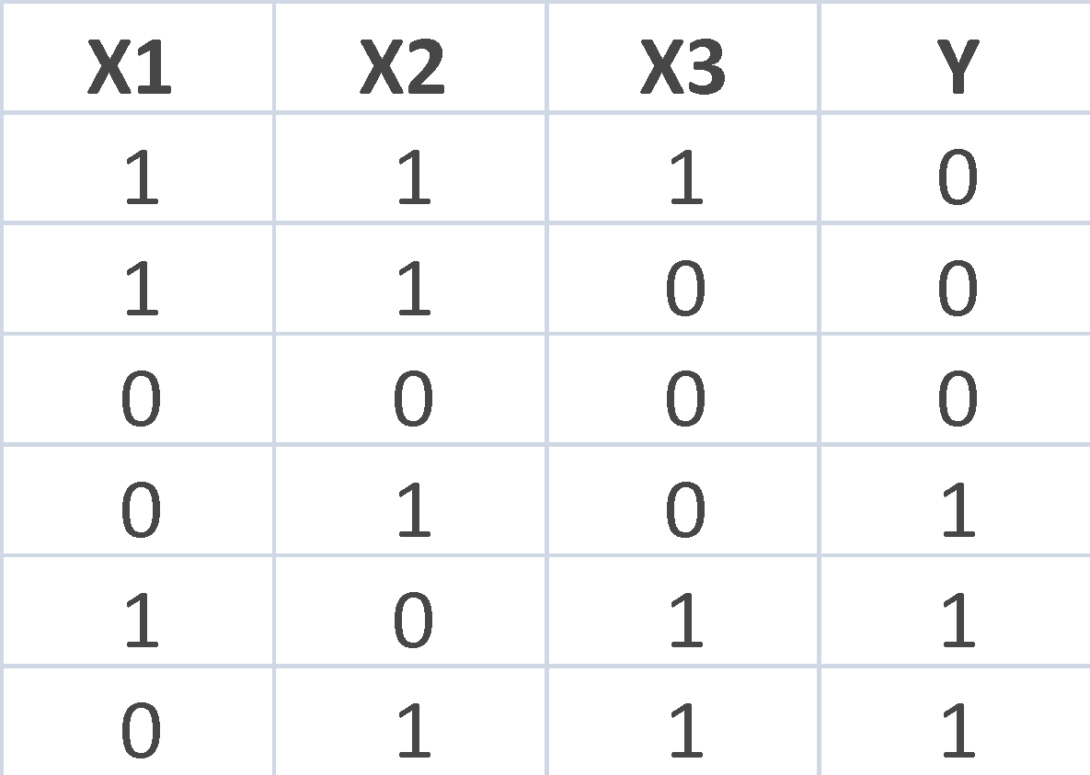
Week
QUIZ 2
07
Your Thoughts?
1. Consider the following Training Data Set:
  Apply the Naïve Bayesian Classifier to this data set and compute
  P(y = 1|X) for X = (1,0,0)
  Show your work
Training Data Set
www.midocean.ae
Independent of class – so it cancels out
32

Slide 33
Examples – NB Algorithm
? Play Tennis
Day | Outlook | Temperature | Humidity | Wind | Play
D1 | Sunny | Hot | High | Weak | No
D2 | Sunny | Hot | High | Strong | No
D3 | Overcast | Hot | High | Weak | Yes
D4 | Rain | Mild | High | Weak | Yes
D5 | Rain | Cool | Normal | Weak | Yes
D6 | Rain | Cool | Normal | Strong | No
D7 | Overcast | Cool | Normal | Strong | Yes
D8 | Sunny | Mild | High | Weak | No
D9 | Sunny | Cool | Normal | Weak | Yes
D10 | Rain | Mild | Normal | Weak | Yes
D11 | Sunny | Mild | Normal | Strong | Yes
D12 | Overcast | Mild | High | Strong | Yes
D13 | Overcast | Hot | Normal | Weak | Yes
D14 | Rain | Mild | High | Strong | No

Slide 34
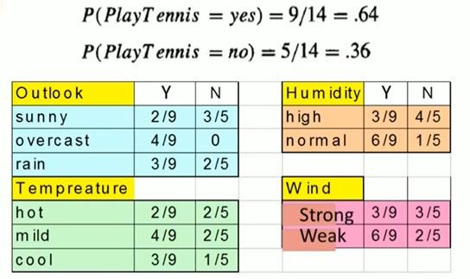
Week
07
Prediction using NB
www.midocean.ae

Slide 35
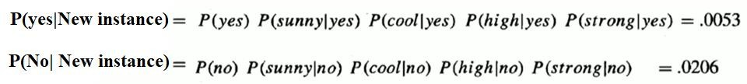
Week
07
Prediction using NB
P(No |New instance) > P(yes | New instance) Hence the new instance belongs to play tennis No
www.midocean.ae

Slide 36
Week
Naïve Bayes Classifier: Training Dataset
07
Class:
C1:buys_computer = ‘yes’
C2:buys_computer = ‘no’
Data to be classified:
X = (age <=30,
Income = medium,
Student = yes
Credit_rating = Fair)
www.midocean.ae

Slide 37
Week
Naïve Bayes Classifier: An Example
07
P(C_{i}): P(buys_computer = “yes”) = 9/14 = 0.643
P(buys_computer = “no”) = 5/14= 0.357
Compute P(X|C_{i}) for each class
  P(age = “<=30” | buys_computer = “yes”) = 2/9 = 0.222
  P(age = “<= 30” | buys_computer = “no”) = 3/5 = 0.6
  P(income = “medium” | buys_computer = “yes”) = 4/9 = 0.444
  P(income = “medium” | buys_computer = “no”) = 2/5 = 0.4
  P(student = “yes” | buys_computer = “yes) = 6/9 = 0.667
  P(student = “yes” | buys_computer = “no”) = 1/5 = 0.2
  P(credit_rating = “fair” | buys_computer = “yes”) = 6/9 = 0.667
  P(credit_rating = “fair” | buys_computer = “no”) = 2/5 = 0.4
X = (age <= 30 , income = medium, student = yes, credit_rating = fair)
P(X|C_{i}) : P(X|buys_computer = “yes”) = 0.222 x 0.444 x 0.667 x 0.667 = 0.044
P(X|buys_computer = “no”) = 0.6 x 0.4 x 0.2 x 0.4 = 0.019
P(X|C_{i})*P(C_{i}) : P(X|buys_computer = “yes”) * P(buys_computer = “yes”) = 0.028
P(X|buys_computer = “no”) * P(buys_computer = “no”) = 0.007
Therefore, X belongs to class (“buys_computer = yes”)
www.midocean.ae

Slide 38
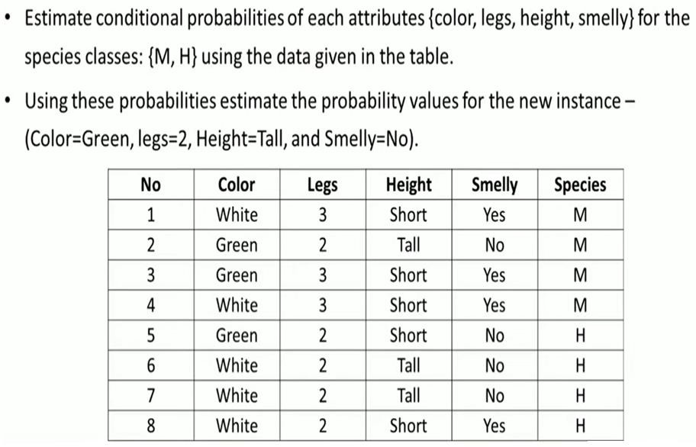
Week
07
Prediction using NB
www

Slide 39
Week
07
Naïve Bayes Classifier: Comments
Advantages
  Easy to implement
  Good results obtained in most of the cases
Disadvantages
  Assumption: class conditional independence, therefore loss of accuracy
  Practically, dependencies exist among variables
    E.g., hospitals: patients: Profile: age, family history, etc.
      Symptoms: fever, cough etc., Disease: lung cancer, diabetes, etc.
    Dependencies among these cannot be modeled by Naïve Bayes Classifier
How to deal with these dependencies? Bayesian Belief Networks
www.midocean.ae

Slide 40
Week
Naïve Bayesian Classifier - Reasons to Choose (+)
and Cautions (-)
07
Reasons to Choose (+) | Cautions (-)
Handles missing values quite well | Numeric variables have to be discrete (categorized) Intervals
Robust to irrelevant variables | Sensitive to correlated variables
Easy to implement | Not good for estimating probabilities Stick to class label or yes/no
Easy to score data
Computationally efficient Handles very high dimensional problems Handles categorical variables with a lot of levels
www.midocean.ae

Slide 41



Thank You

