Slide 1




IT111 - Introduction to Information Technology
Bachelor of Science in Information Technology
Eng. Eman Hamdy
Lecture 5 - Operation on Data

Slide 2


Lecture
Objectives
05
Name several general properties of storage systems.
Describe the two most common types of hard drives and what they are used for today.
Discuss the various types of optical discs available and how they differ from each other.
Identify some flash-memory-based storage devices and media and explain how they are used today.
List at least three other types of storage systems.
Summarize the storage alternatives for a typical personal computer.
List the three categories of operations performed on data.
Perform unary and binary logic operations on bit patterns.
Perform logic shift operations on bit patterns.
Understand some applications of logic and shift operations such as setting, unsetting, and flipping bits.
IT111 - Introduction to Information Technology
Lecture 05– Learning Outcome
Eng. Eman Hamdy

Slide 3
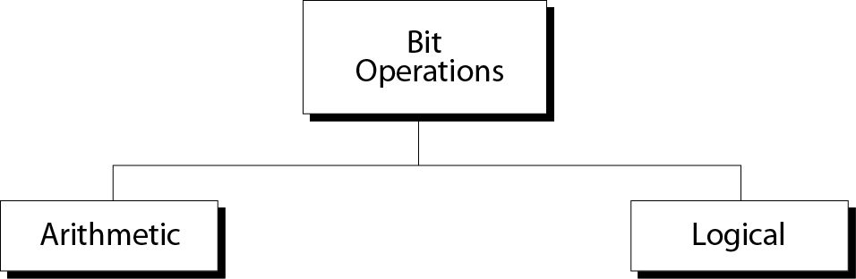
Lecture
05
Operations on bits
Name several general properties of storage systems.
Describe the two most common types of hard drives and what they are used for today.
Discuss the various types of optical discs available and how they differ from each other.
Identify some flash-memory-based storage devices and media and explain how they are used today.
List at least three other types of storage systems.
Summarize the storage alternatives for a typical personal computer.
IT111 - Introduction to Information Technology
Lecture 05– Learning Outcome
Eng. Eman Hamdy

Slide 4
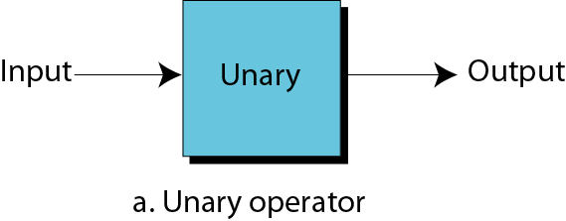
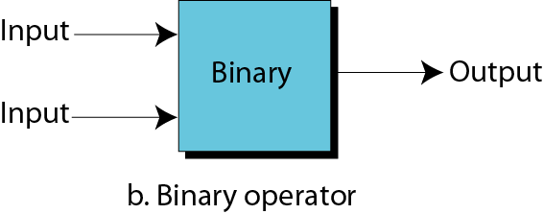
Lecture
Unary and binary operations
05
Name several general properties of storage systems.
Describe the two most common types of hard drives and what they are used for today.
Discuss the various types of optical discs available and how they differ from each other.
Identify some flash-memory-based storage devices and media and explain how they are used today.
List at least three other types of storage systems.
Summarize the storage alternatives for a typical personal computer.
IT111 - Introduction to Information Technology
Lecture 05– Learning Outcome
Eng. Eman Hamdy

Slide 5
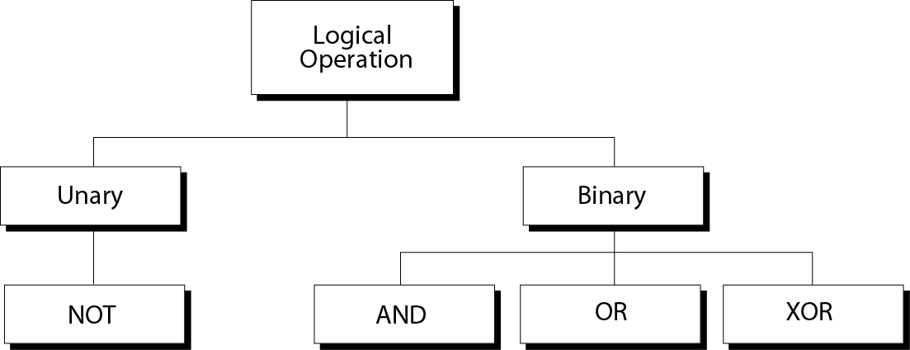
Lecture
05
Logical operations
Name several general properties of storage systems.
Describe the two most common types of hard drives and what they are used for today.
Discuss the various types of optical discs available and how they differ from each other.
Identify some flash-memory-based storage devices and media and explain how they are used today.
List at least three other types of storage systems.
Summarize the storage alternatives for a typical personal computer.
IT111 - Introduction to Information Technology
Lecture 05– Learning Outcome
Eng. Eman Hamdy

Slide 6
Lecture
05
Logical operations
Logic operations refer to those operations that apply the same basic operation on individual bits of a pattern, or on two corresponding bits in two patterns.
This means that we can define logic operations:
at the bit level: A bit can take one of the two values: 0 or 1.
at the pattern level
Name several general properties of storage systems.
Describe the two most common types of hard drives and what they are used for today.
Discuss the various types of optical discs available and how they differ from each other.
Identify some flash-memory-based storage devices and media and explain how they are used today.
List at least three other types of storage systems.
Summarize the storage alternatives for a typical personal computer.
IT111 - Introduction to Information Technology
Lecture 05– Learning Outcome
Eng. Eman Hamdy

Slide 7
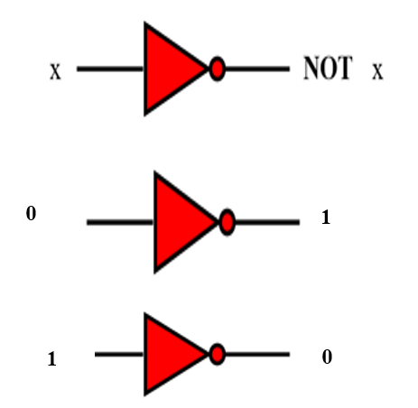
Lecture
Logic operations at bit level
05
Name several general properties of storage systems.
Describe the two most common types of hard drives and what they are used for today.
Discuss the various types of optical discs available and how they differ from each other.
Identify some flash-memory-based storage devices and media and explain how they are used today.
List at least three other types of storage systems.
Summarize the storage alternatives for a typical personal computer.
IT111 - Introduction to Information Technology
Lecture 05– Learning Outcome
Eng. Eman Hamdy

Slide 8

Lecture
05
Logic operations at pattern level
Name several general properties of storage systems.
Describe the two most common types of hard drives and what they are used for today.
Discuss the various types of optical discs available and how they differ from each other.
Identify some flash-memory-based storage devices and media and explain how they are used today.
List at least three other types of storage systems.
Summarize the storage alternatives for a typical personal computer.
0 1 1 0
4 Logical operation(Not Gate/Not Operator)
1 0 0 1
a logic operation at the pattern level is n logic operations, of the same type, at the bit level where n is the number of bits in the pattern.
IT111 - Introduction to Information Technology
Lecture 05– Learning Outcome
Eng. Eman Hamdy

Slide 9
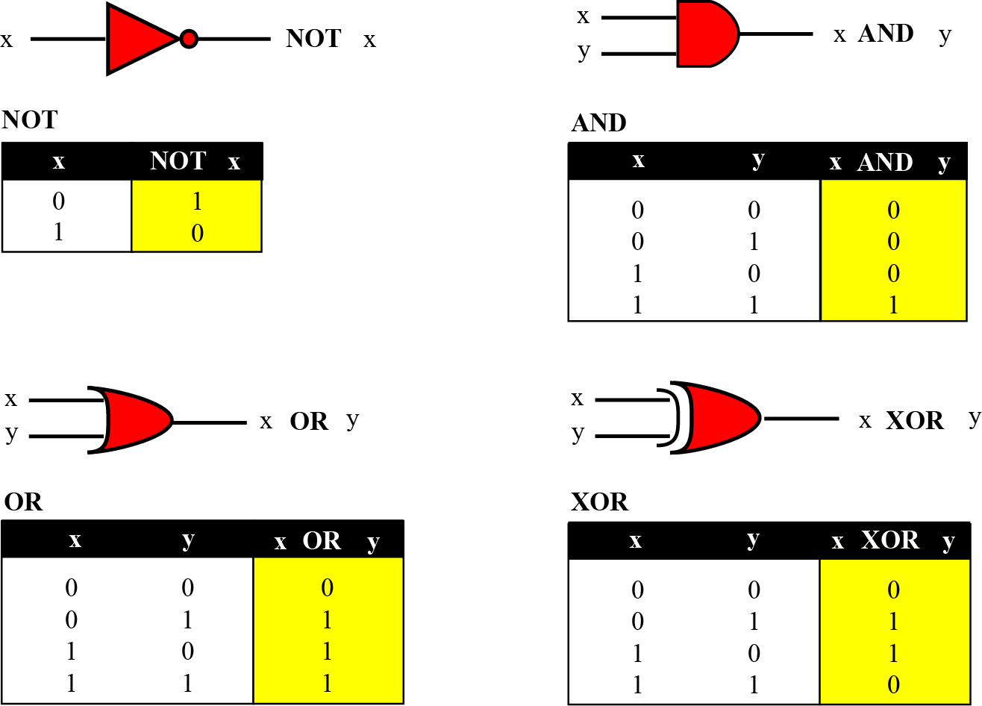
Lecture
05
Logic operations/ Logic gates
Name several general properties of storage systems.
Describe the two most common types of hard drives and what they are used for today.
Discuss the various types of optical discs available and how they differ from each other.
Identify some flash-memory-based storage devices and media and explain how they are used today.
List at least three other types of storage systems.
Summarize the storage alternatives for a typical personal computer.
NOT
The NOT operator is a unary operator: it takes only one input. The output bit is the complement of the input.
IT111 - Introduction to Information Technology
Lecture 05– Learning Outcome
Eng. Eman Hamdy

Slide 10
Lecture
05
Logic operations/ Logic gates
Name several general properties of storage systems.
Describe the two most common types of hard drives and what they are used for today.
Discuss the various types of optical discs available and how they differ from each other.
Identify some flash-memory-based storage devices and media and explain how they are used today.
List at least three other types of storage systems.
Summarize the storage alternatives for a typical personal computer.
AND
The AND operator is a binary operator: it takes two inputs. The output bit is 1 if both inputs are 1s and the output is 0 in the other three cases.
IT111 - Introduction to Information Technology
Lecture 05– Learning Outcome
Eng. Eman Hamdy

Slide 11
Lecture
05
Logic operations/ Logic gates
Name several general properties of storage systems.
Describe the two most common types of hard drives and what they are used for today.
Discuss the various types of optical discs available and how they differ from each other.
Identify some flash-memory-based storage devices and media and explain how they are used today.
List at least three other types of storage systems.
Summarize the storage alternatives for a typical personal computer.
OR
The OR operator is a binary operator: it takes two inputs. The output bit is 0 if both inputs are 0s and the output is 1 in the other three cases.
IT111 - Introduction to Information Technology
Lecture 05– Learning Outcome
Eng. Eman Hamdy

Slide 12
Lecture
05
Logic operations/ Logic gates
Name several general properties of storage systems.
Describe the two most common types of hard drives and what they are used for today.
Discuss the various types of optical discs available and how they differ from each other.
Identify some flash-memory-based storage devices and media and explain how they are used today.
List at least three other types of storage systems.
Summarize the storage alternatives for a typical personal computer.
XOR
The XOR operator is a binary operator like the OR operator, with only one difference: the output is 0 if both inputs are 1 or 0.
IT111 - Introduction to Information Technology
Lecture 05– Learning Outcome
Eng. Eman Hamdy

Slide 13
Lecture
05
Logic operations/ Logic gates
Name several general properties of storage systems.
Describe the two most common types of hard drives and what they are used for today.
Discuss the various types of optical discs available and how they differ from each other.
Identify some flash-memory-based storage devices and media and explain how they are used today.
List at least three other types of storage systems.
Summarize the storage alternatives for a typical personal computer.
IT111 - Introduction to Information Technology
Lecture 05– Learning Outcome
Eng. Eman Hamdy

Slide 14
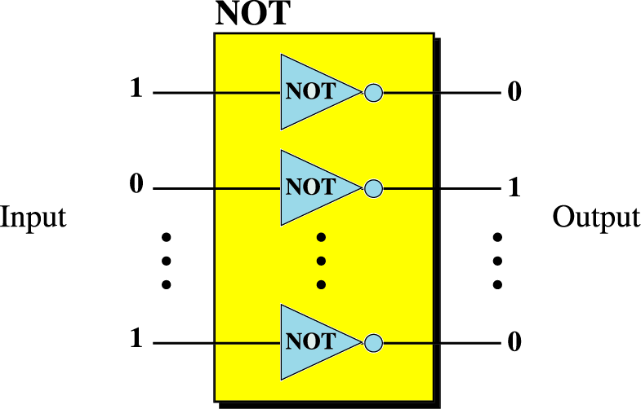
Lecture
Example
05
Name several general properties of storage systems.
Describe the two most common types of hard drives and what they are used for today.
Discuss the various types of optical discs available and how they differ from each other.
Identify some flash-memory-based storage devices and media and explain how they are used today.
List at least three other types of storage systems.
Summarize the storage alternatives for a typical personal computer.
IT111 - Introduction to Information Technology
Lecture 05– Learning Outcome
Eng. Eman Hamdy

Slide 15
Lecture
Example
05
Name several general properties of storage systems.
Describe the two most common types of hard drives and what they are used for today.
Discuss the various types of optical discs available and how they differ from each other.
Identify some flash-memory-based storage devices and media and explain how they are used today.
List at least three other types of storage systems.
Summarize the storage alternatives for a typical personal computer.
Use the NOT operator on the bit pattern 10011000.
Solution
The solution is shown below. Note that the NOT operator changes every 0 to 1 and every 1 to 0.
IT111 - Introduction to Information Technology
Lecture 05– Learning Outcome
Eng. Eman Hamdy

Slide 16
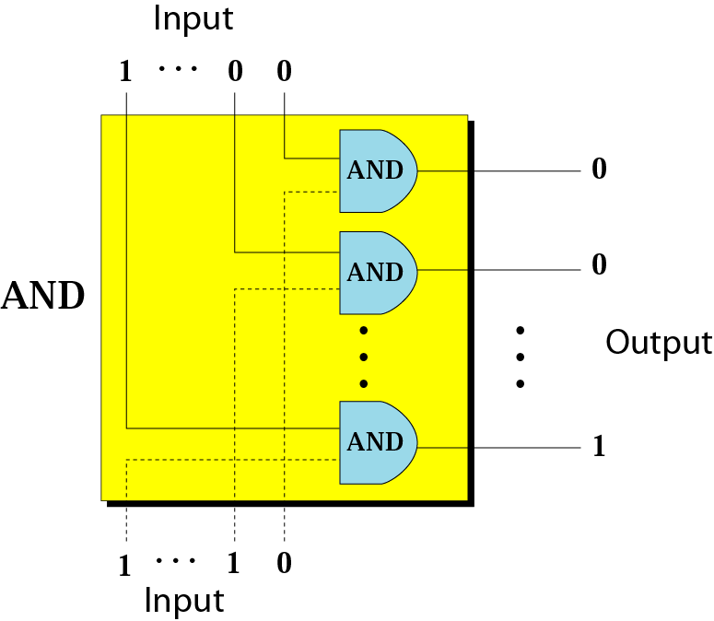
Lecture
Example
05
Name several general properties of storage systems.
Describe the two most common types of hard drives and what they are used for today.
Discuss the various types of optical discs available and how they differ from each other.
Identify some flash-memory-based storage devices and media and explain how they are used today.
List at least three other types of storage systems.
Summarize the storage alternatives for a typical personal computer.
IT111 - Introduction to Information Technology
Lecture 05– Learning Outcome
Eng. Eman Hamdy

Slide 17
Lecture
Example
05
Name several general properties of storage systems.
Describe the two most common types of hard drives and what they are used for today.
Discuss the various types of optical discs available and how they differ from each other.
Identify some flash-memory-based storage devices and media and explain how they are used today.
List at least three other types of storage systems.
Summarize the storage alternatives for a typical personal computer.
Use the AND operator on the bit patterns 10011000 and 00101010.
Solution
The solution is shown below. Note that only one bit in the output is 1, where both corresponding inputs are 1s.
IT111 - Introduction to Information Technology
Lecture 05– Learning Outcome
Eng. Eman Hamdy

Slide 18
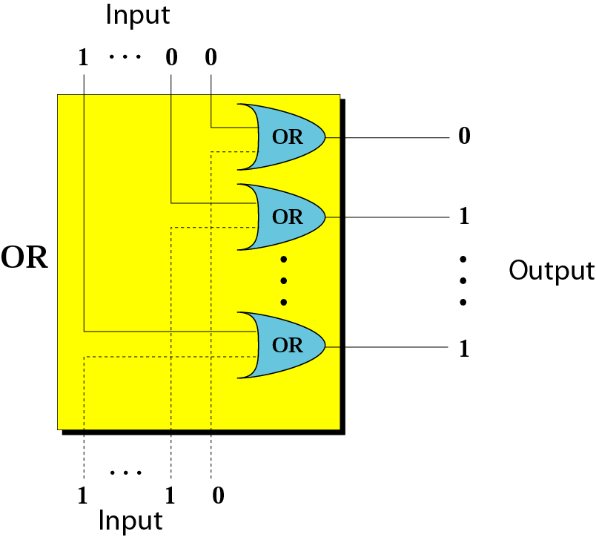
Lecture
Example
05
Name several general properties of storage systems.
Describe the two most common types of hard drives and what they are used for today.
Discuss the various types of optical discs available and how they differ from each other.
Identify some flash-memory-based storage devices and media and explain how they are used today.
List at least three other types of storage systems.
Summarize the storage alternatives for a typical personal computer.
IT111 - Introduction to Information Technology
Lecture 05– Learning Outcome
Eng. Eman Hamdy

Slide 19
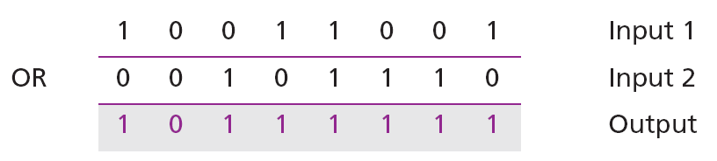
Lecture
Example
05
Name several general properties of storage systems.
Describe the two most common types of hard drives and what they are used for today.
Discuss the various types of optical discs available and how they differ from each other.
Identify some flash-memory-based storage devices and media and explain how they are used today.
List at least three other types of storage systems.
Summarize the storage alternatives for a typical personal computer.
Use the OR operator on the bit patterns 10011001 and 00101110.
Solution
The solution is shown below. Note that only one bit in the output is 0, where both corresponding inputs are 0s.
IT111 - Introduction to Information Technology
Lecture 05– Learning Outcome
Eng. Eman Hamdy

Slide 20
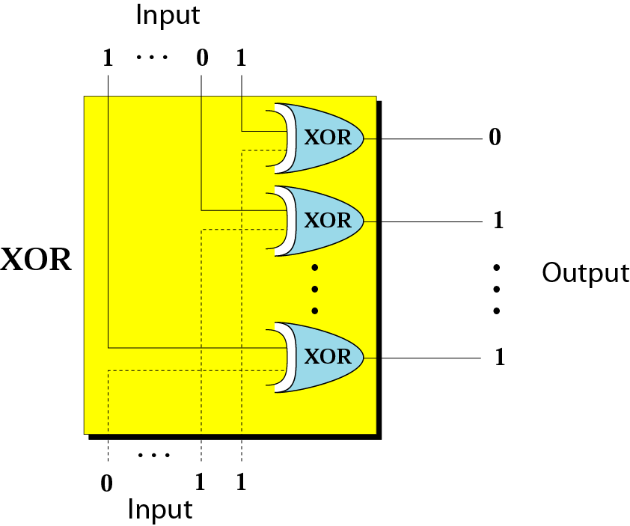
Lecture
Example
05
Name several general properties of storage systems.
Describe the two most common types of hard drives and what they are used for today.
Discuss the various types of optical discs available and how they differ from each other.
Identify some flash-memory-based storage devices and media and explain how they are used today.
List at least three other types of storage systems.
Summarize the storage alternatives for a typical personal computer.
IT111 - Introduction to Information Technology
Lecture 05– Learning Outcome
Eng. Eman Hamdy

Slide 21
Lecture
Example
05
Name several general properties of storage systems.
Describe the two most common types of hard drives and what they are used for today.
Discuss the various types of optical discs available and how they differ from each other.
Identify some flash-memory-based storage devices and media and explain how they are used today.
List at least three other types of storage systems.
Summarize the storage alternatives for a typical personal computer.
Use the XOR operator on the bit patterns 10011001 and 00101110.
IT111 - Introduction to Information Technology
Lecture 05– Learning Outcome
Eng. Eman Hamdy

Slide 22
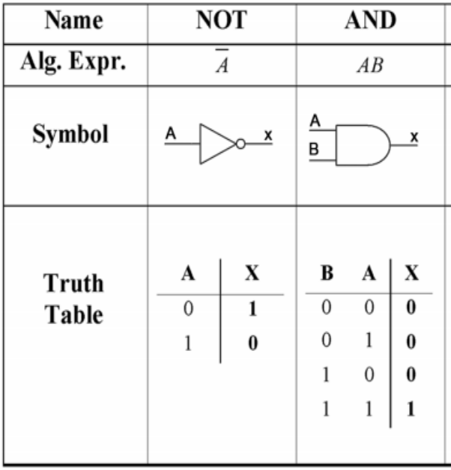
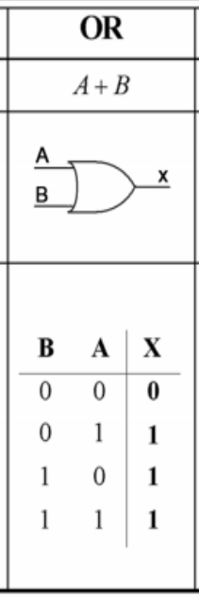
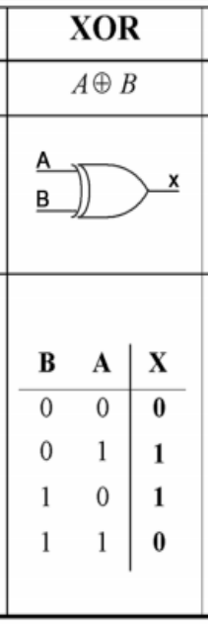
Lecture
05
Name several general properties of storage systems.
Describe the two most common types of hard drives and what they are used for today.
Discuss the various types of optical discs available and how they differ from each other.
Identify some flash-memory-based storage devices and media and explain how they are used today.
List at least three other types of storage systems.
Summarize the storage alternatives for a typical personal computer.
IT111 - Introduction to Information Technology
Lecture 05– Learning Outcome
Eng. Eman Hamdy

Slide 23
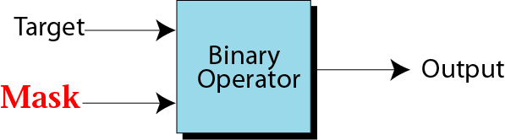
Lecture
Mask
05
Name several general properties of storage systems.
Describe the two most common types of hard drives and what they are used for today.
Discuss the various types of optical discs available and how they differ from each other.
Identify some flash-memory-based storage devices and media and explain how they are used today.
List at least three other types of storage systems.
Summarize the storage alternatives for a typical personal computer.
IT111 - Introduction to Information Technology
Lecture 05– Learning Outcome
Eng. Eman Hamdy

Slide 24
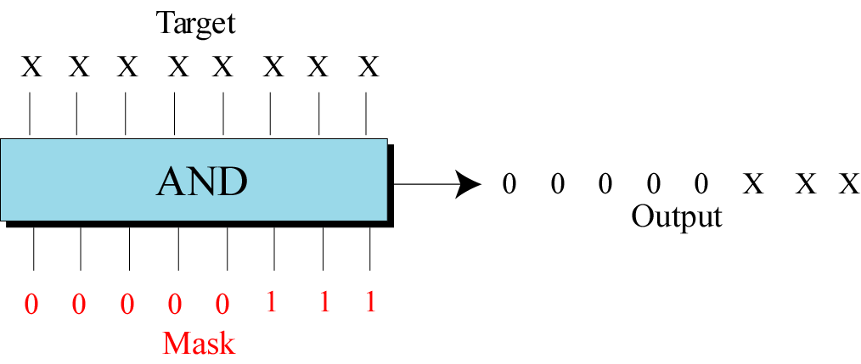
Lecture
Example of unsetting specific bits
05
Name several general properties of storage systems.
Describe the two most common types of hard drives and what they are used for today.
Discuss the various types of optical discs available and how they differ from each other.
Identify some flash-memory-based storage devices and media and explain how they are used today.
List at least three other types of storage systems.
Summarize the storage alternatives for a typical personal computer.
IT111 - Introduction to Information Technology
Lecture 05– Learning Outcome
Eng. Eman Hamdy

Slide 25
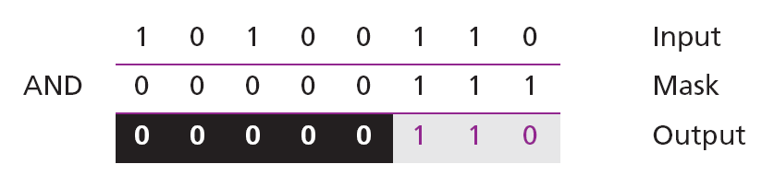
Lecture
05
Example
Name several general properties of storage systems.
Describe the two most common types of hard drives and what they are used for today.
Discuss the various types of optical discs available and how they differ from each other.
Identify some flash-memory-based storage devices and media and explain how they are used today.
List at least three other types of storage systems.
Summarize the storage alternatives for a typical personal computer.
Test the mask with the pattern 10100110.
The mask is 00000111. The result of applying the mask is:
IT111 - Introduction to Information Technology
Lecture 05– Learning Outcome
Eng. Eman Hamdy

Slide 26
Lecture
05
Example
Name several general properties of storage systems.
Describe the two most Ph.D. of Computer Science: Informatics
common types of hard drives and what they are used for today.
Discuss the various types of optical discs available and how they differ from each other.
Identify some flash-memory-based storage devices and media and explain how they are used today.
List at least three other types of storage systems.
Summarize the storage alternatives for a typical personal computer.
Use the mask 10111111 to AND with the target pattern. The only 0 bit (bit 7) in the mask turns off
Target 1 1 0 0 0 1 1 1 AND
Mask 1 0 1 1 1 1 1 1
------------------
Result 1 0 0 0 0 1 1 1
IT111 - Introduction to Information Technology
Lecture 05– Learning Outcome
Eng. Eman Hamdy

Slide 27
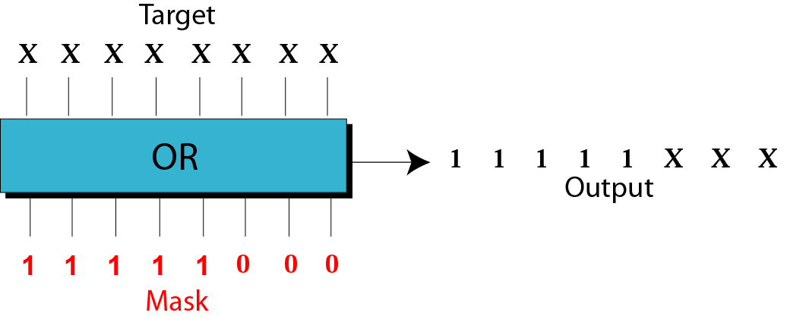
Lecture
Example of unsetting specific bits
05
Name several general properties of storage systems.
Describe the two most common types of hard drives and what they are used for today.
Discuss the various types of optical discs available and how they differ from each other.
Identify some flash-memory-based storage devices and media and explain how they are used today.
List at least three other types of storage systems.
Summarize the storage alternatives for a typical personal computer.
IT111 - Introduction to Information Technology
Lecture 05– Learning Outcome
Eng. Eman Hamdy

Slide 28
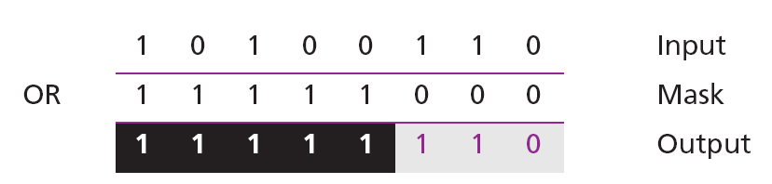
Lecture
05
Example
Name several general properties of storage systems.
Describe the two most common types of hard drives and what they are used for today.
Discuss the various types of optical discs available and how they differ from each other.
Identify some flash-memory-based storage devices and media and explain how they are used today.
List at least three other types of storage systems.
Summarize the storage alternatives for a typical personal computer.
Use a mask to set the five leftmost bits of a pattern. Test the mask with the pattern 10100110.
The mask is 11111000. The result of applying the mask is:
IT111 - Introduction to Information Technology
Lecture 05– Learning Outcome
Eng. Eman Hamdy

Slide 29
Lecture
05
Example
Name several general properties of storage systems.
Describe the two most common types of hard drives and what they are used for today.
Discuss the various types of optical discs available and how they differ from each other.
Identify some flash-memory-based storage devices and media and explain how they are used today.
List at least three other types of storage systems.
Summarize the storage alternatives for a typical personal computer.
Using the power plant example, how can you use a mask to show that pump 6 is now turned on?
Use the mask 00100000.
Target 1 0 0 0 0 1 1 1 OR
Mask 0 0 1 0 0 0 0 0
------------------
Result 1 0 1 0 0 1 1 1
IT111 - Introduction to Information Technology
Lecture 05– Learning Outcome
Eng. Eman Hamdy

Slide 30
Shift Operations
Lecture
05
IT111 - Introduction to Information Technology
Lecture 05– Learning Outcome
Eng. Eman Hamdy

Slide 31
Lecture
Shift Operations
05
Shift operations move the bits in a pattern, changing the positions of the bits. They can move bits to the left or to the right. We can divide shift operations into two categories:
1. logical shift operations
  Logical shift
  Logical circular shift (Rotate)
2. Arithmetic shift operations.
IT111 - Introduction to Information Technology
Lecture 05– Learning Outcome
Eng. Eman Hamdy

Slide 32
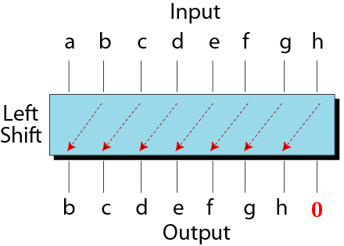
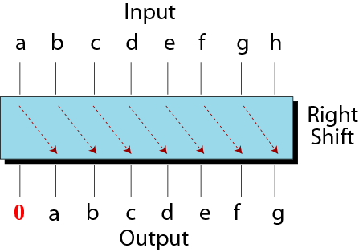
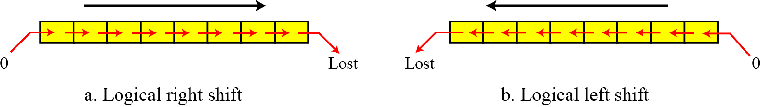
Lecture
Shift Operations
05
IT111 - Introduction to Information Technology
Lecture 05– Learning Outcome
Eng. Eman Hamdy

Slide 33
Lecture
Shift Operations
05
Use a logical left shift operation on the bit pattern 10011000.
Solution
The solution is shown below. The leftmost bit is lost and a 0 is inserted as the rightmost bit.
Discarded
Added
IT111 - Introduction to Information Technology
Lecture 05– Learning Outcome
Eng. Eman Hamdy

Slide 34
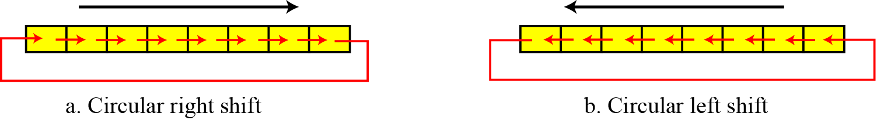
Lecture
Circular shift operations
05
IT111 - Introduction to Information Technology
Lecture 05– Learning Outcome
Eng. Eman Hamdy

Slide 35
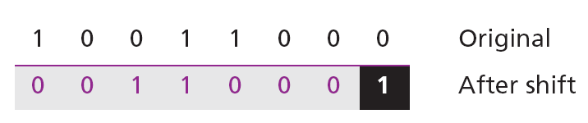
Lecture
Circular shift operations
05
Use a circular left shift operation on the bit pattern 10011000.
Solution
The solution is shown below. The leftmost bit is circulated and becomes the rightmost bit.
IT111 - Introduction to Information Technology
Lecture 05– Learning Outcome
Eng. Eman Hamdy

Slide 36
Binary operations
Lecture
05
IT111 - Introduction to Information Technology
IT111 - Introduction to Information Technology
Lecture 05– Learning Outcome
Eng. Eman Hamdy

Slide 37
Lecture
05
Binary operations
Name several general properties of storage systems.
Describe the two most common types of hard drives and what they are used for today.
Discuss the various types of optical discs available and how they differ from each other.
Identify some flash-memory-based storage devices and media and explain how they are used today.
List at least three other types of storage systems.
Summarize the storage alternatives for a typical personal computer.
Binary Addition
Case | Sum | Carry
0+0 | 0 | 0
0+1 | 1 | 0
1+0 | 1 | 0
1+1 | 0 | 1
1+1+1 | 1 | 1
IT111 - Introduction to Information Technology
Lecture 05– Learning Outcome
Eng. Eman Hamdy

Slide 38
Lecture
05
Binary operations
Add the binary numbers and show the equivalent decimal addition.
111+001
111
+
001
___________
  1000
Case | Sum | Carry
0+0 | 0 | 0
0+1 | 1 | 0
1+0 | 1 | 0
1+1 | 0 | 1
1+1+1 | 1 | 1
IT111 - Introduction to Information Technology
Lecture 05– Learning Outcome
Eng. Eman Hamdy

Slide 39
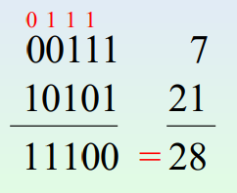
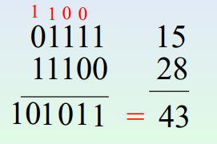
Lecture
05
Example
Case | Sum | Carry
0+0 | 0 | 0
0+1 | 1 | 0
1+0 | 1 | 0
1+1 | 0 | 1
1+1+1 | 1 | 1
IT111 - Introduction to Information Technology
Lecture 05– Learning Outcome
Eng. Eman Hamdy

Slide 40
Lecture
05
Binary operations
1010 + 1010
= 010100
1010
+
1010
___________
= 10100
1010 + 101
= 1111
1010
+
101
___________
= 1111
Case | Sum | Carry
0+0 | 0 | 0
0+1 | 1 | 0
1+0 | 1 | 0
1+1 | 0 | 1
1+1+1 | 1 | 1
IT111 - Introduction to Information Technology
Lecture 05– Learning Outcome
Eng. Eman Hamdy

Slide 41

Thank you

