Slide 1



Operating Systems
Prepared by Dr. Alaa Eldeen Ahmed
IT263 / CYB510
Processes
Lecture 2

Slide 2
Lecture
02
Process
Objectives:
  Process Concept
  Process Scheduling
  Operations on Processes
  Interprocess Communication

Slide 3
Lecture
02
Process
Topics:
  Identify the separate components of a process and illustrate how they are represented in an operating system.
  Describe how processes are created and terminated in an operating system.
  Describe and contrast inter-process communication using shared memory and message passing.

Slide 4
Lecture
02
Process Concept
Any program to be developed and established, the following steps are followed”
  The program needed is written using some high-level language such as C++, Java …… etc.
  The basic computer system doesn’t understand High level languages, it understands only binary codes which are 0’s and 1’s
  Programs are converted to binary code using compilers.
  Program are converted into executable binary format and then it is ready for execution.

Slide 5
Lecture
02
Process Concept
  How should the program inform the computer what should be done by the program instructions --→ by starting execution
  The program to execute, it has to be loaded into the memory and use the different resources of the computer system.
  The operating system is responsible for loading the executable program into the memory and allocate its resources to allow the program to start execution.

Slide 6
Lecture
02
Process Concept (Cont.)
Program is a passive entity stored on disk (executable file). Passive means that the program is not doing any activities until that moment.
When the program start execution then the program becomes a processes and it will be an active entity.
  Program becomes process when executable file loaded into memory
Execution of program started via GUI mouse clicks, command line entry of its name, etc
One program can be several processes
  Consider multiple users executing the same program

Slide 7
Lecture
02
Process Concept
Process – a program in execution; process execution must progress in a specific order.
A process refers to an entity that helps in representing the fundamental unit of work that must be implemented in any Operating system.
In other words, we write the computer programs in the form of a text file, thus when we run them, these turn into processes that complete all of the duties specified in the program.

Slide 8
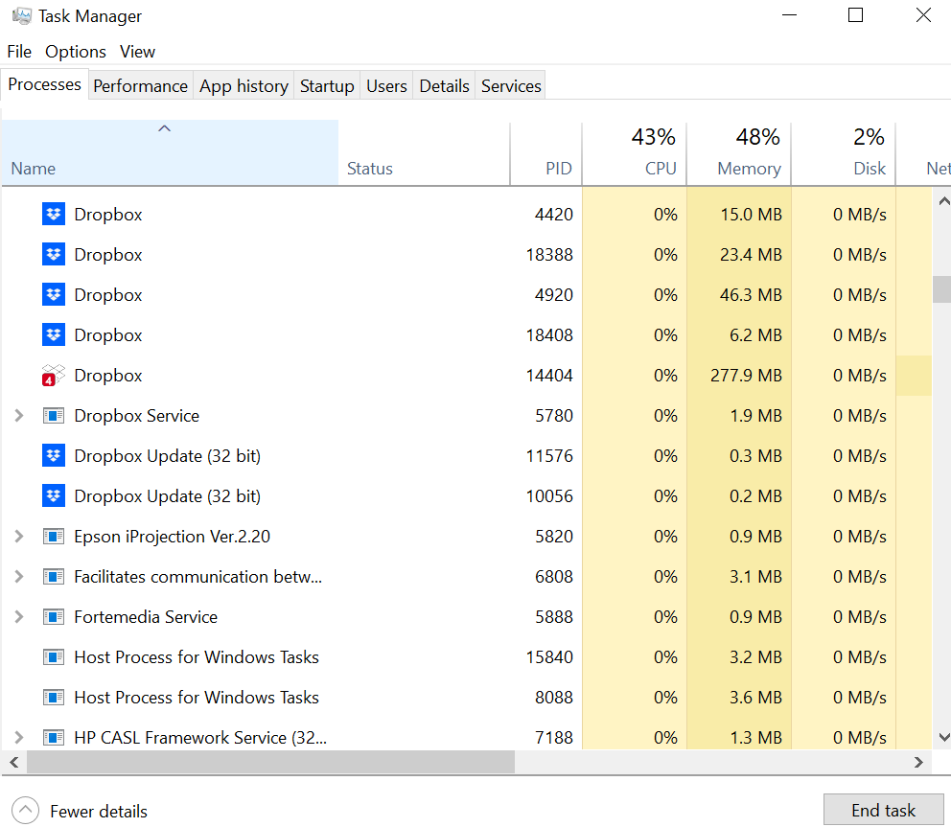
Lecture
02
Process Concept

Slide 9
Lecture
02
Process Concept
A program can be divided into group of pieces when put into memory to become a process:
  The program code, also called text section
  Current activity including program counter, processor registers
  Stack containing temporary data
    Function parameters, return addresses, local variables
  Data section containing global variables
  Heap containing memory dynamically allocated during run time

Slide 10
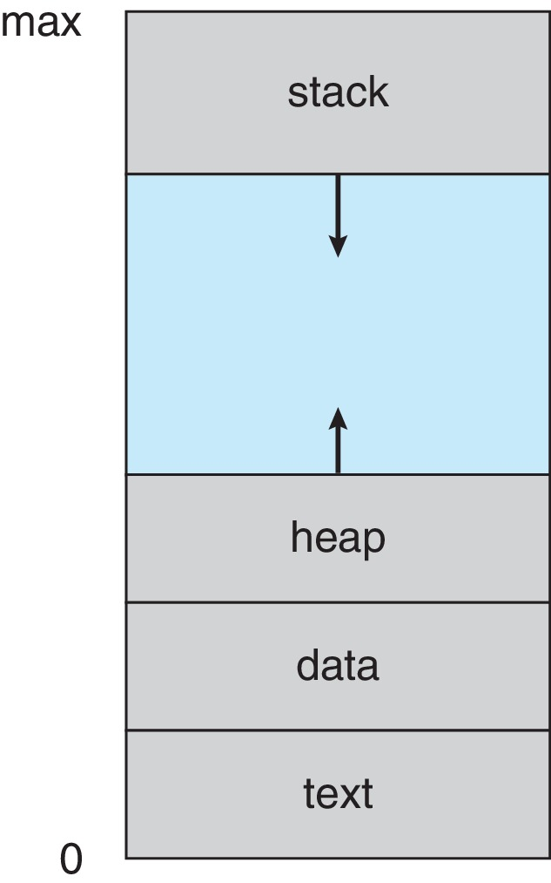
  Current activity including program counter, processor registers
Lecture
02
Process in Memory
  Stack containing temporary data
    Function parameters, return addresses, local variables
  Data section containing global variables
  Heap containing memory dynamically allocated during run time
  The program code, also called text section

Slide 11
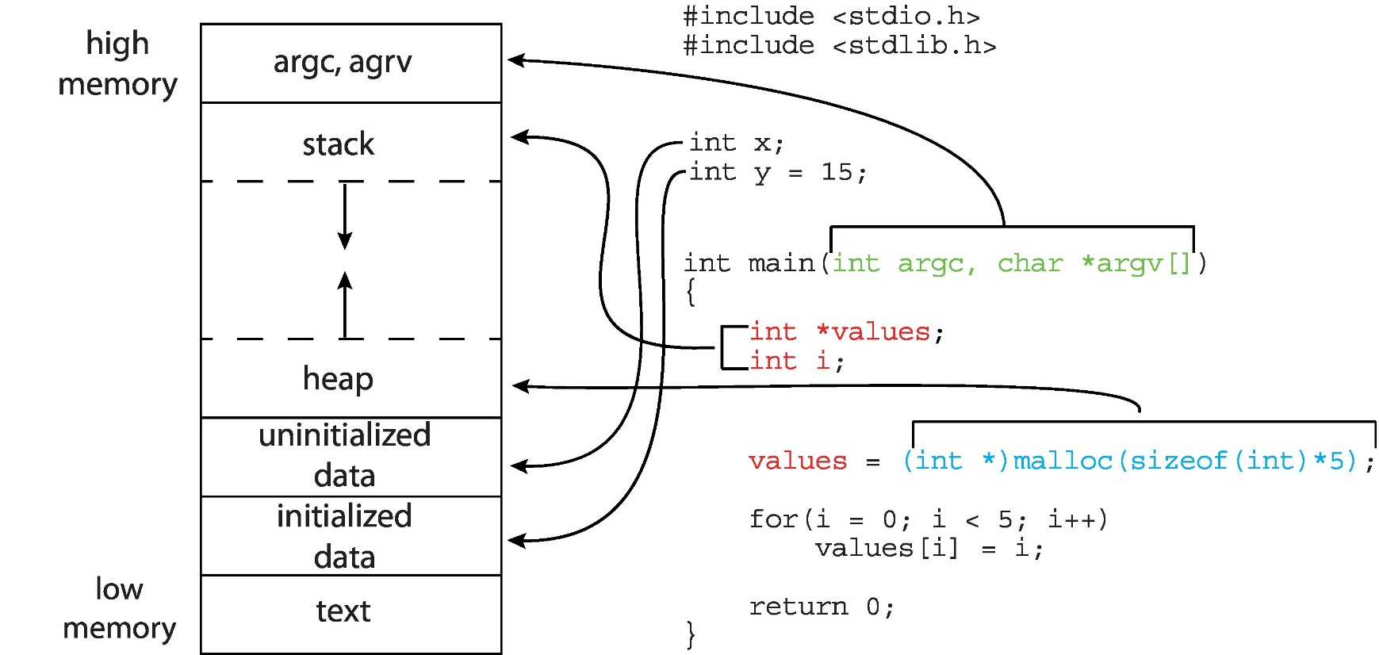
Lecture
02
Memory Layout of a C Program

Slide 12
Lecture
02
Process State
As a process executes, it changes state.
The state of a process is defined in part by the current activity of that process.
  New: The process is being created
  Ready: The process is waiting to be assigned to a processor
  Running: Instructions are being executed
  Waiting: The process is waiting for some event to occur
  Terminated: The process has finished execution

Slide 13
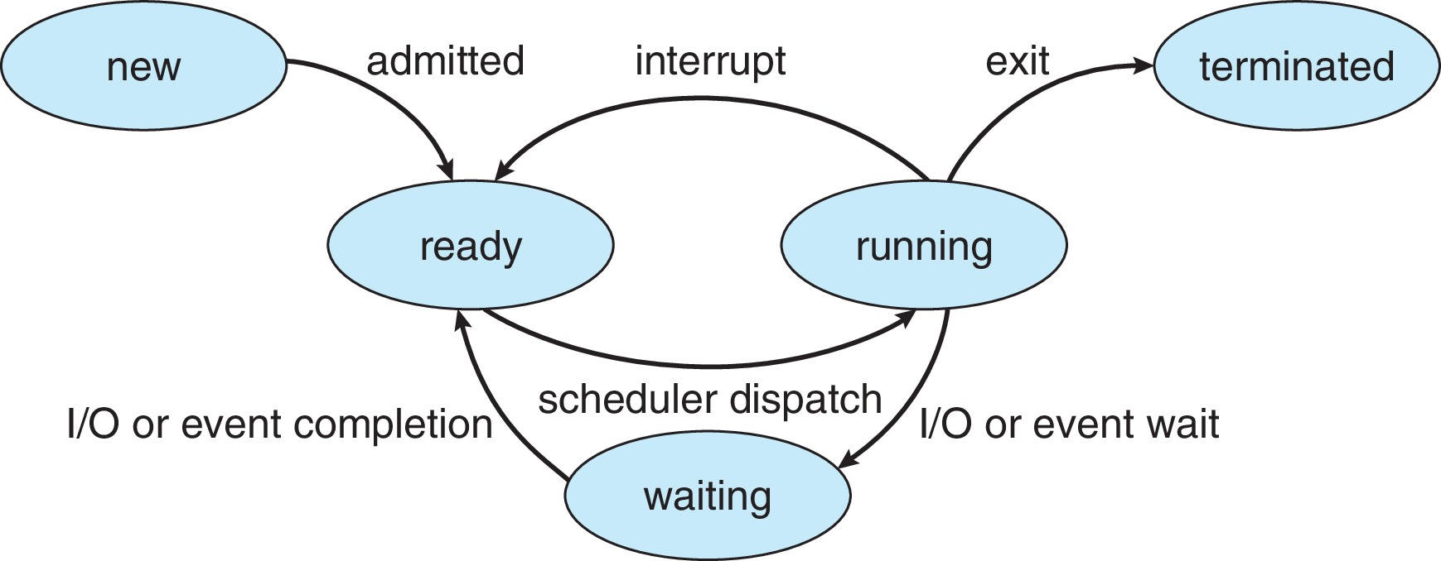
Lecture
02
Diagram of Process State

Slide 14
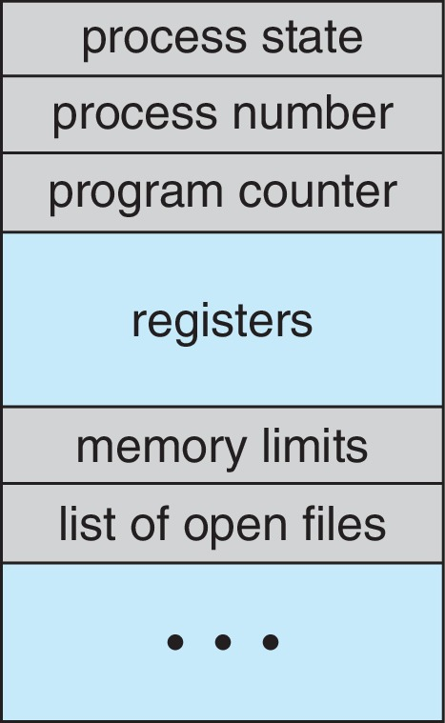
Lecture
02
Process Control Block (PCB)
Every process has a process control block, which is a data structure managed by the operating system.
PCB stores all of the information required to maintain track of a process.
  Process state – running, waiting, etc
  Process Number (ID). Each process in the OS has its own unique identifier.

Slide 15
Lecture
02
Process Control Block (PCB)
  Program counter – location )address) of instruction to next execute. (the next instruction to be executed)
  CPU registers – contents of all process-centric registers.
  CPU scheduling information- priorities.

Slide 16
Lecture
02
Process Control Block (PCB)
  Memory-management information – memory allocated to the process
  Accounting information: Account of all resources used by the process such as (CPU time , memory, ….)
  I/O status information – I/O devices allocated to process, list of open files.
  The PCB architecture is fully dependent on the operating system, and different operating systems may include different information.

Slide 17
Lecture
02
Process Scheduling
When there are several or more runnable processes, the operating system chooses which one to run first; this is known as process scheduling.
A scheduler is a program that uses a scheduling algorithm to make choices.

Slide 18
Lecture
02
Process Scheduling
OS, Maintains scheduling queues of processes
All processes, upon entering the system, are stored in the Job Queue (set of all processes in the system)
Processes in the Ready state are placed in the Ready Queue (set of all processes residing in main memory, ready and waiting to execute)

Slide 19
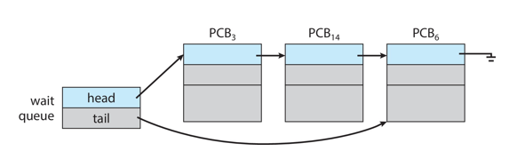
Lecture
02
Process Scheduling
Processes waiting for a device to become available are placed in Device Queues. There are unique device queues available for each I/O device.
Processes migrate among the various queues

Slide 20
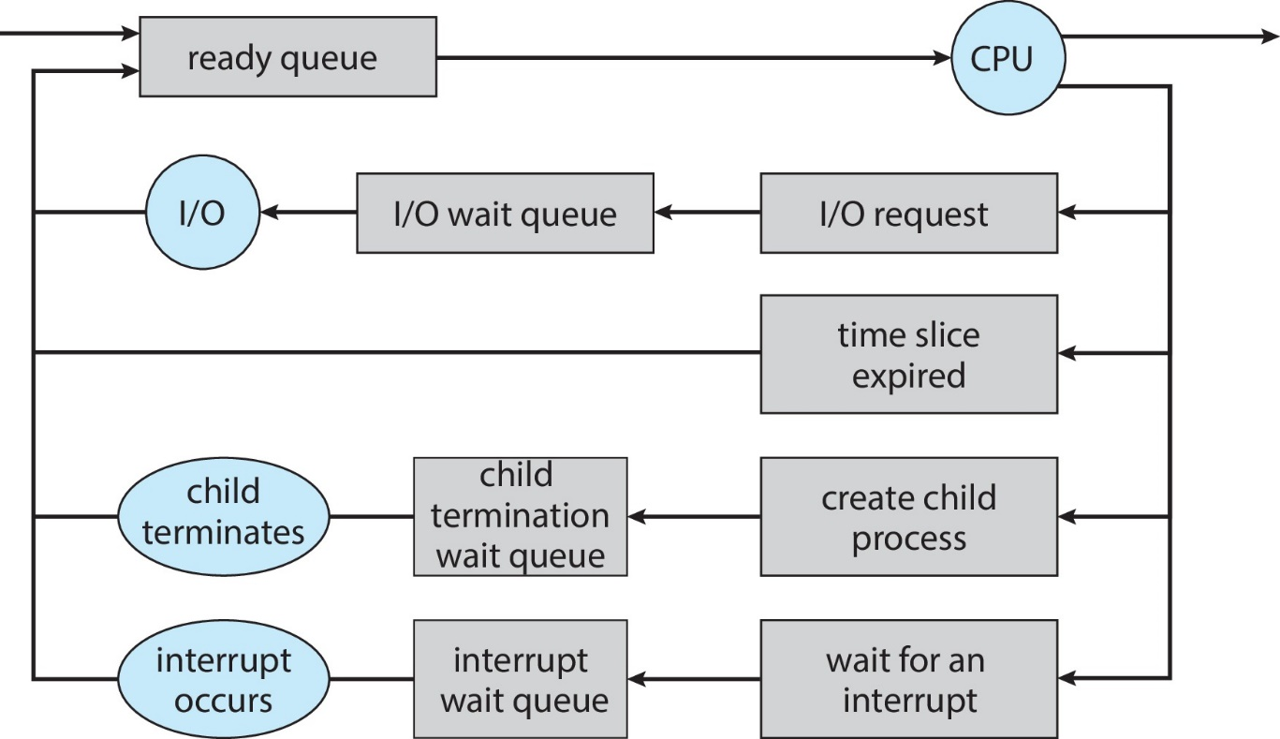
Lecture
02
Representation of Process Scheduling

Slide 21
Lecture
02
Representation of Process Scheduling
A new process is initially put in the Ready queue.
It waits in the ready queue until it is selected for execution(or dispatched).
Once the process is assigned to the CPU and is executing, one of the following several events can occur:
    The process could issue an I/O request, and then be placed in the I/O queue.
    The process could create a new subprocess and wait for its termination.
    The process could be removed forcibly from the CPU, as a result of an interrupt, and be put back in the ready queue.

Slide 22
Lecture
02
schedulers
Short-term scheduler (or CPU scheduler) – selects which process should be executed next and allocates CPU
  Sometimes the only scheduler in a system
  Short-term scheduler is invoked frequently (milliseconds) ⇒ (must be fast)

Slide 23
Lecture
02
Schedulers
Long-term scheduler (or job scheduler) – selects which processes should be brought into the ready queue
  Long-term scheduler is invoked infrequently (seconds, minutes) ⇒ (may be slow)
  The long-term scheduler controls the degree of multiprogramming

Slide 24
Lecture
02
Schedulers
Processes can be described as either:
  I/O-bound process – spends more time doing I/O than computations, many short CPU bursts
  CPU-bound process – spends more time doing computations; few very long CPU bursts
Long-term scheduler strives for good process mix

Slide 25
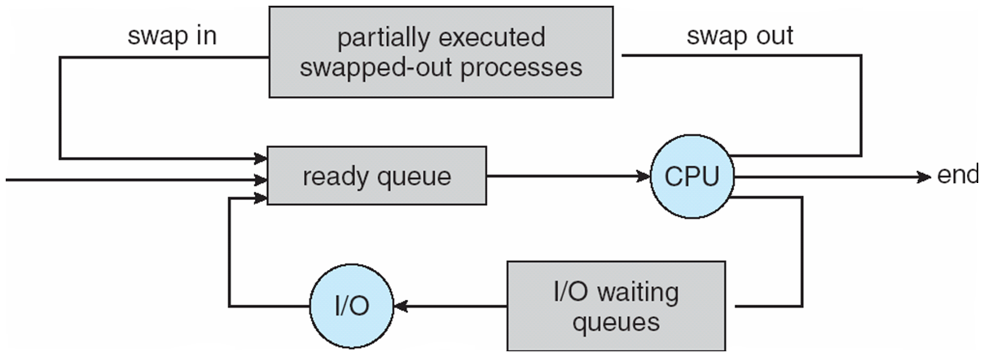
Lecture
02
Medium term schedulers
Medium-term scheduler can be added if degree of multiple programming needs to decrease
  Remove process from memory, store on disk, bring back in from disk to continue execution: swapping

Slide 26
Lecture
02
Context Switch
When CPU switches to another process, the system must save the state of the old process and load the saved state for the new process via a context switch
Context of a process represented in the PCB. When a context switch occurs, the Kernel saves the context of the old process in its PCB and loads the saved context of the new process scheduled to run.

Slide 27
Lecture
02
Context Switch
Context-switch time is overhead; the system does no useful work while switching
  The more complex the OS and the PCB ➔ the longer the context switch
Time dependent on hardware support
  Some hardware provides multiple sets of registers per CPU ➔ multiple contexts loaded at once

Slide 28
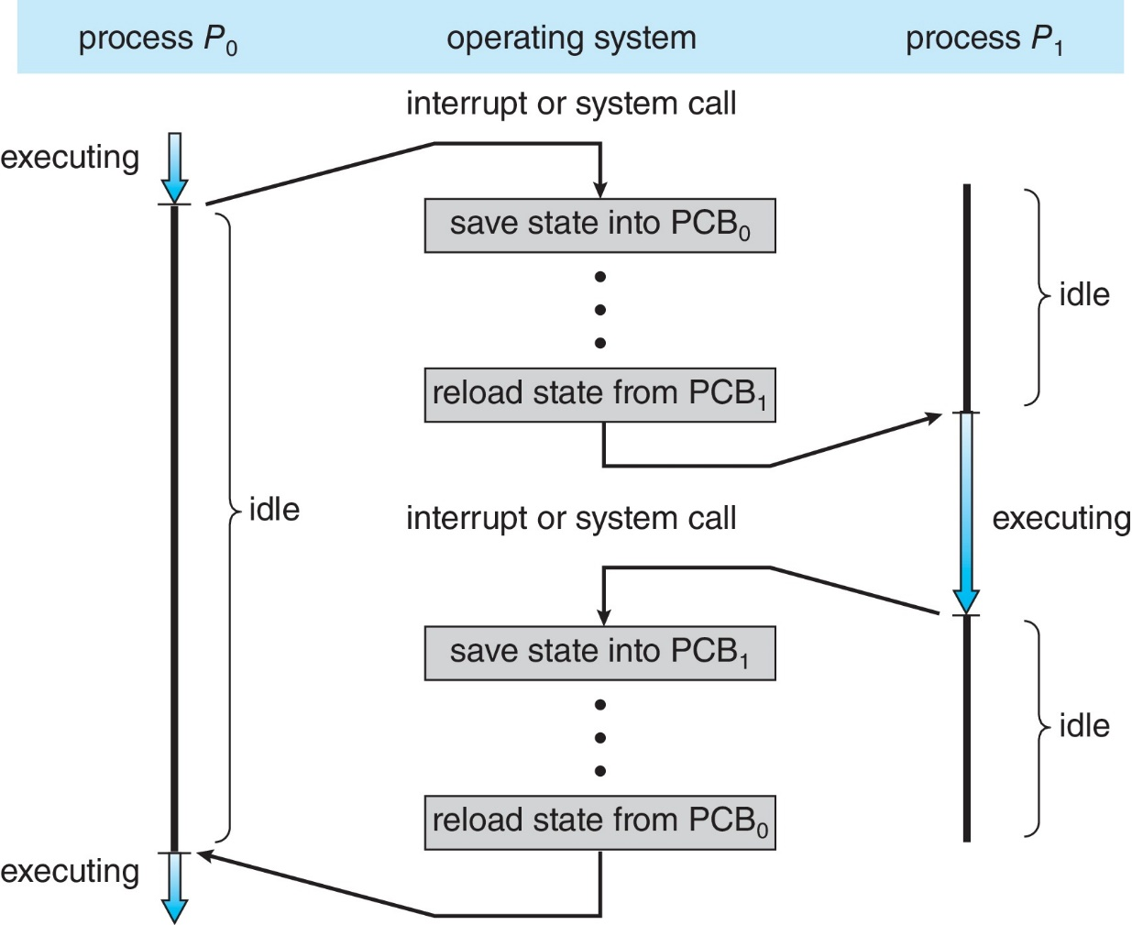
Lecture
02
CPU Switch From Process to Process

Slide 29
Lecture
02
Operations on Processes
System must provide mechanisms for:
  process creation
  process termination

Slide 30
Lecture
02
Process Creation
A process may create several new processes, via create process system call during the course if execution.
Parent process create children processes, which, in turn create other processes, forming a tree of processes
Generally, process identified and managed via a process identifier (pid)
Resource sharing options
  Parent and children share all resources
  Children share subset of parent’s resources
  Parent and child share no resources

Slide 31
Lecture
02
Process Creation
Execution options
  Parent and children execute concurrently.
  Parents Wait for the child process to terminate before proceeding. Parent process makes a wait() system call, for either a specific child process or for any particular child process, which causes the parent process to block until the wait() returns.

Slide 32
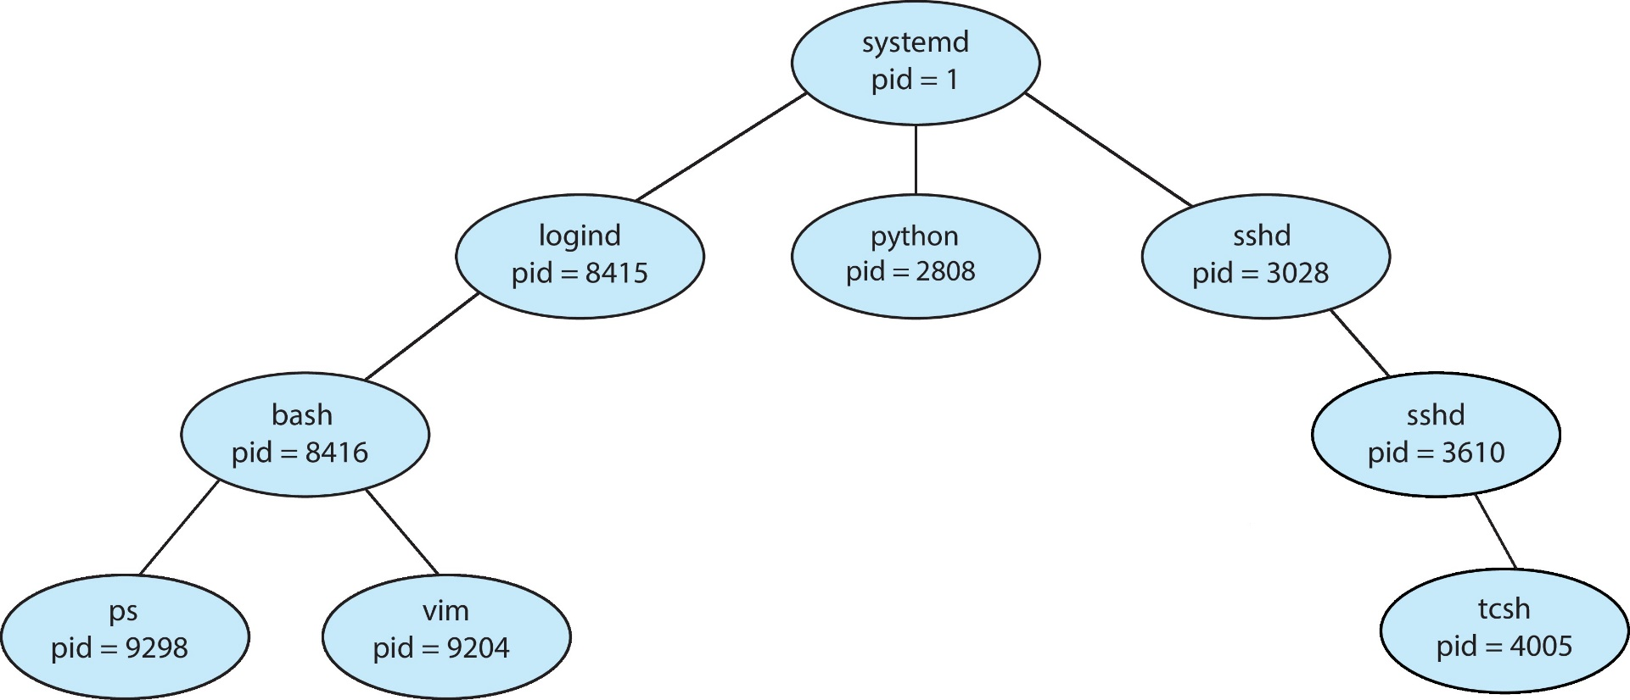
Lecture
02
Tree Of processes in Linux

Slide 33
Lecture
02
Process Creation (Cont.)
There are also two possibilities in terms of the address space of the new process:
  Child duplicate of parent
  Child has a program loaded into it
UNIX examples
  fork() system call creates new process
  exec() system call used after a fork() to replace the process’ memory space with a new program
  Parent process calls wait() for the child to terminate

Slide 34
Lecture
02
Fork() System Call
The fork system call creates a new process.
If the operation is successful, there are then both
parent and child processes and both see fork return, but with different values:
  it returns a value of 0 in the child process
  It returns the child's process ID (+ve value) in the parent process.
  It returns a value of -1 if the process creation failed, the parent process and no child is created.

Slide 35
Lecture
02
Fork() System Call
Parent
x = Fork()
If (x == 0) // child is running
print (“I’m child”);
else
print (“I’m parent”);
x>0
x=0
Parent
Child
Output :
I’m parent
I’m child
Output :
I’m child
I’m parent
or

Slide 36
Lecture
02
wait() System Call
Parent
x = Fork()
If (x == 0) // child is running
print (“I’m child”);
Else
wait();
print (“I’m parent”);
x>0
x=0
Parent
Child
Output :
I’m child
I’m parent

Slide 37
Lecture
02
Process Termination
A process terminate when it finish executing its last statement and then asks the operating system to delete it using the exit() system call.
Process’ resources are deallocated by operating system

Slide 38
Lecture
02
Process Termination
Parent may terminate the execution of children processes using the abort() system call. Some reasons for doing so:
  Child has exceeded allocated resources
  Task assigned to child is no longer required
  The parent is exiting, and the operating systems does not allow a child to continue if its parent terminates
If no parent waiting (did not invoke wait()) process is a zombie
If parent terminated without invoking wait , process is an orphan

Slide 39
Lecture
02
Process Termination
Some operating systems do not allow child to exists if its parent has terminated. If a process terminates, then all its children must also be terminated.
  cascading termination. All children, grandchildren, etc. are terminated.
  The termination is initiated by the operating system.
The parent process may wait for termination of a child process by using the wait()system call. The call returns status information and the pid of the terminated process

Slide 40
Lecture
02
Inter-Process Communication
Processes within a system may be independent or cooperating
Cooperating process can affect or be affected by other processes, including sharing data
Reasons for cooperating processes:
  Information sharing
  Computation speedup
  Modularity
  Convenience

Slide 41
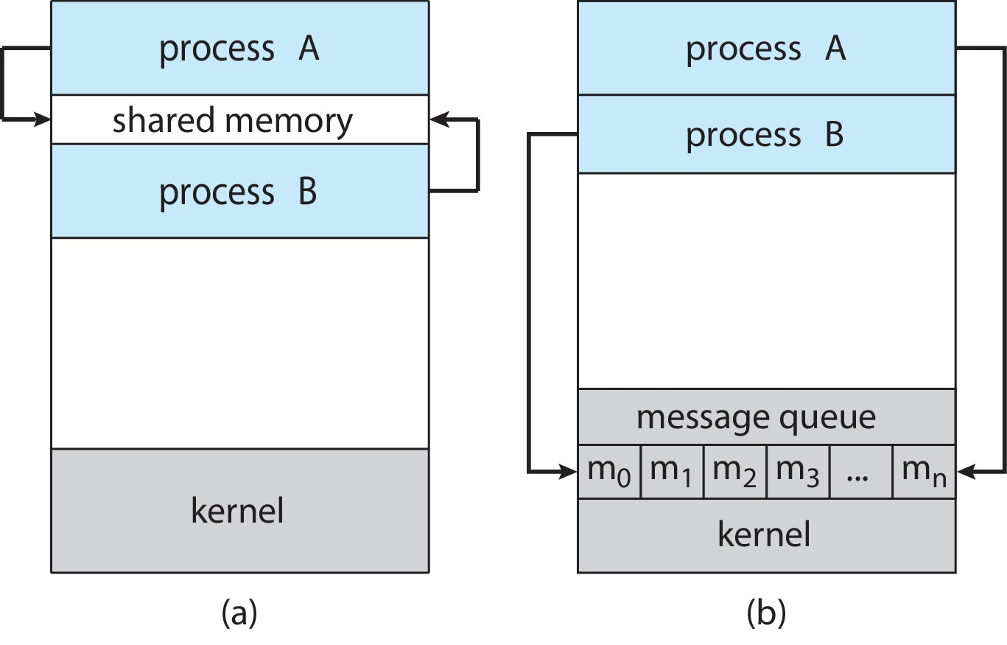
Lecture
02
Inter-Process Communication
Cooperating processes need inter-process communication (IPC)
Two models of IPC
  Shared memory
  Message passing

Slide 42
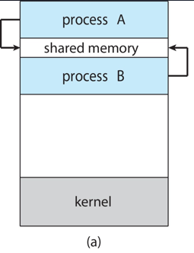
Lecture
02
Shared Memory
An area of memory shared among the processes that wish to communicate
The communication is under the control of the users processes not the operating system.
Major issues is to provide mechanism that will allow the user processes to synchronize their actions when they access shared memory.
Synchronization is discussed in great details in Lecture 4

Slide 43
Lecture
02
Shared Memory
Typically, a shared memory region resides in the address space of the process creating the shared memory segment.
Other processes that wish to communicate using this
shared memory segment much attach it to its
address space.
Normally , the operating system tries to prevent one
Process from accessing another process memory.
Shared memory requires that two or more processes
agree to remove this restriction.

Slide 44
Lecture
02
Producer Consumer Problem
Is a typical problem where the producer process produces information that's consumed by a consumer process
For example, compiler may produce assembly code which is consumed the assembler, the assembler In turn produce object modules which are consumed by the loader program and so on…
One solution to the producer consumer problem is the use of shared memory.
To allow the producer and consumer processes to run concurrently we must have a buffer of items that can be filled by the producer and emptied by the consumer

Slide 45
Lecture
02
Producer Consumer Problem
The buffer reside in region of memory that is shared by the producer and the consumer processes
The producer and consumer must be synchronized so that the consumer doesn't try to consume item that has not yet been produced

Slide 46
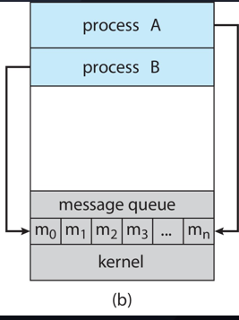
Lecture
02
Message Passing
Mechanism for processes to communicate and to synchronize their actions
Message system – processes communicate with each other without resorting to shared variables
Message passing is useful in distributed environment where the communication processes may reside on computers connected by a network.
IPC facility provides two operations:
  send(message)
  receive(message)
  [The message size is either fixed or variable]

Slide 47
Lecture
02
Message Passing
If processes P and Q wish to communicate, they need to:
  Establish a communication link between them
  Exchange messages via send/receive
Implementation of communication link
  Physical:
    Shared memory
    Hardware bus
    Network
  Logical:
    Direct or indirect
    Synchronous or asynchronous

Slide 48
Lecture
02
Direct Communication
Processes must name each other explicitly:
  send (P, message) – send a message to process P
  receive(Q, message) – receive a message from process Q
Properties of communication link
  Links are established automatically
  A link is associated with exactly one pair of communicating processes
  Between each pair there exists exactly one link
  The link may be unidirectional, but is usually bi-directional

Slide 49
Lecture
02
In-direct Communication
Messages are directed and received from mailboxes (also referred to as ports)
  Each mailbox has a unique id
  Processes can communicate only if they share a mailbox
Properties of communication link
  Link established only if processes share a common mailbox
  A link may be associated with many processes
  Each pair of processes may share several communication links
  Link may be unidirectional or bi-directional

Slide 50
Lecture
02
Synchronization
Message passing may be either blocking or non-blocking
Blocking is considered synchronous
  Blocking send -- the sender is blocked until the message is received
  Blocking receive -- the receiver is blocked until a message is available

Slide 51
Lecture
02
Synchronization
Non-blocking is considered asynchronous
  Non-blocking send -- the sender sends the message and continue
  Non-blocking receive -- the receiver receives:
    A valid message, or
    Null message
Different combinations possible
  If both send and receive are blocking, we have a rendezvous

Slide 52


Thank You

