Slide 1


Introduction to Healthcare Quality
Prepared by Dr. Hesham Mousli
MHA623
Healthcare Quality
Lecture 1

Slide 2

Intended Objectives
Chapter
01
Recognize the different terms assigned to quality .
Explain the relationship between cost and quality.
Demonstrate an understanding of the varied dimensions of healthcare quality.
Recognize the principals of TQM in healthcare

Slide 3
WHAT IS QUALITY?
Chapter
01
In its broadest sense, quality is an attribute of a product or service.
The perspective of the person evaluating the product or service influences her judgment of the attribute.

Slide 4
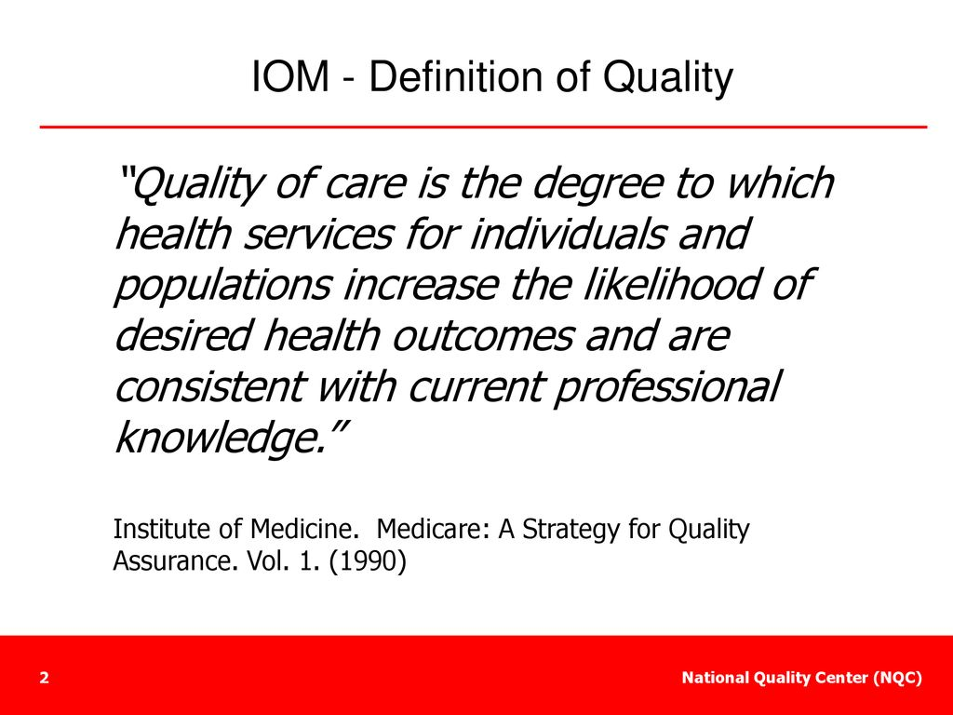
Chapter
01

Slide 5
What is Reliability in Healthcare?
Chapter
01
Definition:
  Reliability refers to the ability of a medical process, procedure, or service to consistently perform its intended function without failure, within the required time frame, and under normal conditions.
Importance:
  Ensures patients receive consistent, high-quality care.
  Builds trust in healthcare systems and services.
  Reduces errors and enhances patient safety.

Slide 6

What is Reliability in Healthcare?
Chapter
01
Failure of Reliability:
  Reliability ends when a process, procedure, or service fails to perform as intended.
Consequences:
  Compromised patient care and safety.
  Loss of trust in healthcare systems.
  Potential harm or negative outcomes for patients.

Slide 7
Examples
Chapter
01
Reliable process:
  A diagnostic test is reliable when it consistently provides accurate results under normal operating conditions.
Unreliable process:
  A nurse administers the wrong dosage of a medication to a patient due to unclear or inconsistent dosage instructions in the electronic health record (EHR) system.

Slide 8

Quality related terms
Chapter
01
Quality Control (QC)
  A management process where actual performance is measured against expected performance., and actions are taken on the difference.
  Focus:
    Inspection.
    Maintain the status quo.

Slide 9

Quality related terms
Chapter
01
Quality Assurance (QA)
  It is the process of assuring compliance with standards, requirements or specifications and implementing methods to achieve that.
  Focus:
    Monitoring.
    On process level.
    Gives feedback to provider.

Slide 10
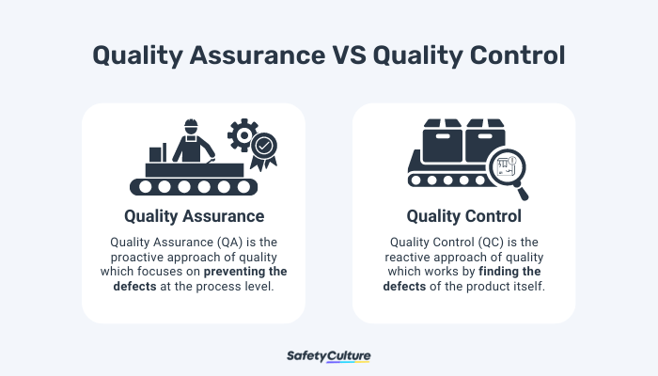
01

Slide 11
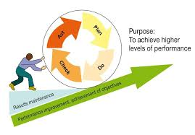
Quality related terms
Chapter
01
Quality Improvement (QI)
  Selectively identifies opportunities to achieve improvements in products/ services.
  Characteristics:
    More comprehensive.
    Broader-based approach.
    Focuses on the whole system.

Slide 12
Quality related terms
Chapter
01
Continuous Quality Improvement (CQI)
  Continuously improves every process in every part of an organization, with the intent of meeting and exceeding customer expectations and outcomes.
  Characteristics:
    Cyclical process.
    Continuously improve quality even in absence of problems.
    Never ending.
    Daily part of everyday functions.

Slide 13
What’s TQM ?
Chapter
01
Total: Whole
Quality: degree of excellence a product or service provides.
Management: Act, art, or manner of handling, controlling, directing.
TQM is the art managing the whole to achieve excellence.

Slide 14
What’s TQM ?
Chapter
01
TQM is a philosophy.
It says that: In order to do a better job, you have to involve the people doing the job and ask for their suggestions.
CQI is the process itself, it is a plan putting TQM into action, it is responsible how the job will be done.

Slide 15
What’s TQM ?
Chapter
01
CQI (Continuous Quality Improvement) is an organized approach that engages personnel in systematically planning and implementing ongoing improvements to healthcare systems. The goal is to deliver high-quality care that meets or surpasses patient expectations.

Slide 16
What’s TQM ?
Chapter
01
“In late 1980's, many health care organizations started to apply the concept of TQM, a concept that has proved its worth in industry.”

Slide 17

What’s TQM ?
Chapter
01
TQM does not occur overnight; there are no quick remedies. It takes a long time to build the appropriate emphasis and techniques into the culture.

Slide 18

What’s TQM ?
Chapter
01
Overemphasis on short term results and profits must be set aside so long term planning and constancy of purpose will dominate.

Slide 19
COST−QUALITY Relationship
Chapter
01
We expect to receive value when purchasing products or services.
We become disappointed when we receive poor service at a restaurant.
How you respond to disappointing situations depends on how you are affected by them.

Slide 20
COST−QUALITY Relationship
Chapter
01
Cost and quality affect the customer experience in all industries. But in healthcare, these factors are harder for the average consumer to evaluate than in other types of business.

Slide 21
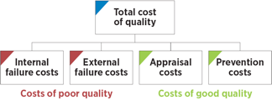
Chapter

Slide 22
Internal failure costs
Chapter
01
Are incurred to remedy defects discovered before the product or service is delivered to the customer.
These costs occur when the results of work fail to reach design quality standards and are detected before they are transferred to the customer.

Slide 23
Internal failure costs
Chapter
01
Examples:
  Costs associated with re-testing patients due to inaccurate lab results.
  Time and resources spent correcting medication errors before they reach the patient.
  Investigating and addressing near-miss incidents (e.g., almost administering the wrong drug).
  Delays in treatment due to miscommunication among healthcare teams.

Slide 24
External failure costs
Chapter
01
Are incurred to remedy defects discovered by customers.
These costs occur when products or services that fail to reach design quality standards are not detected until after transfer to the customer.

Slide 25
External failure costs
Chapter
01
Examples:
  Legal fees and settlements resulting from medical malpractice lawsuits.
  Costs of readmissions due to complications or incomplete treatment.
  Loss of reputation and patient trust after a preventable adverse event.
  Additional treatments required to address harm caused by errors (e.g., infections from improper sterilization).

Slide 26
Prevention costs
Chapter
01
Are incurred to prevent or avoid quality problems. These costs are associated with the design, implementation, and maintenance of the quality management system.

Slide 27
Prevention costs
Chapter
01
Examples:
  Training healthcare staff on infection control protocols to prevent hospital-acquired infections.
  Implementing electronic health record (EHR) systems to reduce documentation errors.
  Conducting regular maintenance of medical equipment to avoid breakdowns.

Slide 28
Appraisal costs
Chapter
01
Are associated with measuring and monitoring activities related to quality.
These costs are associated with the suppliers’ and customers’ evaluation of purchased materials, processes, products, and services to ensure that they conform to specifications.

Slide 29
Appraisal costs
Chapter
01
Examples:
  Conducting routine patient satisfaction surveys to assess service quality.
  Performing regular audits of medical records to ensure compliance with standards.
  Testing and calibrating diagnostic equipment to ensure accuracy.
  Hiring external reviewers to evaluate the quality of care provided.

Slide 30

Basic dimensions of Healthcare Quality (STEEEP)

Slide 31
Safety
Timeliness
Effectiveness
Patient centeredness
Equity
Efficiency

Slide 32
Safety
Chapter
01
Avoid injuries to patients from the care that is intended to help them.
  In 2008, the WHO introduced the Surgical Safety Checklist to minimize surgical errors by ensuring critical steps are followed before, during, and after procedures.
  It prevents mistakes like wrong-site surgeries, retained instruments, or medication errors. This tool has significantly improved patient safety and reduced complications.

Slide 33
Timeliness
Chapter
01
Reduce waits and sometimes harmful delays for both those who receive and those who give care.
  An example of improving timeliness in healthcare is the implementation of Electronic Health Records (EHRs) and triage systems in emergency departments. For instance, a hospital in the U.S. introduced an EHR system that streamlined patient data access and prioritized cases based on severity.

Slide 34
Effectiveness
Chapter
01
Provide services based on scientific knowledge to all who could benefit, and refraining from providing services to those not likely to benefit.
  example is the use of evidence-based guidelines for prescribing antibiotics. Doctors provide antibiotics to patients with bacterial infections, where they are proven effective, but avoid prescribing them for viral infections like the common cold, where they offer no benefit and can contribute to antibiotic resistance.

Slide 35
Efficiency
Chapter
01
Avoid waste, including waste of equipment, supplies, ideas, and energy.
  A hospital implemented a digital inventory system to track medical supplies, reducing overstocking and expiration waste. By optimizing supply chain management, they saved costs and ensured timely availability of essential items, improving overall care quality.

Slide 36
Equity
Chapter
01
Provide care that doesn’t vary in quality because of personal characteristics such as gender, ethnicity, geographic location, and socioeconomic status.
  A health system ensures equitable care by standardizing protocols and using tools like mobile clinics or telehealth to bridge gaps, ensuring consistent quality regardless of gender, ethnicity, location, or income.

Slide 37
Patient Centeredness
Chapter
01
Provide care that is respectful of and responsive to individual patient preferences, needs, and values, and ensuring that patient values guide all clinical decisions.
  An elderly diabetic patient chooses diet and lifestyle changes over medication.
  The healthcare team supports their decision, providing guidance and monitoring for safe, effective management.

Slide 38
Wrap Up
Chapter
01
Quality in Healthcare: Defined by attributes like safety, timeliness, effectiveness, efficiency, equity, and patient-centeredness.
Reliability: Ensures consistent, high-quality care, reducing errors and building trust.
Cost-Quality Relationship: Balancing cost and quality is critical for patient satisfaction and system efficiency.
TQM & CQI: Total Quality Management (TQM) and Continuous Quality Improvement (CQI) are essential for long-term excellence in healthcare delivery.

Slide 39
Wrap Up
Chapter
01
Patient-Centered Care: Prioritizes individual preferences, needs, and values, ensuring clinical decisions align with patient goals.
STEEEP Framework: Safety, Timeliness, Effectiveness, Efficiency, Equity, and Patient-Centeredness are the pillars of healthcare quality.
Continuous Improvement: Emphasizes the importance of ongoing efforts to enhance care quality, reduce costs, and improve patient outcomes.

Slide 40



Thank You

