Slide 1


Project Risk Management
Prepared by Dr. Usama Al-Fendi
PMG 510
Project Risk Management
Lecture 9

Slide 2

Lecture
Lecture Organization
9
Core business processes
Risk management responsibilities
Cost of risk controls

Slide 3
Lecture
Core business processes
9
Dynamic business models
Organizations will often establish business objectives and strategic objectives as separate documents.
When seeking to ensure that risk management makes a full contribution to the organization, it is important to view both of these sets of objectives and explore the relationship between them.
Business objectives will often relate to the annual budget that has been produced by the organization. This budget will contain details of the anticipated sales as income and the cost of sales as expenditure.

Slide 4
Lecture
Core business processes
9
Dynamic business models
Underpinning the business objectives of the organization will be the business delivery model (or business model for short) that the organization has developed.
The business delivery model (or business model for short) will be the core variable in achieving the business objectives of the organization
For example:
a membership organization will seek sponsorship from organizations that deliver services to the membership.
This source of sponsorship income will be a fundamental part of the business model and the annual business objectives.

Slide 5
Lecture
Core business processes
9
Dynamic business models
The membership body will need to estimate income from membership subscriptions and from sponsorship, and determine what services will be delivered to the members in return for their membership fee and what benefits will be delivered to the sponsors in return for their sponsorship money.
The efficiency and robustness of the business model will identify the risks that are attached to business objectives.
The risks that are attached to business objectives are associated with the robustness of the business model and the efficiency of the business model.

Slide 6
Lecture
Core business processes
9
Dynamic business models
In the pervious examples When undertaking a risk assessment of the annual budget, the events that could undermine sponsorship and membership income, together with the events that could disrupt the delivery of services and benefits, should be considered.
The essence of the business objectives normally relate to the organization as it currently exists.

Slide 7
Lecture
Core business processes
9
Dynamic business models
Business delivery and development models
Whenever a business is established, it either explicitly or implicitly employs a particular business delivery model that describes the architecture of the value creation, delivery, and capture mechanisms employed by the business enterprise. The essence of a business delivery model is that it defines the manner by which the business delivers value to customers, entices customers to pay for value, and converts those payments to profit: it thus reflects the belief of the organization about what customers want, how they want it, and how the enterprise can organize to best meet those needs, get paid for doing so, and make a profit.

Slide 8
Lecture
Core business processes
9
Dynamic business models
Business delivery and development models
The business delivery model is used to describe and classify businesses, but is also used by management inside companies to explore possibilities for future development. Future enhancement of the business delivery model is achieved by implementation of a business development plan. In fact, a well-established business delivery model will act as the basis for creative organizations to develop future strategy

Slide 9
Lecture
Core business processes
9
Dynamic business models
Most organizations recognize that the existing business model will not continue to be successful on an open-ended basis.
If business objectives are to be delivered year after year, then the business will need to develop.
These developments could include exploring greater sponsorship opportunities, delivering new services and products that will generate new income, and increasing efficiency in the delivery of the existing business model.

Slide 10
Lecture
Core business processes
9
Dynamic business models
Once the overall strategy is established, the tactics that will deliver it need to be identified.
If the strategy requires changes to core processes or the introduction of new core processes, then projects or programes of work will be required.

Slide 11
Lecture
Core business processes
9
Dynamic business models
The tactics introduced by the organization should ensure that effective and efficient core processes to deliver the desired outcomes in the most cost-effective manner are in place.
In relation to operations, the desired state of the organization is the continuity of normal efficient operations with no unplanned disruption

Slide 12
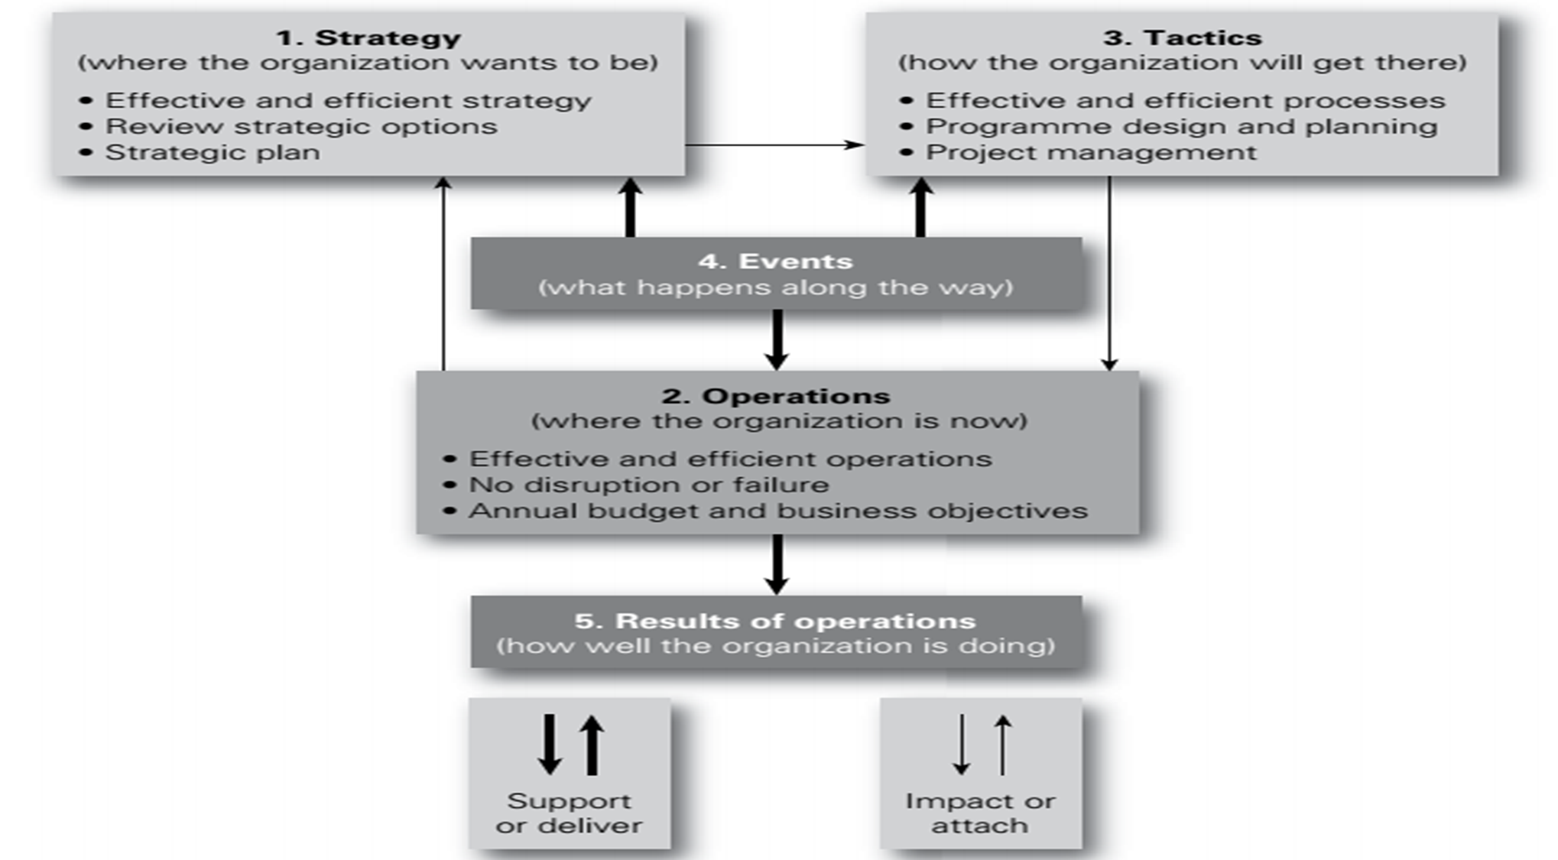
Lecture
Core business processes
9
Dynamic business models

Slide 13
Lecture
Core business processes
9
Types of business processes
There are four basic types of core process. These are processes designed, implemented and managed to ensure the following:
development and delivery of strategy;
management of tactics, projects and enhancements;
continuity and monitoring of routine operations;
activities that are designed to ensure compliance

Slide 14
Lecture
Core business processes
9
Types of business processes
Weaknesses or gaps in the core processes of the organization are likely to be present, as follows:
There may be weaknesses related to the development and delivery of strategy. These weaknesses will result in the organization failing to retain its position as a market leader. They give rise to a leadership gap.
There may be weaknesses related to the management of tactics, including projects and product or service enhancements. These weaknesses will result in failure to keep up with competitors. They give rise to a competition gap.

Slide 15
Lecture
Core business processes
9
Types of business processes
Weaknesses or gaps in the core processes of the organization are likely to be present, as follows:
3. There may be weaknesses related to failure to ensure efficiency, continuity and monitoring of routine operations. These weaknesses will result in failure to maintain efficient operations. They give rise to an efficiency gap.
4. There may be weaknesses related to the activities designed to fulfil mandatory requirements placed on the organization. These weaknesses will result in failure to maintain reputation. They give rise to a compliance gap.

Slide 16
Lecture
Risk management responsibilities
9
Allocation of responsibilities
There should be clear statements of responsibilities for the following aspects of the management of each priority significant risk:
setting required risk standards;
implementing risk standards;
monitoring risk performance.

Slide 17
Lecture
Risk management responsibilities
9
Range of responsibilities
The risk management professionals involved will include the following individuals (at least), depending on the size of the organization:
insurance risk manager;
corporate treasurer;
finance director;
internal auditor;
compliance manager;
health, safety and environment manager;
business continuity manager.

Slide 18
Lecture
Risk management responsibilities
9
Risk management responsibilities
The responsibilities of risk management includes:
1- Main risk management responsibilities for the CEO:
Determine strategic approach to risk management
Establish the structure for risk management
Understand the most significant risks
Consider the risk implications of poor decisions
Manage the organization in a crisis

Slide 19
Lecture
Risk management responsibilities
9
Risk management responsibilities
The responsibilities of risk management includes:
2. Main RM responsibilities for the location manager:
Build risk-aware culture within the location
Agree risk management performance targets for the location
Evaluate reports from employees on risk management matters
Ensure implementation of risk improvement recommendations
Identify and report changed circumstances/risks

Slide 20
Lecture
Risk management responsibilities
9
Risk management responsibilities
The responsibilities of risk management includes:
3. Main RM responsibilities for individual employees:
Understand, accept and implement RM processes
Report inefficient, unnecessary or unworkable controls
Report loss events and near-miss incidents
Cooperate with management on incident investigations
Ensure that visitors and contractors comply with procedures

Slide 21
Lecture
Risk management responsibilities
9
Risk management responsibilities
The responsibilities of risk management includes:
4. Main risk management responsibilities for the risk manager:
Develop the risk management policy and keep it up-to-date
Facilitate a risk-aware culture within the organization
Establish internal risk policies and structures
Coordinate the risk management activities
Compile risk information and prepare reports for the board

Slide 22
Lecture
Risk management responsibilities
9
Risk management responsibilities
The responsibilities of risk management includes:
5. Main RM responsibilities for specialist risk management functions:
Assist the company in establishing specialist risk policies
Develop specialist contingency and recovery plans
Keep up-to-date with developments in the specialist area
Support investigations of incidents and near misses
Prepare detailed reports on specialist risks

Slide 23
Lecture
Risk management responsibilities
9
Risk management responsibilities
The responsibilities of risk management includes:
6. Main risk management responsibilities for internal audit manager:
Develop a risk-based internal audit programme
Audit the risk processes across the organization
Provide assurance on the management of risk
Support and help develop the risk management processes
Report on the efficiency and effectiveness of internal controls

Slide 24
Lecture
Risk management responsibilities
9
Risk management responsibilities
Next Figure shows the risk architecture for a typical large corporate entity that is subject to the requirements of the Sarbanes–Oxley Act.
This risk architecture should be set out in the risk management manual for the organization.
Terms of reference of the various committees and a schedule of the activities should also be established, either in the risk management manual or in a calendar of risk management activities.
This schedule of activities should be aligned with the other corporate activities in the organization.

Slide 25
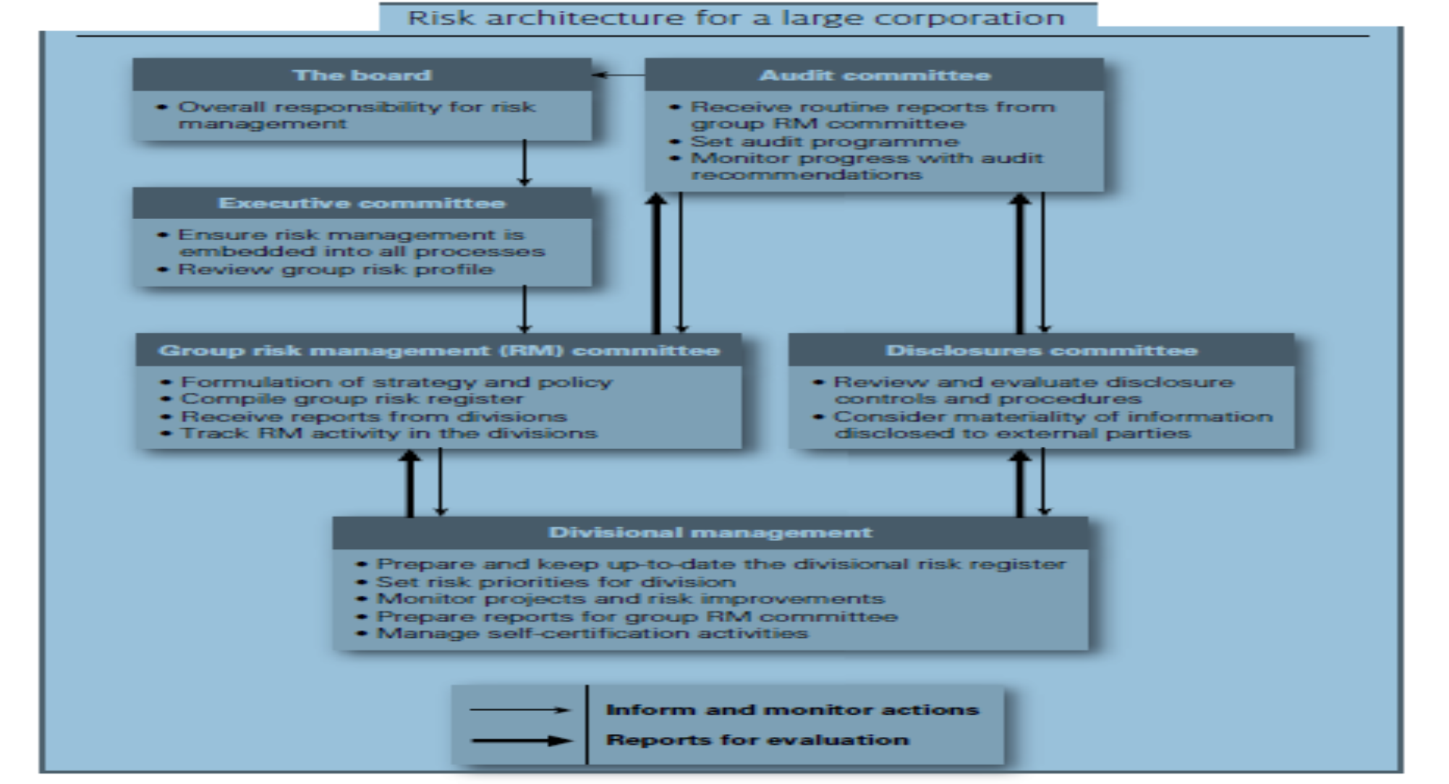
Lecture
Risk management responsibilities
9
Risk management responsibilities

Slide 26
Lecture
Risk management responsibilities
9
Cost of risk controls
The inherent level of a risk is the level of the risk with no control measures in place. This is sometimes referred to as the gross level of the risk.
The current level of risk is the level that takes account of the control measures currently in place. This is sometimes referred to as the net level of risk or the residual risk.

Slide 27
Lecture
Risk management responsibilities
9
Cost of risk controls
Next Figure provides an illustration of the control effect or control vector when controls are put in place.
When considering the inherent, intermediate (when more than one control is in place) and target risk levels, the organization should be aware of the cost involved in implementing controls.
The cost of the control measures should be considered to be part of the total cost of risk for the organization. The organization can then evaluate whether the controls in place are cost-effective

Slide 28
Lecture
Risk management responsibilities
9
Cost of risk controls
As can be seen in the next Figure , a series of lines can be drawn for Risk A to represent the effect of each individual risk control measure.
It is obvious that the longer the line, the greater the effect of the control.
It is also the case that the longer the line, the greater the control effort, in terms of management time, effort and money.

Slide 29
Lecture
Risk management responsibilities
9
Cost of risk controls
For Risk A, three controls (Control A1, Control A2 and Control A3) are required to get to the target level of risk.
For Risk B, only one control is required (Control B1) and this demonstrates that much more effort is needed to maintain Risk A at the target level of risk.
Management and internal audit need to be aware of this, so that they can ensure that all of the controls (especially for Risk A) are operating in an effective and efficient manner.

Slide 30
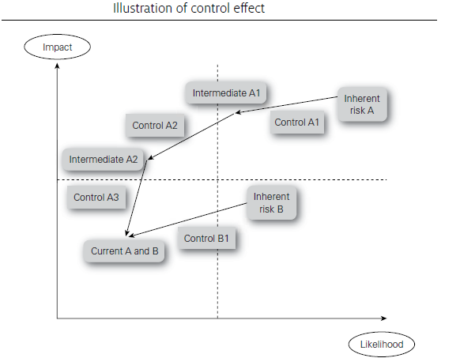
Lecture
Risk management responsibilities
9
Cost of risk controls

Slide 31
Lecture
Risk management responsibilities
9
Cost of risk controls
If a calculation is undertaken of the risk exposure at the original level and a further calculation is undertaken of the risk exposure at the new level, the overall benefit of each control can be measured.
Consideration of the cost of each control can then be undertaken, so that a cost–benefit analysis of individual controls may be completed.
This will be an important exercise for the organization to undertake, so that cost-effective risk control priorities may be established

Slide 32
Lecture
Risk management responsibilities
9
Cost of risk controls
Risk treatment is sometimes referred to as risk response or risk control, and it includes the selection and implementation of actions to reduce risk likelihood and risk impact.
when deciding the nature and extent of risk control activities that should be implemented.
When reasonably practicable, it is obvious that preventive controls should be introduced as the first option. If prevention is not possible, then corrective controls should be introduced to minimize the likelihood and impact of an adverse event.

Slide 33
Lecture
Risk management responsibilities
9
Cost of risk controls
When selecting and implementing controls, it is important to ensure that cost-effective controls are selected.
Next Figure plots increasing the level of control (horizontal-axis) against both the increasing cost of controls and the reducing potential loss (vertical-axis).
By adding the total cost of controls and the equivalent potential loss for each level of control, the figure illustrates that there is an optimum level of control that represents the lowest combined cost as a sum of the cost of control and the level of potential losses.

Slide 34
Lecture
Risk management responsibilities
9
Cost of risk controls
By adding the total cost of controls and the equivalent potential loss for each level of control, the figure illustrates that there is an optimum level of control that represents the lowest combined cost as a sum of the cost of control and the level of potential losses.

Slide 35
Lecture
Risk management responsibilities
9
Cost of risk controls

Slide 36


Thank You

