Slide 1



Employment Relations
Understanding employment relations
Prepared by Dr. Nourhan Sayed
HRM 624
3rd Lecture
Lecture (3)

Slide 2




Employment Relations
Understanding employment relations
Lecture (3)
HRM 624
2nd Lecture
Prepared by
Dr. Nourhan Sayed
www.midocean.ae

Slide 3
Define employment relations

Slide 4

Define Employment Relations
Employment Relations Employment Relations (ER) covers a broad range of topics relating to the world of work. ER is concerned about the behaviour and interaction of people in the workplace and is primarily associated with the relationship between employers and their employees(Slade, 2002).

Slide 5
ER, IR and HRM are they the same?

Slide 6

ER, IR and HRM are they the same?
The incorporation of a pluralistic frame of reference and the integration of Industrial Relations and Human Resources Management into some kind of whole creates a discipline called ‘Employment Relations’ (Slade, 2002).

Slide 7
ER, IR and HRM are they the same?
It can be argued that Industrial Relations, Human Resources Management and Employee Relations are each representative of differing ideologies. Industrial Relations might be seen as encompassing a set of ideologies that are pluralist in character, whilst HRM is largely unitarist in nature (Slade, 2002).

Slide 8
Industrial relations and HRM

Slide 9
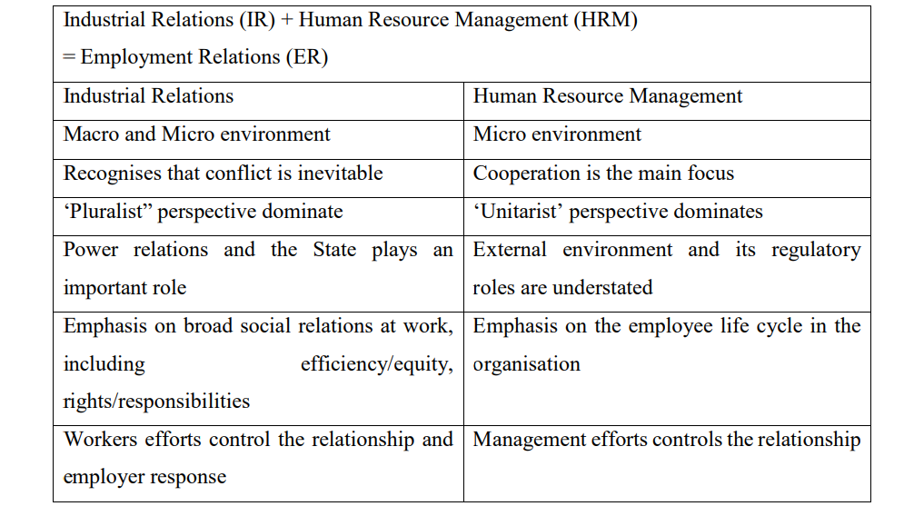
Table 1.3 Industrial Relations and Human Resource Management

Slide 10

Human Resource Management
Human Resource Management (HRM) is defined as the process of designing management systems to ensure that human talent is used effectively and efficiently to accomplish organisational goals.

Slide 11

Human’ represents the dimension of HRM which relates to:
the soft aspects:
such as the commitment of employees through participation and understanding that the most important assets are the employees.
‘Resource’ represents the hard aspects, such as the strategy link of HRM and the importance of the efficient utilisation of employees. “Management” represents the role of HRM as part of management. This implies that it is not only an administrative function that carries out the formulated policies, but it is also a managerial function which contributes to the formulation of strategy

Slide 12

Human’ represents the dimension of HRM which relates to:
‘Resource’ represents the hard aspects, such as the strategy link of HRM and the importance of the efficient utilisation of employees.

Slide 13
Management vs HRM
“Management” represents the role of HRM as part of management. This implies that it is not only an administrative function that carries out the formulated policies, but it is also a managerial function which contributes to the formulation of strategy

Slide 14

Human resources management view
HRM sees people as a resource. A resource is viewed (in a business sense) as something that must be obtained as cheaply as possible, used sparingly, developed and exploited as much as possible. As indicated by Kleiman (2000) in this view, HRM is concerned with efficiency and achieving results. Performance management is crucial and tightly controlled employee activities are seen to be the best way for this to be achieved.

Slide 15
Soft vs. hard HRM

Slide 16
Soft HRM
Soft (HRM) focuses on people and is associated with the ‘human’ side of Human Resource Management.

Slide 17
Hard HRM
Hard HRM sees people as a resource and is associated with the ‘resource’ side of Human Resource Management.

Slide 18
Historical developments in HRM
The first was the Industrial Welfare movement in the 1880s-1940, which led to a shift in the way that managers viewed and treated employees.
Employees were not just seen as a ‘resource’, (hard HRM) to enhance the productivity and profitability of the organisation, but more as ‘humans’ (soft HRM) where their rights and feelings were considered (Storey, 1995).

Slide 19
Conclusion
Soft vs hard HRM

Slide 20
Historical developments in HRM
Another important influence was Frederick Taylor (1911) who outlined management methods for gaining greater productivity from low level production workers.
Taylor’s pioneering research involved incentive systems that rewarded employees for their performance.

Slide 21
Conclusion
Incentive system is where employees are rewarded employees for their performance.

Slide 22
Historical developments in HRM
Elton Mayo’s Hawthorne Studies is another pioneering milestone which has influenced the development of Human Resource Management.
The Hawthorne Studies involved conducting a number of experiments to see how groups of workers reacted in different situations.
(Bruce, 2006; Bruce & Nyland, 2011)

Slide 23

Conclusion
The Hawthorne Studies were research experiments conducted in the 1920s and 1930s at Western Electric and involved conducting a number of experiments to see how groups of workers reacted in different situations

Slide 24
Employment relations and psychological contract

Slide 25

The Employment Relationship
Lewis, Thornhill and Saunders (2003, p. 6) define the employment relationship as ‘an economic, legal, social, psychological and political relationship in which employees devote their time and expertise to the interests of their employer in return for a range of personal financial and nonfinancial rewards’.

Slide 26
Conclusion
Employment Relations is concerned about the behaviour and interaction of people in the workplace

Slide 27
The psychological contract
The psychological contract is the expectation that employers and employees have of each other (Noe, 1999) and their working relationship.

Slide 28
Characteristics of the employment relationship

Slide 29
Characteristics of the employment relationship
1st: The Employment Relationship is multifaceted and continuous

Slide 30
Characteristics of the employment relationship
1st: The Employment Relationship is multifaceted and continuous:
The employment relationship is not a simple, straight forward transaction such as buying an apple or a laptop. Instead, the relationship involves people who come from different backgrounds, have different personalities and different needs.

Slide 31
Characteristics of the employment relationship
2nd: The Employment Relationship is complex.

Slide 32
Characteristics of the employment relationship
2nd: The Employment Relationship is complex and involves many dimensions:
such as Economic (unemployment, wages and availability of labour), Social (values, diversity and equity), Cultural (teamwork, power-distance, work-life balance, ageing workforce), Legal (Workplace health and safety, legislation) and Psychological (Emotions and Personality)

Slide 33
Characteristics of the employment relationship
3rd: The Employment Relationship involves mutual responsibilities.

Slide 34
Characteristics of the employment relationship
3rd: The Employment Relationship involves mutual responsibilities.
It is important that both employees and employer carry out their duties and responsibilities. Employer responsibilities include paying wages or salaries as agreed, providing a safe working environment and reimbursing any expenses incurred. Employee responsibilities include obeying reasonable, lawful and safe instructions, working in a competent manner to take reasonable care and not harm employer’s interests

Slide 35
Characteristics of the employment relationship
4th: The Employment Relationship includes tangible and intangible elements.

Slide 36
Characteristics of the employment relationship
4th: The Employment Relationship includes tangible and intangible elements.
The tangible elements may include pay, company car and conditions of employment. The intangible elements may include more motivational aspects such as a sense of satisfaction and self-fullfilment.

Slide 37
Characteristics of the employment relationship
5th: The Employment Relationship is indeterminate and incomplete.

Slide 38
Characteristics of the employment relationship
5th: The Employment Relationship is indeterminate and incomplete:
It is difficult to provide a definitive list of all aspects involved in the relationship. Also, as the relationship evolves, new terms and conditions of employment are often generated

Slide 39
Characteristics of the employment relationship
6th : The Employment Relationship denotes the importance of cooperation and conflict:

Slide 40
Characteristics of the employment relationship
6th : The Employment Relationship denotes the importance of cooperation and conflict:
It is important to cooperate and work with people to develop long-term successful relations. However, the acknowledgement of conflict in the relationship may also help to overcome differences and create new and innovative ways of conducting business

Slide 41
Characteristics of the employment relationship
7th : The Employment Relationship is about balancing power:

Slide 42
Characteristics of the employment relationship
7th: The Employment Relationship is about balancing power:
Power should be balanced between the employee and the employer. The involvement of the state and employee and employer representatives helps to ensure that the balance of power exists in the employment relationship.

Slide 43
References:
Slade, P. (2002). What is employment relations? International Employment Relations Review, 8(2), 49-59.
Lewis, P., Thornhill, A., & Saunders, M. (2003). Employee Relations: Understanding the Employment Relationship. England: Prentice Hall.
Noe, R. A. (1999). Employee Training & Development. Boston, MA: Irwin/McGraw-Hill.
Kleiman, L. S. (2000). Human Resource Management: A Managerial Tool for Competitive Advantage. Cincinnati: South-Western College Publishing

Slide 44



Thank You

