Slide 1


Marketing Management
MGM 612
Prepared by
Dr. Magdy Al-haj
  Lecture - 2-
Market Segmentation and Targeting, and
Positioning for Competitive Advantage

Slide 2


Chapter 2
Market Segmentation and Targeting, and Positioning for Competitive Advantage
Lecture 2
Re-prepare By
Dr. Ayman Hassan

Slide 3

Learning Outcomes
After studying this chapter you should be able to:
Define and explain market segmentation, target markets, and product differentiation and positioning.
Understand the criteria for Effective Segmentation
Know the role of market segmentation in the development of marketing strategies and programs.
Understand the Positioning for Competitive Advantage
Steps in Segmentation, Targeting, and Positioning

Slide 4
Chapter 2
Market Segmentation
  Market Segmentation:
  Divides a market into subsets of prospective customers who behave in the same way, have similar wants, or have similar characteristics that relate to purchase.
  Intermarket Segments:
  Well-defined, similar clusters of customers across national boundaries.

Slide 5
The Importance of Market Segmentation
Markets have a variety of product needs and preferences.
Marketers can better define customer needs.
Decision makers can define objectives and allocate resources more accurately.

Slide 6
Top 10 benefits of the Market Segmentation
1- Higher Rate of Success 2- Increases Profitability
3- Increases Competitiveness 4- Retention of Customer
5- Creates and Provides Market Opportunities 6- Effective Market Campaigning
7- Wise and Efficient Use of Resources. 8- Higher Customer Satisfaction
8- Cost-Efficient 10- Know your Customer Better

Slide 7
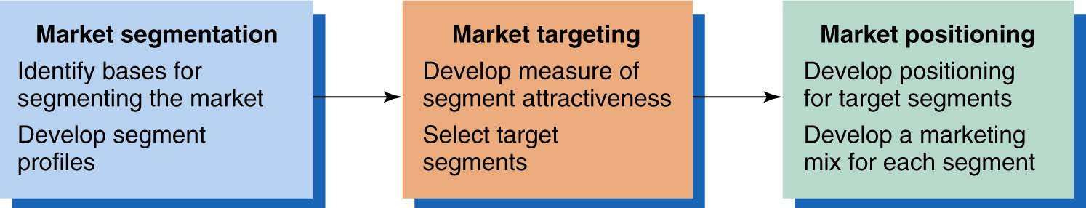
Steps in Market Segmentation, Targeting, and Positioning “ STP ”

Slide 8
Market Segmentation
Market Segmentation define:
Dividing Markets into Smaller Segments that Can be Reached More Efficiently And Effectively With Products and Services That Match Their Unique Needs..

Slide 9
Target Markets
Targeting:
Selecting which segments in a market are appropriate to focus on and designing the means of reaching them.

Slide 10
Positioning
Positioning:
  Designing a marketing program, including
  the product mix, that is consistent with how
  the company wants its products or
  services to be perceived.
Repositioning:
  When a firm wants to shift consumer
  opinions about an existing brand.

Slide 11
Criteria for Effective Segmentation
Five Criteria:
  Measurability
  Accessibility
  Substantial
  Durability
  Differential Responsiveness

Slide 12
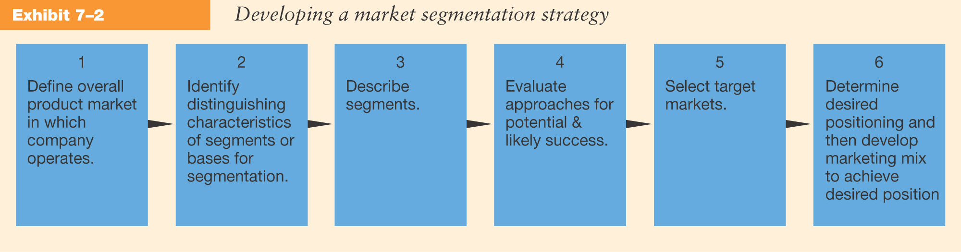
Stages in Developing Market Segmentation Strategies

Slide 13
Bases for Segmentation
Demographics
Geographic's
Psychographics & Lifestyles
Benefit Segmentation
Economic Segmentation
International Segmentation

Slide 14
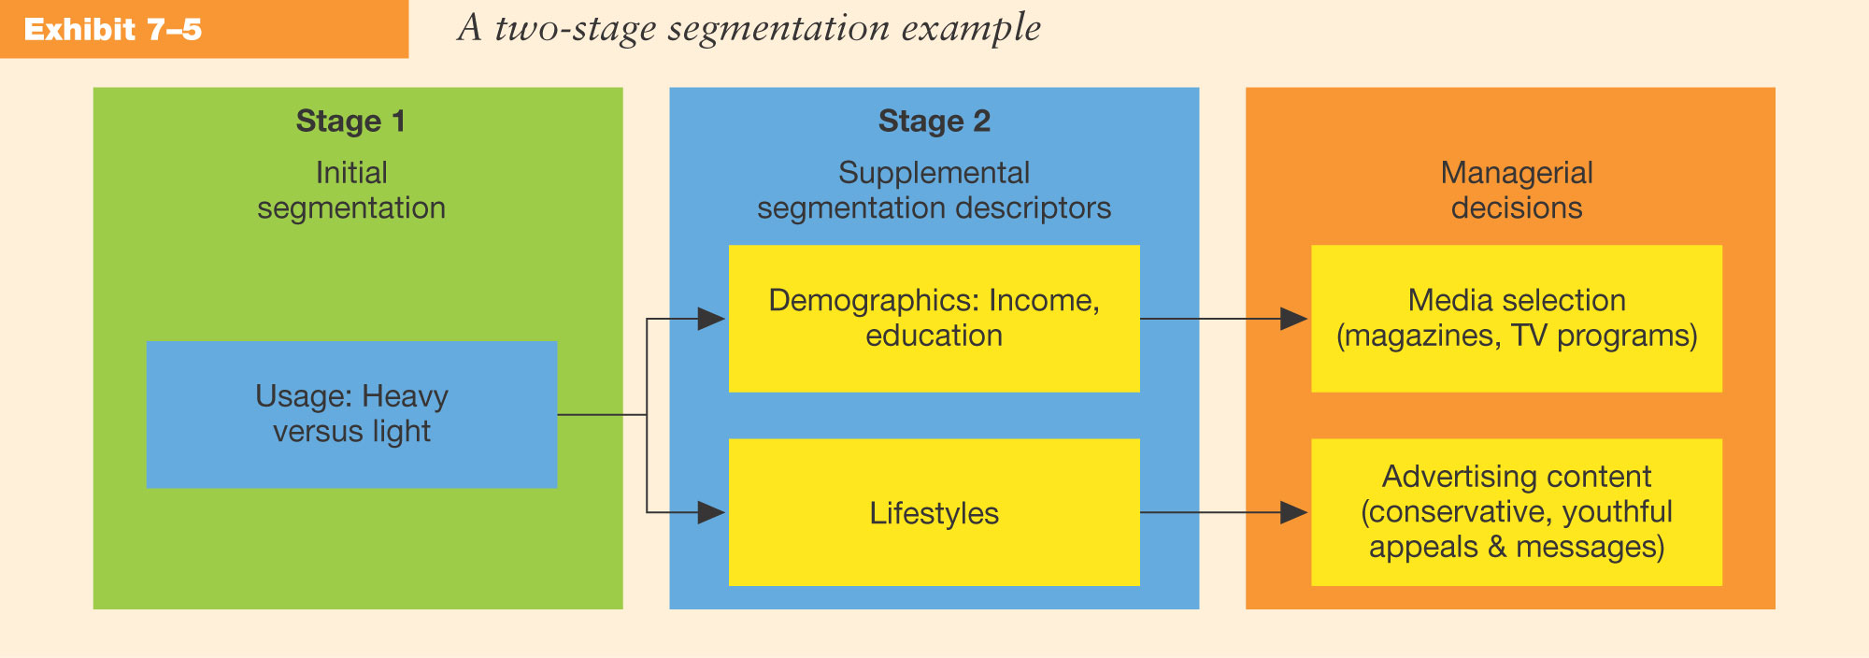
Combining Bases of Market Segmentation
www.midocean.ae

Slide 15
Segmentation Strategies
Undifferentiated Strategy
Differentiated Strategy
Concentrated Strategy

Slide 16
Factors Influencing Segmentation Strategy
Size and type of the market
Competitive factors
Product-related factors:
  Stage in the product life cycle.
  Degree to which the product may be varied or modified.
Firm’s size and financial position

Slide 17

Estimating Segment Potentials
Set time period of interest.
Define product level.
Specify segment characteristics or bases.
Identify geographic market boundaries.

Slide 18
Estimating Segment Potentials.. CONT
Make assumptions about the marketing environment.
Make assumptions about company’s own marketing efforts and programs (controllable factors).
Make estimates of market potential, industry sales, and company sales.

Slide 19
Developing Forecasts
Qualitative Procedures:
  Survey of Buyers’ Intentions
  Expert Opinion
  Composite of Salesforce Estimates
Quantitative Methods:
  Trend Analysis
  Market Tests
  Statistical Demand Analysis

Slide 20
Targeting Market Segments
To select target segments, the firm must consider:
  The segment’s potential sales volume and profits.
  Competition currently selling to the segments.
  The firm’s abilities and objectives.

Slide 21
Micromarketing
Micromarketing
  Combines census and
  Demographic data to identify
  clusters of households
  that share similar
  consumption patterns.

Slide 22
Micromarketing
Enhances the effectiveness of marketing efforts by:
  Identifying potential markets for direct selling through mail and telemarketing campaigns.
  Profiling customers by matching them to demographic and lifestyle clusters.
  Learning which areas offer the greatest potential in site selection for new stores or offices.
  Tailoring advertising themes and planning media.

Slide 23
Market Segmentation and Ethics
  Advertising to Children
  Harmful Products
  Privacy Issues
  Product Proliferation

Slide 24
Positioning for Competitive Advantage

Slide 25
What is Positioning?
A couple of definitions
Creating distinct and valued physical and perceptual differences between one’s product and its competitors, as perceived by the target customer.
The act of designing the firm’s market offering so that it occupies a distinct and valued place in the minds of its target customers.

Slide 26
Steps in Segmentation, Targeting, and Positioning
Target
6. Develop Marketing
Mix for Each Target Segment
Market
Positioning
5. Develop Positioning
for Each Target Segment
4. Select Target
Segment
Market
Targeting
3. Develop Measures
of Segment Attractiveness
2. Develop Profiles
of Resulting Segments
1. Identify Bases
for Segmenting the Market
Market Segmentation

Slide 27
Mass Marketing
Same product to all consumers
(no segmentation)
Segment Marketing
Different products to one or more segments
(some segmentation)
Mass Marketing
Same product to all consumers
(no segmentation)
Niche Marketing
Different products to subgroups within segments
( more segmentation)
Step 1. Market Segmentation
Levels of Market Segmentation
Micromarketing
Products to suit the tastes of individuals or locations
(complete segmentation)

Slide 28
Step 1. Market Segmentation
Bases for Segmenting Consumer Markets
Geographic
Nations, states,
regions or cities
Demographic
Age, gender, family size and life cycle, or income
Psychographic
Social class, lifestyle, or personality
Behavioral
Occasions, benefits, uses, or responses

Slide 29
Step 1. Market Segmentation
Bases for Segmenting Business Markets
Personal
Characteristics
Demographics
Personal
Characteristics
Bases
for Segmenting
Business
Markets
Bases
for Segmenting
Business
Markets
Situational
Factors
Operating
Characteristics
Operating
Characteristics
Purchasing
Approaches
Purchasing
Approaches

Slide 30
Step 1. Market Segmentation
Bases for Segmenting International Markets
Industrial Markets
Geographic
Economic
Political/
Legal
Cultural
Intermarket

Slide 31

Measurable
Step 1. Market Segmentation
Requirements for Effective Segmentation
Accessible
Substantial
Size, purchasing power, profiles
of segments can be measured.
Differential
Segments must be effectively
reached and served.
Actionable
Segments must be large or profitable enough to serve.
Segments must respond differently to different marketing mix elements & actions.
Must be able to attract and serve the segments.

Slide 32
Step 2. Market Targeting
Evaluating Market Segments
Segment Size and Growth
  Analyze sales, growth rates and expected profitability.
Segment Structural Attractiveness
  Consider effects of: Competitors, Availability of Substitute Products and, the Power of Buyers & Suppliers.
Company Objectives and Resources
  Company skills & resources relative to the segment(s).
  Look for Competitive Advantages.

Slide 33
Step 2. Market Targeting
Market Coverage Strategies
Company
Marketing
Mix
Market
Company
Marketing Mix 1
Segment 1
Company
Marketing Mix 2
A. Undifferentiated Marketing
Segment 2
Segment 3
Company
Marketing Mix 3
Segment 1
Company
Marketing
Mix
Segment 2
B. Differentiated Marketing
Segment 3
C. Concentrated Marketing
www.midocean.ae

Slide 34
Step 2. Market Targeting
Choosing a Market-Coverage Strategy
Company
Resources
Product
Variability
Product’s Stage
in the Product Life Cycle
Market
Variability
Competitors’
Marketing Strategies

Slide 35
Step 3. Positioning for Competitive Advantage
Product’s Position - the place the product occupies in consumers’ minds relative to competing products; i.e. Volvo positions on “safety”.
Marketers must:
  Plan positions to give products the greatest advantage
  Develop marketing mixes to create planned positions

Slide 36

Step 3. Positioning for Competitive Advantage: Strategies
Product
Class
Product
Attributes
Away from
Competitors
Benefits
Offered
G
Usage
Occasions
Against a
Competitor
H
C
A
E
D
Users
B
F

Slide 37

Steps to Choosing and Implementing a Positioning Strategy
Step 1. Identifying a set of possible competitive advantages: Competitive Differentiation.
Step 2. Selecting the right competitive advantage.
Step 3. Effectively communicating and delivering the chosen position to the market.

Slide 38
Product
Service
Areas for Competitive Differentiation
Developing Competitive Differentiation
Personnel
Image

Slide 39
Selecting the Right Competitive Advantages
Important
Profitable
Distinctive
Criteria
for
Determining
Which
Differences
to
Promote
Affordable
Superior
Preemptive
Communicable
www.midocean.ae

Slide 40
Operating Characteristics
Segmenting Business Markets
Purchasing Approaches
Business Marketers Use Many of the Same Consumer Variables, Plus:
Situational Factors
Personal Characteristics

Slide 41

Segmenting International Markets
Geographic
Location
Factors Used to Segment International Markets
Economic
Factors
Cultural
Factors
Political and Legal Factors
May Also Use Intermarket Segmentation

Slide 42

Thank You

