Slide 1

International Business Management
Prepared by Dr. Dr.Noha Adel
Lecture 4

Slide 2
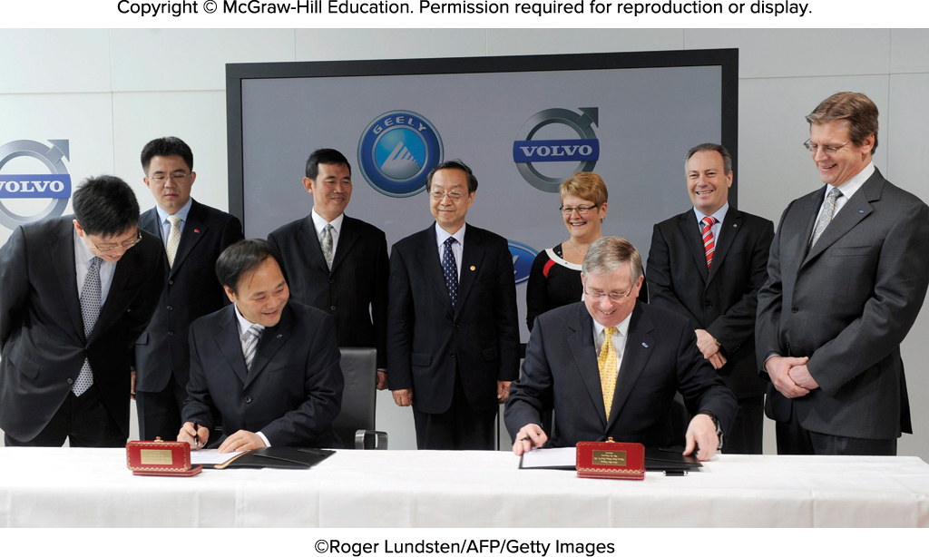
Chapter 4: Foreign Direct Investment
Source: ©Roger Lundsten/AFP/Getty Images

Slide 3
Learning Objectives
4-1 Recognize current trends regarding foreign direct investment (FDI) in the world economy.
4-2 Explain the different theories of FDI.
4-3 Understand how political ideology shapes a government’s attitudes toward FDI.
4-4 Describe the benefits and costs of FDI to home and host countries.
4-5 Explain the range of policy instruments that governments use to influence FDI.
4-6 Identify the implications for managers of the theory and government policies associated with FDI.

Slide 4
Opening Case:
Geely Goes Global
Geely, a Chinese auto manufacturer founded by Li Shufu in 1986, began as a manufacturer of refrigerators
Quickly became second largest automobile manufacturer in China
Li’s personal favorite car maker was Volvo and he bought it in 2009
  Gained brand name, engineering and design skills
China has emerged as a major market for Volvo
Geely pledged to produce a “death-proof” car by 2020
Following its success with Volvo, Geely now making foreign investments in British, Malaysian, and Swedish automobile industries

Slide 5
Introduction
Foreign direct investment (FDI): a firm invests directly in new facilities to produce or market in a foreign country
  According to U.S. Department of Commerce, FDI occurs when there is a 10 percent interest taken in a foreign business entity
  A firm engaged in FDI is a multinational enterprise

Slide 6
Foreign Direct Investment in the World Economy 1
Flow of FDI: the amount of FDI undertaken over a given time period
Stock of FDI: the total accumulated value of foreign-owned assets at a given time
Outflows of FDI: the flows of FDI out of a country
Inflows of FDI: the flows of FDI into a country
Notes:
LO 8-1 Recognize current trends regarding foreign direct investment (FDI) in the world economy.

Slide 7
Foreign Direct Investment in the World Economy 2
Trends in FDI
  Both the flow and stock of FDI in the world economy have increased over the last 25 years
  FDI flow has grown more rapidly than world trade and world output
    Firms still fear protectionist policies
    The shift toward democratic political institutions and free market economies encourages FDI
    Globalization is prompting firms to ensure they have a significant presence in many regions of the world

Slide 8
Foreign Direct Investment in the World Economy 3
The Direction of FDI
  Historically, most FDI has been directed at the developed nations of the world
    United States and European Union are favorite targets
  More recently, developing nations have been the recipients of FDI
    South, East, and Southeast Asia — particularly China — have received significant inflows
    Latin America is also emerging as an important region for FDI
    China is becoming a major investor in Africa especially in the extraction industries

Slide 9
Foreign Direct Investment in the World Economy 4
The Source of FDI
  Since World War II, the U.S. has been the largest source country for FDI
  Other important source countries: the United Kingdom, the Netherlands, France, Germany, and Japan
  Chinese firms recently emerging as major foreign investors
Notes:
The largest source countries—the United States, United Kingdom, Japan, France, Germany, and the Netherlands—also predominate in rankings of the world’s largest multinationals.

Slide 10
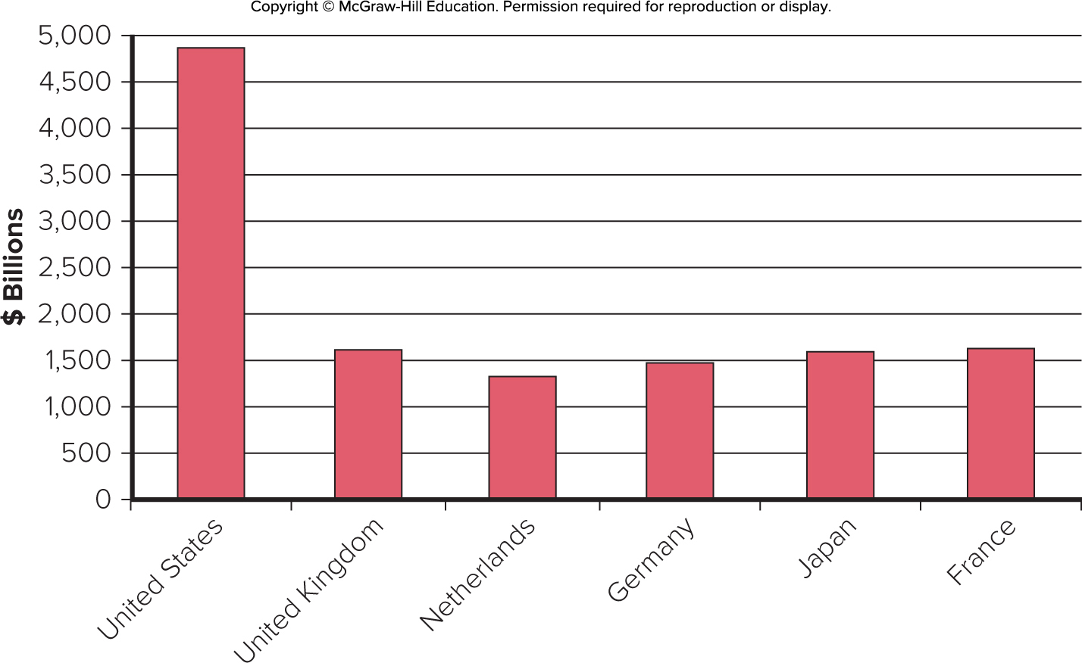
Figure 4.3 Cumulative FDI Outflows, 1998 to 2017 ($ billions)
Access the text alternative for these images.
Source: UNCTAD statistical data set, http://unctadstat.unctad.org

Slide 11
Foreign Direct Investment in the World Economy 5
The Form of FDI: Acquisitions versus Greenfield Investments
  Greenfield investments: establishing new operations in a foreign country
  Acquisitions are attractive because:
    They are quicker to execute than greenfield investments
    It is easier and less risky for a firm to acquire desired assets than build them from the ground up
    Firms believe they can increase the efficiency of an acquired unit by transferring capital, technology, or management skills

Slide 12
Theories of Foreign Direct Investment 1
Three complementary perspectives
  Why does a firm favor direct investment over exporting and licensing?
  Why do firms in same industry undertake foreign direct investment at the same time and favor certain locations as targets for FDI?
  Eclectic paradigm combines these two perspectives
Notes:
LO 8-2 Explain the different theories of FDI.

Slide 13
Theories of Foreign Direct Investment 2
Why Foreign Direct Investment?
  Exporting: producing goods at home and then shipping them to the receiving country for sale
  Licensing: granting a foreign entity the right to produce and sell the firm’s product in return for a royalty fee on every unit that the foreign entity sells

Slide 14
Theories of Foreign Direct Investment 3
Why Foreign Direct Investment? continued
  Limitations of Exporting
    An exporting strategy can be limited by transportation costs and trade barriers
    When transportation costs are high, exporting can be unprofitable
      Low value-to-weight ratio
    Foreign direct investment may be a response to actual or threatened trade barriers such as import tariffs or quotas

Slide 15
Theories of Foreign Direct Investment 4
Why Foreign Direct Investment? continued
  Limitations of Licensing
    Internalization theory (or market imperfections approach)
    Licensing could result in a firm’s giving away valuable technological know-how to a potential foreign competitor
    Licensing does not give a firm the tight control over manufacturing, marketing, and strategy in a foreign country that may be required to maximize its profitability
    Licensing may be difficult if the firm’s competitive advantage is not amenable to it
Notes:
All of this suggests that when one or more of the following conditions holds, markets fail as a mechanism for selling know-how and FDI is more profitable than licensing: (1) when the firm has valuable know-how that cannot be adequately protected by a licensing contract, (2) when the firm needs tight control over a foreign entity to maximize its market share and earnings in that country, and (3) when a firm’s skills and know-how are not amenable to licensing.

Slide 16
Theories of Foreign Direct Investment 5
Why Foreign Direct Investment? continued
  Advantages of Foreign Direct Investment
    FDI will be favored over exporting when:
      Transportation costs are high
      Trade barriers are high
    FDI will be favored over licensing when:
      The firm wants control over its technological know-how
      The firm wants control over its operations and business strategy
      The firm’s capabilities are not amenable to licensing

Slide 17
Theories of Foreign Direct Investment 6
The Pattern of Foreign Direct Investment
  Strategic Behavior
    Knickerbocker explored the relationship between FDI and rivalry in oligopolistic industries — industries composed of a limited number of large firms
      FDI flows reflect strategic rivalry between firms
    This theory can be extended to multipoint competition — when two or more enterprises encounter each other in different regional markets, national markets, or industries
      Firms will try to match each other’s moves in different markets to try to hold each other in check
Notes:
Although Knickerbocker’s theory and its extensions can help explain imitative FDI behavior by firms in oligopolistic industries, it does not explain why the first firm in an oligopoly decides to undertake FDI rather than to export or license. Internalization theory addresses this phenomenon.

Slide 18
Theories of Foreign Direct Investment 7
The Eclectic Paradigm
  Dunning’s eclectic paradigm: in addition to the various factors discussed earlier, two additional factors must be considered when explaining both the rationale for and the direction of foreign direct investment
    Location-specific advantages: arise from using resource endowments or assets that are tied to a particular location and that a firm finds valuable to combine with its own unique assets
    Externalities: knowledge spillovers that occur when companies in the same industry locate in the same area
Notes:
Dunning’s theory, therefore, seems to be a useful addition to those outlined previously because it helps explain how location factors affect the direction of FDI.

Slide 19

Location Factors and FDI
Silicon Valley, where Google is based, has long been known as the epicenter of the computer and semiconductor industry.
Source: ©Phillip Bond/Alamy Stock Photo

Slide 20
Political Ideology and Foreign Direct Investment 1
Ideology toward FDI has ranged from a radical stance that is hostile to all FDI to the noninterventionist principle of free market economies
  Between these two extremes is an approach that might be called pragmatic nationalism
Notes:
LO 8-3 Understand how political ideology shapes a government's attitudes toward FDI.

Slide 21
Political Ideology and Foreign Direct Investment 2
The Radical View
  MNE is an instrument of imperialist domination and a tool for exploiting host countries to the exclusive benefit of their capitalist-imperialist home countries
  The radical view has been in retreat since the 1990s due to:
    The collapse of communism in Eastern Europe
    The poor economic performance of those countries that embraced the policy
    The strong economic performance of developing countries that embraced capitalism
Notes:
The radical view traces its roots to Marxist political and economic theory.

Slide 22
Political Ideology and Foreign Direct Investment 3
The Free Market View
  International production should be distributed among countries according to the theory of comparative advantage
    Countries should specialize in the production of goods and services they can produce most efficiently
    FDI by the MNE increases the overall efficiency of the world economy
Notes:
The free market view traces its roots to classical economics and the trade theories of Adam Smith and David Ricardo.

Slide 23
Political Ideology and Foreign Direct Investment 4
Pragmatic Nationalism
  FDI has benefits and costs
    Benefits: inflows of capital, technology, skills, and jobs
    Costs: repatriation of profits to the home country and a negative balance of payments effect
  FDI should be allowed only if benefits outweigh the costs
  Tendency to aggressively court FDI believed to be in the national interest by offering subsidies

Slide 24
Political Ideology and Foreign Direct Investment 5
Shifting Ideology
  In recent years, there has been a strong shift toward the free market stance
    A surge in the volume of FDI worldwide
    An increase in the volume of FDI directed at countries that have recently liberalized their regimes
      China, India, Vietnam
    But, some countries are becoming more hostile to FDI
      Venezuela, Bolivia

Slide 25
Benefits and Costs of FDI 1
Host-Country Benefits
  Resource-Transfer Effects
    FDI can bring capital, technology, and management resources that would otherwise not be available
  Employment Effects
    FDI can bring jobs that would otherwise not be created there
    Opponents say not all “new jobs” represent net additions in employment
Notes:
LO 8-4 Describe the benefits and costs of FDI to home and host countries.
Foreign management skills acquired through FDI may also produce important benefits for the host country. Foreign managers trained in the latest management techniques can often help improve the efficiency of operations in the host country, whether those operations are acquired or greenfield developments.

Slide 26
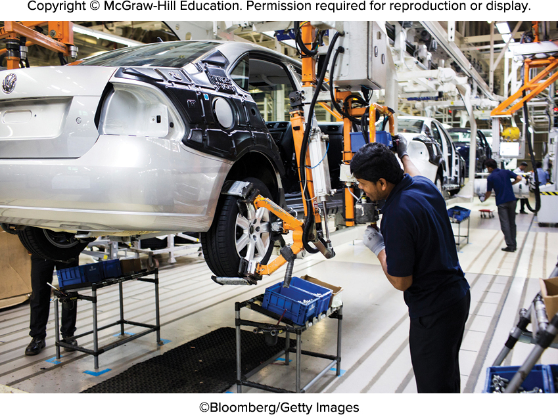
FDI and Job Creation
Job creation is a result of FDI. These workers assemble cars at a manufacturing plant in Chakan, Maharashtra, India.
Source: ©Bloomberg/Getty Images

Slide 27
Benefits and Costs of FDI 2
Host-Country Benefits continued
  Balance-of-Payments Effects
    The balance-of-payments account records a country’s payments to and receipts from other countries
    The current account records a country’s export and import of goods and services
    A surplus is usually favored over a deficit
    FDI can help achieve a current account surplus
      If it is a substitute for imports of goods and services
      If the MNE uses a foreign subsidiary to export goods and services to other countries

Slide 28
Benefits and Costs of FDI 3
Host-Country Benefits continued
  Effect on Competition and Economic Growth
    FDI in the form of greenfield investment
      Increases the level of competition in a market
      Drives down prices
      Improves the welfare of consumers
    Increased competition leads to:
      Increased productivity growth
      Product and process innovation
      Greater economic growth
Notes:
FDI’s impact on competition in domestic markets may be particularly important in the case of services, such as telecommunications, retailing, and many financial services, where exporting is often not an option because the service has to be produced where it is delivered.

Slide 29
Does Foreign Direct Investment Promote Growth?
There are multiple reasons for companies to make foreign direct investments. Lowering the cost of production, increasing capacity (volume) of production, and strategically locating production facilities to serve world regions are some of the many reasons for FDI by a company. For the host countries that receive the investment by multinational corporations, the logic is that the influx of capital and increase in tax revenues will benefit the host country in the form of new infrastructure, increased knowledge, and general economic development. However, the evidence so far is very mixed on the value of FDI to the host, ranging from beneficial to detrimental. What do you think? Does FDI promote growth in the host country?
Source: L. Alfaro, A. Chanda, S. Kalemli-Ozcan, and S. Sayek, Does Foreign Direct Investment Promote Growth? Exploring the Role of Financial Markets on Linkages (Cambridge, MA: Harvard Business School, 2009), www.people.hbs.edu/lalfaro/fdiandlinkages.pdf.

Slide 30
Benefits and Costs of FDI 4
Host-Country Costs
  Adverse Effects on Competition
    The subsidiaries of foreign MNEs may have greater economic power than indigenous competitors because they may be part of a larger international organization
      The MNE could draw on funds generated elsewhere to subsidize costs in the local market
      Doing so could allow the MNE to drive indigenous competitors out of the market and create a monopoly position
Notes:
In general, while FDI in the form of greenfield investments should increase competition, it is less clear that this is the case when the FDI takes the form of acquisition of an established enterprise in the host nation.

Slide 31
Benefits and Costs of FDI 5
Host-Country Costs continued
  Adverse Effects on the Balance of Payments
    Two possible adverse effects of FDI on a host country’s balance-of-payments:
      The capital outflows as foreign subsidiaries repatriate earnings to the parent country
      There is a debit on the current account of the host country’s balance of payments associated with imports of input products by the foreign subsidiary

Slide 32
Benefits and Costs of FDI 6
Host-Country Costs continued
  Possible Effects on National Sovereignty and Autonomy
    FDI can mean some loss of economic independence
    Key decisions that can affect the host country’s economy will be made by a foreign parent that has no real commitment to the host country, and over which the host country’s government has no real control
Notes:
Political scientist Robert Reich has noted that such concerns are the product of outmoded thinking because they fail to account for the growing interdependence of the world economy. In a world in which firms from all advanced nations are increasingly investing in each other’s markets, it is not possible for one country to hold another to “economic ransom” without hurting itself.

Slide 33
Benefits and Costs of FDI 7
Home-Country Benefits
  The effect on the capital account of the home country’s balance of payments from the inward flow of foreign earnings
  The employment effects that arise from outward FDI
  The gains from learning valuable skills from foreign markets that can subsequently be transferred back to the home country

Slide 34
Benefits and Costs of FDI 8
Home-Country Costs
  Balance-of-payments
    Suffers from the initial capital outflow required to finance the FDI
    Current account is negatively affected if the purpose of the FDI is to serve the home market from a low-cost production location
    Current account suffers if the FDI is a substitute for direct exports
  Employment effects of outward FDI
    If the home country is suffering from unemployment, there may be concern about the export of jobs

Slide 35
Benefits and Costs of FDI 9
International Trade Theory and FDI
  Home country concerns about the negative economic effects of offshore production — FDI undertaken to serve the home market — may not be valid
    FDI may actually stimulate economic growth by freeing home country resources to concentrate on activities where the home country has a comparative advantage
    Consumers may also benefit in the form of lower prices

Slide 36
Government Policy Instruments and FDI 1
Home-Country Policies
  Encouraging Outward FDI
    Have government-backed insurance programs to cover major types of foreign investment risk
    Have special funds or banks that make governmental loans to firms investing in developing countries
    Have eliminated double taxation of foreign income
    Many host nations have relaxed restrictions on inbound FDI
Notes:
LO 8-5 Explain the range of policy instruments that governments use to influence FDI.

Slide 37
Government Policy Instruments and FDI 2
Home-Country Policies continued
  Restricting Outward FDI
    Virtually all investor countries, including United States, have exercised some control over outward FDI from time to time
    Countries manipulate tax rules to make it more favorable for firms to invest at home
    Countries may restrict firms from investing in certain nations for political reasons

Slide 38
Government Policy Instruments and FDI 3
Host-Country Policies
  Encouraging Inward FDI
    Governments offer incentives to foreign firms to invest in their countries
      Gain from the resource-transfer and employment effects of FDI
      Capture FDI away from other potential host countries

Slide 39
Government Policy Instruments and FDI 4
Host-Country Policies continued
  Restricting Inward FDI
    Ownership restraints:
      Exclude foreign firms from certain sectors on the grounds of national security or competition
      Local owners can help maximize the resource-transfer and employment benefits of FDI
    Performance requirements:
      Used to maximize the benefits and minimize the costs of FDI for the host country

Slide 40
Government Policy Instruments and FDI 5
International Institutions and the Liberalization of FDI
  Until recently, there has been no consistent involvement by multinational institutions in the governing of FDI
  The formation of the World Trade Organization in 1995 changed this
    The WTO has had some success in establishing a universal set of rules to promote the liberalization of FDI

Slide 41
Focus on Managerial Implications 1
FDI and Government Policy
The Theory of FDI
  The location-specific advantages argument associated with Dunning help explain the direction of FDI
  However, internalization theory is needed to explain why firms prefer FDI to licensing or exporting
Notes:
LO 8-6 Identify the implications for managers of the theory and government policies associated with FDI.

Slide 42
Focus on Managerial Implications 2
The Theory of FDI continued
Exporting is preferable to licensing and FDI as long as transportation costs and trade barriers are low
Licensing is unattractive when:
  The firm’s proprietary property cannot be properly protected by a licensing agreement
  The firm needs tight control over a foreign entity in order to maximize its market share and earnings in that country
  The firm’s skills and capabilities are not amenable to licensing
Notes:
Finally, it should be noted that the product life-cycle theory and Knickerbocker’s theory of FDI tend to be less useful from a business perspective. The problem with these two theories is that they are descriptive rather than analytical. They do a good job of describing the historical evolution of FDI, but they do a relatively poor job of identifying the factors that influence the relative profitability of FDI, licensing, and exporting. Indeed, the issue of licensing as an alternative to FDI is ignored by both these theories.

Slide 43
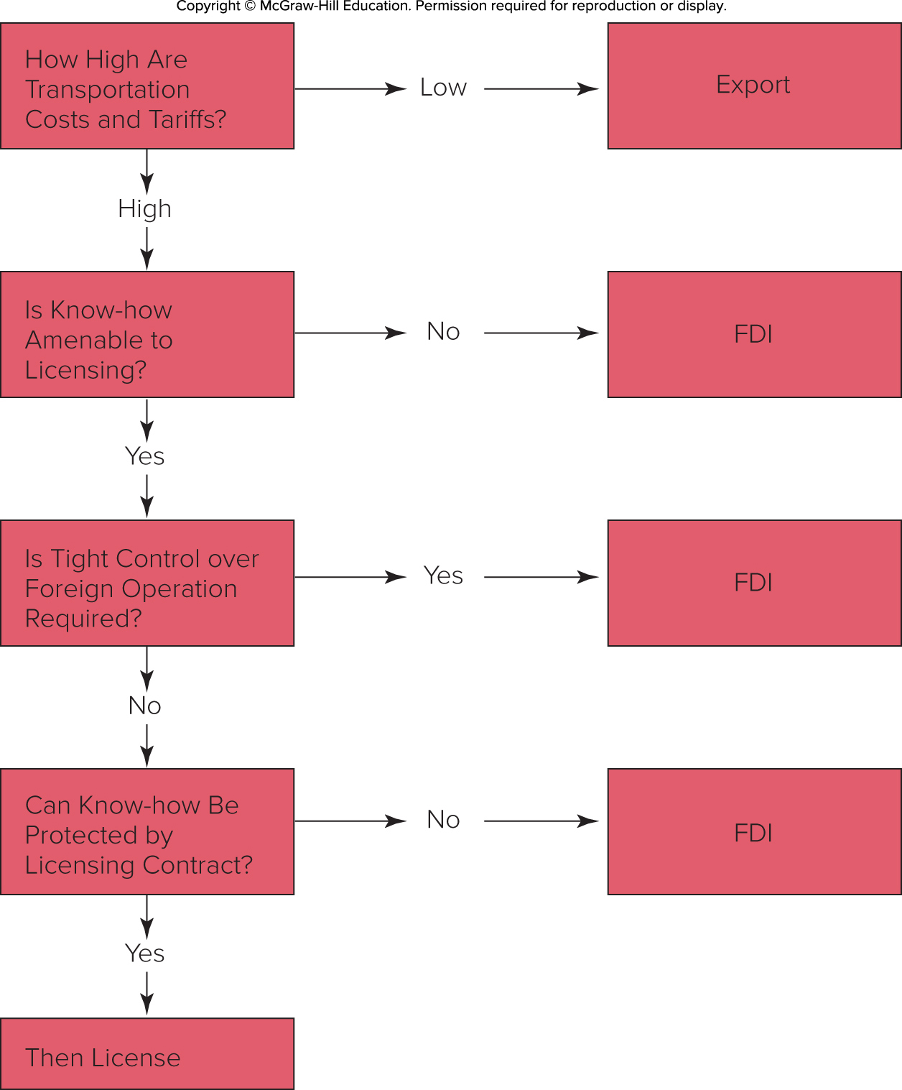
Figure 8.4
A Decision Framework
Access the text alternative for these images.

Slide 44
Thank you

