Slide 1


Slide 2


Slide 3

classification

Slide 4
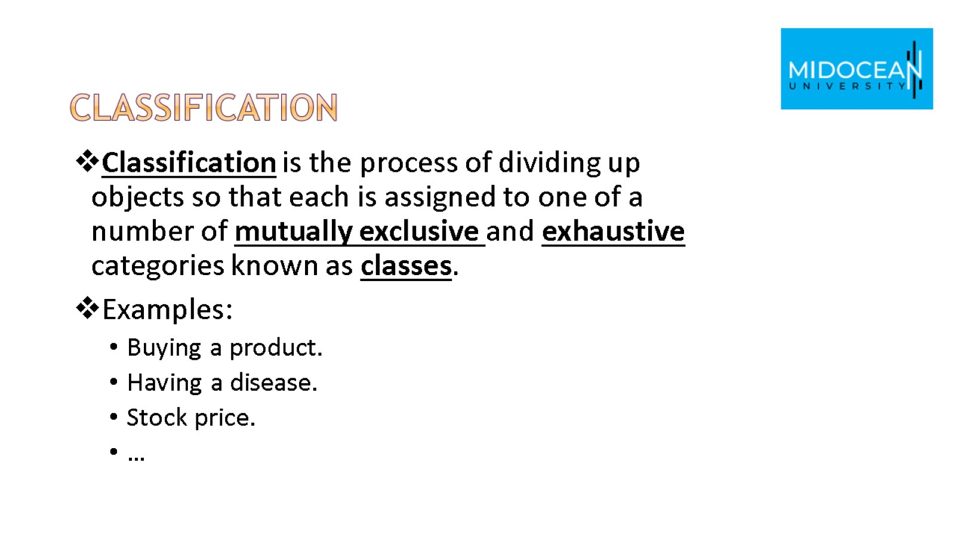
classification

Slide 5
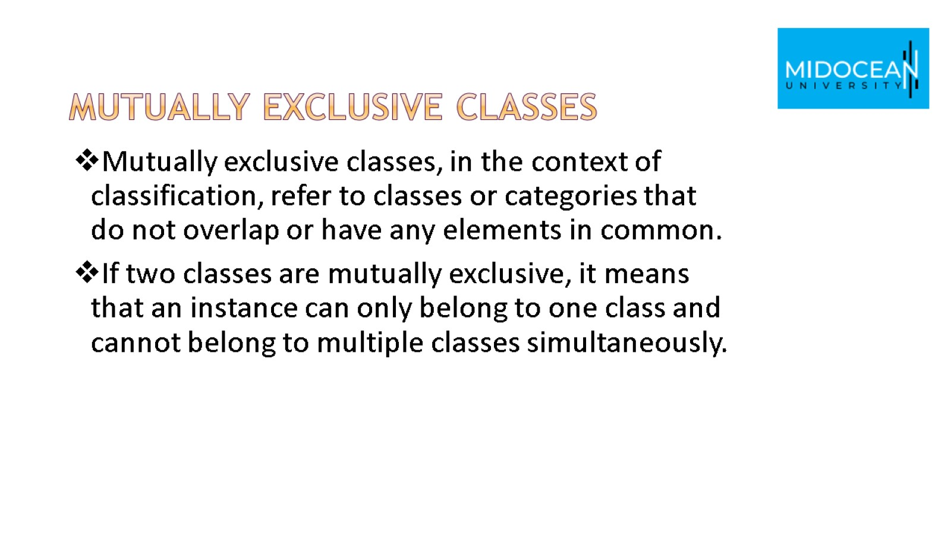
Mutually exclusive classes

Slide 6
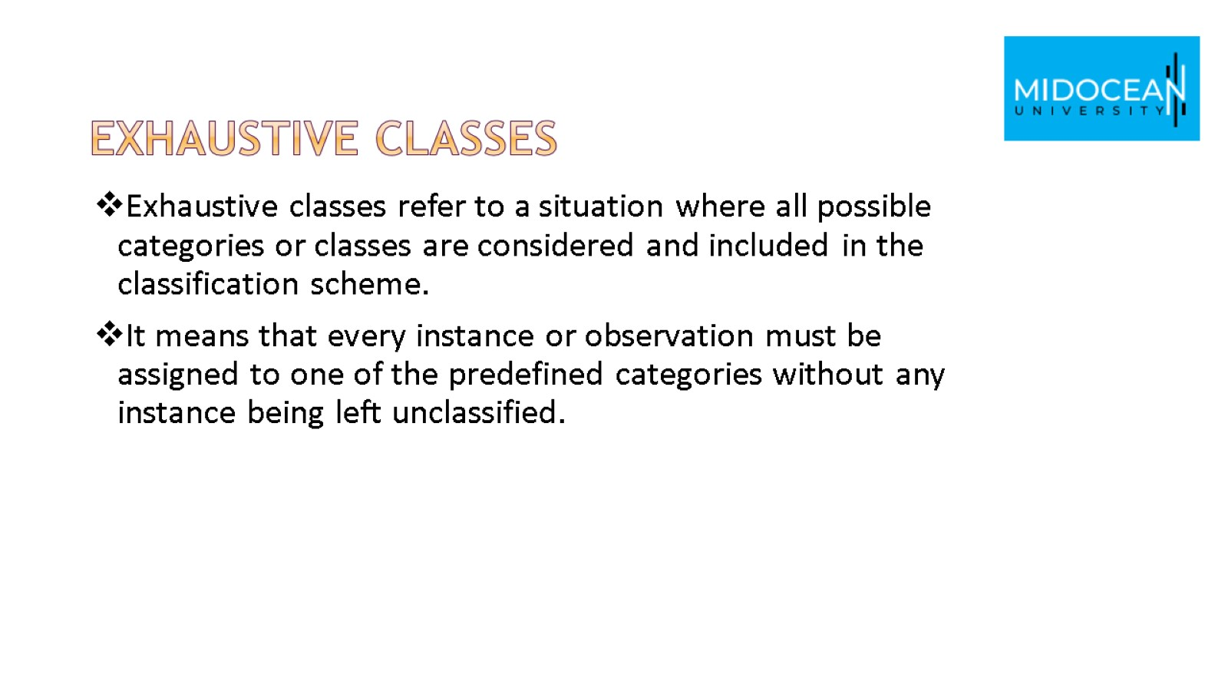
Exhaustive classes

Slide 7

naïve Bayes Classifiers

Slide 8
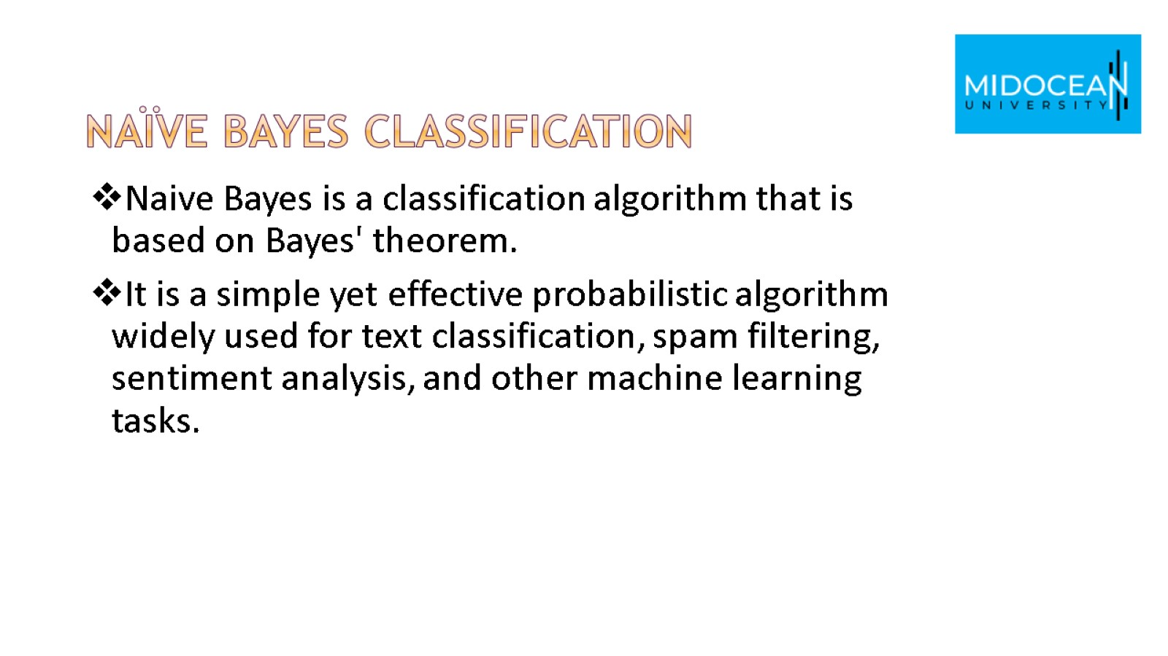
Naïve bayes classification

Slide 9
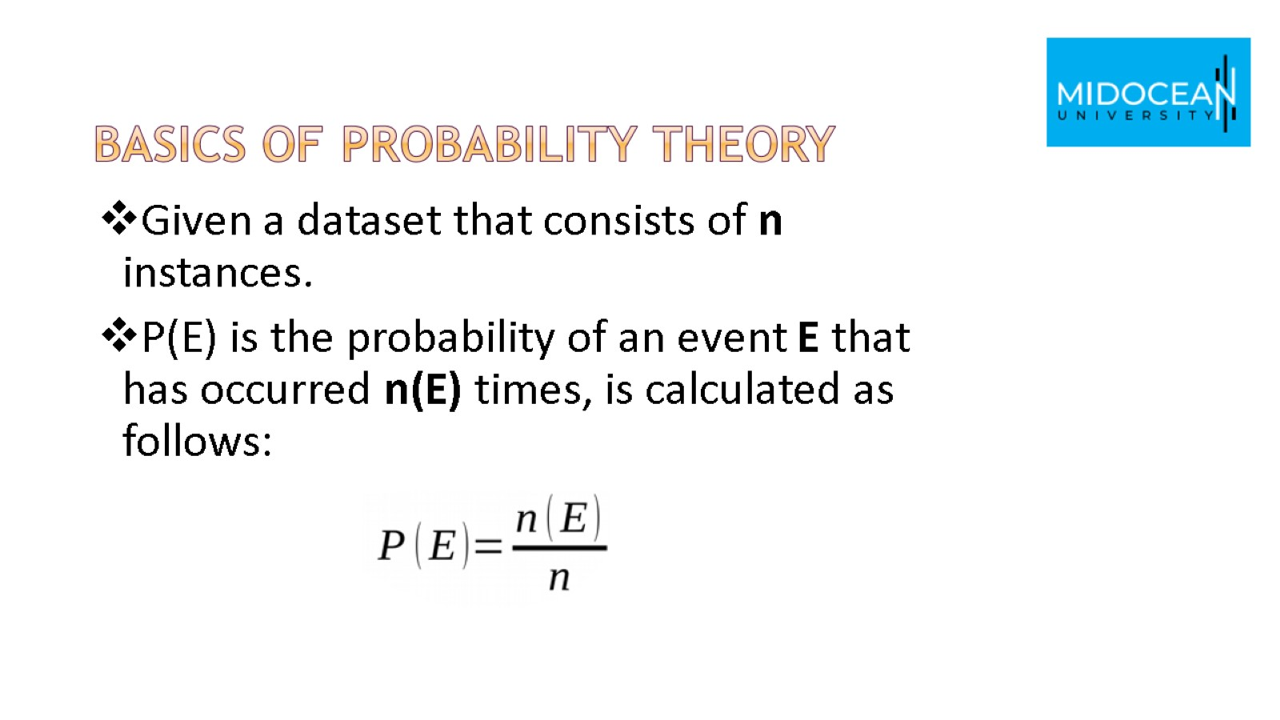
Basics of Probability theory

Slide 10
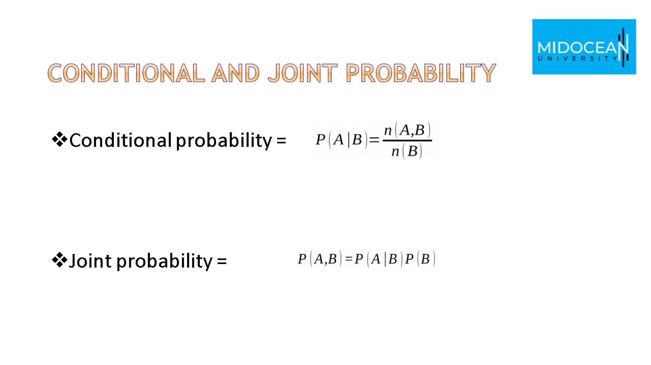
Conditional and joint probability

Slide 11
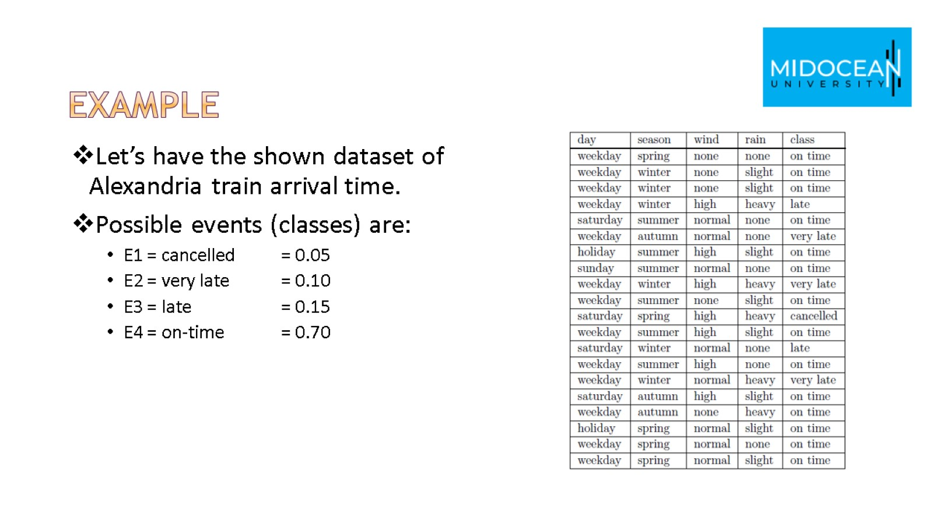
Example

Slide 12
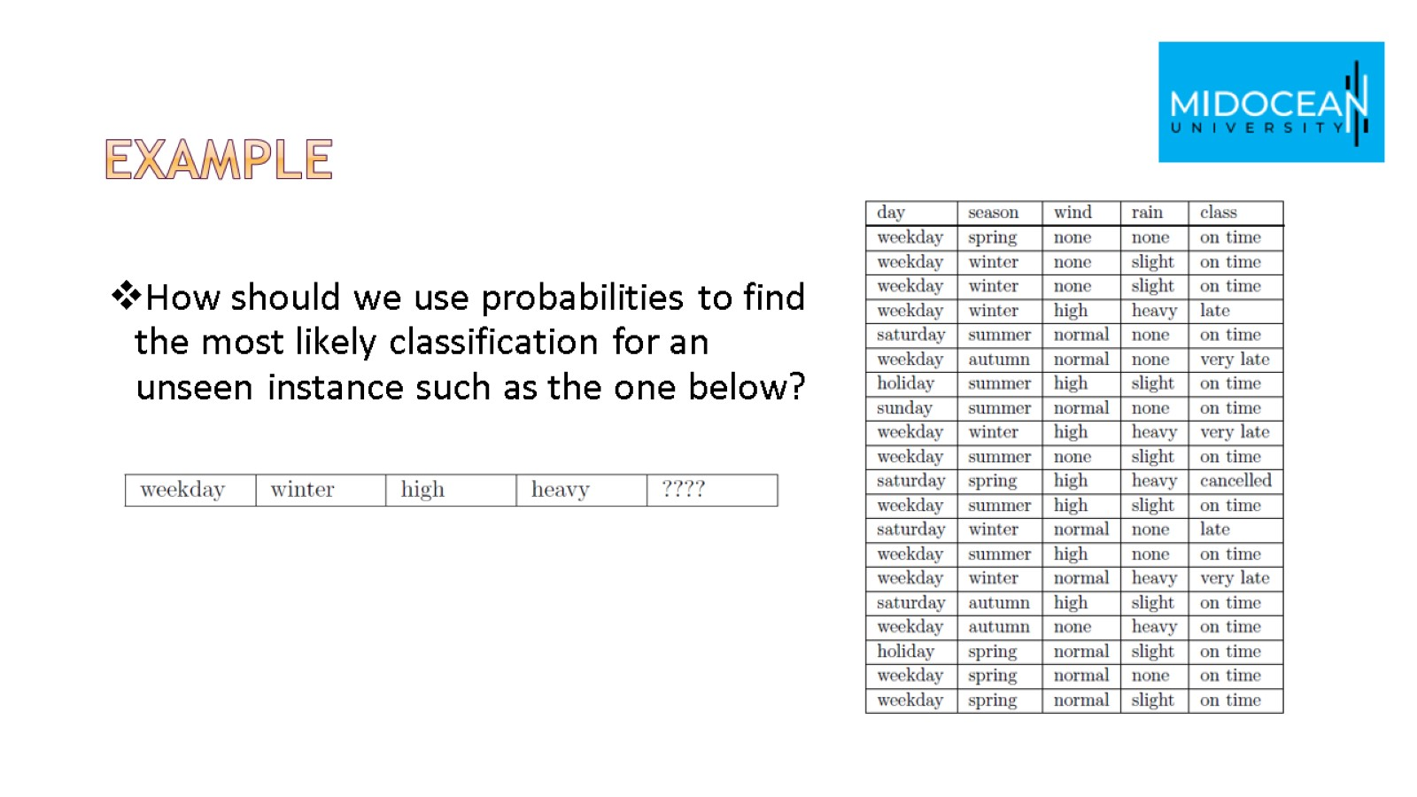
Example

Slide 13
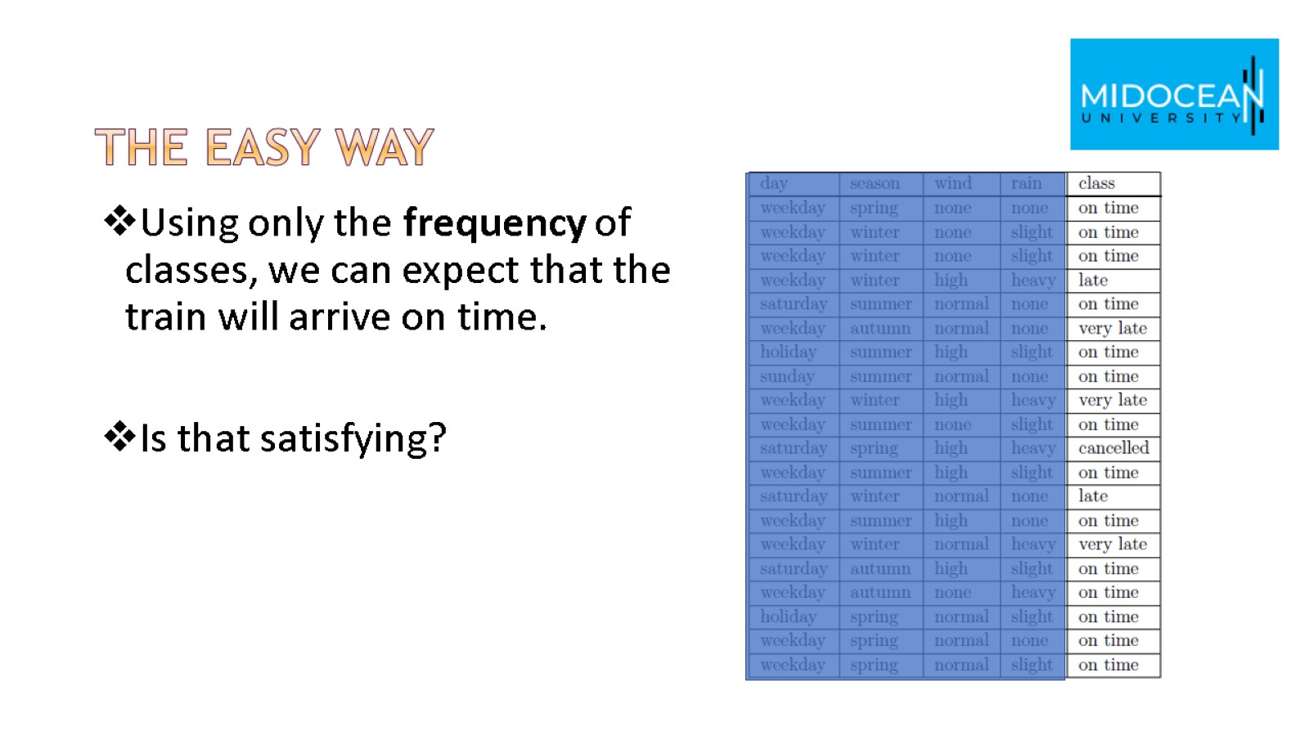
The easy way

Slide 14
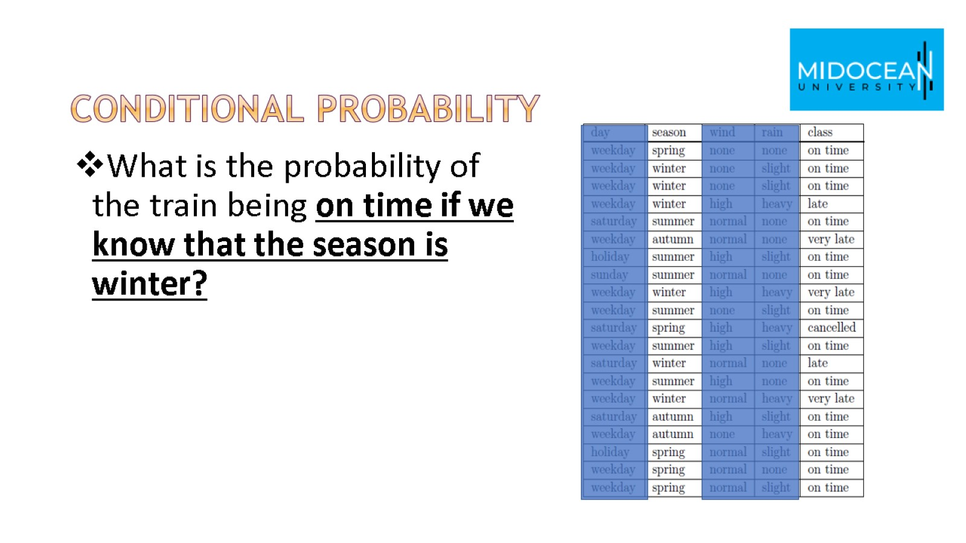
conditional probability

Slide 15
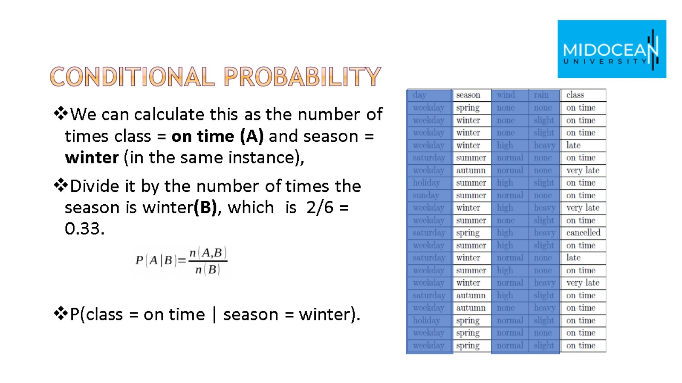
conditional probability

Slide 16
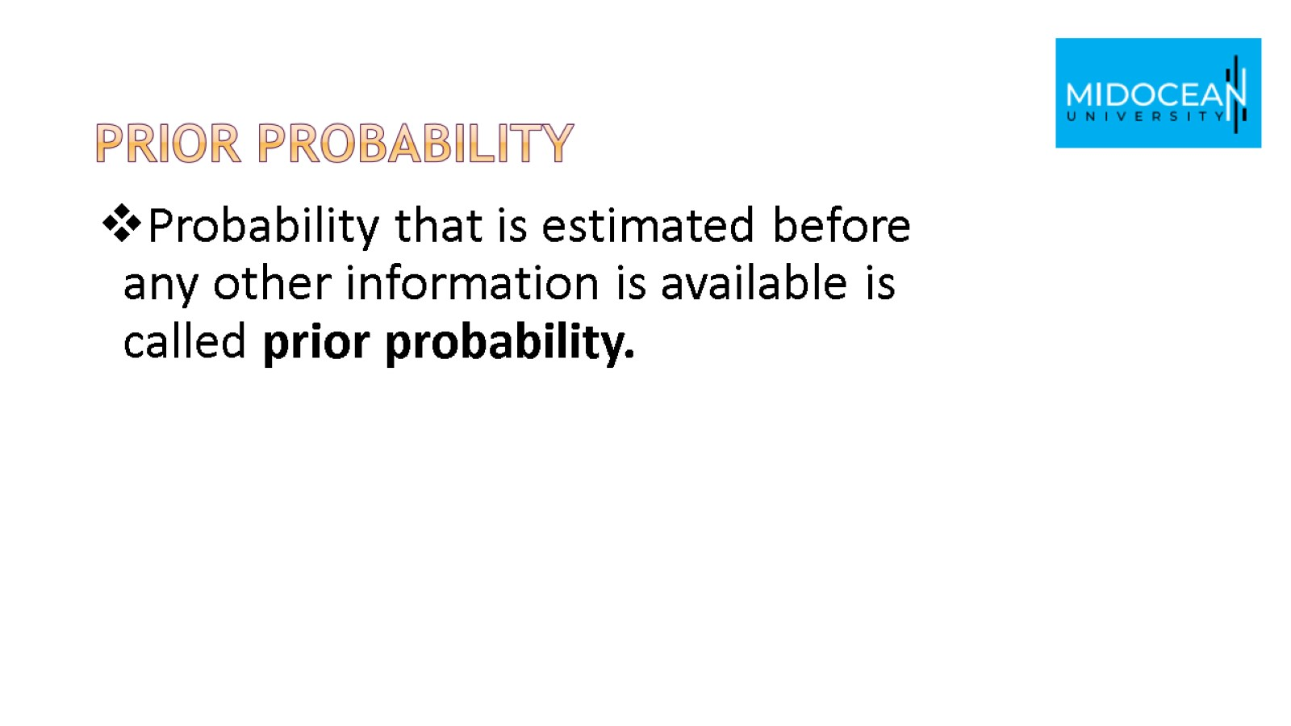
prior probability

Slide 17
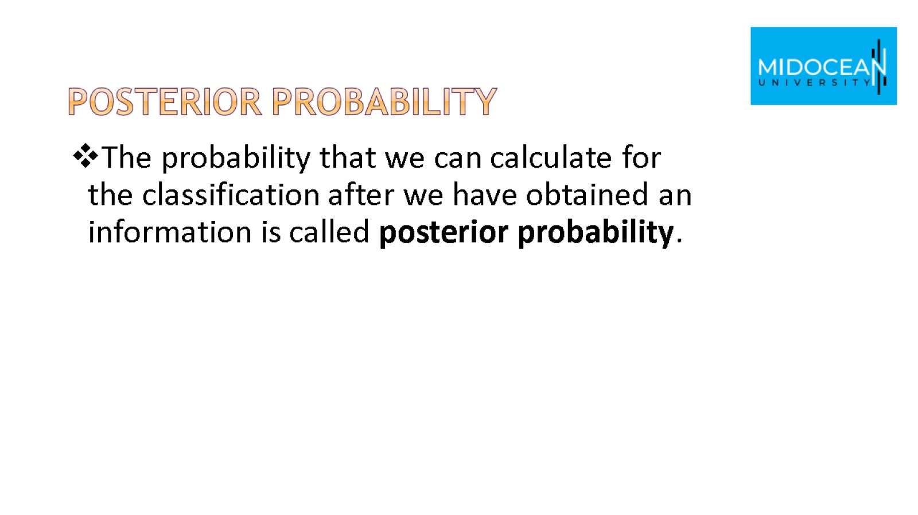
Posterior probability

Slide 18
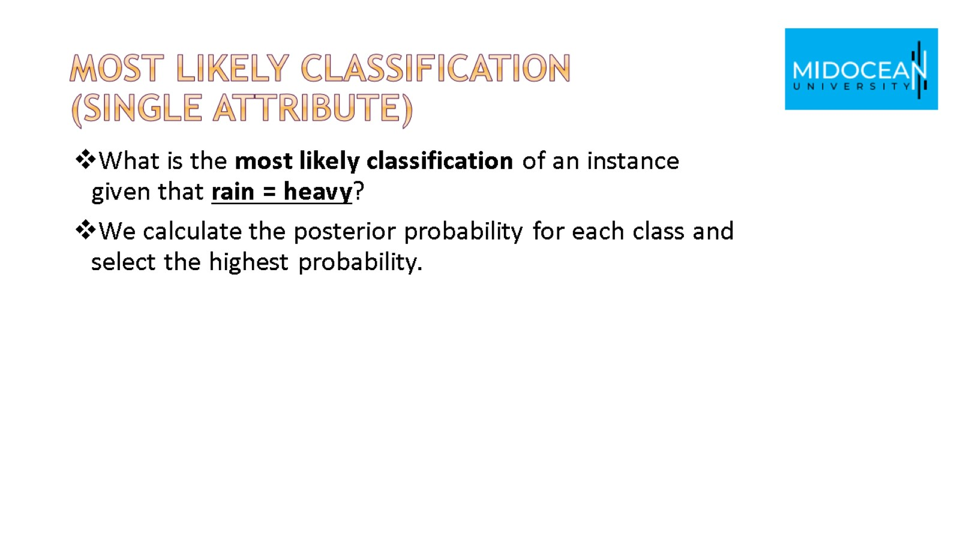
Most Likely classification
(single attribute)

Slide 19
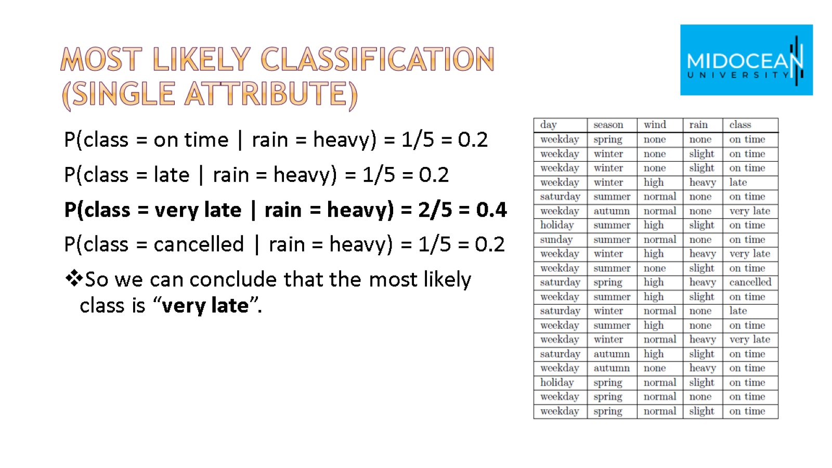
Most Likely classification
(single attribute)

Slide 20
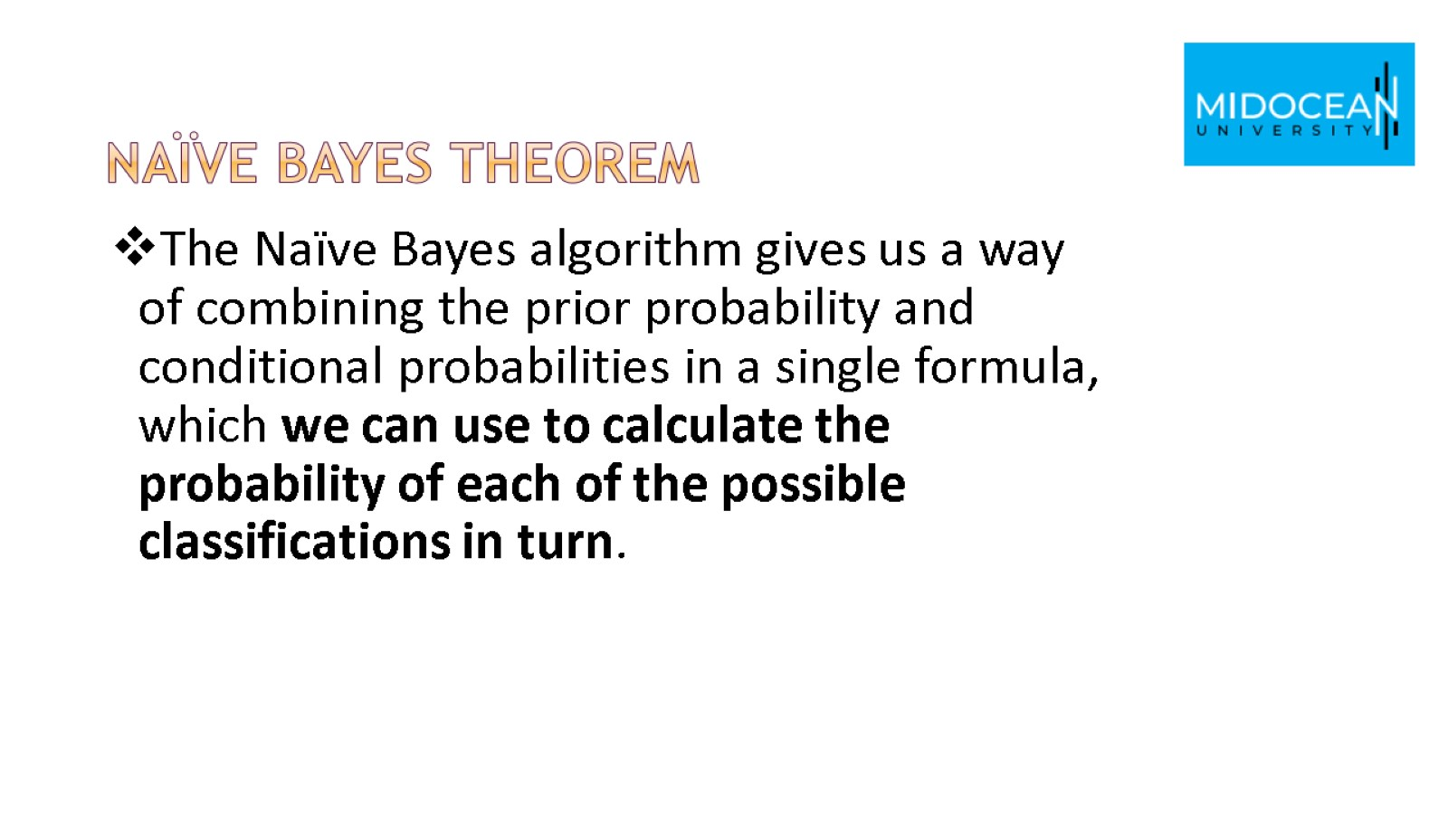
Naïve Bayes theorem

Slide 21
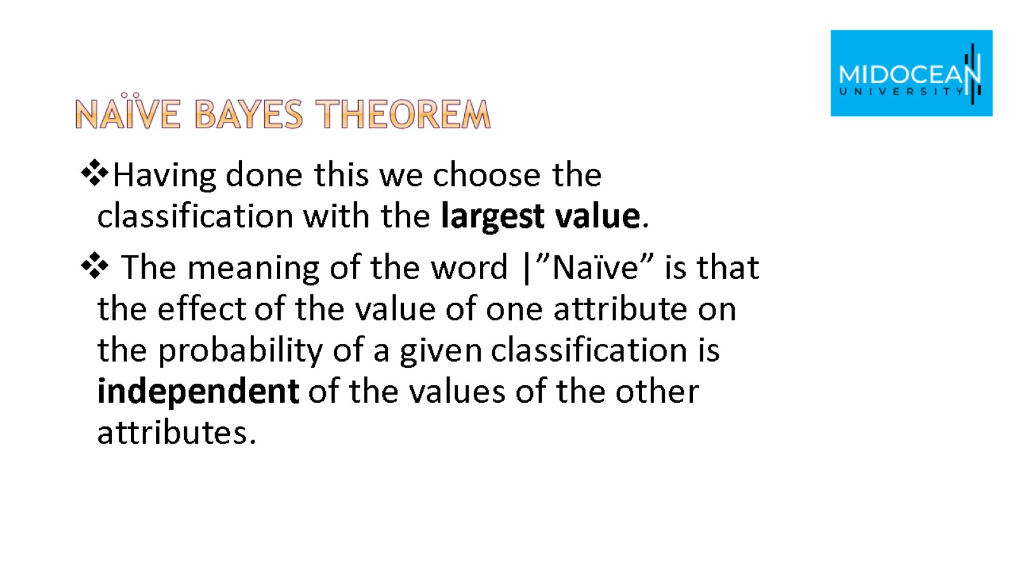
Naïve Bayes theorem

Slide 22
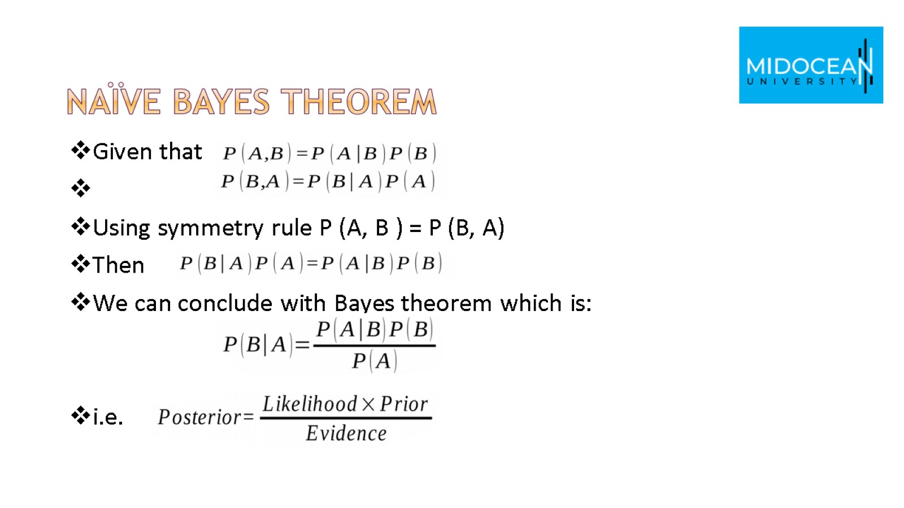
Naïve Bayes theorem

Slide 23
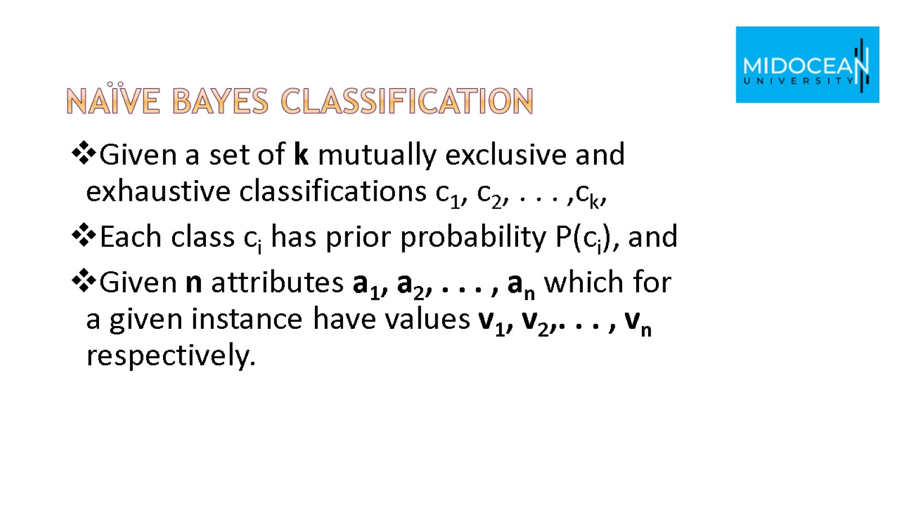
Naïve Bayes Classification

Slide 24
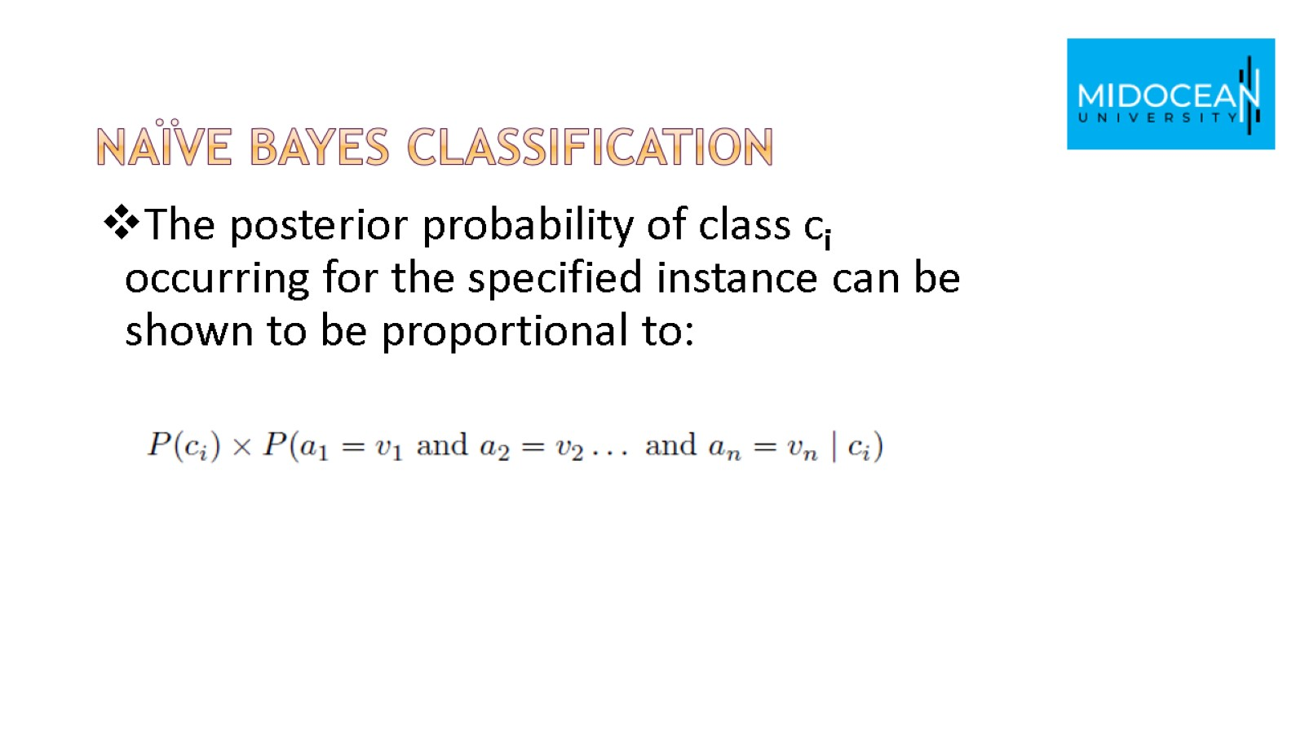
Naïve Bayes Classification

Slide 25
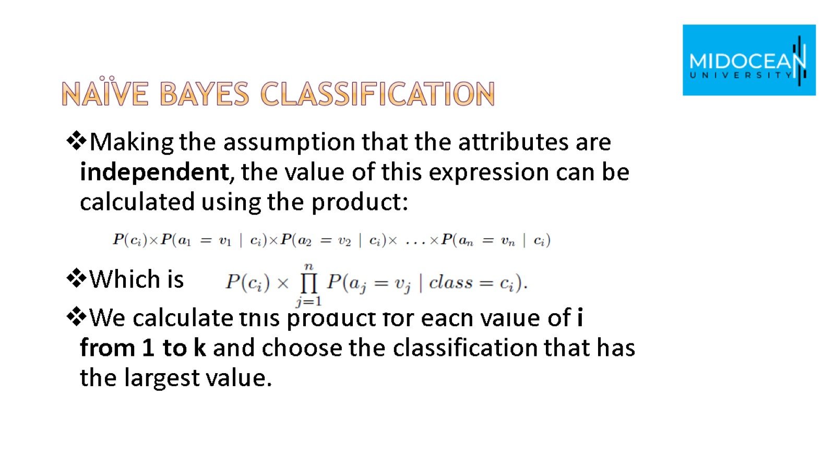
Naïve Bayes Classification

Slide 26
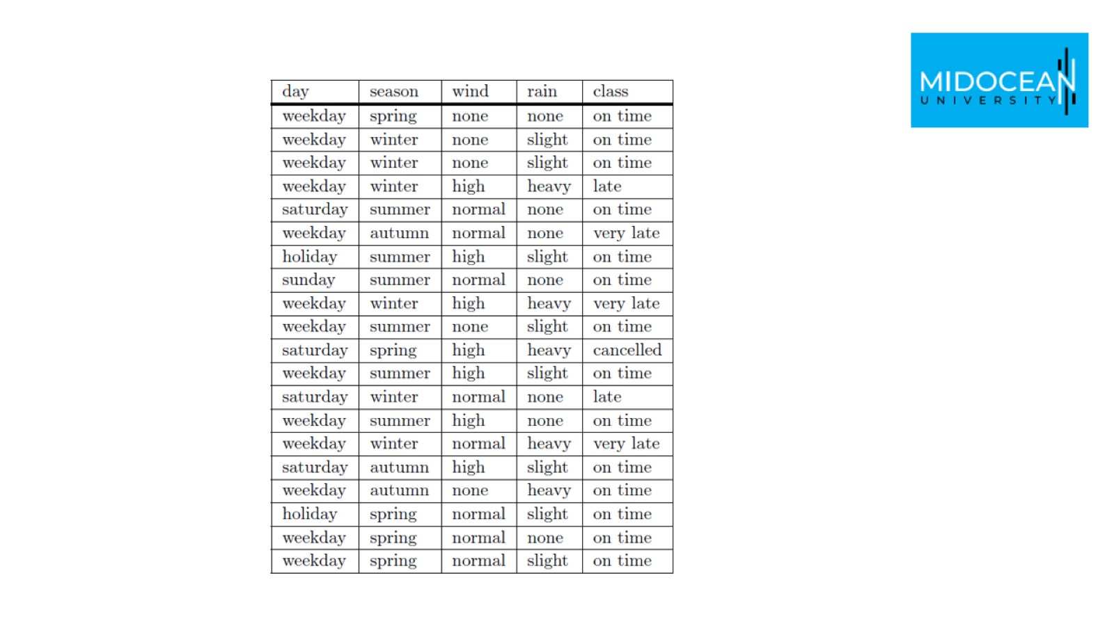

Slide 27
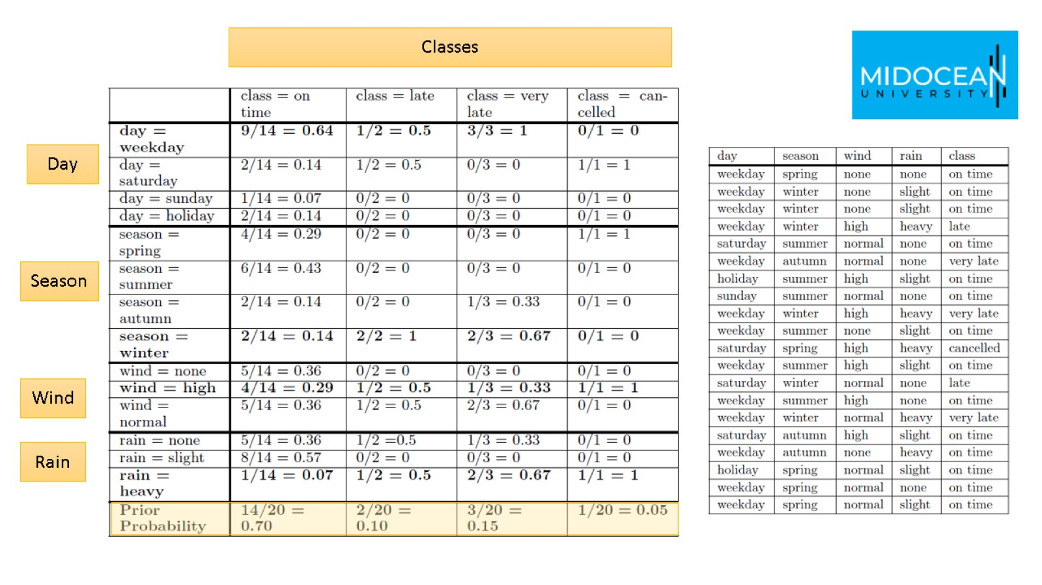

Slide 28
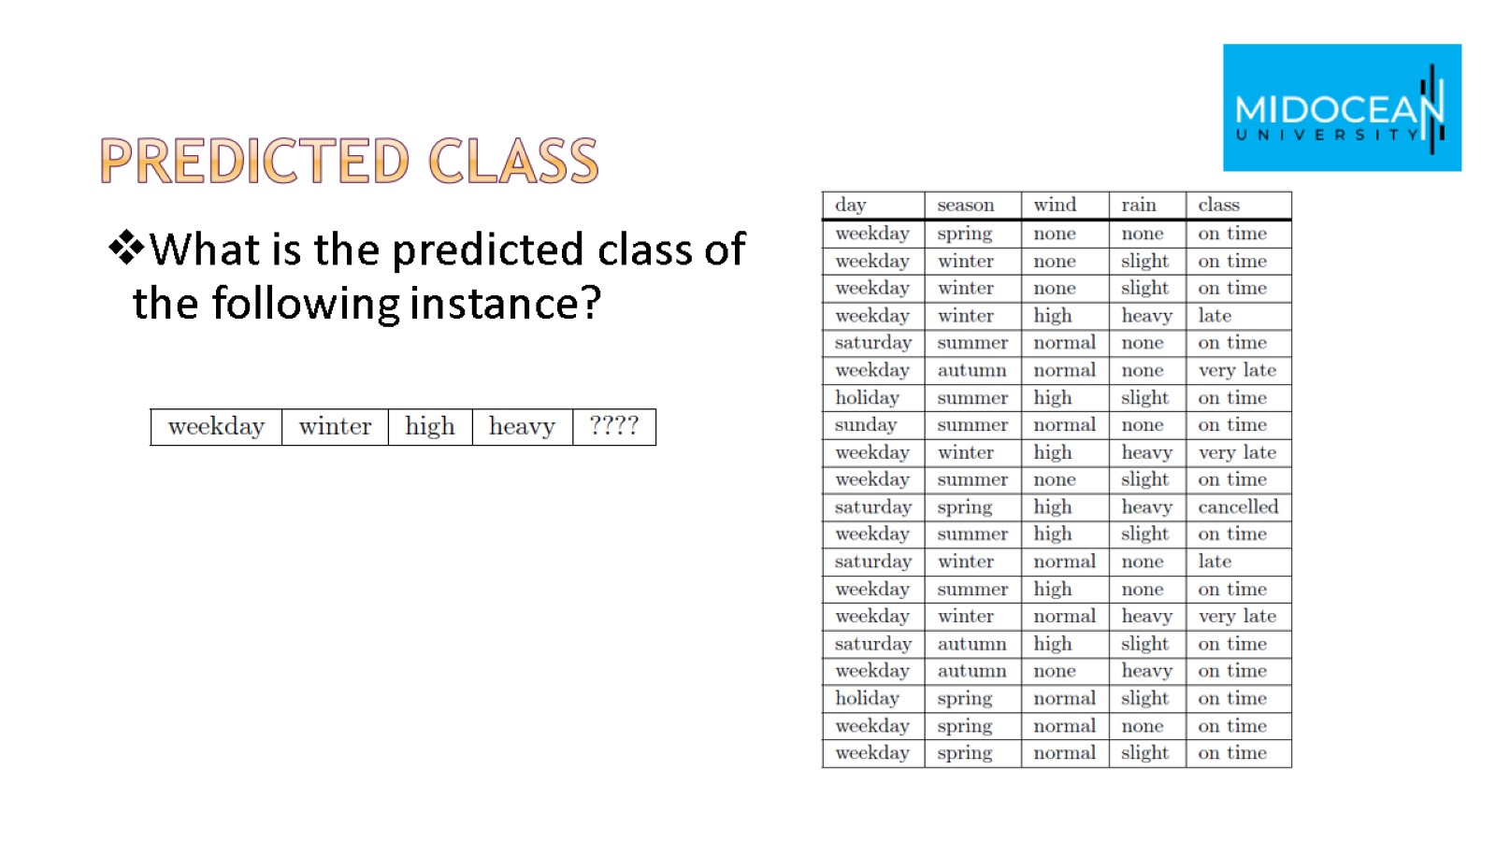
predicted class

Slide 29
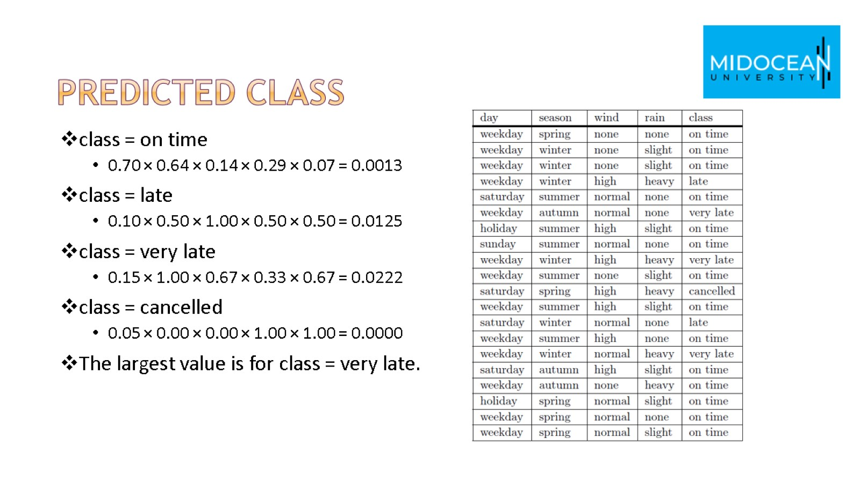
predicted class

Slide 30

Measuring accuracy

Slide 31
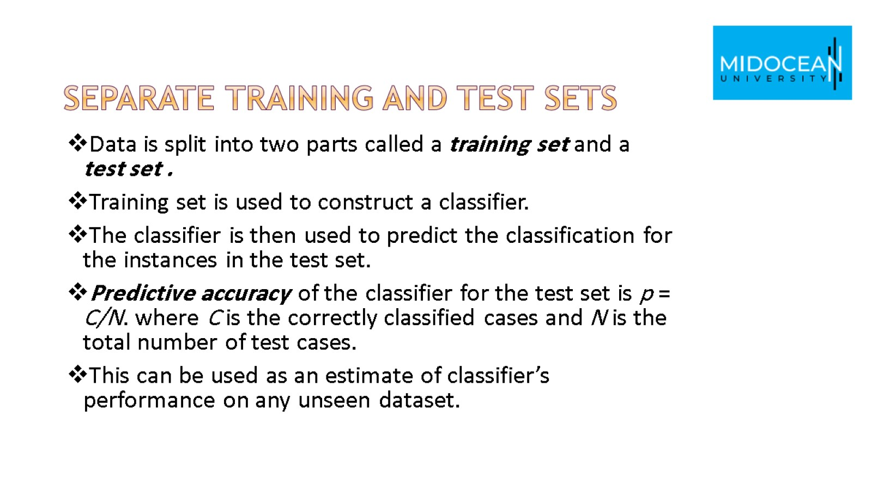
Separate Training and Test Sets

Slide 32
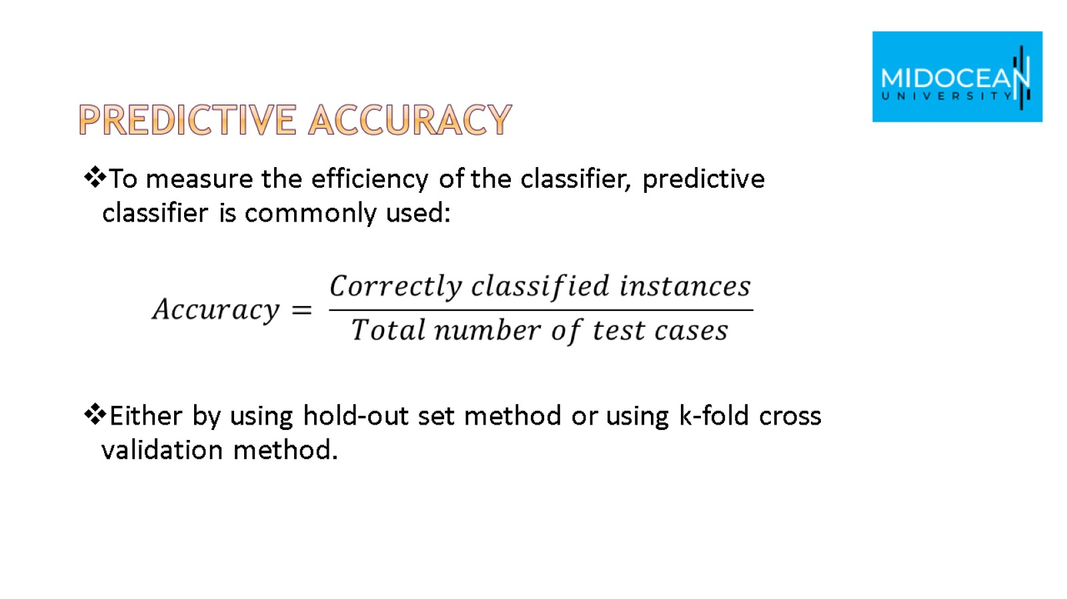
Predictive Accuracy

Slide 33
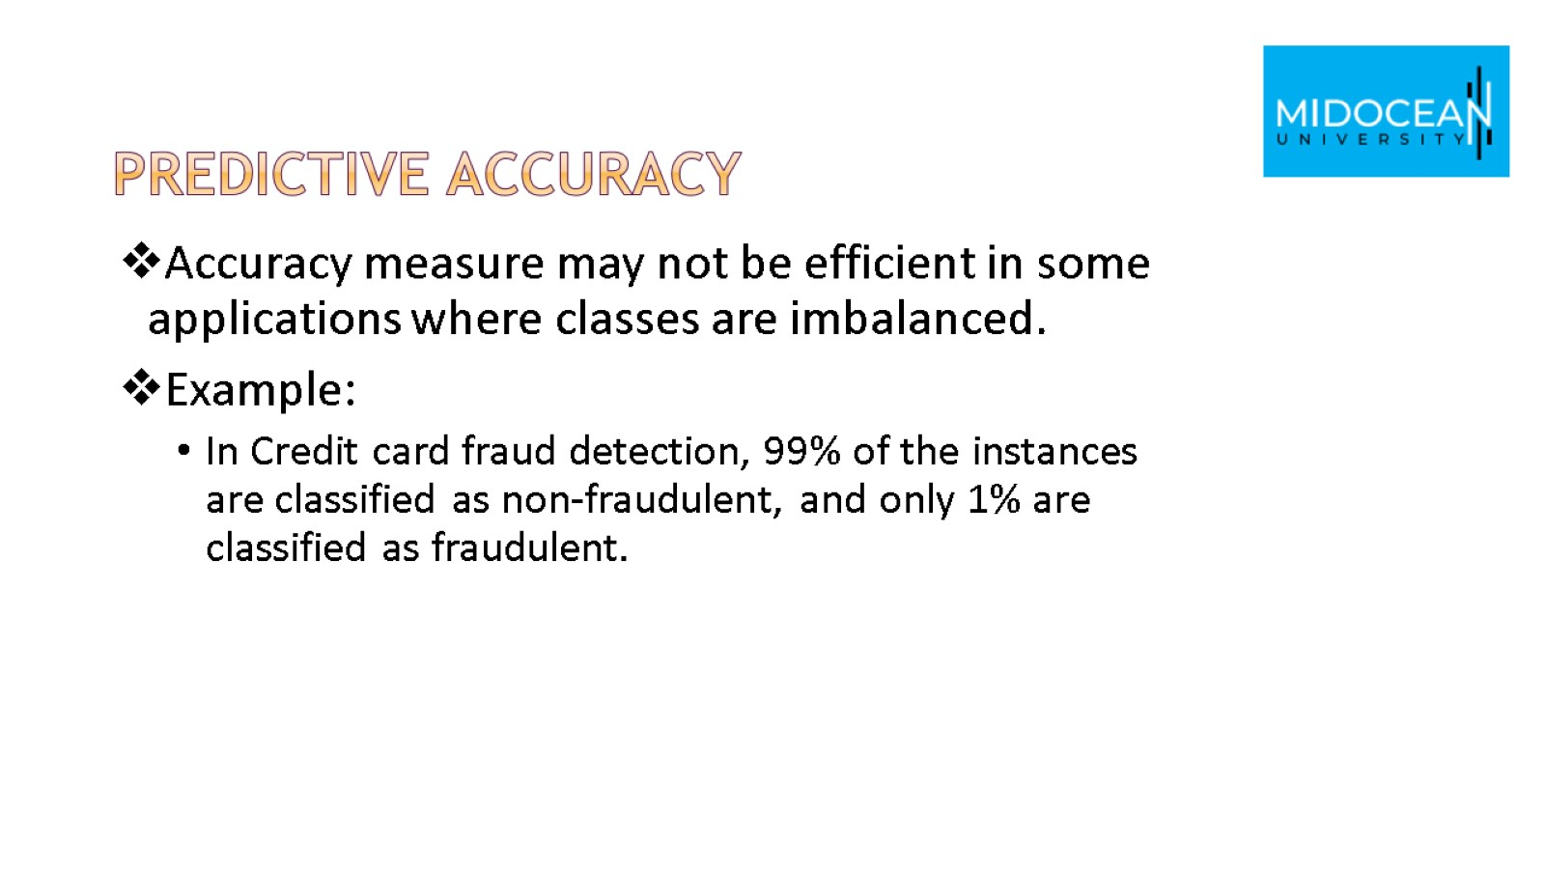
Predictive Accuracy

Slide 34
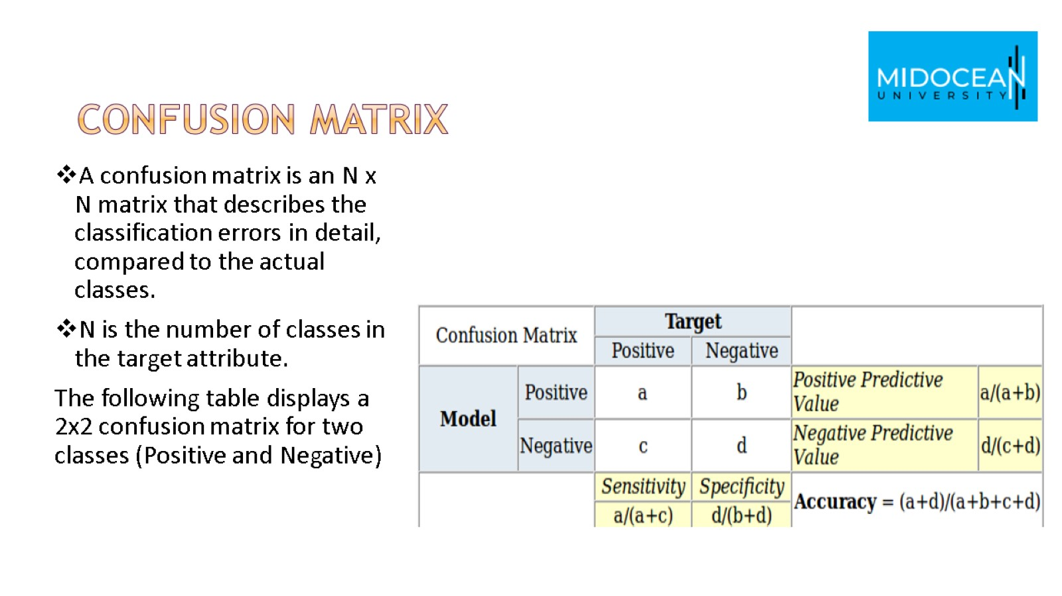
Confusion matrix

Slide 35
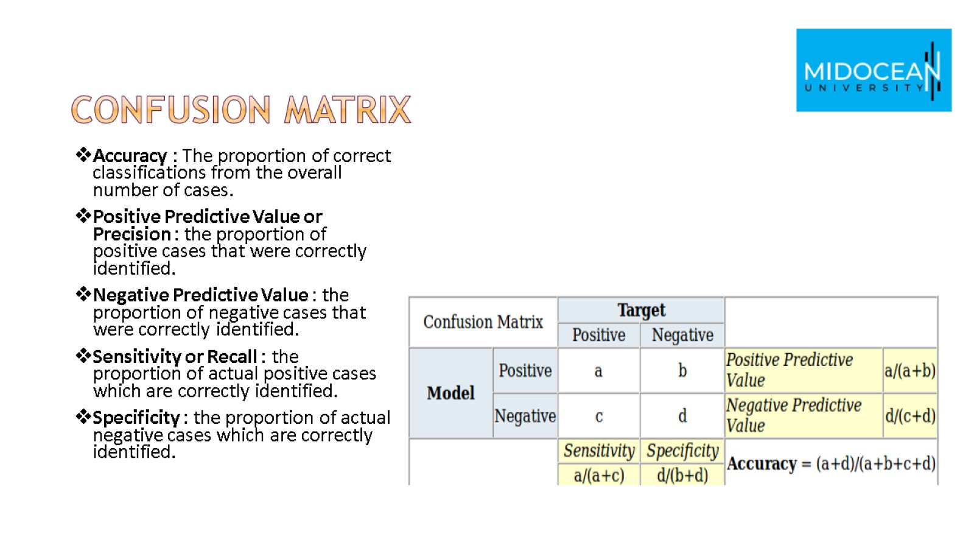
Confusion matrix

Slide 36
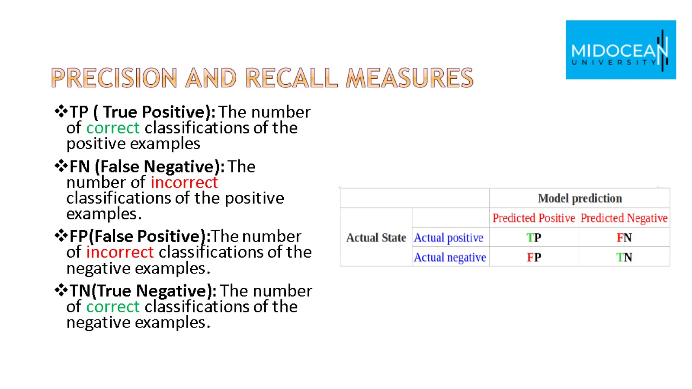
precision and recall measures

Slide 37
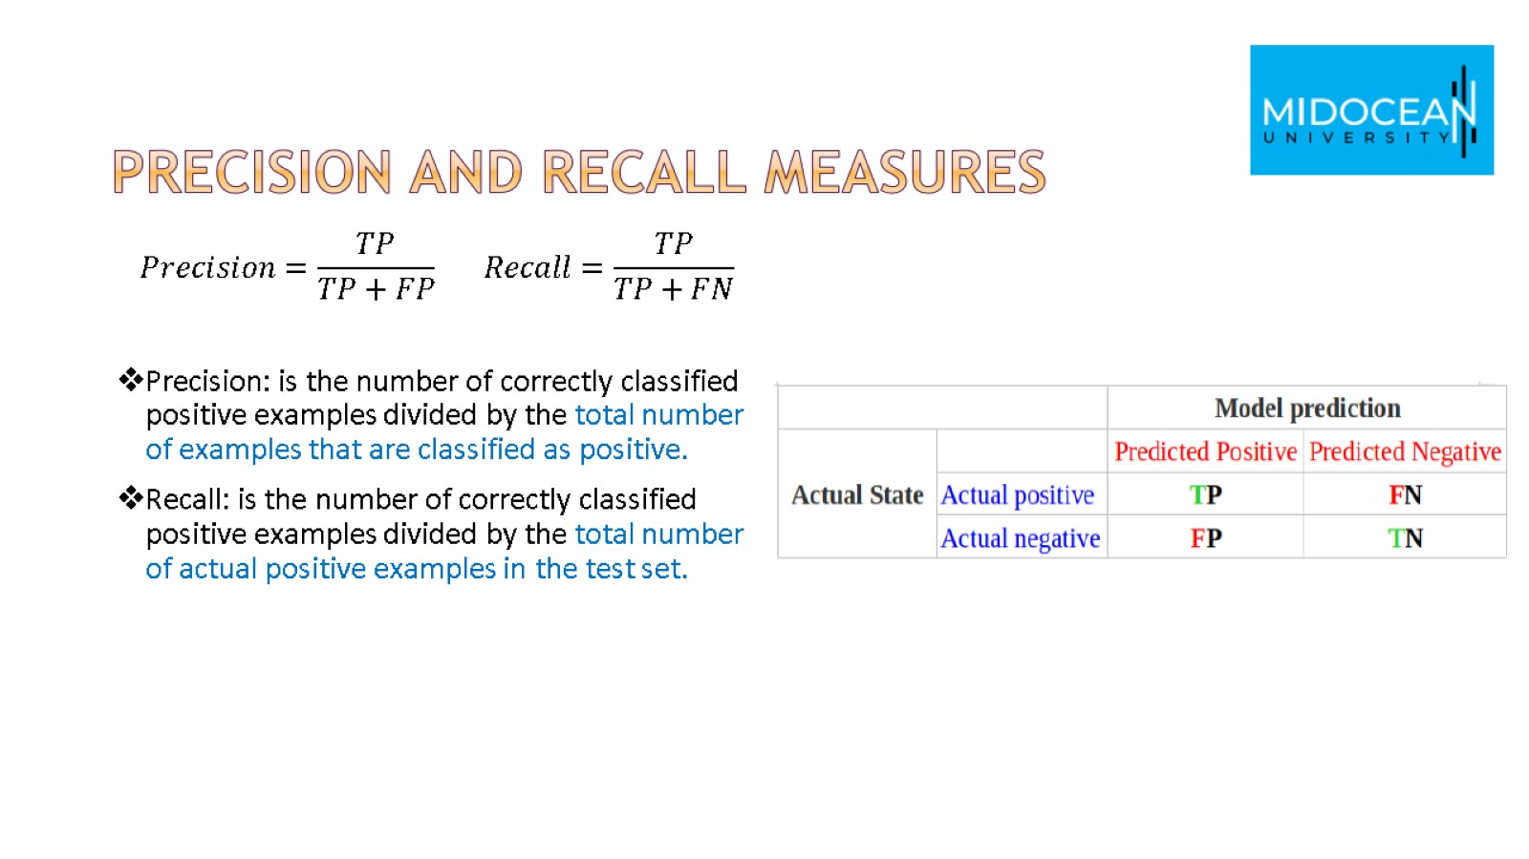
precision and recall measures

Slide 38
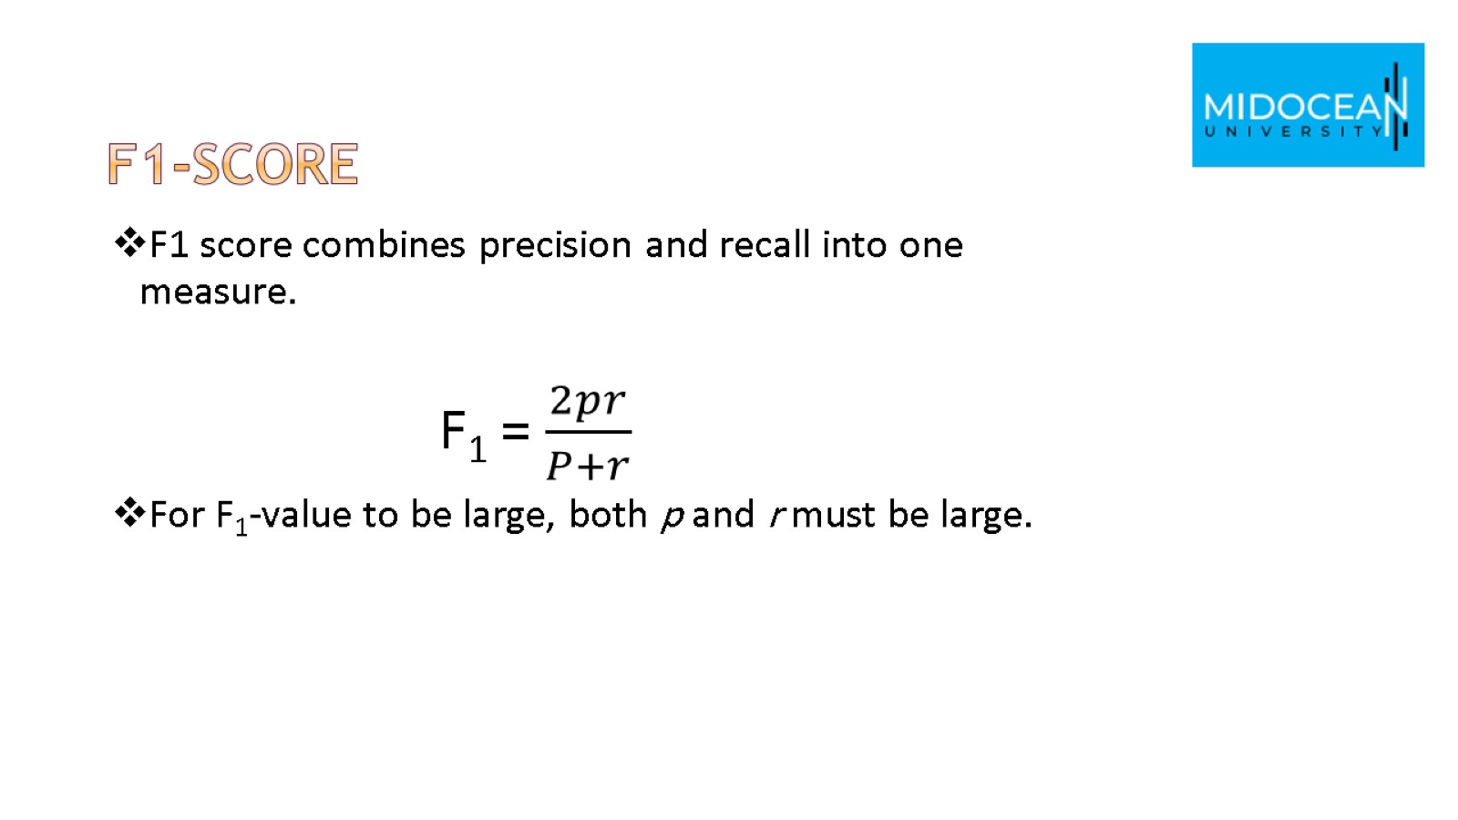
F1-Score

Slide 39


Slide 40


