Slide 1



Network
Programming
in Python
Prepared by Dr. Hamada I. AbdulWakel
Lecture 7

Slide 2



Domain Name System
Lecture 7
Prepared by
Dr. Hamada I. AbdulWakel
www.midocean.ae

Slide 3
Lecture
RECAP: LECTURE 6
07
Broadcasting client/server model.
Securing Sockets and SSL module.
www.midocean.ae

Slide 4
Lecture
LECTURE MAIN POINTS
07
Domain Name System (DNS).
DNS module in Python.
The getaddrinfo() method.
www.midocean.ae

Slide 5
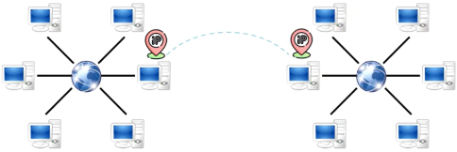
Lecture
07
NAME RESOLUTION
Although TCP/IP uses IP addresses to locate and connect to hosts, users typically prefer to use friendly names.
www.midocean.ae

Slide 6

Lecture
07
NAME RESOLUTION
Cont'd
Name resolution systems provide the translation between alphanumeric names and numerical addresses.
www.midocean.ae

Slide 7
Lecture
07
NAME RESOLUTION
Cont'd
There are two common methods for implementing name resolution:
  A static file on each host on the network, containing all the name-to-address translations.
    Like HOSTS file in Windows/Linux.
    If a change occurs, every device’s HOSTS file must be updated.
  A centralized server that all hosts on the network connect to for name resolution.
    All devices point to this centralized DNS server for name resolution, ensuring that changes only need to occur in one place.
www.midocean.ae

Slide 8
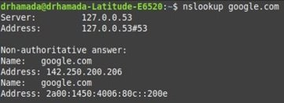
Lecture
07
DOMAIN NAME SYSTTEM
DNS is used on the Internet to provide a standard naming convention for locating IP-based computers.
DNS servers: connected servers have powerful computing resources, storing data, and providing IP addresses for requested domains.
On Windows/Linux
  NOTE: IP may vary
nslookup google.com
www.midocean.ae

Slide 9

Lecture
07
DOMAIN NAME SYSTTEM
www.midocean.ae

Slide 10

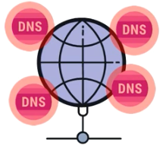
Lecture
07
DNS SERVERS
There are four types of DNS servers:
  DNS Resolver:
    Provided by Internet Service Provider (ISP).
    Connects machines with DNS name server.
  Root Name Server (RNS):
    Identical 13 DNS servers around the world.
    Keep tracking of new added domains names.
www.midocean.ae

Slide 11

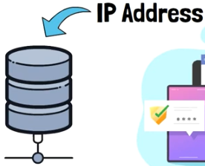
Lecture
07
DNS SERVERS
Cont'd
There are four types of DNS servers:
  Top-level Domain Server (TLD):
    Stores all domain names with the same extension.
      Domain extensions like .com, .net, .info, .org, .edu, …....
Extension together with country code like ae
form the set of possible suffixes for valid domain names.
  Authoritative Name Server (ANS):
    Stores the IP address of the requested website.
    Ensures if the user has the permissions to access IP or not.
www.midocean.ae

Slide 12
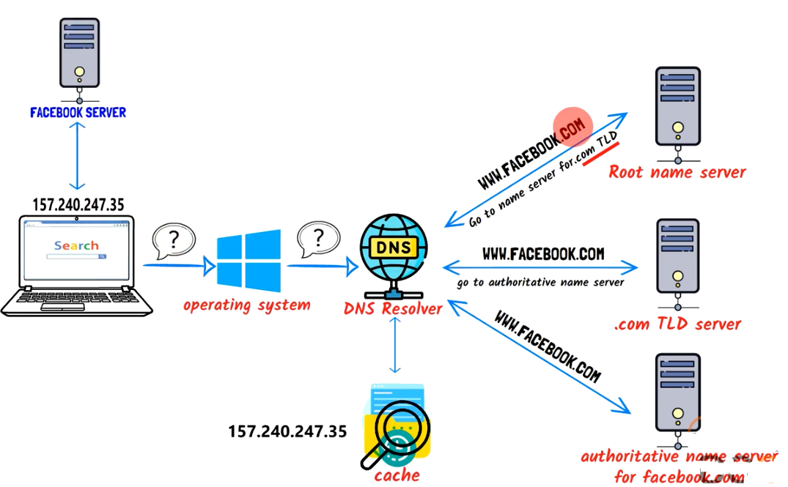
Lecture
07
INTERNAL WORK OF DNS
www.midocean.ae

Slide 13
Lecture
07
INTERNAL WORK OF DNS
Cont'd
Writing a website URL, browsers does not understand it, it needs IP address, So:
  Browser sends a query to OS which forwards it to the DNS resolver.
  DNS resolver checks if it has the requested IP in its cache or not.
    If it is in the cache, it gets IP address and sends it back to the browser.
    If not, the query will be sent to the RNS which checks for the domain extension and sends back the IP address for the corresponding TLD.
    The DNS resolver query the given TLD to get the IP address for the authoritative name server, which contains the IP address for the requested website.
www.midocean.ae

Slide 14
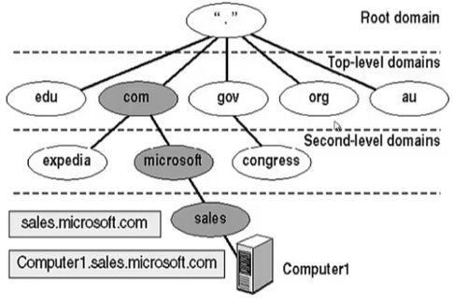
Lecture
07
INTERNAL WORK OF DNS
Cont'd
www.midocean.ae

Slide 15
Lecture
07
INTERNAL WORK OF DNS
Cont'd
The naming system on which DNS is based is a hierarchical and logical tree structure called the domain namespace.
Every node in the DNS domain tree can be identified by a fully qualified domain name (FQDN).
To allow computers to properly recognize a fully qualified domain name:
  Dots are placed between each part of the name.
  All resolvers start their lookups at the root.
  The resolver navigates its way down the tree until it gets to the left-most part of the domain name.
www.midocean.ae

Slide 16
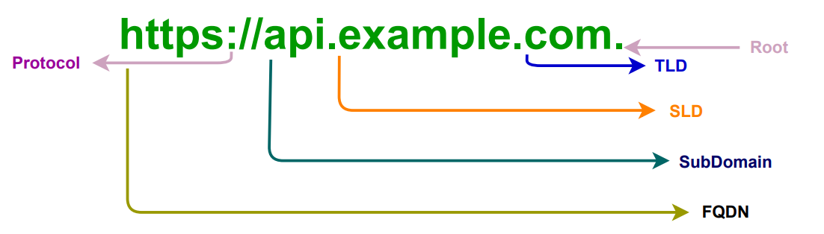
Lecture
07
FULLY QUALIFIED DOMAIN NAME
Fully qualified domain name (FQDN): names an internet site or host by appending its organization's full domain name to the name of a particular machine in that organization.
www.midocean.ae

Slide 17
Lecture
DNS RECORD INFORMATION
07
A: used for converting domain name to IPv4 address.
AAAA: used for converting domain name to IPv6 host address.
PTR (Pointer) : used for converting IP to a domain name.
CNAME (Canonical Name): used to map a domain name as an alias for another domain.
MX (Mail eXchanger): specifies a mail server responsible for accepting email messages on behalf of a recipient's domain.
NS (Name Server): gives a name for each group of servers used in a domain.
TXT (Descriptive Text): lets the administrator insert into the DNS record.
www.midocean.ae

Slide 18
Lecture
DNS RECORD INFORMATION
07
Cont'd
Install DNS corresponding module.
  In Windows:
  python -m pip install dnspython3
  In Linux:
  pip install dnspython3
python3 -m pip install dnspython3
  Do not name your code file with dns.py, because the import statement will give more errors.
www.midocean.ae

Slide 19
Lecture
DNS RECORD INFORMATION
07
Cont'd
Code:
import dns.resolver as dns
def lookup(name):
NSrecord = dns.query(name, 'NS')
for ns in NSrecord:
print(ns)
lookup('google.com')
lookup('matrix219.com')
www.midocean.ae

Slide 20
Lecture
DNS RECORD INFORMATION
07
Cont'd
Code:
import dns.resolver
def lookup(name):
for qtype in 'A', 'AAAA', 'CNAME', 'MX', 'NS':
answer = dns.resolver.query(name, qtype, raise_on_no_answer=False)
for val in answer:
print(val)
lookup('google.com')
www.midocean.ae

Slide 21
SOCKETS WITH GETADDRINFO METHOD
Lecture
07
The getaddrinfo() uses the DNS protocol to talk to your name servers, which are configured using their IP address.
The getaddrinfo() method returns a list of tuples - [(), ()] - for a given network service with which socket objects can be created to connect to that service.
socket.getaddrinfo(host, port, family=0, type=0, proto=0, flags=0)
www.midocean.ae

Slide 22
SOCKETS WITH GETADDRINFO METHOD
Lecture
07
Cont'd
socket.getaddrinfo(host, port, family=0, type=0, proto=0, flags=0)
Host: IP address or host name.
Port: could be a number or service name like http and www.
Family: IP version.
Type: Stream or Datagram.
Proto: TCP or UDP.
Flags: used for filtering the addresses.
www.midocean.ae

Slide 23
SOCKETS WITH GETADDRINFO METHOD
Lecture
07
Cont'd
Code.
import socket
infolist = socket.getaddrinfo('google.com', 'www')
print(infolist)
info = infolist[0]
print(*info[0:2])
sok = socket.socket(*info[0:2])
print(info[4])
sok.connect(info[4])
www.midocean.ae

Slide 24
CLIENT/SERVER USING GETADDRINFO METHOD
Lecture
07
If you want an address to provide to bind(), then you will call getaddrinfo() with None as the hostname.
Infolist = socket.getaddrinfo(None, 'www', socket.AF_INET)
www.midocean.ae

Slide 25
CLIENT/SERVER USING GETADDRINFO METHOD
Lecture
07
Cont'd
Code: the server.
import socket
infolist = socket.getaddrinfo(None, 'www', socket.AF_INET)
info = infolist[0]
soc = socket.socket(*info[0:2])
soc.bind(info[4]); soc.listen();
con, addr = soc.accept()
con.send("Server: Hello".encode())
msg = con.recv(1024).decode()
print(msg)
www.midocean.ae

Slide 26
CLIENT/SERVER USING GETADDRINFO METHOD
Lecture
07
Cont'd
Code: the client.
import socket
infolist = socket.getaddrinfo(None, 'www', socket.AF_INET)
info = infolist[0]
soc = socket.socket(*info[0:2])
soc.connect(info[4])
msg = soc.recv(1024).decode()
print(msg)
soc.send("client: I received your msg".encode())
www.midocean.ae

Slide 27
Lecture
07
SOCKETS FILTERS
To able to use AF_INET6 with socket object, you should first test if the python supports IPv6 by checking the has_ipv6.
print(socket.has_ipv6)
Using the getaddrinfo() with AI_ADDRCONFIG flag, will filter out any IPv6 addresses that are impossible for your computer to reach.
If the service that you are connecting supports only IPv4, you will also want to specify AI_V4MAPPED to return the IPv4 addresses.
www.midocean.ae

Slide 28
Lecture
07
SOCKETS FILTERS
Cont'd
Code:
import socket
print(socket.getaddrinfo('fedoraproject.org', 'ftp')
print(socket.getaddrinfo('fedoraproject.org',
'ftp',
socket.AF_INET,
socket.SOCK_STREAM,
0,
socket.AI_ADDRCONFIG |
socket.AI_V4MAPPED))
www.midocean.ae

Slide 29
Lecture
07
QUESTIONS FOR ONLINE DISCUSSION
Try to modify the getaddrinfo() client/server program to allow the server to accept multiple clients.
www.midocean.ae

Slide 30


Thank You

