Slide 1




Mathematics 3 – MAT132
Dr. Israa Lewaa
Lecture 4 – Introduction to Fourier Series

Slide 2



Lecture Objective
Lecture
05
Chapter Objectives
Fourier Series Formula
Derivatives of Basic Trigonometric Functions
Derivatives for other functions with Trigonometric Functions
Important Relations for Trigonometric Functions
Extra Practice
Lecture 4 Dr. Israa Lewaa Mathematics 3

Slide 3
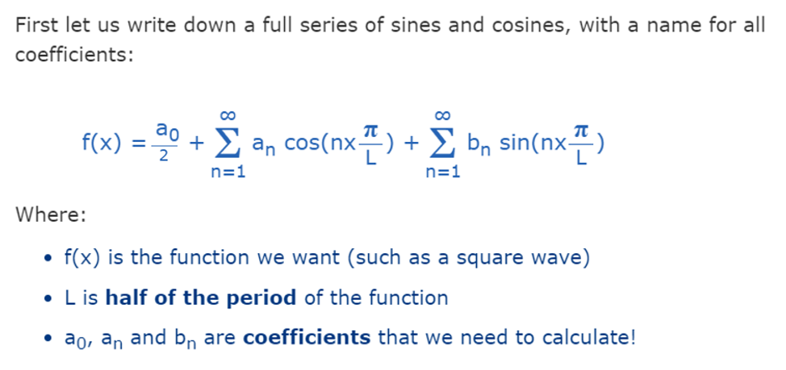
Fourier Series Formula
Lecture
05
Chapter Objectives
Lecture 4 Dr. Israa Lewaa Mathematics 3

Slide 4
Lecture
05
Important knowledge for Fourier Series
Chapter Objectives
Derivatives of Basic Trigonometric Functions
Lecture 4 Dr. Israa Lewaa Mathematics 3

Slide 5
Lecture
05
Derivatives of Basic Trigonometric Functions
Chapter Objectives
Let’s sketch the graph of the function:
f(x) = sin x and use the interpretation of f’(x) as the slope of the tangent to the sine curve in order to sketch the graph of f’.
Lecture 4 Dr. Israa Lewaa Mathematics 3

Slide 6
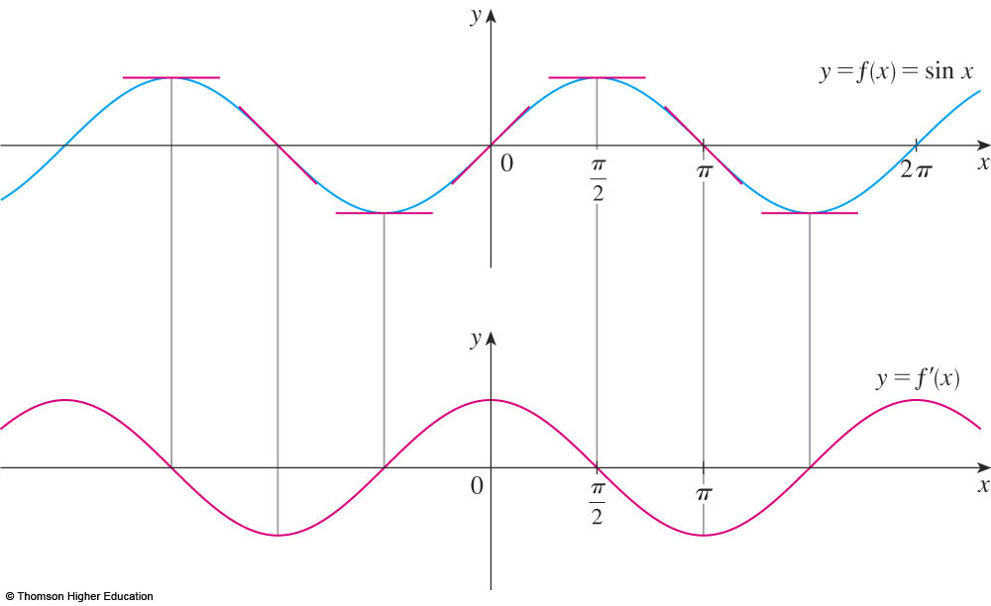
Derivatives of Basic Trigonometric Functions
Lecture
05
Chapter Objectives
Then, it looks as if the graph of f’ may
be the same as the cosine curve.
Lecture 4 Dr. Israa Lewaa Mathematics 3

Slide 7
Rules for Derivatives of Basic Trigonometric Functions
Lecture
05
Chapter Objectives
Lecture 4 Dr. Israa Lewaa Mathematics 3

Slide 8
Derivatives of Basic Trigonometric Functions
Lecture
05
Chapter Objectives
Let’s try to confirm
our guess that, if f(x) = sin x,
then f’(x) = cos x.
Lecture 4 Dr. Israa Lewaa Mathematics 3

Slide 9
Derivatives of Basic Trigonometric Functions
Lecture
05
Chapter Objectives
From the definition of a derivative, we have:

Slide 10
Derivatives of Basic Trigonometric Functions
Lecture
05
Chapter Objectives
Two of these four limits are easy to evaluate.
Lecture 4 Dr. Israa Lewaa Mathematics 3

Slide 11
Derivatives of Basic Trigonometric Functions
Lecture
05
Chapter Objectives
Since we regard x as a constant when computing a limit as h → 0, we have:
Lecture 4 Dr. Israa Lewaa Mathematics 3

Slide 12
Derivatives of Basic Trigonometric Functions
Lecture
05
Chapter Objectives
Lecture 4 Dr. Israa Lewaa Mathematics 3

Slide 13
Important relations I
Lecture
05
Chapter Objectives
Lecture 4 Dr. Israa Lewaa Mathematics 3

Slide 14
Lecture
05
Important relations II
Chapter Objectives
Lecture 4 Dr. Israa Lewaa Mathematics 3

Slide 15
Extra Practice
Lecture
05
Chapter Objectives
Extra Practice
Lecture 4 Dr. Israa Lewaa Mathematics 3

Slide 16
Extra Practice – Example 1
Lecture
05
Chapter Objectives
Differentiate:
y = x² sin x.
Lecture 4 Dr. Israa Lewaa Mathematics 3

Slide 17
Example 1 Solution
Lecture
05
Chapter Objectives
y = x² sin x.
  Using the Product Rule and Formula 4, we have:
Lecture 4 Dr. Israa Lewaa Mathematics 3

Slide 18
Extra Practice – Example 2
Lecture
05
Chapter Objectives
Differentiate
y = tan x.
Lecture 4 Dr. Israa Lewaa Mathematics 3

Slide 19
Example 2 Solution
Lecture
05
Chapter Objectives

Slide 20
Extra Practice – Example 3
Lecture
05
Chapter Objectives
Differentiate
Lecture 4 Dr. Israa Lewaa Mathematics 3

Slide 21
Example 3 Solution
Lecture
05
Chapter Objectives

Slide 22
Extra Practice – Example 4
Lecture
05
Chapter Objectives
Find:
The 27th derivative of cos x.
Lecture 4 Dr. Israa Lewaa Mathematics 3

Slide 23
Example 4 Solution
Lecture
05
Chapter Objectives
  The first few derivatives of f(x) = cos x
  are as follows:
Lecture 4 Dr. Israa Lewaa Mathematics 3

Slide 24
Remark for Example 4
Lecture
05
Chapter Objectives
  We see that the successive derivatives occur
  in a cycle of length 4 and, in particular,
  f ^{(n)}(x) = cos x whenever n is a multiple of 4.
  Therefore, f ⁽²⁴⁾(x) = cos x
  Differentiating three more times,
  we have:
  f ⁽²⁷⁾(x) = sin x
Lecture 4 Dr. Israa Lewaa Mathematics 3

Slide 25
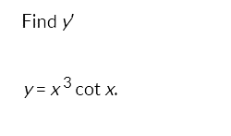
Extra Practice – Example 5
Lecture
05
Chapter Objectives
Lecture 4 Dr. Israa Lewaa Mathematics 3

Slide 26
Example 5 Solution
Lecture
05
Chapter Objectives
Lecture 4 Dr. Israa Lewaa Mathematics 3

Slide 27
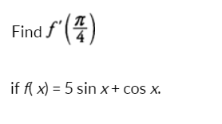
Extra Practice – Example 6
Lecture
05
Chapter Objectives
Lecture 4 Dr. Israa Lewaa Mathematics 3

Slide 28
Example 6 Solution
Lecture
05
Chapter Objectives
Lecture 4 Dr. Israa Lewaa Mathematics 3

Slide 29

Extra Practice – Example 7
Lecture
05
Chapter Objectives
Differentiate
Lecture 4 Dr. Israa Lewaa Mathematics 3

Slide 30
Example 7 Solution
Lecture
05
Chapter Objectives
Lecture 4 Dr. Israa Lewaa Mathematics 3

Slide 31

Extra Practice – Example 8
Lecture
05
Chapter Objectives
Differentiate
Lecture 4 Dr. Israa Lewaa Mathematics 3

Slide 32
Example 8 Solution
Lecture
05
Chapter Objectives
Lecture 4 Dr. Israa Lewaa Mathematics 3

Slide 33
Extra Practice – Example 9
Lecture
05
Chapter Objectives
Differentiate
Lecture 4 Dr. Israa Lewaa Mathematics 3

Slide 34
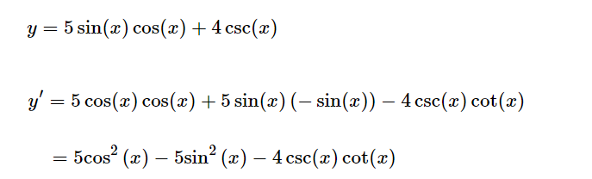
Example 9 Solution
Lecture
05
Chapter Objectives
Lecture 4 Dr. Israa Lewaa Mathematics 3

Slide 35

Extra Practice – Example 10
Lecture
05
Chapter Objectives
Differentiate
Lecture 4 Dr. Israa Lewaa Mathematics 3

Slide 36
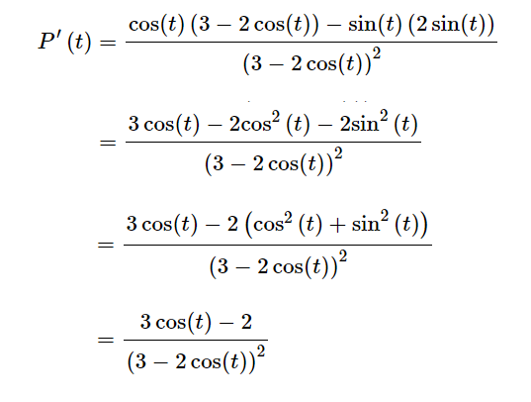
Example 10 Solution
Lecture
05
Chapter Objectives
Lecture 4 Dr. Israa Lewaa Mathematics 3

Slide 37
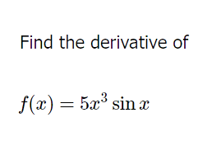
Extra Practice – Example 11
Lecture
05
Chapter Objectives
Lecture 4 Dr. Israa Lewaa Mathematics 3

Slide 38
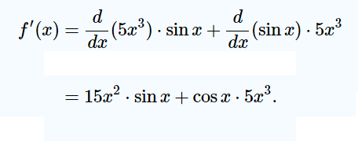
Example 11 Solution
Lecture
05
Chapter Objectives
Lecture 4 Dr. Israa Lewaa Mathematics 3

Slide 39
Lecture Summary
Lecture
05
Chapter Objectives
Fourier Series Formula
Derivatives of Basic Trigonometric Functions
Derivatives for other functions with Trigonometric Functions
Important Relations for Trigonometric Functions
Extra Practice
Lecture 4 Dr. Israa Lewaa Mathematics 3

