Slide 1


Prepared by Dr. Mahitab ELrafii
Social Media Management (DGM721
Lecture 6

Slide 2



Social Media Management (DGM721
Lecture 6
Prepared by
Dr. Mahitab ELrafii

Slide 3

Chapter
Lecture Content
5
Social Network Analysis

Slide 4


Content of lecture
The Content of lecture 6 Includes the following:
What is Network Analysis?
Social Relations.
Kinds of Network Analysis.
Social Sentiment Indicator.
Recording Social Sentiment

Slide 5
What is Network Analysis?
Social network analysis (SNA) is a process of quantitative and qualitative analysis of a social network.
SNA measures and maps the flow of relationships and relationship changes between knowledge-possessing entities. Simple and complex entities include websites, computers, humans, groups, organizations and nations.

Slide 6
The SNA structure is made up of node entities, such as humans, and ties, such as relationships. The advent of modern thought and computing facilitated a gradual evolution of the social networking concept in the form of highly complex, graph-based networks with many types of nodes and ties. These networks are the key to procedures and initiatives involving problem solving, administration and operations.

Slide 7
Social network data are important for discovering knowledge about a community, which is critical in criminology, terrorism, public health, and many other applications.
At the same time, there is a great deal of private information about individuals in a social network, which makes it sensitive when social network data are shared across organizations. Without sharing social network data, each organization may only have part of a large global social network.

Slide 8
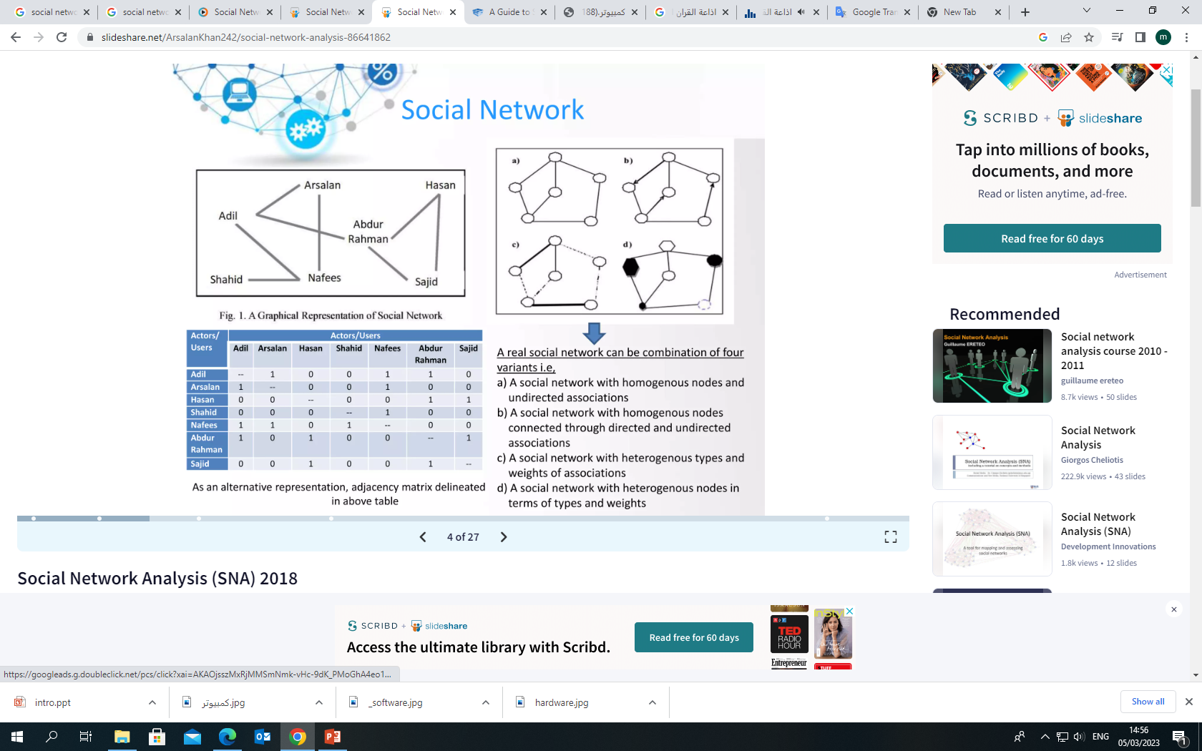

Slide 9
Social Relations
Social relations can be thought of as dyadic attributes. Whereas mainstream social science is concerned with monadic attributes (e.g., income, age, sex, etc.), network analysis is concerned with attributes of pairs of individuals, of which binary relations are the main kind.

Slide 10
Some examples of dyadic attributes:
Kinship: brother, father .
Social Roles: boss, teacher, friend .
Affective: likes, respects, hates.
Cognitive: knows, views as similar.
Actions: talks to, has lunch with, attacks.
Flows: number of cars moving between.
Distance: number of miles between.
Co-occurrence: is in the same club as, has the same color hair as.
Mathematical: is two links removed from.

Slide 11
1. Substantive effects of social network variables
Attributes of ego network --> access to resources, mental/physical health
Network closeness --> influence, diffusion
Similarity of position --> similarity of risks, opportunities, outcomes
2. Substantive determinants of social network variables
Personality --> centrality?
Similarity --> friendship ties
Reduction of cognitive dissonance --> transitivity?
Strategic "networking"
3. Network determinants of network variables
Relationship between density and centrality

Slide 12
Kinds of Network Analysis
There are two basic kinds of network analysis, reflecting two basically different kinds of data:
ego network analysis.
complete network analysis.

Slide 13
Ego network analysis
Ego network analysis can be done in the context of traditional surveys. Each respondent is asked about the people they interact with, and about the relationships among those people.
Since respondents might be sampled randomly from a large population, in ego network analysis it is unlikely that the respondents will know anyone in common, and no attempt is made to link up the networks.

Slide 14
Typically, the analysis of ego networks involves assessing the quality of a person's networks (size, diversity, average income, etc.) or relating attributes of ego with attributes of their alters (homophily).
Ego network analysis is extremely convenient because it can be used in conjunction with random sampling, which enables classical statistical techniques to be used to test hypotheses.

Slide 15
Complete network analysis
Complete network analysis is where you try to obtain all the relationships among a set of respondents, such as all the friendships among employees of a given company.
Most of the rhetoric surrounding network analysis is based on complete networks.
Techniques such as subgroup analysis, equivalence analysis and measures like centrality all require complete networks.

Slide 16
Problems with Network Analysis
The field of network analysis is conventionally criticized for being too much methodological and too little theoretical. Critics say that there are few truly network theories of substantive phenomena. This is not a well-considered argument, however, because when examples of network theories are presented, critics say 'that's not really a network theory'. This is natural because theories that account for, say, psychological phenomena, tend to have a lot of psychological content. Theories that account for sociological phenomena have sociological independent variables. Only theories that explain network phenomena tend to have a lot of network content.

Slide 17
A real problem with network analysis in the past has been the inability to test hypotheses statistically, because the data are by their very nature auto correlated, violating assumptions of independence (random sampling) built-in to most classical statistical tests. With the advent of permutation tests, however, this is much less of problem now.

Slide 18
A continuing problem is the lack of sufficient computing resources to handle large datasets. It is often a problem to bound a social network.
If we are looking at needle-sharing among drug users, we can artificially bound the network at some arbitrary boundary, such as city or neighborhood, but this distorts the data. Yet we cannot let the network get too large because we cannot process the data.

Slide 19
Social Sentiment Indicator
What Is a Social Sentiment Indicator?
A social sentiment indicator analyzes aggregated social media data to help businesses understand how they are performing in the eyes of consumers.
Social sentiment indicators enable companies to discover what they are doing right and how they might improve.

Slide 20
These measures can also give investors an idea of how publicly-listed stocks might perform.
Social sentiment should not be confused with market sentiment indicators, which are designed to represent how a group or population feels about the overall market or economy.

Slide 21
How a Social Sentiment Indicator Works
Keeping customers cheerful is paramount for companies targeting long-term success. When the public is happy with a service or product, and all its other interactions with the provider, company revenues and profits are more likely to rise.
In the digital age, it has become much easier for companies, investors, potential employees, regulators, and the government to gauge how well businesses are treating their customers. Social sentiment indicators can tell us a lot about the emotions that the public has for a certain company, at least in terms of what is being said on social media.

Slide 22
These indicators extract information users post publicly to Facebook, Twitter, blog posts, discussion groups, and forums. If the social sentiment indicator shows a negative change in reputation, the company might be able to address the problem before it grows and starts potentially heavily weighing on its share price.

Slide 23
Advantages of Social Sentiment Indicators
Social sentiment indicators serve a variety of purposes. Companies might blame social media for triggering a rise in complaints and encouraging hate campaigns. However, these same firms can use the internet and social.

Slide 24
sentiment indicators to their advantage, too, including in the following ways:
Identify trends to target new customers.
Develop successful marketing campaigns and gauge if they are spending marketing dollars wisely.
Determine how consumers feel about competitors and similar products.
Assess what to expand on and what to drop or change.
Protect and improve their brand identity and image.

Slide 25
Social sentiment indicators are also helping to reduce the burden on customer service email and call centers. Nowadays, it is possible to address questions and problems masse via social media.
In some cases, these communication methods might even be used to reach out to highly influential individuals with a track record of swaying sentiment on popular chat platforms.

Slide 26
Investors, too, can benefit from social sentiment indicators because the type of information that they collate tends to have a bearing on stock prices.
If an investor spots that people on social media have suddenly started to complain about a particular company, they could opt to sell before the rest of the market reacts. Value investors, on the other hand, might use these tools to buy into a stock that they believe has been excessively punished by internet gossip.

Slide 27
Recording Social Sentiment
Given that companies and brands may create huge volumes of social media posts, gauging how effective they are or how they have been received can be a big task. Accordingly, there are a number of social sentiment analysis tools available, such as BuzzSumo, HootSuite, Google Alerts, and People Browsr.

Slide 28
Slight differences can be found in each tool.
Some, for example, might specialize in tracking particular digital comments or trends and not all will analyze every social media platform out there. Normally, the more comprehensive ones charge a fee.

Slide 29
Examples of Social Sentiment Indicators:
Sport and Entertainment:
Social sentiment indicators can be deployed in different ways. For instance, sports and entertainment companies sometimes use them to give customers a more engaging viewing experience.

Slide 30
Technology giant International Business Machines Corp. (IBM) sought to leverage demand for online commentary by developing its own social sentiment indicator.
Sports fans can tap into this particular tool to see the volume and negative or positive trend of tweets about each player, giving viewers a real-time idea of how fellow viewers are perceiving a match.

Slide 31
Economy
Meanwhile, some companies have created social sentiment indices to gauge public perception of the economy.
One such index, the Wall Street Journal-IHS United States Social Sentiment Index, analyzes the data in over 5 million messages a day localized by time, place, and gender to identify and analyze trends.

Slide 32
Social network data often contain irrelevant content; hence data mining techniques are required to retrieve relevant information out of these data.

Slide 33
The mining procedures can be classified into the following categories:
1.Text mining: Text mining is generally used to deal with unstructured data. Also referred to as text data mining, it is focused on deriving high-quality textual information by means of exploring unstructured data to recognize underlying patterns.
Text mining uses the tools of data mining, information retrieval, statistics, and machine learning to handle natural language texts in any available format.

Slide 34
2. Image and video mining: Images and videos are different forms of continuous data associated with temporal information.
As such, the data complexity is greater. Images/videos are acquired using cameras.
Images may not only contain irrelevant information, but are generally affected by various types of noise, including channel noise and ambient noise, to name a few.

Slide 35
Image mining is a popular tool used for extracting implicit knowledge, relationships between image and data, or patterns. As such, it can be thought of as an extended part of data mining in the image domain involving database processing, machine learning, computer vision, image processing, and artificial intelligence.
Video mining can be thought of as the next level of image mining, which brings to light structures, knowledge, and patterns in video data.

Slide 36
3. Web data mining: Web data mining is an application area of data mining .
It is very useful to uncover patterns from the World Wide Web.
Several automated techniques can be utilized for extracting data from web pages.
Data can also be extracted from server logs and different link structures.

Slide 37
4. Mining of sequence patterns: Mining sequence patterns is a problem in which the association between distinct items in a database needs to be found.
Mining sequence patterns encompasses item sets, substructures, or subsequences which appear within a set of data and have frequency not below a user-specified limit. Frequent pattern mining has been a requisite task in data mining, and researchers have been dedicated to this field for the last couple of years.
Frequent pattern mining finds applications in recommender systems, bioinformatics, and decision making.

Slide 38
5. Mining time series data: In the last few years, mining time series data have gained utmost popularity among data mining researchers.
Different clustering, classification, indexing, and segmentation algorithms have been developed over the decades to find anomalies in time series.

Slide 39
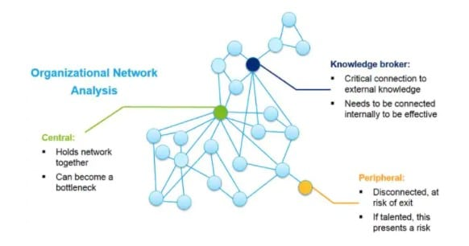

Slide 40
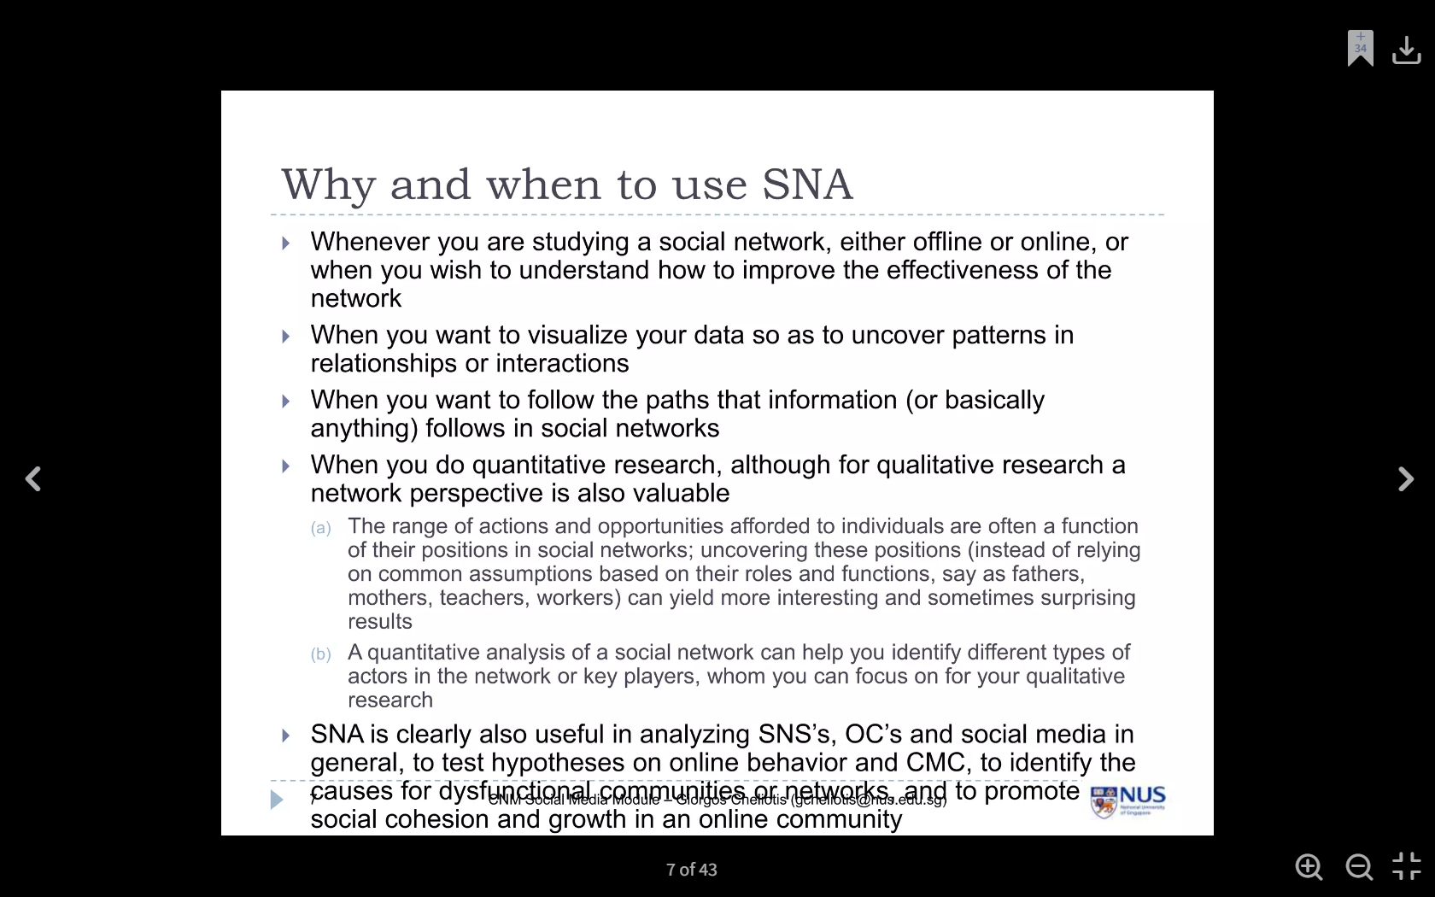

Slide 41
Artificial Intelligence and Social Network Analysis
The fusion of Artificial Intelligence (AI) and Social Network Analysis (SNA) enables deeper insight into social structures and behaviors.
AI enhances the accuracy, scalability, and speed of SNA processes.
AI Applications in SNA ::
Pattern recognition in large-scale networks
Community detection using ML algorithms
Influence estimation using predictive modeling
Anomaly detection in fraudulent or malicious networks
Sentiment analysis from text-based interactions

Slide 42
AI-Powered Network Visualization
AI tools can automate:
Clustering and community discovery.
Dynamic and interactive graph layouts.
Highlighting key influencers using centrality measures.

Slide 43
Benefits of Integrating AI with SNA:
Scalability: Handle massive, real-time datasets.
Speed: Automated analysis saves time.
Accuracy: Enhanced detection of complex patterns.
Prediction: Forecast network evolution and behaviors.
Challenges & Limitations:
Data privacy and ethical concerns.
Algorithmic bias and interpretability issues.
Overfitting in predictive models.

Slide 44



Thank You

