Slide 1


English Language 2
Lecture 2
ENG 102
Prepared by
Ahmed Soliman

Slide 2
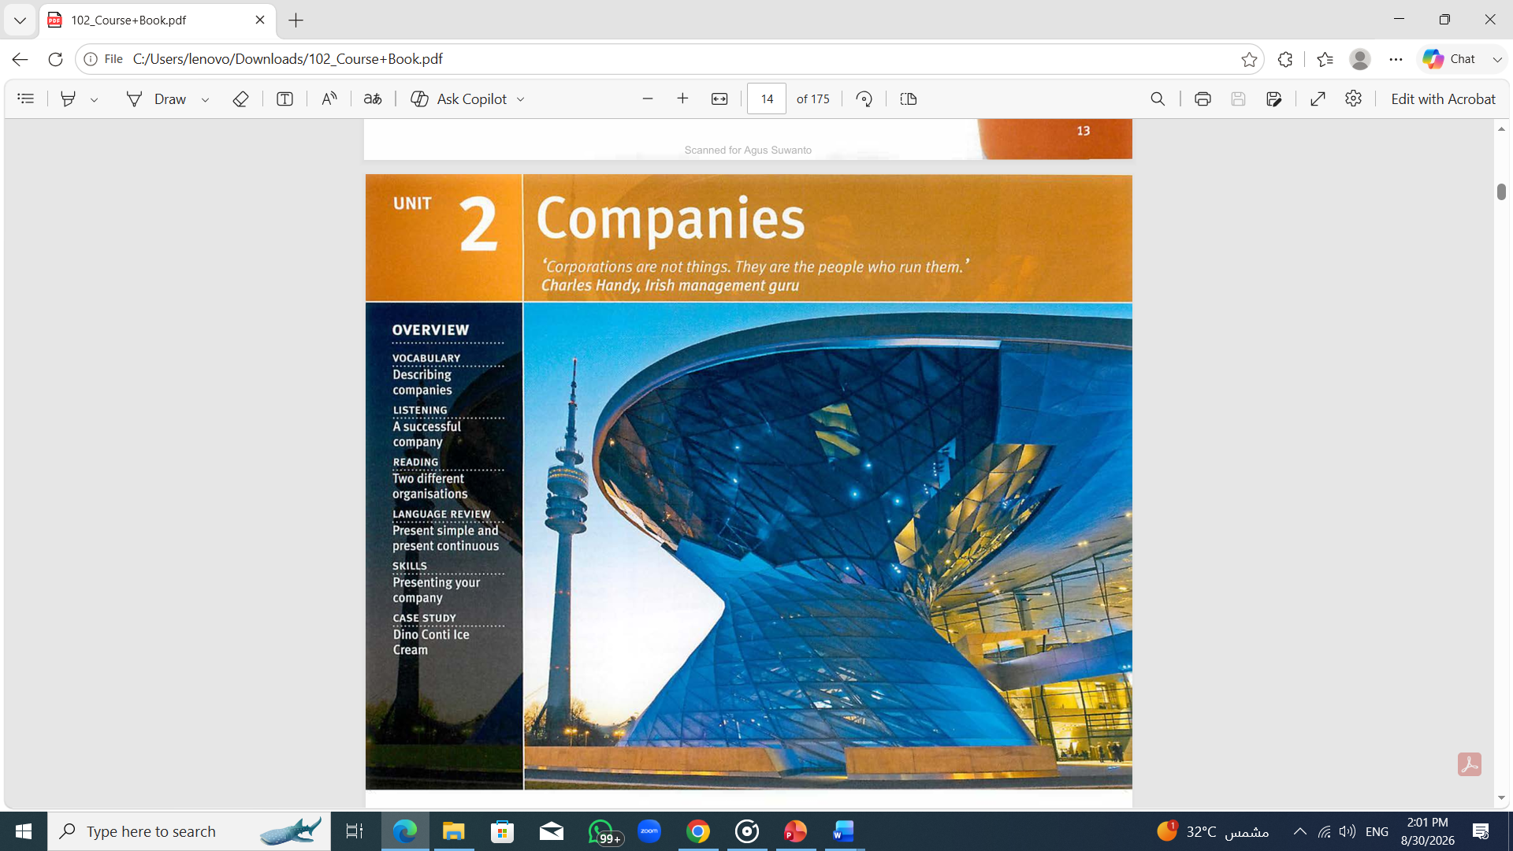

Slide 3
Starting Up
A) Which of these companies do you or would you like to work for?
a family-owned company
a multinational company
your own company (be self-employed)

Slide 4
Starting Up
B) Can you name a company in each of these business sectors? Is there one that you would like to work for?
• Telecommunications/Media • Engineering • Pharmaceuticals/Chemicals • Construction | • Banking and finance • Transport • Manufacturing • IT /Electronics | • Food and drink • Retailing • Another service industry • Tourism

Slide 5
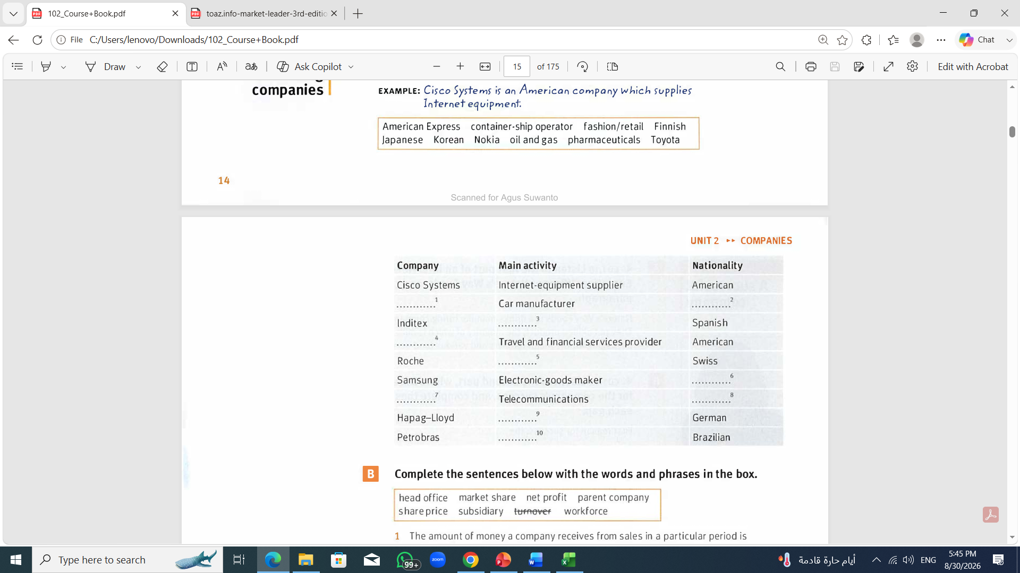

Vocabulary: Describing companies
A) Complete the chart with the information in the box below. Then write sentences about the companies.
EXAMPLE: Cisco Systems is an American company which supplies Internet equipment. .
Toyota
Japanese
fashion/retail
American Express
pharmaceuticals
Korean
Nokia
Finnish
container-ship operator
oil and gas

Slide 6
B) Complete the a below with the words and phrases in the box.
The amount of money a company receives from sales in a particular period is called its ..……….
The money a company makes after taking away its costs and tax is its ...............
A company which owns another company is called a ...................
The employees in a particular country or business are called the ............ .
The percentage of sales a company has in a particular market is its ....................
The main building or location of a large organisation is its ………………
The cost of a company's shares is its ................
A company which is more than 50% owned by another company is called a ............
head office market share net profit parent company share price subsidiary turnover workforce
turnover
net profit
parent company
workforce
market share
head office
share price
subsidiary

Slide 7
C) Complete this extract from a company report with appropriate words or phrases from the box in Exercise B
Financial performance
I am pleased to say the ..…..…………...... has continued its excellent performance. We are changing, growing and doing well at a difficult time for the industry. …………… was €57.2 million, an increase or 15% on last year, and ……………. rose by 5% to €6.4 million.
We are a highly competitive business. We have increased our …........…......... to 20%. Consequently, our …………….… has risen and is now at an all-time high or €9.6.
Increased production and strong demand have had a positive effect on our cashflow, so we are able to finance a number or new projects. We have successfully moved to our new ….……..…… in central London. We are now planning to start full production at the recently opened Spanish …………..… in October.
Finally, thanks once again to our loyal and dedicated ...………… . Our employees will always be our most valuable asset.
parent company
turnover
net profit
market share
share price
head office
subsidiary
workforce

Slide 8
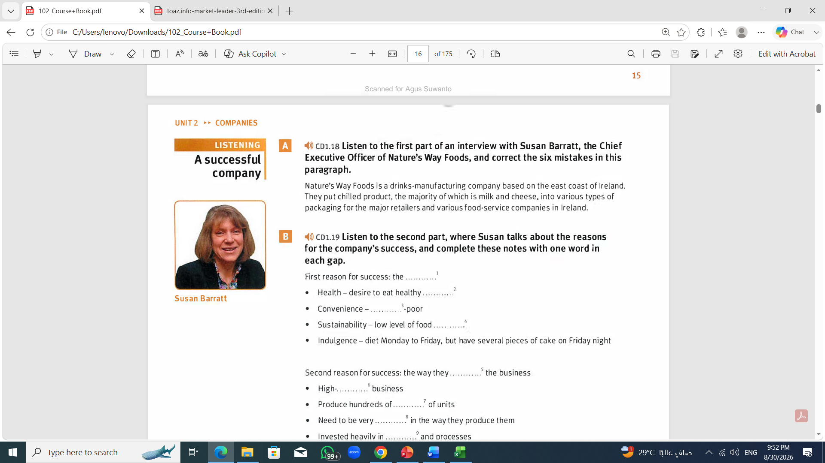
Listen to the first part of an interview with Susan Barratt, the Chief Executive Officer of Nature's Way Foods, and correct the six mistakes in this paragraph.
Nature's Way Foods is a drinks-manufacturing company based on the east coast of Ireland. They put chilled product, the majority of which is milk and cheese, into various types of packaging for the major retailers and various food-service companies in Ireland.
Nature's Way Foods is a food-manufacturing company based on the south coast of England. They put chilled product, the majority of which is lettuce and fruit, into various types of packaging for the major retailers and various food-service companies in the UK.

Slide 9
B) Listen to the second part, where Susan talks about the reasons for the company's success, and complete these notes with one word in each gap.
    First reason for success: the ……………..
        Health - desire to eat healthy ……………..
        Convenience - …………….. - poor
        Sustainability - low level of food ……………..
        Indulgence - diet Monday to Friday, but have several pieces of cake on Friday night
Second reason for success: the way they …………….. the business
    High- …………….. business
    Produce hundreds of …………….. of units
    Need to be very …………….. in the way they produce them
    Invested heavily in …………….. and processes
markets
products
time
miles
run
volume
millions
efficient
systems

Slide 10
C) Listen to the third part and answer these questions.
  What two things has Susan enjoyed the most when running a company?
  What does she not enjoy about running a company?
1. Achieving what you set out to achieve and creating a team ethic
2. The relentlessness of the role as a Chief Executive

Slide 11
D) Listen to the final part and complete this extract.
I've learned a lot of lessons from the companies I've worked for. I think the key thing is that you have to make sure your …………. in the organisation are engaged with the organisation and have a clear ………………. of what that organisation is trying to ………. .
If you can get that clarity of ………… and …….…..……. from the people within the organisation, then that will help move the business forward in itself.
people
understanding
achieve
direction
enthusiasm

Slide 12
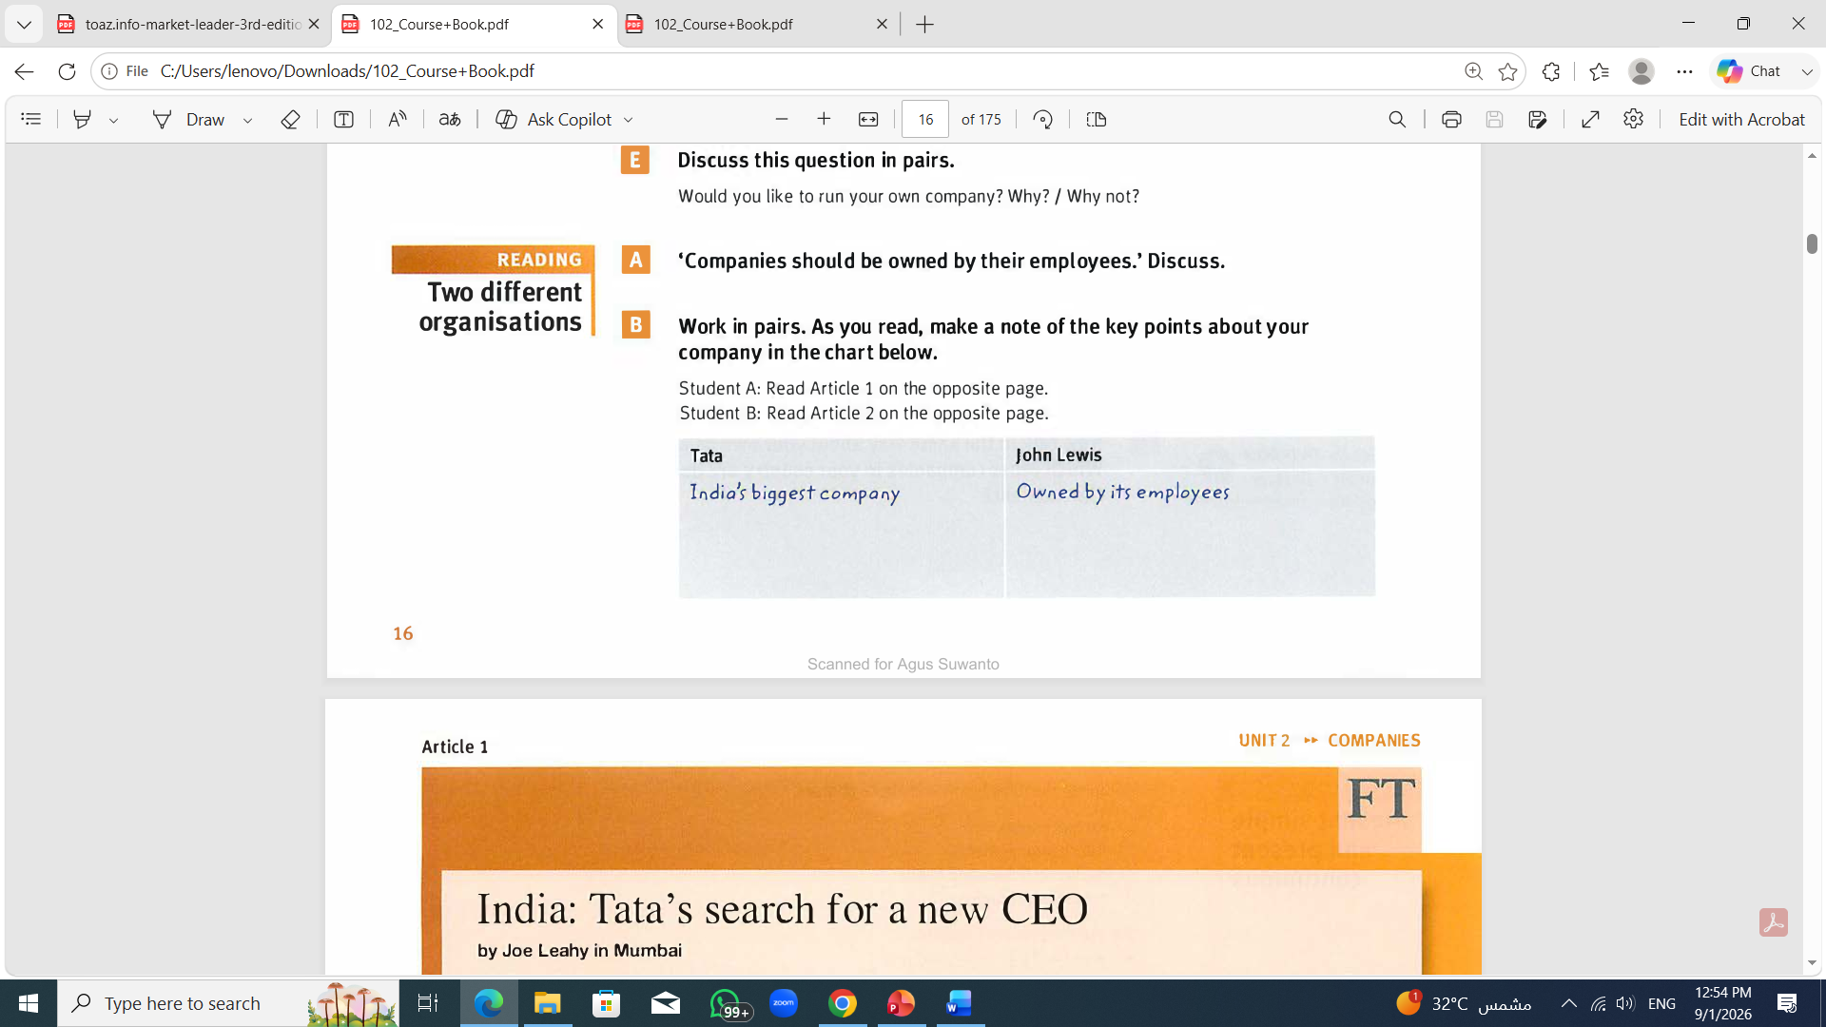
'Companies should be owned by their employees.' Discuss.
An employee-owned company is one where the company's employees are shareholders.
In such companies, employees are often given shares in the company as part of their salary.

Slide 13
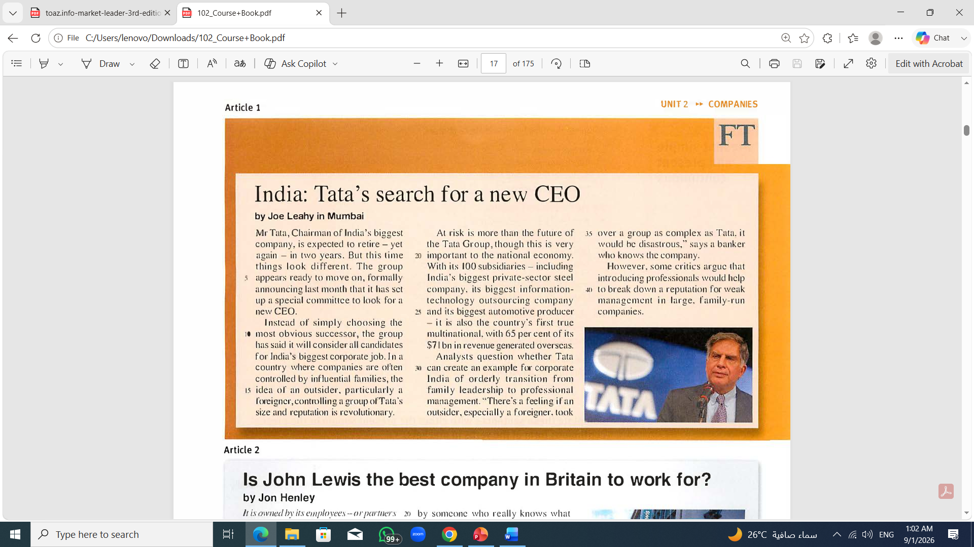

Slide 14
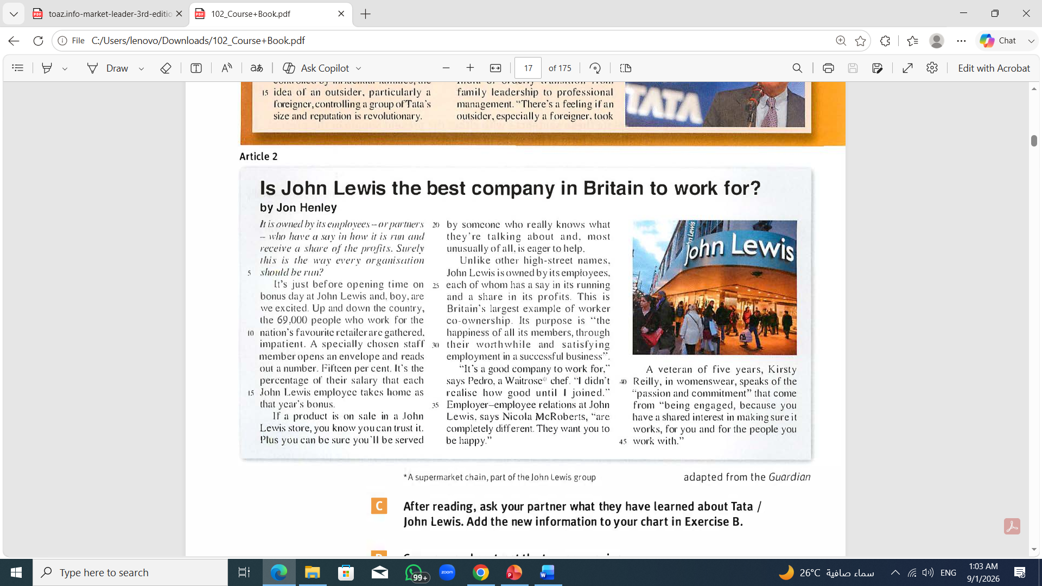

Slide 15
B) As you read, make a note of the key points about companies in the chart below.
Tata | John Lewis
India’s biggest company | Owned by its employees
CEO about to retire (for second time)
Will consider candidates from outside to replace him
Has 100 subsidiaries (including India's biggest private-sector steel company, its biggest information-technology outsourcing company and its biggest automotive producer)
65% of its $71 billion revenue generated overseas
Employs 69,000 people
Has a reputation for trustworthy products and employees who know what they're talking about and are eager to help
Each employee has a say in how the company is run and has a share of the profits
Britain's largest example of a worker co-ownership
Want their staff to be happy

Slide 16
C) Compare and contrast the two companies.
EXAMPLE: Tata is an Indian company, but John Lewis is a British company.
John Lewis is owned by its employees, but Tata isn't.
Tata has got 100 subsidiaries, but John Lewis hasn't got any.
John Lewis isn't family-owned, but Tata is.
Both companies are successful.

Slide 17
D) Discuss these questions.
What are the good and bad points of bringing in someone from outside to run a family-owned business?
Do you know of any company like John Lewis in your country? If so, how successful is it?

Slide 18
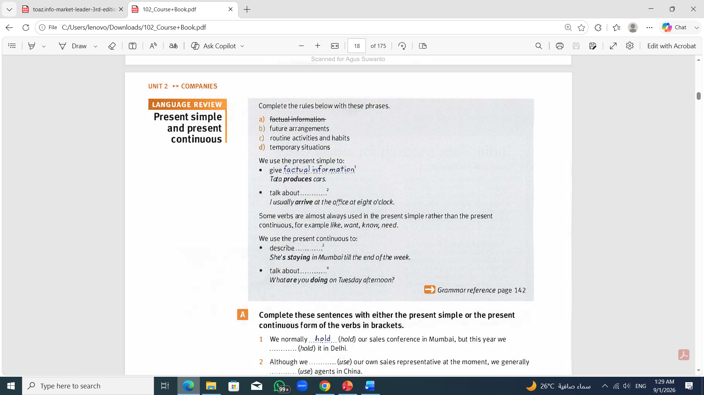
routine activities and habits
temporary situations
future arrangements

Slide 19
Present Simple
Uses
1. We use the present simple to:
• give factual information about permanent activities.
Valentino makes luxury chocolates.
• describe a state that doesn't change.
He looks like his father.
• talk about routine activities, repeated actions or habits. This use of the present simple is associated with adverbs of frequency.
We usually have our weekly sales meeting on Mondays.
I often travel abroad on business.
We sometimes get complaints, but not many.

Slide 20
2. There are verbs that we normally use only in simple tenses, not in continuous tenses.
For example, believe, belong, depend, know, like, love, mean, own, remember, understand, want, etc.
These verbs describe states, not actions.
It depends on the exchange rate (NOT *It is depending ... )
The premises don't belong to them. (NOT *The premises aren't belonging ... )
What do they want? (NOT *What are they wanting ... )

Slide 21
Form
+ I/You/We/They work.
He/She/It works.
- I/You/We/They don't (= do not) work.
He/She/It doesn't (= does not) work.
? Do I/you/we/they work?
Does he/she/it work?

Slide 22
Present continuous
Uses
We use the present continuous to:
• describe activities in progress at the moment of speaking.
She's talking to him on the phone right now.
• describe temporary situations.
The delegation is staying at the Hilton until Friday.
• refer to future arrangements.
He's starting a new job next week.
• describe changing situations.
We're developing a new marketing strategy.

Slide 23
Form
+ I am working.
He/She/It is working.
You/We/They are working.
- I am not working.
He/She/It isn't (= is not) working.
You/We/They aren't (= are not) working.
? Am I working?
Is he/she/it working?
Are you/we/they working?

Slide 24
A) Complete these sentences with either the present simple or the present continuous form of the verbs in brackets.
We normally ............. (hold) our sales conference in Mumbai, but this year we …….…….…. (hold) it in Delhi.
Although we ……..……. (use) our own sales representative at the moment, we generally …..……. (use) agents in China.
Tatsuo ............... (work) for a financial magazine. At the moment, he ……………. (write) an article on insider trading.
Usually, our Sales Director ………… (deal) with important customers, but I ………............ (deal) with all enquiries while she is on holiday.
I …………… (come) from Poland, but at the moment I ……………. (live) in Germany.
John Lewis ………… (want) to continue with expansion this year.
hold
are holding
are using
use
works
is writing
deals
am dealing
come
am living
wants

Slide 25
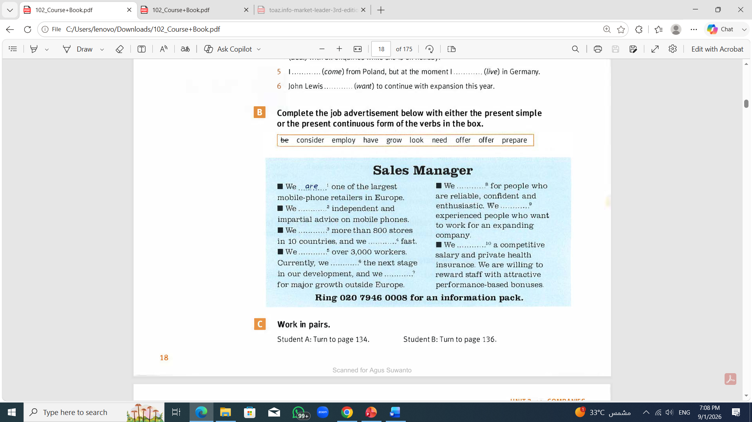
are looking
offer
need
have
are growing
offer/are offering
employ
are considering
are preparing

Slide 26

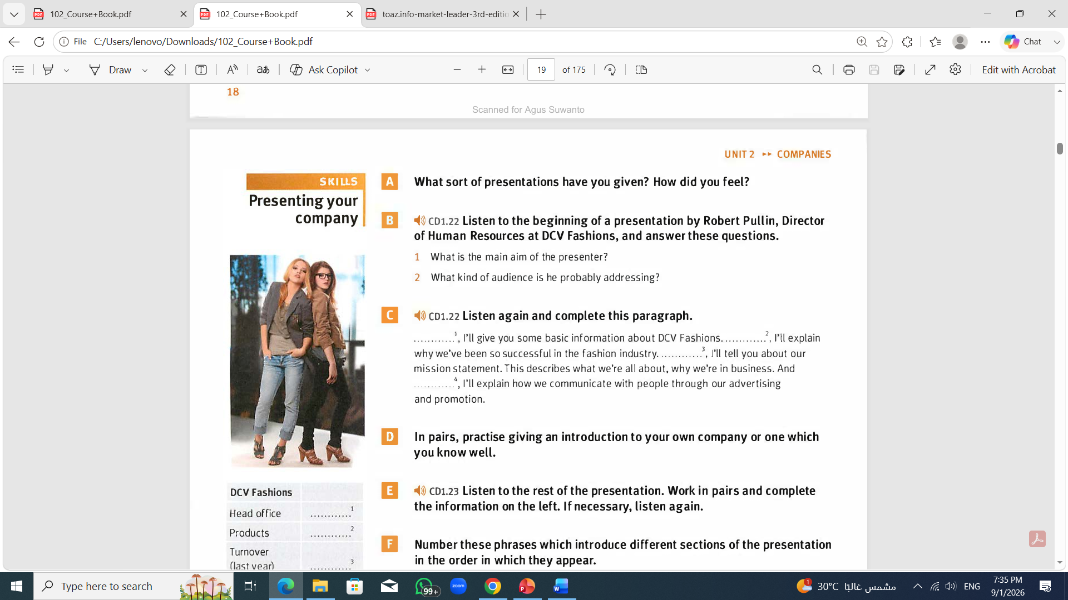
A) What sort of presentations have you given? How did you feel?
B) Listen to the beginning of a presentation by Robert Pullin, Director of Human Resources at DCV Fashions, and answer these questions.
What is the main aim of the presenter?
What kind of audience is he probably addressing?
1. To talk about his company
2. A group of prospective employees

Slide 27
C) Listen again and complete this paragraph.
...……..., I'll give you some basic information about DCV Fashions. …….…., I'll explain why we've been so successful in the fashion industry. ……….., I’ll tell you about our mission statement. This describes what we're all about, why we're in business. And …………, I'll explain how we communicate with people through our advertising and promotion.
First
After that
Next
finally

Slide 28
Assignment
D) Practise giving an introduction to your own company or one which you know well.

Slide 29
E) Listen to the rest of the presentation and complete the information below. If necessary, listen again.
DCV Fashions
Head office | ……………….
Products | ……………….
Turnover (last year) | ……………….
Profits (last year) | ……………….
Reasons for success | ……………….
Advertising and promotion | ……………….
Florence
Clothing and fashion accessories
€300 million
€28 million
Talented team of designers, first-class distribution system, creative advertising and promotion
Advertises on all Italian TV networks and in other major European markets; sponsors fashion shows; products are endorsed by music and sport celebrities

Slide 30
F) Number these phrases which introduce different sections of the presentation in the order in which they appear.
Moving on now to our mission …
Finally, a word about ...
Thanks very much for listening …
OK, some basic facts ...
What's the key to our success?
3
4
5
1
2

Slide 31
Assignment
G)Think about your company or a company you know. Use the headings in the chart in Exercise E to help you prepare a presentation about it.
DCV Fashions
Head office | ……………….
Products | ……………….
Turnover (last year) | ……………….
Profits (last year) | ……………….
Reasons for success | ……………….
Advertising and promotion | ……………….

Slide 32
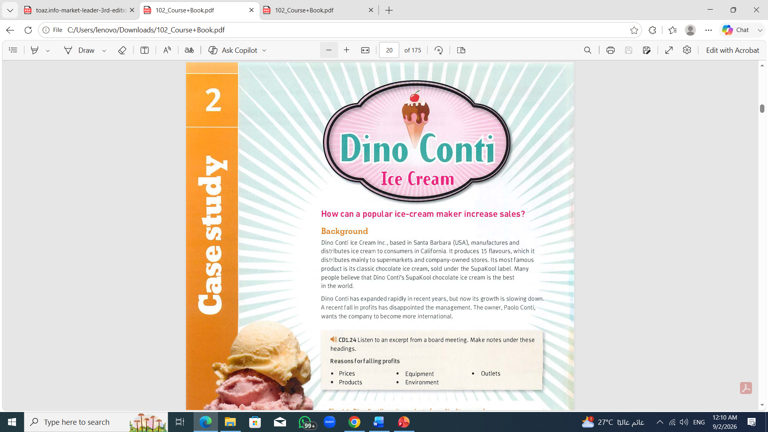

Slide 33
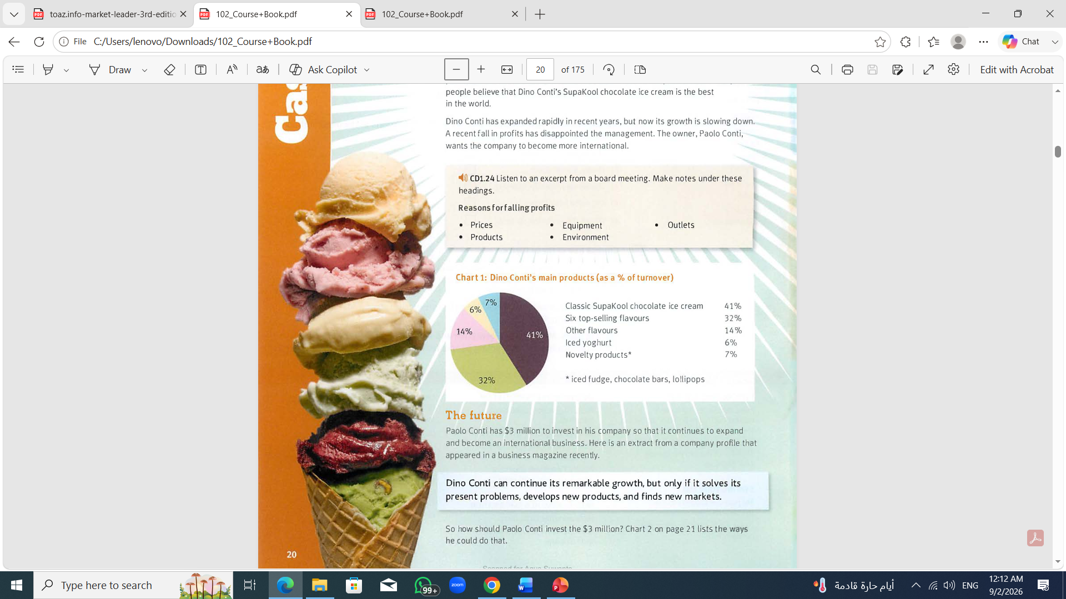

Slide 34
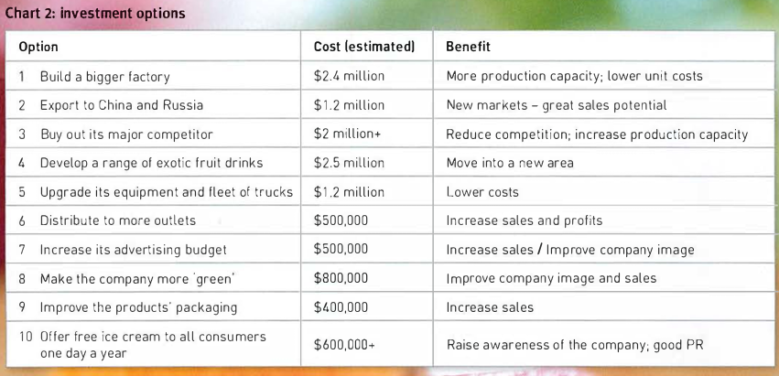

Slide 35
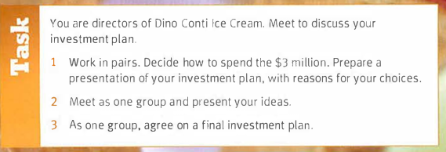

Slide 36


Thank You

