Slide 1


Performance Management
Prepared by Dr. Sahar Ahmed
Week Eight
Lecture 7

Slide 2

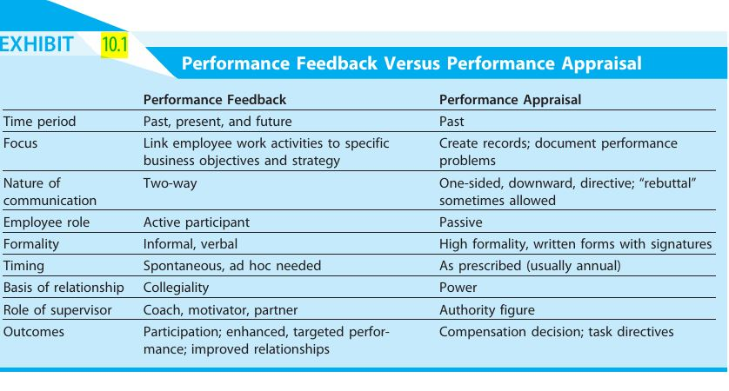
Chapter Summary
www.midocean.ae

Slide 3
Chapter Summary
2. Strategic Choices in Performance Management Systems:
Complexity vs. Simplicity: Organizations can choose between a detailed system with many metrics or a simpler, streamlined approach depending on factors like size and industry.
Focus and Frequency: The system can focus on outcomes (results) or behaviors while achieving them. The frequency of formal reviews can also be tailored (annual vs. more frequent check-ins).
www.midocean.ae

Slide 4
Chapter Summary
Understanding the Pros and Cons:
Pros:
Improved Performance & Engagement: Effective systems can lead to significant gains in performance and employee engagement.
Talent Development & Data-Driven Decisions: Performance data helps identify high-potential employees and informs strategic talent management decisions.
Cons:
Administrative Burden & Subjectivity: Complex systems can be time-consuming and bureaucratic. Performance evaluations can be subjective, leading to potential biases.
Short-Term Focus & Employee Dissatisfaction: Overemphasis on short-term results can discourage long-term development, and poorly designed systems can demotivate employees.
www.midocean.ae

Slide 5
Chapter Summary
Reasons for System Failure and Improvement Strategies:
Lack of Strategic Alignment
Inconsistent Communication
Limited Manager Training
Focus on Punishment & Lack of Employee Involvement
Strategies for Effective Systems:
Simplify the Process: Focus on Meaningful Feedback
Develop Manager Capabilities
Link Performance to Rewards
Embrace Technology
www.midocean.ae

Slide 6
Chapter Summary
A Roadmap for Success:
Collaborative Design & Strategic Alignment: Involve managers in the design process and ensure the system is tightly linked to the organization's strategy.
Fair and Objective Evaluations: Establish clear performance standards using a combination of absolute (rating) and relative (ranking) measures when appropriate.
  The chapter also discussed various evaluation methods beyond setting standards, such as:
    Management by Objectives (MBO)
    360-Degree Feedback
www.midocean.ae

Slide 7
Chapter Summary
Fostering Open Communication: Promote open and frequent communication regarding expectations, performance, and development goals.
Establishing Clear Consequences: Implement clear and consistent consequences for performance, both positive (rewards) and negative (performance improvement plans).
Securing Top-Management Commitment: Gain unwavering commitment from top management to create a performance-driven culture.
Continuous Improvement: Recognize that the system is a dynamic tool and regularly review and refine it to address changing needs and maintain its effectiveness.
www.midocean.ae

Slide 8
Chapter Summary
Ranking Methods
Rating Methods
Other Methods
1
Simple ranking
6
Graphic Rating
1
Critical Incidents
2
Paired comparison
7
Behaviorally anchored rating scales (BARS)
Management by objectives (MBO)
2
3
Forced Distribution
8
Behavioral Observation
Merged Methods
3
www.midocean.ae

Slide 9
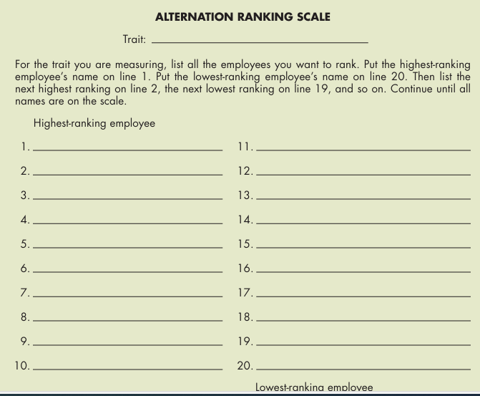
Alternation Ranking Example
www.midocean.ae

Slide 10
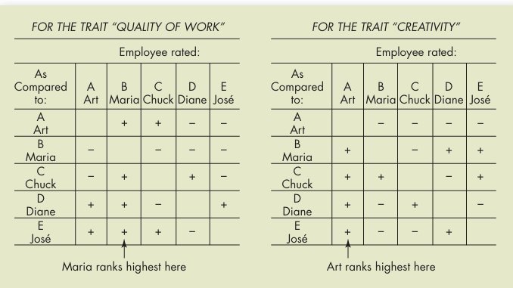
Paired Comparison Example
www.midocean.ae

Slide 11
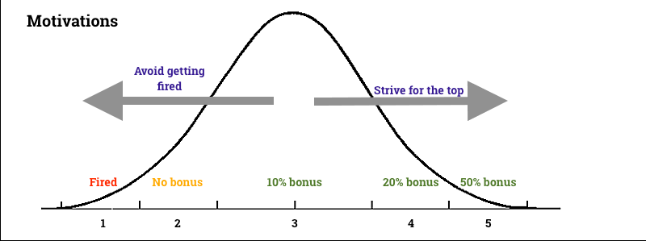
Forced Ranking Example
www.midocean.ae

Slide 12
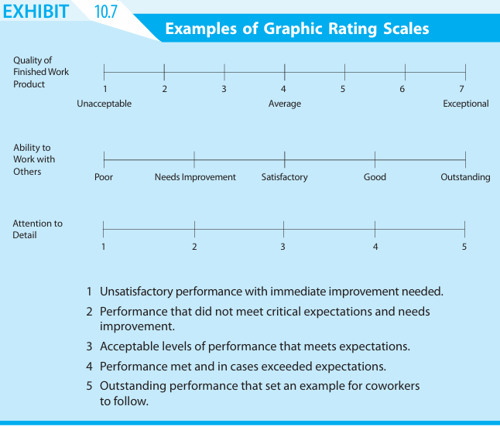
Graphic Rating Scales example
www.midocean.ae

Slide 13
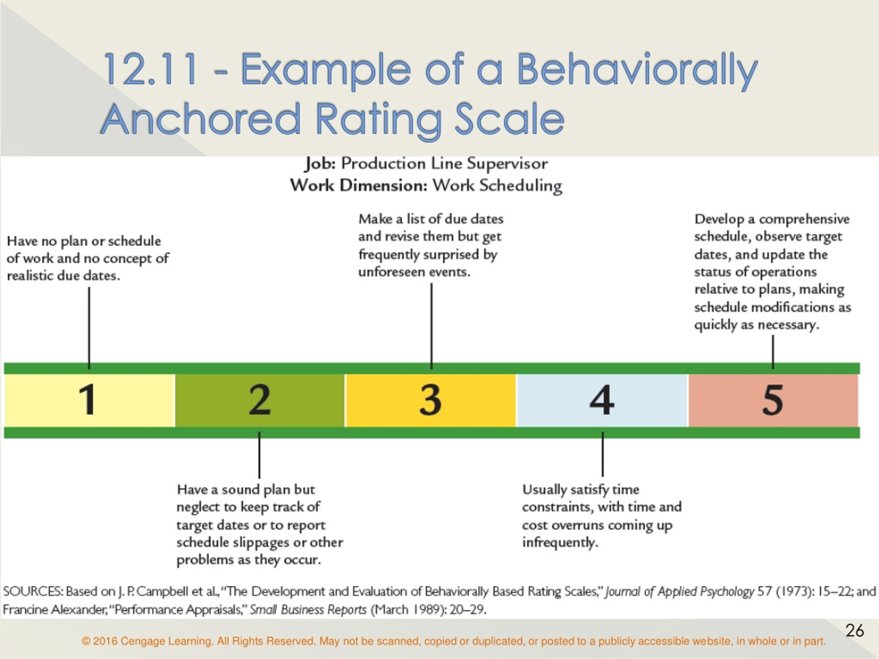
BARS Example
www.midocean.ae

Slide 14
MCQ
Click: https://joinmyquiz.com
Enter Join Code: 1257 2152
Click Start Game
www.midocean.ae

Slide 15
Critical Thinking
Develop a competency-based performance management system for a student in Business Admin. Master program.
How would you go about determining and measuring important competencies?
What benefits might such a system provide?
www.midocean.ae

Slide 16
Critical Thinking
A competency-based performance management system shifts the focus from input (coursework, attendance) to output (demonstrated skills and knowledge). It assesses a student's ability to apply knowledge in real-world situations.
Determining Important Competencies
To determine the crucial competencies for a Business Admin program, a comprehensive approach is necessary:
www.midocean.ae

Slide 17
Determining Important Competencies
1- Job Analysis and Industry Trends:
Research the roles and responsibilities of recent Business Admin graduates.
Identify the core competencies required for success in various business functions (e.g., finance, marketing, human resources).
Analyze industry trends to determine emerging competencies.
2- Program Learning Outcomes:
Align competencies with the program's stated learning outcomes.
Ensure that competencies cover both foundational knowledge and applied skills.
www.midocean.ae

Slide 18
Program Learning Outcomes Example
Program Learning Outcomes (PLOs) | Courses and Linked Competencies
PLO1: Demonstrate a strong foundation in business core principles (accounting, finance, marketing, management) | Financial Accounting, Marketing Principles, Management Fundamentals, Business Strategy, Marketing Research, International Business, Business Law
PLO2: Apply critical thinking and problem-solving skills to analyze business situations and make sound decisions. | Business Strategy, Organizational Behavior, Marketing Research
PLO3: Effectively communicate business ideas and information in written and oral formats. | Business Communication, Business Strategy
PLO4: Work collaboratively and contribute effectively in team settings. | Management Fundamentals, Organizational Behavior
PLO5: Demonstrate ethical decision-making and social responsibility in a business context. | Business Ethics, Business Law
www.midocean.ae

Slide 19
Determining Important Competencies
3- Stakeholder Input:
Involve faculty, alumni, industry professionals, and current students in the competency identification process.
Gather their insights on essential skills and knowledge for business success.
4- Competency Framework:
Organize competencies into a hierarchical structure, with foundational competencies at the base and advanced competencies at higher levels.
Consider using competency frameworks like the National Association of Colleges and Employers (NACE) Career Readiness Competencies as a starting point.
www.midocean.ae

Slide 20
Measuring Competencies
Effective measurement of competencies requires a variety of assessment methods:
1- Direct Observation:
  Assess students' performance in classroom activities, group projects, and presentations.
  Use rubrics to evaluate specific competencies.
2- Portfolios:
  Require students to collect evidence of their work (e.g., reports, case studies, projects).
  Evaluate the portfolio based on competency criteria.
www.midocean.ae

Slide 21
Measuring Competencies
3- Self-Assessment:
Encourage students to reflect on their strengths and weaknesses.
Use self-assessment tools to identify areas for improvement.
4- Peer Assessment:
Have students evaluate their peers' performance on group projects.
This provides opportunities for feedback and self-reflection.
5- Employer Evaluations:
Incorporate feedback from internships or co-op placements.
Evaluate students' performance in real-world work settings.
www.midocean.ae

Slide 22
Critical Thinking
Benefits of a Competency-Based System
Improved Student Focus
Enhanced Employability
Increased Student Engagement
Better Assessment of Student Progress
Stronger Alignment with Industry Needs
Example of KPIs: Quality of work, Time management , Problem-solving skills , Teamwork and collaboration , Communication skills, Professionalism, Initiative and self-motivation, Adaptability
www.midocean.ae

Slide 23
Intranet-Based Performance Management System
The digital age has witnesses a transition from paper-based to intranet-based performance management systems which represents a significant shift in organizational practices.
Critically analyze the potential benefits and drawbacks of this transition. Consider the economic, technological, and human implications of such a transformation.
Explore how these factors might influence an organization's decision-making process.
www.midocean.ae

Slide 24
Intranet-Based Performance Management System
Pros:
Efficiency: Streamlined processes, automated tasks, and real-time data access.
Accessibility: Information is available anytime, anywhere, for authorized users.
Data Analysis: Enables comprehensive data collection and analysis for performance trends and insights.
Collaboration: Facilitates real-time feedback and collaboration among employees and managers.
Environmental Friendliness: Reduces paper consumption and waste.
www.midocean.ae

Slide 25
Intranet-Based Performance Management System
Cons:
Technical Issues: System failures or security breaches can disrupt performance management processes.
Cost: Initial investment in software, hardware, and training can be substantial.
Dependency: Reliance on technology may hinder operations in case of system outages.
Data Security: Protecting sensitive employee data requires robust security measures.
www.midocean.ae

Slide 26
Costs of Transitioning to an Online System
Economic Costs:
  Software and hardware purchases.
  System implementation and customization.
  Employee training.
  Potential consulting fees.
  Data migration costs.
www.midocean.ae

Slide 27
Costs of Transitioning to an Online System
Technical Costs:
System integration with existing HR systems.
Network infrastructure upgrades.
Data security measures.
IT support resources.
Human Costs:
Resistance to change among employees.
Time spent on training and system adoption.
Potential disruptions to work processes during the transition.
www.midocean.ae

Slide 28
Case Study: TechNova
TechNova, a rapidly growing tech startup, had a traditional paper-based performance management system. Annual reviews were a dreaded process, often resulting in generic feedback and little actionable insight. The HR department recognized the need for a more efficient and effective system to align with the company's dynamic culture.
www.midocean.ae

Slide 29
Case Study: TechNova
The Challenge
TechNova faced several challenges with its paper-based system:
Time-consuming: The process of collecting, reviewing, and aggregating feedback was lengthy and inefficient.
Lack of real-time feedback: Employees were often surprised by their annual reviews, with little opportunity for mid-year course corrections.
Limited data insights: Paper-based records made it difficult to analyze performance trends and identify development areas.
Ineffective goal setting: Performance goals were often vague and lacked clear metrics.
www.midocean.ae

Slide 30
Case Study: TechNova
The Solution
To address these challenges, TechNova implemented an intranet-based performance management system. The new system incorporated features such as:
Continuous feedback: Employees could provide and receive feedback throughout the year.
Goal setting: Clear, measurable, and achievable goals were set collaboratively between employees and managers.
Performance tracking: Real-time monitoring of performance metrics.
360-degree feedback: Input from peers, subordinates, and customers was incorporated.
Talent development plans: Customized development plans based on performance data.
www.midocean.ae

Slide 31
Case Study: TechNova
The Results
The transition to an intranet-based system yielded significant benefits:
Increased employee engagement: Employees felt more valued and empowered with regular feedback and goal setting.
Improved performance: The system provided a clear framework for goal achievement and development.
Data-driven decisions: HR could analyze performance data to identify trends and make informed decisions.
Time savings: Automation of many processes freed up time for managers and employees.
Enhanced communication: Regular feedback fostered open communication and collaboration.
www.midocean.ae

Slide 32
Case Study: TechNova
Discussion Questions
How can GreenTech ensure the confidentiality and anonymity of feedback to encourage honest responses?
What strategies can GreenTech use to maximize the impact of the 360-degree feedback on performance improvement?
How can GreenTech measure the return on investment of the 360-degree feedback program?
www.midocean.ae

Slide 33
Case Study: TechNova
Challenges in the Long-Term Use of the Intranet-Based System
Data Quality: Maintaining high-quality data input may become challenging, especially if the system is not user-friendly or if employees perceive the process as time-consuming.
System Obsolescence: As technology evolves, the performance management system may become outdated, requiring updates and maintenance.
Resistance to Change: Employees may resist changes to the system or processes, especially if the initial implementation was not smooth.
www.midocean.ae

Slide 34
Case Study: TechNova
Ensuring Data Privacy and Security
Access Controls: Limit access to performance data to authorized personnel.
Data Encryption: Encrypt sensitive information to prevent unauthorized access.
Regular Security Audits: Conduct routine audits to identify and address vulnerabilities.
Employee Training: Educate employees about data security best practices.
Compliance Adherence: Ensure compliance with relevant data protection regulations (e.g., GDPR, CCPA).
www.midocean.ae

Slide 35
Case Study: TechNova
Maximizing Employee Adoption of the New System
Effective Communication: Clearly communicate the benefits of the new system and how it aligns with the company's goals.
User-Friendly Interface: Ensure the system is easy to navigate and use.
Training and Support: Provide comprehensive training and ongoing support to employees.
Incentives and Recognition: Reward employees for effective use of the system.
Pilot Program: Conduct a pilot program to gather feedback and make necessary adjustments before full-scale implementation.
Change Management: Implement a change management plan to address employee concerns and resistance.
www.midocean.ae

Slide 36
Week
01
References
Main Reference
Mello A .Jeffrey (2011). Strategic Management of Human Resources (3rd ed.) South-Western Cengage Learning.
Additional Resources for extra reading.
Boselie, Paul (2014). Strategic Human Resource Management: A Balanced Approach .McGraw Hill Companies.
Millmor, Mike, Philip Lewis, and others (2007), Strategic Human Resource Management Contemporary issues. Ft Prentice Hall.
www.midocean.ae

Slide 37



Thank You

