Slide 1

PMG 611
Enterprise Risk Management
Prepared by Dr. Abdullah Jameel Halawany
Lecture 11
Establishing an Effective GRC Culture throughout the Enterprise

Slide 2

Session Outline
First Steps to Establishing a GRC Culture
Promoting the Concept of Enterprise Risk
Enterprise Codes of Conduct
GRC Education Programs
Session Outline

Slide 3
Introduction

Slide 4
Introduction
Enterprise Senior Officers and Board Members often talk among themselves about the importance of launching some new enterprise-wide cultural approach or strategic direction.
That type of new approach, however, will not launch new products in the marketplace or open new facilities.
It is also a concept that will be just talk until it is properly communicated to and accepted by all stakeholders in the enterprise.

Slide 5
Introduction
The matter or issue must become part of the enterprise’s ‘‘Culture’’.
A concept that sounds good but is difficult to execute.
Some enterprises, due to their many frequent changes, have never been able to establish a recognized culture, while others have built enduring cultures over the years.

Slide 6
Introduction
Culture refers to an enterprise’s values, beliefs, and behaviors.
In general, it forms the basis on which people interpret experiences and behave, individually and in groups.
Enterprises with strong cultures generally achieve higher results because employees sustain their focus on both what to do and how to do it.
These same factors are also essential for building an effective governance, risk management, and overall compliance culture in an enterprise.

Slide 7
Introduction
Whether the chief executive officer (CEO) and board have indicated that the enterprise wants to grow rapidly and are willing to take necessary steps to get there or they have indicated a strategy of cautious steps for new ventures, they are describing their culture and outlining a high-level risk strategy.

Slide 8
Introduction
In order to get an enterprise operating in either manner, these concepts should be communicated to become part of the overall enterprise-wide culture.
That is, if a rapid growth strategy is planned, managers and staff at all levels need to think and make decisions to help promote that rapid growth.
They are building a culture of growth for the enterprise!

Slide 9
Introduction
That same concept is necessary to build an effective GRC culture in an enterprise.
This should be a culture that reflects the appetite for risk that has been described and defined by senior management, that has strong standards for regulatory and rules compliance, and that has an overall governance program that should be followed by stakeholders at all levels.

Slide 10
First Steps To Establishing A GRC Culture

Slide 11
First Steps To Establishing A GRC Culture
Enterprises worldwide are starting to take corporate governance, risk, and compliance seriously.
There is growing awareness among organizations of the risks of not having such a program in place.
Because every enterprise is unique, there is no ‘‘one size fits all’’ approach toward implementing a successful GRC framework.
There are several common challenges enterprises face when developing and implementing an effective GRC strategy and overall culture.

Slide 12
First Steps To Establishing A GRC Culture
General GRC concepts and concerns must be clearly communicated and understood by all enterprise stakeholders, whether employees, vendors, or others.
This can be a difficult concept for many.
While there is usually a general understanding as to the meaning of the terms governance, risk, and enterprise compliance, many will have problems translating these concepts in any greater level of detail or action plans.

Slide 13
First Steps To Establishing A GRC Culture
Enterprises need to build and establish strong GRC cultures that are understood and implemented throughout their operations and on a continuous ongoing basis.
How to build an enterprise-wide GRC culture?
  Developed and Released a Revised Employee Code of Conduct.
  Launched a Strong Program of Ethics Education.
  Revised and Rewrote Many Existing Policies and Procedures.
  Established a Whistleblower Program.

Slide 14
To Build An Enterprise-Wide GRC Culture
Developed and Released a Revised Employee Code of Conduct.
  A revised set of code of conduct rules should be developed, released, and communicated through strong enterprise-wide code of conduct educational programs.
  After strong CEO and other senior management endorsements, employees have to be asked to formally acknowledge that they had read these code of conduct rules, understood them, and would follow them.

Slide 15
To Build An Enterprise-Wide GRC Culture
Launched a Strong Program of Ethics Education.
  Through company classes, articles in newsletters, posters, and ongoing communications from senior managers, the message to always ‘‘Do The Right Thing’’ must be communicated to all stakeholders.
  The idea is to reinforce the idea of being ethical into the culture of the enterprise.

Slide 16
To Build An Enterprise-Wide GRC Culture
Revised and Rewrote Existing Policies and Procedures.
  Examination of the entire set of enterprise’s policies and procedures.
  Put in place a processes to better review and communicate these ‘‘New Rules’’.
Established a Whistleblower Program.

Slide 17
Promoting The Concept Of Enterprise Risk

Slide 18
Promoting The Concept Of Enterprise Risk
Risk management is one of the three important GRC principles.
Perhaps a tough sell to begin, the concept and importance of risk management needs to be communicated and constantly promoted to all members of the enterprise.
In a very subtle way, this idea of building a risk awareness culture is a bit more difficult than promoting an ethics culture.

Slide 19
Promoting The Concept Of Enterprise Risk
With Ethics, it is often sufficient to encourage employees to ‘‘do the right thing’’ with a shared value that most understand enough of right and wrong to easily make decisions.
Risk management too often involves some ‘‘shades of gray’’ concepts where an enterprise may have an appetite for either high or low levels of risk, and with stakeholder decisions based on that philosophy.

Slide 20
Defining the Risk Management Philosophy
Mutual understanding of the enterprise risk culture is important!
An enterprise needs to clearly define its risk management philosophy in a manner that can be understood at all levels.
Communicating a risk management philosophy can be difficult because there are always shades of variability in any enterprise’s approach to managing its risks.

Slide 21
Defining the Risk Management Philosophy
In many respects, drafting such a formal GRC philosophy statement is similar to developing any high-level statement, such as a management objective or a code of conduct.
In a precise and explicit way, these statements and messages must express a risk management philosophy in a clear and succinct manner.

Slide 22
Defining the Risk Management Philosophy
Depending on the talents and skills within the enterprise, drafting such published statements may require the talents and skills of specialized people in the enterprise or through outside contracted help.
Considerable care must be given to the nature of the message in that philosophy.

Slide 23
Defining the Risk Management Philosophy
It must emphasize that there are risks associated with all business transactions and that stakeholders must make decisions that are consistent with the enterprise’s risk philosophy.

Slide 24
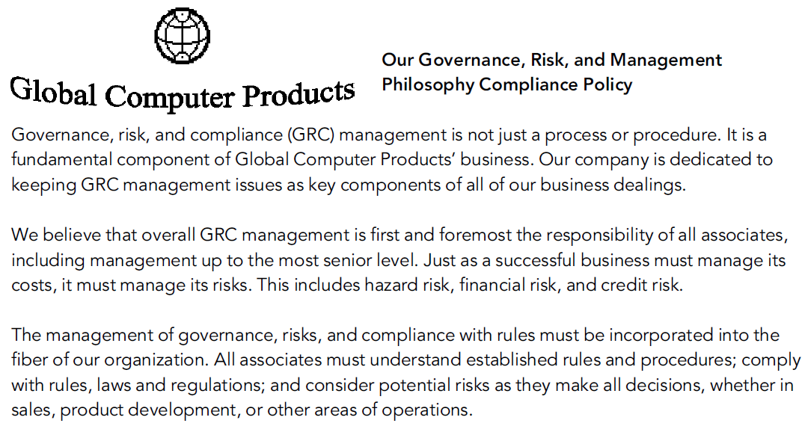
Defining the Risk Management Philosophy

Slide 25
Defining the Risk Management Philosophy
Stakeholders need to understand any such statement and to take active steps to implement it in their day-to-day business activities.
They need to understand that all activities involve some risks, but their activities should be consistent with that philosophy.

Slide 26
Translating a Risk Philosophy into a Culture
3M Corporation is a good example of a company where stakeholders at all levels were encouraged to try new products or ventures to build the business.
Not every new venture worked, but the team there has evidently been encouraged over the years to take some prudent risks in order to encourage strong growth patterns.
This appears to be an environment where some risk appears to be tolerated in order to achieve growth.

Slide 27
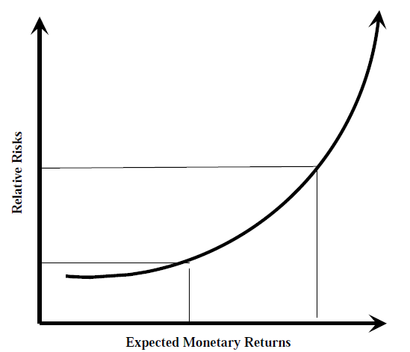
Translating a Risk Philosophy into a Culture
Too much of a high-risk culture with poor governance procedures is usually not good.
Both of extremes of very high - or very low-risk approaches are the results of fairly deliberate management strategies that should be understood by stakeholders.
Relative Risks versus Expected Returns

Slide 28
Translating a Risk Philosophy into a Culture
Repeat Higher-Risk or Lower-Risk Strategies in All Business Communications.
Understand the Rules and Take Appropriate Compliance Actions..
Clearly Reward People for Making Appropriate Risk-Based Decisions.
Encourage All Stakeholders to Follow Good GRC Policies and Procedures.

Slide 29
Enterprise Codes Of Conduct

Slide 30
Enterprise Codes Of Conduct
While a mission statement is a keystone to hold together the overall structure of corporate governance, an effective code of conduct provides the supporting rules for enterprise stakeholders.
An enterprise today should develop and enforce a code of conduct that covers a set of appropriate ethical, business, and governance rules for all of its stakeholders, whether the financial officers, all other employees, or a larger group of stakeholders.

Slide 31
Enterprise Codes Of Conduct
An effective Code Of Conduct will promote ethical business and GRC practices throughout an enterprise.
It is a key component of an enterprise’s GRC culture.
A Code Of Conduct should be a clear, unambiguous set of rules or guidance that outlines rules or what is expected of members of the enterprise, whether officers, employees, contractors, vendors, or other stakeholders.
The Code should be both based on the values and legal issues surrounding an enterprise.

Slide 32
Enterprise Codes Of Conduct -Examples
"During working hours, employees are only permitted to use technology such as cellphones, social media or the internet for personal use while on break.“
"Our company's dress code is laid back most days. Employees are free to wear jeans, t-shirts, sweatshirts and leggings that are not see-through. Of course, if employees wish to wear business casual attire, they are encouraged to do so.”

Slide 33
GRC Education Programs

Slide 34
GRC Education Programs
Beyond strong messages to stakeholders, an appreciation of all elements of the GRC program should be communicated through ongoing training programs.
New stakeholders at all levels should learn that their enterprise faces risks and compliance requirements at all levels.
They are expected to take appropriate actions to consider those risks and to install corrective actions to guard against them.

Slide 35
GRC Education Programs
Many enterprises are not large enough nor have the time and resources to develop specialized risk management, compliance, and governance training materials, the message of the enterprise’s GRC culture can be folded into other training materials covering other areas.

Slide 36
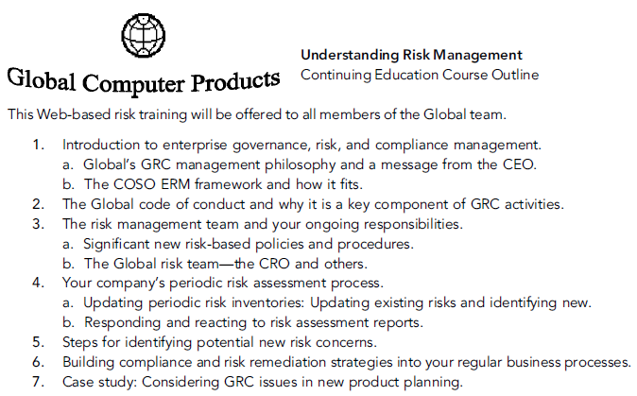
GRC Education Programs

Slide 37
Summary

Slide 38
This should be a culture that reflects the appetite for risk that has been described and defined by senior management, that has strong standards for regulatory and rules compliance, and that has an overall governance program that should be followed by stakeholders at all levels.
A strong ethics program, based on a meaningful mission statement and a code of conduct, are key elements to any overall program of corporate governance in an enterprise.

Slide 39
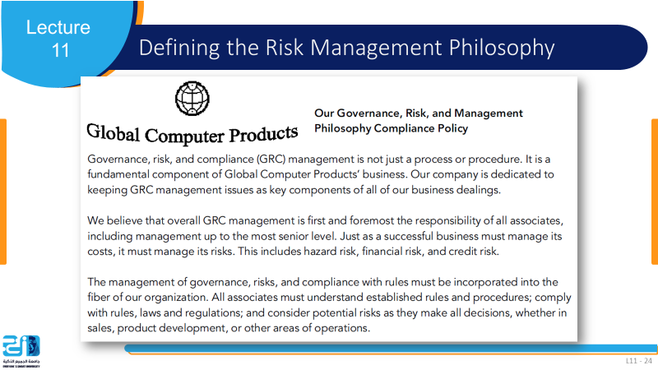
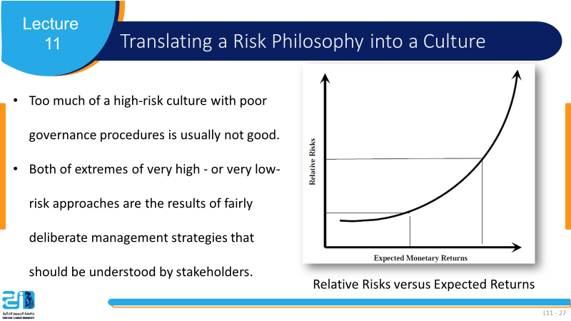

Slide 40
References
COSO Enterprise Risk Management: Establishing Effective Governance, Risk, and Compliance Processes. Robert R. Moeller.

