Slide 1


Slide 2
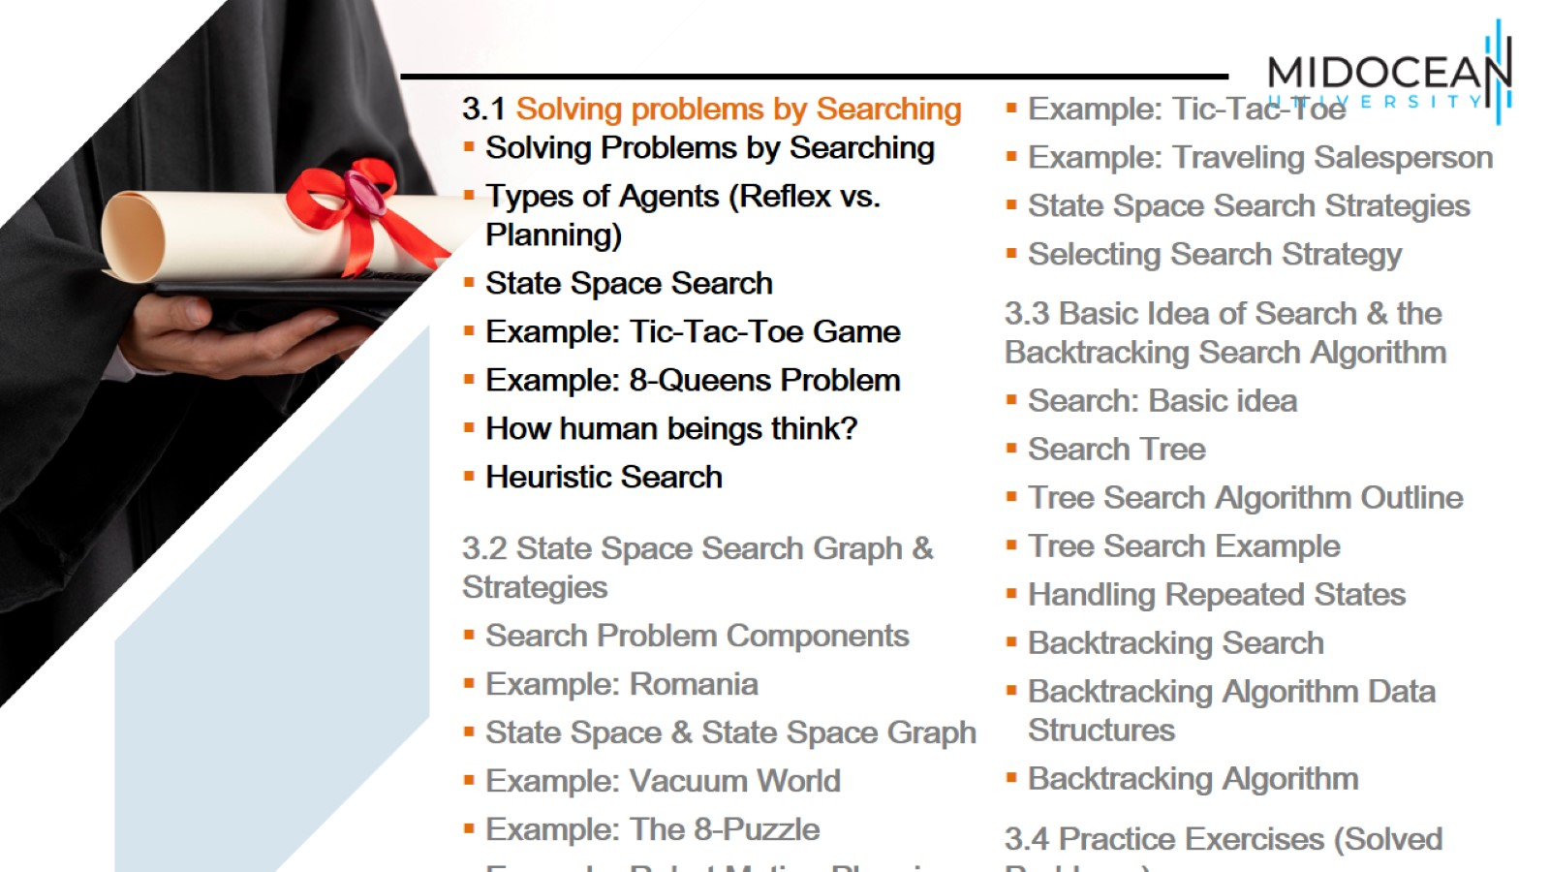

Slide 3
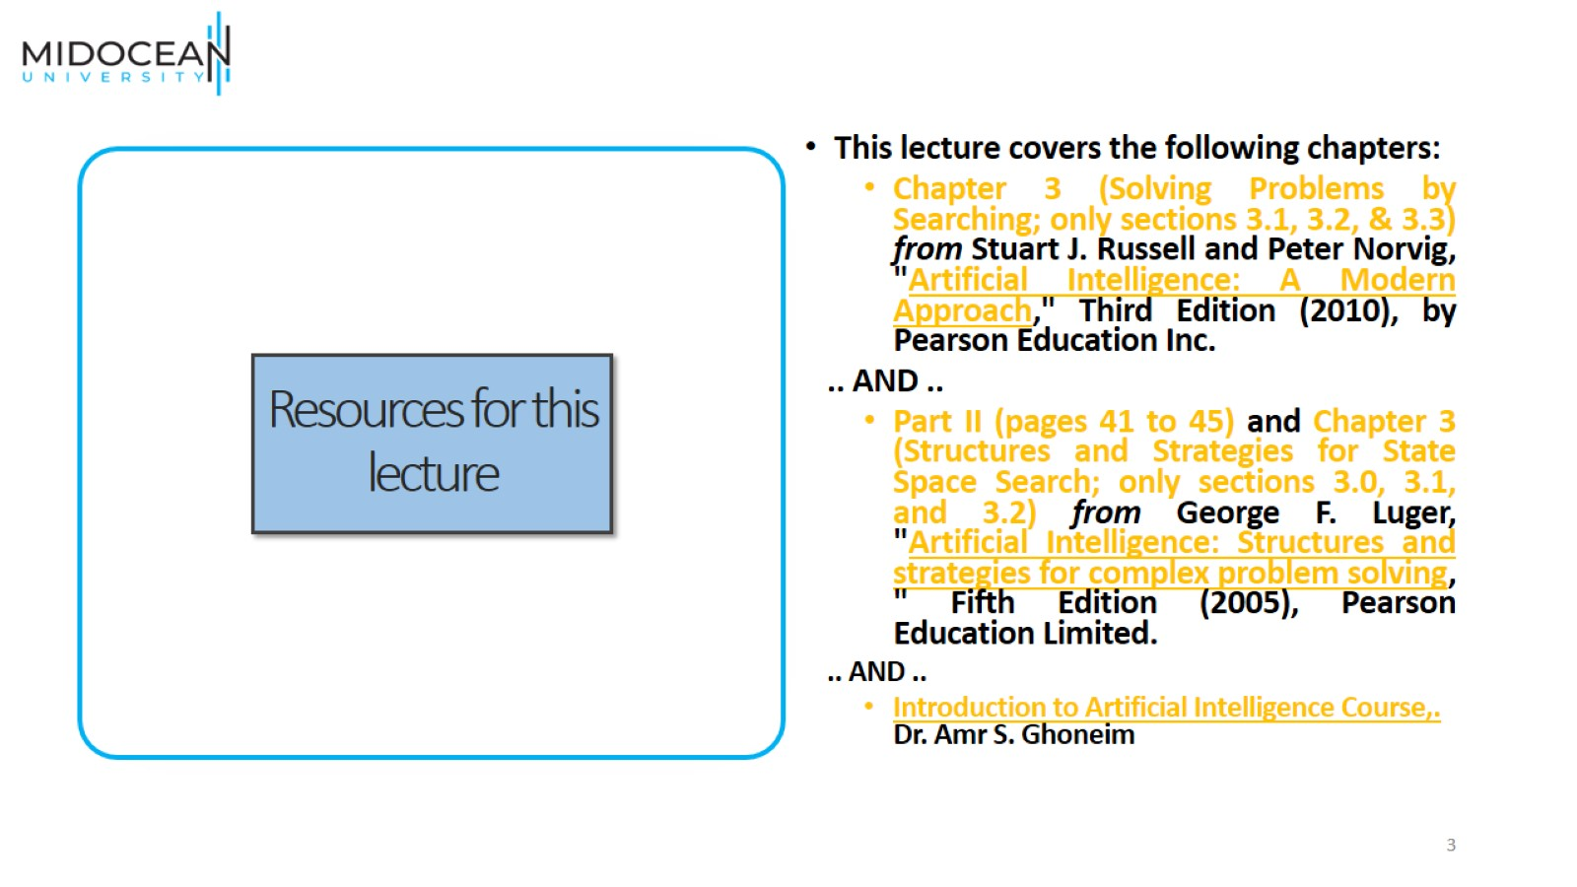
Resources for this lecture

Slide 4
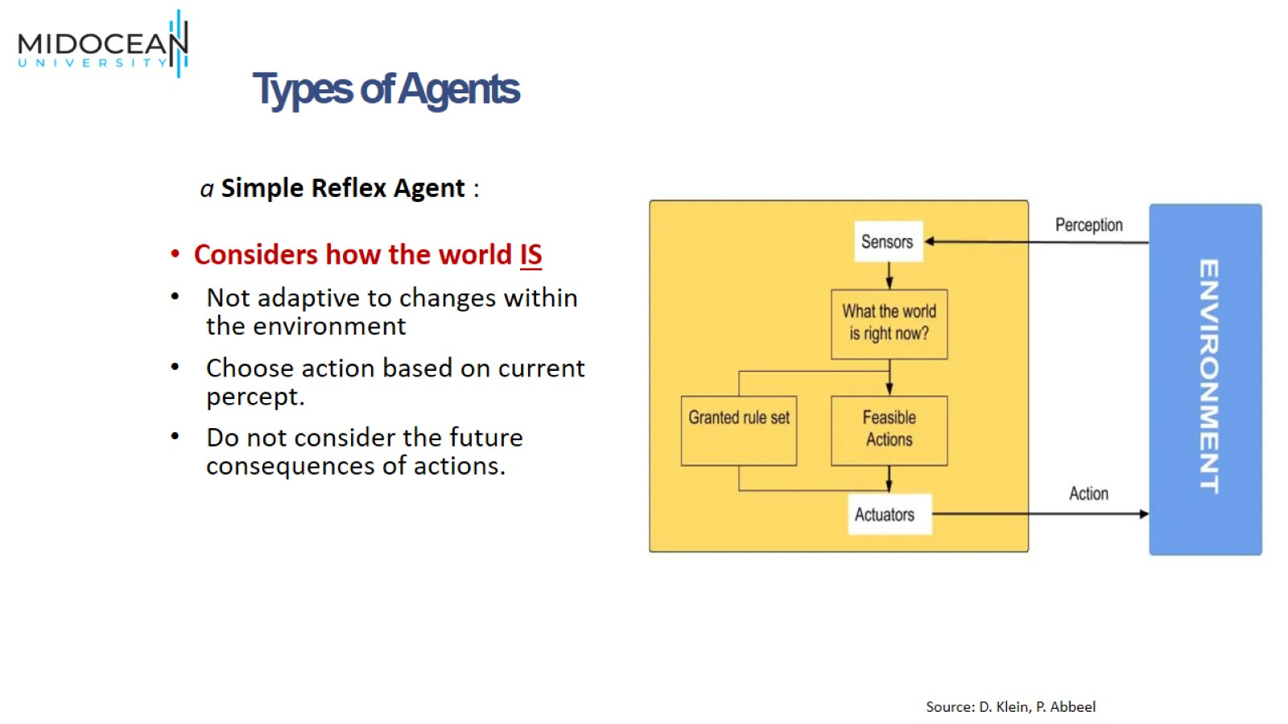

Slide 5
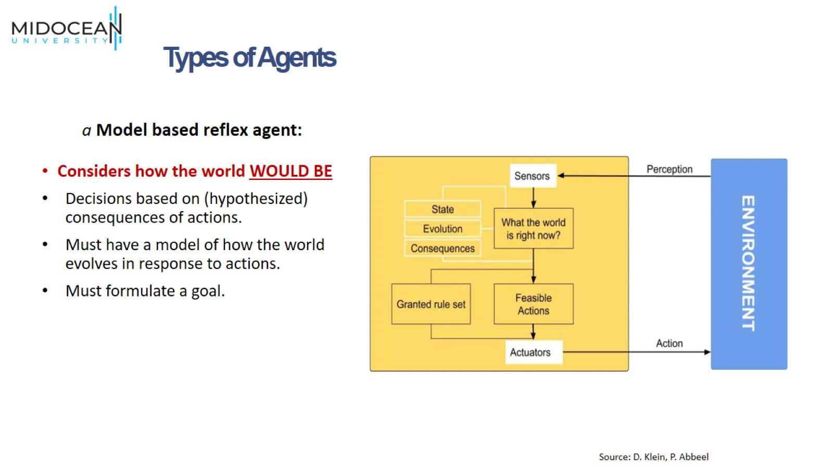

Slide 6
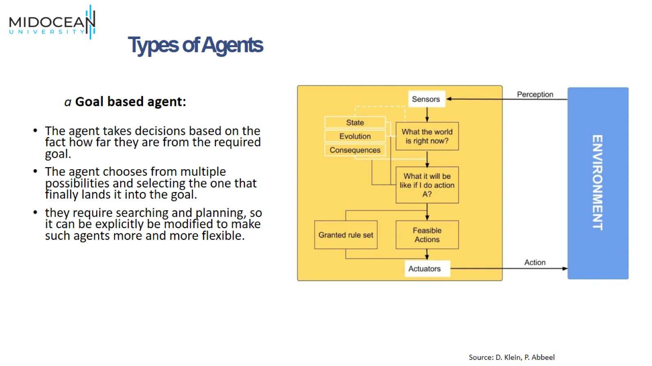

Slide 7
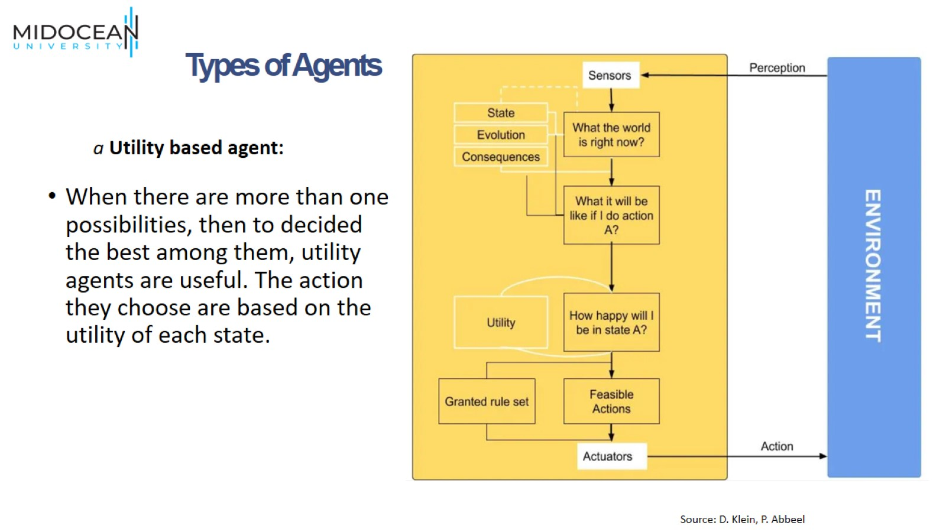

Slide 8
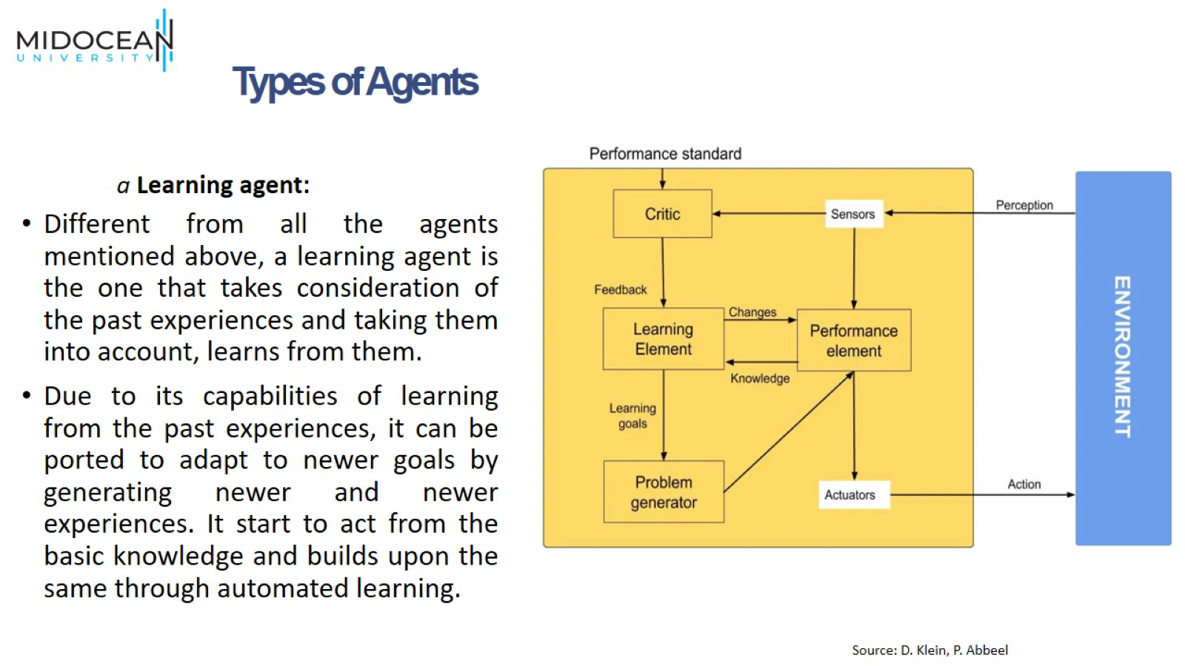

Slide 9
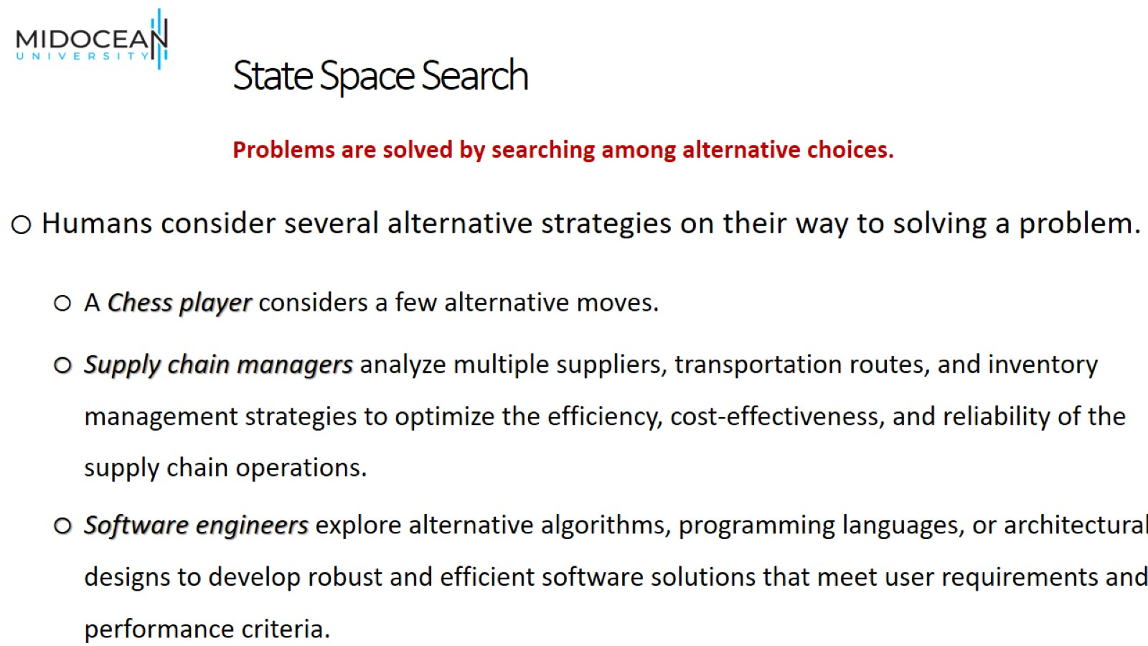
State Space Search

Slide 10
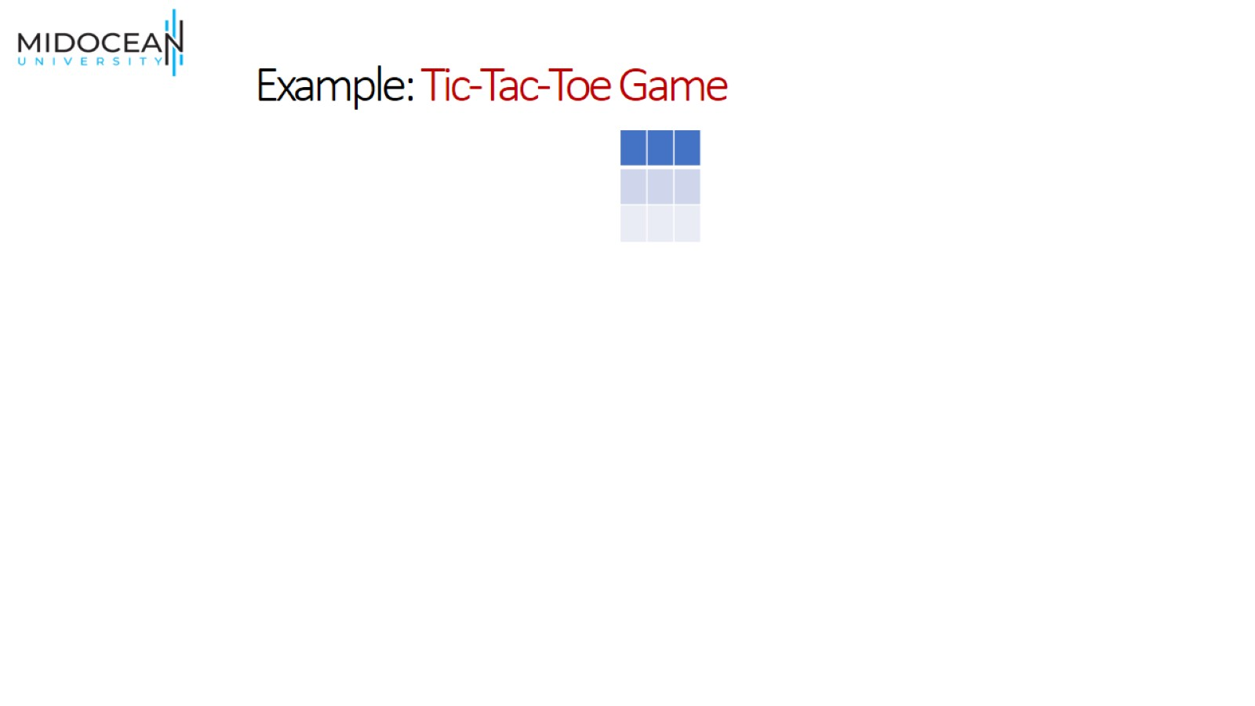
Example: Tic-Tac-Toe Game

Slide 11
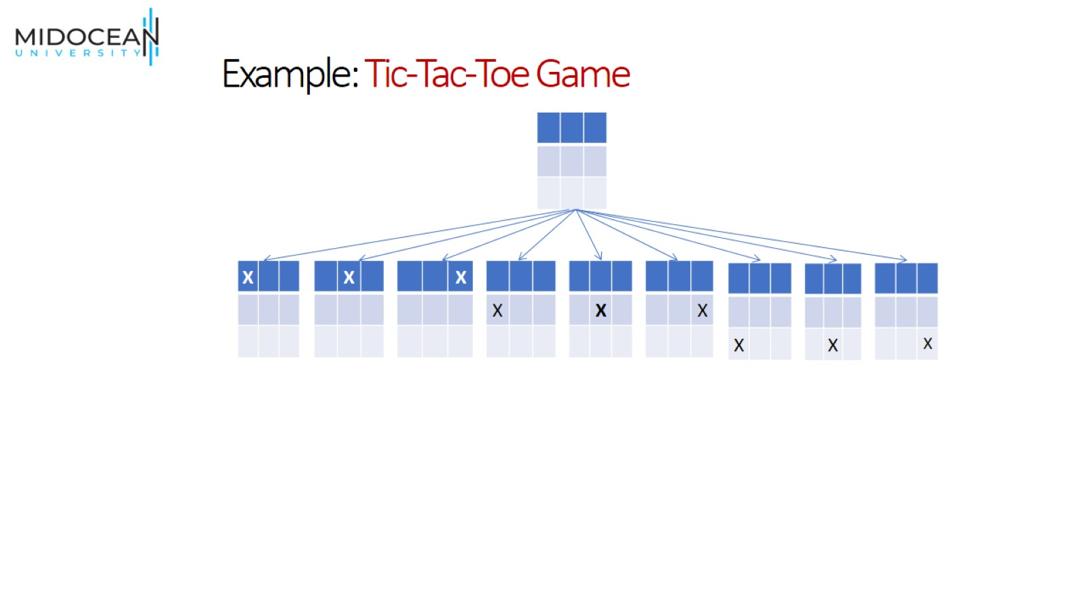
Example: Tic-Tac-Toe Game

Slide 12
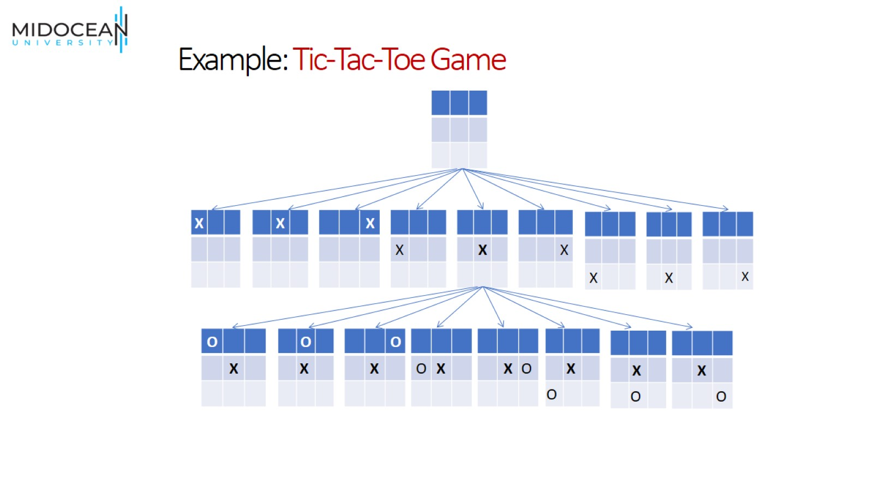
Example: Tic-Tac-Toe Game

Slide 13
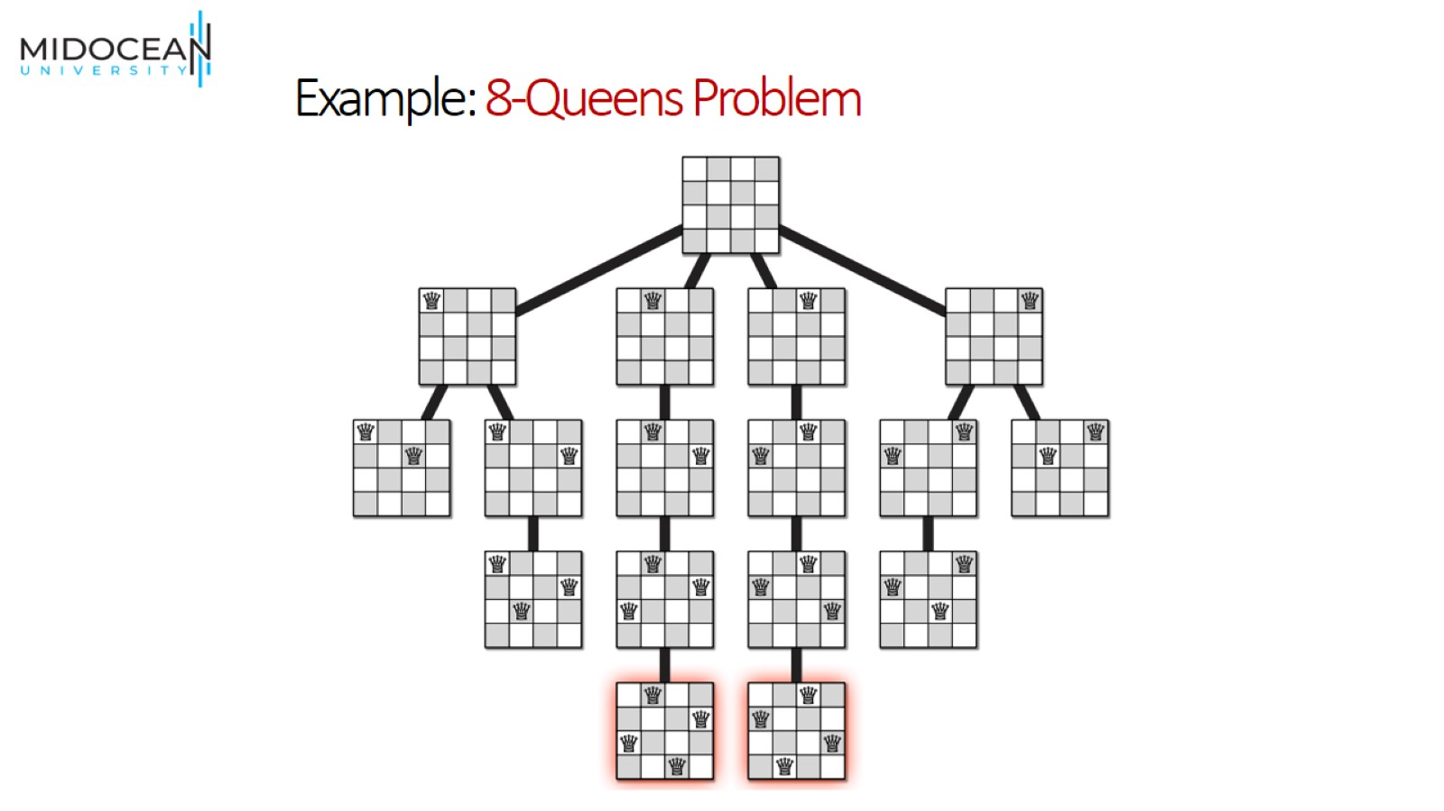
Example: 8-Queens Problem

Slide 14
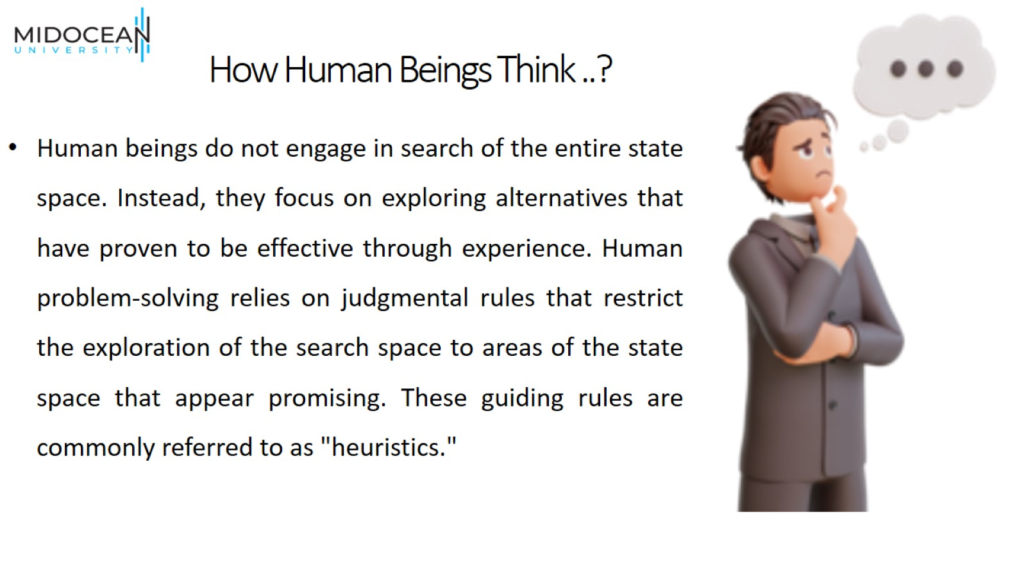
How Human Beings Think ..?

Slide 15
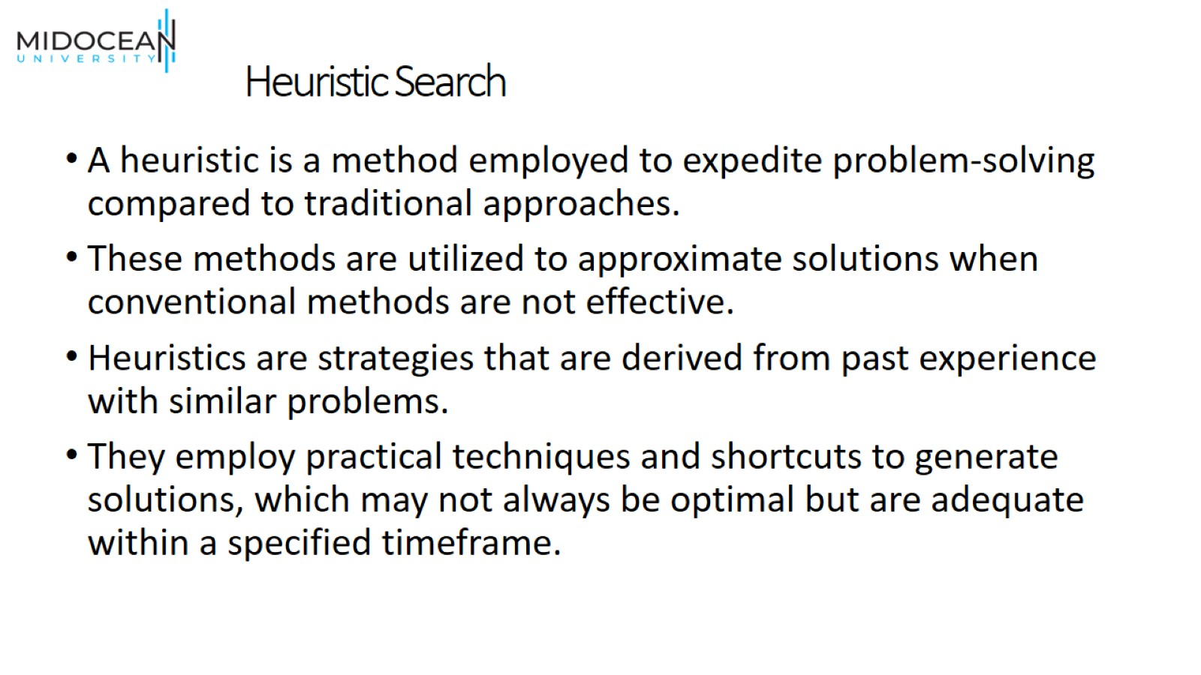
Heuristic Search

Slide 16
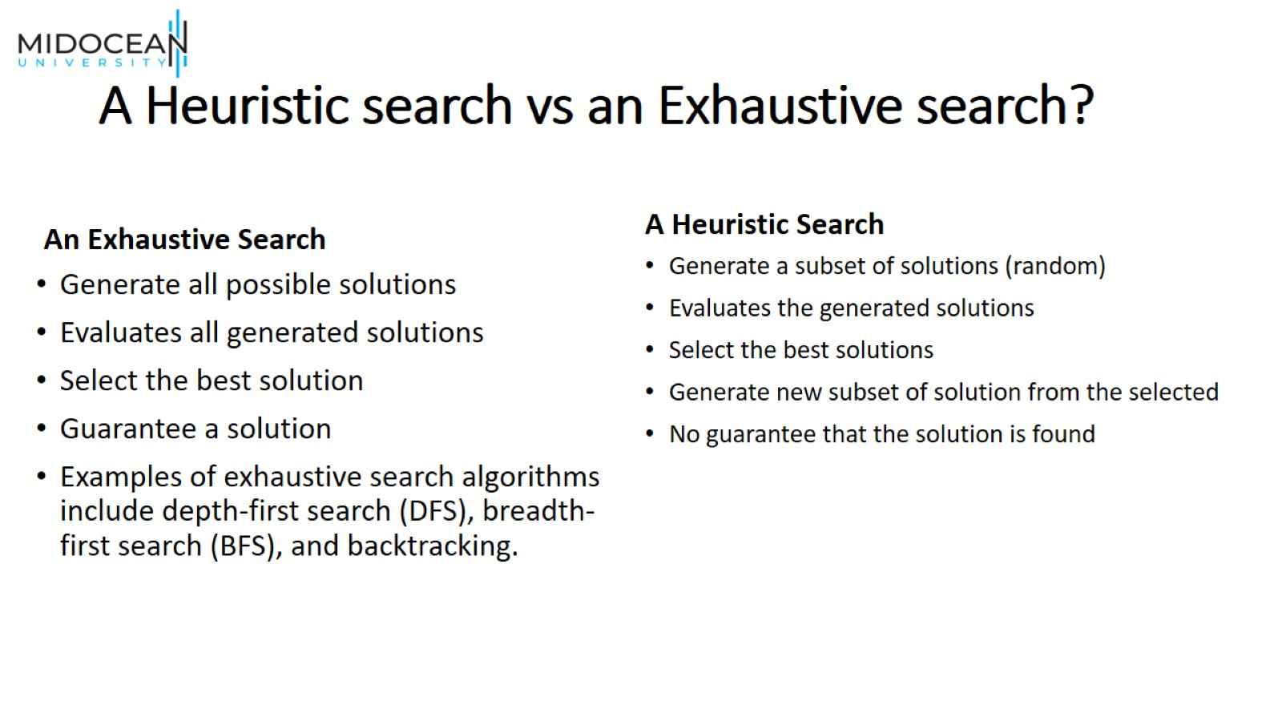
A Heuristic search vs an Exhaustive search?

Slide 17
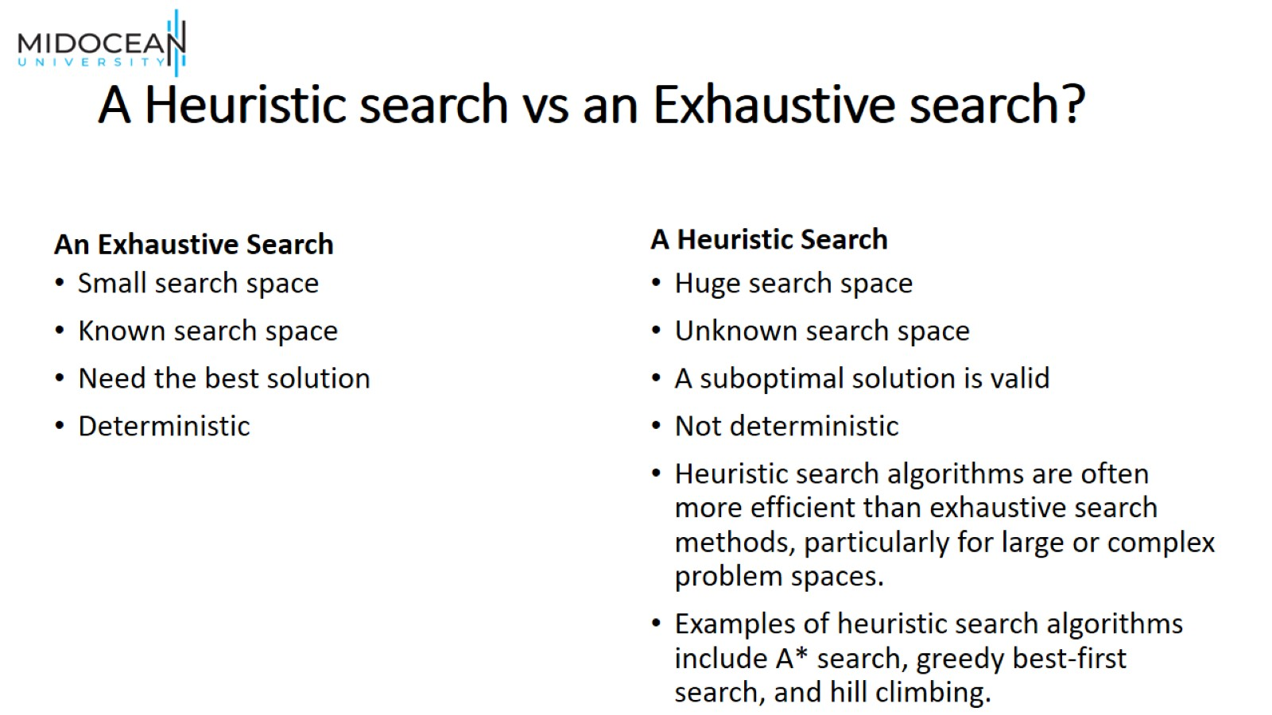
A Heuristic search vs an Exhaustive search?

Slide 18
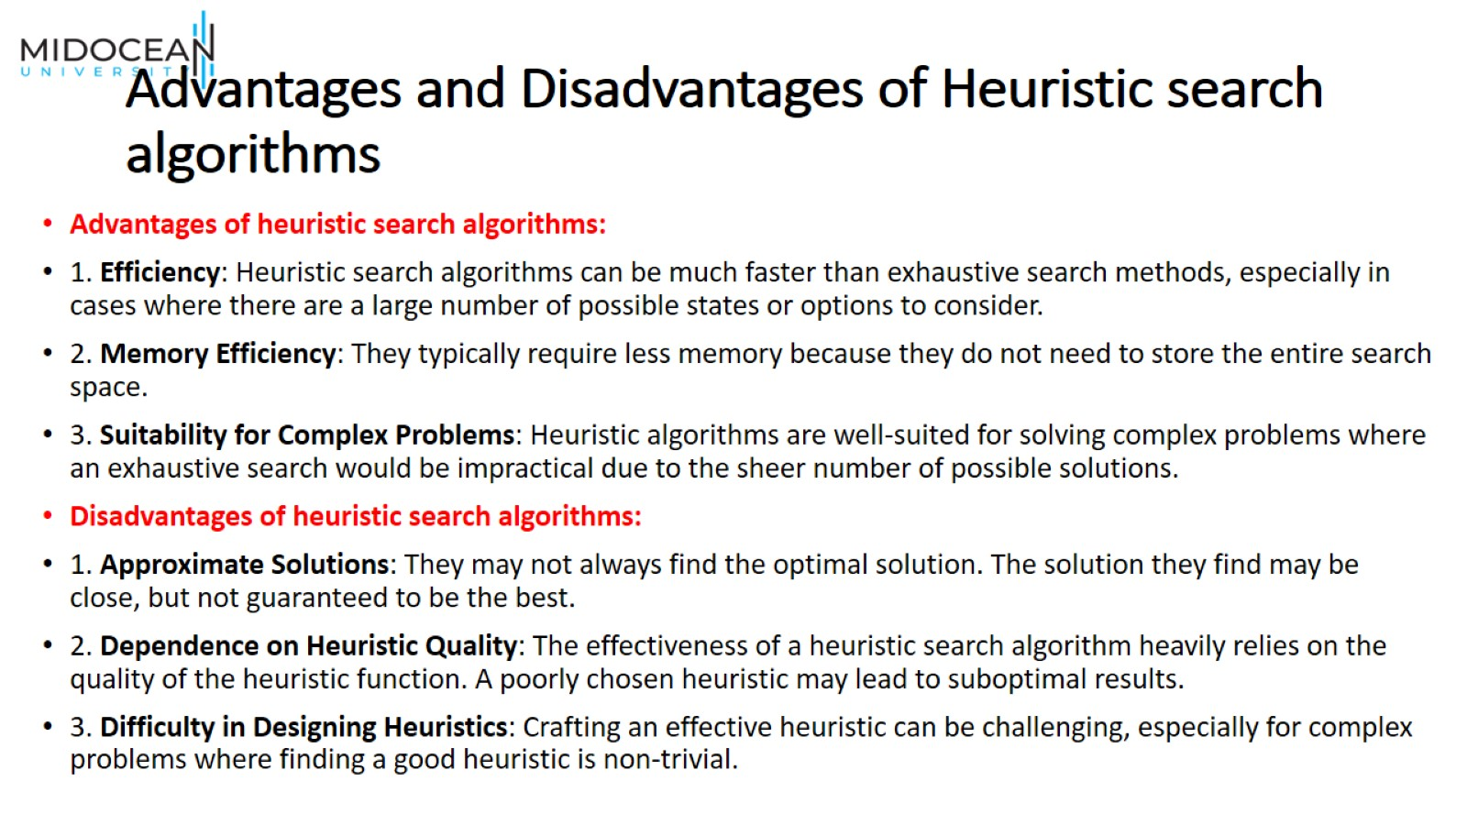
Advantages and Disadvantages of Heuristic search algorithms

Slide 19
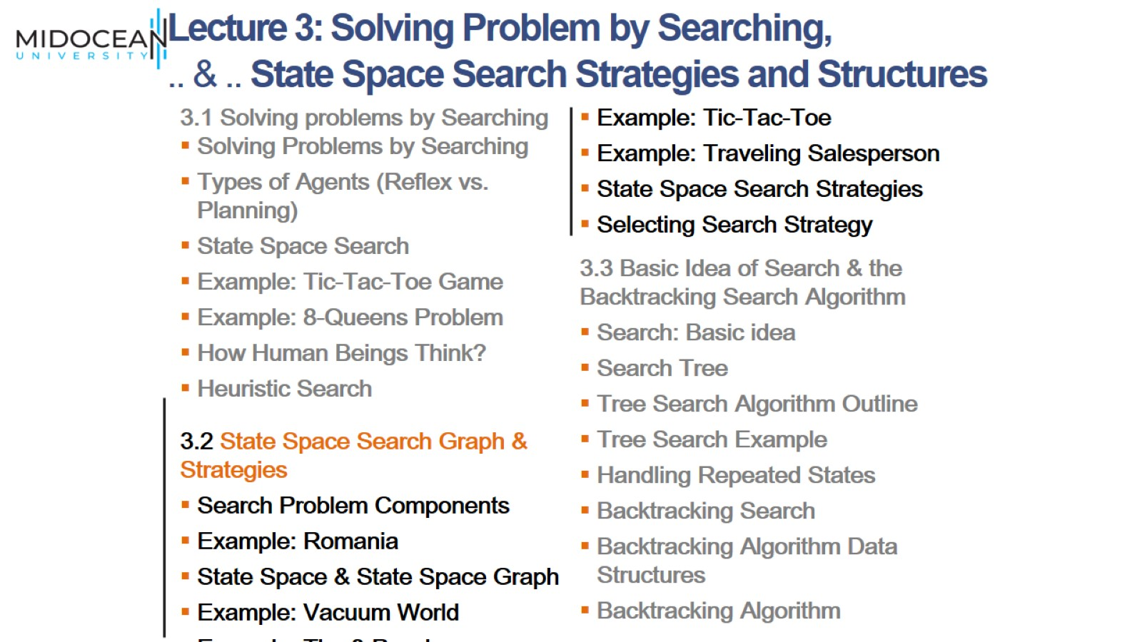

Slide 20
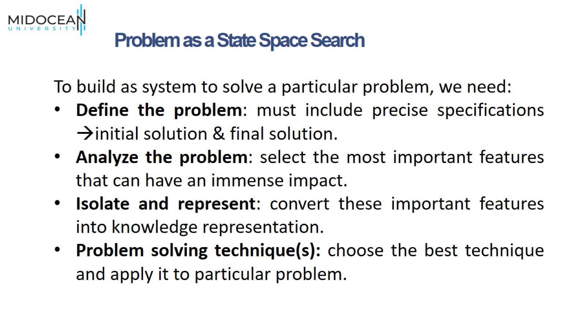

Slide 21
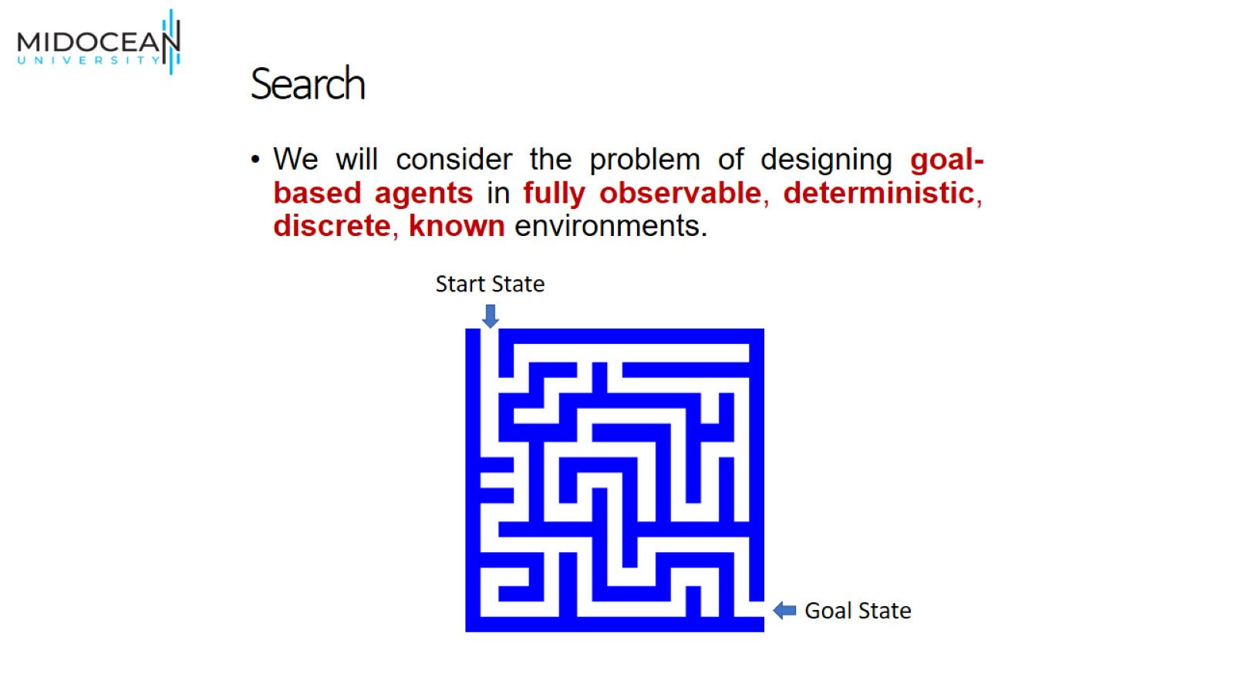
Search

Slide 22
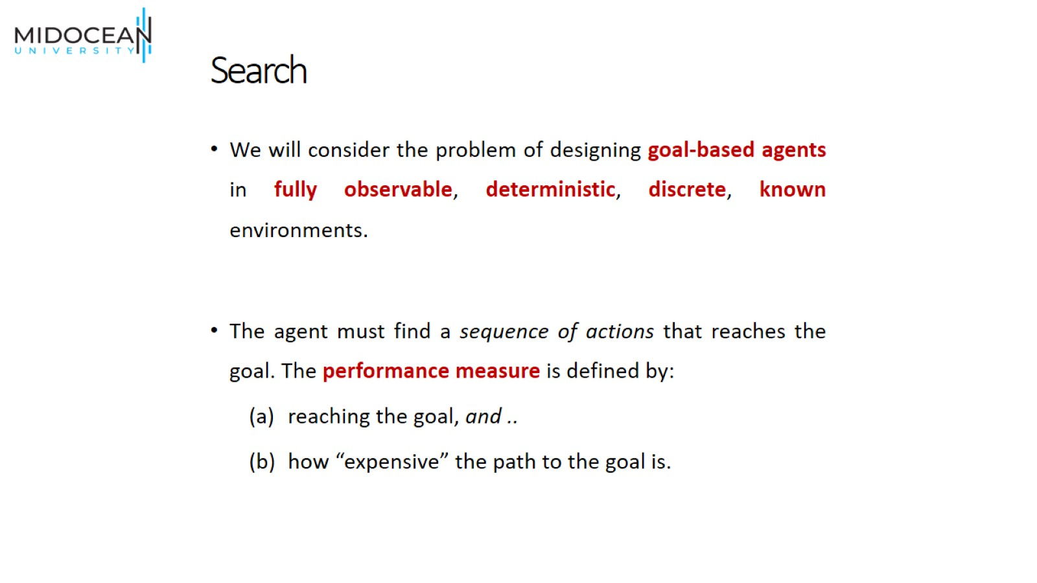
Search

Slide 23
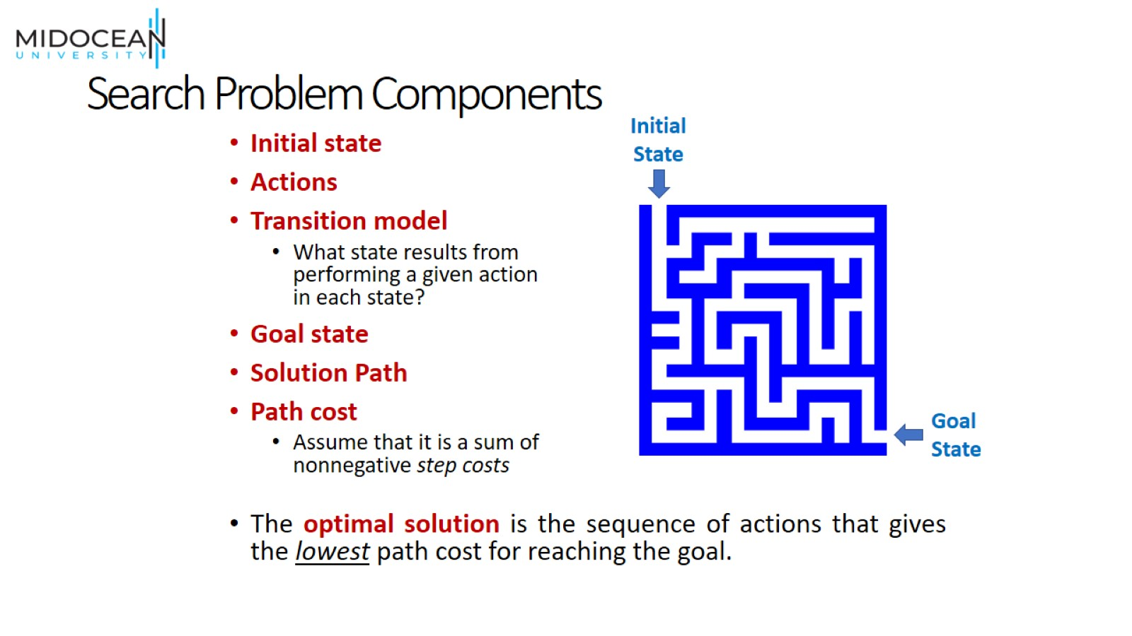
Search Problem Components

Slide 24
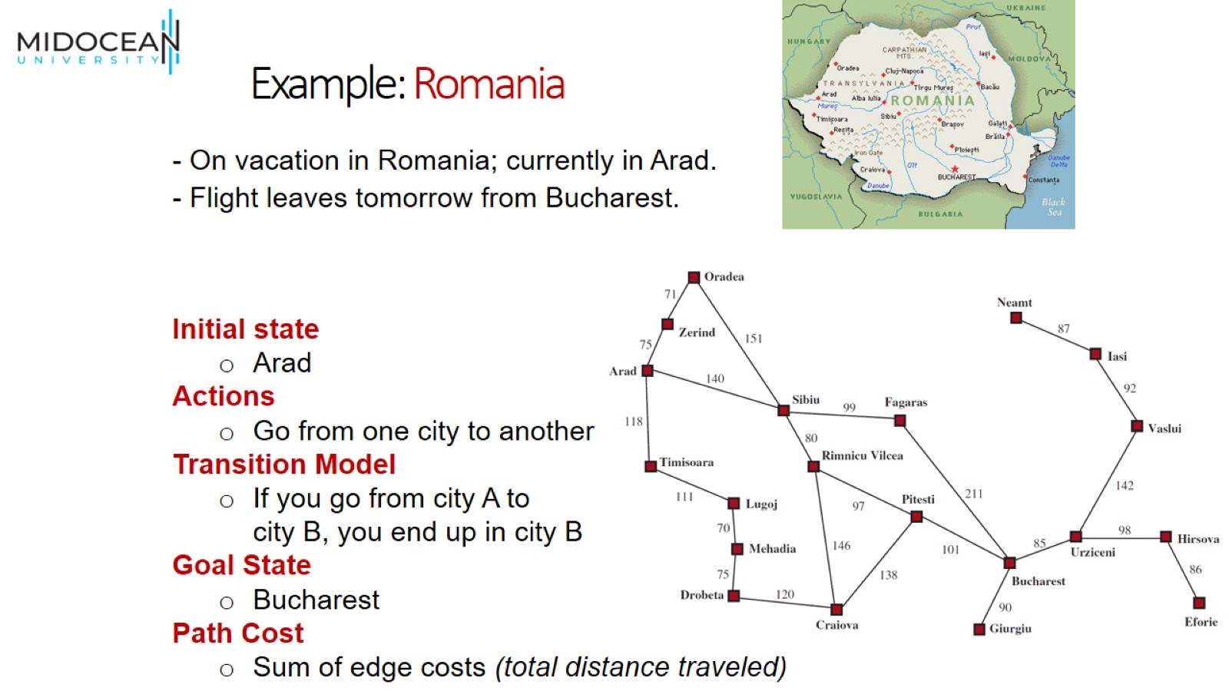
Example: Romania

Slide 25
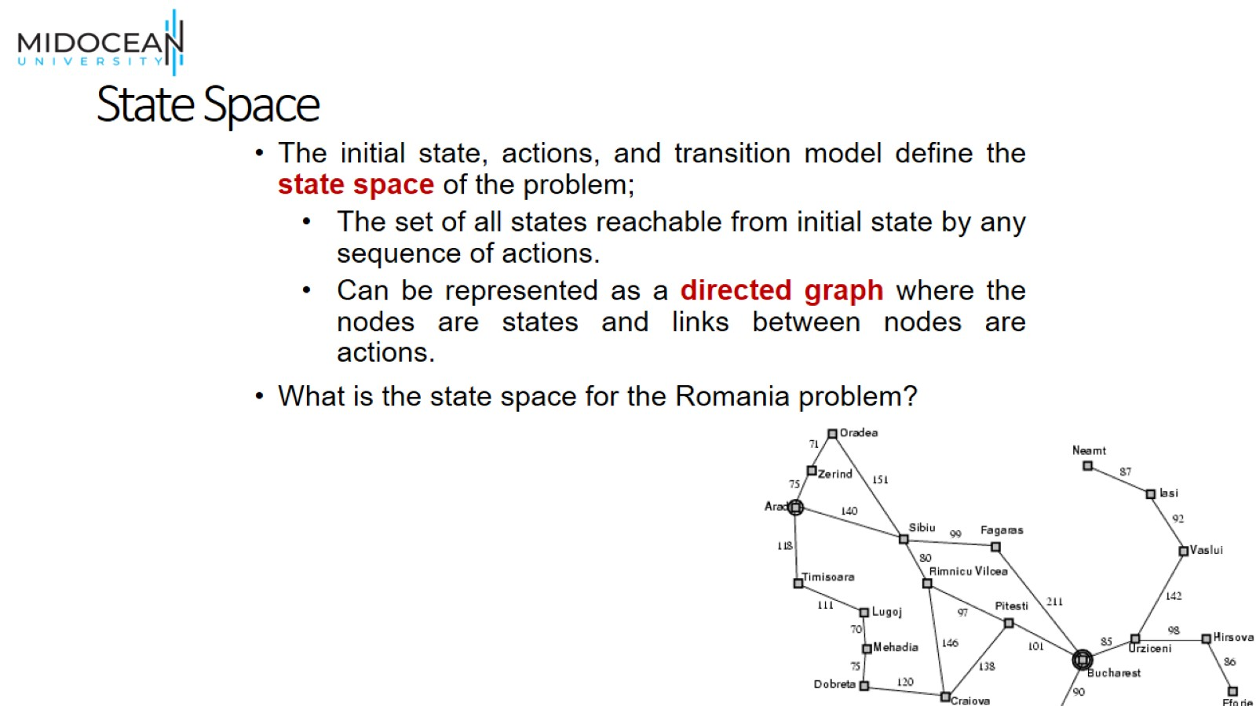
State Space

Slide 26
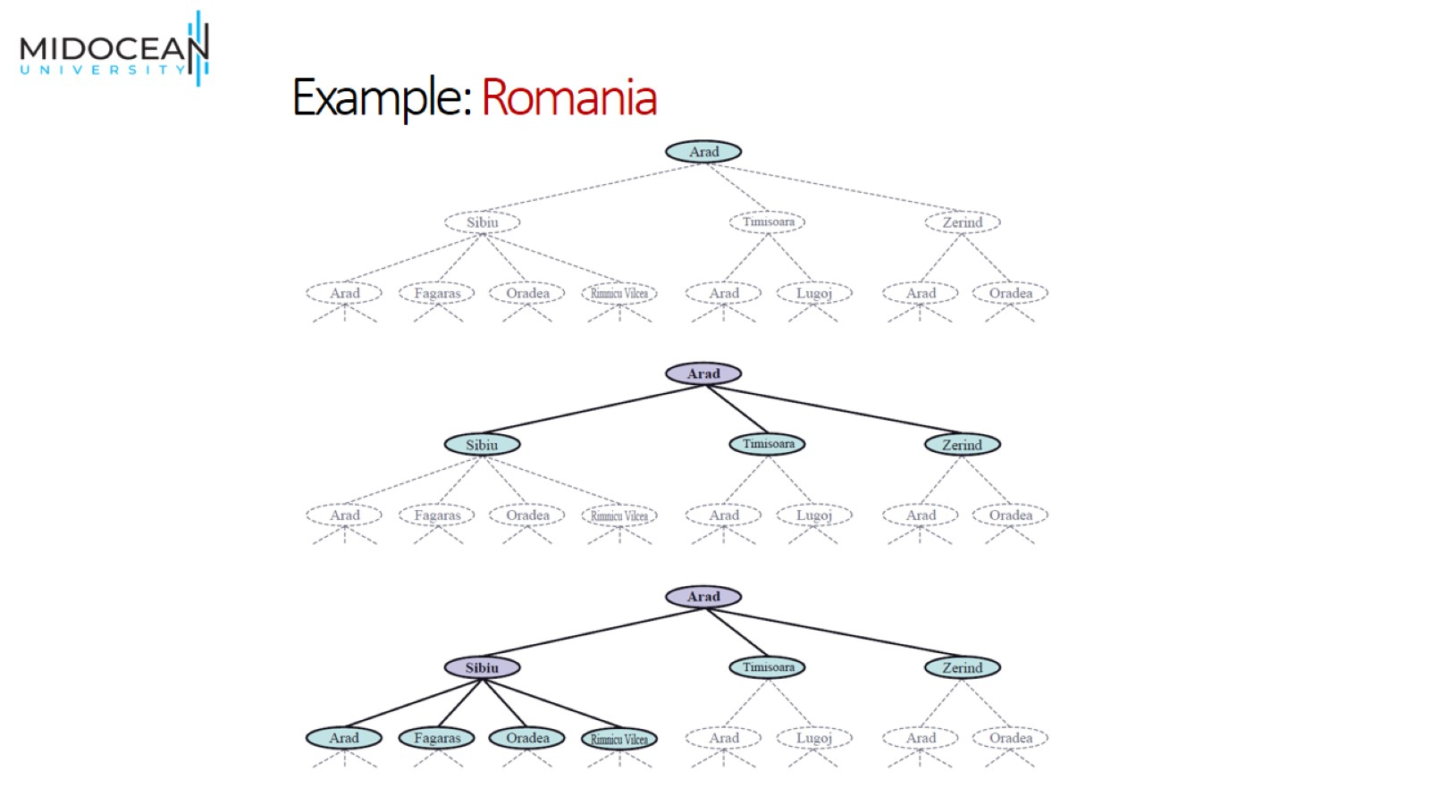
Example: Romania

Slide 27
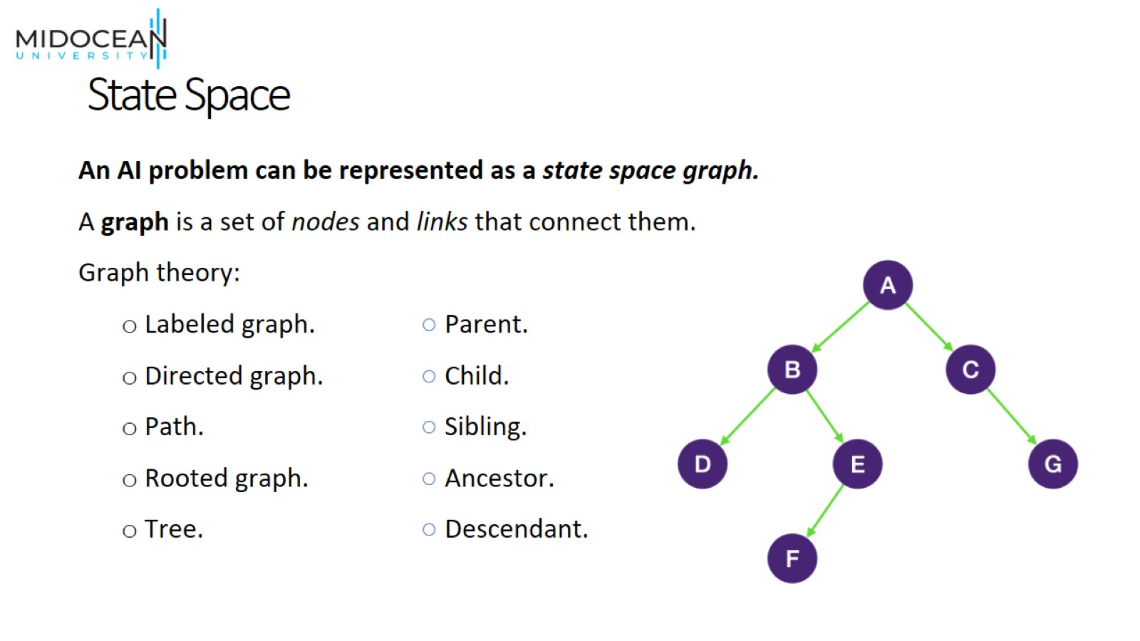
State Space

Slide 28
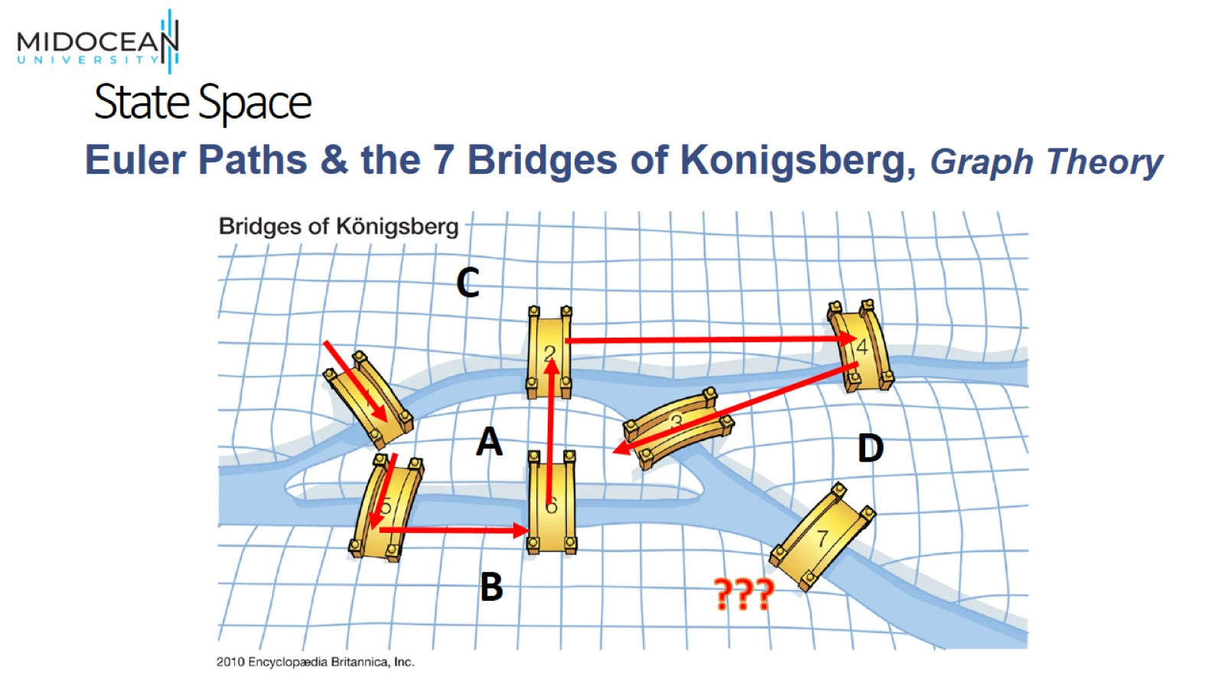
State Space

Slide 29
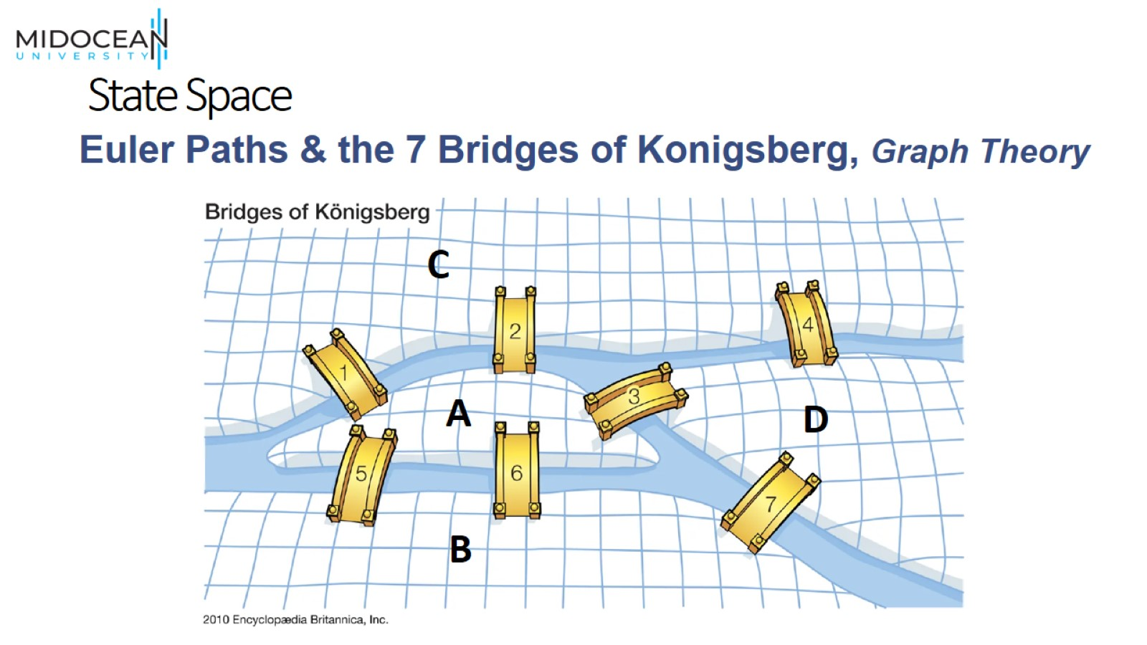
State Space

Slide 30
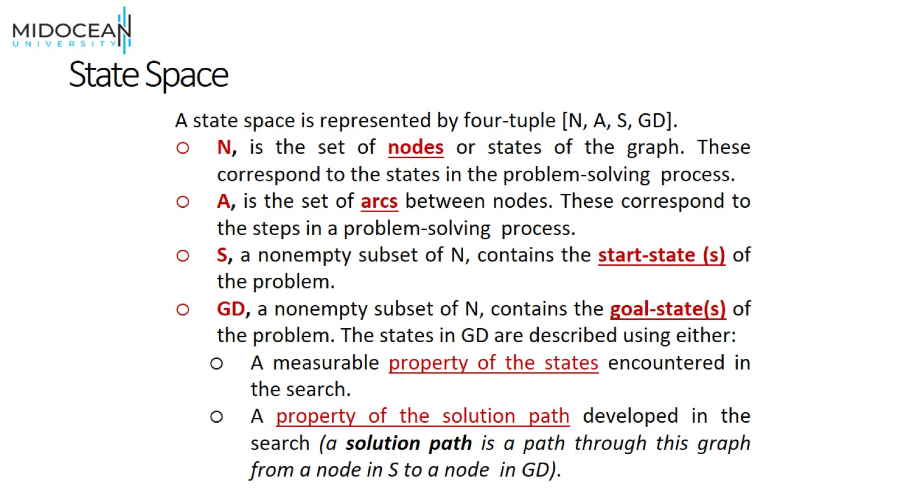
State Space

Slide 31
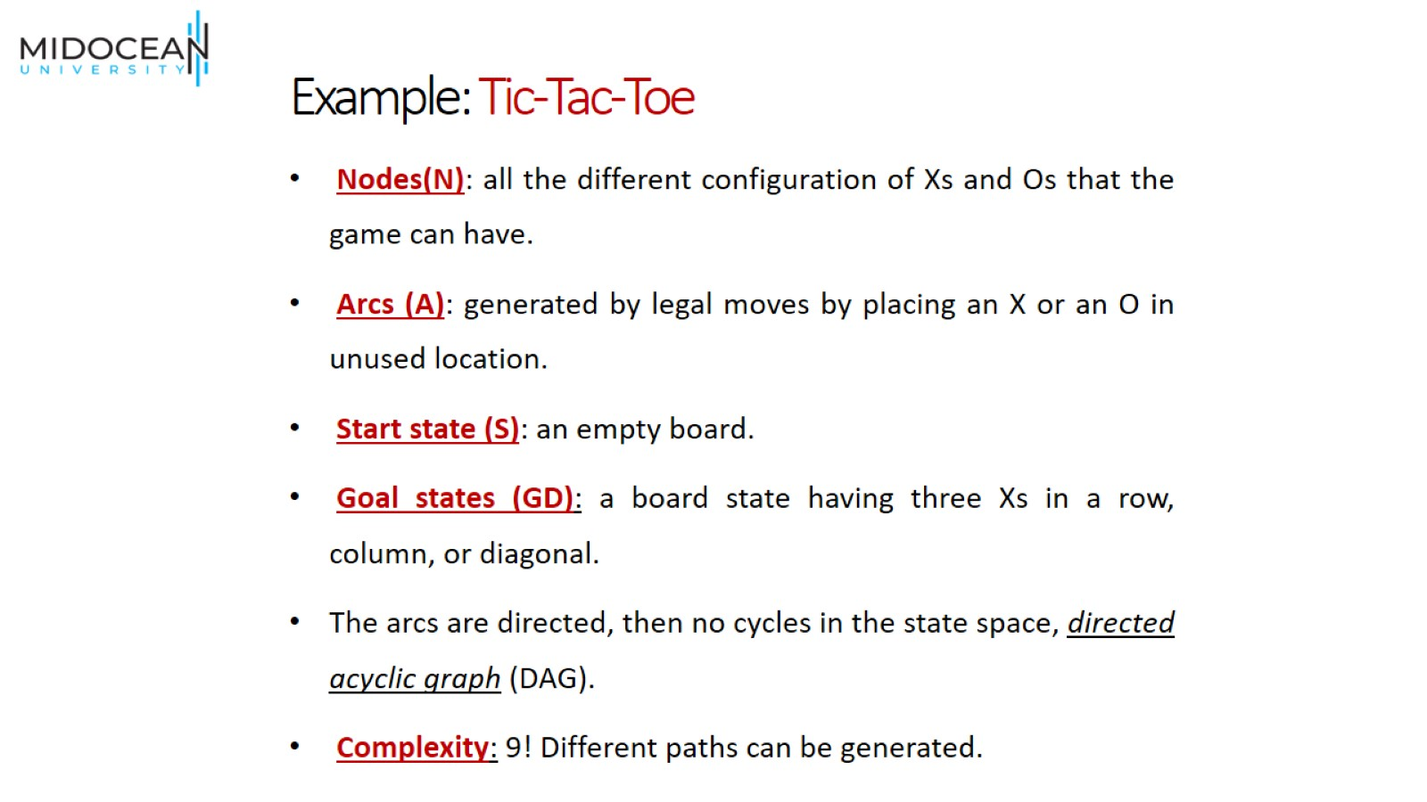
Example: Tic-Tac-Toe

Slide 32
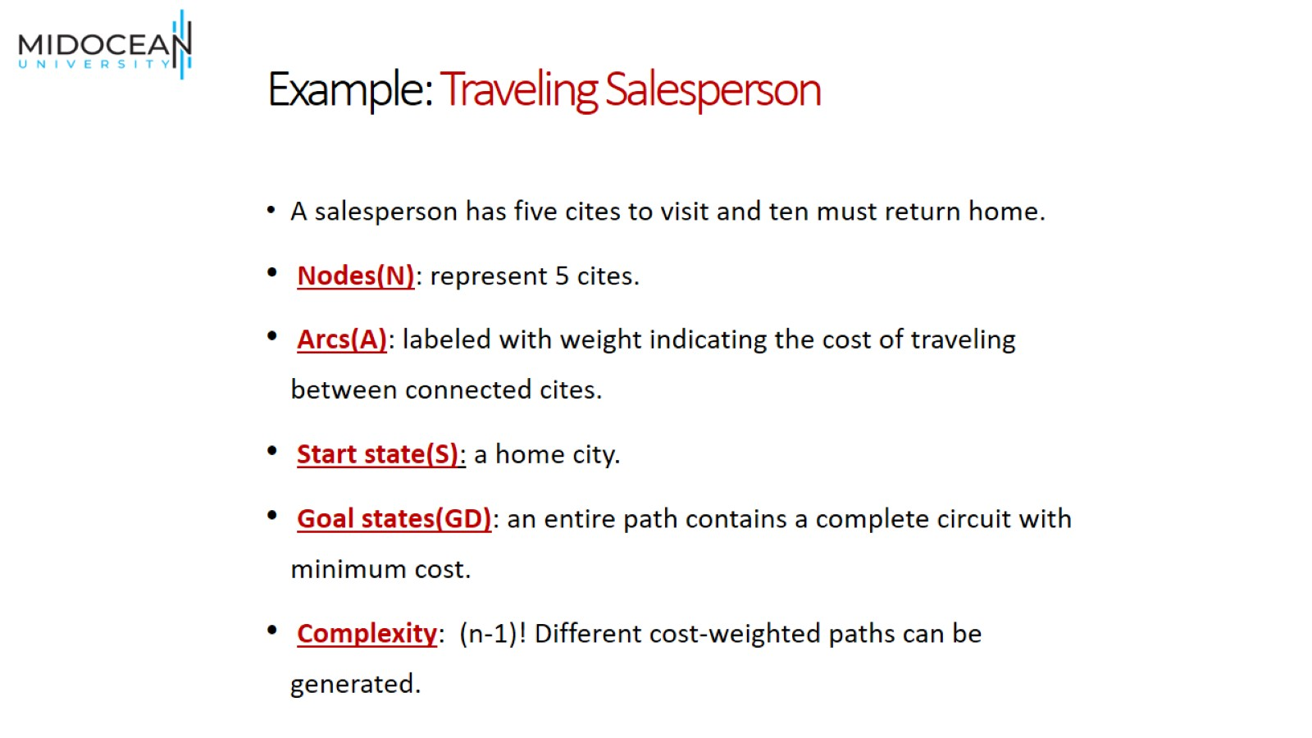
Example: Traveling Salesperson

Slide 33
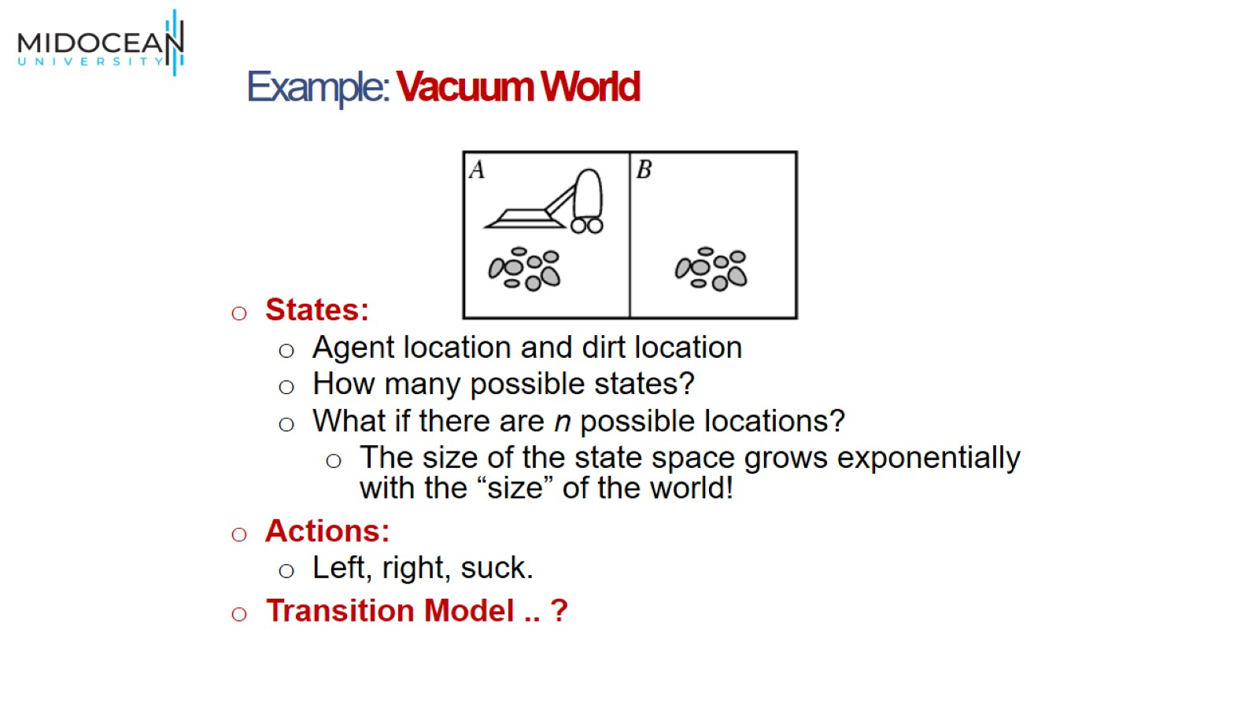

Slide 34
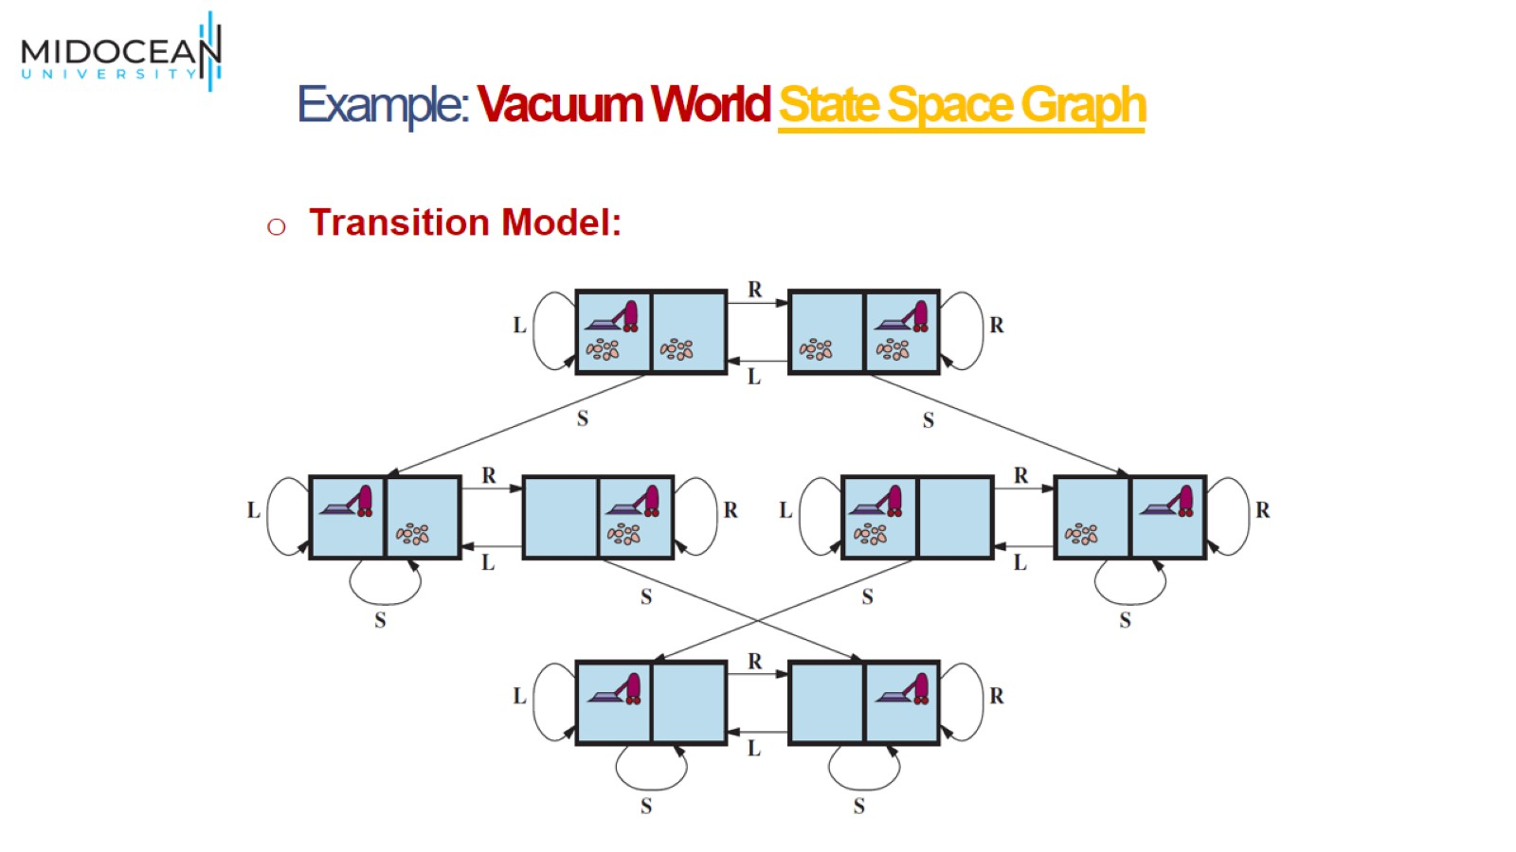

Slide 35
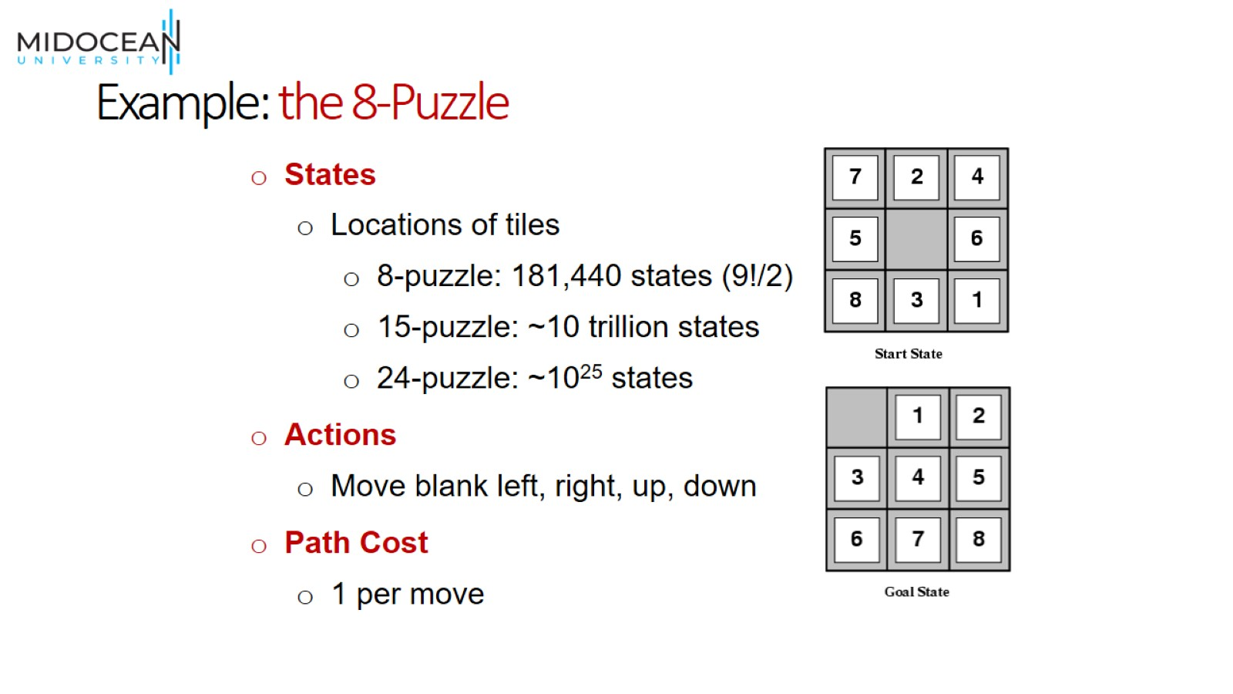
Example: the 8-Puzzle

Slide 36
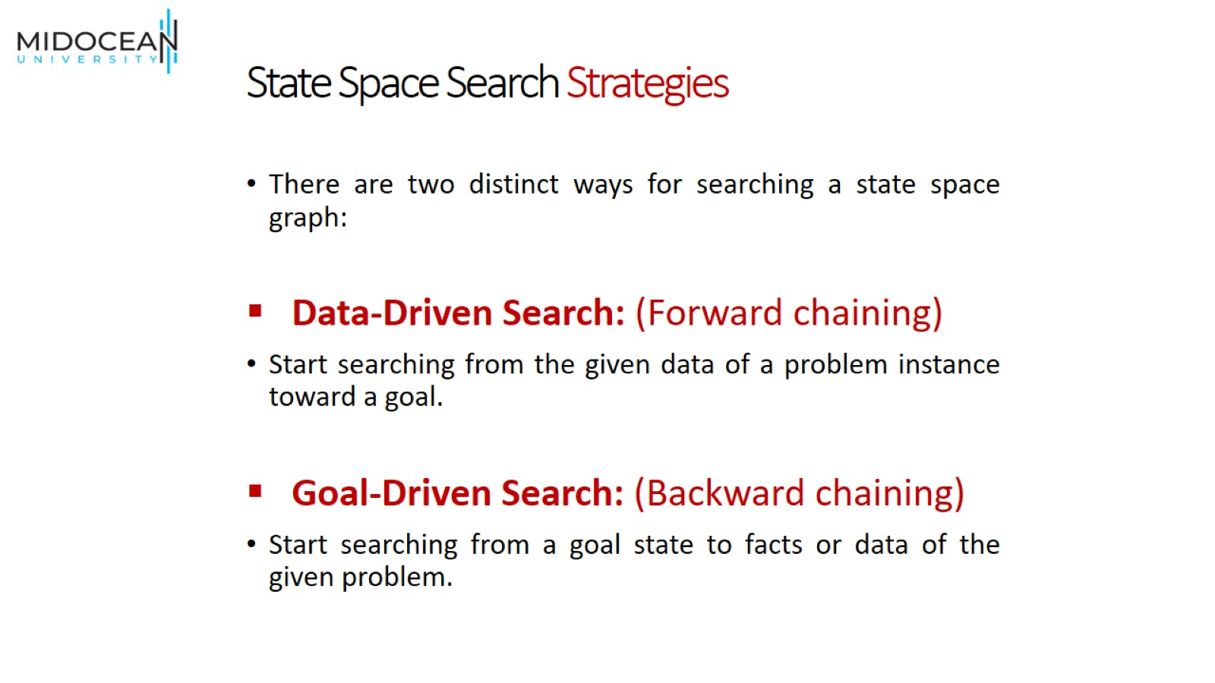
State Space Search Strategies

Slide 37
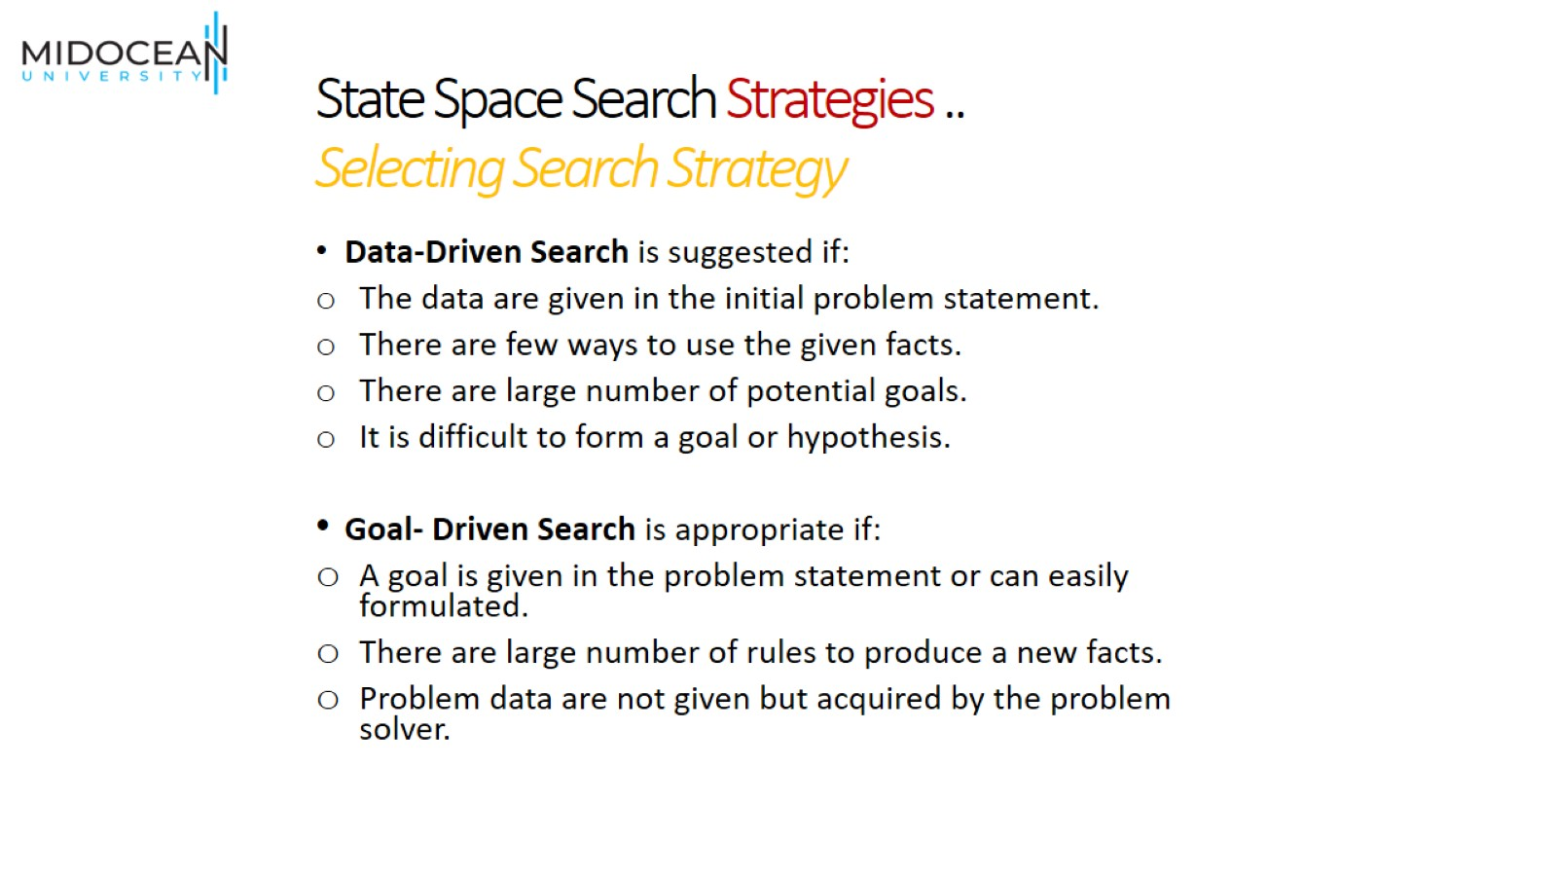
State Space Search Strategies ..
Selecting Search Strategy

Slide 38


Slide 39
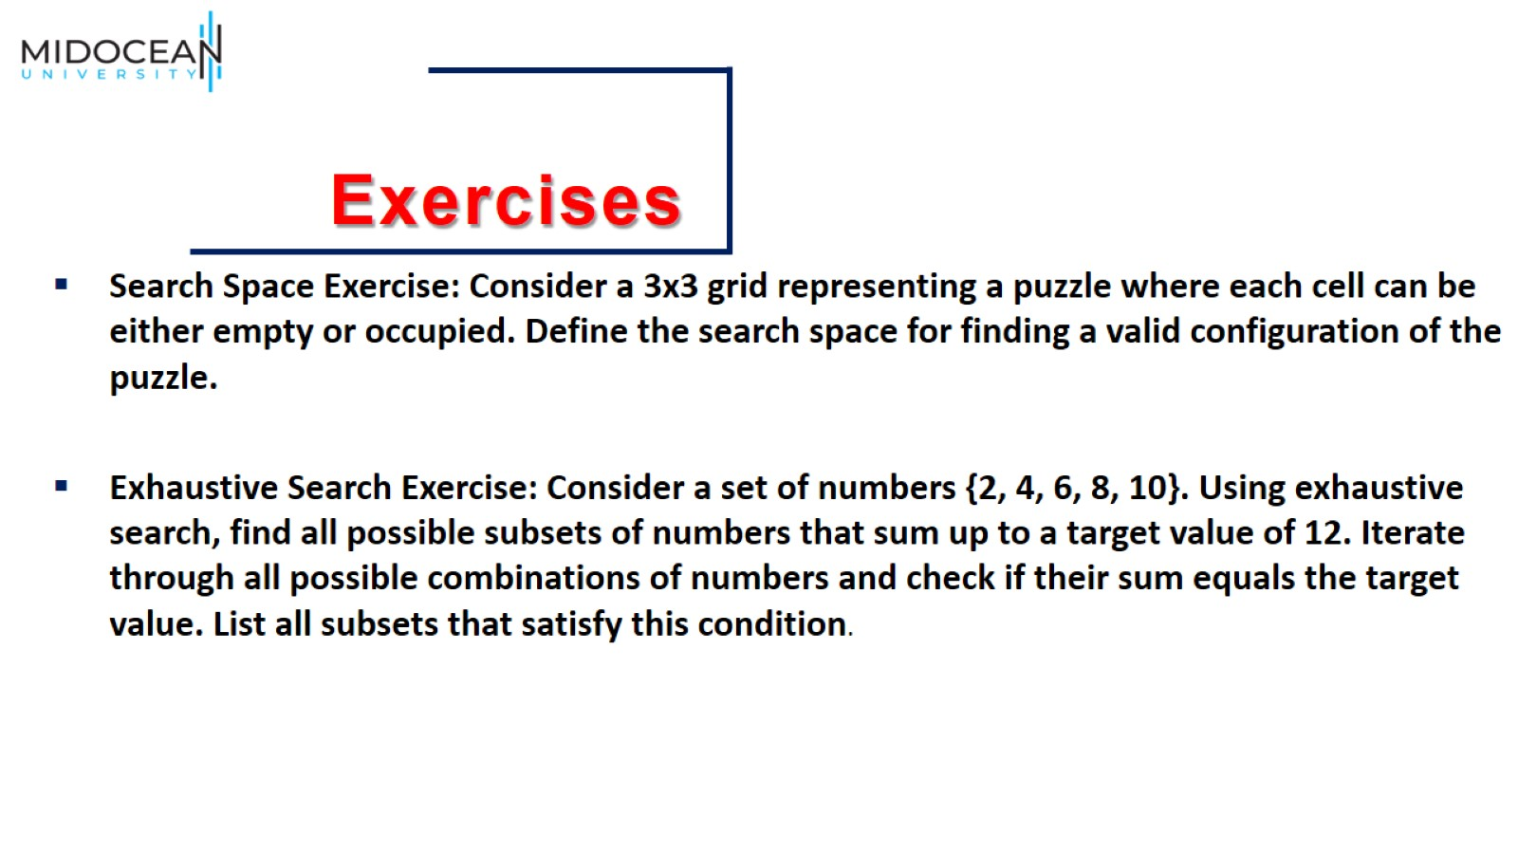

Slide 40


