Slide 1


Presentation and Writing Skills
Prepared by Dr. Manal El-Sayed
Introduction to the course
MGM223

Slide 2
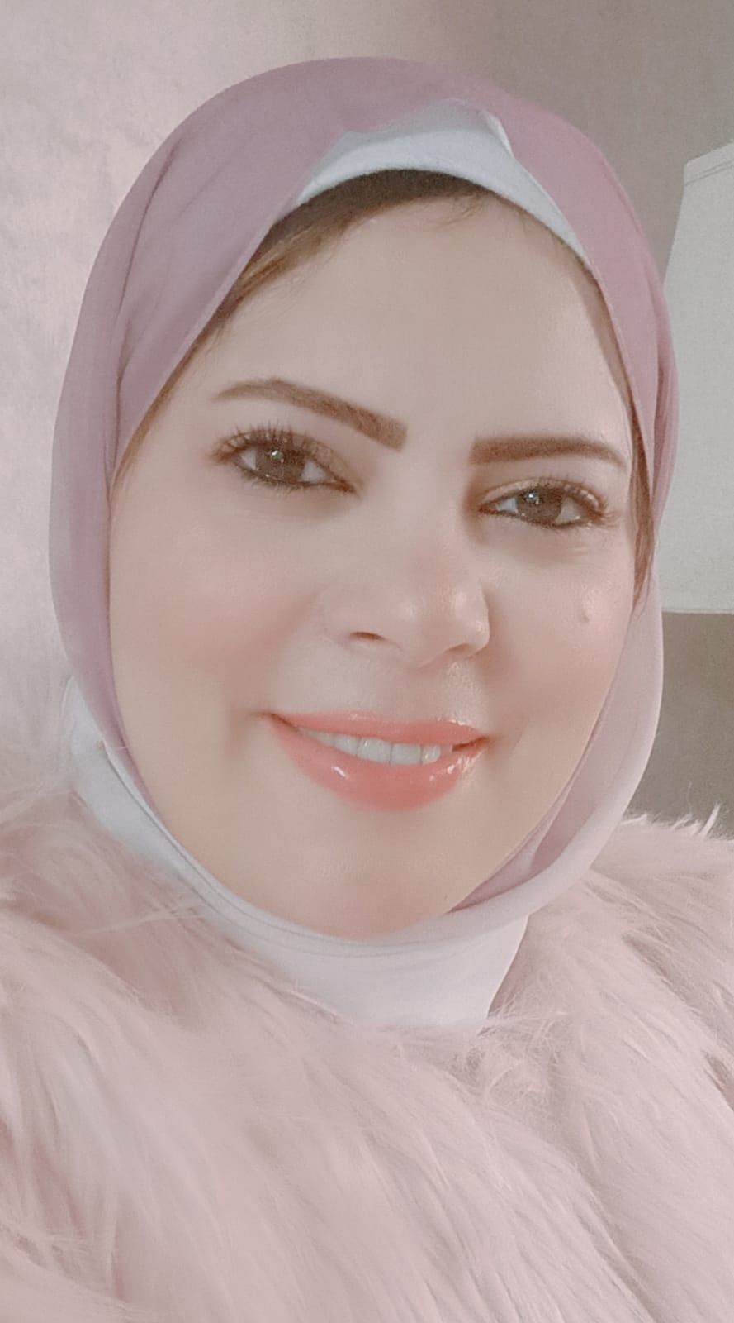
BREIF BIO
ABOUT THE INSTRUCTOR
PHD Holder from Cairo University. Faculty of Economics and political Science. Public Administration Department.
Assistant professor at an Egyptian University.
Consultant for Administrative and institutional development.
Reviewer to many different international journals.
Supervisor on DPA programs in an academy.

Slide 3

مواعيد المحاضرات الخاصة بالكورس

Slide 4
GO THROUGH YOUR COURSE PLAN
YOUR COURSE TITTLE IS
PRESENTATIONS AND WRITING SKILLS

Slide 5
This course helps students discover how to craft presentations around essential objectives, present key concepts and ideas with power and enthusiasm, design, and present effective visuals, and employ techniques for polishing and mastering presentation delivery. Executives, managers, and staff alike will boost presentation performance with this training course.

Slide 6
Topics:
Communication Types.
Types of Audience.
The main Types of writing.
Effective Persuasive content.
Essentials for Dynamic Presentations.
Learning Outcomes:
Explore how presentation and writing work.
Understand what happens in front of an audience.
Practice a whole range of techniques.
Learn the hints and tips for an effective presentation.
Stretch your capacity to present.
Present with style and presence.
Using support materials.

Slide 7
THE FOLLOWING TOPICS WILL BE COVERED:
THE MAIN TOPICS
CHAPTER 1: UNDERSTANDING BUSINESS COMMUNICATION IN TODAY’S WORKPLACE.
Which will cover:
Understanding Why Communication Matters
Communicating in Today’s Global Business Environment.
Exploring the Communication Process.
Committing to Ethical Communication.
Communicating in a World of Diversity.

Slide 8
The following topics will be covered:
CHAPTER 2: MASTERING TEAM SKILLS INTERPERSONAL COMMUNICATION.
Communicating Effectively in Teams.
Collaborating on Communication Efforts.
Making Your Meetings More Productive
Improving Your Listening Skills.
Improving Your Nonverbal Communication Skills
Developing Your Business Etiquette.
Advantages and Disadvantages of Teams.
The most effective teams share the following characteristics.

Slide 9
The following topics will be covered:
CHAPTER 3: PLANNING BUSINESS MESSAGES
Which will cover:
Understanding the Three-Step Writing Process
Planning business messages
Writing business messages
Completing business messages

Slide 10
The following topics will be covered:
CHAPTER 4: WRITING BUSINESS MESSAGES
WHICH WILL COVER:
Being Sensitive to Your Audience’s Needs.
Building Strong Relationships with Your Audience.
Composing Your Message: Choosing Strong Words.
Composing Your Message: Creating Effective Sentences

Slide 11
The following topics will be covered:
CHAPTER 5: WRITING PERSUASIVE MESSAGES.
WHICH WILL COVER:
Using the Three-Step Writing Process for Persuasive Messages
Step 1: Planning Persuasive Messages
Step 2: Writing Persuasive Messages
Step 3: Completing Persuasive Messages

Slide 12
The following topics will be covered:
CHAPTER 6: UNDERSTANDING AND PLANNING REPORTS AND PROPOSALS.
WHICH WILL COVER:
The Types Of Reports.
Applying the Three-Step Writing Process to Reports and Proposals.
Supporting Your Messages with Reliable Information.
Conducting Secondary Research.
Documenting Your Sources

Slide 13
The following topics will be covered:
CHAPTER 7 : WRITING AND COMPLETING REPORTS AND PROPOSALS
WHICH WILL COVER:
Adapting to Your Audience.
Drafting Proposal Content.
Helping Readers Find Their Way.
Designing Effective Visuals
Completing Reports and Proposals

Slide 14
The following topics will be covered:
CHAPTER 8 : BULDING CAREERS AND WRITING RESUMES
WHICH WILL COVER:
how to find the ideal opportunity in today’s job market.
building an effective LinkedIn profile.

Slide 15
The following topics will be covered:
CHAPTER 9 : APPLYING AND INTERVIEWING FOR EMPLOYMENT.
WHICH WILL COVER:
PREPARING FOR A JOB INTERVIEW
INTERVIEWING FOR SUCCESS
FOLLOWING UP AFTER AN INTERVIEW.

Slide 16


شكرًا جزيلًا

