Slide 1
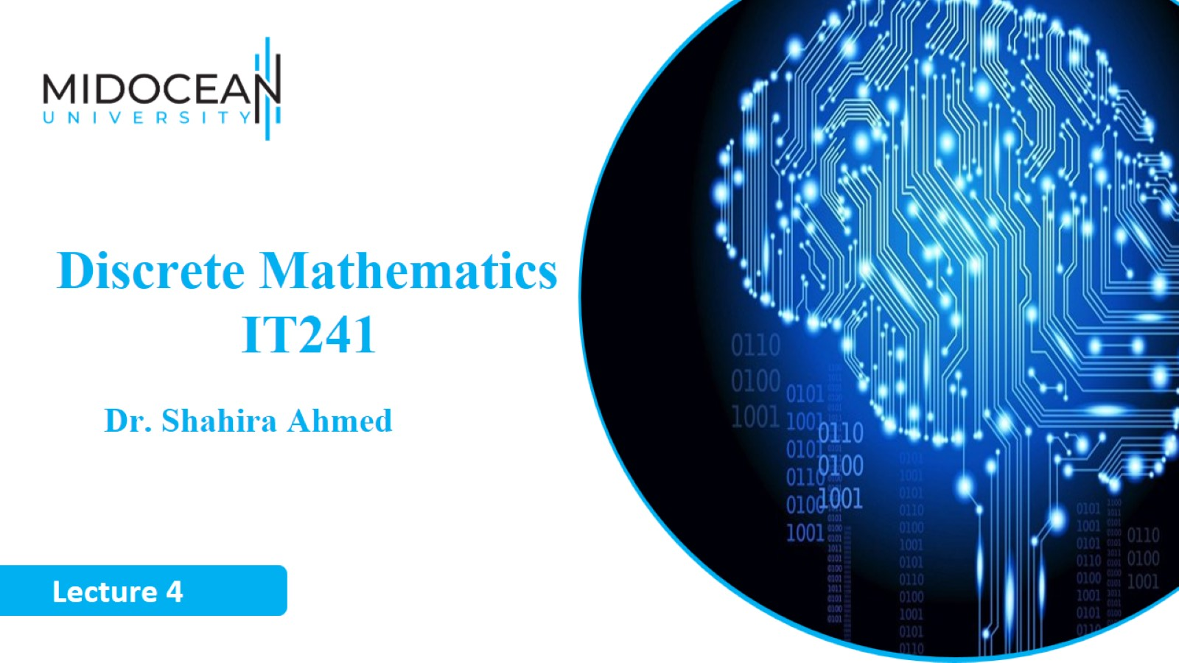

Slide 2
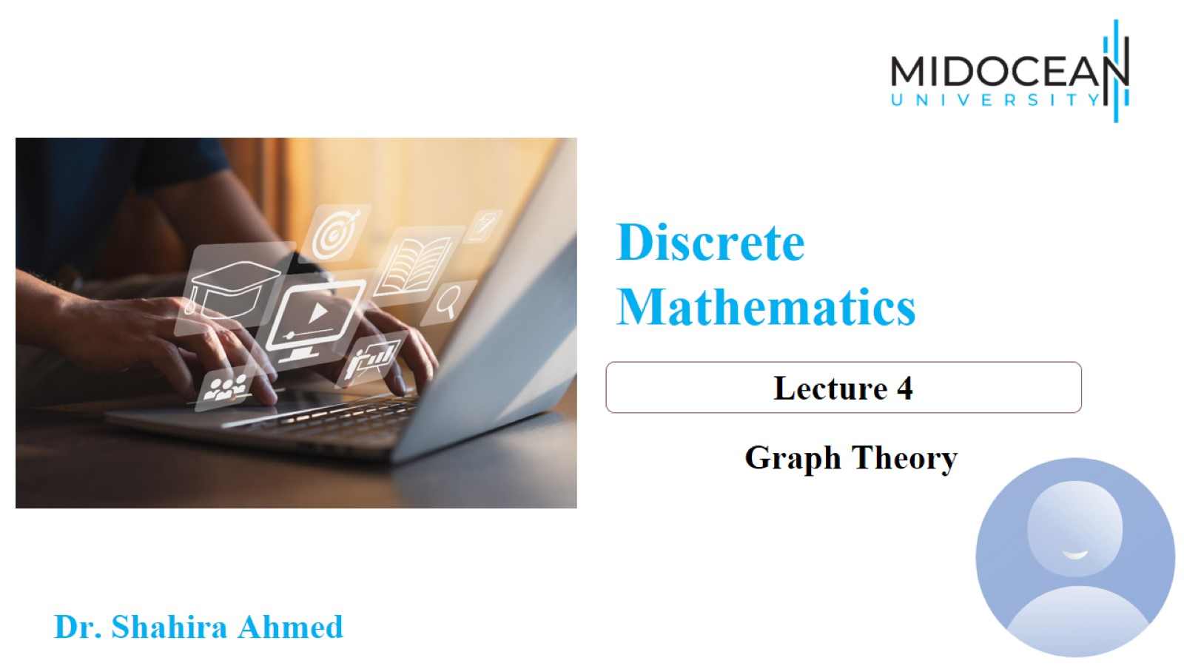

Slide 3
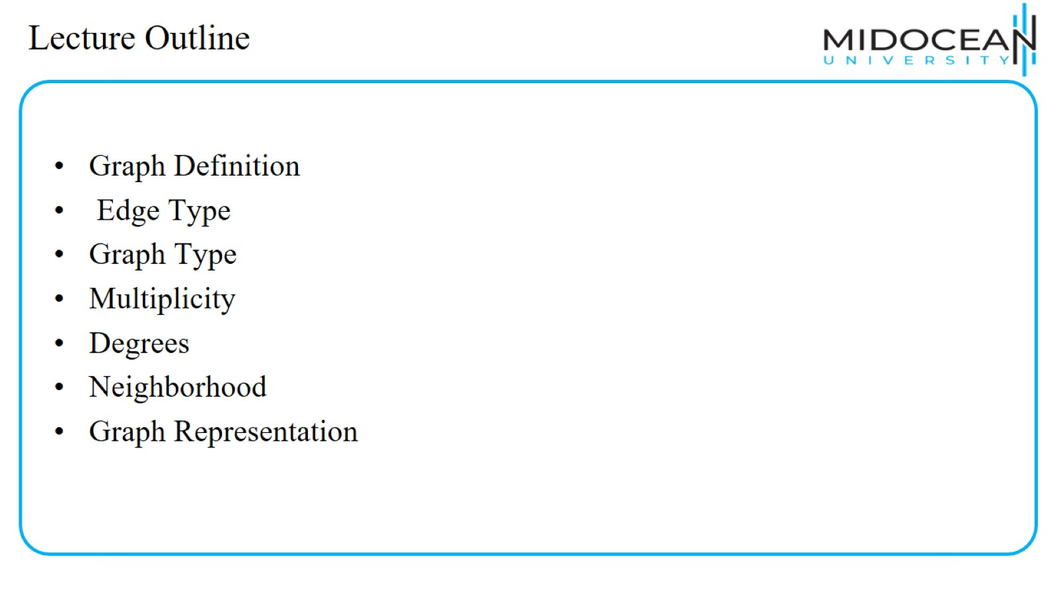
Lecture Outline

Slide 4
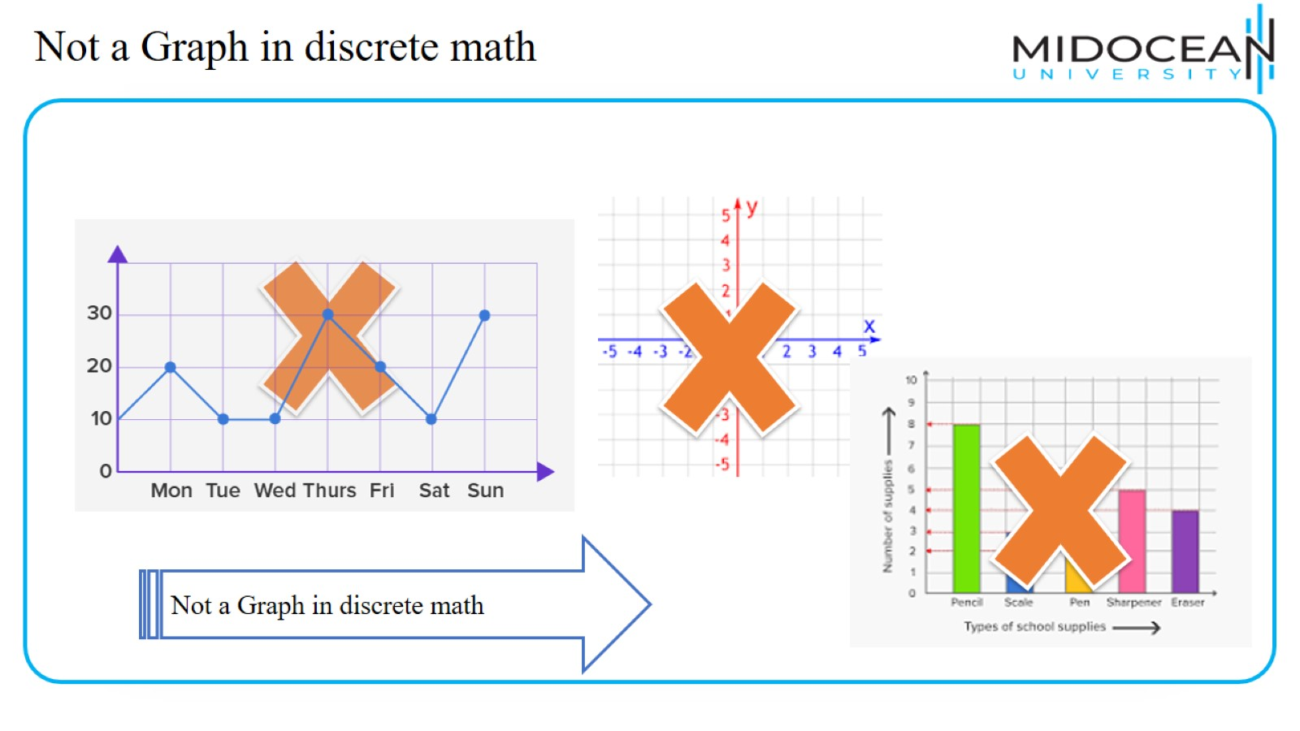
Not a Graph in discrete math

Slide 5
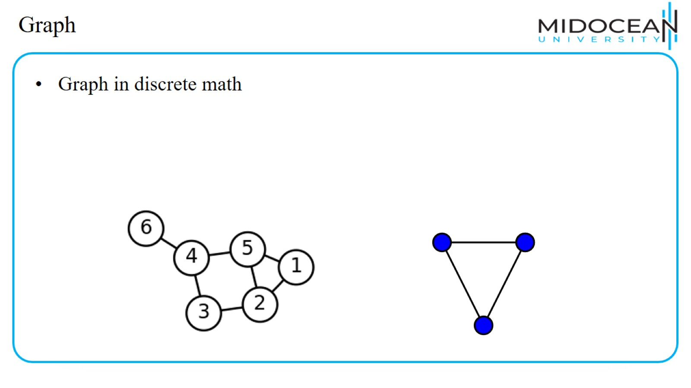
Graph

Slide 6
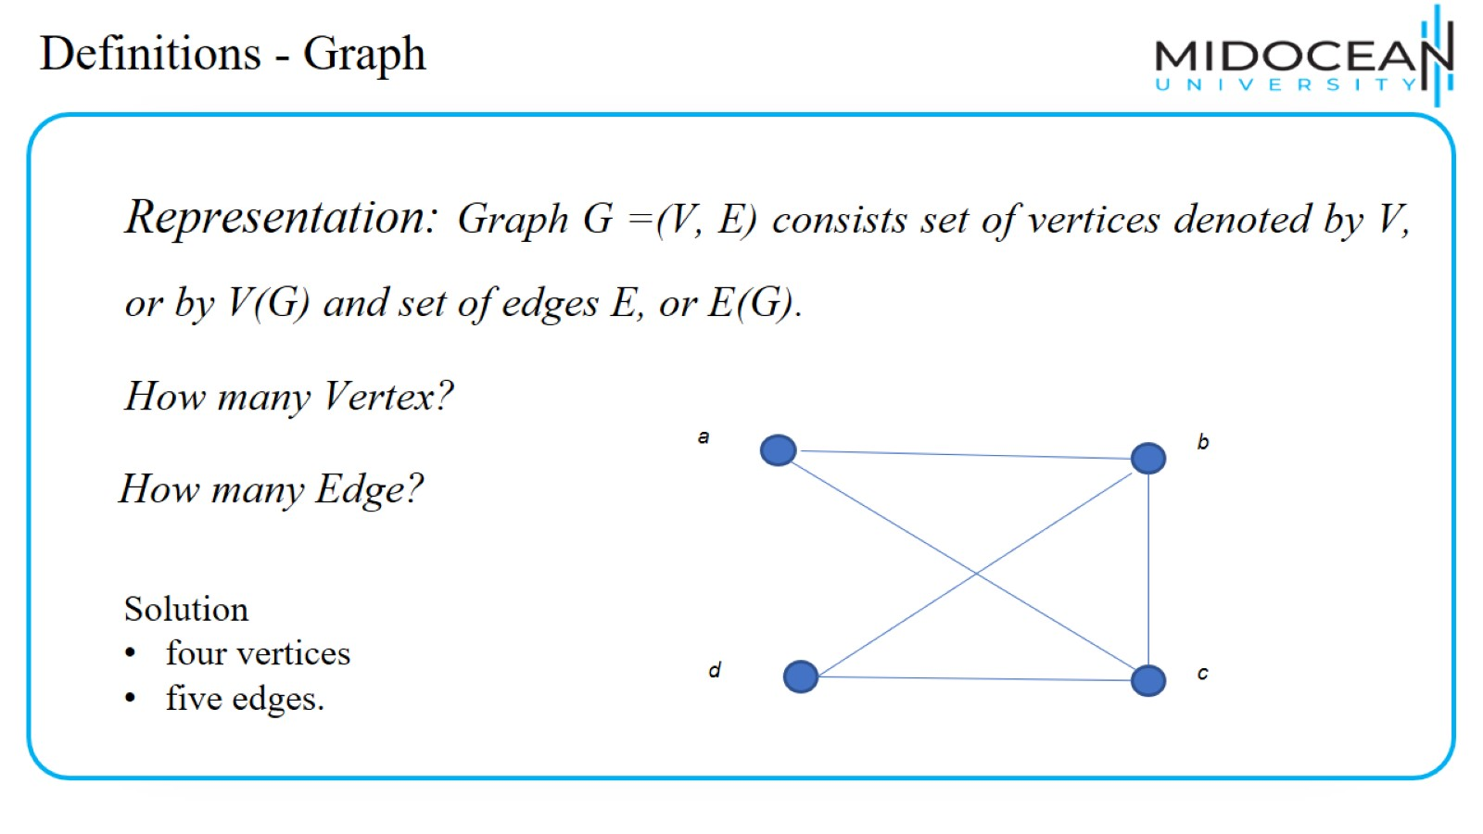
Definitions - Graph

Slide 7
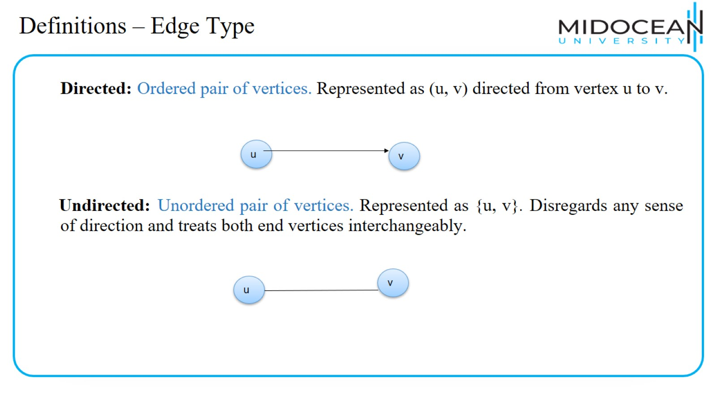
Definitions – Edge Type

Slide 8
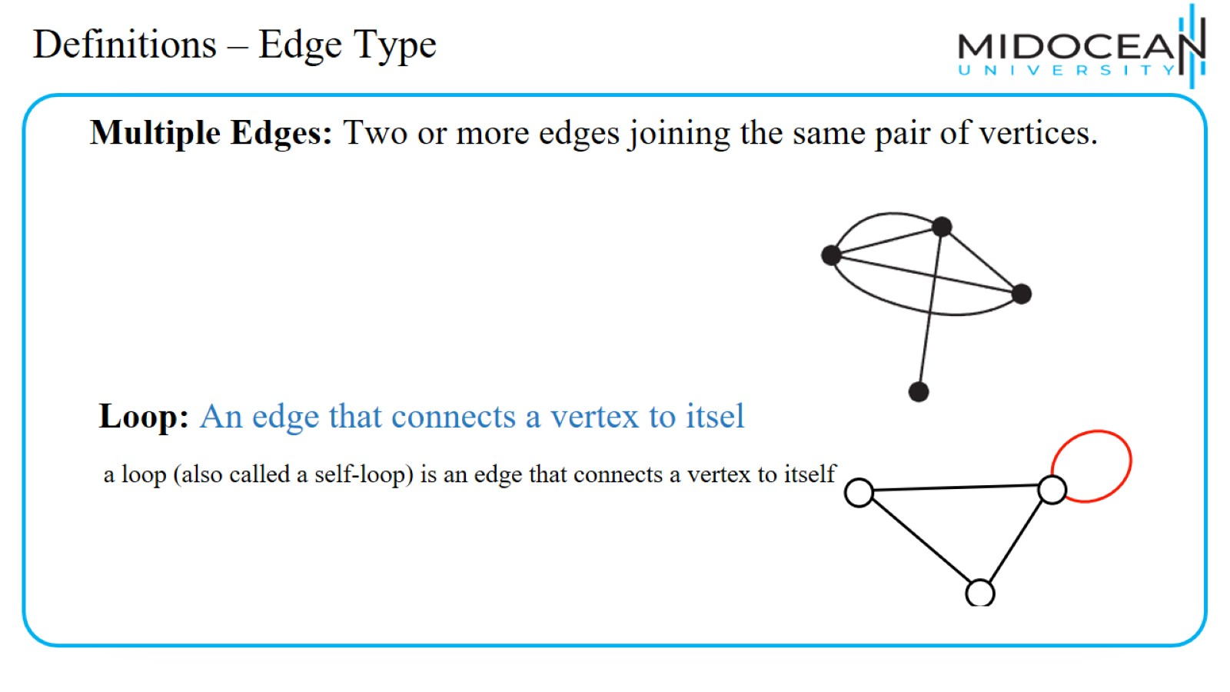
Definitions – Edge Type

Slide 9
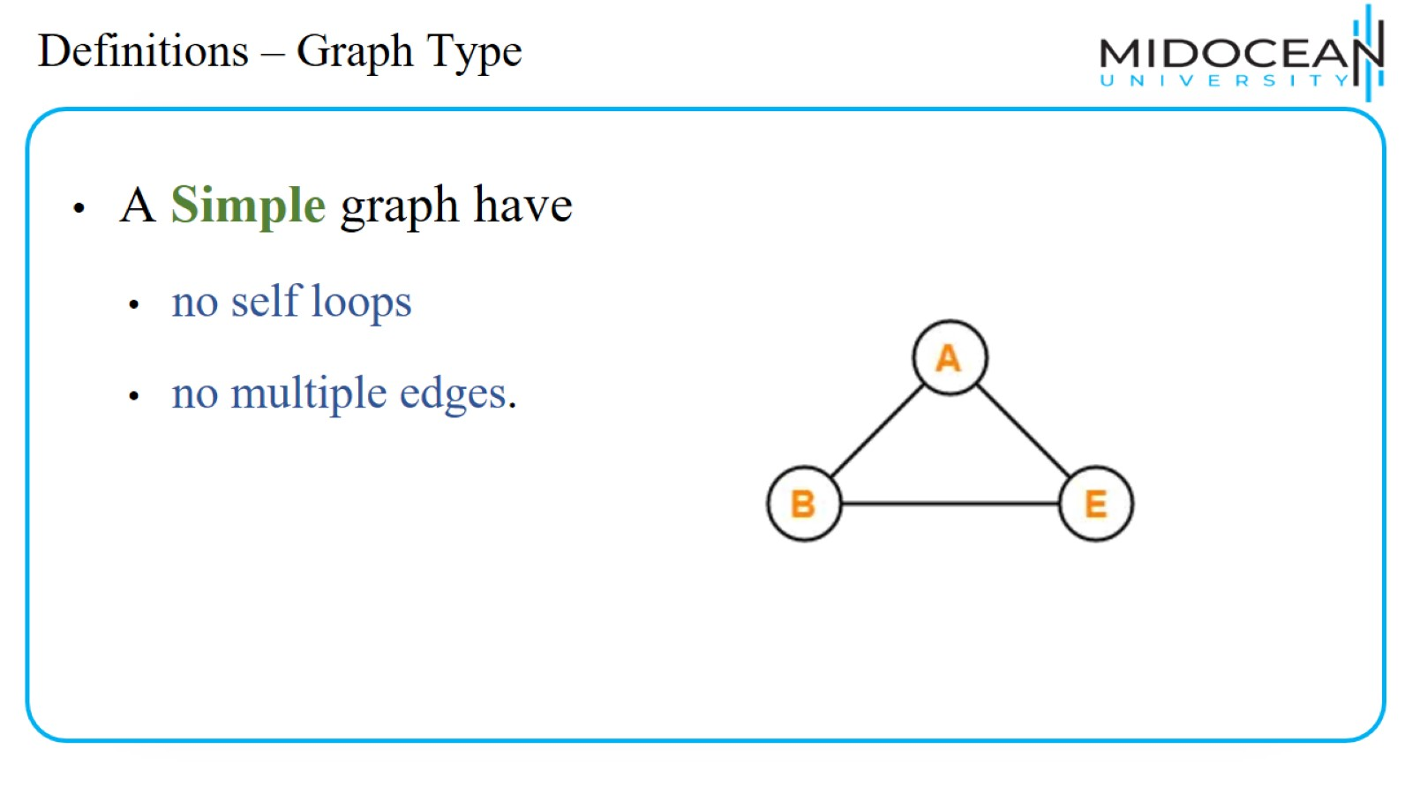
Definitions – Graph Type

Slide 10
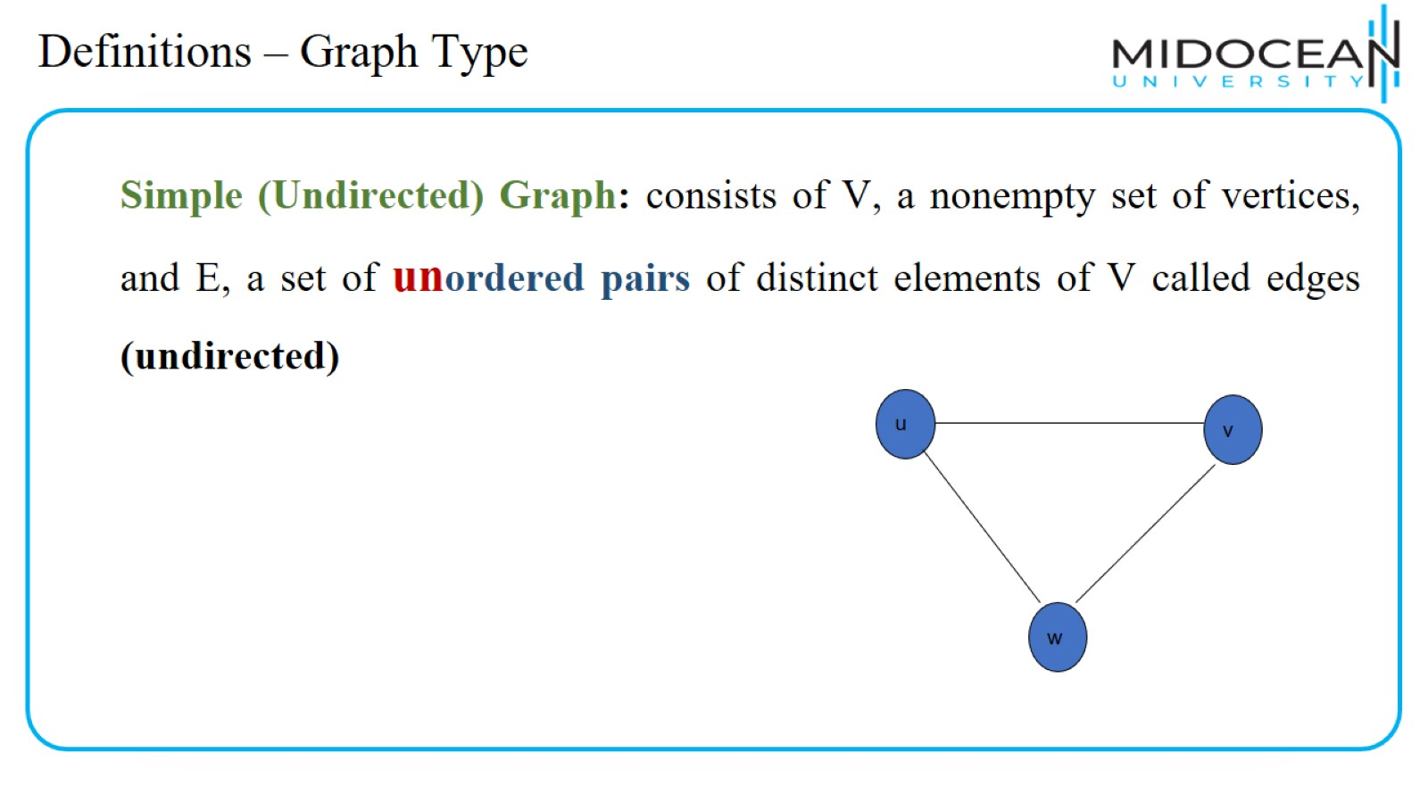
Definitions – Graph Type

Slide 11
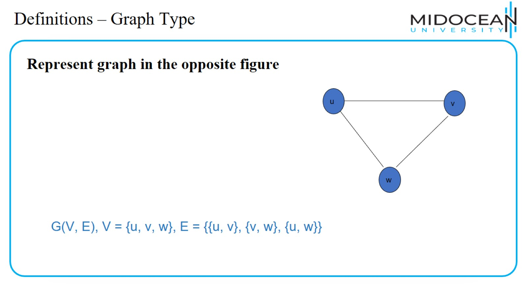
Definitions – Graph Type

Slide 12
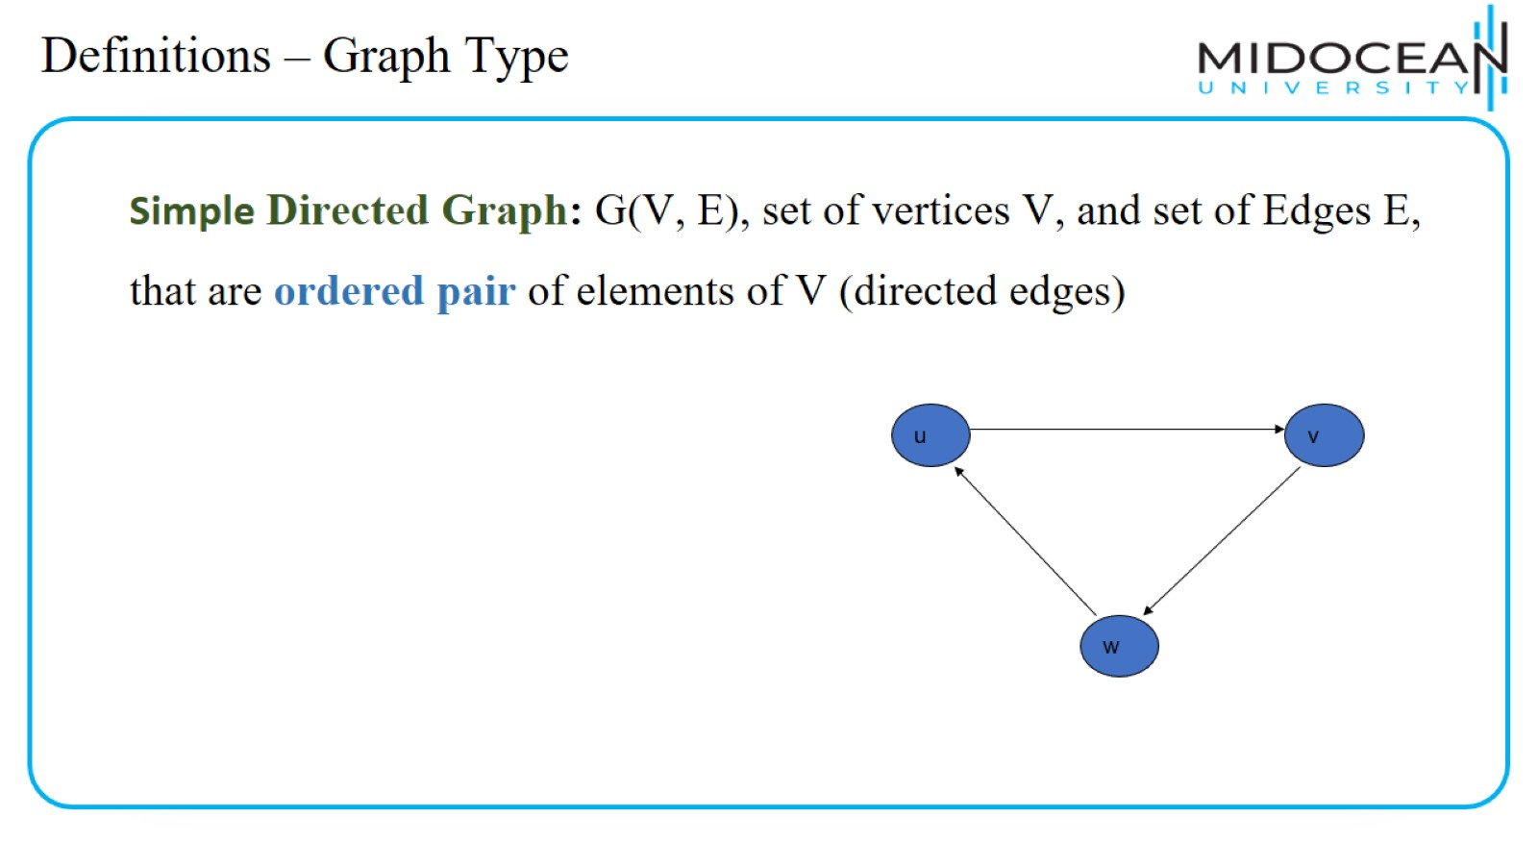
Definitions – Graph Type

Slide 13
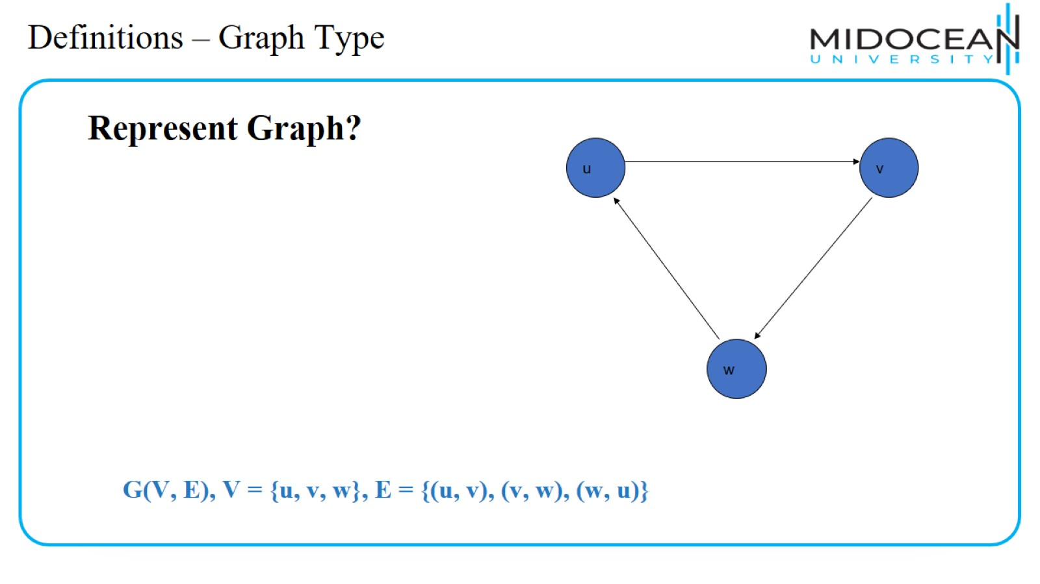
Definitions – Graph Type

Slide 14
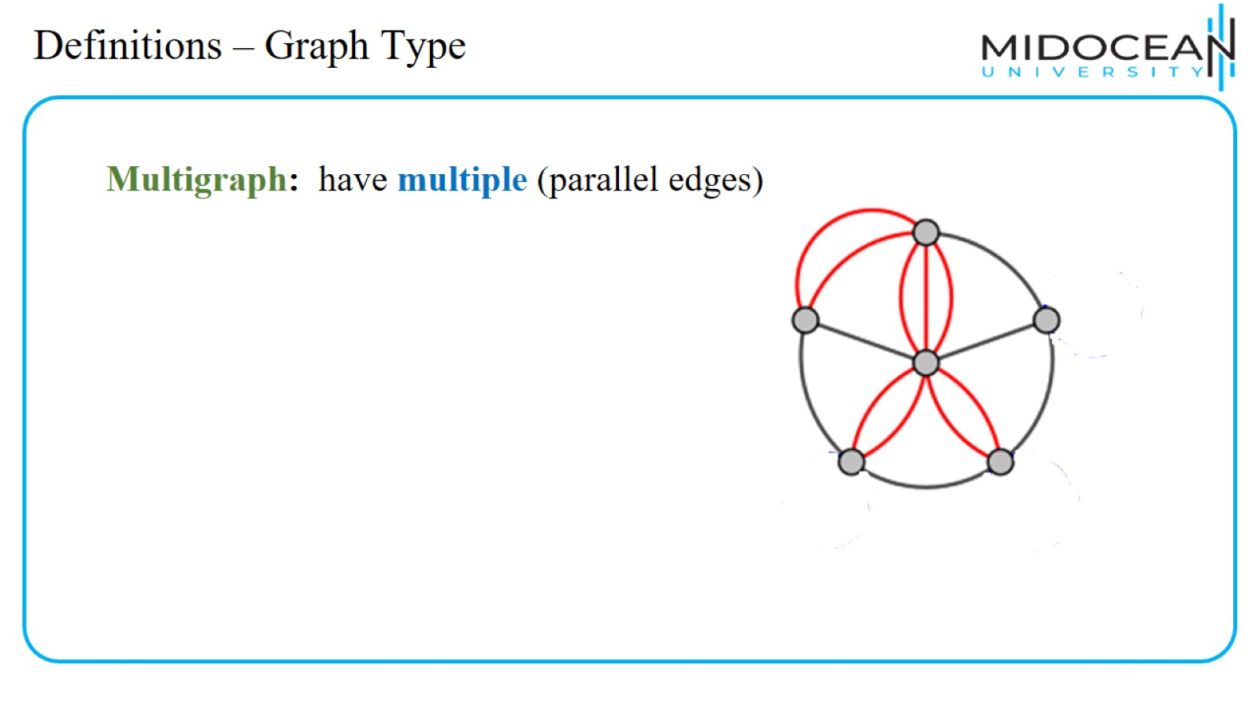
Definitions – Graph Type

Slide 15
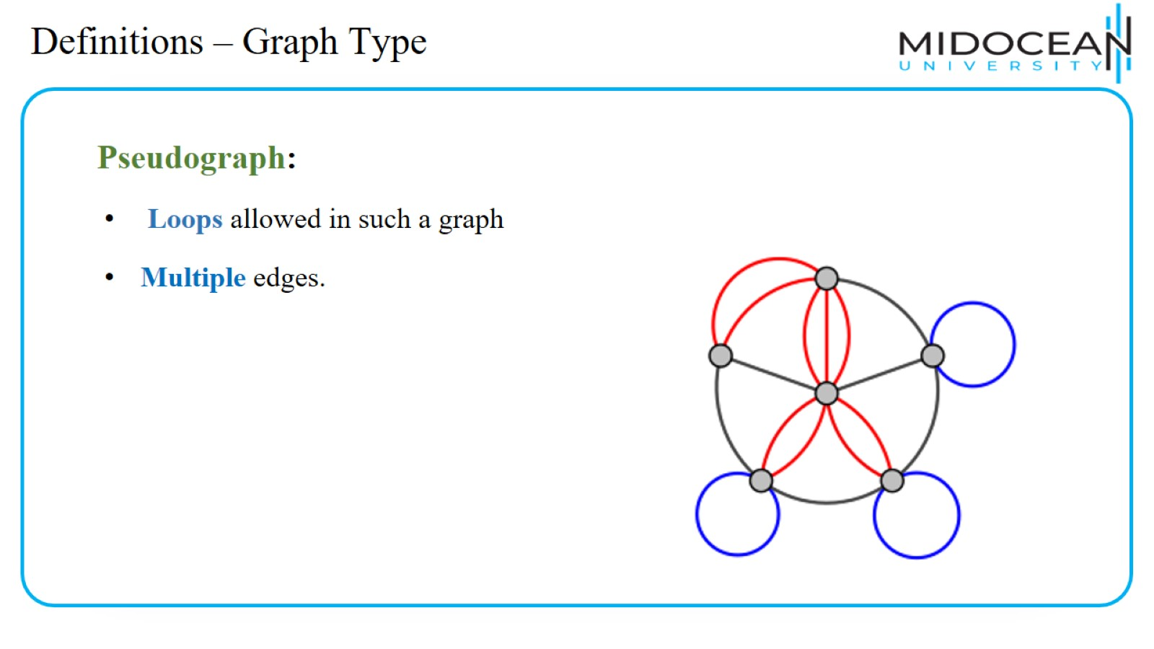
Definitions – Graph Type

Slide 16
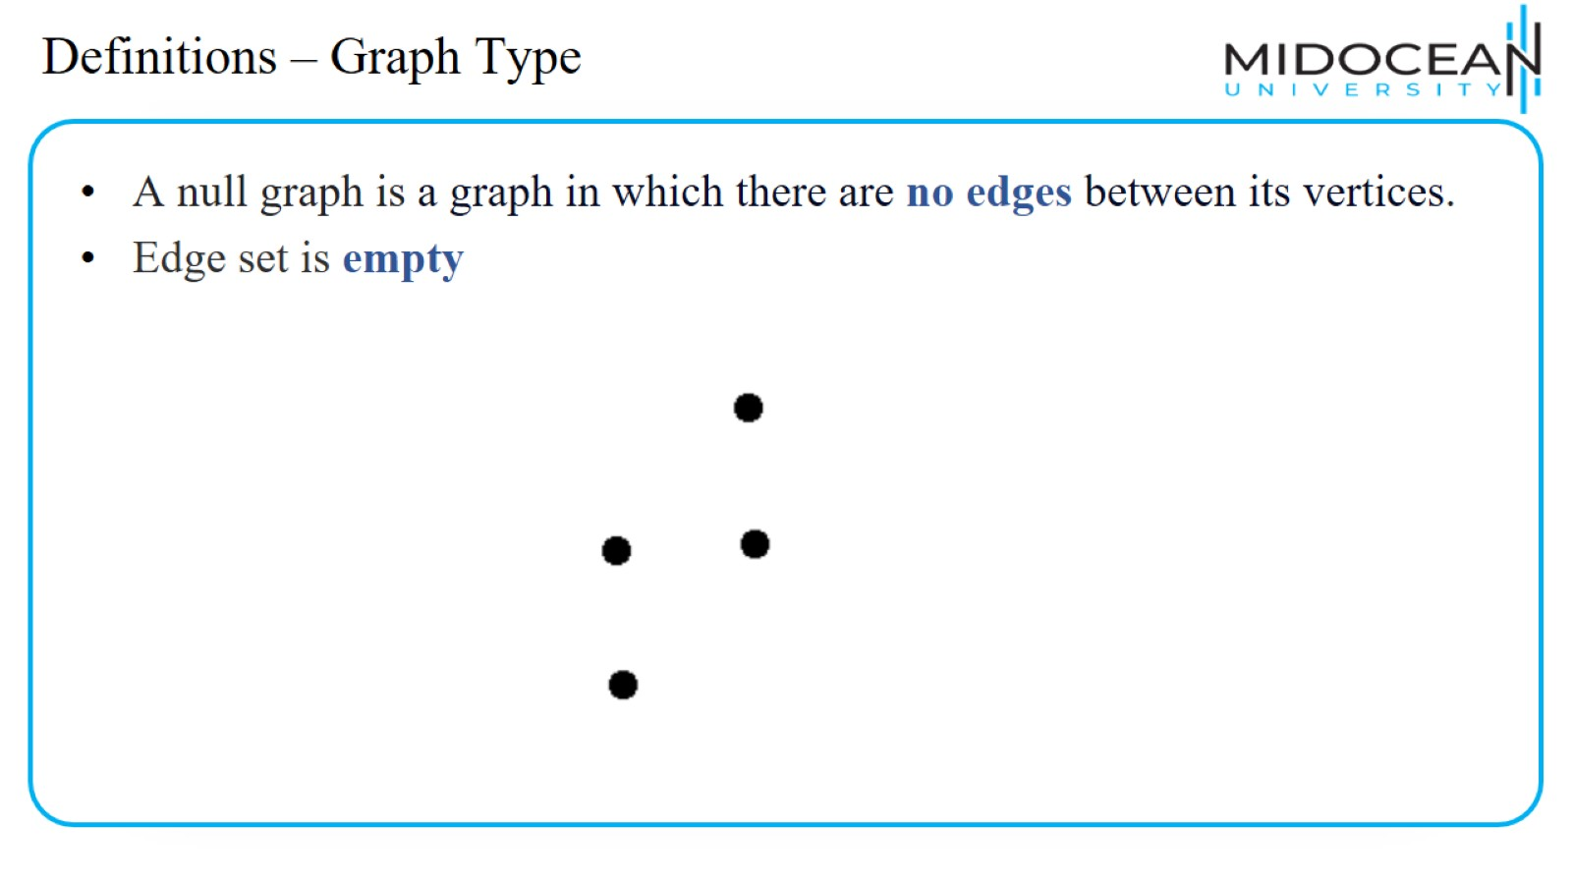
Definitions – Graph Type

Slide 17
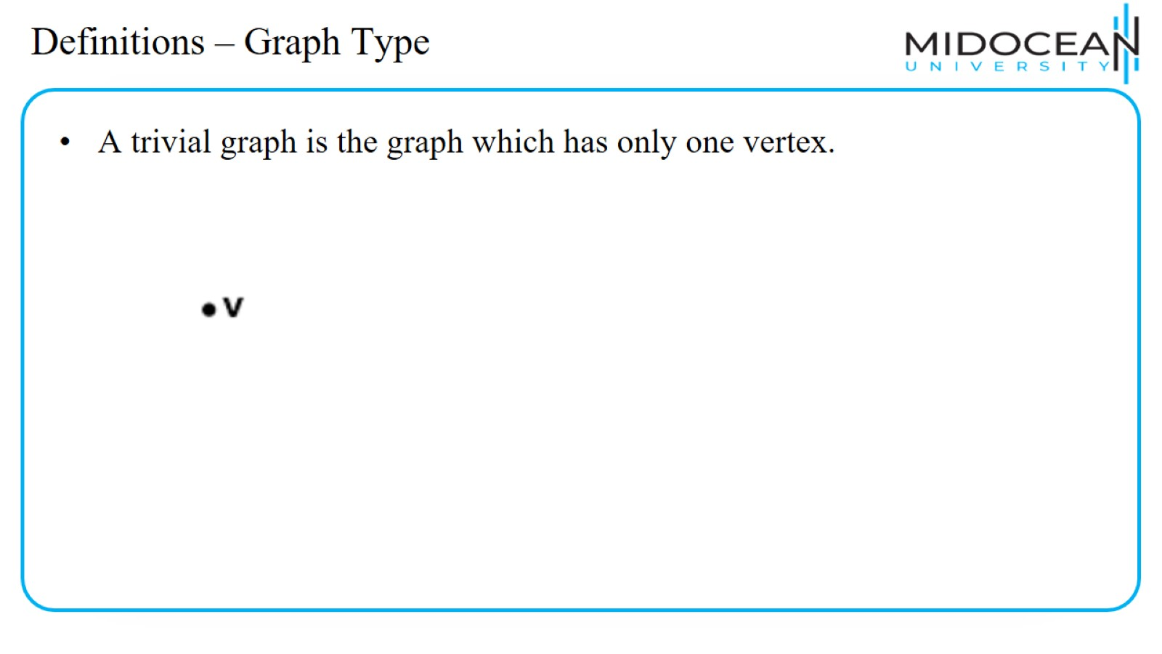
Definitions – Graph Type

Slide 18
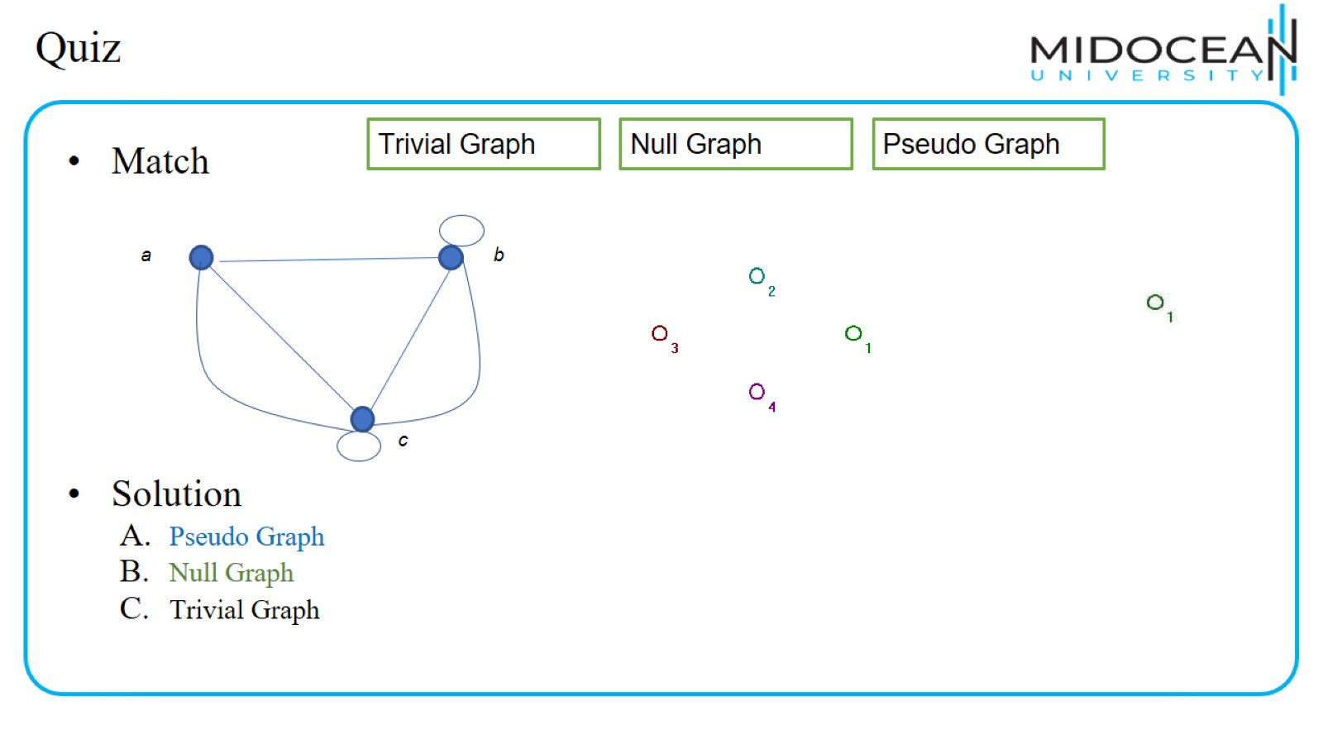
Quiz

Slide 19
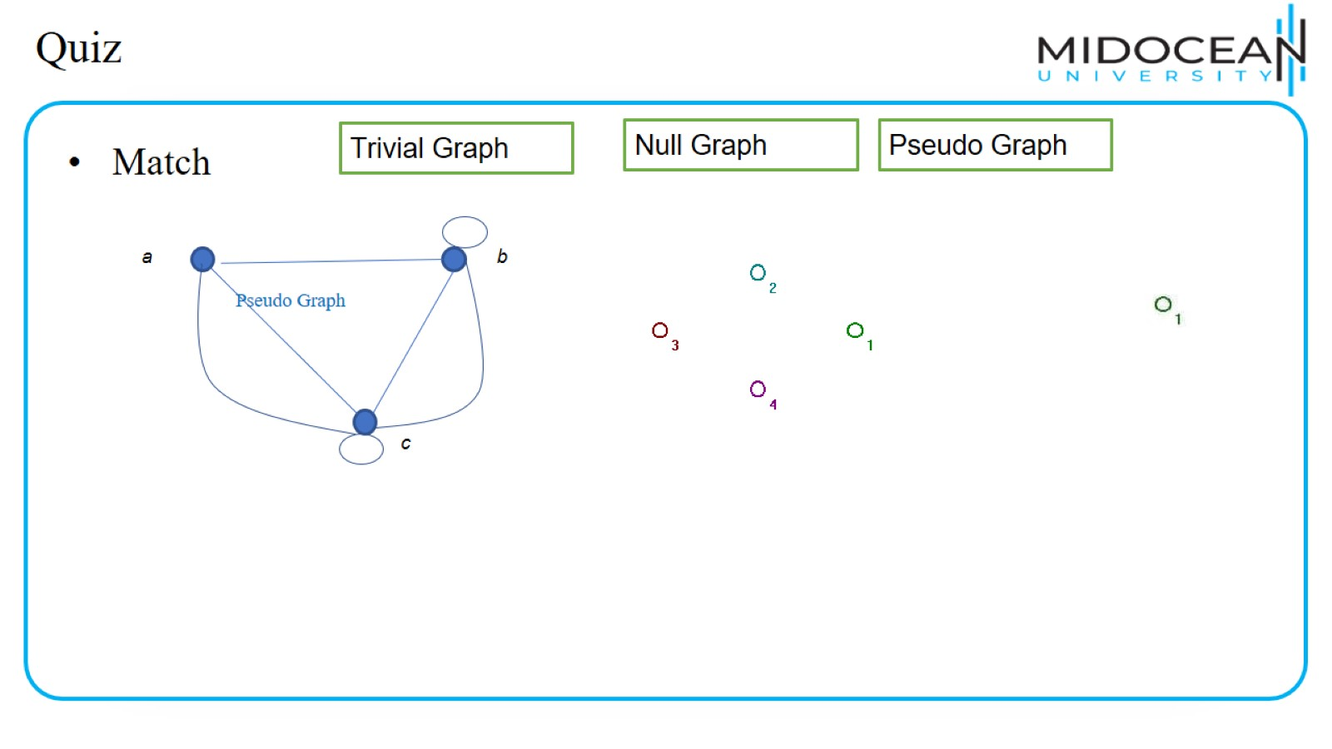
Quiz

Slide 20
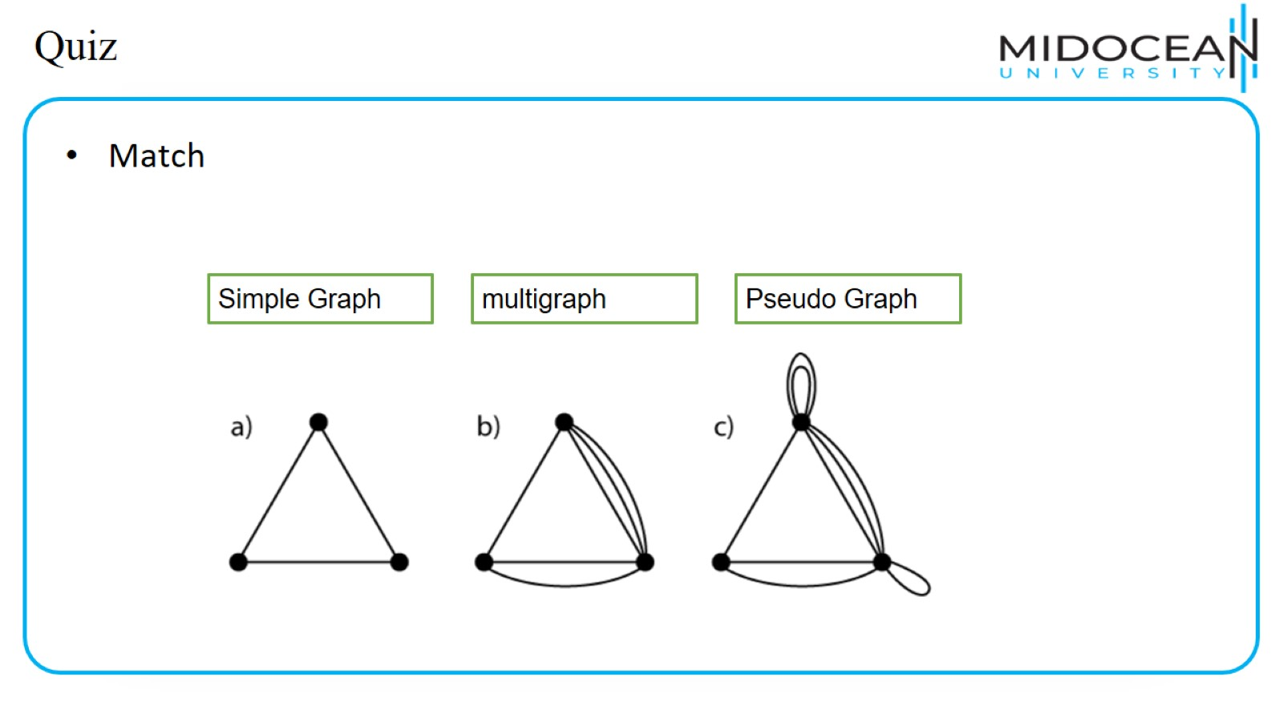
Quiz

Slide 21
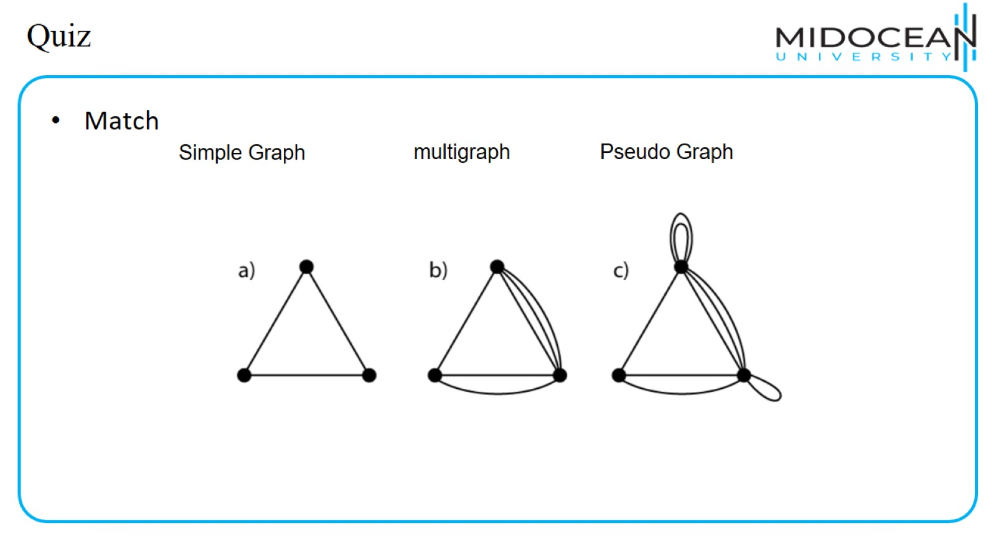
Quiz

Slide 22
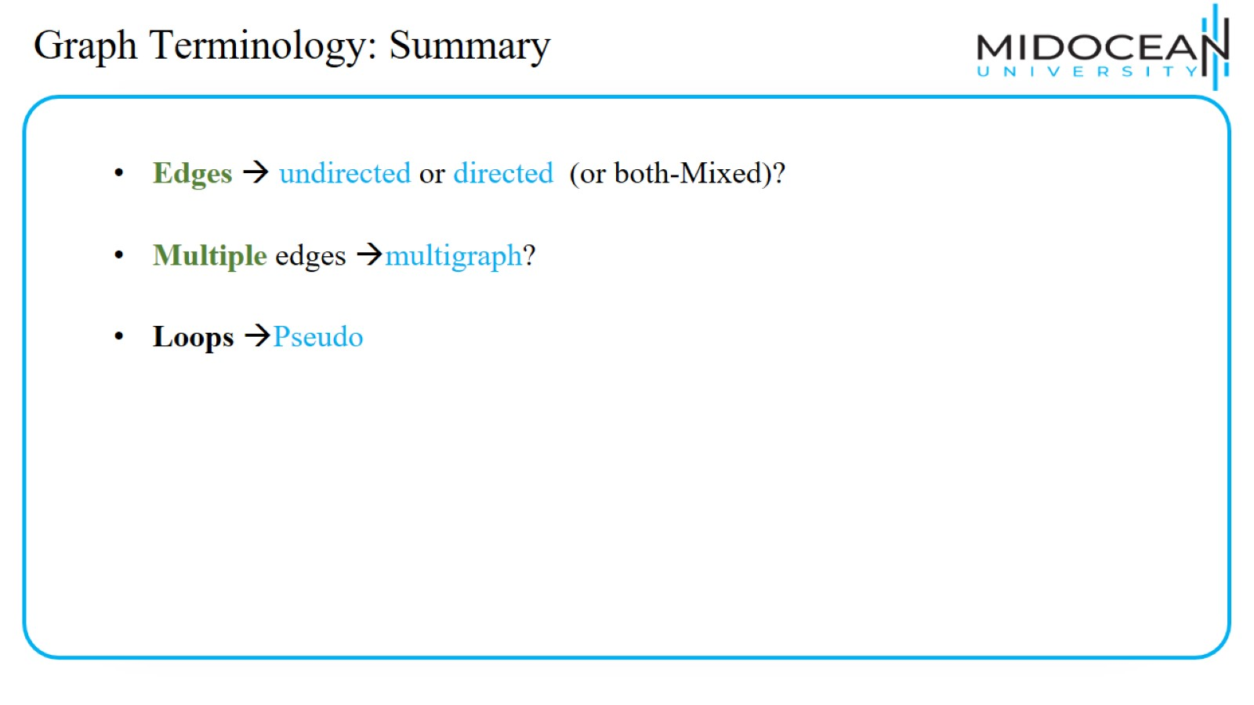
Graph Terminology: Summary

Slide 23
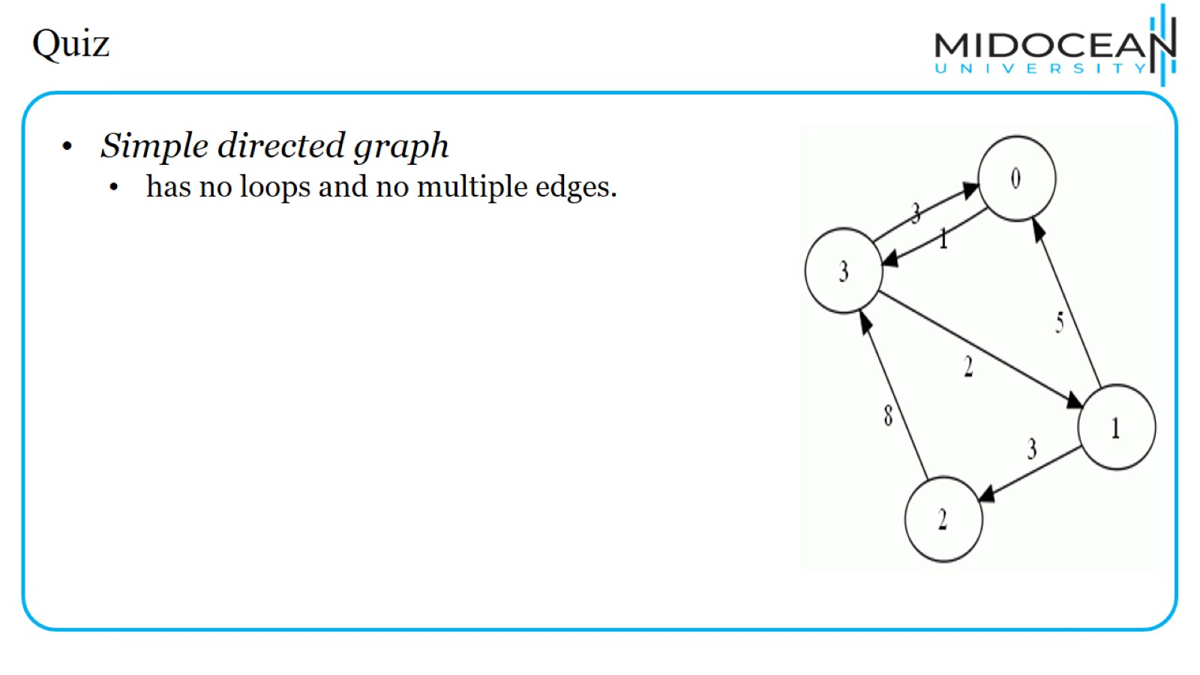
Quiz

Slide 24
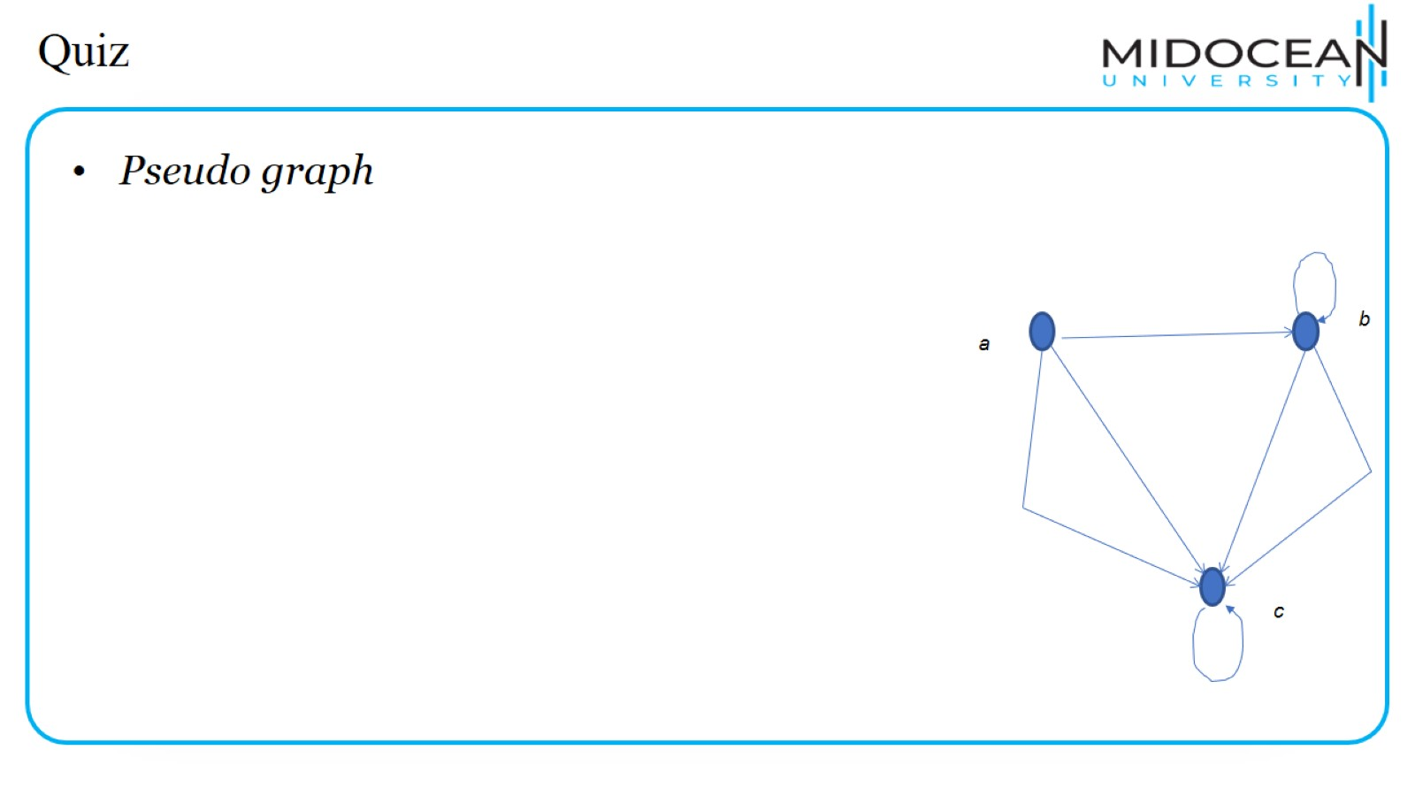
Quiz

Slide 25
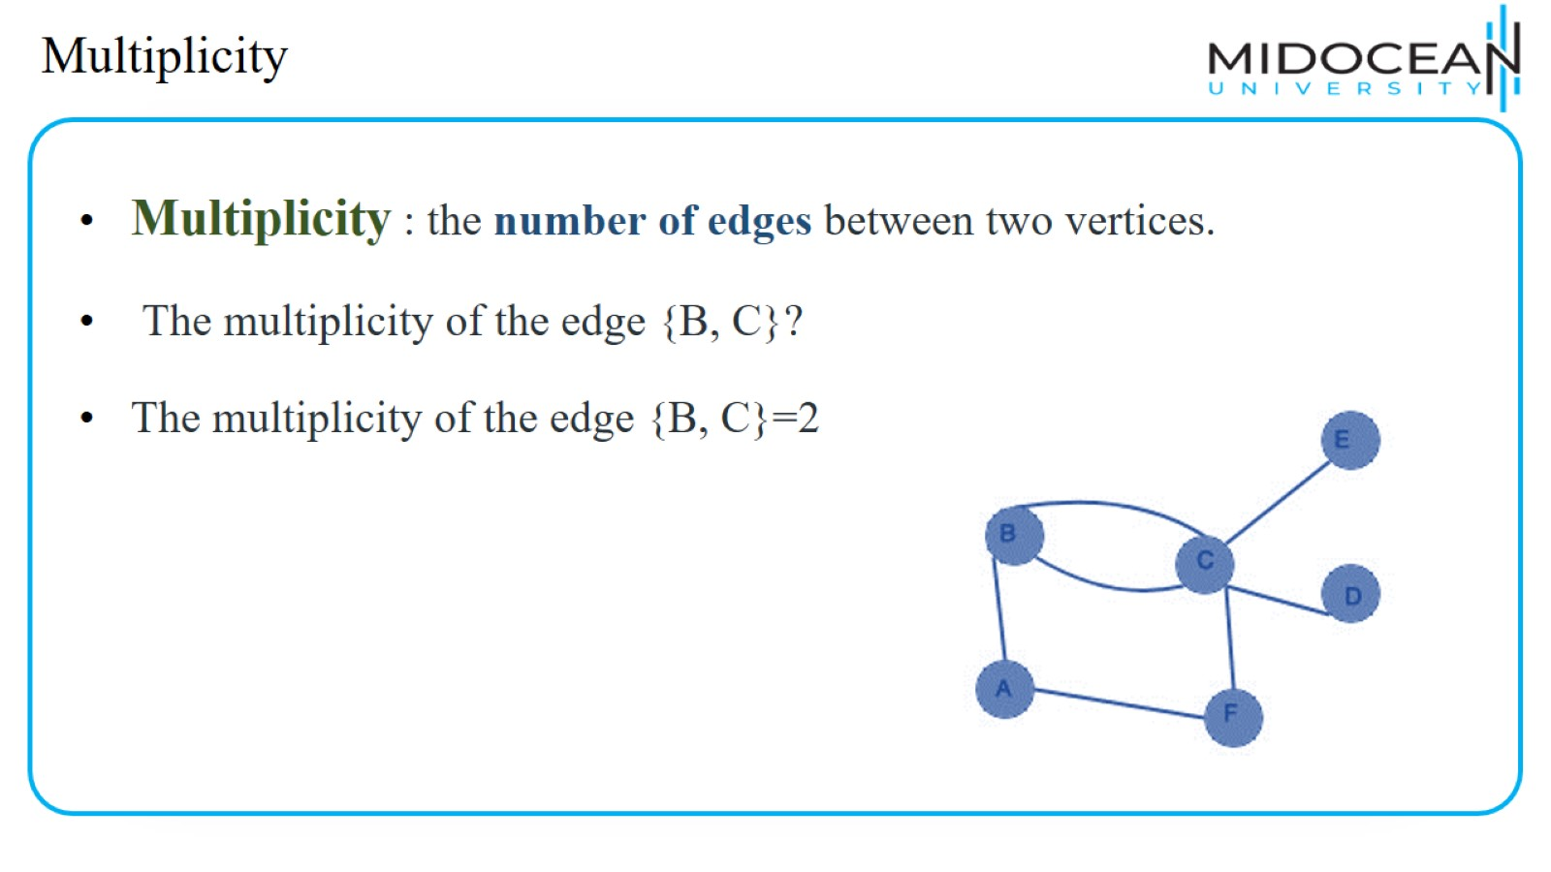
Multiplicity

Slide 26
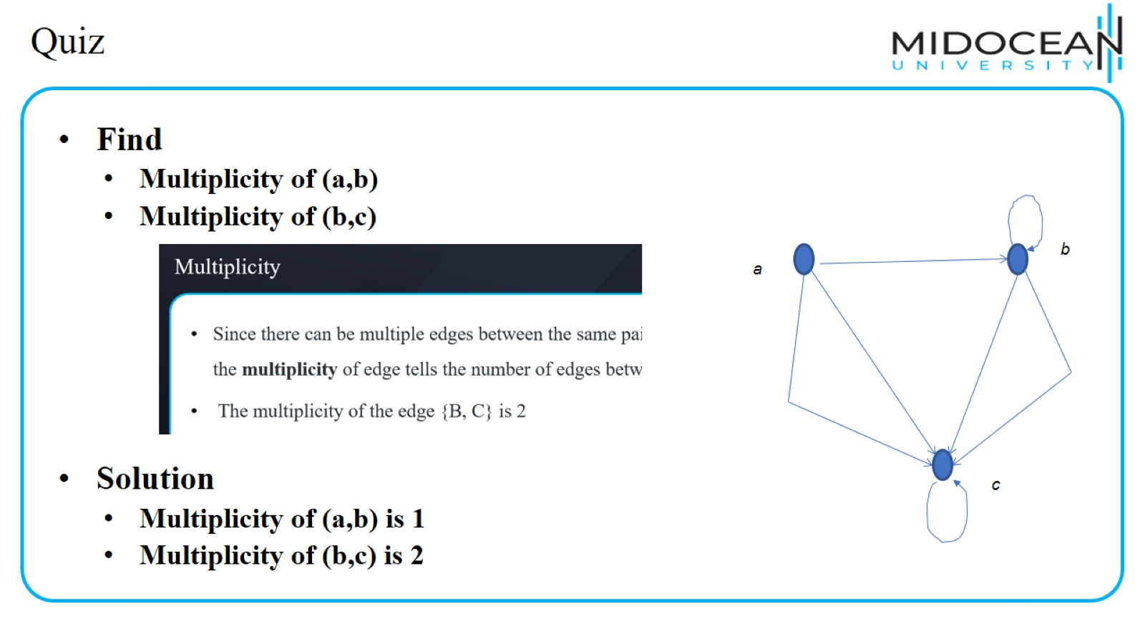
Quiz

Slide 27
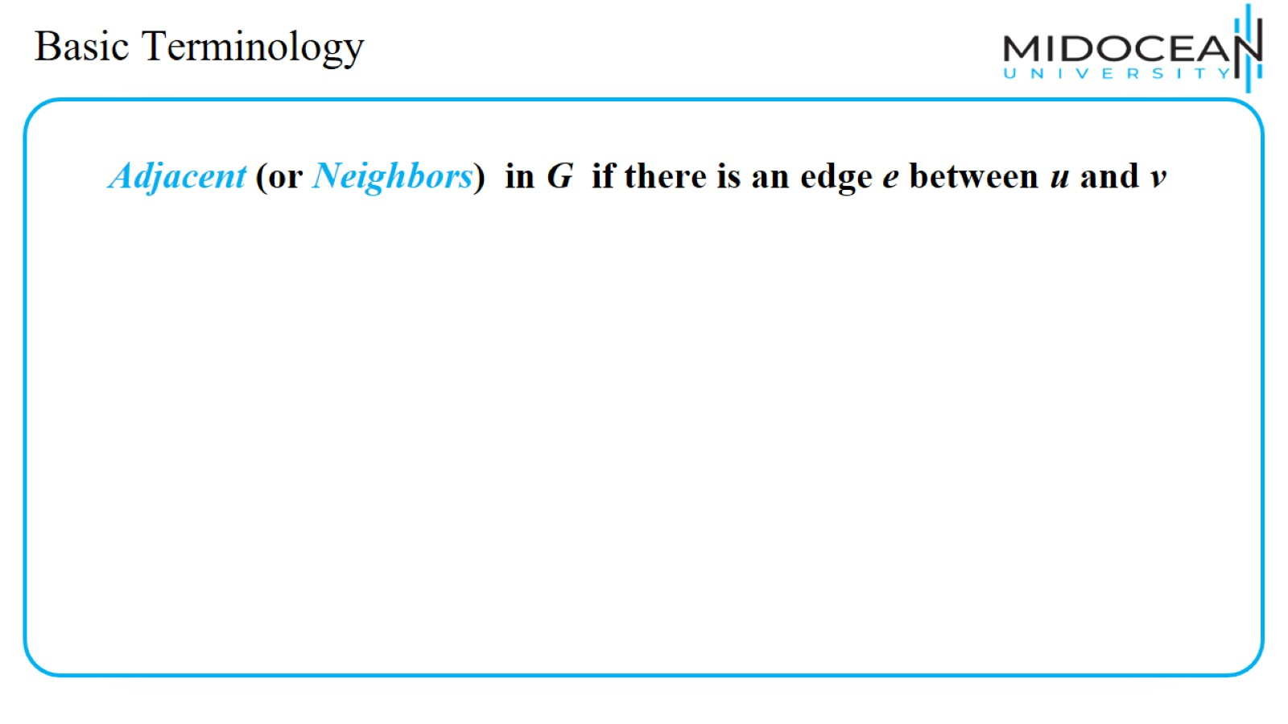
Basic Terminology

Slide 28
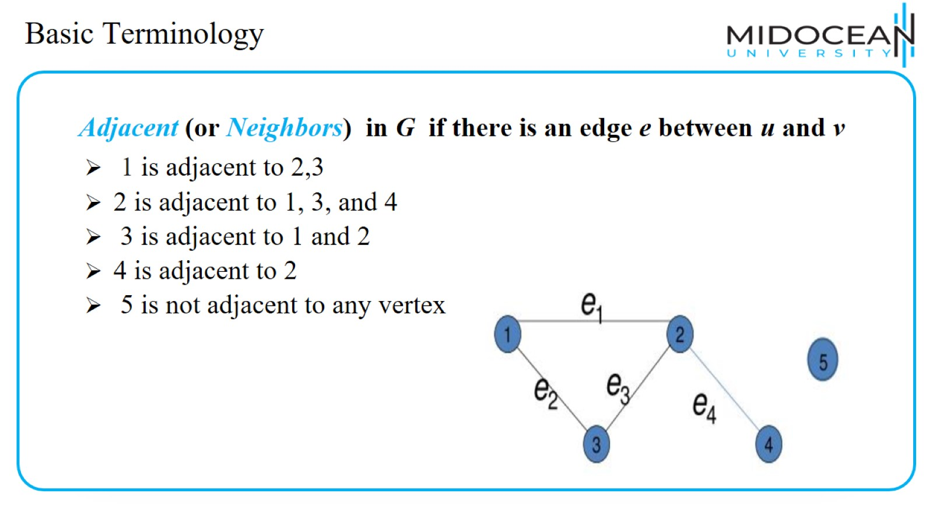
Basic Terminology

Slide 29
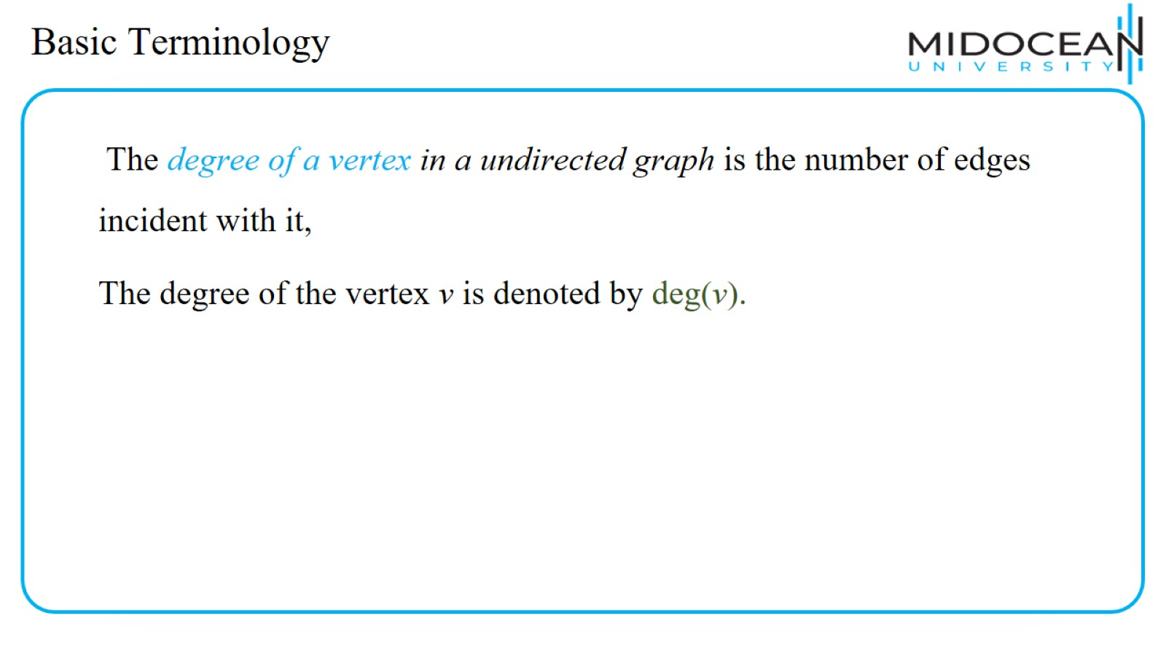
Basic Terminology

Slide 30
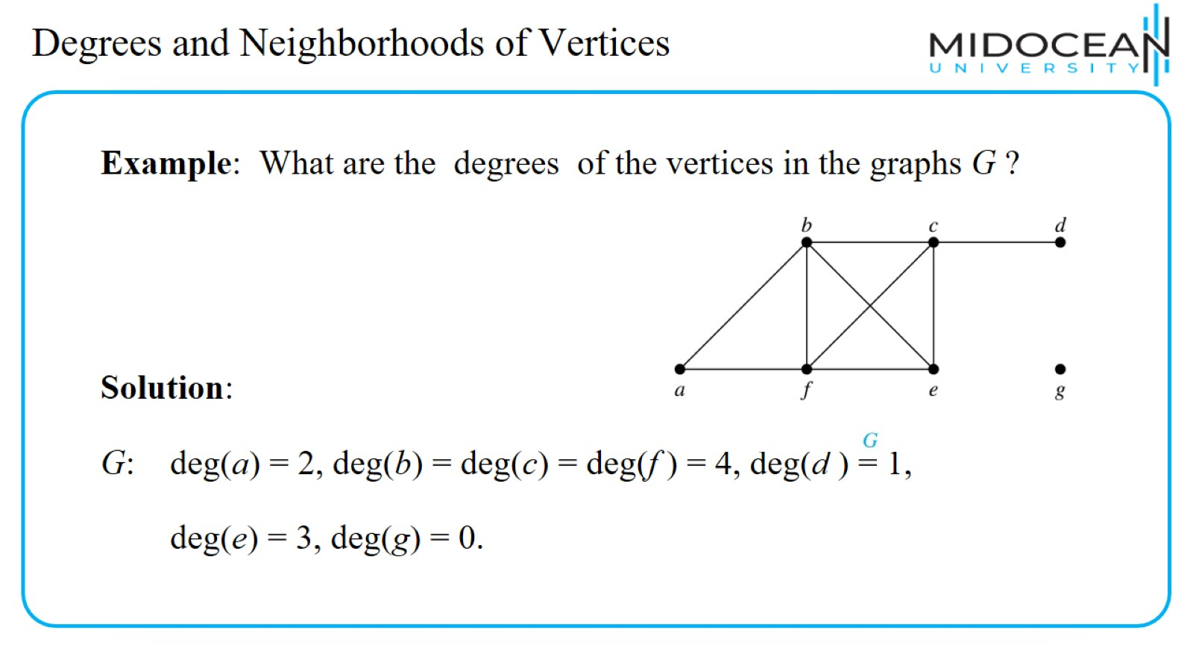
Degrees and Neighborhoods of Vertices

Slide 31
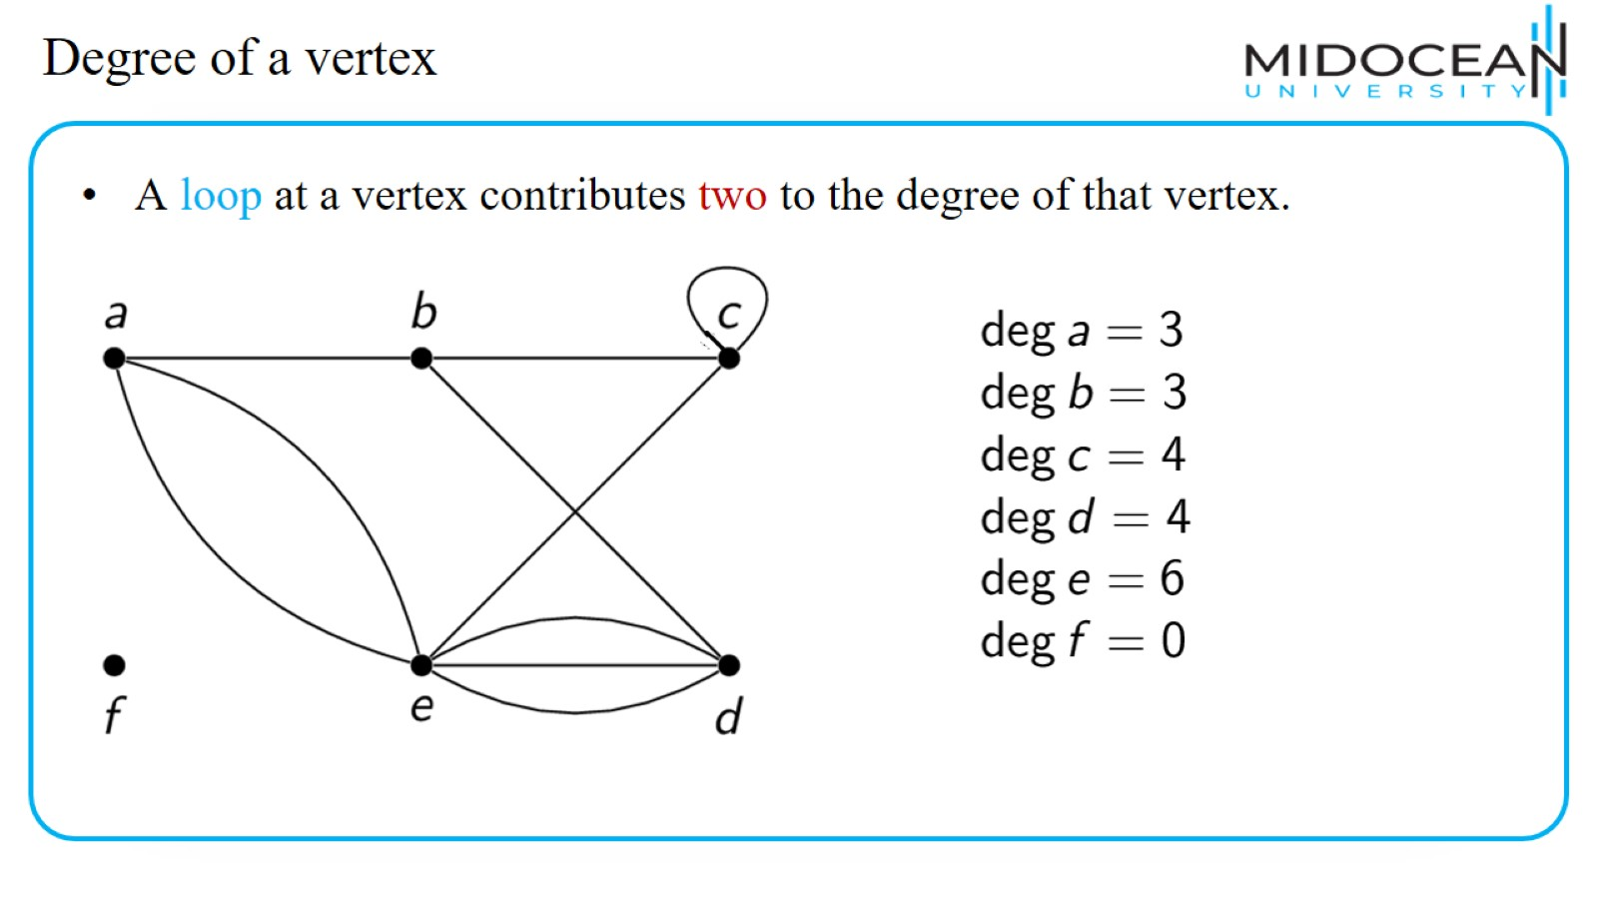
Degree of a vertex

Slide 32
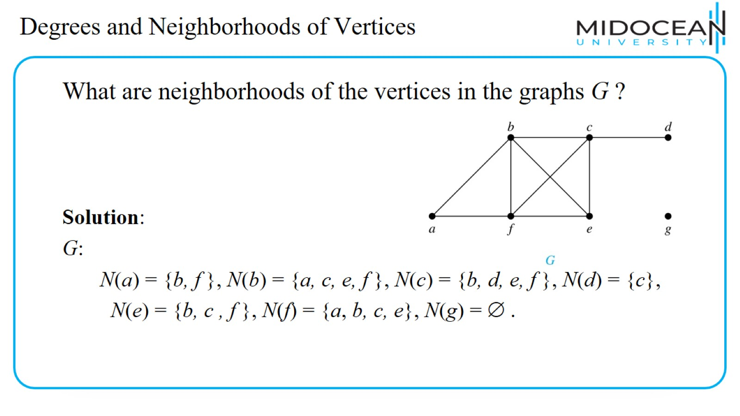
Degrees and Neighborhoods of Vertices

Slide 33
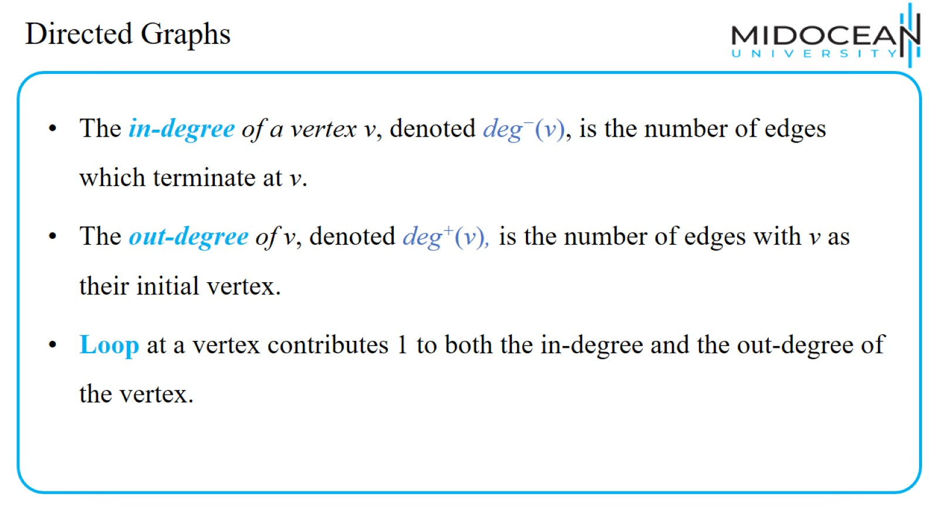
Directed Graphs

Slide 34
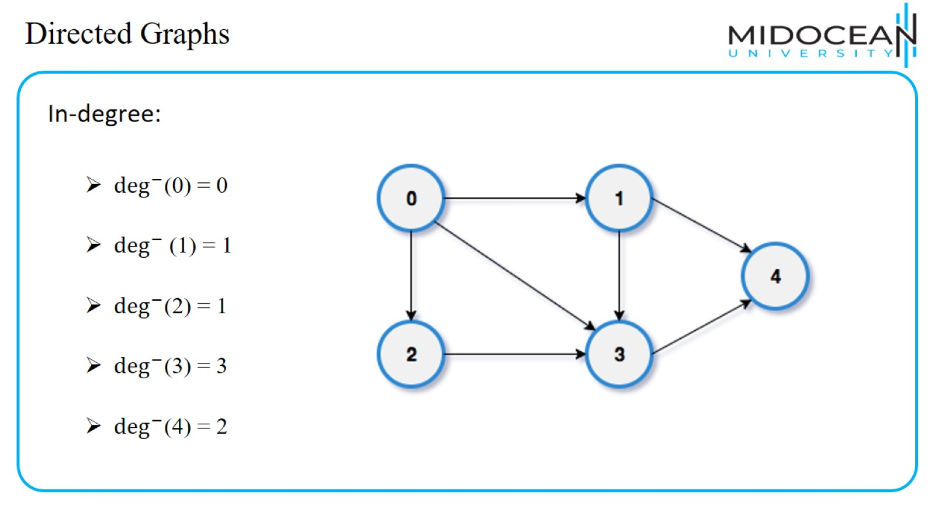
Directed Graphs

Slide 35

Directed Graphs

Slide 36
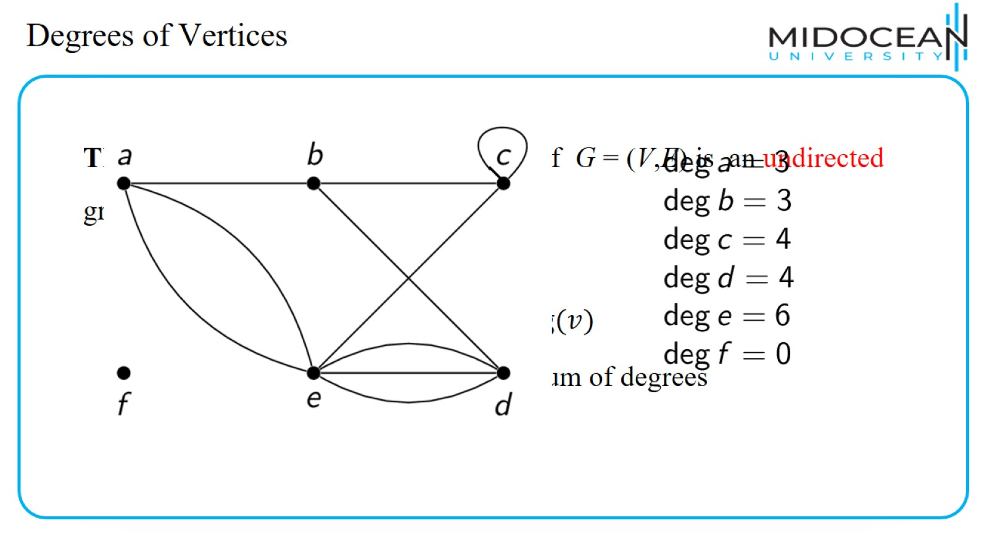
Degrees of Vertices

Slide 37
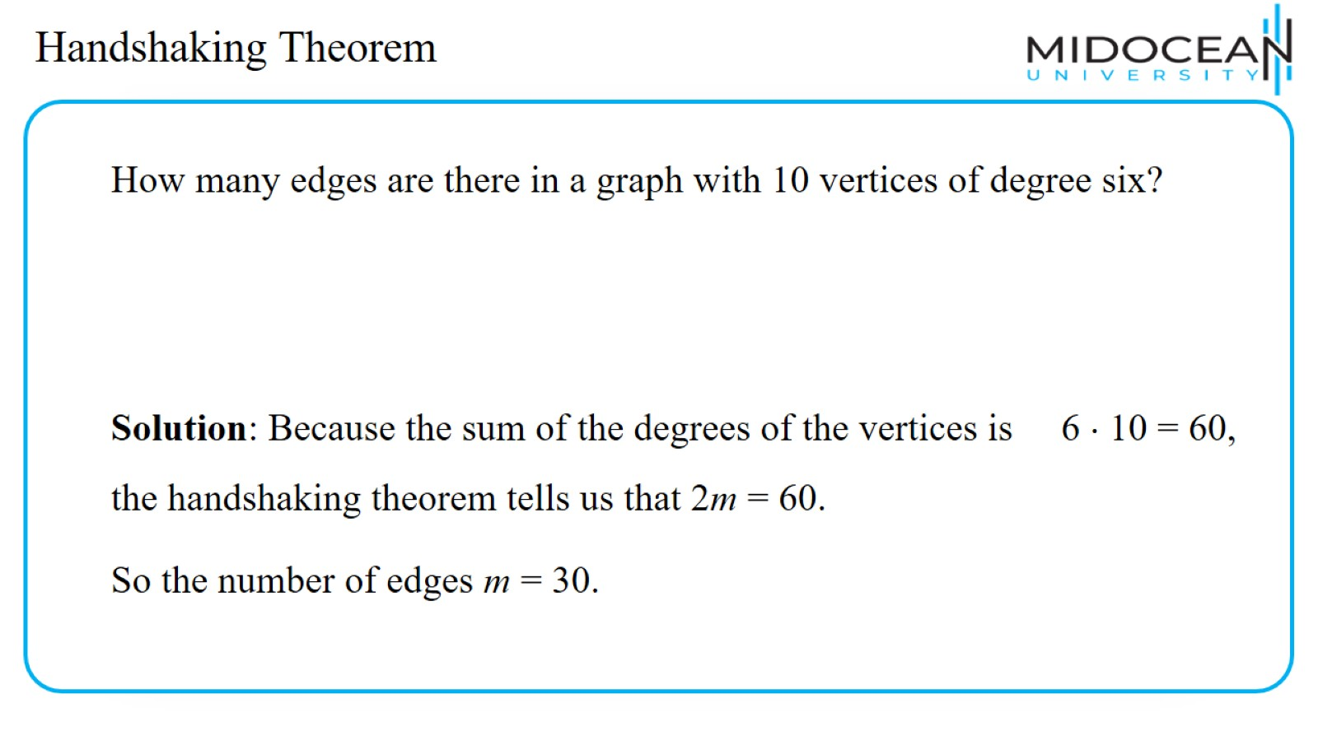
Handshaking Theorem

Slide 38
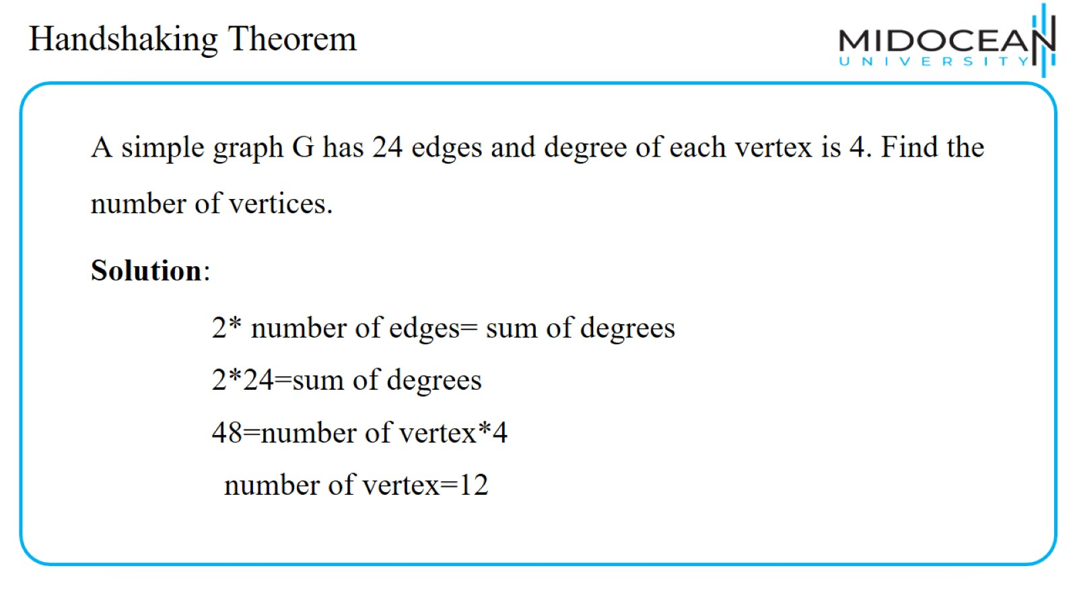
Handshaking Theorem

Slide 39
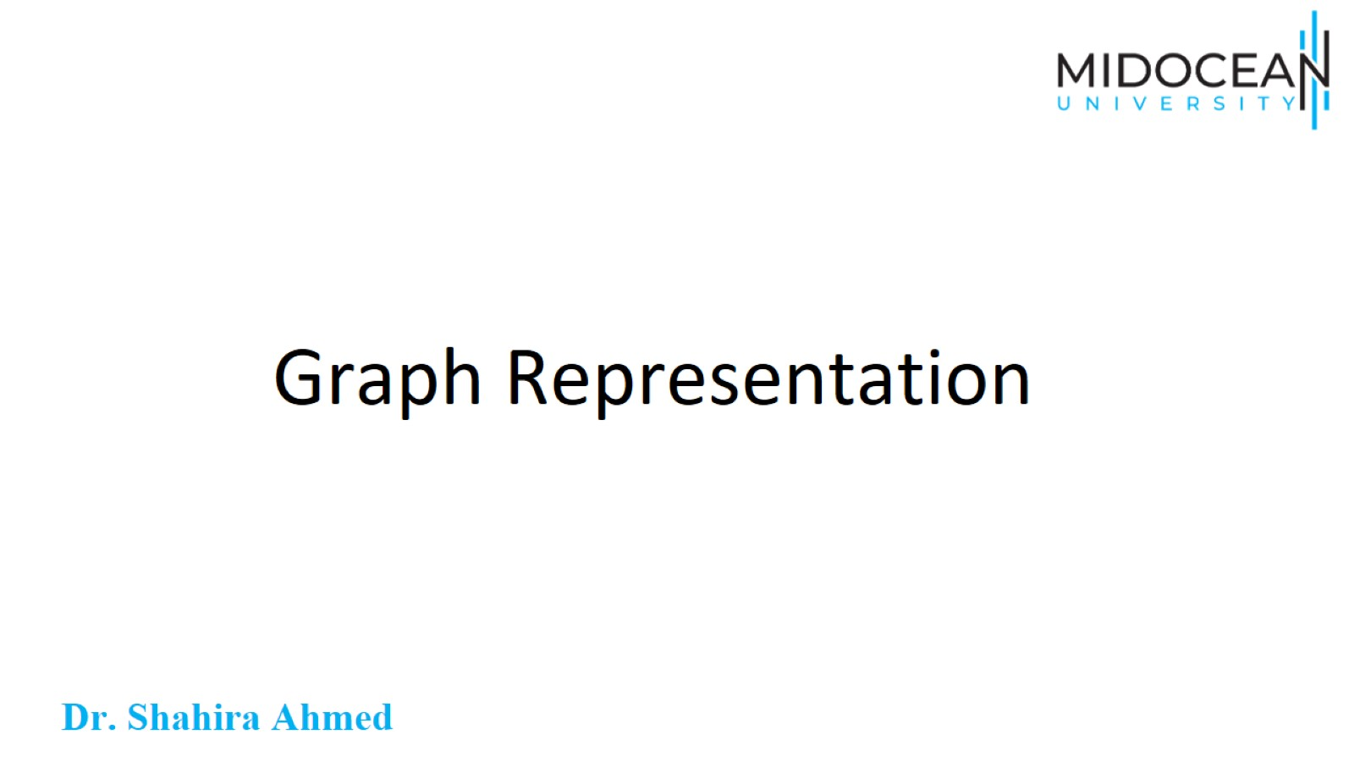
Graph Representation

Slide 40
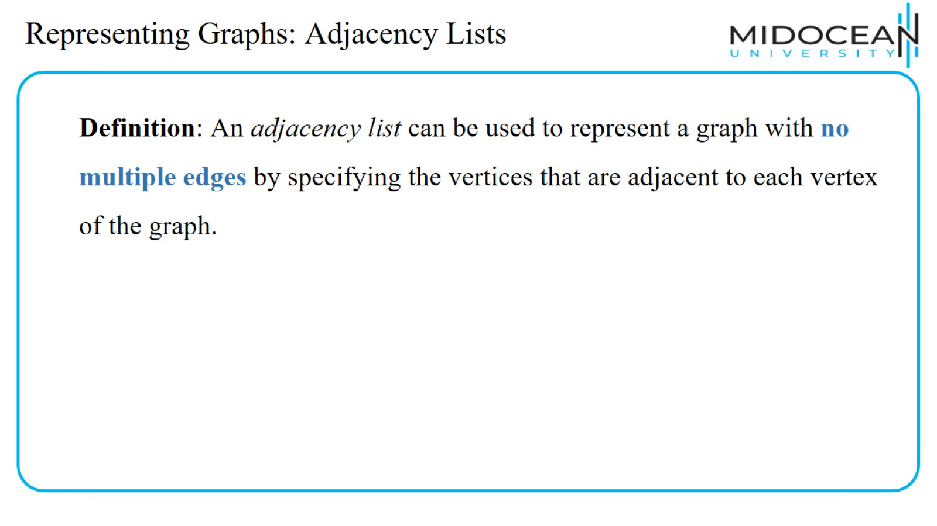
Representing Graphs: Adjacency Lists

Slide 41
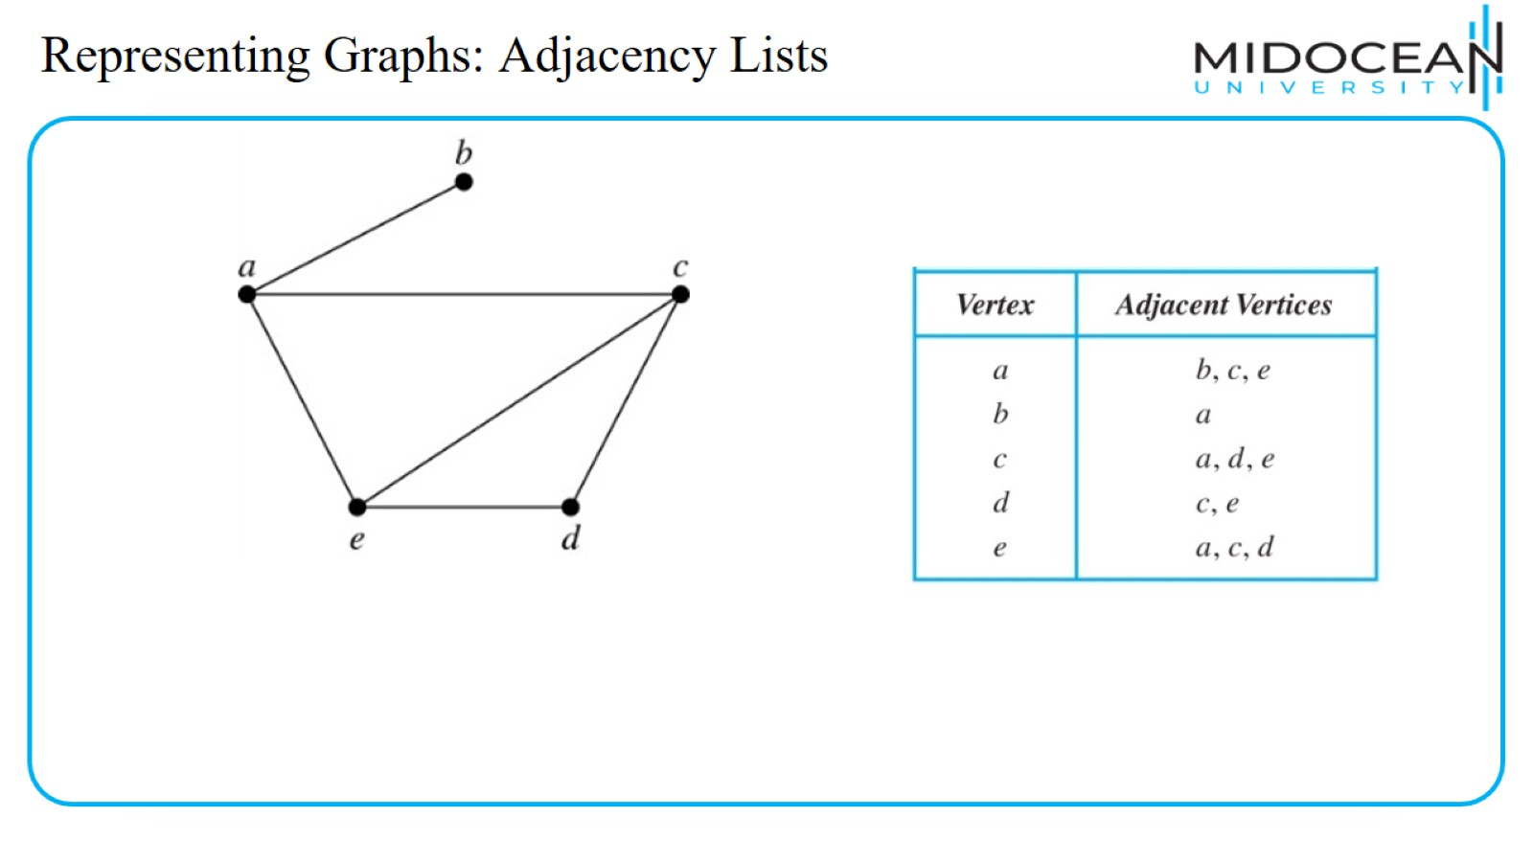
Representing Graphs: Adjacency Lists

Slide 42
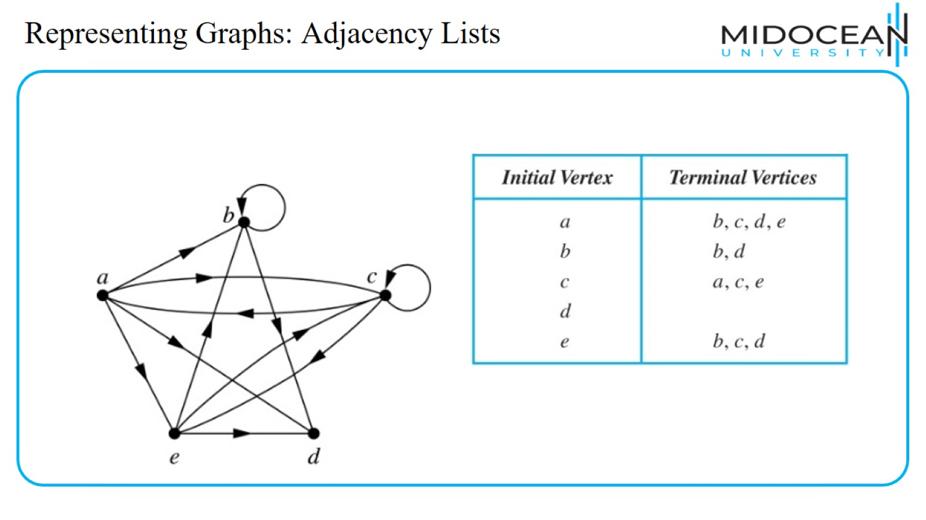
Representing Graphs: Adjacency Lists

Slide 43
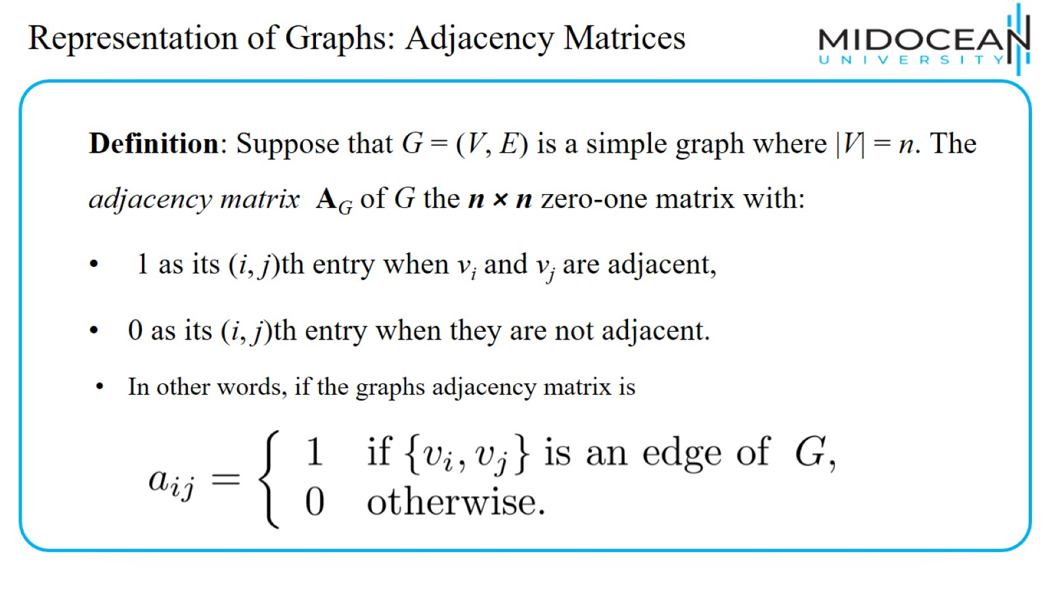
Representation of Graphs: Adjacency Matrices

Slide 44
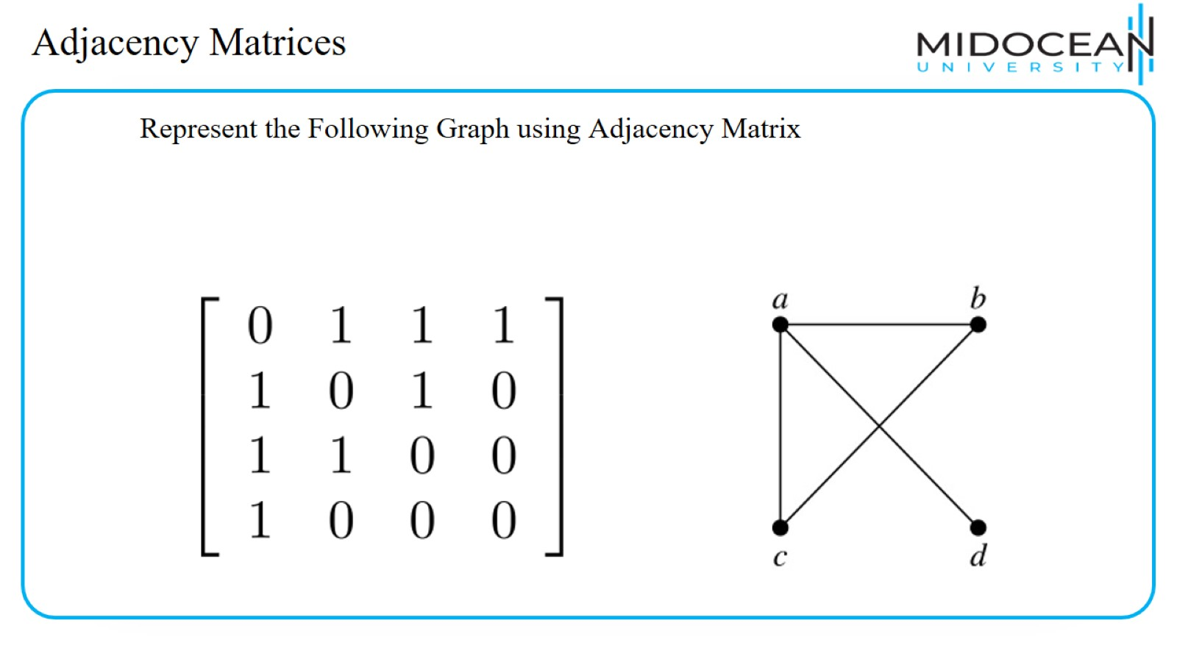
Adjacency Matrices

Slide 45
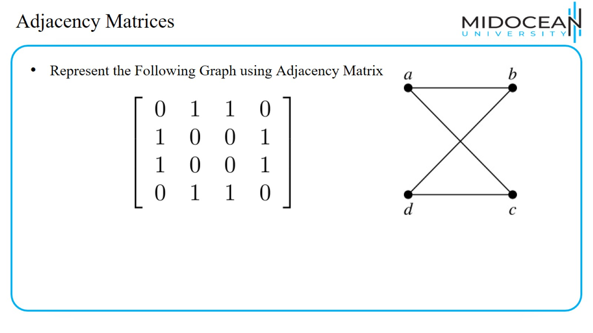
Adjacency Matrices

Slide 46
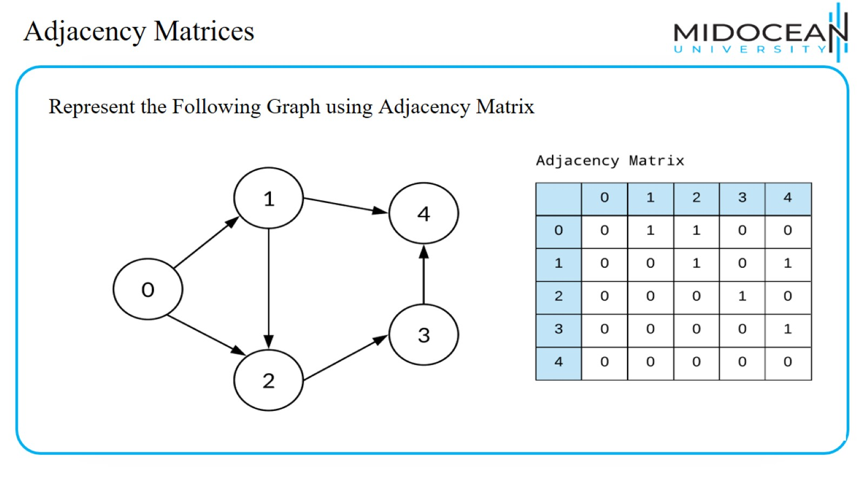
Adjacency Matrices

Slide 47
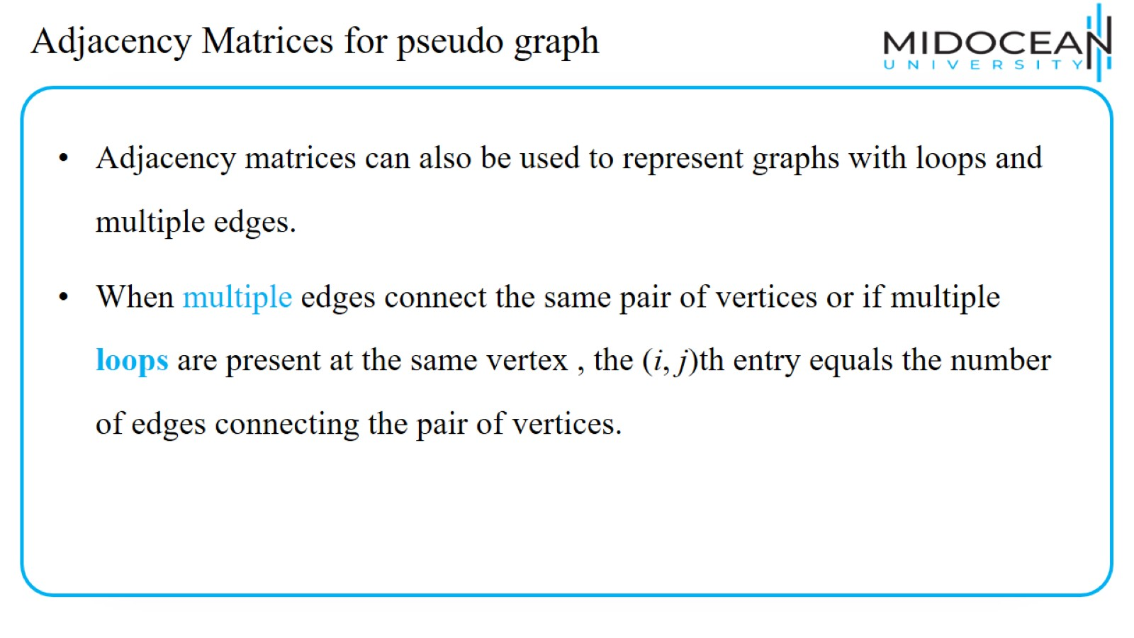
Adjacency Matrices for pseudo graph

Slide 48
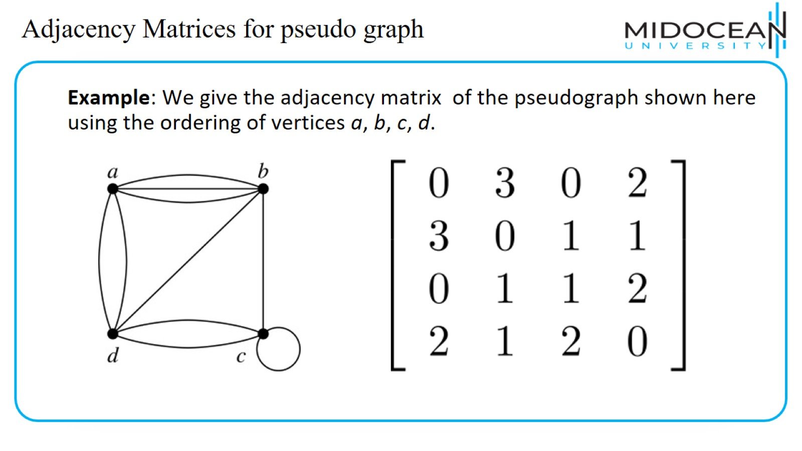
Adjacency Matrices for pseudo graph

Slide 49
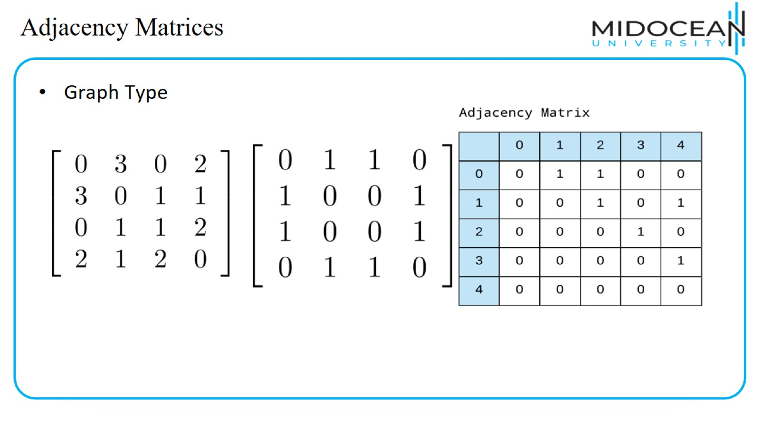
Adjacency Matrices

Slide 50
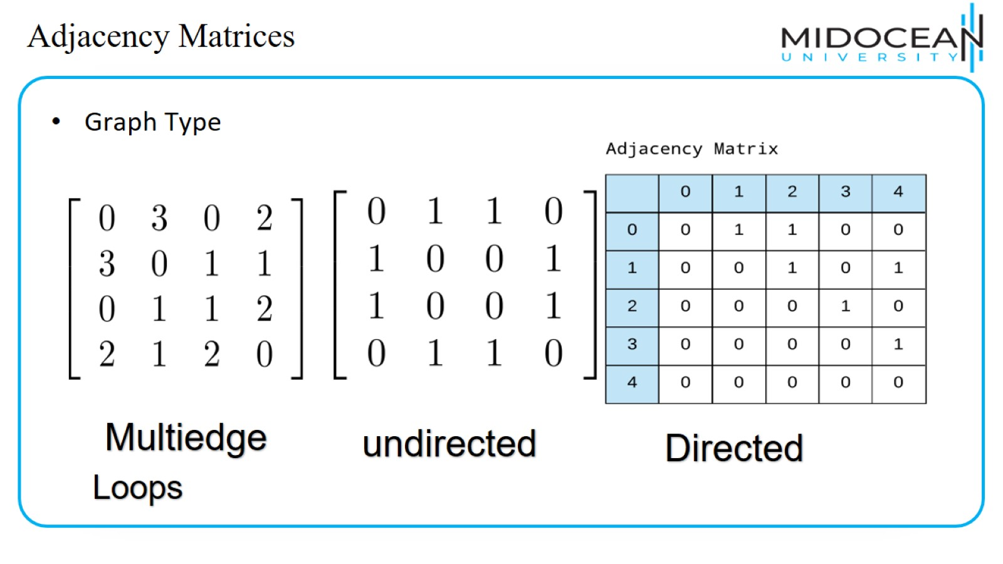
Adjacency Matrices

Slide 51

Recap

Slide 52
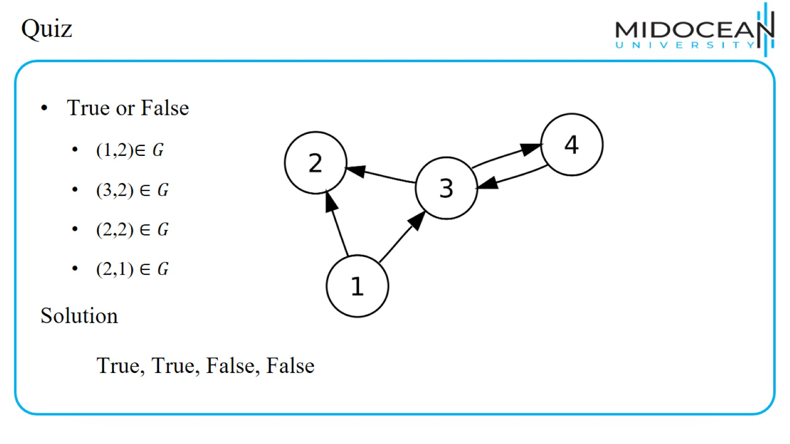
Quiz

Slide 53

Quiz

Slide 54
Quiz

Slide 55

Quiz

Slide 56

Quiz

Slide 57

Quiz

Slide 58

Quiz

Slide 59

Quiz

Slide 60

Quiz

Slide 61

Quiz

Slide 62

Quiz

Slide 63

Quiz

Slide 64

Quiz

Slide 65

Quiz

Slide 66

Quiz

Slide 67

Quiz

Slide 68

Quiz

Slide 69

Summary

Slide 70


