Slide 1


Advanced Project Management
PMG 506
Lecture 3
-Strategic Management
and Project Selection

Slide 2


Lecture
Strategic Management and Project Selection
03
Strategic Management and Project Selection

Slide 3
Lecture
Strategic Management and Project Selection
03
2.4 TYPES OF PROJECT SELECTION MODELS
Numeric Models: Scoring
In an attempt to overcome some of the disadvantages of profitability models, particularly their focus on a single decision criterion, a number of
evaluation/selection models that use multiple criteria to evaluate a project
have been developed.

Slide 4
Lecture
Strategic Management and Project Selection
03
2.4 TYPES OF PROJECT SELECTION MODELS
Numeric Models: Scoring
Unweighted 0–1 Factor Model
A set of relevant factors is selected by management and then usually listed in a preprinted form. One or more raters score the project on each factor, depending on whether or not it qualifies for an individual criterion. The criteria for choice are (1) a clear understanding of organizational goals and (2) a good knowledge of the firm’s potential project portfolio.
The main advantage of such a model is that it uses several criteria in the decision process. The major disadvantages are that it assumes all criteria are of equal importance and it allows for no gradation of the degree to which a specific project meets the various criteria.

Slide 5
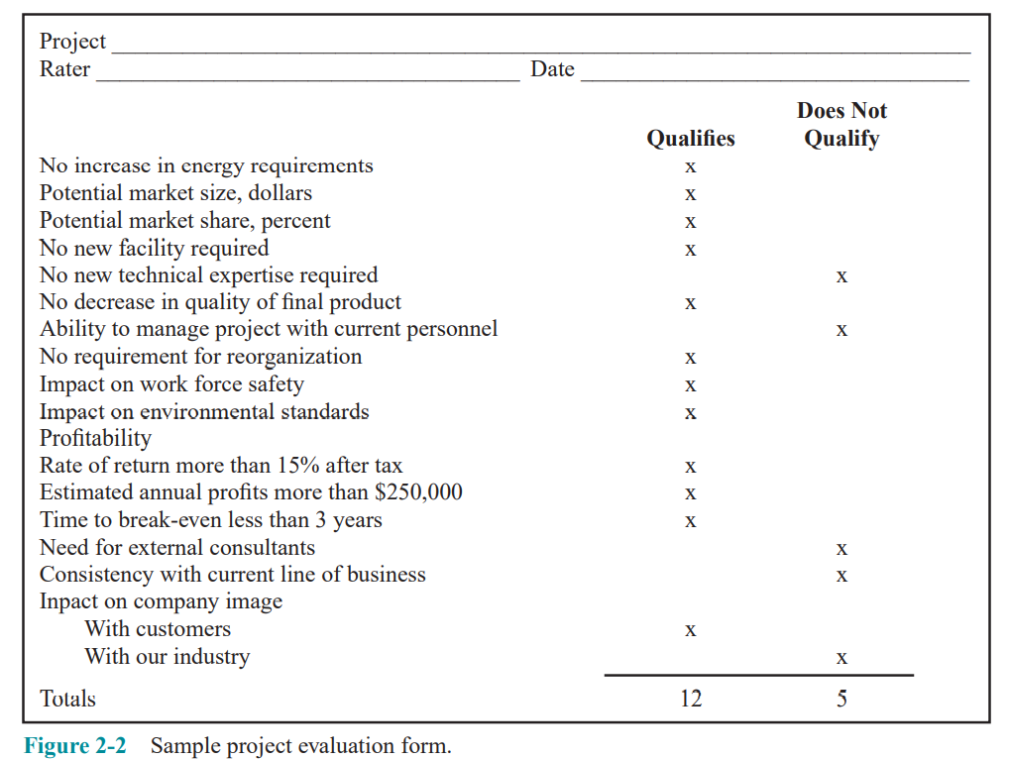
Lecture
Strategic Management and Project Selection
03
2.4 TYPES OF PROJECT SELECTION MODELS
Numeric Models: Scoring
Unweighted 0–1 Factor Model

Slide 6
Lecture
Strategic Management and Project Selection
03
2.4 TYPES OF PROJECT SELECTION MODELS
Numeric Models: Scoring
Unweighted Factor Scoring Model
The second disadvantage of the 0–1 factor model can be dealt with by constructing a simple linear measure of the degree to which the project being evaluated meets each of the criteria contained in the list. Often a five-point scale is used, where 5 is very good, 4 is good, 3 is fair, 2 is poor, 1 is very poor. (Three-, seven-, and 10-point scales are also common.) The column of scores is summed, and those projects with a total score exceeding some critical value are selected.
However, the criticism that the criteria are all assumed to be of equal importance still holds.

Slide 7
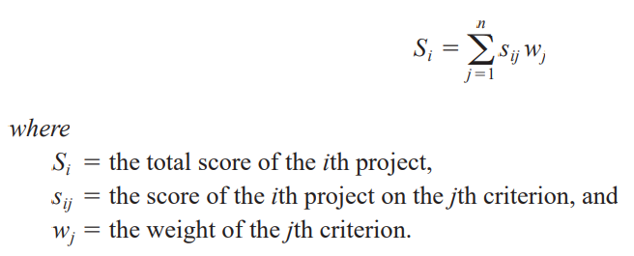
Lecture
Strategic Management and Project Selection
03
2.4 TYPES OF PROJECT SELECTION MODELS
Numeric Models: Scoring
Weighted Factor Scoring Model When numeric weights reflecting the relative importance of each individual factor are added, we have a weighted factor scoring model.

Slide 8
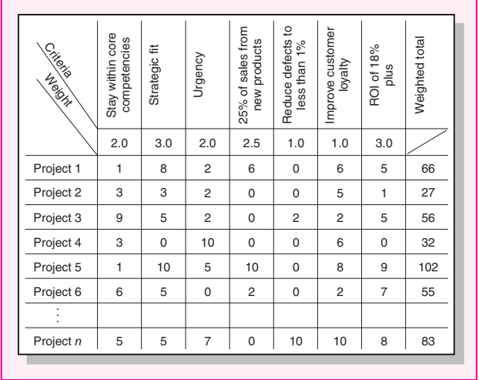
Lecture
Strategic Management and Project Selection
03

Slide 9
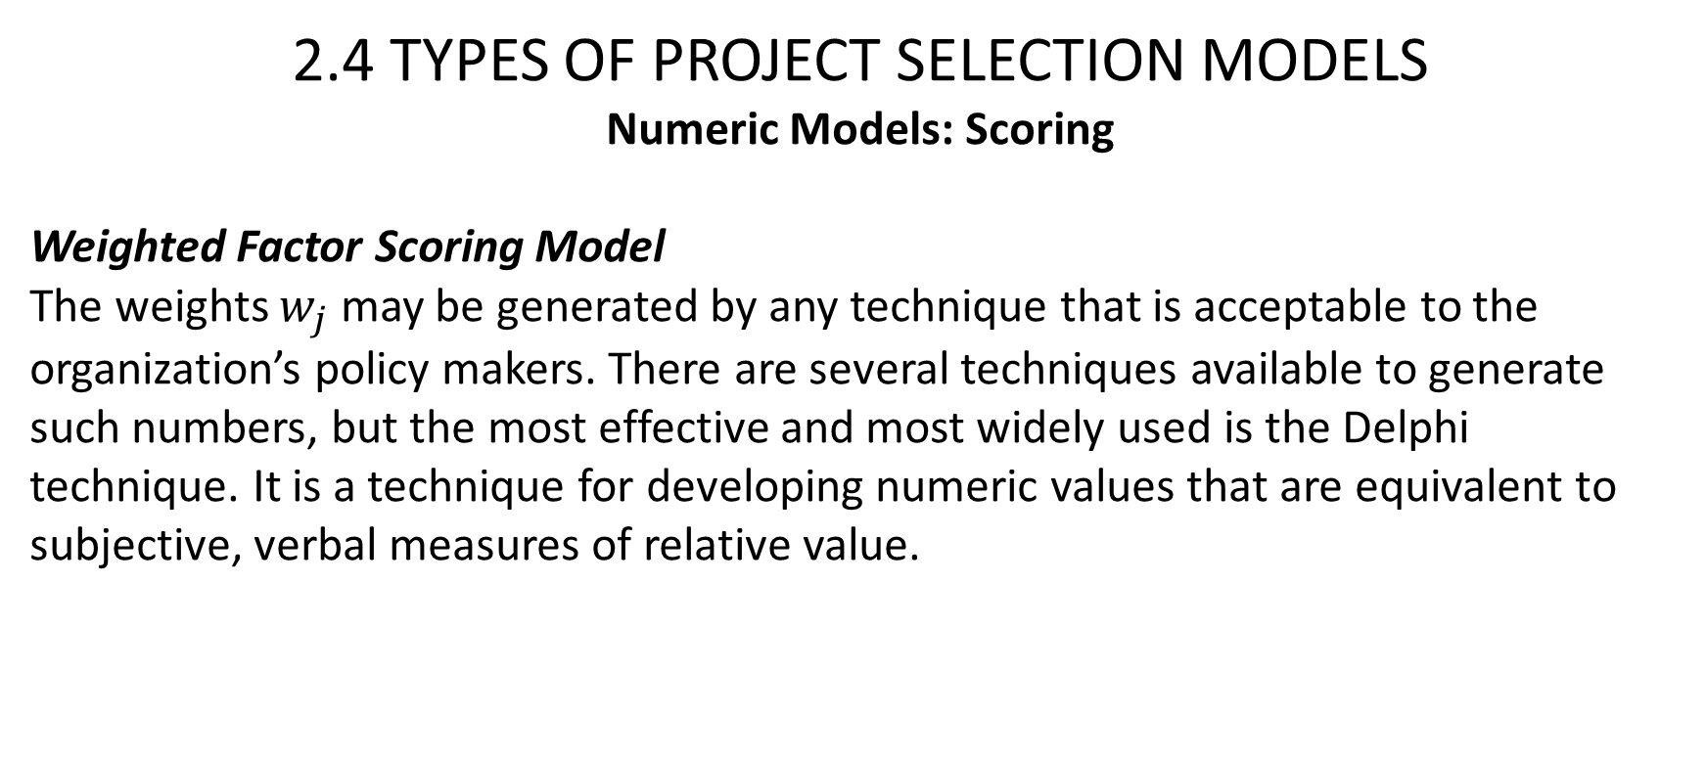
Lecture
Strategic Management and Project Selection
03
2.4 TYPES OF PROJECT SELECTION MODELS
Numeric Models: Scoring
Weighted Factor Scoring Model
The weights $w_{j}$ may be generated by any technique that is acceptable to the organization’s policy makers. There are several techniques available to generate such numbers, but the most effective and most widely used is the Delphi technique. It is a technique for developing numeric values that are equivalent to subjective, verbal measures of relative value.

Slide 10
Lecture
Strategic Management and Project Selection
03
2.4 TYPES OF PROJECT SELECTION MODELS
Numeric Models: Scoring
Scoring models advantages are:
1. These models allow multiple criteria to be used for evaluation and decision making, including profit/profitability models and both tangible and intangible criteria.
2. They are structurally simple and therefore easy to understand and use.
3. They are a direct reflection of managerial policy.

Slide 11
Lecture
Strategic Management and Project Selection
03
2.4 TYPES OF PROJECT SELECTION MODELS
Numeric Models: Scoring
Scoring models advantages are:
4. They are easily altered to accommodate changes in the environment or managerial policy.
5. Weighted scoring models allow for the fact that some criteria are more important than others.
6. These models allow easy sensitivity analysis. The trade-offs between the several criteria are readily observable.

Slide 12
Lecture
Strategic Management and Project Selection
03
2.4 TYPES OF PROJECT SELECTION MODELS
Numeric Models: Scoring
The disadvantages are:
1. The output of a scoring model is strictly a relative measure. Project scores do not represent the value or “utility” associated with a project and thus do not directly indicate whether or not the project should be supported.
2. In general, scoring models are linear in form and the elements of such models are assumed to be independent.

Slide 13
Lecture
Strategic Management and Project Selection
03
2.4 TYPES OF PROJECT SELECTION MODELS
Numeric Models: Scoring
3. The ease of use of these models is conducive to the inclusion of a large number of criteria, most of which have such small weights that they have little impact on the total project score.
4. Unweighted scoring models assume all criteria are of equal importance, which is almost certainly contrary to fact.
5. To the extent that profit/profitability is included as an element in the scoring model, this element has the advantages and disadvantages noted earlier for the profitability models.

Slide 14
Lecture
Strategic Management and Project Selection
03
Window-of-Opportunity Analysis
That one ability to achieve a new technology does not necessarily imply that the new technology is worth implementing, or economically profitable. Given some idea for a new product or process, we can invert this traditional approach by attempting to determine the cost, timing, and performance specifications that must be met by this new technology before any R & D is undertaken. (This is called the window-of-opportunity for the innovation.)

Slide 15
Lecture
Strategic Management and Project Selection
03
2.4 TYPES OF PROJECT SELECTION MODELS
Choosing a Project Selection Model
Selecting the type of model to aid the evaluation/selection process depends on the philosophy and wishes of management.
We strongly Favor weighted scoring models for three fundamental reasons.
First, they allow the multiple objectives of all organizations to be reflected in the important decision about which projects will be supported and which will be rejected.
Second, scoring models are easily adapted to changes in managerial philosophy or changes in the environment.
Third, they do not suffer from the bias toward the short run that is inherent in profitability models that discount future cash flows.

Slide 16
Lecture
Strategic Management and Project Selection
03
2.5 ANALYSIS UNDER UNCERTAINTY — THE MANAGEMENT OF RISK
Risk has been interpreted as being unsure about project task durations and/or costs, but uncertainty plagues all aspects of the work on projects and is present in all stages of project life cycles. In this section, we will consider uncertainty as it affects the selection process.
Before proceeding, it is useful to discuss briefly the distinction between two words, “risk” and “uncertainty.”

Slide 17
Lecture
Strategic Management and Project Selection
03
2.5 ANALYSIS UNDER UNCERTAINTY — THE MANAGEMENT OF RISK
The outcome of any decision depends on two things:
(1) what the decision maker does; and
(2) what nature does—“nature” being the set of exogenous factors that interact with the decision maker’s course of action to produce an outcome.

Slide 18
Lecture
Strategic Management and Project Selection
03
2.5 ANALYSIS UNDER UNCERTAINTY — THE MANAGEMENT OF RISK
If the decision maker knows the probability of each and every state of nature and thus of each and every outcome, he can find the expected value of each alternative course of action he has.
The expected value of a specific action is the sum of the values of each outcome associated with the action times the probability that it will occur. . he can select the course of action associated with the best of these expected values. This is decision making under conditions of risk

Slide 19
Lecture
Strategic Management and Project Selection
03
2.5 ANALYSIS UNDER UNCERTAINTY — THE MANAGEMENT OF RISK
If the decision maker’s information is not so complete and he does not know and cannot collect sufficient data to determine the probability of occurrence for some states of nature, he cannot find the expected value for each alternative actions. This is decision making under conditions of uncertainty.

Slide 20
Lecture
Strategic Management and Project Selection
03
2.5 ANALYSIS UNDER UNCERTAINTY — THE MANAGEMENT OF RISK
When relationships between inputs and outputs in the projects are complex, Monte Carlo simulation can handle such uncertainty by exposing the many possible consequences of embarking on a project. Risk analysis is a method based on such a procedure. With the great availability of microcomputers and user-friendly software, these procedures are becoming very common.

Slide 21
Lecture
Strategic Management and Project Selection
03
2.5 ANALYSIS UNDER UNCERTAINTY — THE MANAGEMENT OF RISK
Risk Analysis and Simulation
While a project manager may be able to reduce uncertainty, it cannot be eliminated. Decisions must be made in the face of the ambiguity that results from uncertain information. Risk analysis does not remove the ambiguity, it simply describes the uncertainties in a way that provides the decision maker with a useful insight into their nature.

Slide 22
Lecture
Strategic Management and Project Selection
03
2.5 ANALYSIS UNDER UNCERTAINTY — THE MANAGEMENT OF RISK
Risk Analysis and Simulation
To apply risk analysis, one must make assumptions about the probability distributions that characterize key parameters and variables associated with a decision and then use these to estimate the risk profiles or probability distributions of the outcomes of the decision. This can be done analytically or by Monte Carlo simulation, an easy-to-use technique that is well-adapted to evaluating the risk in certain situations.
When the decisions involve several input variables or parameters, simulation is highly preferable to the tedious calculations required by analytic methods.

Slide 23
Lecture
Strategic Management and Project Selection
03
2.5 ANALYSIS UNDER UNCERTAINTY — THE MANAGEMENT OF RISK
-General Simulation Analysis
The analysis gives a picture of the proposed change in terms of the costs and times that will be affected. The uncertainty associated with each individual element of the process is included. Simulation runs will then indicate the likelihood of achieving various levels of savings. Note also that investigation of the simulation model will expose the major sources of uncertainty in the final cost distributions

Slide 24
Lecture
Strategic Management and Project Selection
03
2.6 COMMENTS ON THE INFORMATION BASE FOR SELECTION
Our bias in favor of weighted scoring models is quite clear and weighted scoring models can be simulated because both the scores and the weights are usually estimates.
The use of any project selection model assumes that the decision-making procedure takes place in a reasonably rational organizational environment.
Three special problems affecting the data used in project selection models are:
2.6 COMMENTS ON THE INFORMATION BASE FOR SELECTION
Our bias in Favor of weighted scoring models is quite clear and weighted scoring models can be simulated because both the scores and the weights are usually estimates.
The use of any project selection model assumes that the decision-making procedure takes place in a reasonably rational organizational environment.
Three special problems affecting the data used in project selection models are:

Slide 25
Lecture
Strategic Management and Project Selection
03
2.6 COMMENTS ON THE INFORMATION BASE FOR SELECTION
Accounting Data
Managers can find it useful to reflect on the methods and assumptions used in the preparation of accounting data. Among the most crucial are the following:
Cost and revenue data are assumed to vary linearly with associated changes in inputs and outputs.

Slide 26
Lecture
Strategic Management and Project Selection
03
2.6 COMMENTS ON THE INFORMATION BASE FOR SELECTION
2. The cost-revenue information that is derived from standard cost analyses may or may not be accurate representations of the cost-revenue structure of the physical system they purport to represent.
3. The data provided by the accounting system may or may not include overhead costs.

Slide 27
Lecture
Strategic Management and Project Selection
03
2.6 COMMENTS ON THE INFORMATION BASE FOR SELECTION
Measurements
To use the scoring methods discussed or to practice risk management in project selection, we need to represent expected project performance for each criterion in numeric form.
Subjective versus Objective
All too often the word objective is held to be synonymous with fact and subjective is taken to be a synonym for opinion. Where fact = true and opinion = false. A measurement taken by reference to an external standard is said to be “objective.” Reference to a standard that is internal to the system is said to be “subjective.”

Slide 28
Lecture
Strategic Management and Project Selection
03
2.6 COMMENTS ON THE INFORMATION BASE FOR SELECTION
Measurements
Quantitative versus Qualitative
The true distinction is that one may apply the law of addition to quantities but not to qualities. For example, Water has a volumetric measure and a density measure. The former is quantitative and the latter qualitative. Two one-gallon containers of water poured into one larger container give us two gallons, but the density of the water, before and after joining the two gallons, is still the same

Slide 29
Lecture
Strategic Management and Project Selection
03
2.6 COMMENTS ON THE INFORMATION BASE FOR SELECTION
Measurements
Reliable versus Unreliable
A data source is said to be reliable if repetitions of a measurement produce results that vary from one another by less than a prespecified amount.

Slide 30
Lecture
Strategic Management and Project Selection
03
2.6 COMMENTS ON THE INFORMATION BASE FOR SELECTION
Measurements :
Valid versus Invalid
Validity measures the extent to which a piece of information actually means what we believe it to mean. A measure may be reliable but not valid.
To be satisfactory when used in the previous project selection models, the measures may be either subjective or objective, quantitative or qualitative, but they must be numeric, reliable, and valid.

Slide 31
Lecture
Strategic Management and Project Selection
03
The value of k is found by trial and error.
The value of k is found by trial and error.
2.6 COMMENTS ON THE INFORMATION BASE FOR SELECTION
Uncertain Information
In the section on weighted scoring models, we noted some useful methods for finding the numeric weights and criteria scores when they take the form of verbal descriptors rather than numbers. These same methods are also useful when estimating the inputs for risk analysis models.

Slide 32
Lecture
Strategic Management and Project Selection
03
Summary
This chapter initiated our discussion of the project management process by describing procedures for strategically evaluating and selecting projects. We first described the strategic objective of using projects to help achieve the organization’s goals and strategy, and a project portfolio process to help achieve this. We then outlined some criteria for project selection models and then discussed the general nature of these models. The chapter then described the types of models in use and their advantages and disadvantages.

Slide 33
Lecture
Strategic Management and Project Selection
03
Summary
Considering the degree of uncertainty associated with many projects, a section was devoted to evaluating the impact of risk and uncertainty. Concluding the discussion, some general comments were made about data requirements and the use of these models. The final section discussed the documentation of the evaluation/selection process via project proposals. The following specific points were made in this chapter:
• The role of projects in achieving the organization’s goals and strategy is critical.
• The eight-step project portfolio process is an effective way to select and manage projects that are tied to the organization’s goals.
• Primary model selection criteria are realism, capability, flexibility, ease of use, and cost.

Slide 34
Lecture
Strategic Management and Project Selection
03
Summary
• Preparatory steps in using a model include: (1) identifying the firm’s objectives; (2) weighting them relative to each other; and (3) determining the probable impacts of the project on the firm’s competitive abilities.
• Project selection models can generally be classified as either numeric or nonnumeric; numeric models are further subdivided into profitability and scoring categories.
• Nonnumeric models include: (1) the sacred cow; (2) the operating necessity; (3) the competitive necessity; and (4) comparative benefit.

Slide 35
Lecture
Strategic Management and Project Selection
03
• Profitability models include standard forms such as: (1) payback period; (2) average rate of return; (3) discounted cash flow; (4) internal rate of return; and (5) profitability index.
• Project management maturity measurement is a way of assessing an organization’s ability to conduct projects successfully.
• Scoring models—the authors’ preference—include: (1) the unweighted 0–1 factor model; (2) the unweighted factor scoring model; (3) the weighted factor scoring model; and (4) the constrained weighted factor scoring model.
Summary
Summary
• • Profitability models include standard forms such as: (1) payback period; (2) average rate of return; (3) discounted cash flow; (4) internal rate of return; and (5) profitability index.
• Project management maturity measurement is a way of assessing an organization’s ability to conduct projects successfully.
• Scoring models—the authors’ preference—include: (1) the unweighted 0–1 factor model; (2) the unweighted factor scoring model; (3) the weighted factor scoring model.

Slide 36
Lecture
Strategic Management and Project Selection
03
2.4 TYPES OF PROJECT SELECTION MODELS
Numeric Models: Profit/Profitability
Glossary
Decision Support System A computer package and data base to aid managers in making decisions. It may include simulation programs, mathematical programming routines, and decision rules.
Deterministic Predetermined, with no possibility of an alternate outcome. Compare with stochastic. Expert System A computer package that captures the knowledge of recognized experts in an area and can make inferences about a problem based on decision rules and data input to the package.
Maturity The sophistication and experience of an organization in managing multiple projects.

Slide 37
Lecture
Strategic Management and Project Selection
03
Glossary
Model A way of looking at reality, usually for the purpose of abstracting and simplifying it, to make it understandable in a particular context.
Network A group of items connected by some common mechanism.
Portfolio A group or set of projects with varying characteristics.
Pro forma Projected or anticipated, usually applied to financial data such as balance sheets and income statements.
Programming An algorithmic methodology for solving a particular type of complex problem, usually conducted on a computer.

Slide 38
Lecture
Strategic Management and Project Selection
03
Glossary
Project portfolio process An eight-step procedure for selecting, implementing, and reviewing projects that will help an organization achieve its strategic goals.
Risk analysis A procedure that uses a distribution of input factors and probabilities and returns a range of outcomes and their probabilities.
Sensitivity analysis Investigation of the effect on the outcome of changing some parameters or data in the procedure or model.

Slide 39
Lecture
Strategic Management and Project Selection
03
Glossary
Simulation A technique for emulating a process, usually conducted a considerable number of times to understand the process better and measure its outcomes under different policies.
Stochastic Probabilistic, or not deterministic.
Delphi A formalized method of group decision making that facilitates drawing on the knowledge of experts in the group.

Slide 40

Thank You

