Slide 1


Slide 2
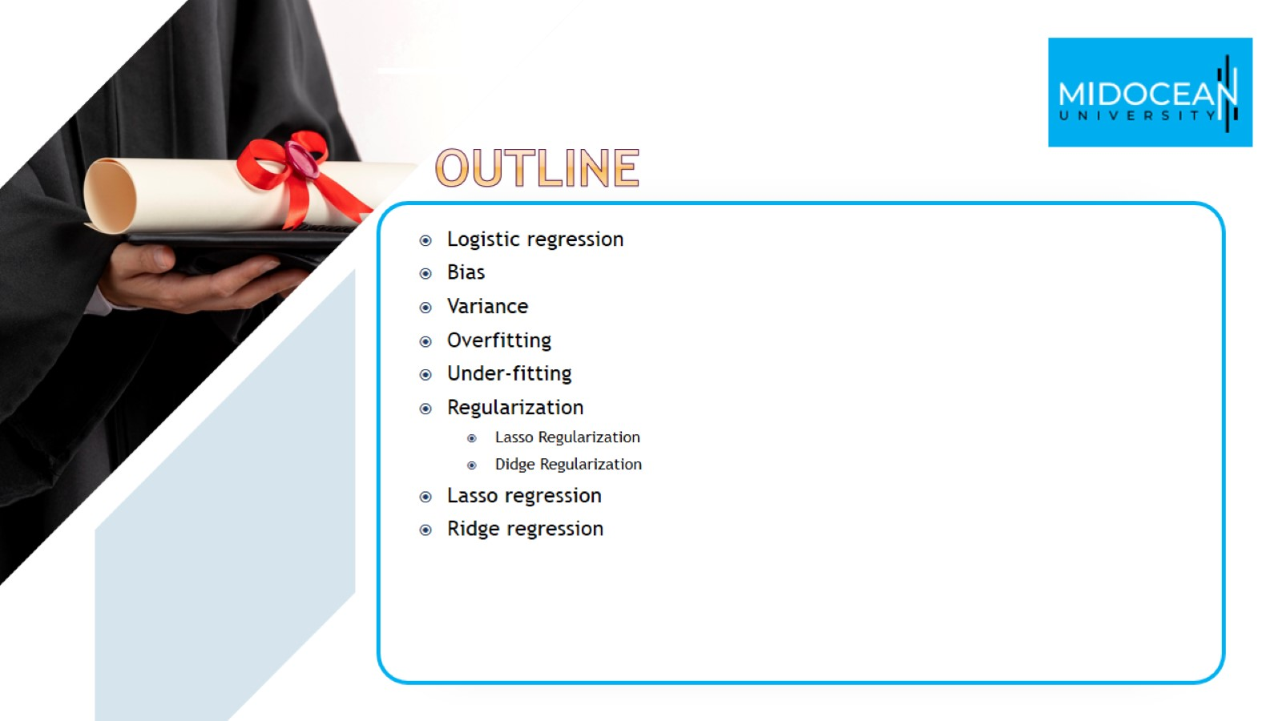

Slide 3
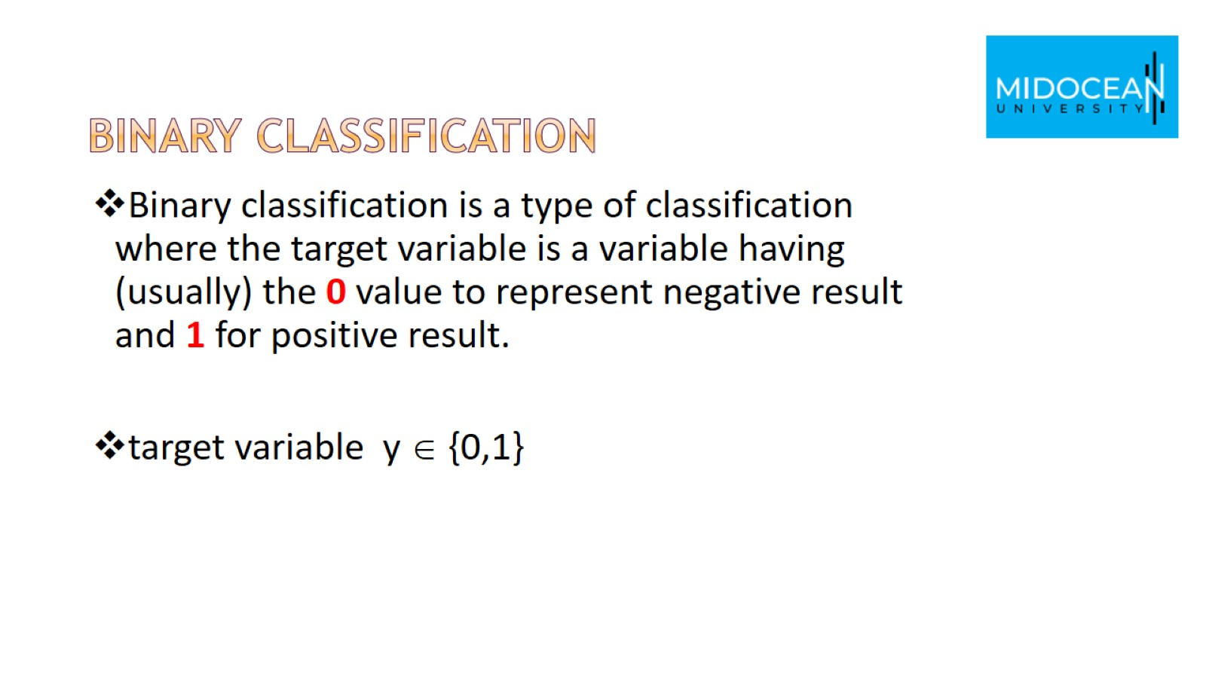
Binary classification

Slide 4
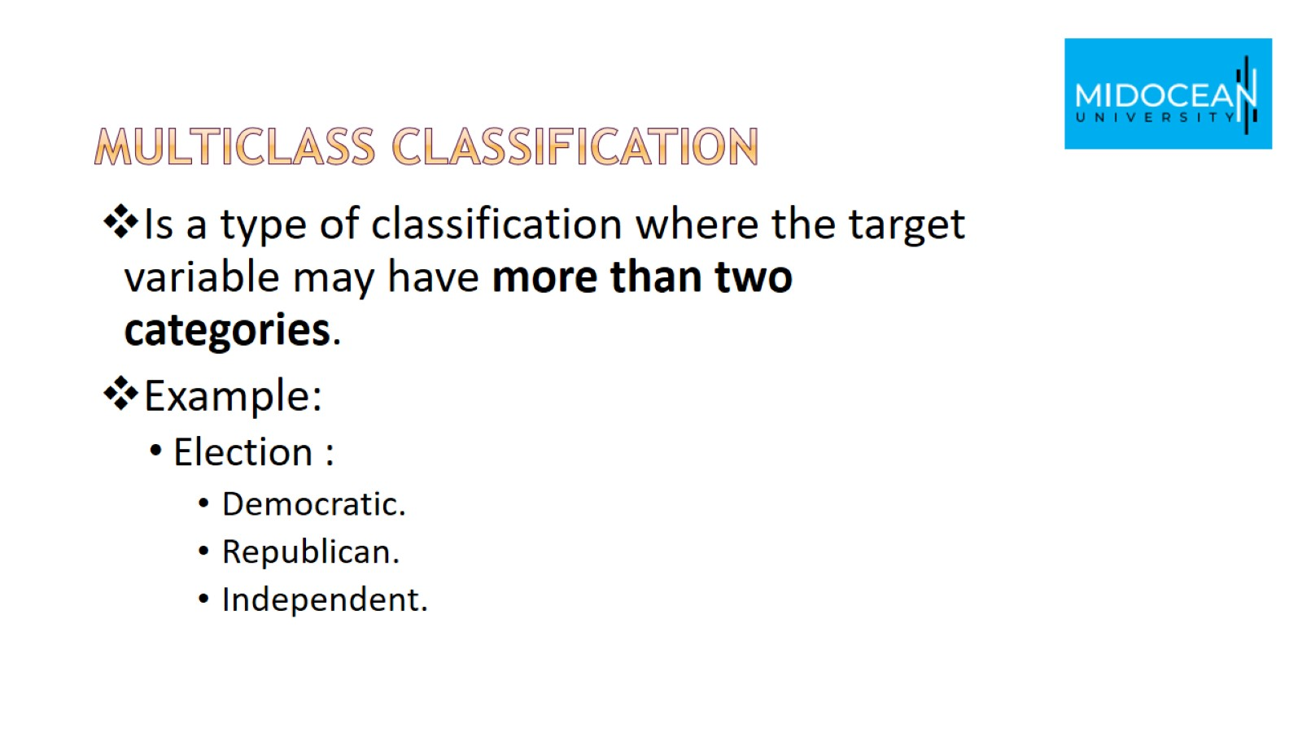
Multiclass classification

Slide 5
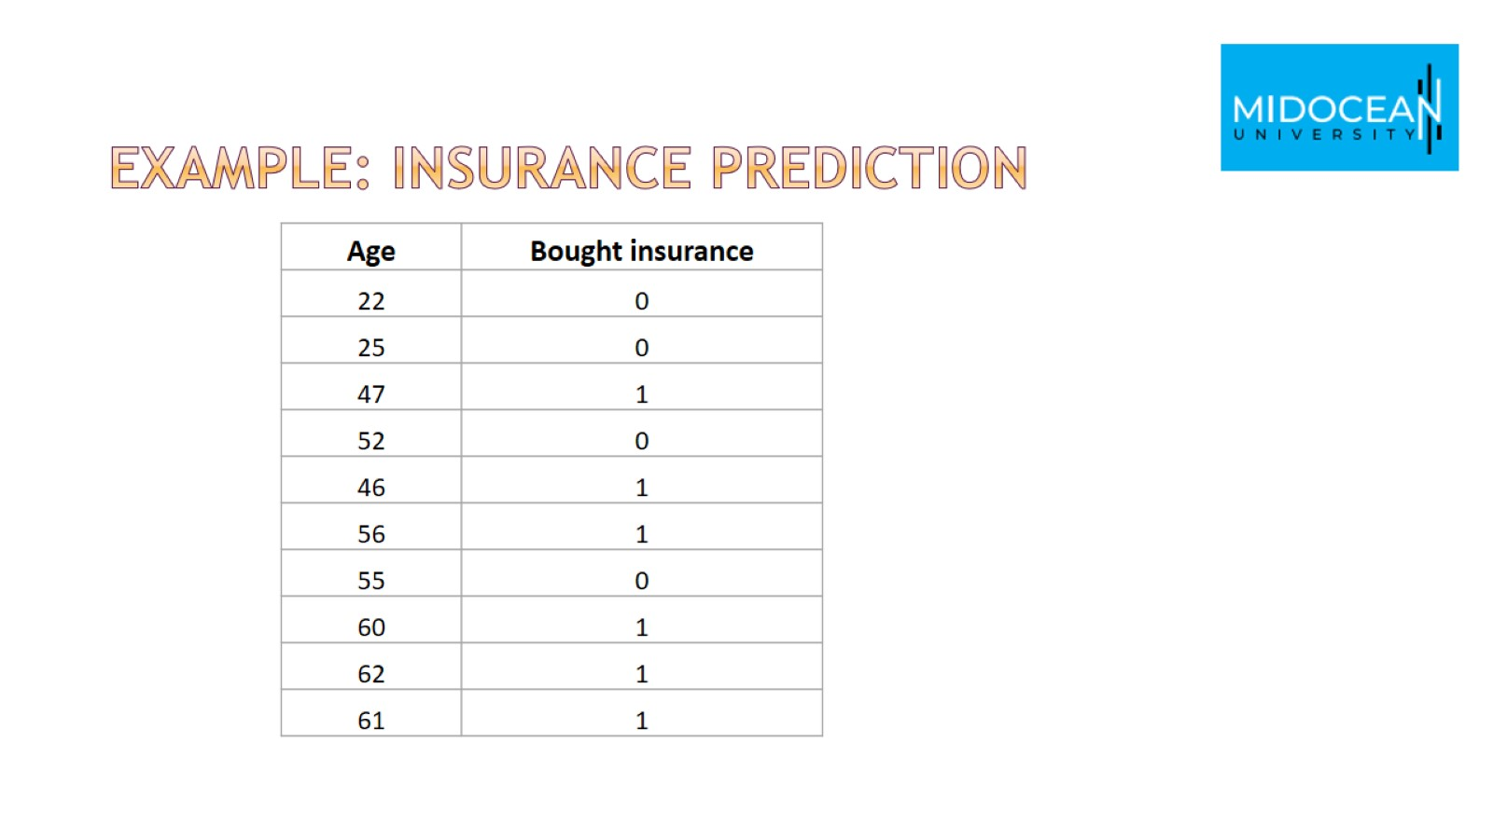
Example: Insurance prediction

Slide 6
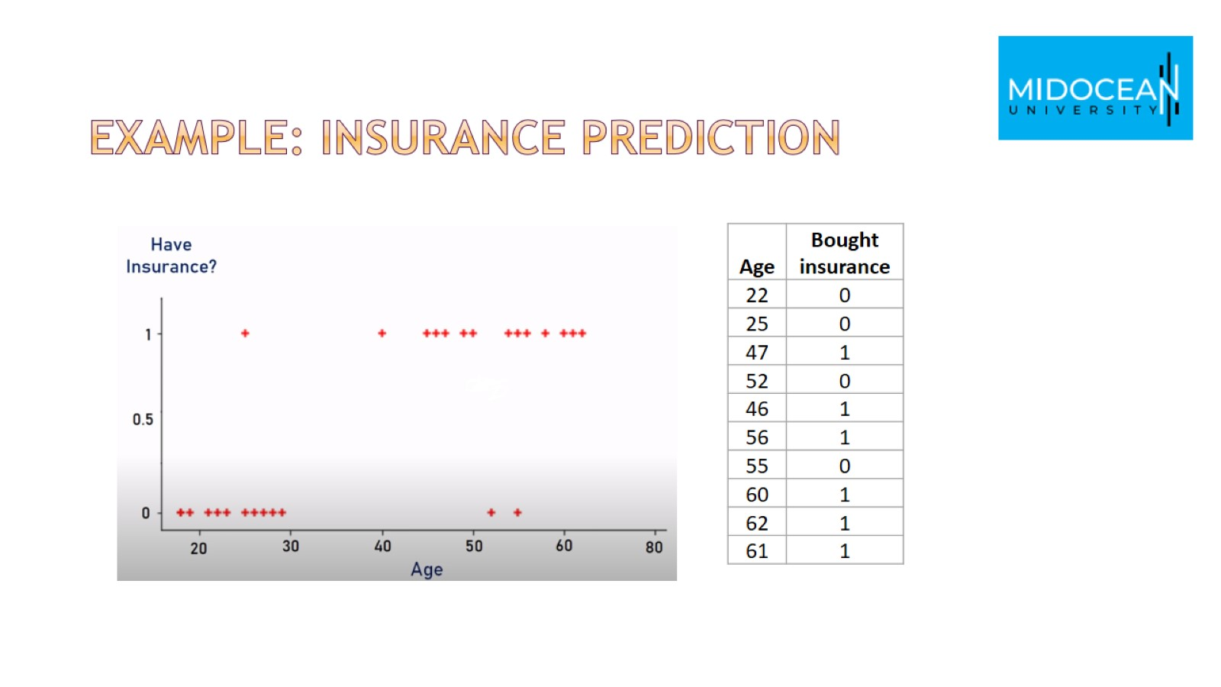
Example: Insurance prediction

Slide 7
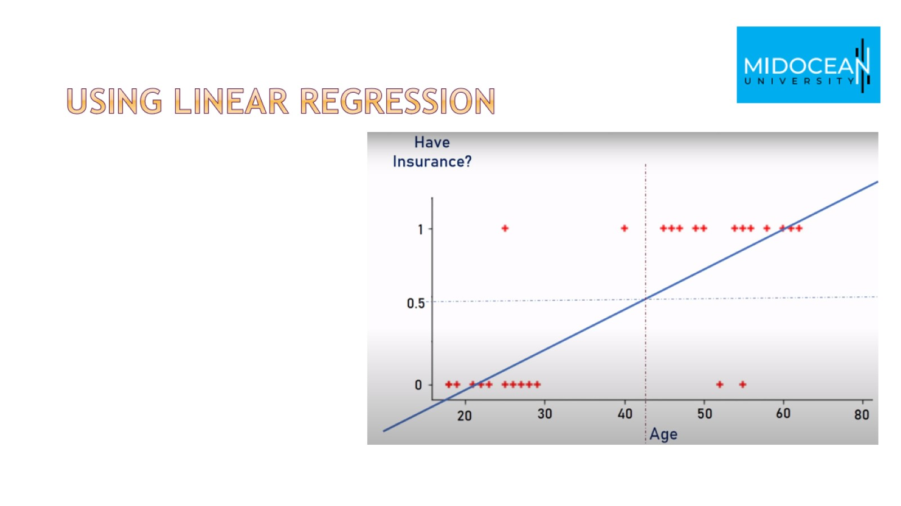
Using linear regression

Slide 8
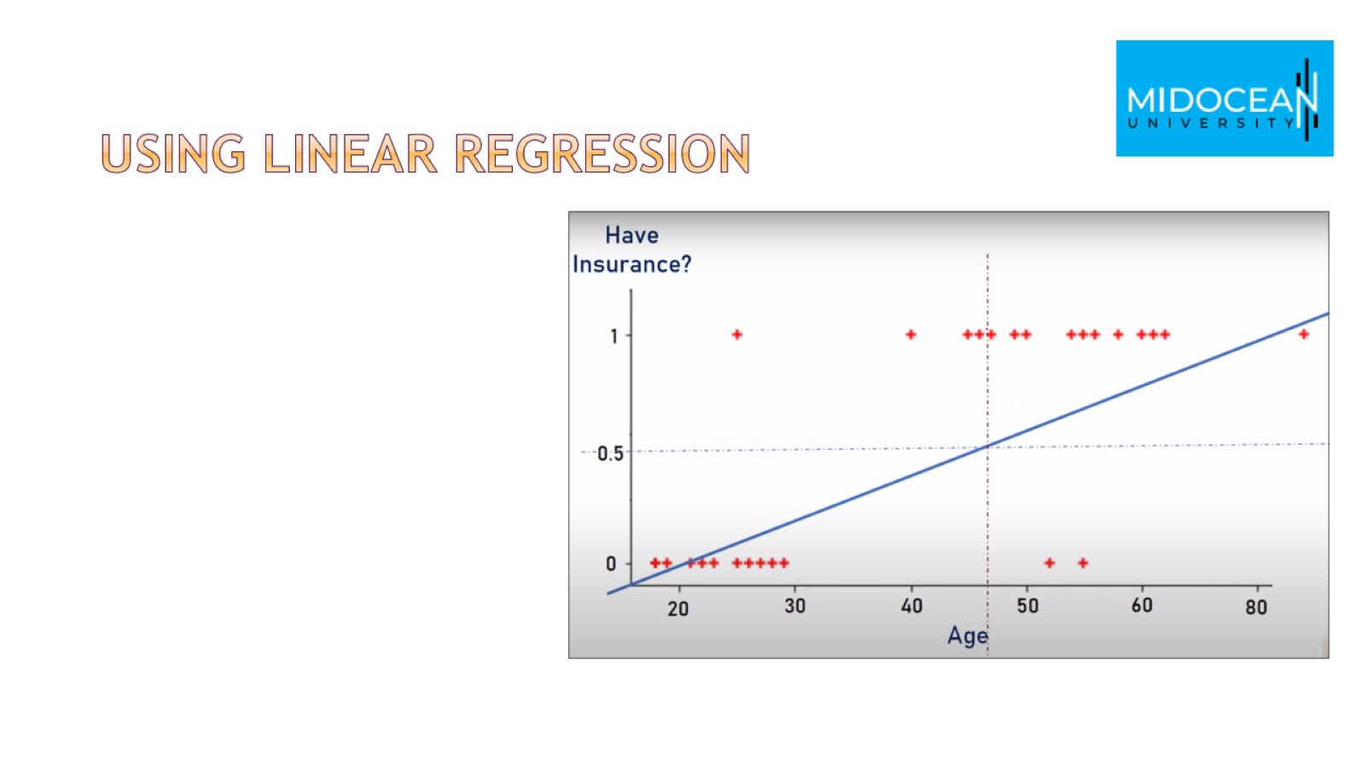
Using linear regression

Slide 9
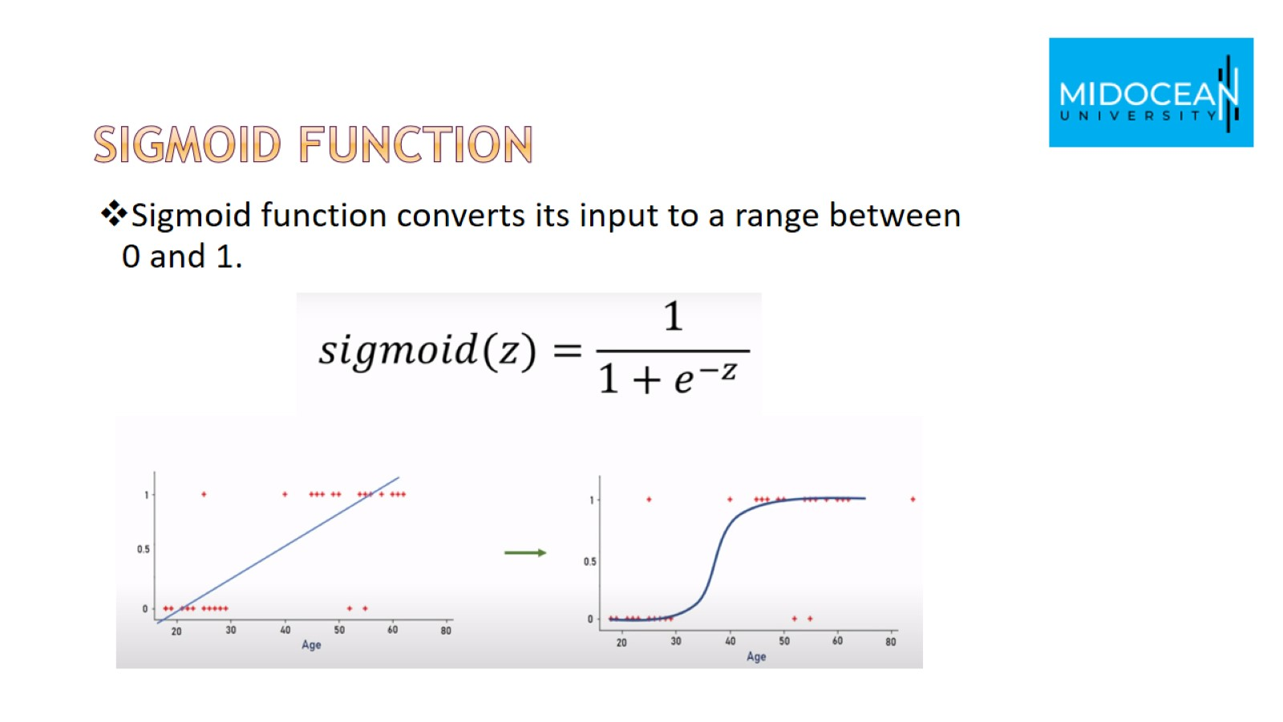
Sigmoid function

Slide 10
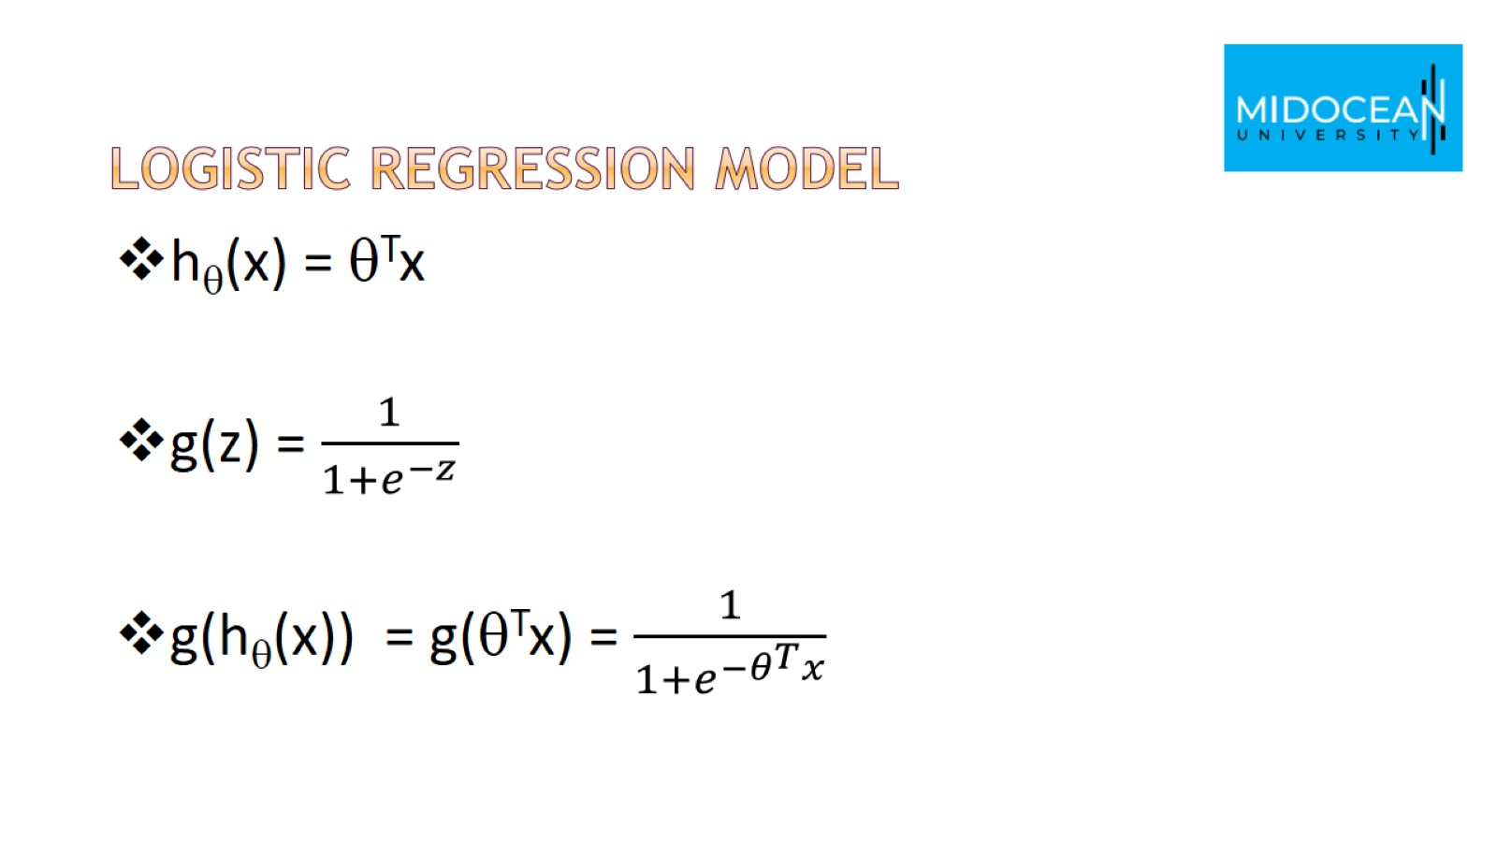
Logistic regression model

Slide 11
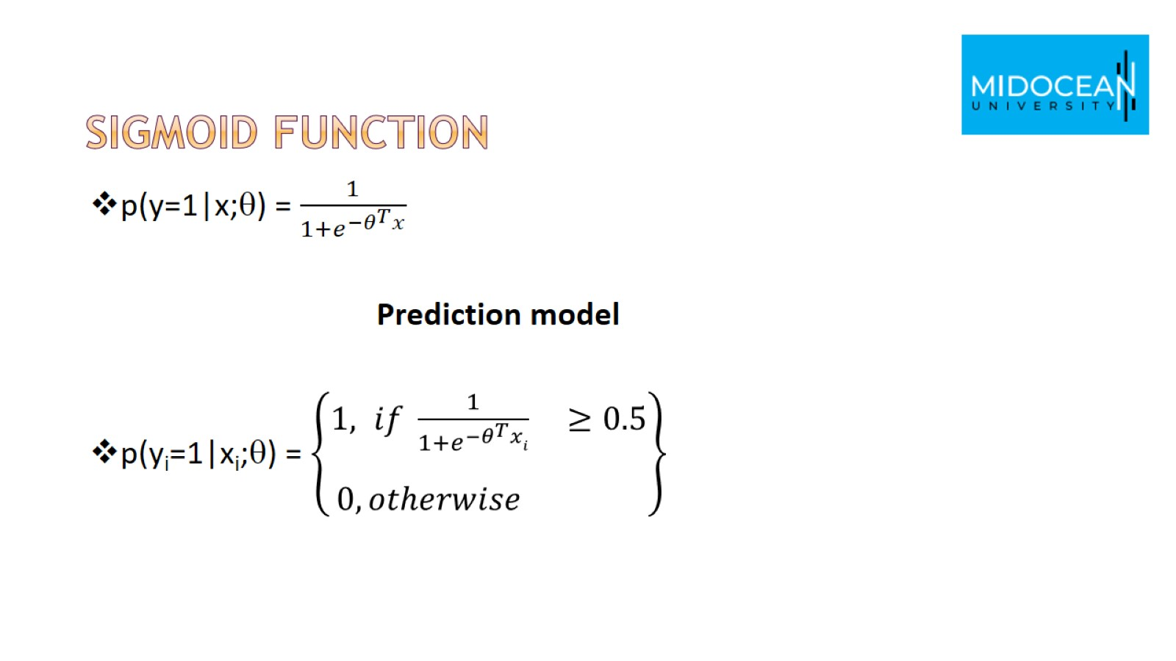
Sigmoid function

Slide 12
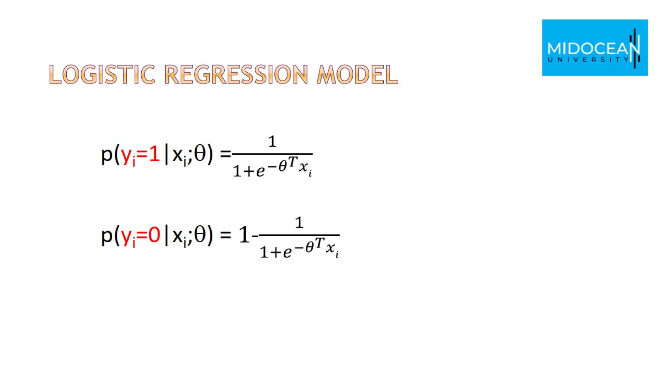
logistic regression model

Slide 13
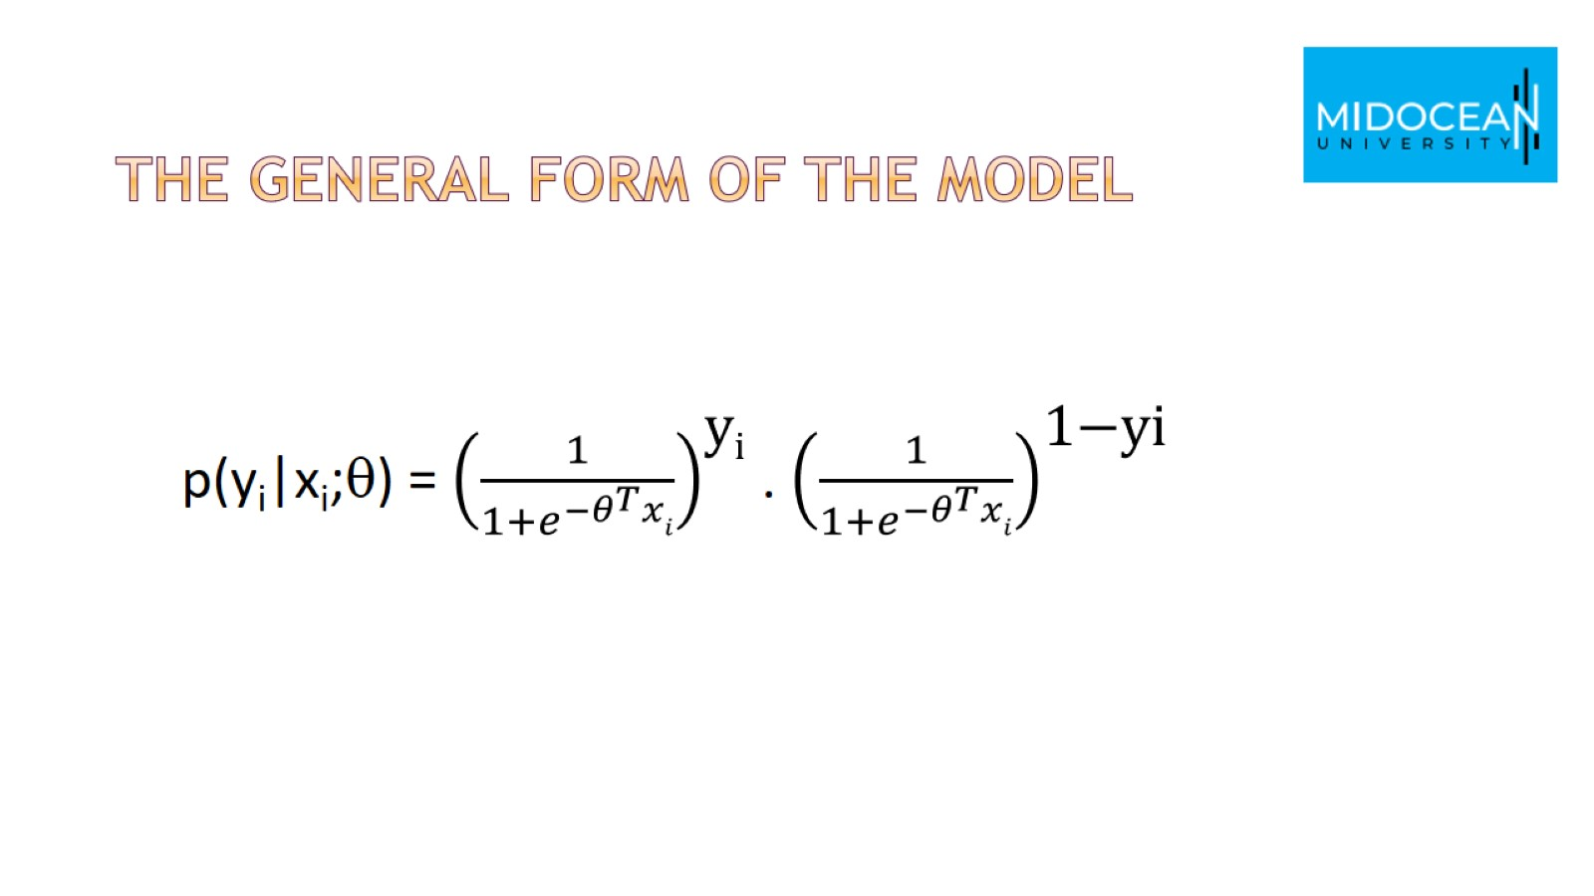
The general form of the model

Slide 14
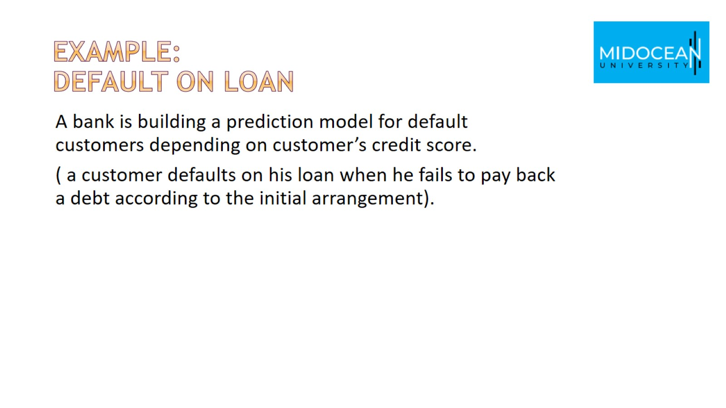
Example:
Default on loan

Slide 15
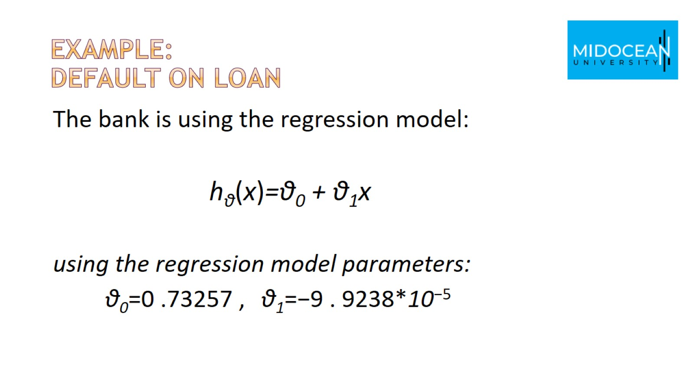
Example:
Default on loan

Slide 16
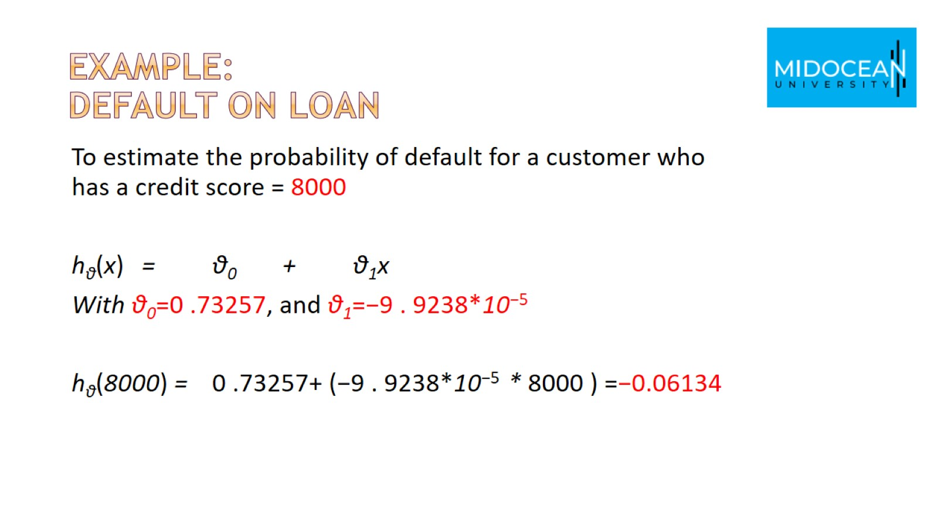
Example:
Default on loan

Slide 17
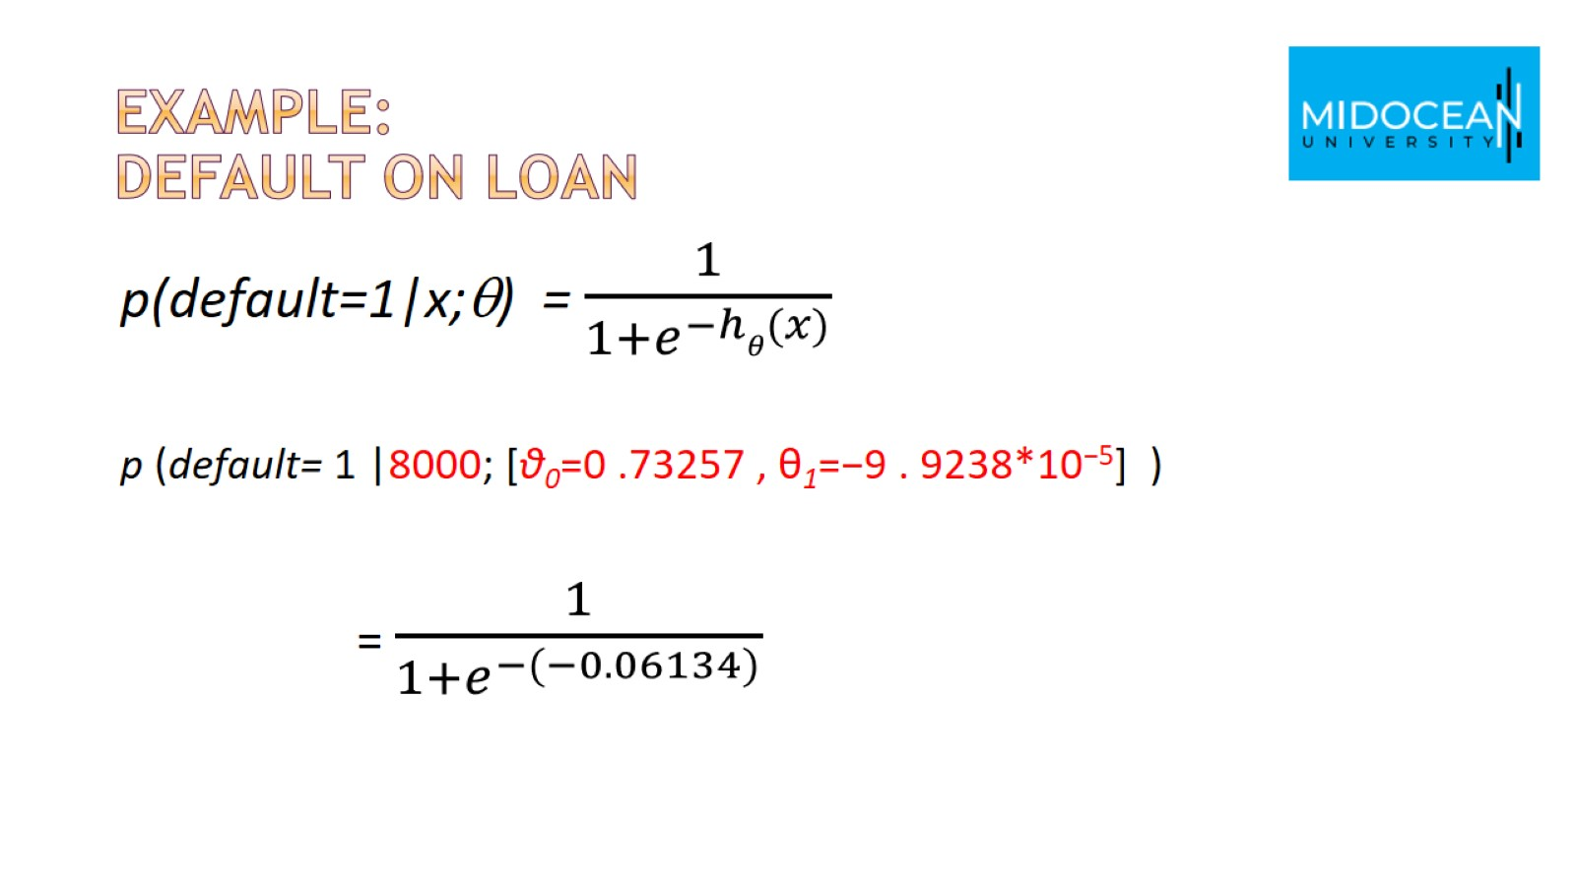
Example:
Default on loan

Slide 18
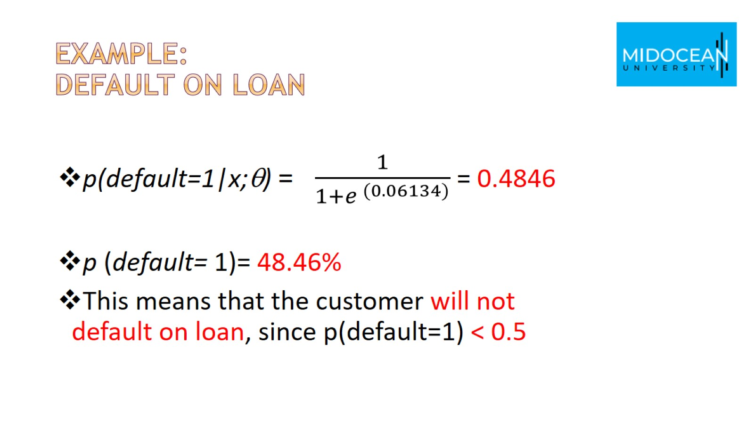
Example:
Default on loan

Slide 19
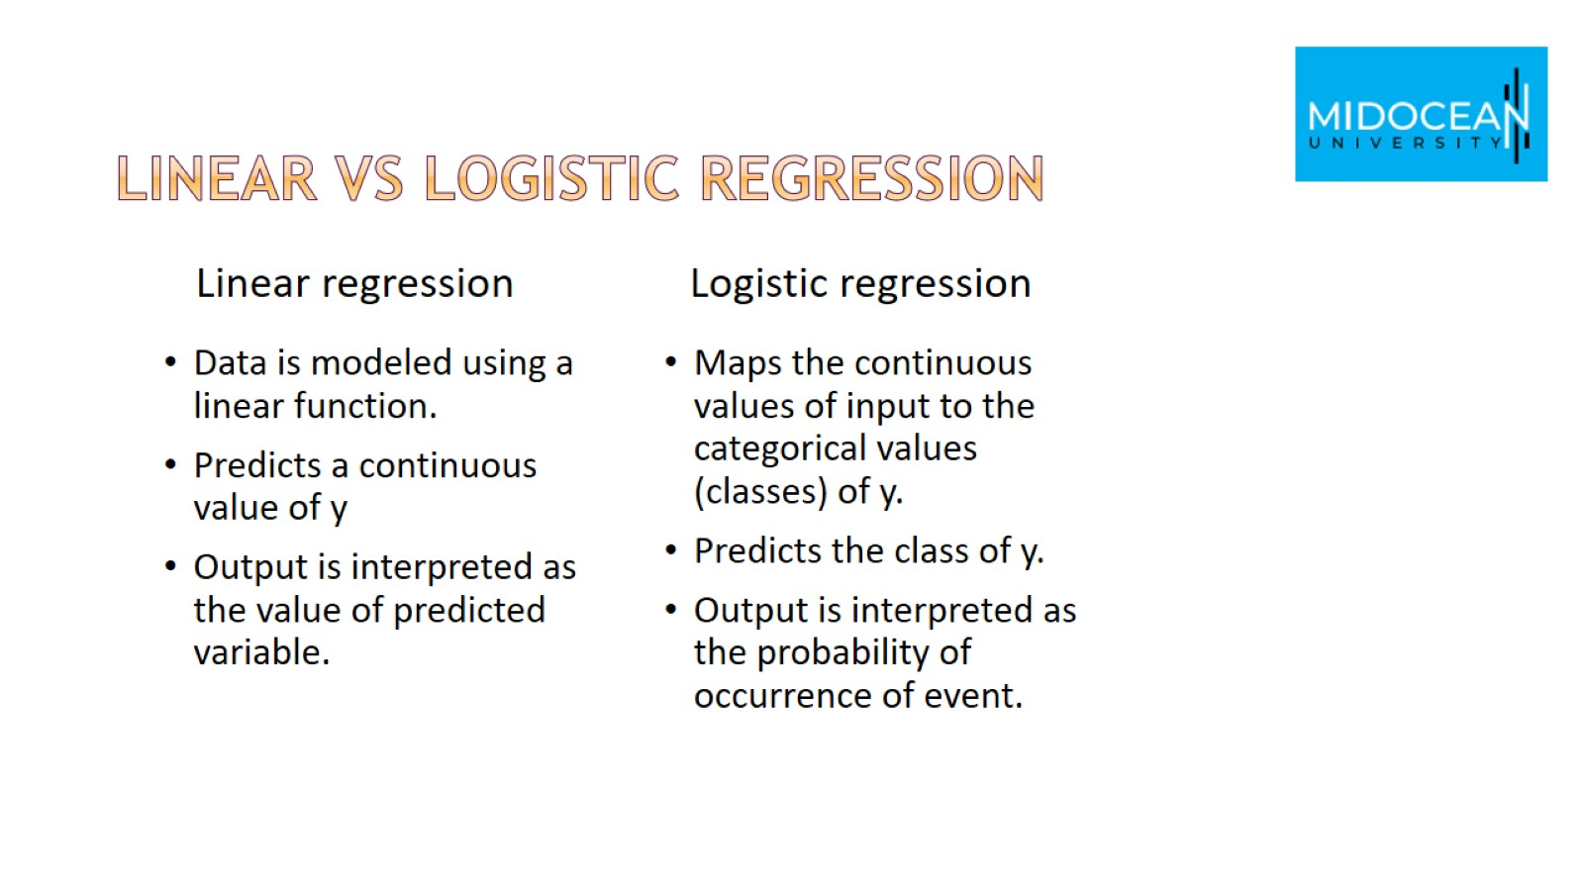
Linear vs Logistic Regression

Slide 20
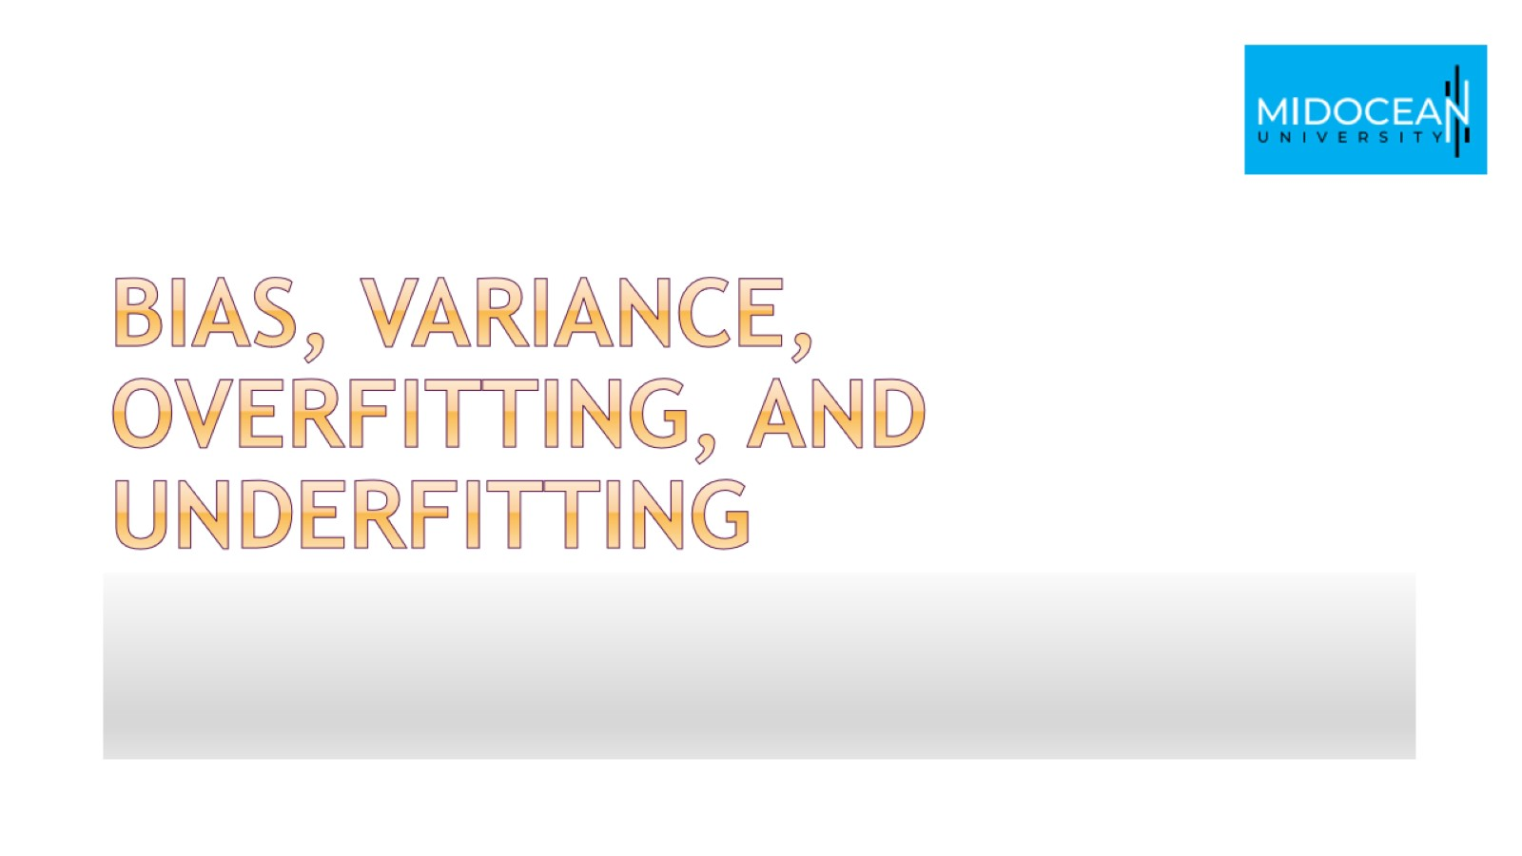
Bias, variance, overfitting, and underfitting

Slide 21
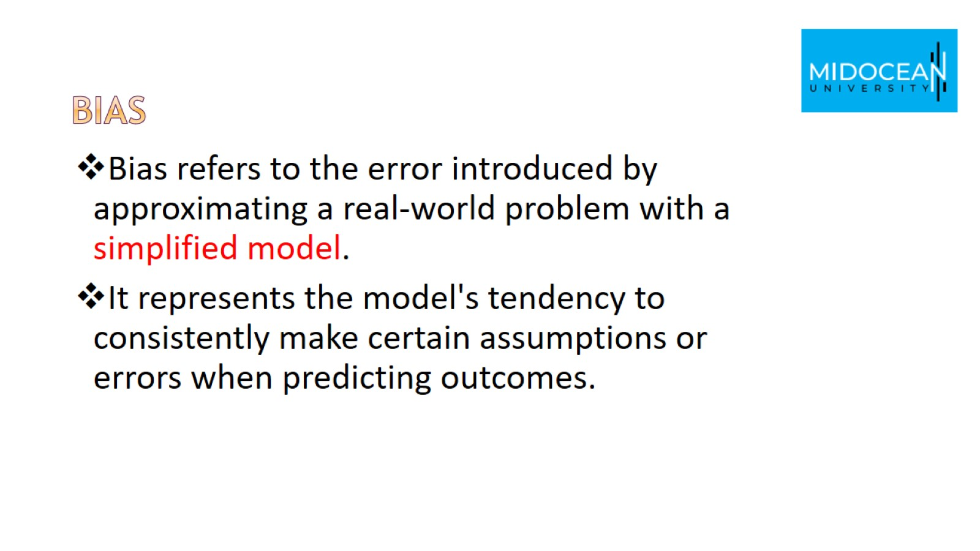
Bias

Slide 22
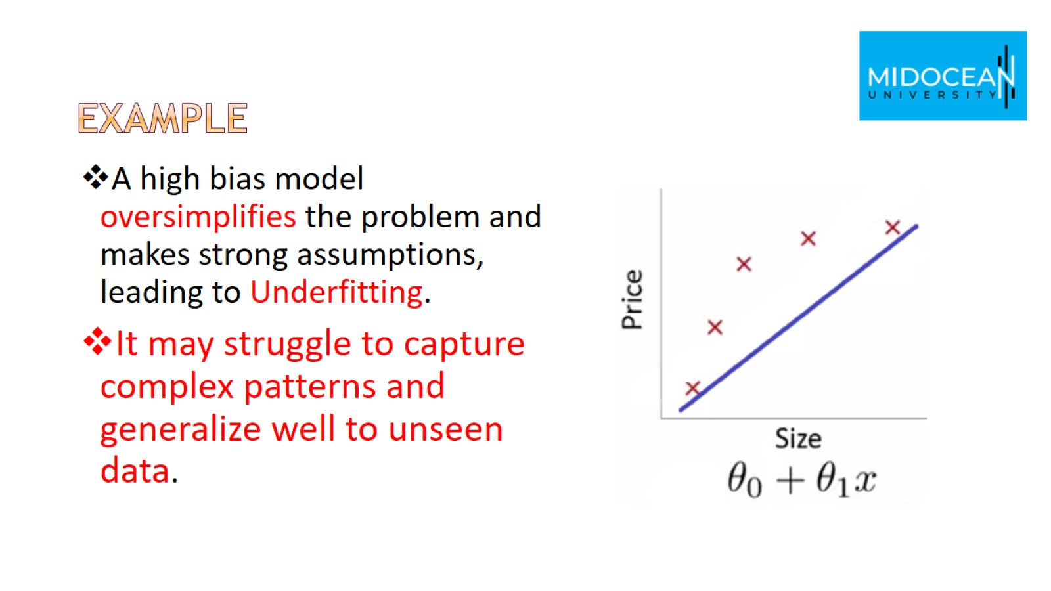
Example

Slide 23
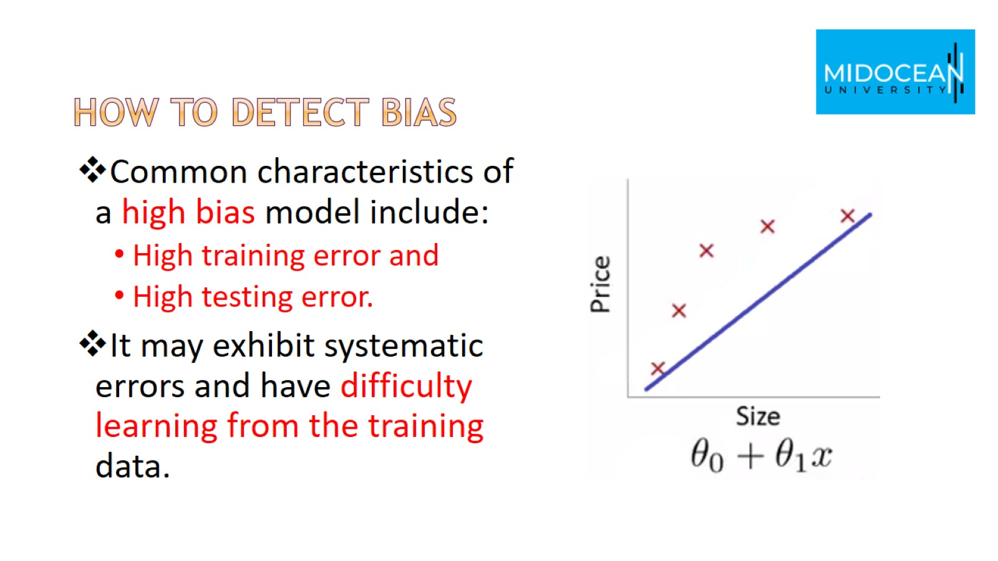
How to detect bias

Slide 24
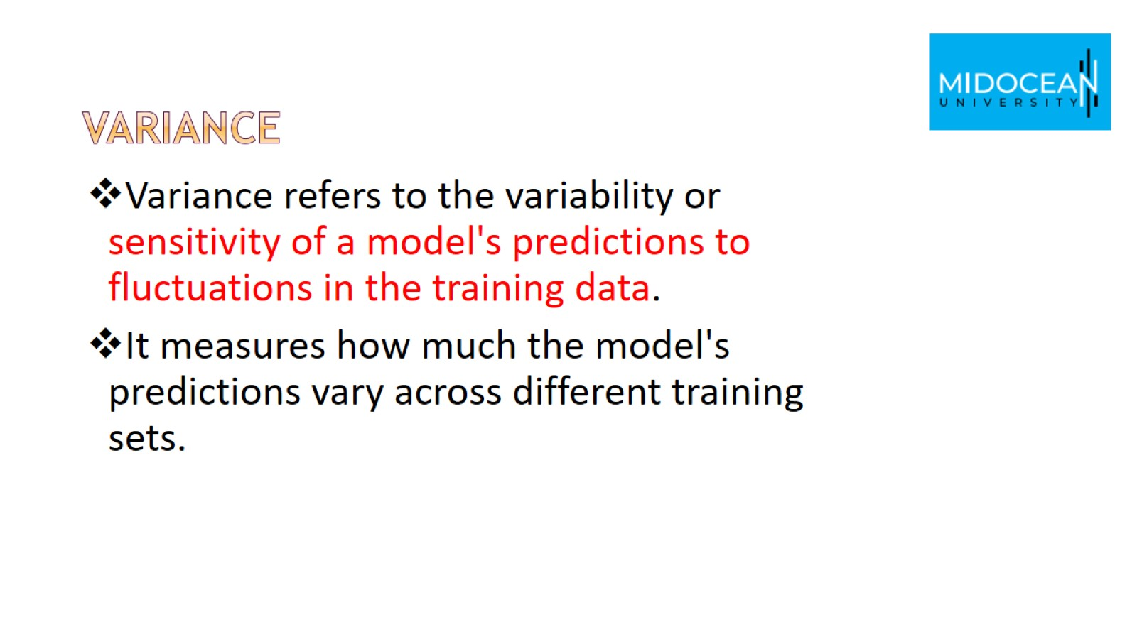
Variance

Slide 25
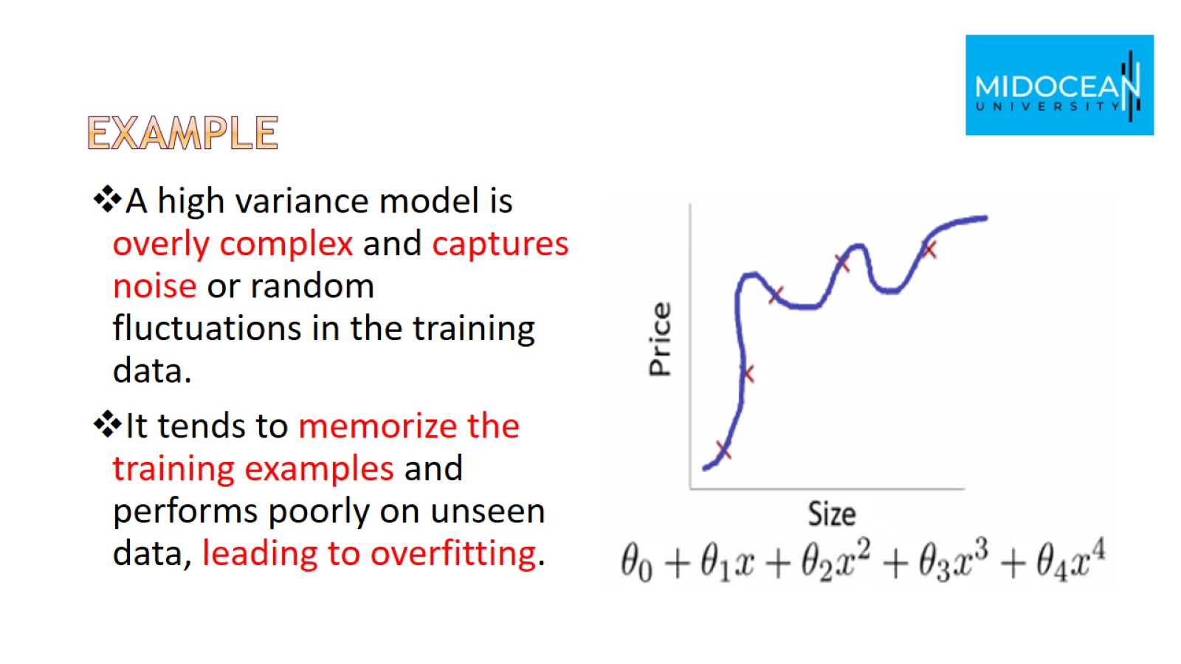
example

Slide 26
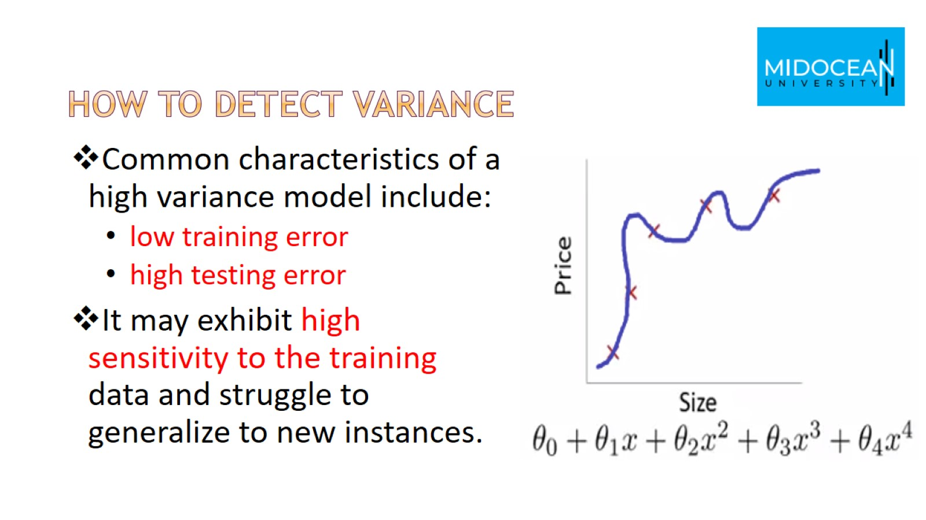
How to detect variance

Slide 27
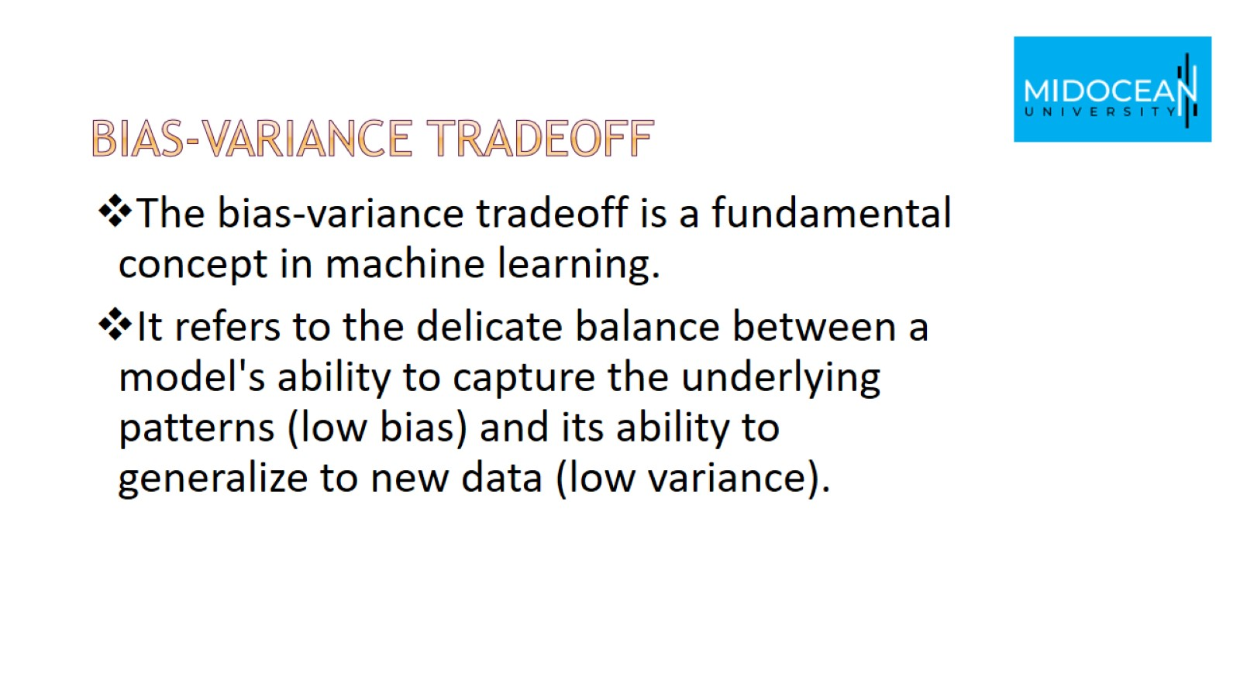
Bias-Variance Tradeoff

Slide 28
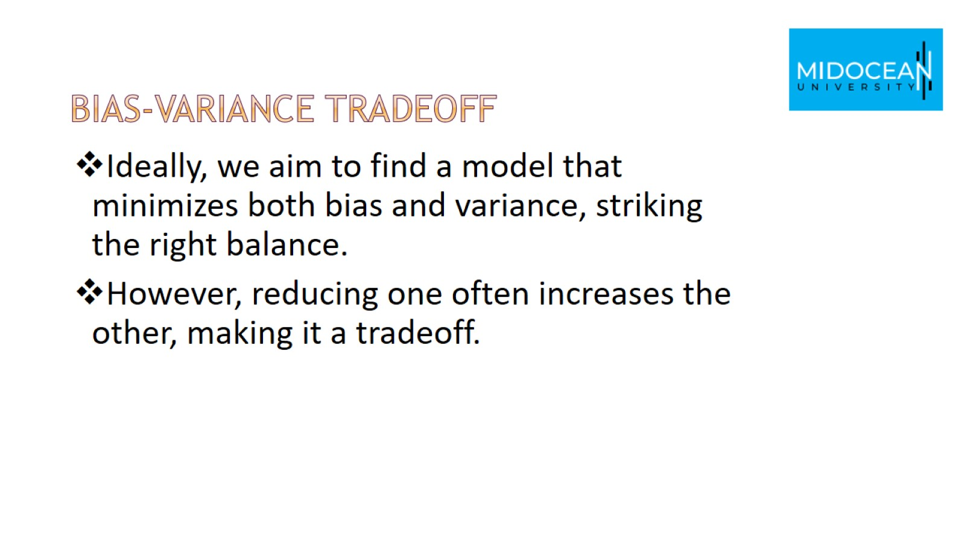
Bias-Variance Tradeoff

Slide 29
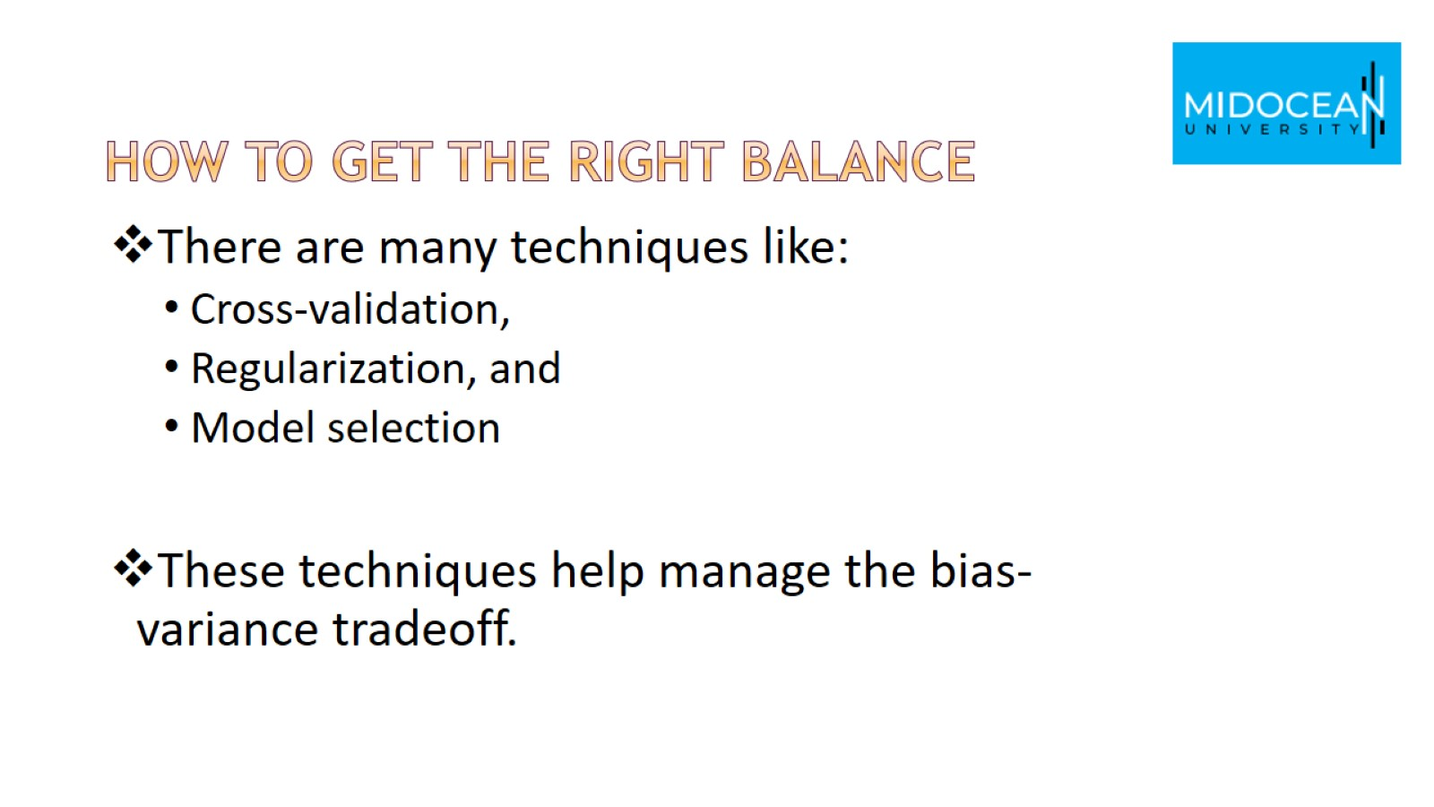
How to get the right balance

Slide 30
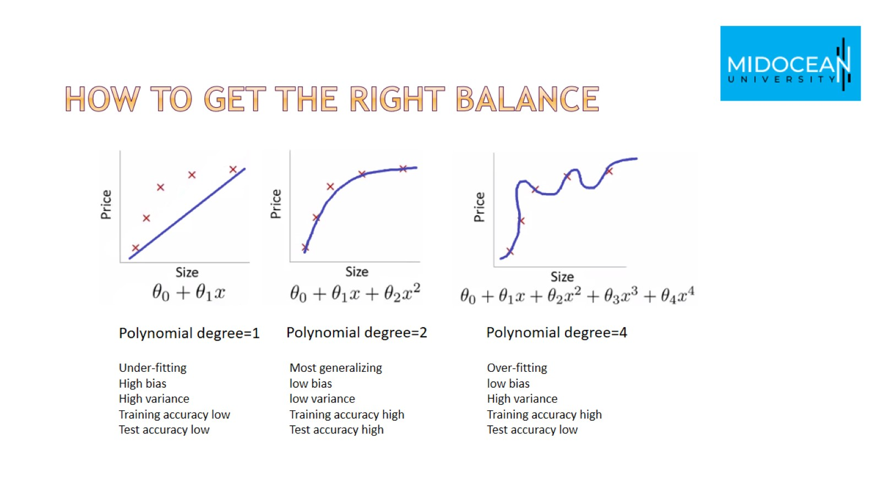
How to get the right balance

Slide 31
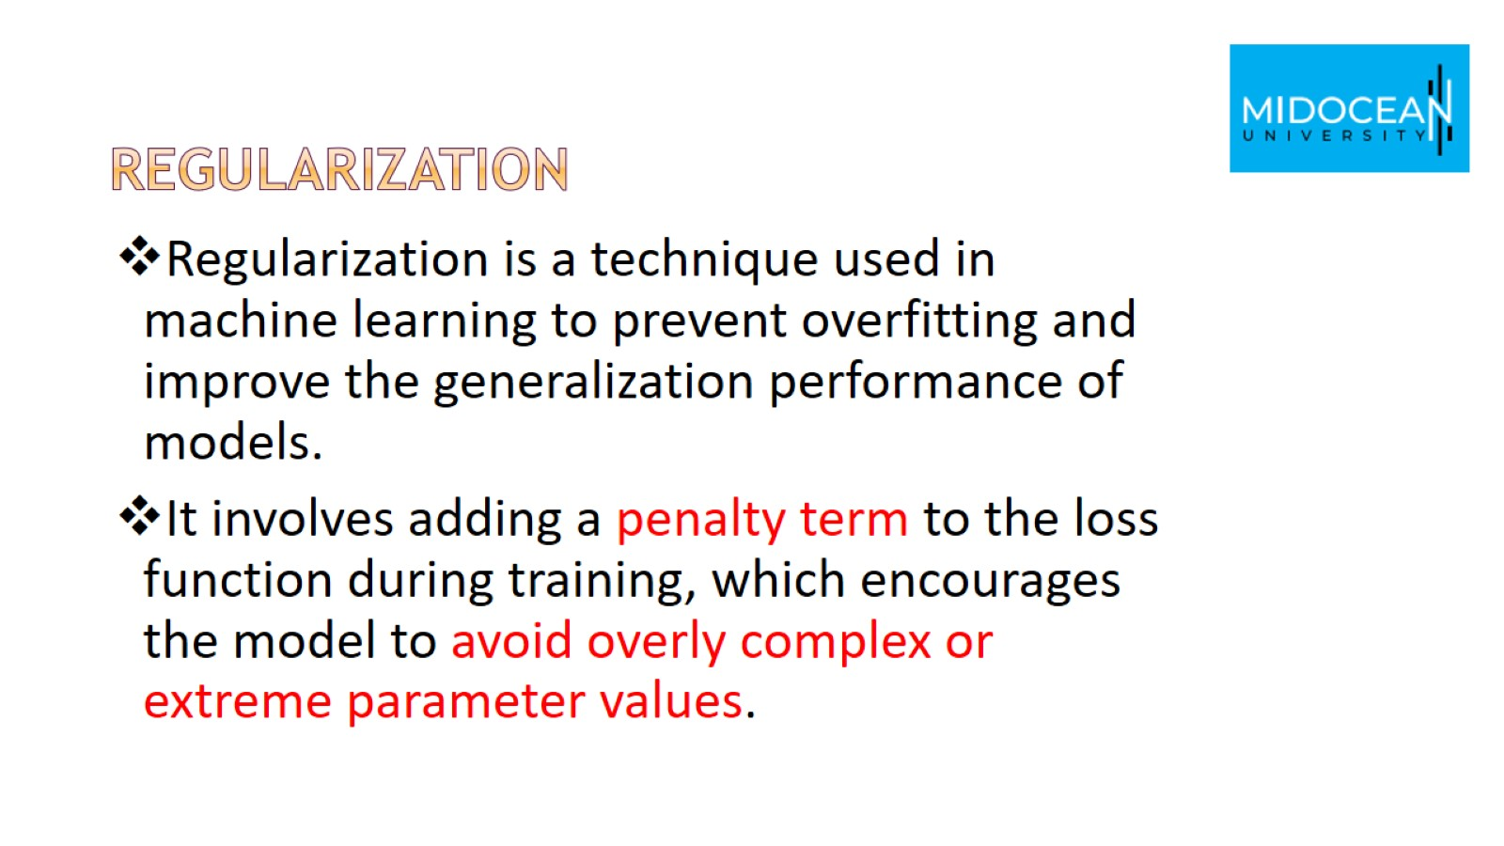
regularization

Slide 32
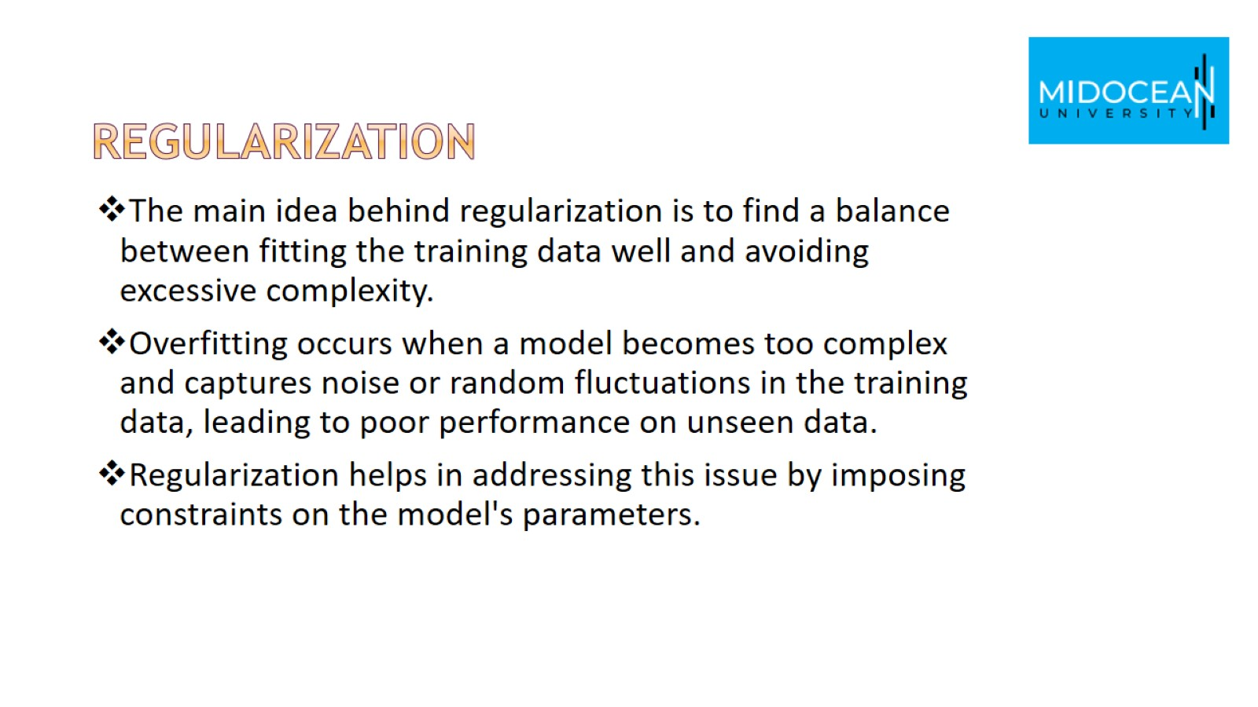
regularization

Slide 33
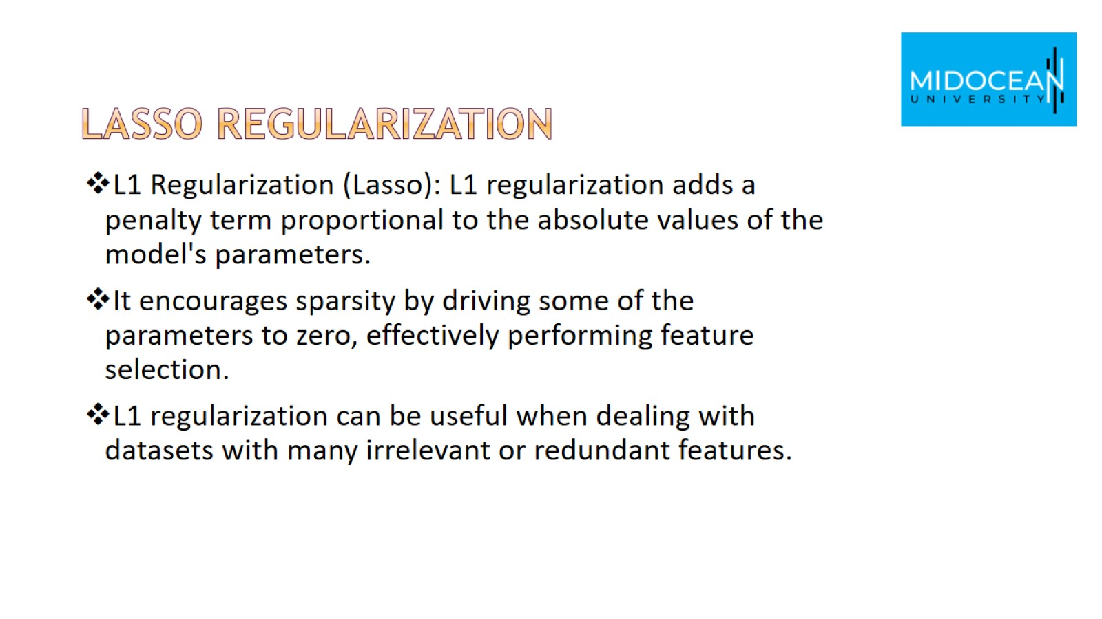
Lasso regularization

Slide 34
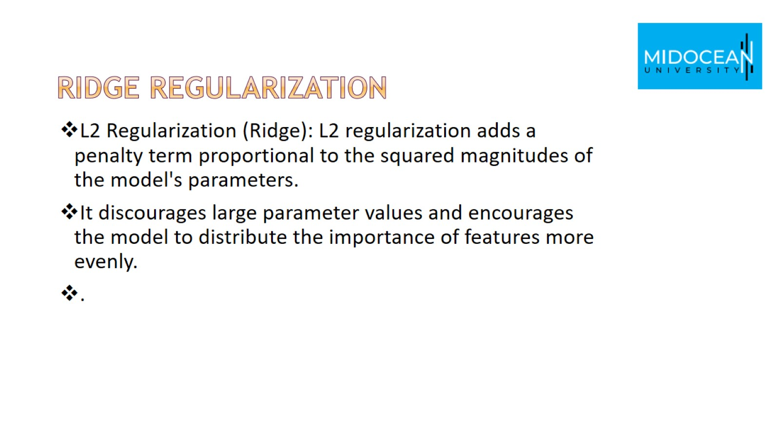
Ridge regularization

Slide 35
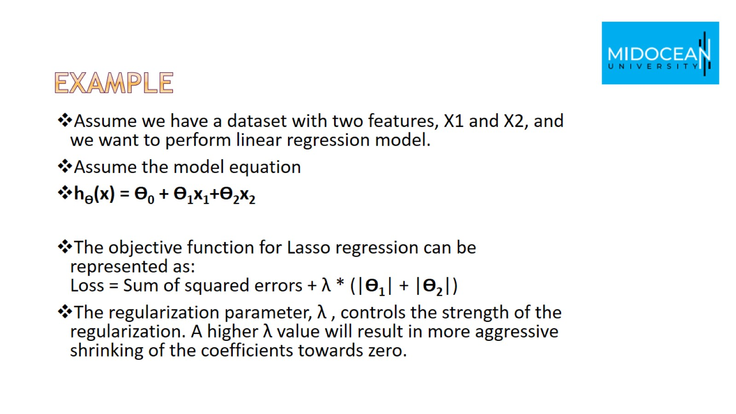
Example

Slide 36
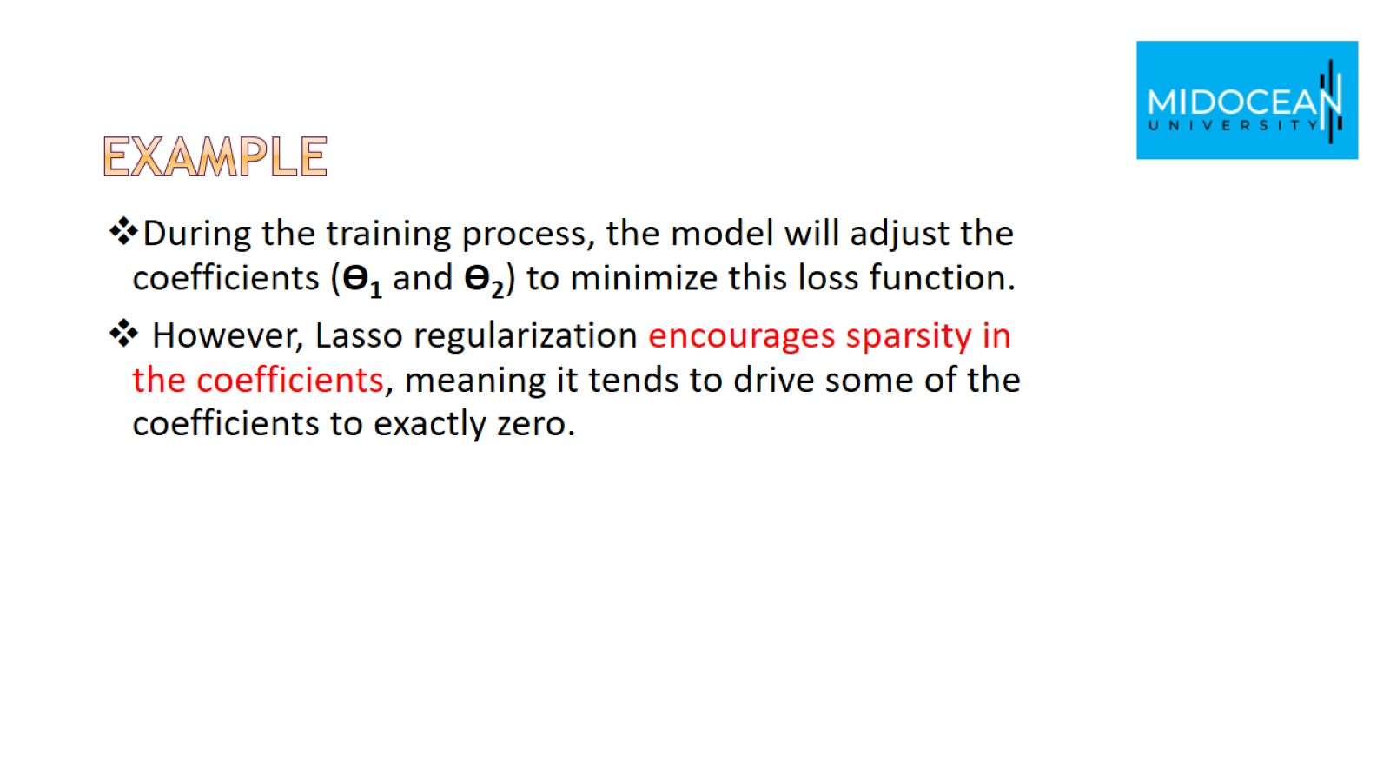
Example

Slide 37
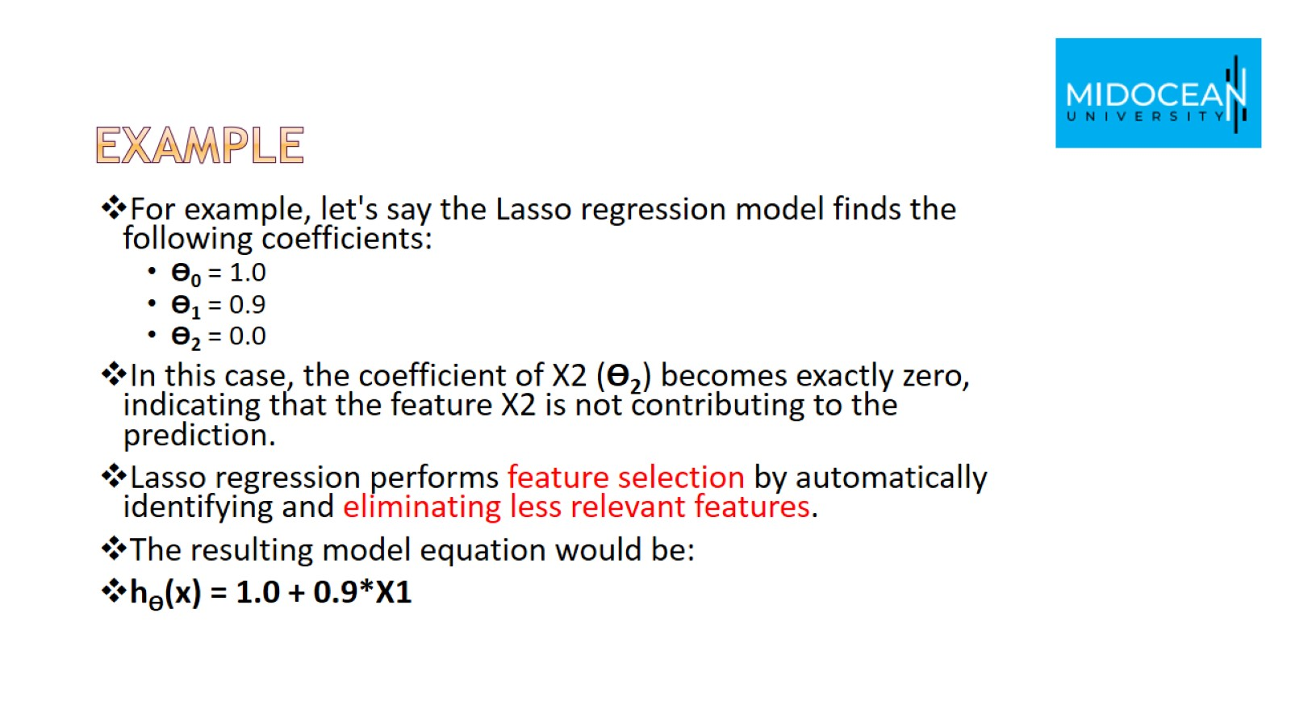
Example

Slide 38
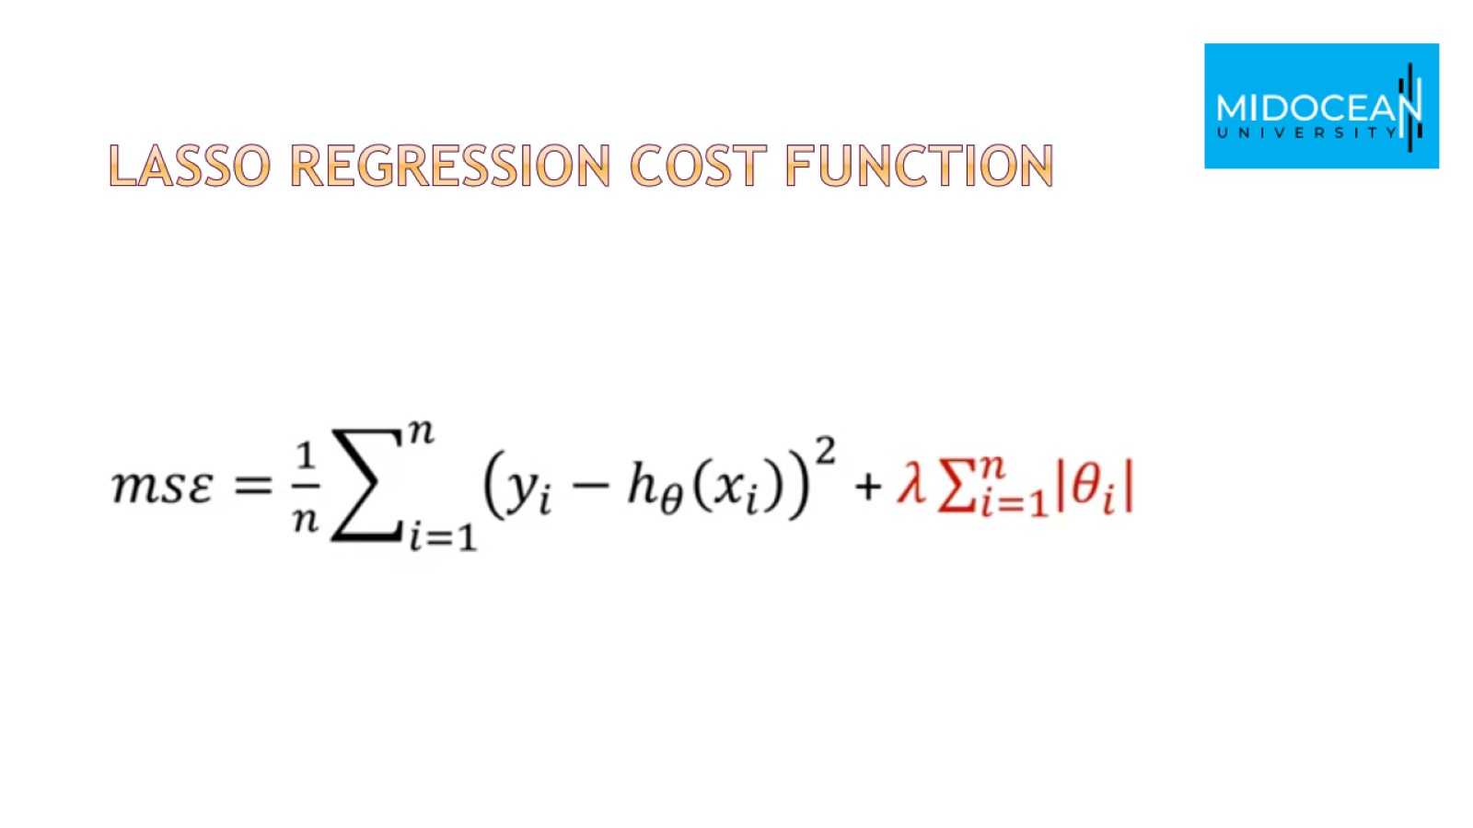
Lasso regression cost function

Slide 39
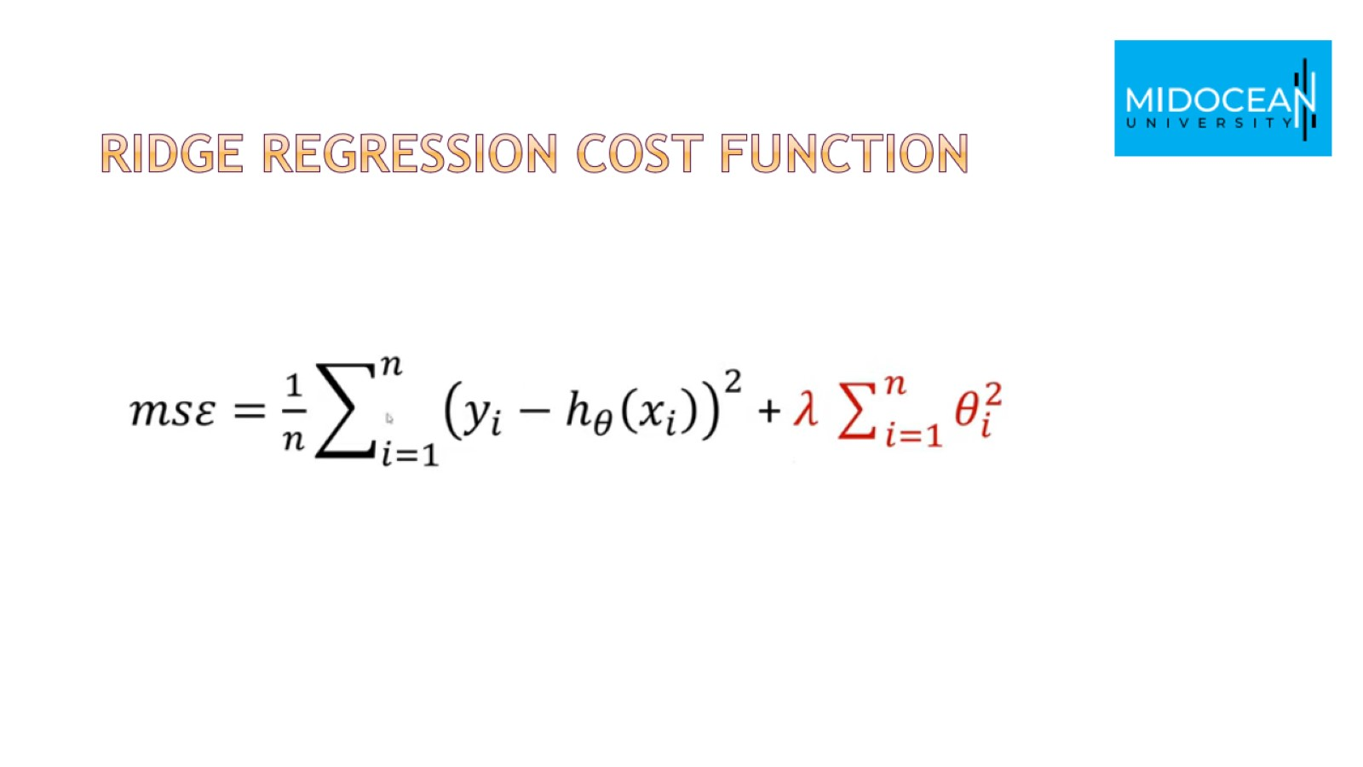
Ridge regression cost function

Slide 40


Slide 41


