Slide 1
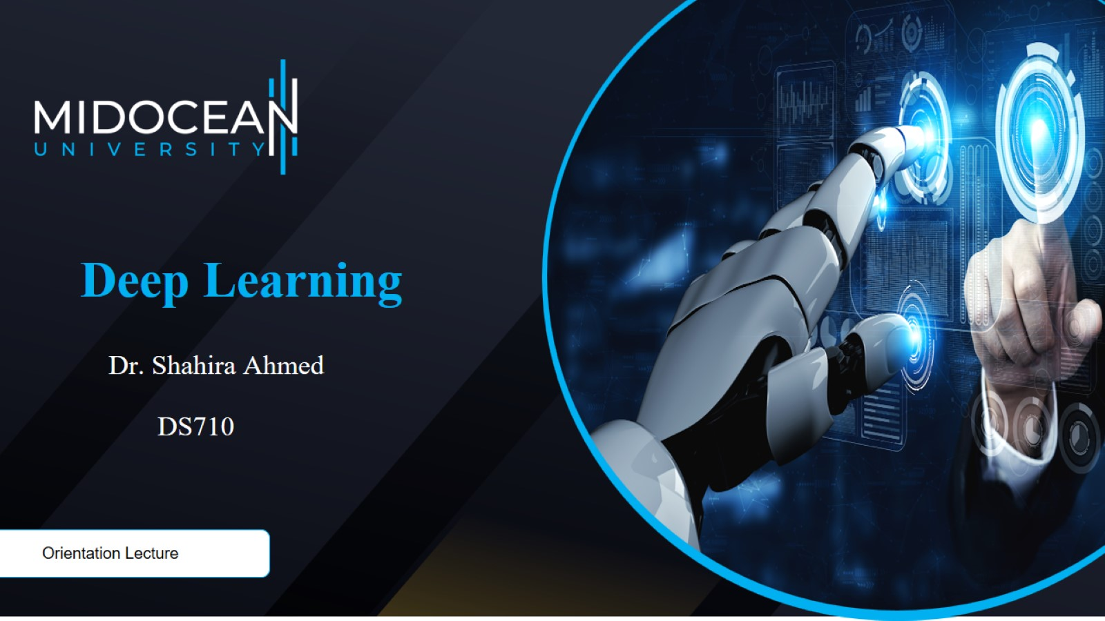

Slide 2
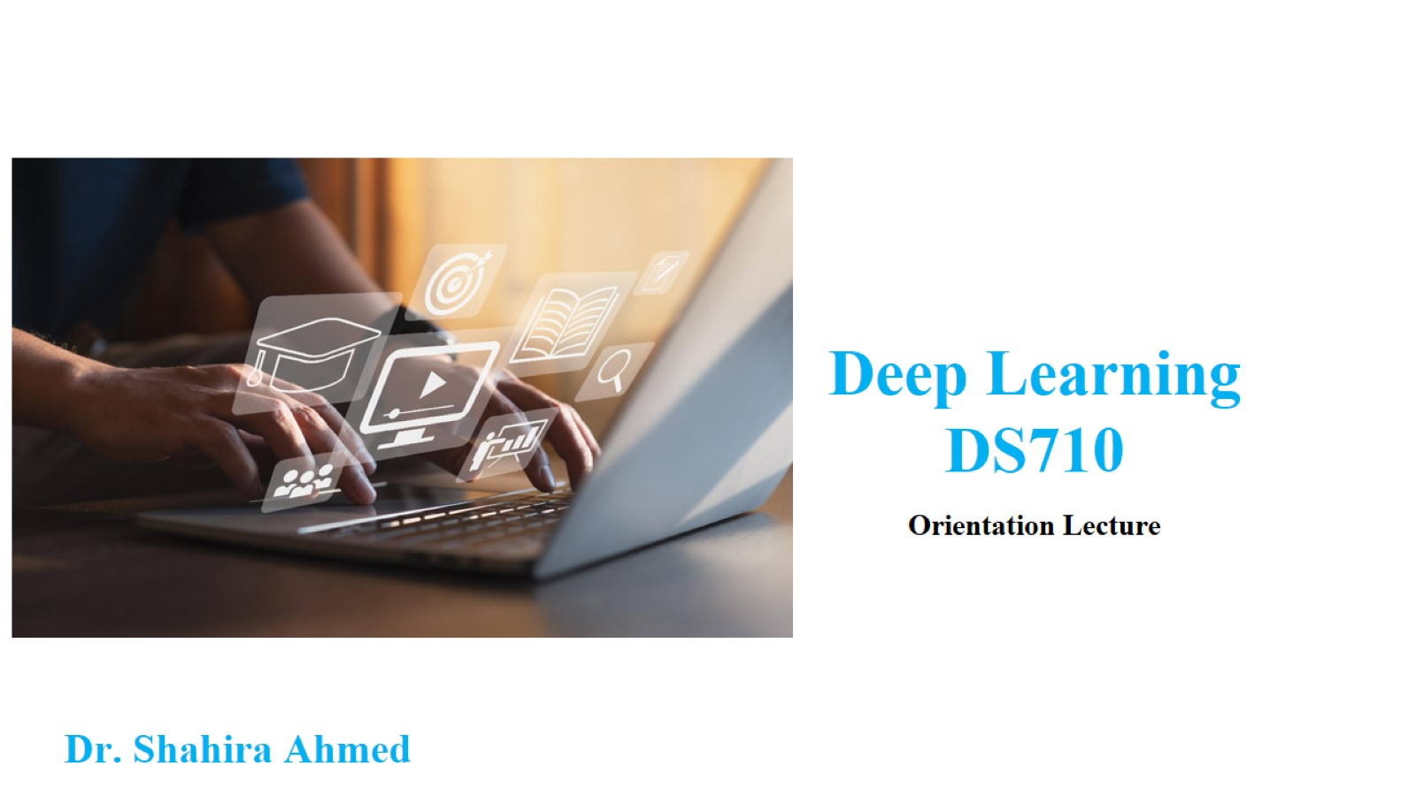

Slide 3

Dr. Shahira Ahmed shahira.ahmed@midocean.ae

Slide 4
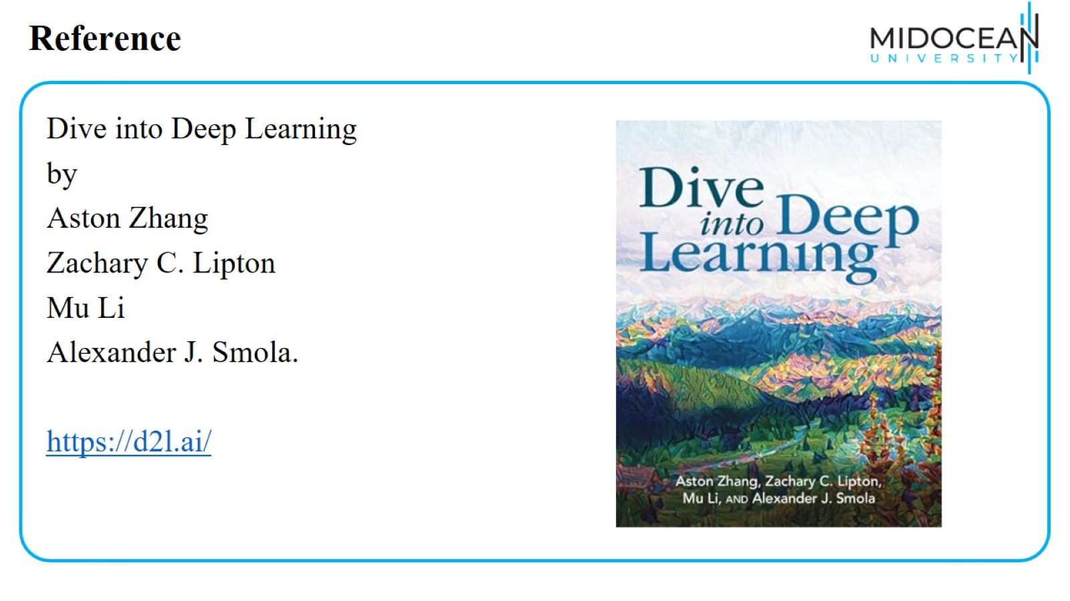
Reference

Slide 5
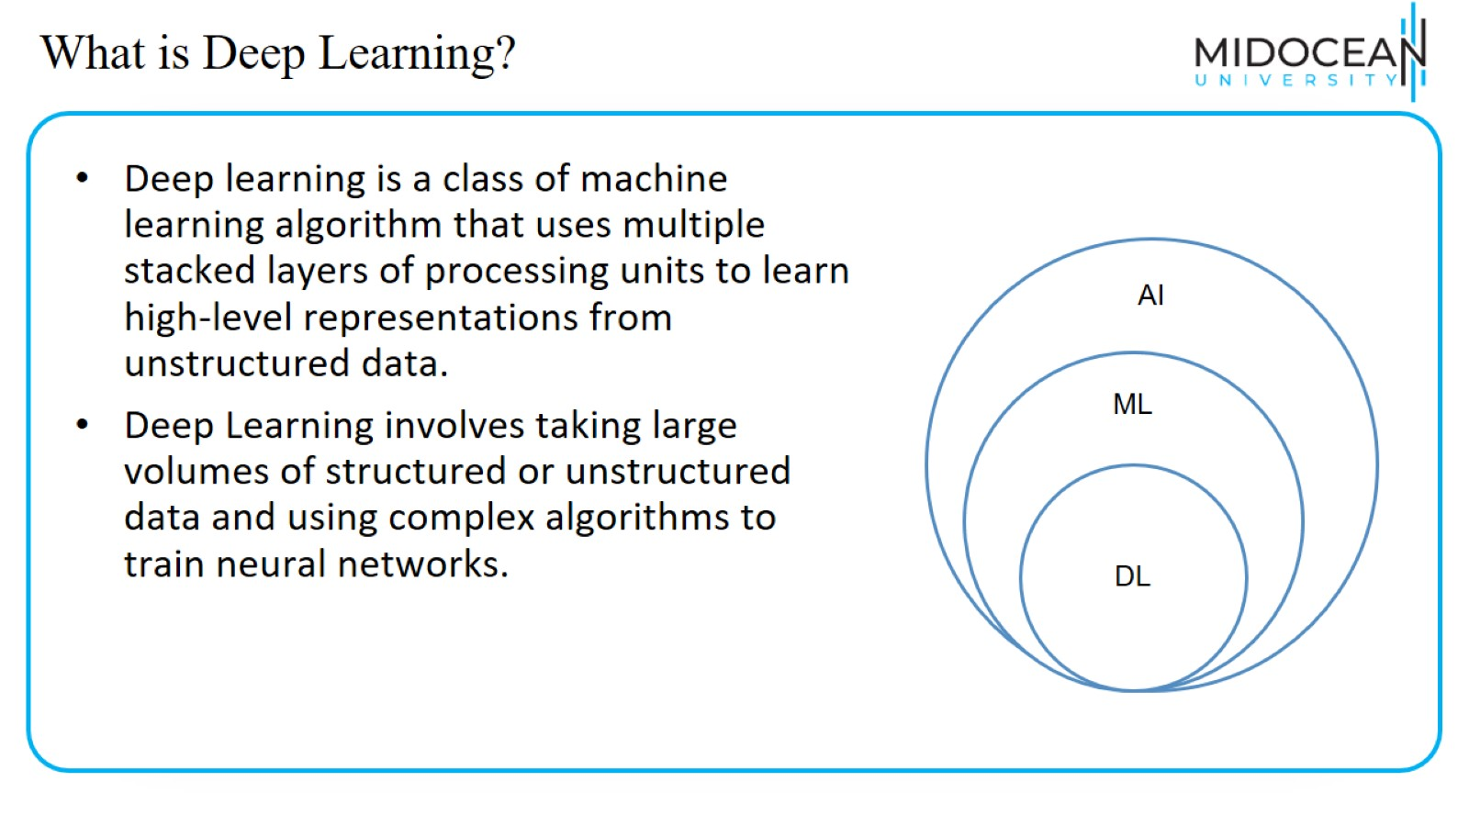
What is Deep Learning?

Slide 6
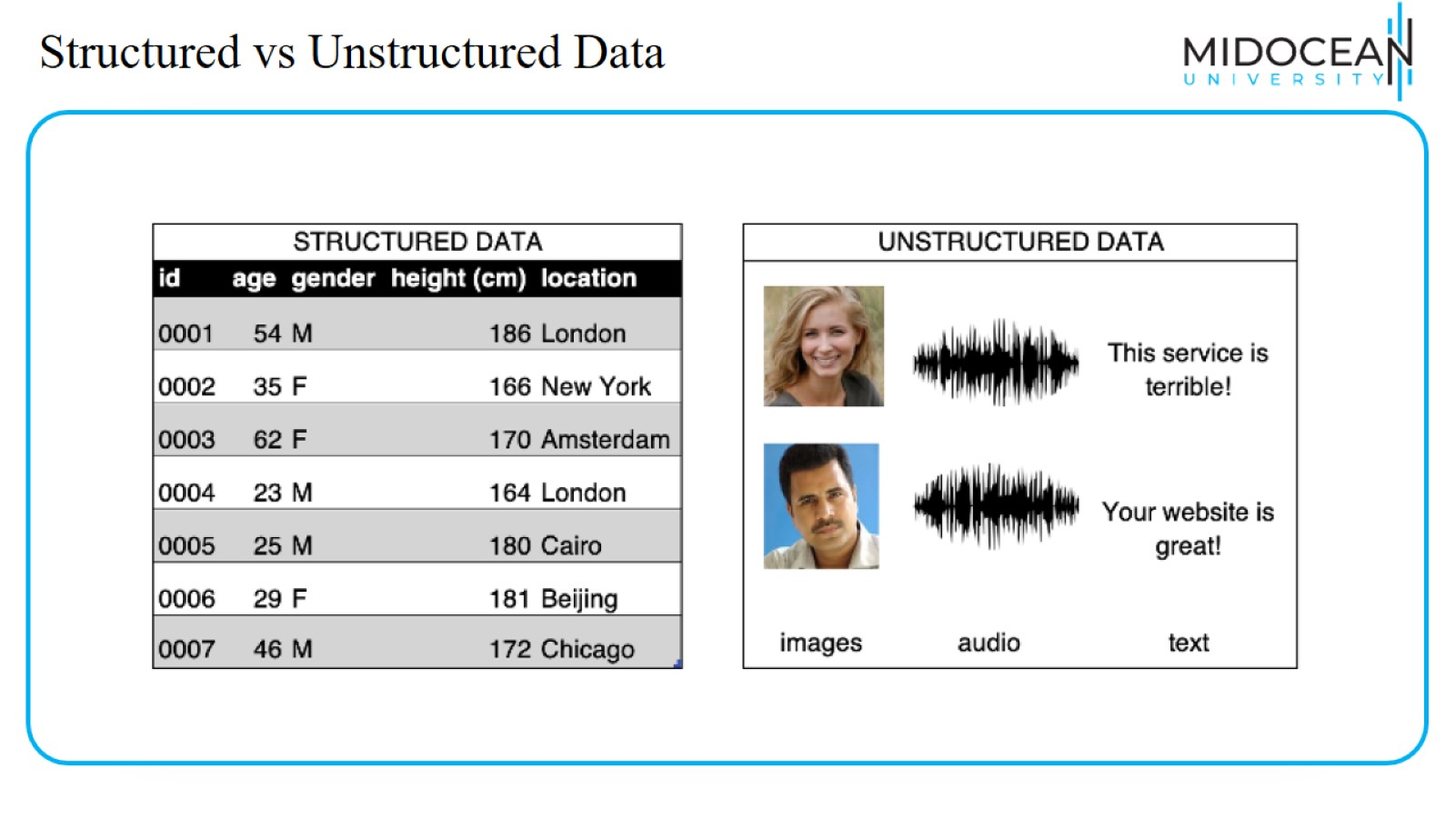
Structured vs Unstructured Data

Slide 7
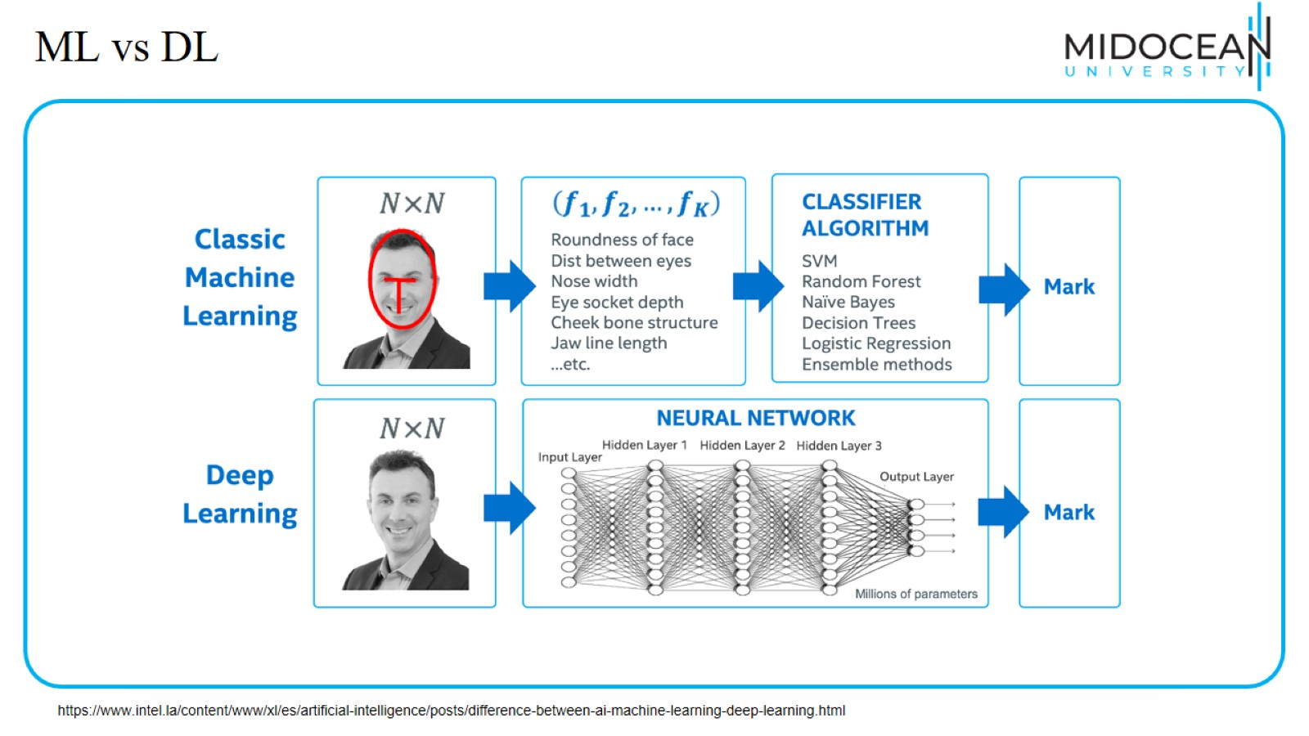
ML vs DL

Slide 8
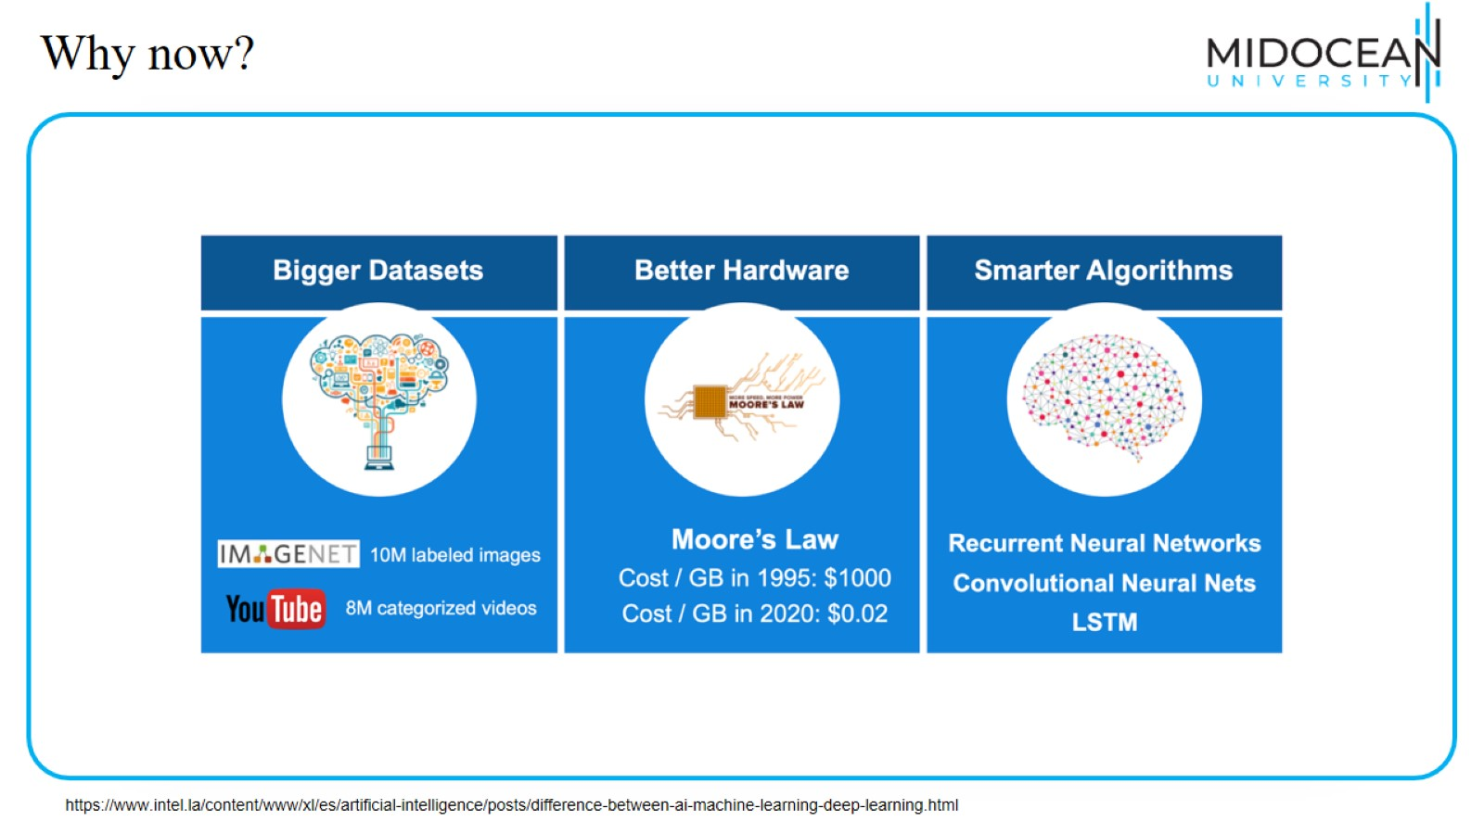
Why now?

Slide 9
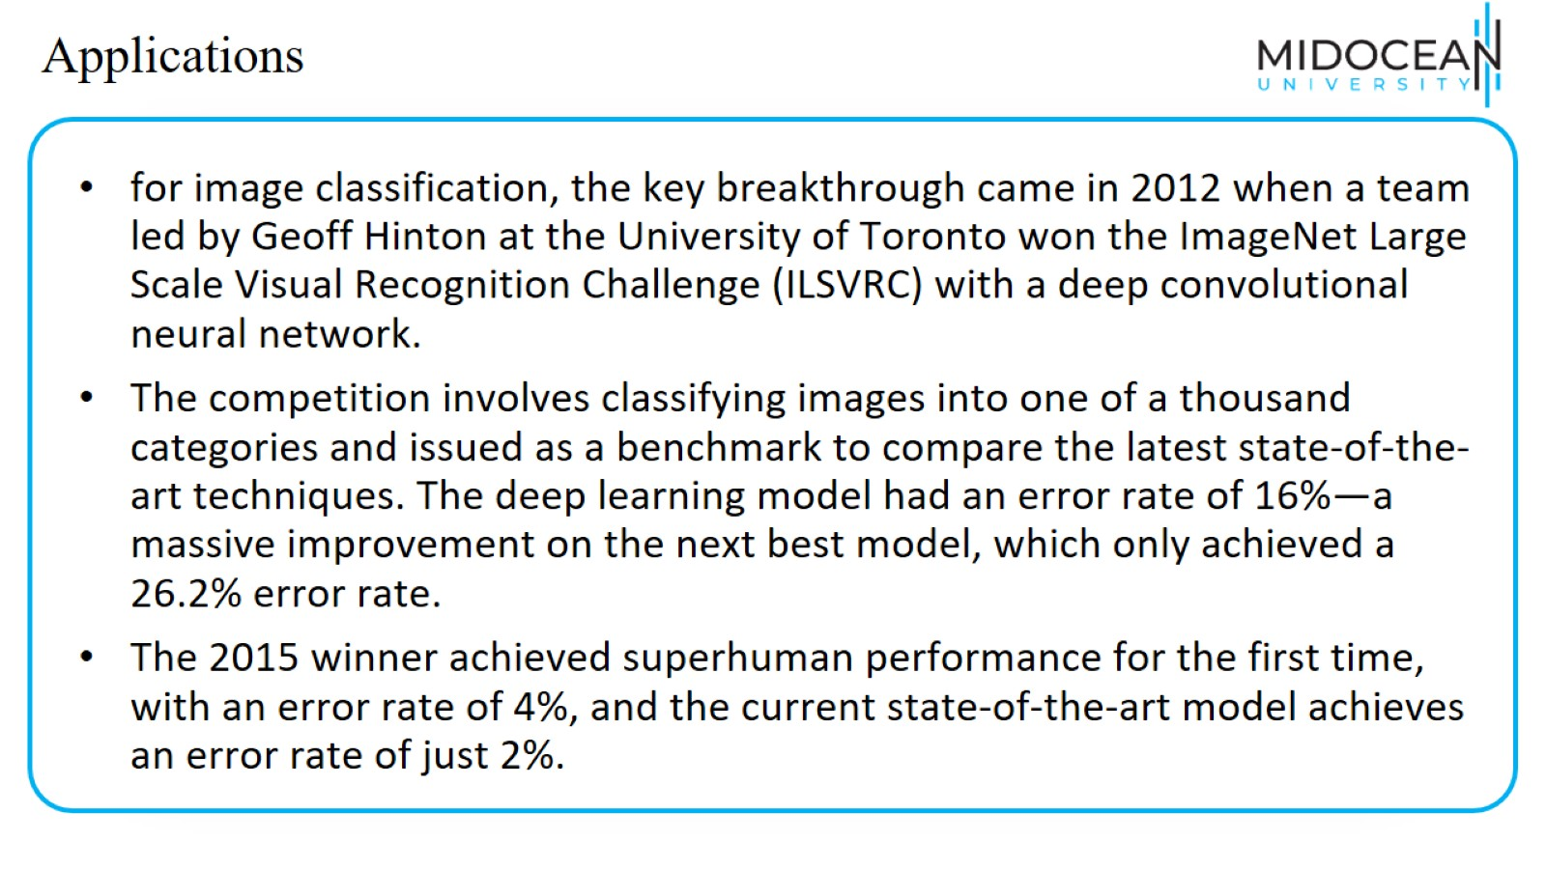
Applications

Slide 10
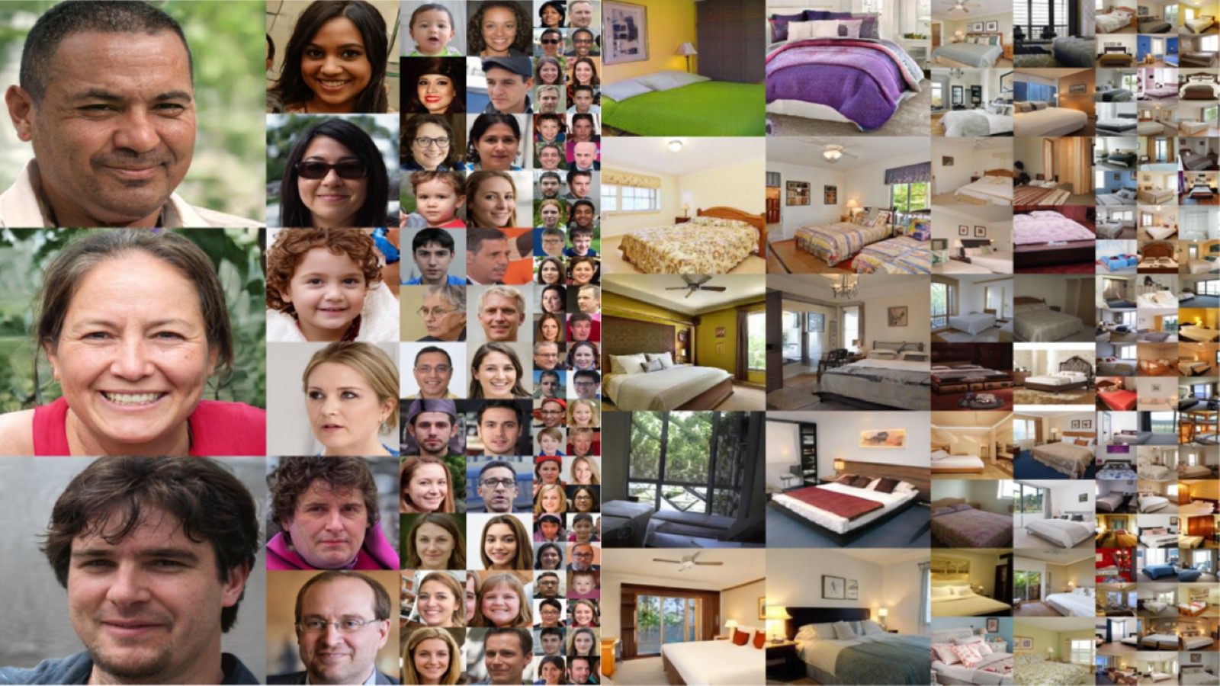

Slide 11
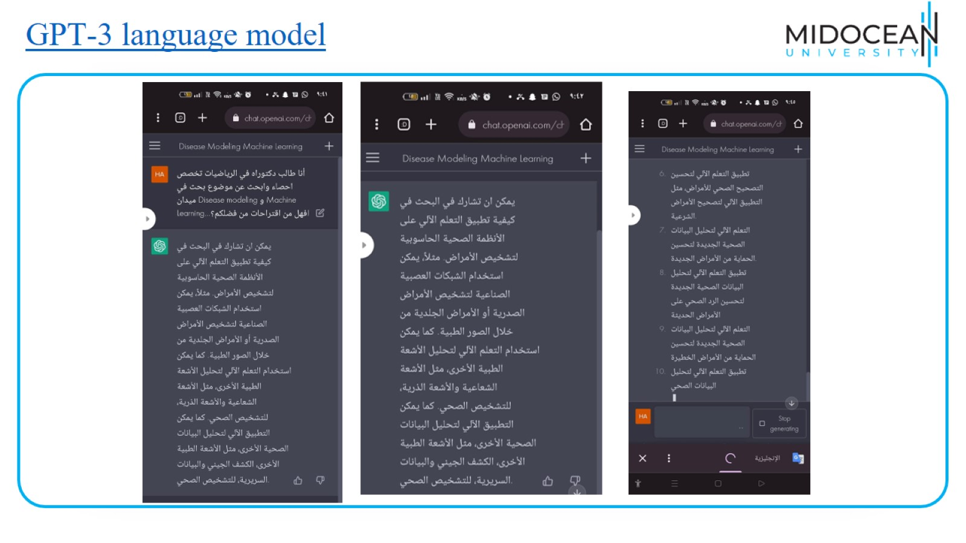
GPT-3 language model

Slide 12
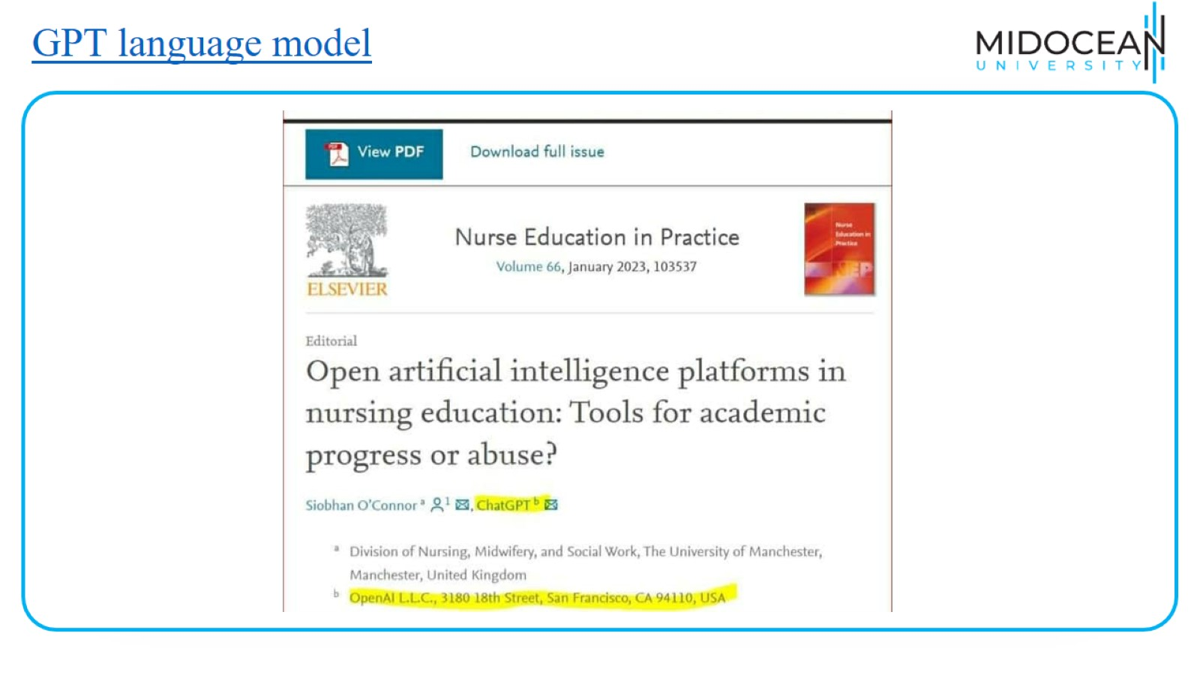
GPT language model

Slide 13


