Slide 1


Database Management System
IT 261
Bachelor of Information Technology
Prepared by Dr. Khaled Eskaf
Assistant Professor of Intelligent System
Lecture: Intro

Slide 2

1-Khaled Eskaf: Assistant Professor of Intelligent System.
2-Ph.D. in Computer Science from the University of Salford in the UK.
Academic Experience:
  3-held several academic positions in Middle East, UK, and Canada.
  4-served as assistant professor, department head of the Faculty of Computing and Information Technology at several universities.
Research Focus:
  5-Researcher in AI, machine learning (ML), deep learning (DL), and robotics
  6-Applies intelligent systems in medical fields and climate change
Work Experience:
  7- Over 20 years of experience in education at universities and colleges.
  8- working in MILA as mentor for graduate students in Canada, and teaching computer science courses and robotics.
  9- International Expert Judge for robotics competitions, First Robotics-Canada and MakesX Mbot Robotics competition.
www.midocean.ae

Slide 3




khaledeskaf@midocean.edu.km
Note: for sending email, Please include:
Subject: course name + your Student ID.
: DBS+ your Student ID.
Wednesday: 9 PM – 10.30 PM
https://scholar.google.com/citations?user=TeE2zCUAAAAJ&hl=en
https://www.linkedin.com/in/keskaf/
www.midocean.ae

Slide 4

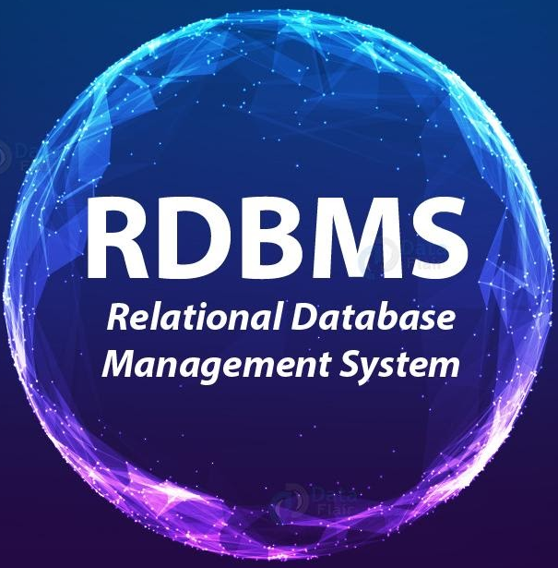
This course is centered on the comprehensive study and application of relational database management systems (RDBMS), with a specific focus on analysis, design, normalization, and implementation techniques. It's tailored to provide a robust understanding of how relational databases function and how they can be effectively utilized and managed using MySQL, a popular open-source relational database management system.
www.midocean.ae

Slide 5

By the end of this course, you will not only understand the theoretical aspects of database management but will have also navigated the practical challenges and solutions in MySQL.
www.midocean.ae

Slide 6

Week | Topic | Objective | MySQL Practical Activities
1 | Introduction to Database Concepts | Understand basic database concepts. | Install MySQL, explore the interface, create a basic database.
2 | Relational Data Model | Learn about the relational data model. | Create relational tables in MySQL.
3 | Relational Integrity Rules | Understand relational integrity constraints. | Implement primary and foreign key constraints in MySQL.
4 | Relational Algebra and Basic SQL | Explore relational algebra and basic SQL commands. | Use basic SQL queries in MySQL.
5 | Advanced SQL Queries | Delve into complex SQL operations. | Execute advanced SQL commands in MySQL.
6 | Introduction to Database Normalization | Begin learning database normalization principles. | Apply the first normal form (1NF) in MySQL.
7 | Advanced Database Normalization | Explore advanced normalization techniques. | Normalize a database in MySQL to 2NF and 3NF.
8 | Data Modeling and ER Diagrams | Understand data modeling and ER diagrams. | Create an ER diagram and implement it in MySQL.
9 | Database Design for Real-World Apps | Apply database design to real-world scenarios. | Develop a database schema based on a real-world example.
10 | Project and Review | Apply all learned concepts in a comprehensive project. | Complete a project in MySQL incorporating all learned skills.
www.midocean.ae

Slide 7

Smart City Data Base Management
www.midocean.ae

Slide 8





www.midocean.ae

Slide 9
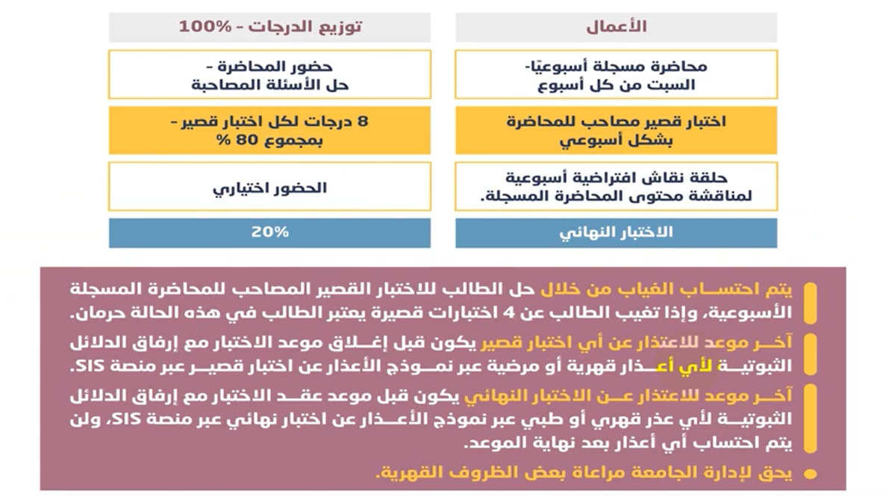
www.midocean.ae

Slide 10



Thank You

