Slide 1


Red Hat System Administration I
Dr. Eng. Gamal Selim
Lecture 05

Slide 2
Agenda
Chapter 9: Controlling Services and Daemons
Chapter 10: Configuring and Securing OpenSSH Service
Red Hat Linux Administration I
Lecture 05
Dr. Eng. Gamal Selim

Slide 3
Chapter 9: Controlling Services and Daemons
Red Hat Linux Administration I
Lecture 05
Dr. Eng. Gamal Selim

Slide 4
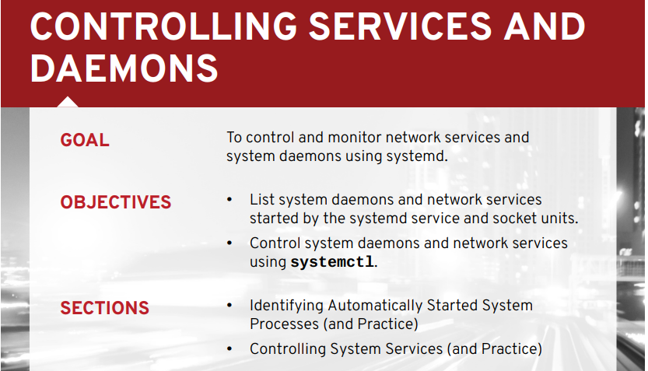

Slide 5
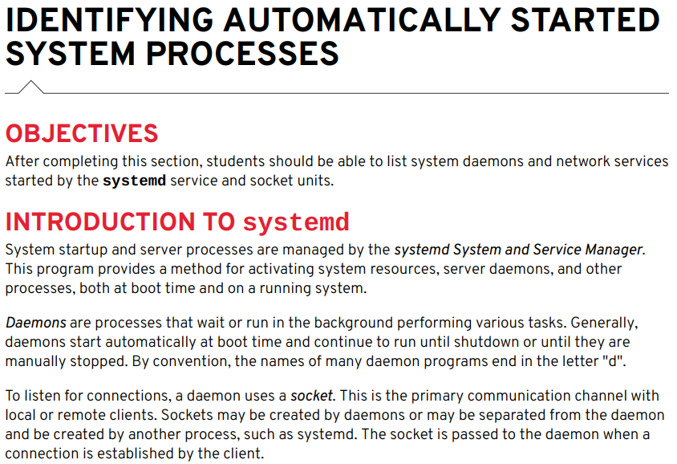
Red Hat Linux Administration I
Lecture 05
Dr. Eng. Gamal Selim

Slide 6
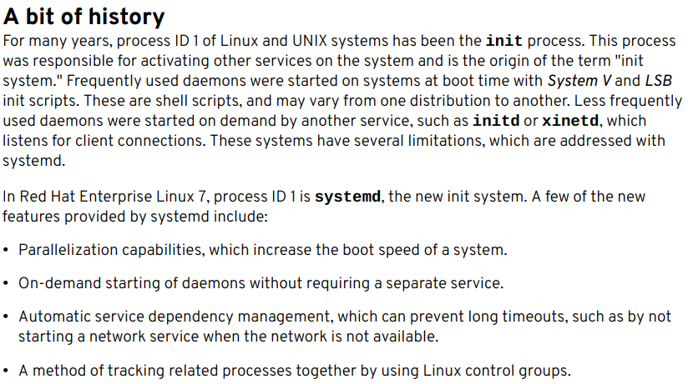
Red Hat Linux Administration I
Lecture 05
Dr. Eng. Gamal Selim

Slide 7

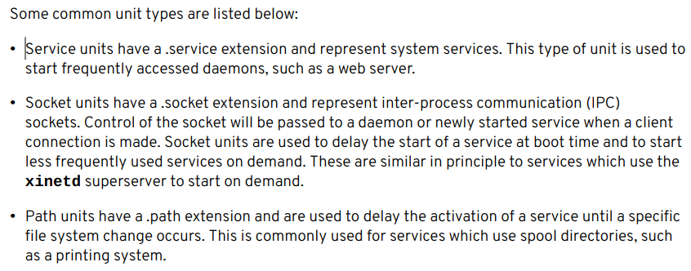
Red Hat Linux Administration I
Lecture 05
Dr. Eng. Gamal Selim

Slide 8
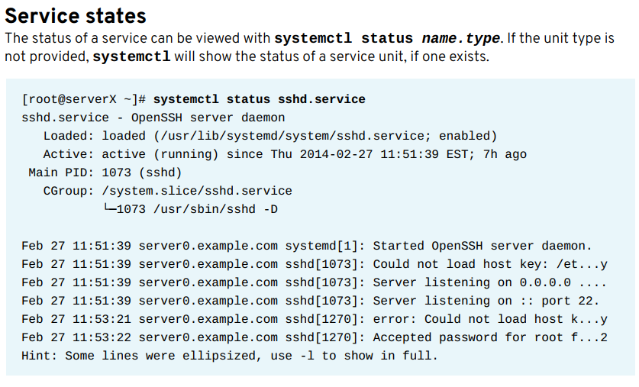
Red Hat Linux Administration I
Lecture 05
Dr. Eng. Gamal Selim

Slide 9
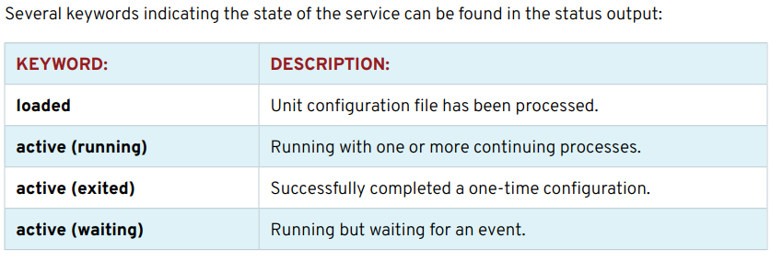
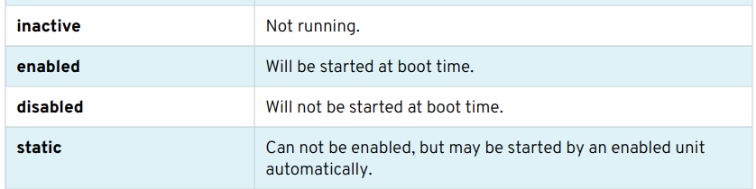
Red Hat Linux Administration I
Lecture 05
Dr. Eng. Gamal Selim

Slide 10
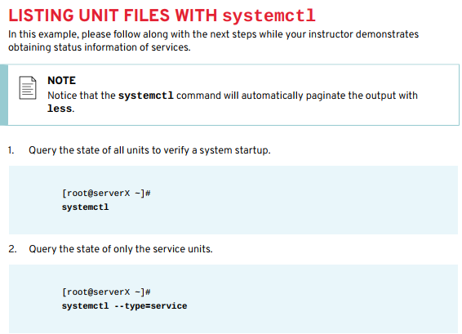
Red Hat Linux Administration I
Lecture 05
Dr. Eng. Gamal Selim

Slide 11
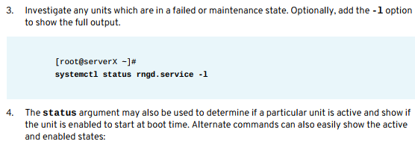
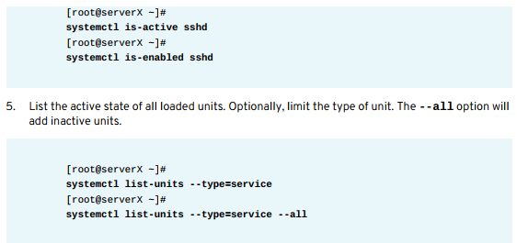
Red Hat Linux Administration I
Lecture 05
Dr. Eng. Gamal Selim

Slide 12
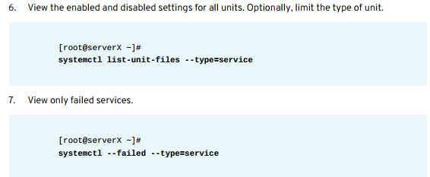
Red Hat Linux Administration I
Lecture 05
Dr. Eng. Gamal Selim

Slide 13
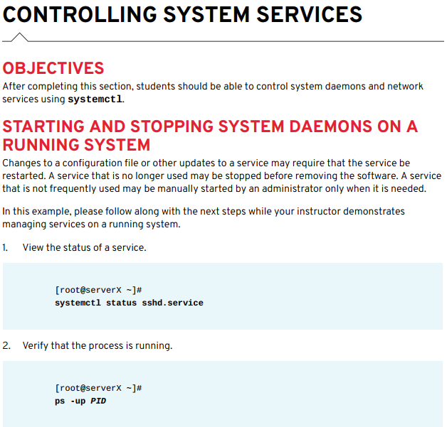
Red Hat Linux Administration I
Lecture 05
Dr. Eng. Gamal Selim

Slide 14
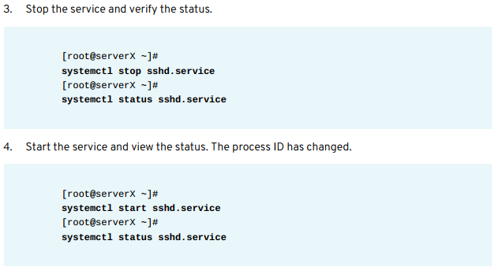
Red Hat Linux Administration I
Lecture 05
Dr. Eng. Gamal Selim

Slide 15
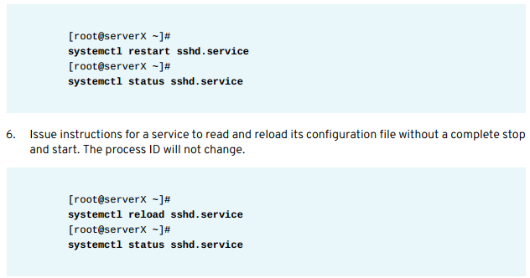
Red Hat Linux Administration I
Lecture 05
Dr. Eng. Gamal Selim

Slide 16
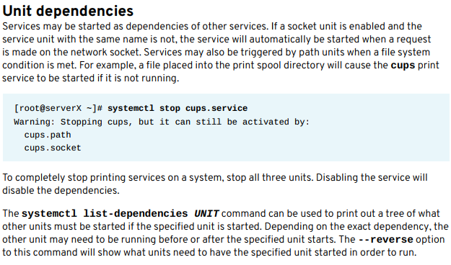
Red Hat Linux Administration I
Lecture 05
Dr. Eng. Gamal Selim

Slide 17
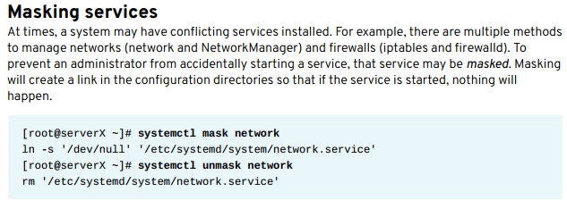
Red Hat Linux Administration I
Lecture 05
Dr. Eng. Gamal Selim

Slide 18
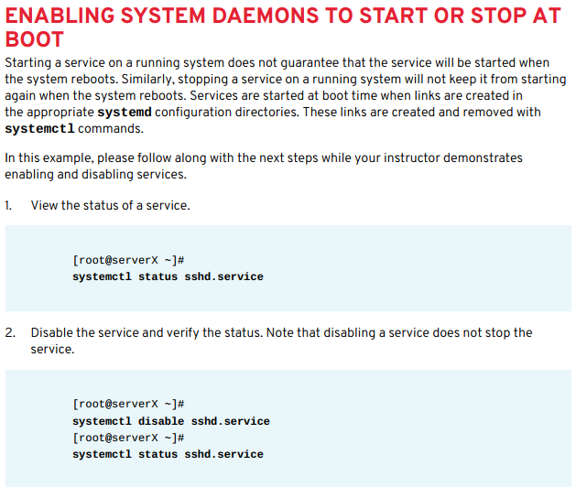
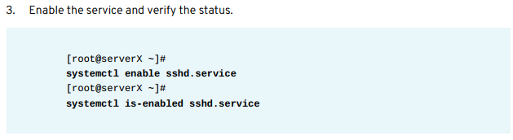
Red Hat Linux Administration I
Lecture 05
Dr. Eng. Gamal Selim

Slide 19
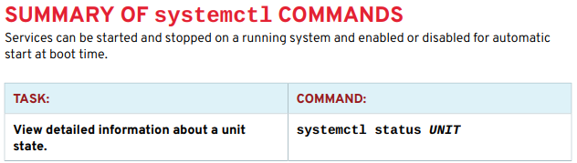
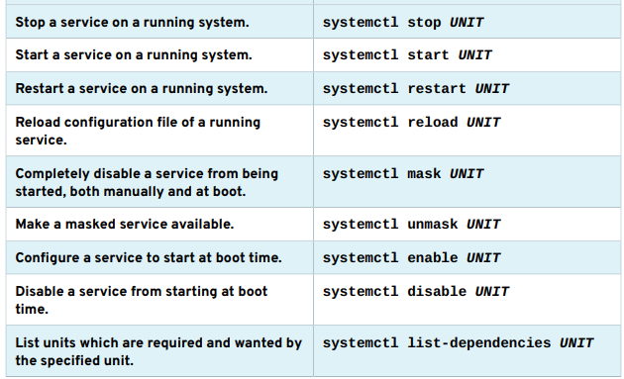
Red Hat Linux Administration I
Lecture 05
Dr. Eng. Gamal Selim

Slide 20
End of Chapter 9
Red Hat Linux Administration I
Lecture 05
Dr. Eng. Gamal Selim

Slide 21
Chapter 10: Configuring and Securing OpenSSH Service
Red Hat Linux Administration I
Lecture 05
Dr. Eng. Gamal Selim

Slide 22
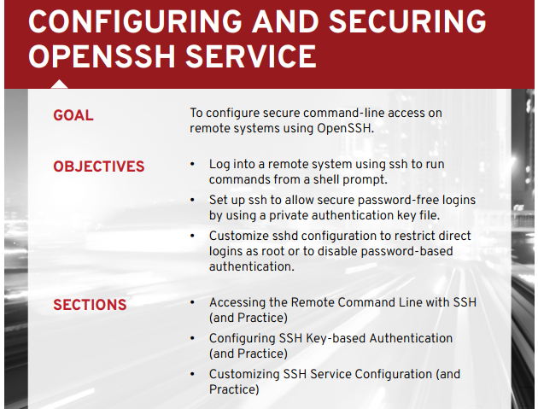

Slide 23
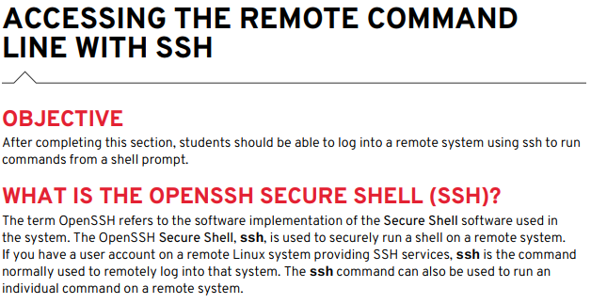
Red Hat Linux Administration I
Lecture 05
Dr. Eng. Gamal Selim

Slide 24
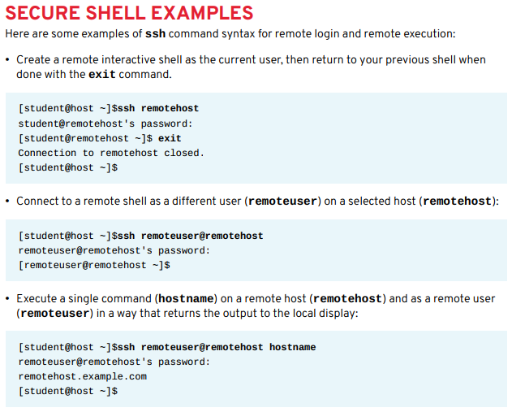
Red Hat Linux Administration I
Lecture 05
Dr. Eng. Gamal Selim

Slide 25
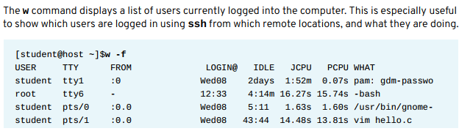
Red Hat Linux Administration I
Lecture 05
Dr. Eng. Gamal Selim

Slide 26
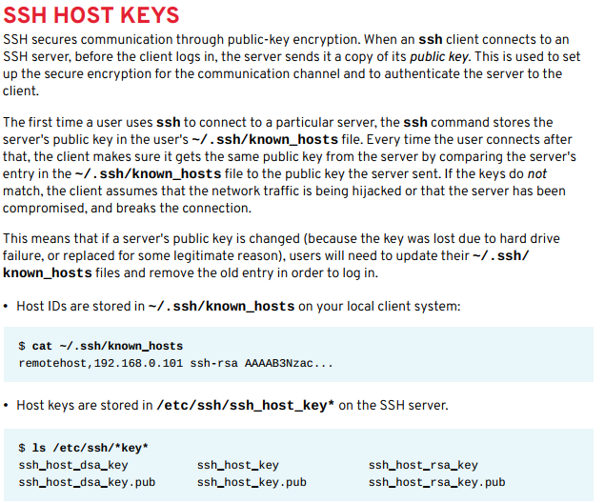
Red Hat Linux Administration I
Lecture 05
Dr. Eng. Gamal Selim

Slide 27
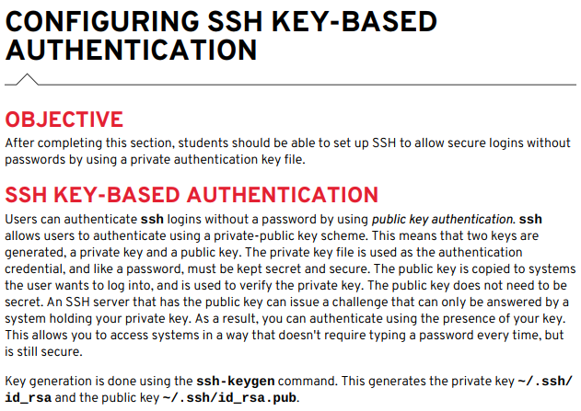
Red Hat Linux Administration I
Lecture 05
Dr. Eng. Gamal Selim

Slide 28
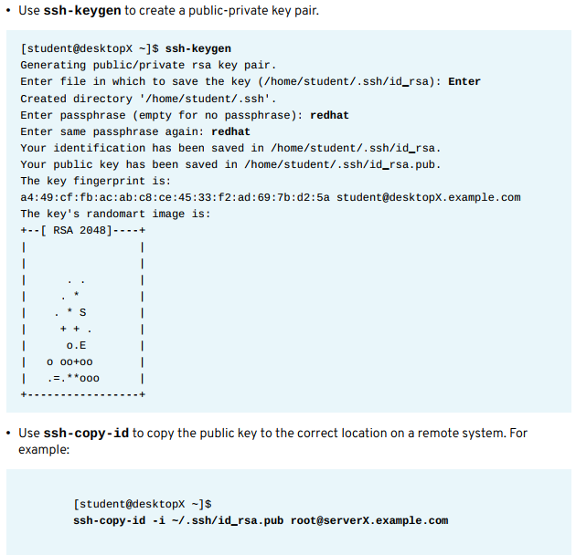
Red Hat Linux Administration I
Lecture 05
Dr. Eng. Gamal Selim

Slide 29
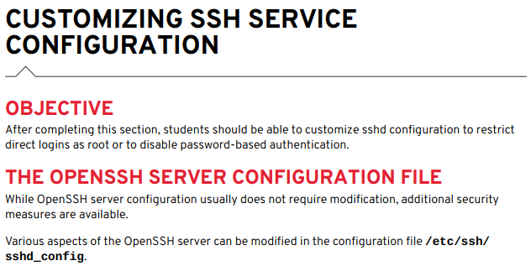
Red Hat Linux Administration I
Lecture 05
Dr. Eng. Gamal Selim

Slide 30
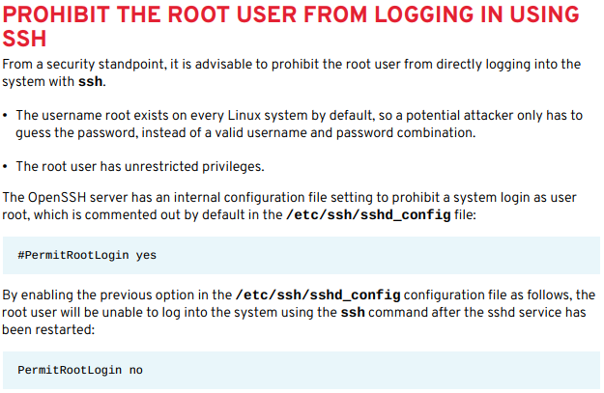
Red Hat Linux Administration I
Lecture 05
Dr. Eng. Gamal Selim

Slide 31
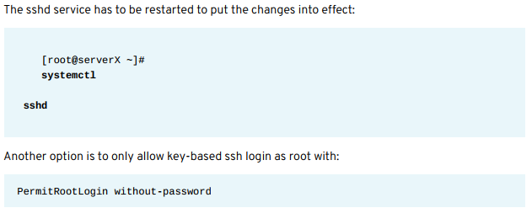
Red Hat Linux Administration I
Lecture 05
Dr. Eng. Gamal Selim

Slide 32
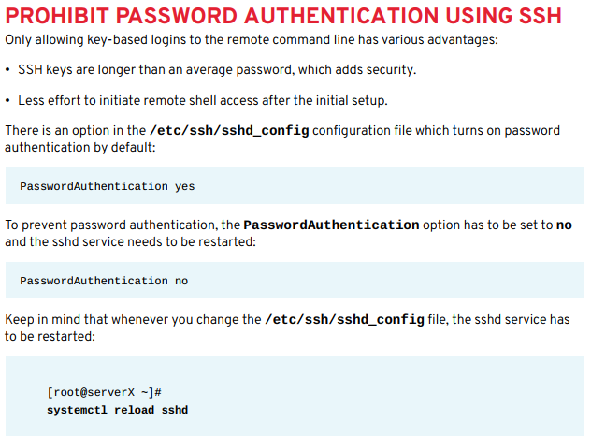
Red Hat Linux Administration I
Lecture 05
Dr. Eng. Gamal Selim

Slide 33
End of Chapter 10
Red Hat Linux Administration I
Lecture 05
Dr. Eng. Gamal Selim

Slide 34


