Slide 1



Basic Router Configuration
Lecture 5
CCNA – Introduction to Networks V7.0 (ITN)
Prepared by
Dr. Abdelrhman Ahmed

Slide 2
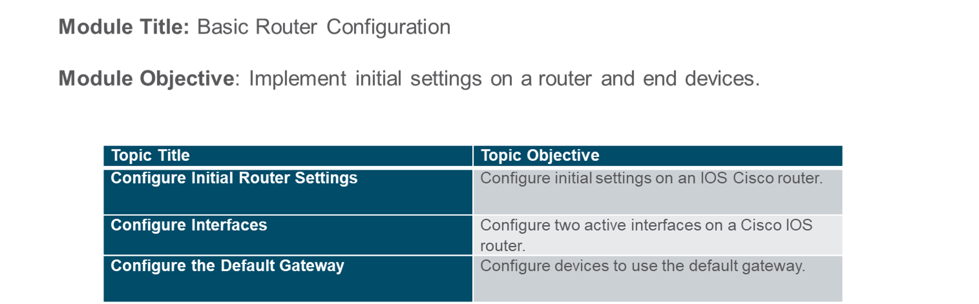
Chapter
Module Objectives
05

Slide 3
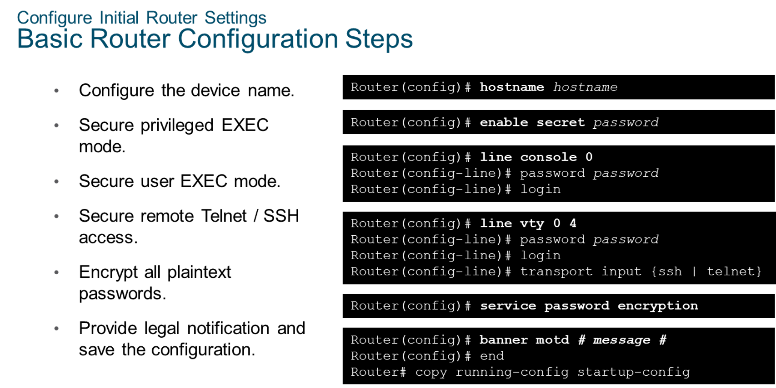
Chapter
Configure Initial Router Settings
05

Slide 4
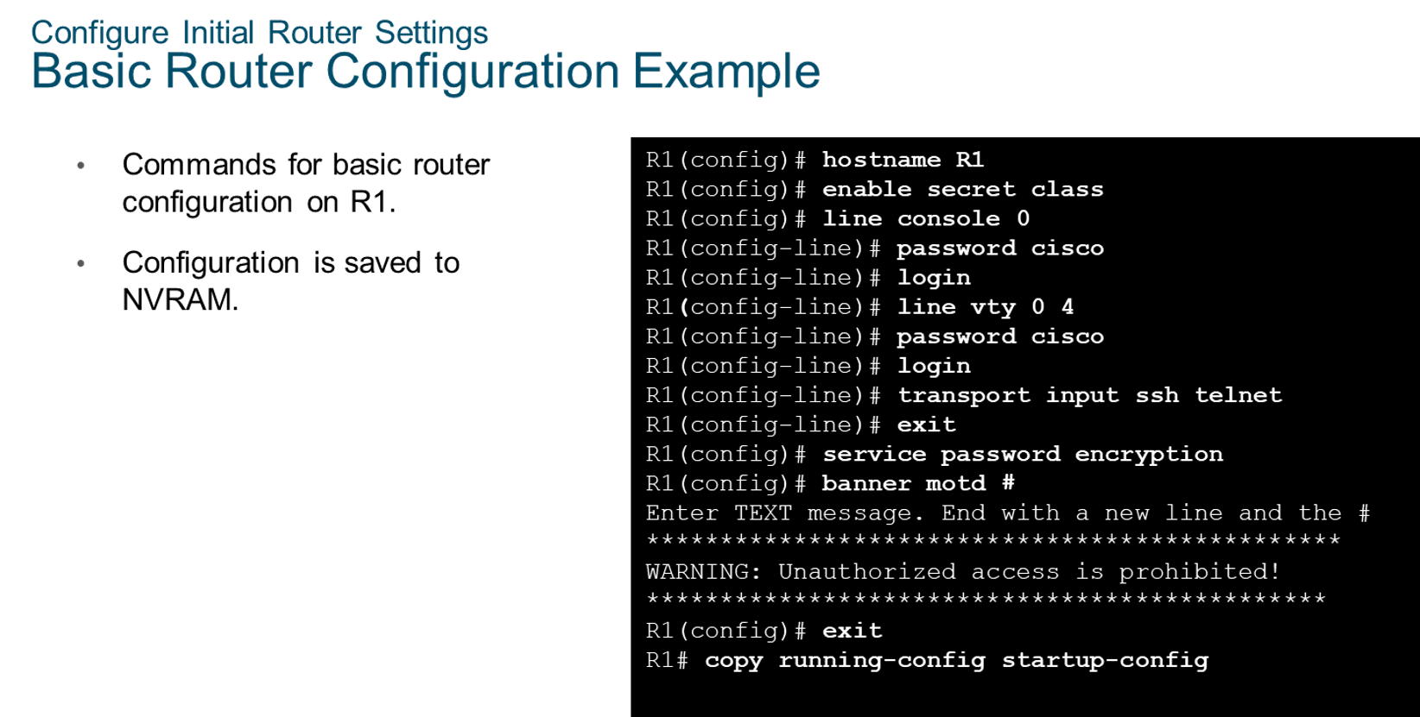
Chapter
Configure Initial Router Settings
05

Slide 5
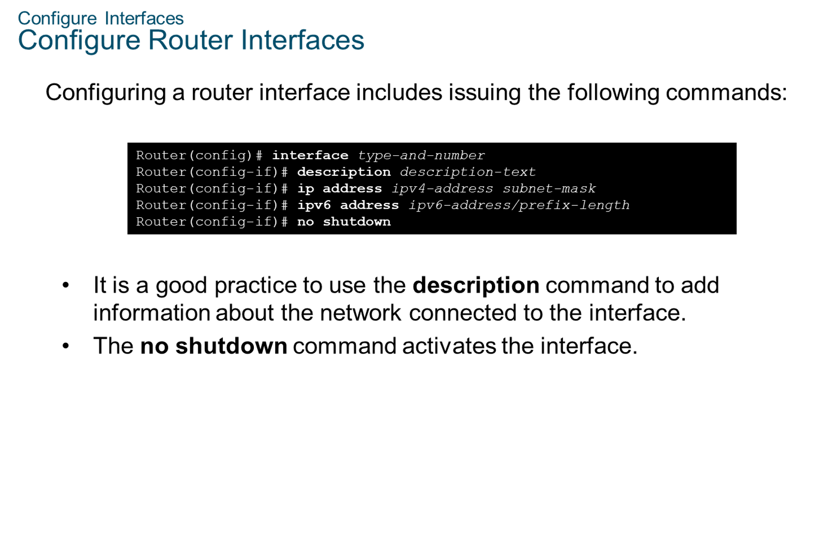
Chapter
Configure Interfaces
05

Slide 6
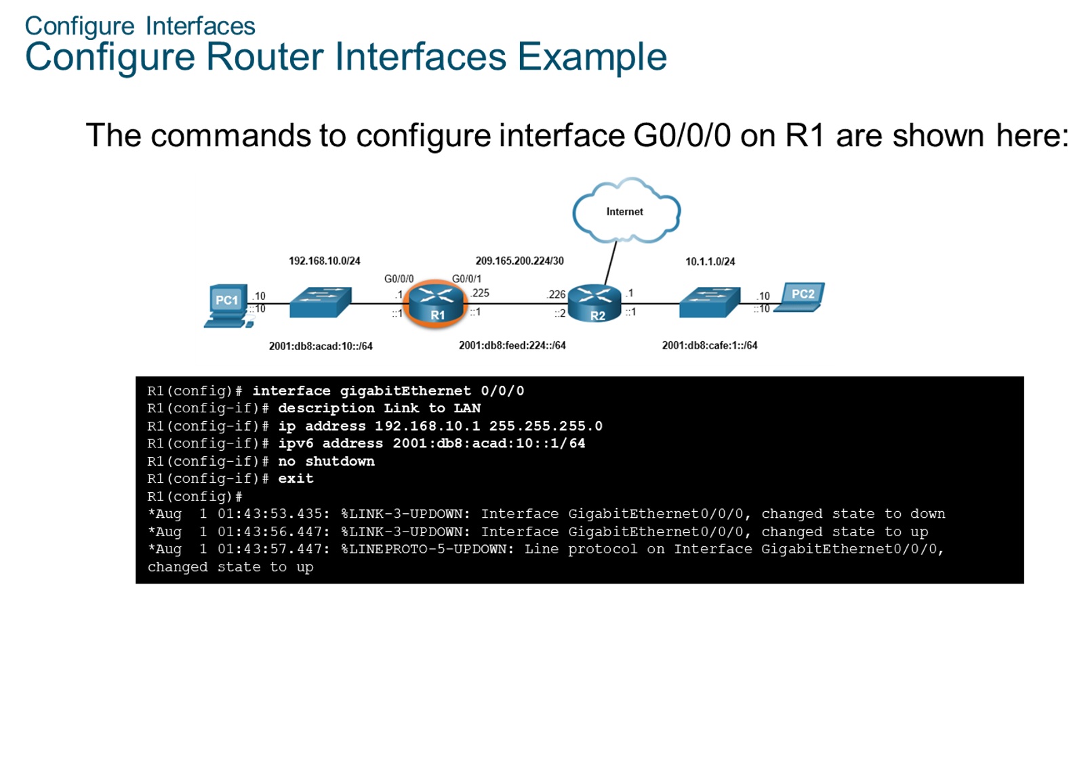
Chapter
Configure Interfaces
05

Slide 7

Chapter
Configure Interfaces
05

Slide 8
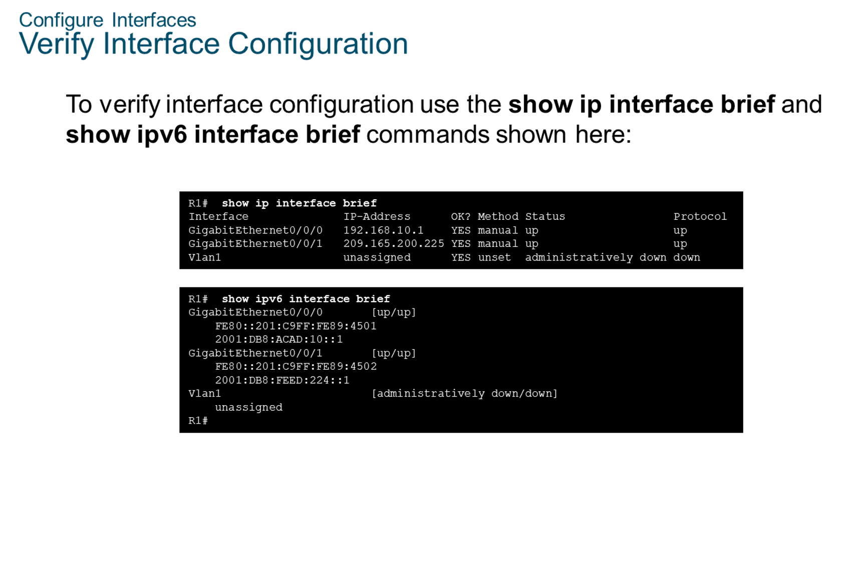
Chapter
Configure Interfaces
05

Slide 9
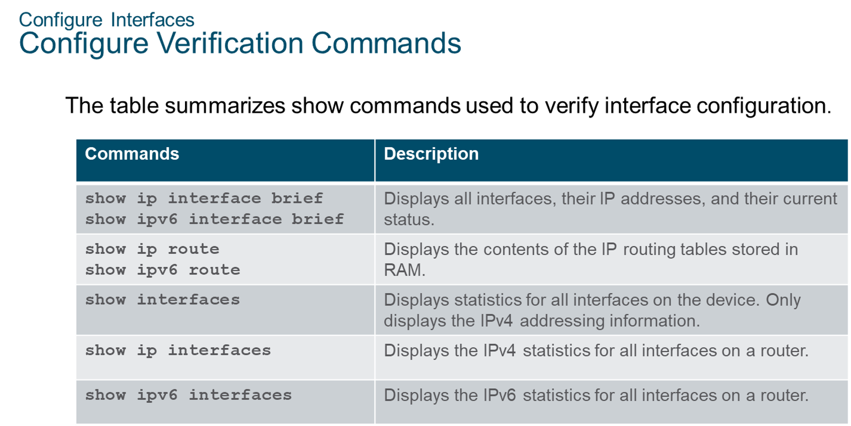
Chapter
Configure Interfaces
05

Slide 10
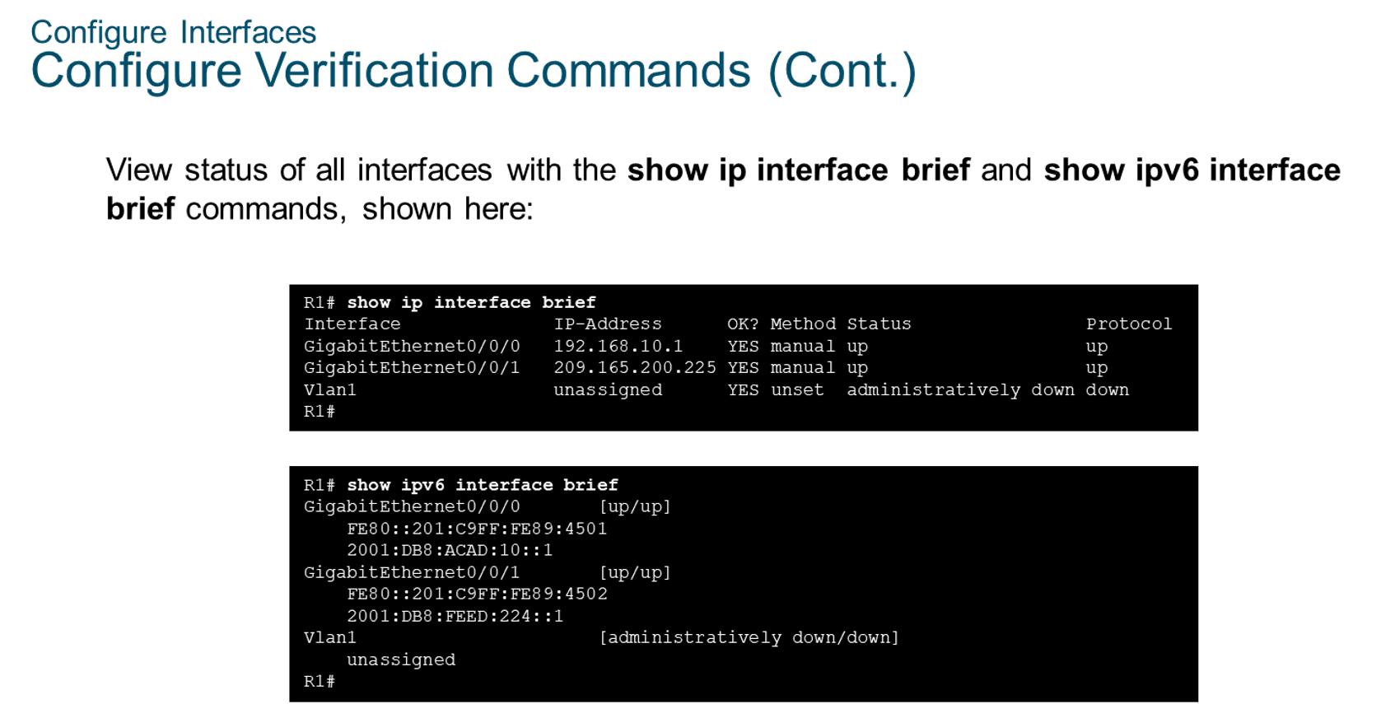
Chapter
Configure Interfaces
05

Slide 11
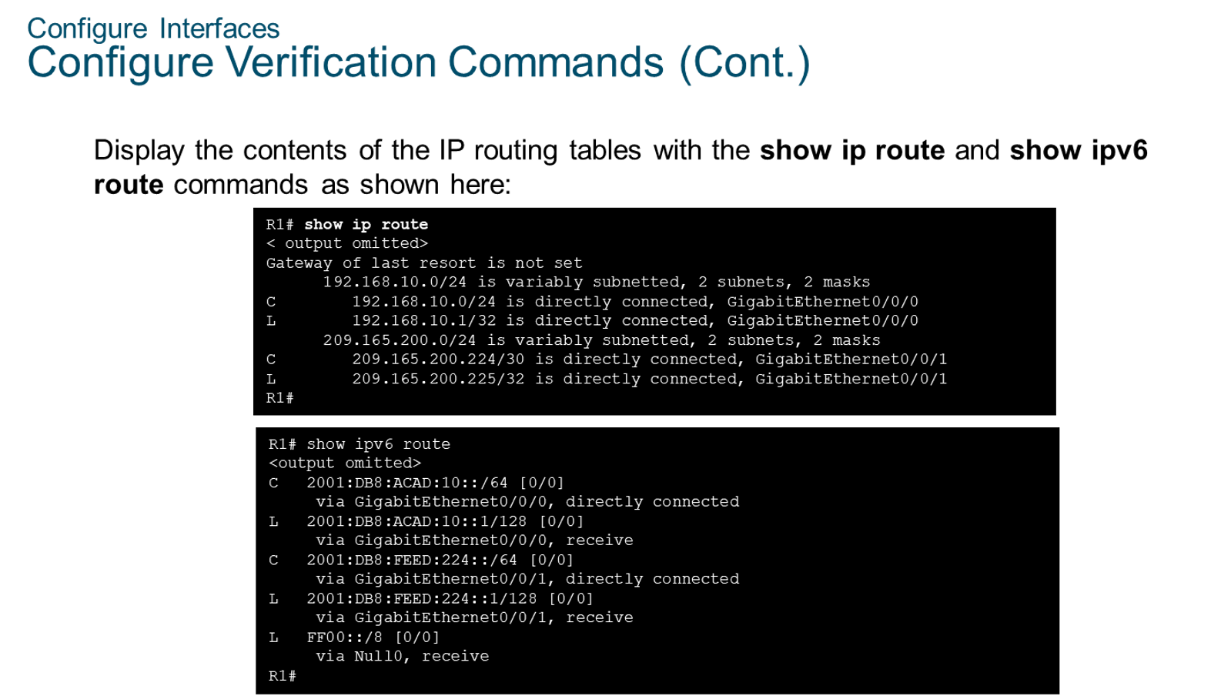
Chapter
05
Configure Interfaces

Slide 12
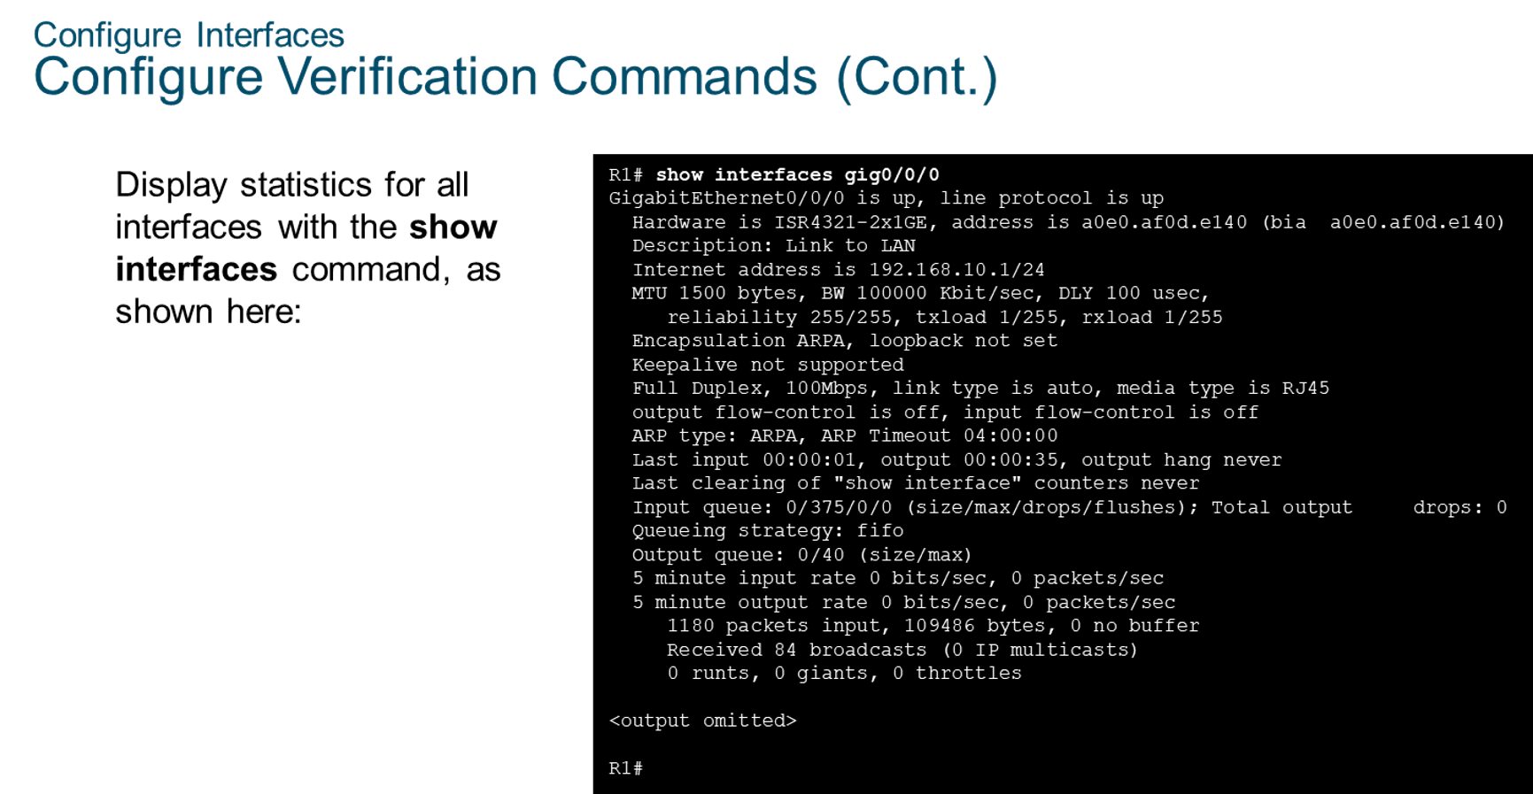
Chapter
Configure Interfaces
05

Slide 13
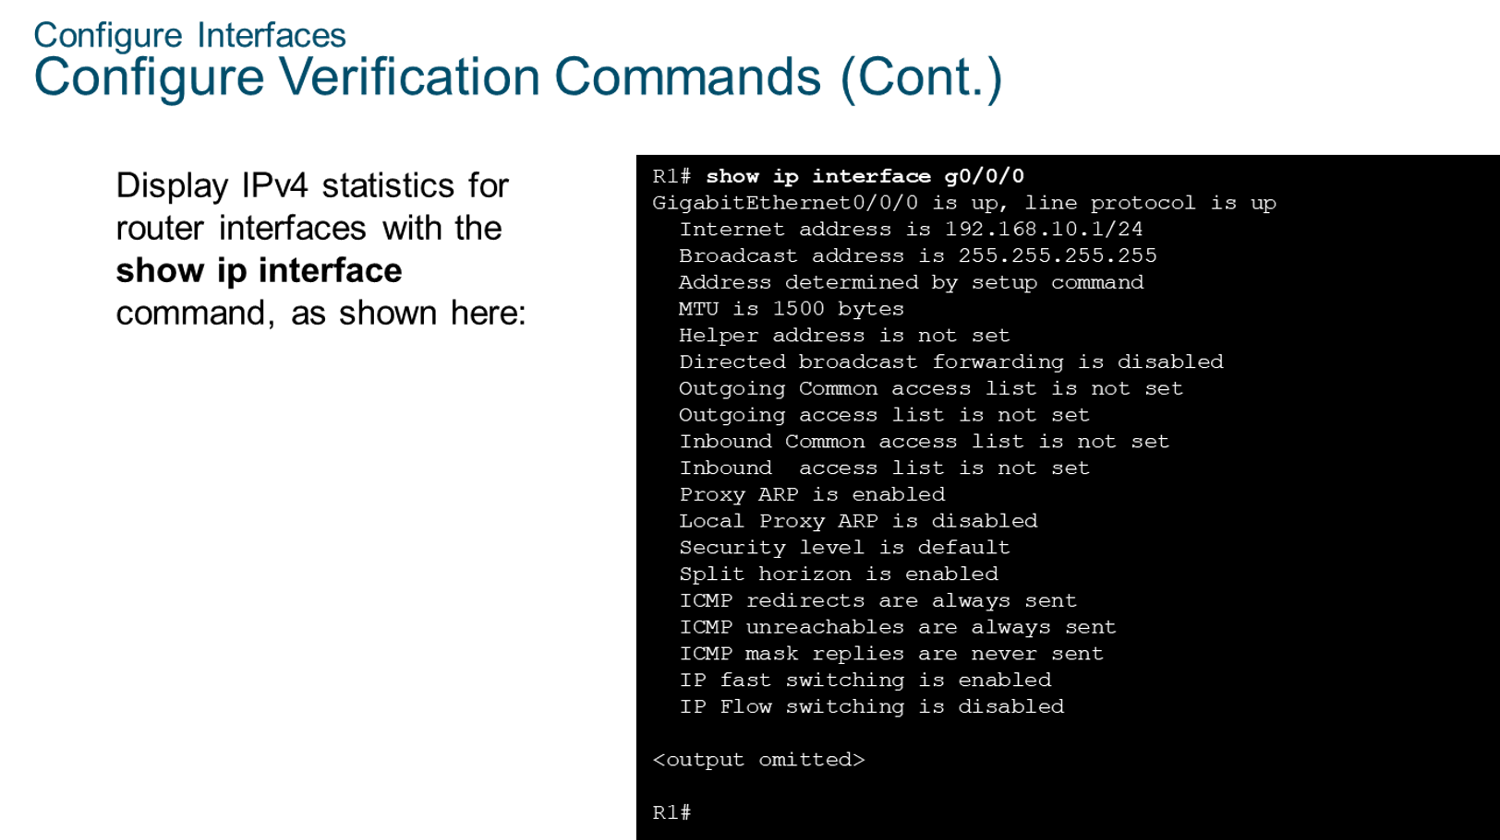
Chapter
Configure Interfaces
05

Slide 14
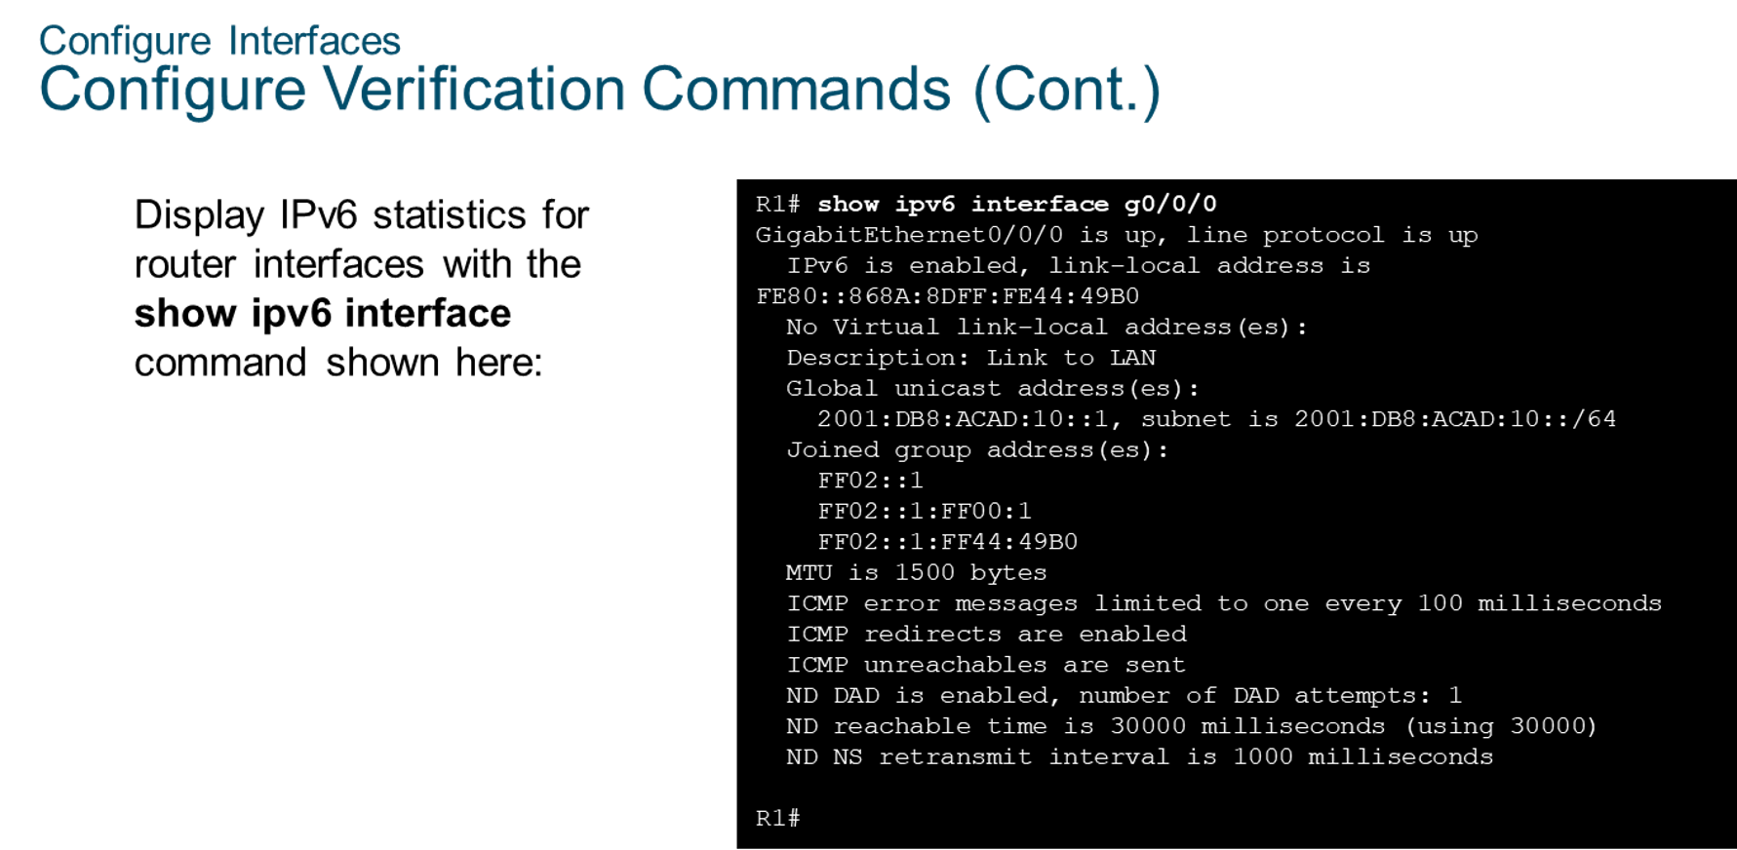
Chapter
Configure Interfaces
05

Slide 15
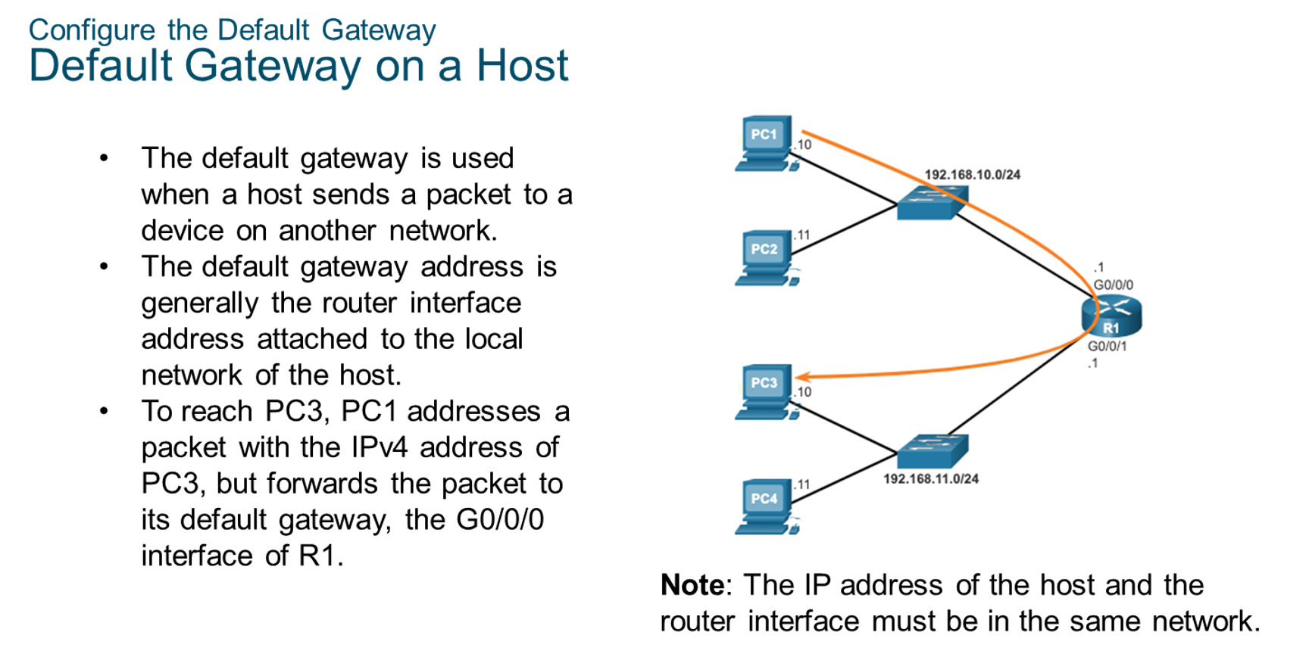
Chapter
Configure the Default Gateway
05

Slide 16
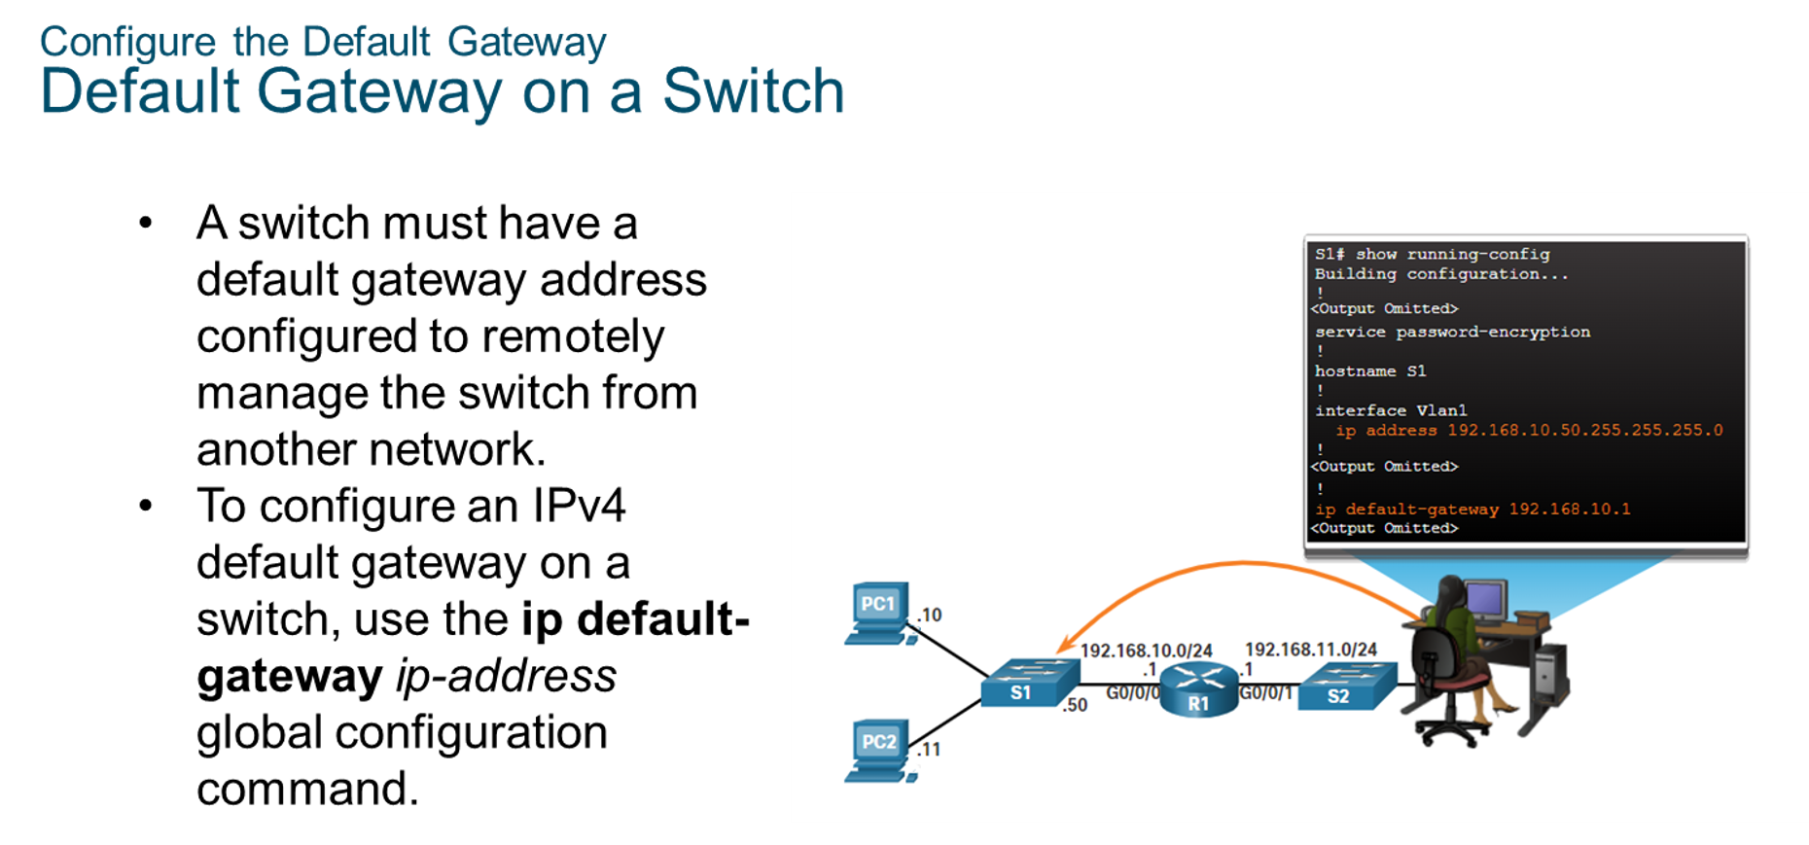
Chapter
Configure the Default Gateway
05

Slide 17



Thank You

