Slide 1



DIGITAL MARKETING
APPLICATIONS
Prepared by Dr. HEBA ZIAD
COURSE CODE - MKT720
lecture 9

Slide 2
DIGITAL MARKETING IMPLEMENTATION AND PRACTICE
Chapter at a glance
Pay-Per-Click marketing
difference between PPC, SEM and SEO
Challenges of display advertising
Advantages of online advertising
the wider range of goals for online campaigns
Display advertising billing
types of ad formats include
digital media placement
Purchasing ad placements
benefits of paid search marketing
COURSE CODE - MKT720
lecture 10

Slide 3

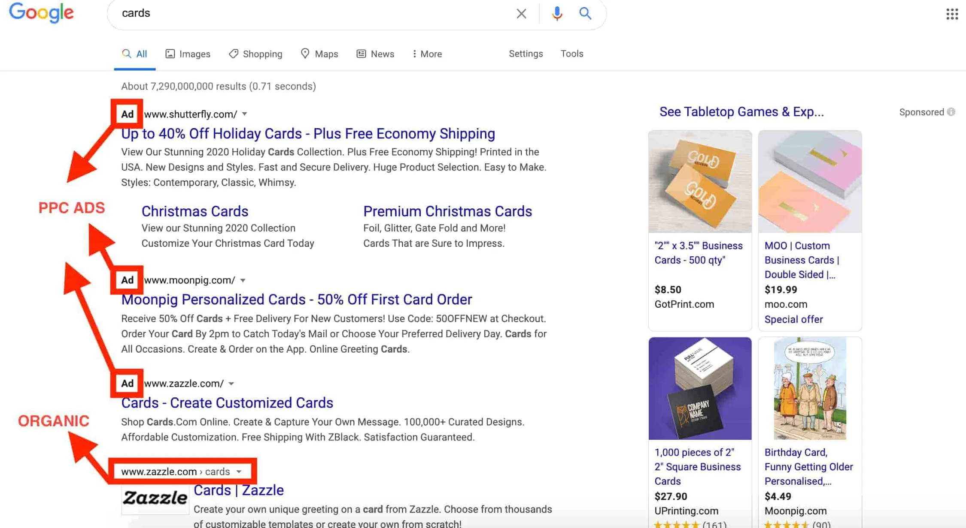
What is PPC? What is PPC – Pay-Per-Click marketing?
Pay-per-click, or PPC, is a form of advertising that allows you to pay a fee to have your website on the search engine result page (SERP) when someone types in specific keywords or phrases to the search engine. The SERP will display the ads you create to direct visitors to your site, and the fee you pay is based on whether people click your ad.
When done right, PPC can earn you quality leads. If you can create a seamless user journey, it could mean a massive ROI for your PPC efforts.
Pay-per-click advertising is most common in search engine results pages, like Google or Bing, but is also used on social channels (although CPM is more common). If you’re wondering where you can find pay-per-click ads, they’re the results you see before and to the right of the organic search results.
Pay-per-click is an internet advertising model used to drive traffic to websites, in which an advertiser pays a publisher when the ad is clicked. Pay-per-click is usually associated with first-tier search engines.

Slide 4




How does PPC work?
Pay-per-click, PPC, is a paid advertising model that falls under search engine marketing (SEM). With PPC, the advertiser only pays when people interact with their ad through impressions or clicks.
the main model for paying for ads in the search engines is pay-per-click marketing, we have called this section paid search marketing since there are, increasingly, other options for payment on what is known as the content network. Retailers have an additional option for paid search known as Product Listing Ads (PLAs), which are ads showing product images and prices that you may have seen when searching for retail products. These account for more than 50 per cent of paid search ad spend. Paid search marketing is an example of biddable media, where businesses have to bid against other businesses to achieve visibility for their adverts. Note that, as we will see in the section on quality score, the amount bid isn't the only factor that affects the prominence of the ad, since relevance of the ad is also important.
Google's Product Listing Ads (PLAs)Product information such as pricing and images are uploaded to Google's servers using a product feed in XML or text formats for display in ads within Google Ads or Google Shopping.
Biddable media Businesses have to bid against other businesses in auctions to achieve visibility for their adverts, for example, when using pay-per-click advertising or programmatic advertising.
CPM (cost per mille) is a paid advertising option where companies pay a price for every 1,000 impressions an ad receives.

Slide 5
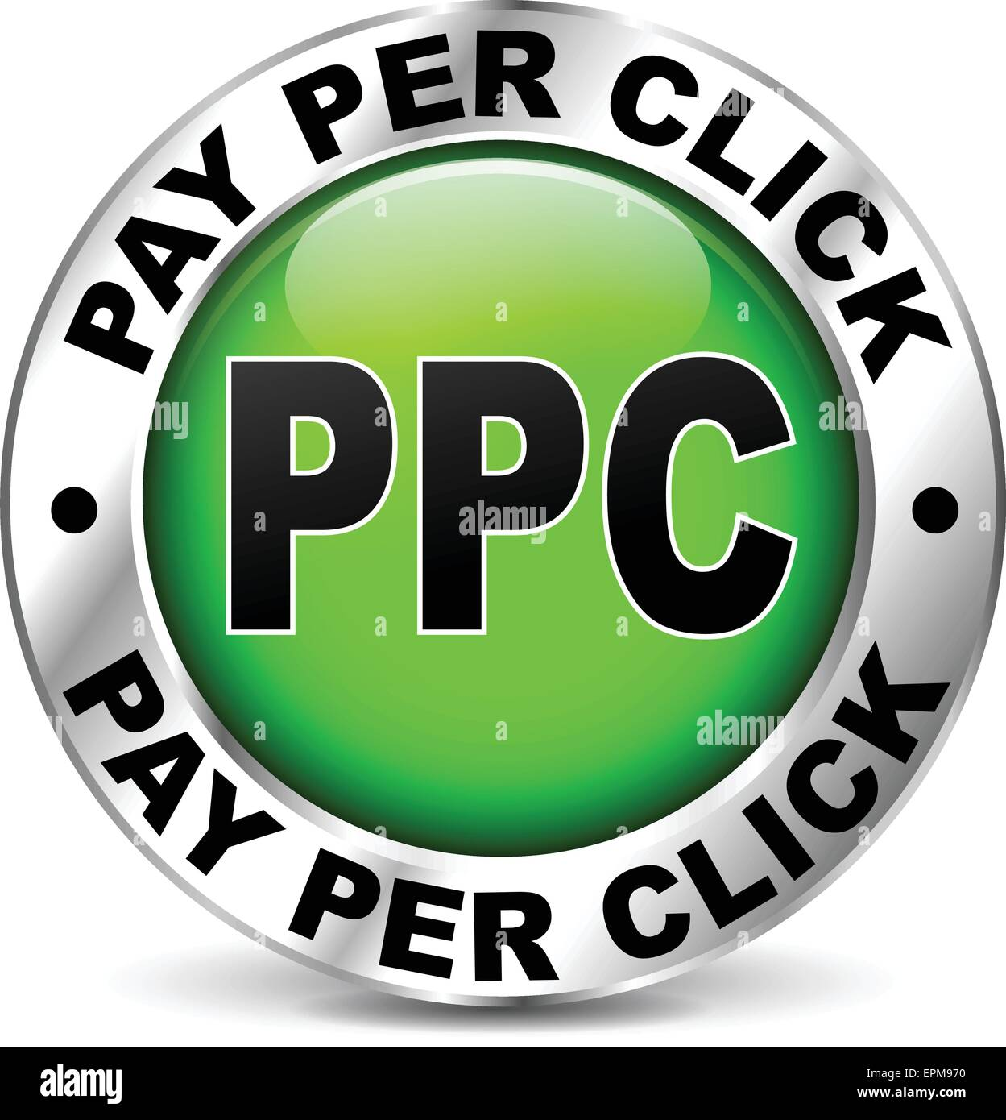

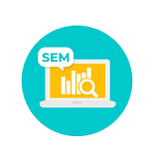
What’s the difference between PPC, SEM and SEO?
Though these three terms get used interchangeably, there is a difference between PPC, SEM (search engine marketing), and SEO (search engine optimization).
SEM is an umbrella term that encompasses PPC but is not limited to only this form of advertising. It references activity that intends to improve how easy it is to find a website through a search engine. SEM is both paid and unpaid, PPC, or organic traffic (SEO).
PPC is online advertising that works with search engines and other channels such as video ads (YouTube) and image ads (Instagram/Facebook).
Search engine optimization (SEO), is a method of optimizing a website’s content and structure to make it more visible to search engines. This is done by researching and using relevant keywords, optimizing meta data, creating quality content, and earning links from other websites. The goal of SEO is to improve a website’s organic (non-paid) search engine rankings and drive traffic to the website through organic search results.

Slide 6
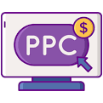
How does PPC work?
PPC advertising works by allowing advertisers to bid on specific keywords or phrases that they want their ads to appear for in search engine results. When a user searches for one of those keywords or phrases, the advertiser’s ad will appear among the top results. The advertiser is then charged a fee each time a user clicks on their ad.
Advertisers create campaigns that target specific demographics, interests, locations, etc. They will set a maximum bid for the keywords they want to target.
The search engine will then use a complex algorithm to determine which ads to show and in what order. The algorithm takes into account factors such as the:
Advertiser’s bid amount
Relevance of the ad to the keyword
Quality of the ad
PPC strategy and campaign planning
Top PPC platforms
How to learn PPC
This form of advertising can also be done through social media platforms, such as Facebook and Instagram.
Display (or content) network Sponsored links are displayed by the search engine on third-party sites such as online publishers, aggregators or social networks. Ads can be paid for on a CPC, CPM or a CPA basis. There are also options for graphical or video ads as well as text-based ads.
Contextual ad relevant to page content on third-party sites brokered by search ad networks.

Slide 7

Why is PPC important?
PPC offers several benefits not found with SEO or social media, including:
Quick results: PPC advertising can drive traffic to a website almost immediately, whereas SEO can take time to show results. Platforms usually approve ads the same day, providing maximum exposure almost immediately. This could be a text ad via Google search, an image ad through Instagram, or even a video featured on YouTube. Using multiple platforms in different formats can increase your brand’s visibility.
Reach your targeted audience: PPC advertising allows marketers to target specific demographics, interests, and location, which helps to reach the right audience. You can even target individuals based on their behaviors and interests; social media sites like Facebook can help you get your ad to the group that’s likely to convert into a sale.

Slide 8
Measurable: PPC advertising provides measurable results. It allows marketers to track conversions, return on investment (ROI), and other key performance indicators (KPIs).
Cost-effective: PPC advertising can be more cost-effective than traditional advertising methods, such as television or print ads, since marketers only pay when a user clicks on their ad, and they can set a budget for their campaign.
Branding: PPC advertising can help to increase brand awareness. Even if users don’t click on the ad, they may still see it and remember the brand.
Complementing SEO: PPC can be used to supplement SEO efforts. While SEO focuses on increasing organic traffic, PPC can be used to drive immediate traffic to a website while SEO efforts are still ongoing.

Slide 9
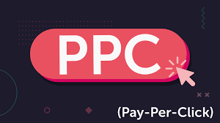
Track your goals: Tools such as Google Analytics can help you track your goals. See how your ads are performing in real-time, and decide what needs to get done to reach your goals more efficiently.
Reputation management: PPC can be used to bid on keywords matching a reputation event and directed to a landing page directly addressing the matter so you can control the narrative, instantly and professionally.
Overall, PPC advertising offers a cost-effective and measurable way to reach a targeted audience, generate leads and sales, and ultimately increase brand awareness.

Slide 10
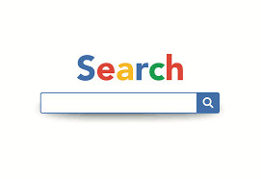
What are the types of PPC ads?
Search
Search pay-per-click ads are the most popular type of PPC ads. A search ad appears at the top of search engine results pages (SERPs) when a user enters a specific query (keyword or phrase) into a search engine (Google and Microsoft Bing being the most popular). These ads are typically text-based and are designed to be highly relevant to the user’s search.
Advertisers typically pay each time a user clicks on one of their ads (the cost of each click is known as CPC or cost per click. Search ads are the most popular way for businesses to promote their products or services and drive traffic to their websites.
“SERP'' stands for “search engine results page.” It’s a page that a search engine displays to a user after they enter a search query. SERPs include links to different webpages that are relevant to the user's query, along with additional information or images.

Slide 11
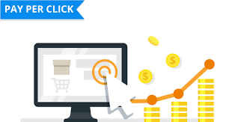
Display
A display ad is a type of ad that appears on websites, apps, and other digital platforms, typically in the form of a banner or other graphical format. Display ads are designed to be visually appealing and can include a variety of media such as images, videos, and interactive elements.
Display ads are often used to raise brand awareness, promote products or services, or drive traffic to a website. Display ads are typically purchased on a cost-per-impression (CPI) or cost-per-thousand-impressions (CPM) basis, meaning that the advertiser pays each time the ad is displayed a certain number of times.

Slide 12
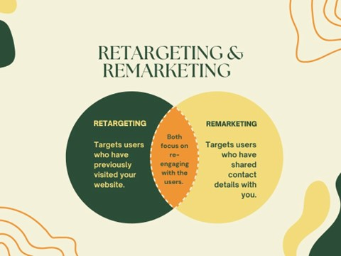
Remarketing (or retargeting)
Remarketing is a form of advertising that allows businesses to show ads to users who have previously interacted with their website or mobile app. Remarketing ads are typically shown to users as they browse other websites, or as they use mobile apps, and are designed to remind the user of the business and encourage them to return to the website or app.
Remarketing ads can be delivered in various formats, such as display ads, search ads, video ads, and social media ads. They are usually purchased on a cost-per-click (CPC) or cost-per-thousand-impressions (CPM) basis.
Remarketing campaigns are highly targeted and effective at driving conversions and sales. They work by tracking users’ behavior on a website or mobile app, then using that data to show them targeted ads as they browse other websites or use other apps. This is done by placing a cookie or pixel on the user’s browser or device, which is then used to identify them and serve them relevant ads.
Retargeting is a strategy that utilizes paid advertisements that help push potential customers further down the marketing funnel.

Slide 13


Video
A video ad uses video content to promote your product, service, or brand. These ads can appear on various platforms, including social media (reels or posts), streaming services such as YouTube, and websites. Video ads on YouTube can be pre-roll, mid-roll, or post-roll ads, meaning they can appear before, during or after a video. Video ads can be skip able or non- skip able.
Video ads are usually interactive and have clickable elements such as calls-to-action, links or forms. They are usually purchased on a cost-per-view (CPV) or cost-per-click (CPC) basis, where the advertiser pays each time the ad is viewed or clicked on.
Other ad types
Additional ad types are covered under one of the above categories, but have different characteristics such as the type of business allowed to use it and set up requirements. These include:
Remarketing Lists for Search Ads (RLSAs)
Performance Max
Local Search Ads (LSAs)

Slide 14

How the ad auction works
What are ad auctions ? Publishers run ad auctions in order to maximize their revenue. Auction logic is used by the ad decision engine to select the ad that is most likely to deliver the highest payout. If ten advertisers bid for one ad slot, the ad server would select the advertiser who is bidding the most.
The Search engines don’t show ads for every query, but when the engines determine a query has commercial intent (a user is looking for information about a service or product), an auction takes place as soon as the user submits their query.
A variety of factors determine:
An advertiser’s eligibility for the auction.
The subsequent order in which eligible ads appear on the page.
How much each advertiser will pay if their ad is clicked.

Slide 15
Your bid. The first factor is how much an advertiser is willing to pay for a click. Advertisers set a maximum bid (called Max CPC) that they’re willing to pay. Bids can be set at the individual keyword level or at the ad group level (a grouping of related keywords).
Your relevance. The search engines aim to show ads that users will actually want to click on. If ads are irrelevant, users have a bad experience and the engines miss out on revenue from ad clicks. That’s where the second factor of ad relevance comes in.
An ad’s Quality Score is a combination of relevancy factors that we’ll get into below. When an ad is eligible for the auction, the engines perform a calculation: Max CPC X Quality Score = Ad Rank. That determine where an ad will show on the page.

Slide 16
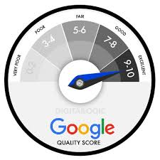
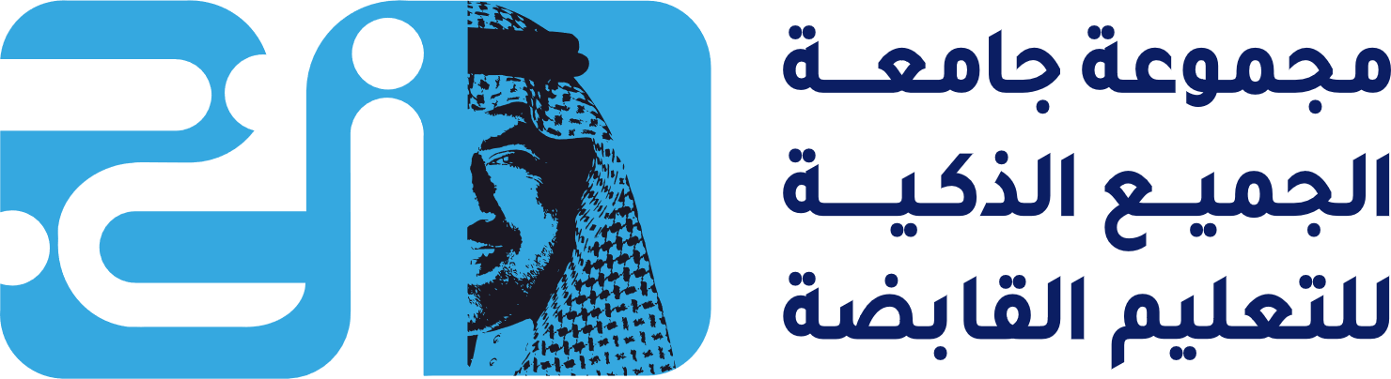
What is Quality Score?
Quality Score indicates how relevant the experience will be to users and plays a big role in what position ads appear in the search results and how much an advertiser will pay per click. Advertisers don’t see an ad’s actual Quality Score, but Google does show an external Quality Score of 1 (bad) to 10 (excellent) at the keyword level in AdWords. When Quality Score improves, cost-per-click may (CPC) go down and/or average position improve.
Google looks at three things when calculating Quality Score:
Expected click-through rate (CTR), which reflects the likelihood a user will click on an ad.
Ad relevance to the query. The ad copy should clearly relate to what the user is looking for.
Landing page experience. Are the users directed to a page that reflects the intent of the query, and does that page provide a good user experience?
What is Quality Score? Quality Score is Google’s rating of the quality and relevance of both your keywords and PPC ads. It is used to determine your cost per click (CPC) and multiplied by your maximum bid to determine your ad rank in the ad auction process.

Slide 17
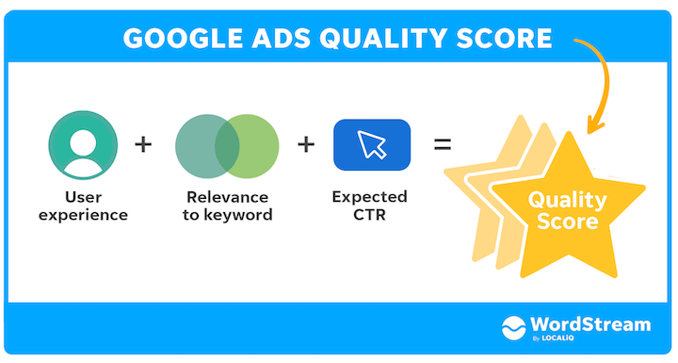
How does Google weigh each Quality Score factor?
How it’s calculated
Quality Score is calculated based on the combined performance of 3 components:
Expected click through rate (CTR): The likelihood that your ad will be clicked when shown.
Ad relevance: How closely your ad matches the intent behind a user's search.
Landing page experience: How relevant and useful your landing page is to people who click your ad.
Each component is evaluated with a status of “Above average,” “Average,” or “Below average.” This evaluation is based on a comparison with other advertisers whose ads showed for the exact same keyword, over the last 90 days.
If one of these components has a status of “Average” or “Below average,” this may indicate an opportunity to make improvements.

Slide 18
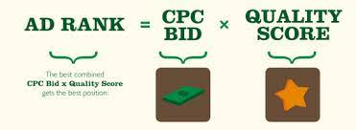
What is Ad Rank?
Ad Rank determines the positions in which ads participating in the auction are shown. The better the Ad Rank, the higher the position. The best Ad Rank gets the top ad position.
It takes into account an ad’s Quality Score and the advertiser’s Max CPC, plus the expected click-through rate (CTR) impact of the ad extensions and formats available. Here’s the basic formula:
Ad Rank = Ad quality score x Max CPC [+ a combination of other factors, including the context of the search such as device and expected impact of ad extensions]
Ad Rank = CPC Bid x Quality Score
Using this formula, the best combined CPC bid and Quality Score gets your ad a better position. In other words, advertisers with low quality scores will need to increase their CPC bid to get optimum ad placement.
Ad Rank is a value that's used to determine where ads are shown on a page relative to other ads, and whether your ads will show at all. Your Ad Rank is recalculated each time your ad is eligible to appear. It competes in an auction, which could result in it changing each time depending on your competition, the context of the person's search, and your ad quality at that moment.

Slide 19
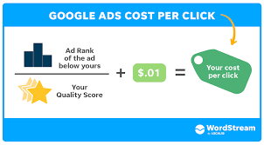
How is CPC calculated?
Ad Rank has a big impact on the actual cost-per-click (CPC) an advertiser pays when someone clicks on their ads.
It is often misstated that advertisers pay one cent more than the advertiser in the spot below them. In fact, that’s really just one piece of the CPC calculation. CPC is calculated using this formula:
CPC = The Ad Rank of Advertiser Below/Quality Score + $0.01
In AdWords, because pricing is based in part on the Ad Rank of the next competitor, actual CPCs can vary widely.
Ad Rank (Max CPC Bid x Quality Score) determines the position in which an ad is shown. The Ad Rank of the ad below is factored into the actual CPC that an advertiser will pay if someone clicks on their ad
Cost Per Click (CPC) refers to the actual price you pay for each click in your pay-per-click (PPC) marketing campaigns.

Slide 20

Understanding the reporting metrics
There are several metrics you’ll need to understand when running and analyzing PPC campaigns.
Impressions: The number of times your ads were served in the search results.
Clicks: The number of times users clicked on or engaged with your ads.
Click-through rate (CTR): The percentage of people who clicked on your ad. It is calculated by dividing clicks by impressions. CTR is a very important indicator of how well your ads are performing.
Average CPC: The average cost per click paid for the clicks received.
Average position: Where your ads appeared on the search results page (SERP.) The higher the position, the greater the visibility you’ll have. Average position also indicates how your Ad Rank compares with other ads.
Conversions: The number of conversion actions your ads have generated. The actions to be tracked are set up at the account level.
Conversion rate: The percentage of people who clicked on your ads and ended up converting.
Quality Score: Reported at the keyword level on a scale of 1 to 10, Quality Score is an indicator of how relevant your ads, keywords and landing page are to the user. A higher Quality Score can mean lower CPCs and better ad positions.

Slide 21
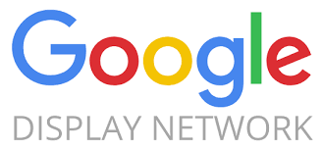
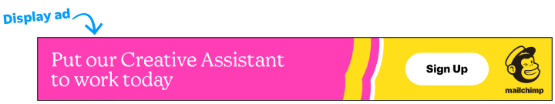
The main benefits of paid search marketing are:
• The advertiser is not paying for the ad to be displayed. wastage is much lower with paid search compared to traditional advertising Cost is only incurred when an ad is clicked on and a visitor is directed to the advertiser's website. Hence it's a cost-per-click (CPC) model! However, there are increasingly options for paid search marketing using other techniques - Google also offers PM (site targeting) options on the Google Display Network (GDN), where contextual ads are displayed on third-party sites relevant to the content on a page.
Display ads are visual-based ads you see while reading an article on your favorite blog, watching a video on YouTube, or using a mobile app.
Google Display Network (GDN)Different types of online publishers agree for Google to display contextual ads on their sites for a fee, for example as part of the AdSense program me.

Slide 22
• PPC advertising is highly targeted. The relevant ad with a link to a destination web page is only displayed when the user of a search engine types in a specific phrase (or the ad appears on the content network, triggered by relevant content on a publisher's page), so there is limited wastage compared to other media. You Tube users can also be targeted through Google's 'promoted video' PPC option. Users responding to a particular key phrase or reading related content have high intent or interest and so tend to be good-quality leads.
• Good accountability. With the right tracking system, the ROI for individual keywords can be calculated.
Display ads are visual-based ads you see while reading an article on your favorite blog, watching a video on YouTube, or using a mobile app.
Google Display Network (GDN)Different types of online publishers agree for Google to display contextual ads on their sites for a fee, for example as part of the AdSense program me.

Slide 23
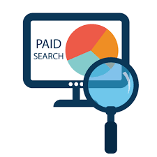
• Predictable. Traffic, rankings and results are generally stable and predictable in comparison with SEO.
• Technically simpler than SEO. Position is based on combination of bid amount and quality score. Whereas SEO requires long-term, technically complex work on page optimization, site re-structuring and link building.
• Remarketing. Google offers a remarketing option for retargeting through cookies placed on the searcher's computer to display ads on the content network after someone has clicked on a paid search ad or visited a specific page on a site as a reminder to act. These can be effective in boosting the conversion rate to lead or sale.

Slide 24

• Prospecting with customer match. By uploading similar audiences Google can serve ads to people who are similar in terms of their profile and behavior.
• Speed. PPC listings get posted quickly, usually in a few days (following editor review! SEO results can take weeks or months to be achieved. Moreover, when a website is revised for SEO, rankings will initially drop while the site is re-indexed by the search engines.
• Branding. Tests have shown that there is a branding effect with PPC, even if users do not click on the ad. This can be useful for the launch of products or major campaigns

Slide 25

Disadvantages of paid search marketing However, there are disadvantages to be managed:
• Competitive and expensive. Since pay-per-click has become popular, some companies may get involved in bidding wars that drive bids up to an unacceptable level. Some phrases such as 'car insurance' can exceed £10 per click.
• Inappropriate. For companies with a lower budget or a narrower range of products on which to generate lifetime value, it might not be cost-effective to compete.
• Requires specialist knowledge. PPC requires a knowledge of configuration, bidding options and of the reporting facilities of different ad networks. Internal staff can be trained, but they will need to keep up to date with changes to the paid search services.
• Time-consuming. To manage a PPC account can require daily or even hourly checks on the bidding in order to stay competitive. This can amount to a lot of time. The tools and best practice varies frequently, so keeping up to date is difficult
• Irrelevant. Sponsored listings are only part of the search engine marketing mix. Many search users do not click on these because they don't trust advertisers, although these are mainly people involved in marketing!

Slide 26
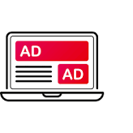
WHAT IS DISPLAY ADVERTISING
Display advertising involves an advertiser paying for an advertising placement on third-party sites such as publishers or social networks. The process usually involves ad serving from a different server from that on which the page is hosted (ads can be served on destination sites in a similar way). Ad serving uses a specialist piece of software, possibly mounted on an independent server such as DoubleClick (now owned by Google). In 2008, Google launched its free ad manager service (www.google.com/admanager) to help site owners sell, schedule, optimize revenue, serve ads and measure directly sold and network-based inventory. Advertising is used on a range of sites in order to drive traffic to an organization's destination site, or alternatively a microsite or nested ad content on the media owner's site or on the destination site. The destination page from a banner ad will usually be designed as a specifically created direct-response page to encourage further action.
Run-of-site Cost per 1,000 ad Impressions. CPM is usually higher for run-of site advertisements where advertisements occur on all pages of the site.
Destination site The site reached on click- through.
Microsite small-scale destination site reached on click through that is part of the media owner's site
Ad serving The term for displaying an advertisement on a website .Often the advertisement will be served from a web server different from the site on which it is placed.

Slide 27
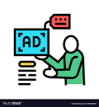
Purchasing ad placements
When media is purchased, it is either purchased on a specific site such as The Times or New York Times, or it is purchased across several sites, which are known as an ad network. Display advertising is purchased for a specific period. It may be purchased for the ad to be served on:
• the run-of-site (the entire site)
• a section of site
• according to keywords entered on a search engine
Traditionally, the most common payment is according to the number of customers who view the page as a cost-per-thousand (CPM) ad or page impressions. Typical CPM is in the range £10-30. Other options that benefit the advertiser if they can be agreed are per click-through or per action, such as a purchase on the destination site. Although initially media owners were able to control charging rates and largely used a per-exposure model, with the increase in unused ad inventory there has been an increase in results-based payment methods, particularly within ad networks.
Display advertising Display ads are paid ad placements using graphical or rich media ad units within a web page to achieve goals of delivering brand awareness, familiarity, favorability and purchase by clicking through to a site.
Results-based payment Advertisers pay according to the number of times the ad is clicked on

Slide 28

what is digital media placement?
digital media placement is the process of choosing and purchasing placements for ads on digital channels, such as websites and apps. And, media placement is a key part of the media planning and media buying process.
Digital media channels can include:
Video ads
Mobile app ads
Digital out-of-home (DOOH) ads
Search engine marketing (SEM)
Display and pay-per-click (PPC) ads
Social media ads When it comes to digital media placement, there are two types of bidding: real-time bidding (RTB) and programmatic buying.
So, what’s the difference?
Demand Side Platforms (DSPs)A service that enables ads to be managed across multiple ad networks and ad exchanges through a single interface designed for managing reporting and performance
Real-time bidding (RTB)Bids for buying ads against keywords can be managed in real time in conjunction with a DSP.

Slide 29
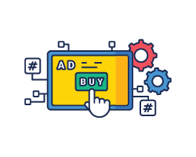
With RTB, media buyers bid on impressions one at a time based on demographic targeting. If they win, their ad is displayed immediately. RTB involves the publisher providing the inventory (ad space), the advertisers purchasing the ad, and sometimes the demand-side platform (DSP) to help automate purchasing.
Whereas, programmatic buying is the automated buying and selling of digital ad space based on data and audience targeting. It includes the use of DSPs, supply-side platforms (SSPs), and data management platforms (DMPs):
DSPs facilitate the process of buying ad placements on the open market.
SSPs help publishers manage their ad space inventory.
DMPs use cookie data to help you reach your target audience.
Whether you use RTB, programmatic buying, or a mixture of the two, strategic digital media planning and placement helps brands get their ads in front of the right audiences at the right time.
Programmatic ad buying describes the purchase of online display advertising that is aggregated, booked, analyzed and optimized via demand-side software interfaces and algorithms. It includes RTB and also non-RTB methods and buy types such as Facebook Ads API and the Google Display Network.

Slide 30
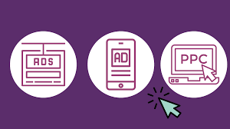
Types of display advertising
When considering display advertising, it’s important to look at the various types of targeting and ad formats to effectively reach and engage the desired audience.
Targeting types include:
Traditional display ads. Ads are placed on websites or apps based on demographics, interests, or location.
Responsive ads. Responsive ads dynamically adjust their size, format, and appearance to fit different ad placements and screen sizes.
Retargeting ads. Display ads that are shown to users who have previously interacted with a brand.
Native display ads. Ads that blend in with the surrounding content, providing a non-disruptive user experience.
Social display ads. Ads that are specifically designed for social media platforms, tailored to match the platform’s visual style and user behavior.

Slide 31
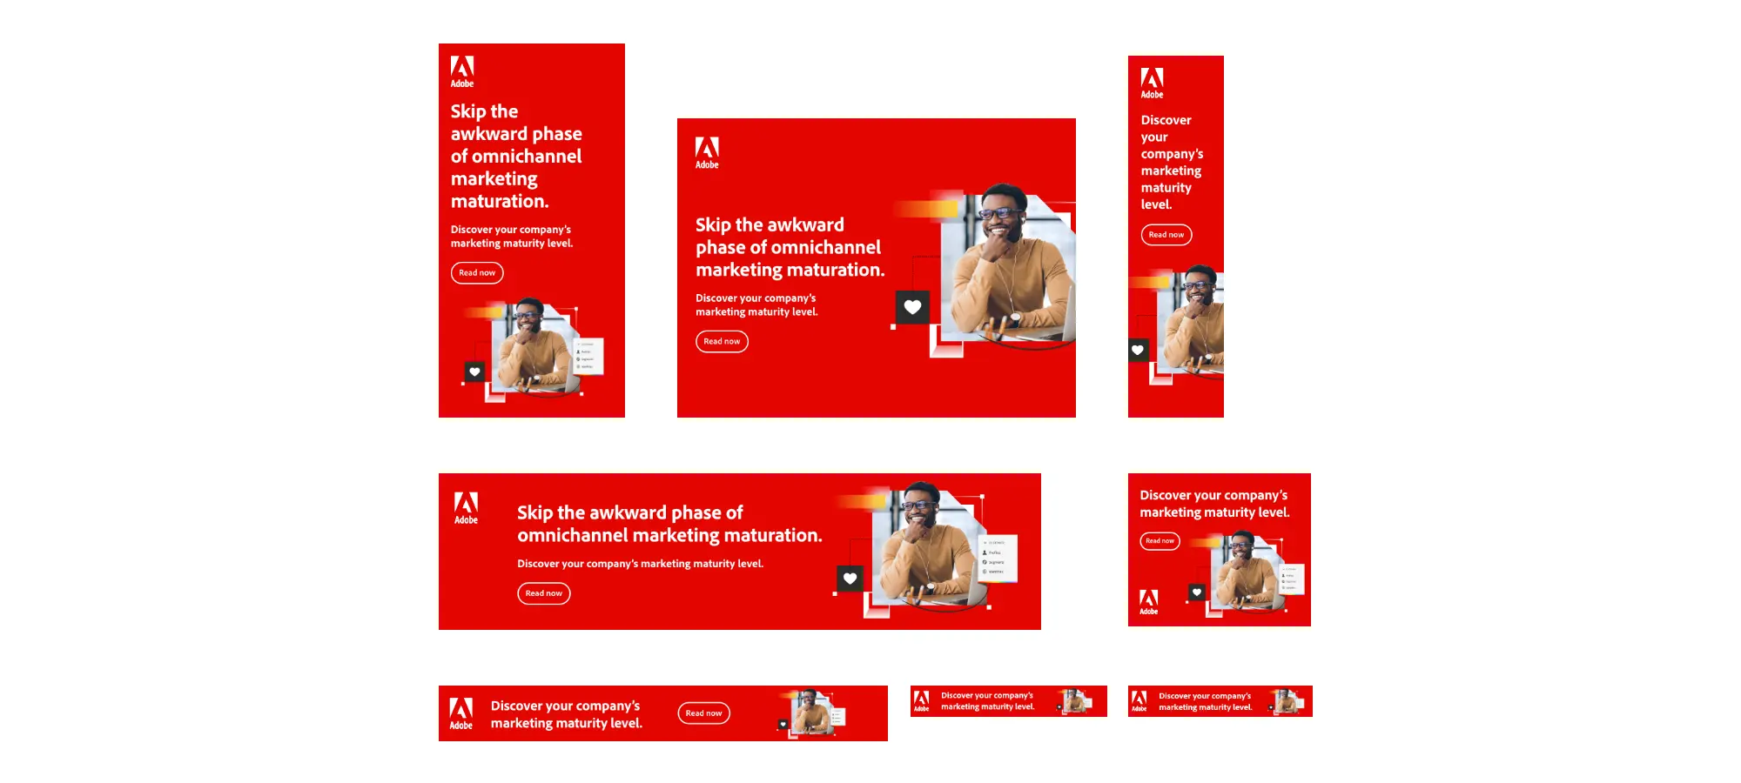
Some types of ad formats include:
Banner ads. Rectangular or square ads that are typically displayed at the top, bottom, or sides of a webpage.
Rich media. Interactive ads that incorporate elements like animation, audio, video, or expandable features.
Video ads. Ads in video format — often inserted before, during, or after online video content.
Pop-up ads. Ads that appear in separate windows or overlays on top of the main content.
Rewarded ads. Ads that offer users incentives, such as in-game rewards or access to premium content.
Interactive content. Ads that allow quizzes, games, or product configurators.
With a variety of targeting types and ad formats comes flexibility and opportunities to tailor display advertising campaigns according to the needs of different businesses.

Slide 32

Display advertising billing
When a business starts using display advertising, they need to understand the various billing agreements that determine how advertisers are charged for their ad campaigns. Here’s an overview of the most common billing agreements:
Flat rate. Advertisers pay a predetermined fixed amount for a specific duration or number of impressions, regardless of the performance or engagement of the ad.
Cost per mille (CPM). Advertisers are charged based on the number of impressions their ads receive, typically per 1,000 impressions. CPM focuses on exposure and brand visibility.
Cost per click (CPC). Advertisers pay for each click their ads receive. This billing model is performance-oriented, as advertisers only pay when users actively engage with the ad.
Cost per lead (CPL). Advertisers pay based on the number of leads generated through the ad campaign. It’s commonly used when the primary goal is lead generation.
Cost per sale (CPS). Advertisers are charged based on the number of sales generated that were directly attributed to the ad campaign. This model is often used in affiliate marketing or ecommerce scenarios.

Slide 33

the wider range of goals for online campaigns, including.
• Delivering content. This is the typical case where a click-through on a banner advertisement leads to a destination site giving more detailed information on an offer. This is where a direct response is sought. Today ads often embed videos or whitepapers to deliver content directly within the ad.
• Enabling transaction. If a click-through leads to a merchant such as a travel site or an online bookstore this may lead directly to a sale. A direct response is also sought here.
• Shaping attitudes. An advertisement that is consistent with a company brand can help build brand awareness.
• Soliciting response. An advertisement may be intended to identify new leads or as a start for two-way communication. In these cases an interactive advertisement may encourage a user to type in an email address or other information.
• Encouraging retention. The advertisement may be placed as a reminder about the company and its service and may link through to on-site sales promotions such as a prize draw. These objectives are not mutually exclusive, and more than one can be achieved with a well-designed ad campaign.

Slide 34

Advantages of online advertising.
Reach to drive awareness. Ads enable companies to reach and influence consumers and business people as they use publisher sites and social networks. The visual imagery of a display ad can generate awareness about a brand, product or need. display ads are useful for reaching audiences whose consumption of traditional media has decreased.
Direct response. Display advertising can generate an immediate direct response via click. through to a website, enabling transaction for retail products,
Advertising now available for smaller advertisers. Previously, ad buying online was limited to larger advertisers. But now a small business can purchase a small-scale, highly targeted ad campaign for a few dollars using the Google Display Network options in Google Ads or the advertising programs available on the social networks such as Facebook, Twitter or LinkedIn. They can now use self-service tools to retarget across all of these to boost conversion.

Slide 35
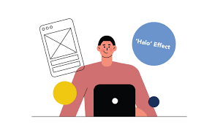
Media-multiplier or halo effect. Repeated exposure to ads online, particulate in association with other media, can increase brand awareness and ultimate purchase intent . Furthermore, practitioners report A media-multiplier or halo effect of Buying on line ads which can help increase the response rate from other online media for example if a web user has been exposed to banner ads, this may increase their response to pad; search ads and may also increase their likelihood of converting on a site since brand awareness and trust may be higher.
Achieving brand interactions. Many modern display ads comprise two parts- an initial Visual encouraging interaction through a rollover and then another visual or application encouraging interaction with a brand. This enables advertisers to calculate an interaction rate (IR) to assess the extent to which viewers interact with a brand ad.
Media-multiplier or halo-effect
The halo effect is evident when the response rates of other online channels increases due to exposure to display ads. That's because repeated exposure to banners, search ads, promotions and others can increase awareness of the brand and ultimately lead to purchase intent.

Slide 36

Targeting. Media buyers can select the right site or channel within a site to reach the audience , Audiences can also be targeted via their profile through serving personalized ads, or ads in emails if visitors have registered on a site . Behavioral re-targeting options are used in an ad network to preferentially serve an ad to someone who seems to have an interest in a topic from the content they consume. Effectively the ad follows the viewer around the site.
Re-targeting can work across an ad network too and can even be sequential, where the messages are varied for an individual the more times they are exposed to the ad. Search re-targeting offers the option to display an ad after a visitor has searched on a particular term. Tracking of individuals is achieved through use of cookies.

Slide 37
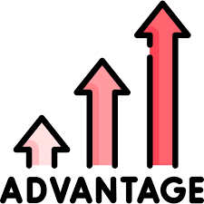
• cost-effective e.g. compared to traditional advertising formats, TV, radio, printing, the digital display is much more economical.
• Dynamic updates to ad campaigns. In comparison with traditional media, where media placements have to be bought weeks or months in advance, online ads are more flexible since it is possible to place an advertisement more rapidly and make changes during the campaign. Experienced online advertisers build in flexibility to change targeting through time
increases product considerations and creates purchase intentions;
effective in the e-commerce industry

Slide 38
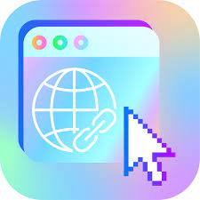
Challenges of display advertising
Despite its benefits, display advertising can produce some obstacles that hinder its effectiveness. These challenges include ad blockers limiting ad visibility, banner blindness leading to low click-through rates (around 0.1%), and random clicks — especially on mobile devices.
Advertisers must be cautious about potential pitfalls within their control, such as ineffective creative approaches that fail to captivate audiences and poor targeting that results in inefficient ad placements. Addressing these challenges through strategic measures can enhance the impact and performance of display advertising campaigns.

Slide 39

Chapter at a glance
Pay-Per-Click marketing
difference between PPC, SEM and SEO
Challenges of display advertising
Advantages of online advertising
the wider range of goals for online campaigns
Display advertising billing
types of ad formats
digital media placement
Purchasing ad placements
benefits of paid search marketing

Slide 40



Thank You

