Slide 1


Slide 2
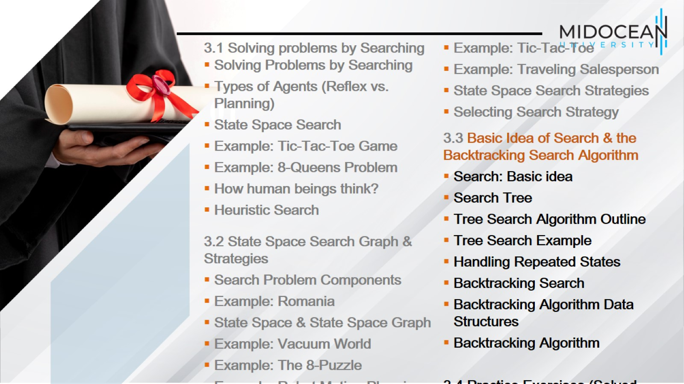

Slide 3
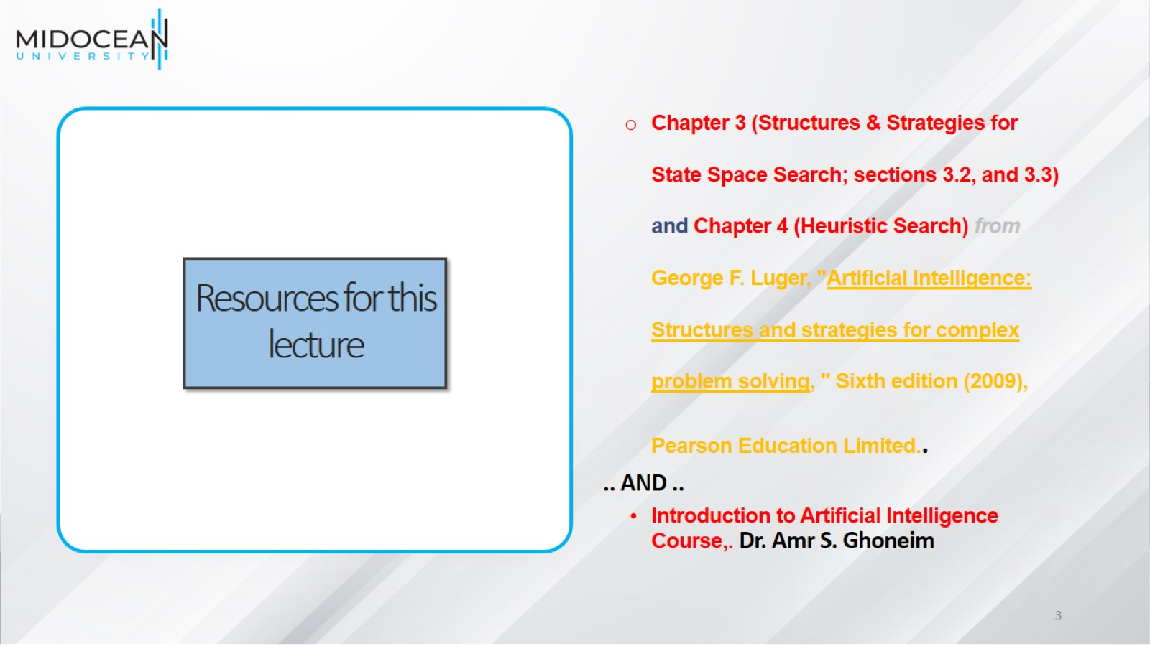
Resources for this lecture

Slide 4
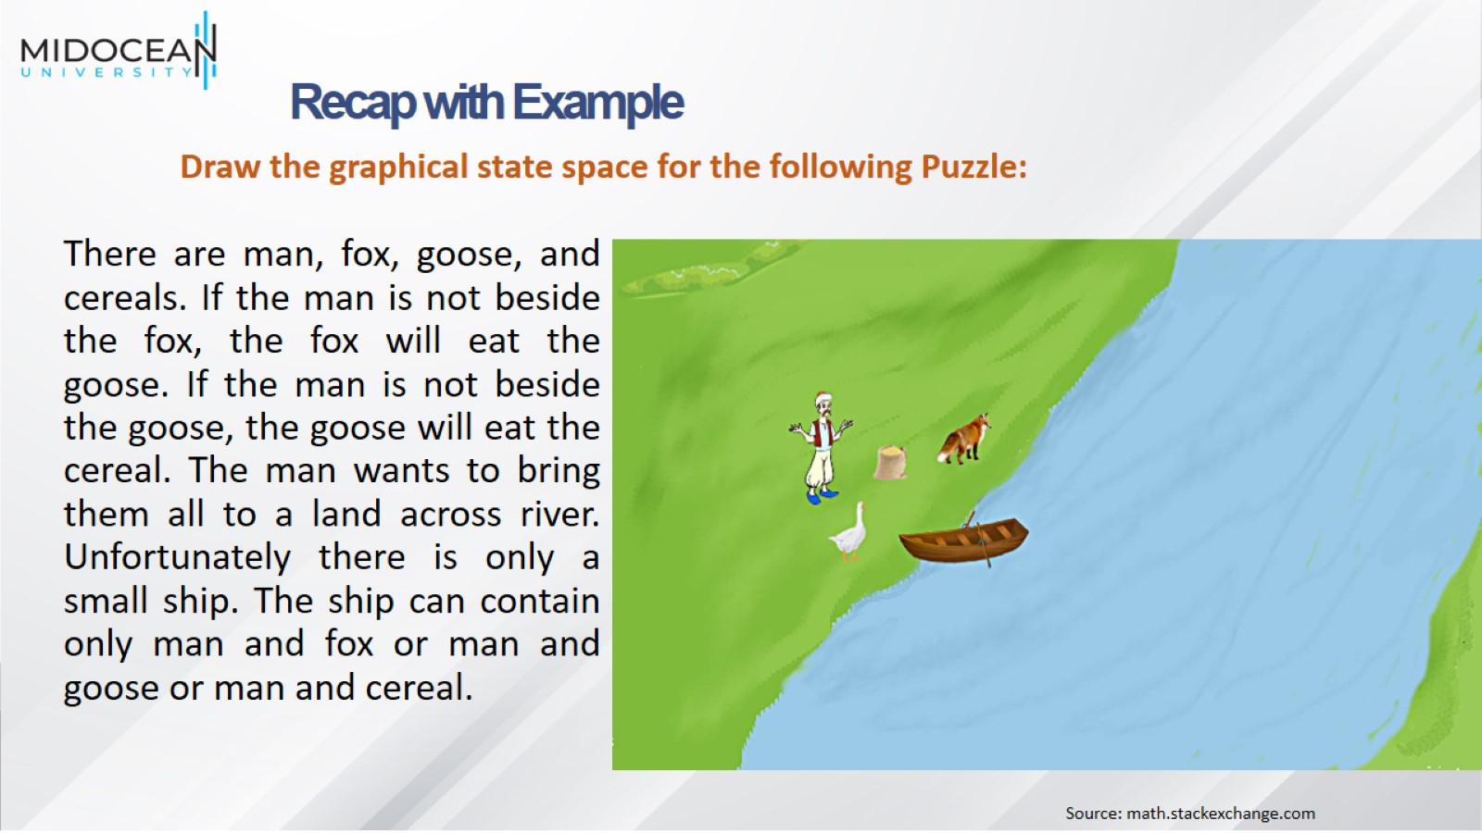

Slide 5
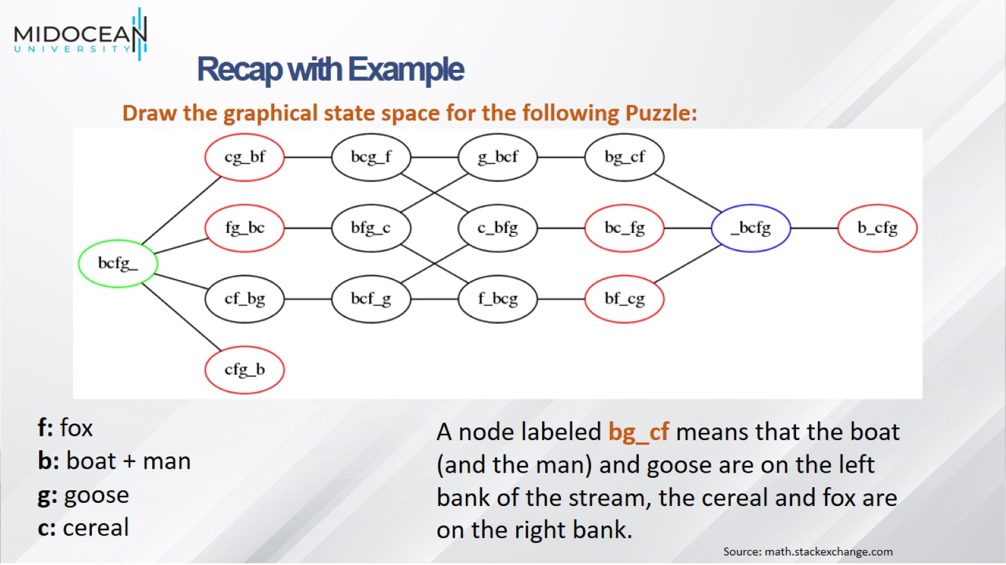

Slide 6
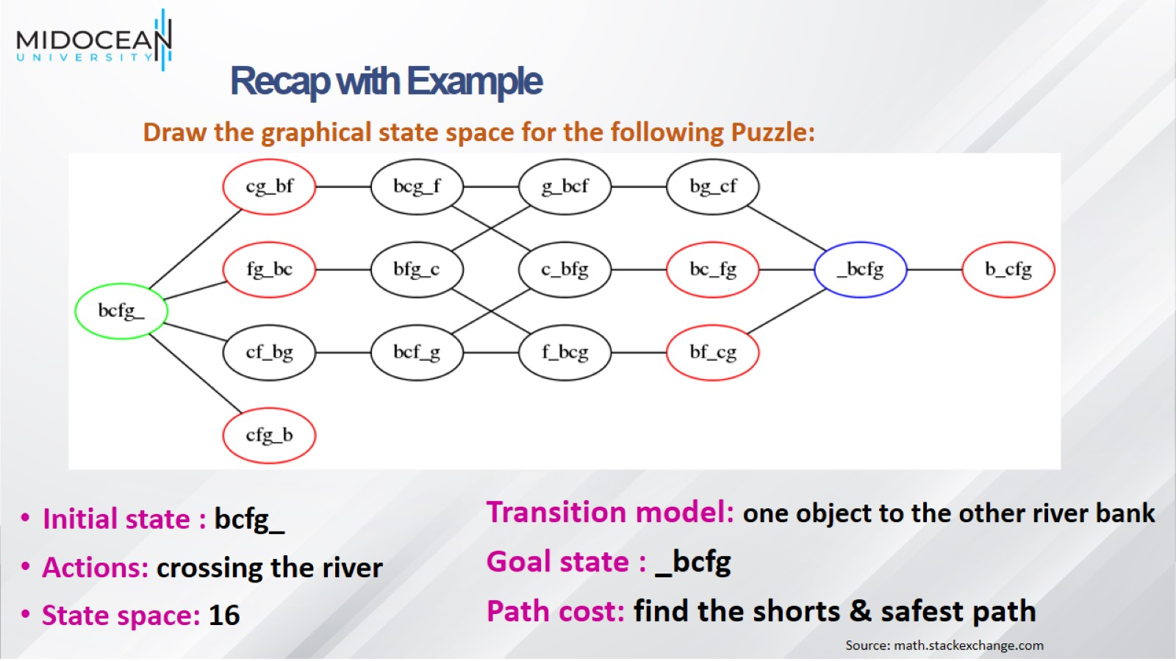

Slide 7
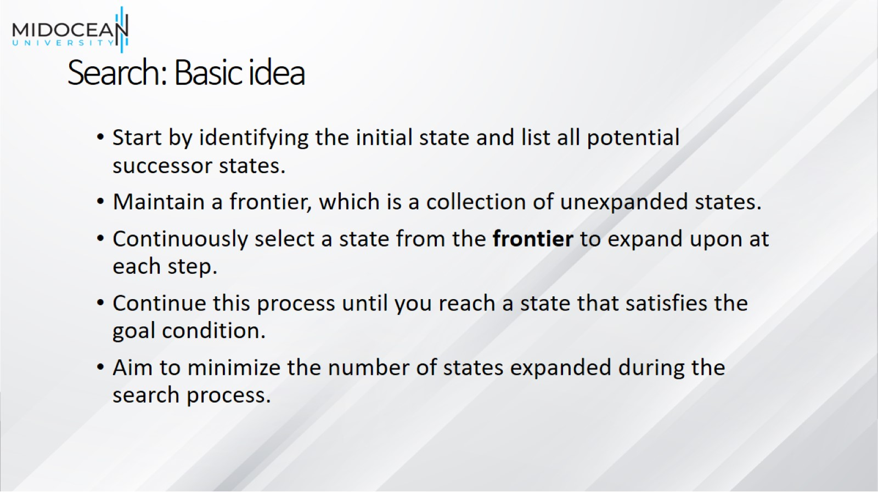
Search: Basic idea

Slide 8

Search: Basic idea

Slide 9

Search: Basic idea

Slide 10

Search: Basic idea

Slide 11
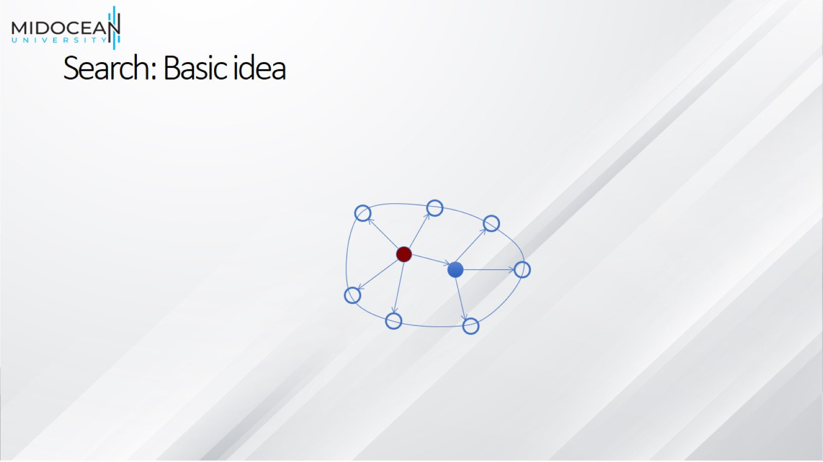
Search: Basic idea

Slide 12
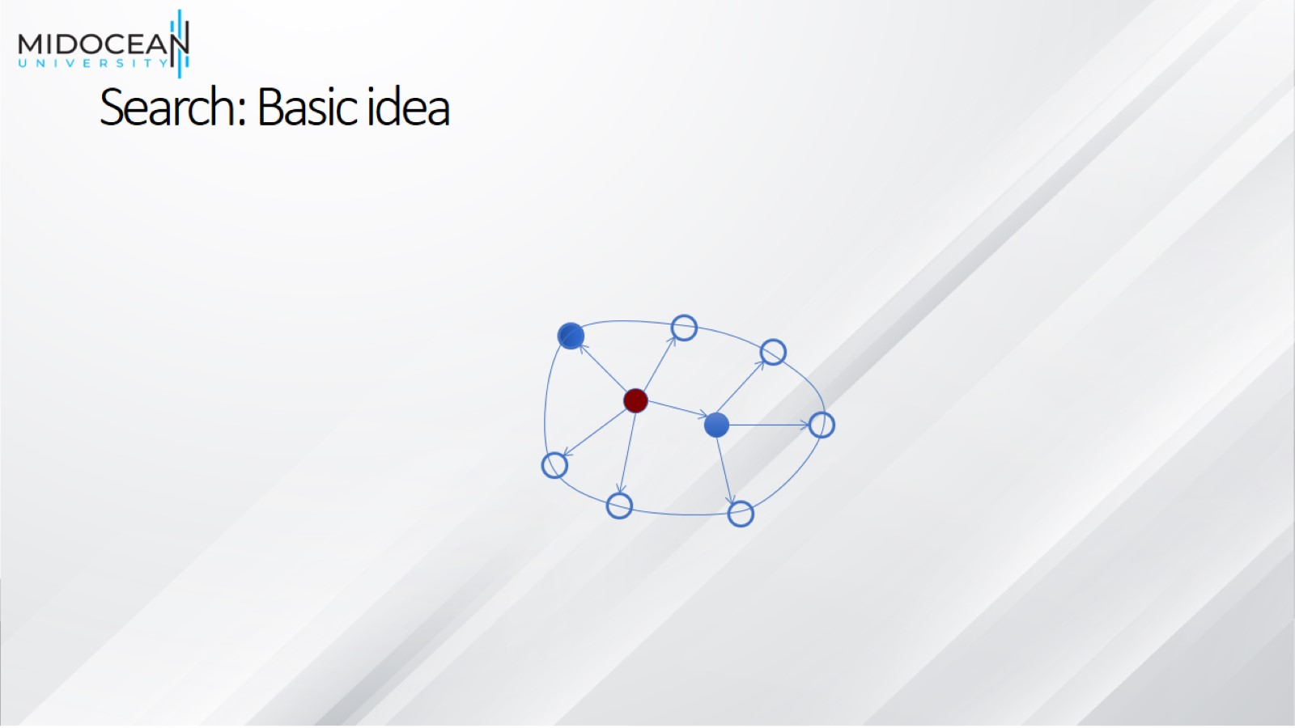
Search: Basic idea

Slide 13

Search: Basic idea

Slide 14

Search: Basic idea

Slide 15

Search: Basic idea

Slide 16

Search: Basic idea

Slide 17

Search: Basic idea

Slide 18

Search: Basic idea

Slide 19

Search: Basic idea

Slide 20
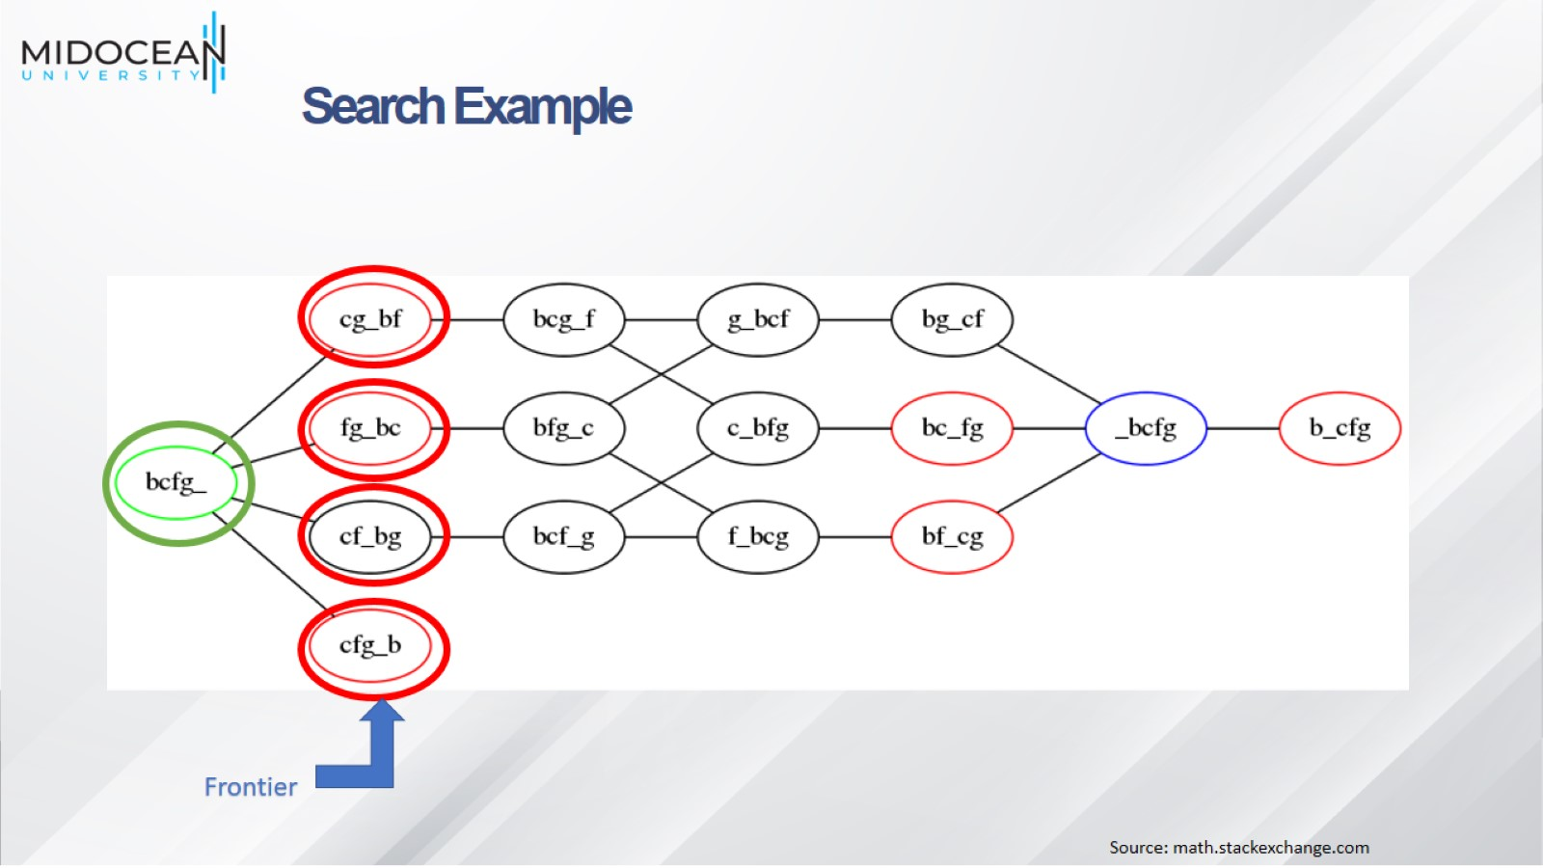

Slide 21
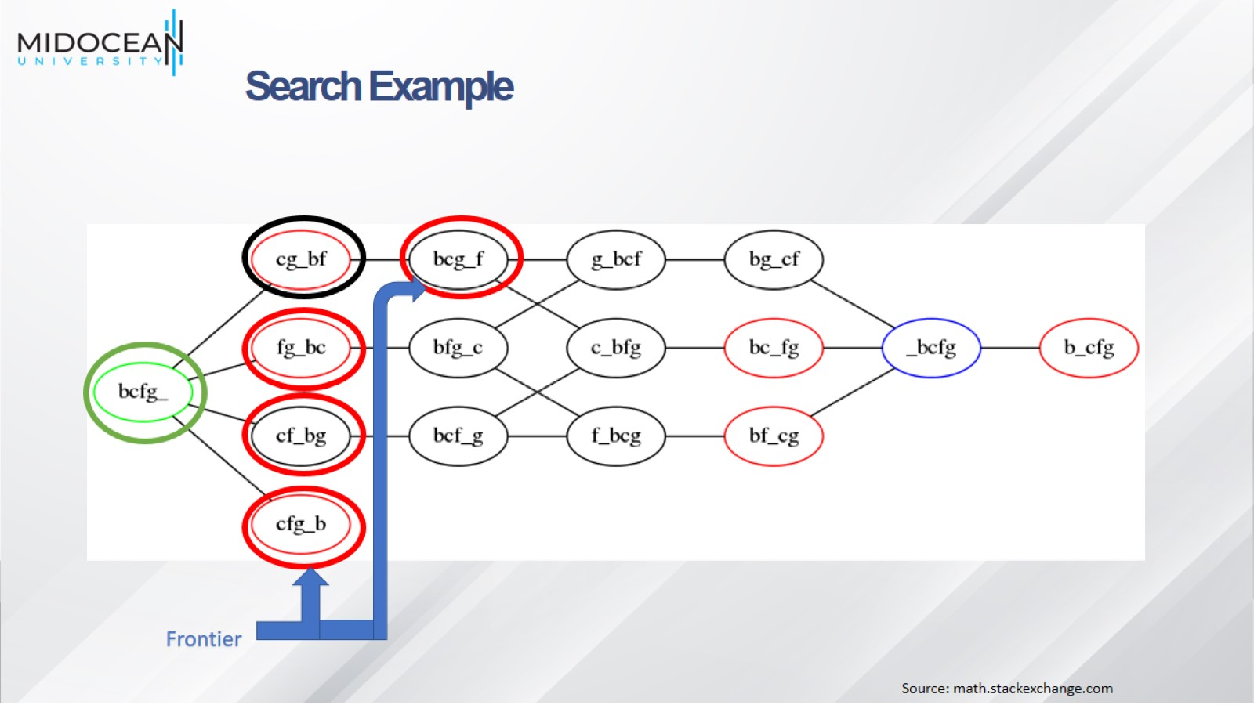

Slide 22
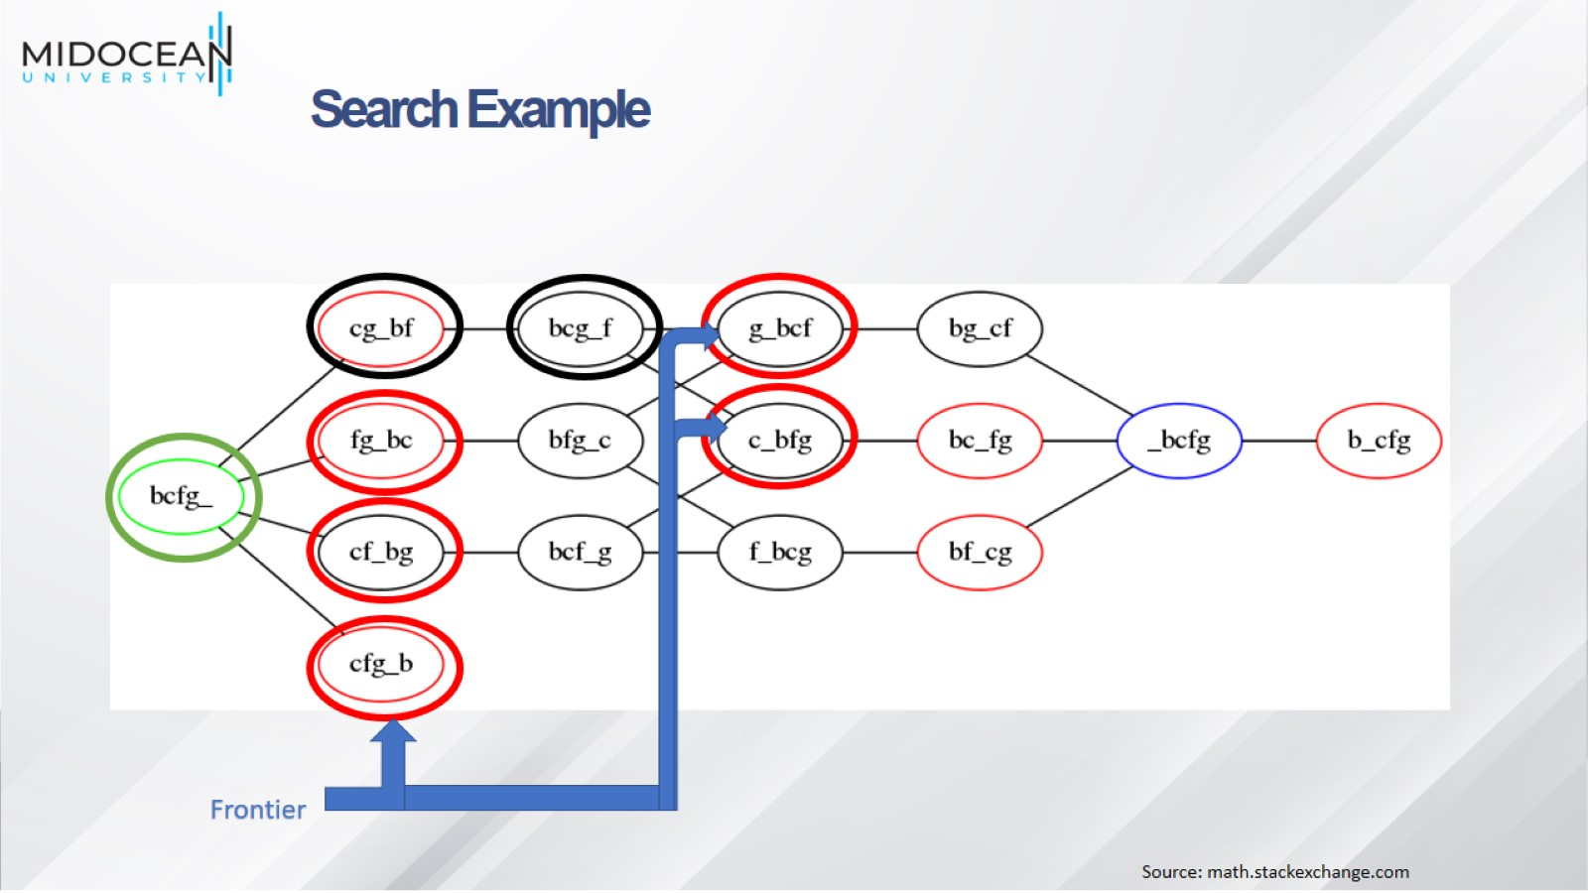

Slide 23
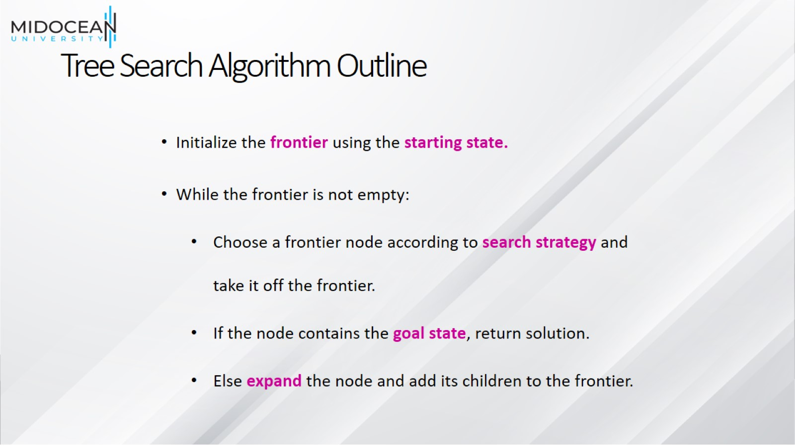
Tree Search Algorithm Outline

Slide 24
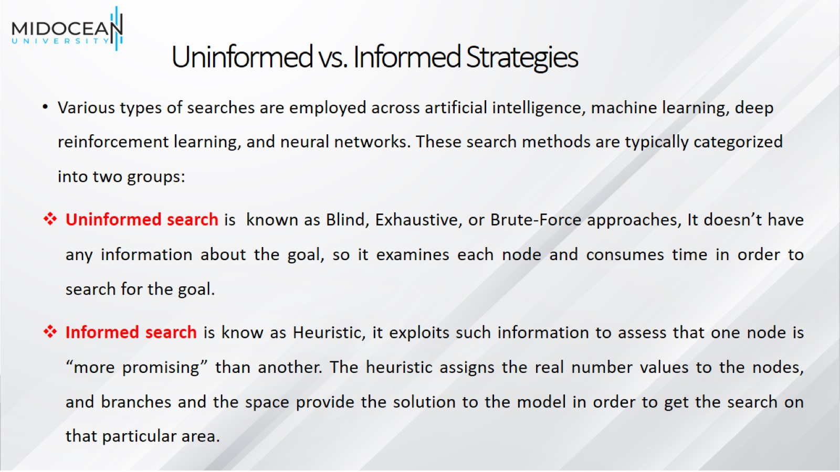
Uninformed vs. Informed Strategies

Slide 25
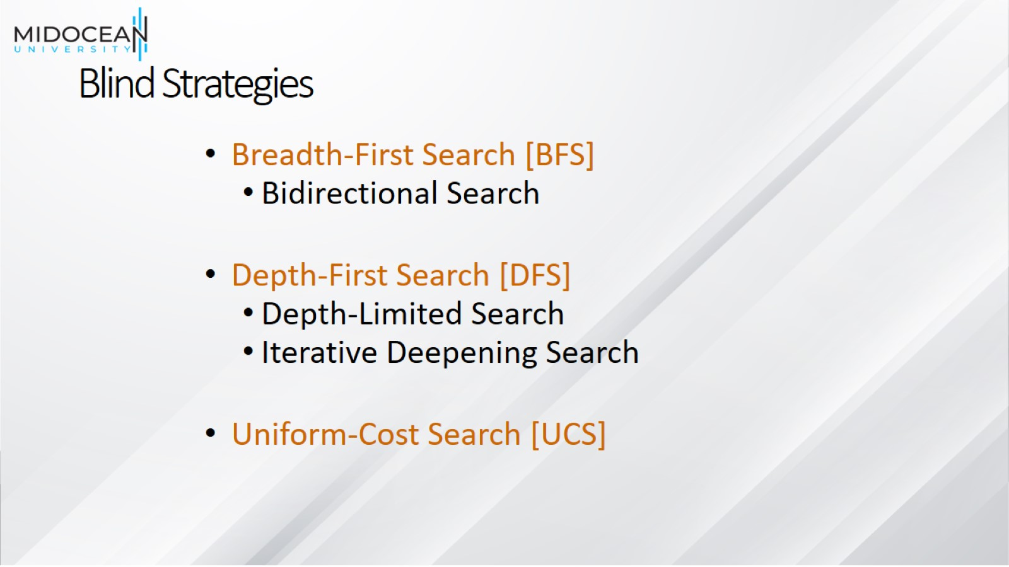
Blind Strategies

Slide 26
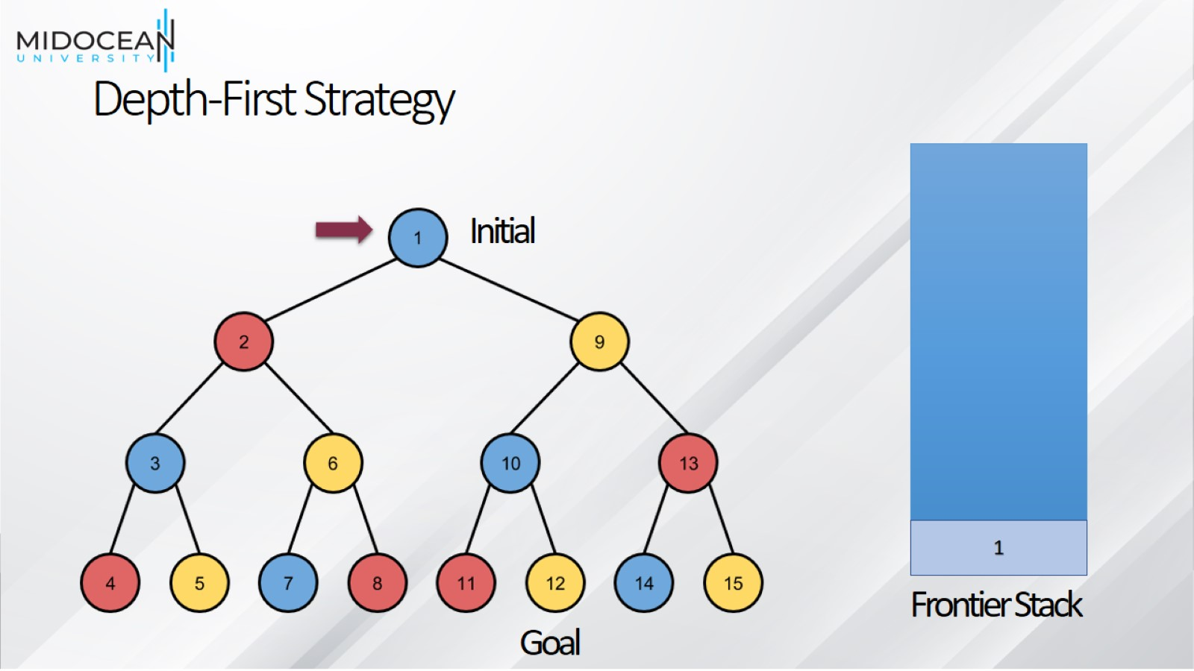
Depth-First Strategy

Slide 27
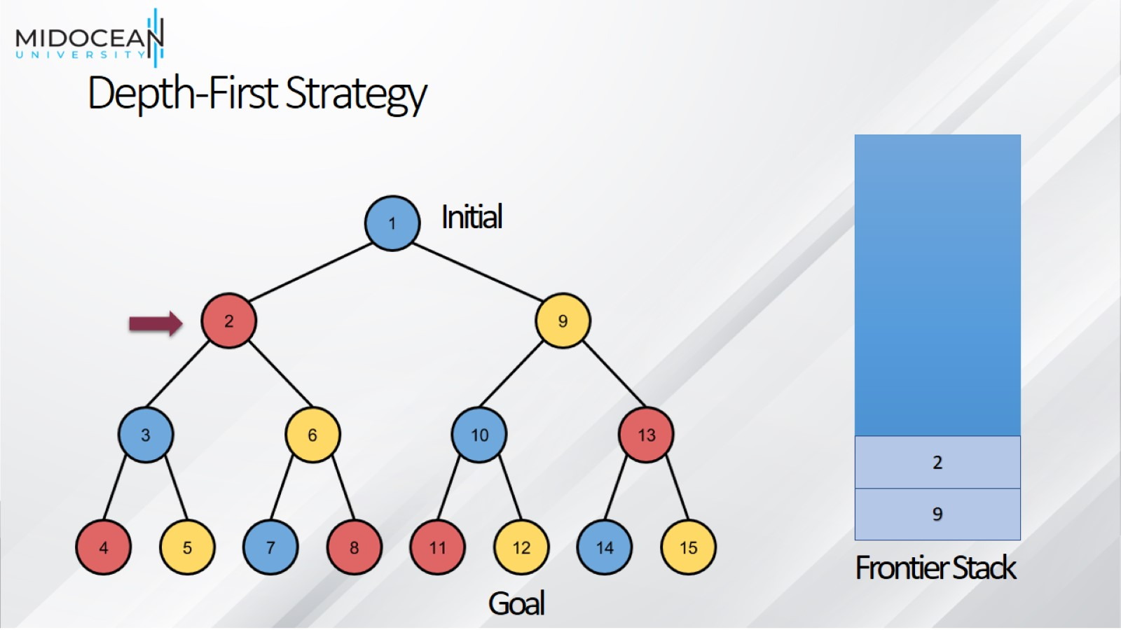
Depth-First Strategy

Slide 28
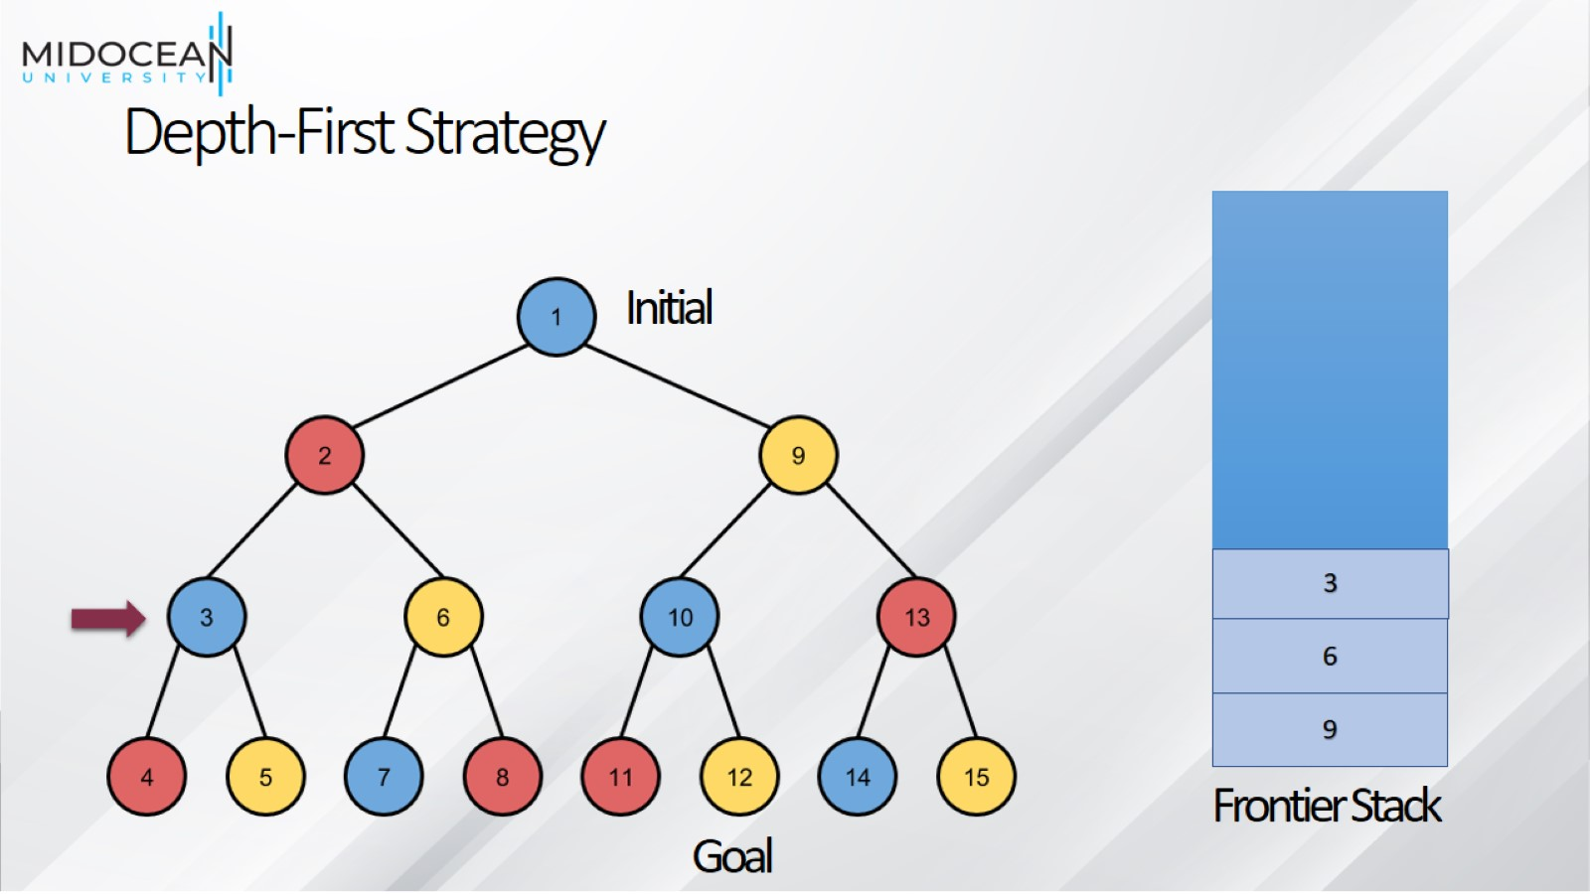
Depth-First Strategy

Slide 29
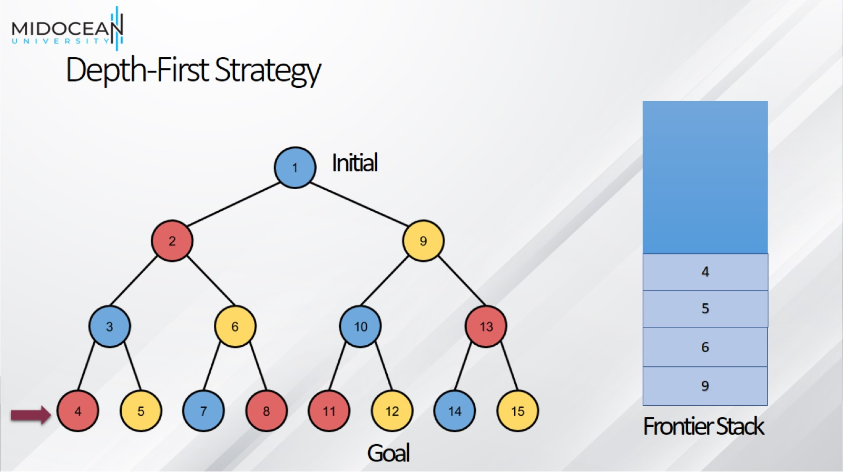
Depth-First Strategy

Slide 30
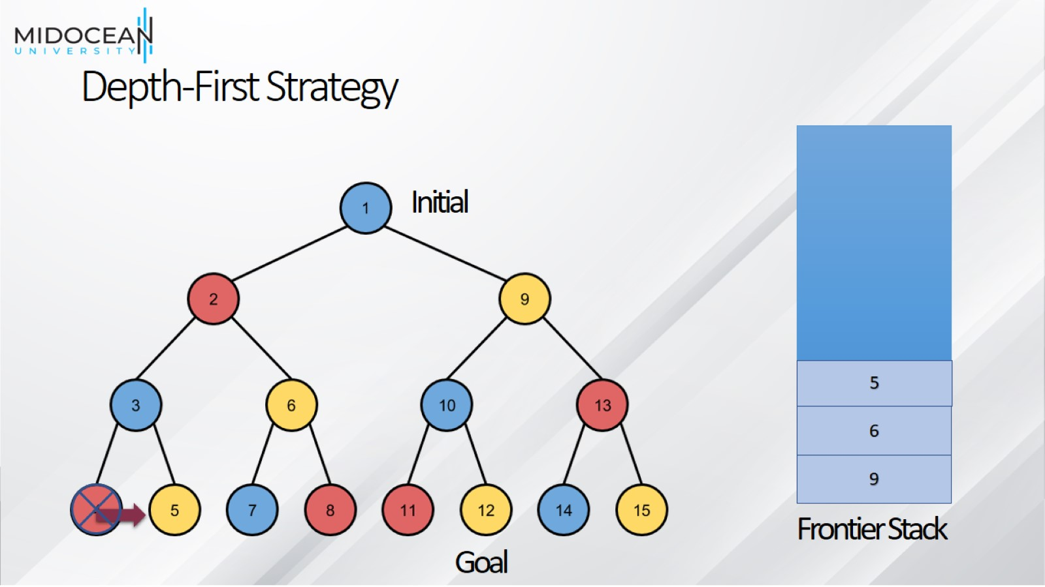
Depth-First Strategy

Slide 31
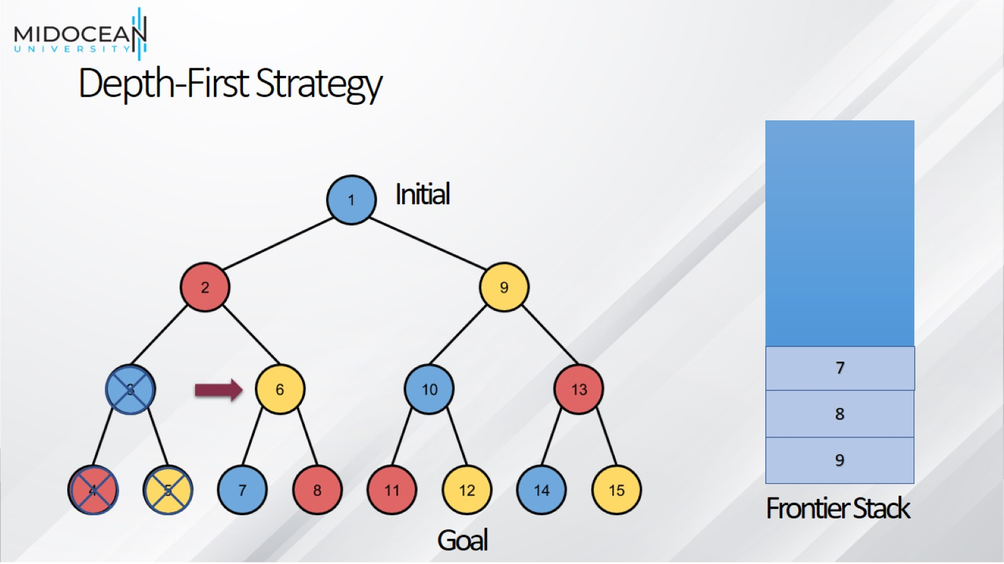
Depth-First Strategy

Slide 32
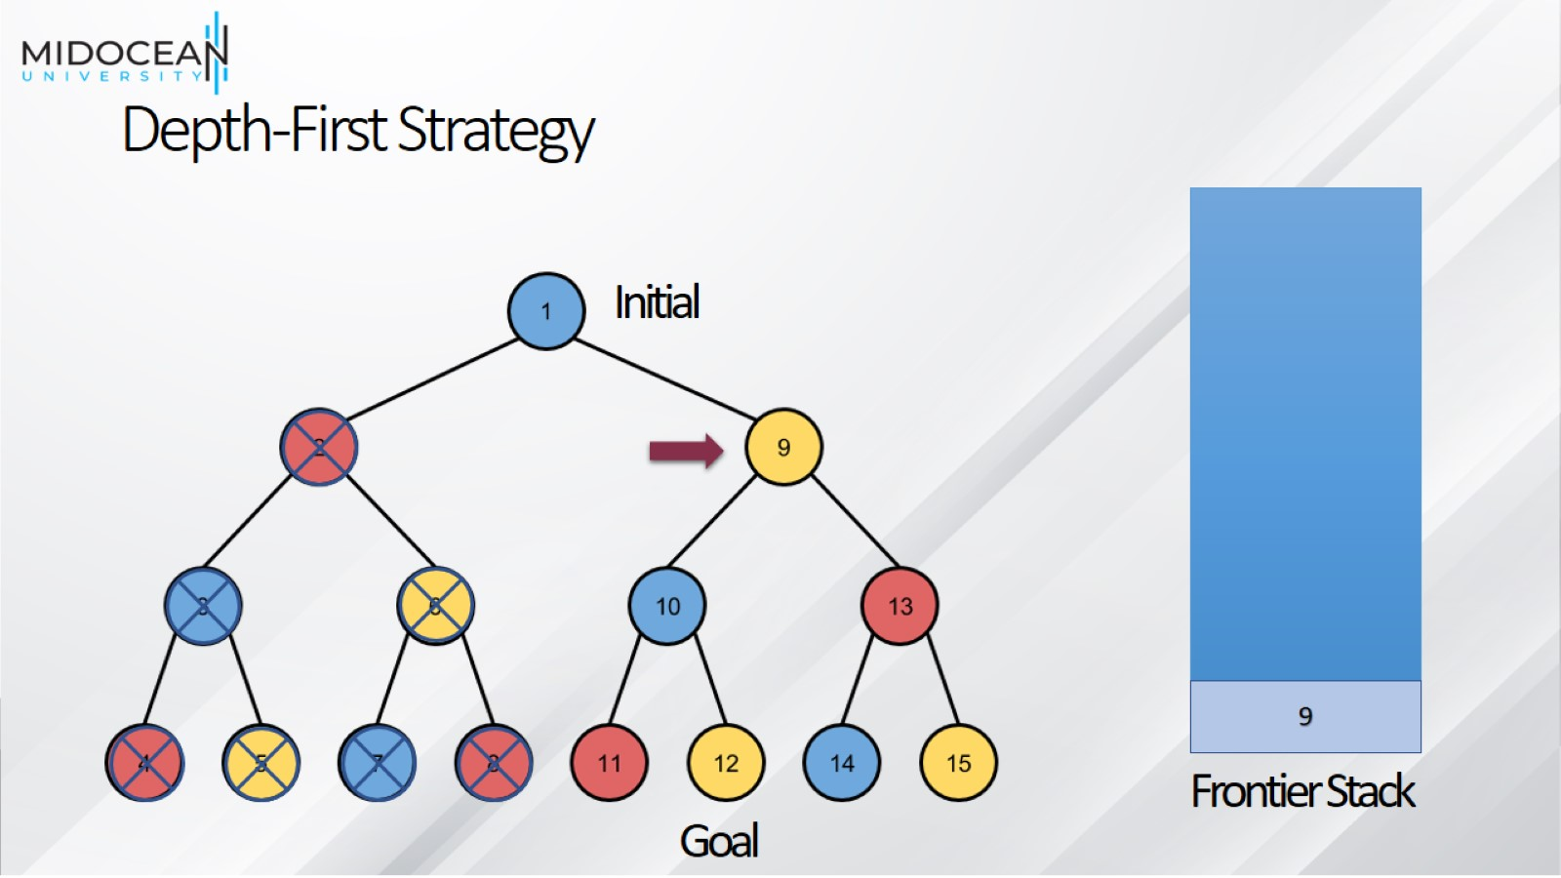
Depth-First Strategy

Slide 33
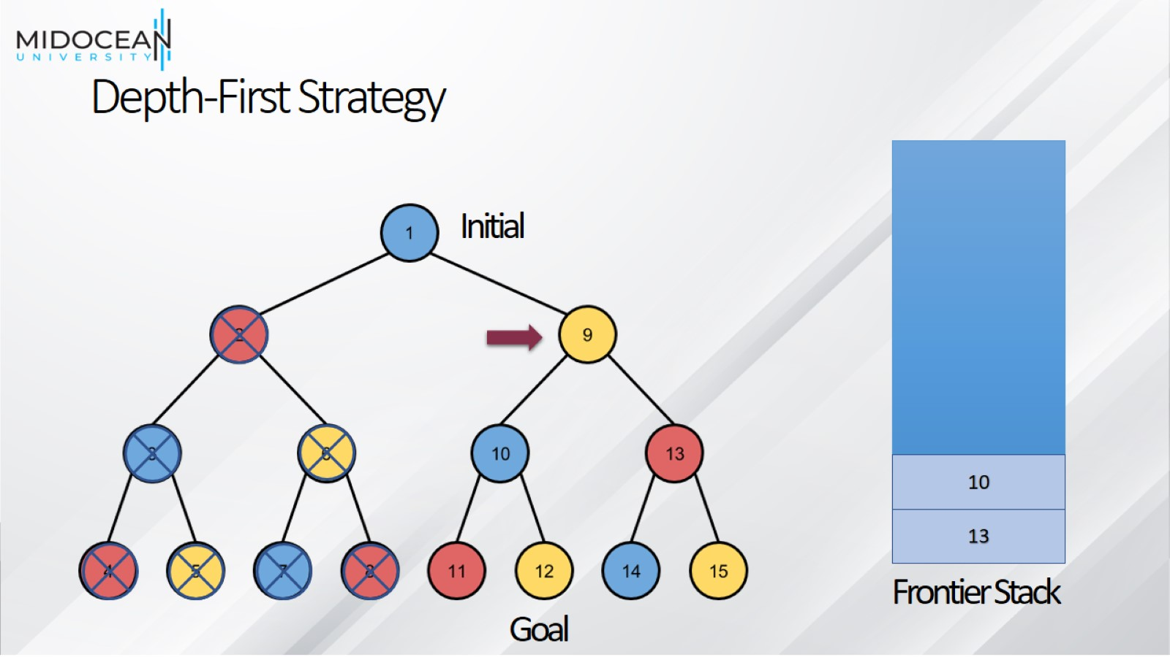
Depth-First Strategy

Slide 34
Depth-First Strategy

Slide 35
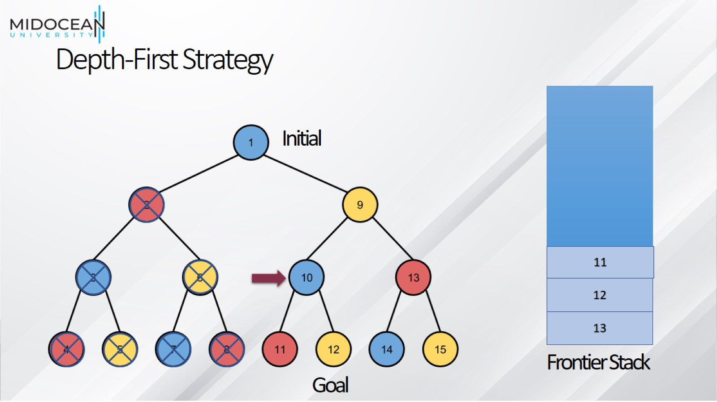
Depth-First Strategy

Slide 36
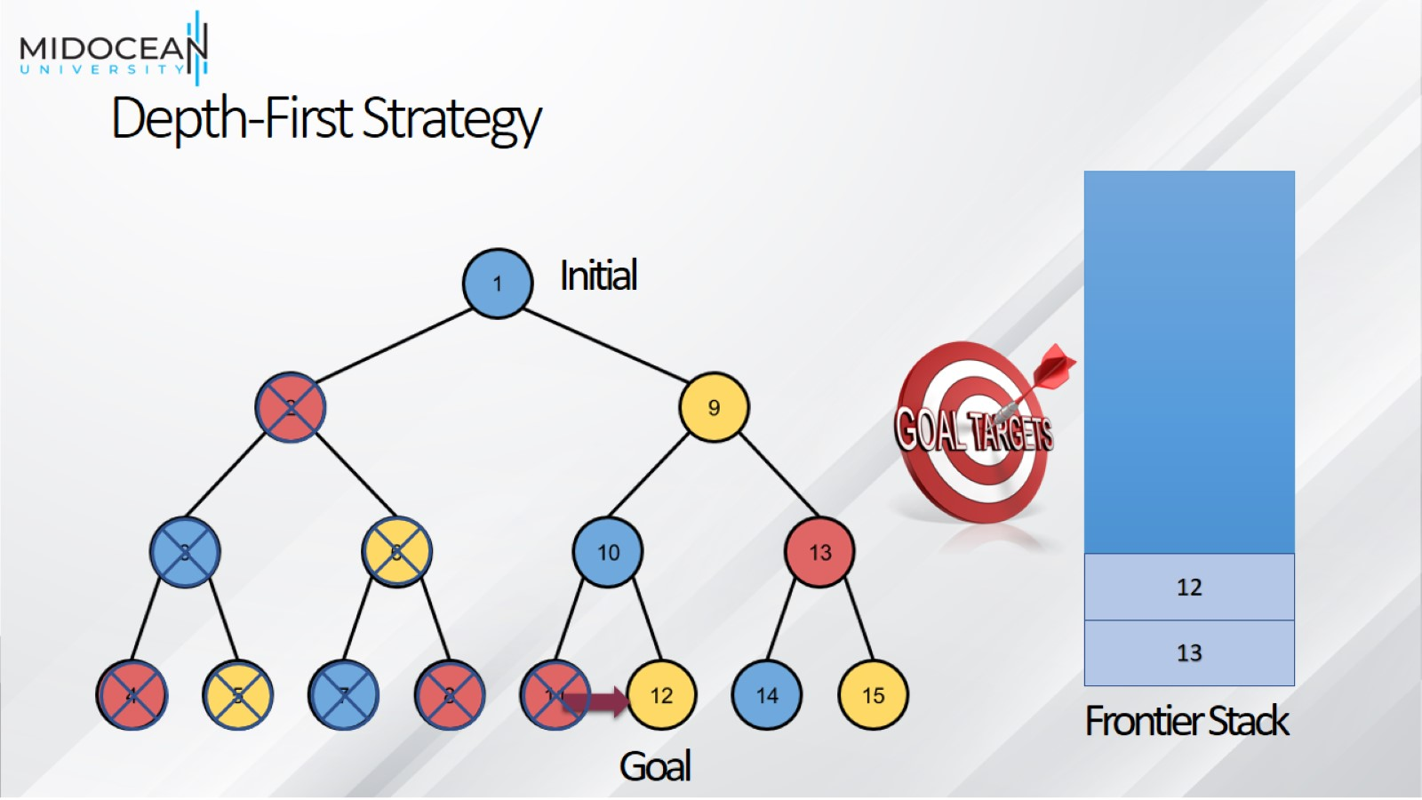
Depth-First Strategy

Slide 37
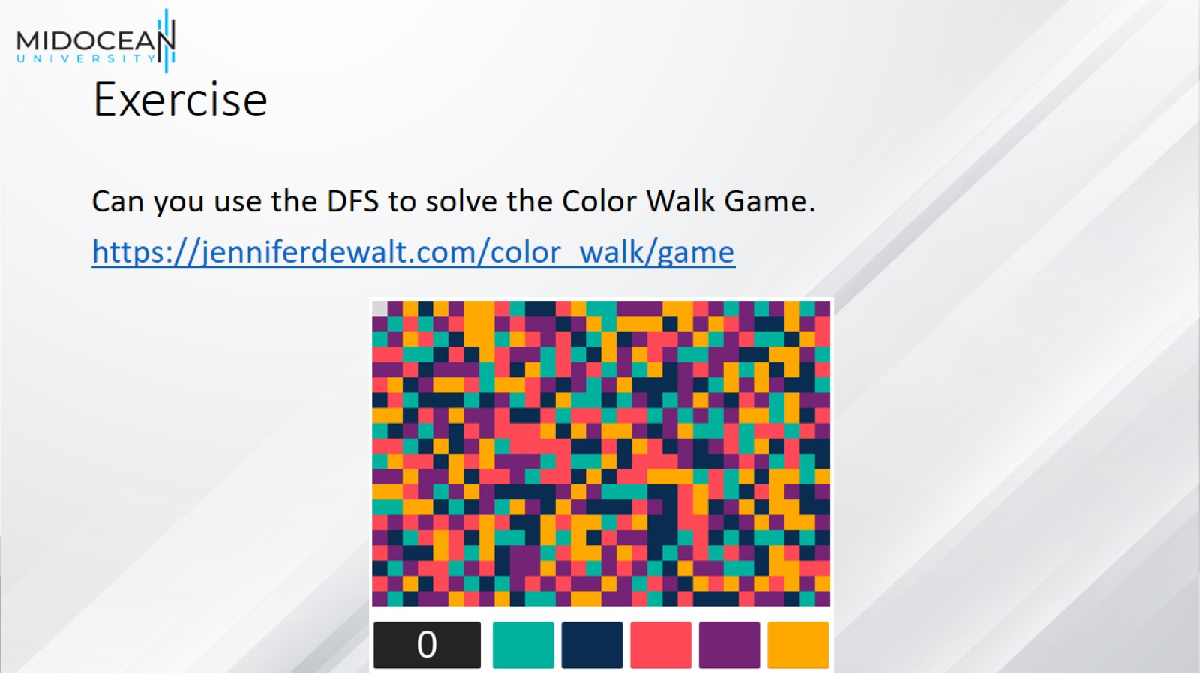
Exercise

Slide 38

Depth-First Strategy

Slide 39
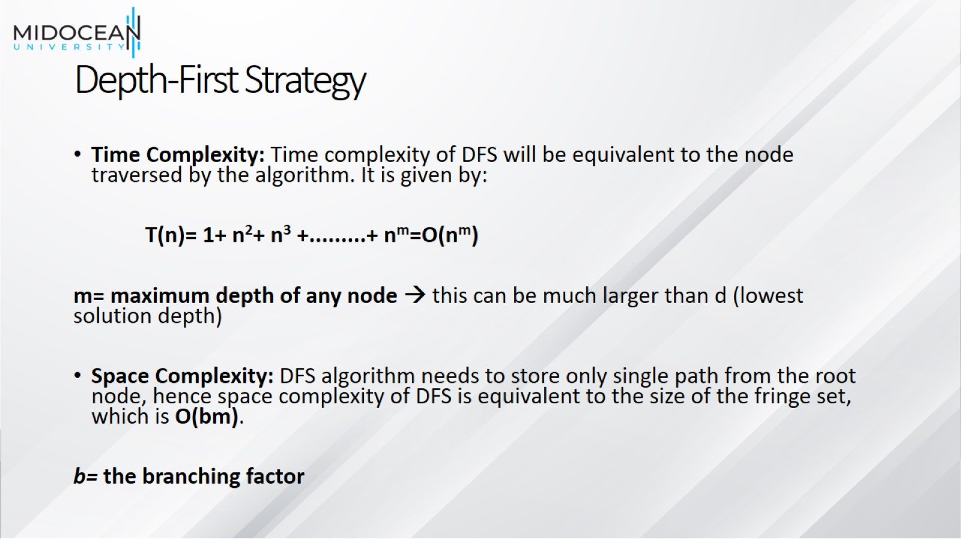
Depth-First Strategy

Slide 40
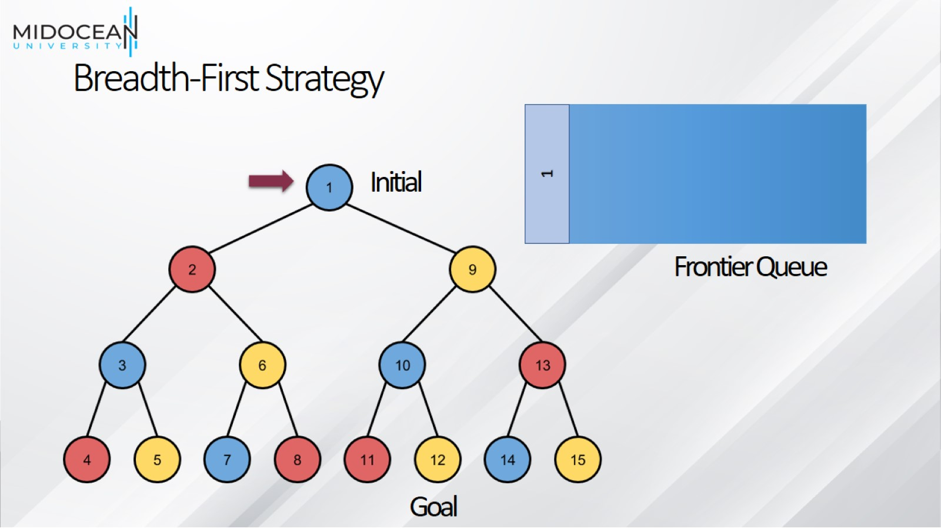
Breadth-First Strategy

Slide 41
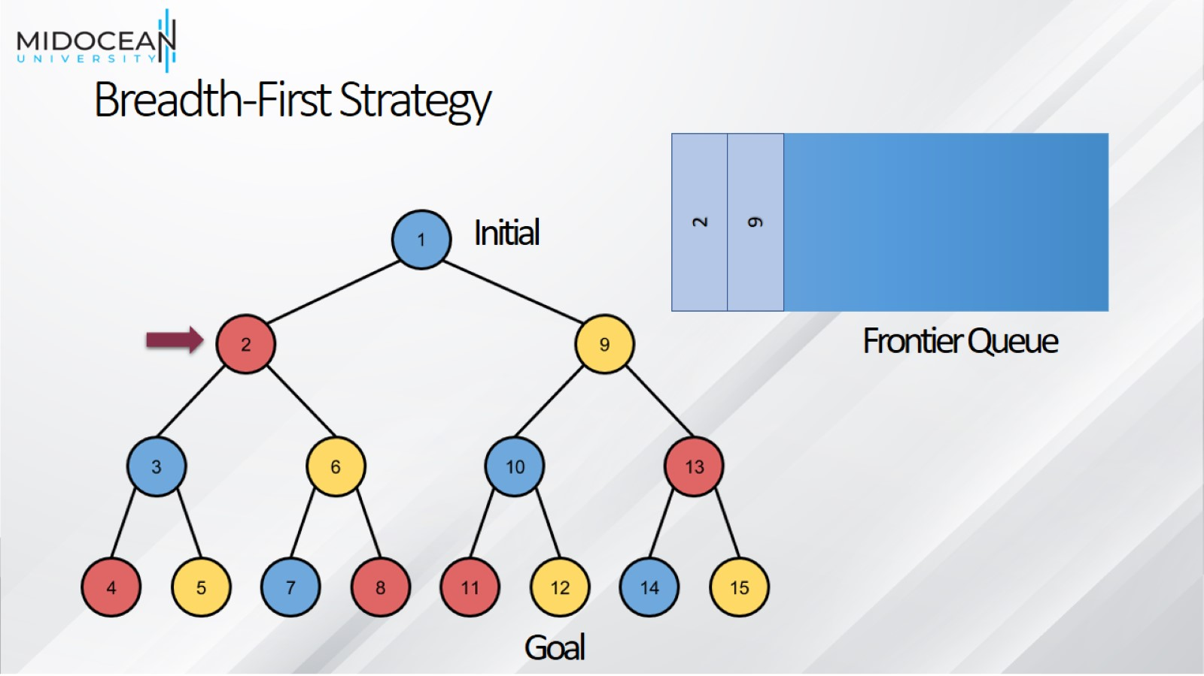
Breadth-First Strategy

Slide 42
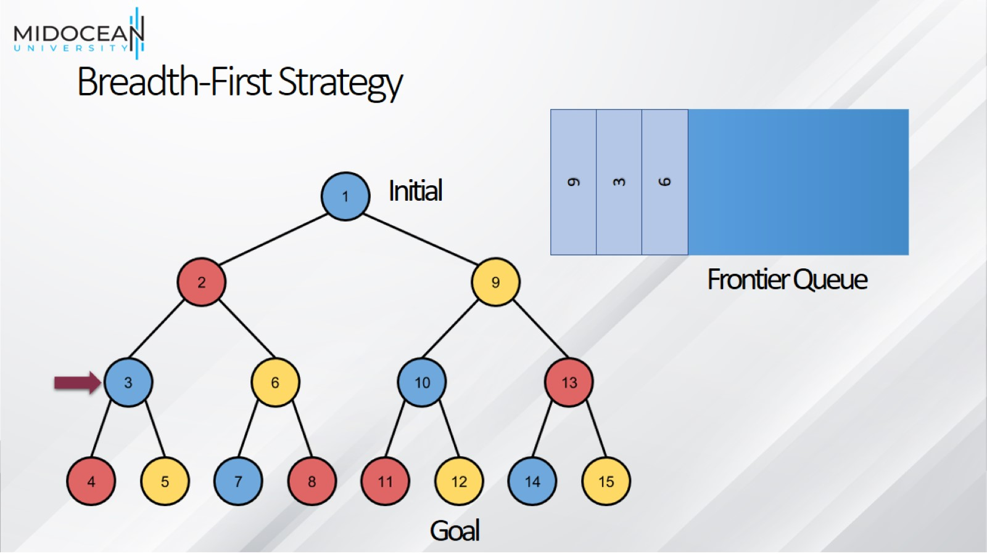
Breadth-First Strategy

Slide 43
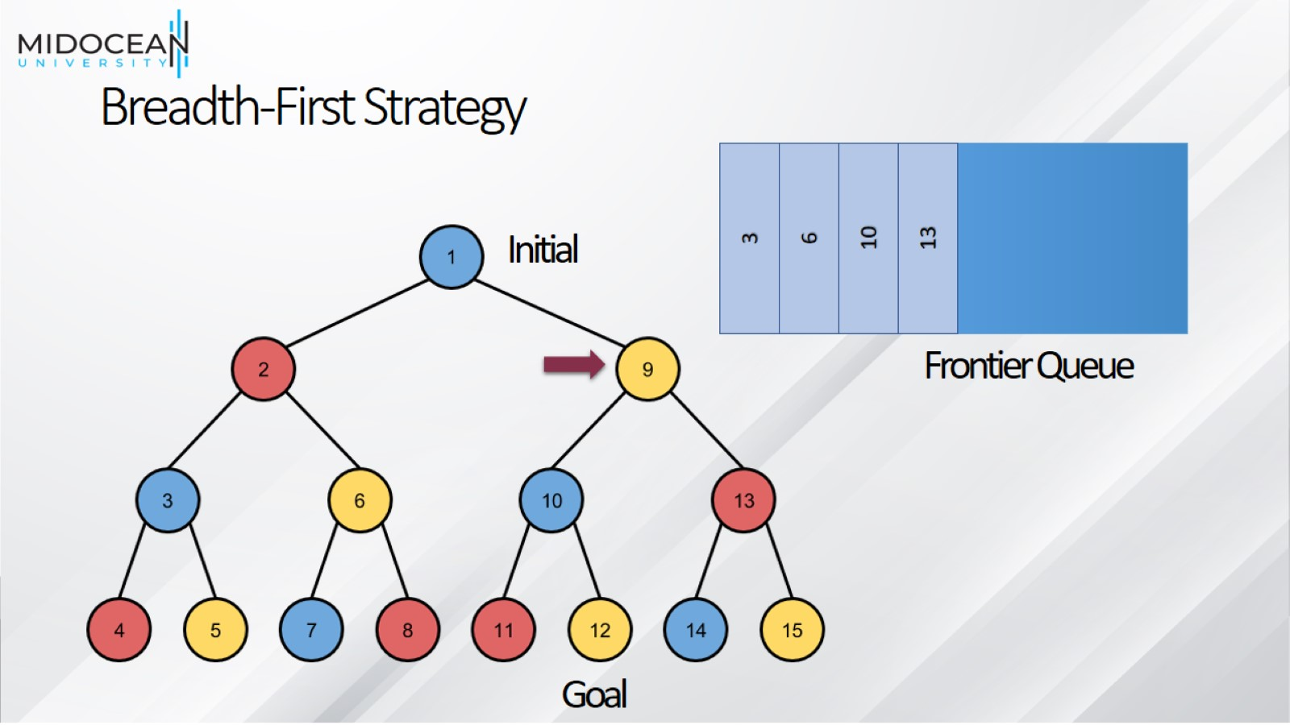
Breadth-First Strategy

Slide 44
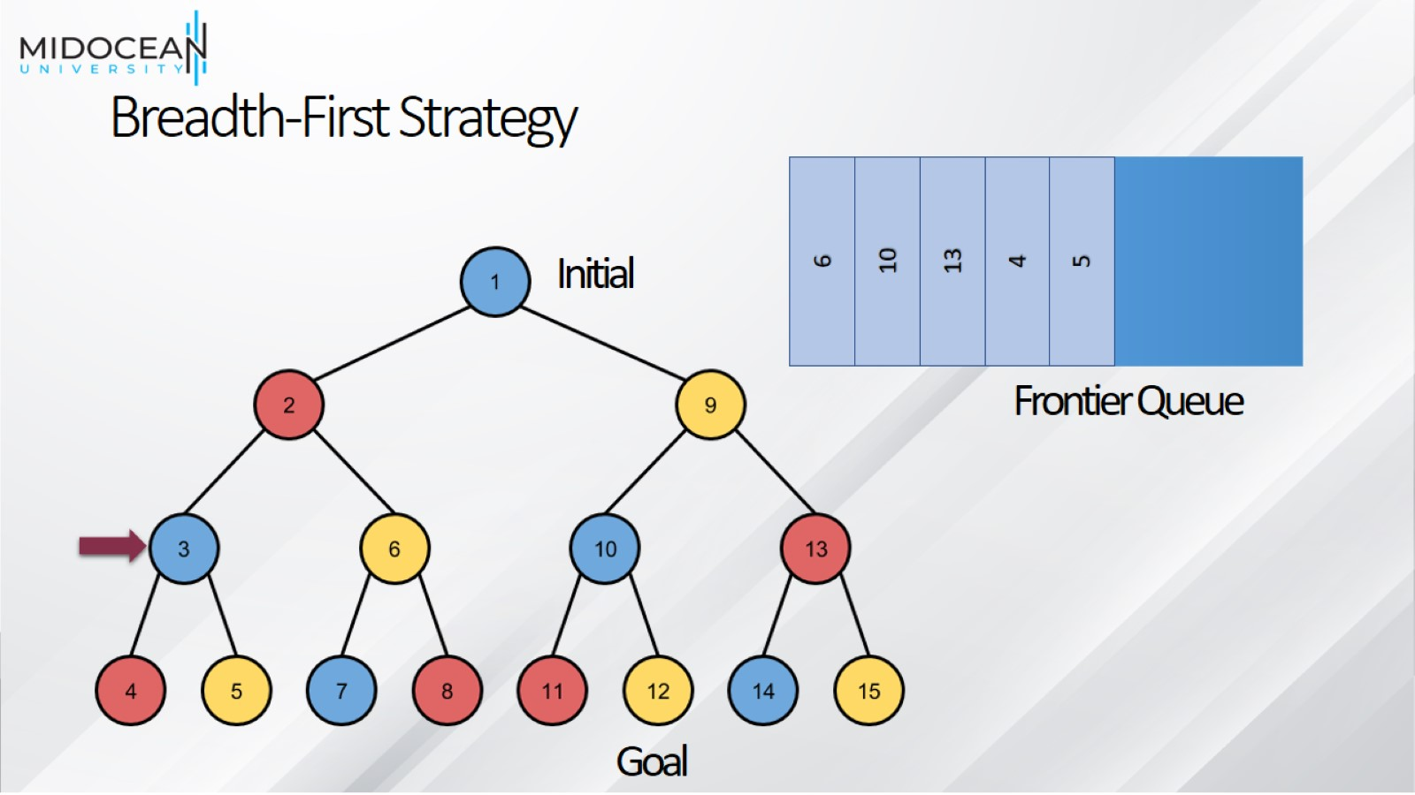
Breadth-First Strategy

Slide 45
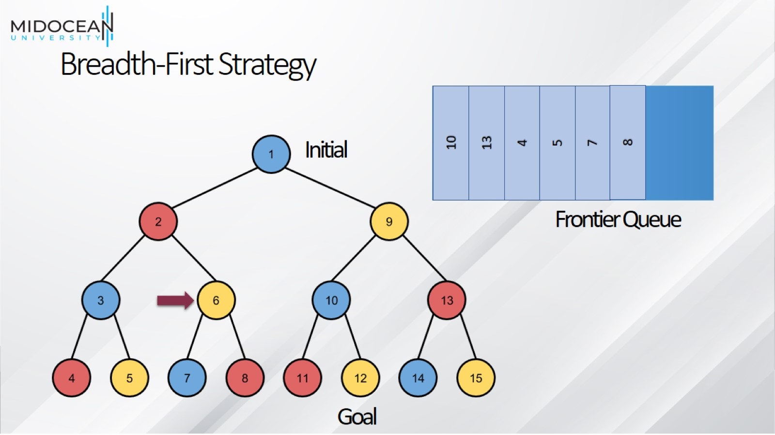
Breadth-First Strategy

Slide 46
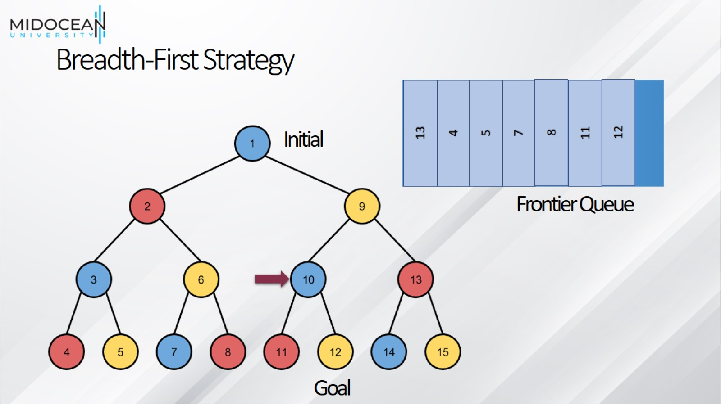
Breadth-First Strategy

Slide 47
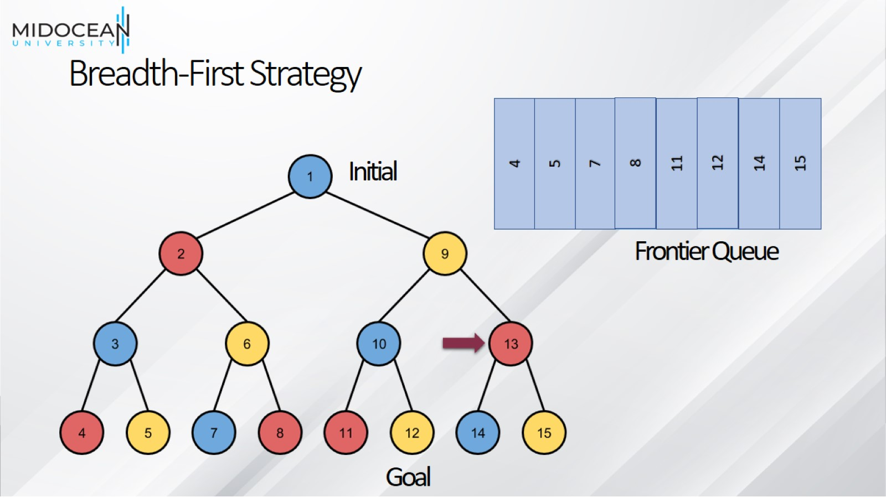
Breadth-First Strategy

Slide 48
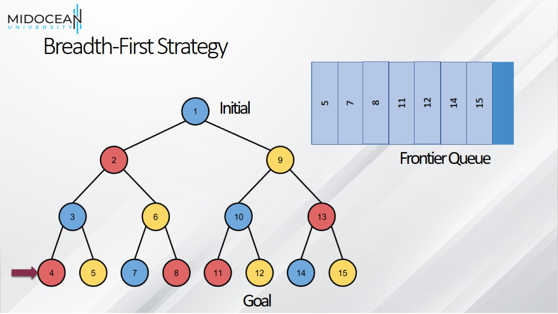
Breadth-First Strategy

Slide 49
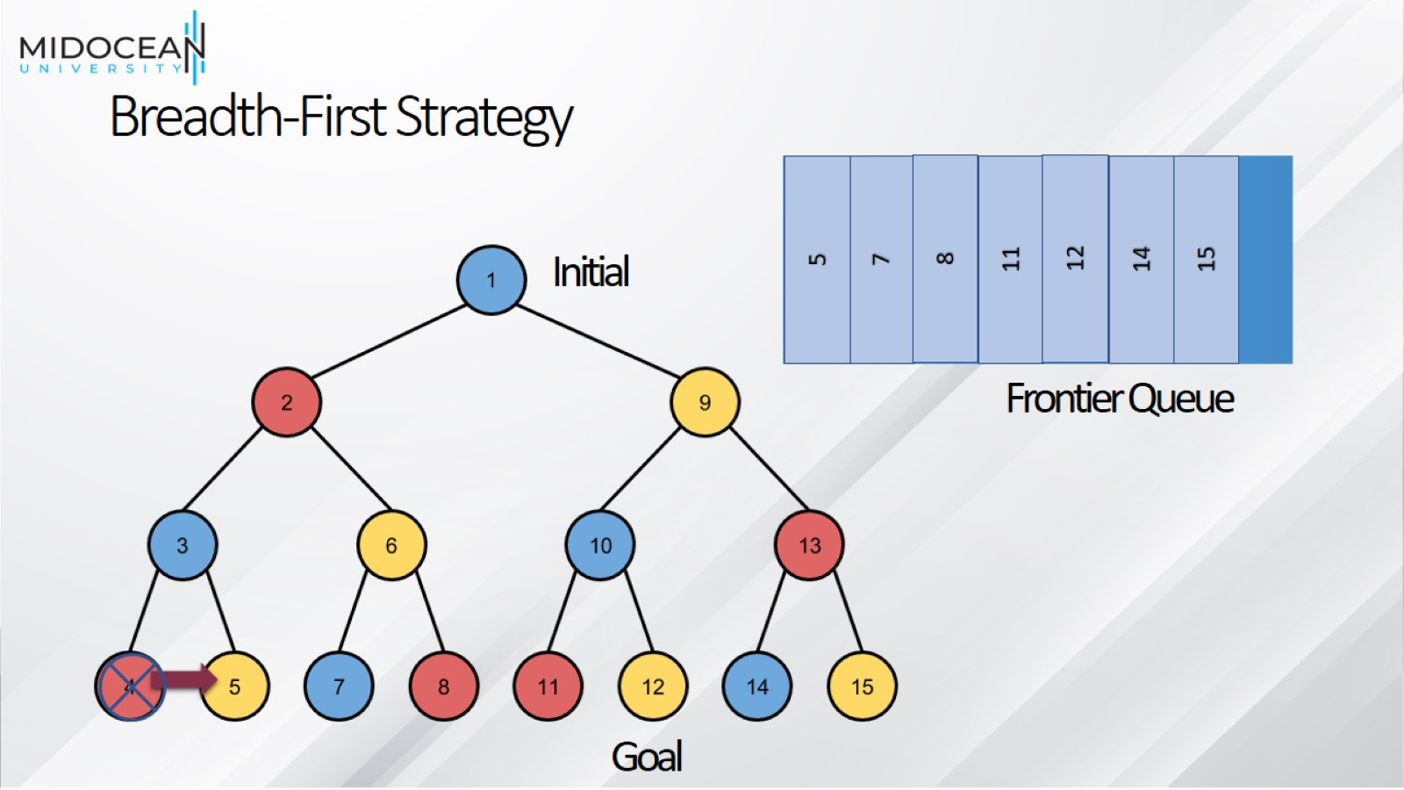
Breadth-First Strategy

Slide 50
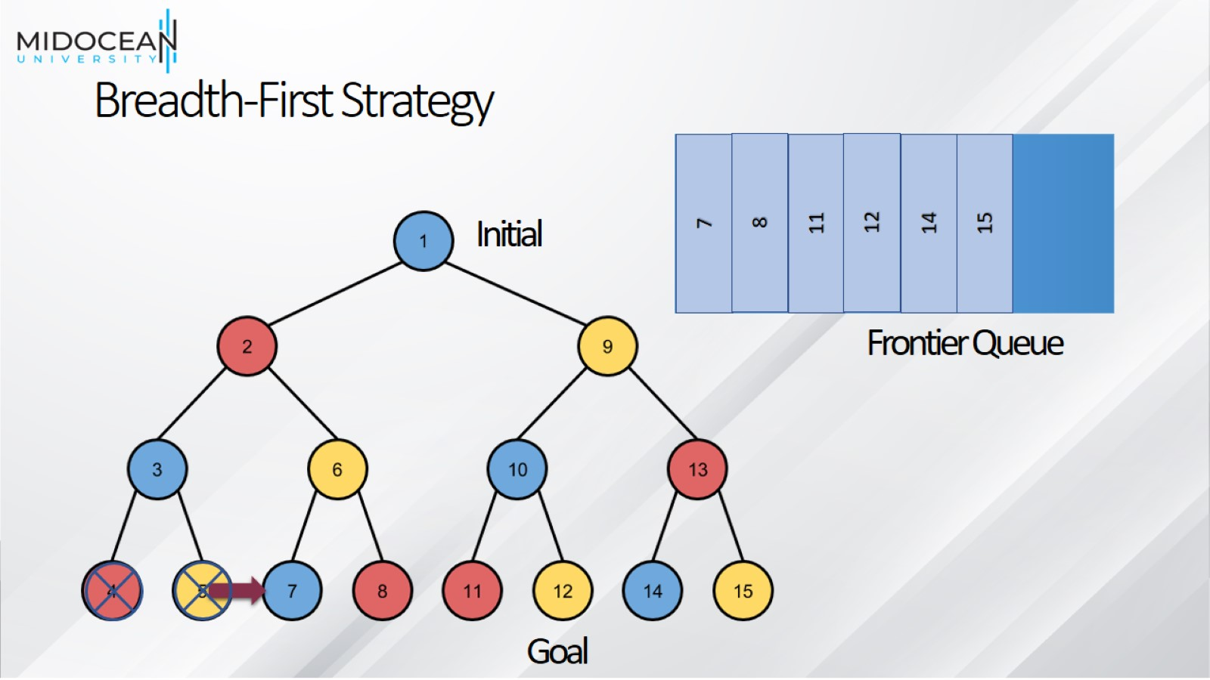
Breadth-First Strategy

Slide 51
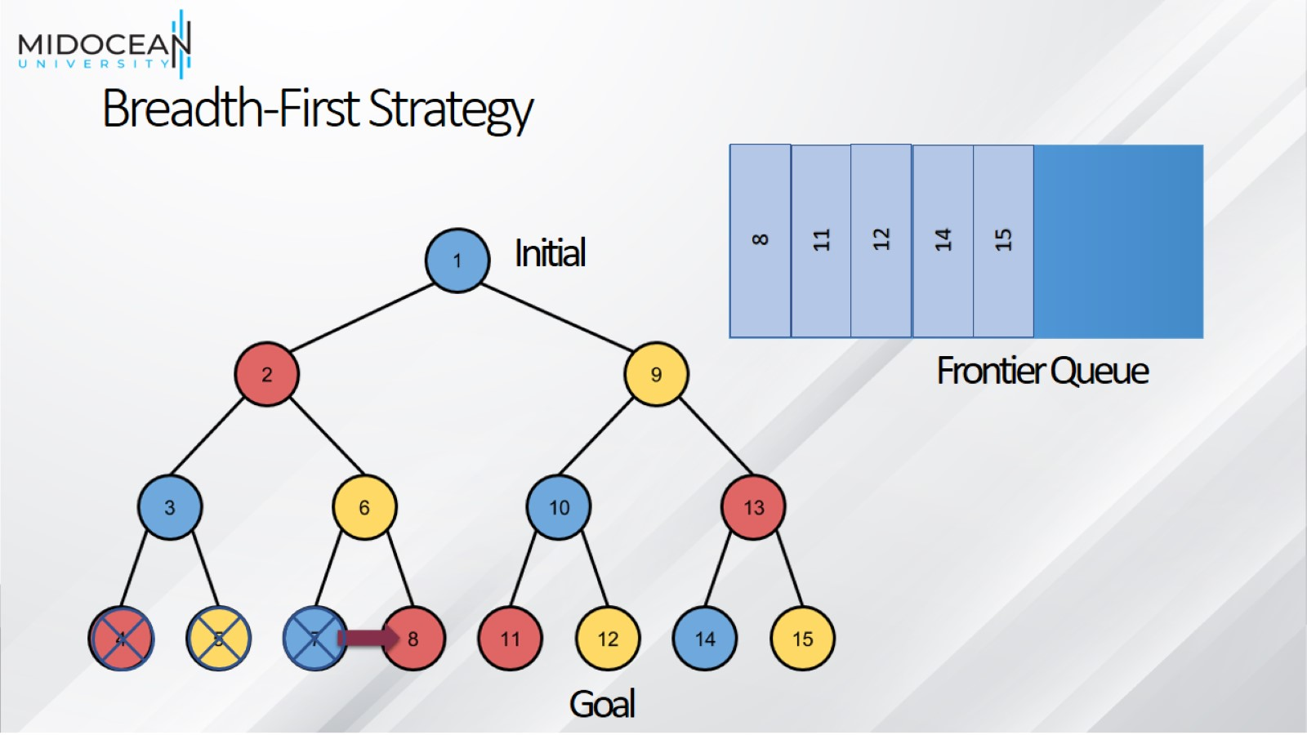
Breadth-First Strategy

Slide 52
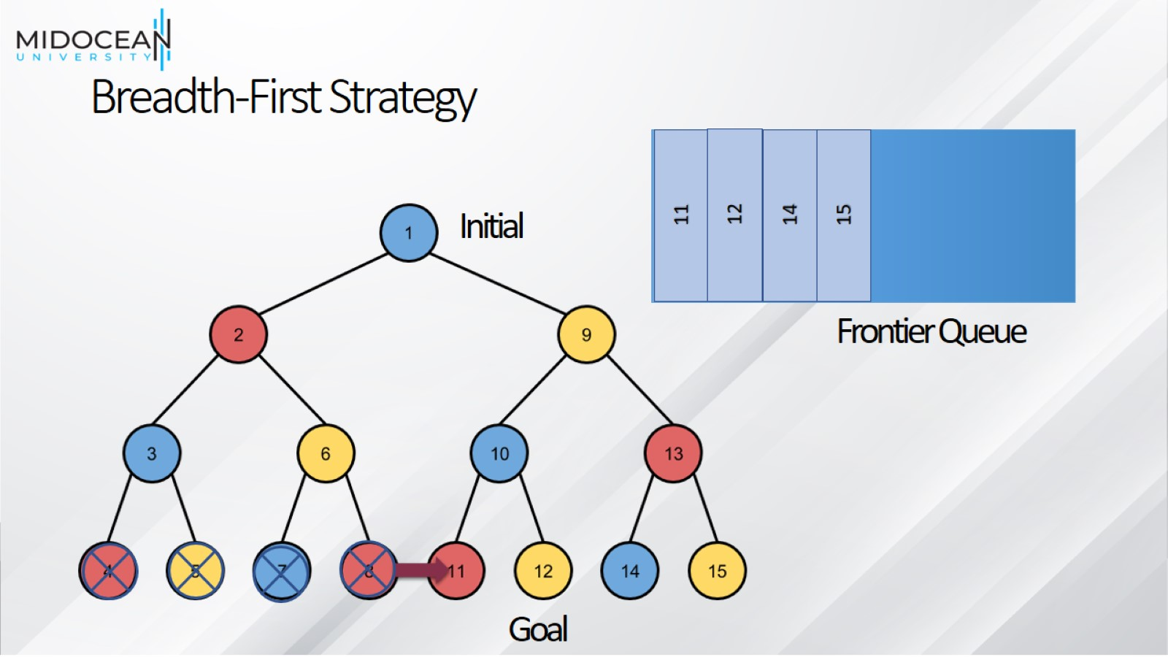
Breadth-First Strategy

Slide 53
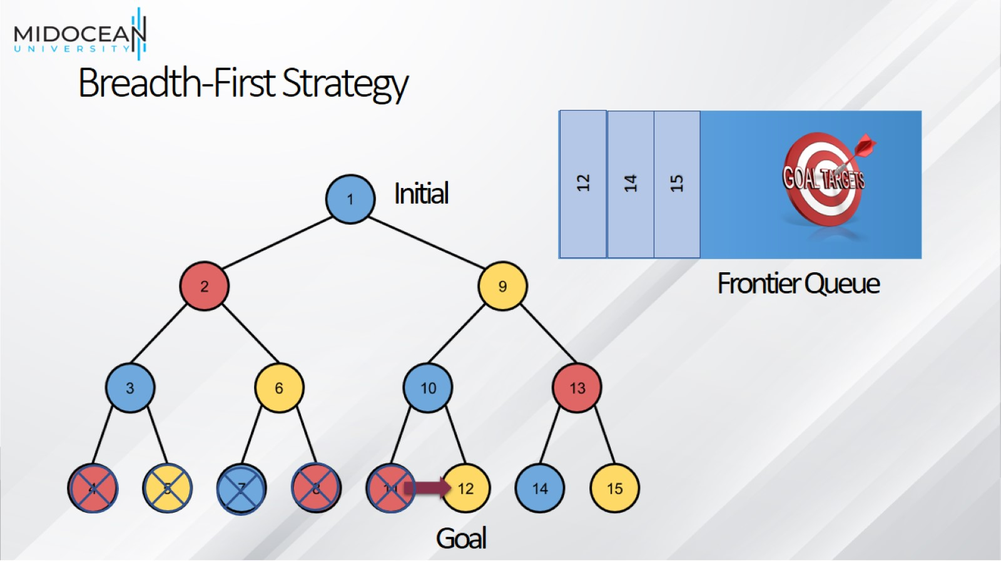
Breadth-First Strategy

Slide 54
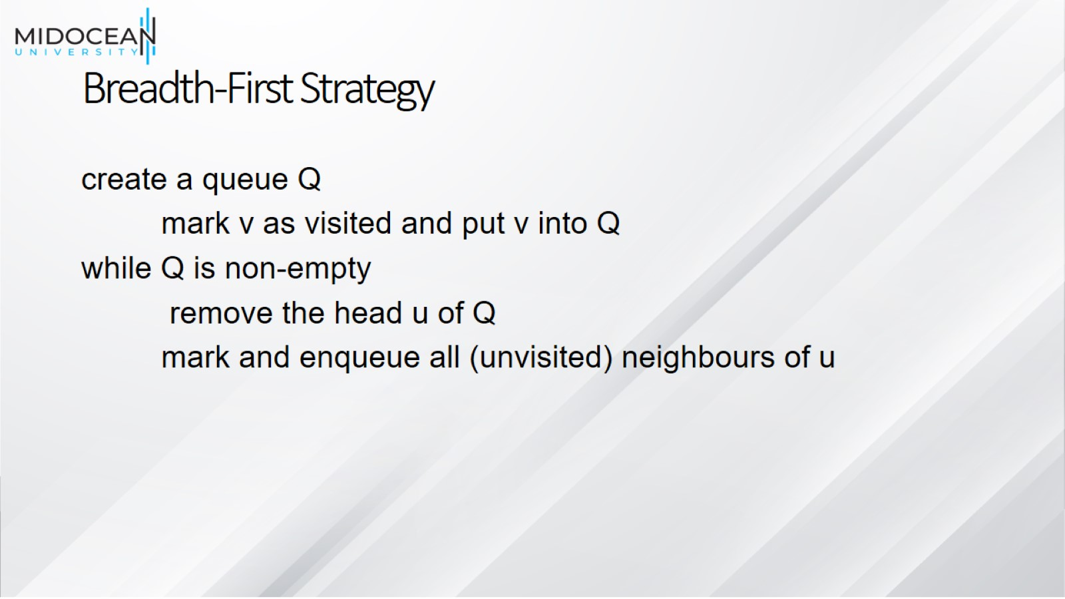
Breadth-First Strategy

Slide 55
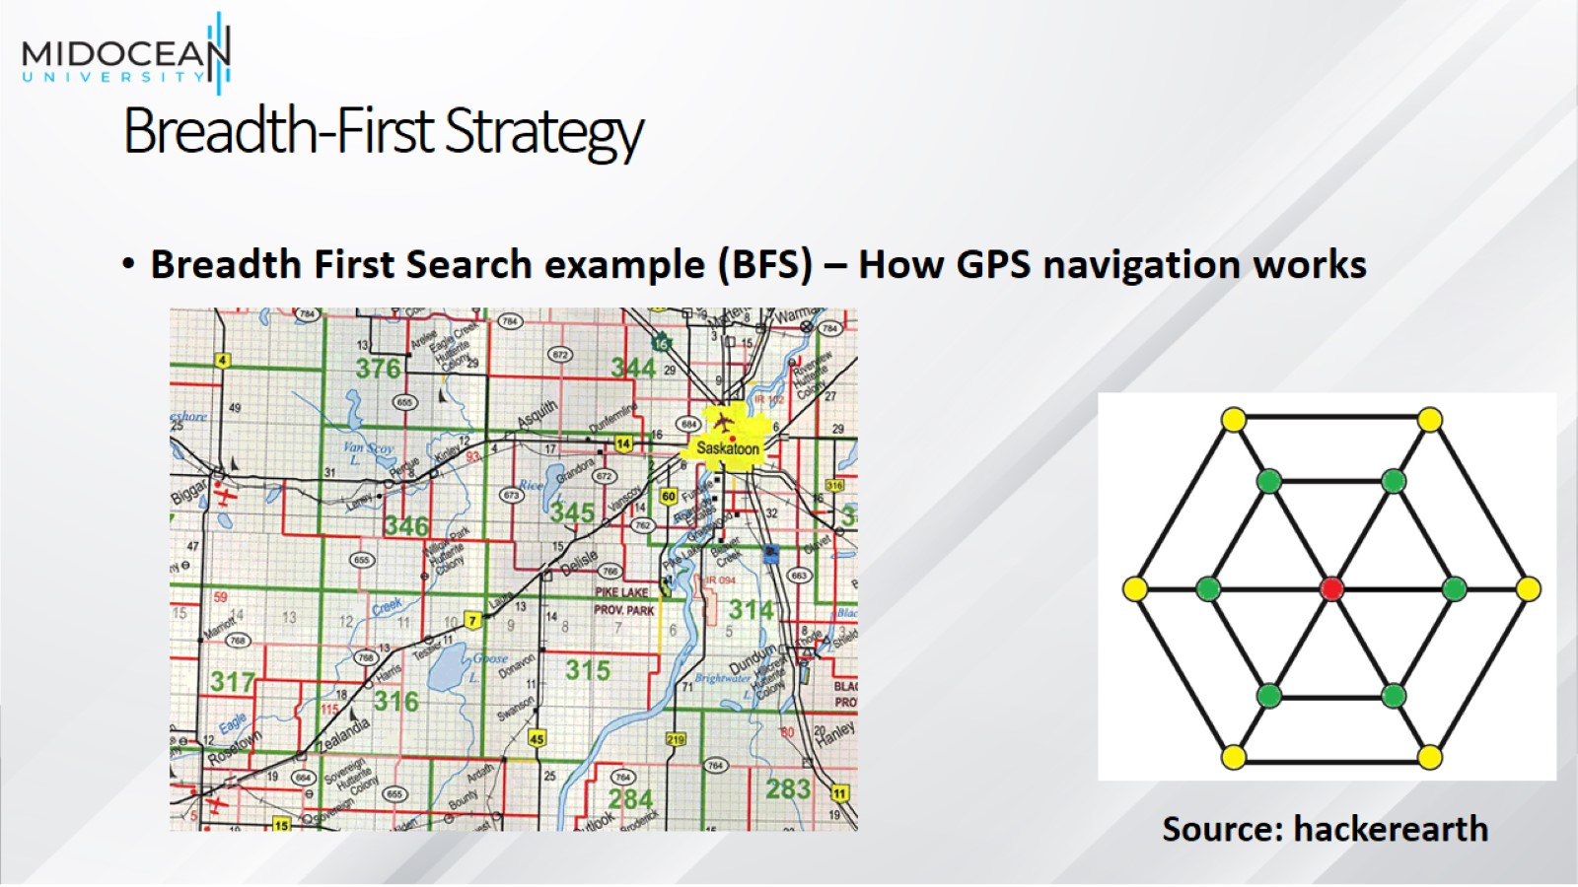
Breadth-First Strategy

Slide 56
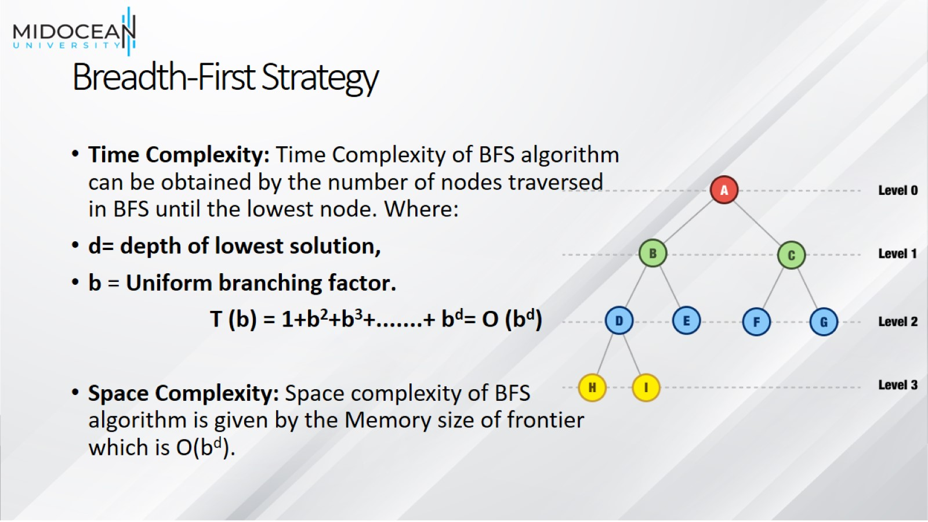
Breadth-First Strategy

Slide 57
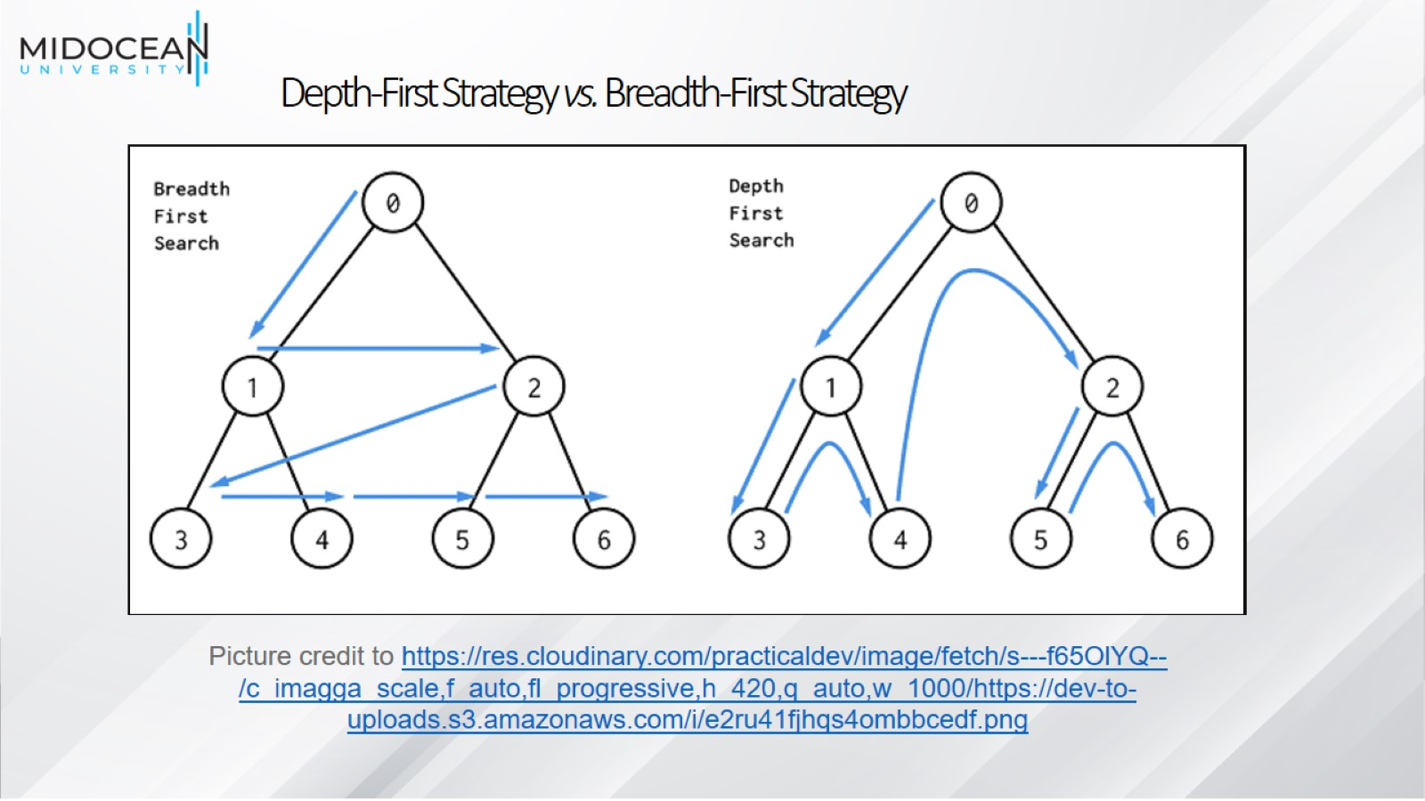
Depth-First Strategy vs. Breadth-First Strategy

Slide 58
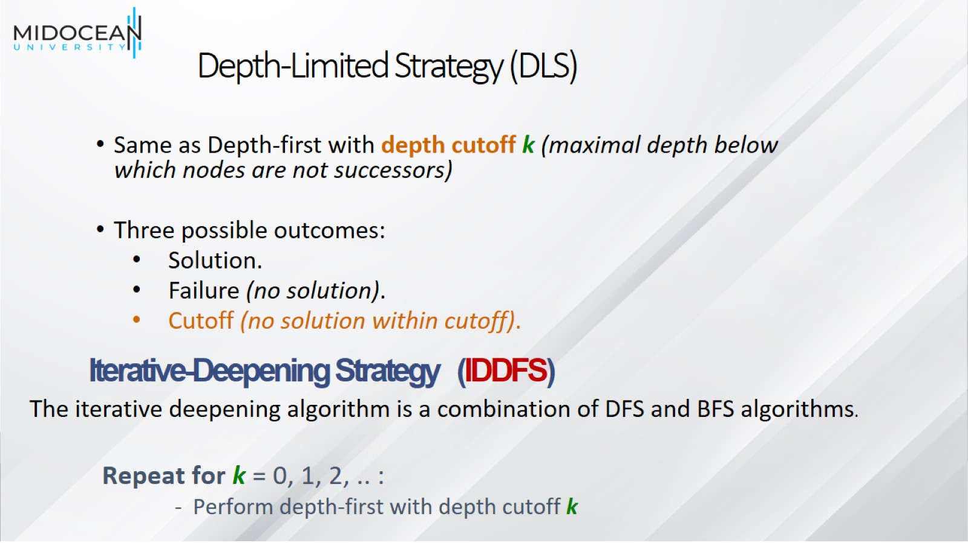
Depth-Limited Strategy (DLS)

Slide 59
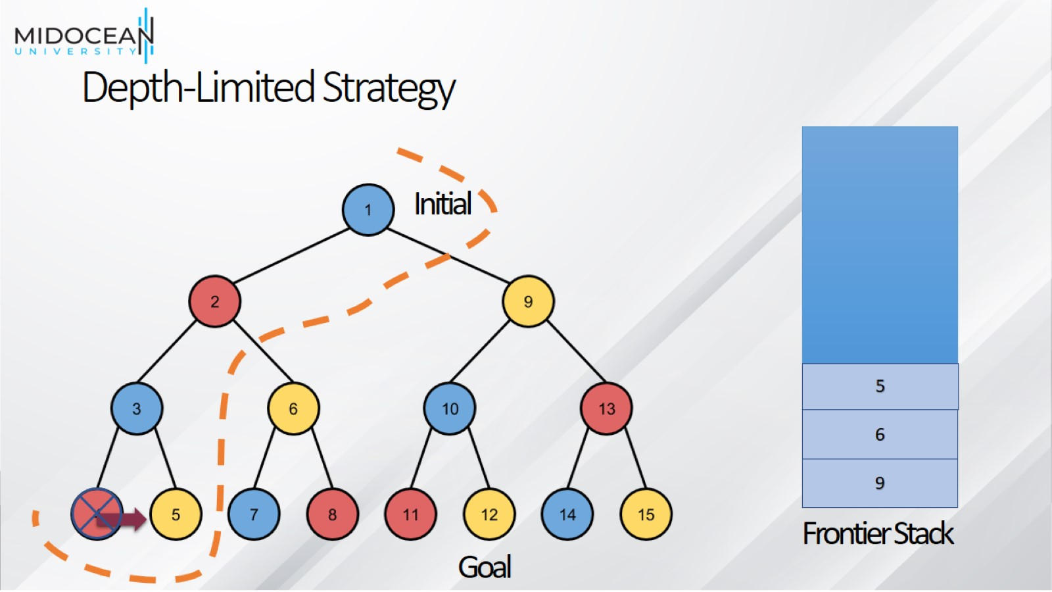
Depth-Limited Strategy

Slide 60
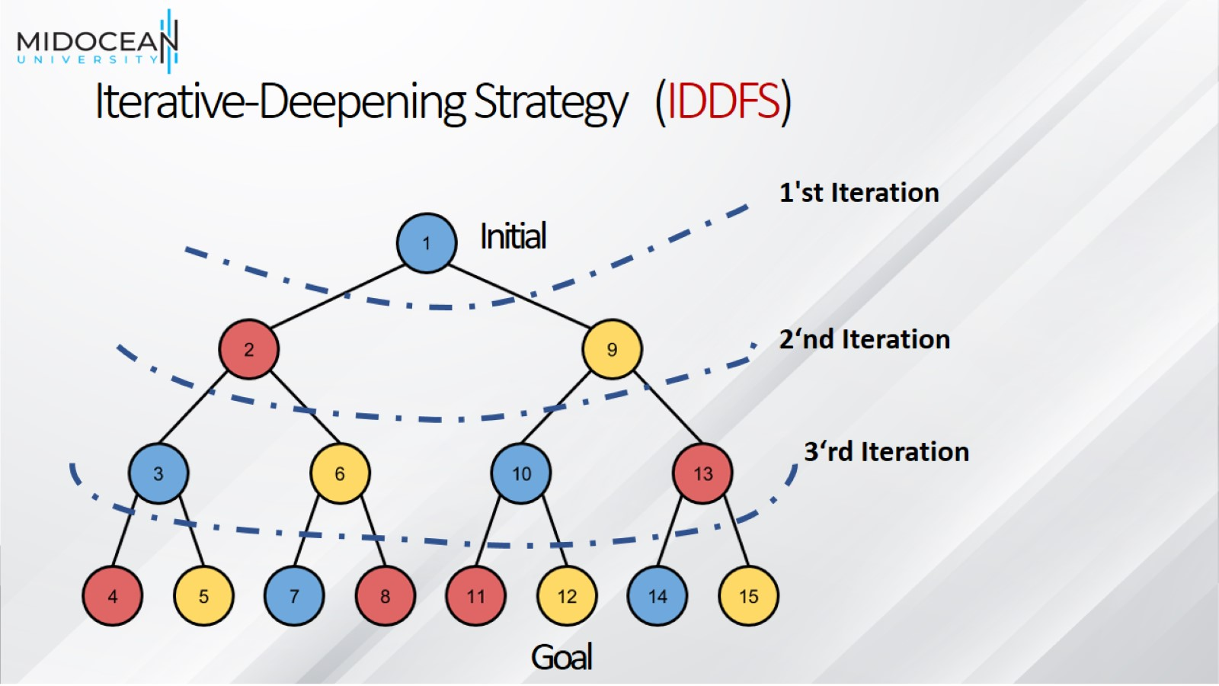
Iterative-Deepening Strategy (IDDFS)

Slide 61
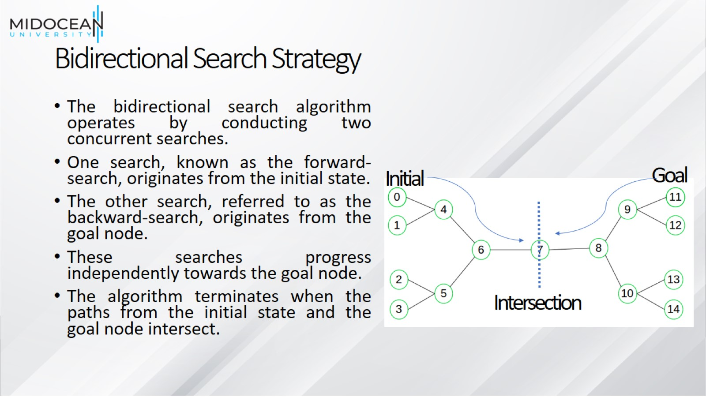
Bidirectional Search Strategy

Slide 62
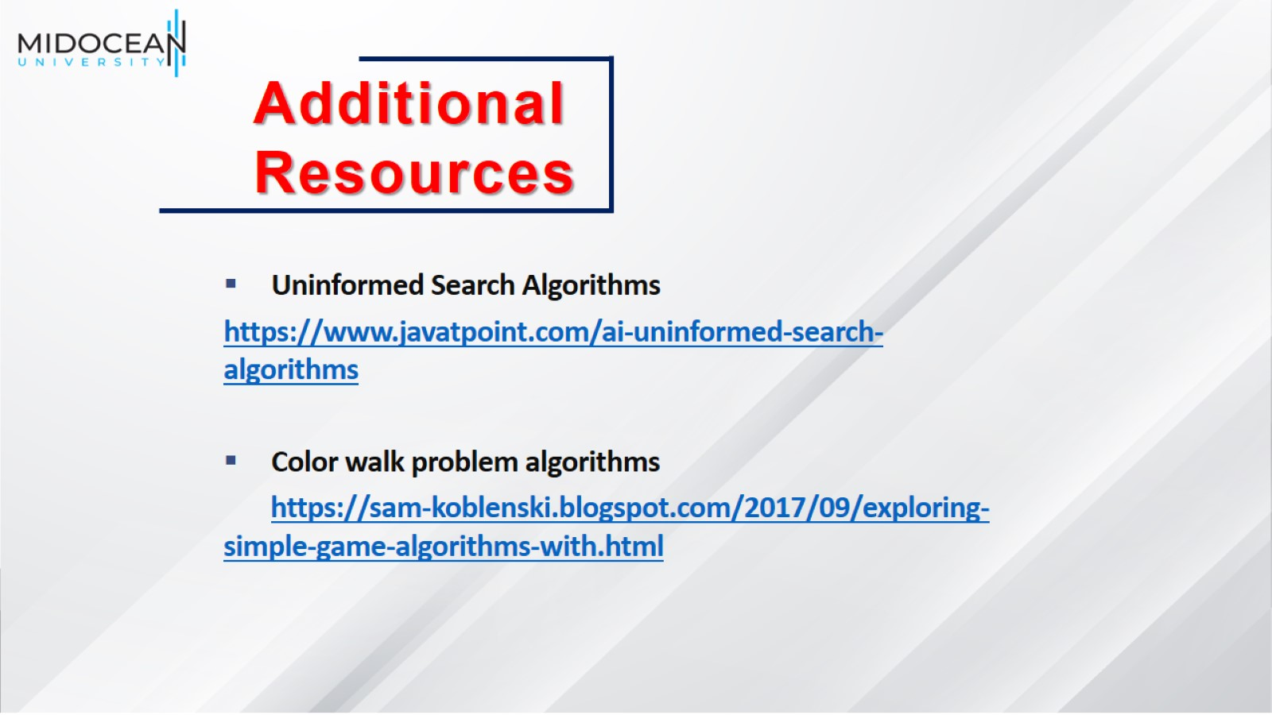

Slide 63
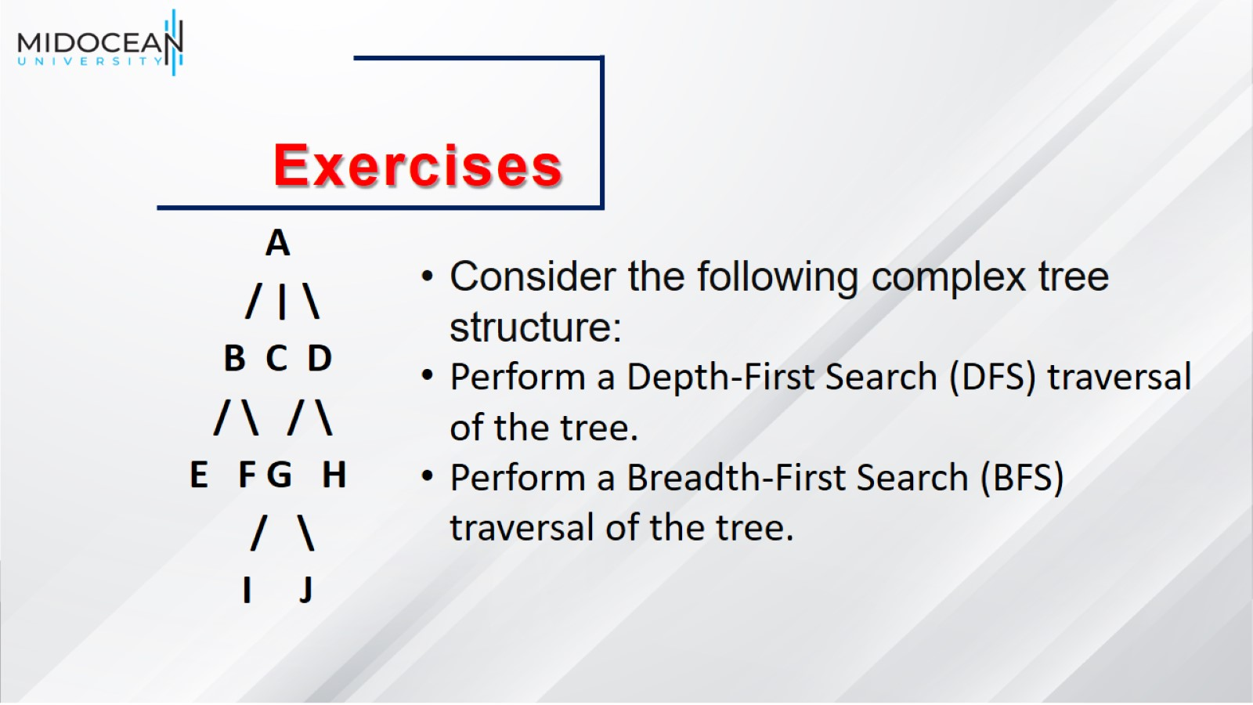

Slide 64


Slide 65


