Slide 1



Protocols & Models
Lecture 2
CCNA – Introduction to Networks V7.0 (ITN)
Prepared by
Dr. Abdelrhman Ahmed

Slide 2
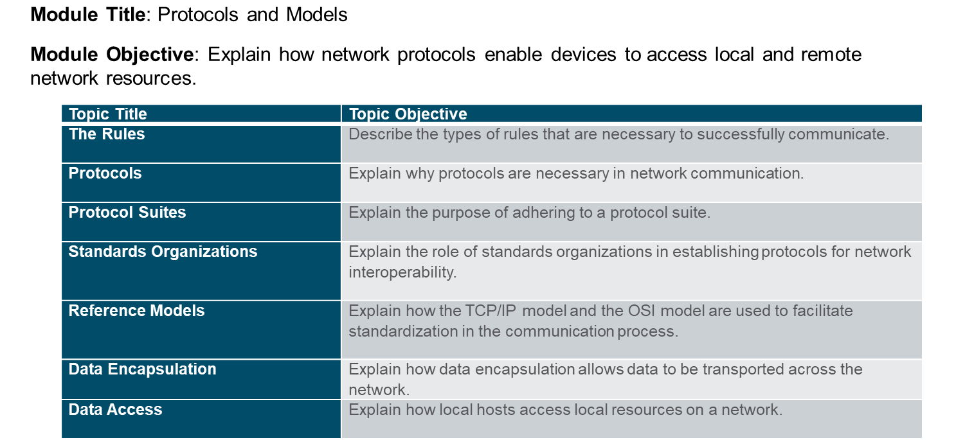
Chapter
Module Objectives
02

Slide 3
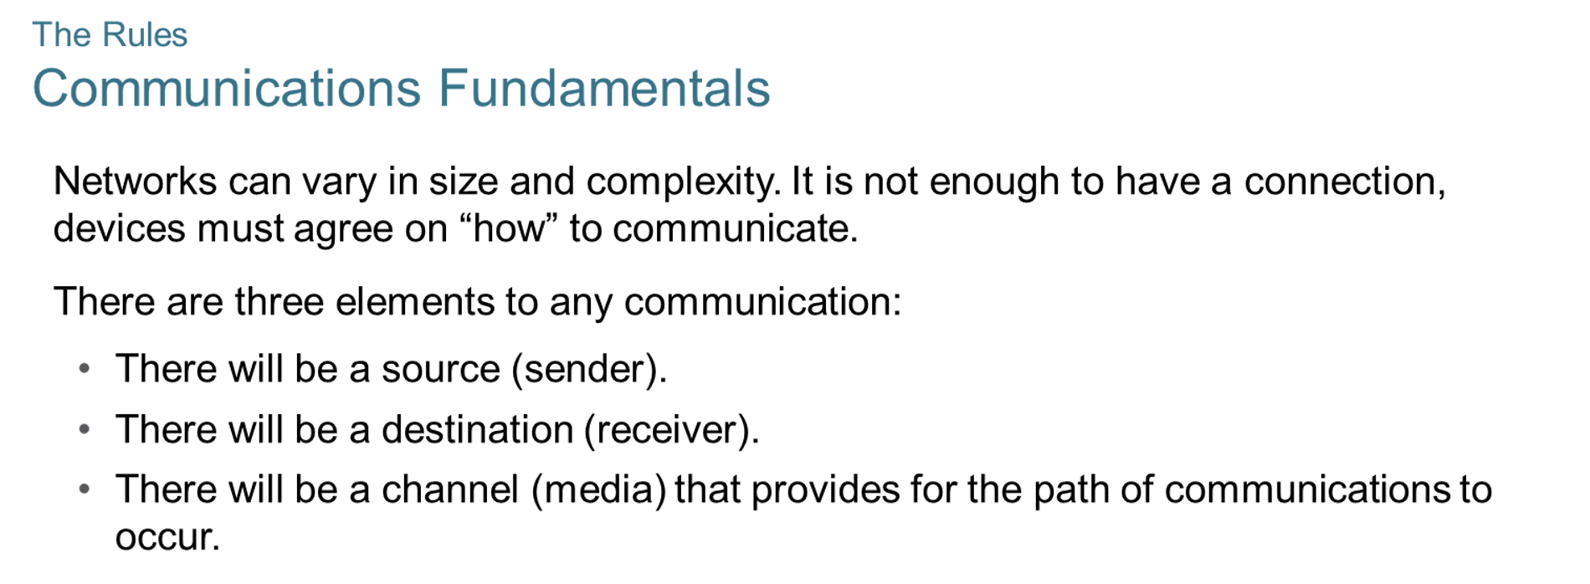
Chapter
The Rules
02

Slide 4
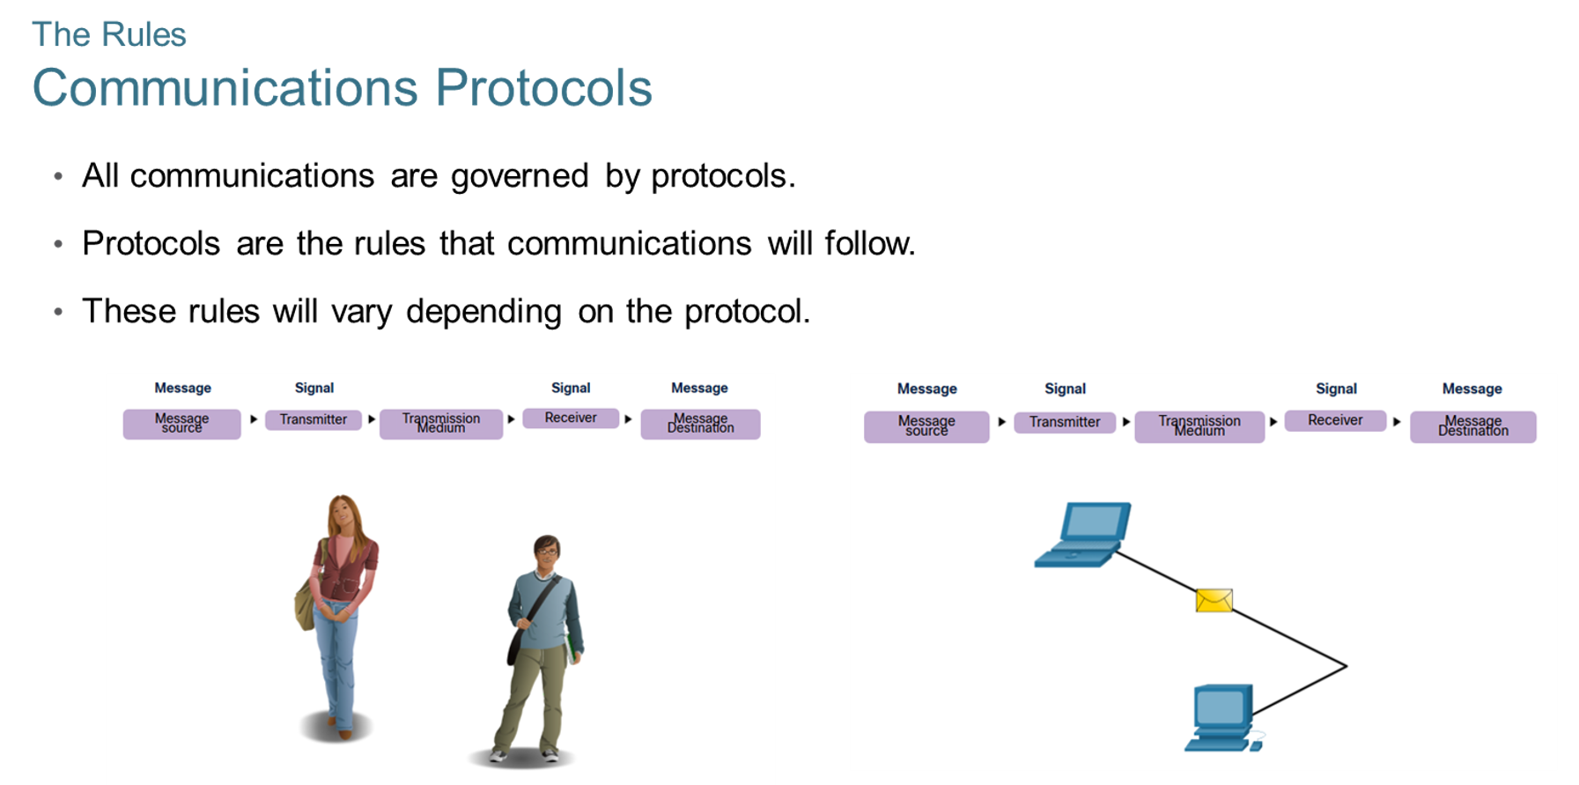
Chapter
The Rules
02

Slide 5
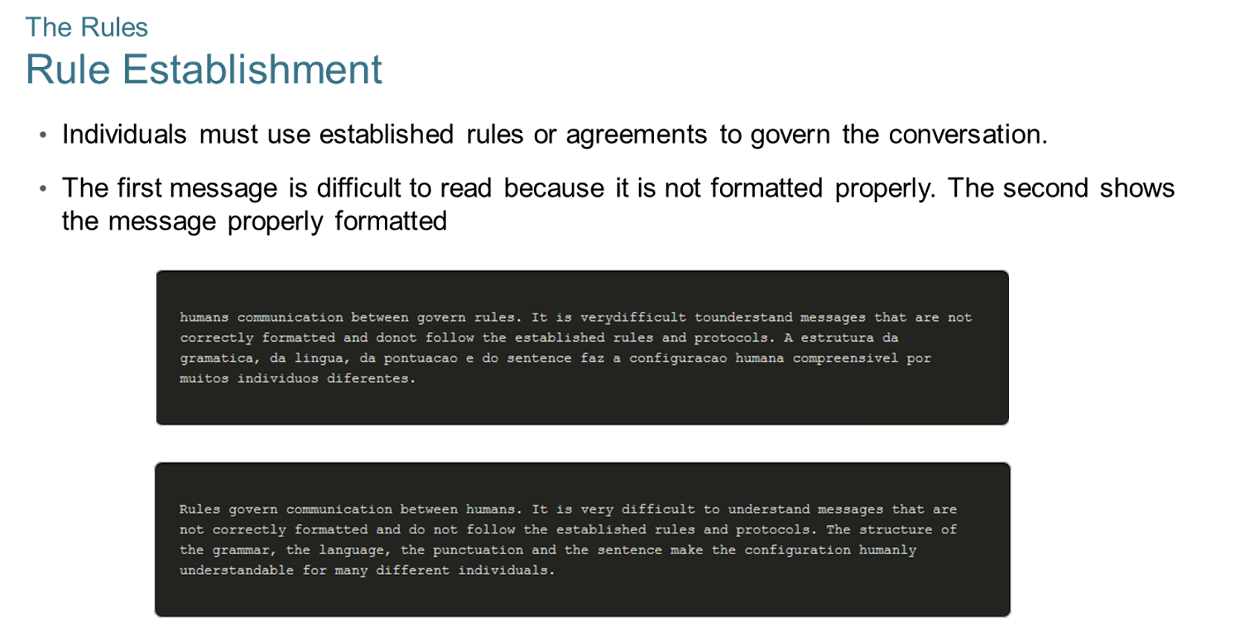
Chapter
The Rules
02

Slide 6
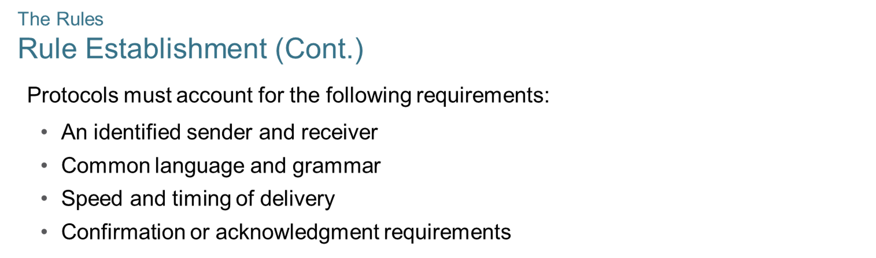
Chapter
The Rules
02

Slide 7
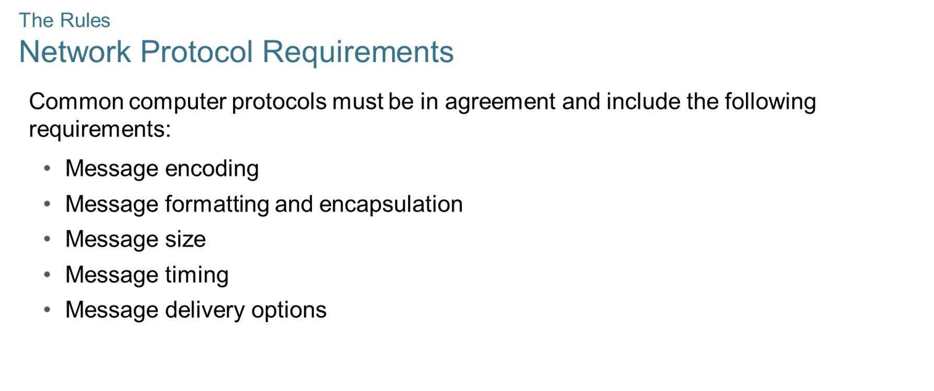
Chapter
The Rules
02

Slide 8
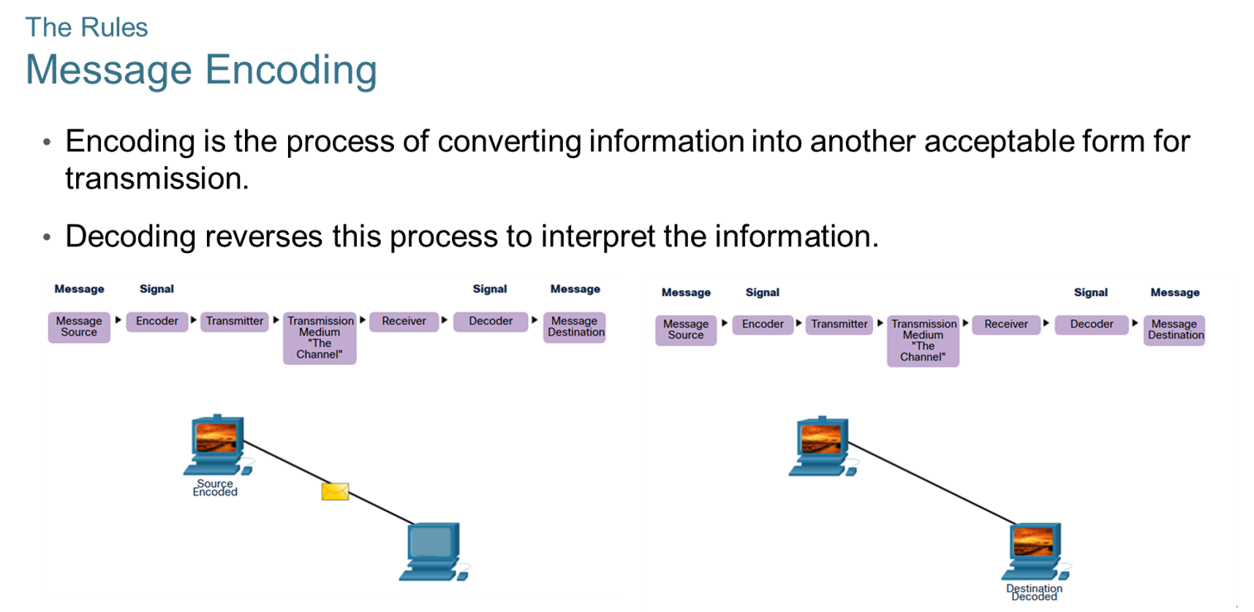
Chapter
The Rules
02

Slide 9
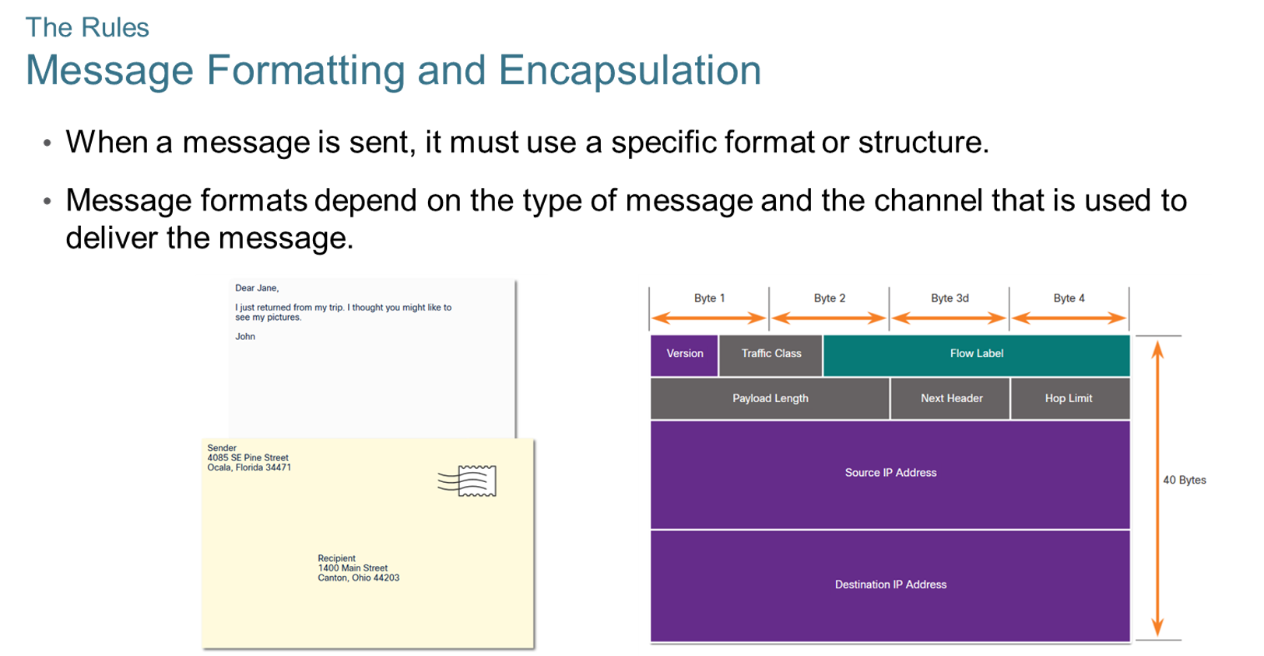
Chapter
The Rules
02

Slide 10
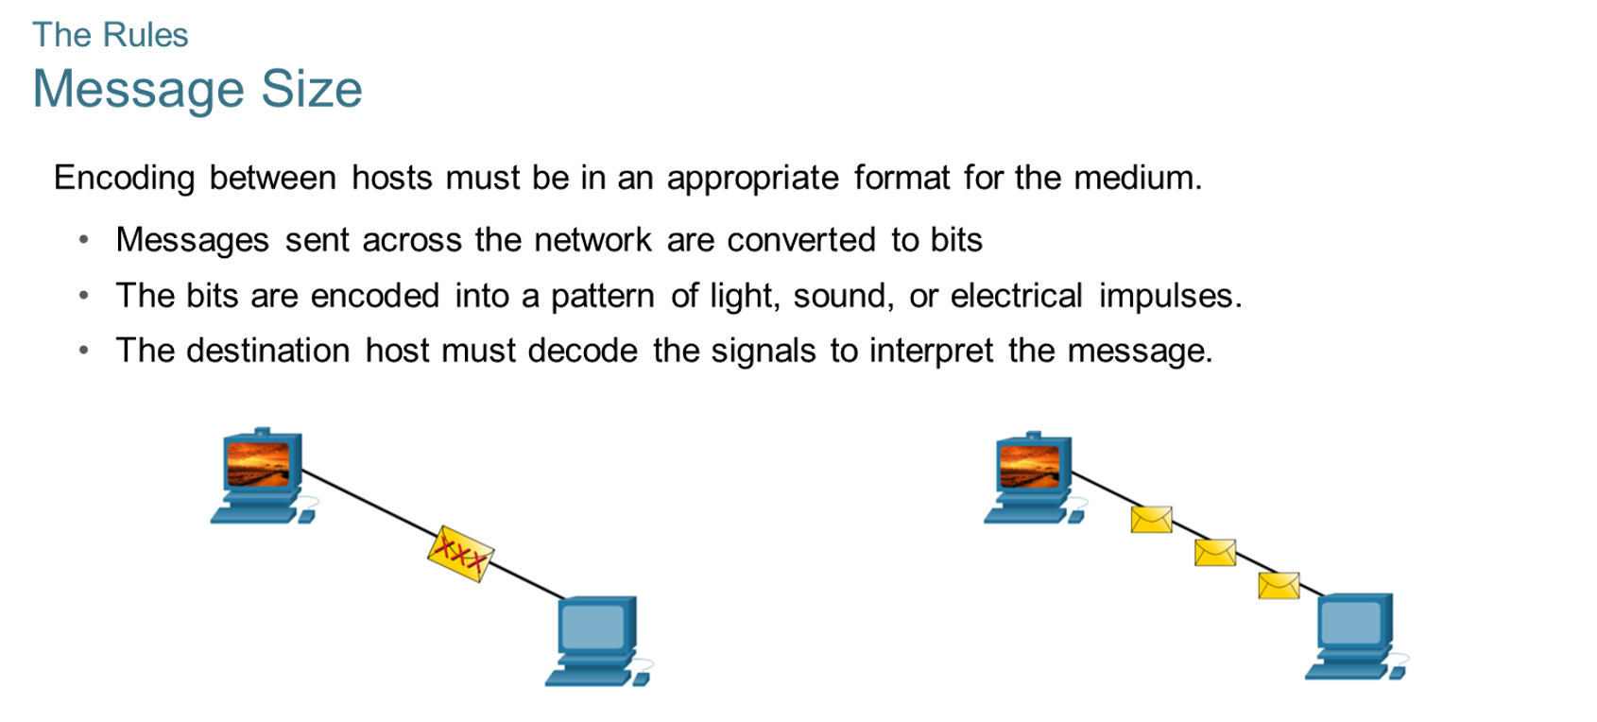
Chapter
The Rules
02

Slide 11
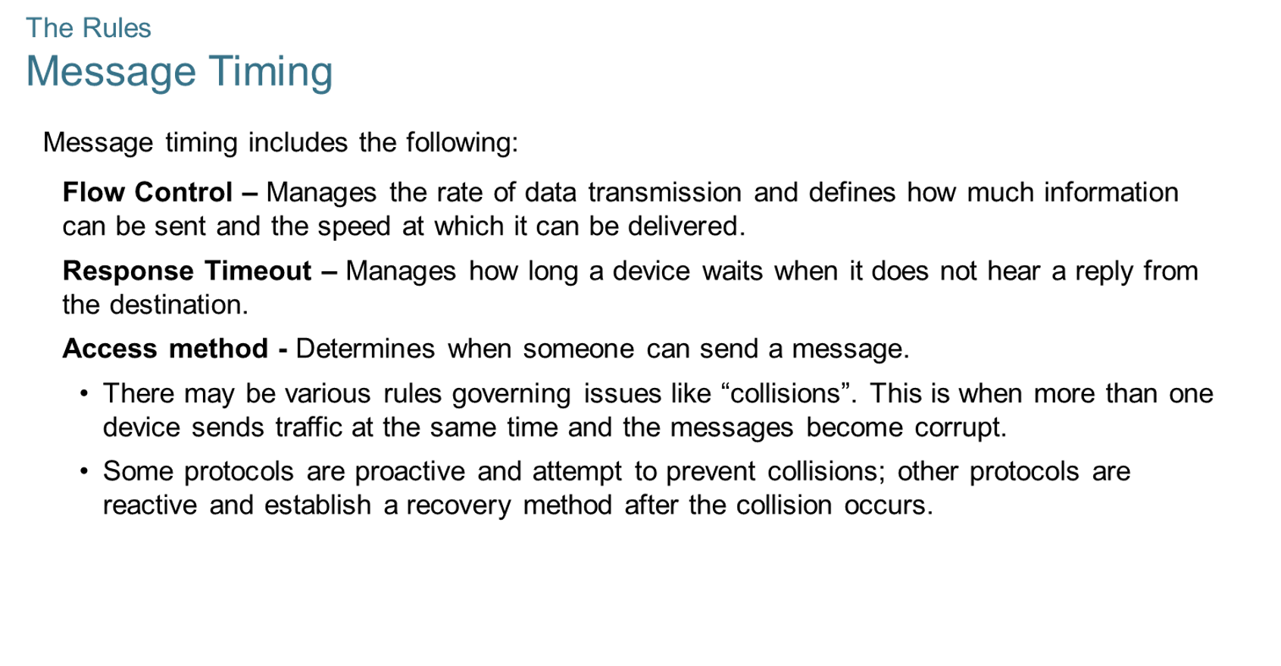
Chapter
The Rules
02

Slide 12
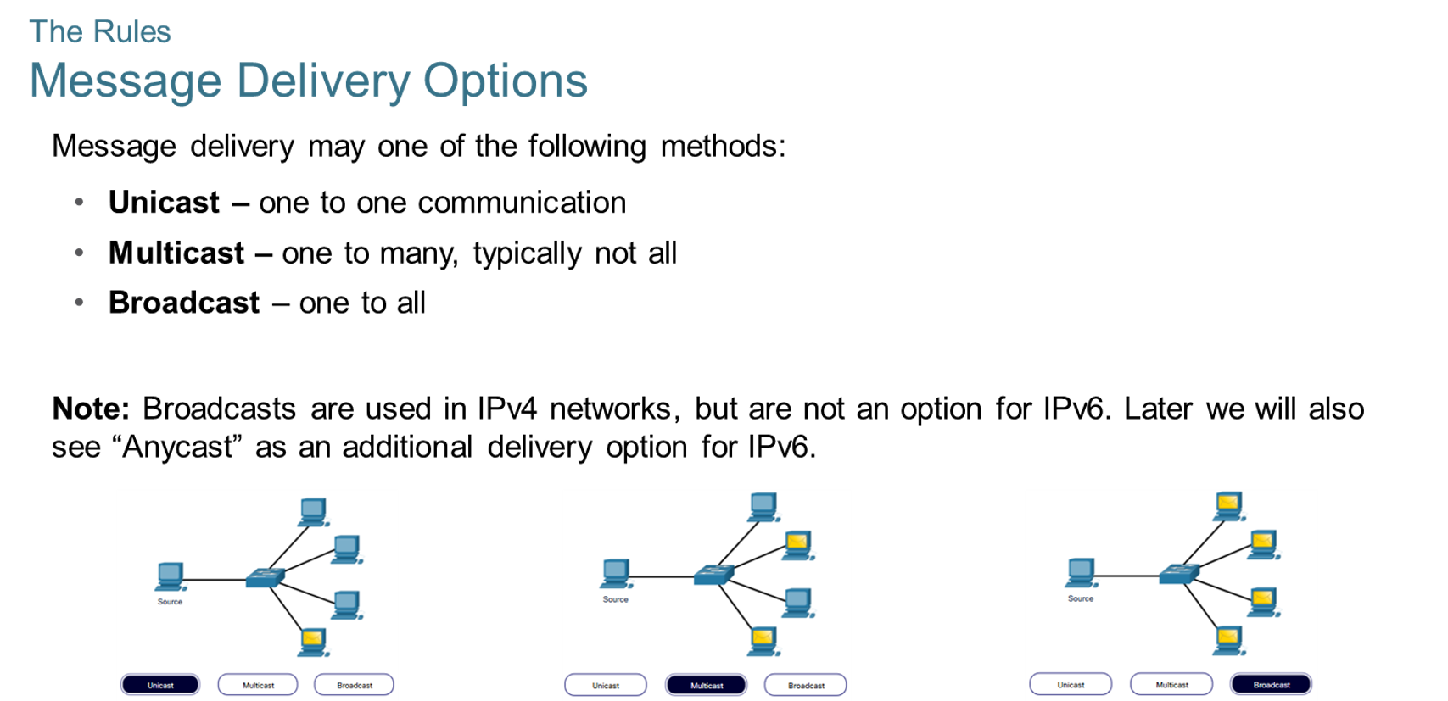
Chapter
02
The Rules

Slide 13
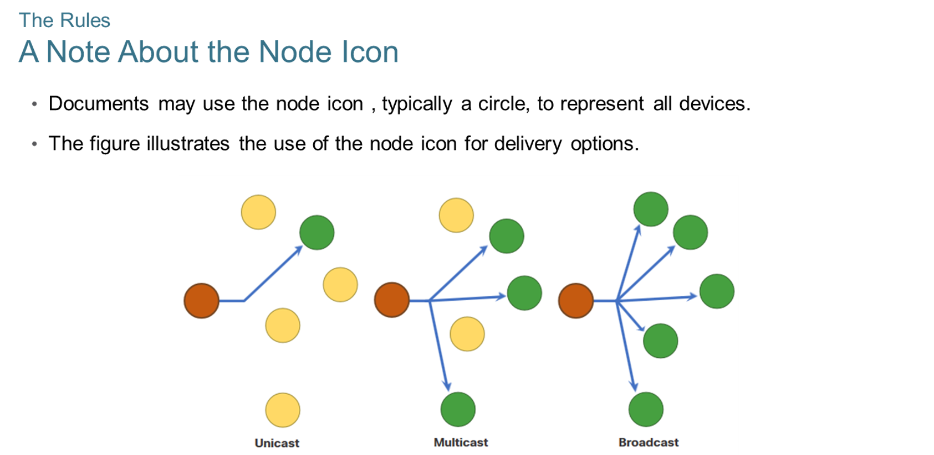
Chapter
The Rules
02

Slide 14
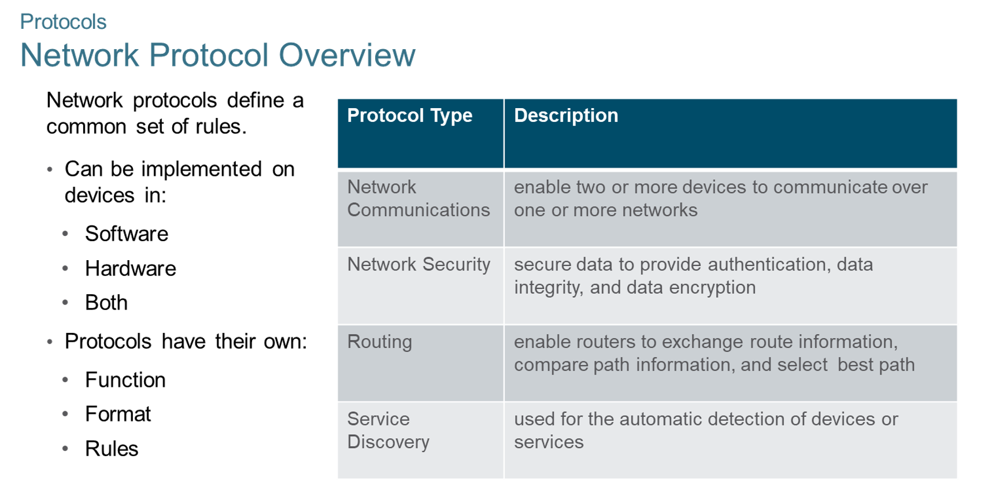
Chapter
Protocols
02

Slide 15
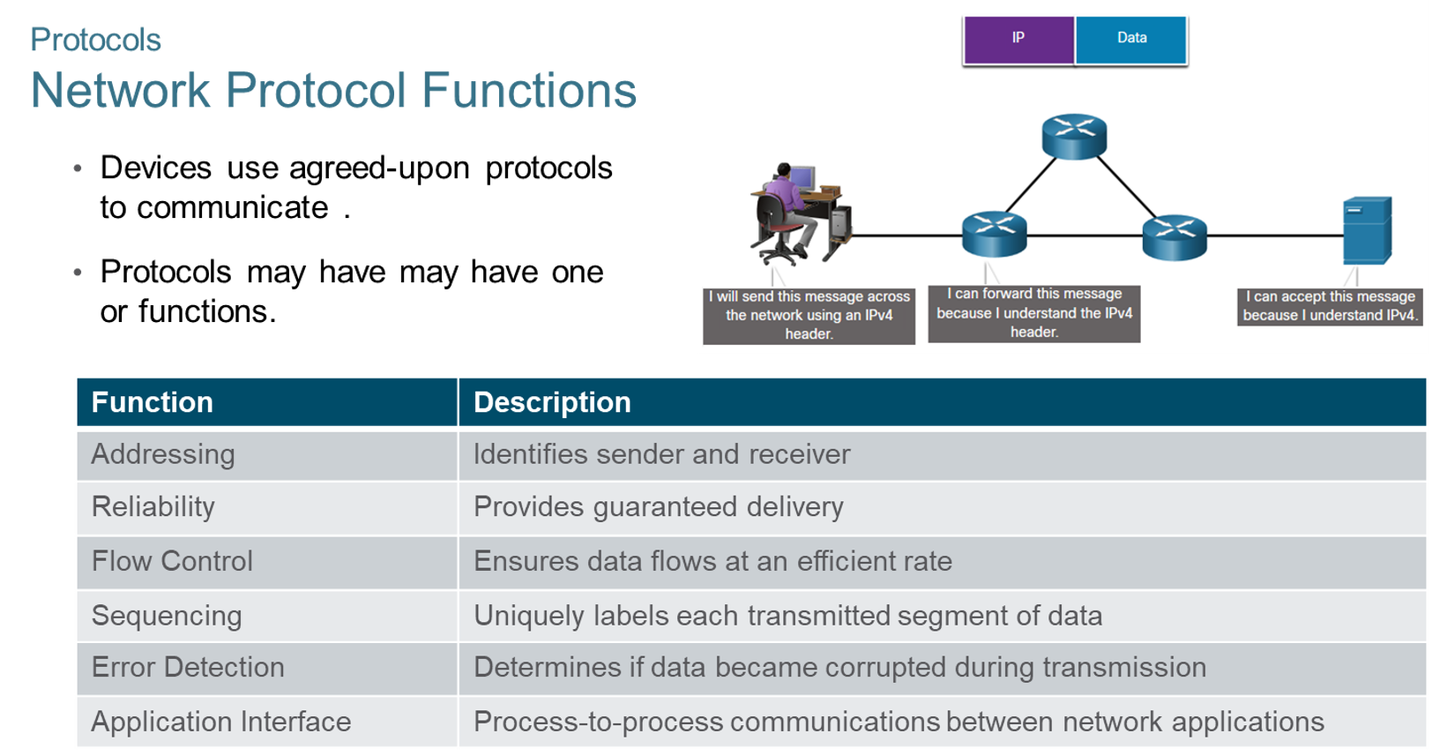
Chapter
Protocols
02

Slide 16
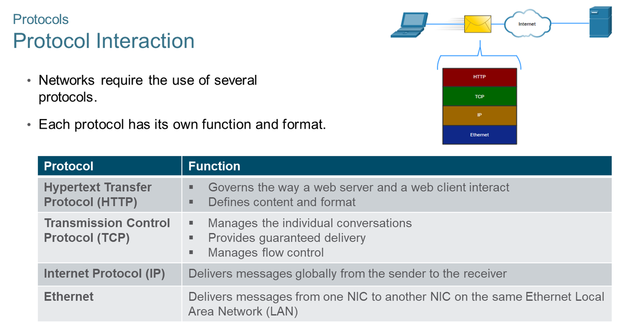
Chapter
Protocols
02

Slide 17
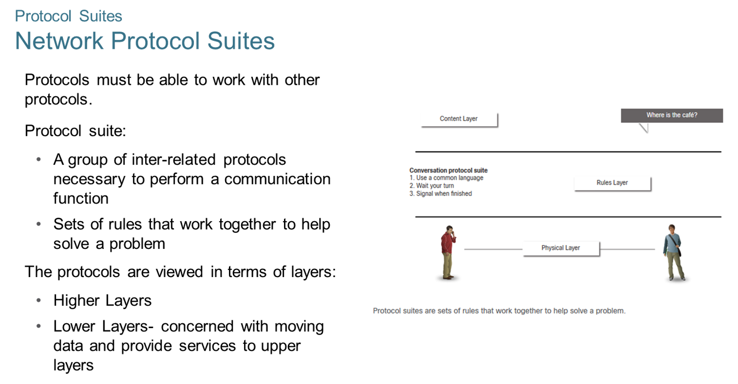
Chapter
Protocol Suites
02

Slide 18
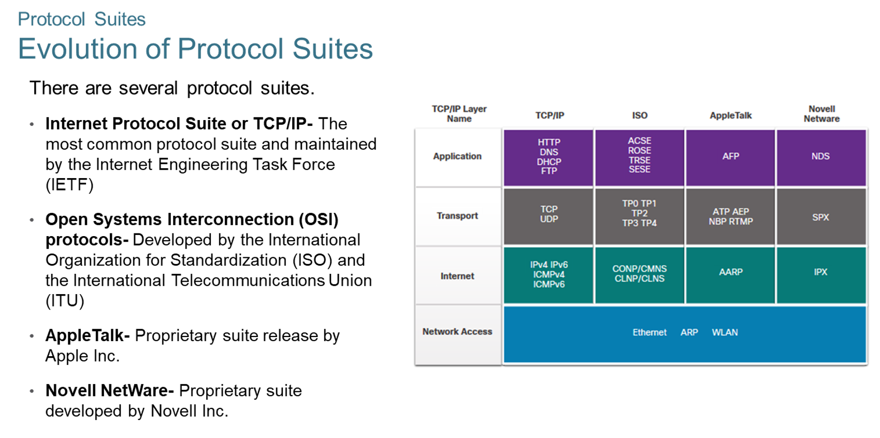
Chapter
Protocol Suites
02

Slide 19
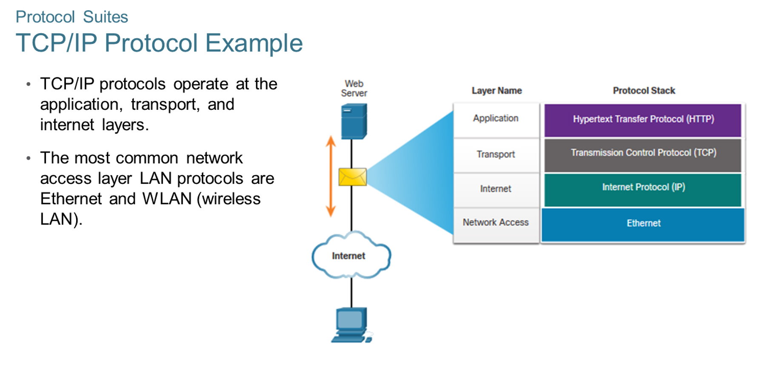
Chapter
Protocol Suites
02

Slide 20
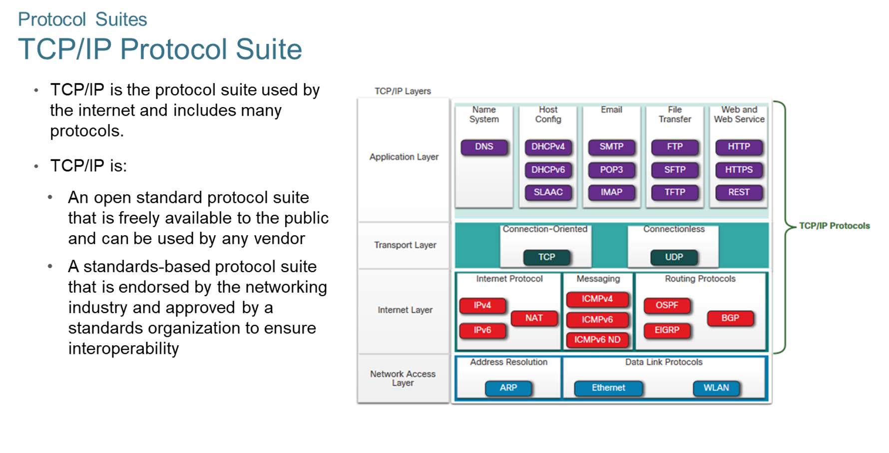
Chapter
Protocol Suites
02

Slide 21
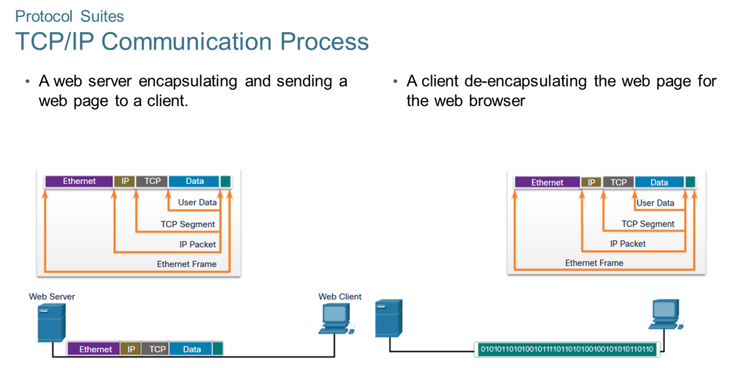
Chapter
Protocol Suites
02

Slide 22
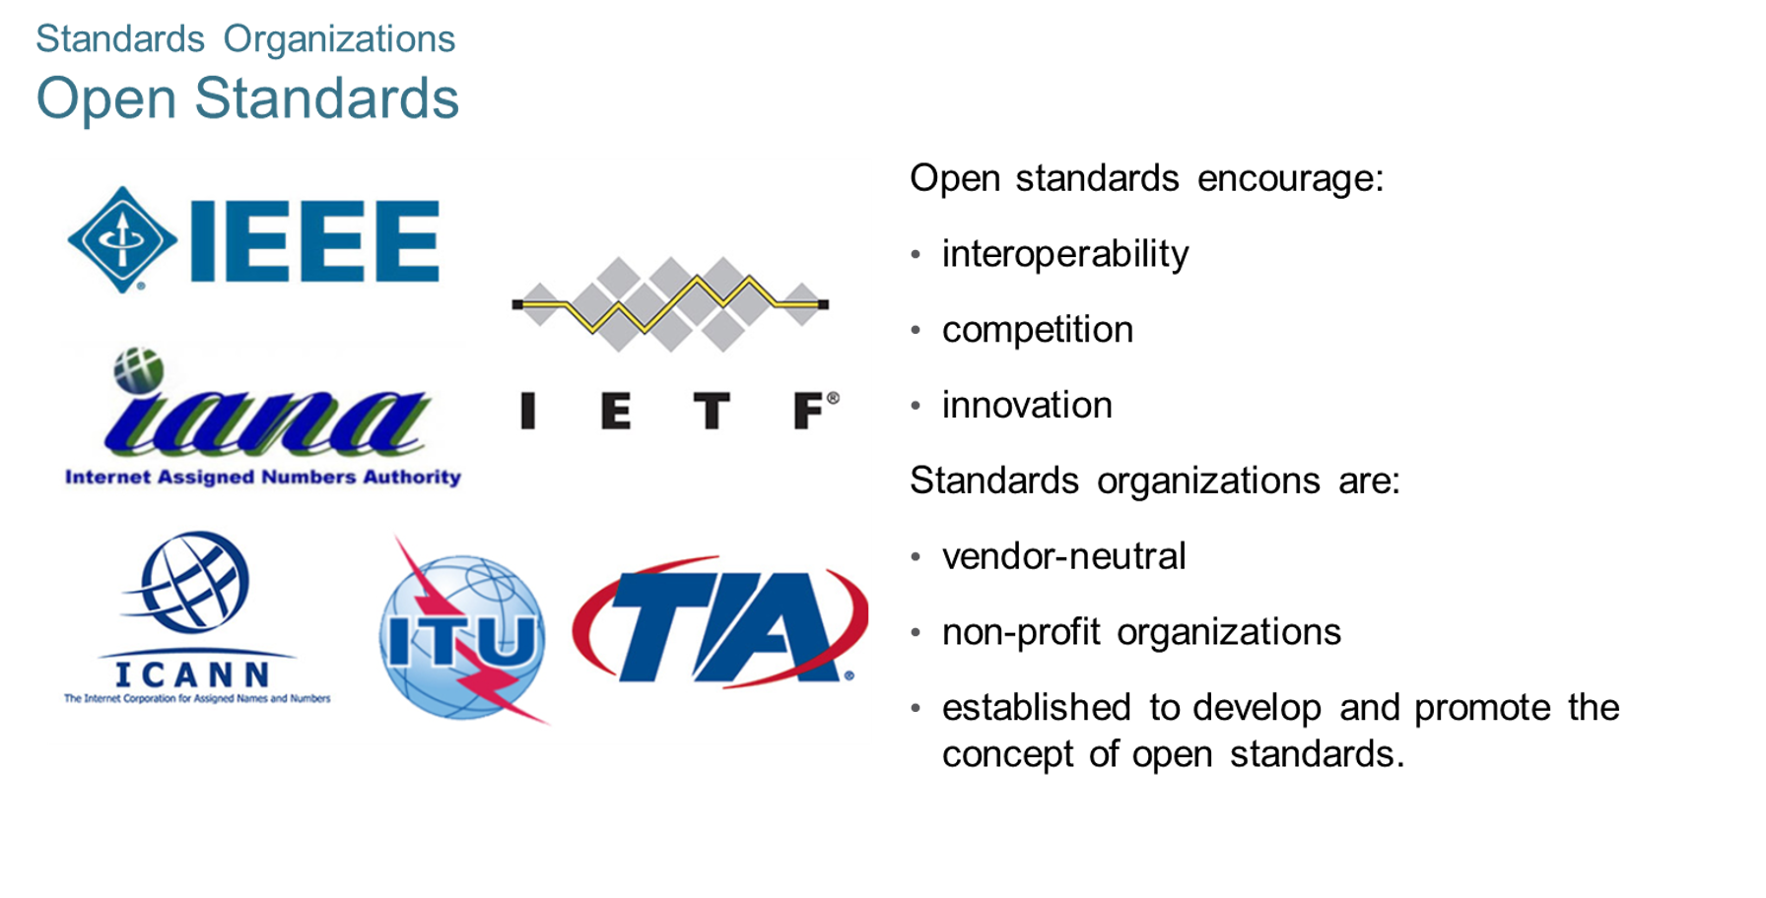
Chapter
Standards Organizations
02

Slide 23
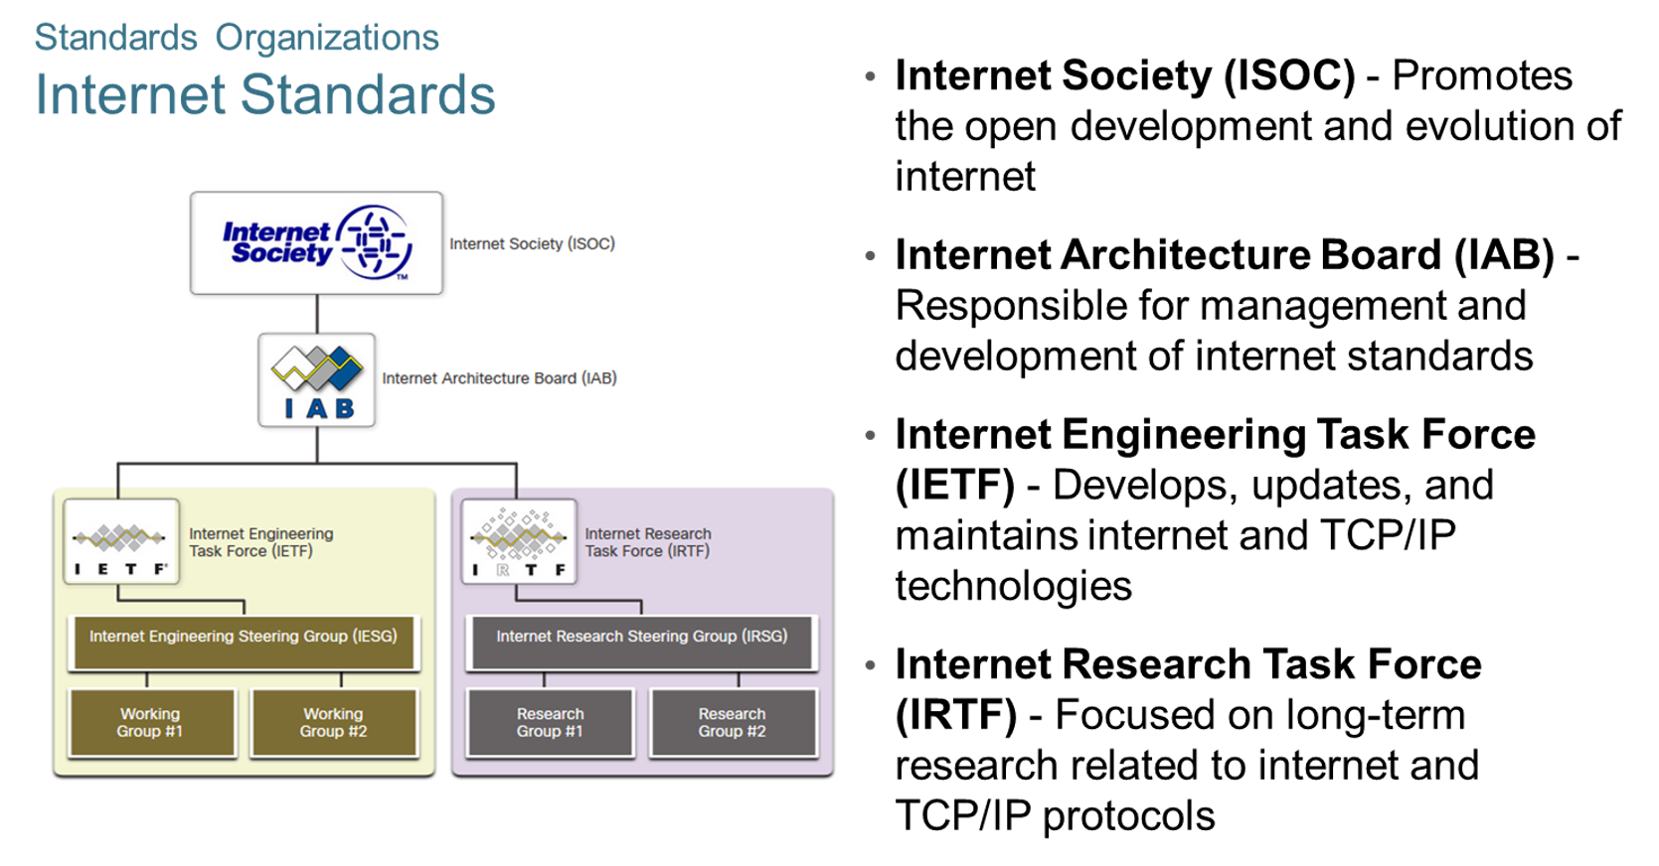
Chapter
Standards Organizations
02

Slide 24
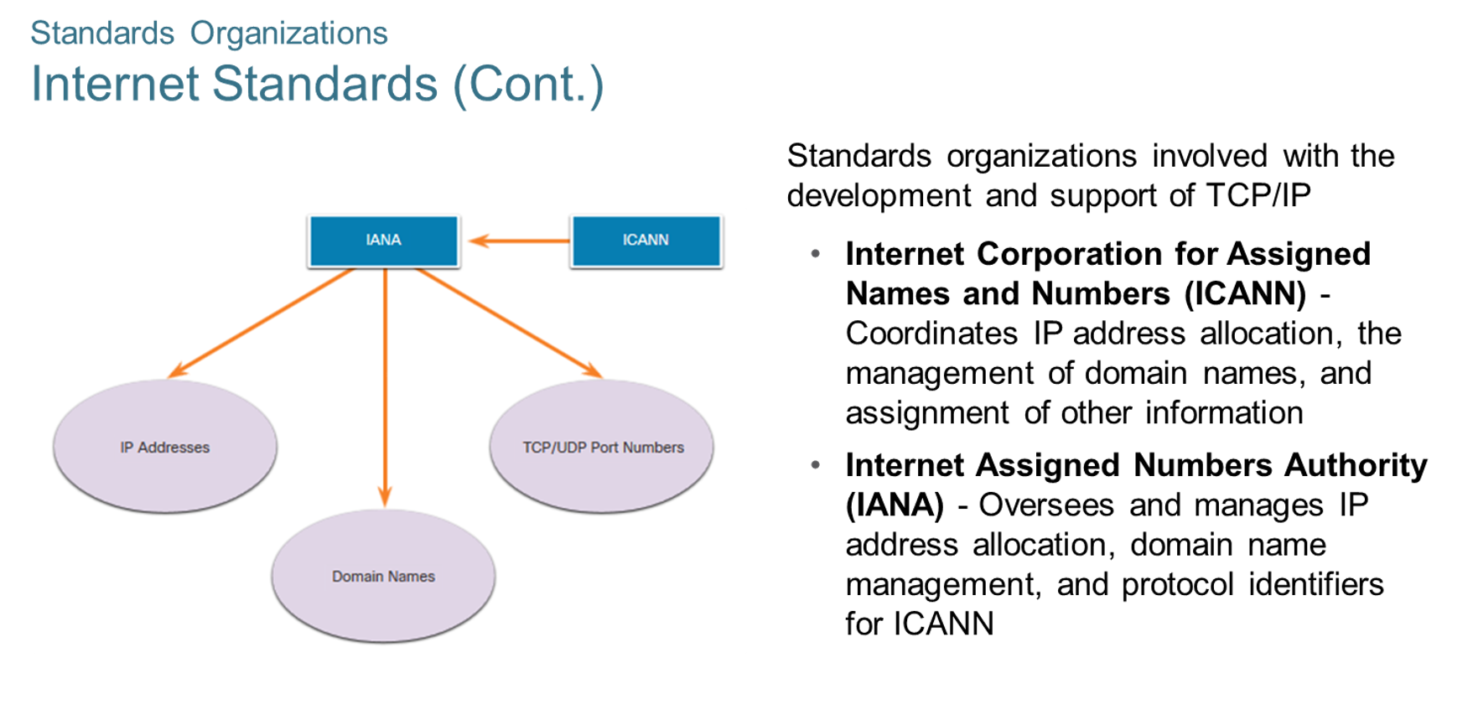
Chapter
Standards Organizations
02

Slide 25
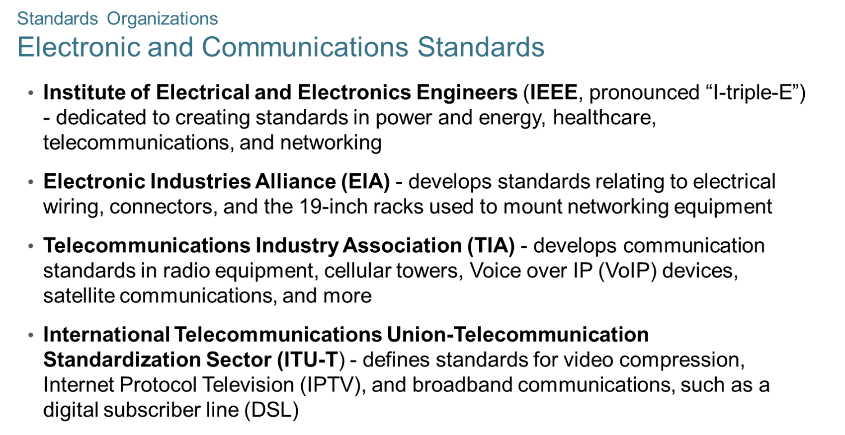
Chapter
Standards Organizations
02

Slide 26
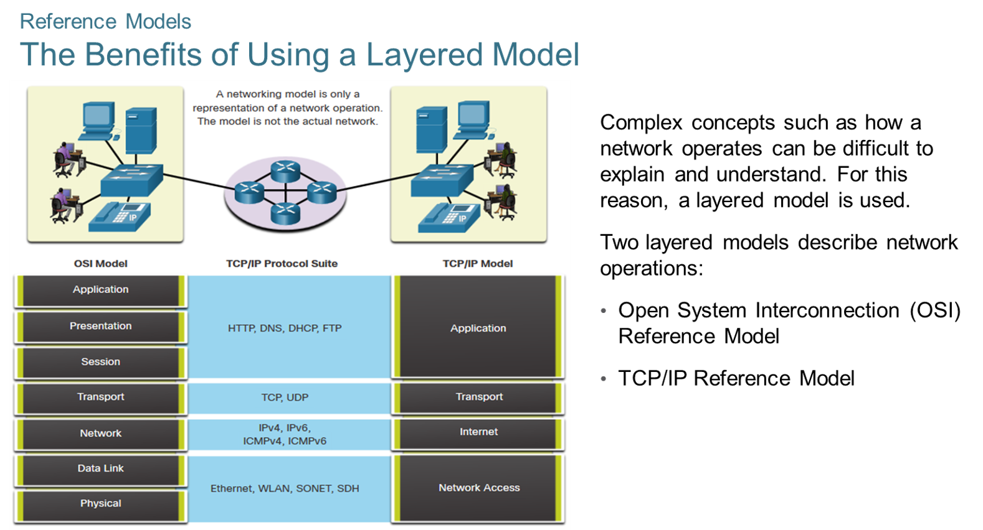
Chapter
Reference Models
02

Slide 27
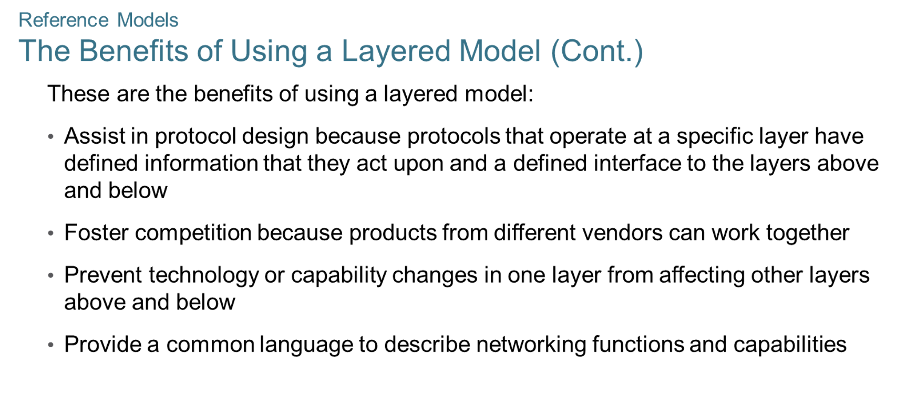
Chapter
Reference Models
02

Slide 28
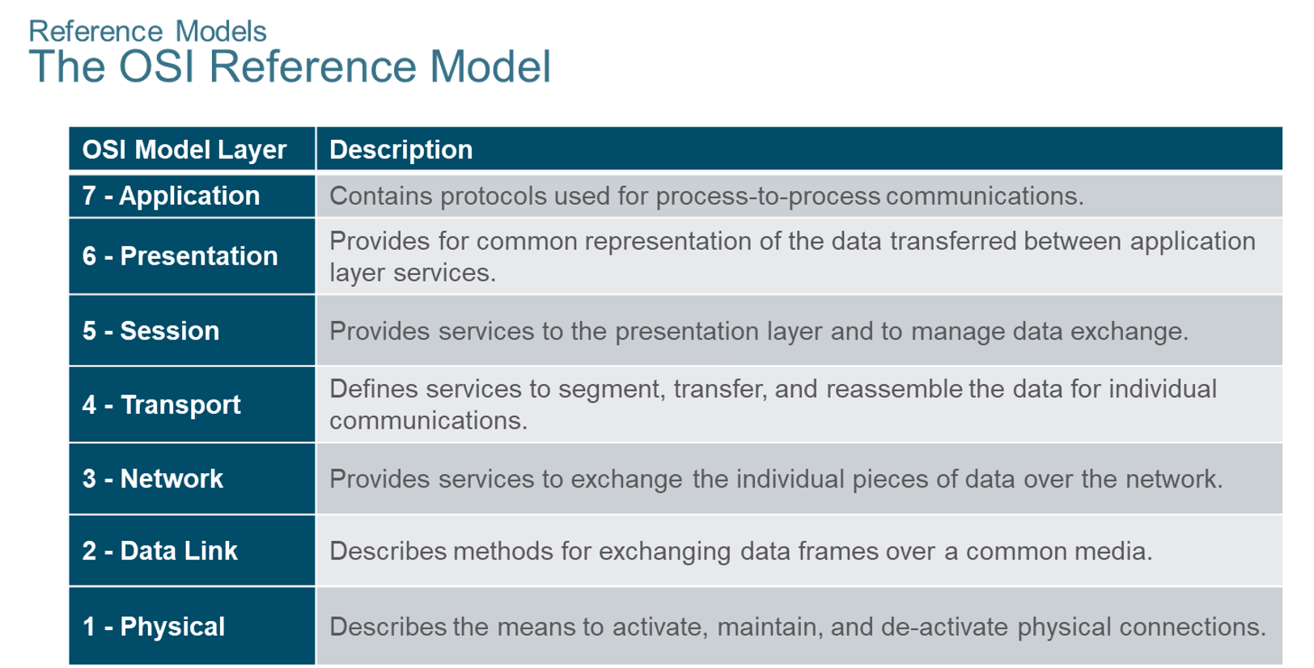
Chapter
Reference Models
02

Slide 29
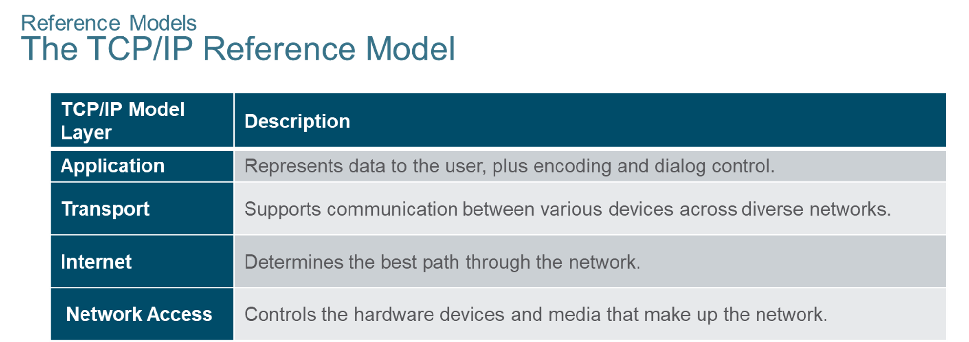
Chapter
Reference Models
02

Slide 30
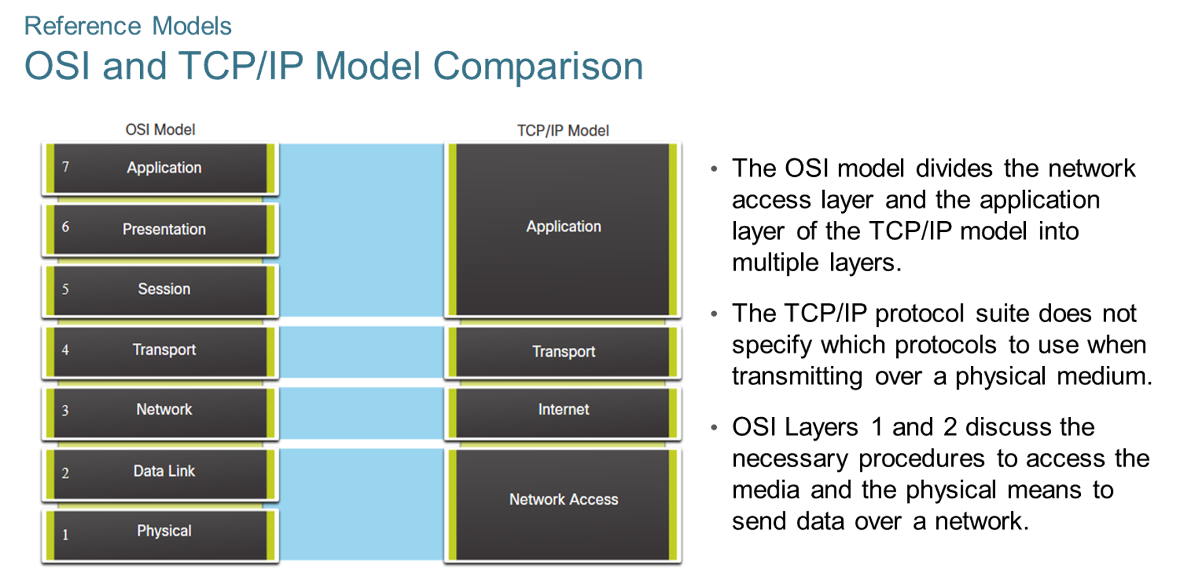
Chapter
Reference Models
02

Slide 31
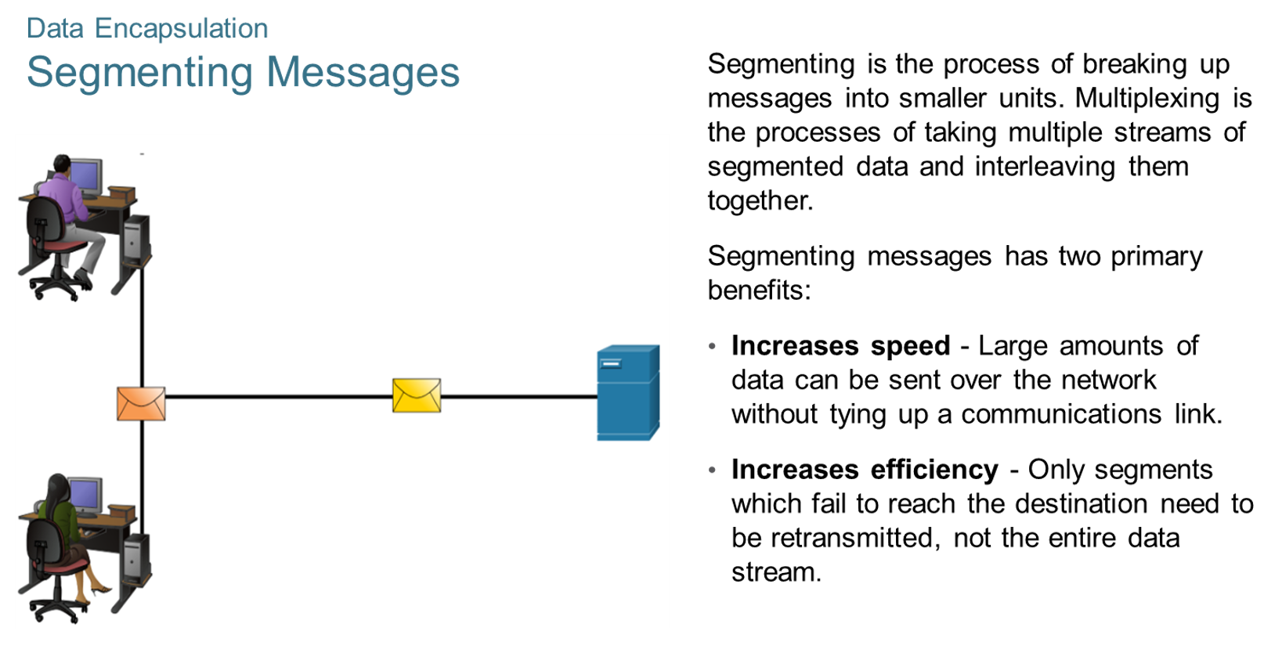
Chapter
Data Encapsulation
02

Slide 32
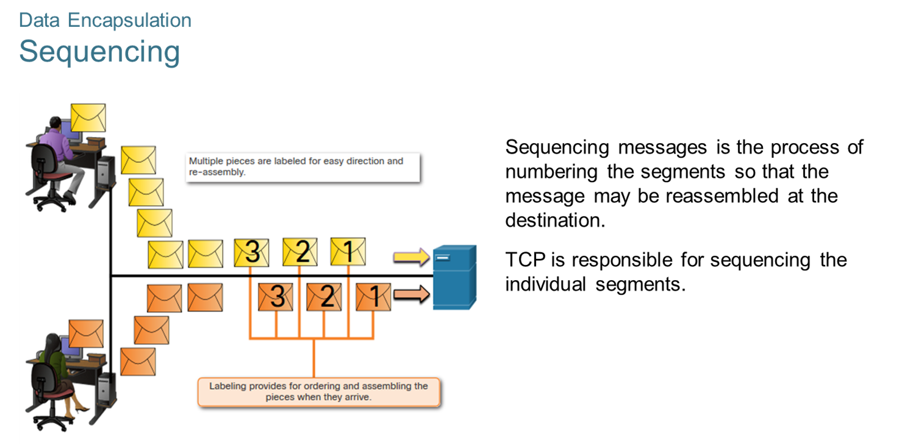
Chapter
Data Encapsulation
02

Slide 33
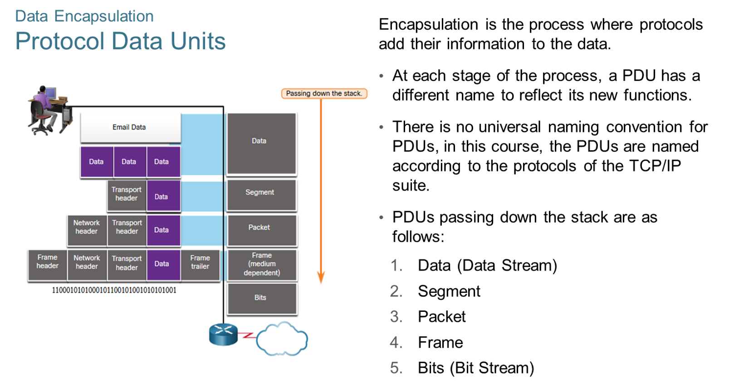
Chapter
Data Encapsulation
02

Slide 34
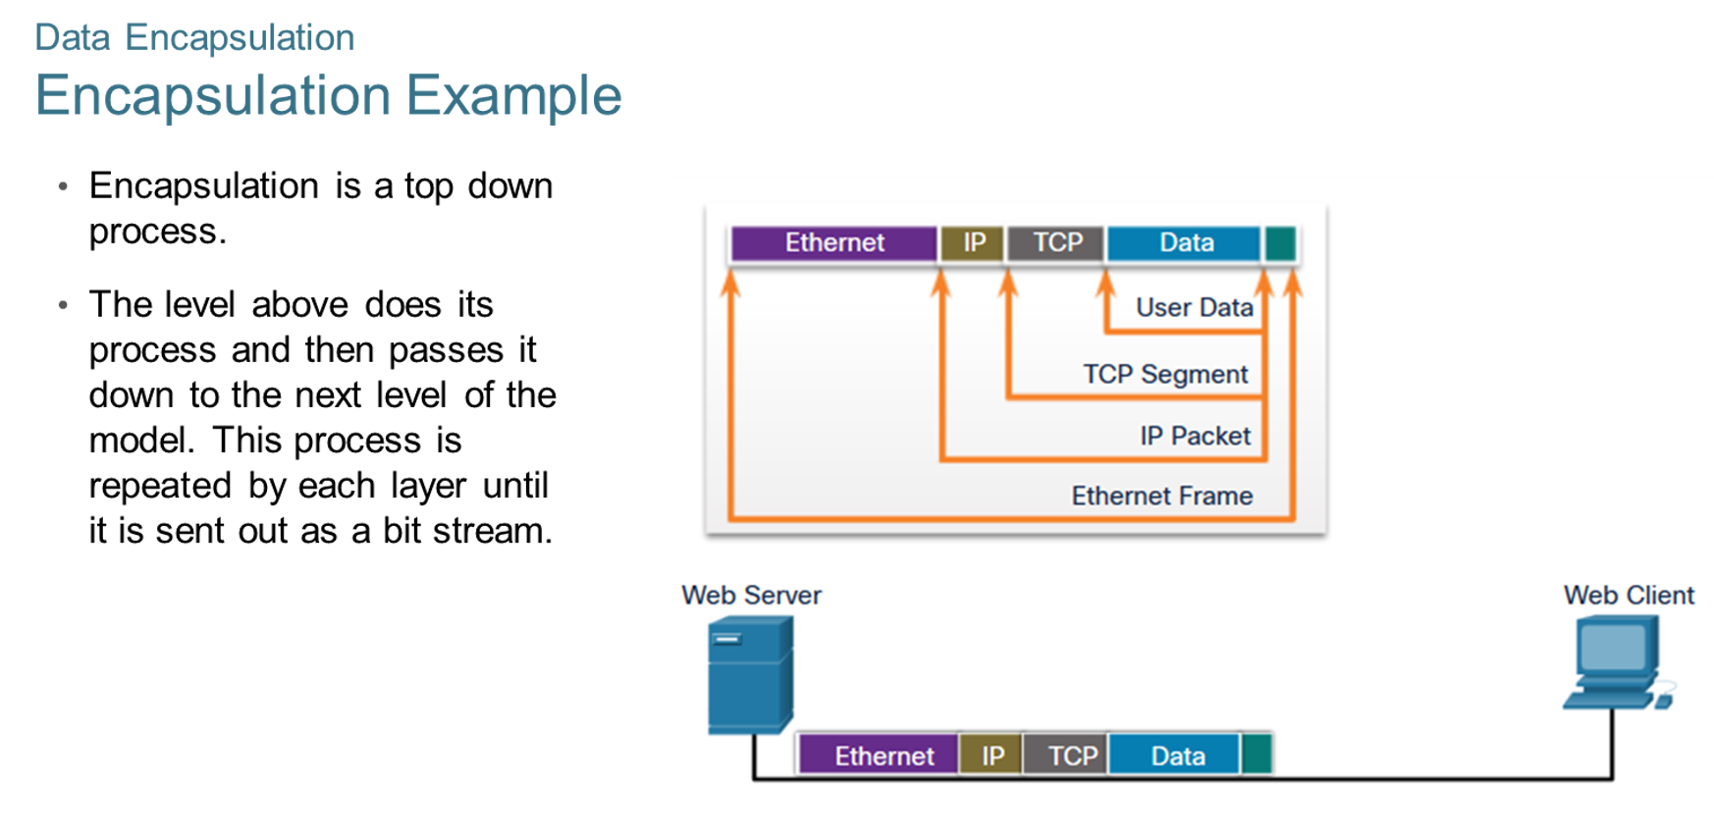
Chapter
Data Encapsulation
02

Slide 35
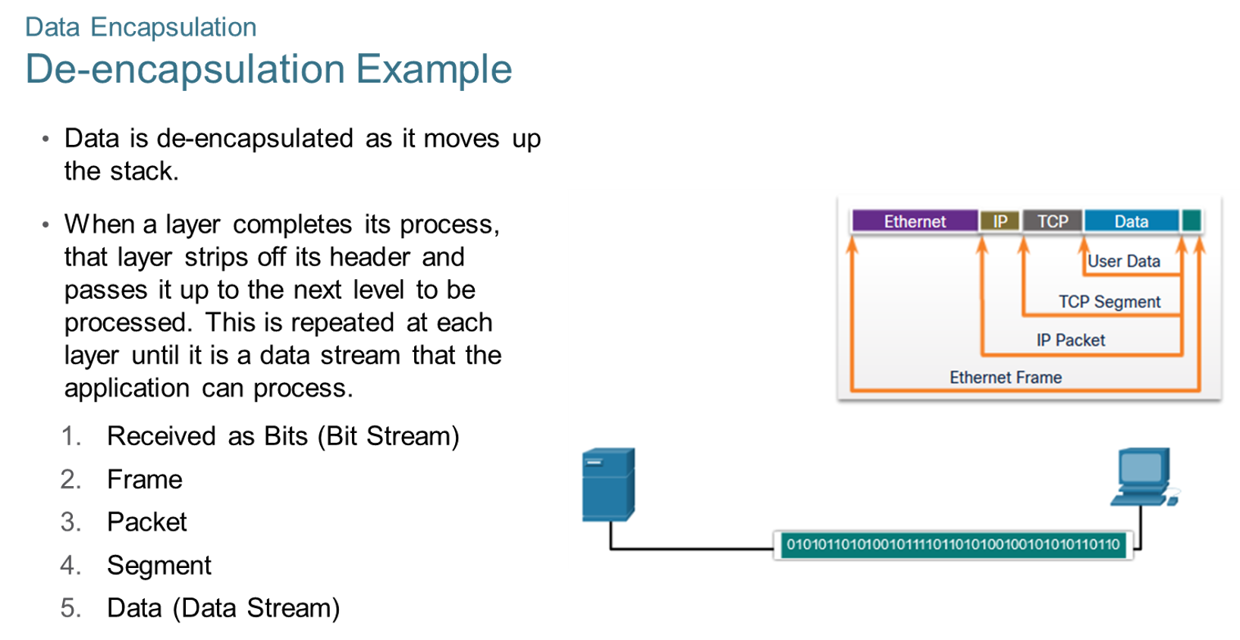
Chapter
Data Encapsulation
02

Slide 36
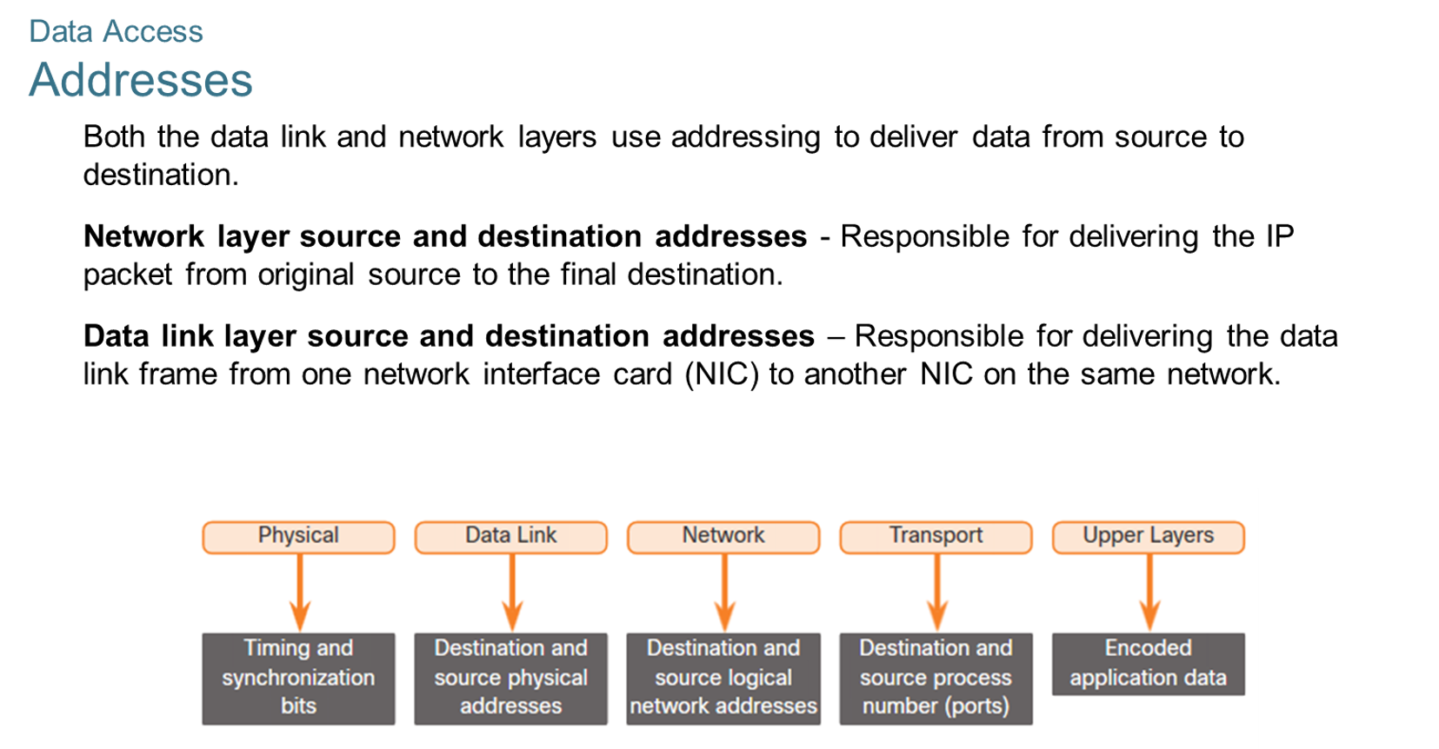
Chapter
Data Access
02

Slide 37
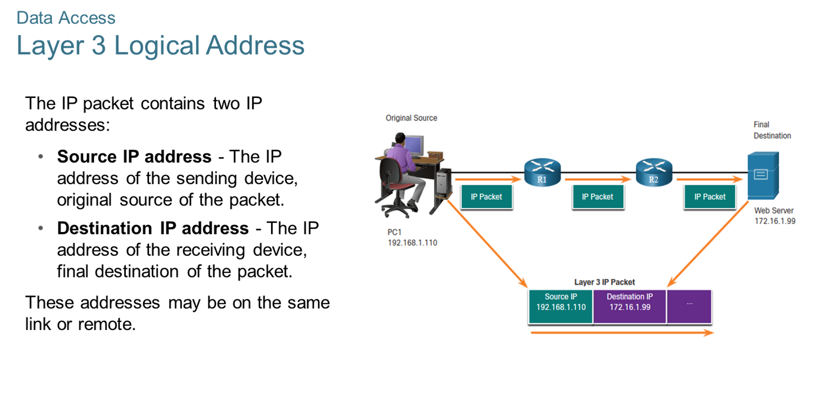
Chapter
Data Access
02

Slide 38
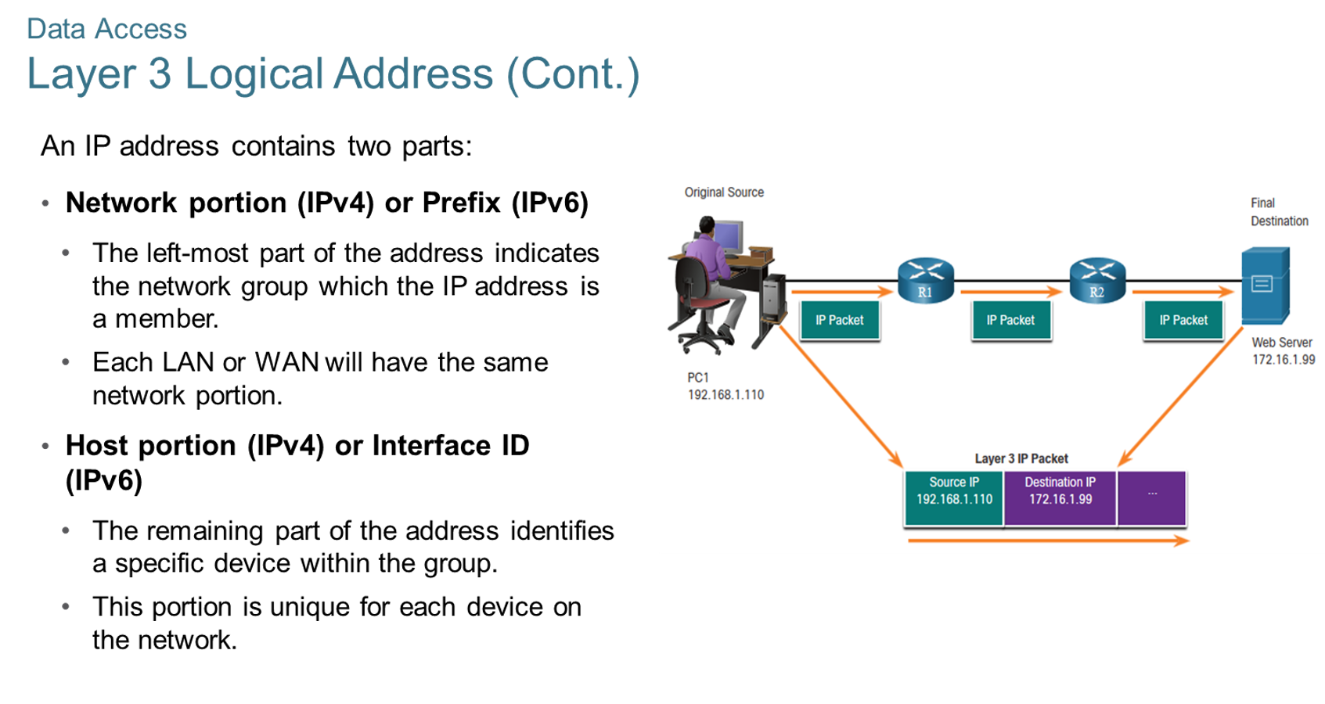
Chapter
Data Access
02

Slide 39
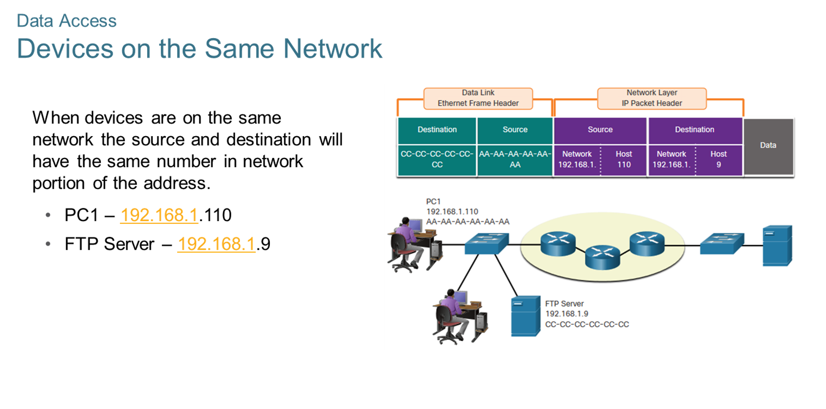
Chapter
Data Access
02

Slide 40
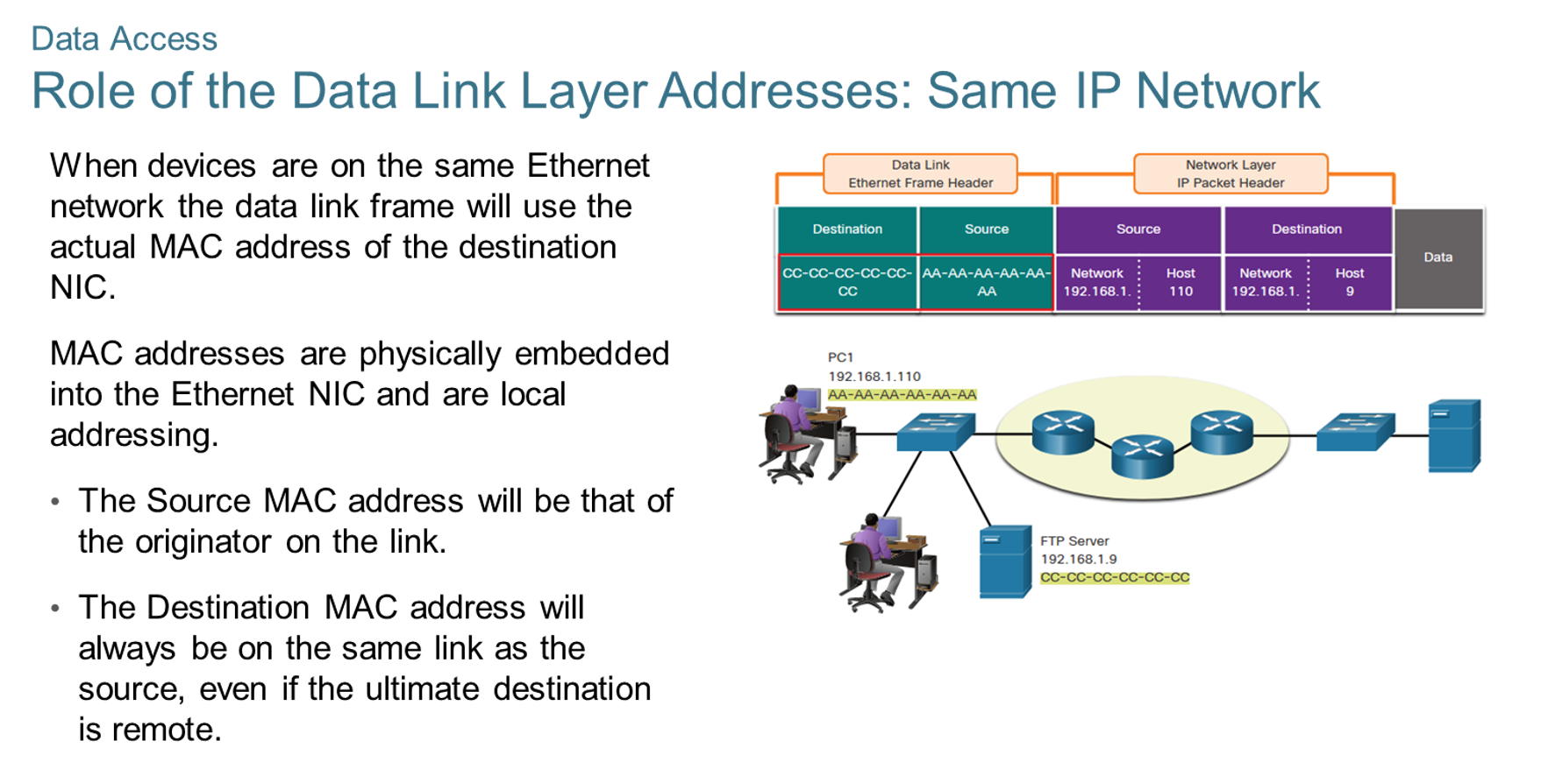
Chapter
Data Access
02

Slide 41
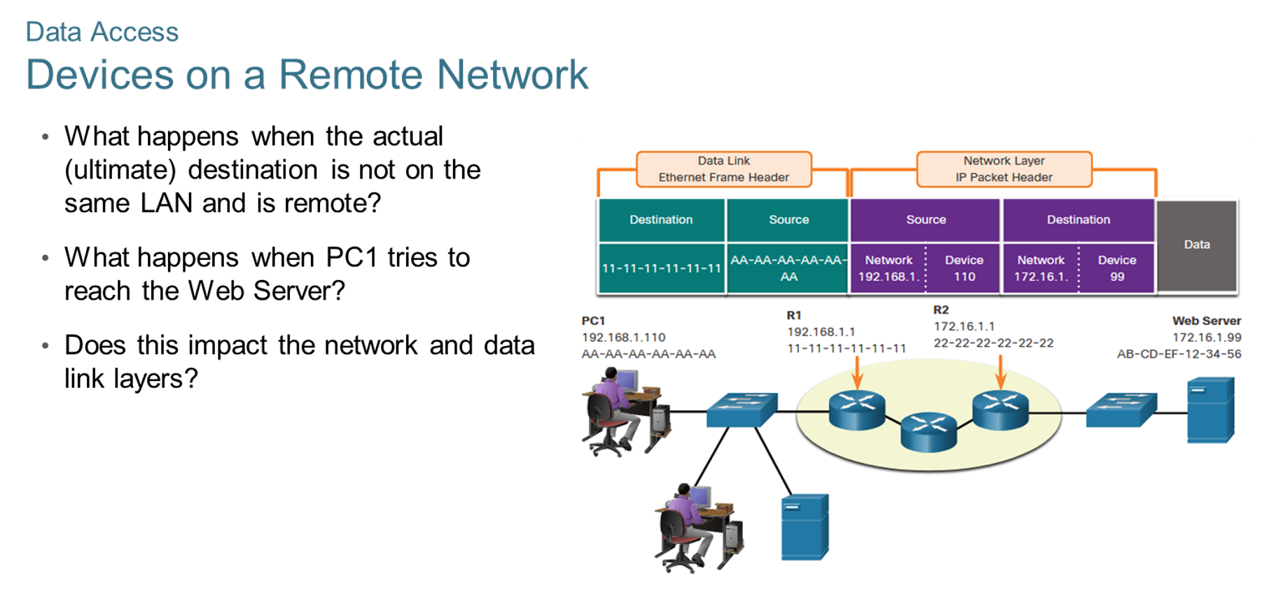
Chapter
Data Access
02

Slide 42
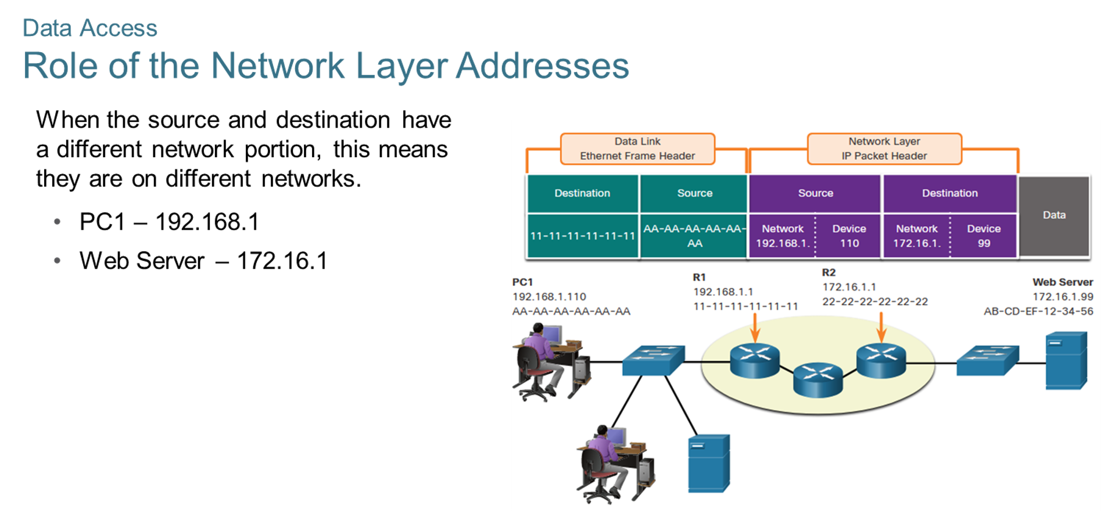
Chapter
Data Access
02

Slide 43
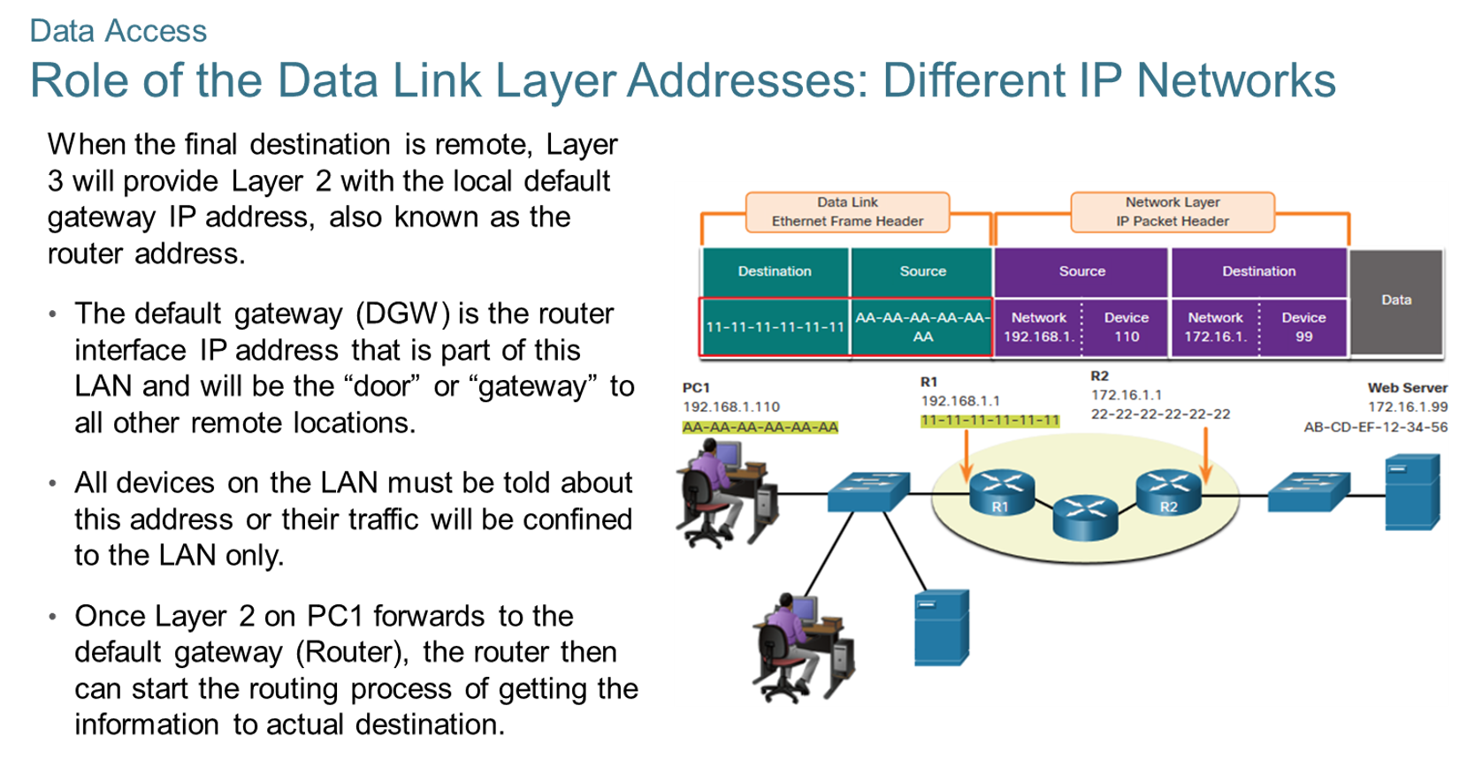
Chapter
Data Access
02

Slide 44
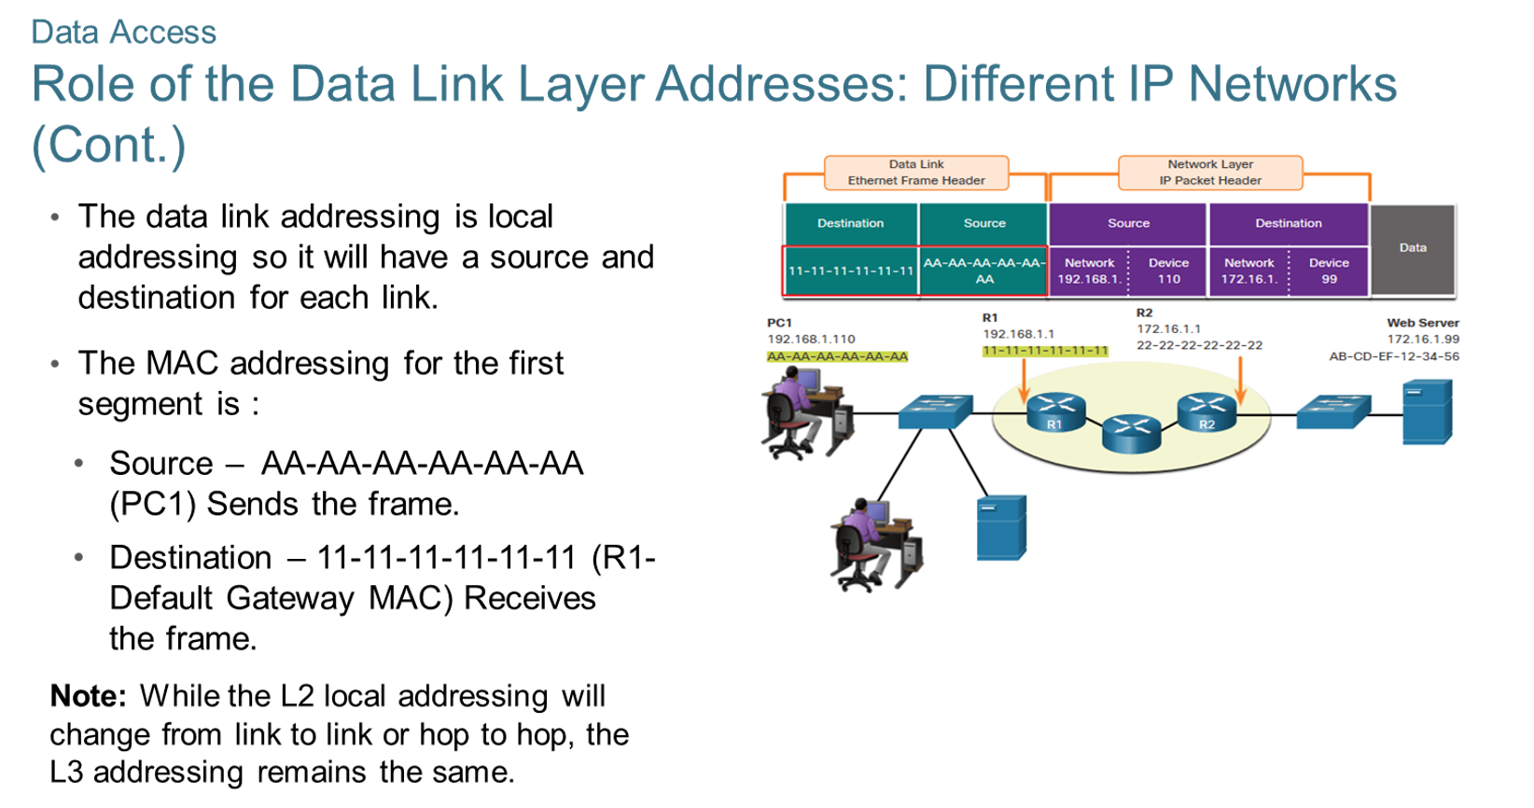
Chapter
Data Access
02

Slide 45
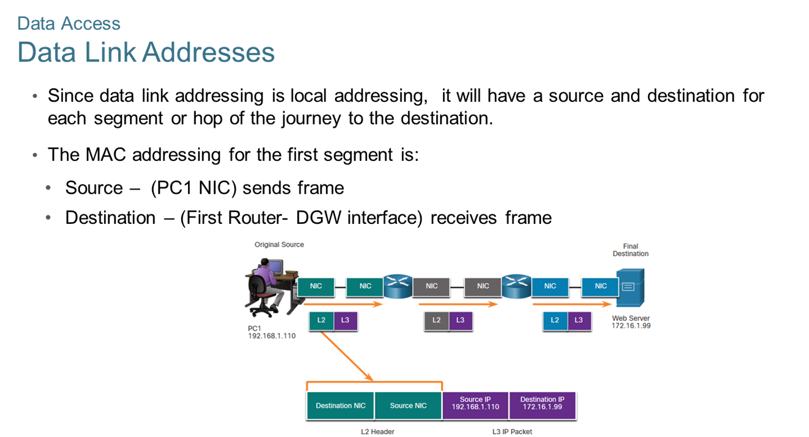
Chapter
Data Access
02

Slide 46
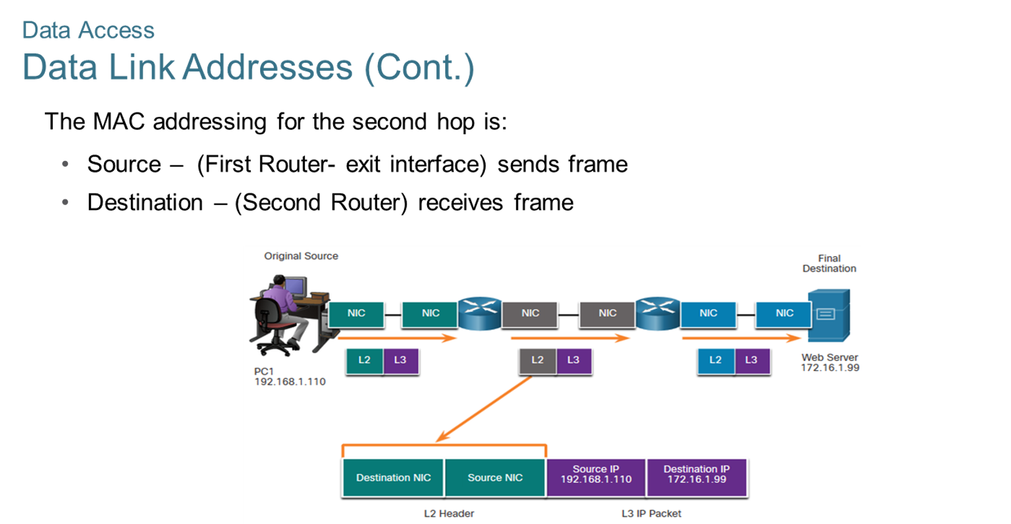
Chapter
Data Access
02

Slide 47
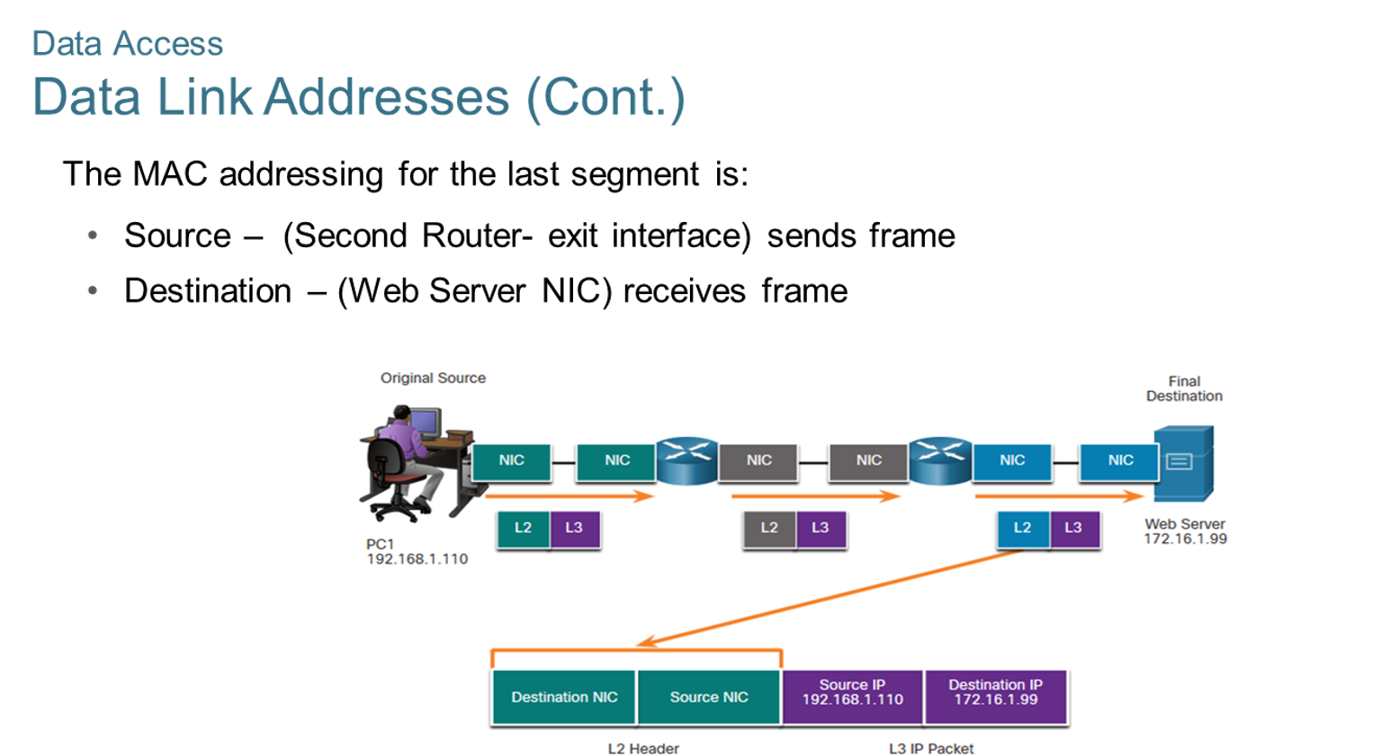
Chapter
Data Access
02

Slide 48
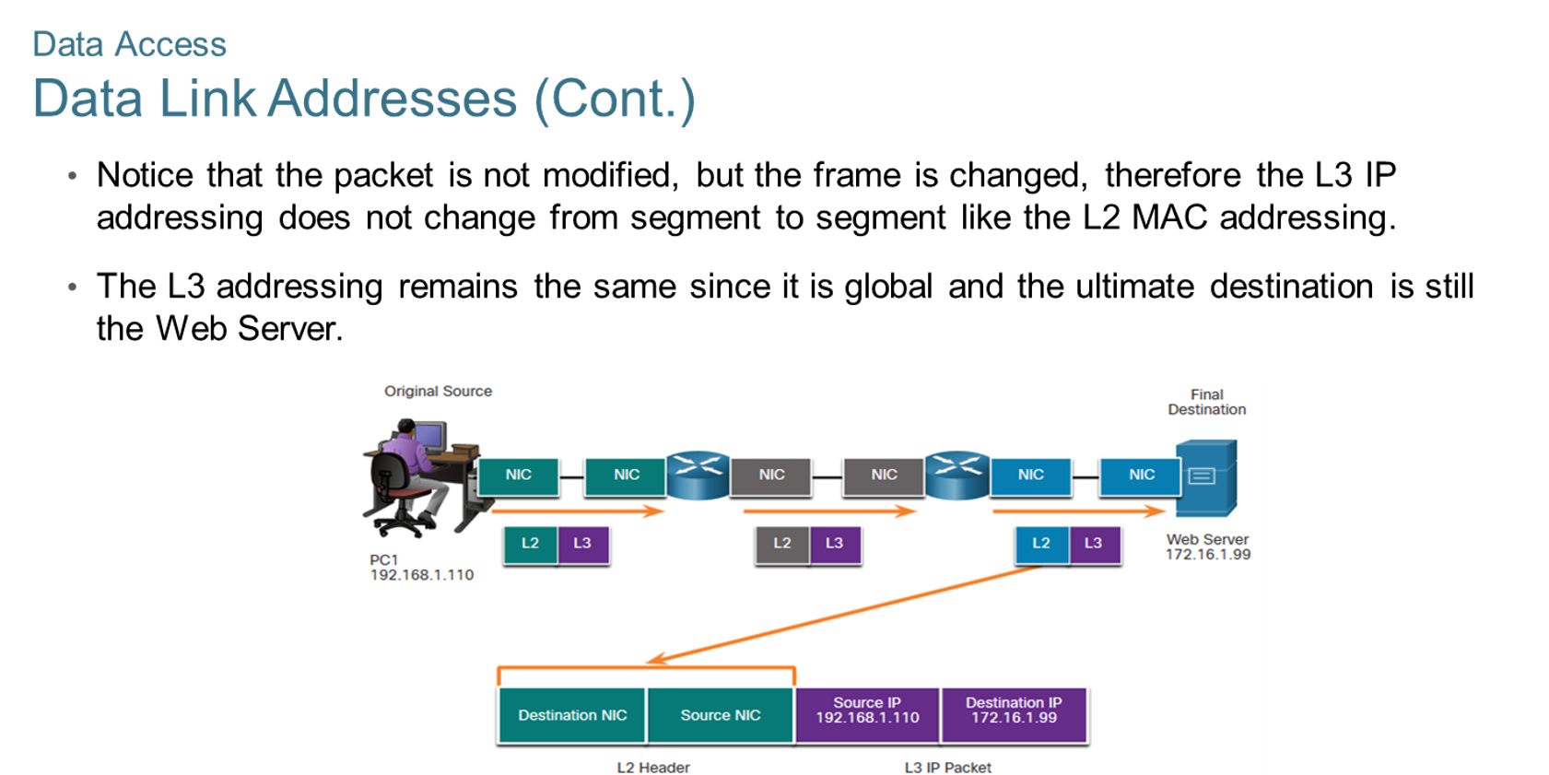
Chapter
Data Access
02

Slide 49



Thank You

