Slide 1


Machine Learning
for Finance
Prepared by Dr. Diaa Salama
FNT633
K Means Clustering
Apriori algorithm
Lecture 7

Slide 2



Machine Learning
for Finance
Lecture 7
FNT633
K Means Clustering
Apriori algorithm
Prepared by
Dr. Diaa Salama
www.midocean.ae

Slide 3
Week
08
Today
Clustering : K means Clustering
Association Rules : Apriori
www.midocean.ae

Slide 4
Week
08
Supervised learning vs. unsupervised learning
    Supervised learning: discover patterns in the data that relate data attributes with a target (class) attribute.
      These patterns are then utilized to predict the values of the target attribute in future data instances.
    Unsupervised learning: The data have no target attribute.
      We want to explore the data to find some intrinsic structures in them.
www.midocean.ae

Slide 5
Week
08
Supervised vs. Unsupervised Learning
Supervised learning (classification)
  Supervision: The training data (observations, measurements, etc.) are accompanied by labels indicating the class of the observations
  New data is classified based on the training set
Unsupervised learning (clustering)
  The class labels of training data is unknown
  Given a set of measurements, observations, etc. with the aim of establishing the existence of classes or clusters in the data
www.midocean.ae

Slide 6
Week
08
Supervised vs. Unsupervised Learning
Learning
Supervised Learning
Unsupervised Learning
Unsupervised learning (clustering)
The class labels of training data is unknown.
Given a set of measurements,
observations, etc.… with the aim of establishing the existence of
classes or clusters in the data.
Supervised learning (classification)
The class labels and the number of classes of training data is known.
New data is classified based on the training set.
www.midocean.ae

Slide 7
Week
What Kind of Problem do I Need to Solve?
How do I Solve it?
08
The Problem to Solve | The Category of Techniques | Covered in this Course
I want to group items by similarity. I want to find structure (commonalities) in the data | Clustering | K-means clustering
I want to discover relationships between actions or items | Association Rules | Apriori
I want to determine the relationship between the outcome and the input variables | Regression | Linear Regression Logistic Regression
I want to assign (known) labels to objects | Classification | Naïve Bayes Decision Trees
I want to find the structure in a temporal process I want to forecast the behavior of a temporal process | Time Series Analysis | ACF, PACF, ARIMA
I want to analyze my text data | Text Analysis | Regular expressions, Document representation (Bag of Words).
www.midocean.ae

Slide 8
Week
03
K Means Clustering
www.midocean.ae

Slide 9
Week
03
KNN
Used for
    Classification
    Regression
www.midocean.ae

Slide 10
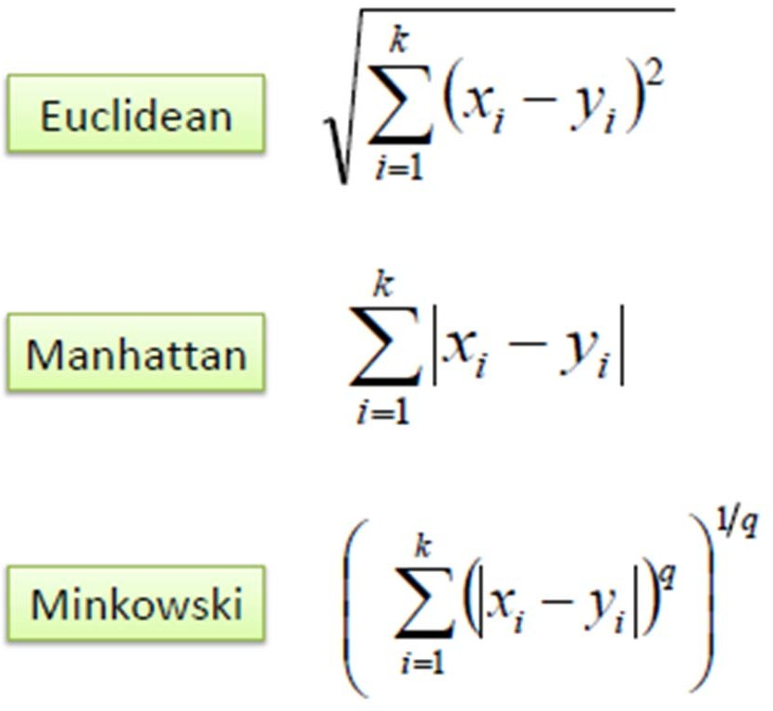
Week
03
K-Nearest Neighbor Classification
K nearest neighbors measured by a distance function.
These functions are valid only with continuous variables.
www.midocean.ae

Slide 11
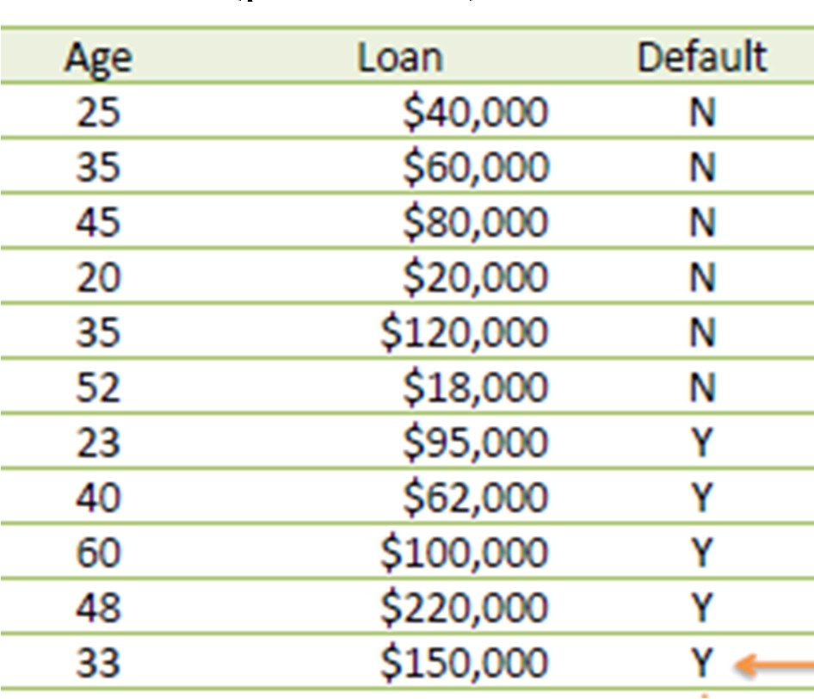
Week
03
KNN Example
Consider the following data concerning credit default. Age and Loan are two numerical variables (predictors) and Default is the target.
Know we want to classify unknown case ((Age=48 and Loan=$142,000) using Euclidean distance.) !!!!
www.midocean.ae

Slide 12
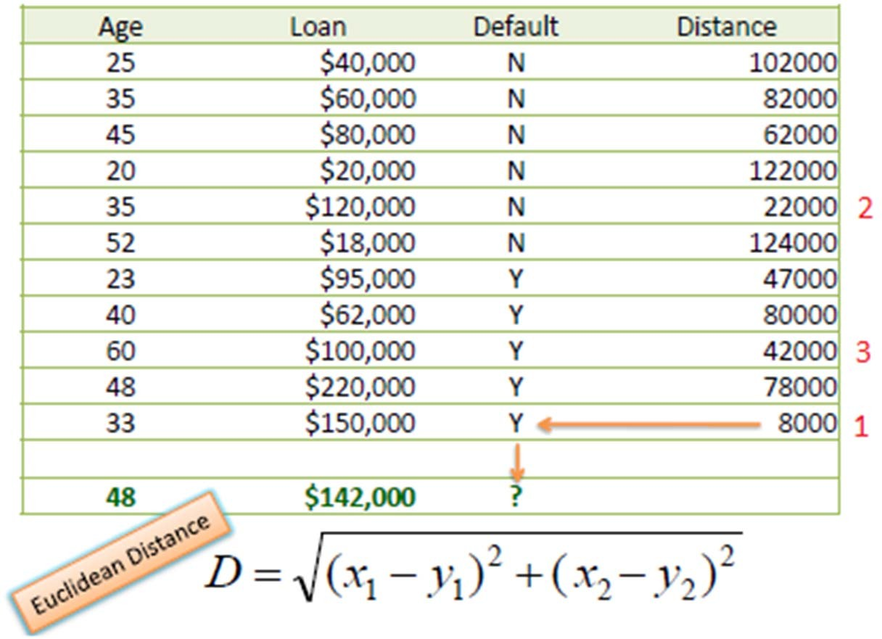
Week
03
KNN Example
Using Euclidean distance: E.g. distance between (48, $142k) and (33, 150k)
▫ Sqrt[(48-33)^2 + (142000-150000)^2] = 8000.01
So for all the dataset
www.midocean.ae

Slide 13
Week
08
K-means Clustering
    During this lesson the following topics are covered:
    Clustering – Unsupervised learning method
    K-means clustering:
    Use cases
    The algorithm
    Determining the optimum value for K
    Diagnostics to evaluate the effectiveness of the method
    Reasons to Choose (+) and Cautions (-) of the method
www.midocean.ae

Slide 14
Week
08
Clustering
    Clustering is a technique for finding similarity groups in data, called clusters. I.e.,
        it groups data instances that are similar to (near) each other in one cluster and data instances that are very different (far away) from each other into different clusters.
    Clustering is often called an unsupervised learning task as no class values denoting an a priori grouping of the data instances are given, which is the case in supervised learning.
    Due to historical reasons, clustering is often considered synonymous with unsupervised learning.
        In fact, association rule mining is also unsupervised
    This chapter focuses on clustering.
www.midocean.ae

Slide 15
Week
08
What is clustering for?
    Let us see some real-life examples
    Example 1: groups people of similar sizes together to make “small”, “medium” and “large” T-Shirts.
        Tailor-made for each person: too expensive
        One-size-fits-all: does not fit all.
    Example 2: In marketing, segment customers according to their similarities
        To do targeted marketing.
www.midocean.ae

Slide 16
Week
08
What is clustering for? (cont…)
    Example 3: Given a collection of text documents, we want to organize them according to their content similarities,
        To produce a topic hierarchy
    In fact, clustering is one of the most utilized data mining techniques.
        It has a long history, and used in almost every field, e.g., medicine, psychology, botany, sociology, biology, archeology, marketing, insurance, libraries, etc.
        In recent years, due to the rapid increase of online documents, text clustering becomes important.
www.midocean.ae

Slide 17
Week
08
Clustering
    How do I group these documents by topic?
    How do I group my customers by purchase patterns?
    Sort items into groups by similarity:
        Items in a cluster are more similar to each other than they are to items in other clusters.
        Need to detail the properties that characterize “similarity”
            Or of distance, the "inverse" of similarity
    Not a predictive method; finds similarities, relationships
    Our Example: K-means Clustering
www.midocean.ae

Slide 18
Week
08
What is clustering
    Aspects of clustering
A clustering algorithm
  Partitional clustering
  Hierarchical clustering
  …
A distance (similarity, or dissimilarity) function
Clustering quality
  Inter-clusters distance ⇒ maximized
  Intra-clusters distance ⇒ minimized
The quality of a clustering result depends on the algorithm, the distance function, and the application.
www.midocean.ae

Slide 19
Week
08
K-means algorithm
    Given k, the k-means algorithm works as follows:
        Randomly choose k data points (seeds) to be the initial centroids, cluster centers
        Assign each data point to the closest centroid
        Re-compute the centroids using the current cluster memberships.
        If a convergence criterion is not met, go to 2).
www.midocean.ae

Slide 20
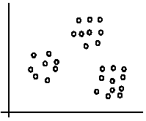
Week
08
An illustration
    The data set has three natural groups of data points, i.e., 3 natural clusters.

Slide 21
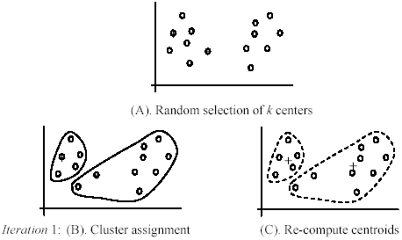
Week
08
An example
www.midocean.ae

Slide 22
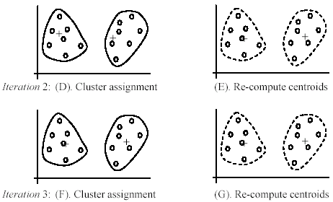
Week
08
An example (cont …)
www.midocean.ae

Slide 23
Week
08
K-Means Clustering - What is it?
    Used for clustering numerical data, usually a set of measurements about objects of interest.
    Input: numerical. There must be a distance metric defined over the variable space.
    Euclidian distance
    Output: The centers of each discovered cluster, and the assignment of each input datum to a cluster.
    Centroid
www.midocean.ae

Slide 24
Week
08
Use Cases
    Often an exploratory technique:
        Discover structure in the data
        Summarize the properties of each cluster
    Sometimes a prelude to classification:
        "Discovering the classes“
    Examples
        The height, weight and average lifespan of animals
        Household income, yearly purchase amount in dollars, number of household members of customer households
www.midocean.ae

Slide 25
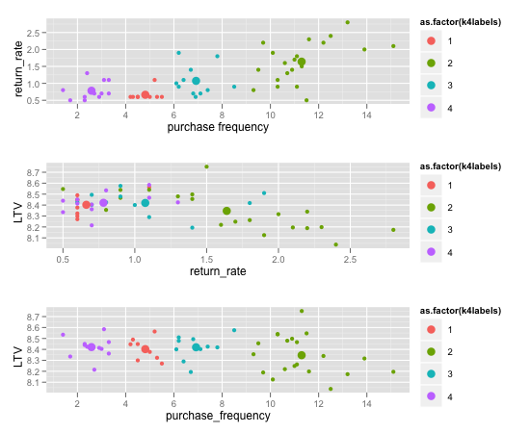
Week
08
Use-Case Example – On-line Retailer
LTV – Lifetime Customer Value
www.midocean.ae

Slide 26
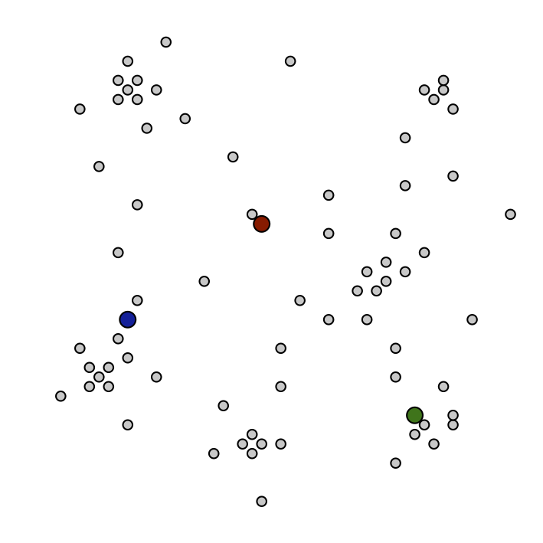
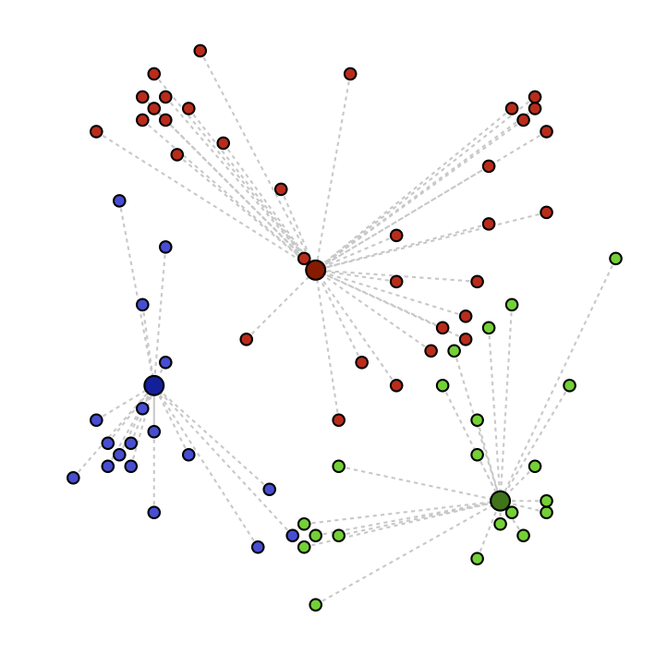
Week
08
The Algorithm
    1- Choose K; then select K random "centroids"
    In our example, K=3
    2. Assign records to the cluster with the closest centroid
www.midocean.ae

Slide 27
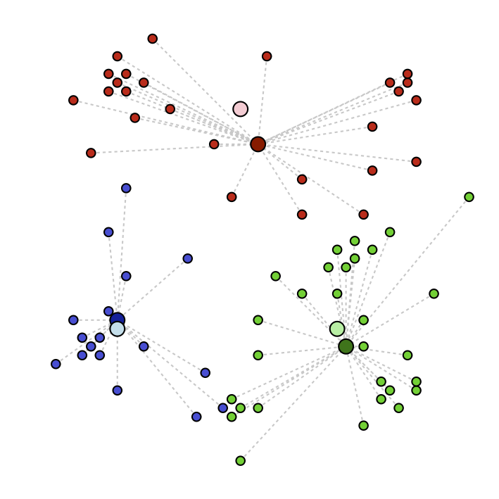
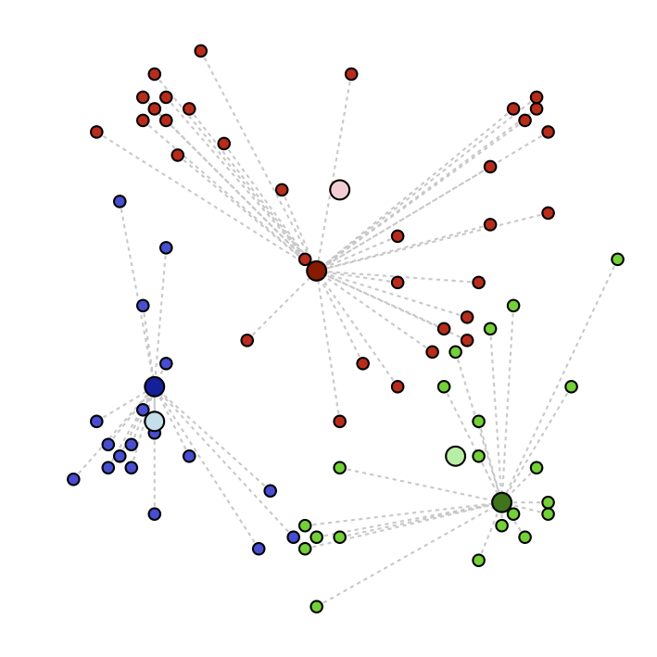
Week
08
The Algorithm
3- Recalculate the resulting centroids
  Centroid: the mean value of all the records in the cluster
4. Repeat steps 2 & 3 until record assignments no longer change
Model Output:
The final cluster centers
The final cluster assignments of the training data
www.midocean.ae

Slide 28
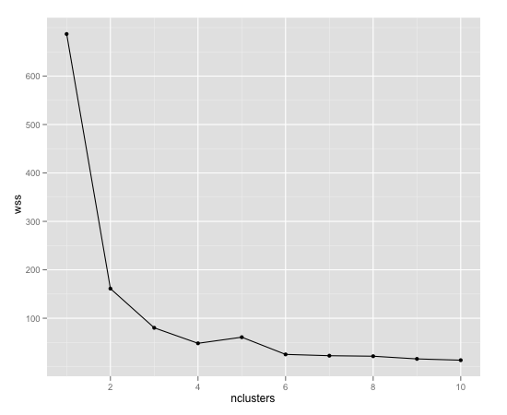
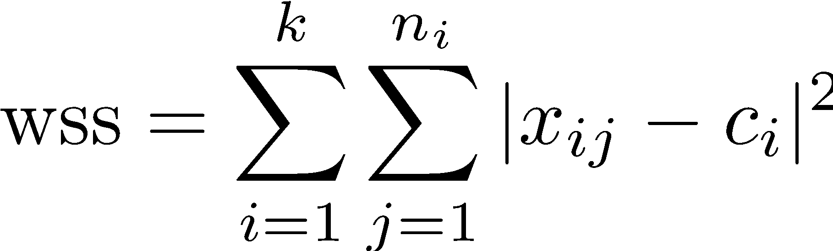
Week
08
Picking K
    Heuristic: find the "elbow" of the within-sum-of-squares (wss) plot as a function of K.
K: # of clusters
n_{i}: # points in i^{th} cluster
c_{i}: centroid of i^{th} cluster
x_{ij}: jth point of i^{th} cluster
www.midocean.ae

Slide 29
Week
08
Diagnostics – Evaluating the Model
    Do the clusters look separated in at least some of the plots when you do pair-wise plots of the clusters?
        Pair-wise plots can be used when there are not many variables
    Do you have any clusters with few data points?
        Try decreasing the value of K
    Are there splits on variables that you would expect, but don't see?
        Try increasing the value K
    Do any of the centroids seem too close to each other?
        Try decreasing the value of K
www.midocean.ae

Slide 30
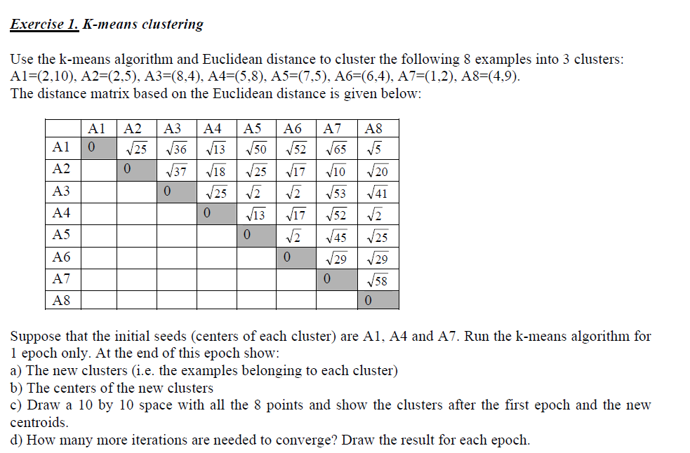
Week
08
Example 1
www.midocean.ae

Slide 31
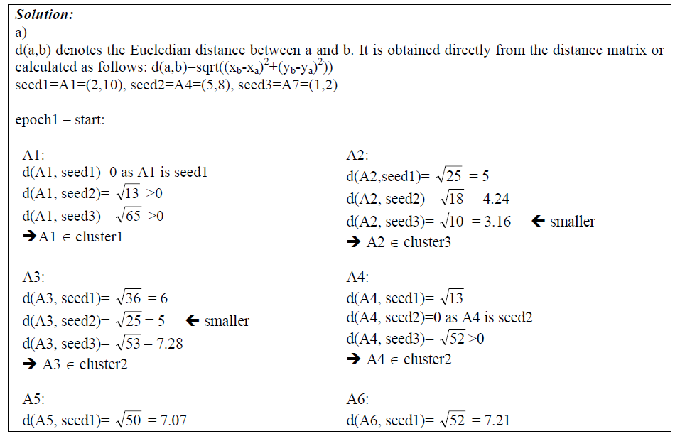
Week
08
Example 1 continue
www.midocean.ae

Slide 32
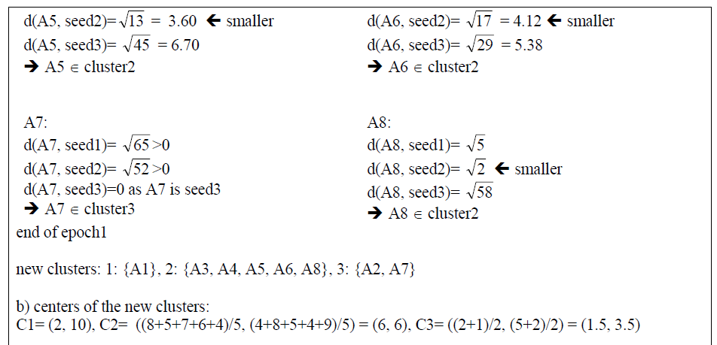
Week
08
Example continue
www.midocean.ae

Slide 33
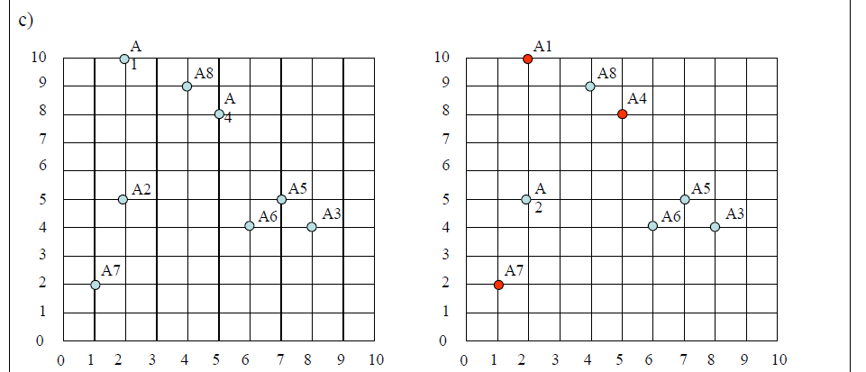
Week
08
Example 1 continue
www.midocean.ae

Slide 34
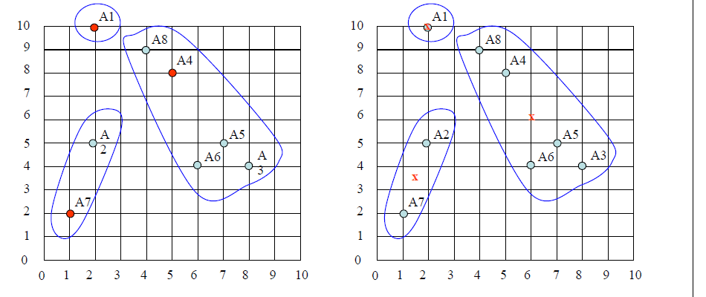
Week
08
Example 1 continue
www.midocean.ae

Slide 35
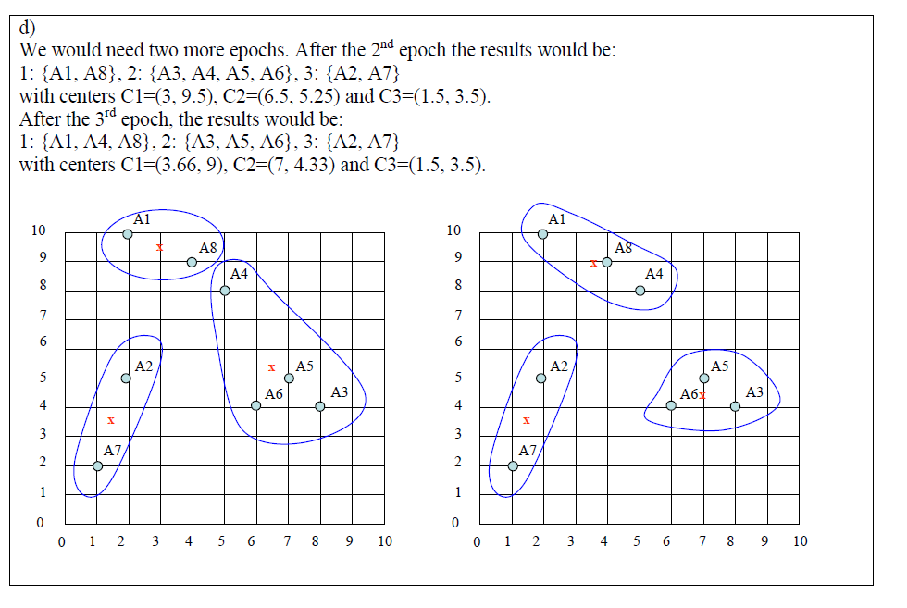
Week
08
Example 2 continue
www.midocean.ae

Slide 36
Week
K-Means Clustering - Reasons to Choose (+) and Cautions (-)
08
Reasons to Choose (+) | Cautions (-)
Easy to implement | Doesn't handle categorical variables
Easy to assign new data to existing clusters Which is the nearest cluster center? | Sensitive to initialization (first guess)
Concise output Coordinates the K cluster centers | Variables should all be measured on similar or compatible scales Not scale-invariant!
 | K (the number of clusters) must be known or decided a priori Wrong guess: possibly poor results
 | Tends to produce "round" equi-sized clusters. Not always desirable
www.midocean.ae

Slide 37
Week
08
Check Your Knowledge
    Why do we consider K-means clustering as a unsupervised machine learning algorithm?
    How do you use “pair-wise” plots to evaluate the effectiveness of the clustering?
    Detail the four steps in the K-means clustering algorithm.
    How do we use WSS to pick the value of K?
    What is the most common measure of distance used with K-means clustering algorithms?
    The attributes of a data set are “purchase decision (Yes/No), Gender (M/F), income group (<10K, 10-50K, >50K). Can you use K-means to cluster this data set?
www.midocean.ae

Slide 38
Week
08
K-means Clustering - Summary
    During this lesson the following topics were covered:
    Clustering – Unsupervised learning method
    What is K-means clustering
    Use cases with K-means clustering
    The K-means clustering algorithm
    Determining the optimum value for K
    Diagnostics to evaluate the effectiveness of K-means clustering
    Reasons to Choose (+) and Cautions (-) of K-means clustering
www.midocean.ae

Slide 39
Week
08
Apriori algorithm
Association Rules :
www.midocean.ae

Slide 40
Week
08
Association Rules
    During this lesson the following topics are covered:
        Association Rules mining
        Apriori Algorithm
        Prominent use cases of Association Rules
        Support and Confidence parameters
        Lift and Leverage
        Diagnostics to evaluate the effectiveness of rules generated
        Reasons to Choose (+) and Cautions (-) of the Apriori algorithm
www.midocean.ae

Slide 41
Week
08
Association Rules
    Which of my products tend to be purchased together?
    What do other people like this person tend to like/buy/watch?
    Discover "interesting" relationships among variables in a large database
      Rules of the form "When X observed, Y also observed"
      The definition of "interesting“ varies with the algorithm used for discovery
    Not a predictive method; finds similarities, relationships
www.midocean.ae

Slide 42
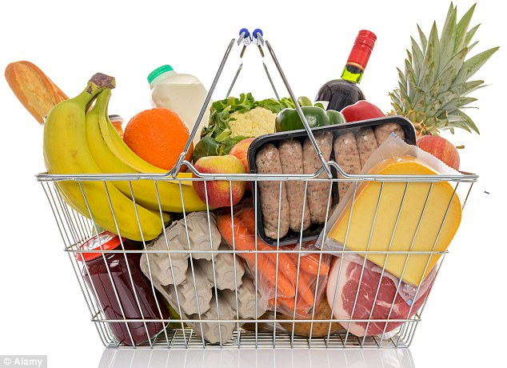
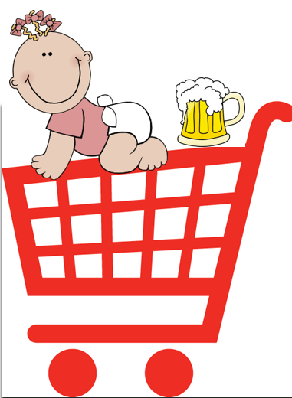
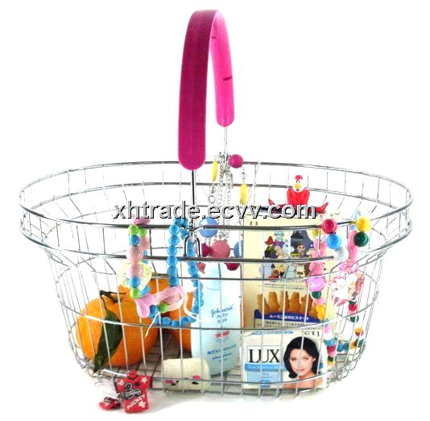
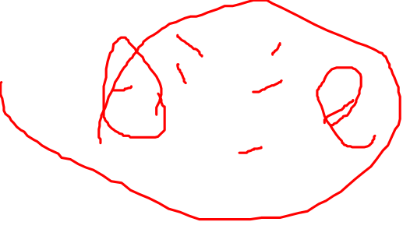
Week
08
`Basket data’
www.midocean.ae

Slide 43
Week
08
`Basket data’
    A very common type of data; often also called transaction data. Next slide shows example transaction database, where each record represents a transaction between (usually) a customer and a shop. Each record in a supermarket’s transaction DB, for example, corresponds to a basket of specific items.
www.midocean.ae

Slide 44
ID apples, beer, cheese, dates, eggs, fish, glue, honey, ice-cream
Week
08
1 | 1 | 1 |  | 1 |  |  | 1 | 1
2 |  |  | 1 | 1 | 1
3 |  | 1 | 1 |  |  | 1
4 |  | 1 |  |  |  | 1 |  |  | 1
5 |  |  |  |  | 1 |  | 1
6 |  |  |  |  |  | 1 |  |  | 1
7 | 1 |  |  | 1 |  |  |  | 1
8 |  |  |  |  |  | 1 |  |  | 1
9 |  |  | 1 |  | 1
10 |  | 1 |  |  |  |  | 1
11 |  |  |  |  | 1 |  | 1
12 | 1
13 |  |  | 1 |  |  | 1
14 |  |  | 1 |  |  | 1
15 |  |  |  |  |  |  |  | 1 | 1
16 |  |  |  | 1
17 | 1 |  |  |  |  | 1
18 | 1 | 1 | 1 | 1 |  |  |  | 1
19 | 1 | 1 |  | 1 |  |  | 1 | 1
20 |  |  |  |  | 1
www.midocean.ae

Slide 45
Week
08
Numbers
    example transaction DB has 20 records of supermarket transactions, from a supermarket that only sells 9 things
    One month in a large supermarket with five stores spread around a reasonably sized city might easily yield a DB of 20,000,000 baskets, each containing a set of products from a pool of around 1,000
www.midocean.ae

Slide 46
Week
08
Association Rules - Apriori
    Specifically designed for mining over transactions in databases
    Used over itemsets: sets of discrete variables that are linked:
        Retail items that are purchased together
        A set of tasks done in one day
        A set of links clicked on by one user in a single session
    Our Example: Apriori
www.midocean.ae

Slide 47
Week
08
Apriori Algorithm - What is it? Support
    Earliest of the association rule algorithms
    Frequent itemset: a set of items L that appears together "often enough“:
        Formally: meets a minimum support criterion
        Support: the % of transactions that contain L
    Apriori Property: Any subset of a frequent itemset is also frequent
        It has at least the support of its superset
www.midocean.ae

Slide 48
Week
08
Apriori Algorithm (Continued) Confidence
    Iteratively grow the frequent itemsets from size 1 to size K (or until we run out of support).
        Apriori property tells us how to prune the search space
    Frequent itemsets are used to find rules X->Y with a minimum confidence:
        Confidence: The % of transactions that contain X, which also contain Y
    Output: The set of all rules X -> Y with minimum support and confidence
www.midocean.ae

Slide 49
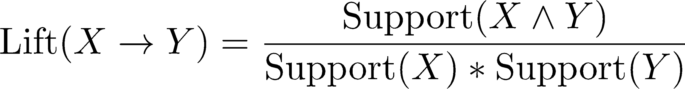
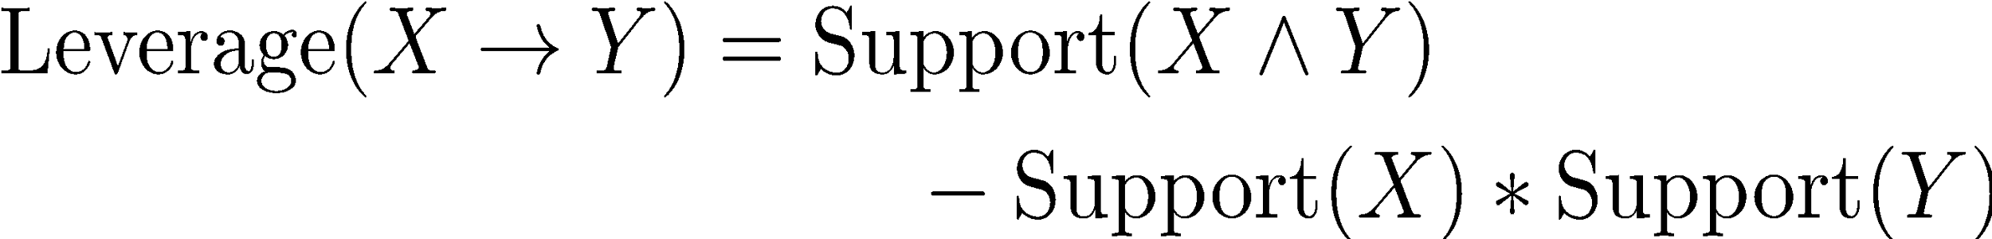
Week
08
Lift and Leverage
www.midocean.ae

Slide 50
Week
08
Association Rules Implementations
    Market Basket Analysis
        People who buy milk also buy cookies 60% of the time.
    Recommender Systems
        "People who bought what you bought also purchased….“.
    Discovering web usage patterns
        People who land on page X click on link Y 76% of the time.
www.midocean.ae

Slide 51
Week
08
Use Case Example: Credit Records
Credit ID | Attributes
1 | credit_good, female_married, job_skilled, home_owner, …
2 | credit_bad, male_single, job_unskilled, renter, …
Minimum Support: 50%
Frequent Itemset | Support
credit_good | 70%
male_single | 55%
job_skilled | 63%
home_owner | 71%
home_owner, credit_good | 53%
The itemset {home_owner, credit_good} has minimum support.
The possible rules are
credit_good -> home_owner
and
home_owner -> credit_good
www.midocean.ae

Slide 52
Week
08
A Sketch of the Algorithm
If L_{k} is the set of frequent k-itemsets:
    Generate the candidate set C_{k+1} by joining L_{k} to itself
    Prune out the (k+1)-itemsets that don't have minimum support Now we have L_{k+1}
We know this catches all the frequent (k+1)-itemsets by the apriori property
    a (k+1)-itemset can't be frequent if any of its subsets aren't frequent
Continue until we reach k_{max}, or run out of support
From the union of all the L_{k}, find all the rules with minimum confidence
www.midocean.ae

Slide 53
Week
08
Step 1: 1-itemsets (L1)
    let min_support = 0.5
    1000 credit records
    Scan the database
    Prune
Frequent Itemset | Count
credit_good | 700
credit_bad | 300
male_single | 550
male_mar_or_wid | 92
female | 310
job_skilled | 631
job_unskilled | 200
home_owner | 710
renter | 179
www.midocean.ae

Slide 54
Week
08
Step 2: 2-itemsets (L2)
Frequent Itemset | Count
credit_good, male_single | 402
credit_good, job_skilled | 544
credit_good, home_owner | 527
male_single, job_skilled | 340
male_single, home_owner | 408
job_skilled, home_owner | 452
    Join L1 to itself
    Scan the database to get the counts
    Prune
www.midocean.ae

Slide 55
Week
08
Step 3: 3-itemsets
    We have run out of support.
    Candidate rules come from L2:
        credit_good -> job_skilled
        job_skilled -> credit_good
        credit_good -> home_owner
        home_owner -> credit_good
Frequent Itemset | Count
credit_good, job_skilled, home_owner | 428
www.midocean.ae

Slide 56
Week
Finally: Find Confidence Rules
08
Rule | Set | Cnt | Set | Cnt | Confidence
IF credit_good THEN job_skilled | credit_good | 700 | credit_good AND job_skilled | 544 | 544/700=77%
IF credit_good THEN home_owner | credit_good | 700 | credit_good AND home_owner | 527 | 527/700=75%
IF job_skilled THEN credit_good | job_skilled | 631 | job_skilled AND credit_good | 544 | 544/631=86%
IF home_owner THEN credit_good | home_owner | 710 | home_owner AND credit_good | 527 | 527/710=74%
If we want confidence > 80%:
IF job_skilled THEN credit_good
www.midocean.ae

Slide 57
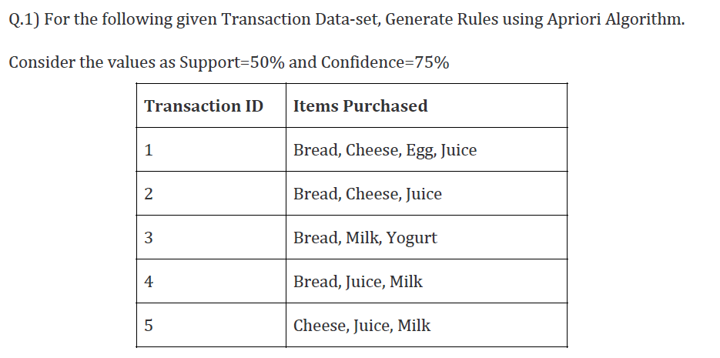
Week
Example 2
08
www.midocean.ae

Slide 58
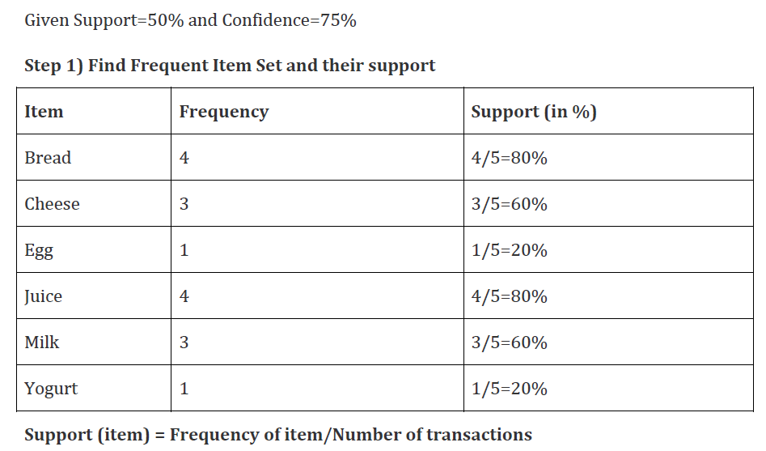
Week
Example 2
08
www.midocean.ae

Slide 59
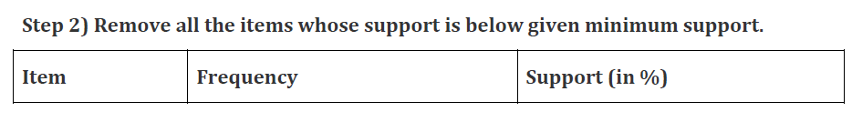
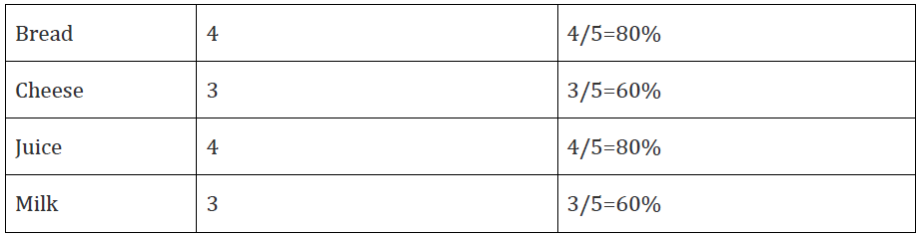
Week
Example 2
08
www.midocean.ae

Slide 60
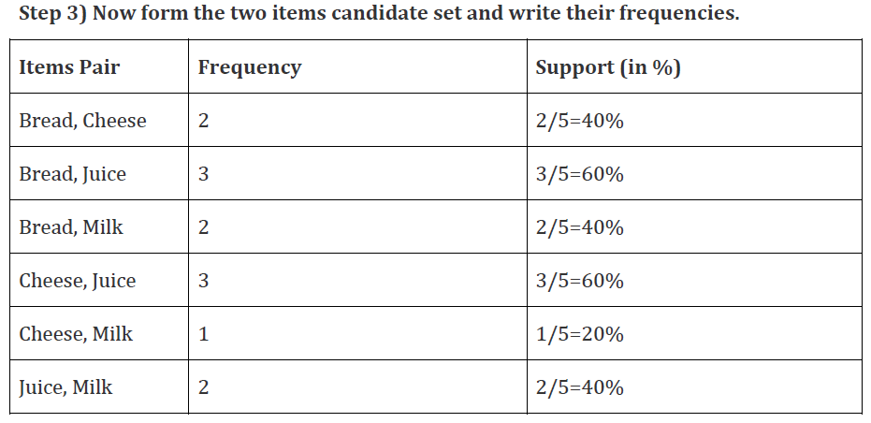
Week
Example 2
08
www.midocean.ae

Slide 61
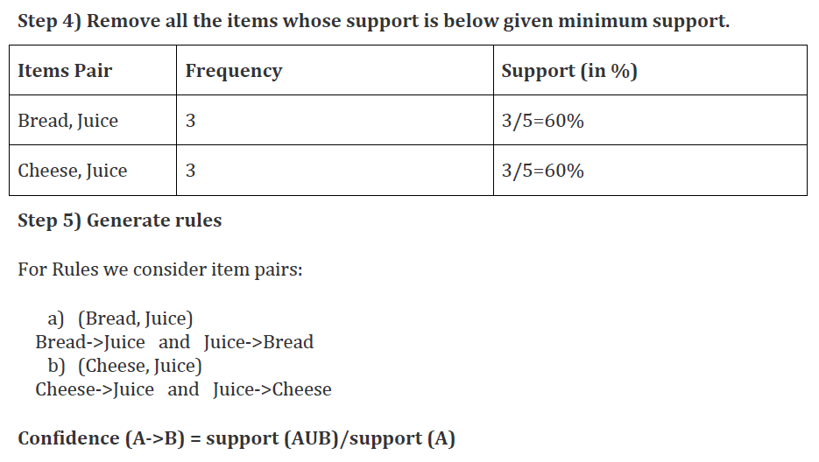
Week
Example 2
08
www.midocean.ae

Slide 62
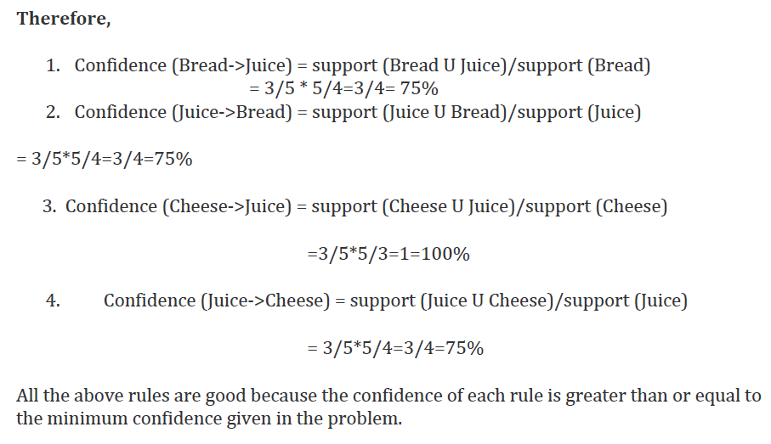
Week
Example 2
08
www.midocean.ae

Slide 63
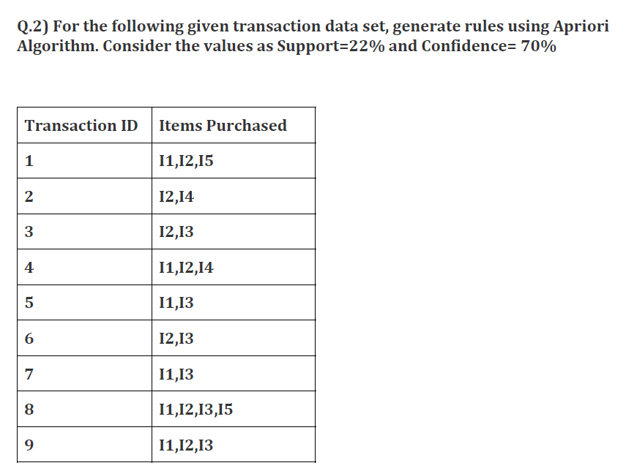
Week
Example 2
08
www.midocean.ae

Slide 64
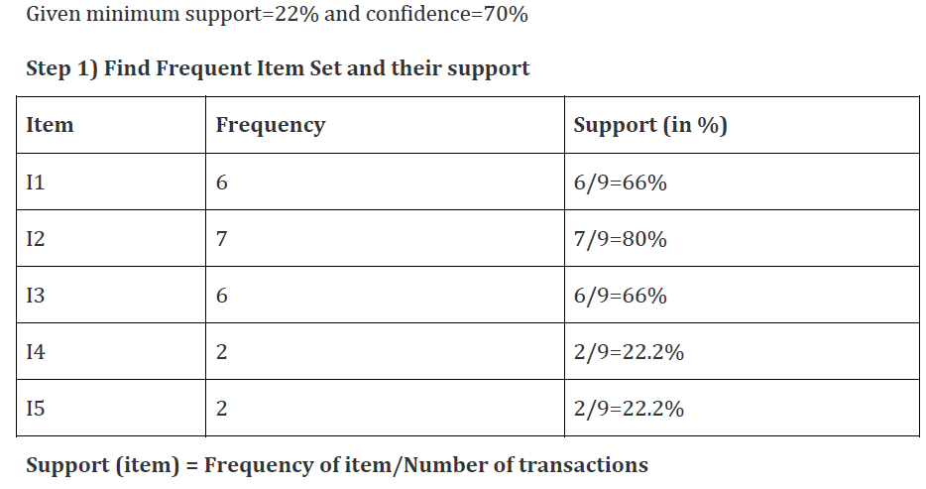
Week
Example 2
08
www.midocean.ae

Slide 65
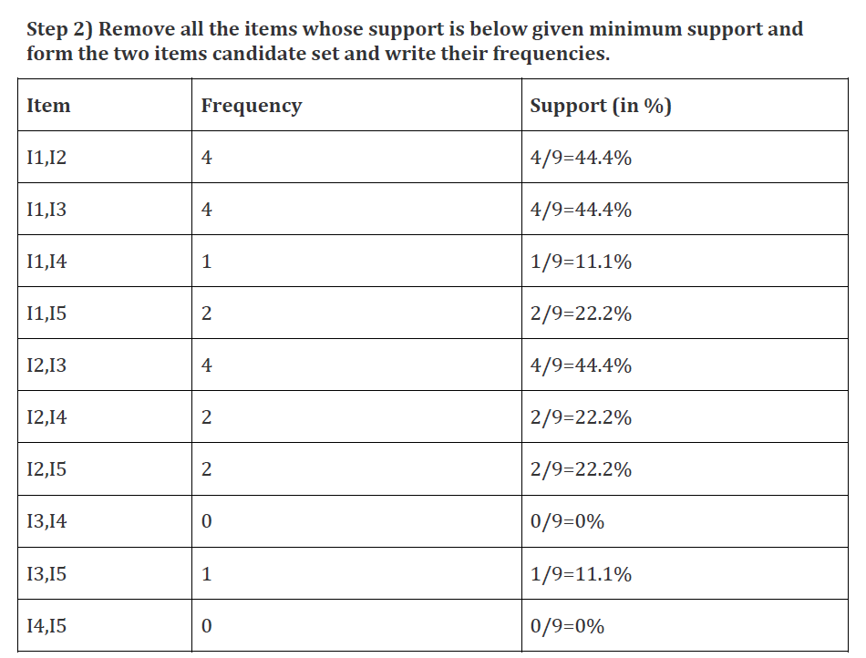
Week
Example 2
08
www.midocean.ae

Slide 66
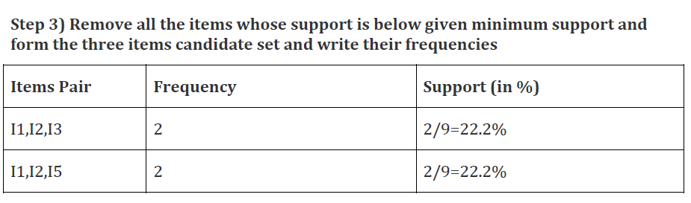
Week
Example 2
08
www.midocean.ae

Slide 67
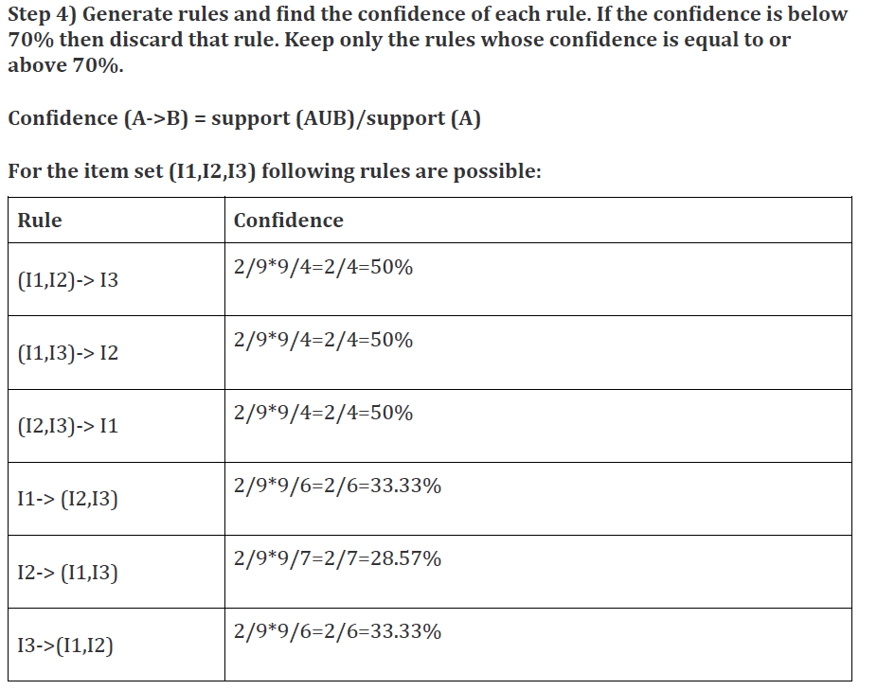
Week
Example 2
08
www.midocean.ae

Slide 68
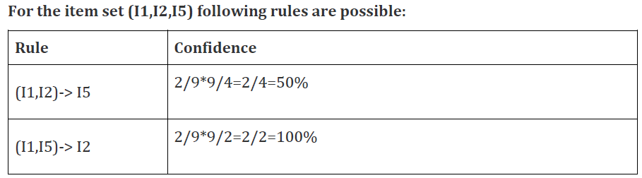
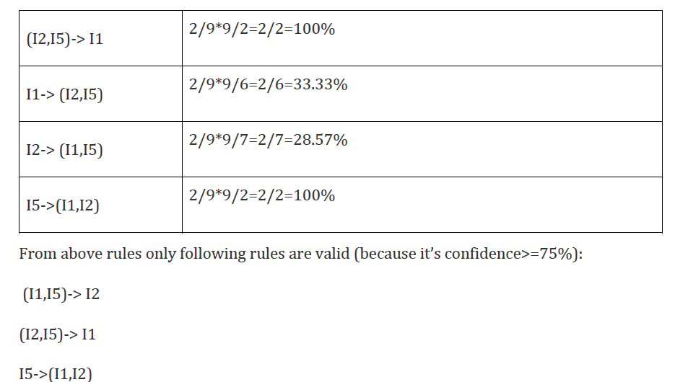
Week
Example 2
08
www.midocean.ae

Slide 69
Week
08
Diagnostics
    Do the rules make sense?
        What does the domain expert say?
    Make a "test set" from hold-out data:
        Enter some market baskets with a few items missing (selected at random). Can the rules predict the missing items?
www.midocean.ae

Slide 70
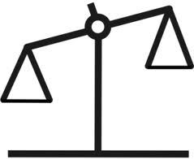
Week
08
Apriori - Reasons to Choose (+) and Cautions (-)
Reasons to Choose (+) | Cautions (-)
Easy to implement | Requires many database scans
Uses a clever observation to prune the search space Apriori property | Exponential time complexity
Easy to parallelize
www.midocean.ae

Slide 71
Week
08
Association Rules - Summary
    During this lesson the following topics were covered:
        Association Rules mining
        Apriori Algorithm
        Prominent use cases of Association Rules
        Support and Confidence parameters
        Lift and Leverage
        Diagnostics to evaluate the effectiveness of rules generated
        Reasons to Choose (+) and Cautions (-) of the Apriori algorithm
www.midocean.ae

Slide 72



Thank You

