Slide 1



Communication skills
Prepared by Dr. Merna Emad
Lecture 2
www.midocean.ae

Slide 2

Section 2
Business and Professional Excellence in the
Workplace
Business and Professional Excellence in the
Workplace
Communication ethics
Communication ethics
Lecture
KEYS for Excellence in the Workplace
KEYS for Excellence in the Workplace
Section 1
Communication models
Communication barriers

Slide 3
Section one

Slide 4

Communication models

Slide 5
Communication models
Transmission Model
Interaction Model
Transaction Model

Slide 6
Communication models
Transmission Model
It describes communication as a linear, one-way process in which a sender intentionally transmits a message to a receiver. This model focuses on the sender and message within a communication encounter. Although the receiver is included in the model, this role is viewed as more of a target or end rather than part of an ongoing process.
Think of how a radio message is sent from a person in the radio studio to you listening in your car. The sender is the radio announcer who encodes a verbal message that is transmitted by a radio tower through electromagnetic waves (the channel) and eventually reaches your (the receiver’s) ears via an antenna and speakers in order to be decoded. The radio announcer doesn’t really know if you receive his or her message or not, but if the equipment is working and the channel is free of static, then there is a good chance that the message was successfully received.

Slide 7
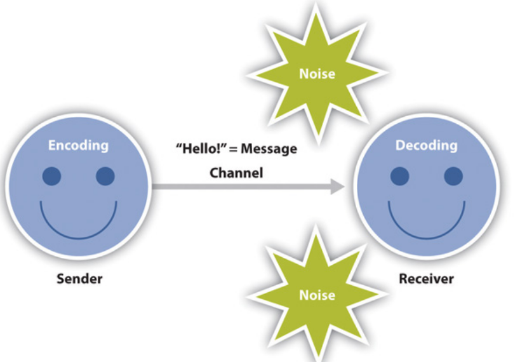
Communication models
Transmission Model
Since this model is sender and message focused, responsibility is put on the sender to help ensure the message is successfully conveyed. This model emphasizes clarity and effectiveness, but it also acknowledges that there are barriers to effective communication.

Slide 8
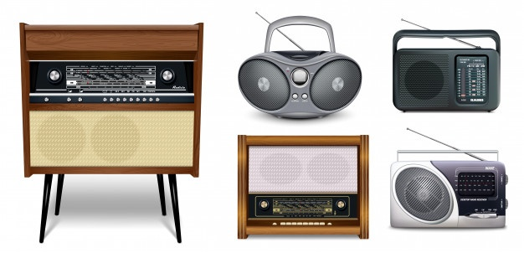
Communication models
Transmission Model
FM antennae can’t decode AM radio signals and vice versa. Likewise, most French speakers can’t decode Swedish and vice versa. Semantic noise can also interfere in communication between people speaking the same language because many words have multiple or unfamiliar meanings.

Slide 9
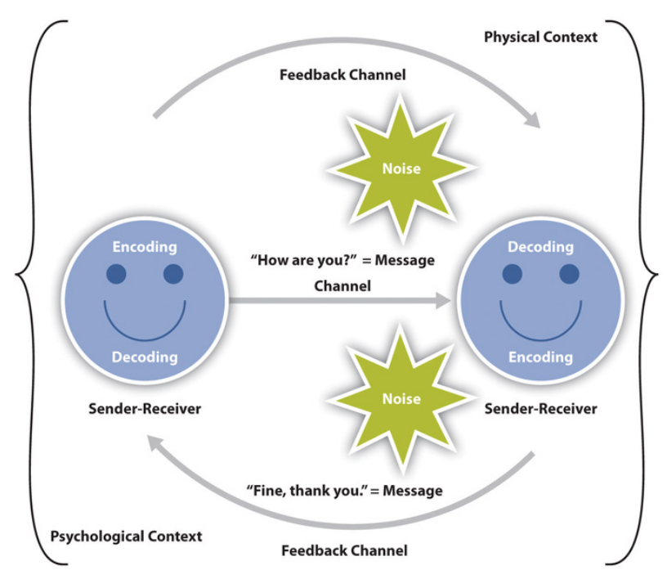
Communication models
Interaction Model
The interaction model of communication describes communication as a process in which participants alternate positions as sender and receiver and generate meaning by sending messages and receiving feedback within physical and psychological contexts

Slide 10
Communication models
Interaction Model
Rather than illustrating communication as a linear, one-way process, the interaction model incorporates feedback, which makes communication a more interactive, two-way process. Feedback includes messages sent in response to other messages.
Rather than having one sender, one message, and one receiver, this model has two sender-receivers who exchange messages. Each participant alternates roles as sender and receiver in order to keep a communication encounter going. Although this seems like a perceptible and deliberate process, we alternate between the roles of sender and receiver very quickly and often without conscious thought.

Slide 11
Communication models
Interaction Model
The interaction model is also less message focused and more interaction focused. While the transmission model focused on how a message was transmitted and whether or not it was received, the interaction model is more concerned with the communication process itself. In fact, this model acknowledges that there are so many messages being sent at one time that many of them may not even be received. Some messages are also unintentionally sent. Therefore, communication isn’t judged effective or ineffective in this model based on whether or not a single message was successfully transmitted and received.

Slide 12
Communication models
Interaction Model
The interaction model takes physical and psychological context into account.
Physical context includes the environmental factors in a communication encounter. The size, layout, temperature, and lighting of a space influence our communication.
Psychological context includes the mental and emotional factors in a communication encounter. Stress, anxiety, and emotions are just some examples of psychological influences that can affect our communication.

Slide 13
Communication models
Communication is more than a process that is used to carry on conversations and convey meaning. We don’t send messages like computers, and we don’t neatly alternate between the roles of sender and receiver as an interaction unfolds. We also can’t consciously decide to stop communicating, because communication is more than sending and receiving messages. The transaction model differs from the transmission and interaction models in significant ways, including the conceptualization of communication, the role of sender and receiver, and the role of context.
Transaction Model

Slide 14
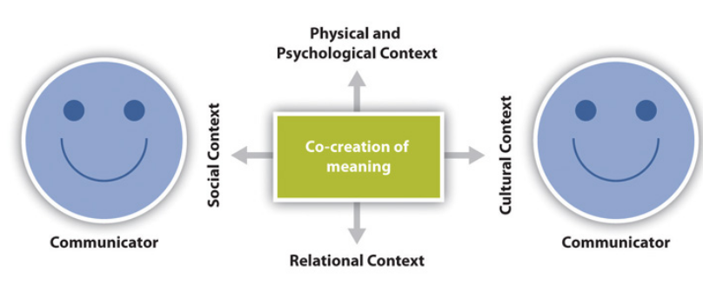
Communication models
Transaction Model
The transaction model of communication describes communication as a process in which communicators generate social realities within social, relational, and cultural contexts. In this model, we don’t just communicate to exchange messages; we communicate to create relationships, form intercultural alliances, shape our self-concepts, and engage with others in dialogue to create communities. In short, we don’t communicate about our realities; communication helps to construct our realities.

Slide 15
Communication models
Transaction Model
The roles of sender and receiver in the transaction model of communication differ significantly from the other models. Instead of labeling participants as senders and receivers, the people in a communication encounter are referred to as communicators. Unlike the interaction model, which suggests that participants alternate positions as sender and receiver, the transaction model suggests that we are simultaneously senders and receivers.

Slide 16
Communication models
Transaction Model
The transaction model considers how social, relational, and cultural contexts frame and influence our communication encounters.
Refers to the stated rules or unstated norms that guide communication. As we are socialized into our various communities, we learn rules and implicitly pick up on norms for communicating.
Social context
Norms
Are social conventions that we pick up on through observation, practice, and trial and error. We may not even know we are breaking a social norm until we notice people looking at us strangely or someone corrects or teases us.

Slide 17
Communication models
Transaction Model
The transaction model considers how social, relational, and cultural contexts frame and influence our communication encounters.
relational context
Includes the previous interpersonal history and type of relationship we have with a person. We communicate differently with someone we just met versus someone we’ve known for a long time. Initial interactions with people tend to be more highly scripted and governed by established norms and rules, but when we have an established relational context, we may be able to bend or break social norms and rules more easily.

Slide 18
Communication models
Transaction Model
The transaction model considers how social, relational, and cultural contexts frame and influence our communication encounters.
Cultural context
Includes various aspects of identities such as race, gender, nationality, ethnicity, sexual orientation, class, and ability.

Slide 19
Communication barriers

Slide 20
Communication barriers
The word barrier means an obstacle, a hindrance or simply a problem that comes in a way of transmission of a message and blocks the process, either completely or partially.
Cultural
Physiological
Organizational
Psychological
Technological
Barriers

Slide 21
Communication barriers
Psychological barriers
The Psychological or Emotional Barriers refers to the psychological state i.e. Opinions, attitudes, status consciousness, emotions, etc. of a person that deeply affects the ability to communicate.
Lack of Attention
1) A person in tragedy, for instance, does not want to listen to other people giving advice.
When the person is pre-occupied by some other things and do not listen carefully what the other person is speaking, then arises the psychological barrier in the communication. When the person does not listen to others, then he won’t be able to comprehend the message as it was intended and will not be able to give proper feedback.
2) A person might be preoccupied by the problems of his/her professional life or personal life, which affects both.

Slide 22
Communication barriers
Psychological barriers
Premature Evaluation
Poor Retention
Many people have a tendency to jump to the conclusions directly and form judgments without considering all the aspects of information. This is generally done by the people who are impatient and resort to a selective listening. This premature evaluation of the information acts as a barrier to the effective communication and lowers the morale of the sender.
The retention refers to the capacity of a brain to retain or store things in the memory. The brain does not store all the information came across but in fact, retain only those which deems to be helpful in the future. Therefore, much of the information gets lost during the retention process, and this acts as a barrier to the effective communication.

Slide 23
Communication barriers
Psychological barriers
Loss by Transmission
Distrust
The loss by transmission means, whenever the information exchanges hand its credibility reduces. It is most often observed in the case of an oral communication where people handle information carelessly and transmits the information which has lost some of its truth. Thus, the improper and lack of information being transmitted to others acts as a hindrance in the communication process.
To have an effective communication, it is must that both the communicators (sender and receiver) trust each other. In case there is a lack of trust between both the parties, then they will tend to derive negative meaning out of the message and often ignore what has been communicated. If the receiver has no trust, then he will not listen to whatever is being said by the sender, and this will result in a meaningless communication.

Slide 24
Communication barriers
Psychological barriers
Emotions
The communication is greatly influenced by the emotions of a person. If a person is not in a good temperament, then he would not listen properly to whatever is said and might say things offending the sender. Several other emotions such as anger, nervousness, confusion, restlessness, etc. affects the communication process.

Slide 25
Communication barriers
Physiological barriers
Physiology is the state of human body and mind. Physiological barriers of communication occur due to the physical condition of sender or receiver which might even be physical disabilities. It includes sensory dysfunction and other physical dysfunctions.
Deafness and Hearing Impairment
Blindness and Vision Impairment
Speech Disorders
Physical Condition

Slide 26
Communication barriers
Cultural barriers
What is culture?
Culture is defined by the shared manners, customs, beliefs, rituals, ceremonies, laws, ideas, thought patterns, arts, tools, social institutions, religious beliefs, myths and legends, knowledge, values, a concept of self, morals, ideals and accepted ways of behaving. We live, do things, think and act in varied ways. These practices are particular ways that give us an identity. These are our cultural ways and give us the cultural identity.

Slide 27
Source of cultural barriers
Communication barriers
Language (Semantic)
Language is considered as the most crucial barrier in cross-cultural communication. Since verbal communication is important in every context, the understandings of the meaning of words are also important. The language barrier occurs not only because of differences in language but also in the forms of a variety of dialects. The examples are of Chinese and Russian language where different dialects are used in several parts of the country. If one communicator is not aware of the exact meaning, it will create misunderstanding and lead to a conflict of ideas.

Slide 28
Source of cultural barriers
Communication barriers
Cultural norms and values
Each culture hold its own values, meaning and norms different from another. This difference is caused because of truth, belief and judgment through which they acquired knowledge about society and culture.
Body languages
Stereotypes are any negative image or preconceived notions on a particular community and identity. These are created through mass media and their content agenda.

Slide 29
Source of cultural barriers
Communication barriers
Values and believes
The differences in values and beliefs in cultures also create a barrier in communication. The difference in the level of acceptability in cultures is an example. The reasons behind these are influenced by religion, political environment or epistemology.
Body gestures
Body language and gestures are another elements of the cultural barrier. It is impossible to communicate without body language and gestures. It provides meaning and justification for communication.

Slide 30
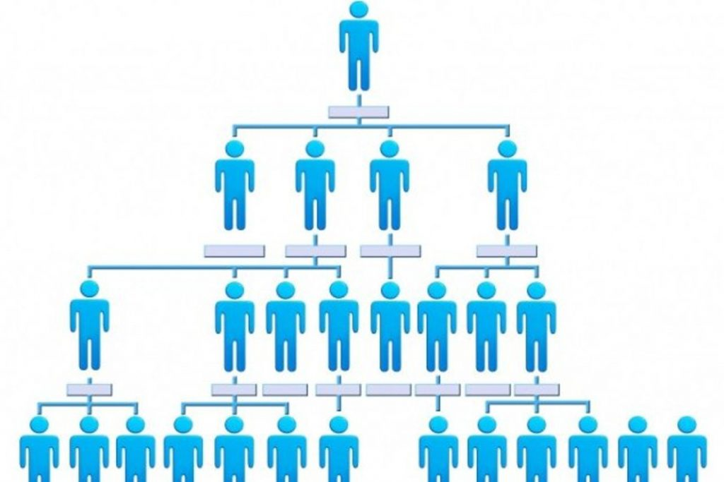
Communication barriers
Organizational structure Barriers
An organization is a collection of people who work together to achieve a common objective. Most of these barriers arise because of misinformation or lack of appropriate transparency available to the employees.
Organizational structure
Organizations are structured based on the hierarchies so that people of different experience levels, roles and responsibilities are at different levels of authority.
Large organizations have a number of layers of supervision and long communication lines. This can cause distance between the workers and the top management resulting in communication barrier, especially as the organization is divided into departments.

Slide 31
Communication barriers
Organizational structure Barriers
Status and power consciousness
Status reflects the degree of power, authority, importance and responsibility placed on an individual by other people in the society. Status consciousness exists in most organizations and is a formidable barrier to genuine communication.
Message filtering
In organizations, some messages are filtered or stopped altogether on their way up or down in the organizational hierarchy. Filtering may involve deleting or delaying negative information, or using subtler words so that events sound more favorable. Managers and supervisors usually filter communication to create a good impression about themselves. Filtering is most common in organizations that reward employees who communicate positive information among employees with strong career mobility aspirations.

Slide 32
Communication barriers
Organizational structure Barriers
Goal conflicts
sometimes clashes may occur between two individuals on the goals they wish to achieve. This happens because their interpersonal relationships are not cordial and hence, even if both wish to achieve the same goal, because of mutual misunderstandings, they appear to be in a goal conflict. This problem is frequent and appears between departments within the organization.
Poor coordination
Poor coordination is a damaging condition to effective communication so that different parts of the organization are working in isolation and not knowing or understanding what other parts are doing. Top executives are out of touch with lower levels, or departments and divisions are so poorly coordinated that people do not understand how the system works together as a whole.

Slide 33
Communication barriers
Technological Barriers
In today’s organizations, technology is largely used to mediate communication. Gone are the days when doing even the easiest task required the hardest labour. Now, with the proliferation of smart computers in organizations, we can perform any task at the click of a mouse, our dependence on technology is all the time high.
Though technology-based communication such as phone conversations, text messages and e-mails have made communication easy for us but on the flip side, it has reduced the possibility of natural face-to-face interaction that is at the helm of any human communication. Without non-verbal cues such as eye contact, facial expressions, and body language, people are more likely to misunderstand messages, causing the quality of communication to suffer. For example, a text message where all the words are in capital letters can be interpreted as an angry ‘yelling’ message, while the reality may be far from that.

Slide 34
Section two

Slide 35
Business and Professional Excellence in the Workplace

Slide 36
Business and Professional Excellence in the Workplace
When you hear the word professional, who or what comes to mind? Do a suit and a
tie equate to professional excellence, or is it something more?
Interviewing
Interviewing is the process of making yourself available to employers in a formal setting and in the best possible light. Although the main goal of interviewing is to get a job, it also gives you the opportunity to determine whether the particular job is right for you.

Slide 37
Business and Professional Excellence in the Workplace
When you hear the word professional, who or what comes to mind? Do a suit and a
tie equate to professional excellence, or is it something more?
Interviewing
Knowing how to prepare for an interview.
Anticipating questions.
Interviewing is a two-way street; you should also use this time to make sure that an organization meets your needs as a professional and that the organizational culture will allow you to thrive.
Dressing appropriately.
Providing credible and effective answers, and following up after an interview are all critical aspects of being a competent interview participant.

Slide 38
Business and Professional Excellence in the Workplace
Relational Communication
Although you may be an effective communicator in interpersonal settings, you need to know the following:
1
The way to apply relational communication to the business and professional world. Communication initiation, maintenance, and even disengagement are all necessary skills to possess for workplace relationships.
2
The way to handle all the forming effective relationships with your coworkers, supervisors, customers, vendors, and subordinates

Slide 39
Business and Professional Excellence in the Workplace
Relational Communication
Although you may be an effective communicator in interpersonal settings, you need to know the following:
3
The way to balance small talk, self-disclosure, task delegation, and many other functions that are essential in the workplace.
4
In addition, when business relationships turn sour or costly, you must know how to end the relationship with minimal tension and negative consequences.

Slide 40
Business and Professional Excellence in the Workplace
Mediated Communication
The new media have opened numerous new channels for communication professionals. Computer-mediated communication offers convenience and timely access to pertinent information, and it connects communicators across the globe via screen taps and mouse clicks.
However, as a communication professional you must be aware of the inherent
Drawbacks of mediated communication.
Be aware that traditional public speaking skills do not always translate as effectively (e.g., video or telephone conferences) and must be altered to fit the situation at hand.

Slide 41
Business and Professional Excellence in the Workplace
Presentational speaking
Public speaking is one of the most feared—but also most important—functions of business and professional communication.
Types of business presentations
Informative
Persuasive
Public

Slide 42
Business and Professional Excellence in the Workplace
Presentational speaking
What does it take?
1
Research and prepare your presentation.
2
Analyze your audience (as well as who your target audience should be).
3
Create memorable and effective introductions and conclusions that will stick in the mind of your audience.
4
Create having excellent content while also delivering it to the audience in an engaging way.

Slide 43
Business and Professional Excellence in the Workplace
Written documents
Although the type of written communication you engage in can vary greatly depending on your profession, there are certain universal skills, You should always have, include:
Structure the information
Select the right style/tone/language.
Determine what length is appropriate to cover all the important information
Cultivate and maintain credibility.
Use appropriate grammar and punctuation to emphasize professionalism.

Slide 44
Communication Ethics

Slide 45
Communication Ethics
What are ethics?
Ethics is the general term for the discussion, determination, and deliberation processes that attempt to decide what is right or wrong, what others should or should not do, and what is considered appropriate in our individual, communal, and professional lives.
The discipline concerned with what is morally good and bad and morally right and wrong. The term is also applied to any system or theory of morals values or principles. Ethical behavior must serve as a foundation for people to be treated with fairness, dignity, and respect.

Slide 46
BASIS FOR COMPARISON | LAW | ETHICS
Meaning | . The law refers to a systematic body of rules that governs the whole society and the actions of its individual members | Ethics is a branch of moral philosophy that guides people about the basic human conduct.
What is it? | Set of rules and regulations | Set of guidelines
Governed By | Government | Individual, Legal and Professional norms
Expression | Expressed and published in writing. | They are abstract.
Violation | Violation of law is not permissible which may result in punishment like imprisonment or fine or both. | There is no punishment for violation of ethics.
Objective | Law is created with an intent to maintain social order and peace in the society and provide protection to all the citizens. | Ethics are made to help people to decide what is right or wrong and how to act.
Binding | Law has a legal binding. | Ethics do not have a binding nature.

Slide 47
Key Differences Between Law and Ethics
The law is defined as the systematic body of rules that governs the whole society and the actions of its individual members. Ethics means the science of a standard human conduct.
The law consists of a set of rules and regulations, whereas Ethics comprises of guidelines and principles that inform people about how to live or how to behave in a particular situation.
The law is created by the Government, which may be local, regional, national or international. On the other hand, ethics are governed by an individual, legal or professional norms, i.e. workplace ethics, environmental ethics and so on.
The law is expressed in the constitution in a written form. As opposed to ethics, it cannot be found in writing form.

Slide 48
Key Differences Between Law and Ethics
The objective of the law is to maintain social order and peace within the nation and protection to all the citizens. Unlike, ethics that are the code of conduct that helps a person to decide what is right or wrong and how to act.
The law creates a legal binding, but ethics has no such binding on the people
The breach of law may result in punishment or penalty, or both which is not in the case of breach of ethics

Slide 49
Examples of Unethical Behavior in the Workplace
Taking Sides in an Employee Argument
It is not uncommon for conflicts to arise between employees in the workplace. Ethically, it is the job of company leadership and management to remain impartial during these conflicts. For example, if two of a manager's employees are in conflict, it is important for the manager to remain as neutral as possible. When a manager gives preference to a favorite or senior employee or provides a solution that only works in favor of one party, they are participating in unethical behavior. They must allow both employees to speak their piece and then come to a solution that works best for both parties, as well as the business itself.

Slide 50
Examples of Unethical Behavior in the Workplace
Lying
Lying to your employees or customers is the biggest way to break trust. Trust is the best source of dedication and loyalty that any business has. Once that trust is broken, it is extremely difficult to get it back. For example, if a company has a high-performing employee who is asking for a promotion, they may say that there is no room in the budget for a promotion this year. A few months later, another employee may receive a promotion. Telling obvious lies isn't just unethical -- it will drive people away from your business.

Slide 51
Examples of Unethical Behavior in the Workplace
Misusing Company Time
This is a common ethical dilemma that many businesses face. Many employees misuse company time in a variety of ways, whether it's surfing the internet during business hours, taking extended breaks, altering time sheets, or similar. Misusing company time is unethical because the employee is being paid a salary for work that they did not complete or time they did not dedicate to their job.

Slide 52
Examples of Unethical Behavior in the Workplace
Cultivating a Hostile Workplace
While there is bound to be some conflict in the workplace, it is important to make the workplace a safe environment for everyone. Some companies unintentionally cultivate a hostile or overly competitive company culture. For example, employers may encourage an unhealthily competitive environment among employees to drive productivity and innovation. However, cultivating this kind of environment can tax employee mental health, and even encourage unethical, sabotaging behavior among employees who want to get ahead at work.

Slide 53
Examples of Unethical Behavior in the Workplace
Ignoring Conflicts of Interest
Conflicts of interest encourage businesses to act in ways that do not benefit their customers or employees. For example, if a manager has a relative as their direct report, that manager may treat that employee differently than their other reports. It is the duty of the business to address this situation. Removing conflicts of interest can become more complex when a business is publicly traded, non-profit, or receives funds from a government entity.

Slide 54
KEYS for Excellence in the Workplace

Slide 55
KEYS for Excellence in the Workplace
K
Know yourself
It means actively assessing your skills as a communicator and then developing strategies to utilize your strengths and develop your weaknesses.
E
Evaluate the professional context
It entails proactively addressing the needs of your audience and understanding the constraints of the communication situation, as well as developing your skills for communicating with a variety of audiences and situations.

Slide 56
KEYS for Excellence in the Workplace
Y
Your communication interaction
It requires you to monitor your own verbal and nonverbal cues, in addition to the cues from the audience within each communication interaction.
S
Step back and reflect
It encourages you to examine the effectiveness of verbal and nonverbal messages you convey to others and the overall success of various communication interactions and then take what you’ve learned and start the process again, developing the ability to adapt and improve continually.

Slide 57




Thank You

