Slide 1


Introduction to
Research Methods
Prepared by Associate Professor/
Ahmed Rageh Ismail
MGM333
Introduction to Research Methods
Lecture 7

Slide 2

Chapter
Learning Outcomes
7
Identify and distinguish between dichotomous, multiple dichotomous, and rank order questions.
Understand the process of developing a Likert scale and its application in research..
Comprehend the use and analysis of semantic differential scales in assessing subjective meanings..
www.midocean.ae

Slide 3
Chapter
Learning Outcomes
7
Recognize the purposes and appropriate usage of open-ended questions in research questionnaires.
Differentiate between paper-based, electronic, and researcher-administered questionnaires and their respective advantages.
Learn techniques to prevent pattern responses and ensure the reliability of questionnaire data.
www.midocean.ae

Slide 4

Chapter
Introduction to Questionnaire Design
7
Questionnaires are the most popular data collection tools in research involving human subjects.
Common sense plays a crucial role in questionnaire design, but it can often be overlooked by researchers eager to gather data.
This chapter emphasizes the importance of using common sense effectively in designing questionnaires.
www.midocean.ae

Slide 5
Chapter
Reasons for Using Questionnaires
7
Advantages
Reach a large and geographically dispersed audience at a low cost.
Gather data from a larger sample compared to other techniques.
Offer anonymity and confidentiality to respondents.
Data analysis can be pre-determined and coded before distribution.
Common Misconception
New researchers often choose questionnaires to avoid direct interaction, but this is not a credible reason for research.
www.midocean.ae

Slide 6

Chapter
Choosing Questionnaires Wisely
7
Purpose of Investigation
Identify the goal of your research and what you hope to achieve with the data.
Base the choice of data collection method on the aim of the research.
Limitations
Lack of direct interaction with respondents is a significant limitation.
www.midocean.ae

Slide 7
Chapter
Designing Questionnaires
7
Challenges
Questionnaires often have a low response rate unless administered personally.
Questionnaires need to be clear and standalone, as the researcher will not be present to assist respondents.
Importance of Design
Appearance and content are crucial for encouraging responses.
Well-designed questionnaires lead to high response rates and detailed data.
Poor design can discourage participation and increase measurement error.
www.midocean.ae

Slide 8

Chapter
Key Considerations in Design
7
Steps in Designing a Questionnaire
Figure 1 outlines essential steps.
Never omit any step, regardless of time constraints.
Impact of Design
Adequate design can mean the difference between a successful and a failed research effort.
www.midocean.ae

Slide 9
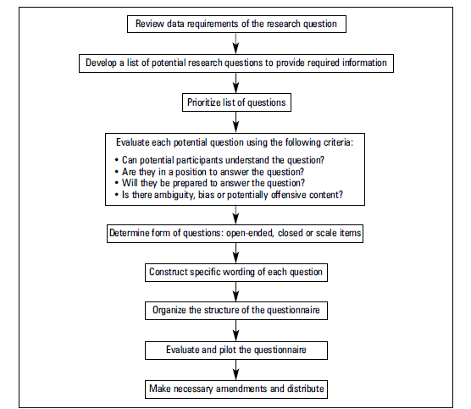

Slide 10

Chapter
Effective Questionnaire Design
7
Holistic Approach
Ensure the overall picture is clear.
Introduction
Start with a brief intro and clear, simple instructions.
Conciseness
Keep the questionnaire concise.
Clarity
Ask clear questions, avoiding ambiguity, bias, and jargon unless necessary.
www.midocean.ae

Slide 11

Chapter
Effective Questionnaire Design
7
Length
Ensure it can be completed in a reasonable time.
Neutral Questions
Avoid leading questions and potentially offensive questions.
Logical Order
Maintain a logical flow with clear pathways.
Appearance
Make it uncluttered and inviting.
Data Processing
Ensure data is easily processed; plan your analysis beforehand.
www.midocean.ae

Slide 12

Chapter
General Points to Remember
7
Appropriate Title
Give the questionnaire a suitable title.
Covering Letter
Include a letter with topic details, purpose, data usage, contact info, and confidentiality statement.
Avoid trivial or antagonizing statements.
Use for anonymous questionnaires, ensuring privacy.
www.midocean.ae

Slide 13

Chapter
Developing Questions
7
Understandability
Questions must be easily understood and answered.
Interpretation Risk
Clear questions to you might not be clear to others.
Explanations
Redundant or repetitive explanations can improve response rates.
www.midocean.ae

Slide 14

Chapter
Structuring the Questionnaire
7
Friendly Start
Begin with unthreatening, easy questions.
Demographic Questions
Save for the end to avoid discouraging respondents.
Usefulness
Include demographic questions only if they are relevant to your analysis.
www.midocean.ae

Slide 15

Chapter
Question Order and Variety
7
Engaging Questions
Start with simple questions, then progress to complex ones.
Opinion Questions
Place them at least a third of the way through.
Variety
Include different types of questions to maintain interest and depth.
www.midocean.ae

Slide 16

Chapter
Question Types
7
Dichotomous Questions
Avoid long lists; they can be boring and superficial.
Open-ended Questions
Limit these as they require more thought and time.
Verbal vs. Written Responses
Verbal responses are easier to give than written ones.
www.midocean.ae

Slide 17

Chapter
Closed Questions
7
Categories
Dichotomous questions
Multiple dichotomous questions
Rank order questions
www.midocean.ae

Slide 18

Chapter
Dichotomous questions
7
Definition
Allows respondents to choose between two possible responses, often with a neutral option.
Considerations
Must be exhaustive to cover all possible respondent conditions.
www.midocean.ae

Slide 19

Chapter
Example
7
One example of a dichotomous question in a survey could be, "Have you ever visited our website?" with response options limited to "yes" or "no."
www.midocean.ae

Slide 20

Chapter
Multiple Dichotomous Questions
7
Definition
Provides a list of possible responses, allowing selection of any number of choices.
Analysis
Consider data harvesting and coding during construction
www.midocean.ae

Slide 21
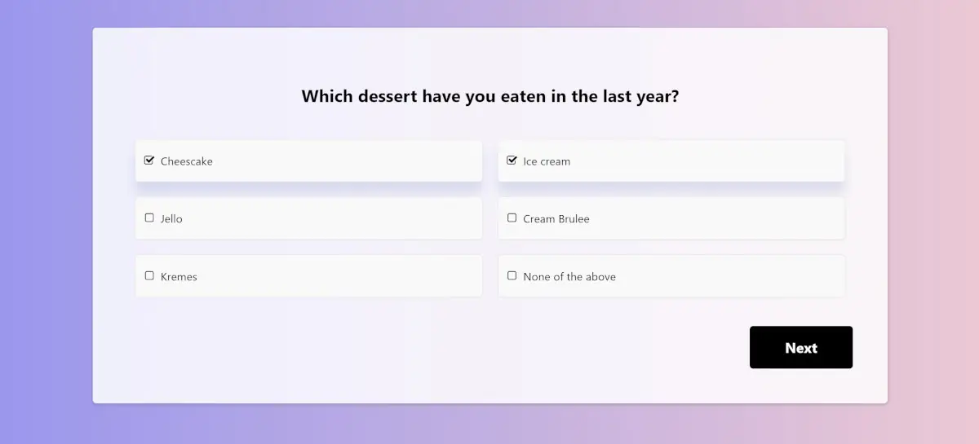
Chapter
Example
7
www.midocean.ae

Slide 22

Chapter
Rank Order Question
7
Definition
Respondents rate or rank each option, providing insights into relative preferences.
Limitation
Avoid long lists (more than 5 items)
www.midocean.ae

Slide 23
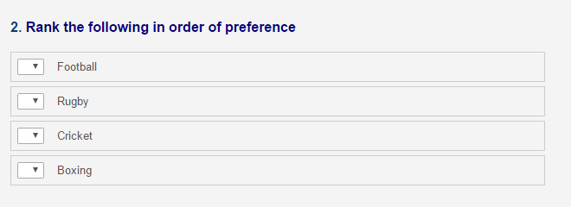
Chapter
Example
7
www.midocean.ae

Slide 24
Chapter
Scale Questions
7
Definition
Attitudinal measures included in questionnaires, requiring detailed preparation.
Advantages
Offer uniformity of response and ease of coding.
Disadvantages:
Can appear superficial and force inappropriate answers.
www.midocean.ae

Slide 25
Chapter
Types of Scale Questions
7
Unidimensional
Measure a single dimension.
Multidimensional
Measure across cognitive, behavioral, and affective dimensions.
Common Examples
Likert scale
www.midocean.ae

Slide 26
Chapter
The Likert Scale
7
Definition
A bipolar scaling technique gauging intensity of attitude.
Example
"Indicate your level of agreement with the following statement."
www.midocean.ae

Slide 27
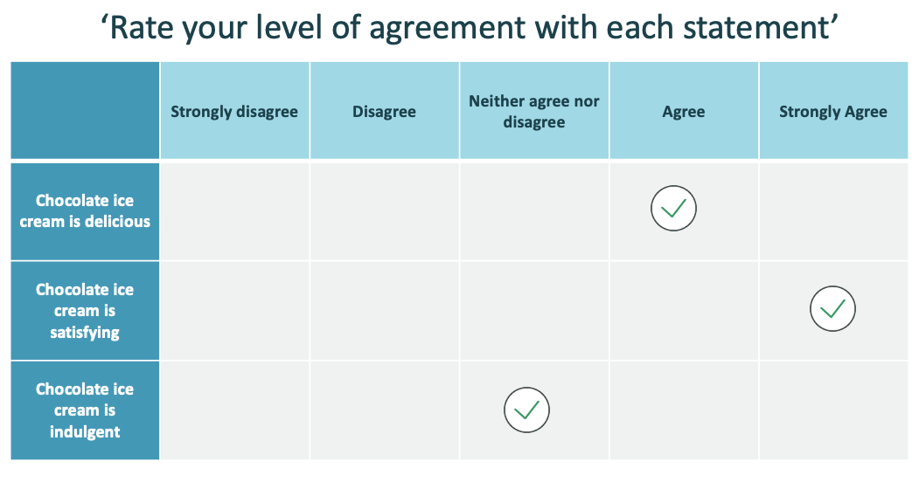

Slide 28
Chapter
Developing a Likert Scale
7
Purpose: Measure attitudes using structured responses
Components
Attitude statements
Response system
Random arrangement of statements
Random test sample
Scoring and ranking
Statement analysis
Final administration
www.midocean.ae

Slide 29
Chapter
Constructing Attitude Statements
7
Source
Literature review and research objectives
Purpose
Relate to the research question
Example Statements
Positive: "I enjoy using new technologies."
Negative: "I find new technologies difficult to use."
www.midocean.ae

Slide 30
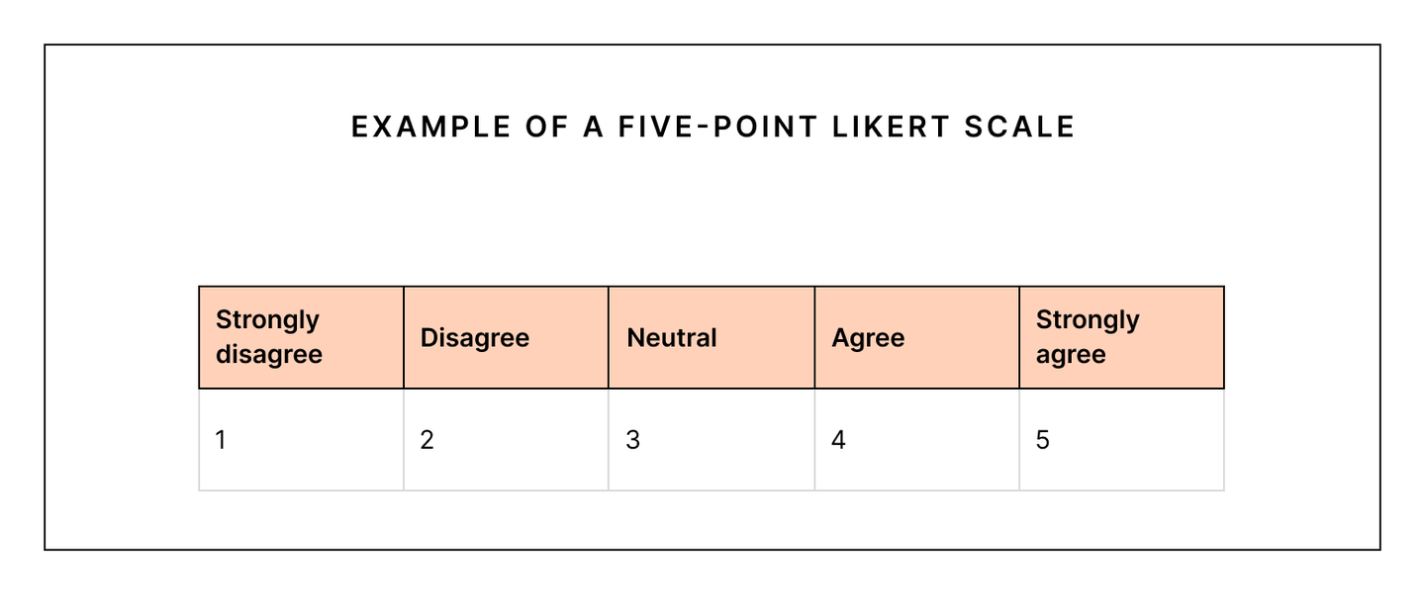
Chapter
Structuring the Response System
7
www.midocean.ae

Slide 31
Chapter
Arranging Statements Randomly
7
Mixing Positive and Negative Statements
Prevents Pattern Responses
Randomly mix positive and negative statements to prevent respondents from falling into a habit of consistently agreeing or disagreeing without carefully considering each statement.
Ensures Thoughtful Responses
Encourages respondents to think about each question individually rather than following a predictable pattern.
www.midocean.ae

Slide 32
Chapter
Selecting a Random Test Sample
7
Size Recommendation
Oppenheim (1992): Suggests a sample size of 100 people.
Dissertation Research: A smaller sample may be sufficient depending on the scope of your study.
Test Criteria
Ask the sample group to rate the statements based on their interest and relevance to the topic, not their own opinion.
www.midocean.ae

Slide 33
Chapter
Scoring and Ranking Responses
7
Scoring System
Assign weights to responses (e.g., strongly agree = 5, strongly disagree = 1).
Ranking
Rank respondents' scores from highest to lowest based on their total score.
Their total score is the sum of their responses to all statements.
www.midocean.ae

Slide 34
Chapter
Statement Analysis and Discriminative Power
7
Discriminative Power (DP)
Calculate the difference in weighted means between the upper and lower quartiles of respondents.
Purpose
Select statements with the highest DP for inclusion in your final list.
www.midocean.ae

Slide 35
Chapter
6
Process
Rank all respondents' scores.
Calculate the mean score for the top 25% (upper quartile) and the bottom 25% (lower quartile).
The difference between these means is the DP for each statement.
www.midocean.ae

Slide 36
Chapter
Final Likert Scale Construction
7
Number of Statements
Include between 10 and 15 statements in your final questionnaire.
Testing
Ensure all statements have been tested for their importance and relevance to your topic.
Mix Statements
Include a mix of positive and negative statements to maintain respondent engagement and accuracy.
www.midocean.ae

Slide 37
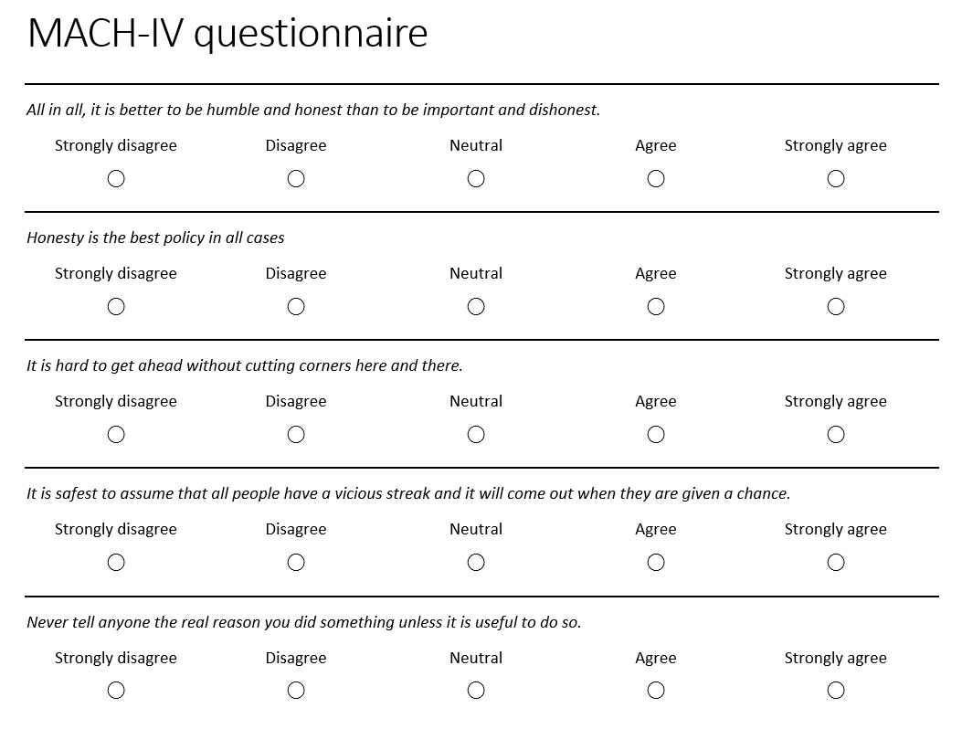

Slide 38
Chapter
Administering the Likert Scale
7
Research Sample
Administer the final scale to your selected respondents.
Objective
Measure the attitude of each respondent in relation to others.
Limitations
Remember that Likert scales produce ordinal data, which means that only non-parametric tests can be used for analysis as they do not assume normal distribution of responses.
www.midocean.ae

Slide 39
Chapter
The Semantic Differential Scale
7
Definition
The semantic differential scale, introduced by Osgood, Suci, and Tannenbaum (1957), is a method for measuring attitudes that captures the connotation associated with a concept through bipolar adjectives.
Usage
This scale is used to assess the subjective meaning of a concept by having respondents choose a point along a continuum between two opposite adjectives.
www.midocean.ae

Slide 40
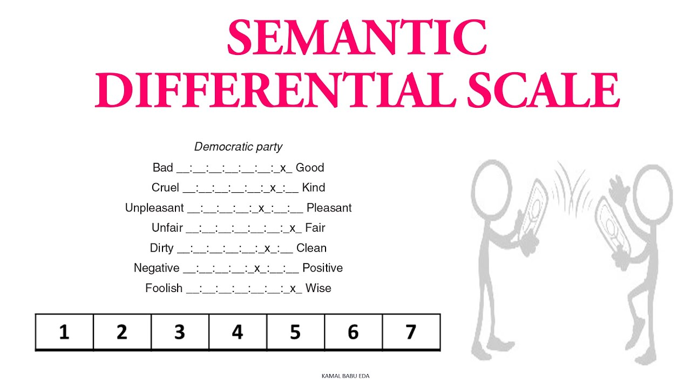

Slide 41
Chapter
Structure
7
Adjectives
The scale involves pairs of bipolar adjectives (e.g., valuable-useless, helpful-unhelpful).
Instructions
Respondents are asked to place a tick at the point between each pair that best represents their feelings about the concept.
www.midocean.ae

Slide 42
Chapter
Construction
7
Simplicity
Constructing a semantic differential scale is straightforward. You select the concept to be assessed and create a list of relevant bipolar adjectives.
Outcome
The results can be a simple comparison between respondents or involve more complex factor analysis to explore relationships between dimensions.
www.midocean.ae

Slide 43
Chapter
Open-Ended Questions
7
Description
Open-ended questions allow respondents to provide detailed and personal answers without predefined options.
Purpose
These questions are used to gain in-depth insights and individual perspectives on a topic.
www.midocean.ae

Slide 44
Chapter
Advantages and Disadvantages
7
Advantages
Detailed Responses: They offer respondents the freedom to express their thoughts fully.
Unanticipated Insights: Can reveal new aspects of an issue that the researcher hadn't considered.
Disadvantages
Analysis Challenges: Coding and analyzing open-ended responses can be difficult and time-consuming.
Response Rate: Respondents may skip these questions or provide minimal answers if they find them too demanding.
www.midocean.ae

Slide 45
Chapter
Usage Guidelines
7
Appropriate Situations
Use open-ended questions when you need more extensive or individualized data, or when the range of possible answers is unknown.
Placement and Phrasing
Avoid starting with open-ended questions to prevent respondents from feeling overwhelmed.
Distribute them throughout the questionnaire to maintain engagement.
Ensure questions cannot be answered with a simple "yes" or "no".
Provide sufficient space for responses on paper-based questionnaires.
www.midocean.ae

Slide 46
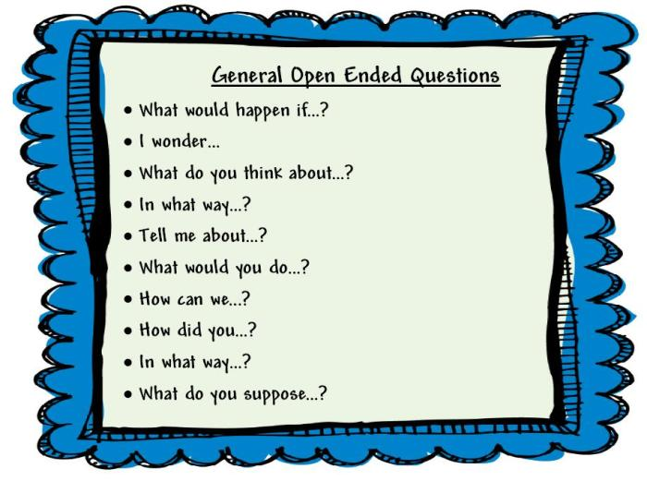

Slide 47
Chapter
Forms of Questionnaires
7
Paper-Based Postal Questionnaires
Distribution Methods: Can be mailed, handed out at events, or left in prominent locations.
Cost and Return Rate: Postal questionnaires are costly due to postage, and rely heavily on respondents' willingness to complete and return them. Handing them out in person is typically more effective.
www.midocean.ae

Slide 48
Chapter
7
Electronic Questionnaires
Online Questionnaires: Located on a web page and filled out online. These can be convenient but may limit your sample population and pose challenges with multiple submissions and browser compatibility.
Email Questionnaires: Sent and returned via email. While easier for some respondents, they can compromise anonymity.
www.midocean.ae

Slide 49
Chapter
7
Researcher-Administered Questionnaires
High Response Rate: These usually generate the highest response rates as the researcher directly engages with respondents and fills out the questionnaire based on their answers.
Example: Market researchers conducting street interviews.
Considerations: Ethical and legal permissions are required, and selecting the appropriate location and time is crucial to reach the desired sample size and composition.
www.midocean.ae

Slide 50



Thank You

