Slide 1

Risk and Decision Analytics
Prepared by Dr. Sami Alzahrani
Lecture 7
Project risk management

Slide 2

Lecture 7
Introduction
Project risk management is about optimizing value. Decision analysis is the discipline for making decisions under uncertainty and provides a logical, consistent process for project management decisions.

Slide 3
Lecture 7
Introduction
The Business Perspective:
A Guide to the Project Management Body of Knowledge (PMBOKB Guide) - 2000 Edition defines project risk management (PRM) as "the systematic process of identifying, analyzing, and responding to project risk." In decision analysis, our understanding of a system is structured and quantified. Probability is the language of uncertainty, and experts express their judgments about risks and uncertainties as probabilities and probability distributions. In this discussion, I will emphasize quantification and value-based decision making beyond what the PMBOKB Guide suggests.

Slide 4
Model Scope
Most projects develop or build some form of asset. The asset life-cycle model represents how business value depends upon the completion date and changes in the asset's functionality or performance. Figure 8.1 illustrates relationships between the asset model and the project model. Both may incorporate the results of detailed sub models developed to understand particular processes, subprojects, or system components.

Slide 5
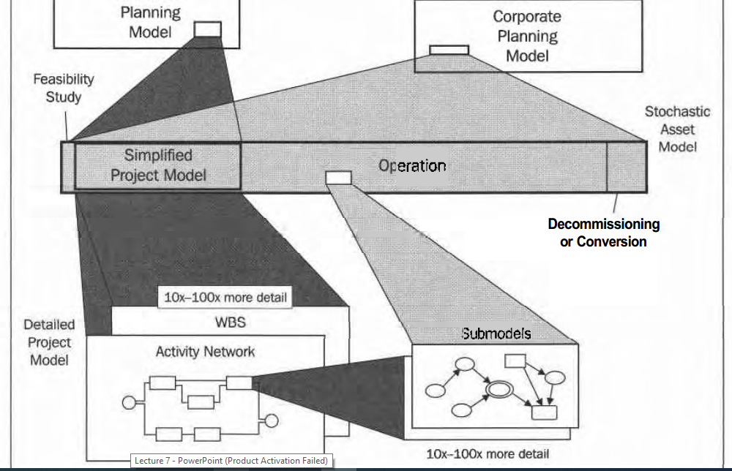

Slide 6
The asset model, itself, may be part of a higher-level corporate or re- source-planning model. The asset model should always be a stochastic model-that is, incorporating probability distributions-because every project has uncertainties. The asset model relates such elements as:
- Cost, time, and performance
Value of early completion
Impact of parameters, such as scope changes
Project projections, including criticality indexes.

Slide 7
The detailed project model is typically deterministic, that is, without distributions. If less than, say, fifty activities, we might incorporate distributions into the detailed project model. The amount of detail appropriate, in either an asset or a project model, depends upon the situation and the capabilities of the analysis team. Models with hundreds or thousands of probability distributions would overwhelm most of us. Expert system assistants (Chapter 17) will enable us to develop, maintain, and apply larger models.

Slide 8
As Figure 8.1 illustrates, I'm advocating (a) a stochastic asset model with a lesser detailed project model inside, and (b) a deterministic project model for detailed planning (not evaluation) and control. We can do most risk-response evaluations on the side as simple decision analyses.

Slide 9
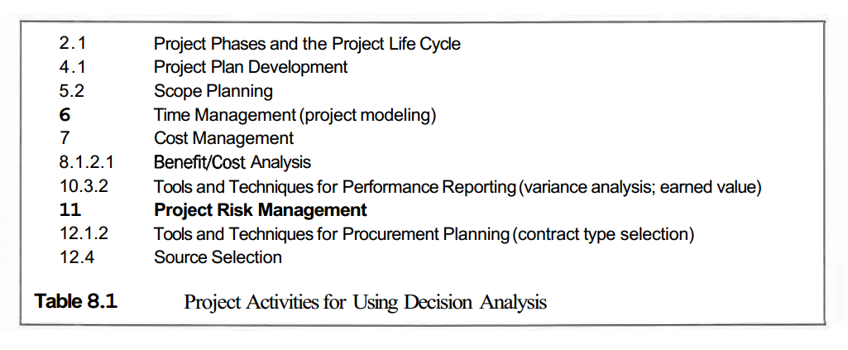

Slide 10
PRM benefits from focusing on the key drivers, risk mitigation actions, and the effects of uncertainty. In contrast, project execution and control benefit from planning in great detail. Thus, the asset life-cycle model typically contains a simplified project sub model, developed initially before the detailed project model. The full project model contains typically ten to 100 times more detail as the asset model, in terms of resolution.

Slide 11
In modeling the project, do not neglect end of life. The asset may have a successor use or be saleable. We might decide to build-on into a next version or renovate to extend the planned life. Some assets will have significant decommissioning or abandonment costs.

Slide 12
Pre-Project Risk Management
Risk management begins in the feasibility study. A stochastic (probabilistic) model of the asset life cycle provides the basis for justifying the project. This includes a preliminary and coarse project model for calculating distributions for time and cost to do the project. The structure of the summary project model developed at this stage has a preliminary work breakdown structure (WBS) or other activity network representation. Include major discrete contingencies. Probability distributions, of course, express judgments about uncertain input variables.

Slide 13
We should maintain this asset model throughout the life cycle. Update this model as new information becomes available. As illustrated in Figure 8.1, there are two project models in different detail. Check the project model and asset model after revisions to ensure consistency. Important risks provide opportunities for improving the project. What alternatives exist to improve the project's risk-versus-value profile?

Slide 14
During the Project
The numbering on the following risk management functions matches the PMBOK@ Guide.
11.1-Risk Management Planning
In the early stages of project initiation, we design and implement the formal risk-management methodology. This defines roles and responsibilities, databases, and control reporting.

Slide 15
It is hoped that, as with decision policy, the procedures and systems are not reinvented with a new project. Rather, the process is a proven, consistent, and well-understood part of the way the organization operates. Special circumstances may require some modification, and the purpose of Risk Management Planning is to fix the process for this project. Appendix 8B, Risk Management Plan, discusses plan elements in more detail.

Slide 16
11.2-Risk Identification
In detailed project planning, the project team creates, as applicable, the bill of materials, WBS, and an activity network diagram. The project model details elements in schedule and cost estimation. Risk Identification is about reviewing every input variable, activity, key material, and resource.

Slide 17
What are the threats and opportunities? Checklists built-up from others' experiences are valuable in getting started and in ensuring completeness. Influence diagrams are able to represent relationships not evident in the activity network diagram. Classifying risks helps identify common and redundant entries. Also, consider potential changes in the environment as risks-i.e., the assumptions may change.

Slide 18
11.3-Risk Assessment
The project base plan is a single scenario where the inputs are EVs for continuous chance variables. For a discrete variable, I use the outcome nearest the EV. Stochastic calculations at an appropriate level, perhaps the asset model, are the means to evaluate schedule, cost, and performance. We need judgments for the values of every input variable in the model. The list includes, especially, risks from Risk Identification. Typically, the most capable available persons judge these values. Their assessments include:

Slide 19
Single values for variables that are well known or can be calculated with precision; single values also suffice for less-important variables (prioritized subjectively at this stage) Probability distributions for important uncertain values in the project model Probabilities for discrete risk events Probability distributions for impact variables that become relevant when the associated risk events occur (e.g., remedial action cost incurred because of a delayed shipment) Single-value or probability distributions for contingency plan implementation costs.

Slide 20
11.4-Risk Analysis
Risk Analysis is about understanding overall project risk. The stochastic asset model is the basis for credible forecasts. Some practitioners carry stochastic calculations through the detailed project model as well, though this may be overkill.
A common display of project risk is a cumulative distribution diagram, such as the solid curve in Figure 8.2. The Base Case is only one scenario, used here as the zero reference.

Slide 21
Cumulative distributions show the possibilities. Here we view project cost distributions (which may incorporate cost-equivalent considerations for schedule and performance) both before and after implementing risk-mitigation actions. An asset's value distribution would be similar (assuming the model includes all life-cycle effects), though the x-axis would instead be the asset value outcome (usually PV).

Slide 22
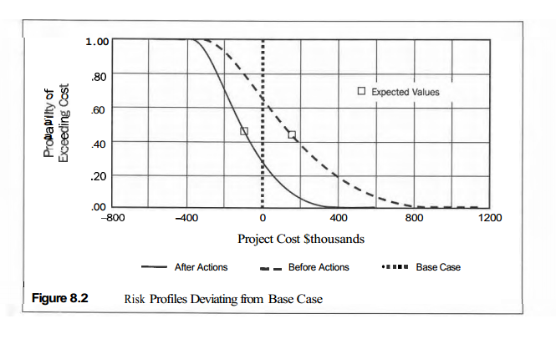

Slide 23
11.5-Risk Response Planning
What we do about the risks? This is the topic of Risk Response Planning. Figure 8.4 shows the hierarchy of this process. Use brainstorming and checklists again to identify candidate actions for mitigating each risk (or enhancing opportunities). Appendix 8C, Mitigating and Avoiding Risks, may provide you with some ideas. For this discussion, we will assume risks are only of the "threat" variety. Actions typically reduce or eliminate risk or affect the impact, should the risk event occur.

Slide 24
From among the potential actions, which are cost effective to implement? The optimal project plan incorporates the combination of actions that adds most value to the organization.

Slide 25
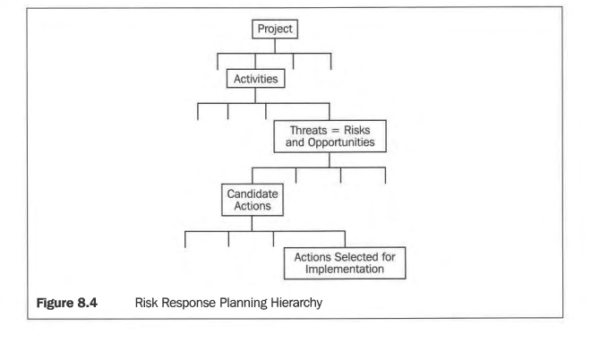

Slide 26
In a simple world, we could do a risk/cost/benefit analysis on every candidate action. The decisions would be simple: Implement those actions that add more EV benefit than their EV cost, However, correlations cloud the picture:
A risk mitigation action may affect more than one risk. Synergies: "Killing two birds with one stone."

Slide 27
Several actions may be candidates for mitigating one risk. Either action may appear feasible, but together they are not. "Diminishing returns." Implementing actions may affect the feasibility of mitigating other risks and the effects of other actions (both in probability and impact).

Slide 28
These are common problems in portfolio analysis. Here, instead of a portfolio of investments, we have a suite of actions and are selecting portfolio of response actions. There is much subjectivity in analysis work, and part of the analysis discipline is focusing on elements that matter most.

Slide 29
What if there isn't enough money (or other constraining resource) to perform all worthwhile risk-abatement actions? Like elsewhere in life, we prioritize.
Instead of implementing every thug with a positive EMV-notwithstanding the portfolio issues just mentioned-we would prioritize to do the best with what we have. Most practitioners use a return on investment-like criterion.

Slide 30

I metion the most popular ranking criterion, discounted return on investment
Choose to implement those actions with the highest DROI first.

Slide 31
11.6-Risk Monitoring and Control
An inventory of risks and actions is core to risk management. A database repository is the foundation. Data fields include various classifications, responsibilities, watch points, and time windows. Recording original estimates and actual outcomes is key to judgment performance feedback. Appendix 8B, Risk Management Plan, provides more details about this
database.

Slide 32
At major milestones or other suitable points, post-implementation reviews are essential for participants' learning and for capturing knowledge. This is perhaps the single most important way in which to improve an organization's planning and evaluation processes and skills.

Slide 33
Recourse:
RISK and DECISION ANALYSIS in Projects
Second Edition
By: John Schuyler
Chapter 8

